Slide 1
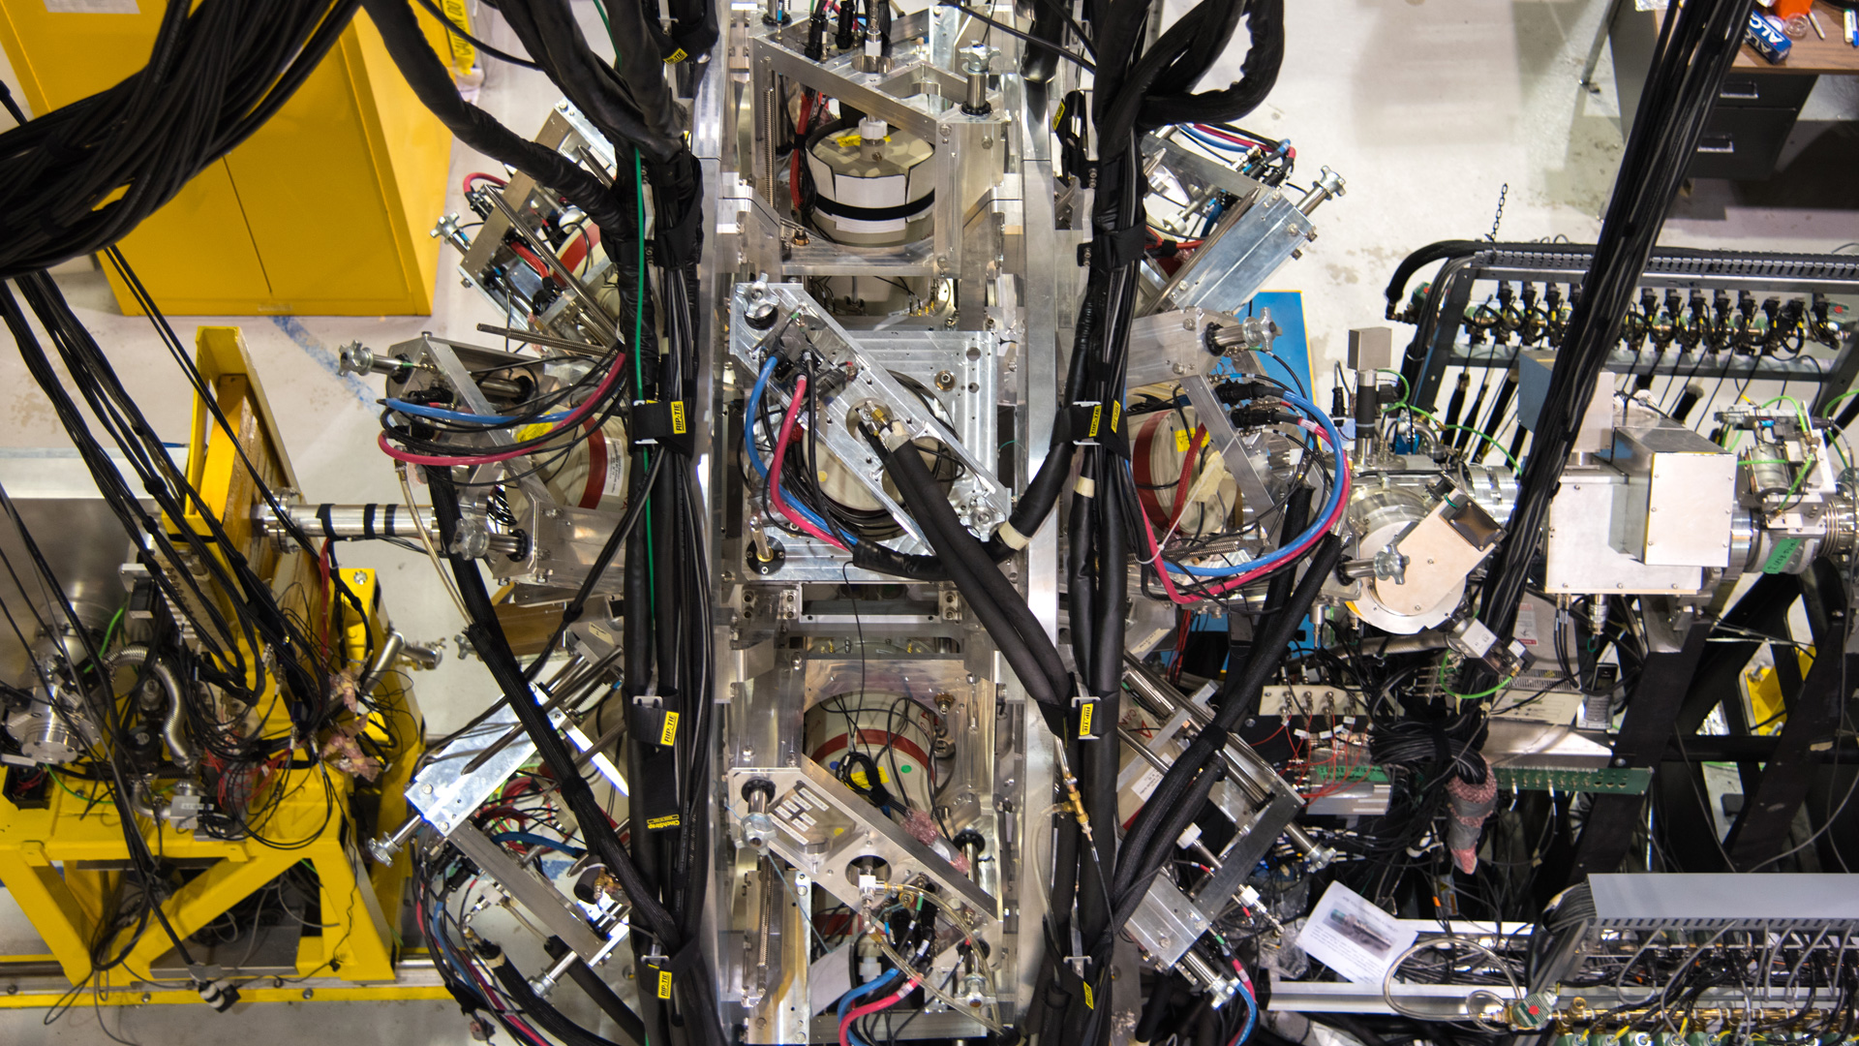
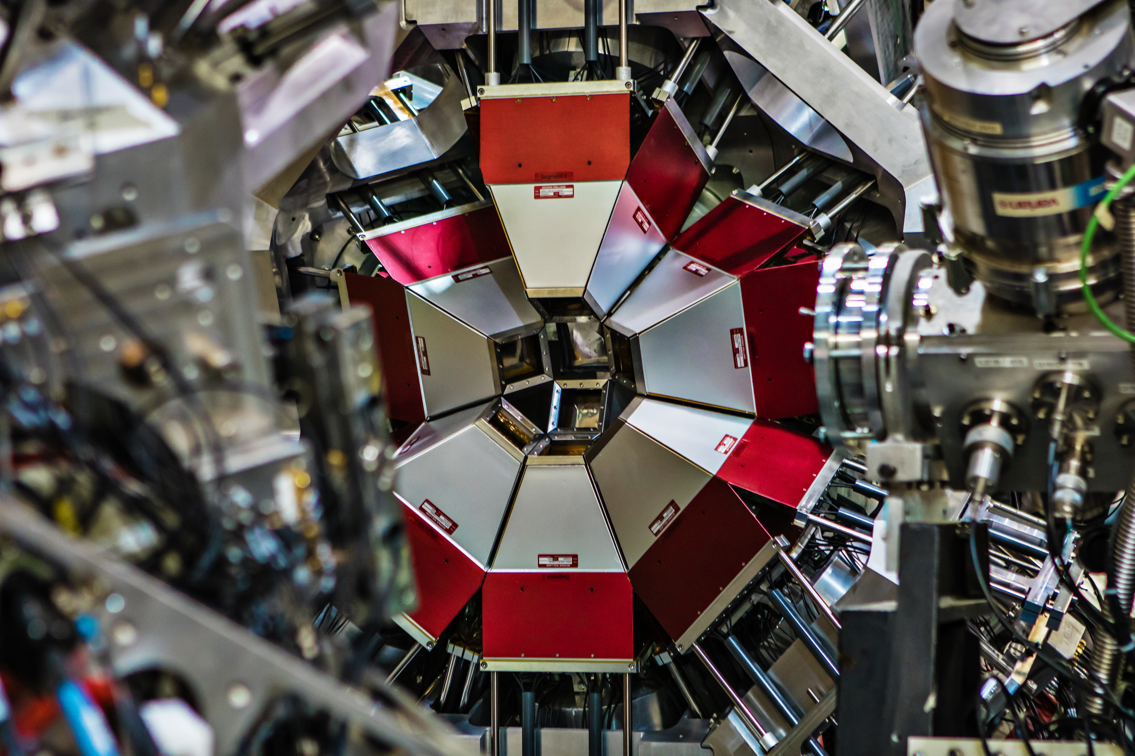
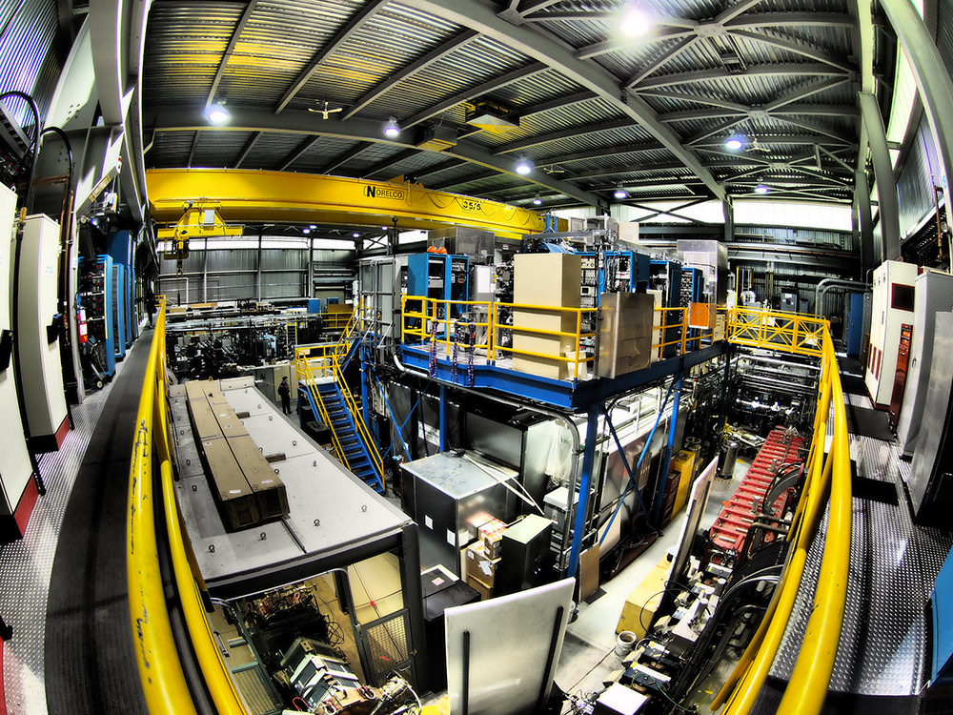
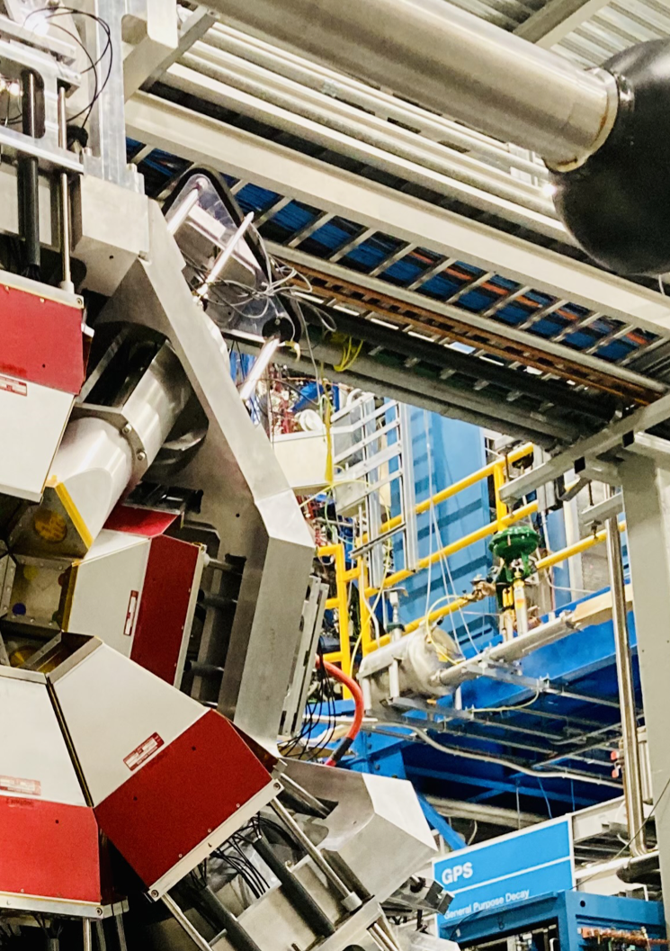


Study of Multiple Shape Coexistence in ¹¹⁰Cd
[1]
[2]
[3]
[4]
[4]
Samantha Lange
February 13th, 2026
WNPPC 2026

Slide 2


INTRODUCTION
Notes:
Let's start somewhere simple. Consider a nucleus in it's ground state (state with minimal energy). If we give it some energy, the nucleus can be excited and go to an excited state. In fact, there are many possible excited states in this nucleus each with specific spin-parities. These states can decay or de-excite by emitting gamma rays and these de-excitations have specific patterns. This is what we call a level scheme. Now, level scheme can be organized in different ways.

Slide 3




INTRODUCTION
Notes:
Let's start somewhere simple. Consider a nucleus in it's ground state (state with minimal energy). If we give it some energy, the nucleus can be excited and go to an excited state. In fact, there are many possible excited states in this nucleus each with specific spin-parities. These states can decay or de-excite by emitting gamma rays and these de-excitations have specific patterns. This is what we call a level scheme. Now, level scheme can be organized in different ways.
These levels can be organized in different ways depending on the internal structure of the nucleus

Slide 4
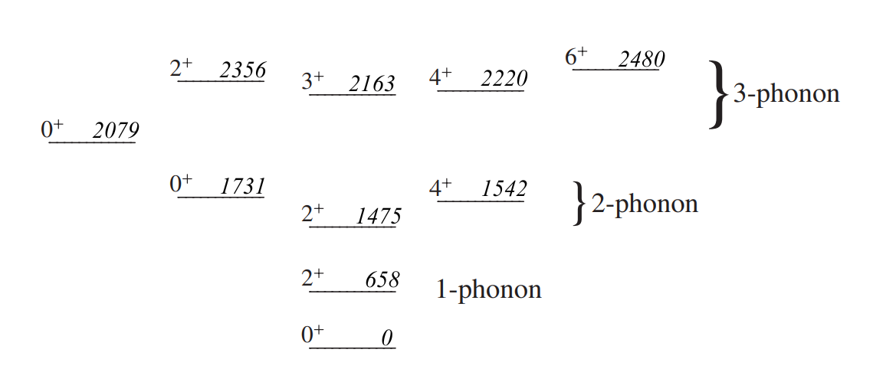
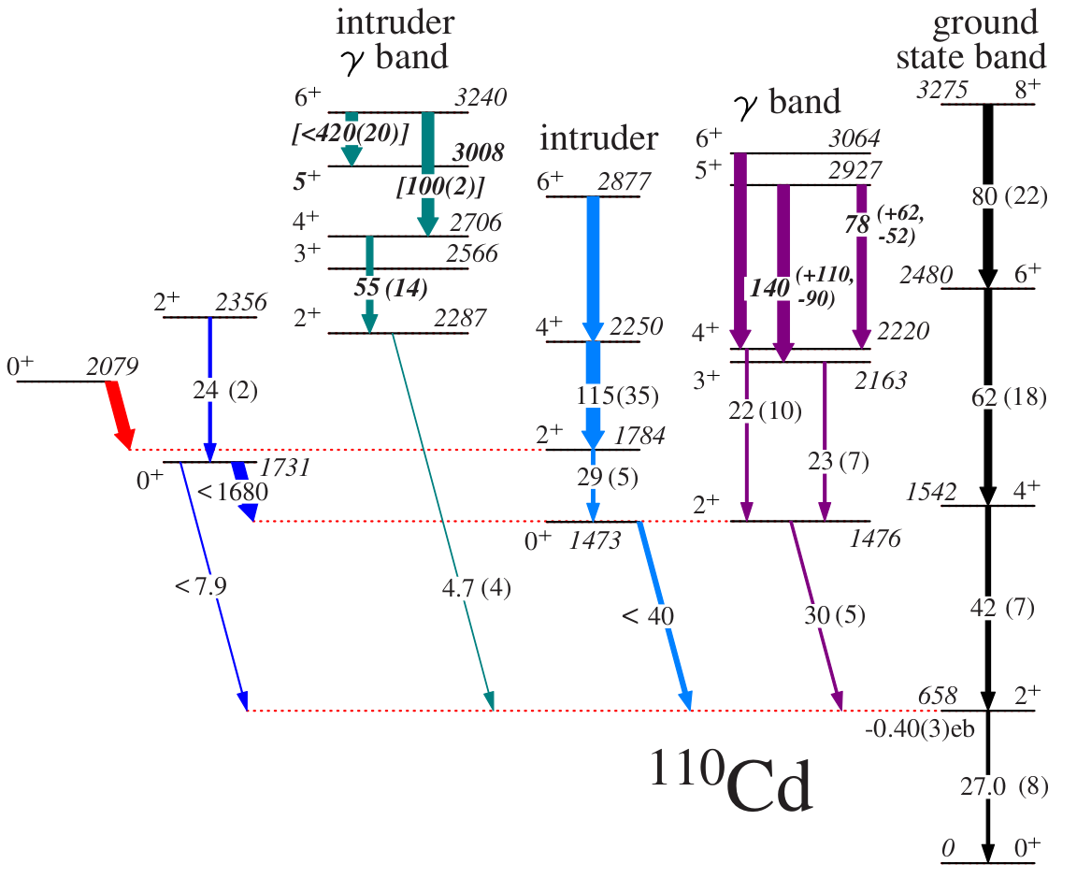
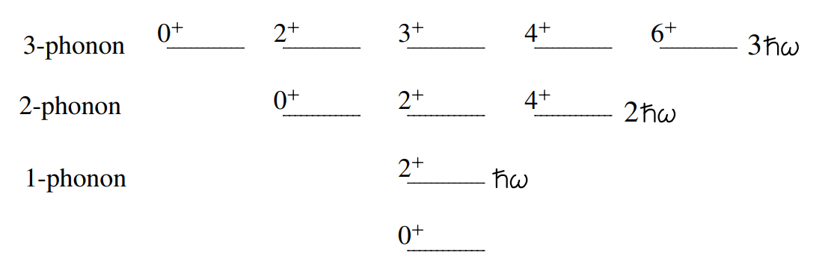
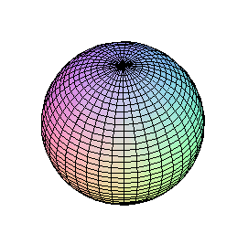
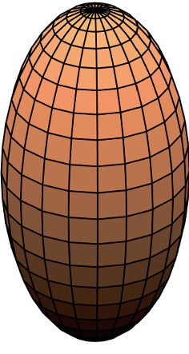

MOTIVATION
Ongoing debate regarding the nuclear structure of ¹¹⁰Cd.
Spherical Vibrational Model
Multiple Shape Coexistence
Nucleus
Nucleus
Nucleus
¹¹⁰Cd
Notes:
Ongoing debate regarding the nuclear structure of ¹¹⁰Cd.
Cd isotopes have long been considered prime examples of sphericalvibrational structures [5].
Recent studies [6,7] suggest that ¹¹⁰Cd (and other Cd isotopes)possess characteristics of multiple shape coexistence.
Multi-Shape Coexisting States built onRotational Bands

Slide 5



INVESTIGATION OF SHAPE COEXISTENCE
CoulEx
⁵⁸Ni beam on ¹¹⁰Cd
Legnaro National Laboratory (LNL)
International campaign to investigate shape coexistence in ¹¹⁰Cd.
Complementary studies use Coulomb Excitation to extract information on the shapes of excited states in Cd isotopes.
Relies on literature spectroscopic data (e.g. branching ratios)
This analysis uses β-decay to improve the precision of branching ratios in ¹¹⁰Cd.
CoulEx
¹¹⁰Cd beam on ²⁰⁸Pb
β⁻ decay of ¹¹⁰Ag
[This Work]
β⁺/EC decay of ¹¹⁰In
Notes:
We started a campaign in several international laboratories where they study via Colomb Excitation the excited states in Cd-110 using various beam and target combinations with the goal to extract information on the shapes of these nuclei.
These studies rely heavily on literature spectroscopic data (e.g. branching ratios, mixing ratios, lifetimes). This is where my research comes in. I'm studying the beta decay of 110Cd and the results from this study help provide spectroscopic data, (specifically branching ratios) to support the CoulEx studies.
In Coulomb excitation, a nucleus is excited by an inelastic collision with another nucleus through the electromagnetic interaction. It is a technique in experimental nuclear physics to probe the electromagnetic aspect of nuclear structure.
The cross sections to exciting different excited states a

Slide 6
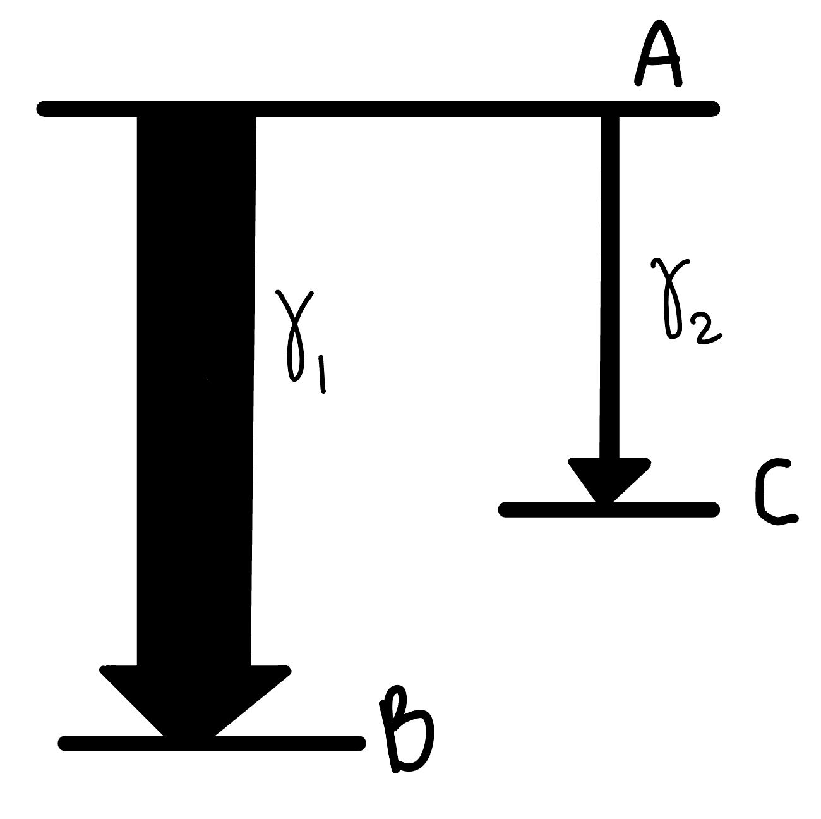
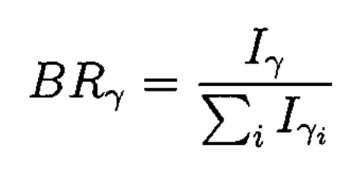

BRANCHING RATIOS
Branching ratios are the relative intensities of transitions depopulating an excited state.
I_{γ1} > I_{γ2}

Slide 7
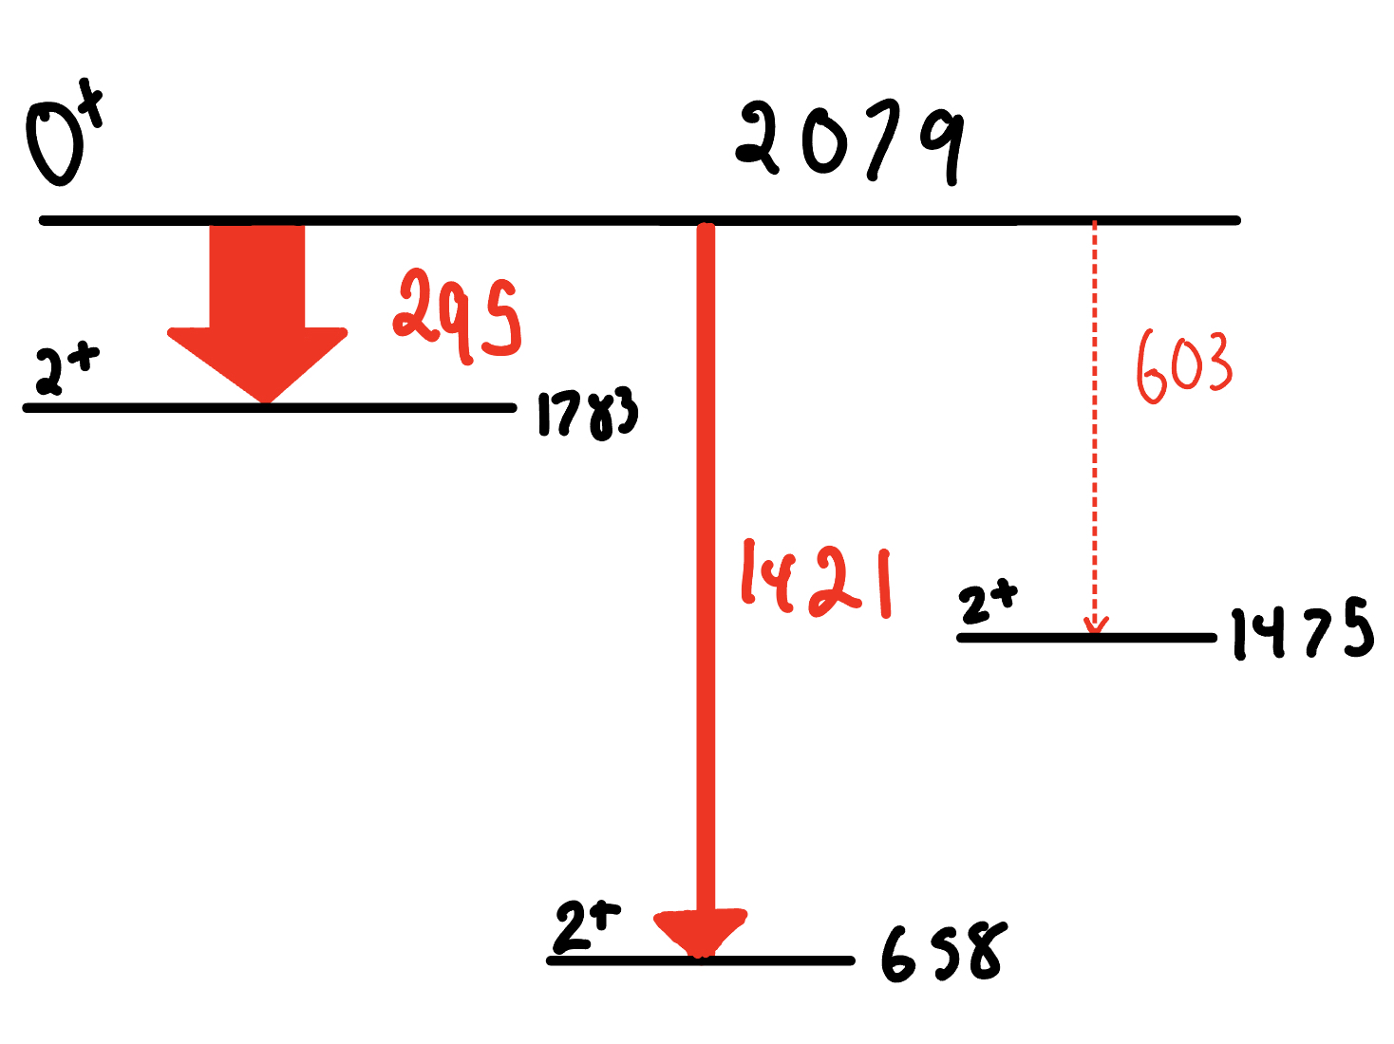
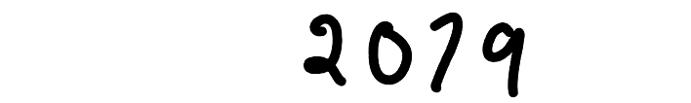

BRANCHING RATIOS
Branching ratios are the relative intensities of transitions populating an excited state.
BR = 0.791(21)
Consider an example from ¹¹⁰Cd.
BR = 0.209(21)

Slide 8
Goals of this study
Level Scheme
Search for structures/bands (e.g. 2⁺ states) built on low-lying 0⁺ states.
Branching Ratios
Assign upper limits to very weak transitions essential for CoulEx analysis.
Confirm and extend existing level scheme of ¹¹⁰Cd.
Improve precision of existing branching ratios.
Notes:
Search for structures (e.g. 2⁺ states) built on low-lying 0⁺ states that could be deformed.
Can add things like levek scheme at the side

Slide 9
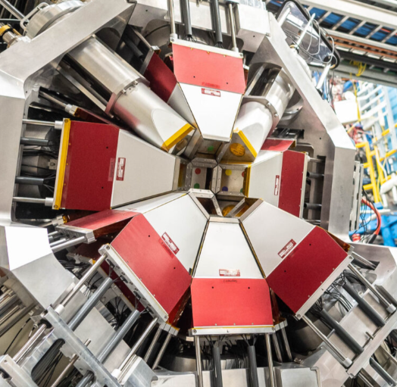
Experimental details
Experiment: β⁻ decay of ¹¹⁰Ag to ¹¹⁰Cd
β⁺/EC decay of ¹¹⁰In to ¹¹⁰Cd
Facilities:
Experimental Setup:
Gamma Ray Infrastructure For Fundamental Investigations of Nuclei (GRIFFIN)
480 MeV proton beam on a UC_{x} target
Notes:
480 MeV is formed before reaching GRIFFIN. Can add image of facility
GRIFFIN - Gamma-Ray Infrastructure For Fundamental Investigations of Nuclei- is a state-of-the-art facility for decay spectroscopy with rare-isotope beams located at the TRIUMF-ISAC-I facility, Vancouver, Canada. An array of 16 high-purity germanium clover detectors coupled to a fully digital data acquisition system dramatically increases gamma-ray detection efficiency and data aquisition throughput over past experiments, while leveraging a powerful suite of ancillary detectors developed for its predecessor, the 8pi spectrometer.

Slide 10
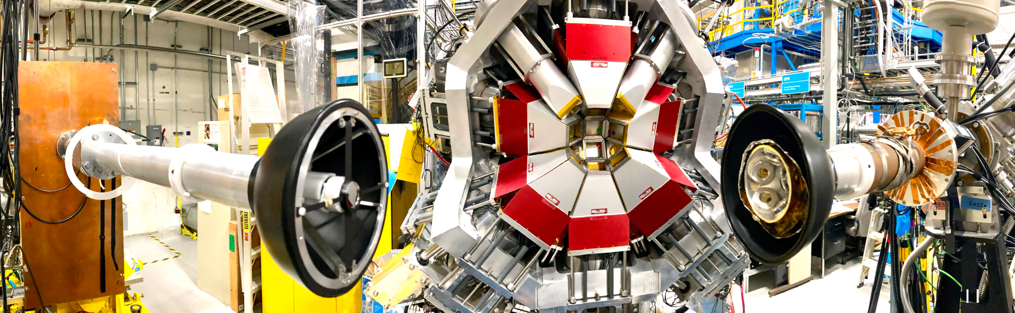
Experimental details - GRIFFIN
¹¹⁰Ag Beam

Slide 11
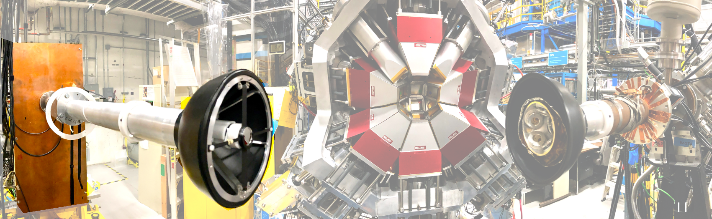
Mylar Tape
25 s beam ON / 30 s beam OFF for ¹¹⁰Ag (t_{1/2} = 24.6s)
Notes:
During the experiment, two tape cycles were employed. A cycle with 25 s beam implantation followed by 30 s of decay was used to focus on the 110Ag decay. For the 110In decay a longer cycle was used that involved building a source for 10–15 min. and counting for 8–10 h.
Behind the lead wall. Inside box there is lead wall
Using a cycle of 25 s beam on results in
the 110 Ag activity as the dominating activity on the tape. However, approximately 95% of the decay
proceeds to the 110 Cd ground state, and thus the rate of γ-ray emission resulting from the 110 Ag
decay is less than that resulting from the 110 In decay. We must emphasize here that the 110 In decay,
both the ground state and isomeric state, are still useful decays to observe, but since they populate
higher-spin states than the 110 Ag, we wish to focus on the latter for the majority of the experiment.

Slide 12
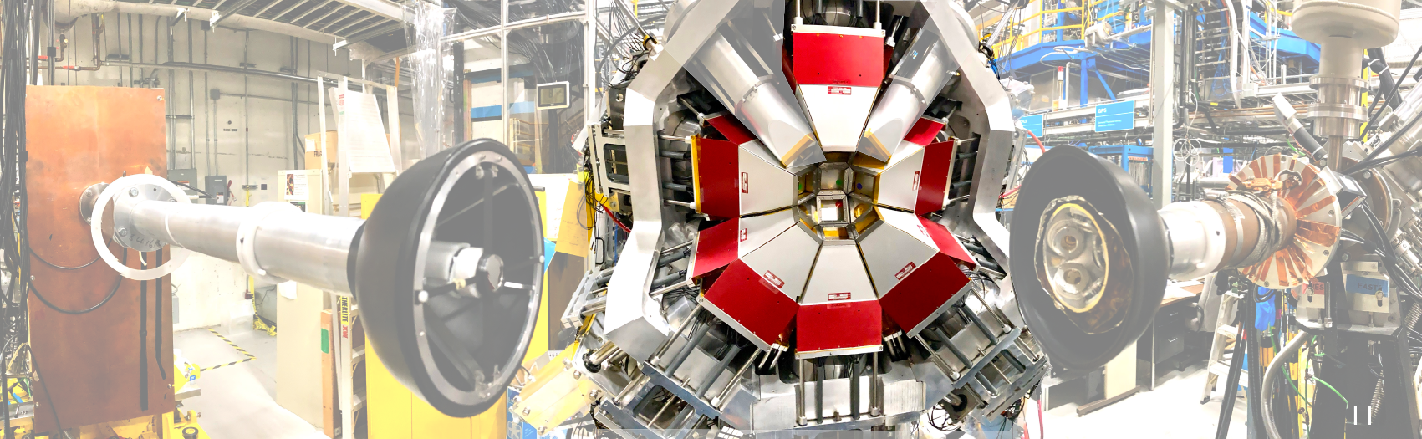
HPGe Detectors
15 HPGe clovers with BGO shielding (60 total crystals)
Used for γ-ray detection
Very good energy resolution

Slide 13
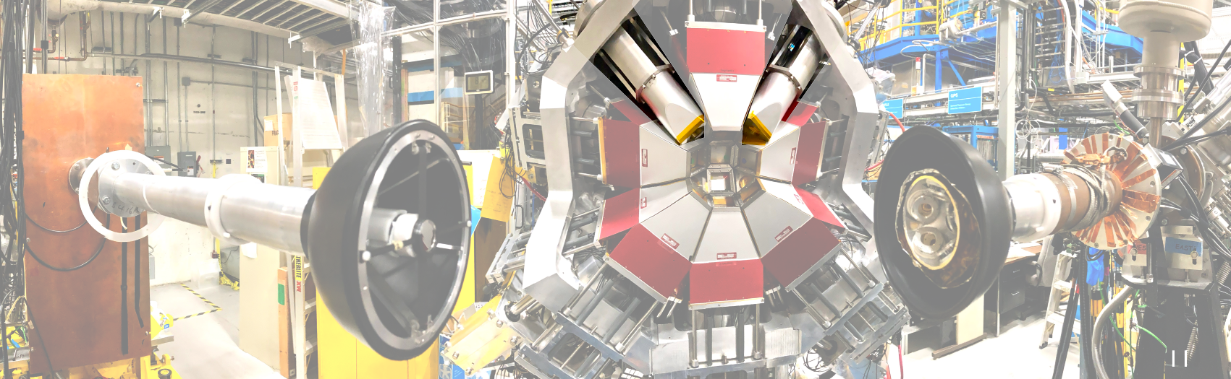
LaBr₃ detectors
Very good timing resolution
Used for lifetime measurements
Notes:
Whereas Ge detectors have excellent energy resolution for gamma rays, these fast scintillators have a very good timing resolution for gamma rays but poorer energy resolution. The fast-timing can be used to measure the lifetime of excited states in daughter nuclei which live for as short a time as 10 picoseconds, thats a hundred thousandth of a millionth of a second.

Slide 14
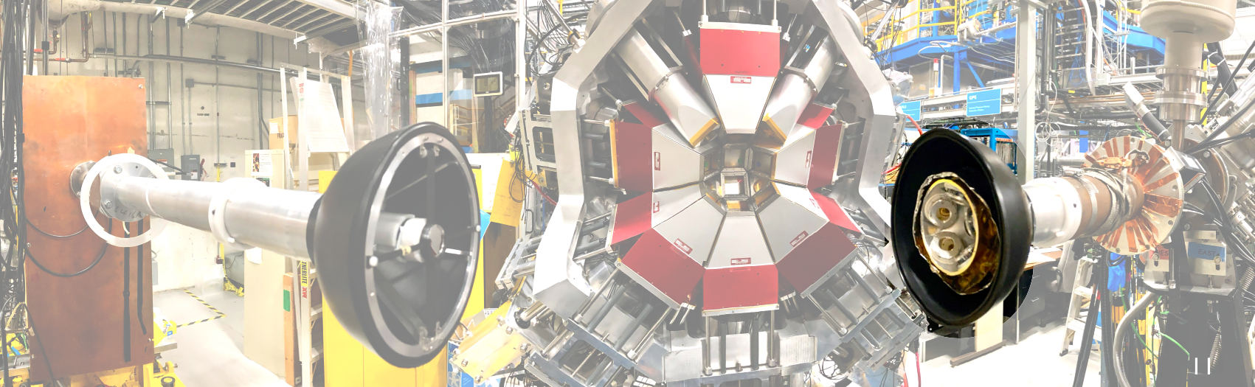
PACES
5 lithium-drifted silicon (Si(Li)) detectors
Used to detect internal conversion electrons
Notes:
PACES (Pentagonal Array for Conversion Electron Spectroscopy) is an array of 5 lithium-drifted silicon (Si(Li)) detectors located inside the vacuum chamber. They are used to detect internal conversion electrons which can be emitted during the decay of excited states in daughter nuclei. These detectors are also used to detect alpha particles which can be emitted when a heavy nucleus decays; this capability is especially important when working with actinide beams at ISAC.

Slide 15
DATA ANALYSIS PROCESS
Energy Calibration
Efficiency Calibration
Level Scheme Construction
Branching Ratios
Determine the probability of a γ-ray being fully detected by GRIFFIN.
Construct level-scheme from γ-γ coincidence matrix.
Determine branching ratios for transitions in level scheme.
Align raw charge readings for γ-rays of the same energy.

Slide 16
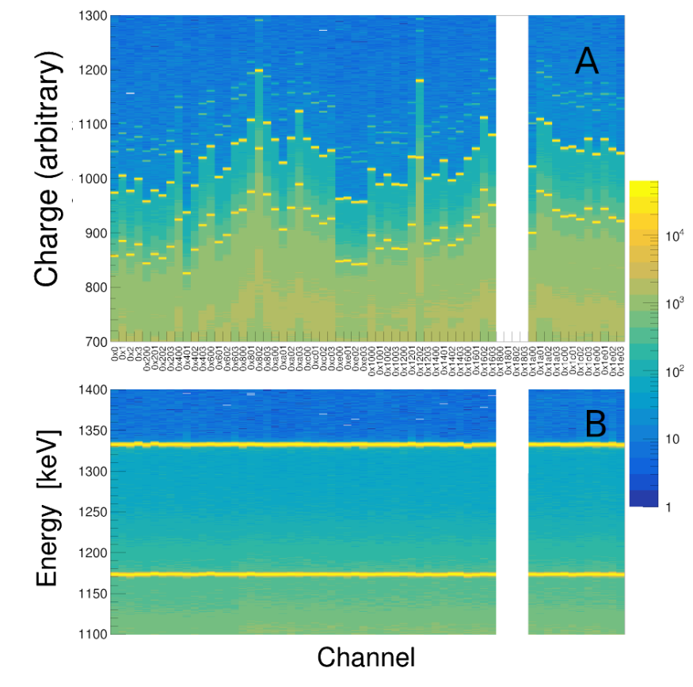
Energy Calibration
Align raw charge readings for γ-rays of the same energy.
Notes:
Very important because we want the best resolution possible. We want to be able to resolve peaks at similar energies.
SHow singles spectrm

Slide 17
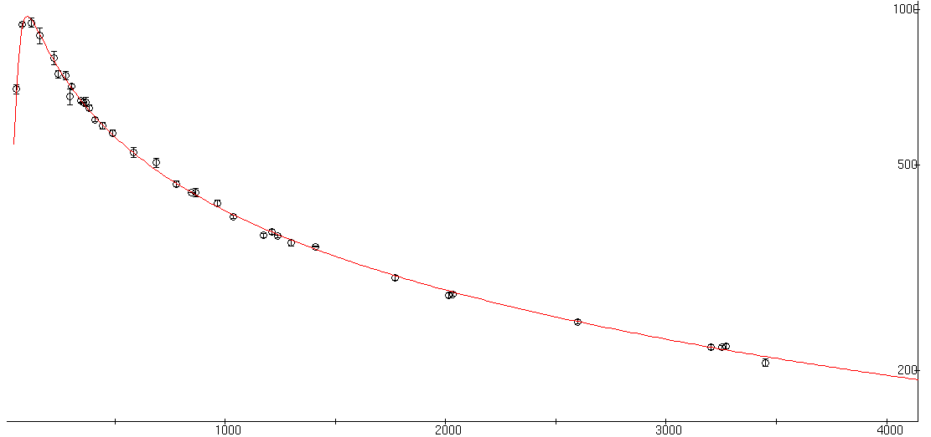
Efficiency Calibration
relative efficiency
Determine the probability of a γ-ray being fully detected by GRIFFIN.
energy [keV]
Notes:
Absolute efficiency of grifffin is about 8% for 1 MeV gamma rays - don't say this

Slide 18
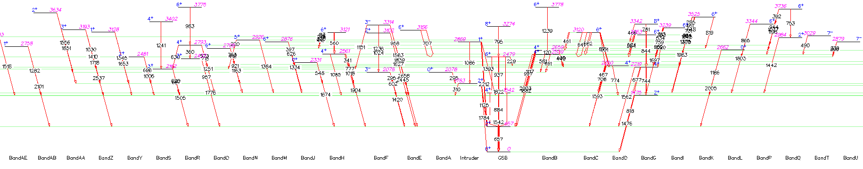
LEVEL SCHEME

Slide 19
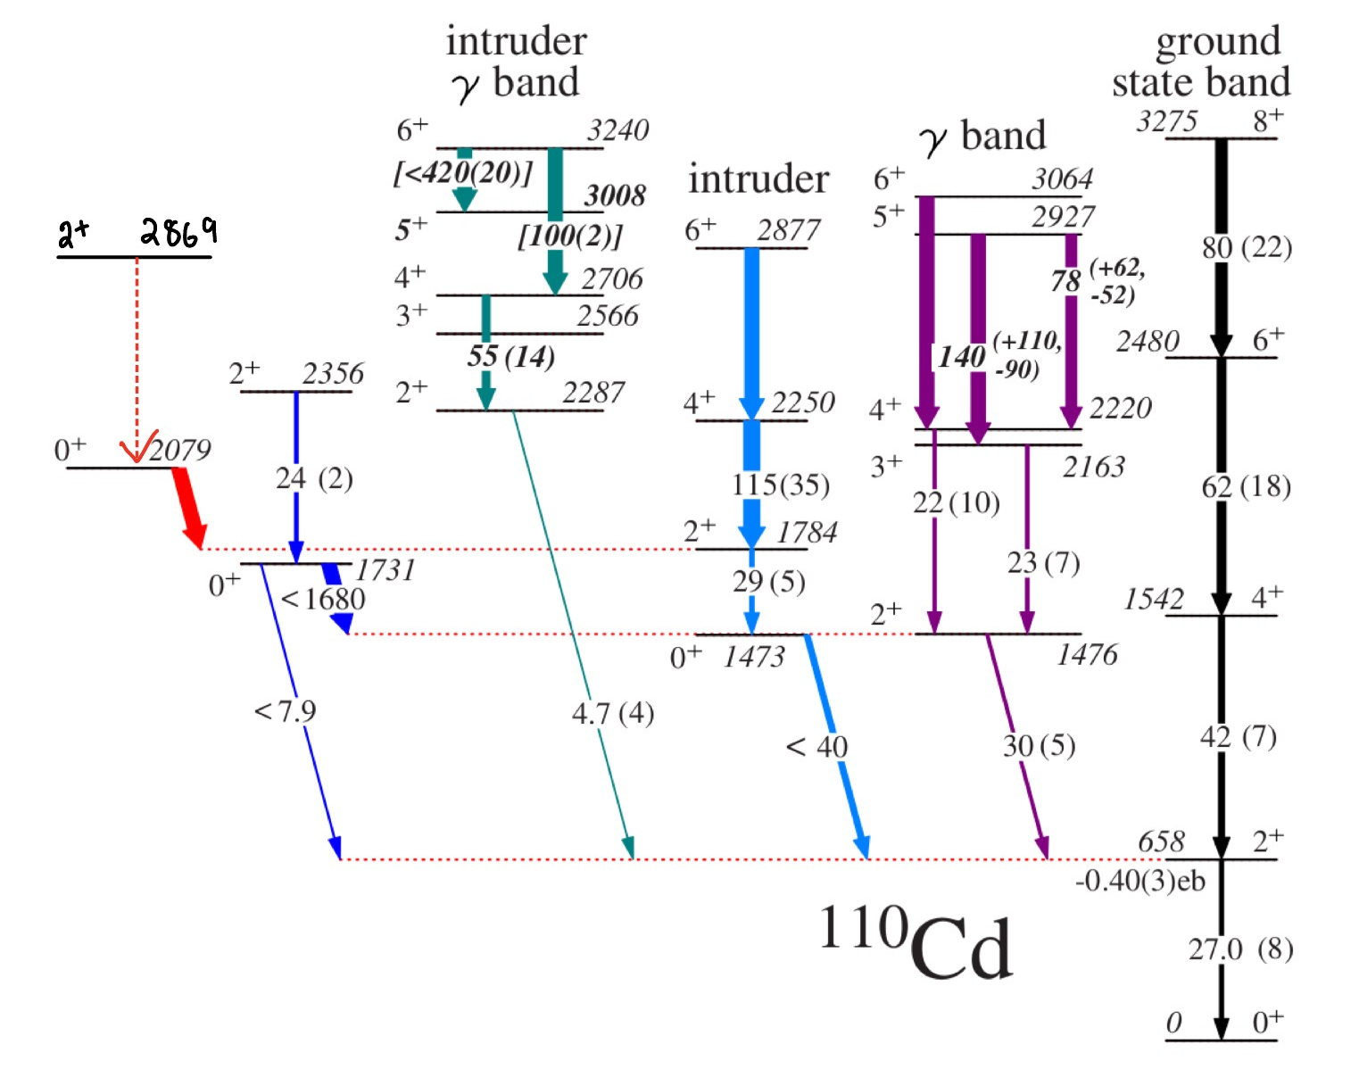
Potential new 2⁺→0⁺ transition
Nucleus
Nucleus
Nucleus

Slide 20
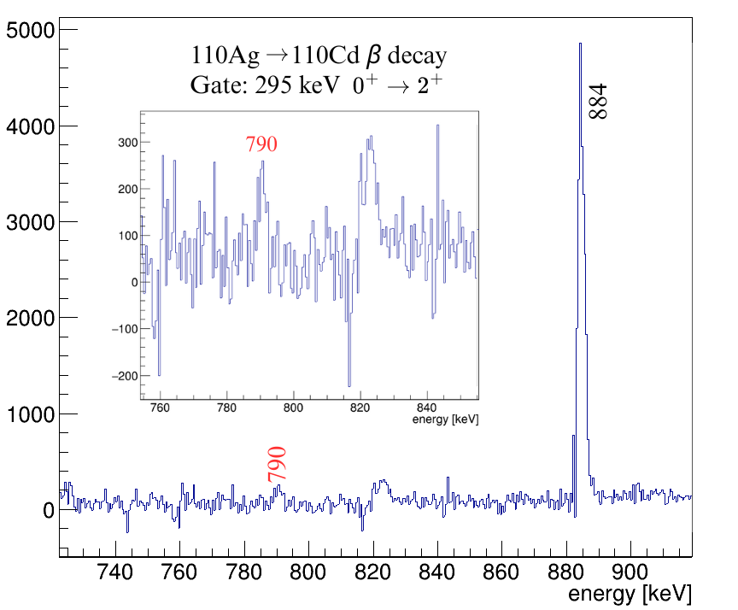
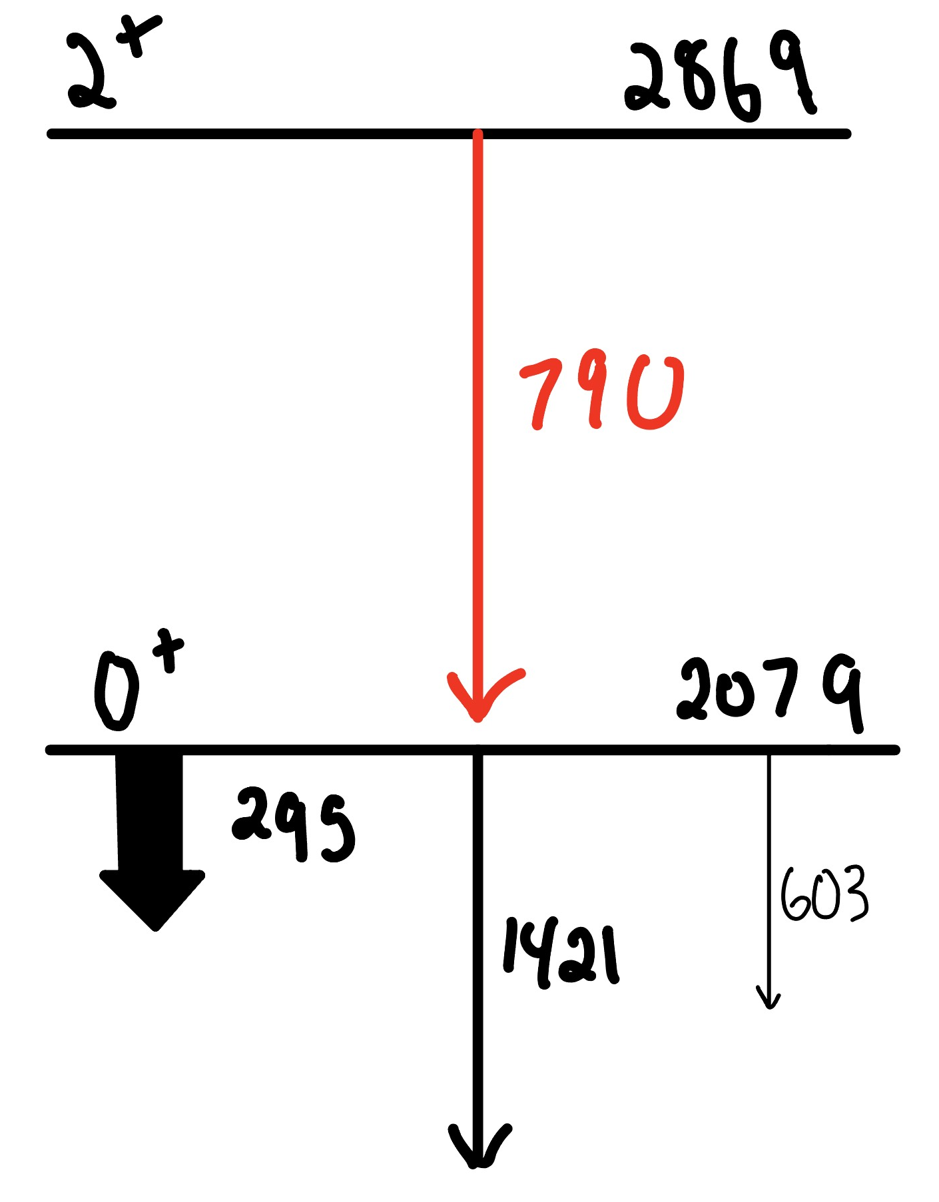
Potential new 2⁺→0⁺ transition
NEW!
Notes:
I found a potential new state bult on the fourth 0+ excited state (show pictuere) but I have a problem because I have a doublet of states and they have a similar decay pattern. How \

Slide 21
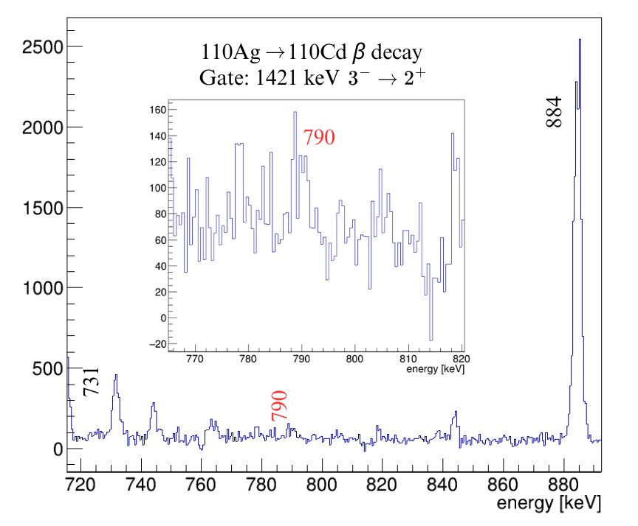
Potential new 2⁺→0⁺ transition
NEW!

Slide 22
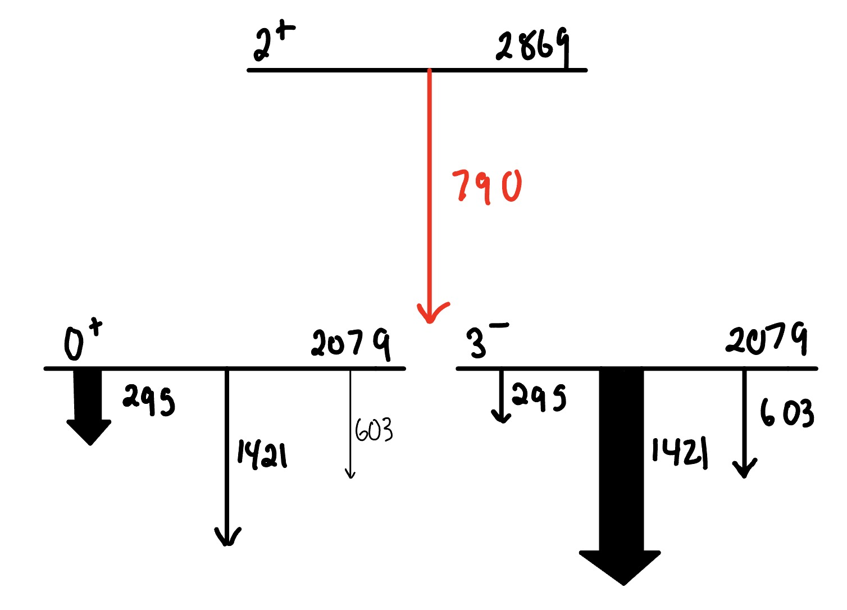
Potential new2⁺→0⁺ transition
Notes:
I have a problem, we have a doublet of states. There are two 2079 keV levels. One with 0+ spin and one with 3-. Each of these transitions are doublets but we can use branching ratios to differentiate between the them. The 295 keV transition is stronger feeding out of the 0+ level while the 1421 keV transition is stronger feeding out of the 3-.

Slide 23
What's happening here?
1
2
3
1
The 790 keV transition only feeds the 0⁺ state.
2
3

Slide 24
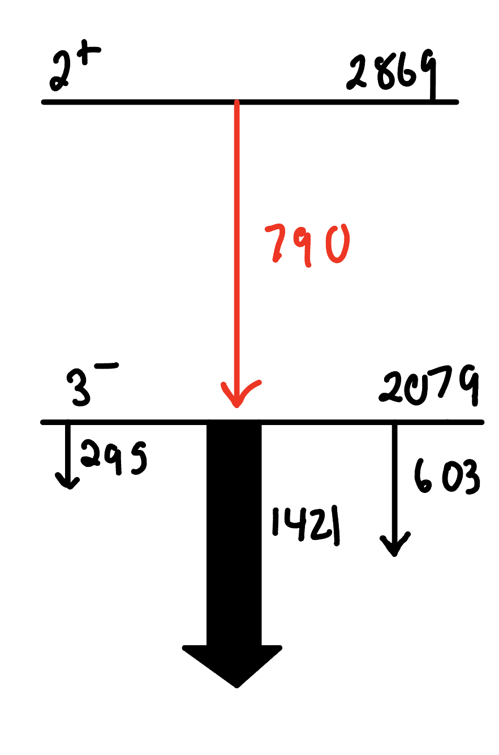
What's happening here?
1
2
3
1
The 790 keV transition only feeds the 3⁻ state.
2
3

Slide 25
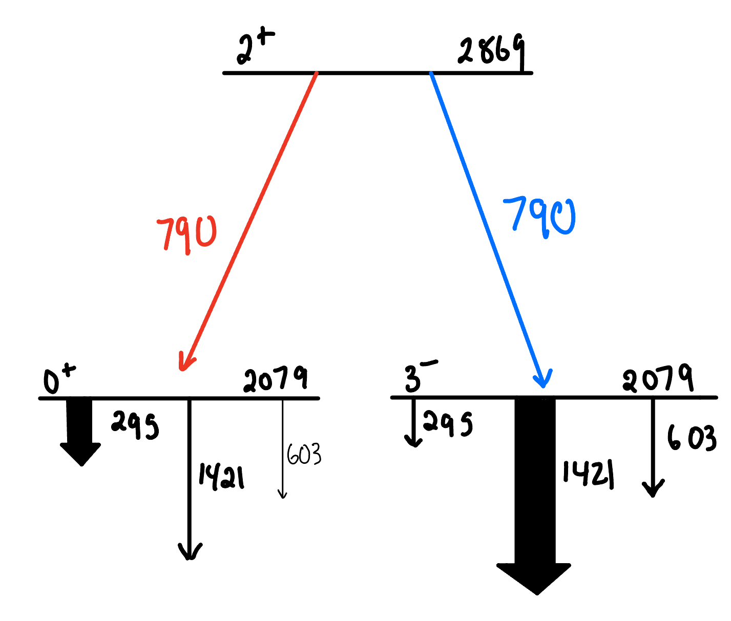
What's happening here?
1
2
3
The 790 keV transition feeds both states (i.e. it's a doublet)
1
2
3

Slide 26
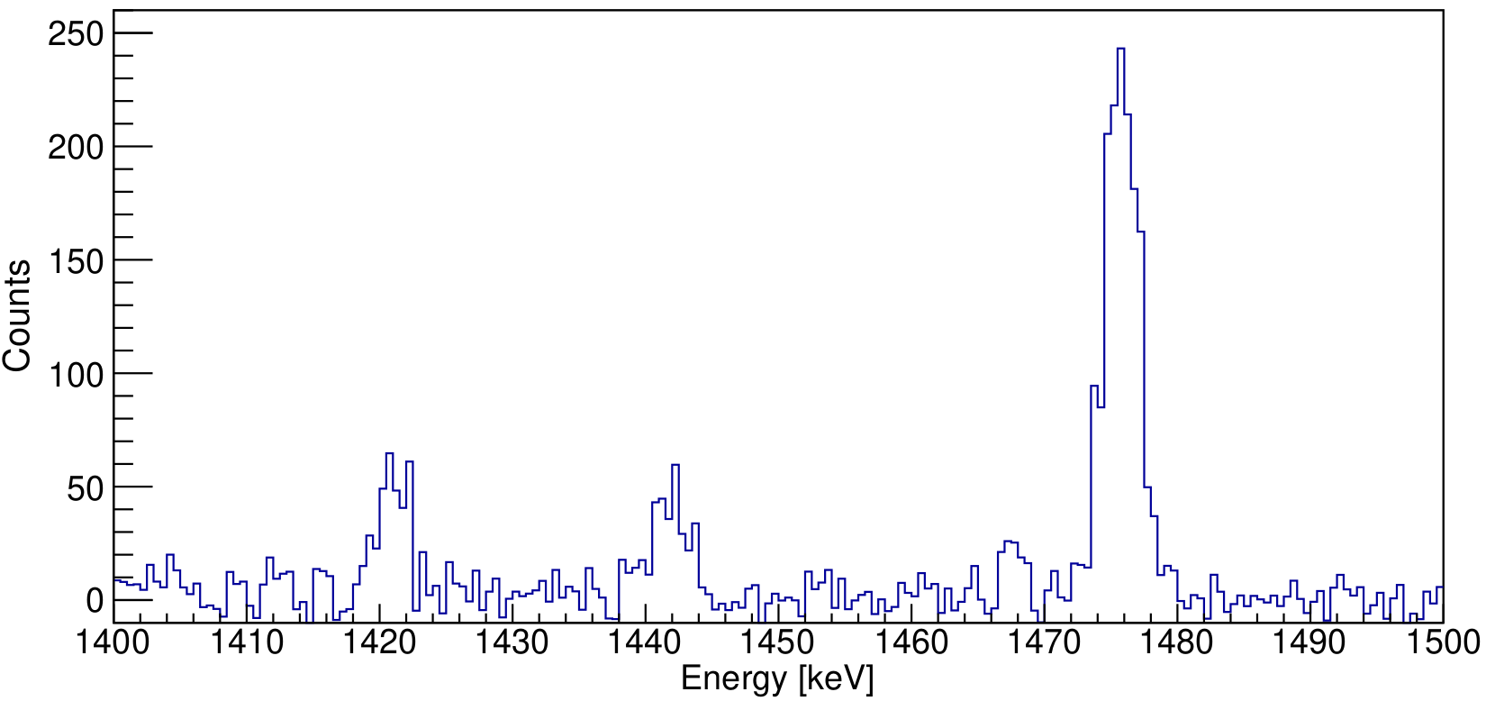
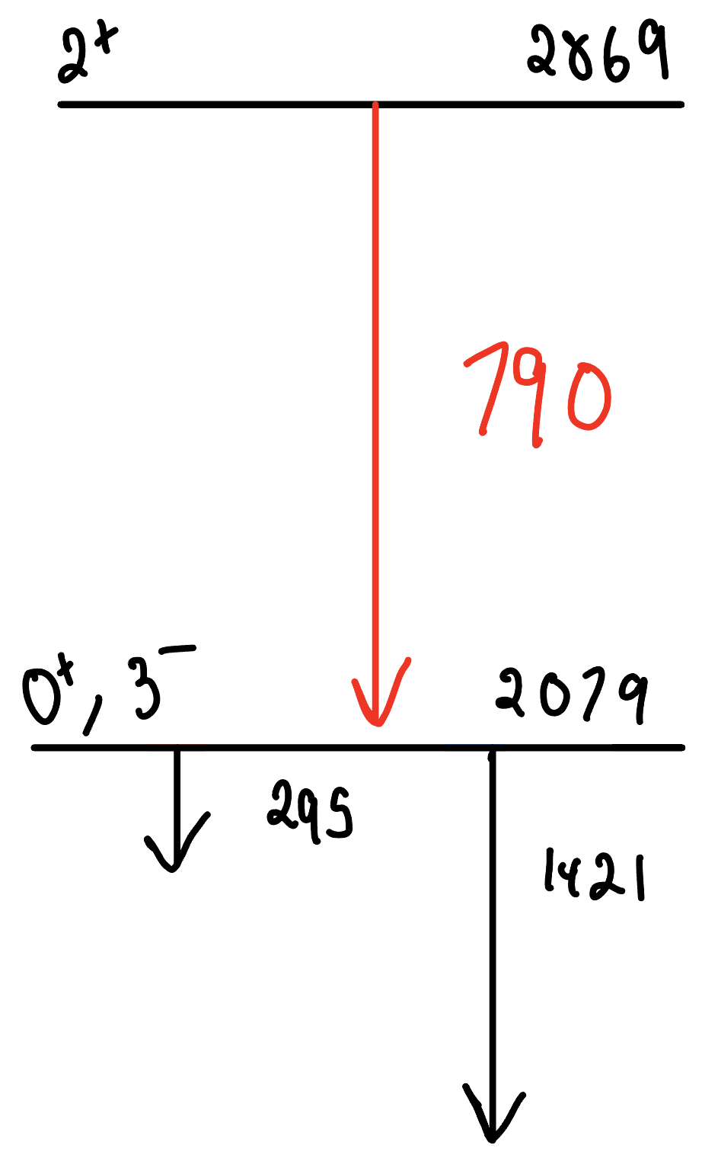
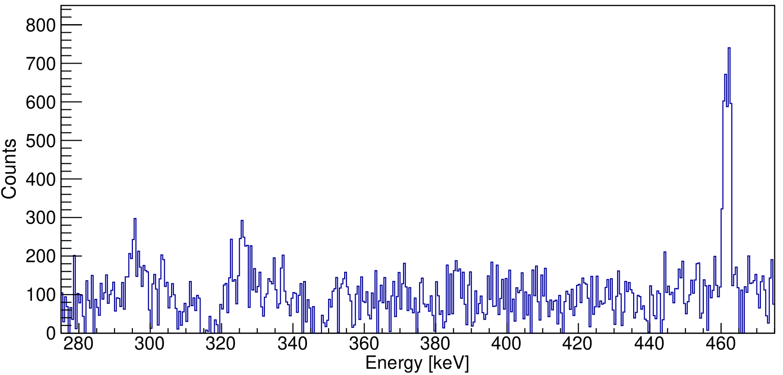
HOW DO WE RESOLVE THIS?
1421 keV
295 keV
Notes:
In order to resolves this issue I can gate on the 790 keV to determine the branching ratio of 295 relative to 1421. We can then compare this with literature to see if the branching ratios align with either the 0+ state, 3- state OR NEITHER
We can use the same way I found the 790 keV but in reverse. Take their areas, correct for efficiency and calculate branching ratios

Slide 27
BRANCHING RATIO WHEN GATING ON 790 keV
E_{i} (keV) | E_{γ} (keV) | E_{f} (keV) | BR (This Work) | BR (Lit. 0⁺ state) | BR (Lit. 3⁻ state)
2078 | 295 | 1783 | 0.6 (2) | 0.791 (21) | 0.0100(7)
 | 1421 | 658 | 0.4 (1) | 0.209 (21) | 0.855(5)
Preliminary results suggest the 790 keV is mostly populating 0⁺ state.
Notes:
MOSTLY POPULATING 0+ STATE BUT WE CAN'T RULE OUT THAT MAY ALSO POPULATE 3-

Slide 28
What’s next?
Preliminary results suggest presence of a possible new 2⁺→0⁺ transition from 2869 keV to 2079 keV.
Continue to search for new transitions in level scheme.
Summary
β-decay analysis of ¹¹⁰In.
Calculate transition strength to compare with theory.
Refine the branching ratios and the uncertainties.
Collected data from β-decay experiments at TRIUMF.
Constructed a level scheme for ¹¹⁰Cd.
Notes:
Refine the branching ratios and the uncertainties
Calculate the transition strengths which gives us information on the deformation
We have beyond mean field theory
For shapoe coexistence they expect collective structure whioch have bery larege transition strnegth whiole spherical moidel has vvery small transitiion strength
Look at Indium

Slide 29

THANK YOU!
& S2196 Collaboration

Slide 30
References
[1] TRIUMF. GRIFFIN. [accessed 2024 Feb 6]. https://fiveyearplan.triumf.ca/teams-tools/griffin-gamma-ray-infrastructure-for-fundamental-investigations-of-nuclei/index.html.
[2] Dall ML. 2018. Matthias Le Dall, 2018 TRIUMF Photowalk. [accessed 2024 Feb 6]. https://www.triumf.ca/current-events/hands-approach-garners-top-honours-2018-triumf-photowalk.
[3] Dornan M. 2014. People’s Choice: 3rd Place. [accessed 2024 Feb 6]. https://www.symmetrymagazine.org/article/december-2014/triumf-announces-photo-contest-winners?language_content_entity=und.
[4] Dornan M. 2014. People’s Choice: 1st Place. [accessed 2024 Feb 6]. https://www.symmetrymagazine.org/article/december-2014/triumf-announces-photo-contest-winners?language_content_entity=und.
[5] J. Kern, P. Garrett, J. Jolie, and H. Lehmann, Nuclear Physics A 593, 21 (1995), ISSN 0375-9474, URL https://www.sciencedirect.com/science/article/pii/037594749500314Q.
[6] P. E. Garrett, T. R. Rodr´ıguez, A. Diaz Varela, K. L. Green, J. Bangay, A. Finlay,R. A. E. Austin, G. C. Ball, D. S. Bandyopadhyay, V. Bildstein, et al., Phys. Rev. C 101,044302 (2020), URL https://link.aps.org/doi/10.1103/PhysRevC.101.044302.
[7] P. E. Garrett, T. R. Rodr´ıguez, A. D. Varela, K. L. Green, J. Ban-gay, A. Finlay, R. A. E. Austin, G. C. Ball, D. S. Bandyopad-hyay, V. Bildstein, et al., Phys. Rev. Lett. 123, 142502 (2019), URLhttps://link.aps.org/doi/10.1103/PhysRevLett.123.142502.
[8] R. J. Joseyphus and J.-M. Greneche, The Nucleus (Springer NatureSingapore, Singapore, 2024), pp. 1–23, ISBN 978-981-99-8653-8, URLhttps://doi.org/10.1007/978-981-99-8653-81.

Slide 31
LaBr₃ detectors​
Mylar Tape
Beam
HPGe Detectors​
PACES​
Notes:
PACES (Pentagonal Array for Conversion Electron Spectroscopy) is an array of 5 lithium-drifted silicon (Si(Li)) detectors located inside the vacuum chamber. They are used to detect internal conversion electrons which can be emitted during the decay of excited states in daughter nuclei. These detectors are also used to detect alpha particles which can be emitted when a heavy nucleus decays; this capability is especially important when working with actinide beams at ISAC.

Slide 32
HOW DO WE RESOLVE THIS?
Place a gate on 790 keV gamma ray
Measure the intensities of the 295 keV and 1421 keV in the coincidence spectrum.
Calculate branching ratio for 295 keV relative to 1421 keV
Compare with literature to see if branching ratio align with either the 0⁺ or 3⁻ states.
Notes:
In order to resolves this issue I can gate on the 790 keV to determine the branching ratio of 295 relative to 1421. We can then compare this with literature to see if the branching ratios align with either the 0+ state, 3- state

