Slide 1
Particle Physics Faculty Meeting
Agenda
News/Update
Research groups Updates

Slide 2
TRIUMF is located on the traditional, ancestral, and unceded territory of thexʷməθkʷəy̓əm (Musqueam) people, who for millennia have passed on their culture, history, and traditions from one generation to the next on this site.
TRIUMF’s home has always been a seat of learning.

Slide 3
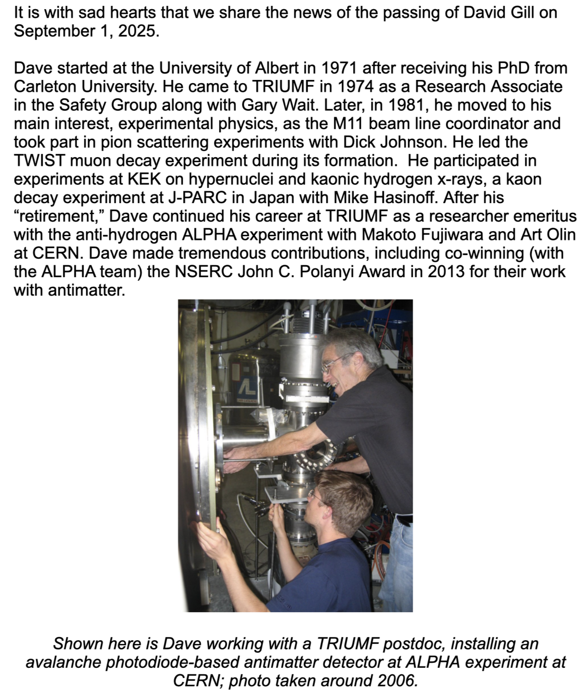
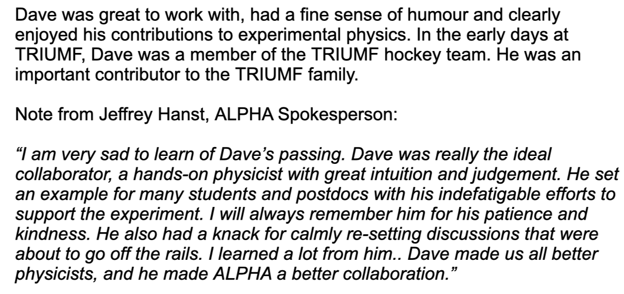
David Gill
There will be a celebration of life on October 18, 2025, 1 – 6 pm in Langley, BC
If you are interested in attending, please email dana@triumf.ca for the full details.

Slide 4
ARIEL
From Ritu:
In today's SMM the attached slide on ARIEL immediate needs was presented. We took a decision that by Thursday this week Department Heads will report back with names of suitable people (Techs., ENGs, BAEs, post docs., Co-ops) against each of the items
Some tasks such as work permits etc. could be done by BAEs. If you don't have anyone suitable/available in your Department please also let me know about that.

Slide 5
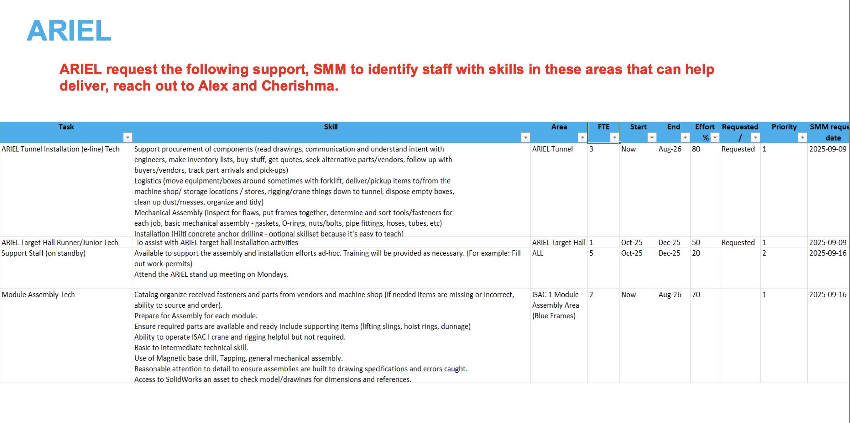
ARIEL

Slide 6
Mark Thomson
CERN Director General—Designate, visit to Canada
At TRIUMF Monday November 17th
Meet with Particle Physics group 1:30-2:30pm in the MOB conference room
There will also be a tour of TRIUMF
Mark will also visit Ottawa on his trip

Slide 7
Various
PSD is collecting info about current grad students
Please enter by tomorrow
PSD Grad Students.xlsx
This is a gentle reminder of the call for submissions for projects that plan to seek TRIUMF support for the CFI IF27 proposals. TRIUMF is extending the deadline for submissions to November 15, 2025.
Note : Only projects that are unsuccessful in the IF25 competition will have an opportunity to submit their PRIS document or update any submitted one by December 5, 2025.

Slide 8
PSD Retreat
Feedback

Slide 9
Round Table
ATLAS
T2K/HyperK
TUCAN
ALPHA
SuperCDMS
DarkLight
n-EXO / PHORWARD
PIONEER
NA62
P-One
SNO+
HALO
g-2
Belle
Theory

