Slide 1
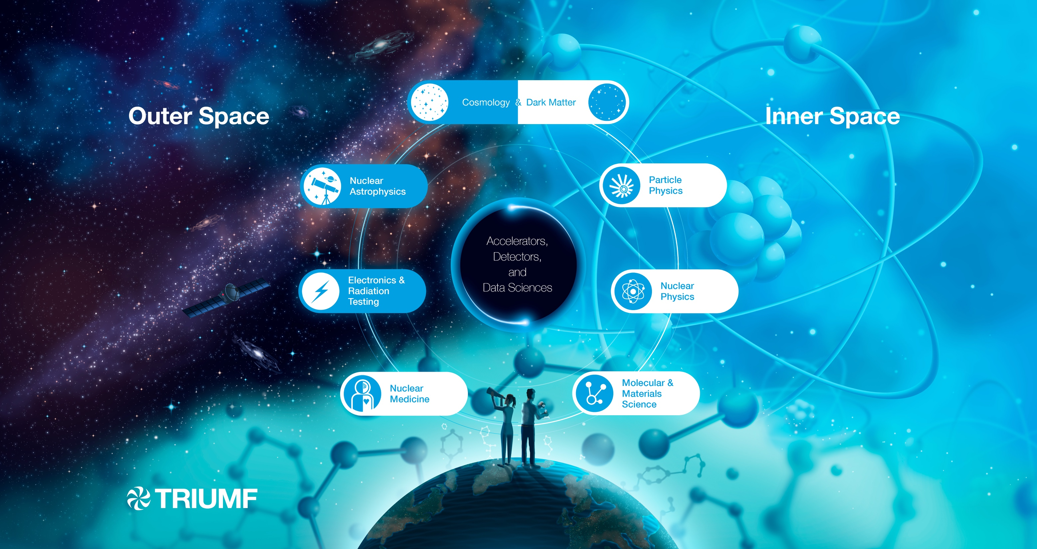
Visit of Mark Thomson
Particle Physics
November 2025

Slide 2
Divisions and Departments
ACCELERATOR
DIVISION
PHYSICAL SCIENCE
DIVISION
LIFE SCIENCE
DIVISION
Molecular and Material Science
ARIEL Experiment Operations
Nuclear Physics
Particle Physics
Science and Technology
Theory
Scientific Computing

Slide 3
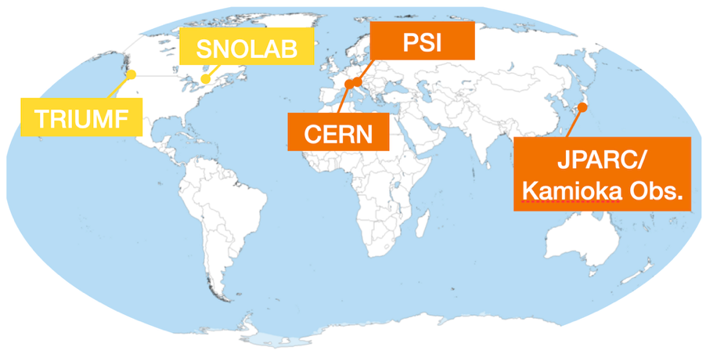
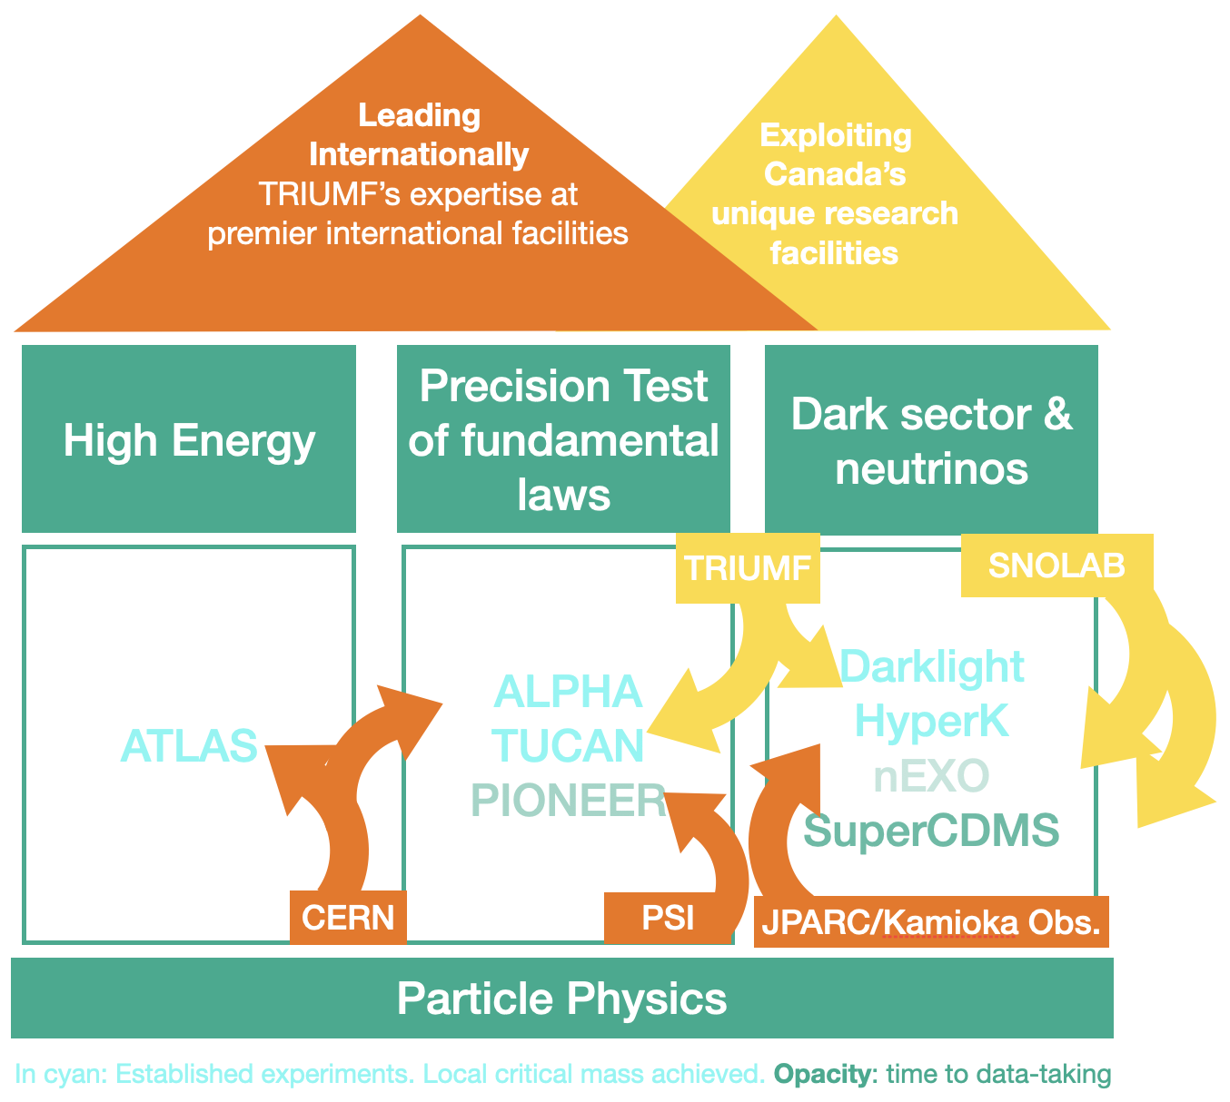

Slide 4
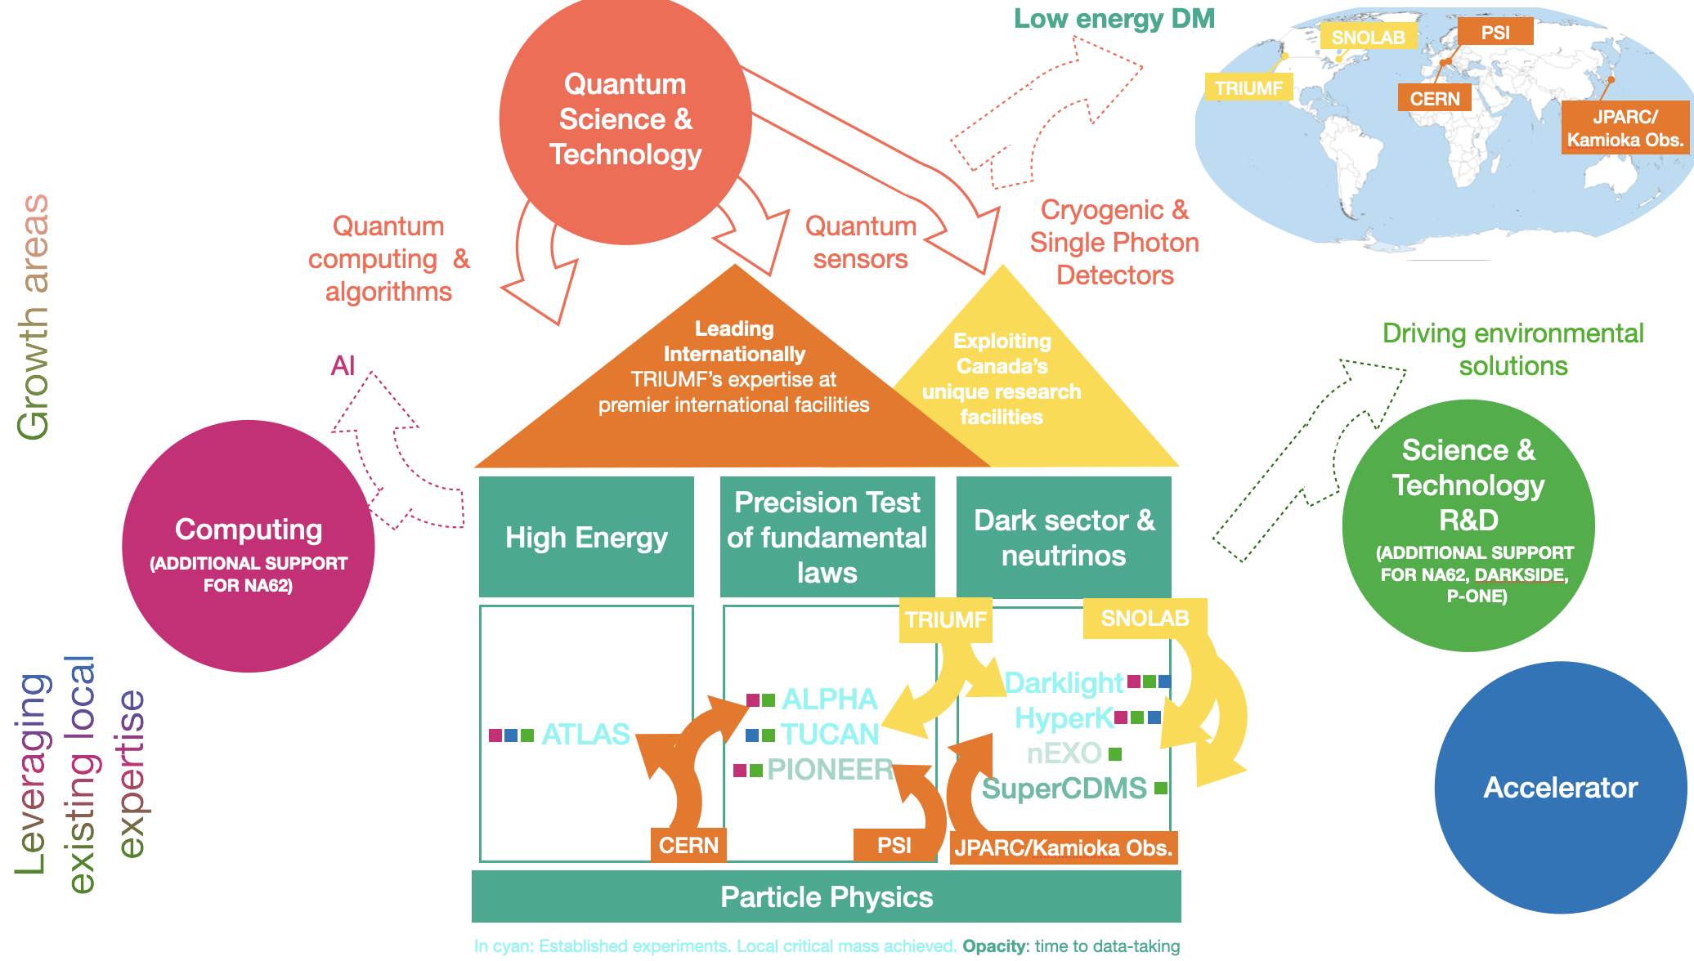
Connections

Slide 5



















Collaborators across Canada
SNOLAB
TRIUMF

Slide 6
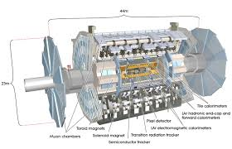
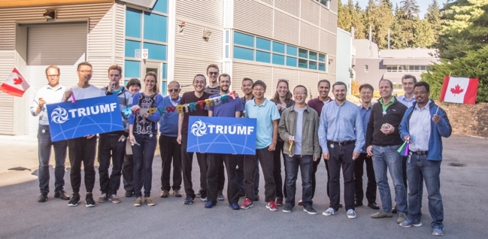
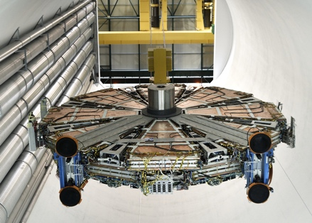
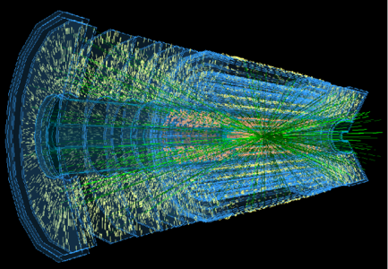
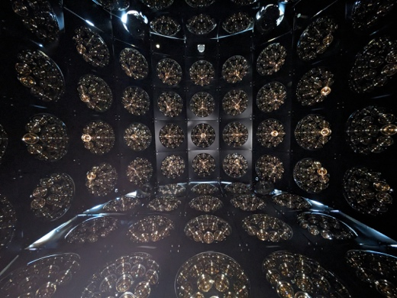
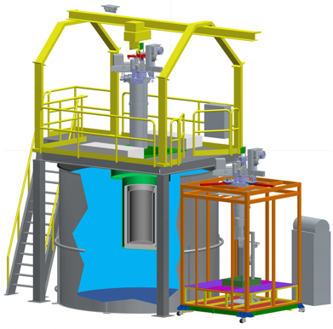
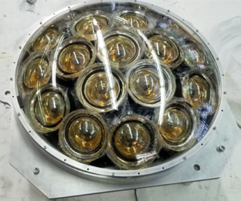
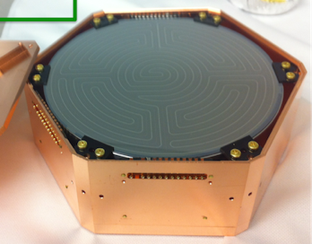
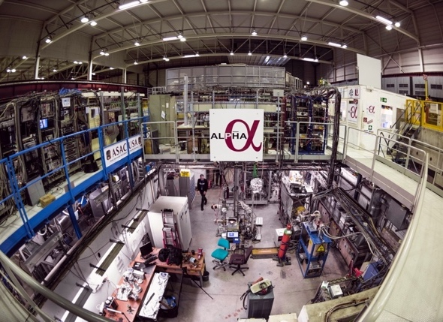
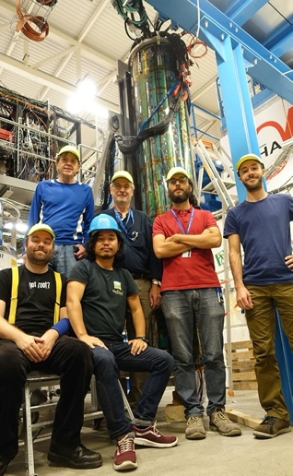
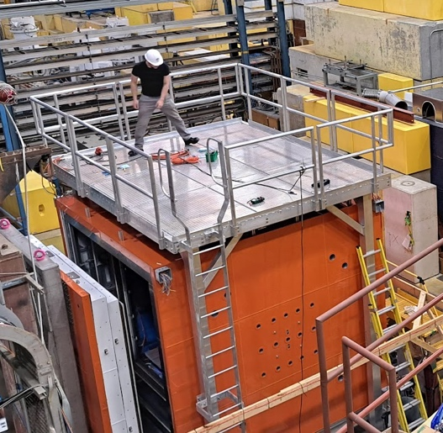
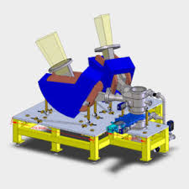
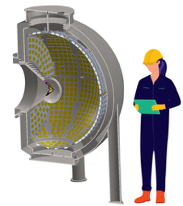
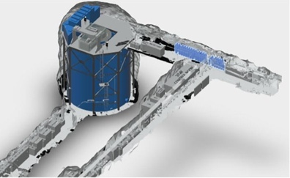
Particle Physics at TRIUMF
High Energy
ATLAS + upgrades
Tier-1, HL-LHC
Dark Sector & Neutrinos
T2K, HyperK, WCTE at CERN and IWCD
SuperCDMS
Precision tests of fundamental laws
ALPHA, ALPHA–g and HAICU
UCN: source, neutron EDM & life-time
Future
DarkLight, PIONEER, nEXO (TBD)

Slide 7


Particle Physics Funding and Training
High Energy
Precision Test of fundamental laws
Dark sector & neutrinos
ATLAS
ALPHA TUCAN PIONEER
Darklight HyperK
nEXO SuperCDMS
Summary of all local HQP and average funding (TRIUMF portion)
5 BAEs
2 P&S 2 Affiliates 3 Joints
5 BAEs
1 P&S 4 Affiliates
5 BAEs
0.5 P&S 5 Affiliates 1 Joint
in 2025
Grad students
Postdocs
Undergrads
12
6
5
9
7.5
11
6
8
8
Average NSERC
~$1M
~$1.3M
~0.8M
CFI 2013-2023
Other
CFI 2025
$23M
$20M
$40M
JSPS $2M
$48M
$2.5M

Slide 9
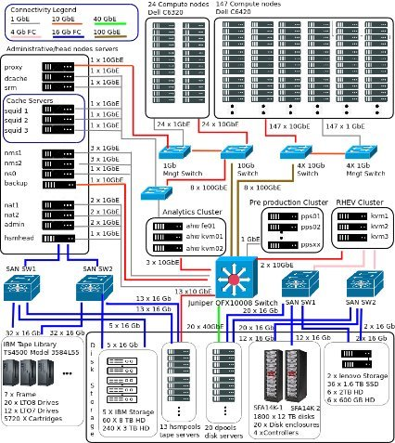

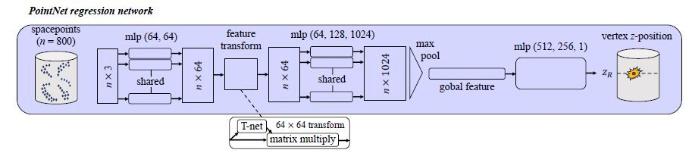
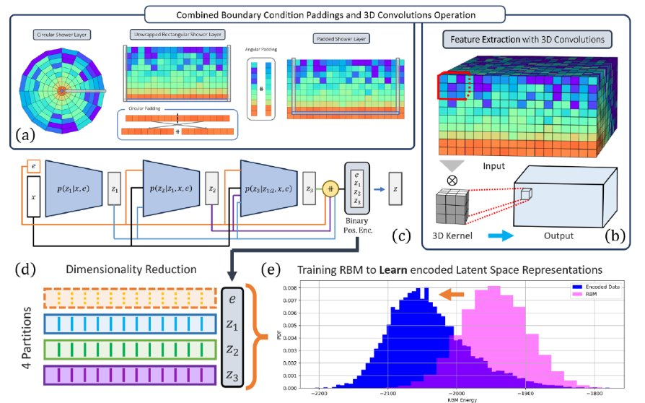
Scientific Computing Department Activities
Canadian ATLAS Tier-1 Centre & Distributed Computing
Large-scale data storage and processing, simulations and user analysis in a highly secure environment
Key user support and tools for the entire collaboration
Operations at TRIUMF since 2007, then Simon Fraser University since 2018 (federation of two sites)
Excellent synergies with CERN & WLCG sites
Machine Learning & Quantum Information Systems (with Particle Physics, SciTech, Accelerator and Life Sciences)
Bayesian Optimisation for Ion Steering at ISAC
Quantum-Assisted generative AI using D-Wave quantum annealers for fast calorimeter simulation for the HL-LHC
Detector design studies and imaging techniques for theranostic applications (Targeted Alpha Therapy with Ac225)
Water Cherenkov detectors for particle reconstruction
Annihilation vertex reconstruction for ALPHA-g
Real time AI using FPGAs for ATLAS calorimeter cluster calibration for the HL-LHC

Slide 12
Discussion Points
European Strategy Update
Future of CERN
Canadian Long-Range Plan
Round table

Slide 13
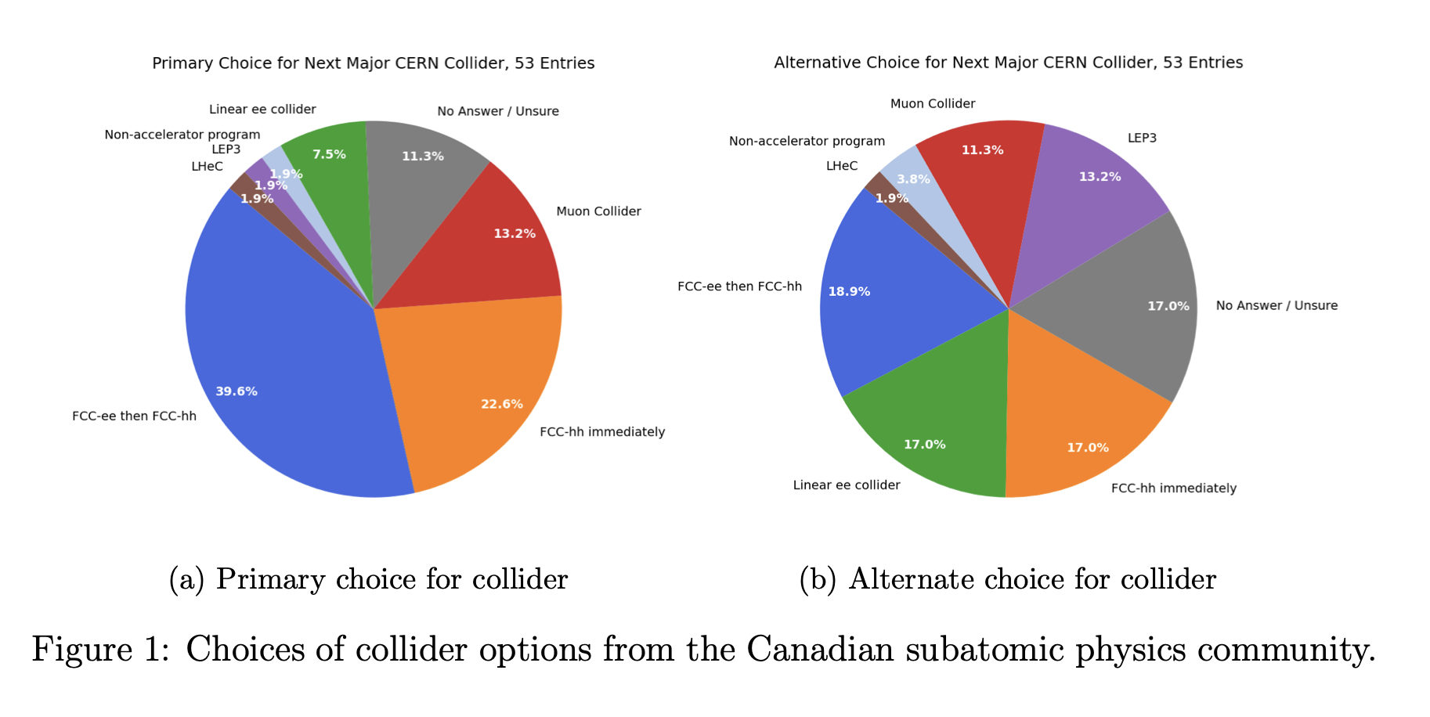
Canadian Survey for ESU

