Slide 1
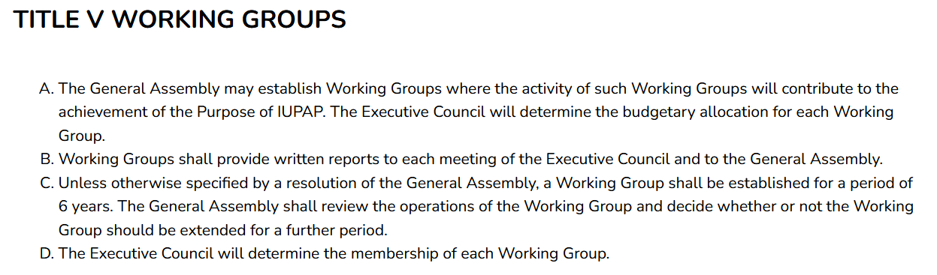
IUPAP Working Groups
https://iupap.org/documents/statutes-bylaws/regulations/

Slide 2
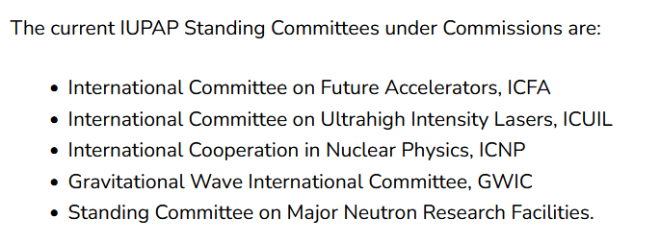
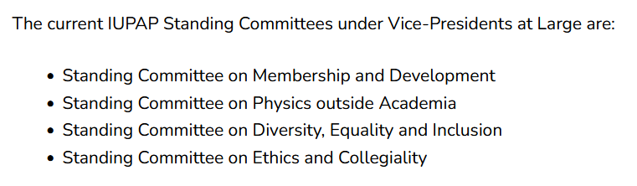
IUPAP Working Group vs. Standing Committees
WG9 was established via recommendation of C12 in 2003
Membership matrix is largely independent of IUPAP Executive Council
IUPAP Rejuvenation efforts by new president: Creation of “Standing Committees” under Commissions or Vice-Presidents at-large
https://iupap.org/who-we-are/internal-organization/standing-committees/

Slide 3
Standing Committee under Commissions
“Standing Committees under Commissions have direct links with one or more IUPAP Commissions. The Chair of one such Commission should serve in an ex-officio capacity within the relevant structures of the Standing Committee and be kept informed of its decisions…
Standing Committees under Commissions constitute a platform for the discussion at a global scale among the leading actors in the field they cover. The organization, composition and terms of reference of these Committees are defined by each of them in consultation with the Commission(s) whose Chair(s) is serving on some of their internal structures…
Standing Committees under Commissions shall provide written reports to each General Assembly and to the Executive Council meeting immediately preceding each General Assembly. ”
https://iupap.org/who-we-are/internal-organization/standing-committees/

Slide 4
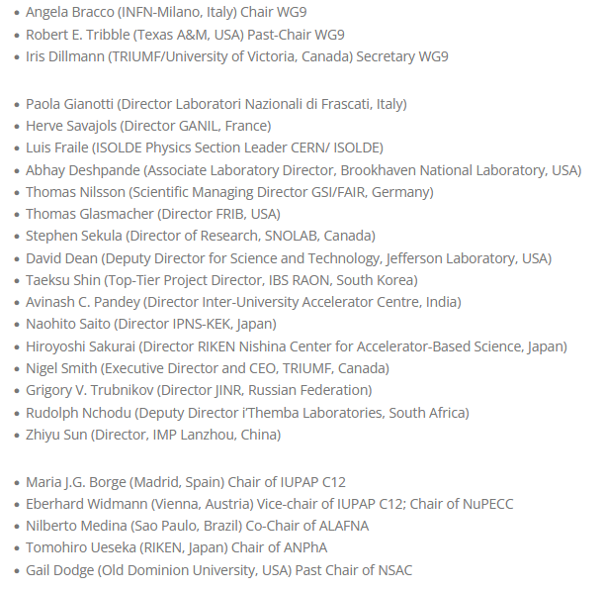
WG9 : Membership (until 2026)
Membership list 2026: https://wg9.triumf.ca/about-us.html
Chair, Past Chair, Secretary (3)
No terms for officers defined
Lab directors or designates (16):
North America (5): Brookhaven, FRIB, SNOLAB, JLab, TRIUMF South America (0): via ALAFNA Europe (5): INFN-LNF, GANIL, ISOLDE, GSI/FAIR, JINR, + via NUPECC
Africa (1): iThemba Labs
Asia (5): IUAC*, IBS RAON, KEK, IMP Lanzhou (+HIAF), RIKEN + via ANPhA
Oceania: via ANPhA
C12 chair and vice-chair (2) Chairs from international associations (3): ALAFNA, NUPECC, ANPhA
NSAC chair (1) (but NSAC does not exist anymore)

Slide 5
Standing Committee ICNP: New ToR (draft)
Define membership in Terms of References:
Governing body: chair, vice-chair, past chair, scientific secretary
C12 chair and vice-chair
Chairs of int. scientific associations: ALAFNA, NUPECC, ANPhA
Members-at-large: Lab directors or designates
No more NSAC: Only international associations!
The governing body (chair, vice-chair, scientific secretary) has to be (re)-elected every 3 years.
Chair: 3y term
Vice-chair (chair-elect) who will become the chair after their 3y term Chair and vice-chair have to be chosen from WG9 members (past term or present)
Scientific secretary: 3y term, renewable once. The scientific secretary does not have to be a previous member and can be chose from suitable candidates, e.g. C12 members.
The total number of terms of any governing body member shall not exceed three terms (9 years), excluding the past chair position.

Slide 6
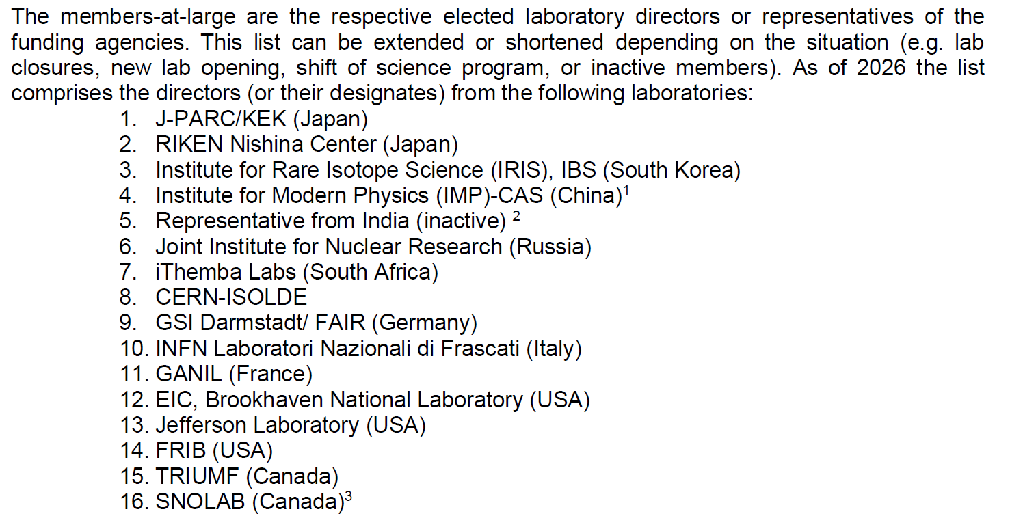
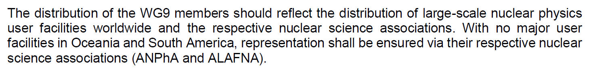
Standing Committee ICNP: New ToR (draft)
China: IMP-CAS for Lanzhou and new HIAF in Huizhou
India: Inactive member from IUAC
New group for “(Nuclear Physics) Underground facilities”

Slide 7
Standing Committee: Change of membership
NSAC (USA) has been dissolved and is no longer a member. Only international scientific associations should have a seat. Suggestion: Long-Range Plan Chairs from large countries can be invited as guests
Representation from India: Prof. Avinash C. Pandey (IUAC New Delhi) has not attended any meeting or replied to any email. Suggestion: Contact VECC if they want to become member
Representation of “Underground facilities”: So far only SNOLAB (Canada) New large (Nuclear Physics) Underground Facilities are operational now: INFN Gran Sasso, SURF in the USA, JUNA in China Suggestion: Rotating seat every year btw 4 facilities

Slide 8
Discussion points

