Slide 1
Marcella Grasso
Scientific Director
Nuclear and Hadronic Physics
CNRS Nucléaire & Particules
IN2P3
France
TRIUMF-ARIEL science workshop
April 23 -> focus on CNRS-TRIUMF IRL Nuclear Physics, Nuclear Astrophysics and Accelerator Tehcnologies (NPAT), TRIUMF

Slide 2
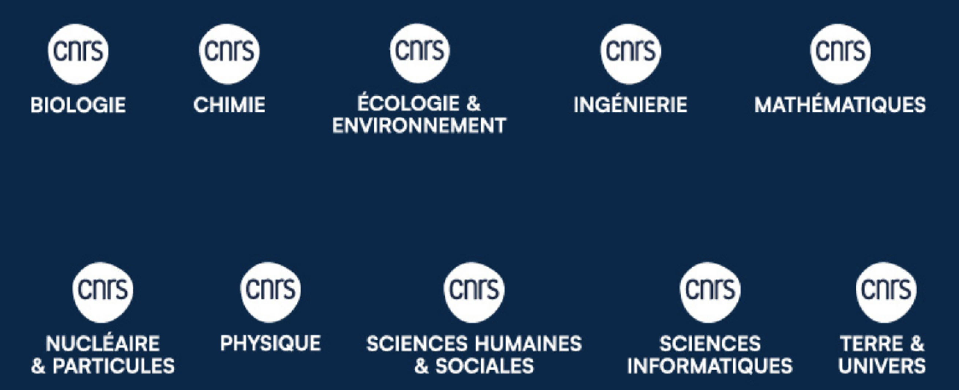
IN2P3 Institut National de Physique Nucléaire et de Physique des Particules One of the 10 institutes of CNRS, with a national mission -> Decree, decision of the French Minister of National Education, Higher Education and Research (2016)
CNRS
More than 34000 employees -> more than 29000 scientists
10 institutes and more than 1000 laboratories
About 80 international laboratories, real CNRS laboratories abroad to strengthen international links

Slide 3
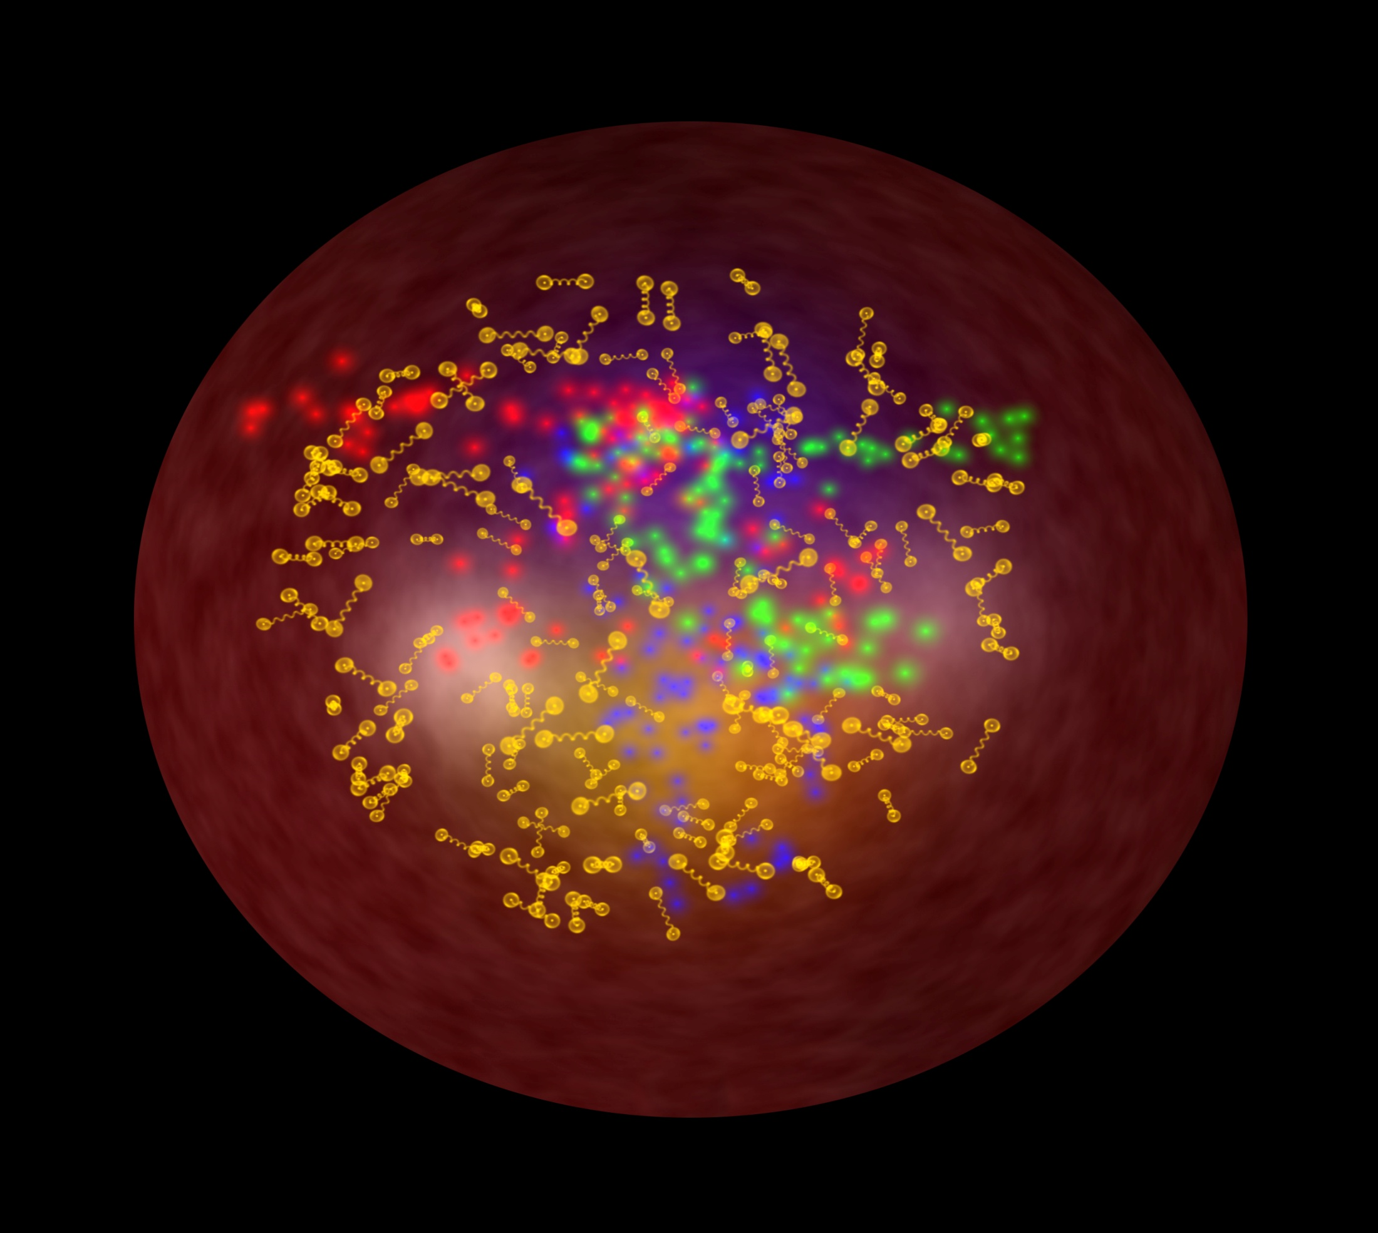
IN2P3: a national institute, with a national mission
COORDINATING RESEARCH IN THE FIELDS OF NUCLEAR, PARTICLE, AND ASTROPARTICLE PHYSICS, RELATED APPLICATIONS AND TECHNOLOGICAL DEVELOPMENTS
Strong links with Universities and CEA
EXPLORES
the physics of the two infinities: from elementary particles to cosmology
RUNS and OVERSEES
COORDINATES
research laboratories in connection with universities and
other finding agencies
research programs,
French involvement in facilities, projects and
international
collaborations
LINKS WITH SOCIETY
DEVELOPS
technologies, applications
of societal interest
expertise,
teaching, training
PROVIDES
Many projects are carried out within international collaborations and in large infrastructures (in coherence with the national Road Map for Research Infrastructures)

Slide 4
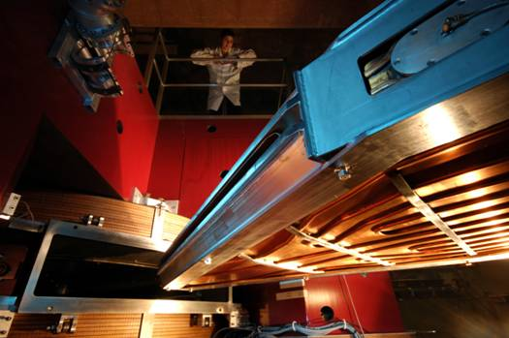
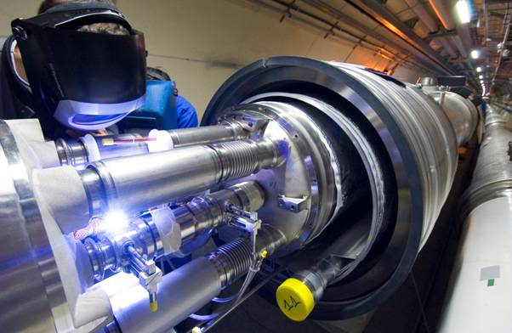
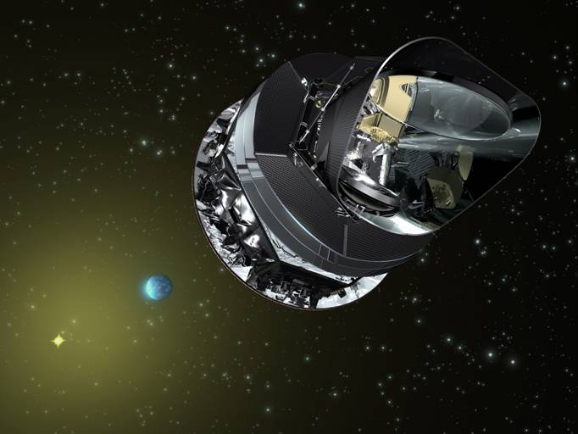
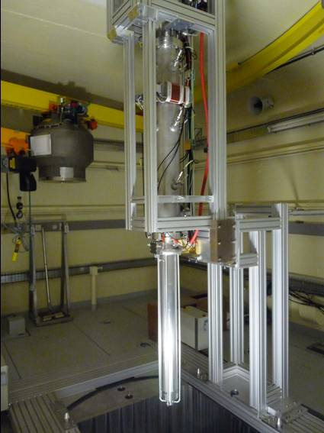
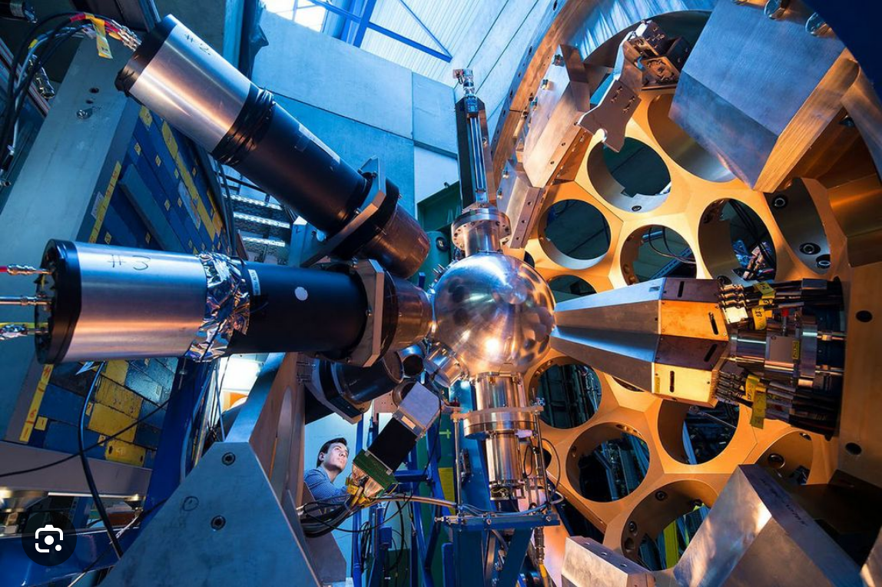
IN2P3 Organizational Chart
Institute Director: C Roy
Deputy: J-L Biarrotte
Administrative Director :
S Pannetier
Technical Director:
R Cornat
Scientific Directors
Accelerators and
Technologies
A Lucotte
Astroparticle Physics and Cosmology
N Leroy
Nuclear and Hadronic Physics
M Grasso
Particle Physics
L Vacavant
Societal-impact activities (energy, health, environment)
J Marteau
15 laboratories (partnerships with local universities), GANIL (CNRS and CEA), 8 national science & technology platforms
About: 1000 physicists (half of them CNRS staff), 1400 engineers, technicians and administration staff (1200 CNRS staff)
About 300 post-doc, 500 PhD students, and 200 engineers, technicians and administration staff with fixed-term contracts
Advisory Committees:
IN2P3 Scientific Council (3 sessions per year)
Laboratory Directors Committee (meetings every month)

Slide 5
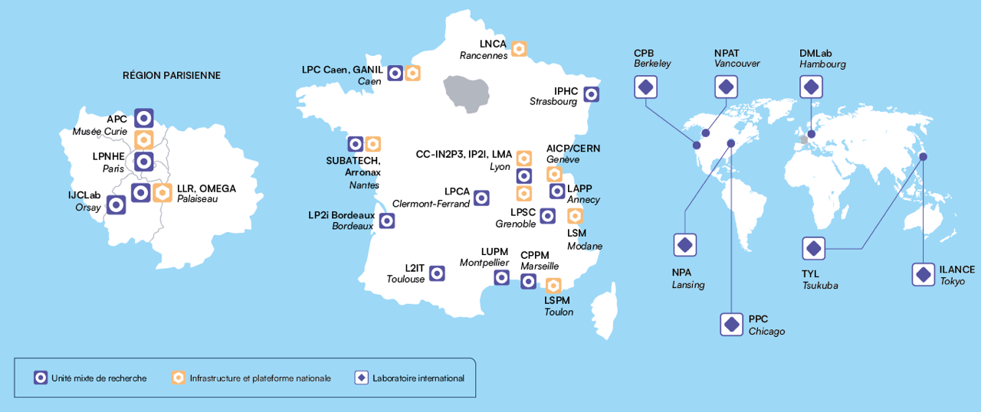
IN2P3 today, a distributed laboratory in France
Partnerships with Universities
GANIL is a CNRS-CEA laboratory

Slide 6
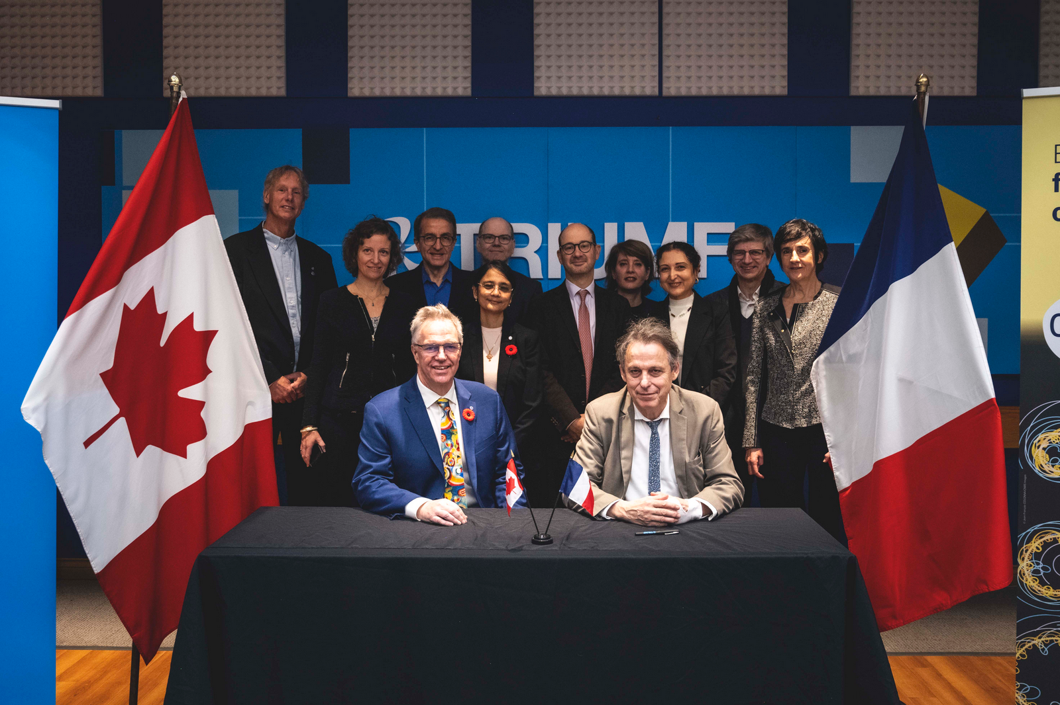
Nuclear physics and nuclear astrophysics international laboratories (IRL)
NPAT
(CNRS-TRIUMF)
Directors:
Ritu Kanungo, TRIUMF
Dave Lunney, IJCLab
Scientific Committee:
Nuclear Physics,
Martin Alcorta (TRIUMF), Thomas Roger (GANIL)
Nuclear Astrophysics, Nicolas De Séréville (IJCLab), Christopher Ruiz (TRIUMF)
Accelerator technologies, Maud Baylac (LPSC),
Oliver Kester (TRIUMF)
NPAT
Inauguration ceremony, November 2024.
Starting date, January 2025

Slide 7
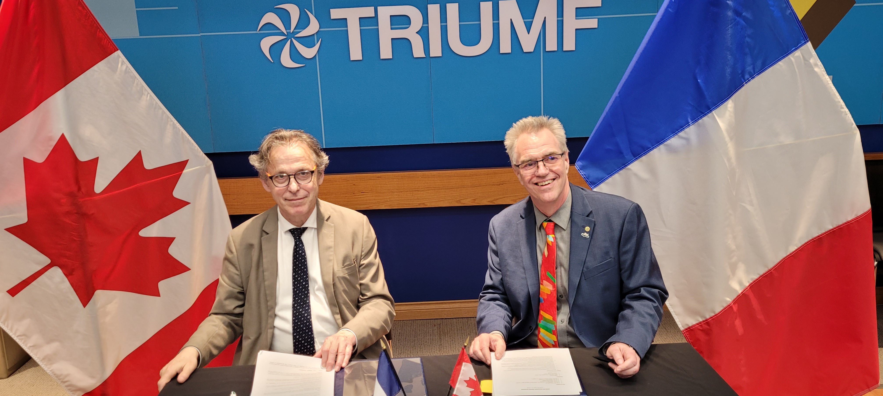
Nuclear physics and nuclear astrophysics international laboratories (IRL)
NPAT
(CNRS-TRIUMF)
Directors:
Ritu Kanungo, TRIUMF
Dave Lunney, IJCLab
Scientific Committee:
Nuclear Physics,
Martin Alcorta (TRIUMF), Thomas Roger (GANIL)
Nuclear Astrophysics, Nicolas De Séréville (IJCLab), Christopher Ruiz (TRIUMF)
Accelerator technologies, Maud Baylac (LPSC),
Oliver Kester (TRIUMF)
NPAT
Signature ceremony, April 2026
Thank you for the organization!

Slide 8
Thank you for your attention

