Slide 1
Experience of the TITAN’s MR-TOF-MS at ISAC and its potential capabilities at ARIEL
Samuel Ayet San Andres
Instituto de Fisica Corpyscular – CSIC - UV
for the FRS Ion Catcher Collaboration
(MR)-TOF-MS
Genealogy
MR-TOF-MS Performance
Isomers

Slide 2
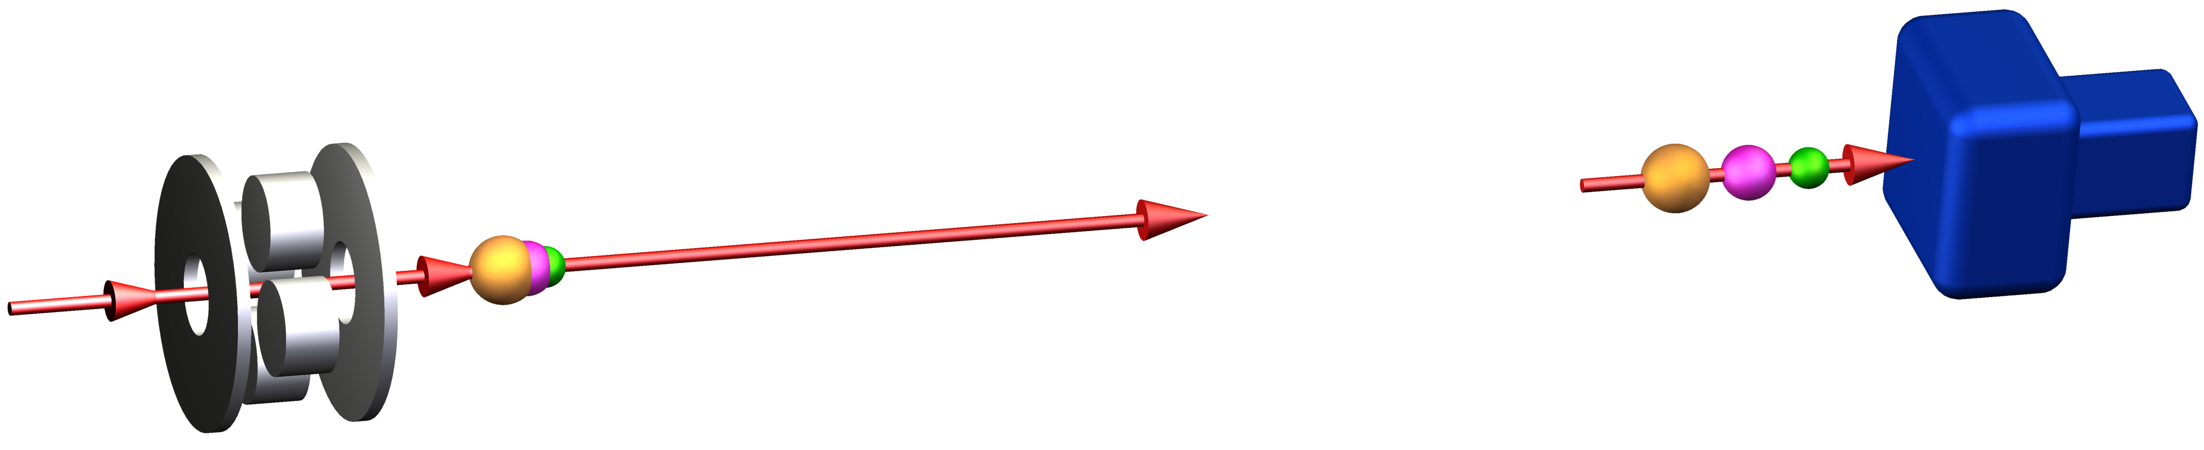
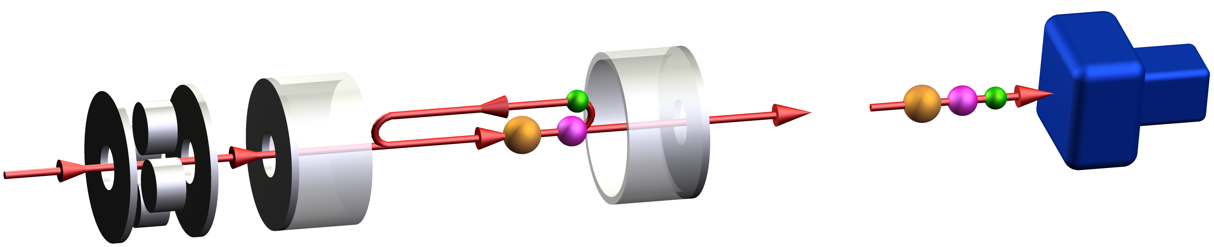
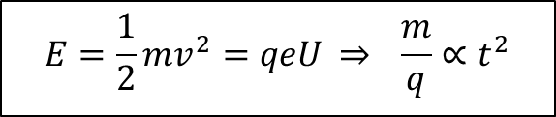
Time-of-flight Mass Spectrometry
Enables high performance
Fast → access to very short-lived ions (T_{1/2} ~ ms)
Sensitive, broadband, non-scanning → efficient, access to rare ions
$$E=\frac{1}{2}mv^{2}=qeU \overset{⇒}{ } \frac{m}{q}∝t^{2}$$
Injection trap
...
Detector
To achieve high mass resolving power and accuracy:
Multiple-reflection time-of-flight mass spectrometer (MR-TOF-MS)
H. Wollnik et al., Int. J. Mass Spectrom. Ion Processes 96 (1990) 267
Injection trap
Analyzer
Detector
Applications
Diagnostics measurements: monitor production, separation and low-energy beam preparation of exotic nuclei
Direct mass measurements of exotic nuclei
High-resolution mass/isomer separator
W.R. Plaß et al., Int. J. Mass Spectrom. 394 (2013) 134
C. Scheidenberger et al., Hyperfine Interact. 132 (2001) 531
W.R. Plaß et al., NIM B 266 (2008) 4560, T. Dickel et al., PLB 744 (2015) 137

Slide 3
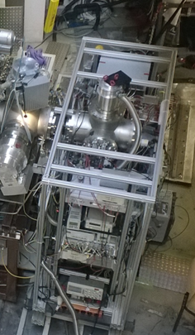
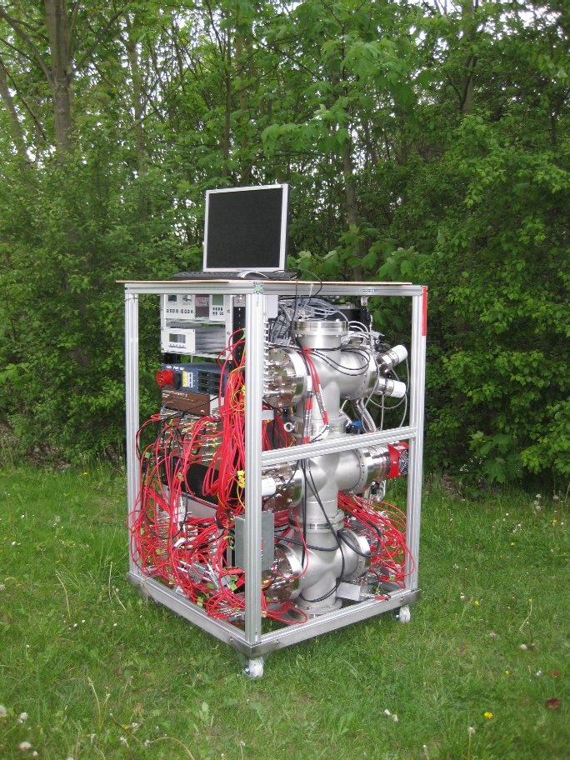
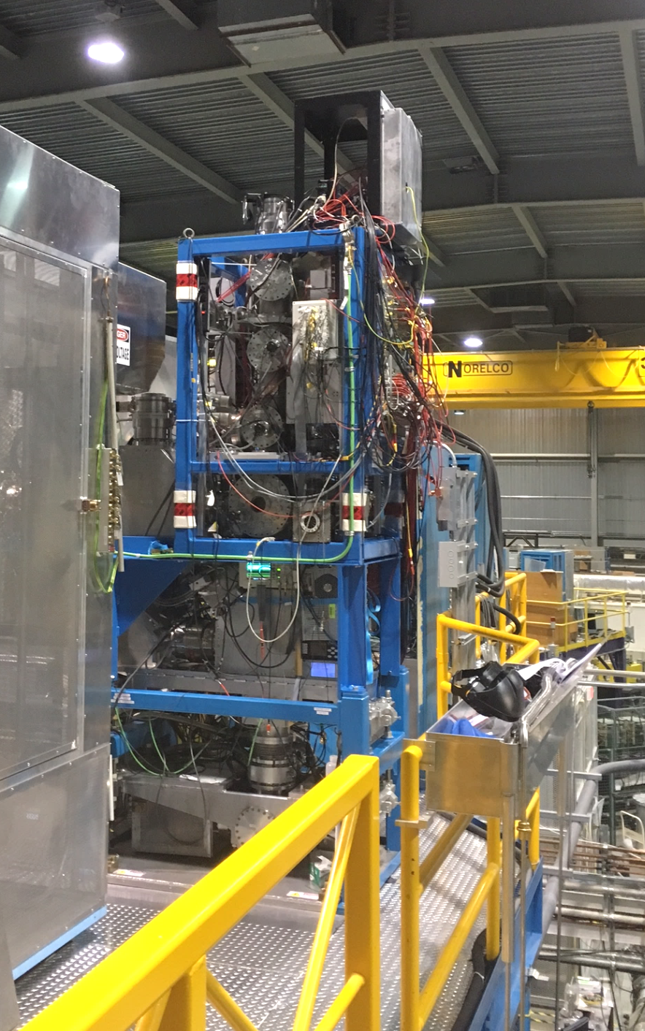
Genealogy of MR-TOF-MS built @ JLU Giessen
MR-TOF-MS at FRS Ion Catcher (GSI)
MR-TOF-MS Isobar separator
for the TITAN facility (TRIUMF)
Mobile MR-TOF-MS for analytical mass spectrometry (JLU)
Inlet
T. Dickel et al., NIM A 777 (2015) 172
Development platform:
Retrapping
Software
Electronics
…
1.2 m
Ion-optical identical scaled down versions
0.8 m
C. Jesch et al., Hyperfine Interact. 235 (2015) 97
Dickel et al. NIM B 317 (2013)
Notes:
MR-TOF-MS around the world.
Show what it can do…

Slide 4
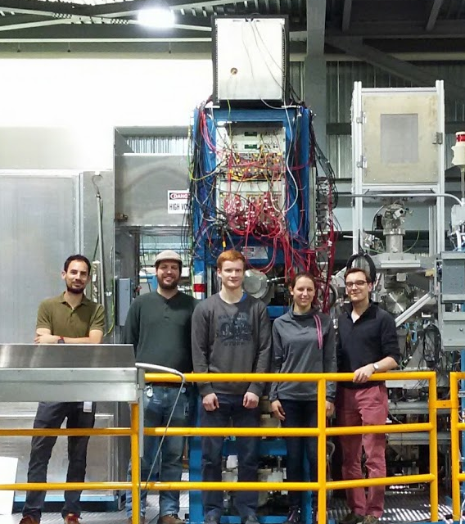
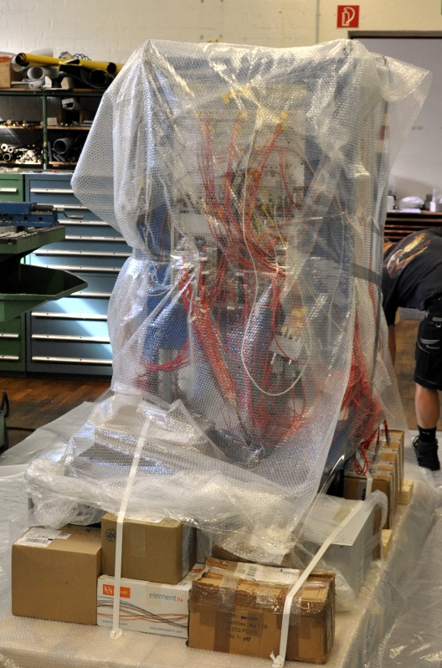
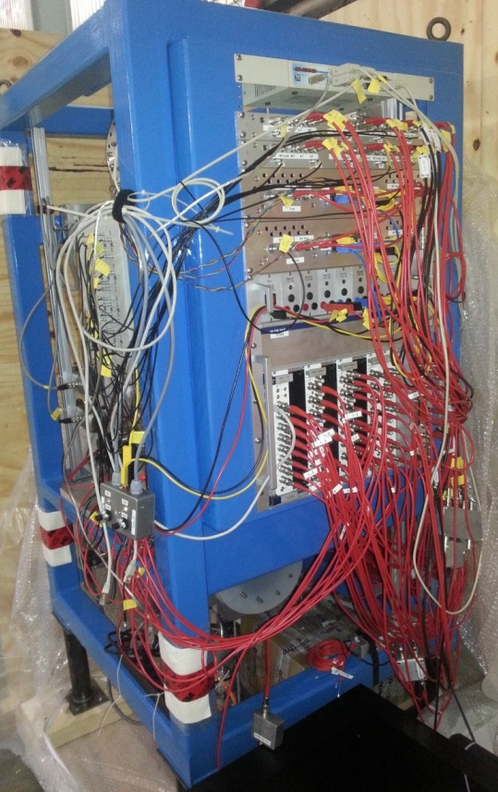
First operation steps…
Installation and first beamtimes:
- MR-TOF-MS @ Platform 20.03.2017
- First Vacuum 25.03.2017
- Offline Commissioning 27.04.2017
- OLIS Beamtime 03.05.2017
- 1st RIB (Titanium) 11.05.2017
- 2nd RIB (Gallium) 18.06.2017

Slide 5

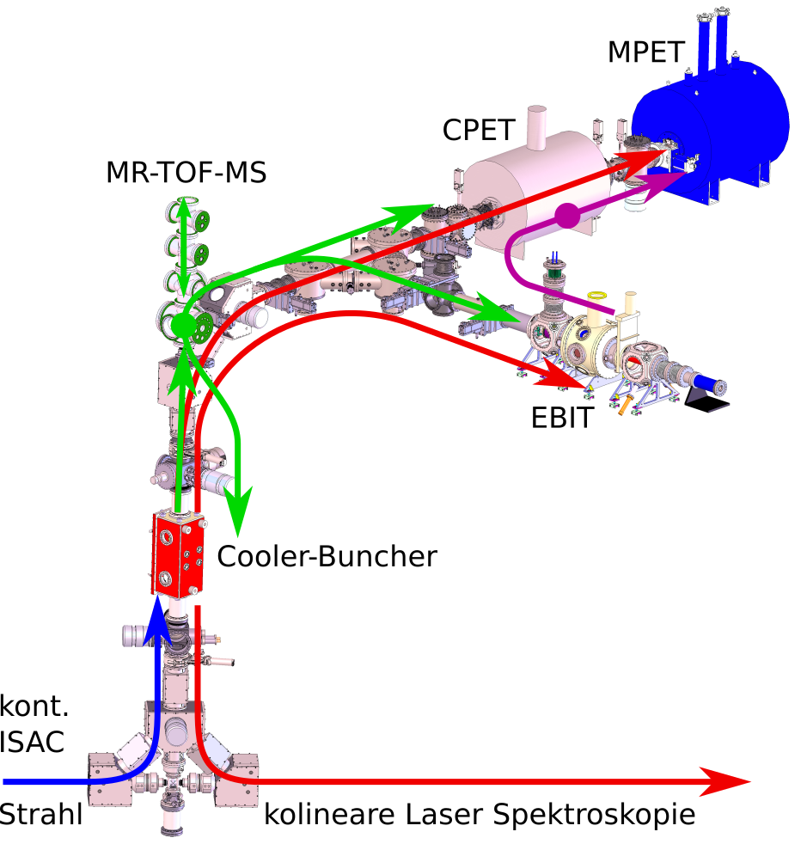

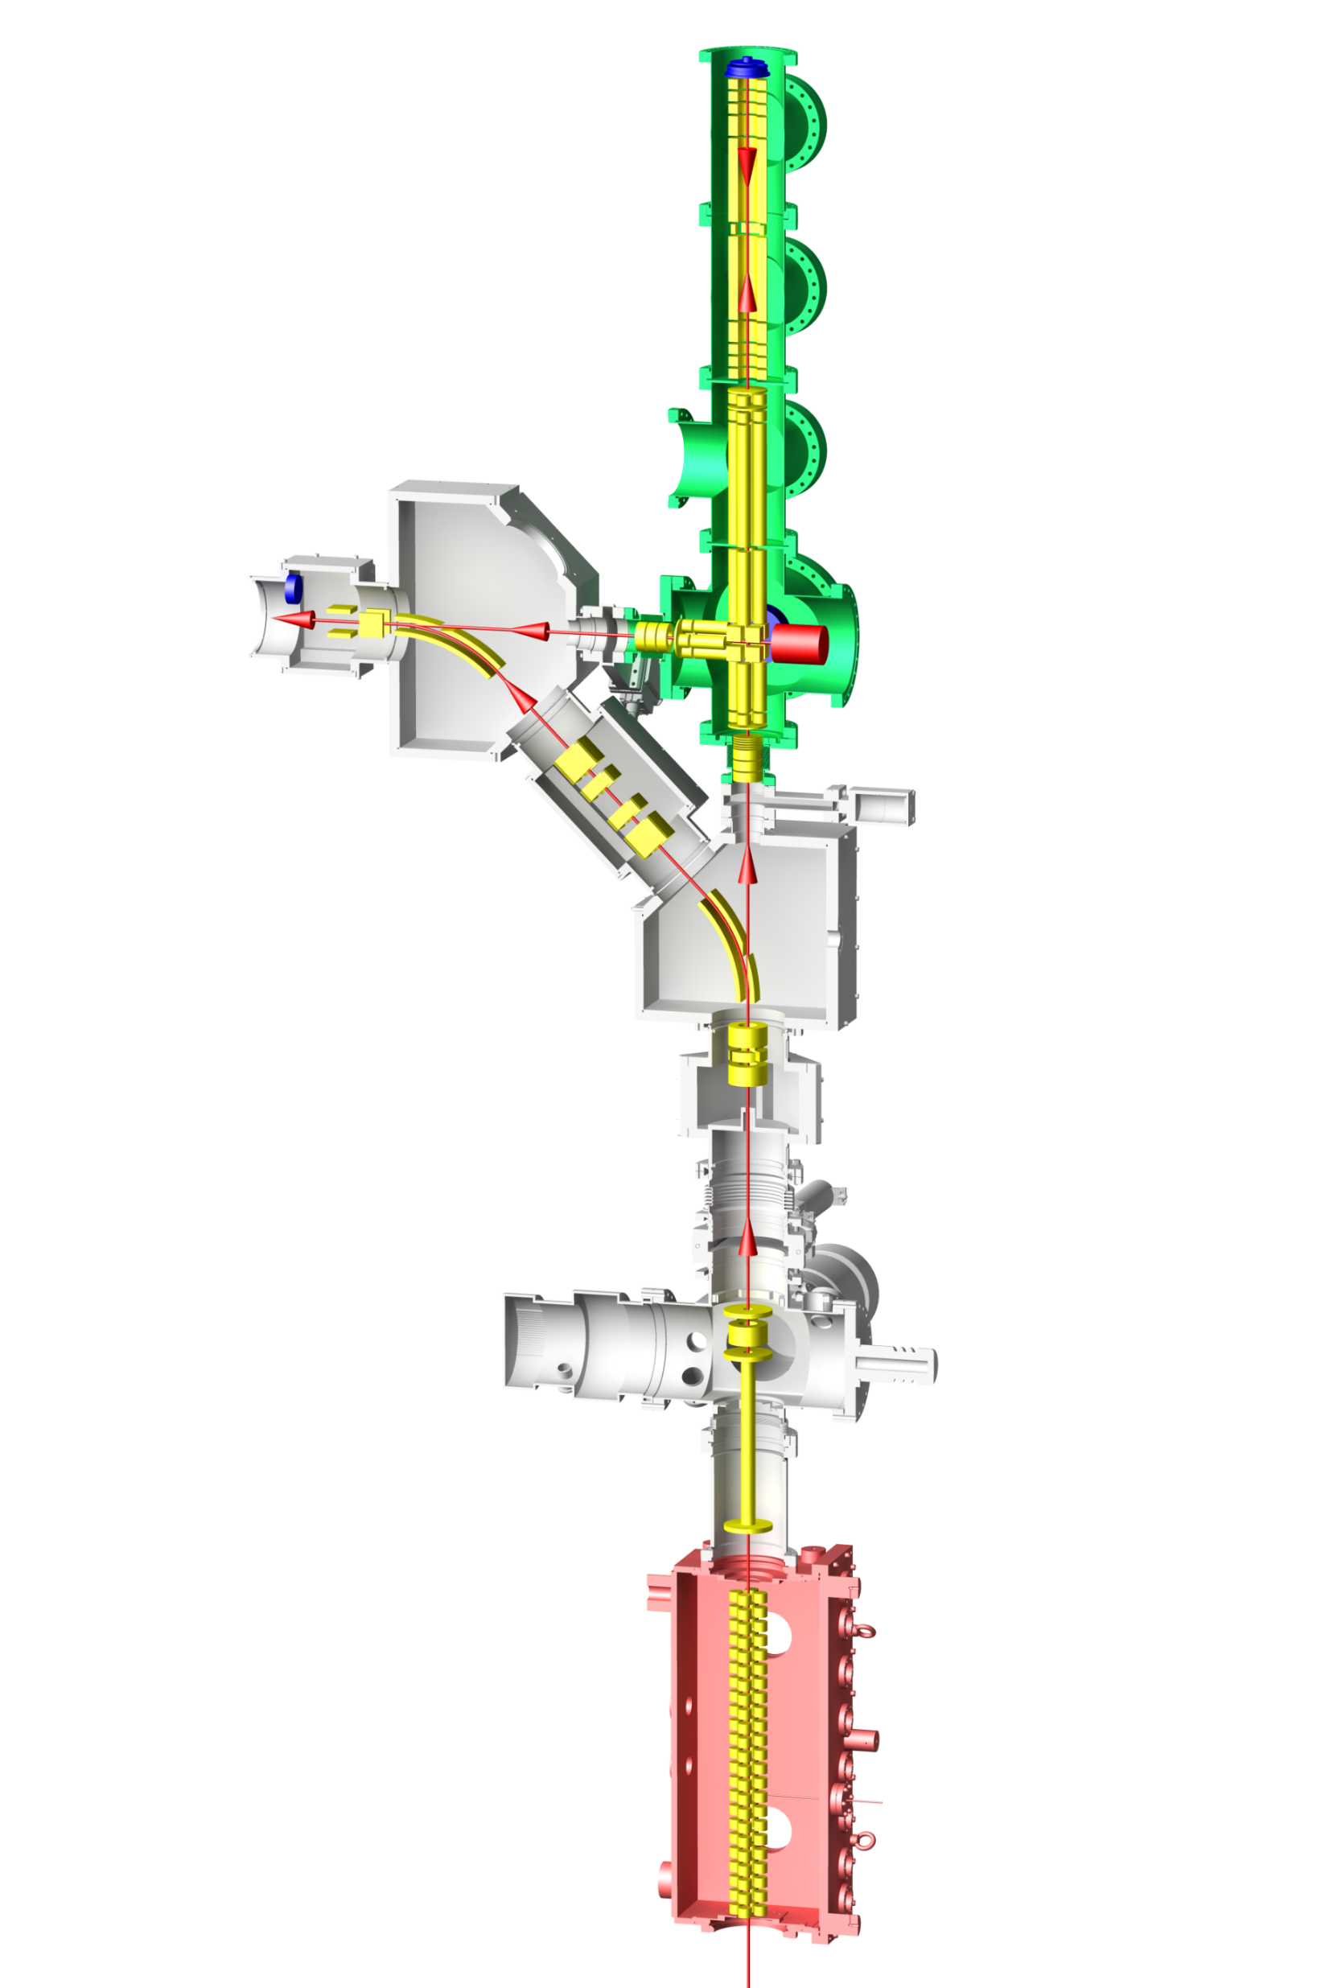

MR-TOF-MS @ TITAN
MR-TOF MS:
remove isobaric contaminants and mass measurements via time-of-flight
MPET:
mass measurement
via determination of cyclotron frequency
Cooler Trap:
Cooling of HCIs
MCP
TOF analyzer
RF
Accumulation
Trap
RF
Injection and
Retrapping
Trap
TRIUMF’s Ion Trap for Atomic and Nuclear Science
High-precision mass measurements
In-trap decay spectroscopy
EBIT: Charge State Breeding
RFQ: accumulate, cool and bunch
J. Dilling et al., NIMB 204 (2003) 492, C. Jesch et al., Hyperfine Interact. 235 (2015) 97

Slide 6

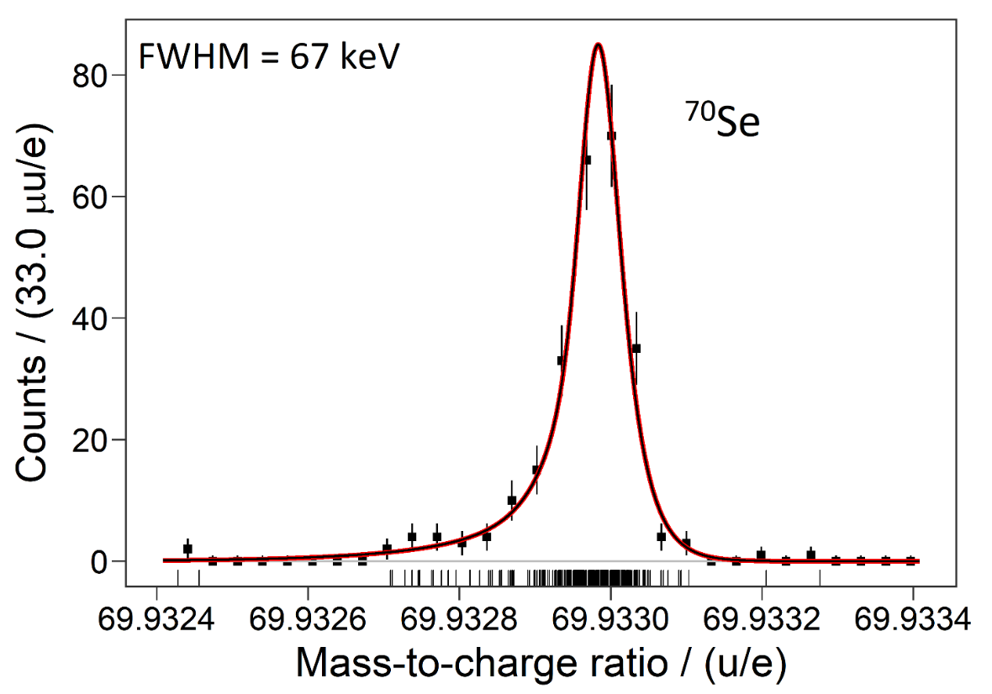
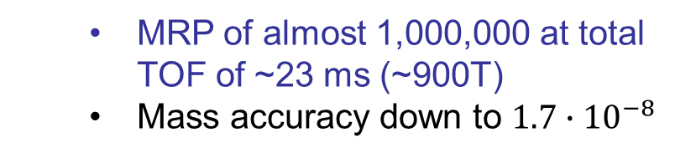
Performance of MR-TOF-MS: Mass resolving power and accuracy
We need:
Faster measurement
Higher precision
Higher sensitivity
Higher rate capability
MRP of almost 1,000,000 at total TOF of ~23 ms (~900T)
Mass accuracy down to $1.7∙{10}^{−8}$
TITAN’s MR-TOF-MS
All species 250k below 9ms!
- 485 events collected
- Δm = 2.6 keV - Δm/m = 4.0×10⁻⁸
I. Mardor et al., PRC 103, 034319 (2021)
M. P. Reiter et al., NIM A 1018 (2021) 165823
Notes:
The vicinity of the N=Z line is of special interest in nuclear structure physics, in nuclear astrophysics and for the basic understanding of nuclear forces and symmetries in nuclei.
Physics Goals:
rp-process
Nuclear structure (isospin symmetry, Wigner energy, pn interaction)
Nuclei in this region have rapidly-changing, varying shapes

Slide 7
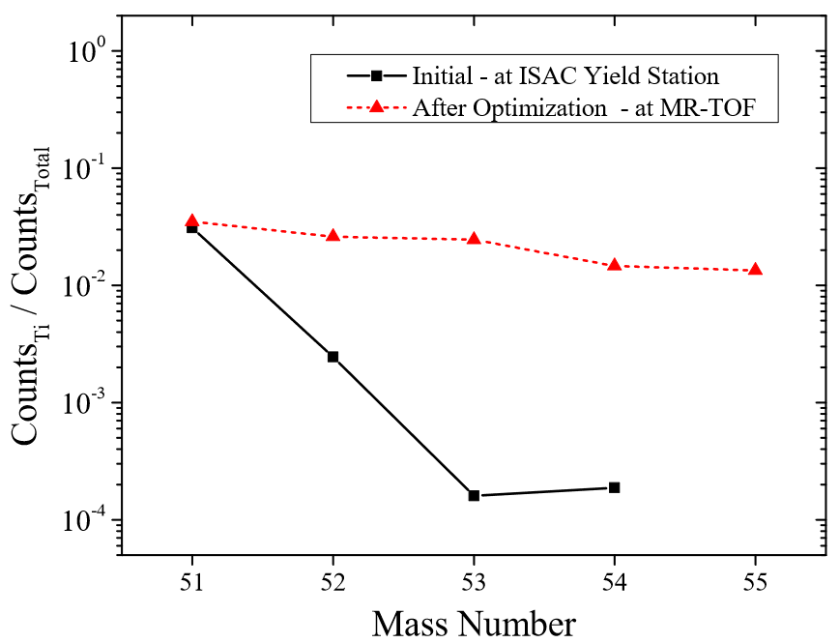
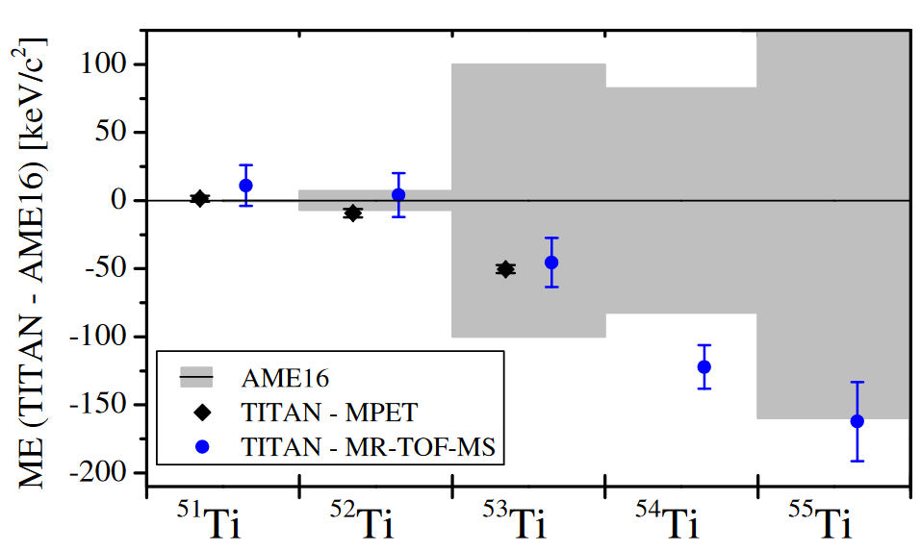
Performance of MR-TOF-MS: Rate capabilities
We need:
Faster measurement
Higher precision
Higher sensitivity
Higher rate capability
Improved diagnostics
→ Improved beam tuning
→ Higher sensitivity
Non scanning & higher efficiency
→Higher sensitivity
Two neutrons more exotic!
M.P. Reiter et al. NIM B 463 (2020) 431-436.
E. Leistenschneider et al., PRL 120 (2018) 062503

Slide 8
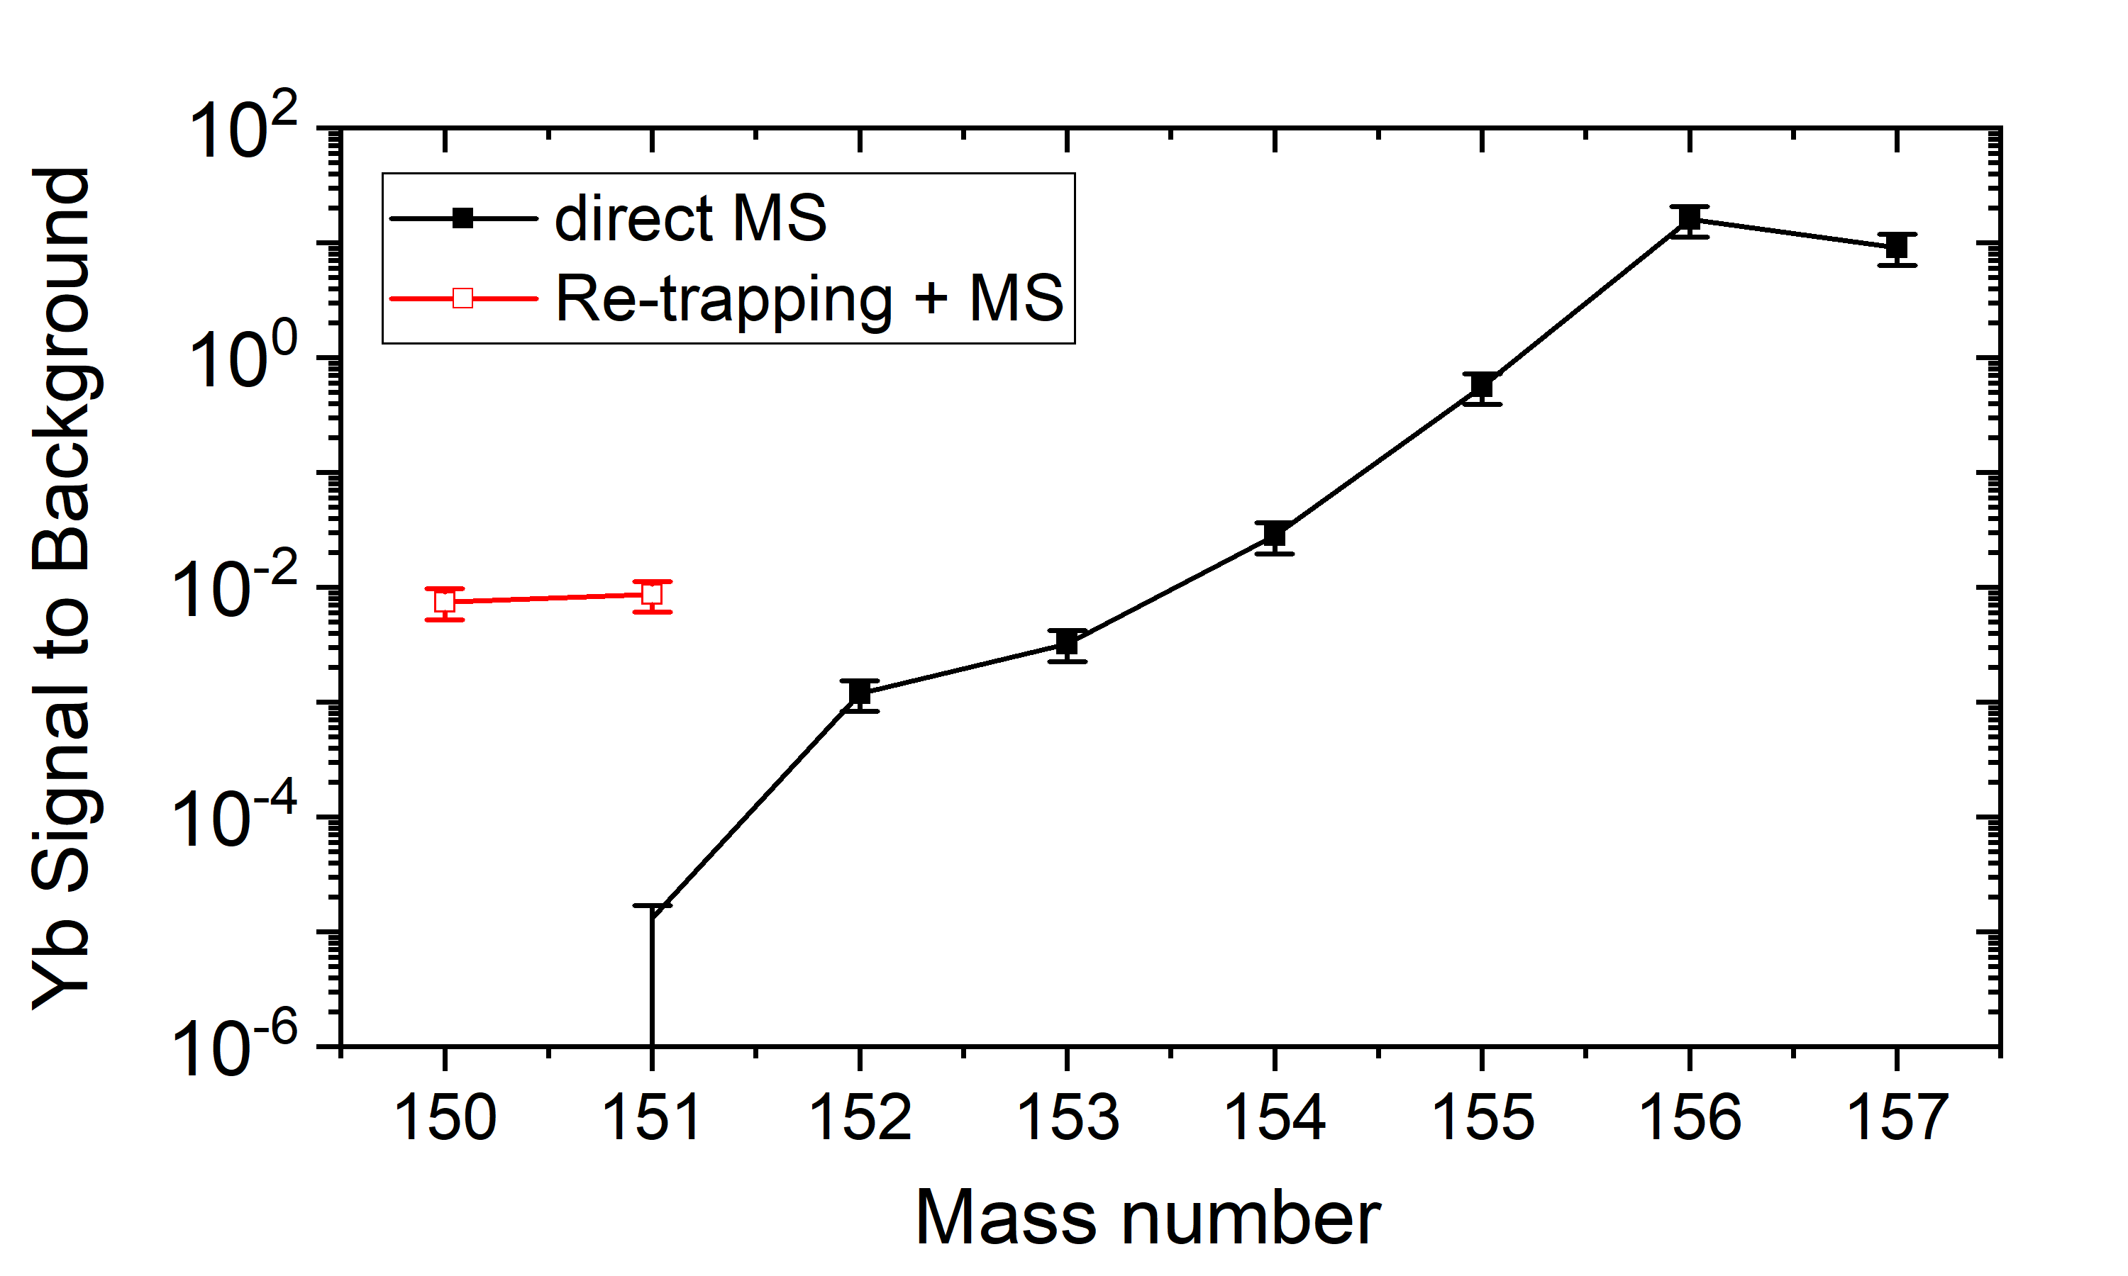
Performance of MR-TOF-MS: Rate capabilities
We need:
Faster measurement
Higher precision
Higher sensitivity
Higher rate capability
Novel method: Mass-selective retrapping → Operate MR-TOF as its own pre-separator
Stage 1: Injection
Stage 3: Re-Trapping
Stage 2: TOF Separation
Injection Trap
Entrance Reflector
Exit Reflector
Detector
U
z
T. Dickel, et al. J. Am. Soc. Mass Spectrom. 28 (2017) 1079.
T. Dickel et al., IJMS 412 (2017) 1-7
Enable at least two neutrons more exotic!
Beck at al., PRL 127(2021)112501

Slide 9
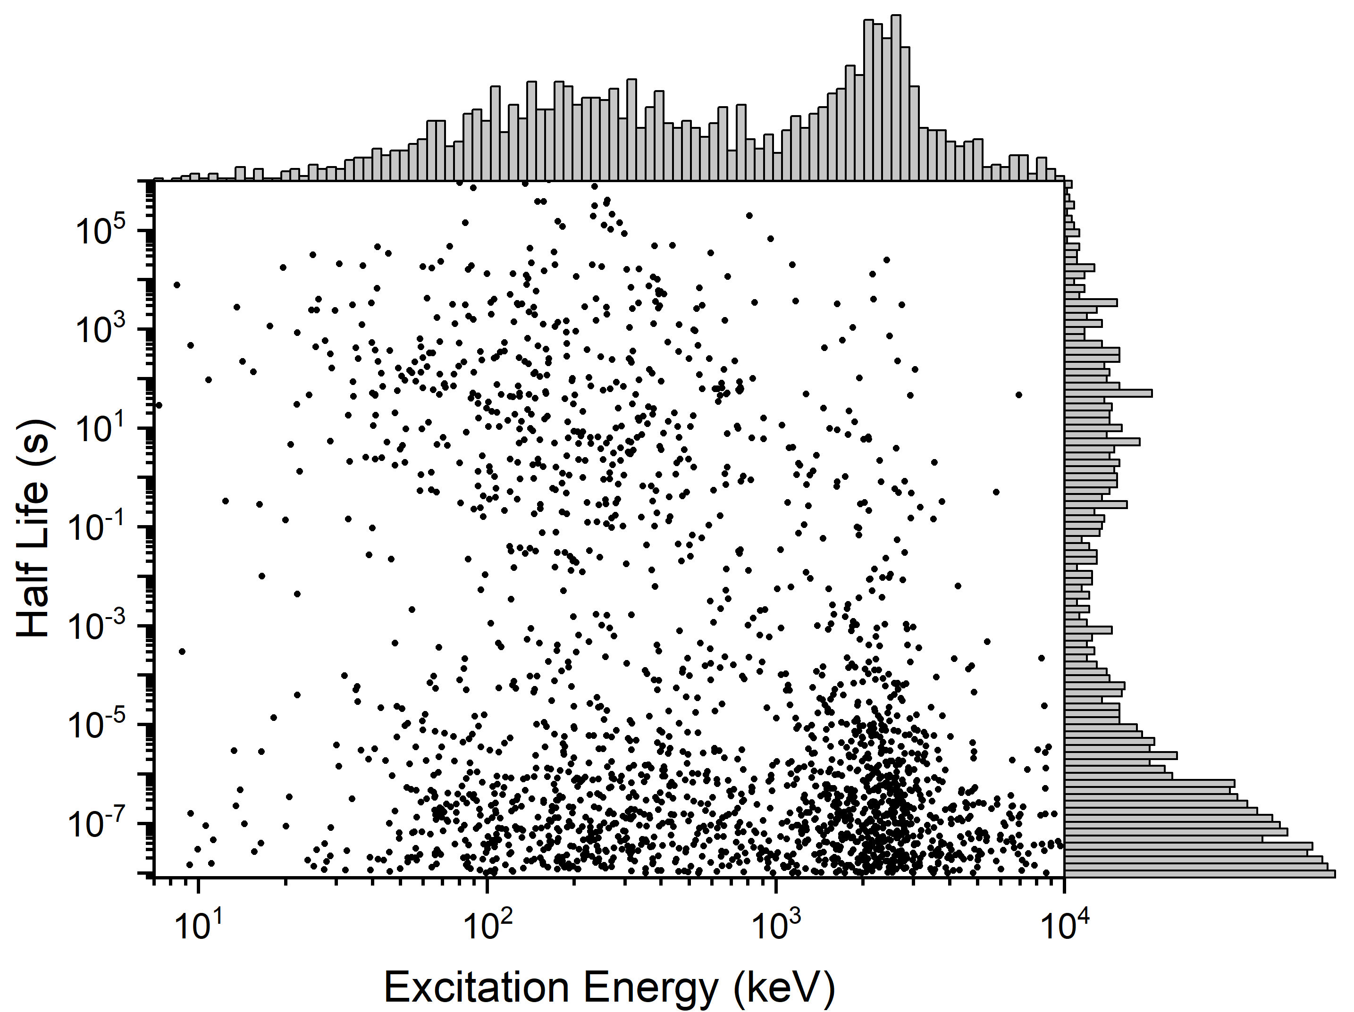
Why a new method to measure isomers?
Atlas of nuclear isomers – second edition
S. Garg et al., At. Data Nucl. Data Tables 150 (2023) 101546
Established mass
spectrometry methods
(e.g., Penning traps and
storage rings)
Requirements for system for
isomere search:
Fast: ~ms
Sensitive: non-scanning
High mass resolving power: >>10⁵
High dynamic range: > 10:1
MR-TOF-MS
γ-spectroscopy

Slide 10
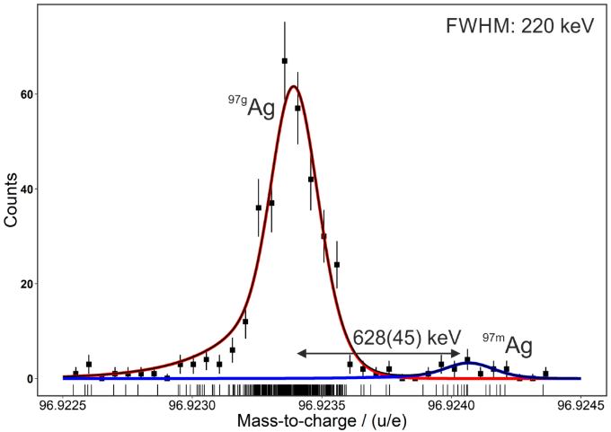
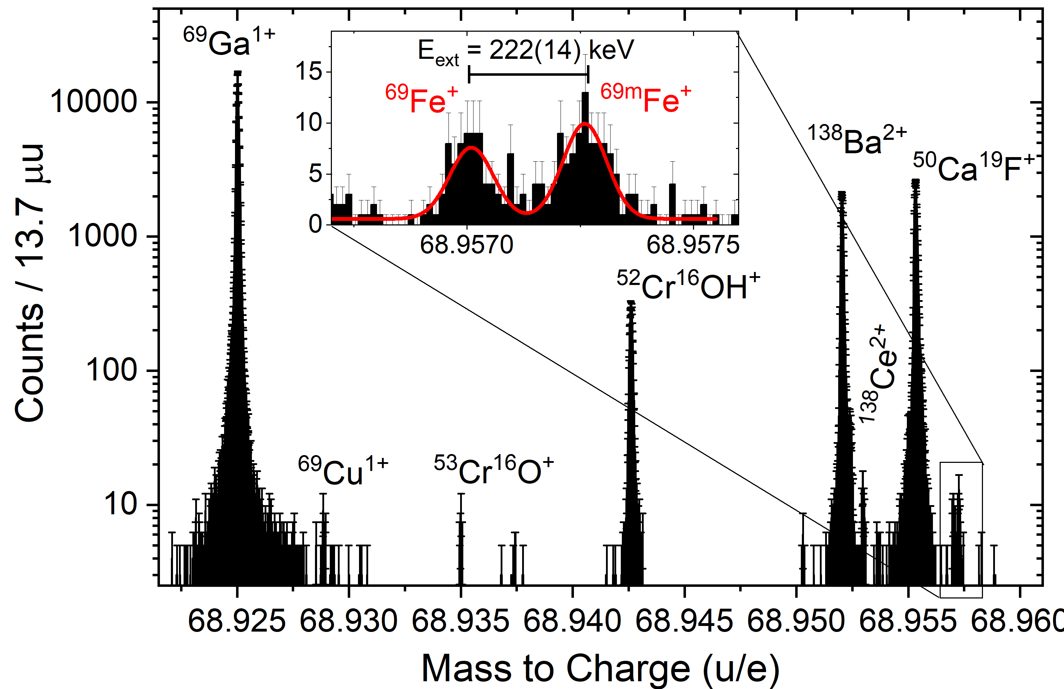
Discovery of isomeric states
FRS Ion Catcher
TITAN@TRIUMF
⁹⁷Ag
Fe isomer
First isomer discovery with an
MR-TOF-MS
C. Hornung et al., PLB 802 (2020) 135200
W. S. Porter et al, PRC Letter 105 (2022) L041301

Slide 11
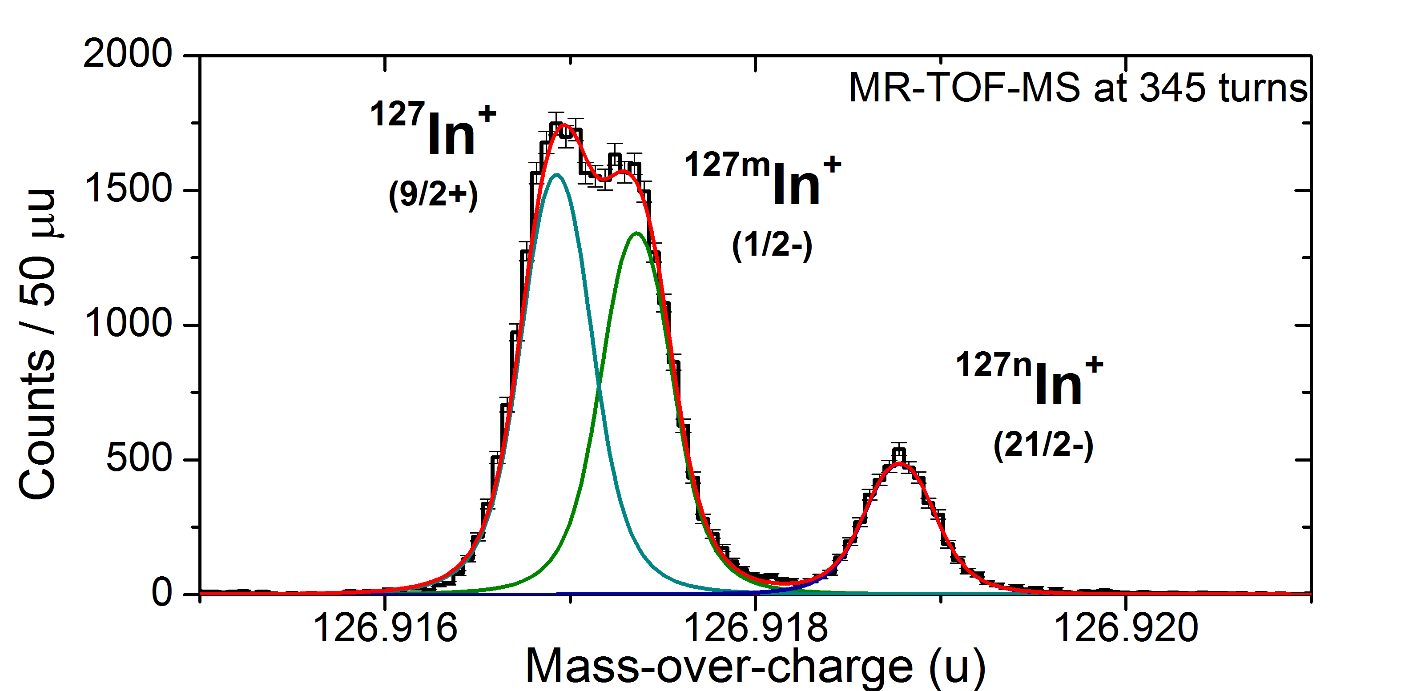
Discovery of isomeric states
Tailoring Isomeric-Clean Beams for Experiments Downstream
Discovery of isomeric states
High-resolution example
e.g. separation of ground and isomeric states
At E_{X} ~ 1.5 MeV
MCP
Detector
MCP
Detector
Ion mirror 2
Ion mirror 2
N = 345 turns
Ion mirror 1
Ion mirror 1

Slide 12
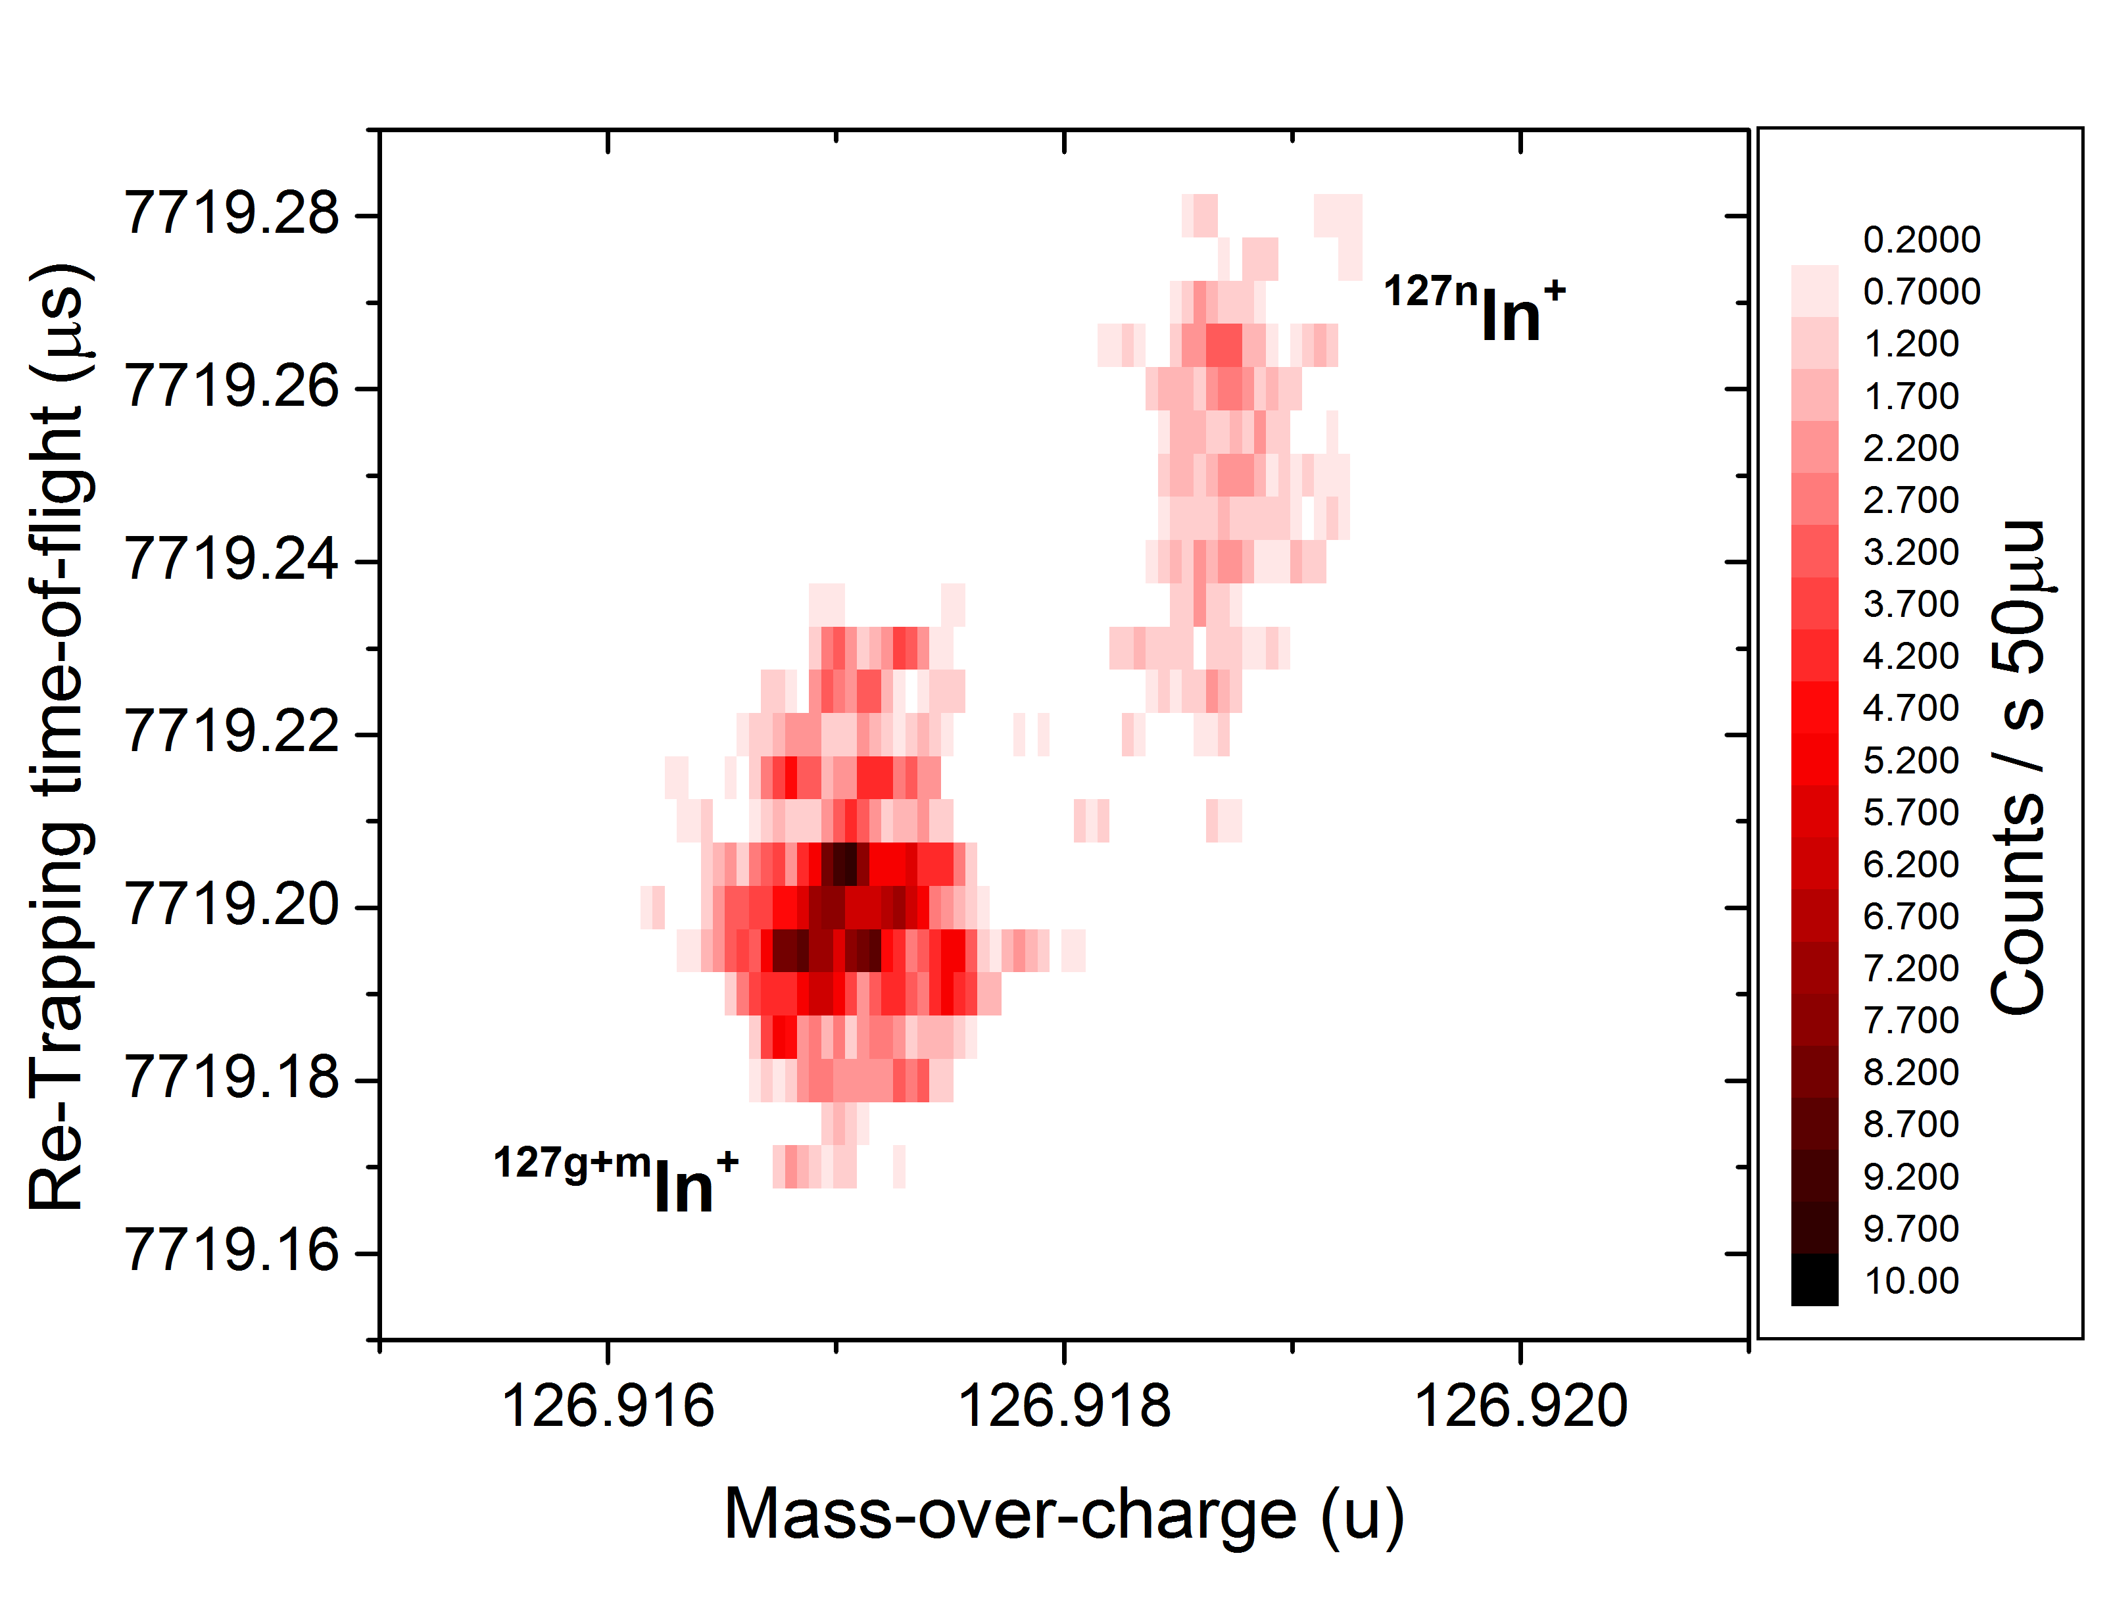
Tailoring Isomeric-Clean Beams for Experiments Downstream
High-resolution example
Set to a t_{RT}=7719.26 µs fully isolates ^{127n}In from ^{127g+m}In
MCP
Detector
MCP
Detector
Trap depth 4.5 V
Ion mirror 2
Ion mirror 2
N = 345 turns
N = 345 turns
Ion mirror 1
Ion mirror 1

Slide 13
Tailoring Isomeric-Clean Beams for Experiments Downstream
High-resolution example
Set to a t_{RT}=7719.26 µs fully isolates ^{127n}In from ^{127g+m}In
Isomeric pure beams for
downstream experiments!
Ongoing project with GSI and TRIUMF to design an “Isomer Beam Line”
Enable dedicated, background free, decay spectroscopy of isomeric states (@GRIFFIN?)
MCP
Detector
MCP
Detector
Trap depth 4.5 V
Ion mirror 2
Ion mirror 2
N = 345 turns
N = 345 turns
Ion mirror 1
Ion mirror 1

Slide 14



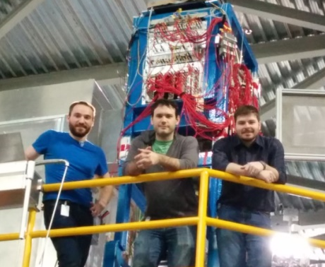
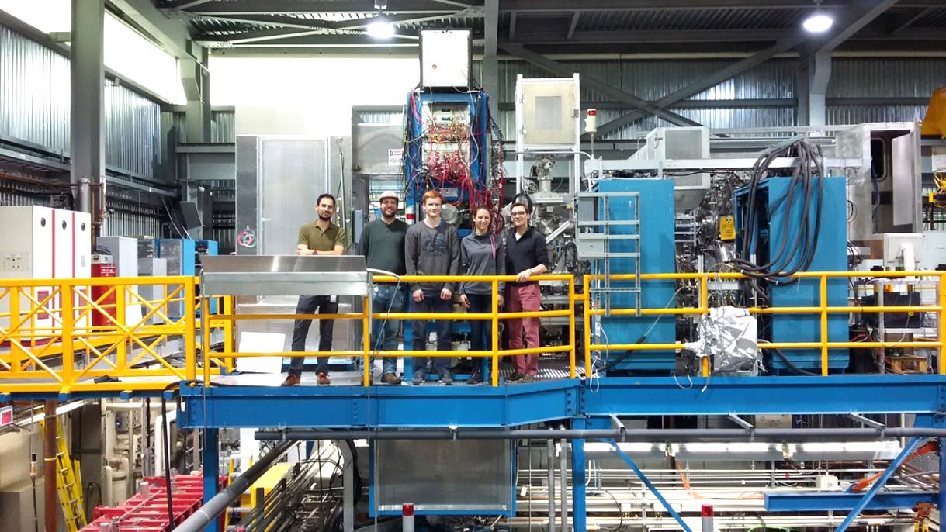
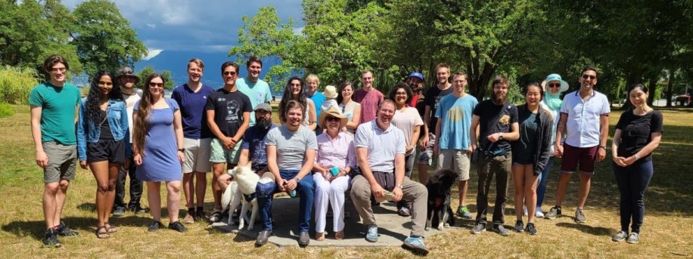
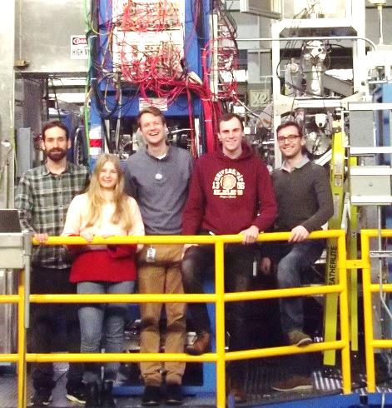
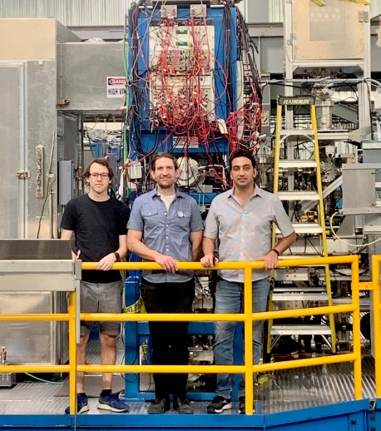
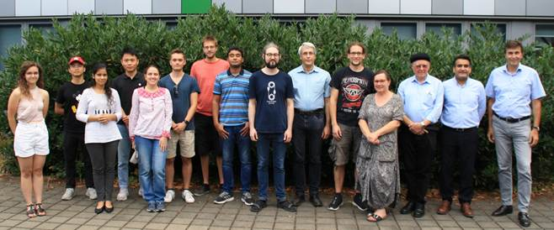
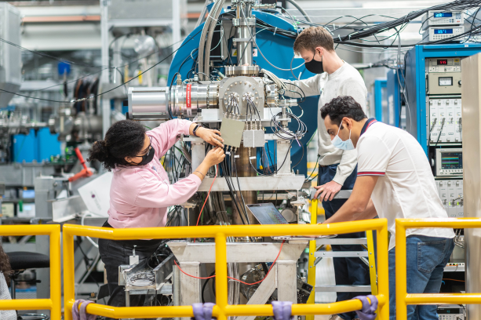
Thanks!
MR-TOF-MS Students and Post-docs:
2016
2017
TITAN @ TRIUMF
2018 - 2019
2024
IONAS @ JLU Giessen
2021

Slide 15
Backup Slides

Slide 16
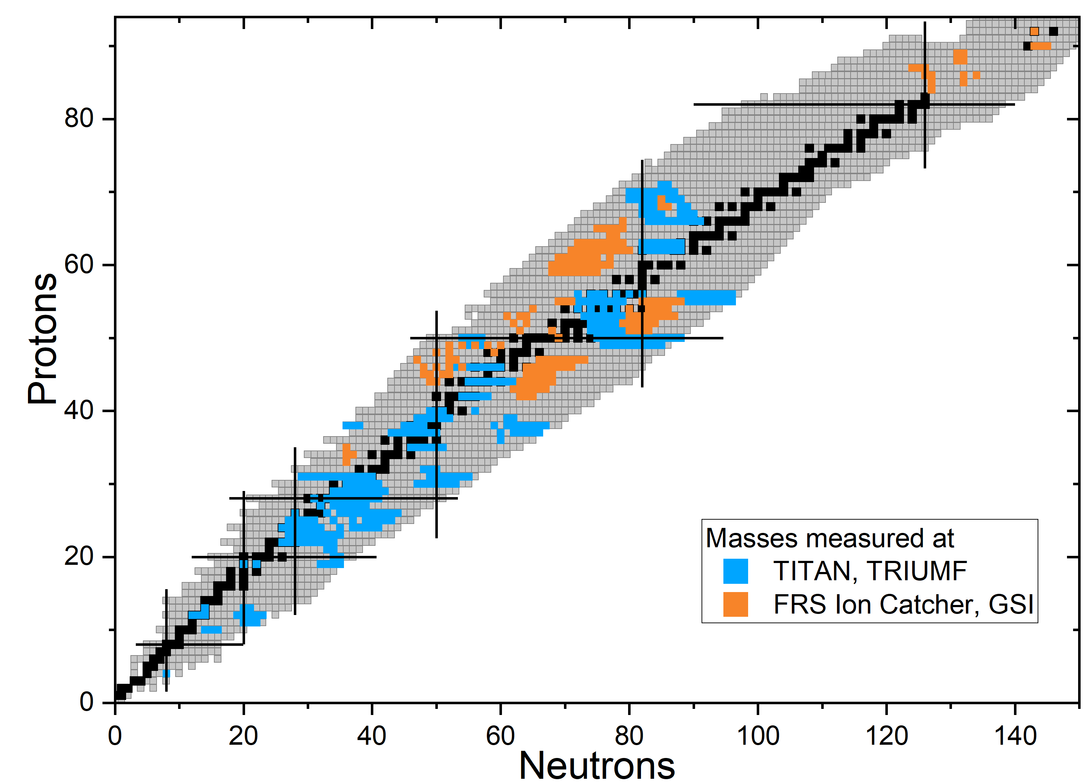

Mass measurements with the JLU MR-TOF-MS
T. Dickel et al., PLB 744 (2015) 137
S. Ayet et al., PRC 99 (2019) 064313
I. Miskun et al., EPJA 55 (2019)148
S. Ayet et al., EPJA 56 (2020) 143
C. Hornung et al., PLB 802 (2020) 135200
A. Spataru et al., BJOP 48 (2021) 535
I. Mardor et al., PRC 103 (2021) 034319
A. Mollaebrahimi et al., PLB 839 (2023) 137833
E. Leistenschneider et al., PRL 120 (2018) 062503
M. P. Reiter et al., PRC 98 (2018) 024310
M. P. Reiter et al., PRC 101 (2020)
E. Leistenschneider at al., PRL 126 (2021) 042501
S. Beck et al., PRL 127 (2021)
I. Mukul et al., PRC 103 (2021)
C. Izzo et al., PRC 103 (2021)
S. F. Paul et al., PRC 104 (2021)
W. S. Porter et al., PRC 105 (2022)
R. Silwal et al., PLB 833 (2022)
W. S. Porter et al., PRC 106 (2022)
A. Jacobs et al., NPA 1033 (2023)
E. M. Lykiardopoulou et al., PRC 107 (2023)

