Slide 1
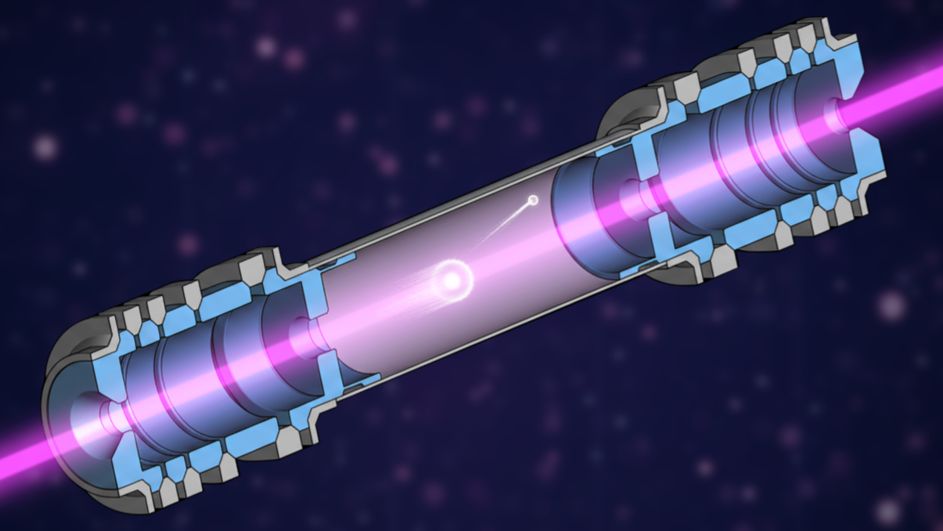






New Science Directions Using a High-Voltage MR-ToF Device
Invited Talk, Ariel Science Workshop
21st Apr. 2026
Franziska Maria Maier
Research Associate FRIB
maierf@frib.msu.edu
+

Slide 2
Outline: New Science Directions Using a High-Voltage MR-ToF Device
Direction 1:
Increase mass separation capabilities
Provide isobarically and isomerically purified beams at high ion intensity
→ unlock new experimental possibilities with pure beams
Direction 2:
Enhance sensitivity for collinear laser spectroscopy
Measure nuclear ground state properties of scarcely produced radionuclides
Measure electron affinities of rarely produced elements and isotope shifts
+

Slide 3
Outline: New Science Directions Using a High-Voltage MR-ToF Device
Direction 1:
Increase mass separation capabilities
Provide isobarically and isomerically purified beams at high ion intensity
→ unlock new experimental possibilities with pure beams
Direction 2:
Enhance sensitivity for collinear laser spectroscopy
Measure nuclear ground state properties of scarcely produced radionuclides
Measure electron affinities of rarely produced ions and isotope shifts
+

Slide 4
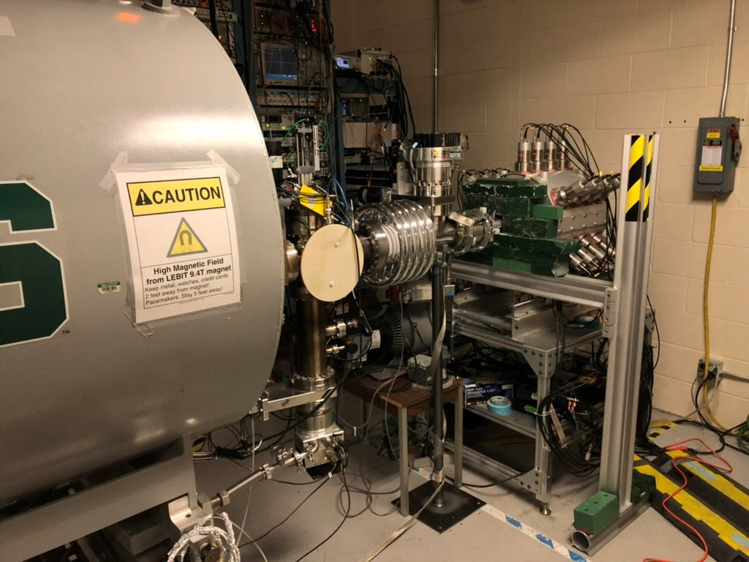
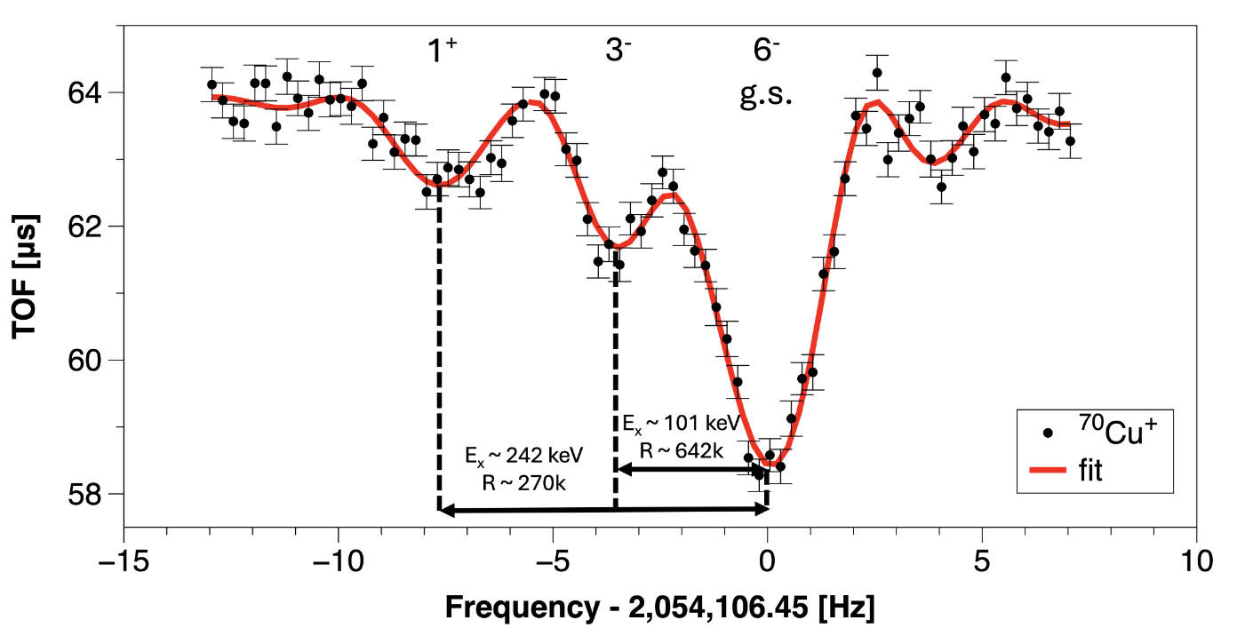
Many experiments at RIB facilities require isobarically and isomerically purified beams at high ion intensity
Example at FRIB:
SuN++ total absorption spectrometer often requires isomerically purified beams
Using LEBIT’s Penning trap, we provided isomerically pure beam of ⁷⁰Cu
Determined electromagnetic nature of the low energy enhancement of the γ-ray strength function of ⁷⁰Zn + constrained astrophysical neutron capture reaction rates
However, with the LEBIT Penning trap only 10 ions/s could be purified whereas 10,000 ions/s would have been available
LEBIT 9.4 T Penning trap
SuN++
E.K. Ronning et al., NIMA 1082, 170930 (2026).
E.K. Ronning et al., Submitted.

Slide 5
Many experiments at RIB facilities require isobarically and isomerically purified beams at high ion intensity
Up to today: Either high mass separation power or high ion intensity
MR-ToF devices: high mass separation power + high ion flux
 | Penning traps (example: LEBIT) | Magnetic mass separators (example: FRIB or ISOLDE)
Mass separation power | > 10⁶ | ~ 2000 (some go higher e.g. CANREB HRS at TRIUMF: ~ 20,000)
Processing time | ~ 100 ms | continuous
Ion flux (= ions/s injected) | ~ 10 ions/s | 10¹³ ions/s

Slide 6
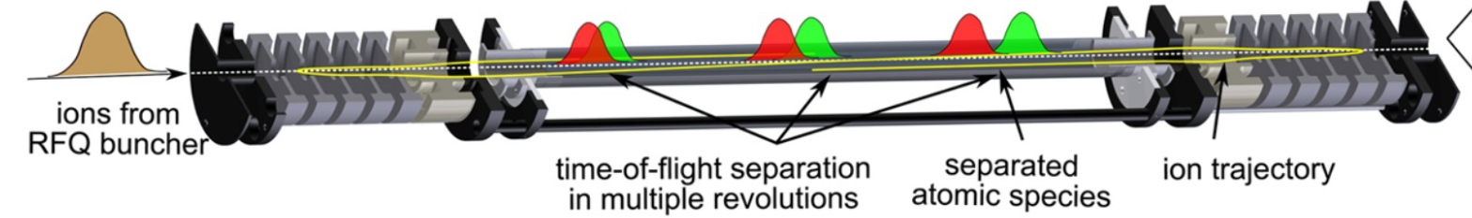

MR-ToF devices can achieve a high mass separation power.
m₁
m₂
Ion mixture
time-of-flight separation in multiple revolutions
separated ion species
ion trajectory
Fig. courtesy R. Wolf
m/Δm > 10⁵ within (some tens of) ms
Ion flux ~10² to 10⁷ ions/s depending on m/Δm
Since 2013 in standard use for many RIB experiments, e.g. TITAN@TRIUMF.
High-precision mass spectroscopy
Beam diagnostics to optimize target and ion source
Mass separation to provide isobaric or isomeric purified ion beams

Slide 7
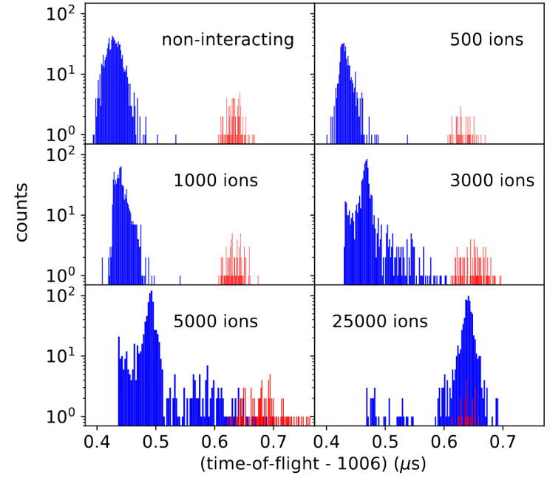
Challenges in Increasing Ion Flux: Coulomb interactions limit number of simultaneously stored ions.
Simulations of extracted ions after 1 ms storage time
m₁
Peak coalescence at high number of stored ions
Ion species are not mass separated.
Maximal ion flux for which ion species can be
separated is limited.
m₂
F.M.Maier et al, NIMA 1056, 168545 (2023)

Slide 8
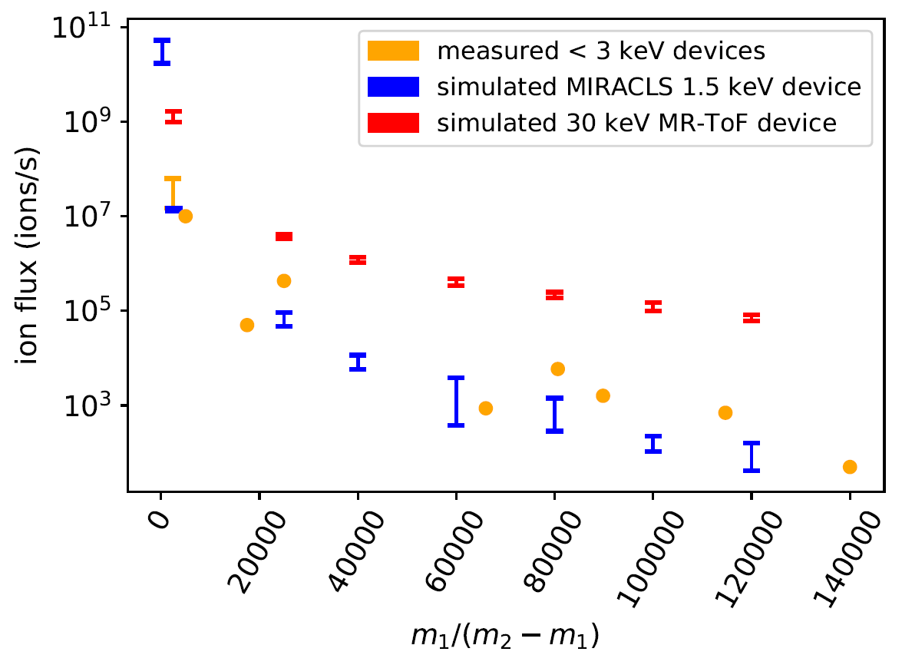

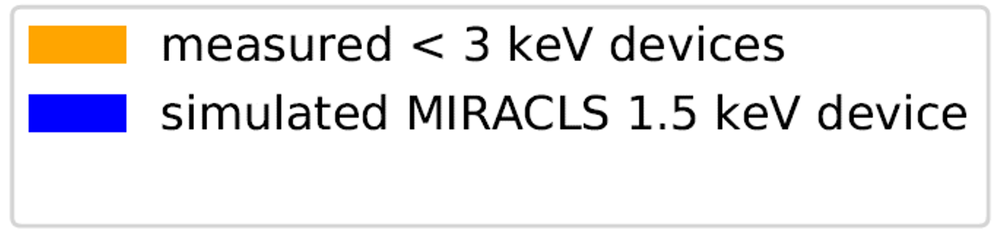
Challenges in Increasing Ion Flux: Ion Flux limitation depends on m₁/(m₂-m₁).
Measured < 3 keV devices
Simulated MIRACLS 1.5 keV device
Experimental data taken from:
ISOLTRAP:
Personal communication with F. Wienholtz.
N.M. Bouwman, Summer student report, 2023.
Giessen:
T. Dickel et al, NIMA 777 172-188 (2015).
TITAN:
Personal communication with A.A. Kwiatkowski.
M.P. Reiter, NIMA 1018 165823 (2021).
C. Izzo, PRC 103 025811 (2021).
S.F. Paul, PRC 104 065803 (2021).
MIRACLS 1.5 keV:
M. Rosenbusch et al, AIP Conf. Proc. 1668 050001 (2015).
M. Rosenbusch et al, AIP Conf. Proc. 1521 53-62 (2013).
MIRACLS 1.5 keV
TITAN
ISOLTRAP
Giessen
ISOLTRAP
ISOLTRAP
ISOLTRAP
ISOLTRAP
TITAN
Updated from F.M. Maier et al, NIMA 1056, 168545 (2023).

Slide 9
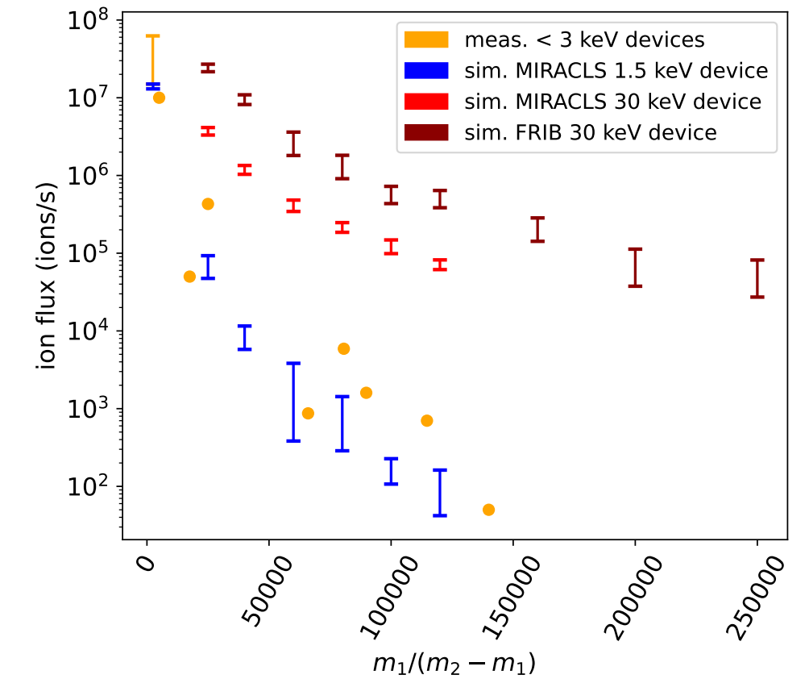

Towards High Separation Power and High Ion Flux Raise the kinetic energy of the stored ions and improve the geometry
Provide isobaric pure beams
fundamental symmetry studies
nuclear structure
nuclear astrophysics
material science
production of medical isotopes
Provide isomeric beams for decay studies for nuclear structure and nuclear astrophysics
F.M. Maier et al, NIMA 1056, 168545 (2023).
F.M. Maier, C.M. Ireland et al., NIMA 1084, 171220, 2026.

Slide 10
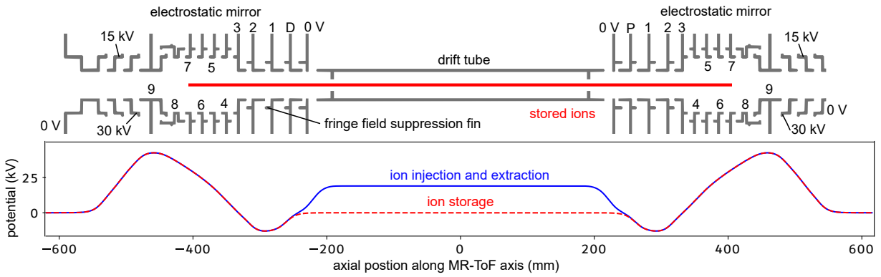
Development of a High-Voltage MR-ToF Device at FRIB Extend Mass Measurement and Separation Capabilities
Advances the design of MIRACLS high-voltage MR-ToF device at ISOLDE/CERN [1-3]
High ion flux, high mass resolving power, short processing time
[1] F.M. Maier, M. Vilen et al, NIMA 1048, 168545 (2023).
[2] F.M. Maier et al, NIMA 1056, 168545 (2023).
[3] F.M. Maier et al, NIMA 1075, 170365 (2025).
F.M. Maier, C.M. Ireland et al., NIMA 1084, 171220, 2026.
C.M. Ireland, F.M. Maier et al., NIMA 1087, 171426, 2026.

Slide 11
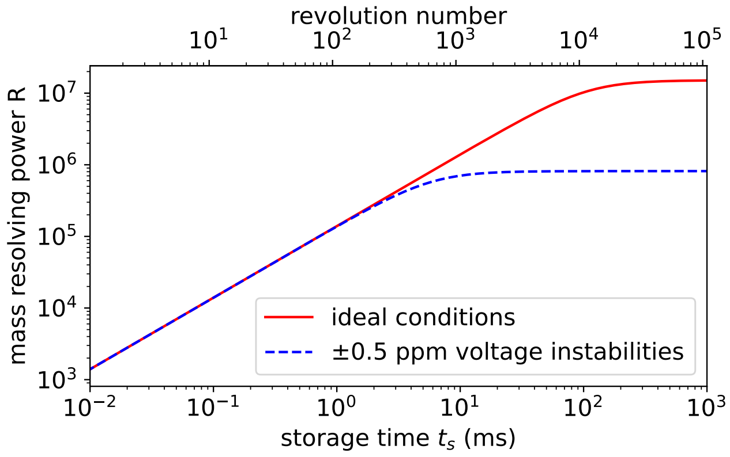
Development of a High-Voltage MR-ToF Device at FRIB Extend Mass Measurement and Separation Capabilities
Simulated mass resolving power is high enough to resolve almost all isobars and 70% of all known isomers with half-lives above 10 ms
F.M. Maier, C.M. Ireland et al., NIMA 1084, 171220, 2026.
C.M. Ireland, F.M. Maier et al., NIMA 1087, 171426, 2026.

Slide 12
Development of a High-Voltage MR-ToF Device at FRIB Extend Mass Measurement and Separation Capabilities
Simulated mass resolving power is high enough to resolve almost all isobars and 70% of all known isomers with half-lives above 10 ms
Simulated ion flux is > 2 orders of magnitude higher compared to state-of-the-art MR-ToF devices
Updated from
F.M. Maier et al,
NIMA 1056,
168545 (2023).
F.M. Maier, C.M. Ireland et al., NIMA 1084, 171220, 2026.
C.M. Ireland, F.M. Maier et al., NIMA 1087, 171426, 2026.

Slide 13
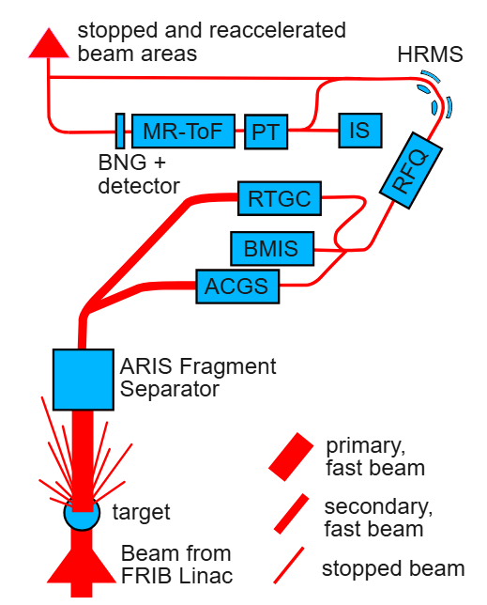
Development of a High-Voltage MR-ToF Device at FRIB Extend Mass Measurement and Separation Capabilities
Suggested expansion of FRIB’s stopped beam area:
Replace current dipole magnet with a High Resolution Magnetic Mass Separator (HRMS)
Expected to achieve mass separation power of 10,000
If HRMS mass separation power is sufficient transfer beam to stopped and reaccelerated beam areas
If higher mass separation power is required inject beam into MR-ToF beamline
MR-ToF beamline can also be used for mass measurements and beam diagnostics
Dedicated Paul trap (PT) and offline ion source (IS) required
F.M. Maier, C.M. Ireland et al., NIMA 1084, 171220, 2026.
C.M. Ireland, F.M. Maier et al., NIMA 1087, 171426, 2026.

Slide 14
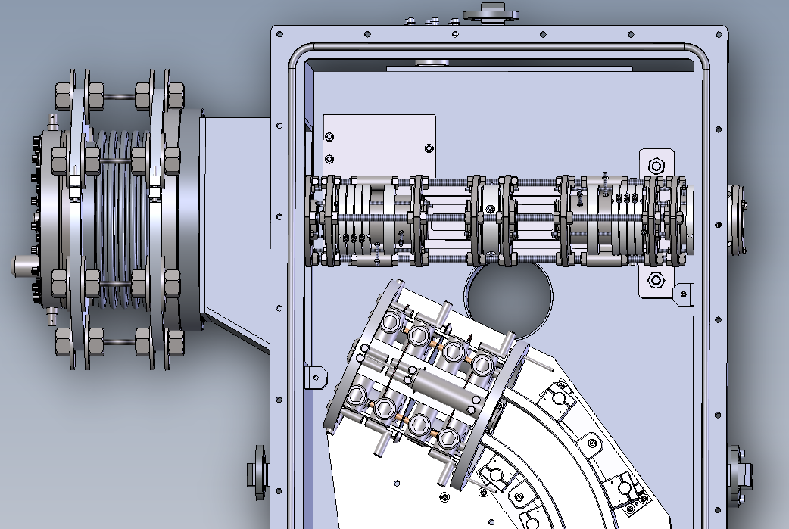
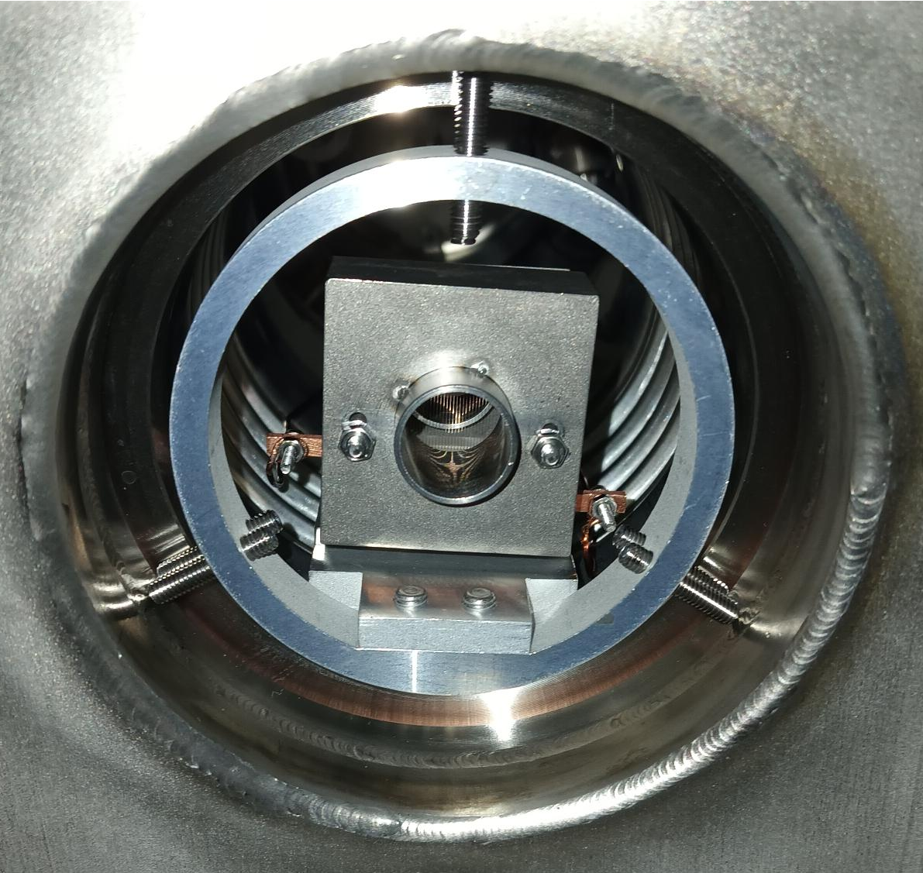
A ‘Quick and Cheap’ Mini-MR-ToF Device at FRIB Bridge the Time Until the Main MR-ToF Device Becomes Available
Developed 1.5 keV Mini-MR-ToF device matching space constraints and performance characteristics of existing Paul trap - Funding received in March 2026
Fast beam diagnostics, low-intensity mass separation for LEBIT and SuN++, mass measurements
445 mm
MR-ToF device
LEBIT’s
Paul-trap cooler-buncher
LEBIT’s Penning trap
Retractable MagneTOF and Bradbury-Nielsen Gate (built and independently commissioned)
Bender towards SIPT

Slide 15
Outline: New Science Directions Using a High-Voltage MR-ToF Device
Direction 1:
Increase mass separation capabilities
Provide isobarically and isomerically purified beams at high ion intensity
→ unlock new experimental possibilities with pure beams
Direction 2:
Enhance sensitivity for collinear laser spectroscopy
Measure nuclear ground state properties of scarcely produced radionuclides
Measure electron affinities of rarely produced elements and isotope shifts
+

Slide 16
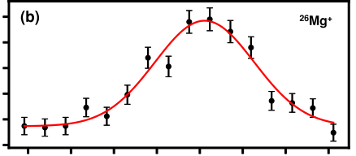
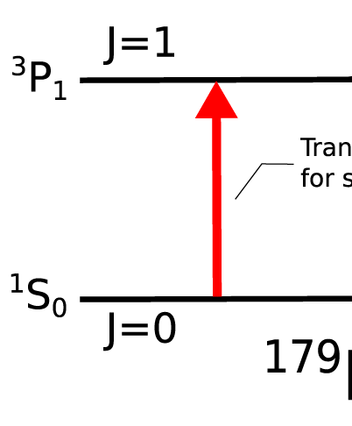




Development of MR-ToF devices for CLS: Enhanced Sensitivity for Fluorescence-Based CLS
Fluorescence-based laser spectroscopy:
excited state
Photon counts
ground state
Excitation using laser photons
De-excitation:
detect fluorescence photons
Relative frequency (MHz)
Electric quadrupole moment Qs
rms charge radius
magnetic dipol moment 𝝁
Photomultiplier Tube
spin I
photon
Laser
ion or atom
K. Blaum et al., Phys. Scr. T152, 014017 (2013)
P. Campbell et al., Prog. Part. and Nucl. Phys. 86, 127-180 (2016)
R. Neugart et al., J. Phys. G: Nucl. Part. Phys. 44, 064002 (2017)

Slide 17
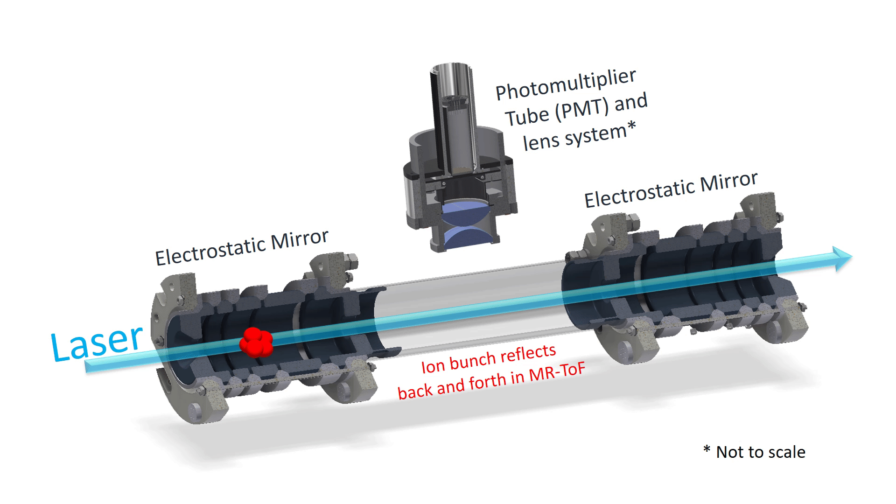
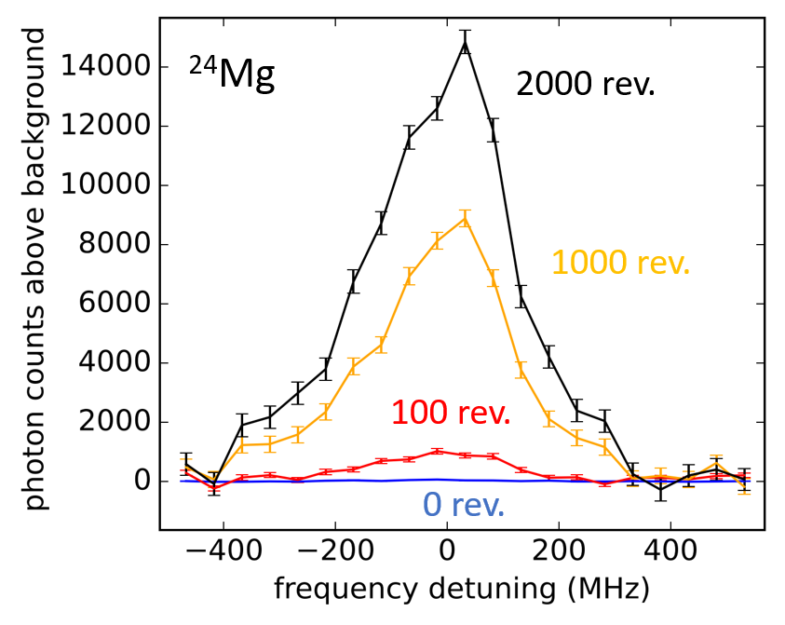
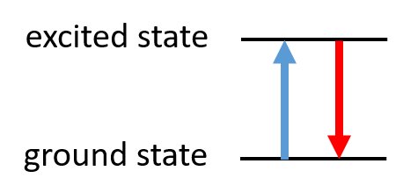
Development of MR-ToF devices for CLS: Enhanced Sensitivity for Fluorescence-Based CLS
Increased observation time → Gain in sensitivity by 1-2 orders of magnitude
More exotic nuclides accessible
low-voltage MR-ToF device

Slide 18
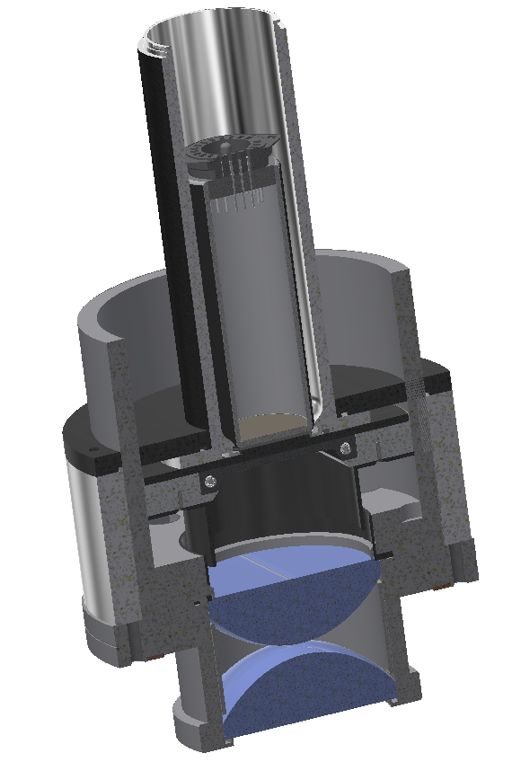
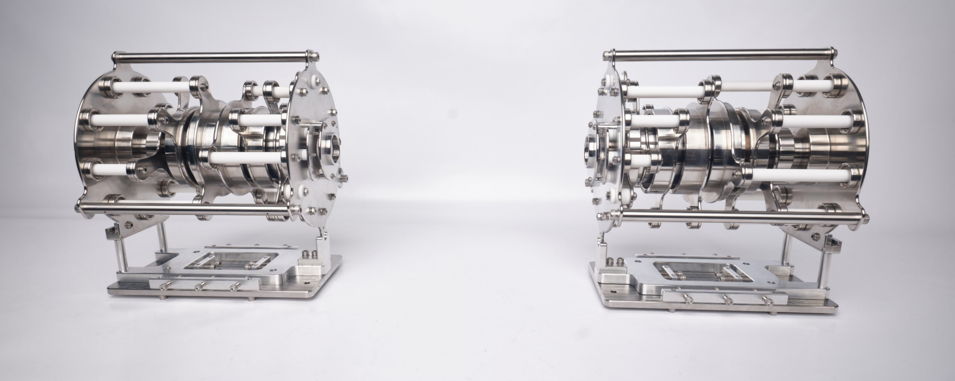
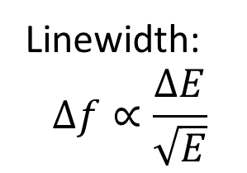
Development of MIRACLS High-Voltage MR-ToF Setup Enhanced Sensitivity for Fluorescence-Based CLS
First MR-ToF device worldwide that stores ions at 15 keV beam energy as required to maintain high resolution
Photomultiplier tube
Linewidth:
$$∆f∝\frac{∆E}{\sqrt{E}}$$
Laser
stored ion bunch
> 50% capture efficiency
electrostatic mirror
electrostatic mirror
F.M. Maier, M. Vilen et al., NIMA 1048, 167927 (2023).
F.M. Maier et al., NIMA 1057, 170365 (2025).

Slide 19
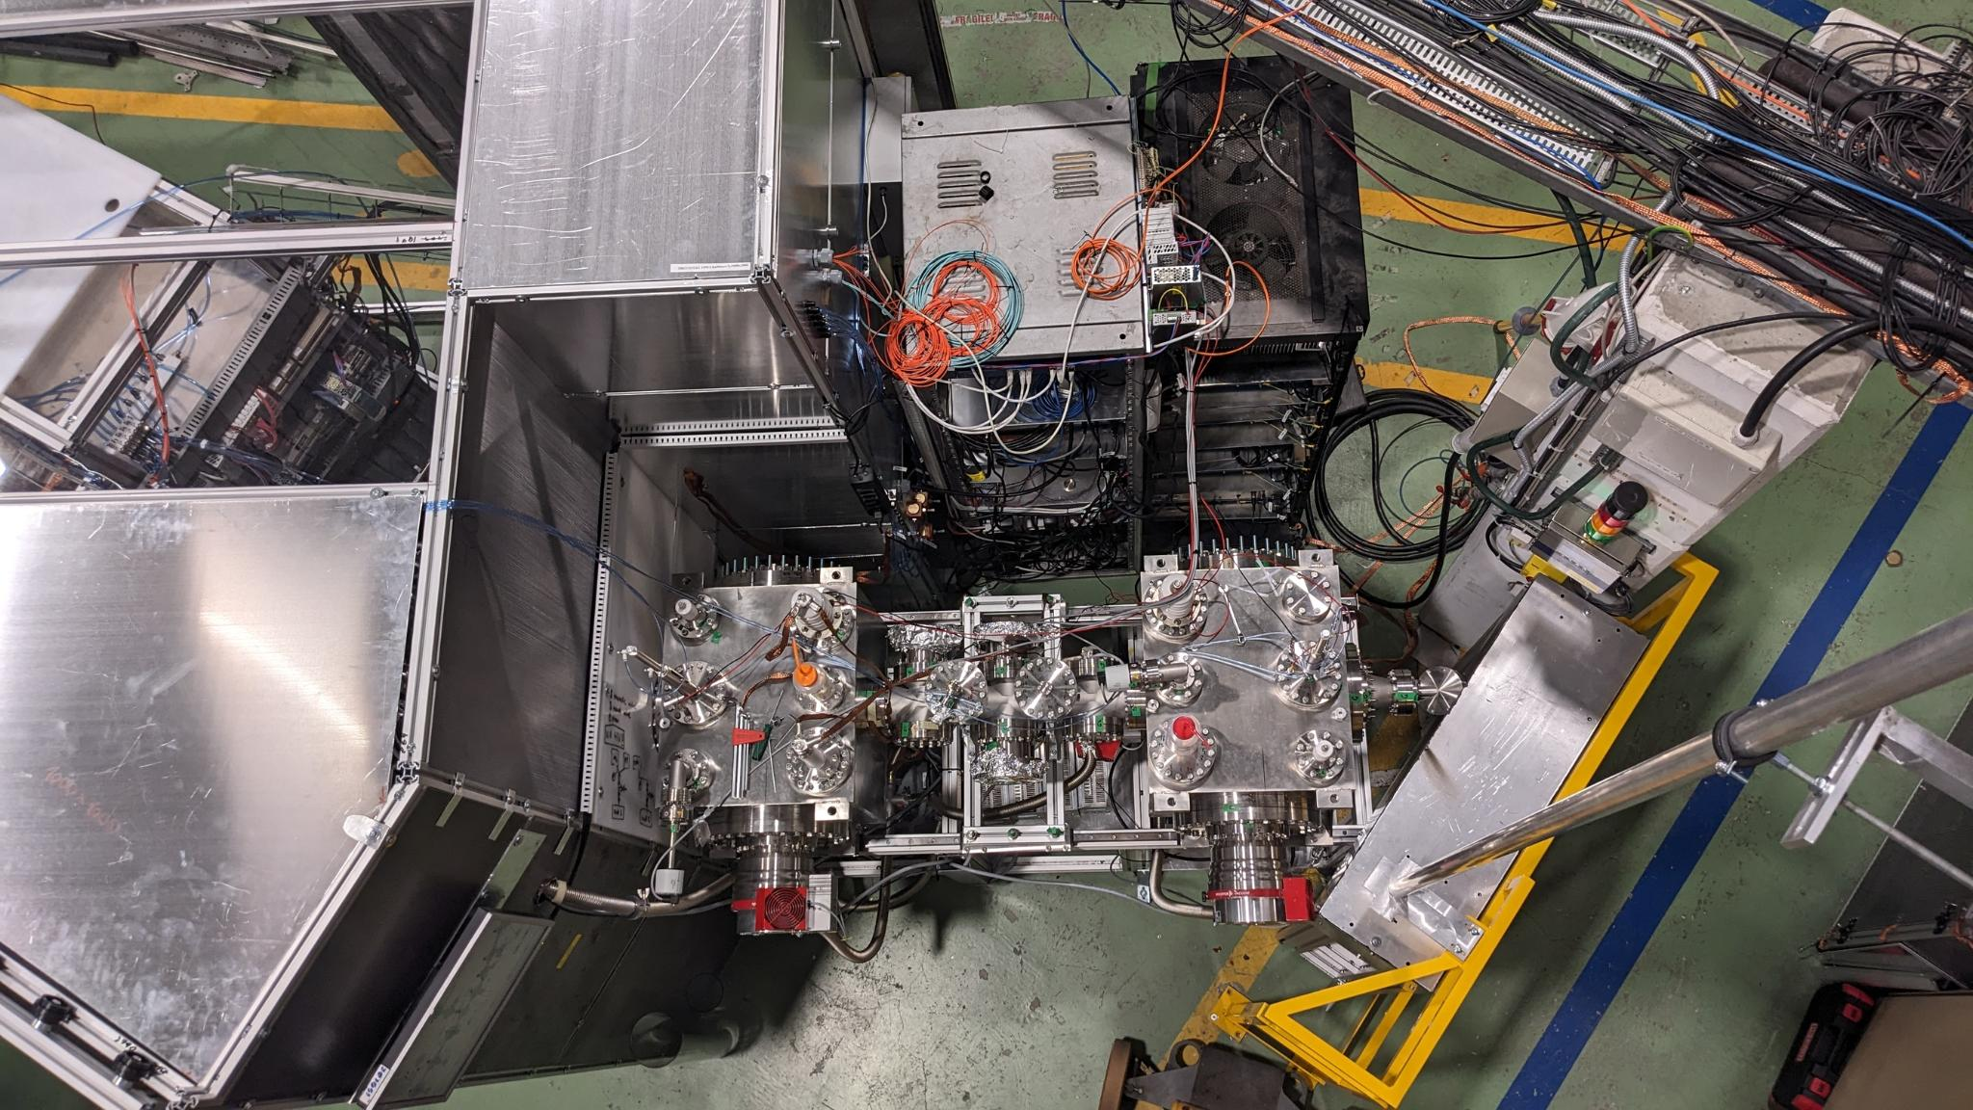
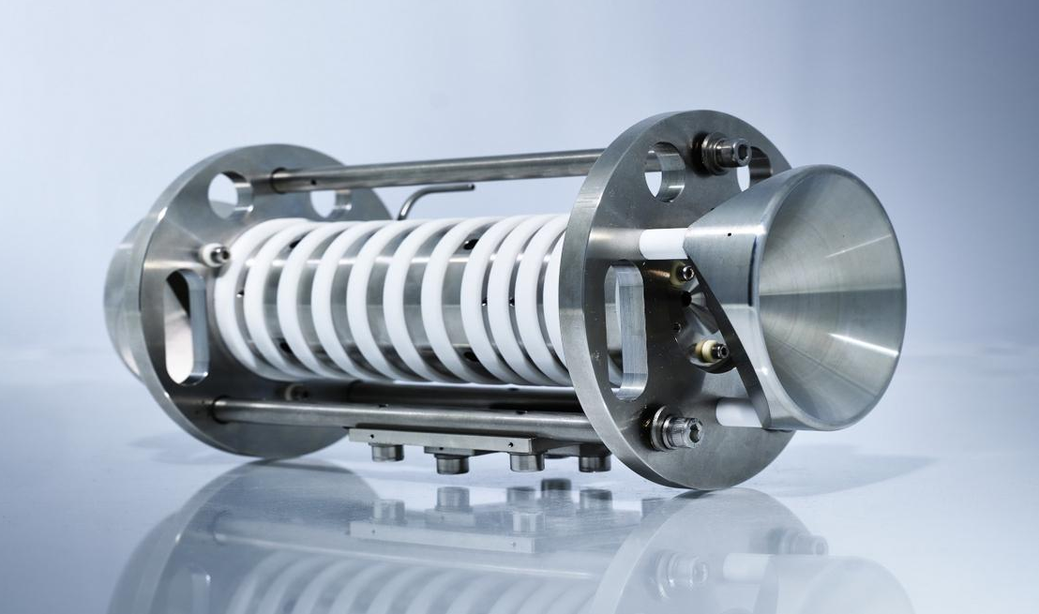
Development of MIRACLS High-Voltage MR-ToF Setup Enhanced Sensitivity for Fluorescence-Based CLS
ISOLDE beam
Offline ion source
Paul-trap cooler-buncher
HV cage with bender
Laser beam
copies of our Paul trap also operational at Greifswald, MIT, Beijing, Darmstadt & ISOLTRAP
15 keV MR-ToF device
F.M. Maier, M. Vilen et al., NIMA 1048, 167927 (2023).
F.M. Maier et al., NIMA 1057, 170365 (2025).
S. Lechner, S. Sels et al., NIMA 1065, 169471 (2024).

Slide 20
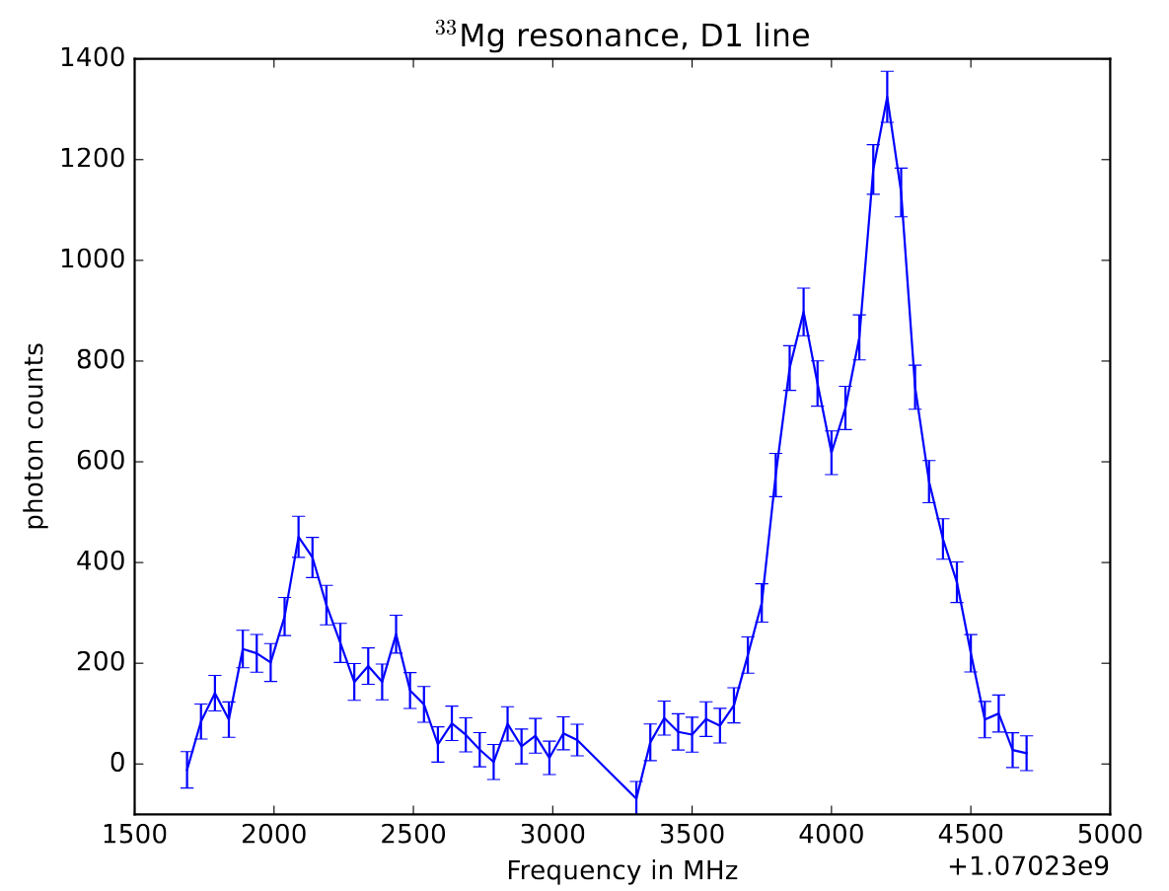
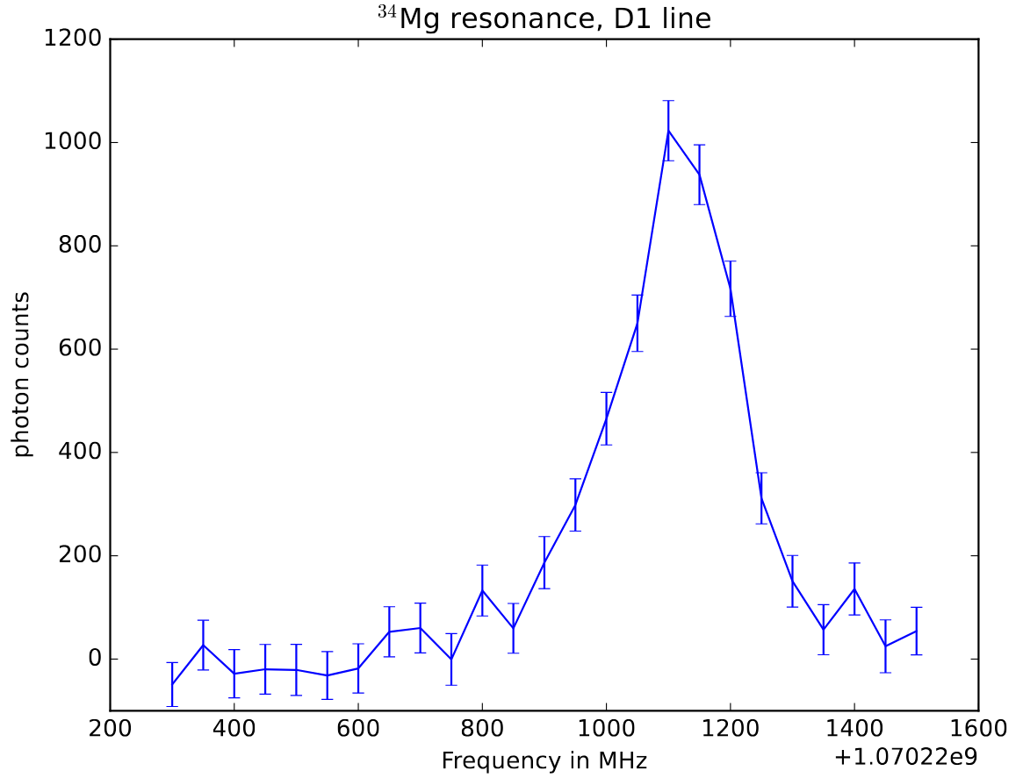
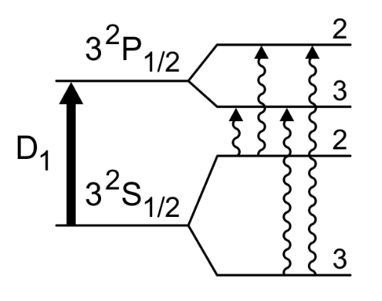
MIRACLS CLS measurement of ^{33,34}Mg will provide insights into island of inversion
Data analysis and physics interpretation in progress
Preliminary
Preliminary
³³Mg
³⁴Mg
Photon counts
Photon counts
Relative frequency (MHz)
Relative frequency (MHz)

Slide 21
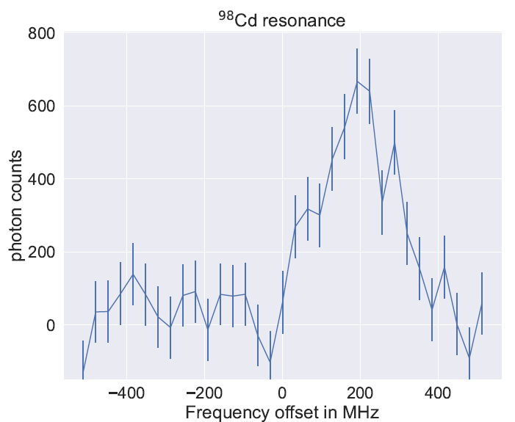
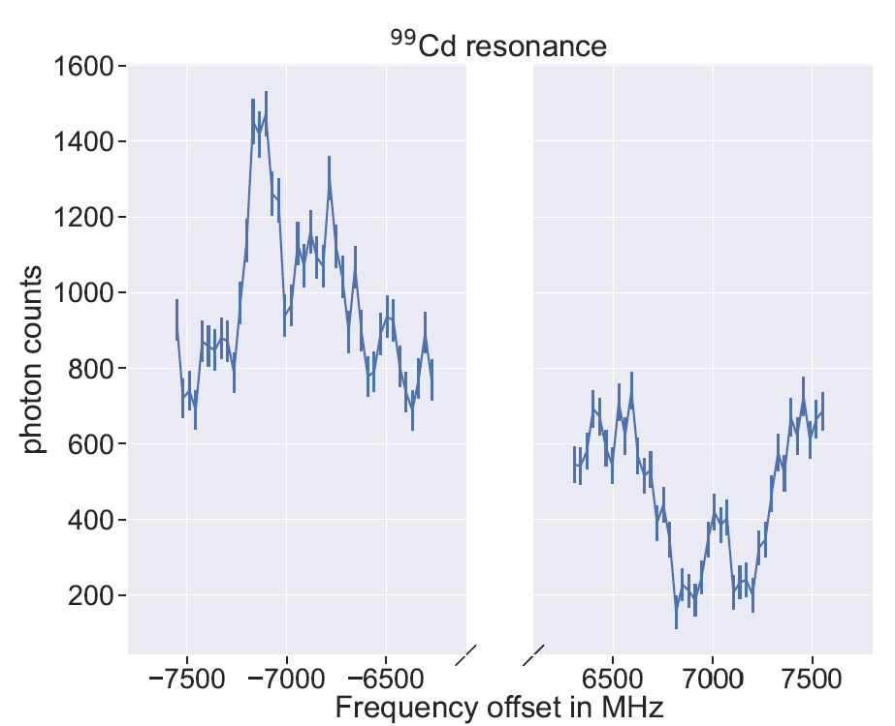

MIRACLS measurement of ^{98,99}Cd will provide insights into N=50 shell closure
⁹⁸Cd
⁹⁹Cd
(new pump and probe scheme)
Preliminary
Preliminary
Photon counts
Relative frequency (MHz)
Relative frequency (MHz)

Slide 22
Outline: New Science Directions Using a High-Voltage MR-ToF Device
Direction 1:
Increase mass separation capabilities
Provide isobarically and isomerically purified beams at high ion intensity
→ unlock new experimental possibilities with pure beams
Direction 2:
Enhance sensitivity for collinear laser spectroscopy
Measure nuclear ground state properties of scarcely produced radionuclides
Measure electron affinities of rarely produced elements and isotope shifts
+

Slide 23
Development of MR-ToF devices for CLS: Enhanced Sensitivity for Electron Affinity Measurements
Electron Affinity (EA):
Energy released when an electron is attached to a neutral atom forming an anion
Encodes key information about atomic structure, electron correlation effects and chemical reactivity
Electron affinities are unknown for about 1/3 of the elements + isotope shifts mostly unknown as well
Atomic Physics
Medical applications
(tumor-targeting biomolecules)
Opportunities to investigate at ARIEL:
First-ever determinations of unknown electron affinities (e.g. of Tc, Fr, Ra, Ac, Pm, Sm, Gd, Dy, Ho, Er, Np)
Isotope shifts in electron affinity
Astrophysics
Electron Affinities
Chemistry
Fundamental Symmetries
Nuclear Structure Studies

Slide 24
Perform laser photodetachment threshold spectroscopy in an MR-ToF device → increased observation time → sensitivity boost by reprobing same anions
How can we overcome sensitivity limits for extremely scarce samples?

Slide 25
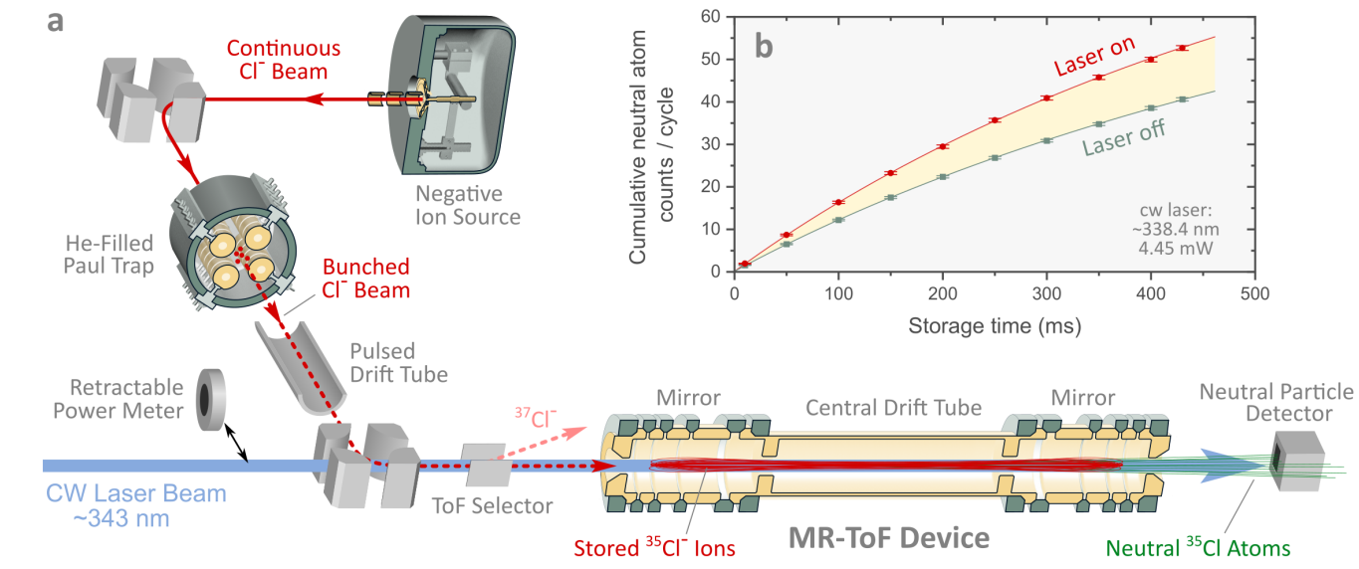
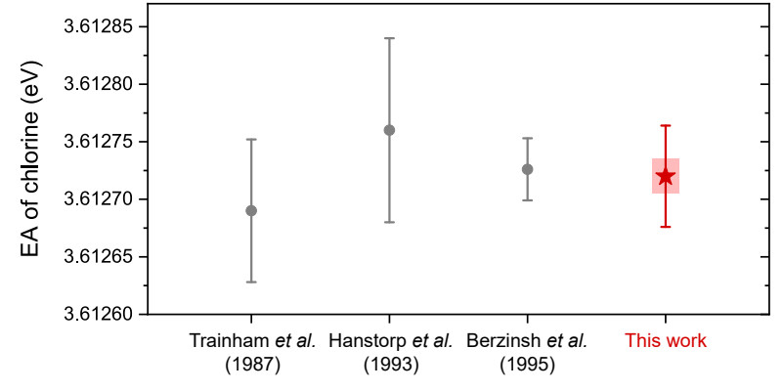
Development of MR-ToF devices for CLS: Enhanced Sensitivity for Electron Affinity Measurements
150,000x less anions
“This breakthrough is poised to have a significant impact on atomic physics, nuclear physics, and the chemistry of super-heavy elements.” (Reviewer Nature Communications)
F.M. Maier, E. Leistenschneider et al., Nat. Commun. 16, 9576 (2025).

Slide 26
New Science Directions Using a High-Voltage MR-ToF Device
Increased mass separation capabilities
More than two orders of magnitude higher ion flux
Higher energy spread tolerance: higher mass resolving power in shorter processing time
Deliver isobaric and isomeric purified beams → unlock new experimental possibilities
Enhanced sensitivity for collinear laser spectroscopy
Measure nuclear ground state properties of scarcely produced radionuclides
Measure electron affinities of rarely produced ions e.g. of superheavy atoms or isotope shifts
+

Slide 27


Thanks to the LEBIT and FRIB MR-ToF Team!
F.M. Maier, E. Dhayal, C. Ireland, E. Leistenschneider, R. Ringle, A. Sjaarda for the FRIB MR-ToF collaboration
F.M. Maier, G. Bollen, S. Campbell, H. Erington, C. Ireland, R. Ringle
for the LEBIT collaboration
Thanks to all our experimental and theory collaboration partners!
Questions: maierf@frib.msu.edu
Undergraduate student
PhD student
PostDoc
This material is based upon work supported by the U.S. Department of Energy, Office of Science, Office of Nuclear Physics and used resources of
the Facility for Rare Isotope Beams (FRIB) Operations, which is a DOE Office of Science User Facility under Award Number DE-SC0023633.

Slide 28
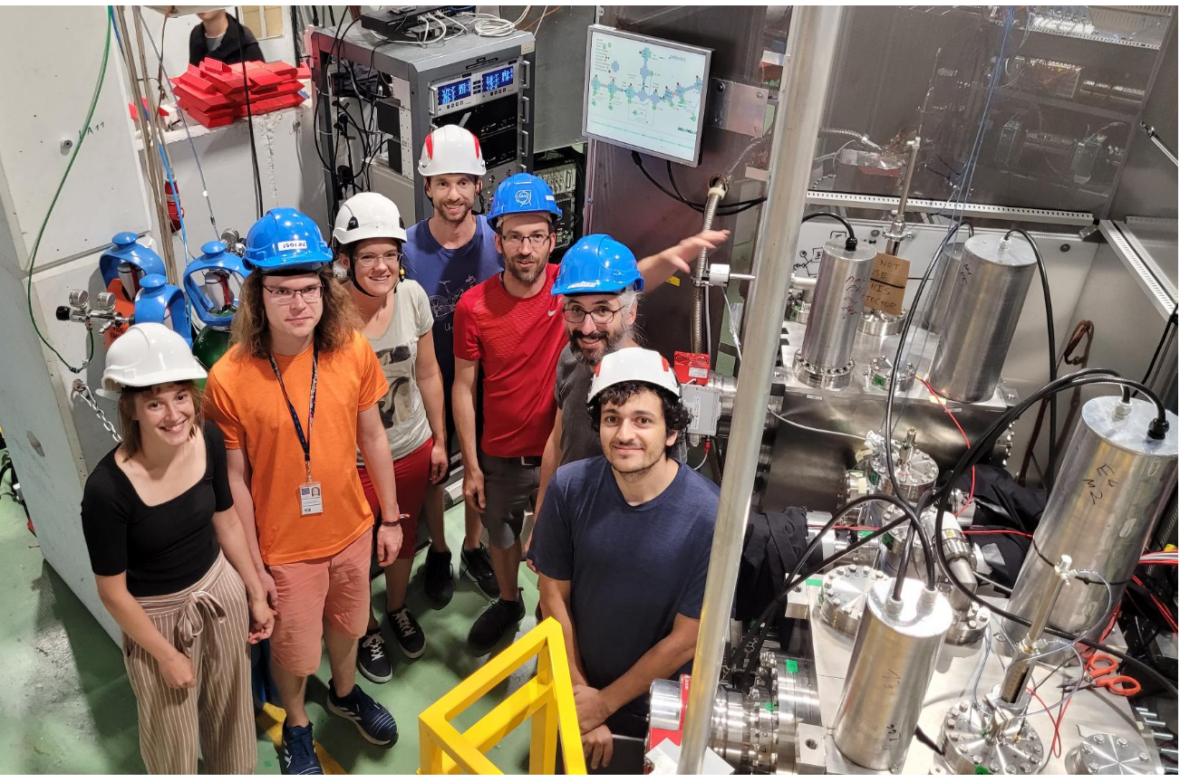

Thanks to the MIRACLS team and collaborators!
MIRACLS proof-of-principle CLS collaboration:
L. Bartels, I. Belosevic, P. Fischer, H. Heylen, F. Hummer, V. Lagaki, S. Lechner, F.M. Maier,
W. Nörtershäuser, P. Plattner, L. V. Rodriguez, M. Rosenbusch, S. Sels, L. Schweikhard, M. Vilen,
F. Wienholtz, R.N. Wolf, S. Malbrunot-Ettenauer
MIRACLS electron affinity collaboration:
M. Au, U. Berzinsh, Y.N. Vila Gracia, D. Hanstorp, C. Kanitz, V. Lagaki, S. Lechner, D. Leimbach,
E. Leistenschneider, F.M. Maier, P. Plattner, M.Reponen, L.V. Rodriguez, S. Rothe, L. Schweikhard,
M. Vilen, S. Malbrunot-Ettenauer
MIRACLS core high-voltage CLS collaboration:
F. Buchinger, L. Croquette, C. Kanitz, S. Lechner, E. Leistenschneider F.M. Maier, L. Nies,
W. Nörtershäuser, P. Plattner, A. Roitman, M. Vilen, L. Schweikhard, S. Malbrunot-Ettenauer
MIRACLS Mg and Cd beam time participants and supporters (in addition to core high-voltage CLS collaboration):
O. Ahmad, T. Fabritz, P. Giesel, R. Hernandez, J. Hughes, C. Klink, F. Koehler, K. Koenig, D. Lange,
L. Lalanne, T. Lellinger, E. Matthews, A. Mcglone, K. Mohr, J. Palmes, V. Repo,
L. V. Rodriguez, C. Schweiger, J. Spahn, J. Warbinek, J. Wilson, Z. Yue, C. Farjado Zambrano
Franziska Maria Maier (maierf@frib.msu.edu)
28

Slide 29
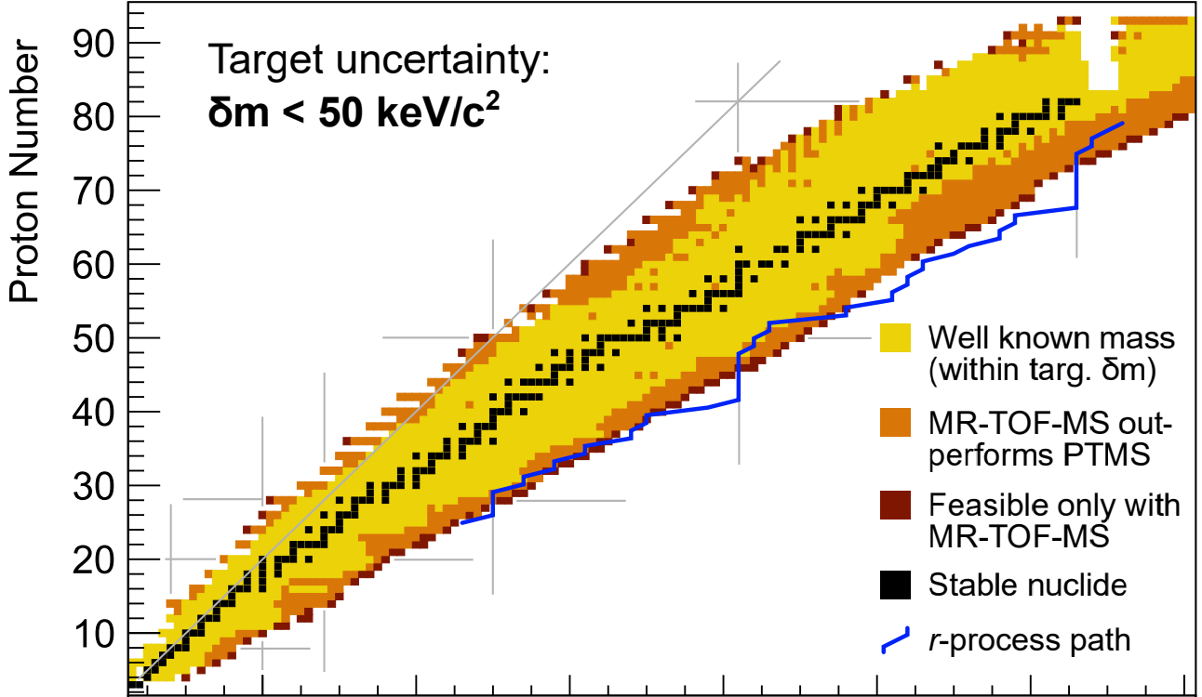
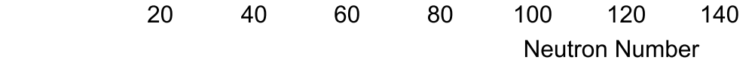
A (High-Voltage) MR-ToF Device Can Also
Extend Reach of Mass Measurement Program at FRIB
High-precision mass measurements of 890 nuclei can be performed which have not been known in AME2020 with less than 50 keV uncertainty in mass excess.
Out of these, 131 nuclei will only be accessible with an MR-ToF MS.
If target δm > 10 keV/c²
Based on FRIB yield estimates for 400 kW primary beam & < 60 hours beam-on-target time
F.M. Maier, C.M. Ireland et al., NIMA 1084, 171220, 2026.
C.M. Ireland, F.M. Maier et al., NIMA 1087, 171426, 2026.

Slide 30
A (High-Voltage) MR-ToF Device Can Also
Extend Reach of Mass Measurement Program at FRIB
Recent mass measurements at LEBIT:
²²Al
S.E. Campbell et al., PRL 132, 152501 (2024).
¹⁰³Sn
C.M. Ireland, F.M. Maier et al., PRC 111, 014314 (2025).
¹⁰¹Sn
C.M. Ireland et al., PRC 113, L021302 (2026).
²³Si
F.M. Maier et al, PRC 112, 014329 (2025).
⁵¹Co + ⁵²Ni
Measured this year
⁷⁷⁻⁸⁰Y + ^{79,80}Zr + ^{82,83}Nb
Measured this year
F.M. Maier, C.M. Ireland et al., NIMA 1084, 171220, 2026.
C.M. Ireland, F.M. Maier et al., NIMA 1087, 171426, 2026.

Slide 31
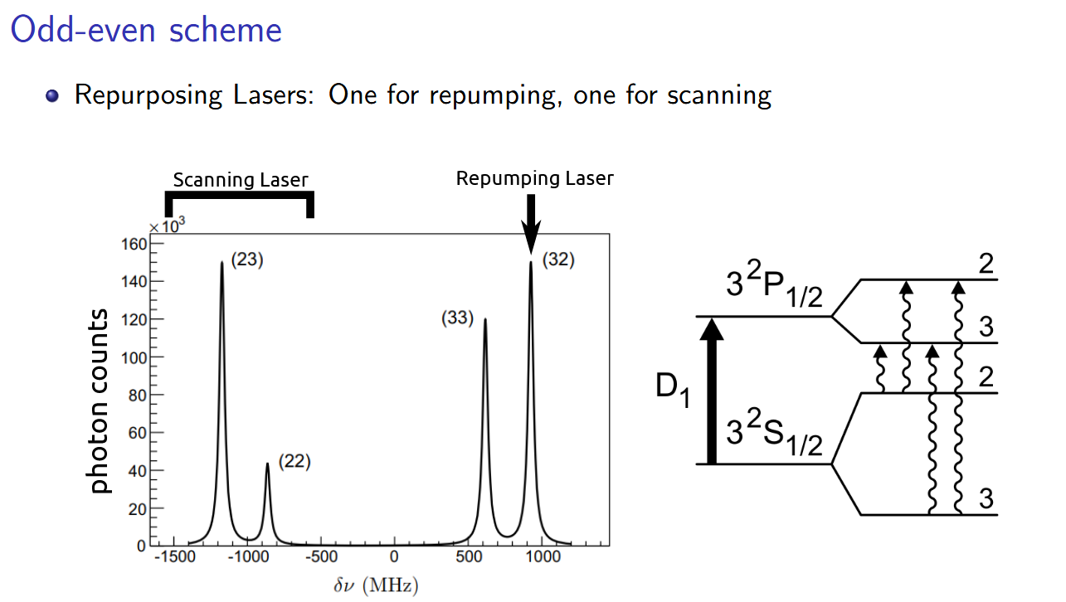
MIRACLS Also Applicable Beyond Closed Two-Level Schemes

Slide 32
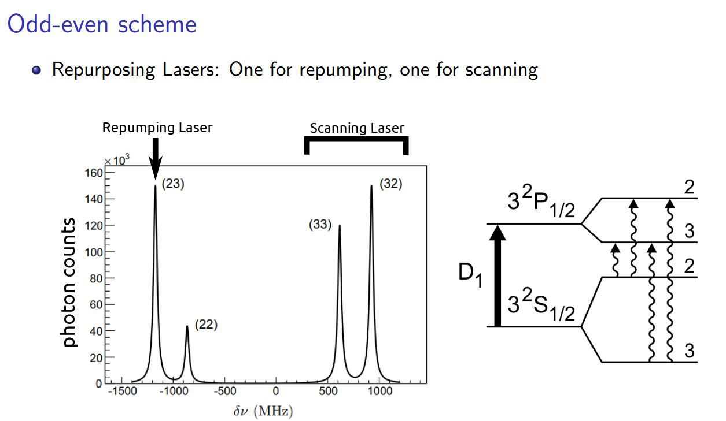
MIRACLS Also Applicable Beyond Closed Two-Level Schemes

Slide 33
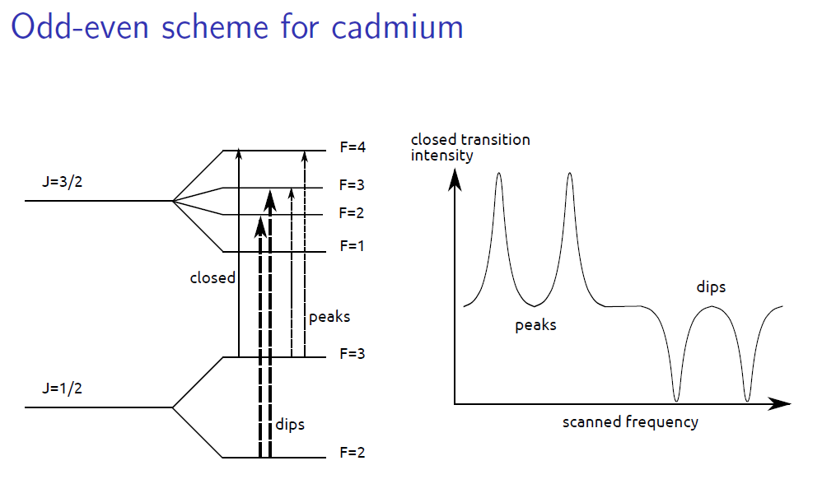
MIRACLS Also Applicable Beyond Closed Two-Level Schemes

