Slide 1
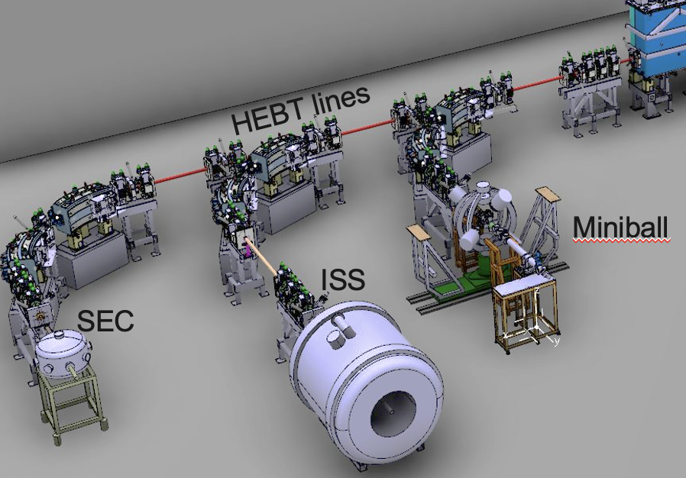
ARIEL in view of HIE-ISOLDE SEC activities at the XT03 beamline of HIE - ISOLDE
Olof TENGBLAD
IEM - CSIC

Slide 2
Introduce CERN and ISOLDE
Pulse structure at HIE-ISOLDE
Introduce the SEC chamber and argue the importance of a place for “travelling experiments”
Specifically enter into light nuclei
The experimental setup needed
Electronics and DAQ
transfer reactions (t,p) (d,p) of 11Be
CERN – LS3 and new instaliations for experiments @ HIE - ISOLDE

Slide 3
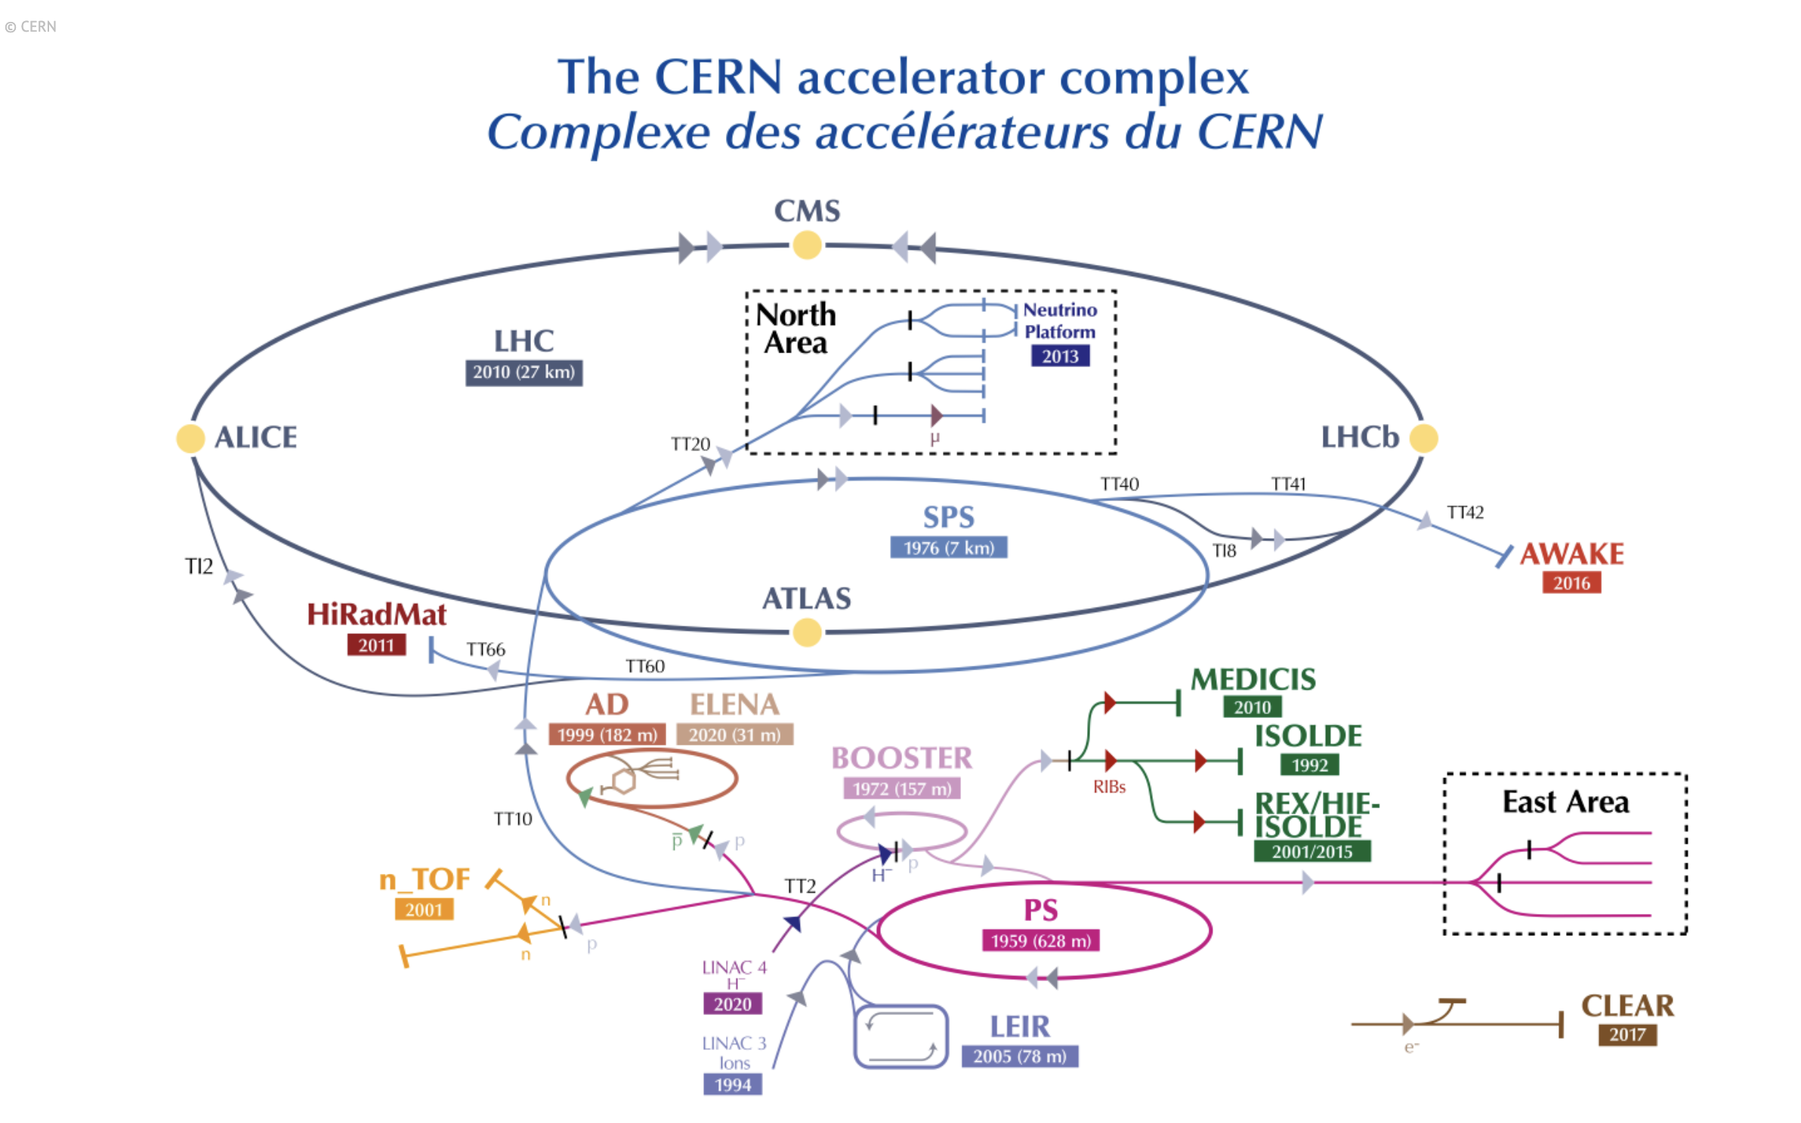

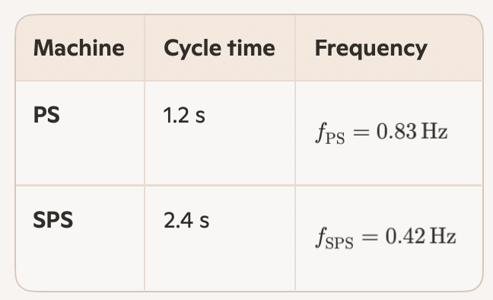
Linac4 → PSB → PS → SPS → LHC
LHC (27 km)
SPS (6.9 km)
CERN super cycle is based in PS 1.2s repetition, SPS on 2.4 s → 50% of p-pulses for pre-SPS physics, main part to ISOLDE

Slide 4

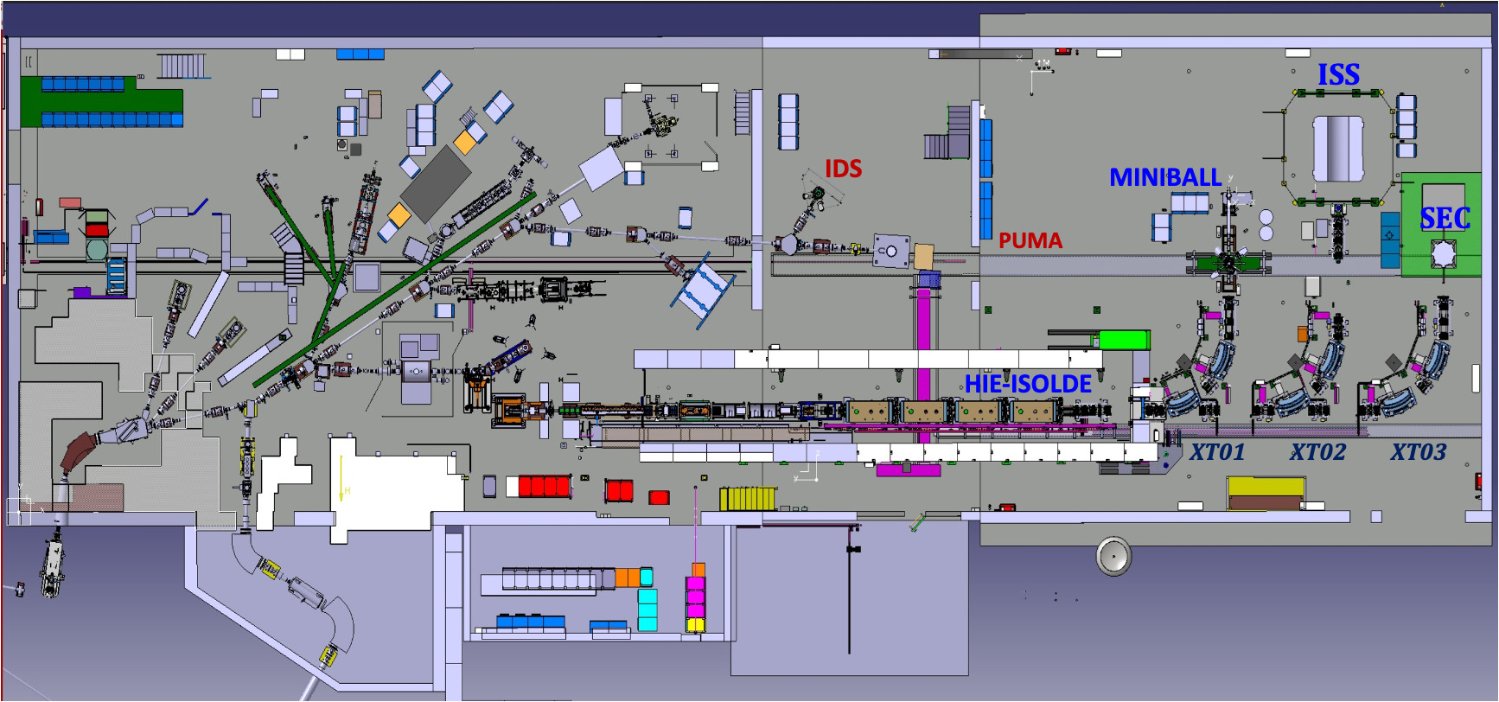
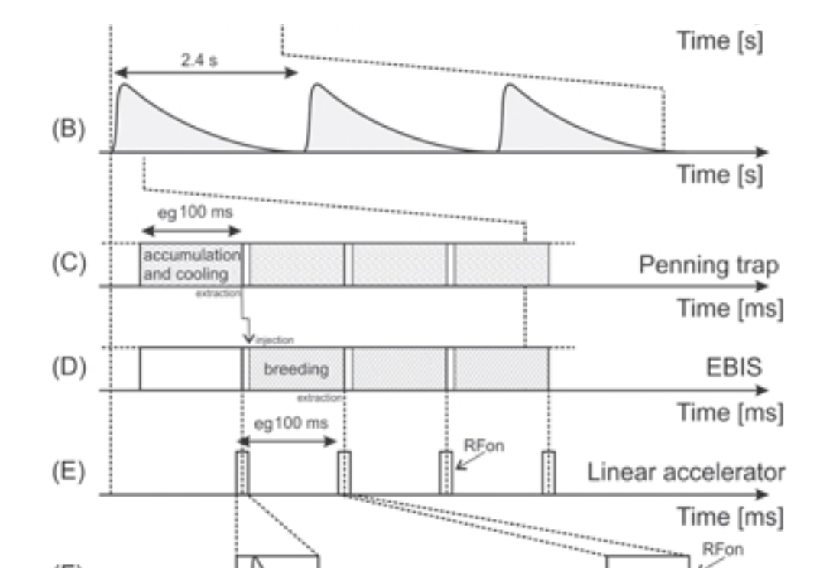
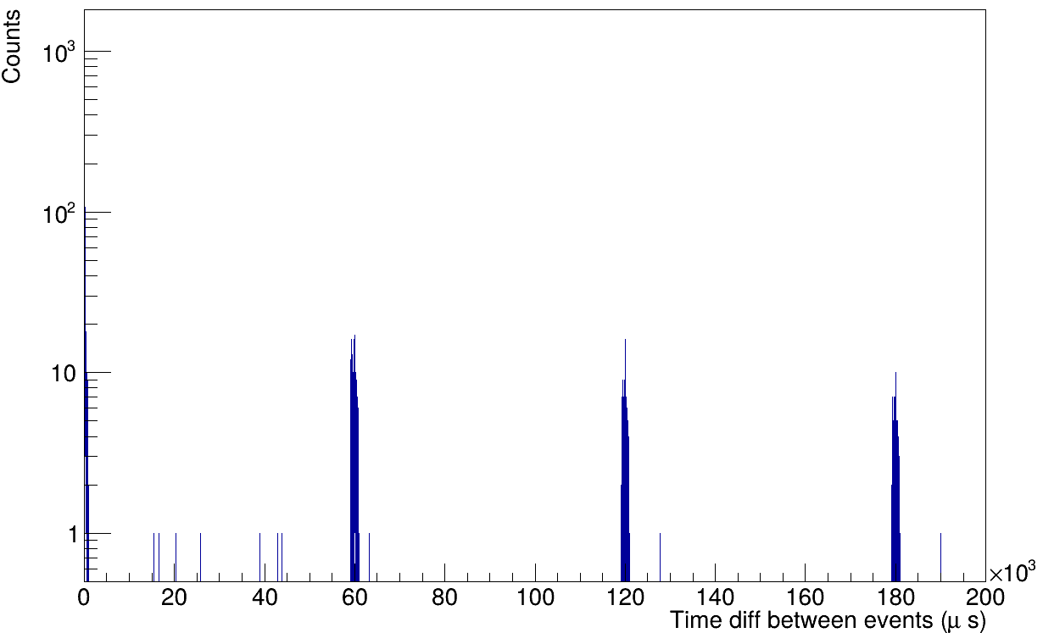
ISOLDE 60 years in 2027
Δ-Timestamp
ISOLDE target get a 3 μs long 3x10¹³ pps of 1.4 GeV from PSB (max 2 μA), extraction 100ms, EBIS breeding 20 ms (50Hz), A/Q=4,
Extraction stretched 3 ms → 10 MeV/u REX 100 MHz → HIE-ISOLDE 200 MHz → μs-structure @ SEC every 60 ms

Slide 5
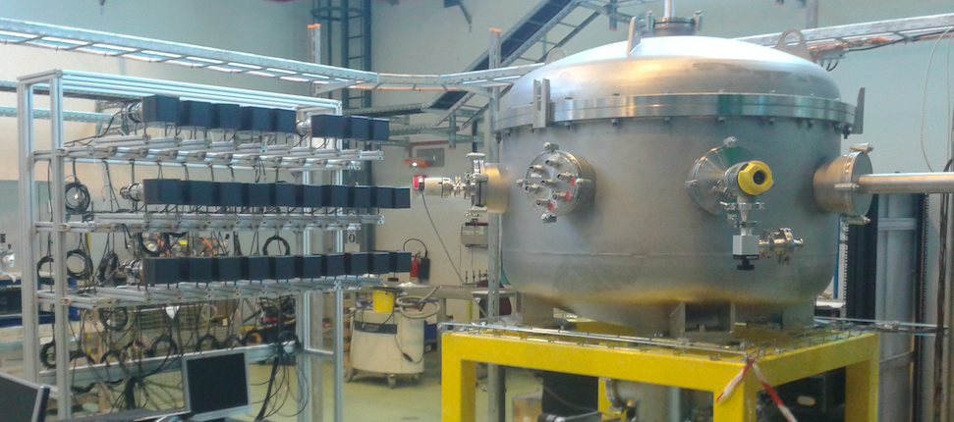
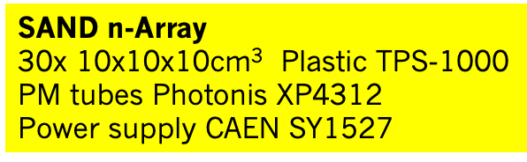
SEC @ XT03 HIE ISOLDE
J. Cederkall joakim.cederkall@nuclear.lu.se O. TENGBLAD olof.tengblad@csic.es
SCATTERING EXPERIMENT CHAMBER
Notes:
Dear audience I Will give you some information on the XT03 activity in RUN3
SEC – Scattering Experiment Chamber is a versatile setup that can facilitate “travelling experiments”
Especially reaction experiment with light nuclei that do not need the gamma detection of miniball.
This chamber of 1m diameter can host a varity of setups inside. We are situated at the laast bend of HIE-ISOLDE

Slide 6
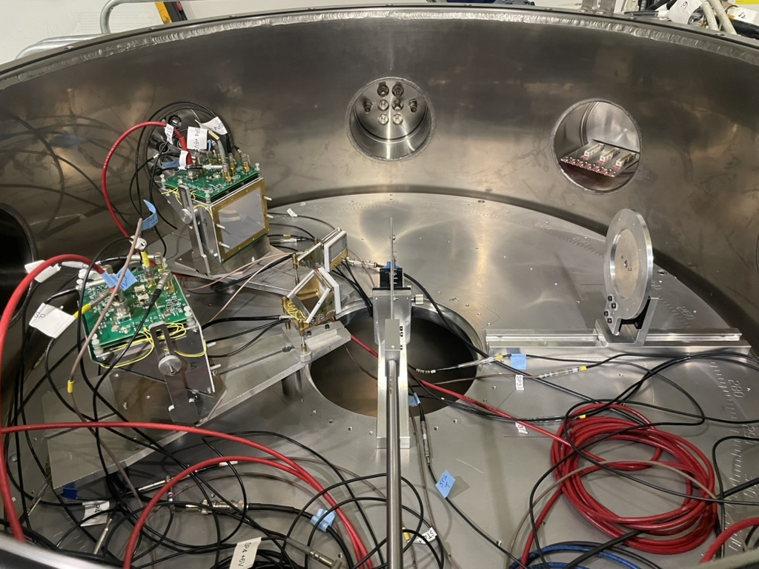
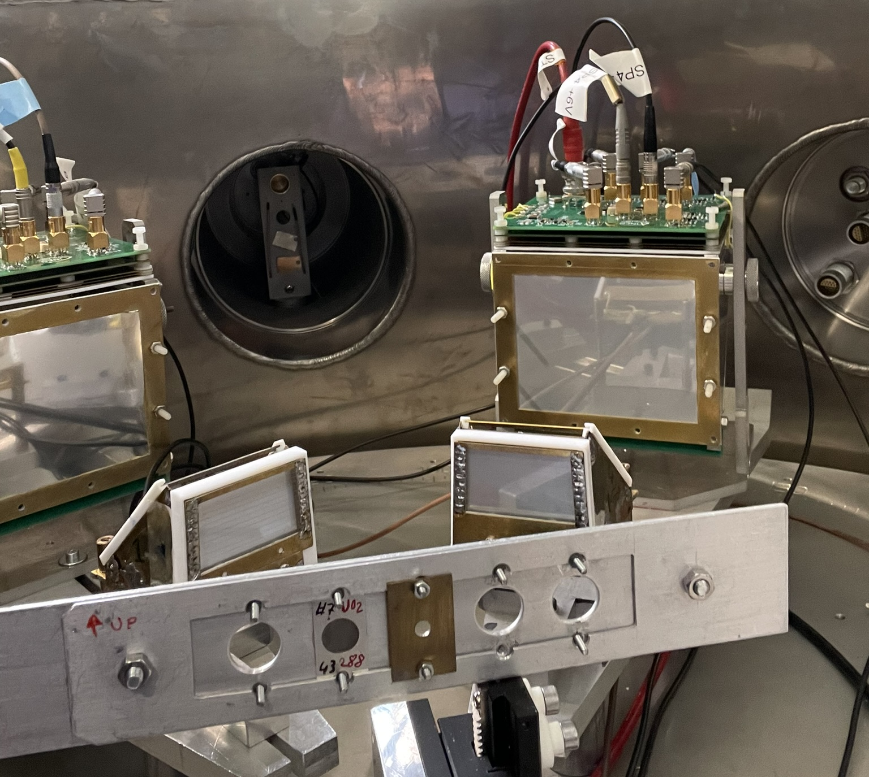
Inside SEC
TOSCA setup IS550
Nov. 2025
Emanuele Vardaci
Notes:
So the equipment of IS690 was cleaneout and replaced by the TOSCA setup

Slide 7
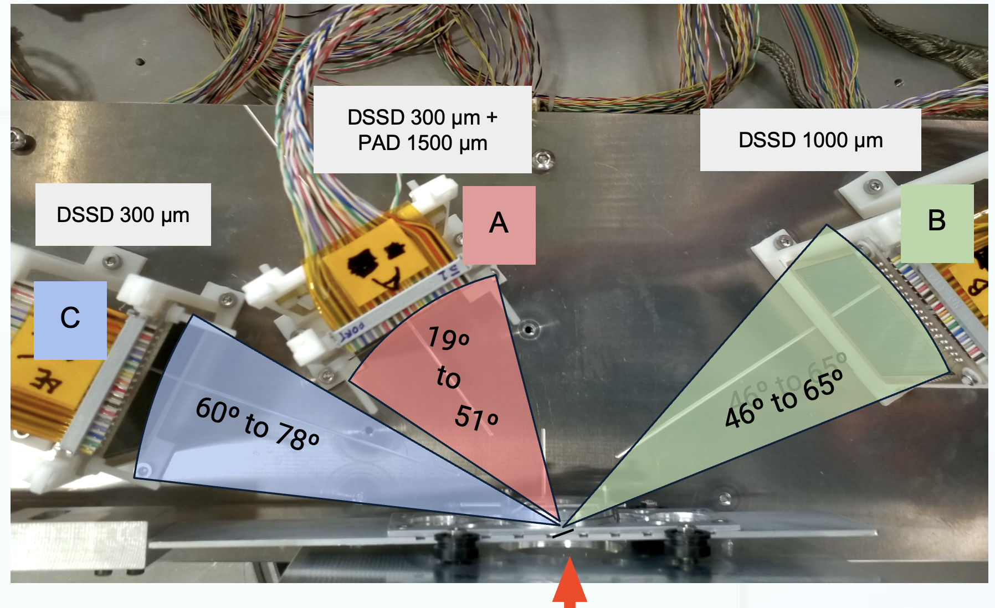
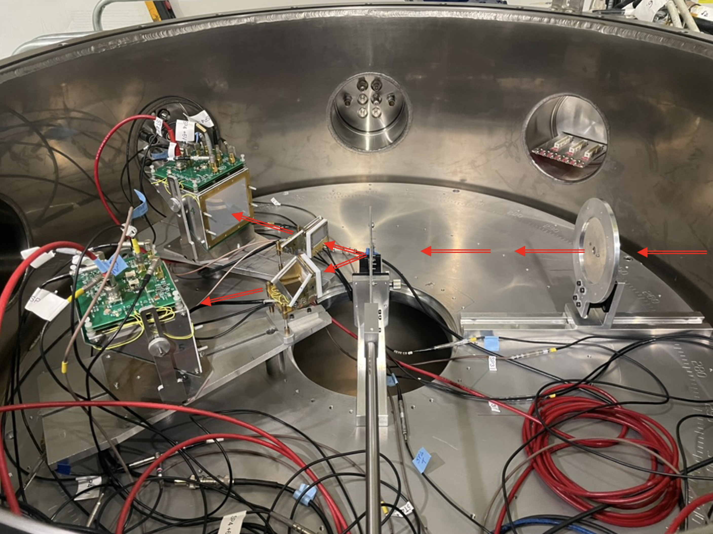
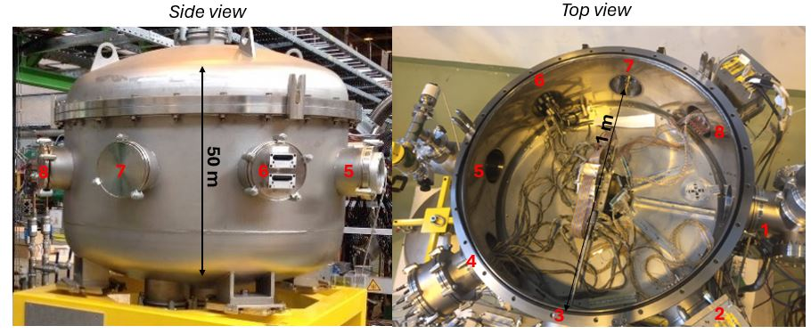
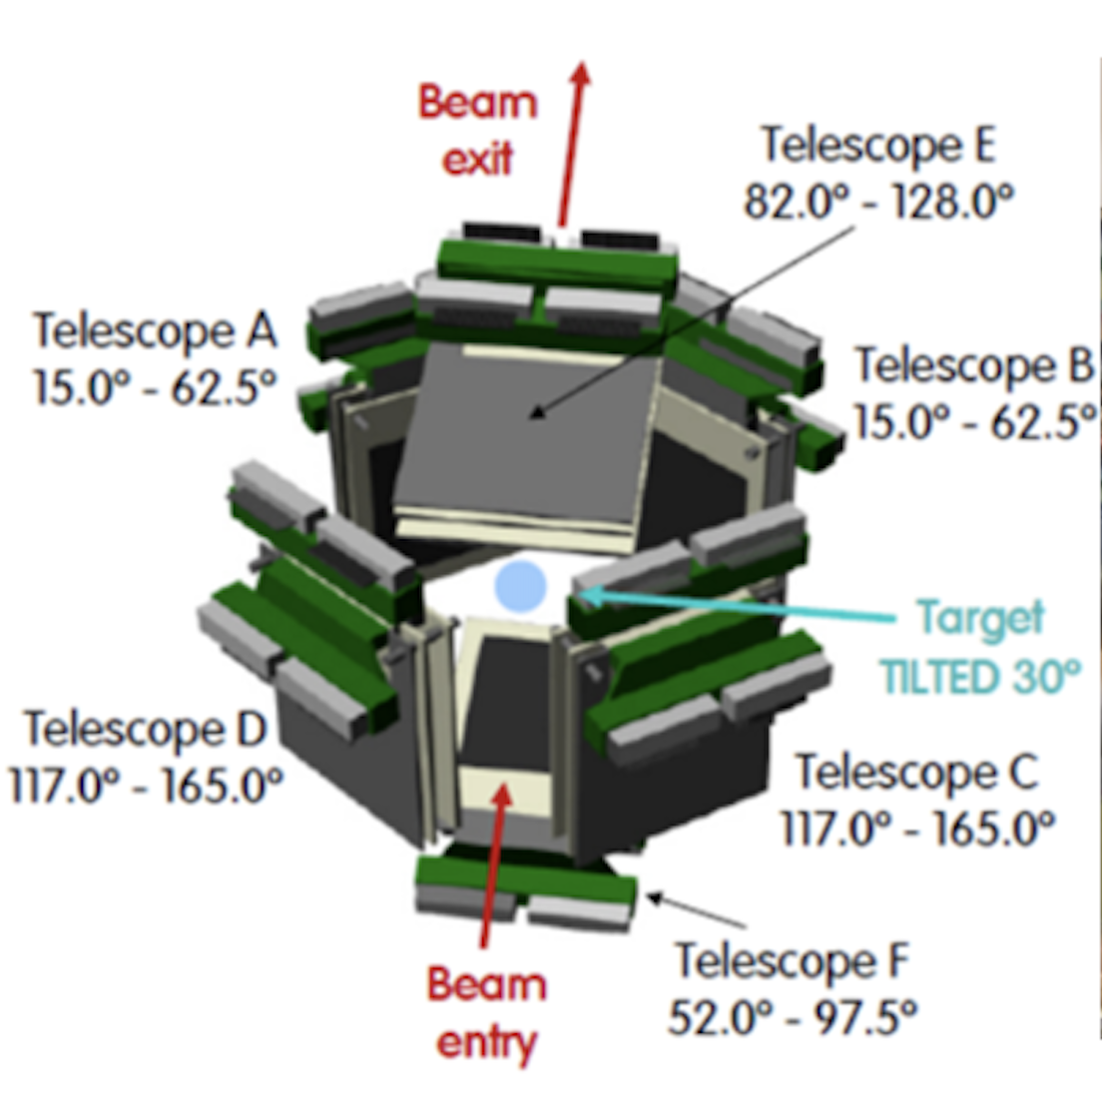
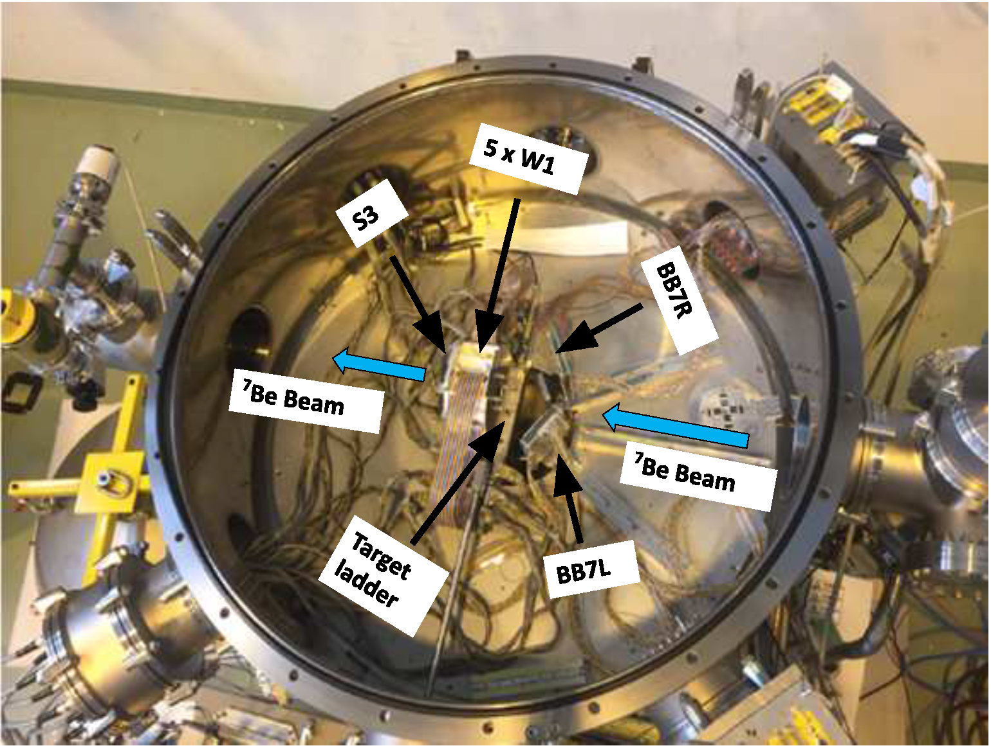
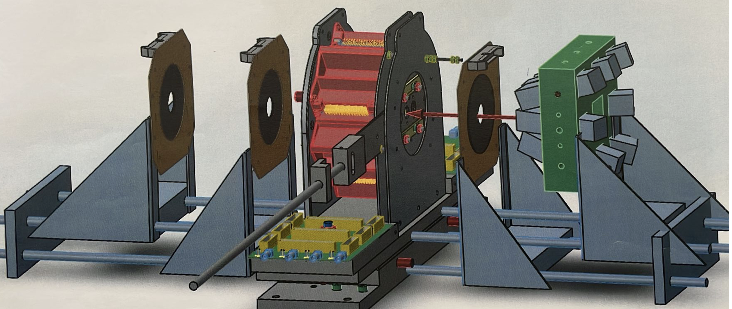
SEC experiments
2022: IS698 D. Galaviz
α-scattering of light Sn-isotopes → p-process
2025:IS550
Study of the Dinuclear System Ni + 238U
GLORIA
2018 A. Di Pietro
IS616: ⁸B + ⁶⁴Zn
2017 I Martel
IS619: ¹⁵C + ²⁰⁸Pb
2024-25: IS690 M. Borge
9Li(t,p) ; 11Be(t,p)
2018: IS561 9Li(t,p) K. Riisager
IS554 ⁷Be(d,p)⁸Be D. Gupta

Slide 8
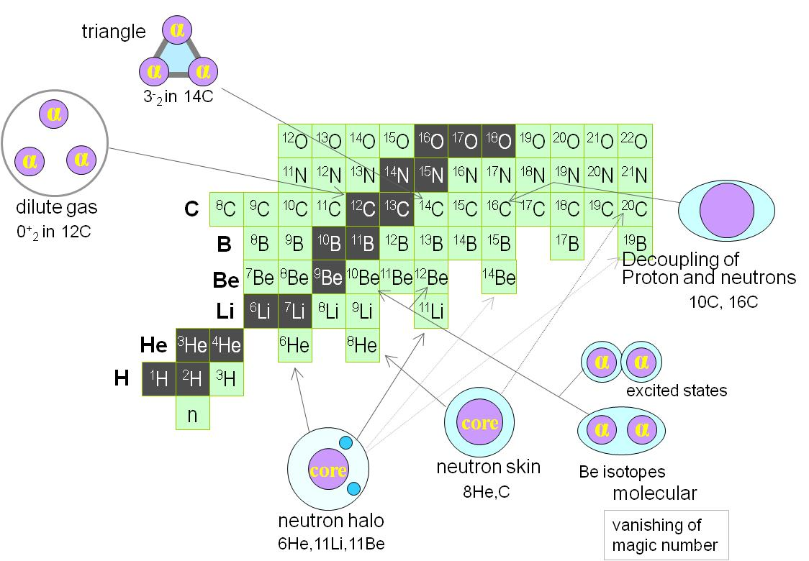
Light nuclei: a laboratory of quantum mechanics
Quantum mechanics plays a role in creating peculiar structures in ground states of light nuclei: nuclear skins and/or nuclear halos, nuclear clusters, nuclear molecules, gas condensate ….
Theoretical understanding of the structure of light drip-line nuclei is challenging
As well as the determination of these exotic structures and their reaction dynamics
Previously @ SEC we have studied reactions with ⁷Be, ⁸B, ⁹Li, ¹⁵C
Courtesy Kanada-En’yo
Notes:
The main activity at SEC is reactions of light RIBs, (earlier have been studied: 7Be, 8B, 9Li, 15C)
Light nuclei: a laboratory of quantum mechanics. Many special nuclear formations appears like “clustering” of alpha particles, halos, n-skin ..

Slide 9
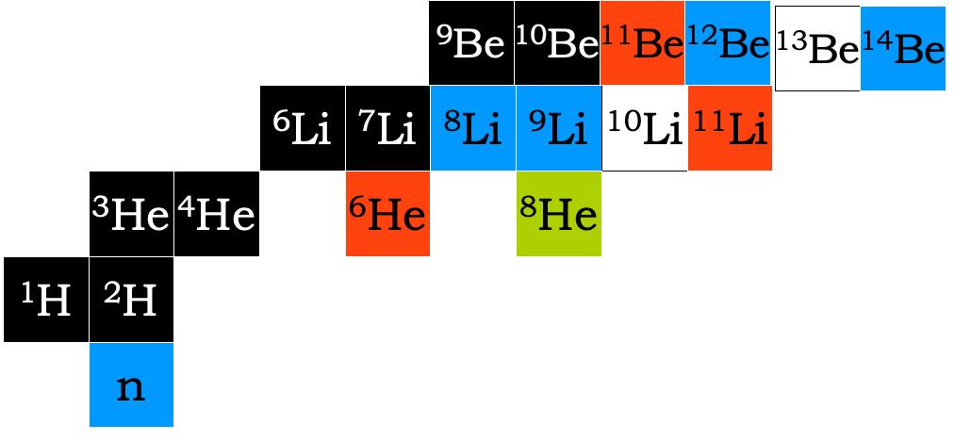
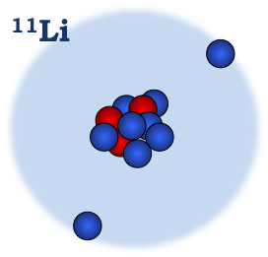
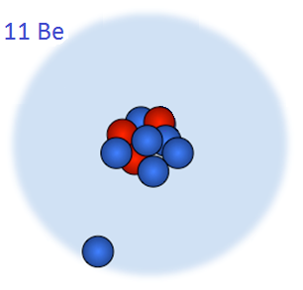
Halo nuclei & reactions
S_{2n} = 0.369 MeV
¹¹Li
¹¹Be
S_{n} = 0.5 MeV
Halo Nuclei: Common “Structural” properties
Rather inert core plus one or two barely unbound
extra (1-2) neutrons or protons
Extended nucleon distribution, large “radius”→ “halo”
Very few excited states – if any.
Unique exotic structure: Insight into slow degrees of freedom (Sn=0.5 MeV, t = 10⁻²¹S; For S_{n} = 8 MeV t = 10⁻²³s
Interplay between Nuclear Structure & Reaction Mechanism
Notes:
As said among these are the halo nuclei like 11Li and 11Be
Using 9Li(t,p) we can produce and study the halo-nuclei 11Li and the resonances of 10Li (non-bound)
Using the halo nuclei 11Be(t,p) we can reach the 13Be 14B

Slide 10
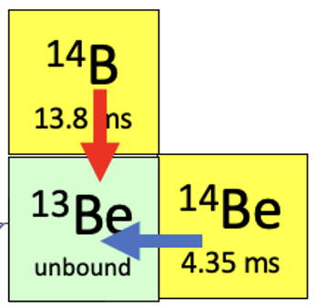
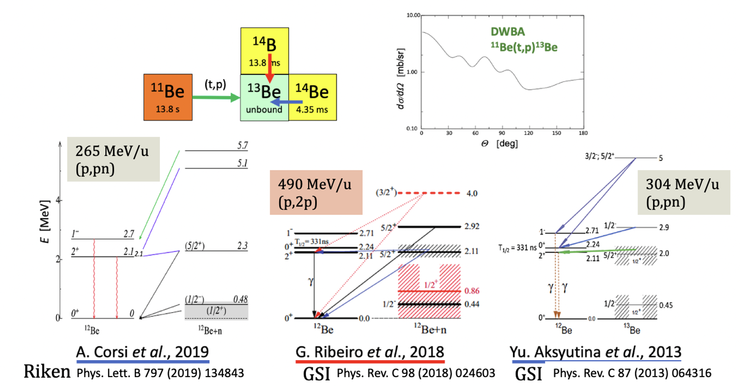
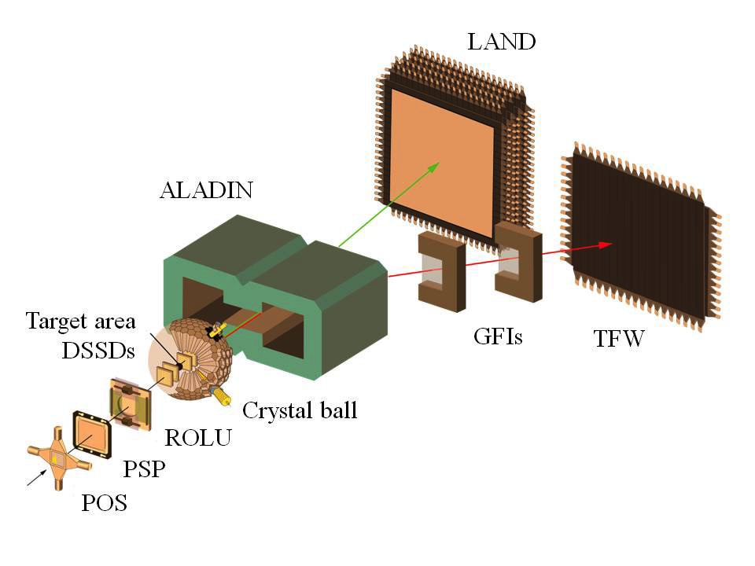
¹³Be is interesting as subsystem of the 2-neutron halo nucleus ¹⁴Be.
The relative positions of the 1/2⁺ and 1/2⁻ resonances are debated.
The 1/2⁻ state obtained from the breakup of ¹⁴Be breakup (¹³Be) appears at a surprisingly low energy compared with its analogue in ¹⁵C (¹⁴C+n).
Notes:
So yes 13Be has been studied in several experiments, but these do not agree fully in the interpretations.
The latest results (2019) results from RIKEN with much better statistics, but still the interpretation of the data differs,
As also indicated in the paper of Corsi et.al the the seed i.e. (p,2p) or (p,pn) populate differently the states.
At R3B we have the UNIQNESS of higher beam energy, the best existing experimental setup and we would like to measure the two reactions
with the same setup in the same beamtime.
We know from G. Randisi et.al. (GANIL) PHYS REV C 89, 034320 (2014) that the seed is important.
Thus it is and will be important to study the two reactions with the same setup at more or les the same time.

Slide 11

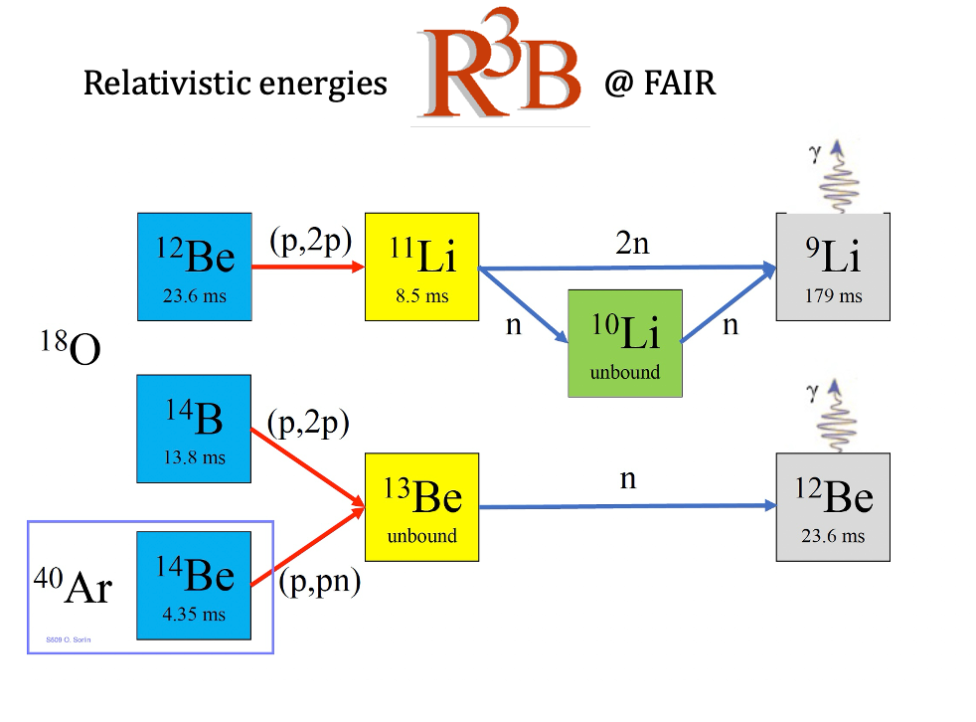
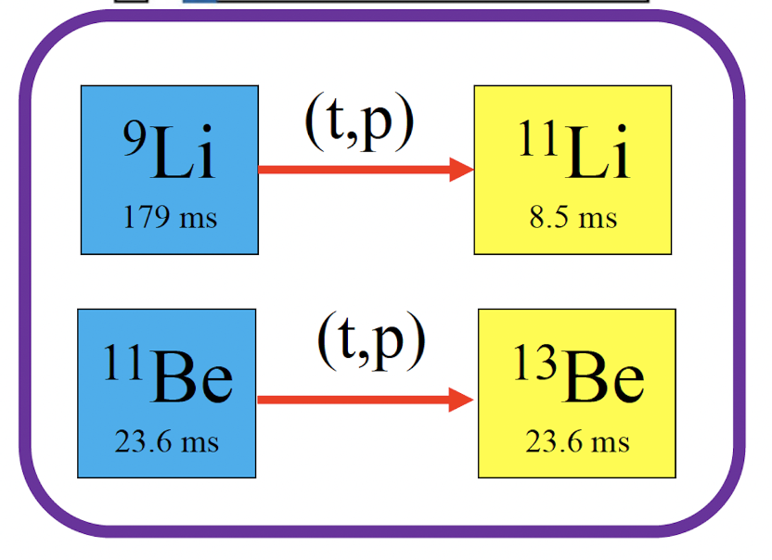
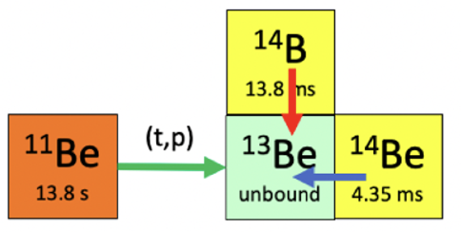
Physics goal: to perform the combined set of experiments
Studying the Structure of Light Exotic Nuclei in Inverse-Kinematics Reactions
Study of open quantum systems, ¹¹Li, and ¹³Be
using (p,2p) and (p,pn) reactions at R3B

Slide 12
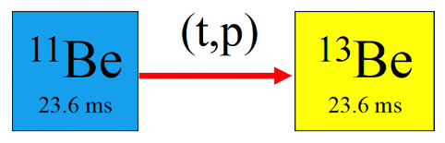
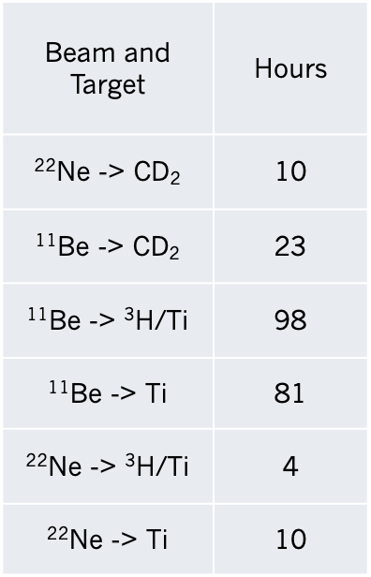
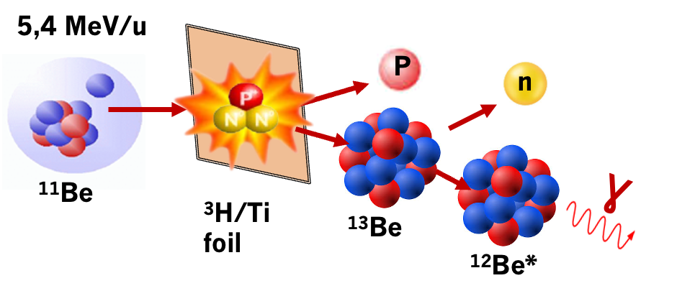
IS690 ¹¹Be(t,p) Experiment
³H-Target: 12 × 5 mm, 1 µm-thick Ti foil loaded with tritium (³H/Ti ≈ 0.4)
activity of the source is 3,38 GBq.
study the angular distribution of the protons, and the
gamma spectrum to characterize the high excited states.
beams @ 5,4 MeV/u
Contaminant in the ¹¹Be beam, of ²²Ne, reduced to about 2–10% using the C-foil stripper.
also run experiment with only ²²Ne beam (no C-stripper foil in the bend to XT03)
Notes:
So IS690 11Be(t,p) @ 5.4 MeV/u at HIE-ISOLDE onto a solid 3H/Ti target
We have 22Ne contaminant in the beam, using the C-stripper foil we reduce this to about 1-2 % but anyhow its is quite a lot in the 11Be beam (this we monitored in our beamdump)
Anyhow we have to take several targets into account: we further used deuteron target for setting up and calibrate the system

Slide 13
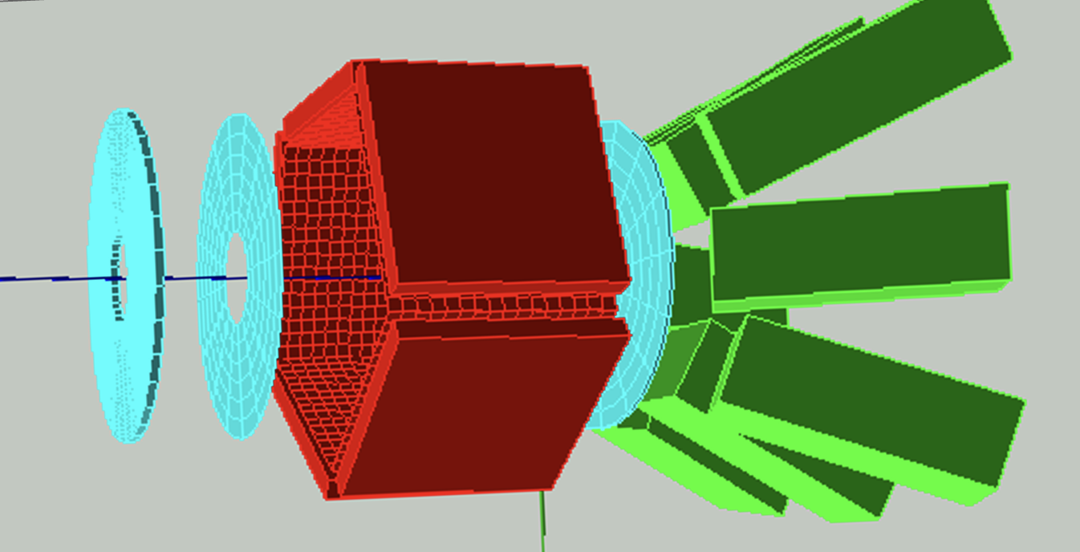
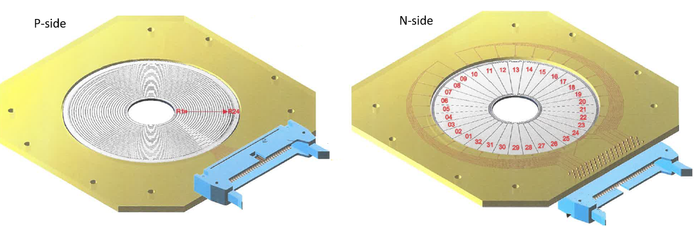
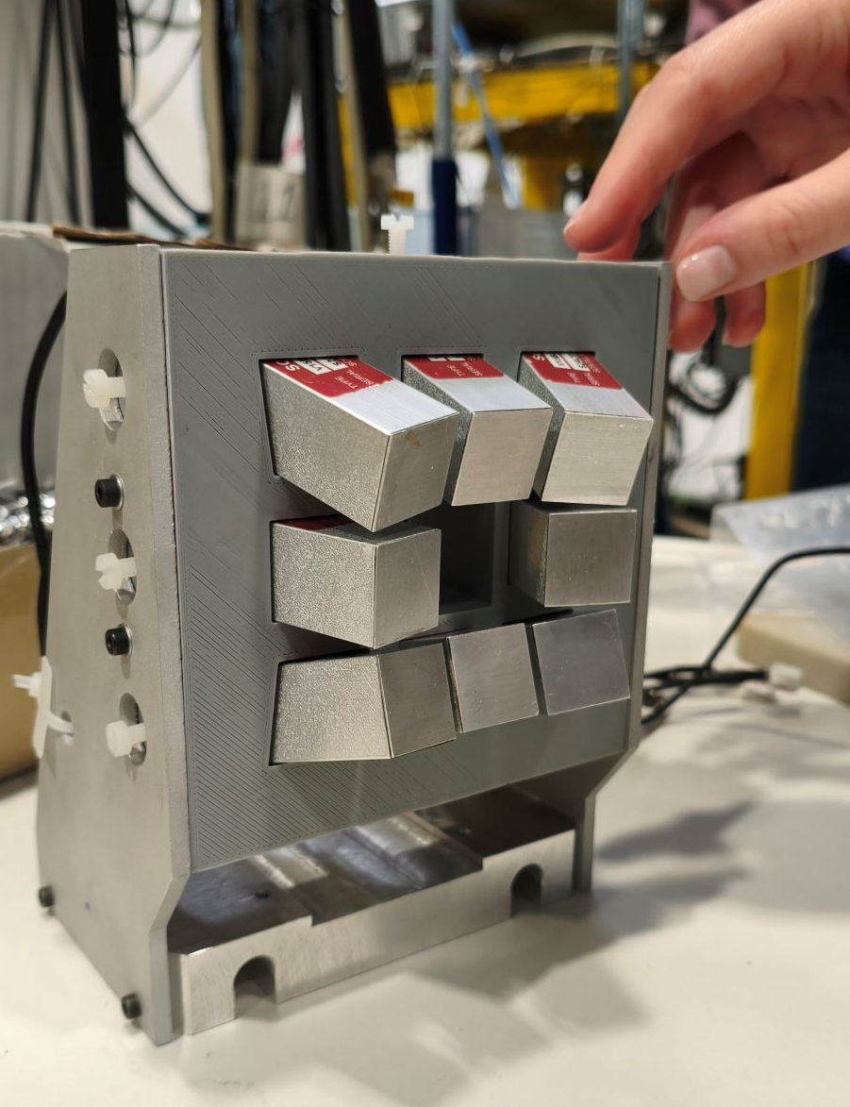
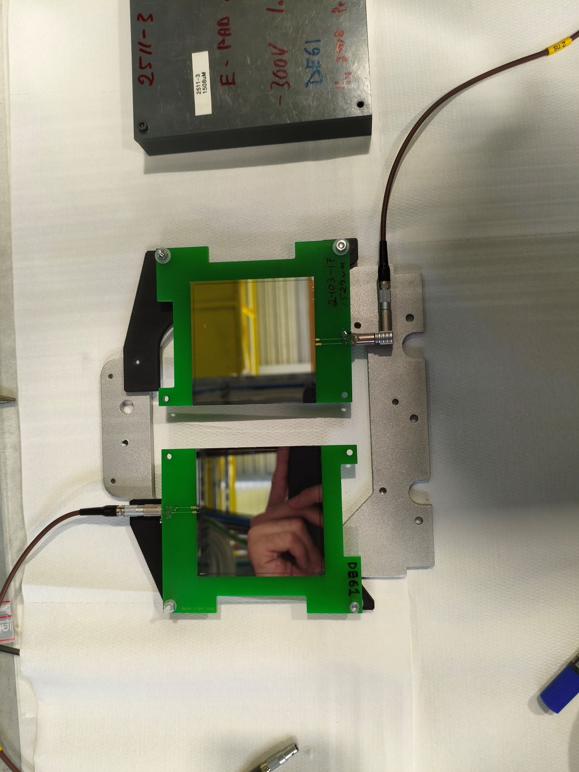
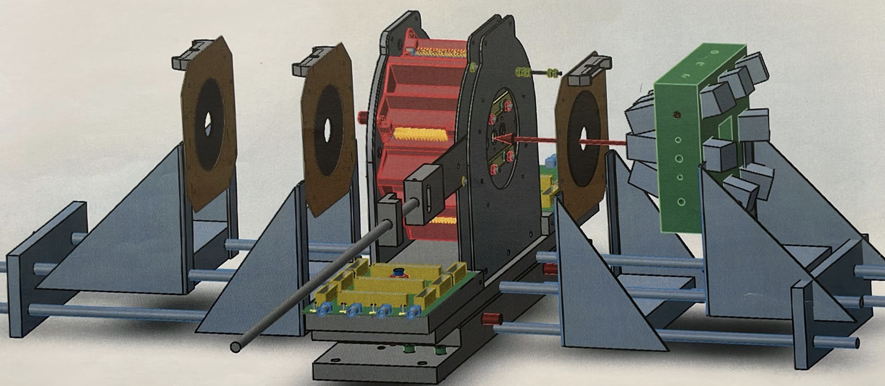
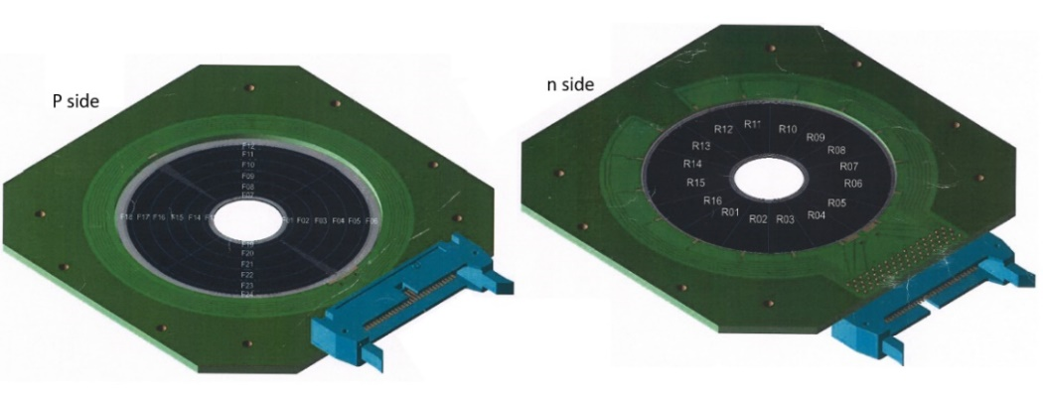
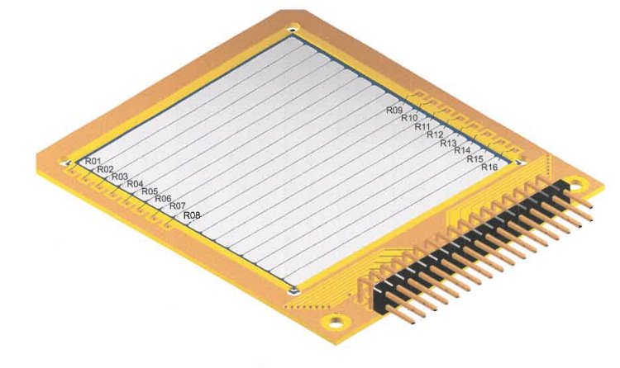
IS690b: ¹¹Be(t,p)¹³Be
SCIONIX Gd₂Al₂Ga₃O₁₂:Ce
8x GAGG for γ detection
S3
16x32 pixels
MSX40
16x24 pixels
S5
W1
MSX25
16x16 pixels
Notes:
To do these studies we need more complicated setup and this means a real upgrade of the SEC capabilities
We have installed a very complete Si detector setup for detection of charge particles
A pentagon of 5x DSSD(60um) + PAD 1500um telescopes
Downstream 2x S3 DSSD telescope discs upstream a S5
Further including 8x GAGG scintillators for gamma detection
So about 2500 detector elements and 450 electronic channels

Slide 14
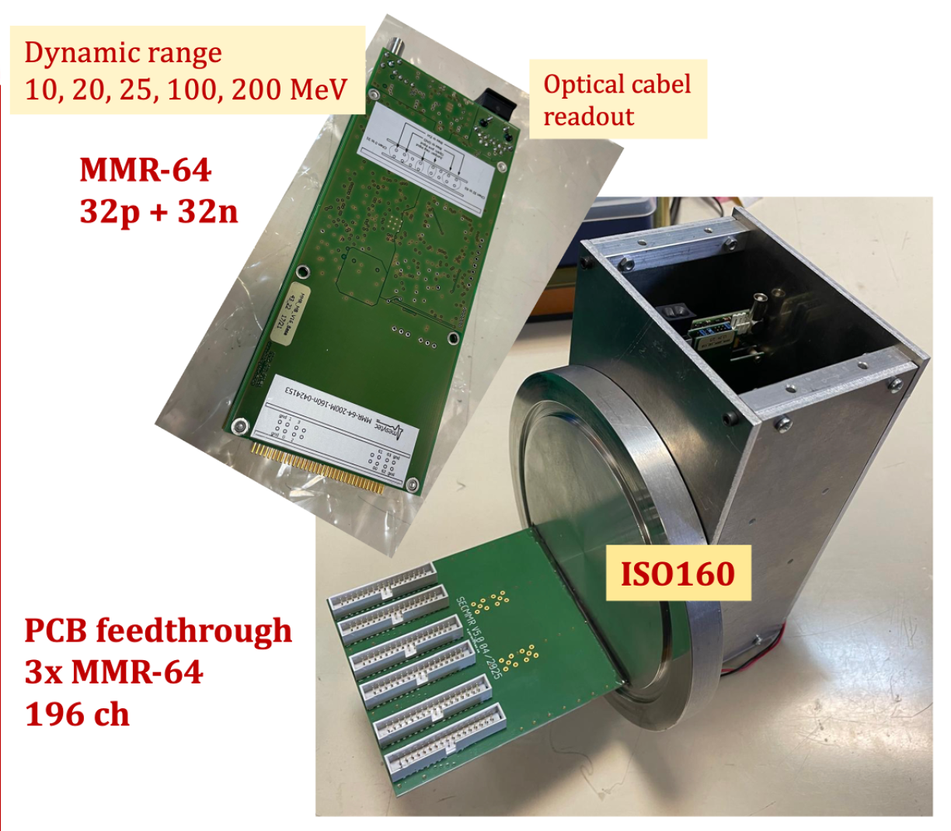
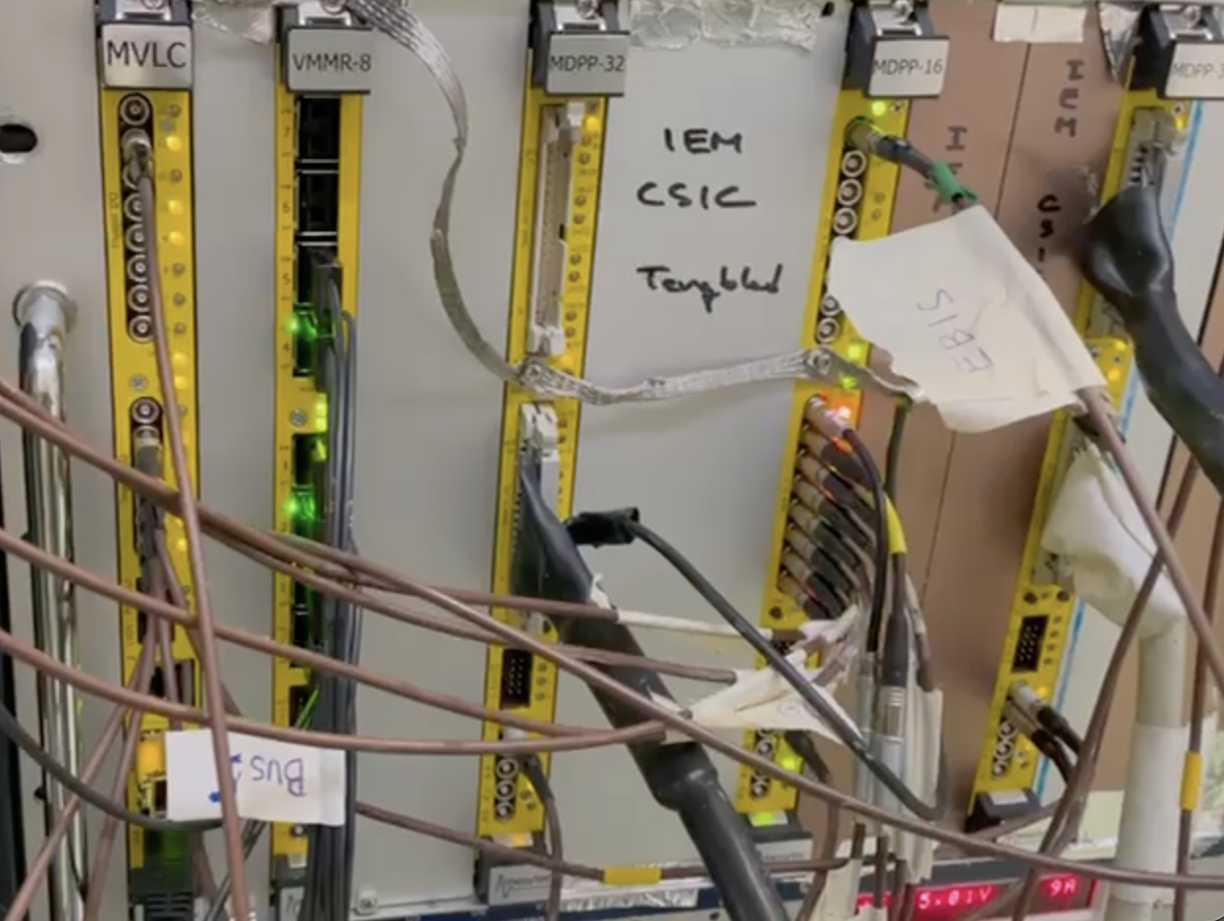
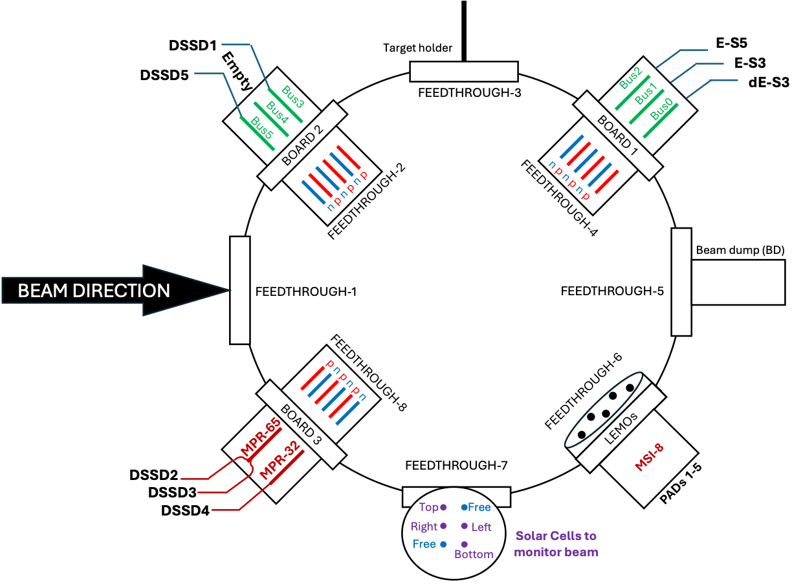
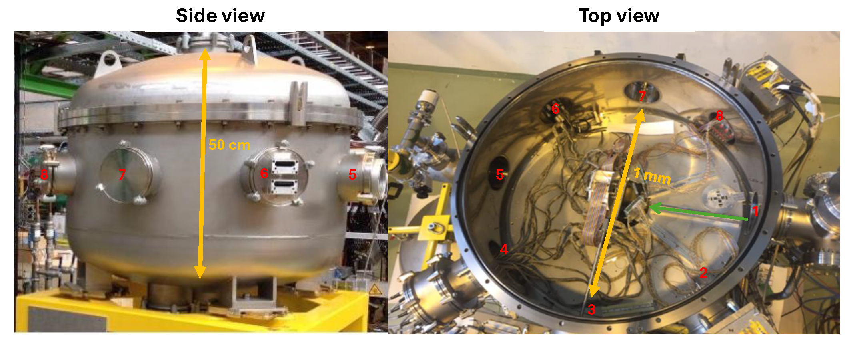

Slide 15
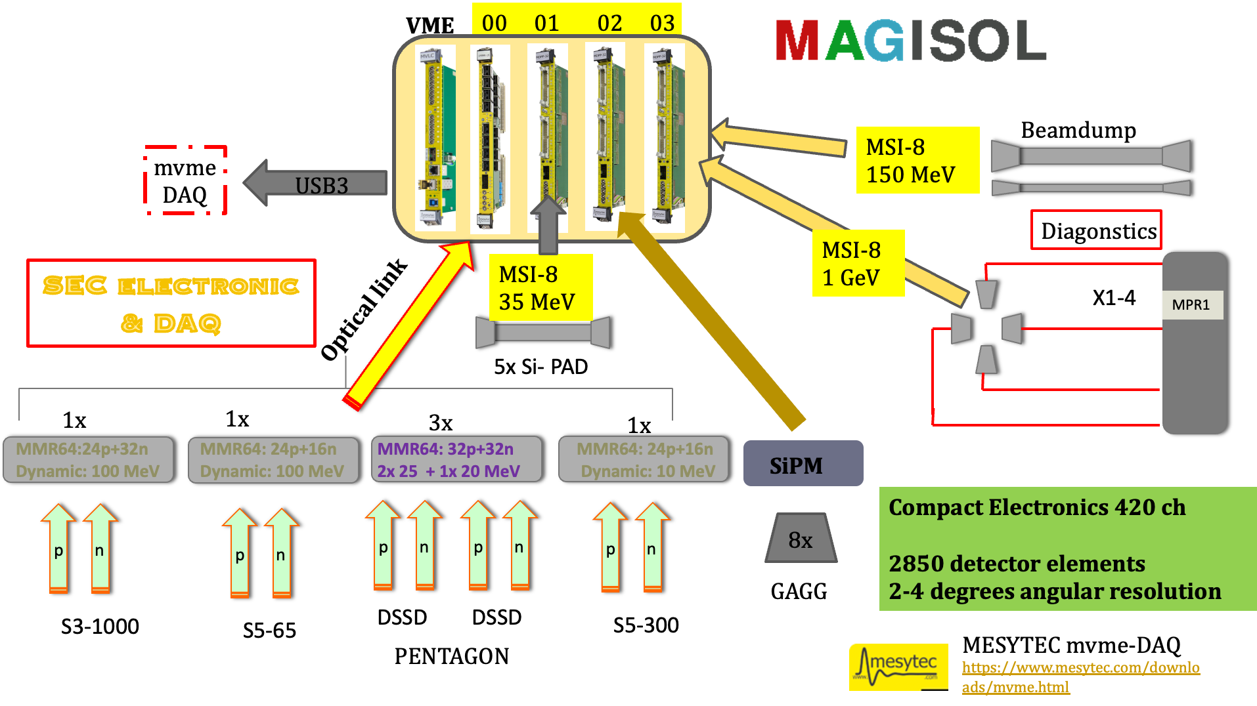
Electronics & DAQ

Slide 16
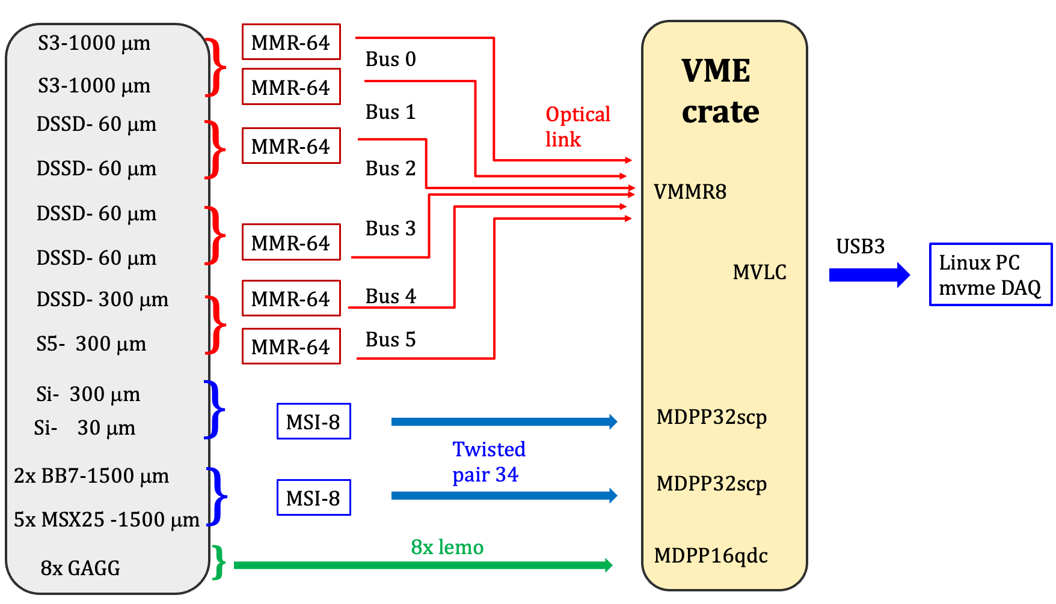
mvme - Mesytec VME Data Acquisition system
SEC chamber
512 ch
MVLC readout controller:
Internal logic (no NIM )
Set by module IRQ1-4
32 ch
32 ch
16 ch

Slide 17
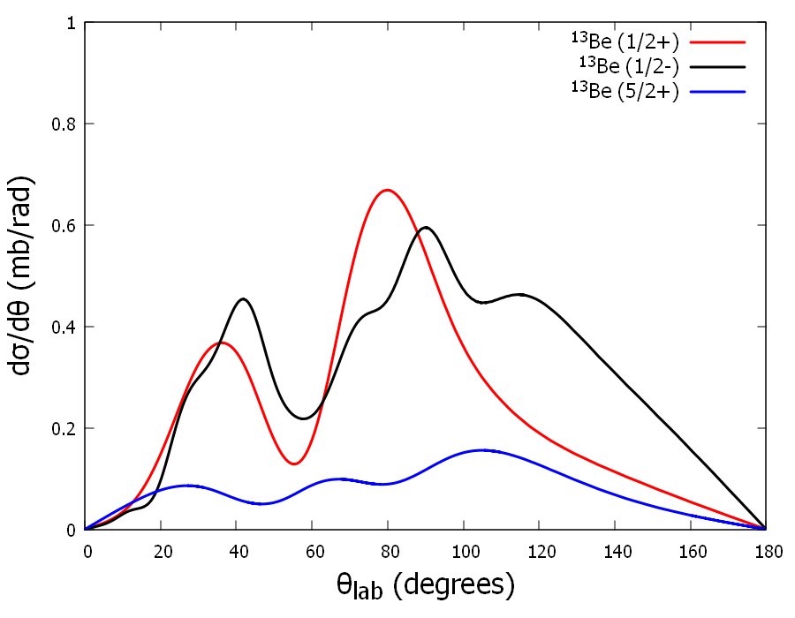
Detectors: Angular Coverage
S3
PENTAGO
S5
Cross sections calculations done by A. Moro and JA Lay Univ. Sevilla
2x S3: 1000 µm DSSDs segmented with 24 rings on the front side and 32 sectors on the back side.
cover angles from ≈ 7° to -- 25°.
5x W1: 4x 30 µm 1x 300 µm DSSDs segmented with 16x16 cover angles from ≈ 4θ -- 80°
1x. S5: 300 µm DSSDs segmented with 4x6 rings on the front side and 16 sectors on the back side.
cover angles from ≈ 110° -- 140°.
All detectors connected Mesytec MMR-64 → VMMR8 → MVLC

Slide 18
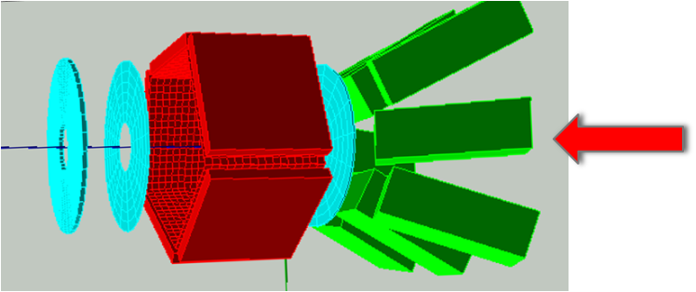
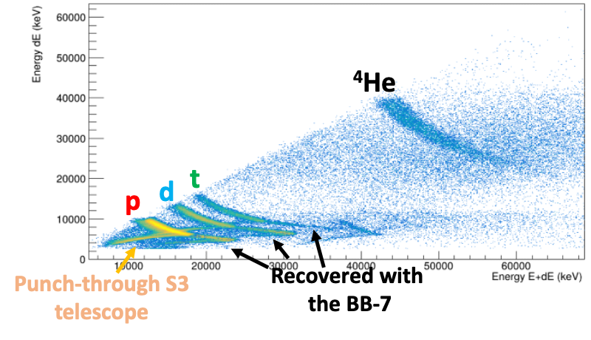
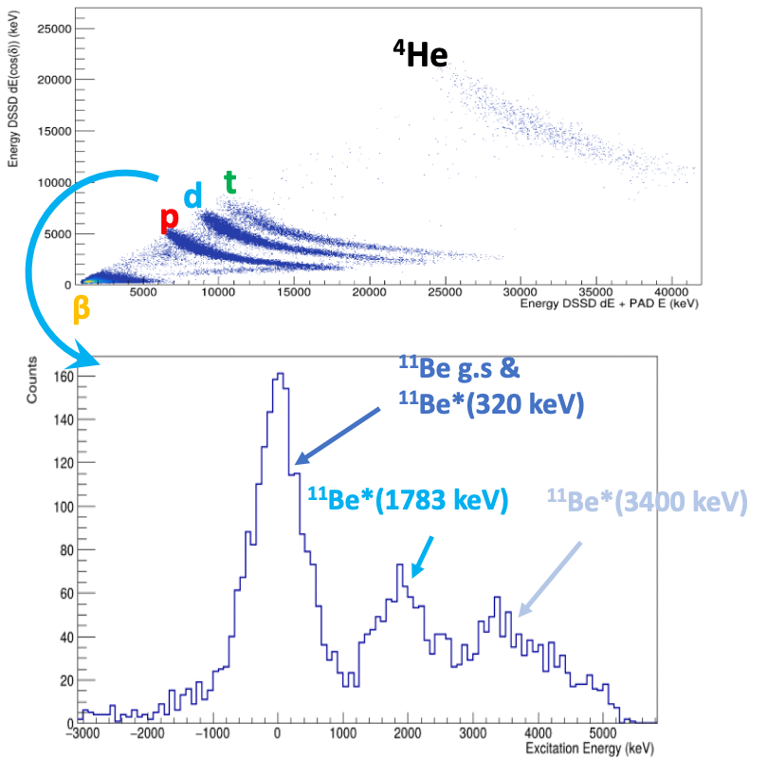
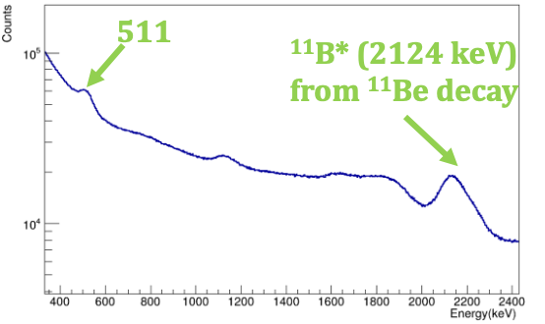
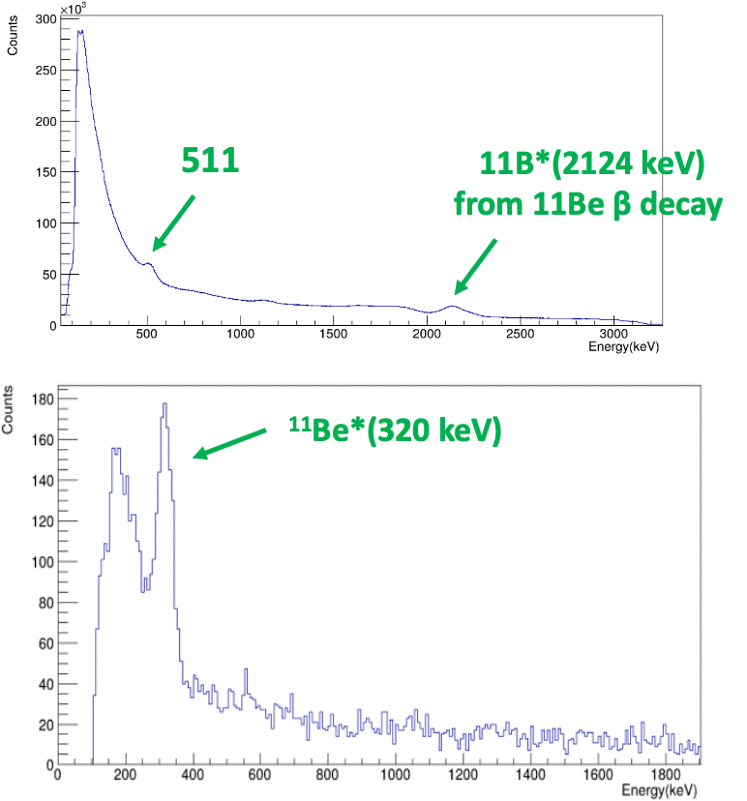
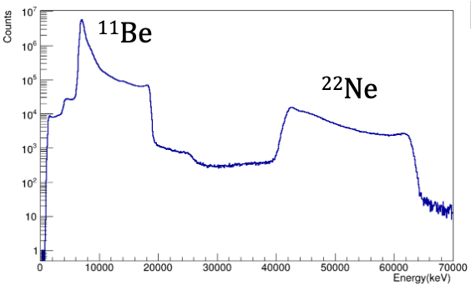
Detector overview; ¹¹Be(d,x)
Pentagon
GAGGs
S3
MSX40
Beam Dump Si
18

Slide 19
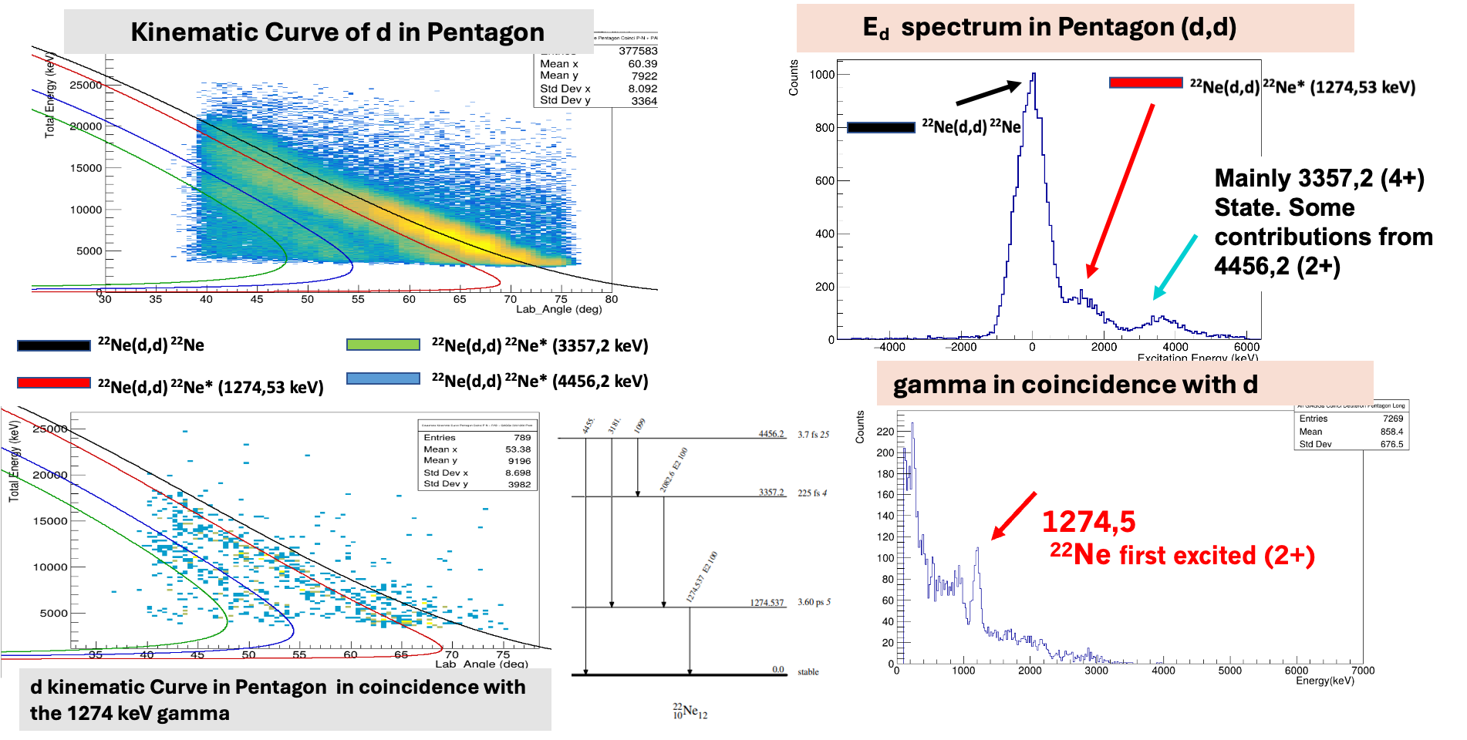
²²Ne (d,d) ²²Ne*
Background
19
Notes:
we use the 2Ne elastic inelastic scattering on the CD2 target (however the data are so very good and will be published soon)
Selecting the deuteron events we can place the theoretical kinematic curve ontop and identify the excitations, further introducing also the GAGG in coincidence
We clearly identify the 1274 gamma rays
So the system works excellently and we can proceed

Slide 20








Deuteron - target
¹¹Be (d,t) ¹⁰Be*
¹¹Be (d,d)¹¹Be*
GAGG
Pentagon
¹¹Be (d,p)¹²Be*

Slide 21






¹¹Be (t,p) ¹³Be*
2n-transfer
Proton Kinematic curve
¹³Be Excitation Spectrum
Ti background subtracted
¹³Be* 2530 & (p,p)
¹³Be* 1610
¹³Be* 3550
¹³Be &
¹¹Be* (390)
21
Notes:
And 2-n transfer to 13Be. Here we have ofcourse to work harde to get out results but they will come

Slide 22
Activity during the
CERN Long Shutdown LS3: 2026-28

Slide 23




HISTARS fast timing array at Miniball 36 LaBr scintillators
LS3 : Work for the future
UCM – IFIC – IEM; LM Fraile
UCM – IFIC – IEM 1 M€
LUXIUM: 48x LaBr crystals
HAMAMATSU 48 PM R13408-Y006
CAEN VX2751 4x 16ch Digitizers
CAEN: SHV system 84 ch
MESYTEC MCFD+MTDC 64ch
Cabling SHV,BNC,MCX

Slide 24


LS3 : Work for the future

Slide 25

ISRS - prototype
UHU – IEM – UV – ESS Bilbao: 3M€

Slide 26

Summary
The SEC chamber is a versatile chamber for reaction experiments
The upgrade of detectors & electronics very positive
The chamber can host different detector setups inside or coupled downstream
Inverse kinematics is a powerful tool to study weakly-bound light nuclei, including excited and resonant states.
11Be(t,p) ¹¹Be beam @ 5 MeV/u with contamination of (1-2% ²²Ne )
(Thesis Sebstian Gomez Garcia; sebastian.gomez@csic.es )
Future during LS3 installation of HISTARS & ISRS-prototype as new tools for experiment
Acknowledge funding via EUROLABS & MCIN AEI under Project PID2022-140162NB-I00

Slide 27









Collaborators
Thank you
Acknowledge funding via EUROLABS & MCIN AEI under Project PID2022-140162NB-I00
Notes:
These are the institute that are collaborating with equipment to SEC

