Slide 1
Coulomb excitation with TIGRESS for nuclear structure
Jack Henderson
ARIEL Science Workshop, 21/04/2026

Slide 2
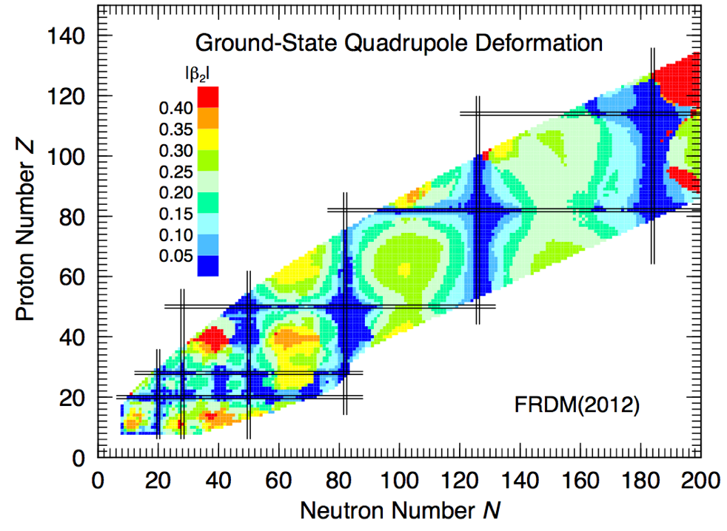
Why Coulomb excitation?
The nucleus is a finite strongly-interacting, many-body system
Collective nuclear properties are emergent properties of the nuclear system arising because of the strongly-interacting, many-body nature of the problem
Collectivity (and deformation) is an extreme test of nuclear models
Experimental signature for collectivity is corresponding electric-multipole strength (e.g. E2, E3, E4, etc..)
Inhibited near nuclear magic numbers – but … everywhere
P. Möller et al., At. Nucl. Data Tables 109 1 (2016)

Slide 3
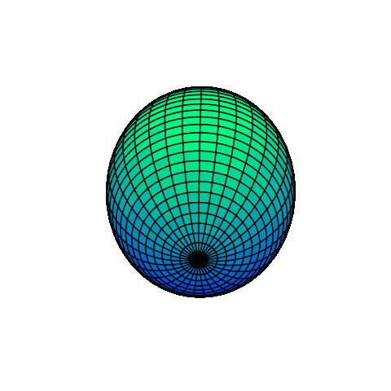
Why Coulomb excitation?
Electromagnetic (“model independent”) probe of the nucleus
Sensitive to magnitudes and (relative) signs of electric multipole matrix elements including spectroscopic quadrupole moments
Large cross sections – well-suited to RIB
Exceptional probe of nuclear deformation through sum rules
Kumar PRL 28 249 (1972)

Slide 4
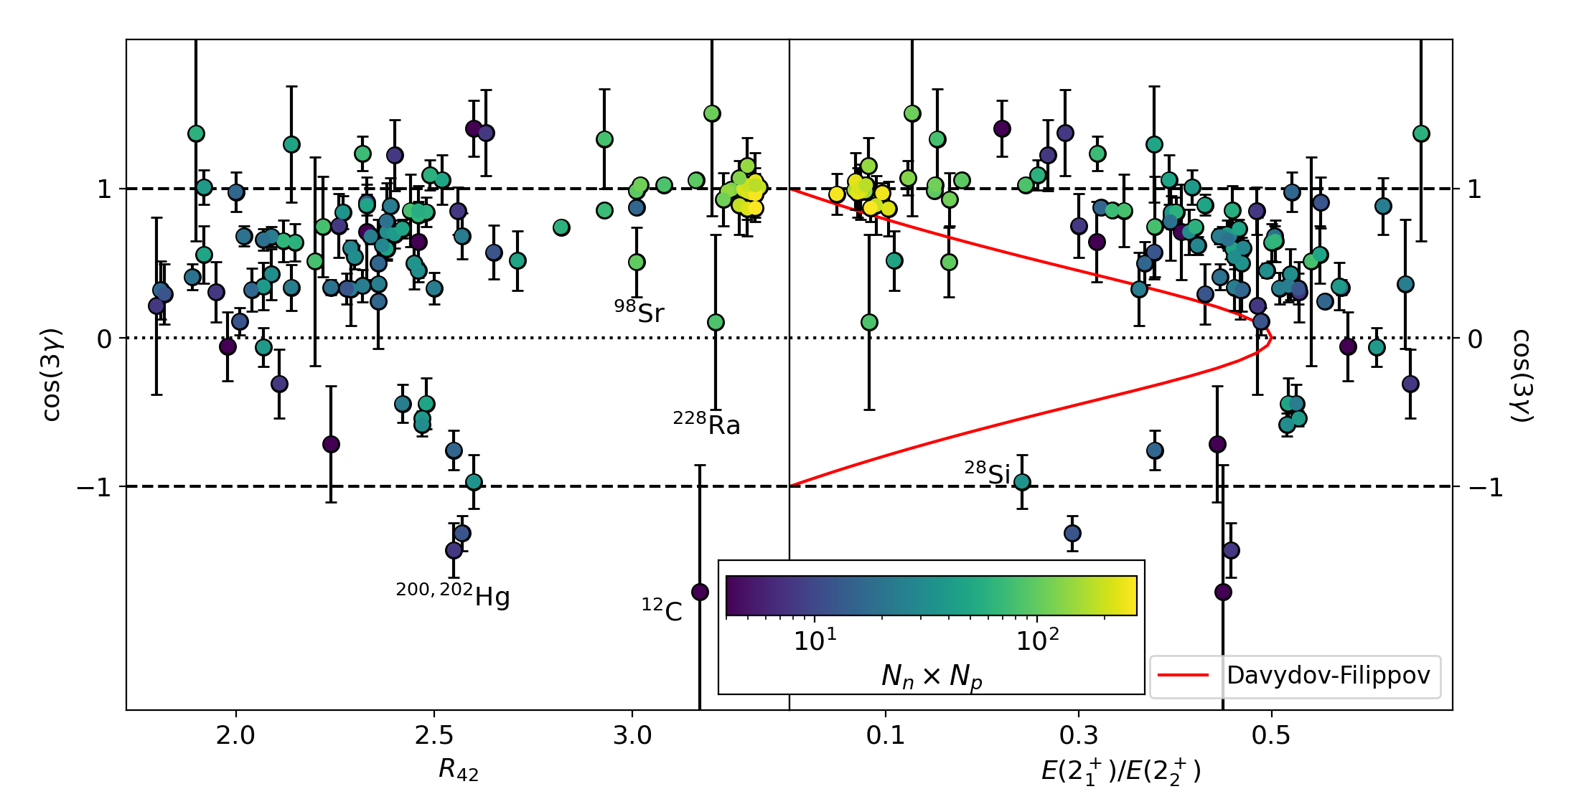


Why Coulomb excitation?
Electromagnetic (“model independent”) probe of the nucleus
Sensitive to magnitudes and (relative) signs of electric multipole matrix elements including spectroscopic quadrupole moments
Large cross sections – well-suited to RIB
Exceptional probe of nuclear deformation through sum rules
Kumar PRL 28 249 (1972)
$$\frac{Q_{s}(2_{1}^{+})}{Q_{rot}(2_{1}^{+})}$$
$$\frac{Q_{s}(2_{1}^{+})}{Q_{rot}(2_{1}^{+})}$$

Slide 5
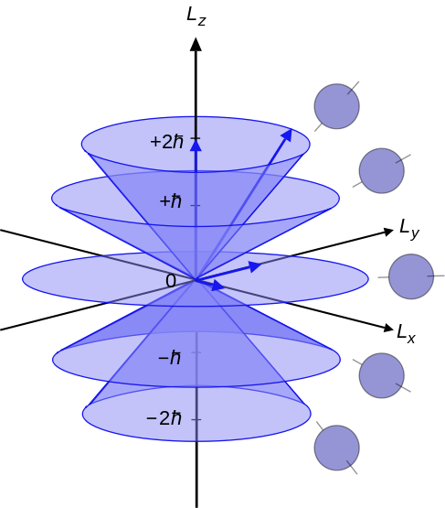
Why Coulomb excitation?
How do we access quadrupole moments?
Qualitative picture: Nuclear moments cause a reorientation in an electric field gradient
Typical CoulEx reaction: dV/dr ≈ 10³⁰ V/cm²
Nucleus aligns relative to symmetry axis
Breaks m-state degeneracy

Slide 6


Why Coulomb excitation?
Splitting ∝ dV/dr ~ 10³⁰ V/cm
$$E\left(t\right)∝eQ_{s}Z/r^{3}(t)$$
M
J^{𝜋}
M
±2
0
2⁺
±1
~100 keV
~100 keV
±1
0
±2
0⁺
0
0
Oblate splitting
Spherical
Prolate splitting

Slide 7

Why Coulomb excitation?
Splitting ∝ dV/dr ~ 10³⁰ V/cm
$$E\left(t\right)∝eQ_{s}Z/r^{3}(t)$$
M
J^{𝜋}
M
0
±2
0
2⁺
±1
~100 keV
~100 keV
±1
$ΔM=0$ excitations are preferred
Excitation probability depends on energy
Introduces a $Q_{s}$ dependence to the cross-section
0
±2
0⁺
0
0
Oblate splitting
Spherical
Prolate splitting

Slide 8
Why Coulomb excitation?
M. Zielinska et al. Eur. J. Phys. A 52 99 (2016)
Since angle and impact parameter are related, this introduces an additional angular dependence to the cross section
Also influences the angle-integrated cross-section
Measure the distribution and/or the integrated cross-section and access the quadrupole moment

Slide 9
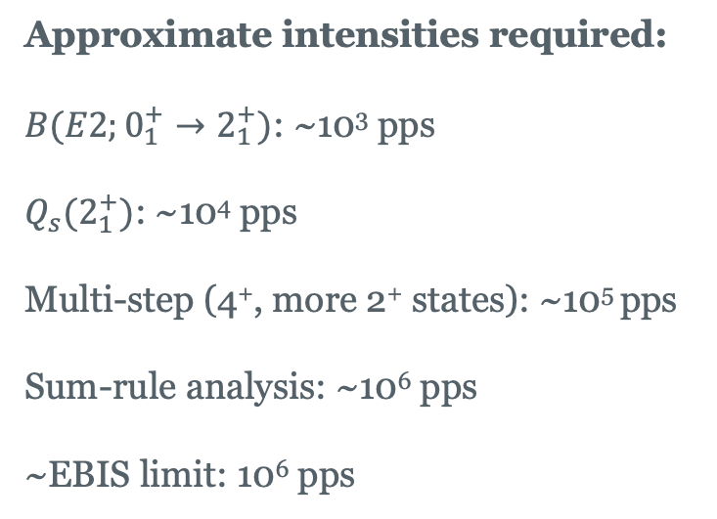
Why Coulomb excitation?
M. Zielinska et al. Eur. J. Phys. A 52 99 (2016)
Approximate intensities required:
$B(E2;0_{1}^{+}→2_{1}^{+})$: ~10³ pps
$Q_{s}(2_{1}^{+})$: ~10⁴ pps
Multi-step (4⁺, more 2⁺ states): ~10⁵ pps
Sum-rule analysis: ~10⁶ pps
~EBIS limit: 10⁶ pps

Slide 10
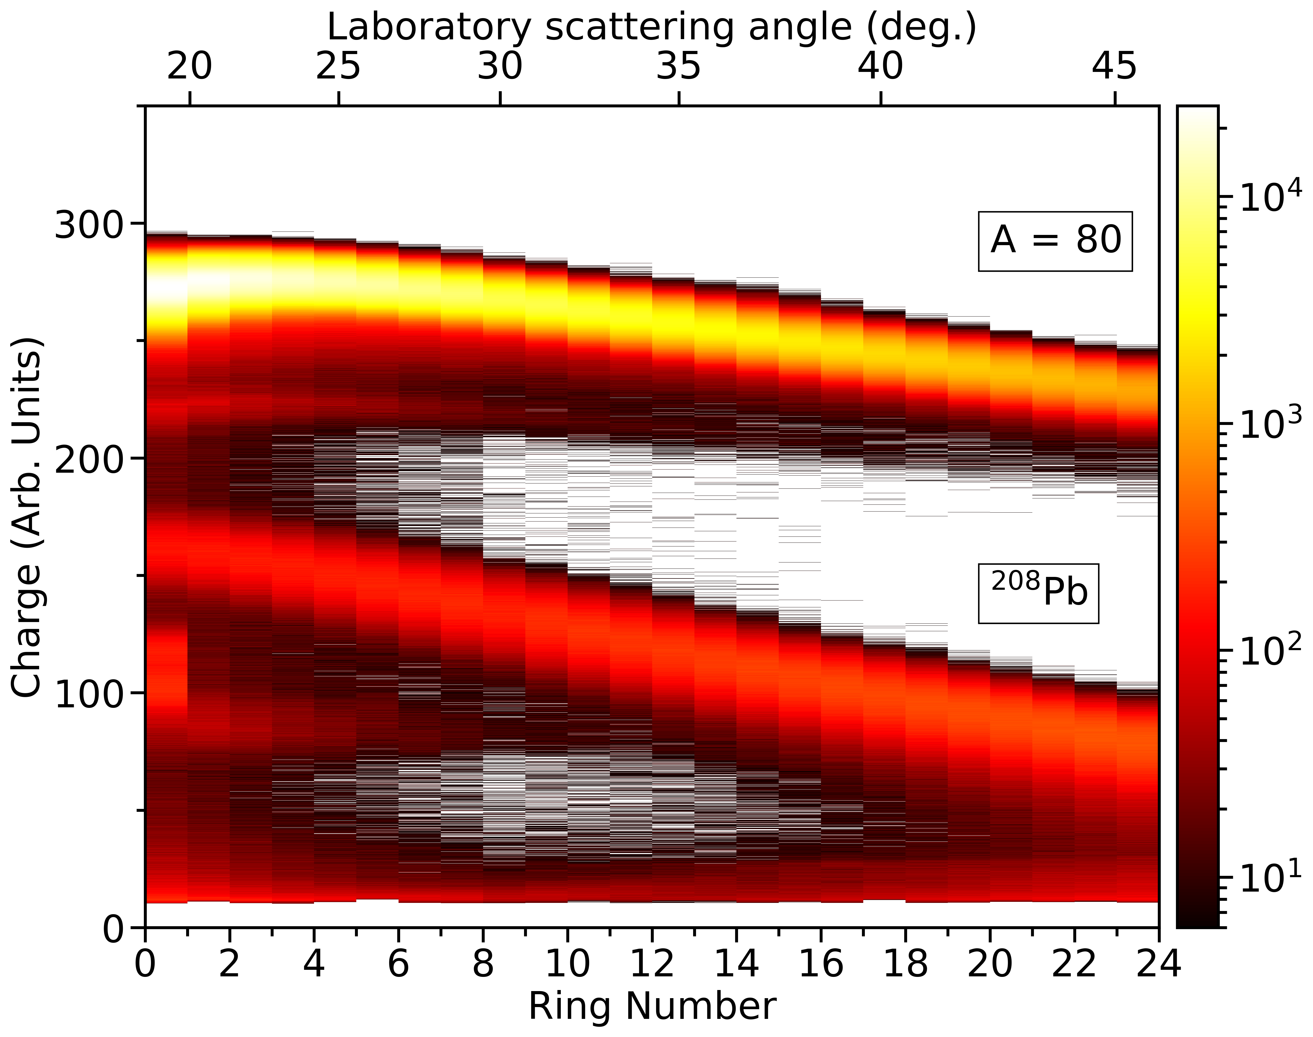
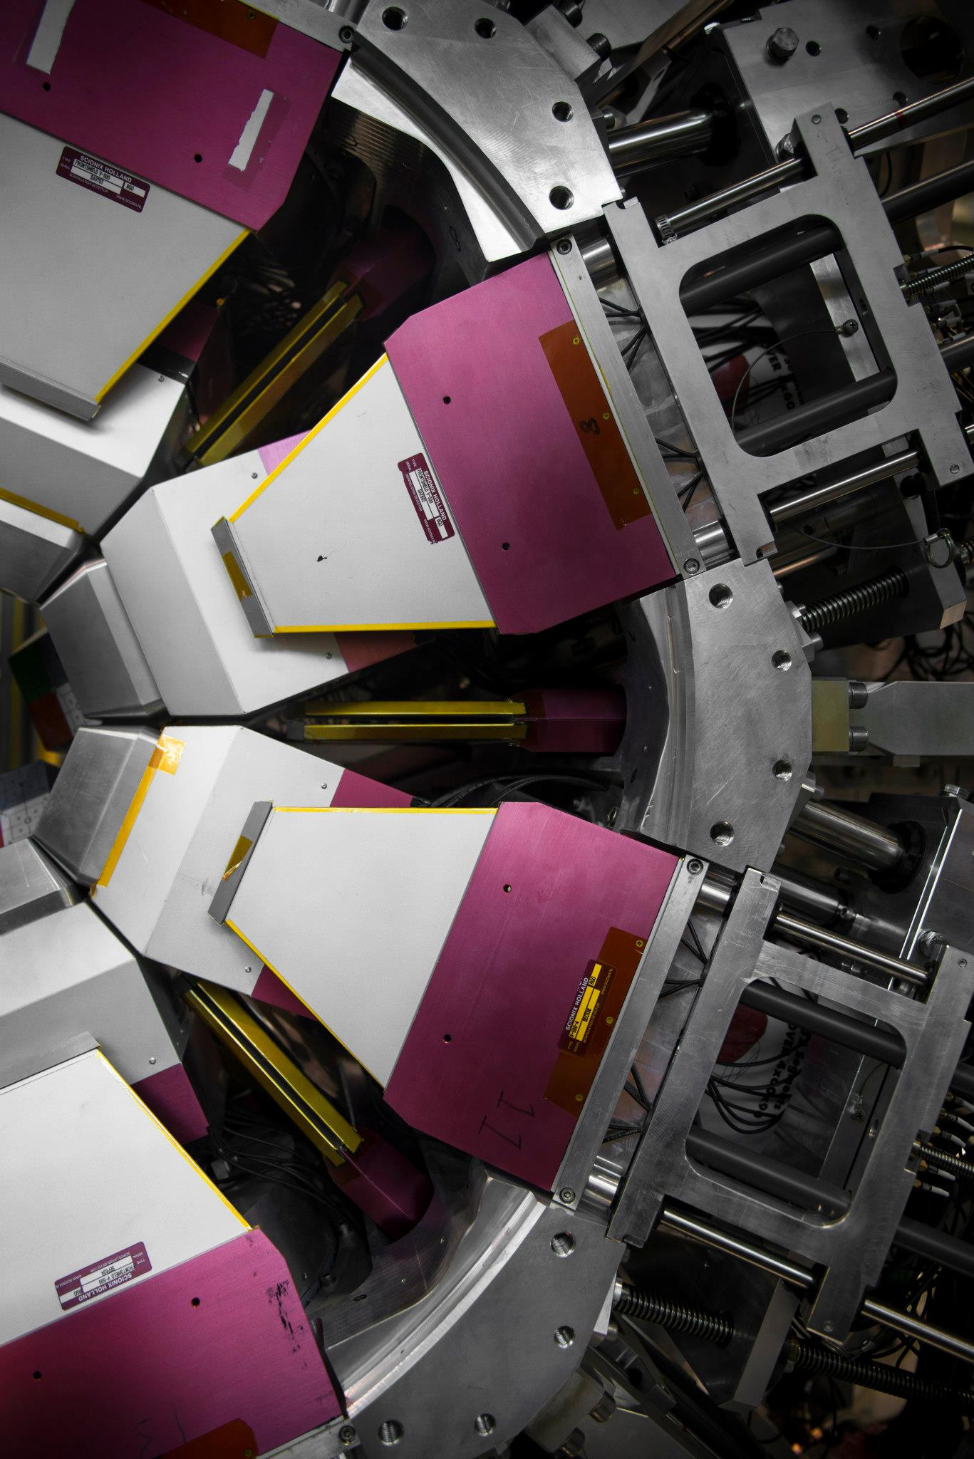
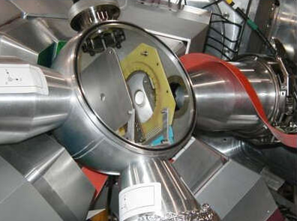
TIGRESS and BAMBINO
Target
Beam
TIGRESS + BAMBINO

Slide 11
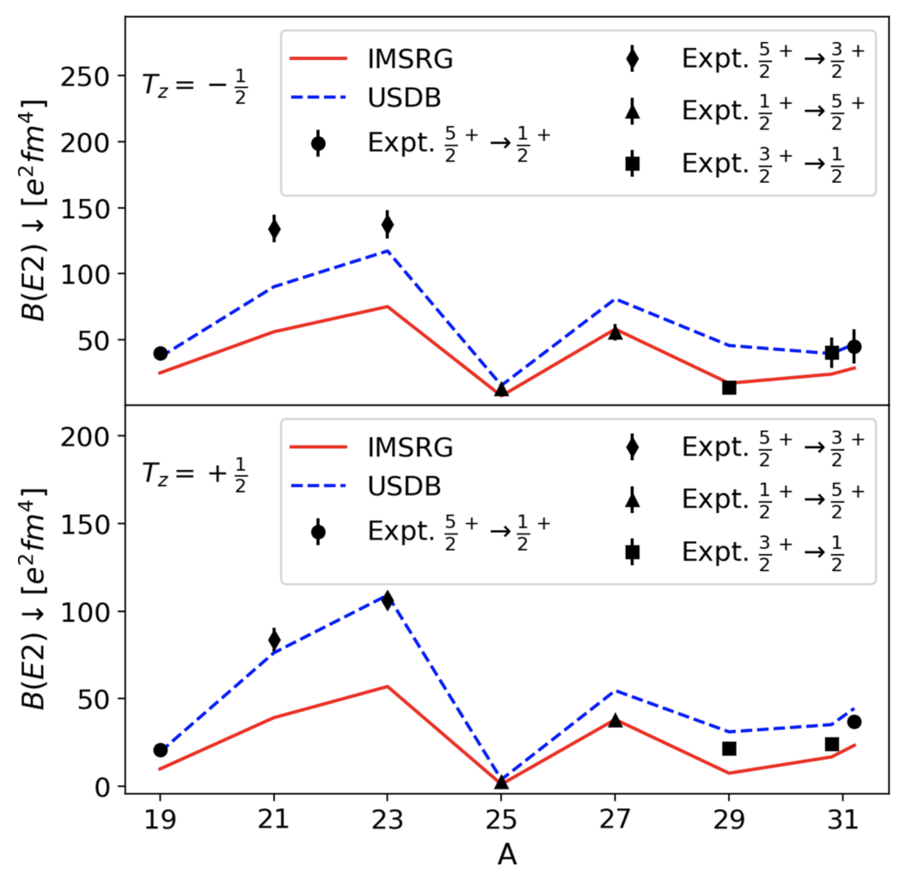
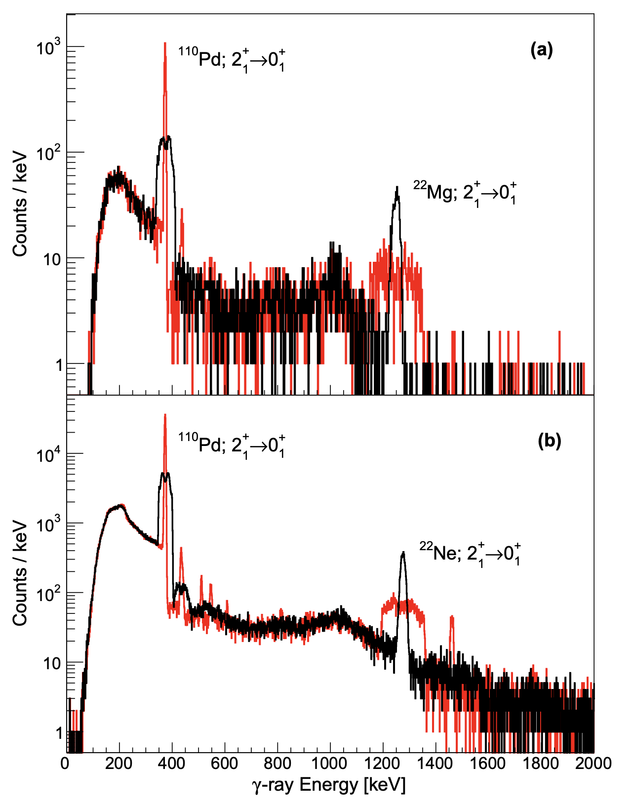
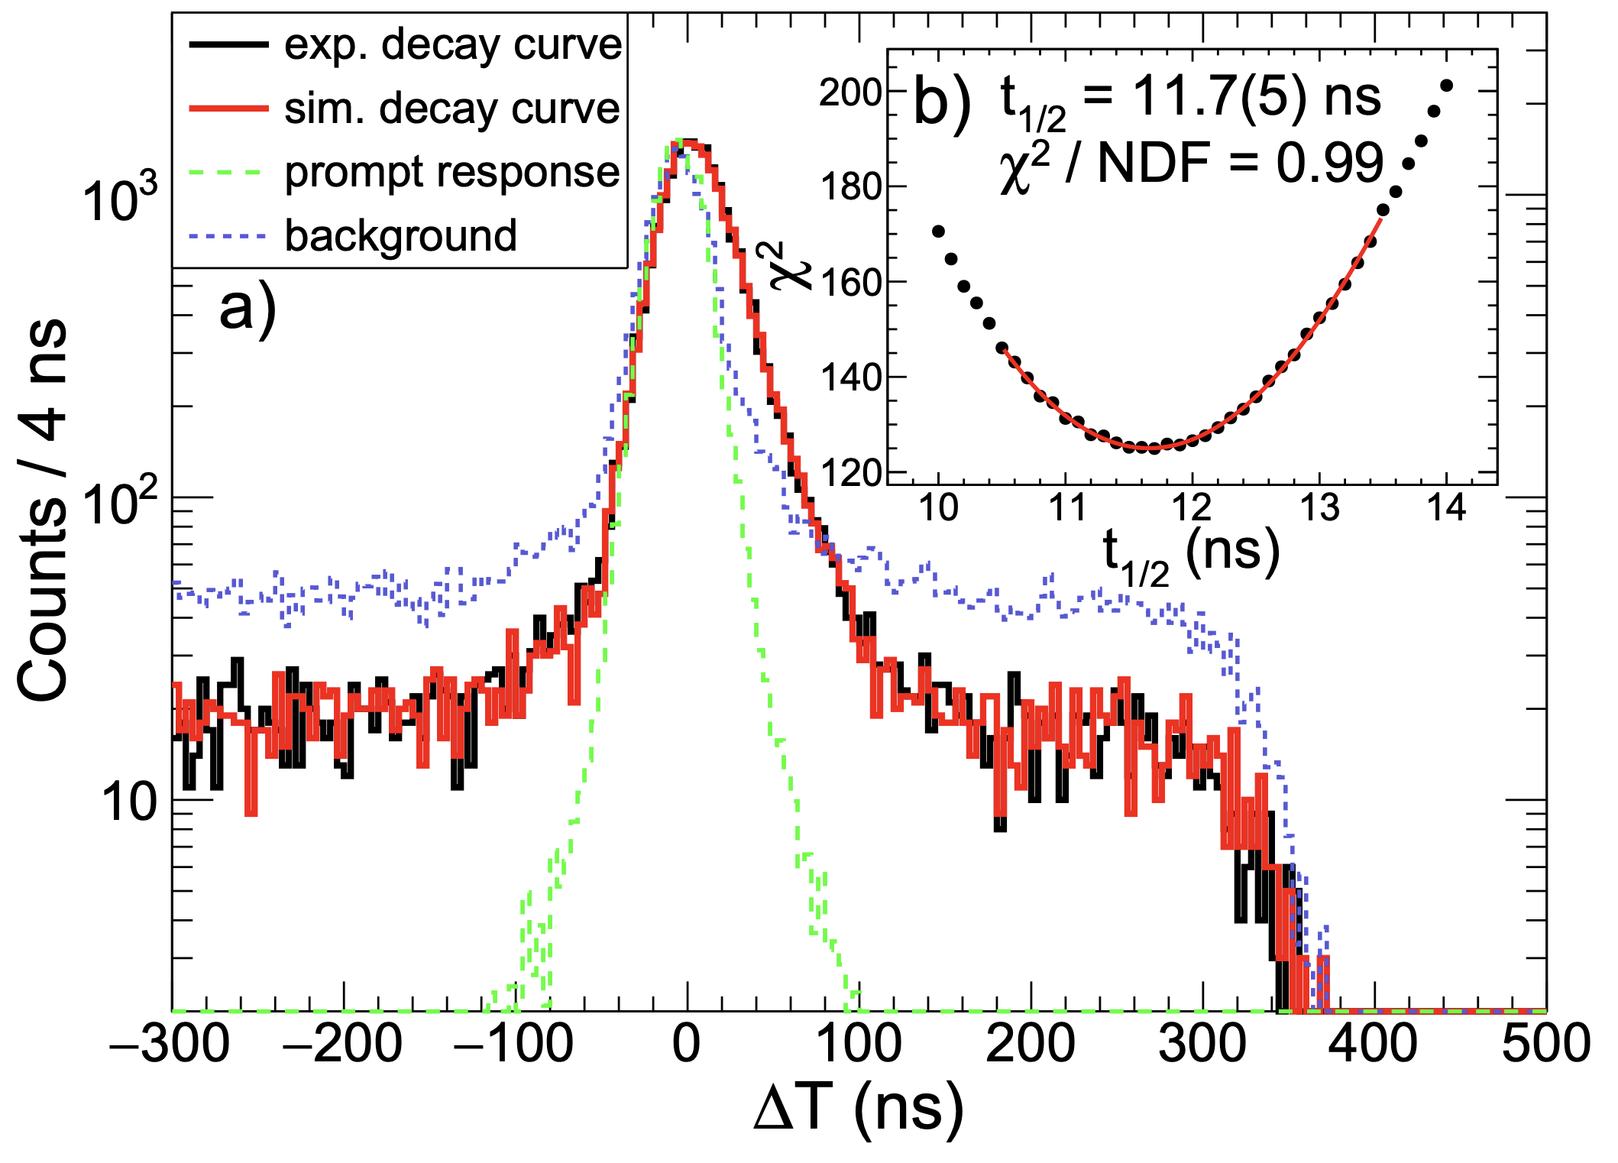
(Some) Past results
Tests of ab initio theory:
²¹Mg [Ruotsalainen PRC 2019]
²²Mg/²²Ne [JH PLB 2018]
²³Mg/²³Na [JH PRC 2022]
¹⁰Be [Orce PRC 2021]
¹²C [Raju PLB 2018]
Shape-coexistence/evolution:
^{80,82}Sr [Russell PRC 2025]
^{78,80,82,(84,86)}Kr [Gillespie PRC 2021]
⁹⁶Sr
^{84m}Rb, ⁸⁴Sr
²⁹Na [Hurst PLB 2012]
Rare-earth:
^{156,158,160}Er

Slide 12
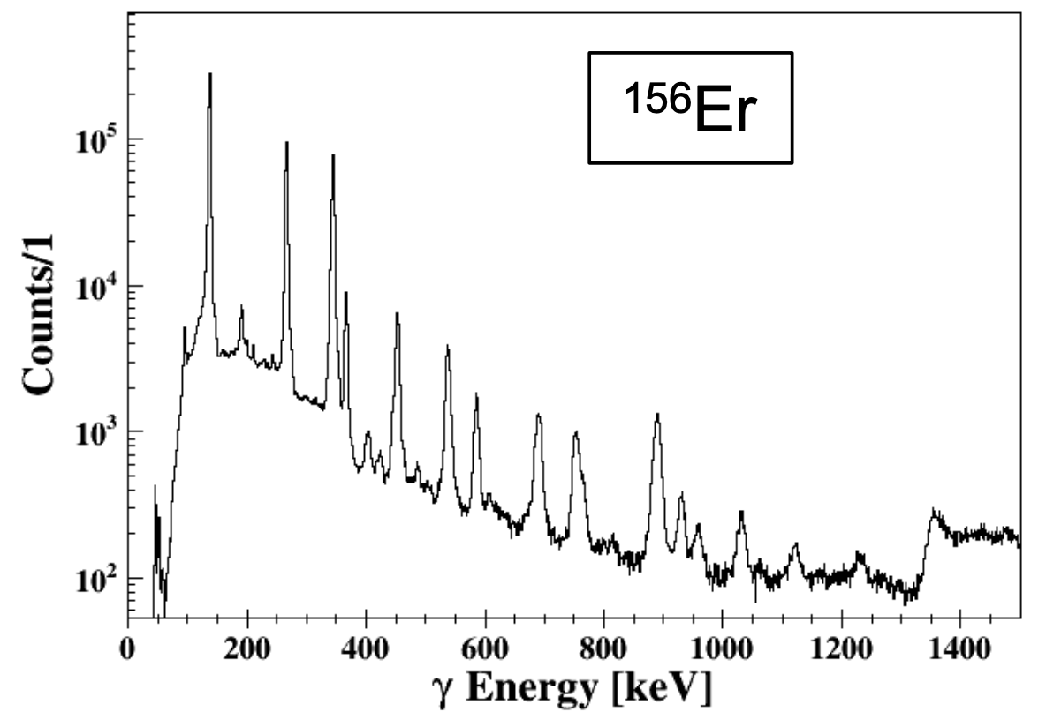
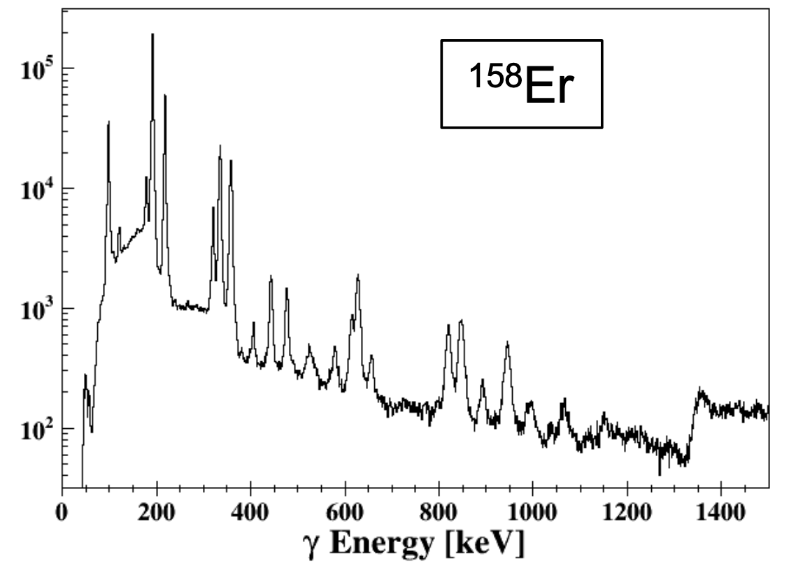
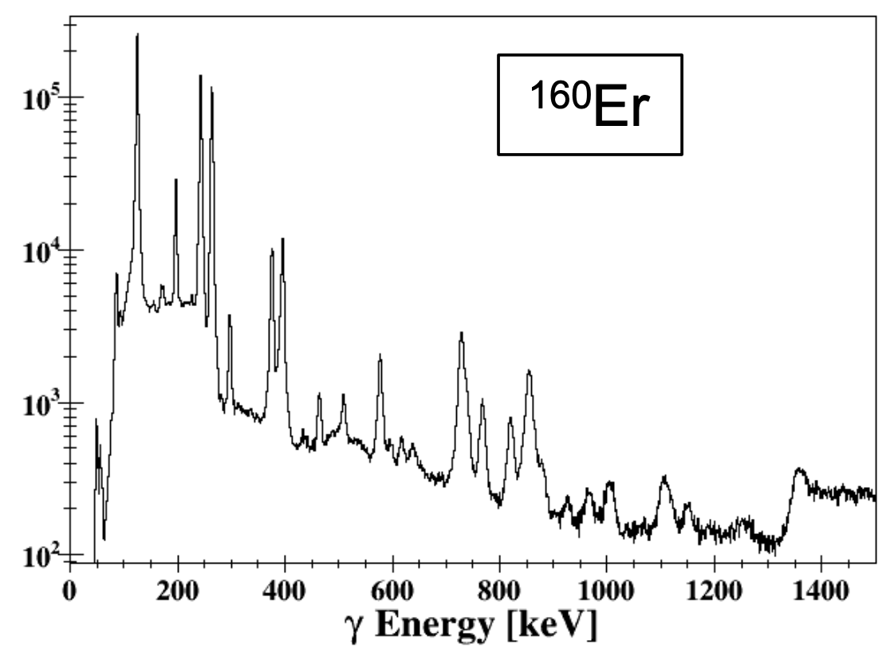
(Some) Past results
Tests of ab initio theory:
²¹Mg [Ruotsalainen PRC 2019]
²²Mg/²²Ne [JH PLB 2018]
²³Mg/²³Na [JH PRC 2022]
¹⁰Be [Orce PRC 2021]
¹²C [Raju PLB 2018]
Shape-coexistence/evolution:
^{80,82}Sr [Russell PRC 2025]
^{78,80,82,(84,86)}Kr [Gillespie PRC 2021]
⁹⁶Sr
^{84m}Rb, ⁸⁴Sr
²⁹Na [Hurst PLB 2012]
Rare-earth:
^{156,158,160}Er

Slide 13
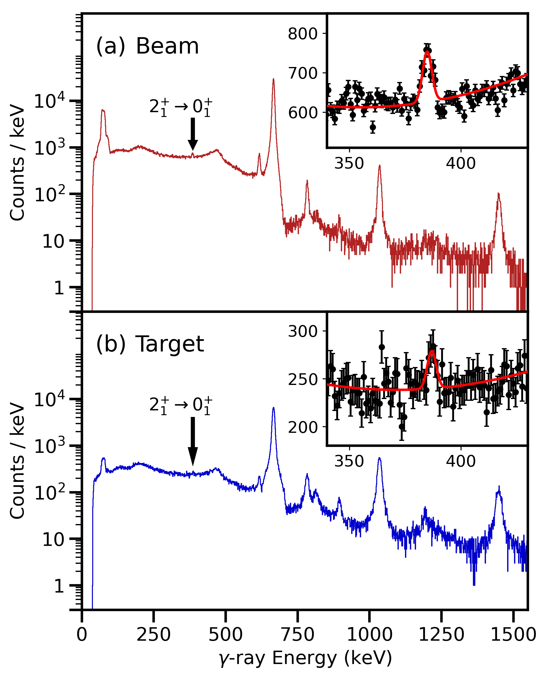
(Some) Past results
Tests of ab initio theory:
²¹Mg [Ruotsalainen PRC 2019]
²²Mg/²²Ne [JH PLB 2018]
²³Mg/²³Na [JH PRC 2022]
¹⁰Be [Orce PRC 2021]
¹²C [Raju PLB 2018]
Current limitation(s):
Charge breeding efficiency,
Cleanliness
IG-LIS useful but CSB contaminants (often) a bigger problem
Shape-coexistence/evolution:
^{80,82}Sr [Russell PRC 2025]
^{78,80,82,(84,86)}Kr [Gillespie PRC 2021]
⁹⁶Sr
^{84m}Rb, ⁸⁴Sr
²⁹Na [Hurst PLB 2012]
Rare-earth:
^{156,158,160}Er

Slide 14
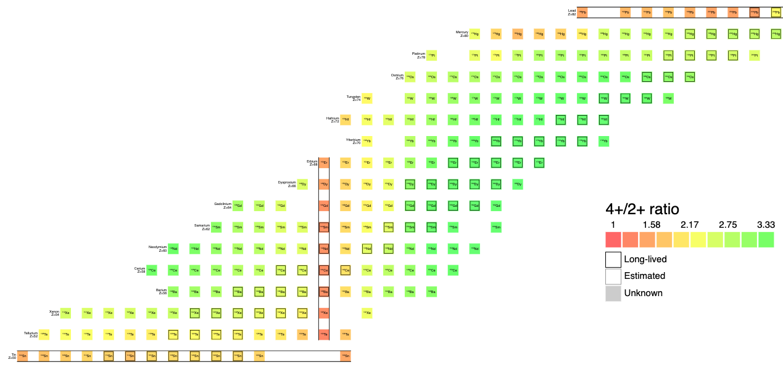
The future?
Rare-earth region:
Well-produced and extracted from ISOL targets
Two significant regions of shape evolution
[neutron-deficient quasi-SU(3) & N=90]
Well-matched to complementary GRIFFIN studies
[e.g., Smallcombe S1716]
… but
Needs IG-LIS to suppress neighbours
Needs efficient charge-breeding to compensate for IG-LIS losses
Needs additional spectroscopy to guide complex analyses
14

Slide 15
The future?
Neutron-deficient quasi-SU(3) region
Neutron-deficient Sr and Kr isotopes (should be) good for ISOL facilities
fp-gds interactions drive exceptional degrees of deformation
[Ha, Nature Comms 2025]
Matrix element analysis essential to understand drivers (what is the shape?)
… but
Needs IG-LIS to suppress neighbours
Needs efficient charge-breeding to compensate for IG-LIS losses
Needs to be competitive with alternative extraction methods (e.g. ReA@FRIB)
15

Slide 16
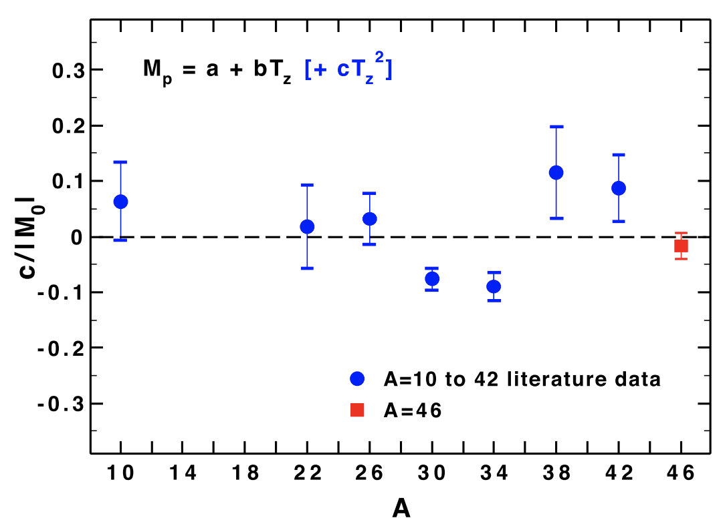
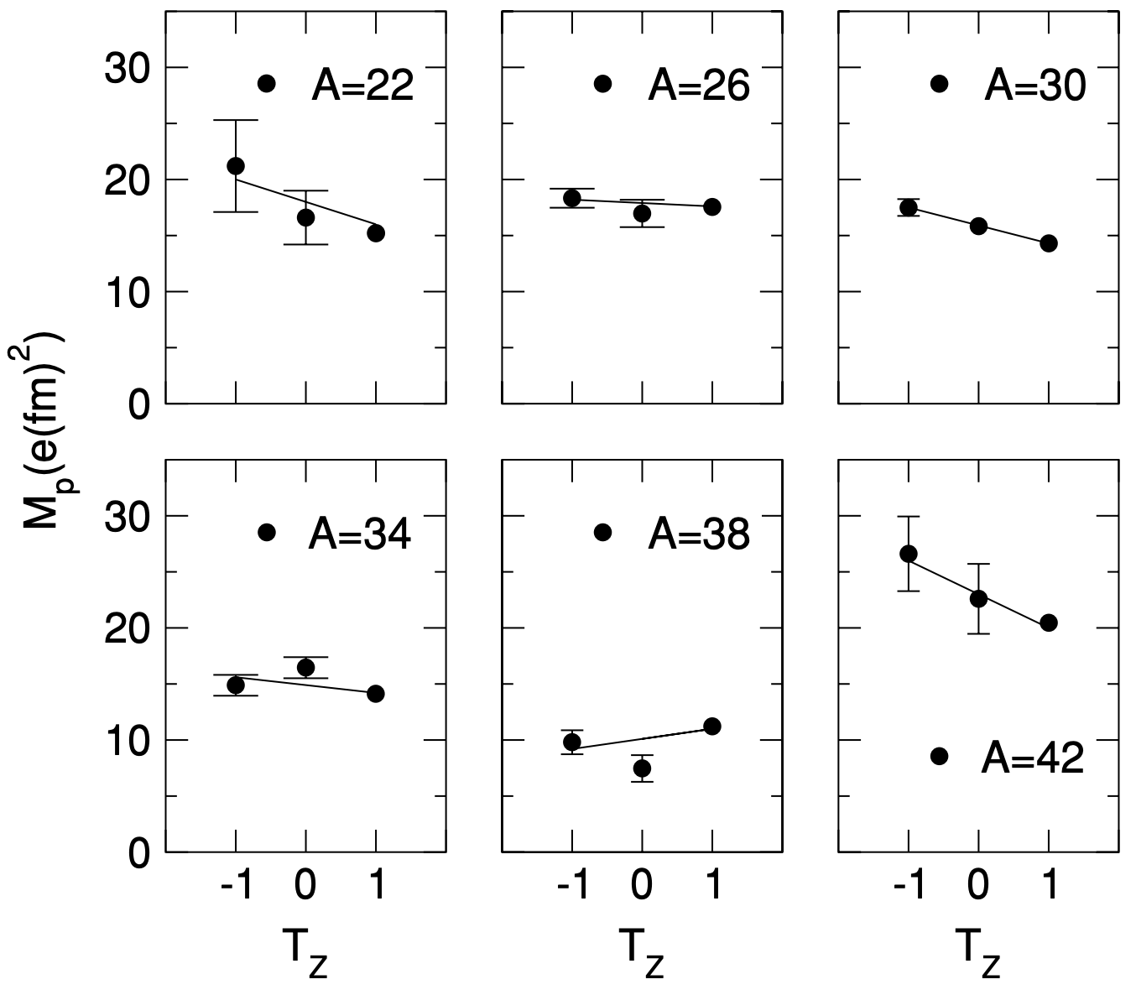
The future?
Boso et al. PLB 2019
Push towards N=Z (esp. odd-odd)
Odd-odd N=Z nuclei some of the most curious in the nuclear landscape
Sensitive to isospin dependence through matrix elements
Isospin mixing effects also important
… and everything is enhanced by p-n overlaps
… but
Beyond A~26 (i.e. ³⁴Cl and ³⁸K) need efficient charge breeding
Needs extraction methods for … tricky… elements (i.e., Cl)
Needs to be competitive with alternative extraction methods (e.g. ReA@FRIB)
Prados Estevez et al. PRC 2007

Slide 17
Conclusions
Coulomb excitation with TIGRESS @ ISAC-II has been a successful research programme, working strongly in the sd-shell
A future programme needs access to mid- and high-mass nuclei, with good charge breeding efficiency and selective extraction to be competitive with alternatives
Potential areas of future investigations include…
Rare-earth nuclei,
Neutron-deficient mid-mass systems,
Heavier systems? [Actinides?]
Investigations of precision B(E2) measurements could be enabled with additional technology
17

Slide 18
Conclusions
Coulomb excitation with TIGRESS @ ISAC-II has been a successful research programme, working strongly in the sd-shell
A future programme needs access to mid- and high-mass nuclei, with good charge breeding efficiency and selective extraction to be competitive with alternatives
Potential areas of future investigations include…
Rare-earth nuclei,
Neutron-deficient mid-mass systems,
Heavier systems? [Actinides?]
Investigations of precision B(E2) measurements could be enabled with additional technology
An active Coulomb-excitation programme would be highly complementary to an investment in a ScRIT-like electron-scattering facility.
Targeted investigations of key nuclei to provide comprehensive measurements of their deformation parameters.
18

