Slide 1

Activities in Fundamental Symmetries and Astrophysics at Central Michigan University
Matthew Redshaw & Alfredo Estrace
Central Michigan University
TRIUMF ARIEL Science Workshop 2026
Vancouver, BC
Wednesday April 21st 2026

Slide 2
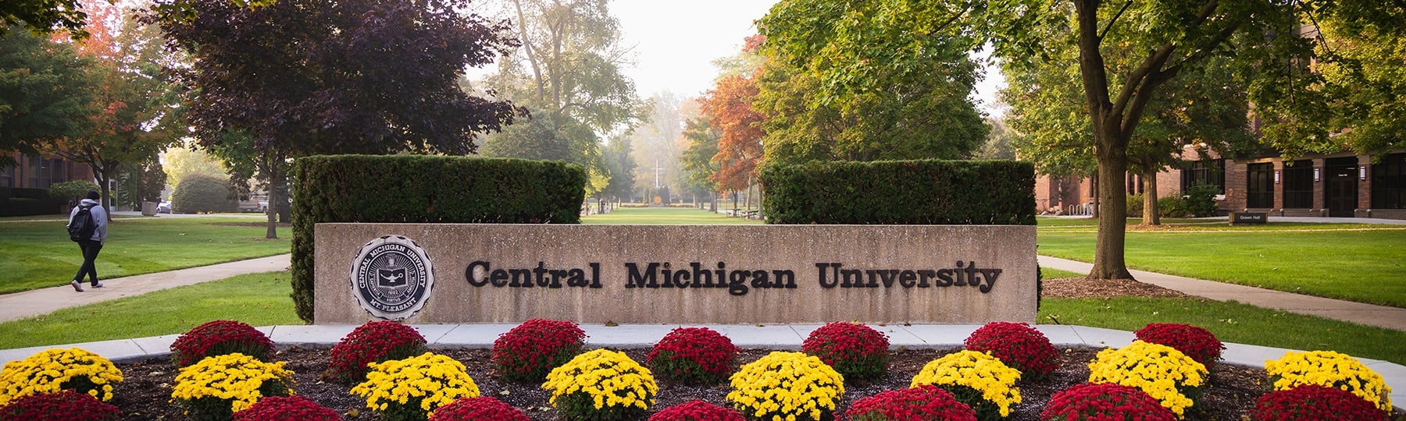
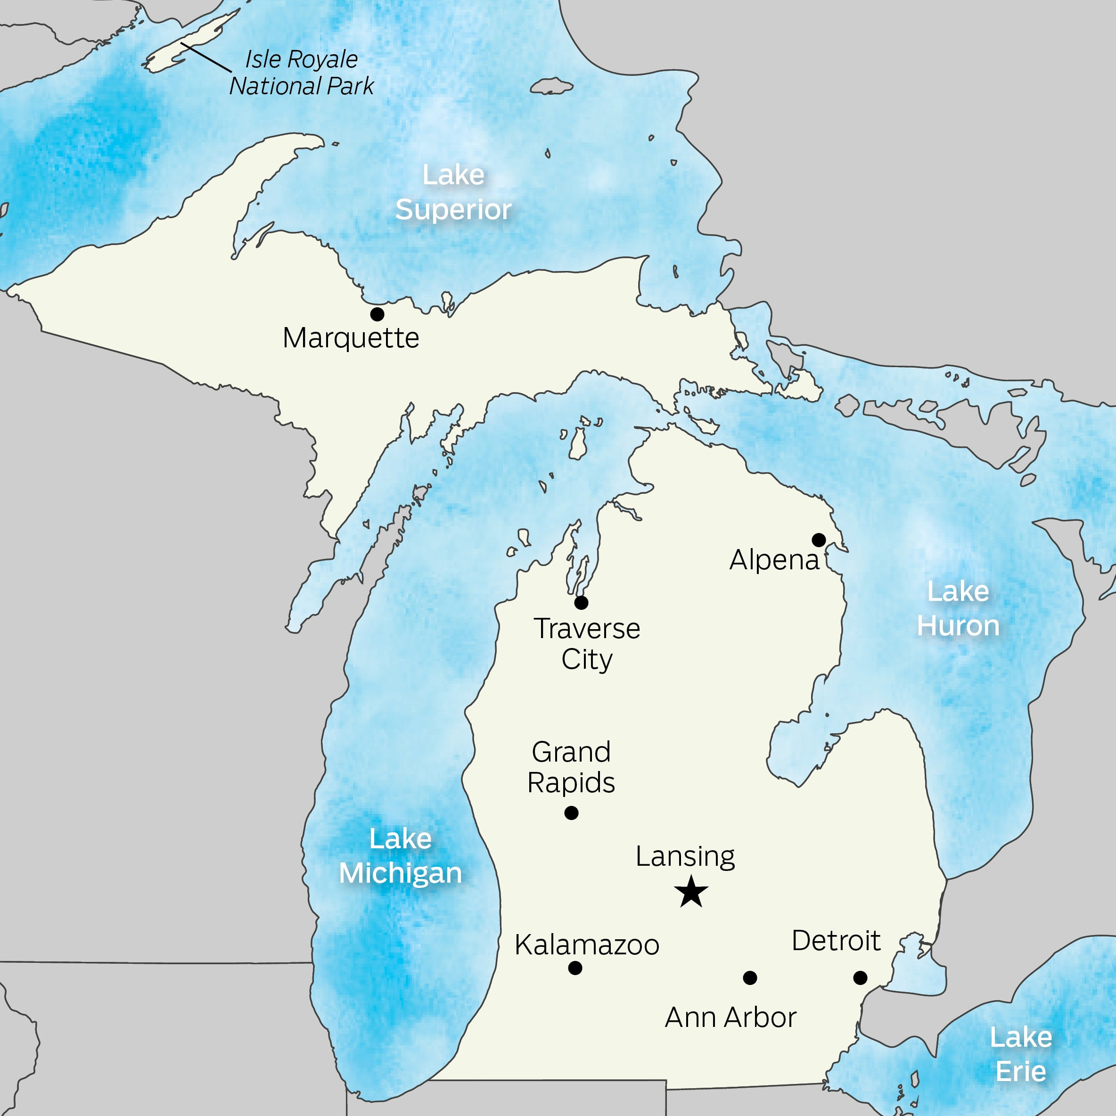

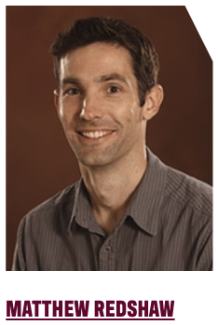
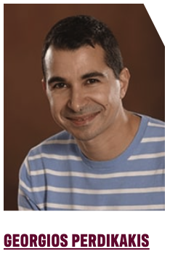
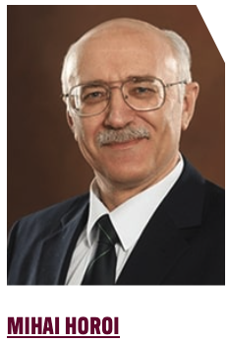
Central Michigan University (the other CMU)
CMU
1 hr
4 hr
FRIB
ANL
Nuclear Astrophysics
Fundamental Symmetries
Nuclear Structure & Astrophysics
Nuclear Theory

Slide 3
Fundamental Symmetries
& Neutrino Physics

Slide 4
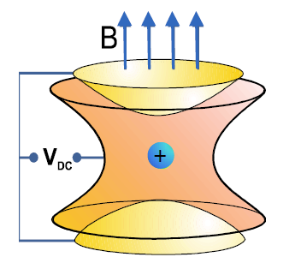
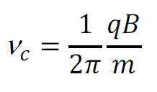


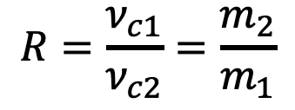

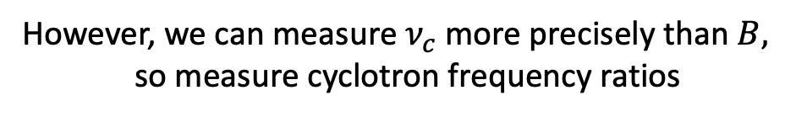

Penning Trap Measurements of Q values
However, we can measure $ν_{c}$ more precisely than $B,$
so measure cyclotron frequency ratios
The Penning trap
Uniform B-Field
Quadrupole E-Field
$$R=\frac{ν_{c1}}{ν_{c2}}=\frac{m_{2}}{m_{1}}$$
Do this for ions of parent, 1 → P, and daughter, 2 → D.
Convert mass ratio to a mass difference
+
+
$Q=\left(M_{P}−M_{D}\right)c^{2}={(M}_{P}−m_{e})(1−R)$ $c^{2}$
ν_{c} = cyclotron frequency
m = mass
q = charge
B = magnetic field strength
$$Q_{β^{−}}^{gs}=\left(M_{X}−M_{Y}\right)c^{2}$$
Measure cyclotron frequency to determine mass
$$Q_{EC}^{gs}=\left(M_{X}−M_{Y}\right)c^{2}$$

Slide 5
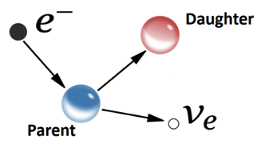
Q values for Fundamental Symmetries & $ν$ Physics
Tests of CKM Matrix Unitarity
Superallowed 𝛽-decays
T = ½ Mirror Nuclei Mixed 𝛽-decays
Neutrino Physics
0𝜈𝛽𝛽 and 0𝜈EC
Sterile 𝜈 searches
Direct 𝜈 mass measurements
Ultra-low Q value decays

Slide 6
Q values for Fundamental Symmetries & $ν$ Physics
Tests of CKM Matrix Unitarity
Superallowed 𝛽-decays
T = ½ Mirror Nuclei Mixed 𝛽-decays
Neutrino Physics
0𝜈𝛽𝛽 and 0𝜈EC
Sterile 𝜈 searches
Direct 𝜈 mass measurements
Ultra-low Q value decays

Slide 7
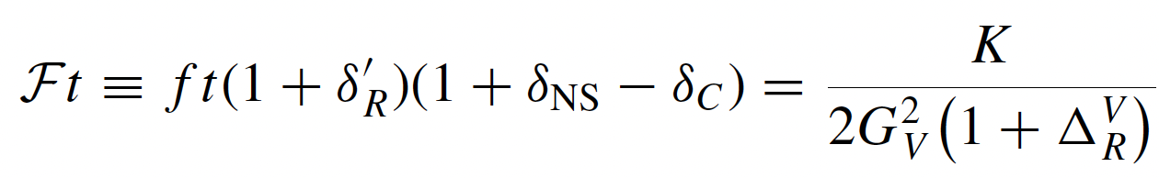
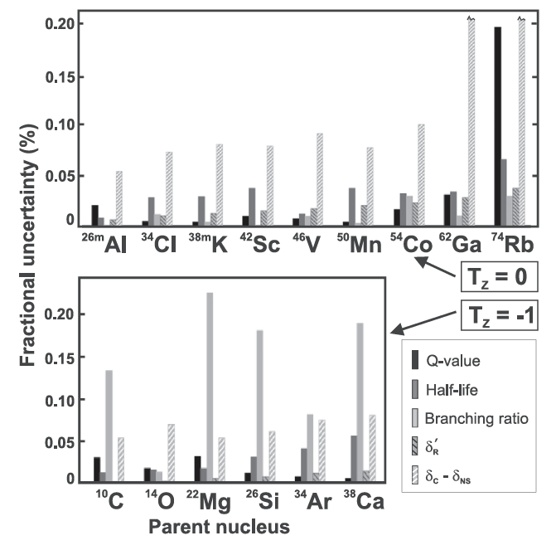
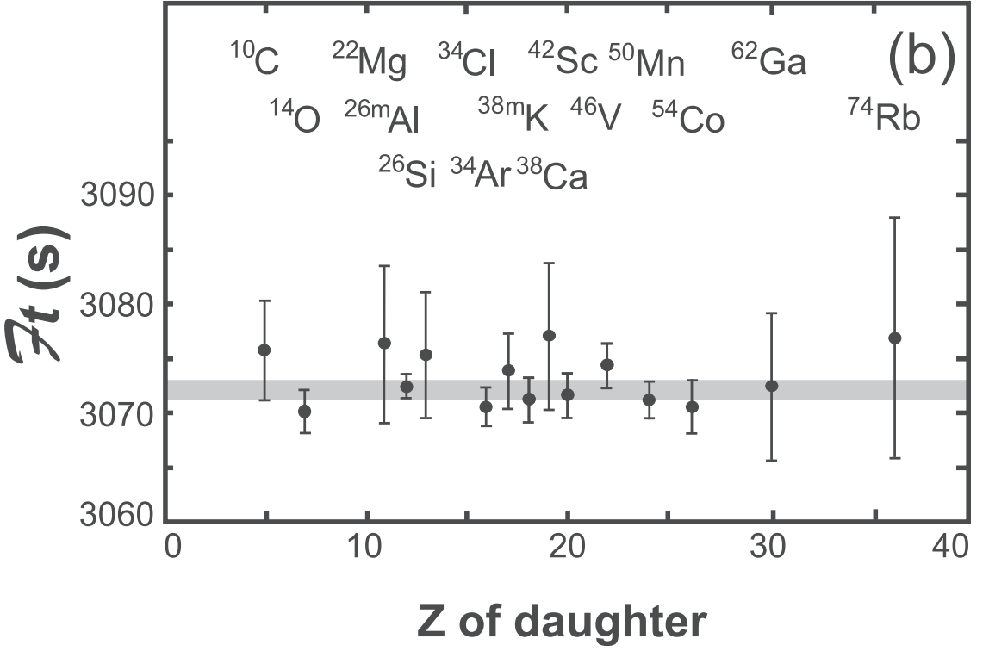
CKM Matrix Unitarity: Superallowed 𝛃-decay
$Q_{EC}$ enters into statistical rate function calculation
Only ⁷⁴Rb remains as nuclide with significant Q value uncertainty
Towner and Hardy, PRC 102, 045501 (2020)

Slide 8
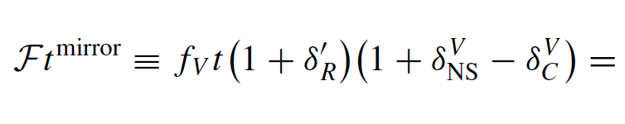
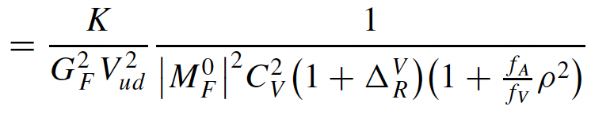
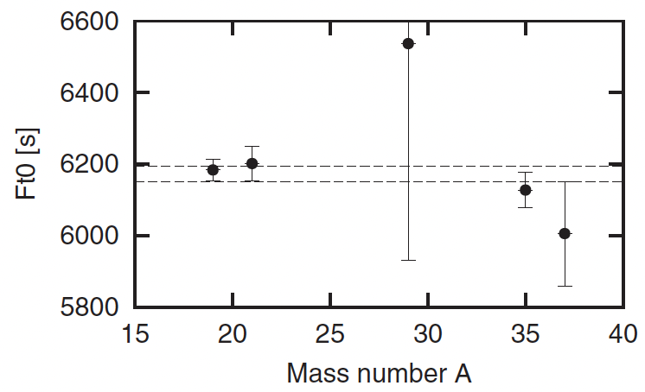
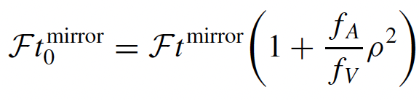
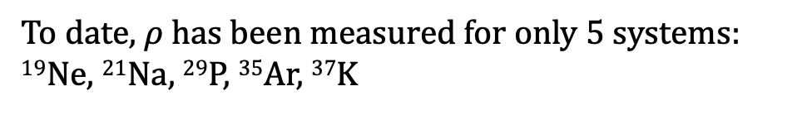
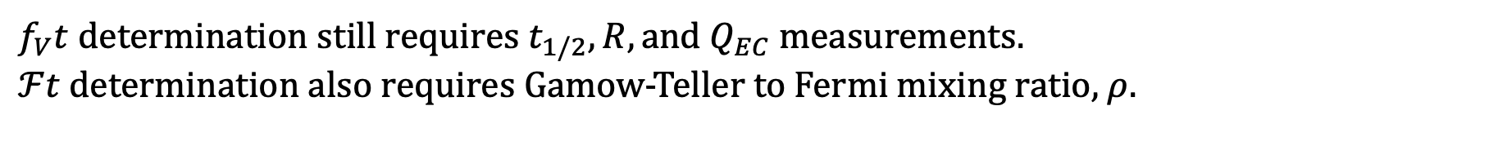
CKM Matrix Unitarity: T = ½ Mirror Nuclei Decays
T = ½ mirror nuclei decays:
Decays between $T=\frac{1}{2},\frac{1}{2}$ integer spin states $⟹$ mixed Fermi/Gamow-Teller transitions
$f_{V}t$ determination still requires $t_{1/2}, R, and Q_{EC}$ measurements.
$ℱt$ determination also requires Gamow-Teller to Fermi mixing ratio, $ρ$.
To date, $ρ$ has been measured for only 5 systems:
¹⁹Ne, ²¹Na, ²⁹P, ³⁵Ar, ³⁷K
²⁹P
¹⁹Ne
³⁵Ar
²¹Na
³⁷K
The Notre Dame St. Benedict group of Maxime Brouder is interested in pursuing precise Q value measurements for Mirror Decay candidates

Slide 9
Q values for Fundamental Symmetries & $ν$ Physics
Tests of CKM Matrix Unitarity
Superallowed 𝛽-decays
T = ½ Mirror Nuclei Mixed 𝛽-decays
Neutrino Physics
0𝜈𝛽𝛽 and 0𝜈EC
Sterile 𝜈 searches
Direct 𝜈 mass measurements
Ultra-low Q value decays

Slide 10
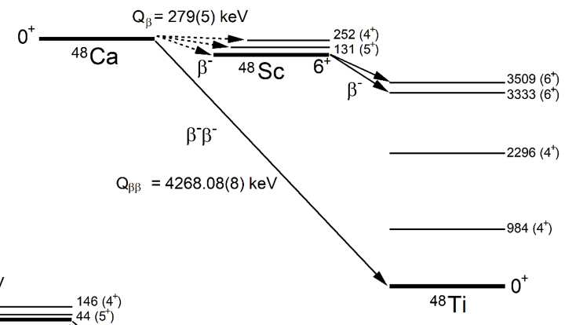
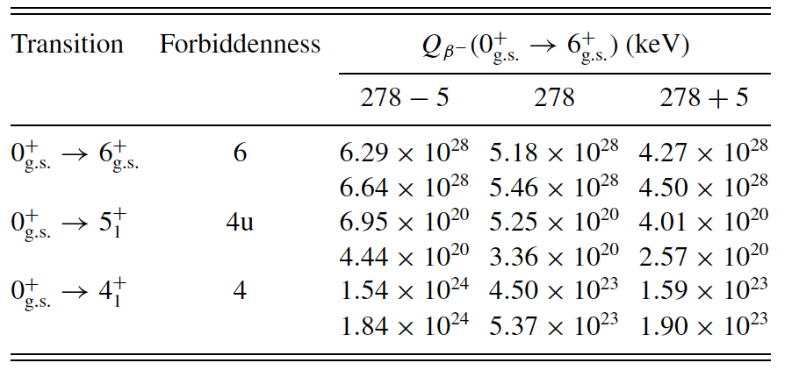
⁴⁸Ca single 𝛃-decay Q value (TITAN @ TRIUMF)
⁴⁸Ca - ⁴⁸Sc Q value measurement with TITAN @ TRIUMF
⁴⁸Ca
⁴⁸Sc
Preliminary result (in preparation):
In agreement with AME Q value
Uncertainty 1 keV
∴ No significant change in calculated single 𝛽-decay lifetime expected

Slide 11
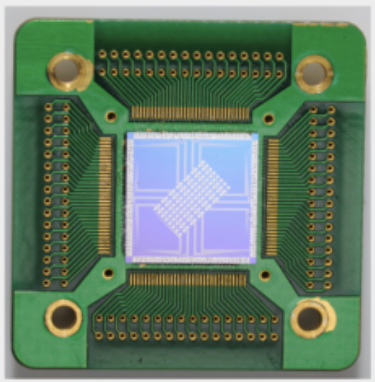
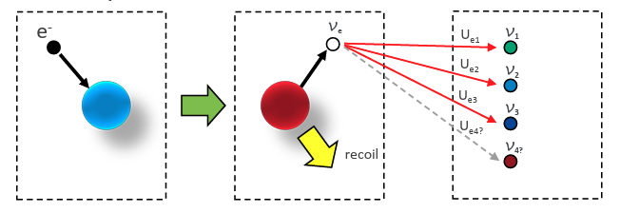

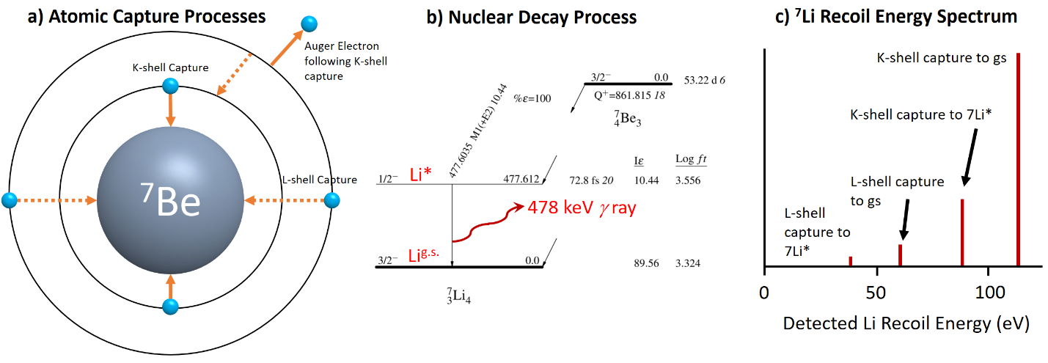
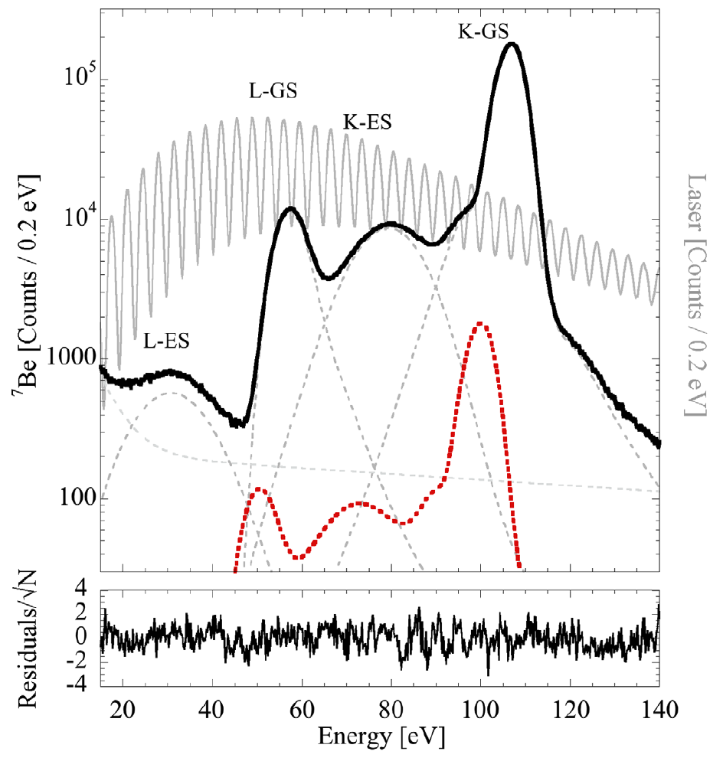


EC Q value of ⁷Be to aid BeEST (LEBIT @ FRIB)
BeEST: Beryllium Electron capture in Superconducting Tunnel junctions
Recoil Energy
$$T_{d}=56.826\left(9\right) eV$$
Limited by $σ_{M({}_{}^{7}{Be})}=70 eV$

Slide 12
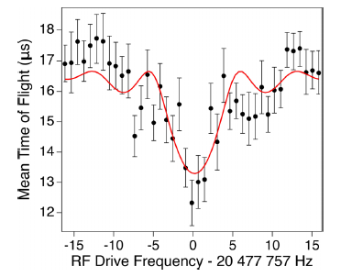
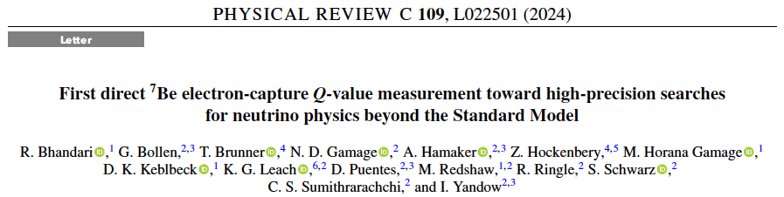
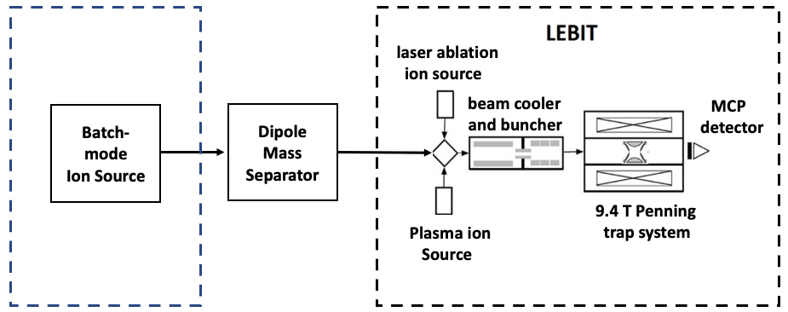
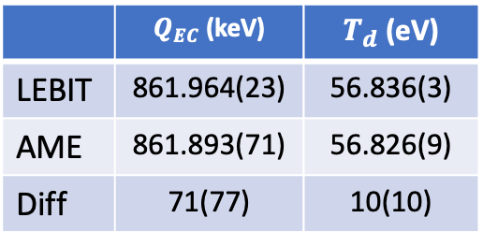
EC Q value of ⁷Be to aid BeEST (LEBIT @ FRIB)
Q-value measured at LEBIT with ⁷Be⁺ beam from BMIS
 | $Q_{EC}$ (keV) | $T_{d}$ (eV)
LEBIT | 861.964(23) | 56.836(3)
AME | 861.893(71) | 56.826(9)
Diff | 71(77) | 10(10)
Reduced uncertainty of ⁷Be Q_{EC} value and ⁷Li recoil energy by factor of 3
Uncertainty in recoil energy similar to that of BeEST Phase I
Future improvements could be needed.

Slide 13
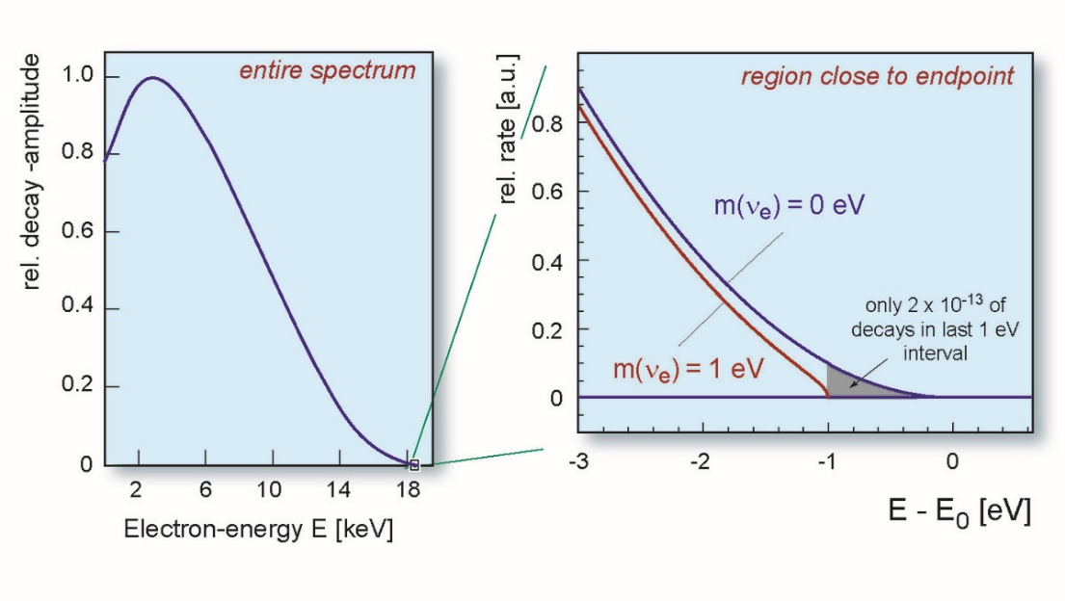



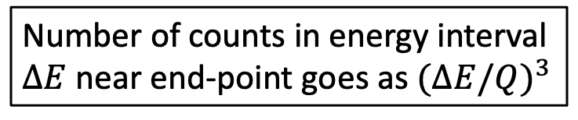
Low Q value 𝛃-decay for 𝜈 mass measurements
Direct neutrino mass measurements
Low Q value β-decays
$${}_{1}^{3}H→{}_{2}^{3}{He}+e^{−}+{\overline{ν}}_{e}$$
Q = 18.592 01(7) keV
$${}_{75}^{187}{Re}→{}_{76}^{187}{Os}+e^{−}+{\overline{ν}}_{e}$$
Q = 2.492(34) keV
$${}_{67}^{163}{Ho}+e^{−}→{}_{66}^{163}{Dy}+ν_{e}$$
Q = 2.863 2(6) keV
g.s. to g.s decays
Number of counts in energy interval $∆E$ near end-point goes as $(∆E/Q)^{3}$

Slide 14
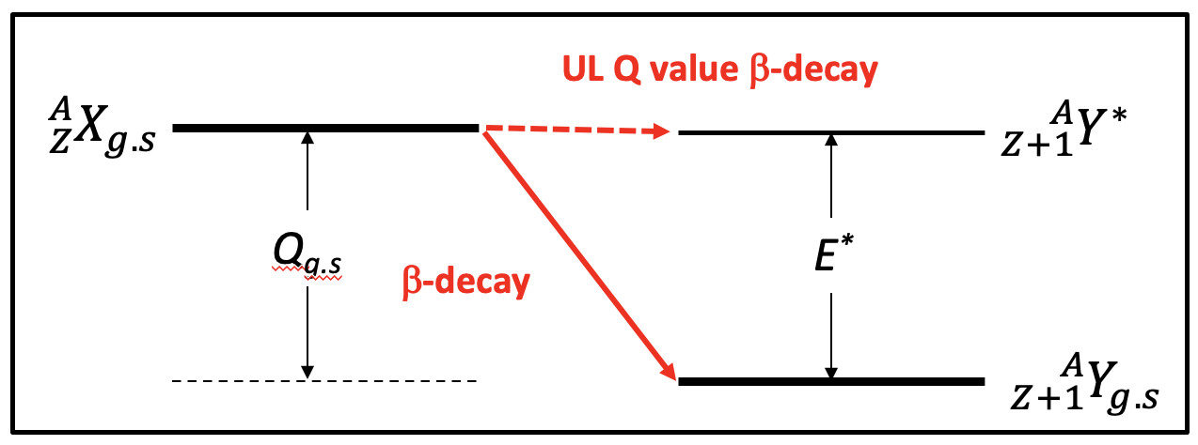
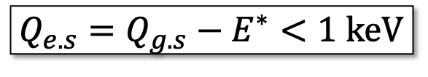

Ultra-low Q value 𝛃-decays
Low Q value β-decays
$${}_{1}^{3}H→{}_{2}^{3}{He}+e^{−}+{\overline{ν}}_{e}$$
Q = 18.592 01(7) keV
$${}_{75}^{187}{Re}→{}_{76}^{187}{Os}+e^{−}+{\overline{ν}}_{e}$$
Q = 2.492(34) keV
$${}_{67}^{163}{Ho}+e^{−}→{}_{66}^{163}{Dy}+ν_{e}$$
Q = 2.863 2(6) keV
$$Q_{e.s}=Q_{g.s}−E^{∗}<1 keV$$
g.s. to g.s. decays
$${}_{49}^{115}{In}→{}_{50}^{115}{{Sn}^{∗}}+e^{−}{+ ν}_{e}$$
Q = 155(24) eV
g.s. to e.s. decays

Slide 15
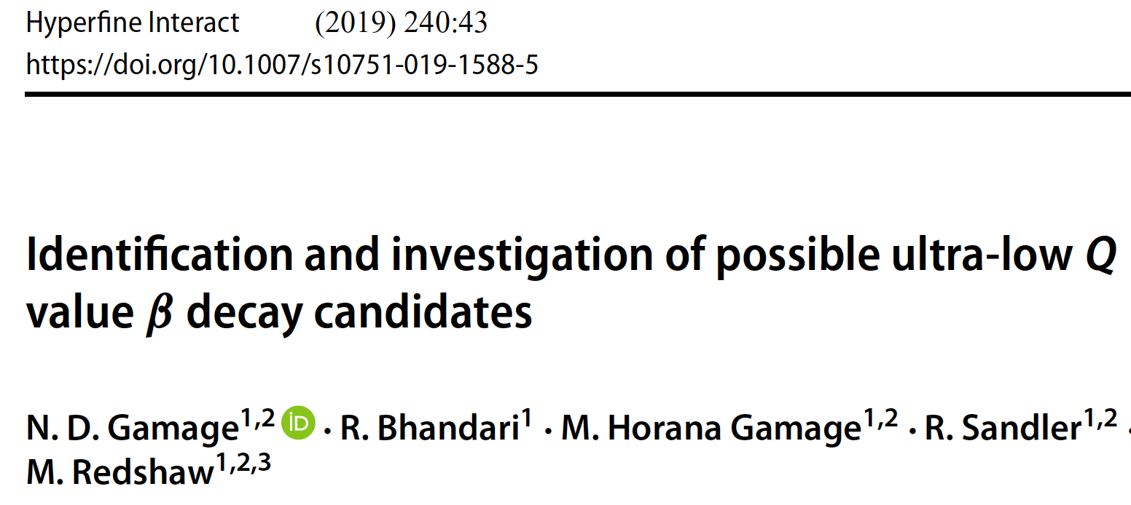
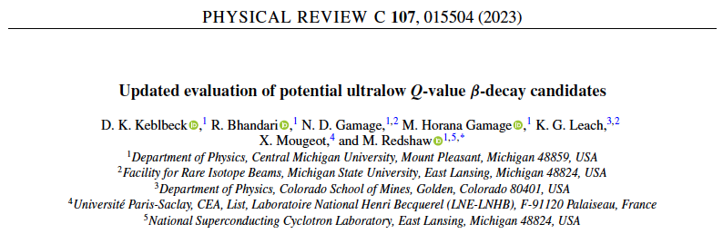
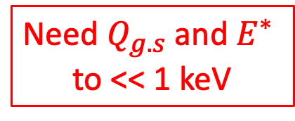
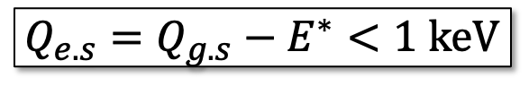
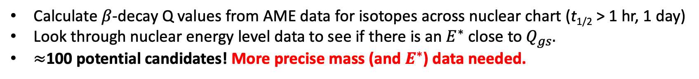
Do other ultra-low Q value 𝛽-decay Candidates exist?
2016 AME Data
2020 AME Data
$$Q_{e.s}=Q_{g.s}−E^{∗}<1 keV$$
Need $Q_{g.s}$ and $E^{∗}$
to << 1 keV
Calculate $β$-decay Q values from AME data for isotopes across nuclear chart (t_{1/2} > 1 hr, 1 day)
Look through nuclear energy level data to see if there is an $E^{∗}$ close to $Q_{gs}.$
$≈$100 potential candidates! More precise mass (and $E^{∗}$) data needed.

Slide 16
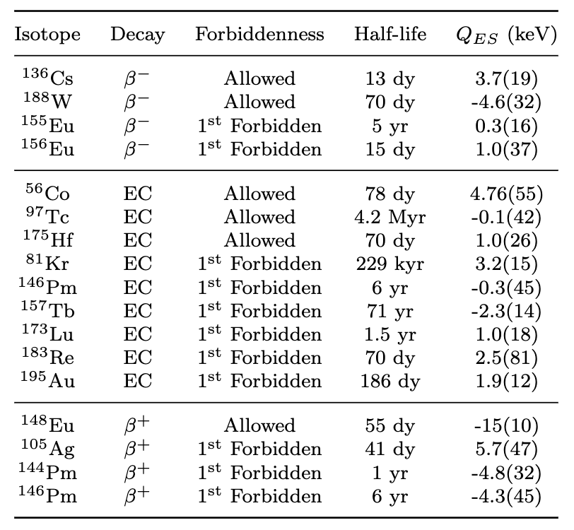
Summary of ULQ value decay candidate searches
LEBIT: Ruled out: ⁸⁹Sr, ¹³⁹Ba, ⁷⁵Ge
Identified: ⁷⁵Se
CPT: Ruled out: ^{112,113}Ag, ¹¹⁵Cd
ISOLTRAP: Ruled out: ¹³¹Cs
JYFLTRAP: Ruled out: ⁷²As, ⁷⁵Ge, ^{76,77}As, ¹³⁶Cs, ¹⁵⁵Tb
Identified: ⁷⁵Se, ¹¹¹In, ¹³¹I, ¹³⁵Cs, ¹⁵⁹Dy
⁹⁵Tc, ^{110m}Ag
ULQ value 𝛽-decays provide interesting opportunities for nuclear theory and possibilities for 𝜈-mass determination experiments.
There are many potential candidates out there, but more precise Q value (mass) data and in some cases, energy level data, is needed.

Slide 17
Astrophysics

Slide 18
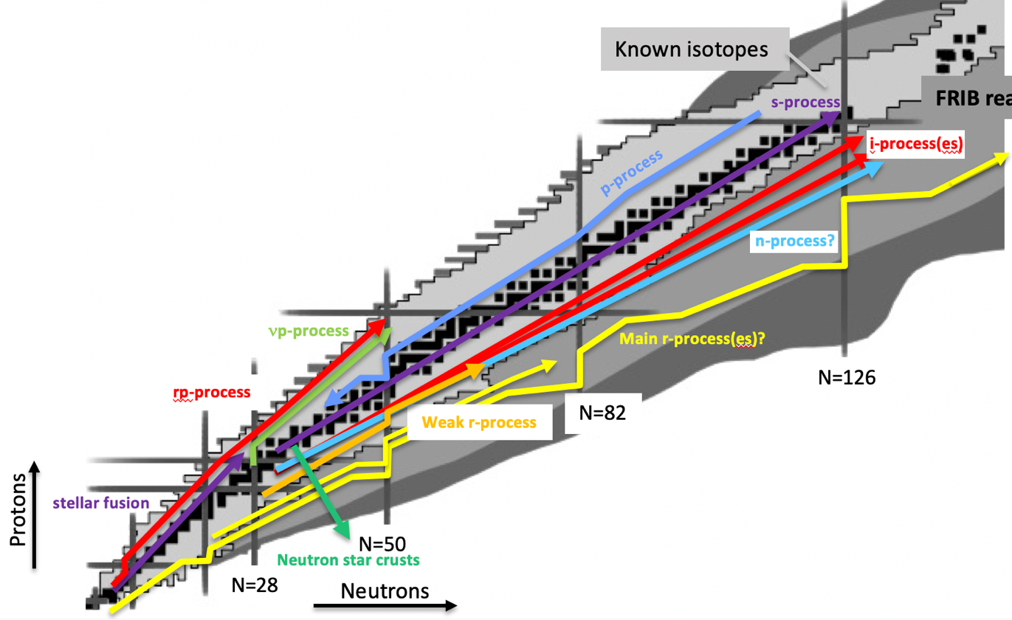
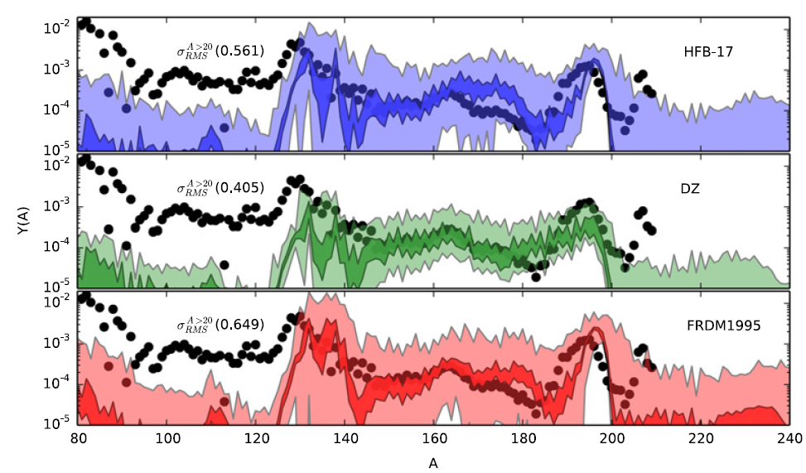
Properties of neutron rich isotopes are key to understand heavy element nucleosynthesis and processes in the crust of neutron stars
ASTRON.
OBSERVATIONS
ASTROPHY.
MODELS
NUCLEAR
DATA
EXP
THEO
Sensitivity study of r-process reaction network calculations to nuclear masses
Horizons: Nuclear Astrophysics in the 2020s and beyond, H. Schatz et al, arXiv:2205.07996
M. Mumpower et al (2015)
Notes:
The group of Alfredo Estrade focuses on measuring masses and beta-decay properties of very neutron rich isotopes, with an emphasis on providing data for astrophysical simulations. There are two main science questions:
1) how nuclear processes in the crust of accreting neutron stars define their thermal properties and composition? (electron capture reactions in the outer crust and more complex reactions paths in the inner crust, like fusion reactions driven by density and so on)
2) how do neutron capture processes in explosive astrophysical scenarios produce heavy elements by the r-process, and what is the footprint of nuclear physics in these processes?

Slide 19
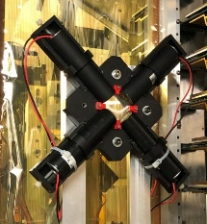
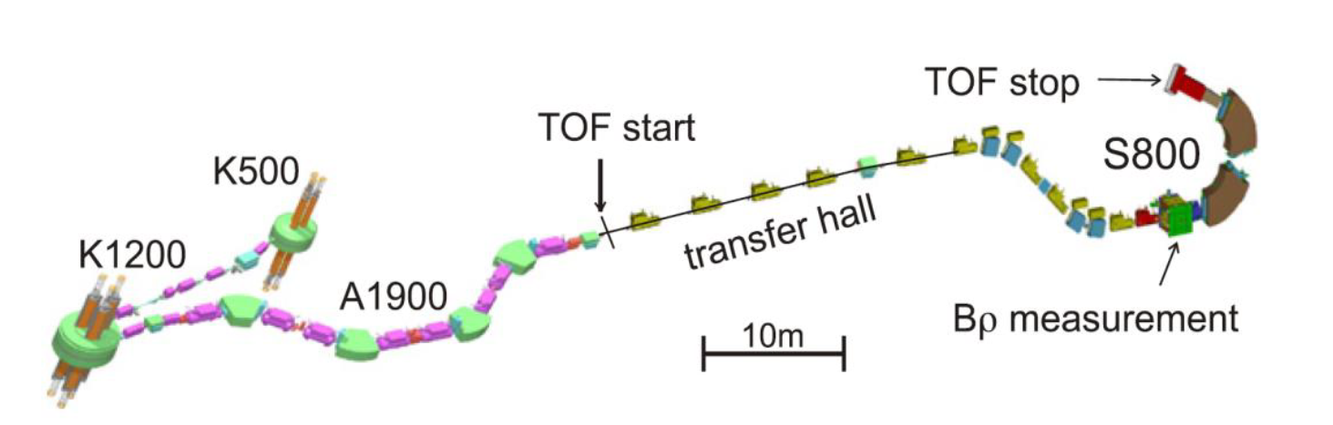
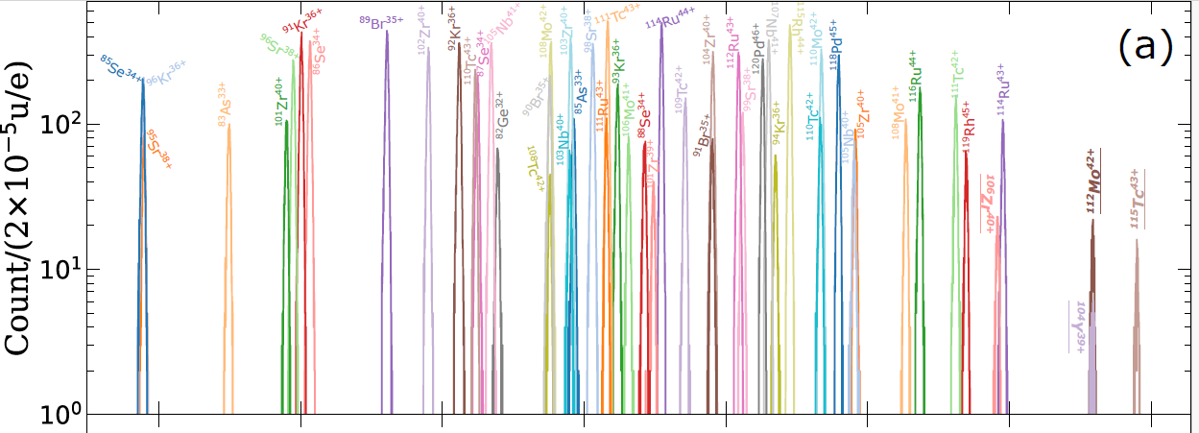
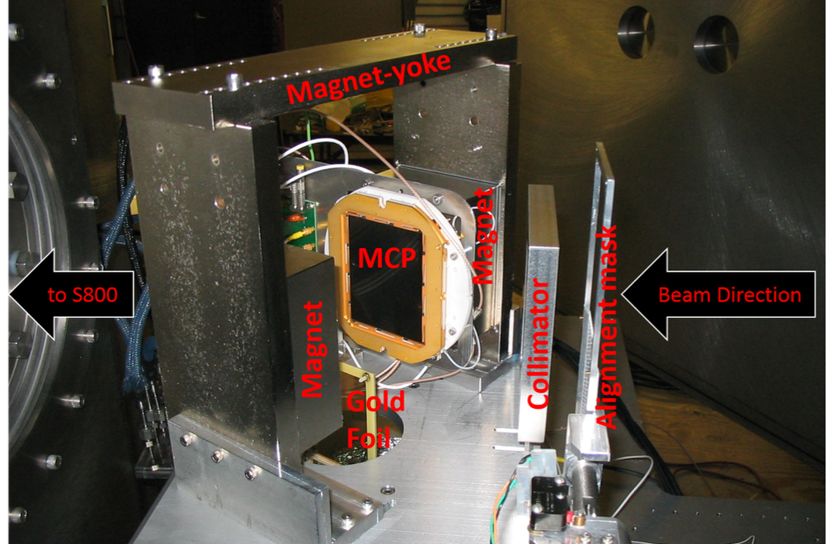
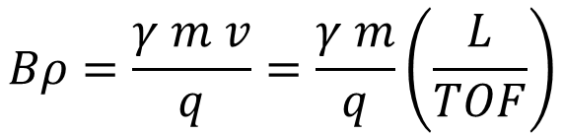
Mass measurements for short-lived nuclei with the TOF-Bρ technique at NSCL and FRIB
FRAGMENT SEPARATOR
$$Bρ=\frac{γ m v}{q}=\frac{γ m}{q}\left(\frac{L}{TOF}\right)$$
production target
time
Bρ
time
Experiments at NSCL focused on neutron star crust physics (N=28 to N=50 region)
Last NSCL experiment expanded to r-process isotopes (Z ~40-45 region) and program will continue at FRIB
Matos et al, NIM 696, 171 (2012)
K. Wang et al, PRC 109, 035806 (2024)
Notes:
We use TOF-Brho technique with the S800 spectrometer to measure the mass of very short-lived isotopes; it’s fast an sensitive to reach short lived isotopes produced as fast beams. With a resolution of ~10,000 we obtain good constraints for masses for astrophysics models (~100 keV uncertainty). At the NSCL we focused on regions important for neutron star crust physics (A~40 to 60). One of the last NSCL experiments (e12022) was a ‘pilot’ measurement that demonstrated we can apply the technique to heavier isotopes, and we will expand the program at FRIB to isotopes interesting to the r-process.
Working on preparations to run the first approved experiment at FRIB

Slide 20
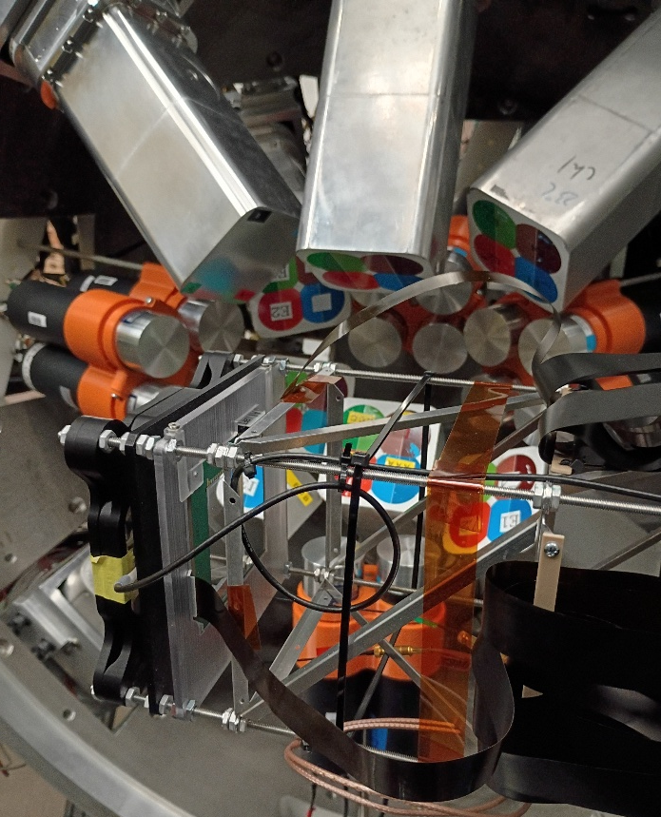
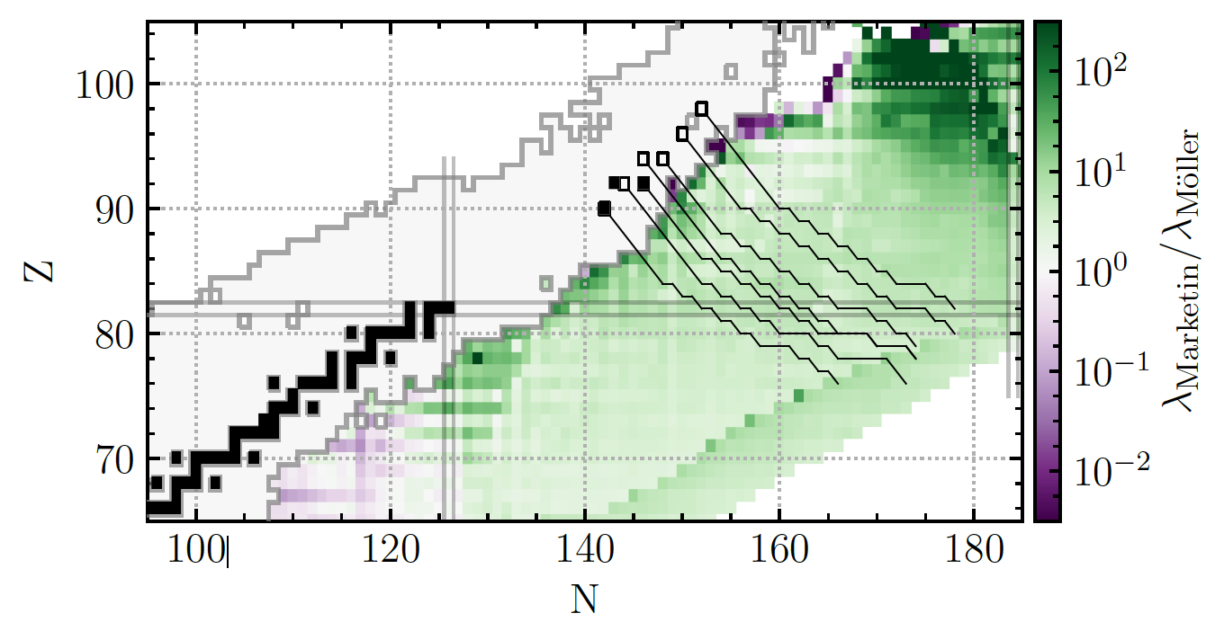
β-decay experiments with the FRIB Decay Station focus on isotopes at the rare-earth region and beyond, relevant to the strong r-process
April 2026: Exp #21080, Decay spectroscopy in the vicinity of the N=126 shell closure (Wu, A. Estrade, O. Tarasov)
Goal: constrain half-lives in region that affects the break-out from N=126 r-process waiting-points
r-process path
XSiS+DEGAi setup for experiment e21080
E. Holmbeck et al, ApJ 870, 23 (2019)
Notes:
We work at beta-decay experiments at FRIB and RIKEN.
Currently we’re focused on experiments with the FRIB Decay Station to measure heavy isotopes important for strong r-process scenarios, like at neutron star mergers (the two I’m co-spokesperson for are in N=126 region and A~170). It includes measurements of half-lives and beta-delayed neutron emission probabilities
The first of these ran a couple of weeks ago, to measure half-lives and gamma-ray spectroscopy of isotopes around N=126 produced by fragmentation of a 208Pb beam. It was one of the first experiments to use the new double-sided silicon strip detector (DSSD) as the implantation detector of the FRIB Decay Station. The detector measured half-lives and was surrounded by Germanium and LaBr gamma-ray detectors.
All went well. If they ask and really want to know about the ‘blob’ of what we studied, 202Os was the N=126 target isotope … But it will take some analysis until we know how far from stability we can really push the measurements

Slide 21






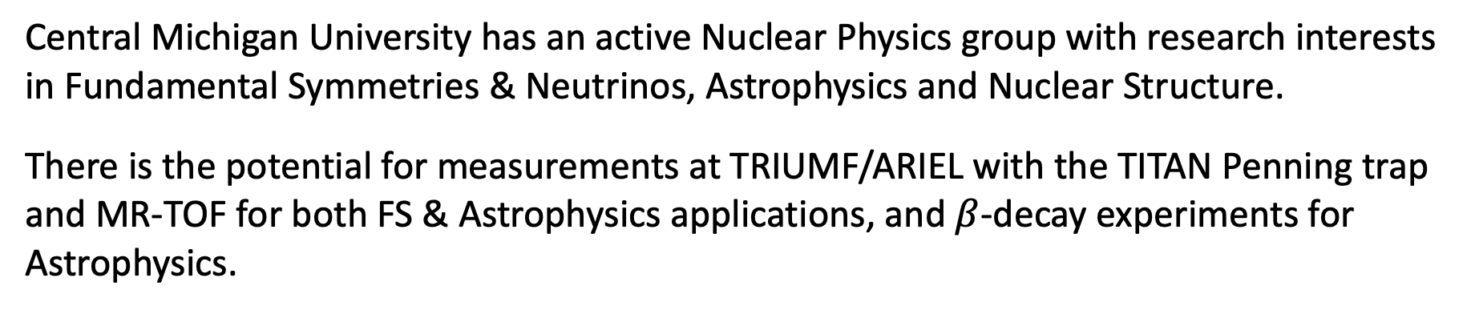
Conclusions
Central Michigan University has an active Nuclear Physics group with research interests in Fundamental Symmetries & Neutrinos, Astrophysics and Nuclear Structure.
There is the potential for measurements at TRIUMF/ARIEL with the TITAN Penning trap and MR-TOF for both FS & Astrophysics applications, and $β$-decay experiments for Astrophysics.
Thanks for listening!
Funding
Central Michigan University
MSU and FRIB
NSF, Grant No. 1307233, 2111302
DOE, Grant No. DE-SC0015927, DE-SC0022538
CMU Group R. Sandler, N. Gamage, M. Horana, R. Bhandari, M. Hasan, D. Perera, A. Dissanayake, E. Chowdhury, D. Keblbeck, I. Sultana
TITAN Group A. Kwiatkowski, S. Kakkar, J. Ash, B. Ashrafkhani, J. Cardona, C. Chambers, A. Czihaly, G. Gwinner, Z. Hockenbery, E. Leistenschneider, M. Lykiardopoulou, F. M. Millan, A. Mollaebrahimi, S. Paul, D. Ray, C. Walls, A. Weaver
Collaborators K. Leach, X. Mougeot
LEBIT Group
G. Bollen, R. Ringle, H. Errington, A. Hamaker, C. Ireland, C. Izzo, D. Puentes, R. Sandler, S. Schwarz, C.S. Sumthrarachchi, A.A. Valverde, I. Yandow
Notre Dame Group
M. Brodeur, W.S. Porter, P. O’Mally

