Slide 1
Study of the octupole collectivity of neutron-rich Ba isotopes
Nobu Imai
(Center for Nuclear Study, the University of Tokyo)
Notes:
i

Slide 2
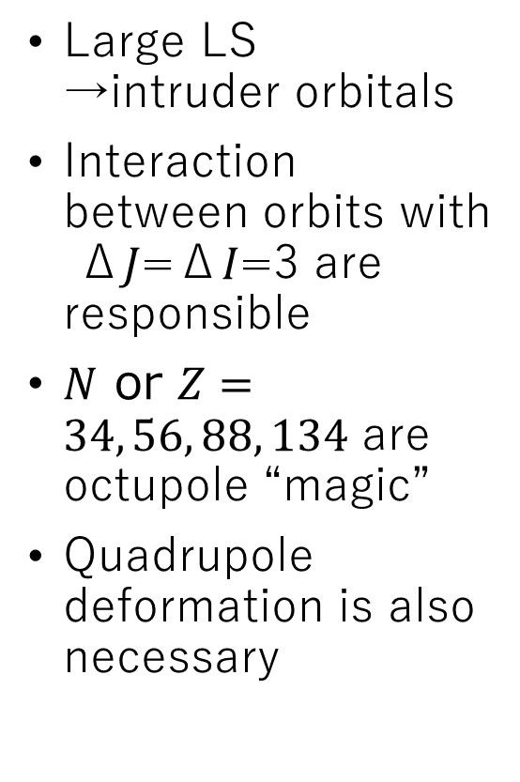
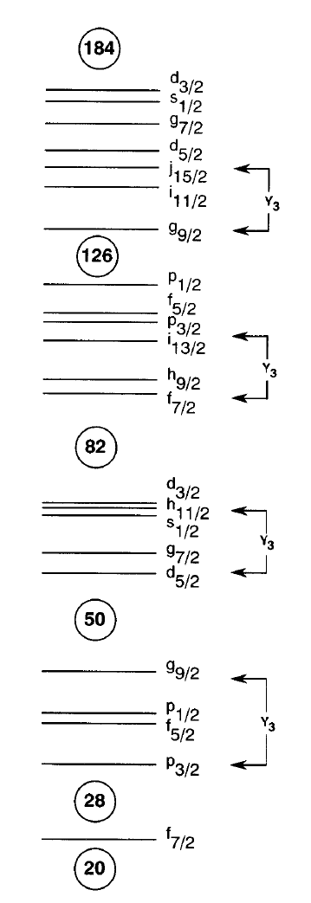
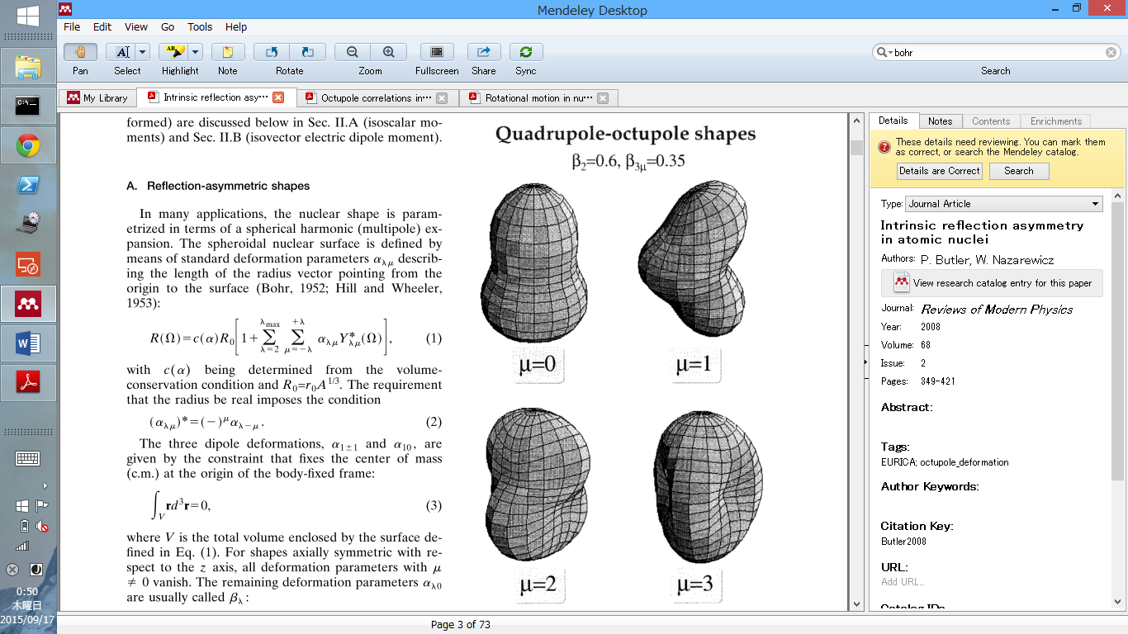




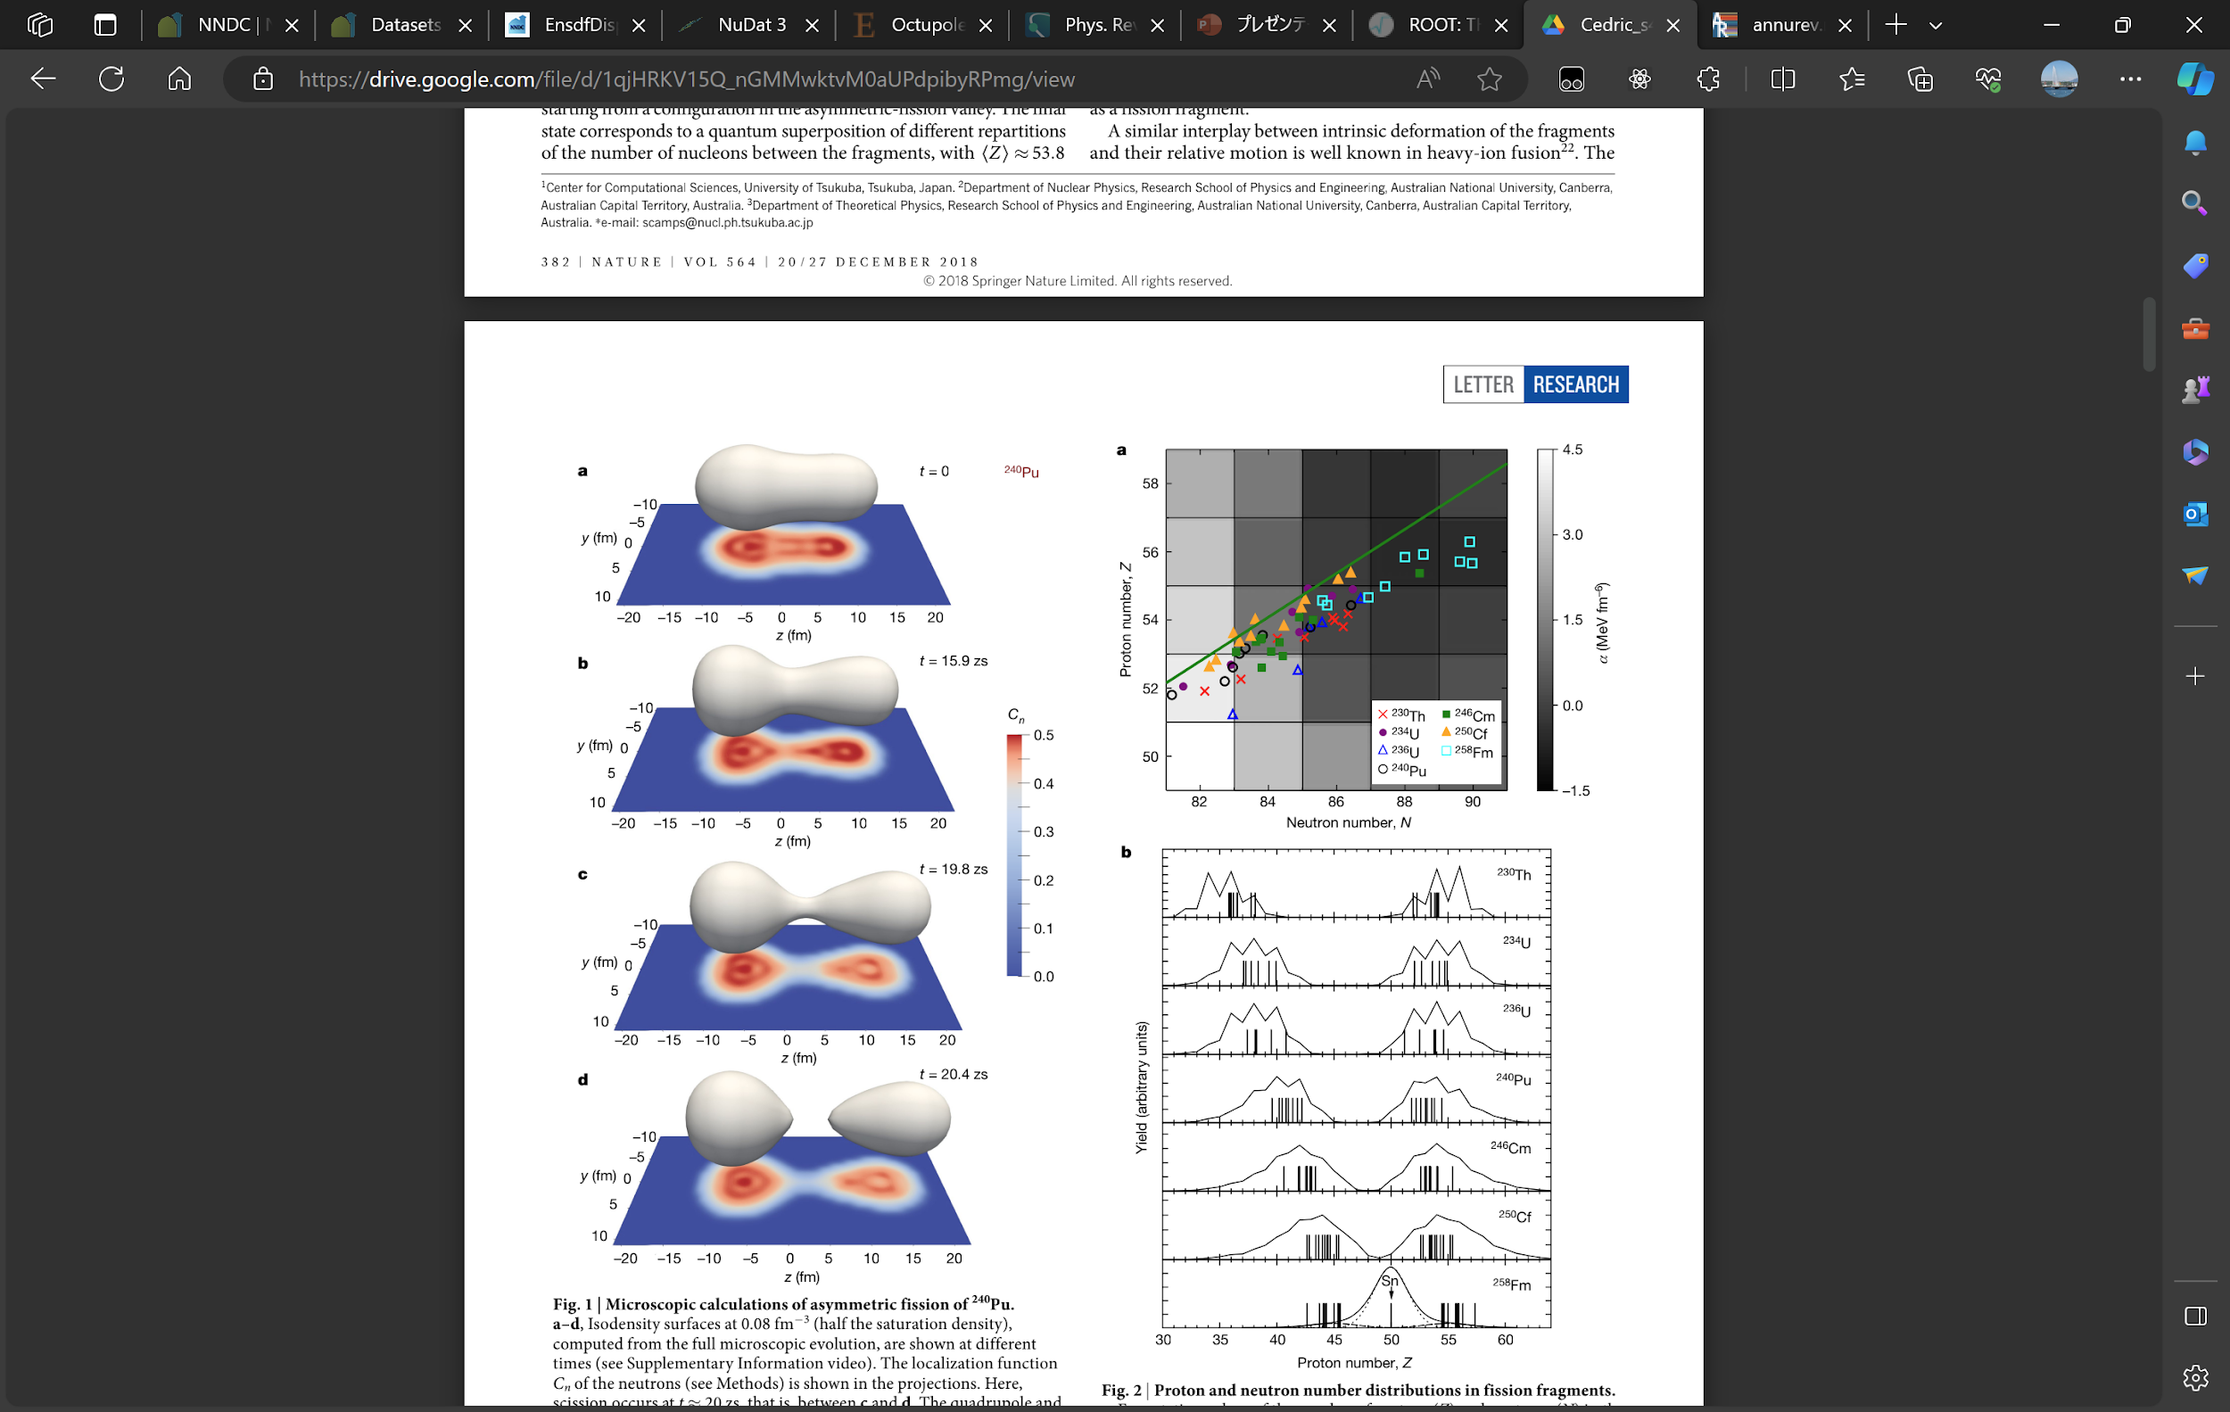
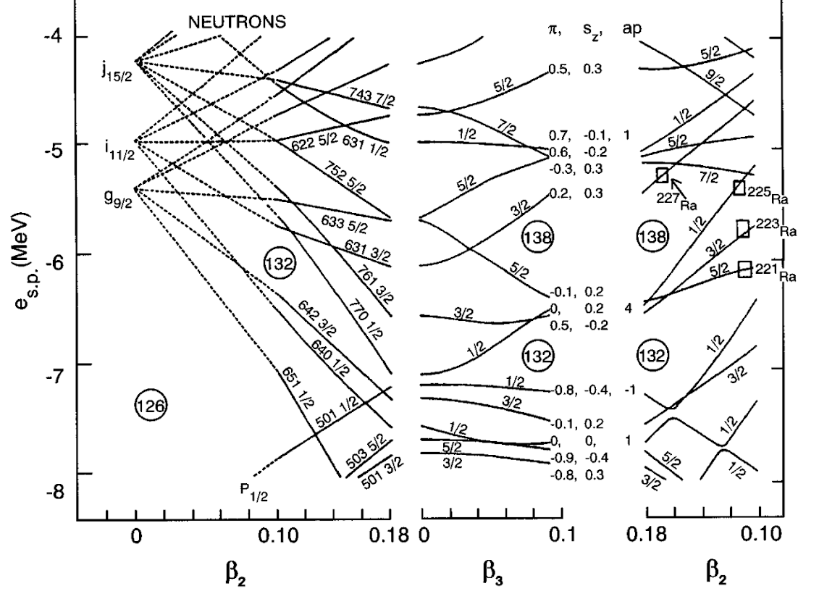
Octupole deformation
…
134
Quadrupole
Octupole
Hexadecupole
Existence of parity-violating shape?
88
Impact of octupole deformation
Atomic EDMs for fundamental symmetry
Mass asymmetric fission
Single particle structures of SHEs [Giu19]
56
Guillaume Scamps and Cédric Simenel, Nature 564, 382-385 (2018)
34
Notes:
octuple deformation Is the nExt leadIng order of thequadrupole. buT most fascinatIng poInt Is tgaT the octupole violate The spatial symmetry.
as discussed yesterdsy.octupole is also important for the fundamental physics, fission properties, and nuclear structure of very heavy elements.
the large octupole collectivity is expected to be measured at the neclei in which there is the orbitals of delata l and delta j 3 difference can be seen around the fermi level.therfore, some spesific numbers are considered as The octupole magic nuclei.
this bottom figure is the nilsson model by taking into account the octupole deformation, indicating that the interplay between quadrupole and octupole deformstion is important to understand the condition to realize the octupole deformation.

Slide 3
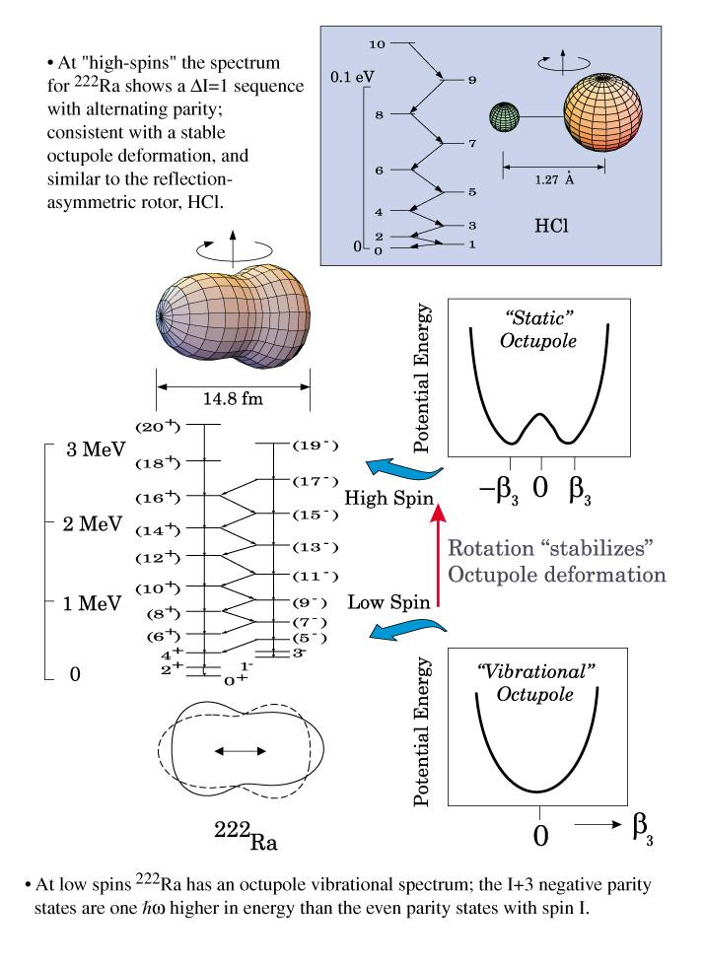
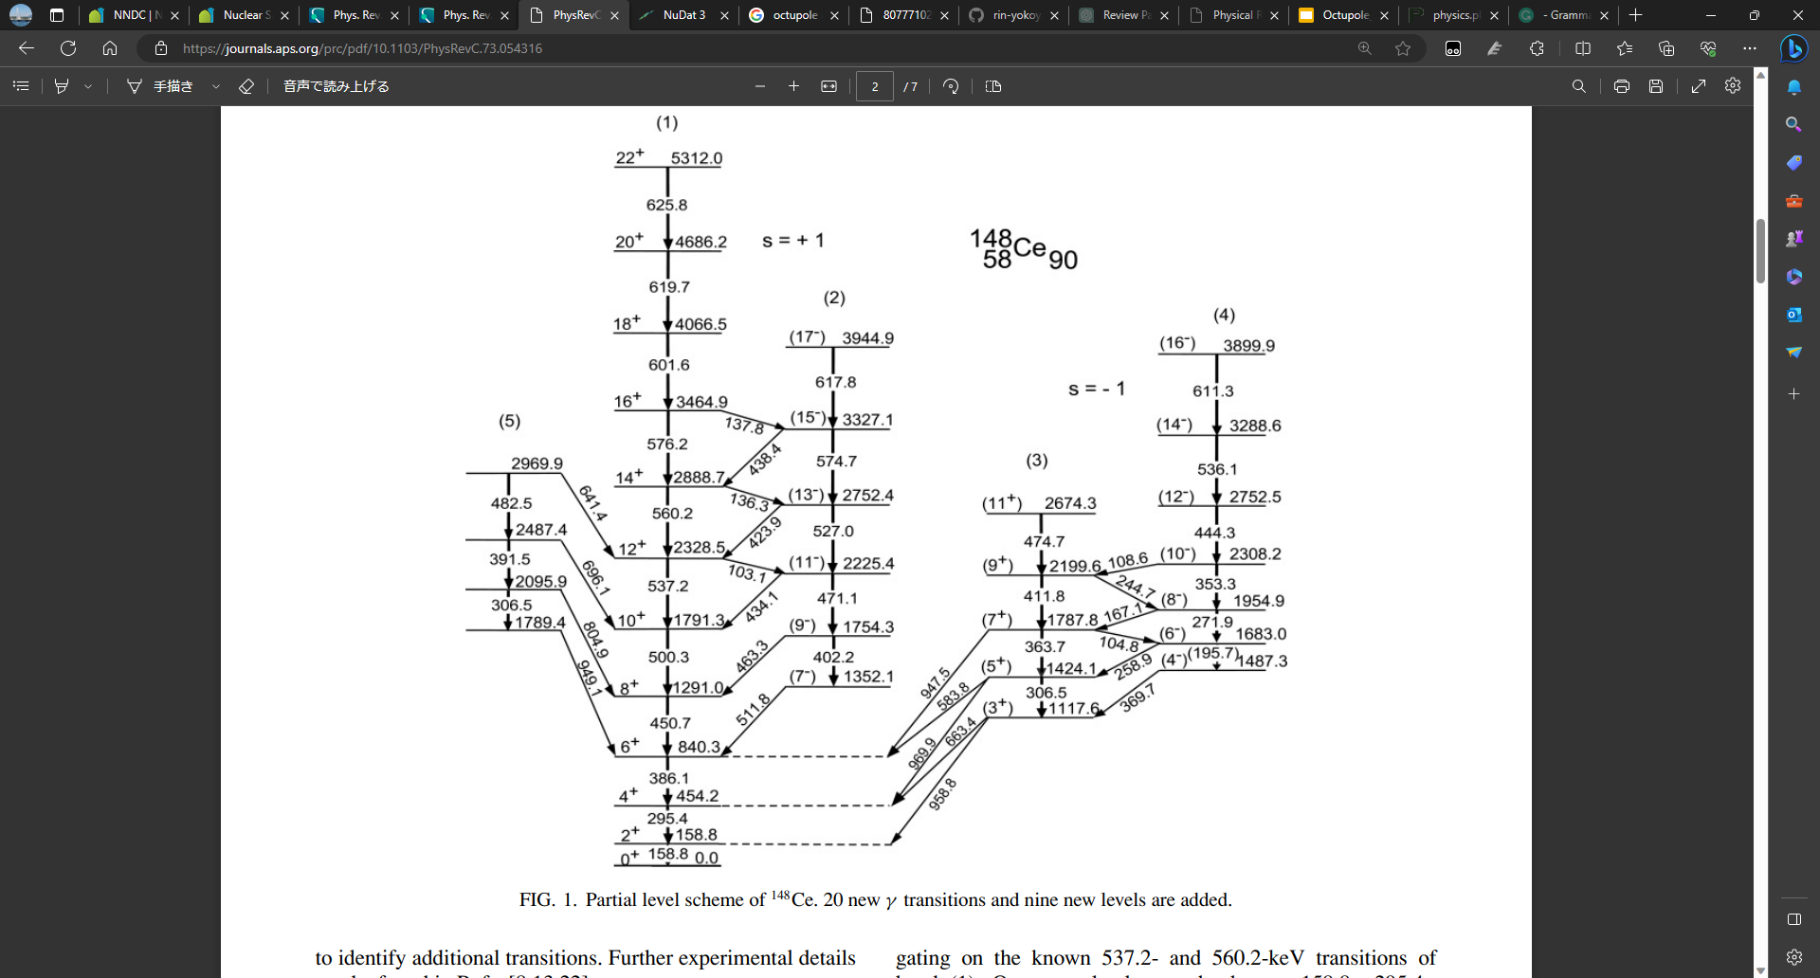
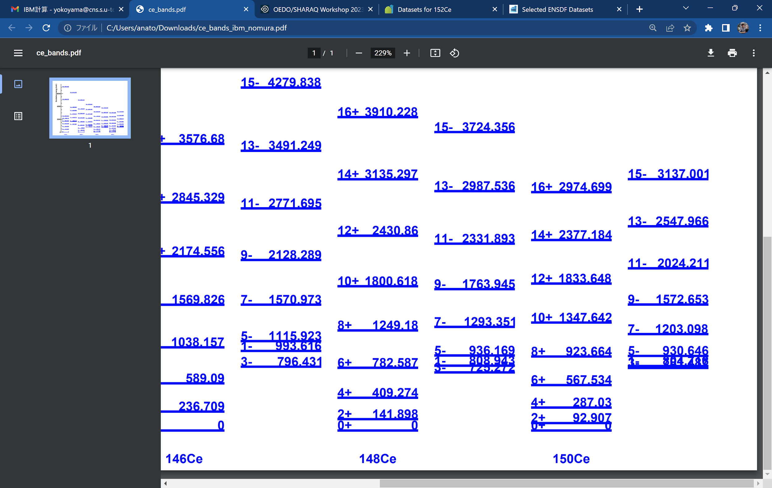
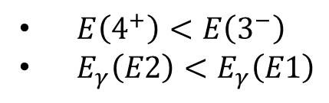
Alternating parity band
IBM by K. Nomura
¹⁴⁸Ce
Difficult to populate the 3- state by fission or fusion
Notes:
but the experimental evidence of the grand state octupole deformation is still under the debate.
in the case of the molecule, the alternsting parity band is observed as the evidence .
however in the cade of the atomic nucleus, even in the 222ra, the negative prity state does not appear at exactly middle of the positive parity states. but in the high excited state, the alternating parity band is seen.
in the case of 146Ce, located around the octupole double magic nucleus 144Ba, no 1-, 3- states have been found.

Slide 4
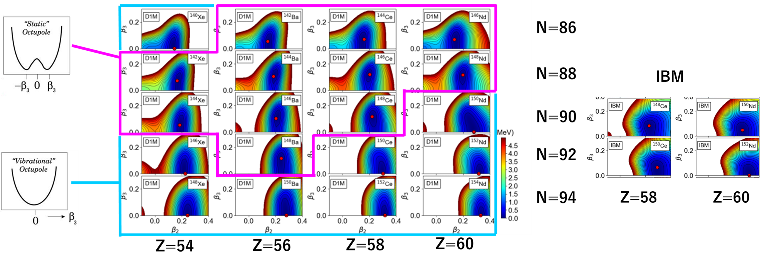
Border of static octupole deformation
SCMF
[Nom21]
Region of static octupole deformation is unclear because the deformation is very soft.
Large theoretical instabilities
Notes:
as i said the interplsy betwern the quadrupOle and octupole is important. accor¥ing tothE meanfield + i model, the ground state 8s consideted to he octupokE deformaTion, eben yhough ilthe potential depTh is shallow.
according to the ThereTical calculaTion, when The n|utron numbet increases, thE quadrupole deformation grows up, and The octupole collectivity is surprresed.
the bo4der of the octupole deformation, or collectivity woUld be a good measure of the octupole deformation.

Slide 5
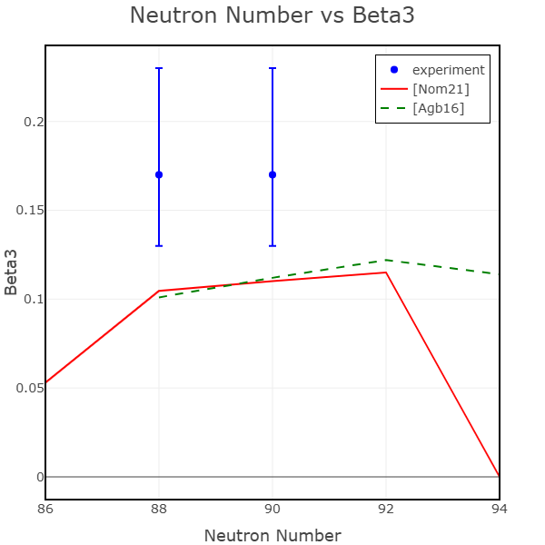
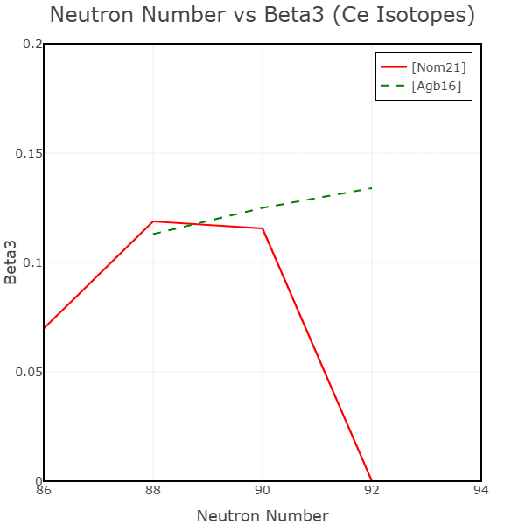
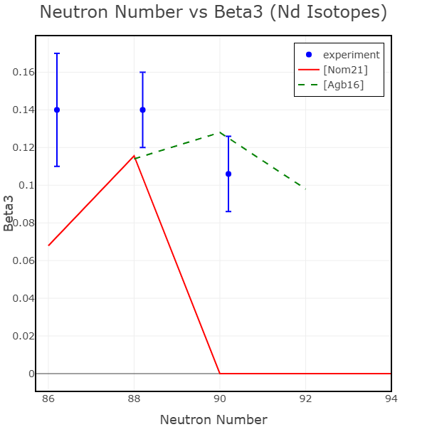
Theoretical predictions of octupole deformation
Ba
Ce
Nd
134
88
56
Large differences in theories
34
octupole “magic”
Z=56, N=88

Slide 6
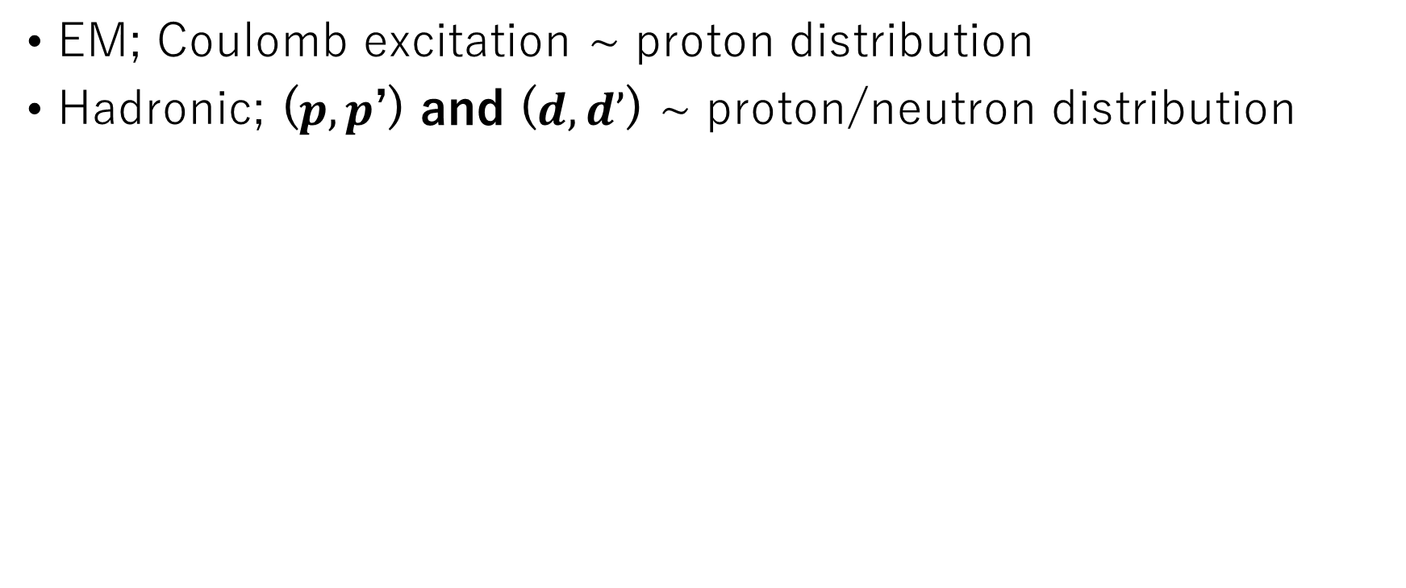
Probes for the octupole collectivity
Notes:
to study the octupOle collectivity, there are srveral ways for the
em mahnetic pobe like coumb excitation.
the protOn, hadronic probe such as ptoton, dEiteron Inelastic scattering is also a good probe to dfTaermIne the degree of the collE’tivity.

Slide 7
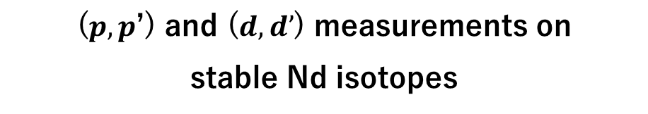
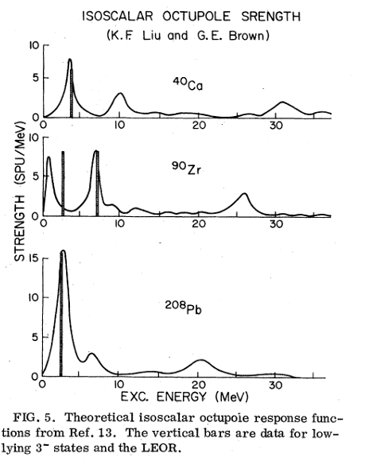


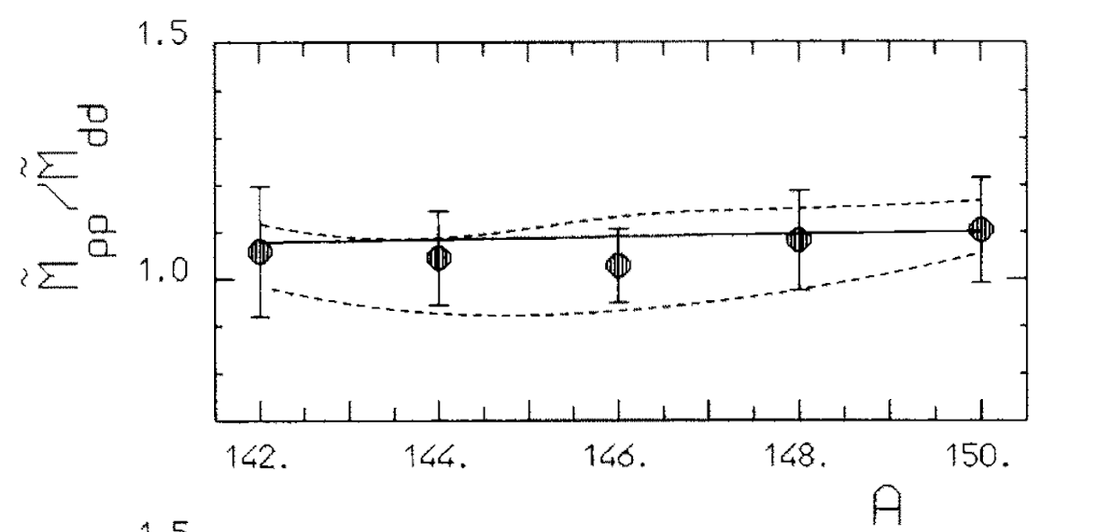
Isovector/Isoscalar octupole moments
Low-lying states are isoscalar? →
No significant variation
M. Pignanelli et al, Nucl. Phys. A559, 1-41 (1993)
Notes:
in the past, like qusdropole deformatiOn, the octupole collectivity has been studied for the stable isotopes
onlY the cOllE’tice nature was measutEd.

Slide 8
Previous experimental studies
Boundary by [Nom21]
N=86
N=88
N=90
N=92
N=94
 |  |  | 152Nd 1- to 5- | 154Nd
144Ce 3- to 11- | 146Ce 3- to 15- | 148Ce (3-) to (17-) | 150Ce 7- to (17-) | 152Ce (7-) to (13-)
142Ba 3- to 11- |  |  | 148Ba 1- to (11-) | 150Ba (1-) to (3-)
No measurements of octupole collectivity on Ce isotopes
3⁻ states are not assigned for some of the isotopes
Z=60
Stable nuclei (coulex+inelastic)
Z=58
252Cf fission
Z=56
252Cf fission
(post-accelerated coulex)
β-decay
B(E3) known
3- state known

Slide 9
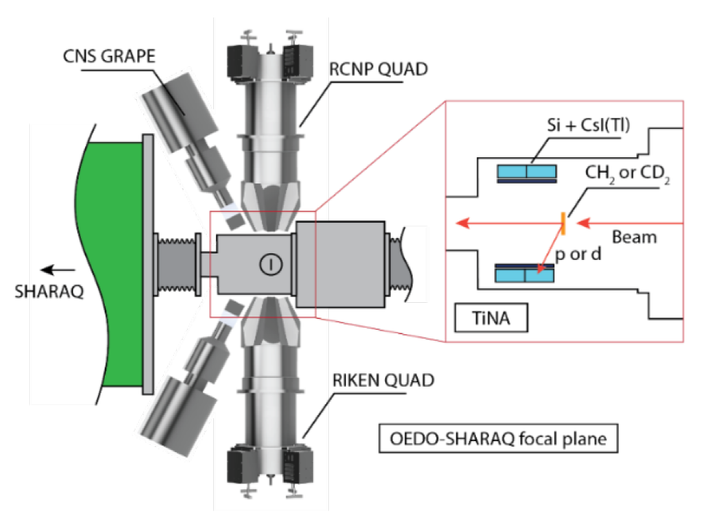
Study of Octupole collectivities of Ce isotopes @RIBF
Spokespersons: R. Yokoyama, N.I
TTT+PAD
CH₂/CD₂ target (5 mg/cm²) on a ladder system
In-beam γ detectors
2 GRETINA-QUAD
12 GRAPEs
Particle detectors
ntdTTT-SSD ΔE-E array
particle identification
~450-keV missing mass resolution
@30MeV/u

Slide 10
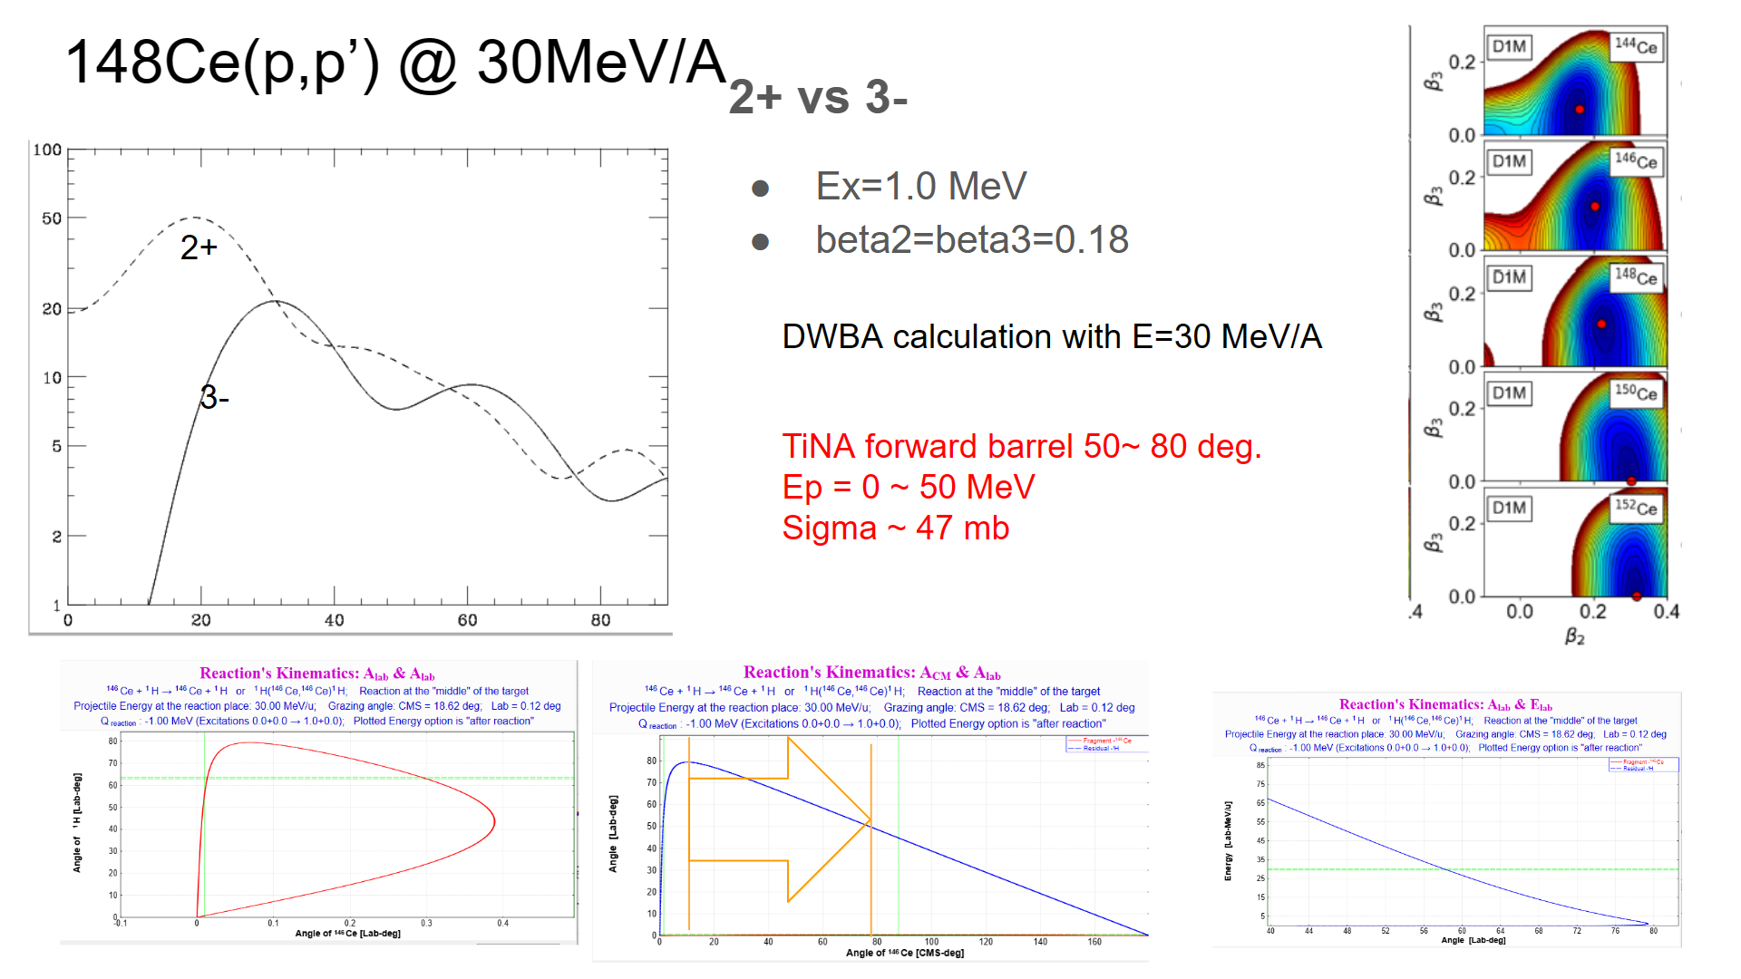
Notes:
as i said in some nuclei, apin parity assignment has not been made yet. thus we need to measure the angular distribution of recoil protons. cthe left figure shows the dwba calculation for populationg 2+ and 3- state at 30eV nucleon. We can identify tthe state

Slide 11
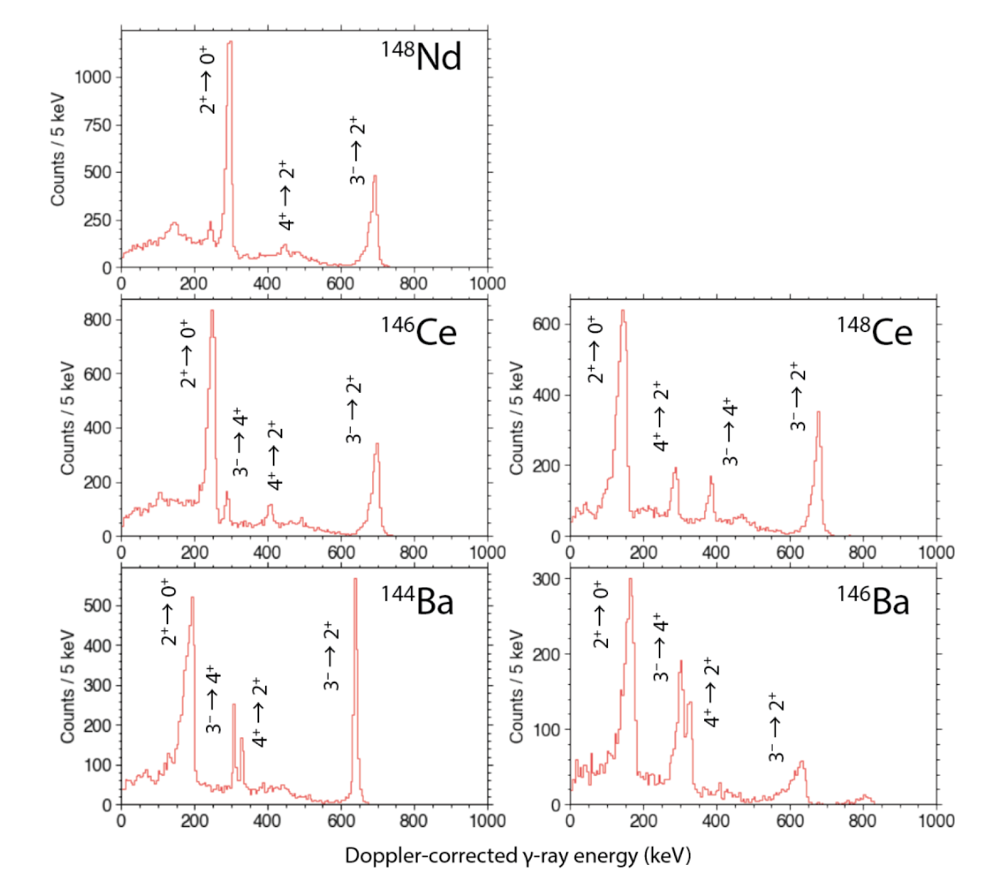
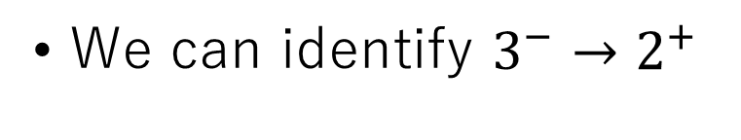
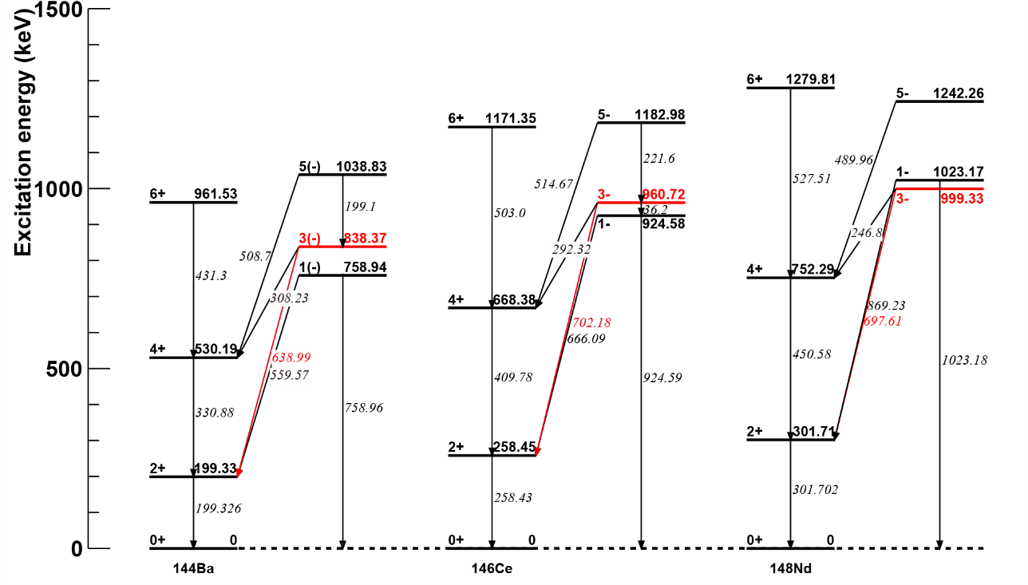
Expected in-beam γ-ray spectra@OEDO/RIBF
Notes:
the gamma energy spectrum must be catefully studiesld before the experiment. becauae of the alternating parity band and multistep excitation. for the ce isotope cases, the expected gamma spectra suggest that we can observe the transotion form3- to 2+ state.

Slide 12
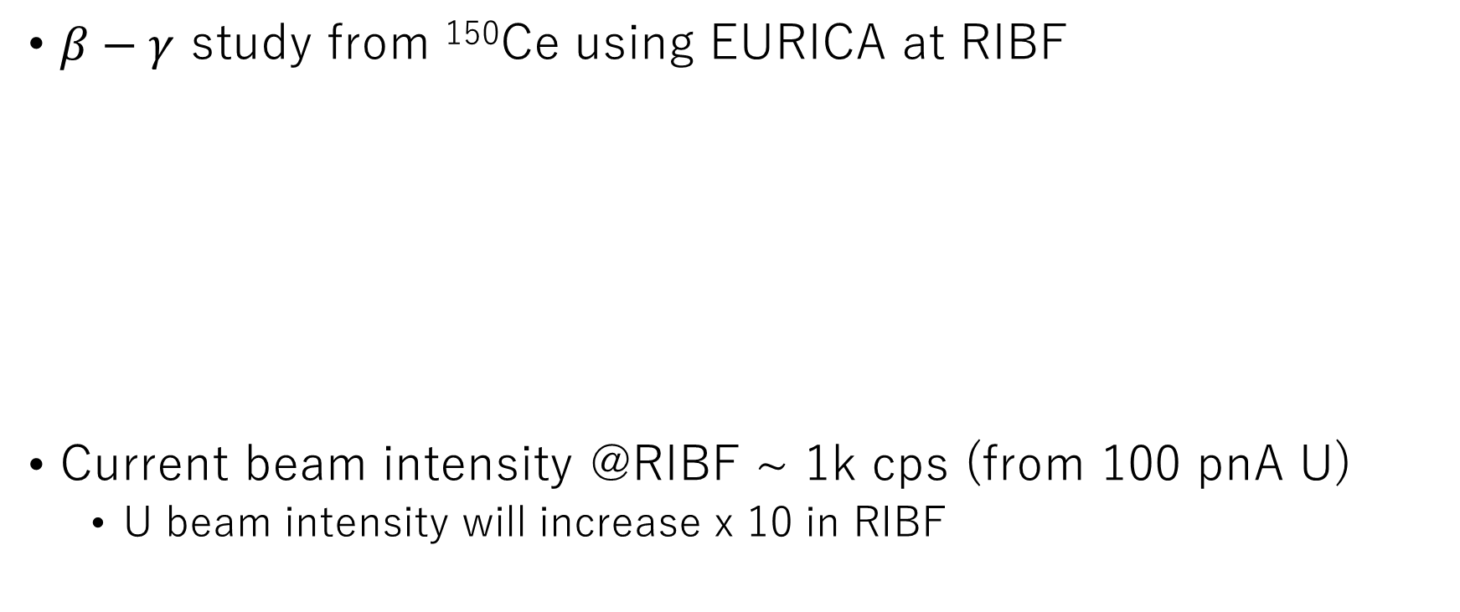
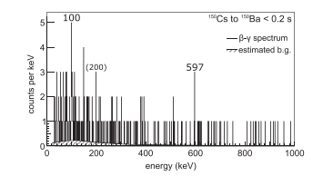
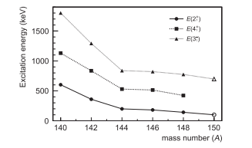

¹⁵⁰Ba
E(2⁺)=100 keV
E(3⁻) =600 keV
R. Yokoyama et al., PTEP 2018 041D02
Notes:
although we will systematically study the 3- state od ce isotkpes to see the edge of the octapole collectivity, in the case of Ba, it is very challenging to clear the edg from the point of view of the available intensity.

Slide 13
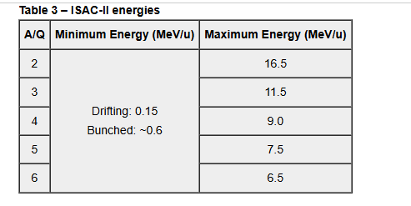
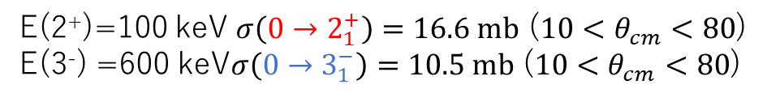
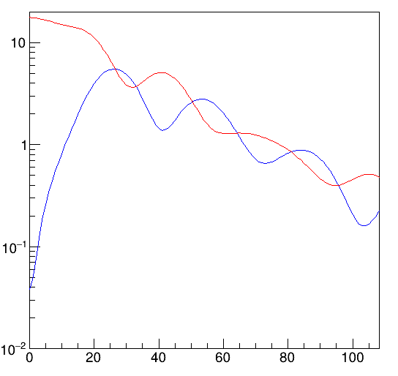



Experiment at ISAC-II
¹⁵⁰Ba; A/Q = 2.67 for fully stripped ions
Maybe A/Q~3?

Slide 14
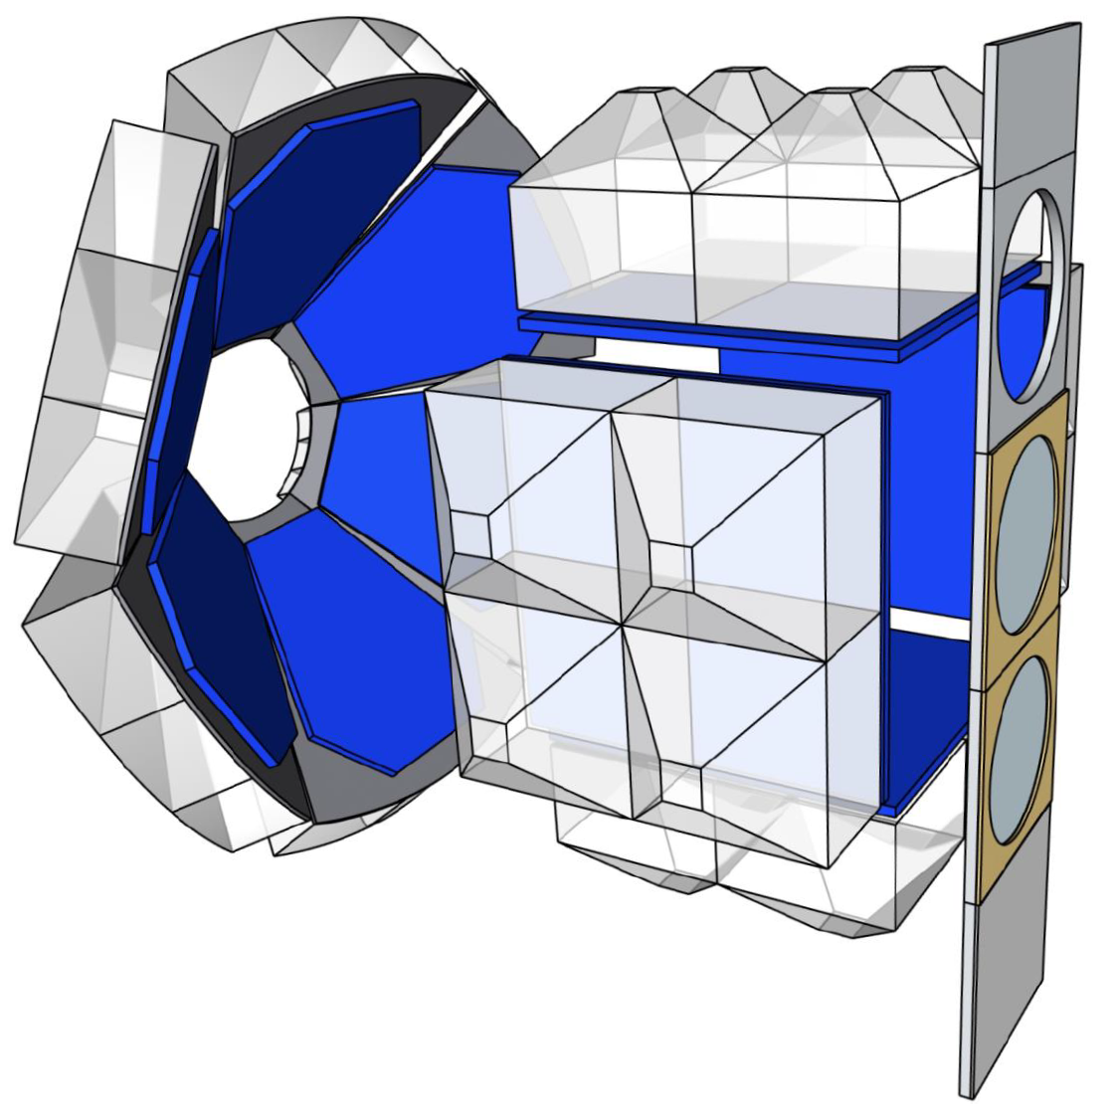
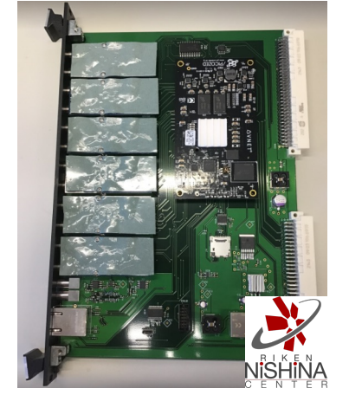
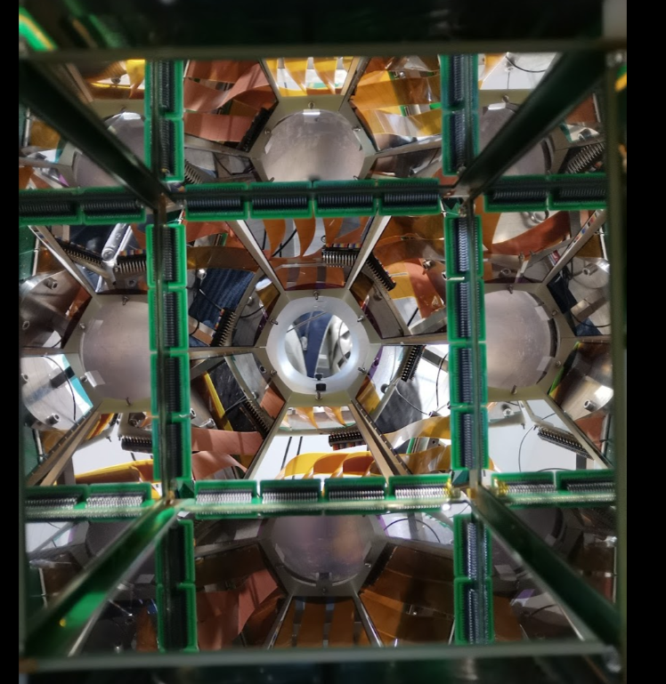
Upgrading Recoil particle detector
TTT-CsI(Tl) + GET electronics
For backward scattering
nTD-TTT-MSX1000
+ Digitizer (125MHz, 14Bit)
Under development

Slide 15
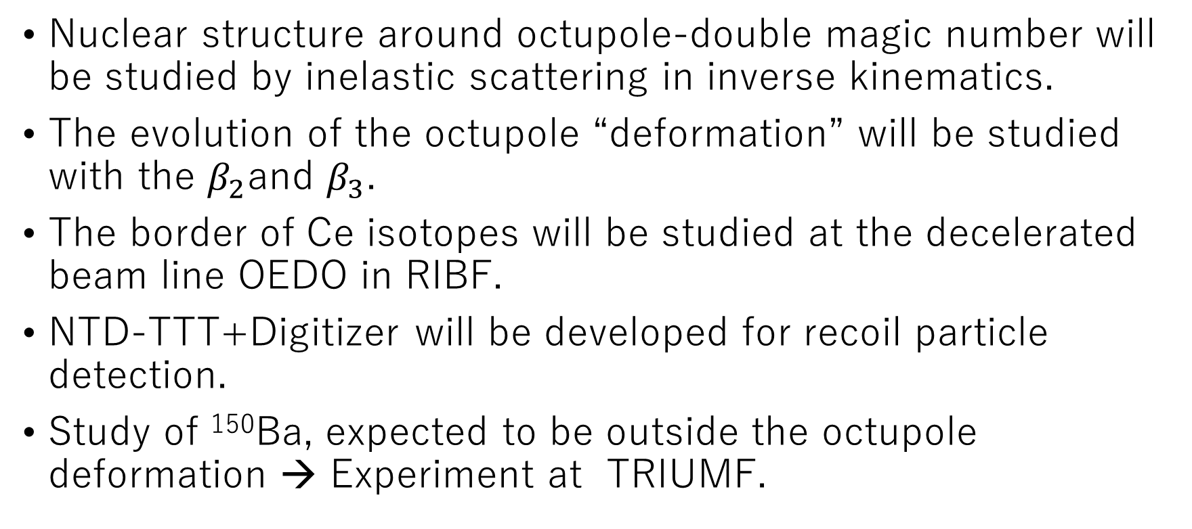
Summary

Slide 17
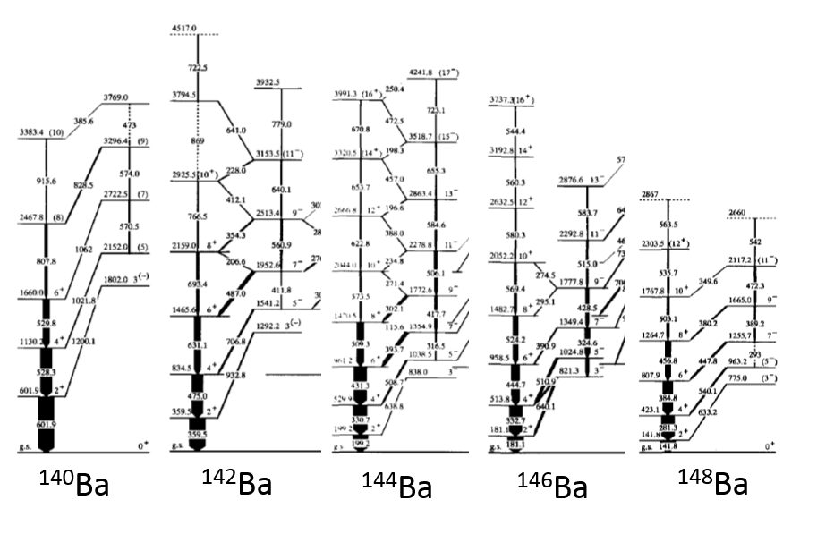
Negative parity octupole band
3- states at low excitation around N=88
3⁻
3⁻
3⁻
3⁻
3⁻
Octupole bands (parity alternating band) with enhanced E1 decays are known in magic regions

Slide 18
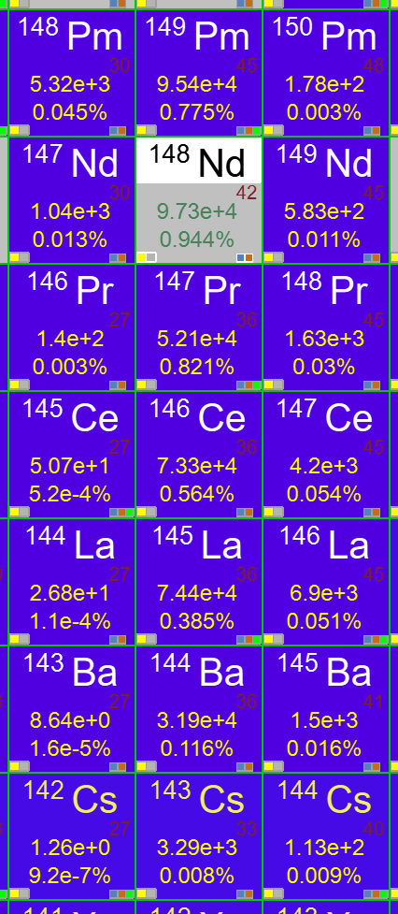
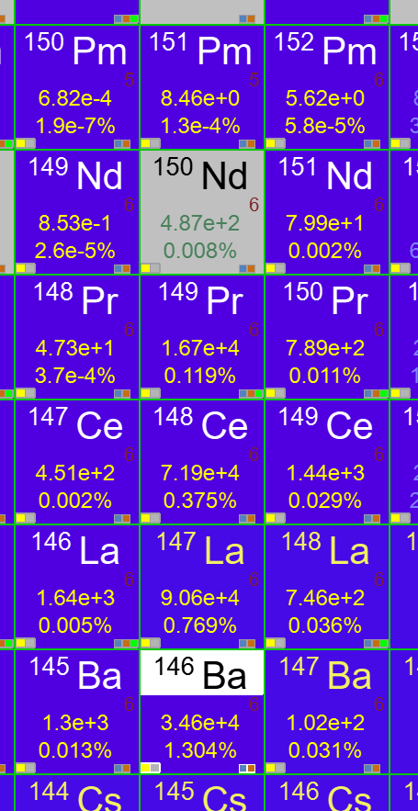
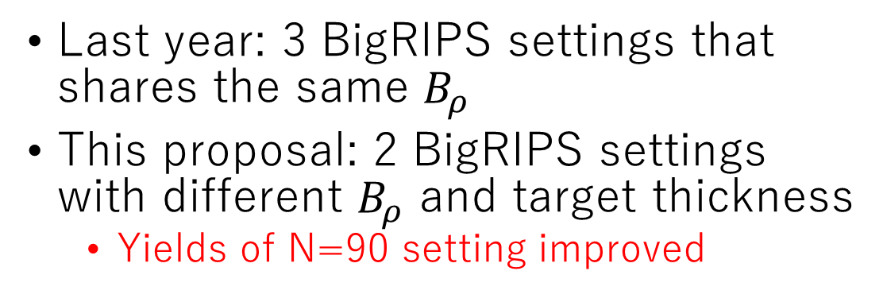
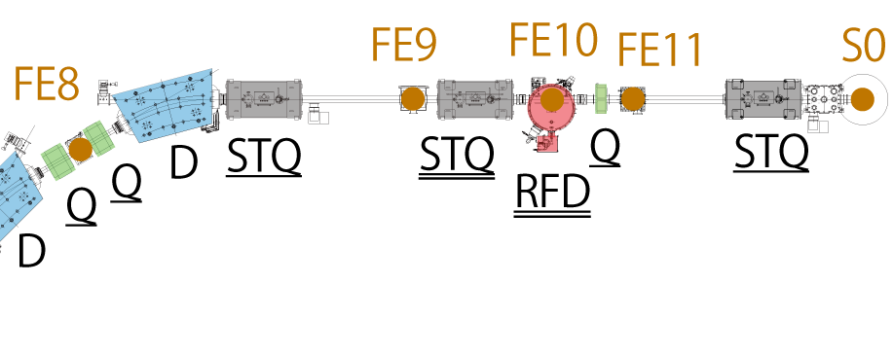
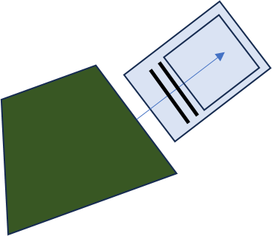
BigRIPS and OEDO settings
N=88 setting
N=90 setting
S1
✖
D1
Nuclei in the same isotopes are in a single BigRIPS setting only by changing the RFD and D1 settings.

Slide 19
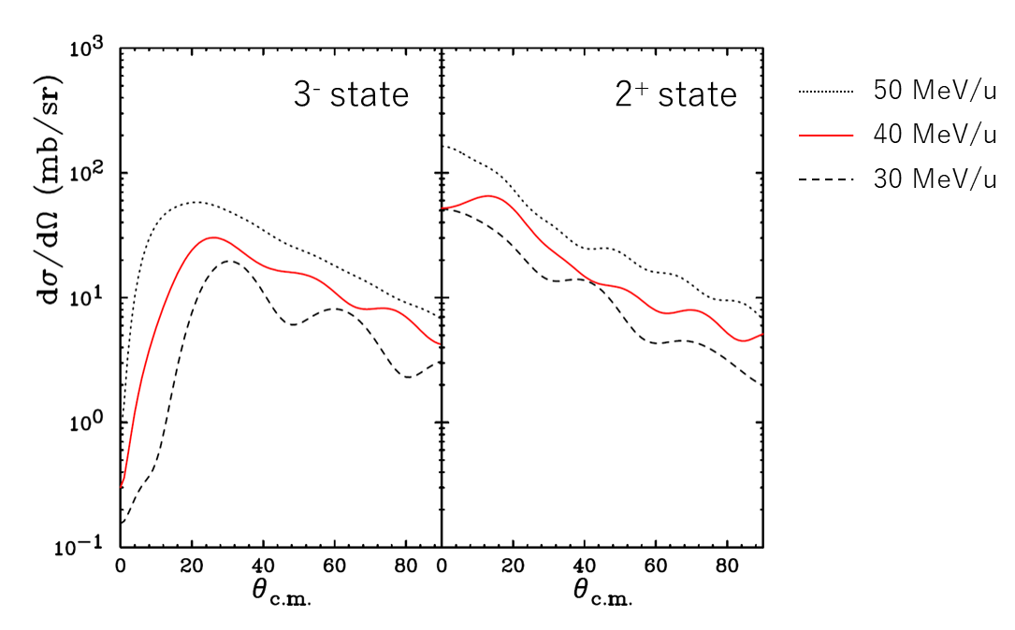
Differential cross sections by ECIS

Slide 20
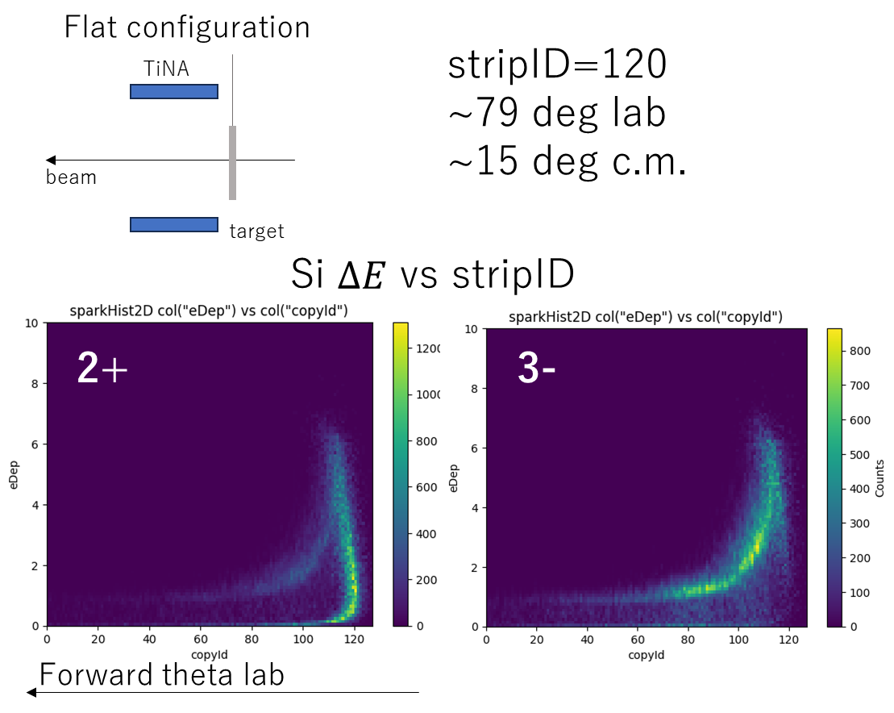
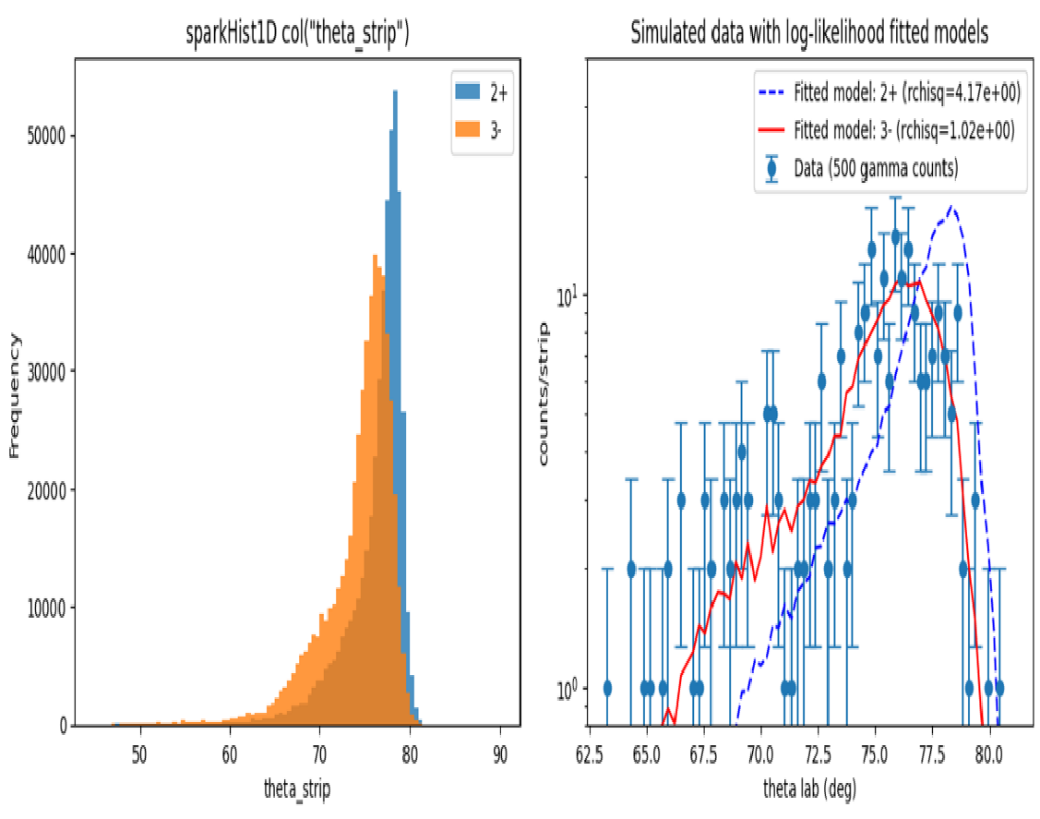
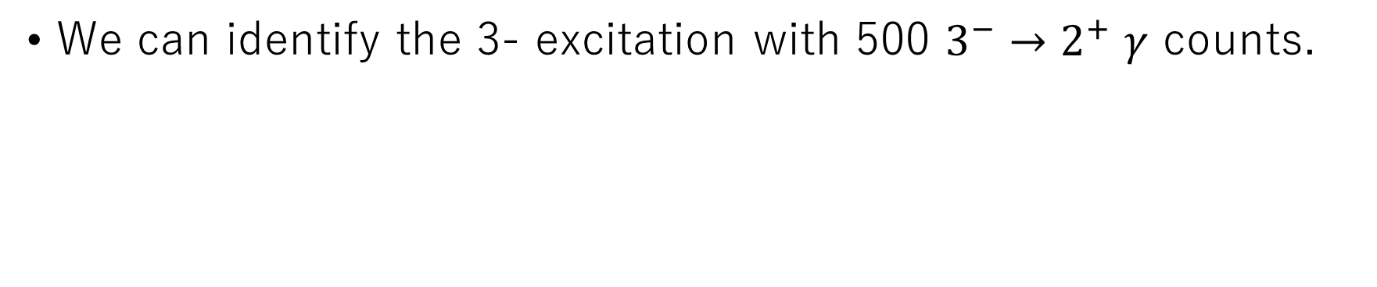
Geant4 simulation of TiNA spectrum
40MeV/u
146Ce beam
CH2 5mg/cm2

Slide 21
Beamtime request
BigRIPS | Nuclide | Target | Estimated Nγ | Beamtime requests (days)
Setting 1 | ¹⁴⁸Nd | CH₂ | 2,100 | 1.0 | 5.75
 | ¹⁴⁸Nd | CD₂ | 1,800 | 0.25
 | ¹⁴⁶Ce | CH₂ | 1,700 | 1.0
 | ¹⁴⁶Ce | CD₂ | 2,800 | 0.5
 | ¹⁴⁴Ba | CH₂ | 1,400 | 2.0
 | ¹⁴⁴Ba | CD₂ | 2,300 | 1.0
Setting 2 | ¹⁴⁸Ce | CH₂ | 700 | 0.5 | 0.75
 | ¹⁴⁸Ce | CD₂ | 1,100 | 0.25
Setting 3 | ¹⁴⁶Ba | CH₂ | 600 | 6.0 | 9
 | ¹⁴⁶Ba | CD₂ | 1,000 | 3.0
Detector tuning |  |  |  |  | 0.5
OEDO beam tuning (including beam switching) |  |  |  |  | 1.5
Total |  |  |  |  | 15.5
Reference

Slide 22
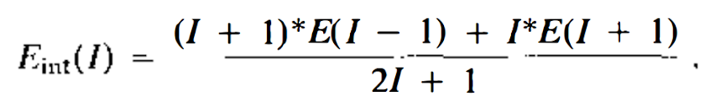
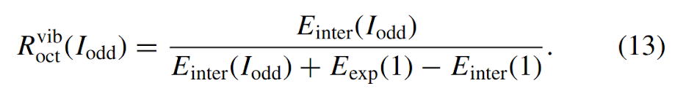
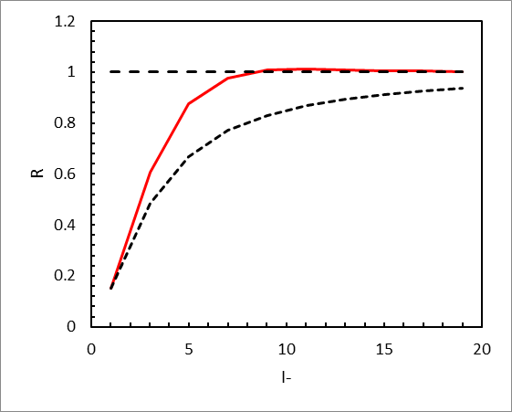
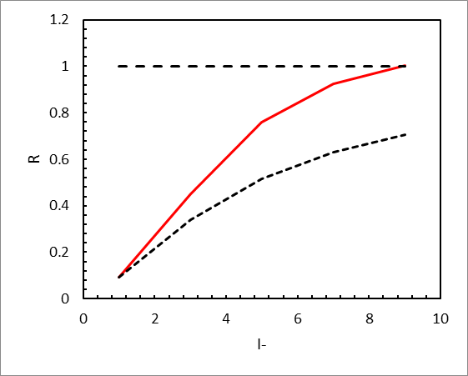
Stabilization of octupole deformation
Interpolation from the positive parity band
Vibrational limit [R. V. Jolos and P. Von Brentano, PRC 92, 044318 (2015)]
rigid
exp
vibrational
²²²Ra
¹⁴⁶Ce

Slide 23
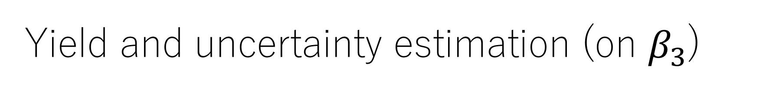
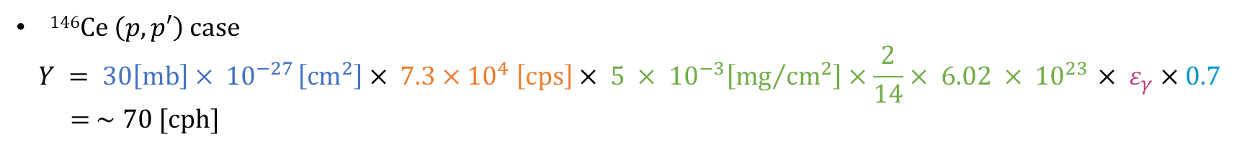
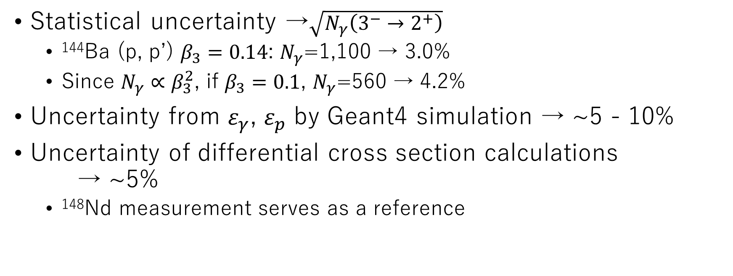
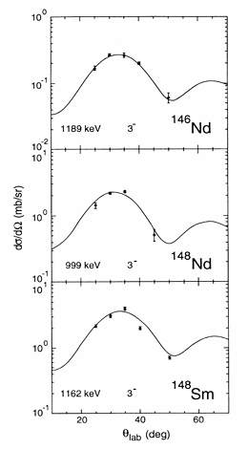
P. D. Cottle et al.

Slide 24
Objectives
Systematic β₃ measurements of Z~56/N~88 region at OEDO
Especially Ce isotopes where no B(E3) or β₃ measurements
Experimentally assign the 3- state (¹⁴⁸Ce) from the angular distribution of recoil particles
From (p, p’) and (d, d’), both electromagnetic and hadronic octupole moments can be obtained
Future
Starting from N=88 isotones, we are planning to extend this measurement to N=92 isotones in the following proposals.
This study could be extended to another region of octupole collectivity

Slide 25


Beamtime request
reference
N=88
3.75d
N=90
3d
We adjusted our beamtime requests to ~1000 gamma counts or ¼ day at minimum.
Beam tuning increased

Slide 26

Previous PAC comments
The authors were forced to readjust the BigRIPS settings following the technical comments and asked for significantly more beam time during the presentation. The PAC considered this change as not an appropriate procedure…
We changed the BigRIPS settings to maximize the rate.
We adjusted the beam time request to 1000 gamma counts.
3.75d for N=88, 3d for N=90
The authors are encouraged to apply at the next opportunity after further clarification on the measurement feasibility at low θCM angles for spin-parity determination.
We added a Geant4 simulation
Comments from referees
What is the confidence level that the fit to the simulated angular distribution shown in fugure9 distinguishes a 3- assignment from 2+ for 148Ce
The chi-square values of simulated spectrum gives 100% confidence level.
>95% confidence with 0.5 deg shift or 1 count/strip background

Slide 27



Impact of octupole deformation
Atomic EDMs for fundamental symmetry
Octupole deformation in SHEs
(N=196, 0k_{17/2} and 1h_{11/2}) affects
Single particle structures
Half-lives
[S. A. Giuliani et al. Rev. Mod. Phys. 91, 011001 (2019)]
EDM limits of octupole nuclei can constrain BSM parameters
T. Chupp and M. Ramsey-Musolf, PRC 91, 035502 (2015)
Mass asymmetric fission
Prefer Z=52 to 56 rather than 50
Octupole shape after fission could be the reason
Guillaume Scamps and Cédric Simenel, Nature 564, 382-385 (2018)

Slide 28
Backup slides

Slide 29



¹³⁰Sn(d,p) experiment analysis status
To identify ^{131, 130}Sn after (d,p) reaction and deduce γ-emission probability for unbound states in ¹³¹Sn
Need to distinguish ^{130,131}Sn. A/Q = 2.766 (¹³⁰Sn⁴⁷⁺), 2.787 (¹³¹Sn⁴⁷⁺)
A/Q Optimization
Excitation Energy
A/Q vs Excitation Energy
SR-PPAC gain correction for better position
Based on SR-PPAC information and optimized optical matrix parameters.
Optimized with conjugate gradient method
σ / (A/Q) = 0.12% for ¹³⁰Sn⁴⁷⁺
A/Q(¹³⁰Sn⁴⁷⁺) – A/Q(¹³¹Sn⁴⁷⁺) ~ 6σ
Excitation energy of ¹³¹Sn after reaction
Calculated from the beam energy based on ToF and proton energy & momentum from Si detectors.
For punch-through events of protons, energy reconstruction using ATIMA calculation
Separated A/Q distributions for ^{131~129}Sn well corresponding to the S_{n}, S_{2n} of ¹³¹Sn (S_{n} = 5.2 MeV, S_{2n} = 12.8 MeV)
Cleaning background events in process.
S_{n}
S_{2n}
A/Q (without target)
¹³⁰Sn⁴⁷⁺
S_{n}
S_{2n}
σ / (A/Q) = 0.12%
¹³⁰Sn⁴⁶⁺
¹³¹Sn⁴⁷⁺
¹³⁰Sn⁴⁷⁺
¹²⁹Sn⁴⁷⁺
¹³⁰Sn⁴⁸⁺
¹³⁰Sn⁴⁵⁺

Slide 30


Questions from reviewers
What is effect of feeding from higher lying states to the 3- state on the extracted value of beta_3?
Feeding from >500 keV above →identified from the missing mass
No concerning states are known at low energy
J<4 states most likely decay to 2₁+ or g.s.
Cross sections of J>4 states are small
Multi-step excitation cross sections of ¹⁴⁶Ce
Simulated proton kinematics
elastic
Ex state at 3 MeV

Slide 31




Known octupole deformed nuclei
① ²²⁰Rn, ²²⁴Ra
① Ra region
② Ba region
L. P. Gaffney et al., Nature 497, 199-204 (2013)
Octupole deformation is known in the region ① and ②.
② ¹⁴⁴Ba
② ¹⁴⁶Ba
B. Bucher et al, PRL 116, 112503 (2016)
B. Bucher et al, PRL 118, 152504 (2017)

Slide 32
Previous experimental studies
Boundary by [Nom21]
N=86
N=88
N=90
N=92
N=94
 |  |  | 152Nd 1- to 5- | 154Nd
144Ce 3- to 11- | 146Ce 3- to 15- | 148Ce (3-) to (17-) | 150Ce 7- to (17-) | 152Ce (7-) to (13-)
142Ba 3- to 11- |  |  | 148Ba 1- to (11-) | 150Ba (1-) to (3-)
No measurements of octupole collectivity on Ce isotopes
3⁻ states are not assigned for some of the isotopes
Z=60
Stable nuclei (coulex+inelastic)
Z=58
252Cf fission
Z=56
252Cf fission
(post-accelerated coulex)
β-decay
B(E3) known
3- state known

Slide 33



Suppressed E1/E2 rate in ¹⁴⁶Ba
Large drop of B(E1) at A=146 is not the result of quenched octupole collectivity
Neutron occupancy of high-j, low-K
Orbitals changes the E1 strength
Shell effect becomes 0 at Z=56, N=90 →

Slide 34

Populating negative parity low J states
148Ce
Exp.
IBM by K. Nomura
Difficult to populate the 3- state by fission or fusion

Slide 35

Isovector/Isoscalar octupole moments
(p,p’) and (d,d’) measurements on
stable Nd isotopes
Low-lying states are isoscalar? →
No significant variation was observed
M. Pignanelli et al, Nucl. Phys. A559, 1-41 (1993)

Slide 36
Previous experimental studies
Boundary by [Nom21]
N=86
N=88
N=90
N=92
N=94
 |  |  | 152Nd 1- to 5- | 154Nd
144Ce 3- to 11- | 146Ce 3- to 15- | 148Ce (3-) to (17-) | 150Ce 7- to (17-) | 152Ce (7-) to (13-)
142Ba 3- to 11- |  |  | 148Ba 1- to (11-) | 150Ba (1-) to (3-)
No measurements of octupole collectivity on Ce isotopes
3⁻ states are not assigned for some of the isotopes
Z=60
Stable nuclei (coulex+inelastic)
Z=58
252Cf fission
Z=56
252Cf fission
(post-accelerated coulex)
β-decay
B(E3) known
3- state known

Slide 37



OEDO/SHARAQ
Beamline
Spectrometer
×
OEDO (2017～)
SHARAQ (2009～)
Secondary target
Functions:
1. Energy control and focusing of RI beams for Production Low-energy RI beams
2. Achromatic & dispersion-matching transport for high-resolution nuclear spectroscopy
Functions:
1. High resolution spectrometer for nuclear spectroscopy
2. Large acceptance spectrometer
for RI identification

Slide 38

RI-beam availability in various facilities in the world
FAIR, FRIB, RIBF
OEDO provides 10 - 50 MeV/u heavy ion RI beams
SPIRAL, NSCL, RIPS
Transfer reactions
Coulomb excitation
Resonance elastic/inelastic scattering
ISOLDE, FRIB(LE), CARIBU, SPIRAL2, RAON
(p,p’), (d,d’)

Slide 39

BigRIPS and OEDO settings
N=88 setting
S1
✖
D1
N=88 isotopes in a single BigRIPS setting only by changing the RFD and D1 settings.

Slide 40

Experimental setup at S0
CH₂/CD₂ target (5 mg/cm²) on a ladder system (isoscaler/isovector)
In-beam γ detectors
2 GRETINA QUAD
12 GRAPE
Particle detectors
Si-CsI(Tl) ΔE-E array
particle identification
~450-keV missing mass resolution
Leading developments to use QUAD detectors

Slide 41

Energy dependence of 3- population in (p,p’)
Angular distribution difference of 2+/3- is clear at 30MeV/u

Slide 42
Expected in-beam γ-ray spectra
¹⁴⁴Ba 3⁻: T_{1/2} < 10 ps
¹⁴⁶Ba 3⁻: T_{1/2} = 237(8) ps suppressed E1 rate is explained as single particle reason [Urb97, Buc17]
Assumed T_{1/2} = 100 ps for other isotopes

Slide 43
Comments from PAC
The authors were forced to readjust the BigRIPS settings following the technical comments and asked for significantly more beam time during the presentation. The PAC considered this change as not an appropriate procedure…
The authors are encouraged to apply at the next opportunity after further clarification on the measurement feasibility at low θCM angles for spin-parity determination.

Slide 44




Geant4 simulation of TiNA spectrum
Flat configuration
TiNA
stripID=120
~79 deg lab
~15 deg c.m.
beam
target
Si+CsI
2+
3-
CH₂ Target
5mg/cm2
Forward
Si strip ID
Beam: 13mmσφ
Forward theta lab
We can cover up to ~15 deg c.m.

Slide 45


Geant4 simulation of TiNA spectrum
With 1M gamma counts
With 500 gamma counts
Forward
Si strip ID
Si strip ID
We can Identify 2+ / 3- with ~500 gamma counts (flat config)

Slide 46



No front Si
front Si 50 um
front Si 75 um
front Si 100 um

Slide 47

Beamtime estimation
4.5 days+2days
BigRIPS | Nuclide | Target | Estimated Nγ | Beamtime requests (days)
Setting 1 | ¹⁴⁸Nd | CH₂ | 2,100 | 1.0 | 5.75
 | ¹⁴⁸Nd | CD₂ | 1,800 | 0.25
 | ¹⁴⁶Ce | CH₂ | 1,700 | 1.0
 | ¹⁴⁶Ce | CD₂ | 2,800 | 0.5
 | ¹⁴⁴Ba | CH₂ | 1,400 | 2.0
 | ¹⁴⁴Ba | CD₂ | 2,300 | 1.0
Setting 2 | ¹⁴⁸Ce | CH₂ | 700 | 0.5 | 0.75
 | ¹⁴⁸Ce | CD₂ | 1,100 | 0.25
Setting 3 | ¹⁴⁶Ba | CH₂ | 600 | 6.0 | 9
 | ¹⁴⁶Ba | CD₂ | 1,000 | 3.0
→~1k
→12h
Reference
→~1k
→4h
→~1k
→15h
→~1k
→5h
→~1k
→35h
→~1k
→11h
→~1k
→18h
→~1k
→6h
We will adjust our beamtime requests to 1000 gamma counts
Remove ¹⁴⁶Ba from the requests

Slide 48


Objectives of the experiment
Updates since the previous PAC

Slide 49
Backup slides

Slide 50

Total kinetic energy measurement by Si+CsI system provides proton kinematics
Feeding from a 3- state >~500 keV above →identified from the missing mass
Simulated proton kinematics
elastic
Ex state at 3 MeV

Slide 51



TiNA configurations
TiNA
TiNA
TiNA
flat
30deg
45deg
beam
beam
beam
target
target
target
With the angled configuration, angular resolution improves while efficiency drops.

Slide 52




Slide 55

PACE4 calculation of the proton distribution by fusion

Slide 56
Proton kinematic curves by simulation
elastic
Ex state at 3 MeV
5 mg/cm2 target
TiNA
3 % CsI resolution

Slide 57
Level schemes of N=88 isotones

Slide 58

Level schemes of N=90 isotones

Slide 59

Suppressed E1 rate in ¹⁴⁶Ba
shell effect becomes 0 at Z=46, N=90
negative dipole moment in ¹⁴⁸Ba

Slide 60
Isovector/Isoscalar octupole
Mn/Mp by (p,p’) and (d,d’) measurements

Slide 61




Cluster interpretation?
0+ → 1- cross section measurement can be compared?

Slide 62



Non-axial octupole deformation
P. Jachimowicz et al, PRC 95, 034329 (2017)

Slide 65
Differencial cross sections by ECIS

Slide 66
PACE4 calculation of the proton distribution by fusion

Slide 67
Proton kinematic curves by simulation
elastic
Ex state at 3 MeV
5 mg/cm2 target
TiNA
3 % CsI resolution

Slide 68
Level schemes of N=88 isotones

Slide 69
Level schemes of N=90 isotones

Slide 70
Suppressed E1 rate in ¹⁴⁶Ba
shell effect becomes 0 at Z=46, N=90
negative dipole moment in ¹⁴⁸Ba

Slide 71
Isovector/Isoscalar octupole
Mn/Mp by (p,p’) and (d,d’) measurements

Slide 72





Previously
Updated configuration
5-mm-thick Al tube was already in the simulation but not in the visualization.
But, the size was small (7-cm inner radius) and overlapped with TiNA.
So, the results are newly obtained with 11-cm inner radius.
5-mm-thick Al tube, 11-cm inner radius
With/without Al tube in full-CsI configuration
QUAD positions from +50 mm to -150 mm
Additionally, half-CsI near the target is checked.

Slide 73





Ba144 40 MeV/u (~ 85 mm/ns) beamOn 42800
J^{π} | E level (keV) | Halflife (ns) (in simulation) | Halflife * 85 mm/ns
3- | 838.37 | 0 | 0
4+ | 530.19 | 0.034 | 2.89
2+ | 199.33 | 0.710 | 60.35
E spectra
50 mm 0 mm -50 mm -100 mm -150 mm
Full CsI without Al tube
Full CsI with Al tube
HalfCsI far from target with Al tube
Half CsI near target with Al tube

Slide 74





Ba146 40 MeV/u (~ 85 mm/ns) beamOn 73000
J^{π} | E level (keV) | Halflife (ns) (in simulation) | Halflife * 85 mm/ns
3- | 821.1 | 0.237 | 20.1
4+ | 513.66 | 0.018 | 1.5
2+ | 181.04 | 0.859 | 73.2
E spectra
50 mm 0 mm -50 mm -100 mm -150 mm
Full CsI without Al tube
Full CsI with Al tube
HalfCsI far from target with Al tube
Half CsI near target with Al tube

Slide 75





J^{π} | E level (keV) | Halflife (ns) (in simulation) | Halflife * 85 mm/ns
3- | 960.72 | 0 | 0
4+ | 668.38 | 0 | 0
2+ | 258.45 | 0.231 | 19.6
Ce146 40 MeV/u (~ 85 mm/ns) beamOn 61100
E spectra
50 mm 0 mm -50 mm -100 mm -150 mm
Full CsI without Al tube
Full CsI with Al tube
HalfCsI far from target with Al tube
Half CsI near target with Al tube

Slide 76





J^{π} | E level (keV) | Halflife (ns) (in simulation) | Halflife * 85 mm/ns
3- | 841.39 | 0 | 0
4+ | 453.45 | 0.1 | 8.5
2+ | 158.467 | 1.01 | 85.9
Ce148 40 MeV/u (~ 85 mm/ns) beamOn 62900
E spectra
50 mm 0 mm -50 mm -100 mm -150 mm
Full CsI without Al tube
Full CsI with Al tube
HalfCsI far from target with Al tube
Half CsI near target with Al tube

Slide 77





J^{π} | E level (keV) | Halflife (ns) (in simulation) | Halflife * 85 mm/ns
3- | 999.33 | 0 | 0
4+ | 752.29 | 0.0069 | 0.6
2+ | 301.71 | 0.08 | 6.8
Nd148 40 MeV/u (~ 85 mm/ns) beamOn 47600
E spectra
50 mm 0 mm -50 mm -100 mm -150 mm
Full CsI without Al tube
Full CsI with Al tube
HalfCsI far from target with Al tube
Half CsI near target with Al tube

Slide 78

Simulated gamma efficiency

Slide 79

TRIP 実験のOnline spectrum
条件は86Kr(p,p) 66MeV/uで、一層目Si 100um、二層目Si 300um、三層目は分厚いCsIです。
図は使って良いと許可をもらってます。本当はtheta_lab vs totalEが良かったのですが、諸事情によりこのプロットはtheta_lab vs 二層目Si deltaEです。

Slide 80


0.5 deg shift of theta lab
Random noise (1 cout/strip) added

