Slide 1
Accelerator technology R&D at TRIUMF
Oliver Kester
Director, Accelerator Division
TRIUMF-CNRS IRL workshop
April 23, 2026

Slide 2
Outline
  The TRIUMF accelerator complex and the future - ARIEL
  Accelerator science at TRIUMF
    Beam physics, secondary particle production and SRF/RF
  Areas of accelerator and associated technologies in the IRL
    Superconducting RF
    ISOL: Rare isotope production with electron beams and laser ionisation
    ECR Ion Sources
    MRTOF and Penning trap (TITAN)

Slide 3
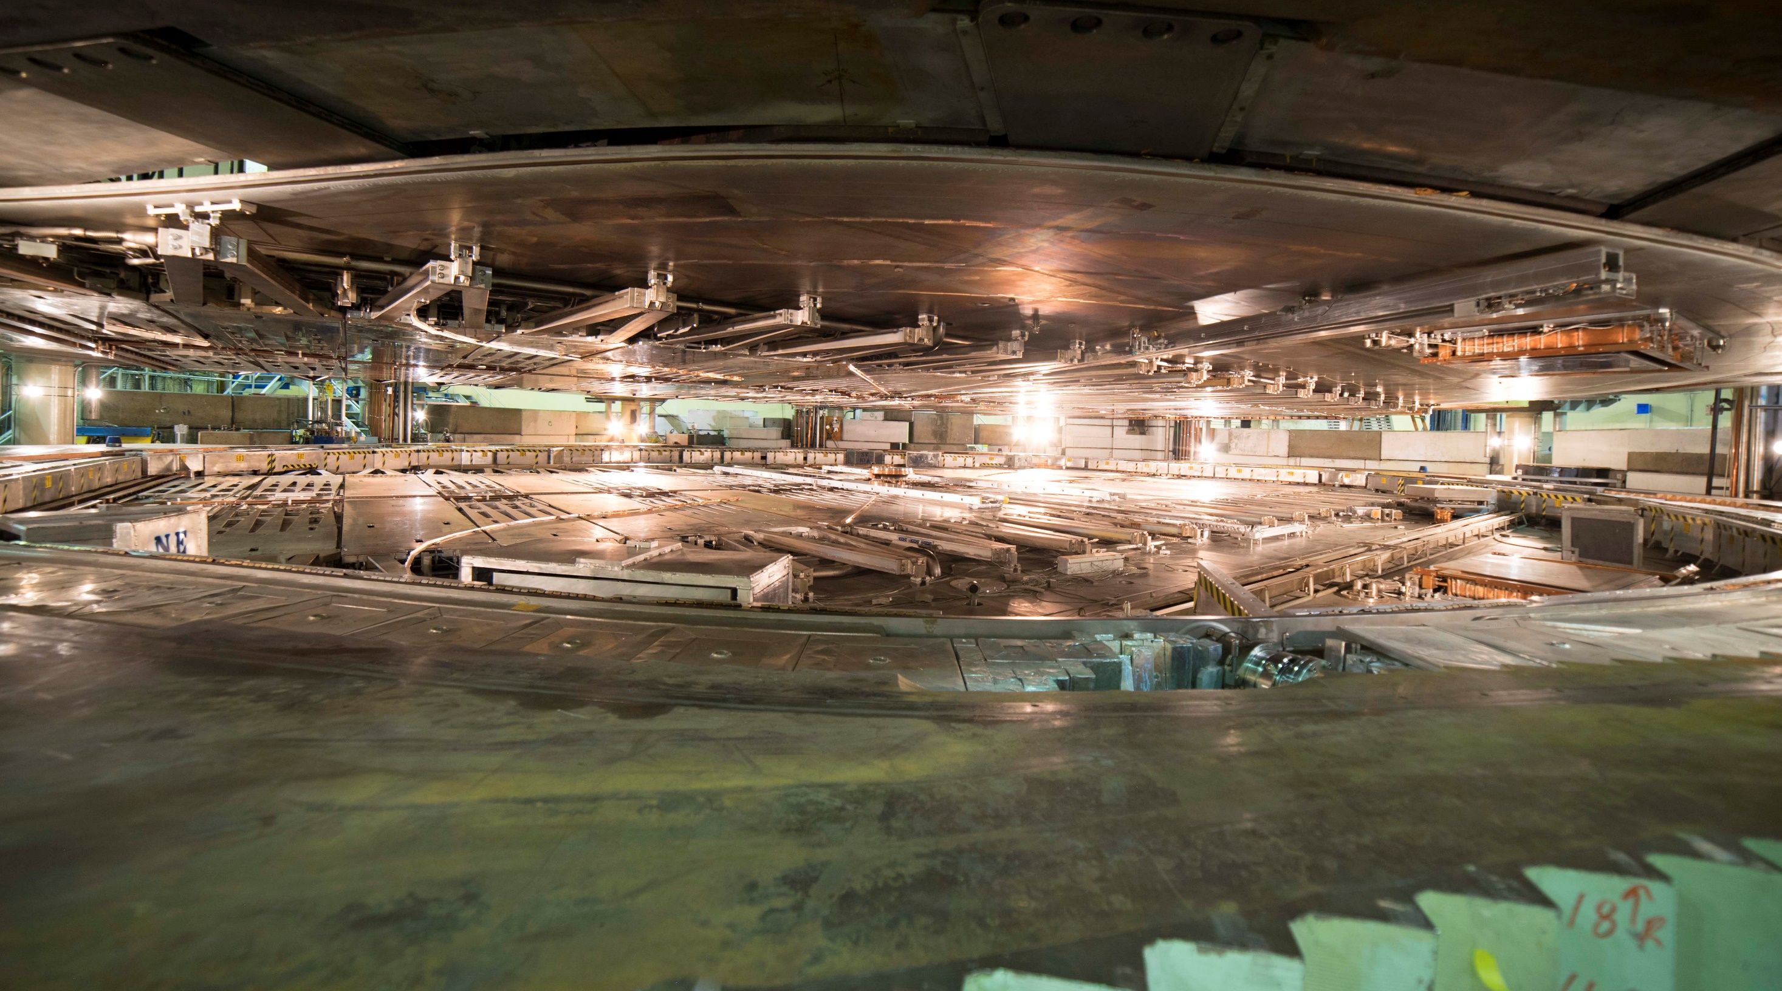
TRIUMF is Canada’s Particle Accelerator Centre, which essentially leads most of the Canadian activities in accelerator sciences.
We have more than five decades of experience in building a rich particle accelerator infra-structure that enables cutting-edge research while growing accelerator expertise.

Slide 4
ARIEL: ISAC×3
ARIEL will have two high power driver accelerators the 520 MeV cyclotron and the ARIEL SC electron linac.
It will triple present rare isotope capabilities of the Isotope Separator and Accelerators (ISAC) by adding
  a 50kW proton target station
  a 100kW electron target station
  Unique beam preparation and transport system (CANadian Rare isotope facility with Electron Beam ion source - CANREB)
ARIEL is the only rare isotope facility
that can and will provide three RIB beams simultaneously to experiments.

Slide 5
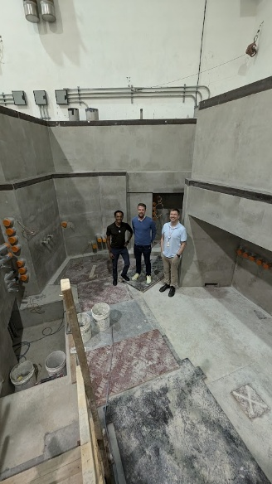
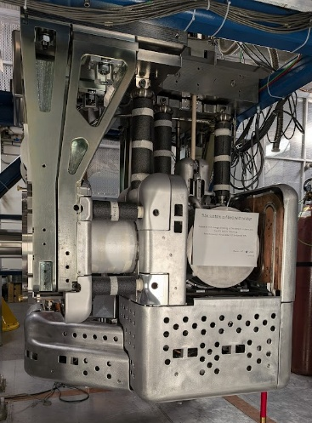
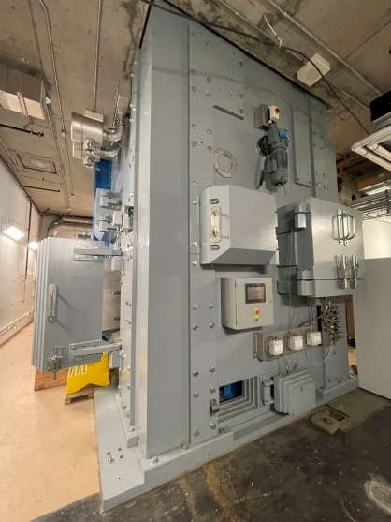
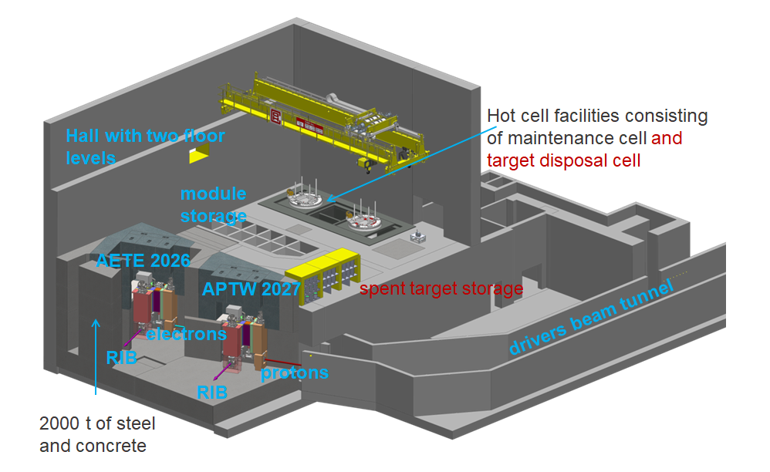
To establish and operate ARIEL
R&D required on:
  Target materials and production
  Offline target operation on a test stand – TISA
  Resonant laser ion sources
  Remote handling: Target decay storage vault, hot cells, target hall shielding, remote controlled crane
  Machine protection system:
  Driver accelerators and electron and proton beam transport lines in the same tunnel
  SRF linac technologies
  Automatic beam tuning, digital twins
Target hall shielding
TISA

Slide 6
Accelerator science at TRIUMF

Slide 7
ACC Division physics and technology activities
  Areas of activities:
  Operation, refurbishment and upgrade of the TRIUMF accelerator complex
  Capacity increase via design and construction of new accelerator systems (ARIEL, CANREB, THz radiation)
  Domestic and international accelerator projects
  → Accelerator research and development
  based on three pillars of excellence in
  beam physics
  secondary particle production
  SRF/RF technologies and research

Slide 8
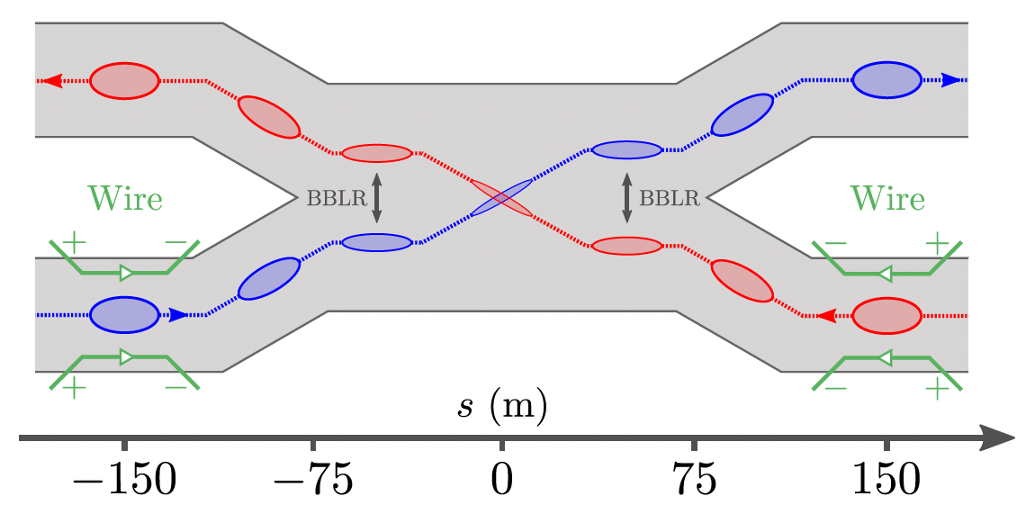
Beam Physics
Beam Physics does focus internally on cyclotrons and linacs and
externally on ring accelerators / colliders:
Beam physics studies of the ARIEL e-linac for THz radiation and DarkLight. Recirculation ring and Energy Recovery Linac operation mode.
Rastering of 100 kW e-beam on the ARIEL electron convertor target.
Commissioning protons (BL4N), simultaneous electron&proton operation.
Increasing the beam current in the cyclotron (500 μA capability, 400 μA daily operation) and overcome issues of high current beam extraction into three beam lines.
RIBs from ARIEL → towards regular ARIEL HRS operation at a resolution oft 20,000.
Dust in accelerators – new hot topic in the accelerator community.
→ UFO analysis in LHC and dust migration in SC linacs.
Investigating the charging mechanism of dust and migration in
the ARIEL electron linac (Aveen Mahon, Ph.D. student Uvic)
Collaboration with CERN on LHC:
Beam-Beam Long Range and compensation methods
Test of Wire Compensators for LHC Run 3 around IP1 and IP5

Slide 9
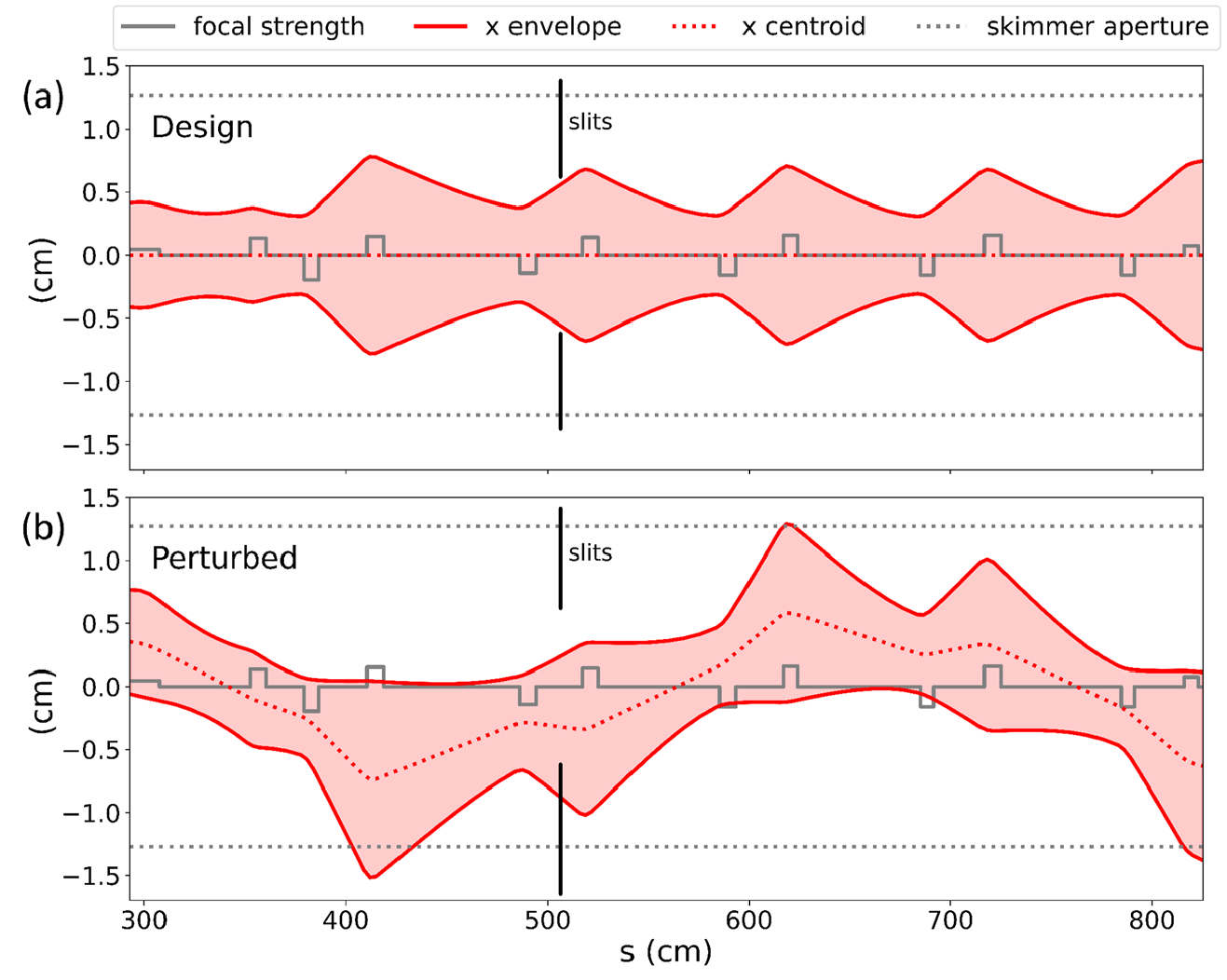
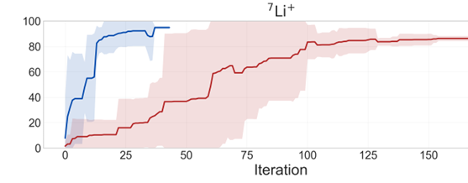
Automatic beam tuning activities
MCAT – TRANSOPTR model of the real machine continuously synchronized (O. Shelbaya, scientist)
Bayesian Optimization for Ion Steering (BOIS):
Optimizes corrective steerers to maximize beam
current on a Faraday cup (O. Hassan, Ph.D. UVic).
Decoupled Machine Coupled ACC tuning (MCAT) and beam orbit correction using Bayesian Optimization (BO).
Easier parameter space to optimize and influence
of quadrupole hysteresis is reduced.
→ limits server requirements
Much faster convergence of the orbit correction!
In the future this approach will be extended
to the ion sources at TRIUMF
(M.Sc. A. Katrusiak, UVic).
Transmission

Slide 10

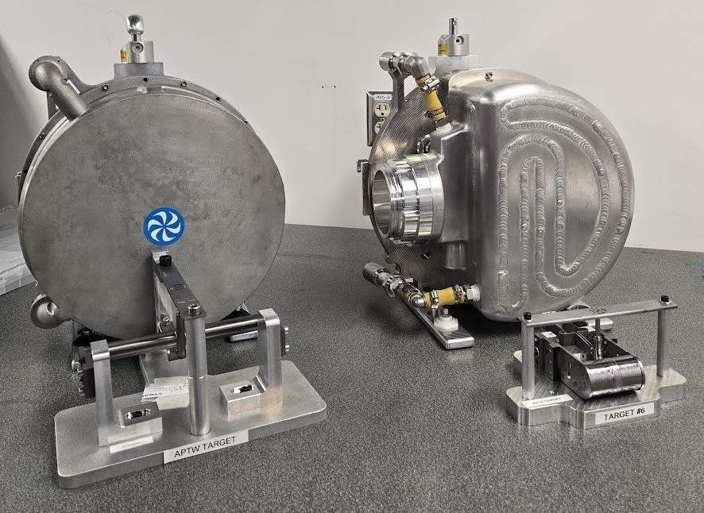
Targets and Ion Sources Research Examples
Converter targets
R&D on high power electron convertor target for ARIEL
Target
Converter
_{e}-
γ
Ion source
Proton-to-neutron convertor to explore fission fragment production
  ARIEL proton & electron targets and target assemblies have been prototyped, optimized and built.
→ Thin target or change of orientation
→ ISAC target geometry not viable for AETE.
→ ISAC isotope extraction efficiencies not directly applicable to ARIEL AETE, but best assumption …

Slide 11
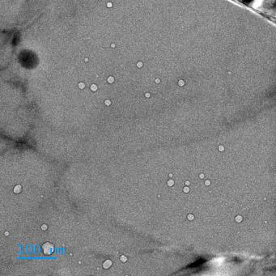
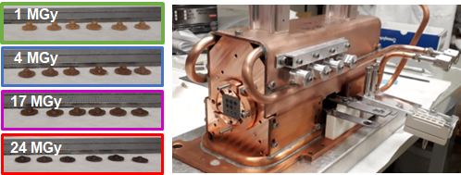
Targets & Ion Sources research examples
Student-led research & development projects continue in the fields of
  Novel target materials for intense radioisotope release → synthesis of highly porous microstructures, post-irradiation examinations and target material thermal conductivity
  → Development of TiC material ongoing
  Material irradiation damage for accelerator and nuclear applications → Radiation
  damage studies
  Example: Canadian Nuclear Labs (CNL) collaboration: Temp. control stage, material
  irradiation and characterization → ongoing studies on Al and Cu alloys for beam
  intercepting elements,
  and PEEK seals for ARIEL targets
  Applications of accelerators and high-power targets
  for neutron and medical isotopes production
  Ionization schemes and laser ionization efficiency
  → at the ARIEL laser ion source systems
Helium bubbles, ISAC irradiated Al6061
Irradiation damage studies – example: PEEK
→ tensile and fracture properties

Slide 12
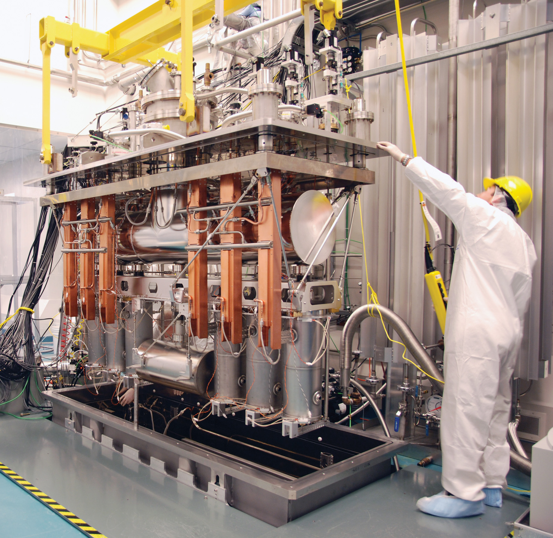
SRF science and technology
(2001-present)
Development towards the ISAC-II Superconducting linac motivated SRF development and infrastructure at TRIUMF
Cavity design, cryomodule design and assembly, fundamental SRF studies are now core competencies at TRIUMF
SRF activities focus on operation of the SRF linacs, external collaborations (HI-Lumi) and student led research in fundamental science and technology
ISAC-II Cryomodule

Slide 13
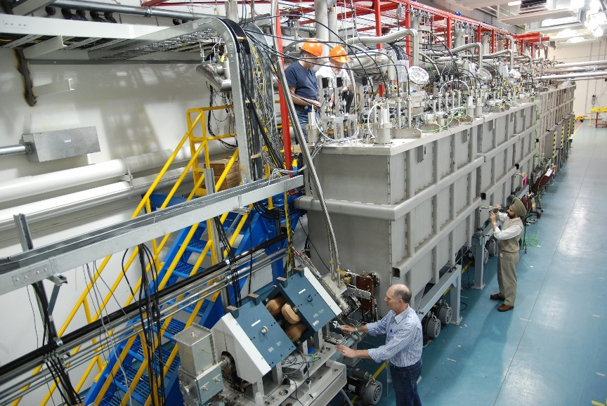

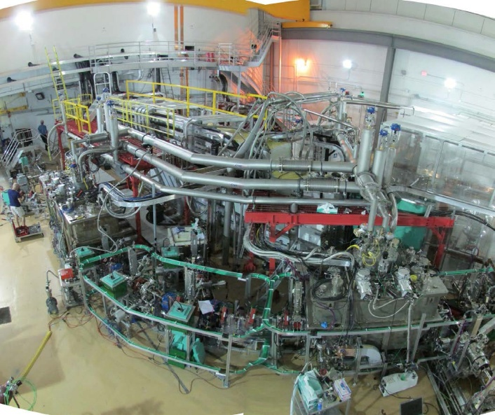
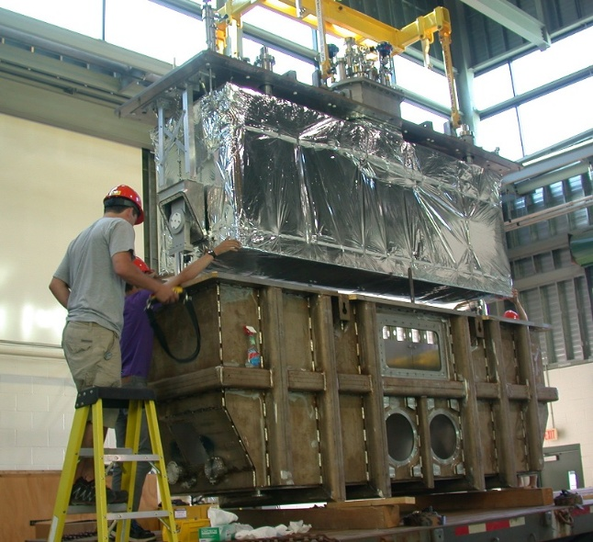
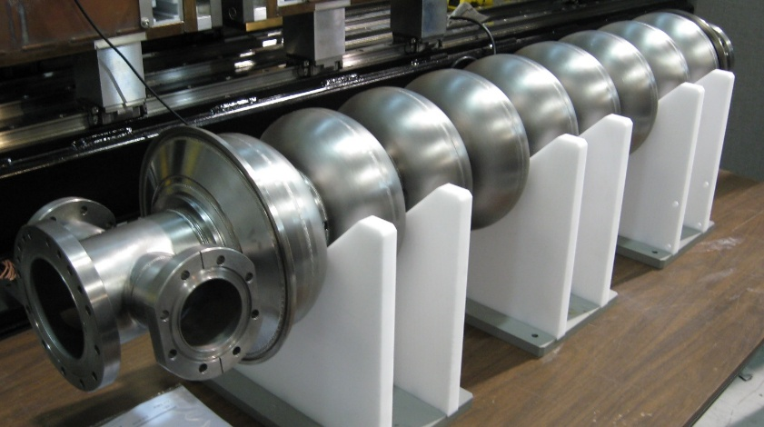
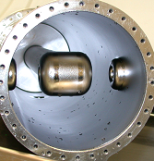
SRF Accelerators at TRIUMF
40MV ISAC-II SRF heavy ion linac @ 106MHz - operational since 2006
30MV ARIEL SRF 10mA electron linac @ 1.3GHz – first beam 2014

Slide 14
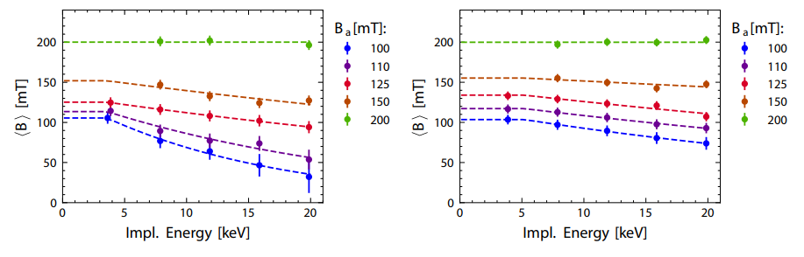
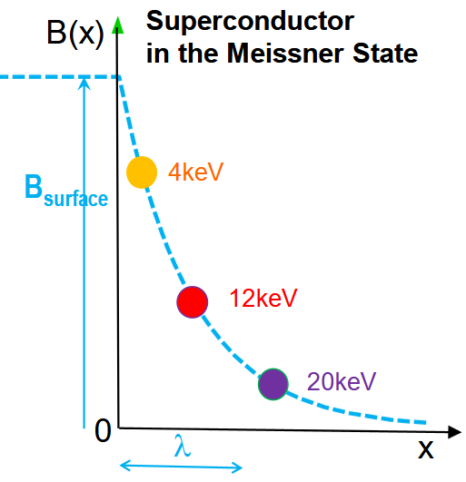
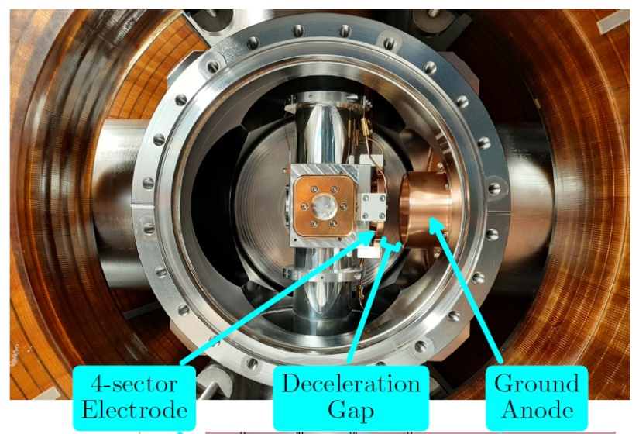
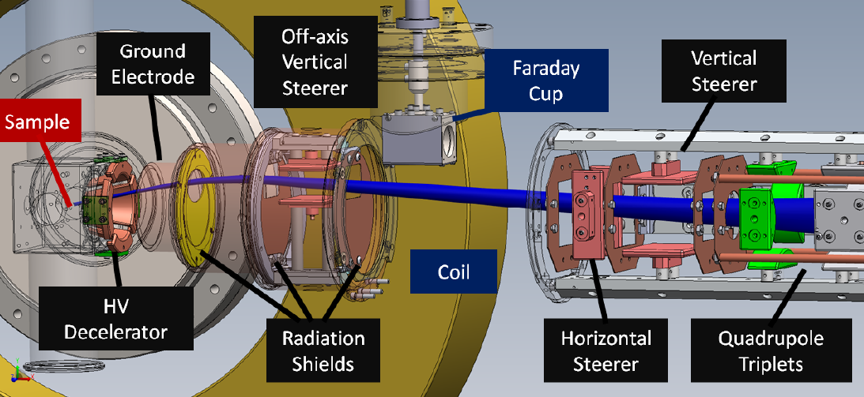

`$β$-SRF’ Facility for SRF material characterization
New beamline extension installed at β-NMR facility for SRF materials characterization
`$β$-SRF’ - Unique facility in the world for depth profiling materials in parallel magnetic fields up to 200mT – SRF regime – critical field of Nb
First results published in Nature Scientific Reports show Meissner screening in two samples as a function of applied field:
Clear difference in screening profile between the two samples
Clear breakdown of Meissner screening with applied field
https://doi.org/10.1063/5.0137368
https://www.nature.com/articles/s41598-024-71724-5
Baseline
Doped
Helmholtz coil

Slide 15
Areas of accelerator and associated technologies in the IRL

Slide 16
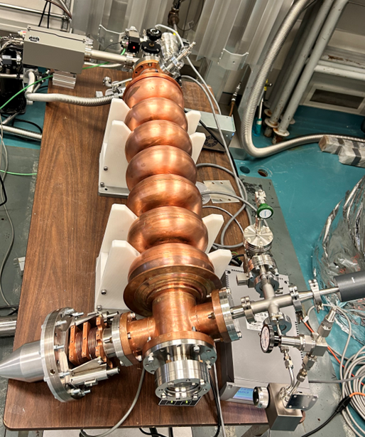
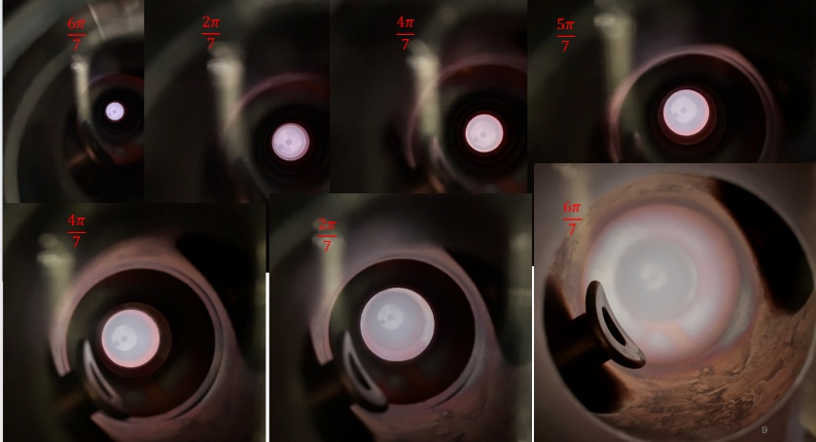
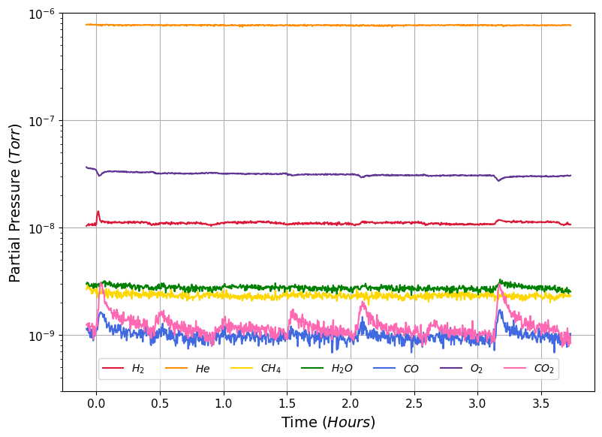
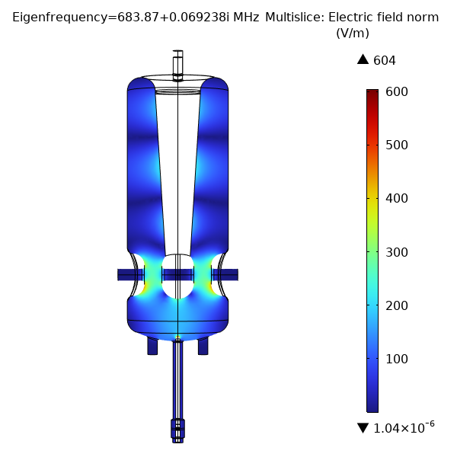
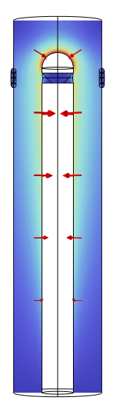
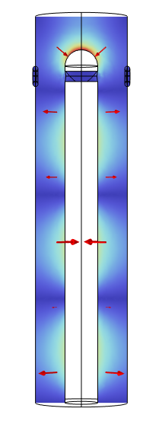
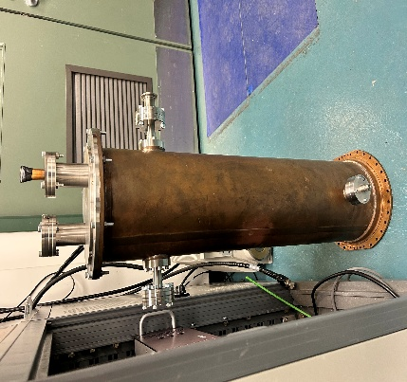





Plasma Processing
Plasma processing is a surface cleaning method used in SRF to reduce the negative impact of field emission that lowers the useful accelerating gradient
  The cleaning method can be deployed with the cavity installed in the linac
Development for ARIEL – Off-line studies demonstrating readiness for electron linac deployment (Will Stokes – UVic MSc)
Development for ISAC-II – test cavity prepared for collaborative study at IJCLab –
Will Stokes to travel to IJCLab in July to work with Camille Cheney (PhD IJCLab) to optimize processing of an ISAC-II quarter wave resonator based on Spiral2 QWR processing
ARIEL clone cavity
Moving He plasma from cell to cell
Cell: 7
6
5
4
3
2
1
$\frac{6π}{7}$
$\frac{2π}{7}$
$\frac{4π}{7}$
$\frac{5π}{7}$
$\frac{4π}{7}$
$\frac{2π}{7}$
$\frac{6π}{7}$
Gas evolution cell by cell during processing
Spiral2 QWR
ISAC-II Cavity copper model

Slide 17
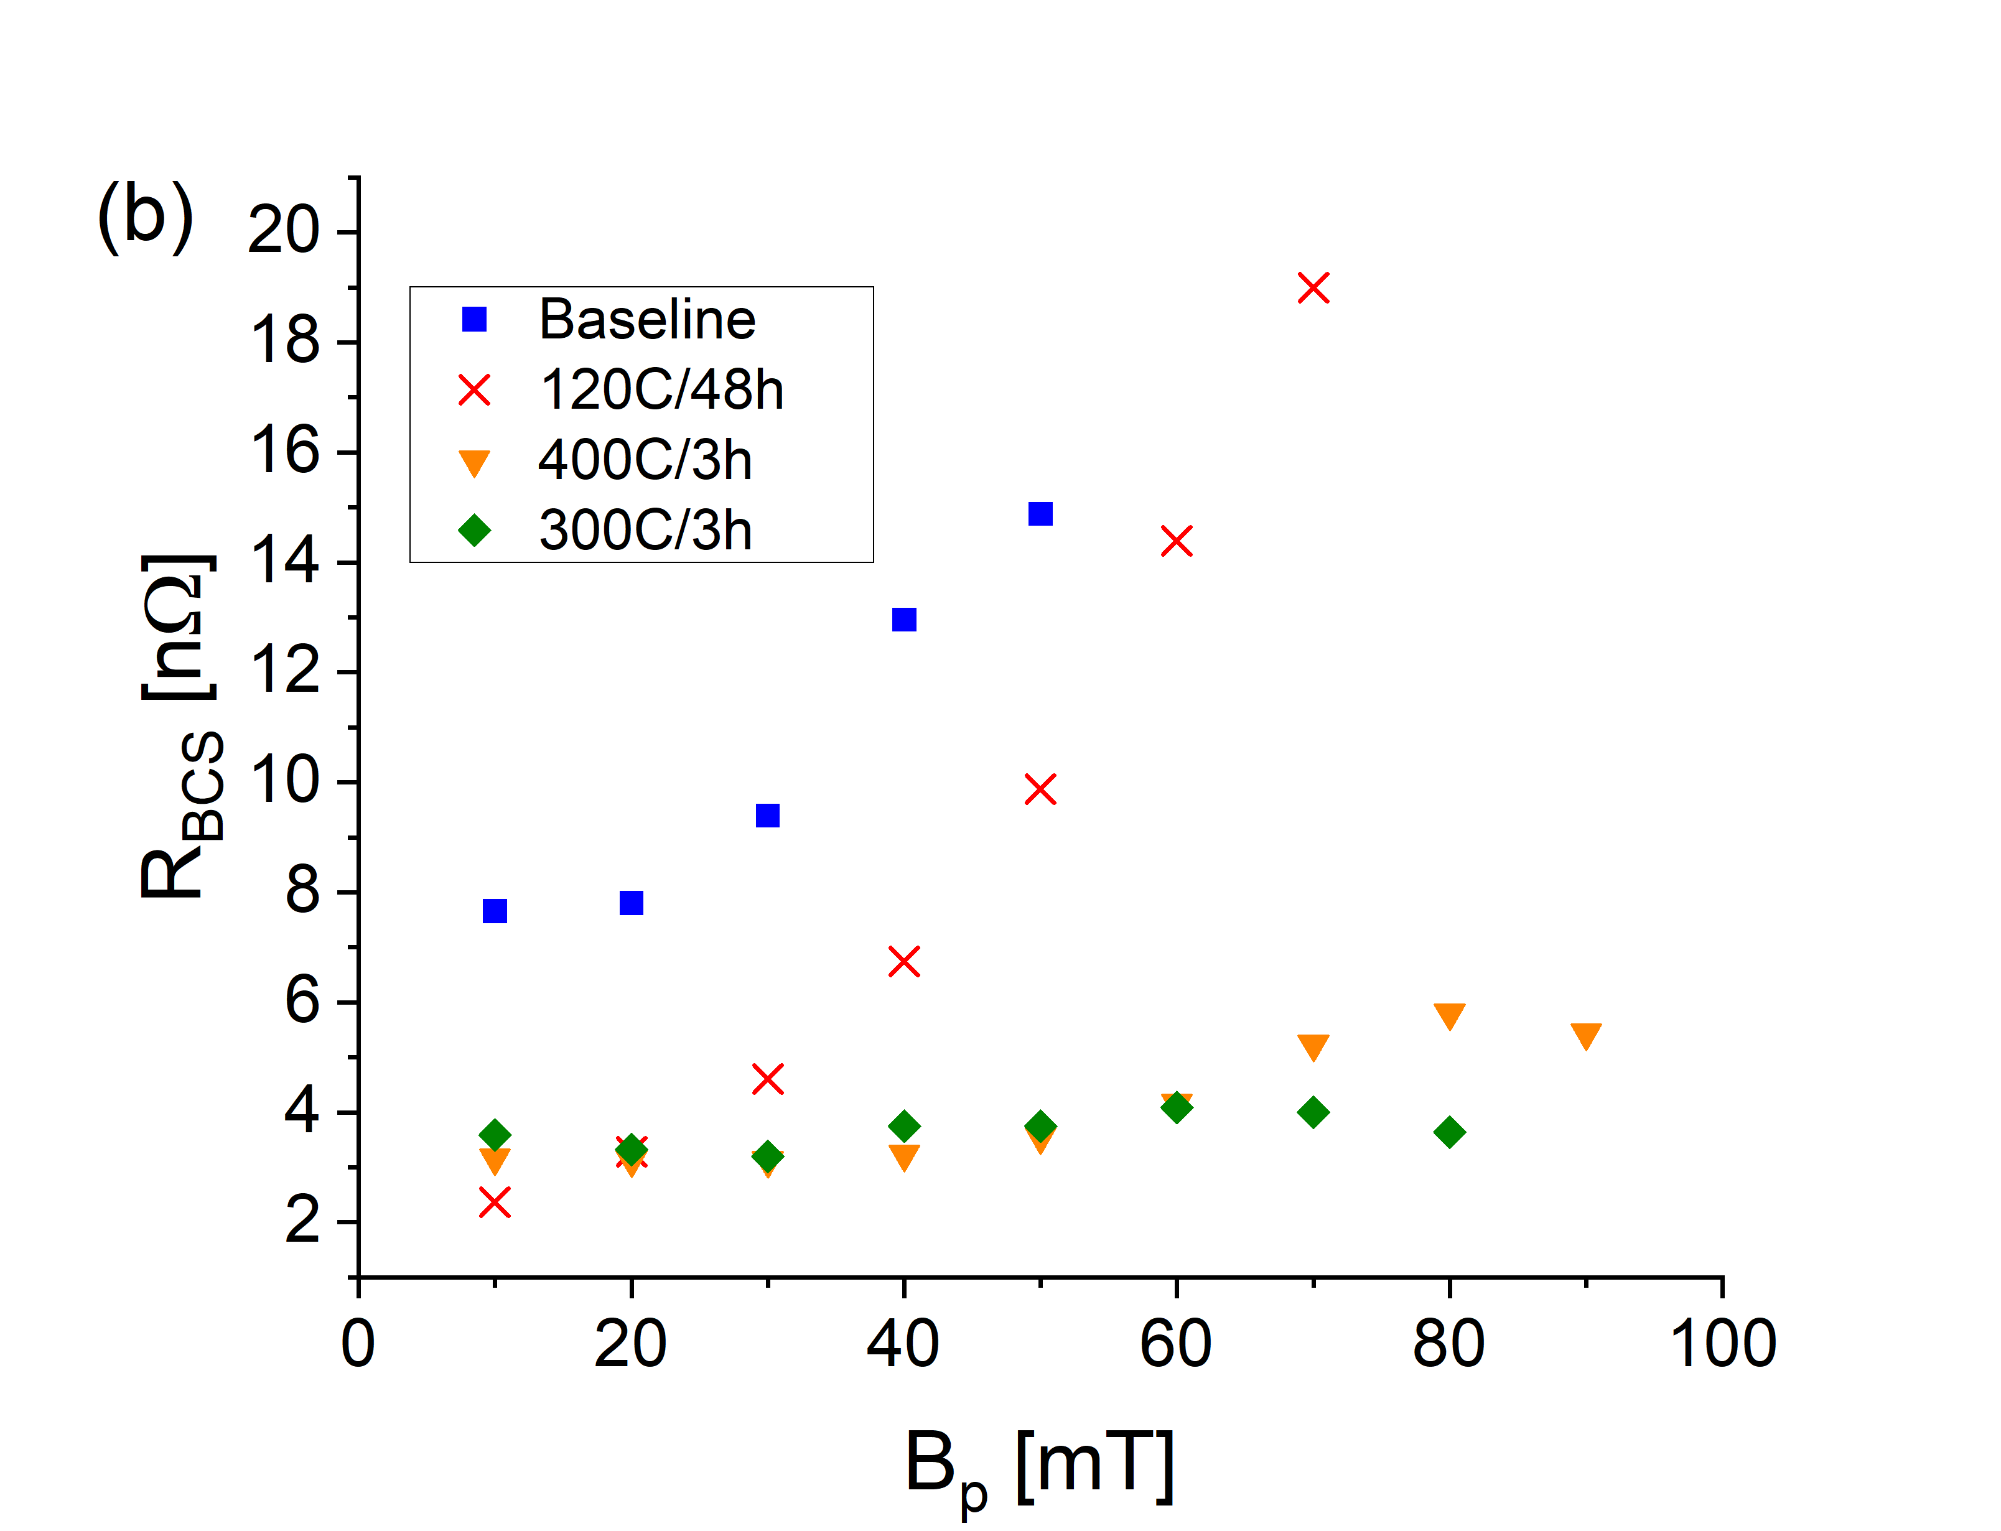
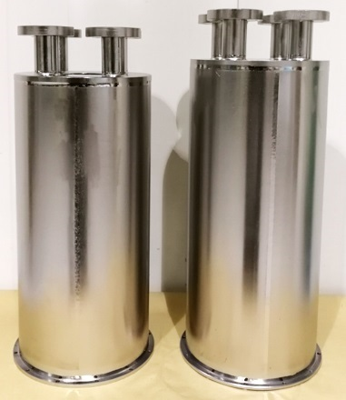
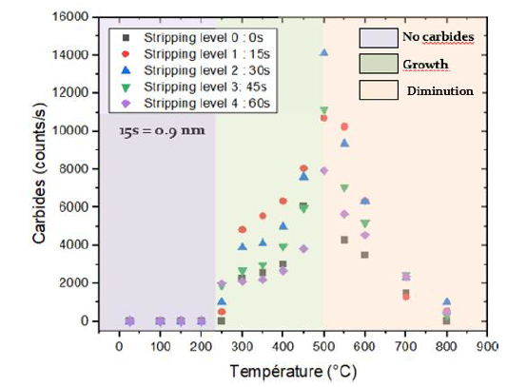
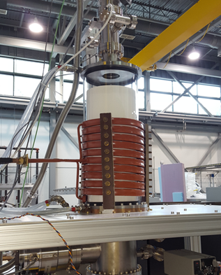
SRF heat treatment study (TRIUMF/IJCLab)
2K – mid-T bake – 1166MHz
TRIUMF’s coaxial cavity program has revealed reduced BCS resistance for high frequency mode after mid-T heat treatment but with higher residual resistance
Concerned about growth of lossy carbides during heat treatment
Sample heat treatment study with IJCLab
  Student visit - Chahinez Boutilaa (IJCLab) - paper/talk SRF2025
  IJCLab/TRIUMF collaborative investigation of carbide formation as a function of temperature on niobium samples
  X-ray Photoelectron Spectroscopy (IJCLab) and TOF-SIMS (Western U.)
Study determined the temperature regime for carbide growth
TRIUMF coaxial cavities
No carbide
Carbide growth
Carbide diffusion
TRIUMF Rf induction oven
Carbide formation vs temperature
Notes:
XPS=X-ray photo-emission spectroscopy, TOF-SIMS=time of flight secondary ion mass spectroscopy

Slide 18
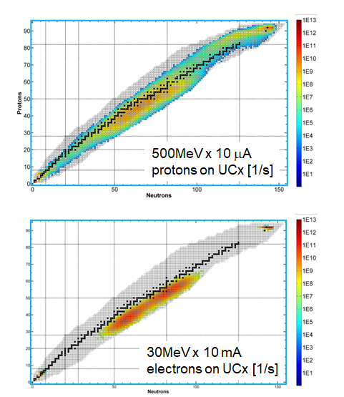

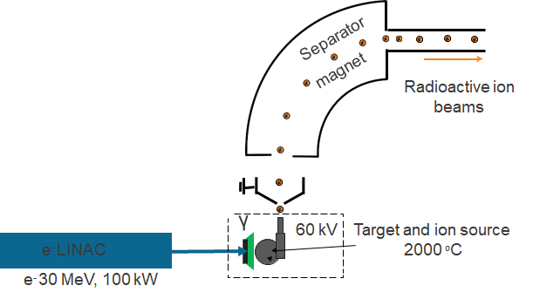
ARIEL Electron Target station
Photofission production from electron beam like at ALTO → we are using 30 MeV electrons but e-linac will be build out to its design energy of 50 MeV
Can provide competitive yield of many neutron rich species with relatively low isobaric contamination with respect to proton induced spallation.
High beam power requires converter technology

Slide 19
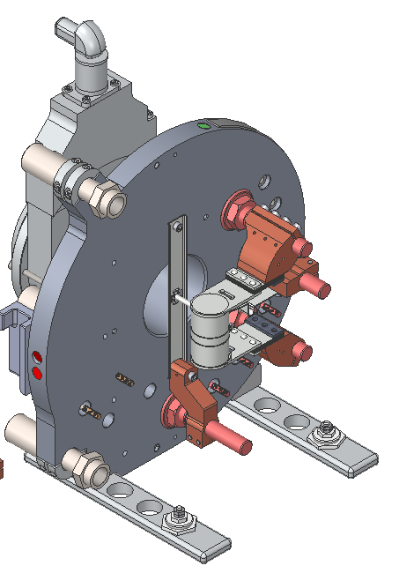
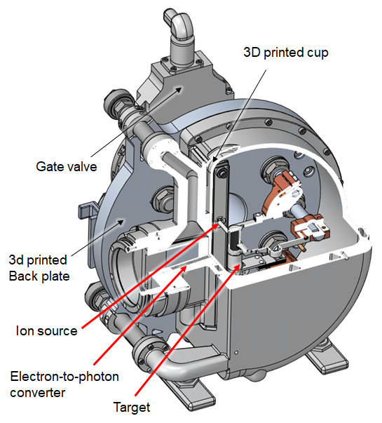
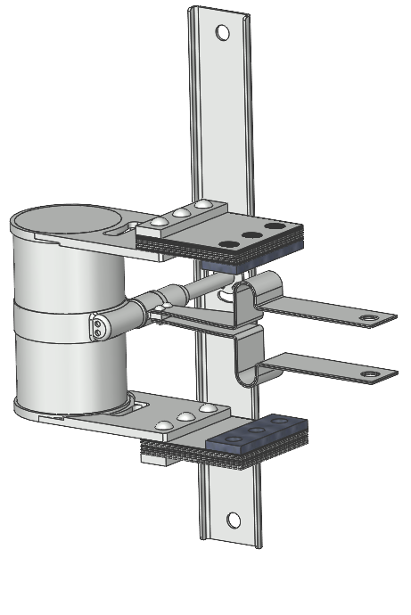
Technical solution for high electron Beam Power
The current world-record for e-induced RIB production is 500 W (ALTO).
We will go towards 100 kW.
At 1 kW and for the small target, the power temperature homogeneity manageable
→ the more we increase beam power, the steeper
temperature gradients are across the target,
mostly in the beam direction
UC_{x} material properties are not well known,
and this uncertainty makes the simulation
more uncertain → online tests required
ISOLDE-style, high-power target vessel
Convertor integrated in the beam window

Slide 20
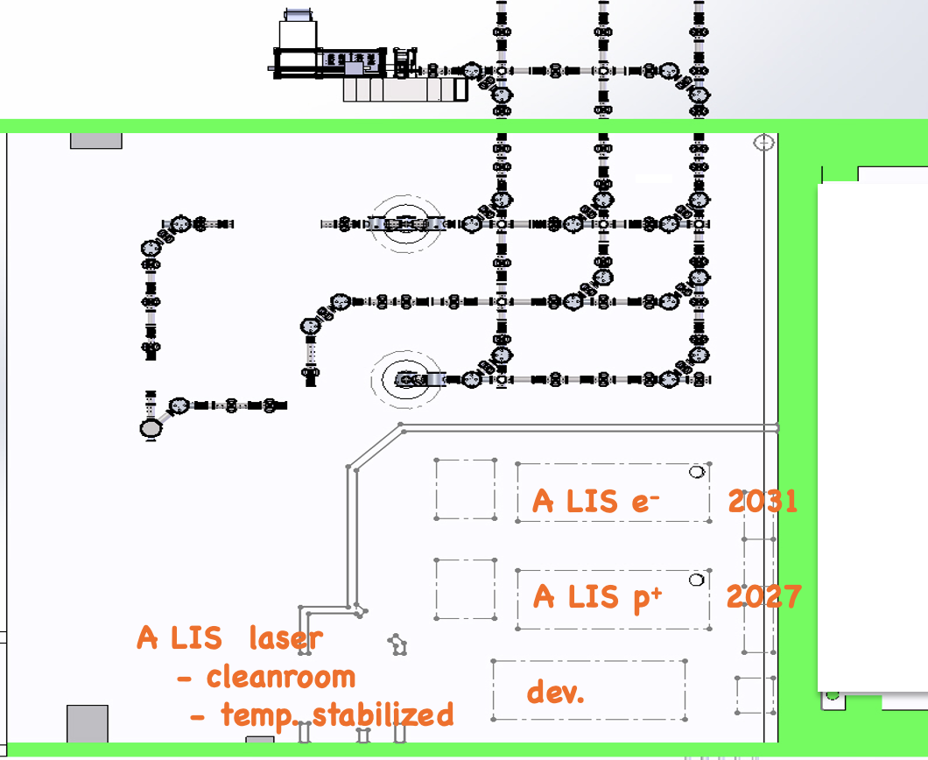

3 laser ion source systems in the ARIEL era
2 accelerated beam
experimental hall (ISAC I)
ARIEL RILIS p⁺
~2031
experimental hall (ISAC I)
radioactive ion beams (RIB)
~10 user facilities
nuclear & atomic physics
material sciences
ARIEL RILIS e⁻
~2027
APTW
AETE
ISOL
(ARIEL)
ISOL
(ISAC)
TRIUMF RILIS
ITW
ITE
BL4N, 100 μA p⁺
BL2A, 100 μA p⁺
cyclotron & beamlines (since ~1975)
RIB lines
meson hall
muon spin rotation
Irradiation p⁺, n
isotope production
ultra cold neutrons
e-linac and beamline (since ~2014)
BL2C
e- LINAC
30 MeV, 10 mA
user facilities
BL1A
ISAC ISOL targets (since ~ 2000)
480 MeV, 100 μA p⁺
ARIEL ISOL targets (from ~2026)

Slide 21
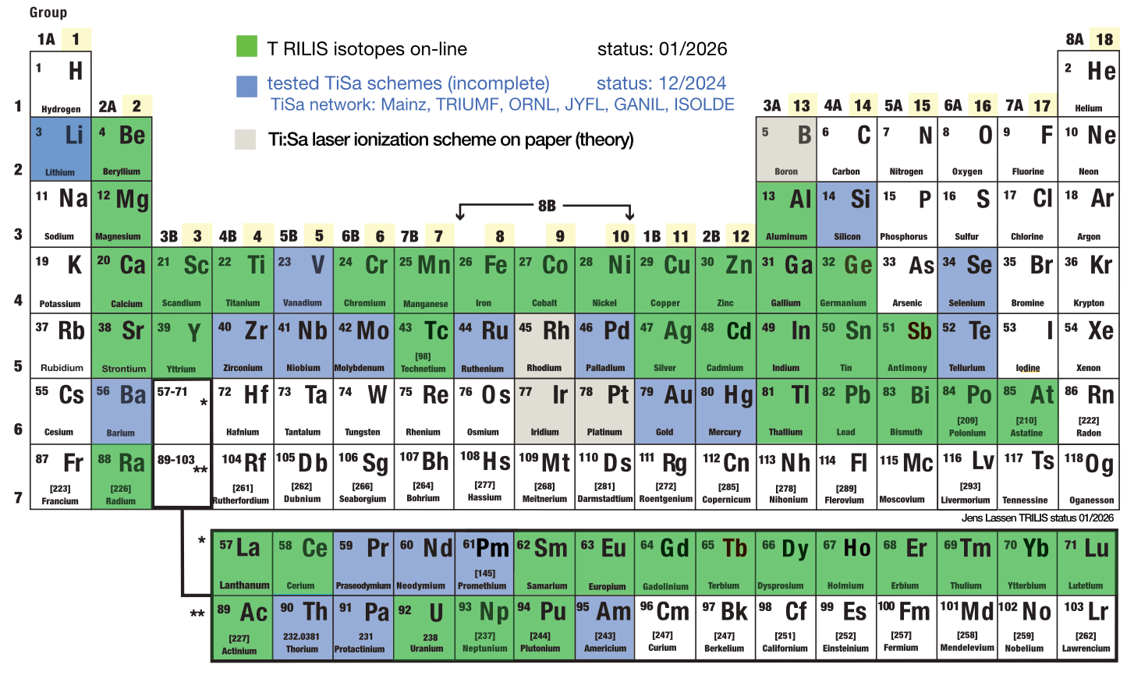
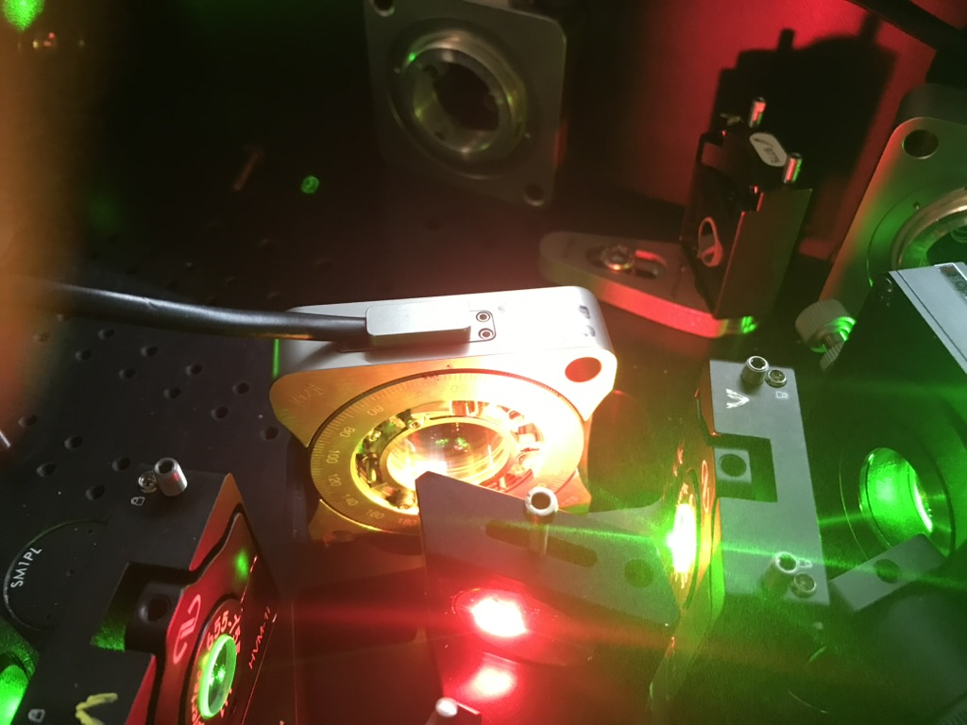
3 laser ion source systems – ARIEL era
Ionization schemes for 45 elements used online (2026)
ionization schemes for 9 elements ready to go online (2026)
6ea ALIS p⁺ station tuneable lasers under construction
6ea ALIS e⁻ station tuneable lasers (FY2031)
ALIS p⁺ and e⁻ laser beam transport under construction
ALIS laser cleanroom commissioning Q3 2026
most complex component “4-plate birefringent filters” developed (BSc/MSc student), build of 12ea in Q2/Q3 2026
TRIUMF TiSa
laserintra-cavity,
birefringent filter
assembly
characterization (2026)
students (Alexia Landry
/ Lucie Savajols)

Slide 22
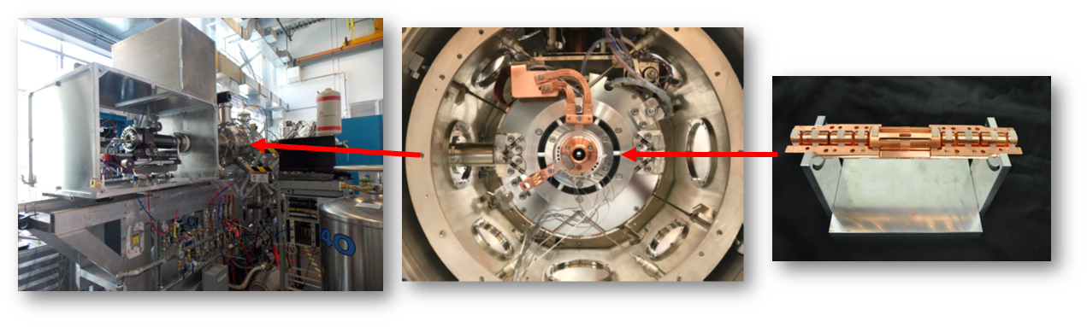
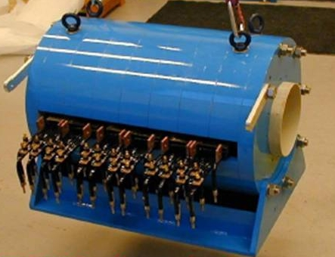
TRIUMF Charge State breeders
1⁺
solenoid
barrier
electrode
electron repeller
electron beam
ion beam
electron collector
drift tubes
CANREB EBIS (similar to the TITAN EBIT): 6T superconducting magnet in a Helmholtz coil set-up → Allows radial optical access to the electron beam. Running at Ultra High Vacuum!
anode
n⁺
RF injection
separation
of rest gas ions
solenoid
singly
coils
charged
Magnetic field confinement
n+ ions
ions
TRIUMF Charge State Booster (CSB): A 14.5 GHz PHOENIX Electron Cyclotron Resonance Ion Source (ECRIS) from PANTECHNIK
→ running at 10⁻⁸ mbar (world record), still significant rest gas ion background

Slide 23
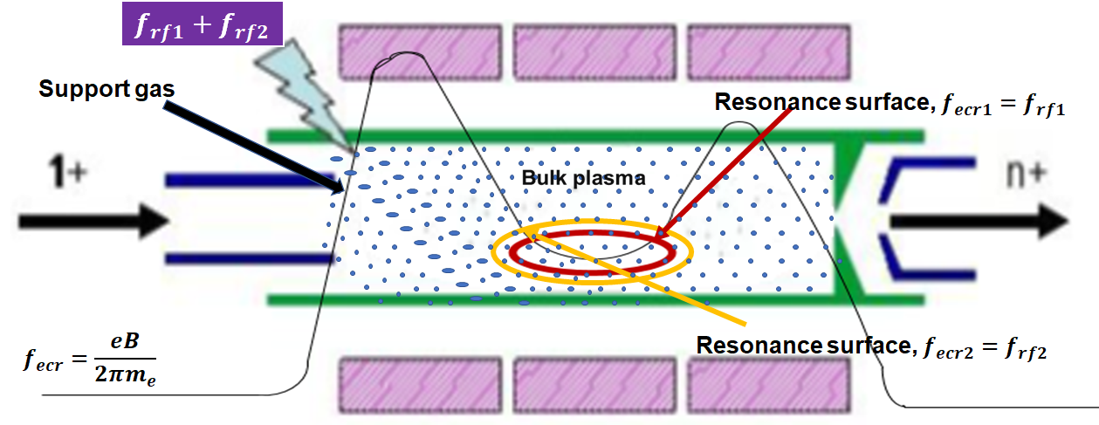
Current research on TRIUMF ECRIS devices
Increase of charge breeding efficiency by implementing
  two-frequency heating technique that provides two resonance zones
  frequency tuning technique to find optimize RF matching (scanning the microwave frequency)
  → Bayesian Optimization
Improving the beam properties by optimizing the extraction system
  Simulations with the code IGUN©
  Benchmarking with emittance measurements using beam tomography (quadrupole scans)

Slide 24
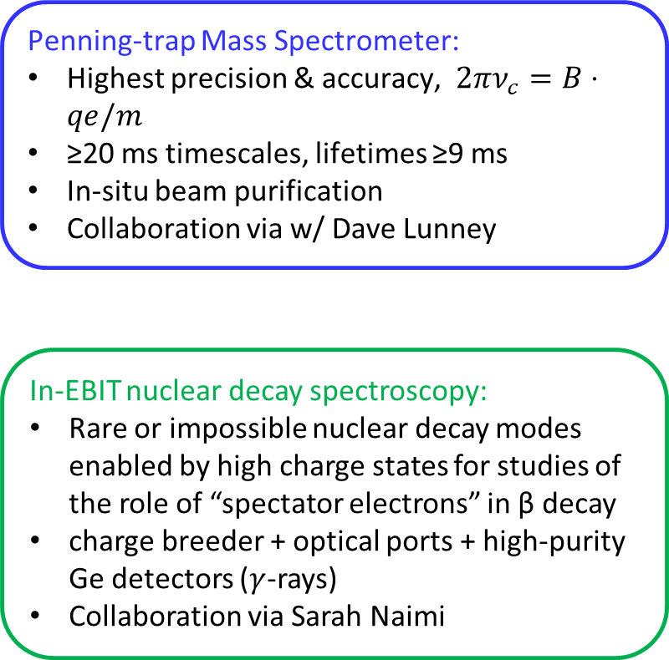
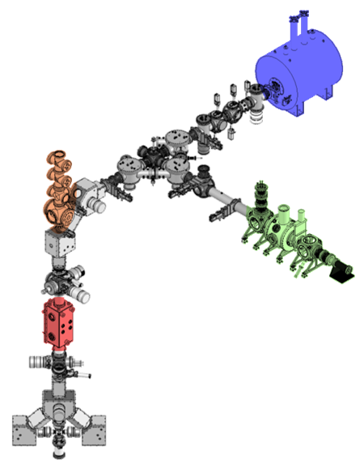
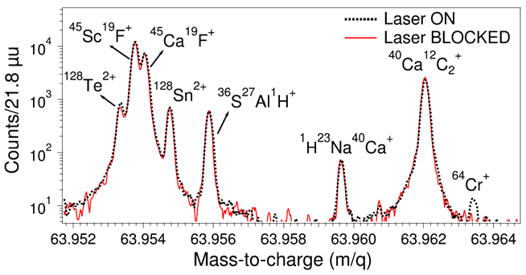
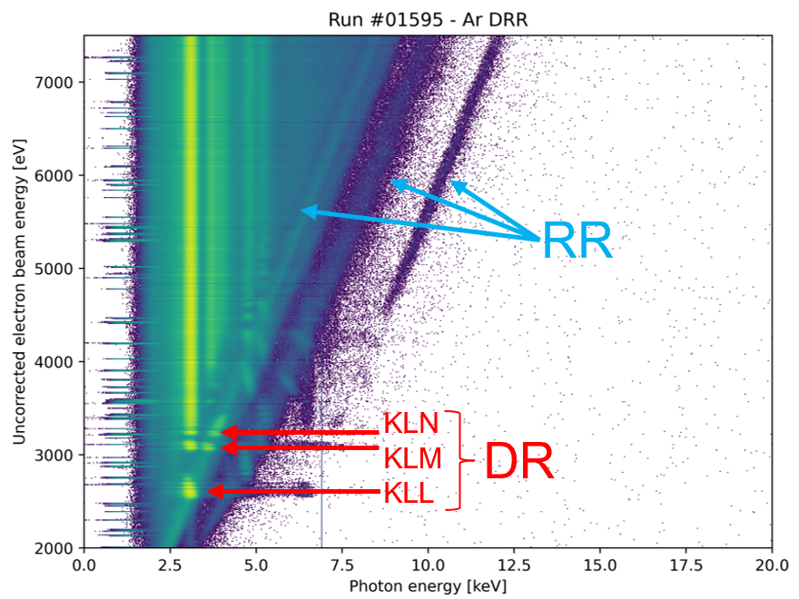
TITAN + IJCLab: Ion Traps for Mass & Exotic Decays
Multi-Reflection Time-Of-Flight Mass Separator / Spectrometer:
Ions bounce between electrostatic mirrors to temporally separate by m/q
Typical R ≈ 500k
In-situ beam purification → dynamic range 10⁴⁻⁸ & yields ≥0.006 pps
Benefits RIB development
Collaboration via w/ Dave Lunney

Slide 25
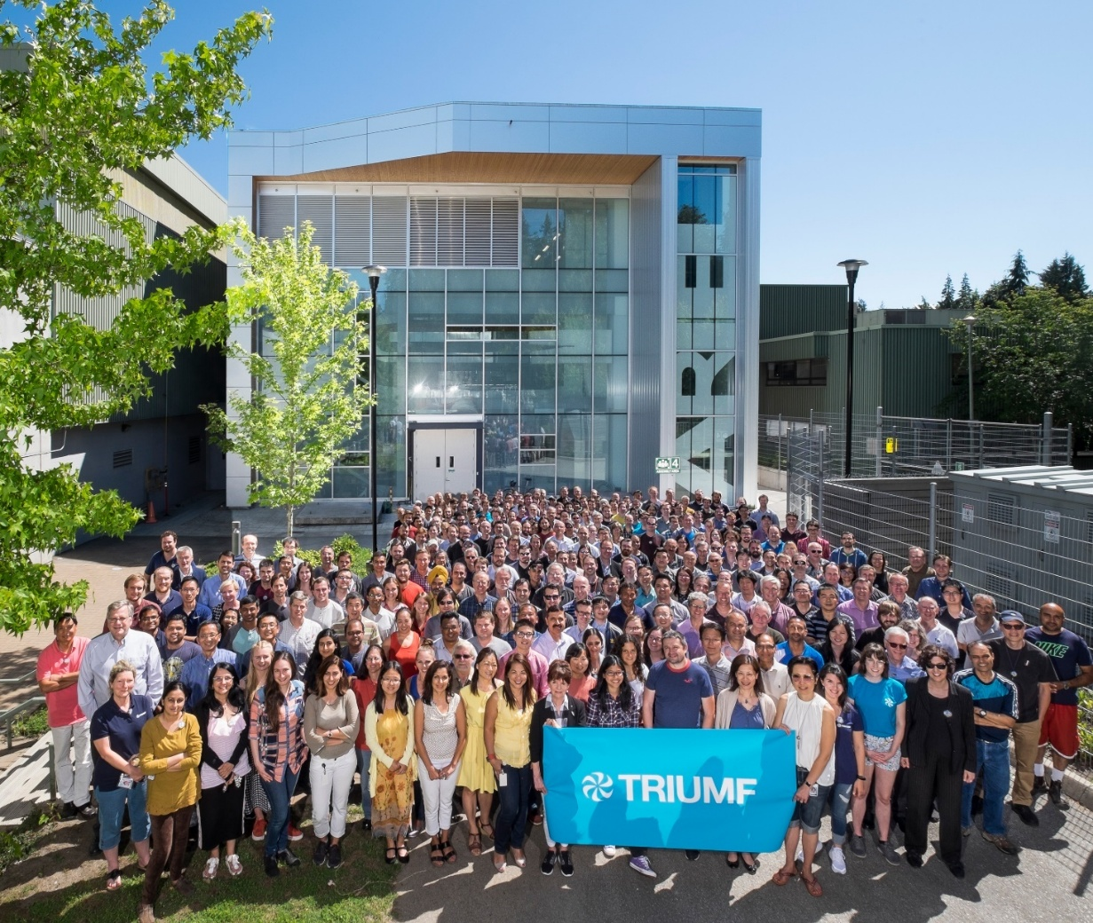
Summary
TRIUMF operates a rich array of particle accelerators for both hadrons and electrons
→ requires expertise in Target and Ion Source, Beam Physics and SRF and a healthy R&D program and collaboration
The future ARIEL facility is the only rare isotope facility that will provide three RIB beams simultaneously to experiments.
The infrastructure and know-how provides opportunities for international collaboration, like in NPAT!

Slide 26
Thank you, Merci
www.triumf.ca

Slide 27
Backup slides

Slide 28
Core Competencies of the Accelerator Division
Operation of a sophisticated accelerator facilities with simultaneous delivery of multiple beams
Particle sources: H⁻-sources, Heavy ion sources, charge state breeder (ECR and EBIS), electron guns
Beam physics: Simulation codes, beam tuning applications, physics of space charge dominated ion and electron beams, collider beam physics
Beam transport systems: Electrostatic and magnetic beam line systems, high resolution mass separators
Target technology and ISOL systems: High power RIB targets, target ion sources (SIS, FEBIAD, LIS), in-target beam purification technologies (IG-LIS, cold transfer line, proton-to-neutron converter), nuclear spin polarization, muon production targets, high-power targetry, material radiation damage
Remote handling: Hot cell technology, robotics, irradiated target and radioisotope handling, manipulation of activated and contaminated parts, cyclotron services, radioactive waste management
Accelerators: Linacs (heavy ions and electrons) normal and superconducting, cyclotrons (H-), synchrotrons, FFA, accelerator design
Accelerator systems: RF (low level and power RF, SRF, cavity development), cryomodules, vacuum (including UHV), cryogenic systems, power converter technologies, high and low intensity beam diagnostics (ions and electrons), machine protection
Accelerator Application: Medical isotope production, irradiation (material, therapy, electronics,…)
Education: Seminars, lectures, lab research projects and thesis research

Slide 29
Link to TRIUMF 20-year vision: Accelerator Science and Facilities
Isotope Valley
With ISAC+ARIEL+IAMI we will greatly expand our capabilities, and establish TRIUMF as a leading global center for isotope research.
Isotopes for physical science
Isotopes for life science
Isotopes to cure Canadians
Canadian Hub
We are Canada’s centre of excellence in accelerator-related science and technology.
We centralize knowledge, and diffuse it through training, counsel, and collaborations.
With our always evolving expertise we remain a leader in Canada’s transformation to a knowledge based economy.
Big Science — Big Tech
International collaborations are key to contribute to the most significant discoveries, attract talents, and maintain cutting-edge expertise.
We support international projects by leveraging our core knowledge and engaging Canadian industry.
We build on our strengths to serve science and invent life-changing technologies.
https://beamphys.triumf.ca/~tplanche/20-year-vision-acc.pdf

Slide 30
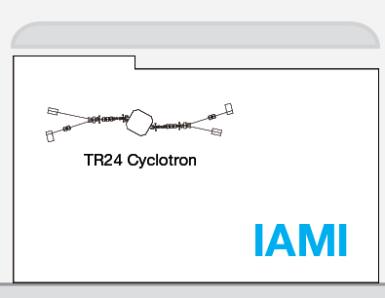
TRIUMF accelerator complex
ISAC-II
High energy
ARIEL
Primary beam driver:
Cyclotron, 500 MeV, H⁻
Produces rare isotopes, neutrons and muons!
Isotope Separator and Accelerator facility - ISAC
Isotope Separator Online (ISOL) facility
ISAC-I: Normal conducting-linac, 0.15-1.5 MeV/u
ISAC-II: Superconducting-linac, 5-15 MeV/u
Advanced Rare Isotope Laboratory - ARIEL
Superconducting electron linac
30 MeV, 10 mA, cw
4 Cyclotrons for medical isotope production
(with a TR24 to be commissioned in the Institute for advanced Medical Isotope – IAMI)
ISAC-I
Low and
medium
energy
Cyclotrons
for medical
Isotope
production
500 MeV
Cyclotron

Slide 31



High Resolution Spectrometer
Latest commissioning results
Two 90-degree dipole design
Electrostatic Multi-pole corrector between dipoles
ΔM/M=1/16000 resolution tune demonstrated with high transmission
Emittance at exit slit before multipole correction
Emittance at exit slit after multipole correction
Collaboration on the DESIR-HRS

Slide 32






SRF: RF Dipole Cryomodule Project at TRIUMF
TRIUMF will produce four crab cavity cryomodules for the Hi-Lumi project at CERN by July 2028
Eight crab cavities fabricated through a US collaboration
32

Slide 33

THz radiation project
beam dump
Transport
to ARIEL
TRIUMF, as part of a pan-Canadian collaboration (including TRIUMF and CLS), will receive CFI funding to develop a THz light source within the ARIEL e-linac hall.
Addition of a new photo-gun to produce short, high brightness, low emittance, beam bunches, and a bunch compression chicane.
A partial recirculation arc and septum will be used to install the chicane off the main linac beamline.
Additional funds are being sought to complete the recirculation ring for either Energy Recovery or Energy doubling for DarkLight for instance.
septum
THz chicane
1.3 GHz SRF Cavities
650 MHz e-Gun
Photo-gun

Slide 34

Example domestic: PC-CANS
TRIUMF is collaborating with the University of Windsor and the Canadian neutron scattering community towards an accelerator-based neutron facility
Collaboration has conceptualized a stageable prototype CANS facility, PC-CANS, based on linac technology.
PC-CANS will allow competitive rates for neutron science, while
simultaneously producing F18 for PET and neutrons for a dedicated
BNCT research and development facility.
The PC-CANS prototype would be the
first CANS in Canada and the first
for BNCT in North America.
The project will augment and solidify
TRIUMF core competence in linac and target systems
and the proton accelerator technology is well aligned with applications

