Slide 1



SRF collaboration with
IJCLab & TRIUMF
David LONGUEVERGNE (Maverics)
Camille CHENEY (Maverics)

Slide 2
Outline
Overview of SRF R&Ds @IJCLab
On-going activities with TRIUMF and perspectives
Conclusion

Slide 3
How are we organized @IJCLab?
MAVERICS team
(~ 8 people involved in SRF activities)
Leading R&D effort in SRF
Driving SRF programs
VIDE & SURFACES Platform
(Material and surface characterization)
Material characterization (SEM, EBSD, EDS, XPS, XRD, SIMS, confocal microscope, …)
Dedicated set-up (SEY, plasma)
SUPRATECH Platform
(Treatment, assembly and test of SRF components)
Cryostats
Dedicated SRF facilities (BCP lab, clean rooms, UHV Furnace)
He Liquefier
Assembly area for cryomodules
Cryogenic Group
(~ 6 people involved in SRF activities)
Expertise in design of cryogenic systems
Operation and maintenance of cryogenic facilities of Supratech
RF Group
(~ 8 people involved in SRF activities)
Driving SRF programs
RF and mechanical design of SRF components (Cavity, tuner, coupler, LLRF)
Operation and maintenance of RF equipment of Supratech

Slide 4
SRF Challenges and Future Projects at IJCLab
SRF Challenges
Associated R&D projects @IJCLab
Heat Treatment: Doping by thermal diffusion (Mid-T baking). R&D @ SUPRATECH
High Q₀ : Decrease of surface resistance to reduce the cost of the accelerator (cryogenic plant) and consequently increase the operating accelerator gradient.
High Gradient (E_{acc}) : Increase of the achievable gradient with the aim of reducing the size and cost of the accelerator
Reliability of cavities in operation: Maintain of cavity performances when equipped with its power coupler and frequency tuning system, increase of surface treatments yield.
SURICAT : New superconducting materials in single or multiple layers. R&D @ Vide&Surface
DECAP : In-situ decontamination by reactive plasma. R&D @ Vide&Surface
PIP-II, COBOT : Integration of a collaborative robot (COBOT) in a cleanroom.
R&D @ SUPRATECH
MULTIPAC : R&D on materials with low secondary electron yield (SEY).
R&D @ Vide&Surface

Slide 5
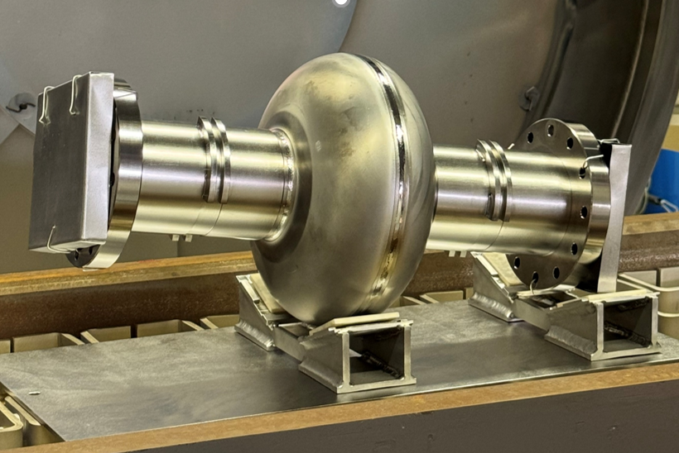
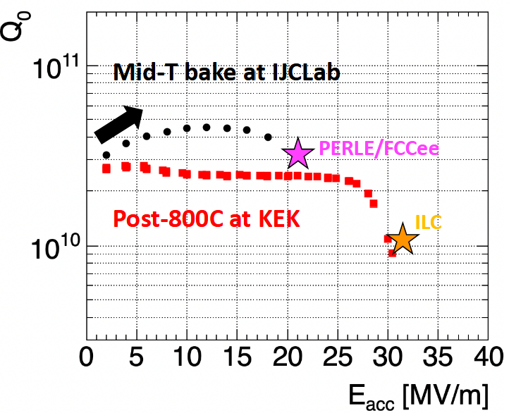
Thermal doping (Heat treatment) and alternative materials (SURICAT)
Superconductor (NbN)
~ 50 nm
2 routes studied for High Q₀ and high Gradient:
Isolator (AlN)
Superconductor (doped Nb, other)
~ 1 um
Superconductor
~ 10 nm
Nb/Cu
Isolator
Nb
Thick layers:
Surface doping of Niobium by thermal diffusion (HEAT TREATMENT)
(SUPRATECH UHV Furnace) => High Q₀
Deposition of an alternative superconducting material (SURICAT) (Development of NbZr via CNRS partners, analyses Vide&Surfaces)
=> High Q₀, High Gradient
Multi-layers (SIS)
Superconducting Layers (NbN, NbTiN) separated by an Insulating Layer.
Investigating NbN mono-layer by CVD (SURICAT)
(Development via CNRS partners, analyses Vide&Surfaces)
1.3 GHz cavity installed in UHV furnace @Supratech
Starting this project. No results yet
Supratech UHV furnace qualified for Mid-T baking
Successful on-going collaboration with KEK and CEA (FJPPN)

Slide 6
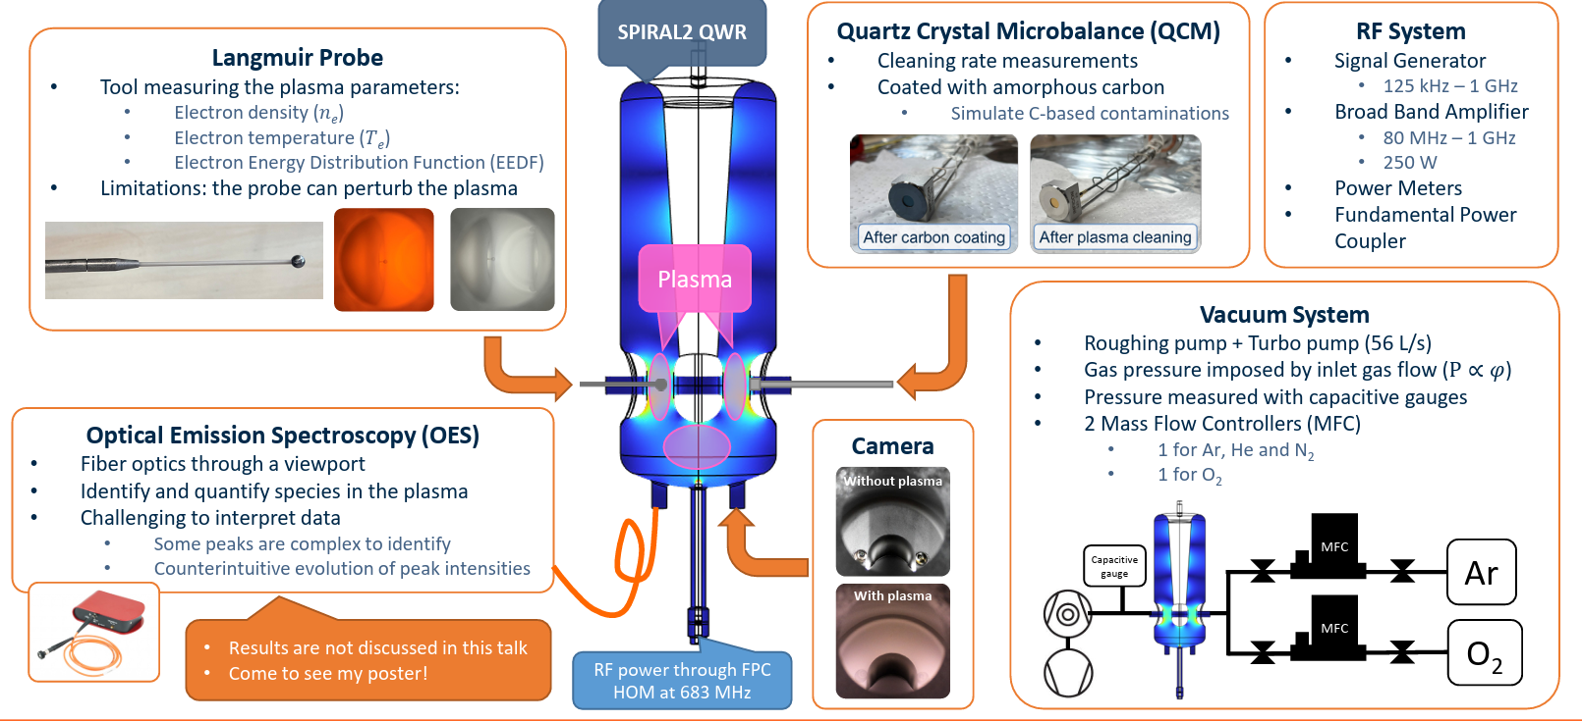
Plasma treatment (DECAP)
R&D plasma set-up to optimize efficiency by dedicated in-situ plasma diagnostics :

Slide 7
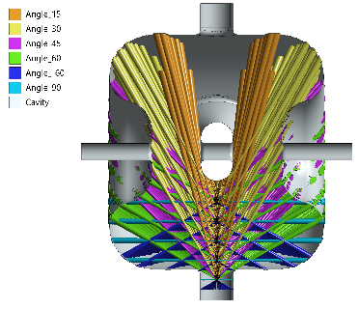
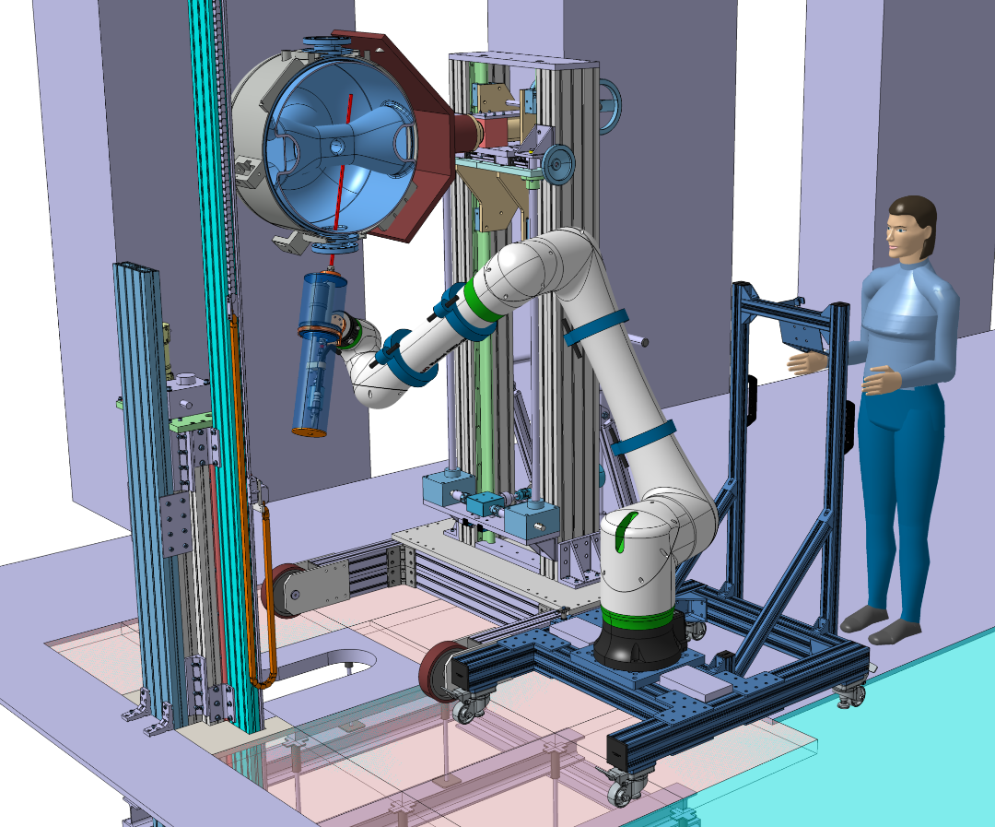
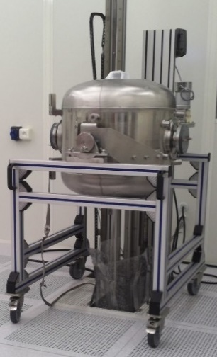
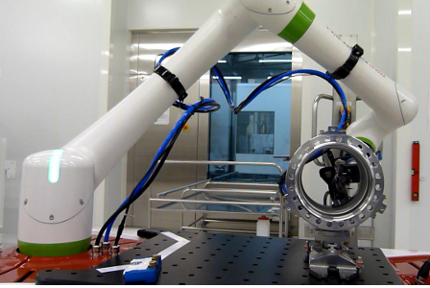
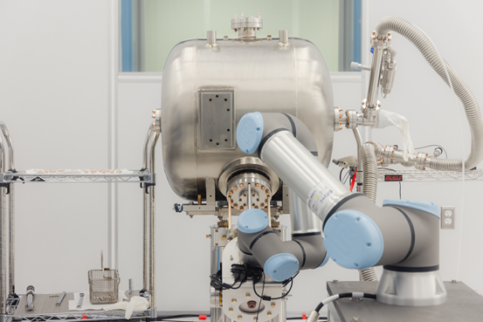
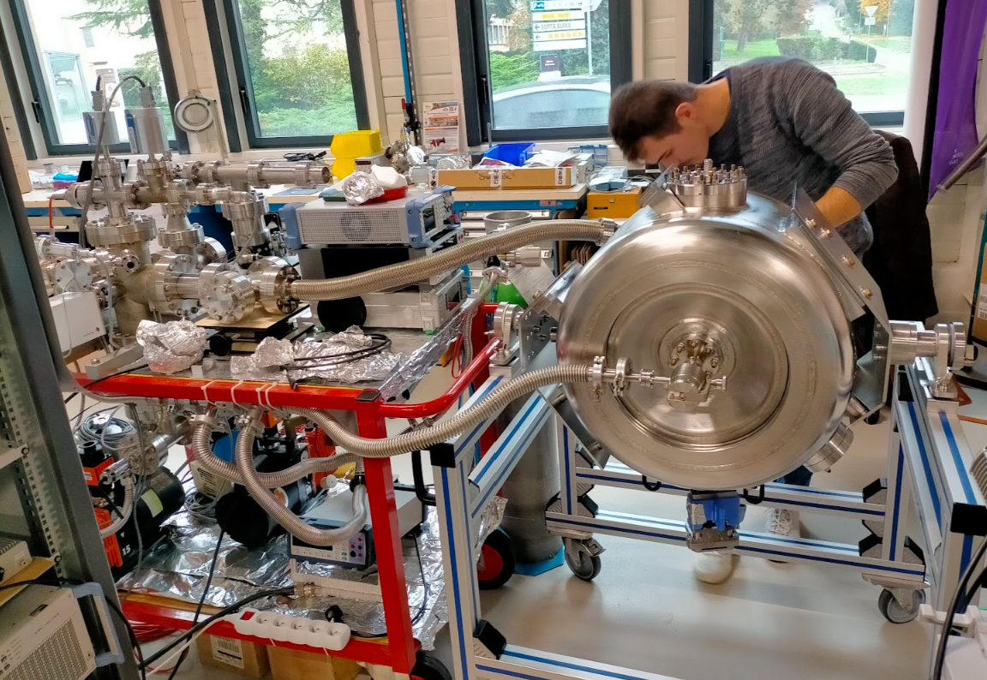
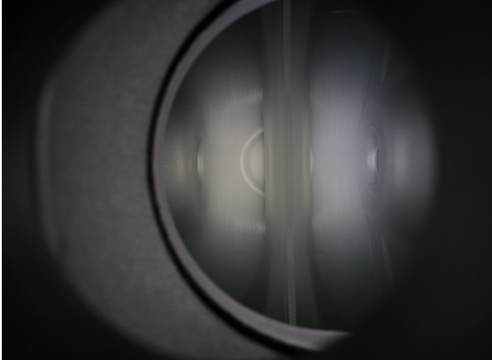
HPR cleaning, clean assembly and plasma decontamination in complex structures (COBOT, PIP-II)
Surface decontamination by high-pressure ultrapure water (HPR) jet:
  Today : important limitations for complex geometries (Spoke type cavity). Strenuous work for the staff (restrictive and noisy environment).
  Goal : Integration of a Cobot (COllaborative roBOT) increases technical capacities while relieving staff.
Maintaining cleanliness during assembly:
  Today : cleanroom assemblies are complex (specific tools). Humans are the main source of contamination in cleanrooms.
  Goal : Integration of a Cobot to assist or automate the assembly of components while reducing dedicated tools and human intervention.
"In situ" decontamination of accelerator cavities by plasma:
  Today : an accelerator module that fails due to a cavity emitting strong ionizing radiation must be taken offline, dismantled, cleaned and reassembled.
  Goal : In situ "curative" decontamination by reactive RF plasma gives a chance to reduce X-ray emission and recover good performance.
  Goal : "Preventive" decontamination could help reducing SEY and manipulating surface chemistry.
PIP-II Cavity installed on HPR set-up @Supratech
Project of HPR assisted by Cobot @Supratech
C. Madec (CEA), TTC, 2023
C. Narug (FNAL), TTC, 2023
Plasma ignited in PIP-II Cavity
PIP-II Cavity installed on plasma set-up @Vide&Surfaces

Slide 8
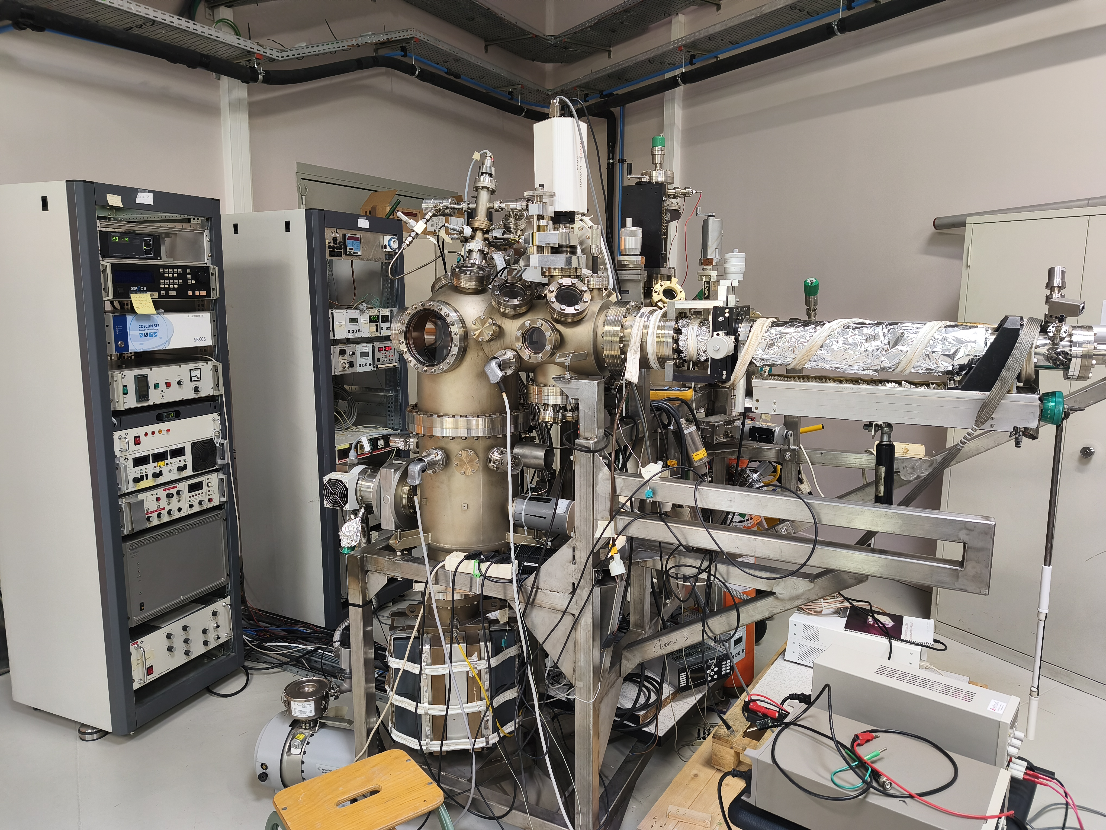
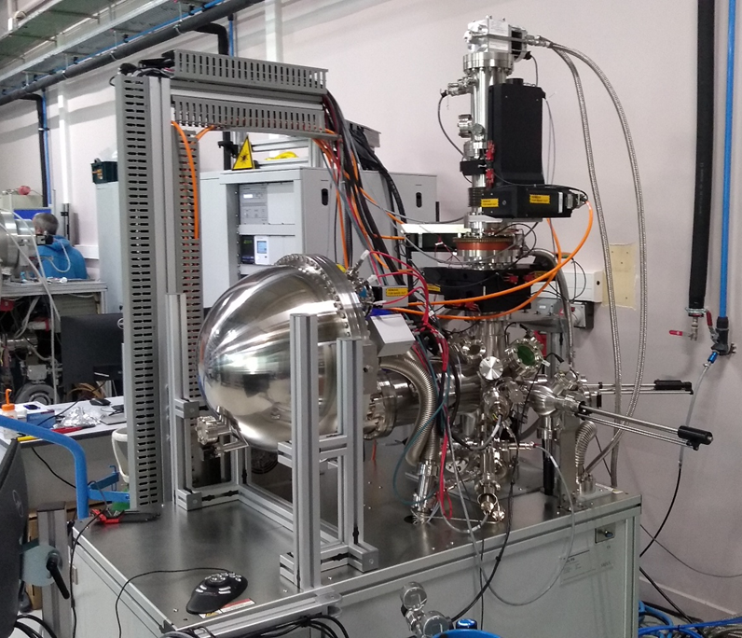
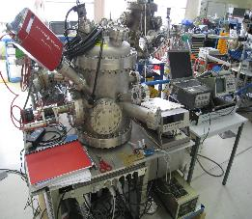
Multipacting mitigation and SEY measurement (MULTIPAC)
Objectives:
Measurement of the secondary emission coefficient (SEY) and its conditioning dynamic of new materials produced by R&D projects (anti-multipacting layers, surface treatment, new superconducting materials, etc.):
  @ Room temperature: in a "routine" SEY set-up: Evolution of SEY as a function of the electronic load received.
  @ Room temperature: in ISIS multi-technical set-up: Evolution of SEY with in-situ XPS, heat treatment <500°C, ion and electronic bombardment, RGA, plasma.
  @ Cryogenic temperature: in OSIRIS multi-technical set-up (not yet operational): Evolution SEY with in-situ XPS, 400K>T>10K, ion and electronic bombardment, RGA, plasma.
Routine SEY @ Vide&Surfaces platform
ISIS set-up @ Vide&Surfaces platform
OSIRIS set-up @ Vide&Surfaces platform

Slide 9
Outline
Overview of SRF R&Ds @IJCLab
On-going activities with TRIUMF and perspectives
  Nb Carbides
  Plasma treatment
Conclusion

Slide 10
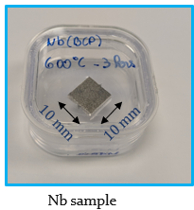
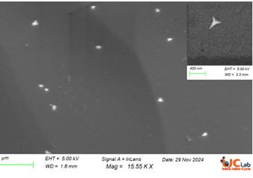
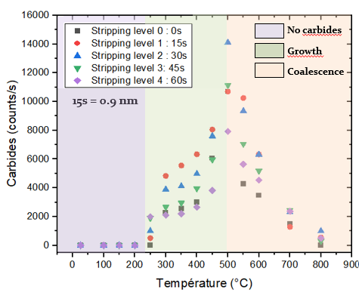
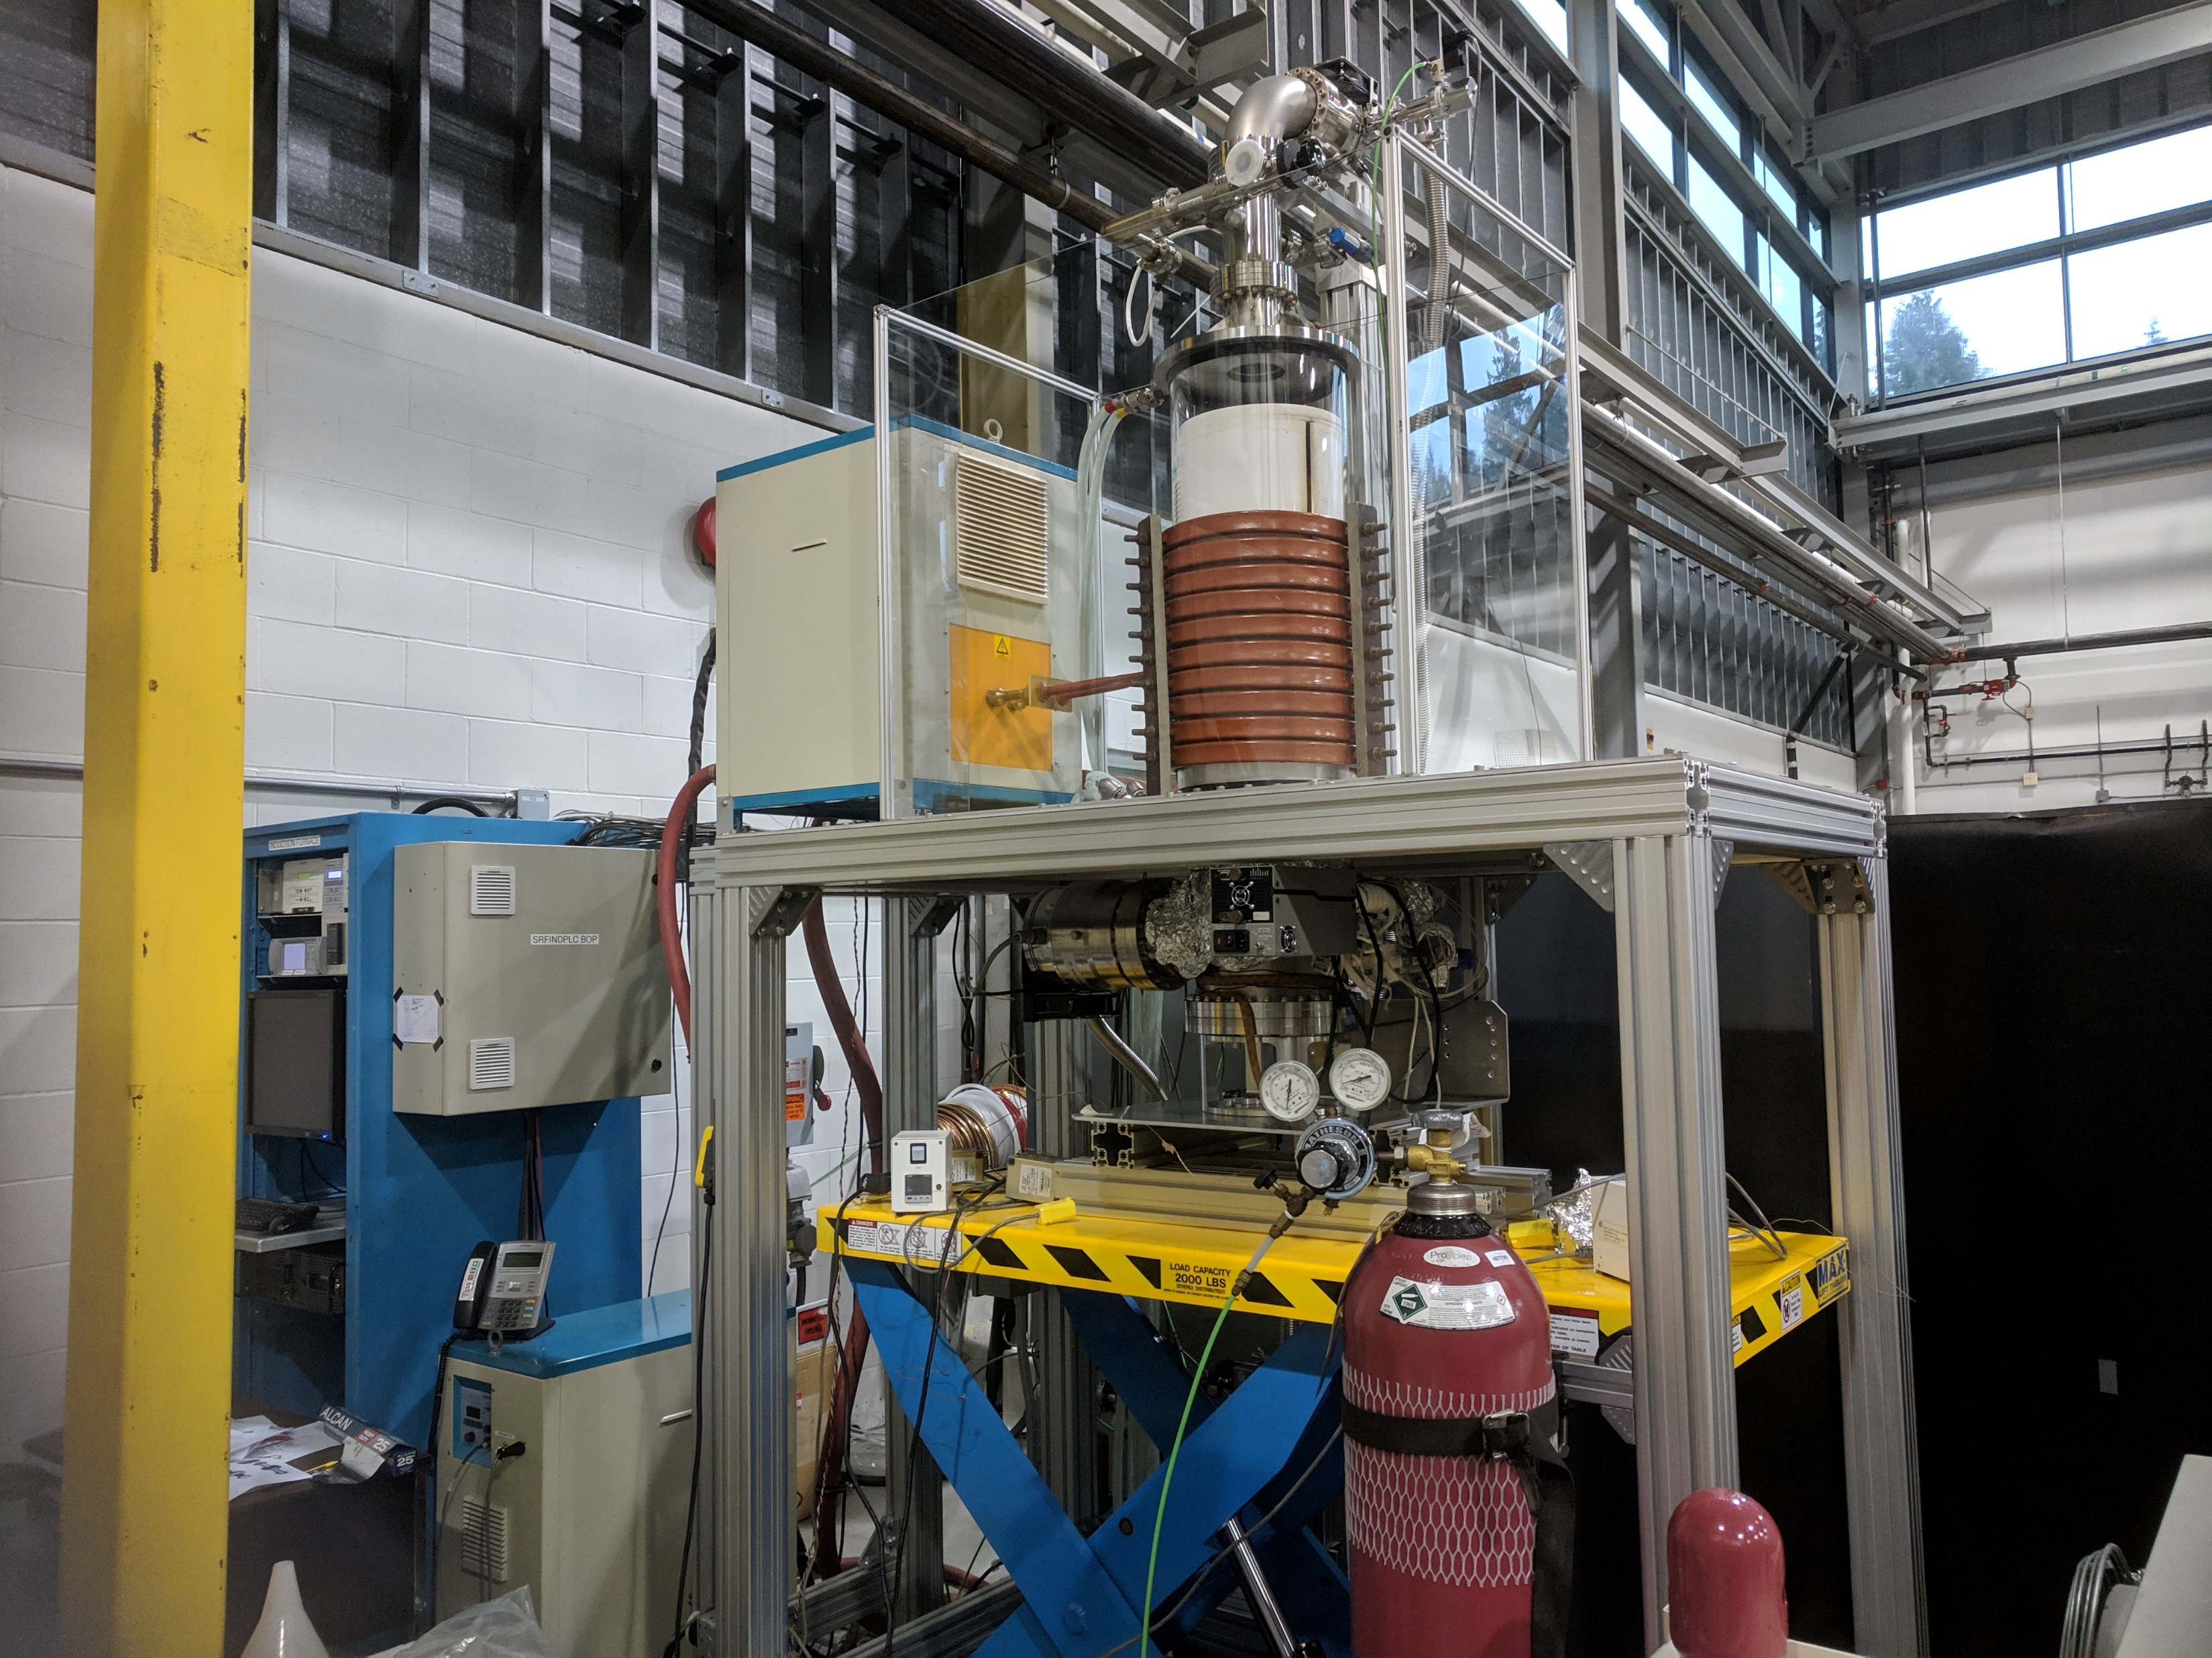
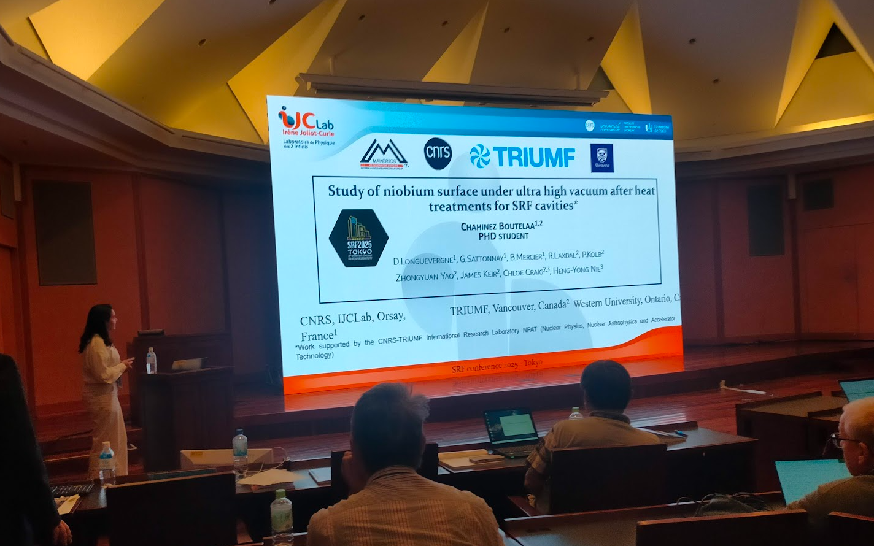
Niobium Carbides and substrates for thin films (HEAT TREATMENT, SURICAT, DECAP)
Objectives:
    Understand in which conditions Niobium carbides are grown at the surface of Niobium during heat treatment
    Mitigate their formation on SRF cavities during Mid-T baking process.
What has been done:
    Production of Nb samples (cutting, chemical etching BCP) and heat treatments @TRIUMF by an IJCLab student (Chahinez Boutelaa)
    SIMS analysis @Western University
    Surface analysis (XPS) on platform Vide&Surfaces @IJCLab
    Heat treatments on Supratech platform @IJCLab
    Dedicated in-situ plasma treatment+XPS analysis (ISIS set-up) on platform Vide&Surfaces @IJCLab
    Publication of a proceeding and talk during SRF conference in 2025
What is planned:
    Publication in a peer-reviewed journal
    Perform Electro-Polishing (EP) @TRIUMF on samples to study impact of chemical treatment
    Discussion on possible activities on NbZr project (sample preparation, flux penetration studies, …)
Carbide after heat treatment (SEM image)
Furnace at TRIUMF)
XPS analysis showing carbide quantity versus temperature
SRF conference

Slide 11
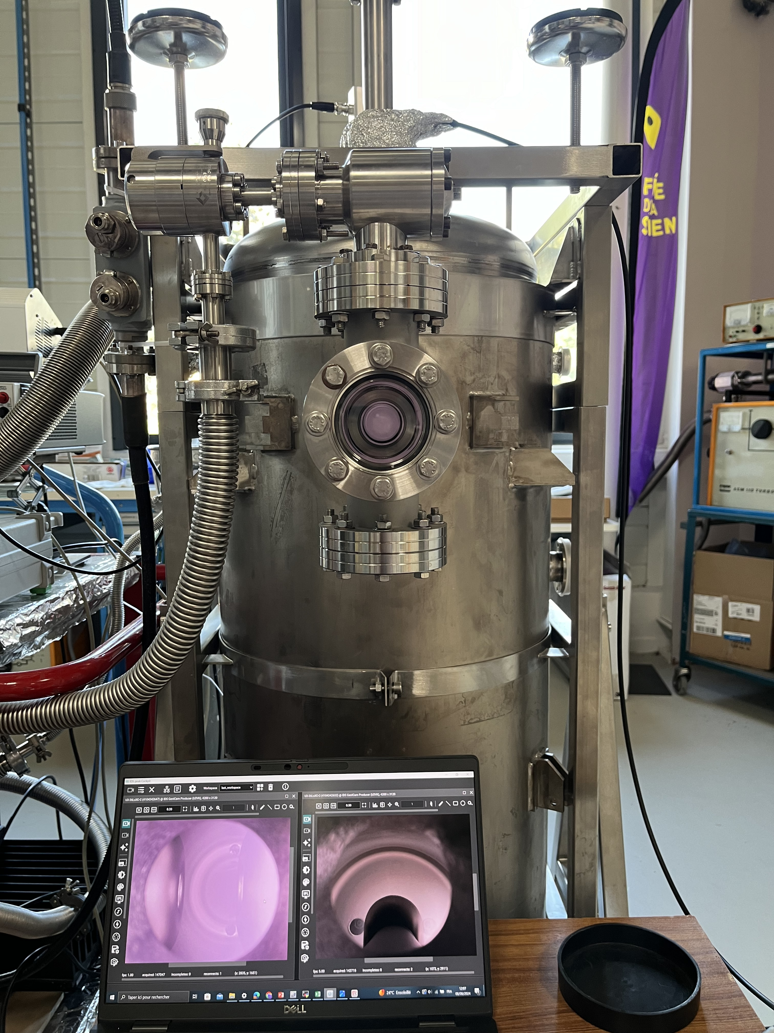
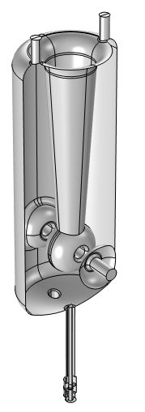
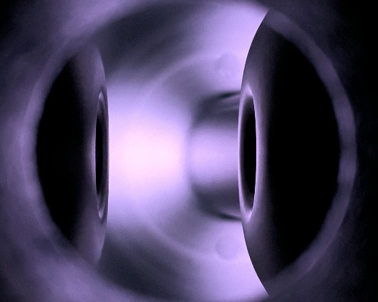
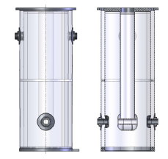
Plasma treatment (DECAP)
Objective:
    Transfer experience of plasma cleaning on SPIRAL2 QWR (Camille Cheney, PhD) to ISAC-II QWR
What is being done:
    Preparation of a ISAC-II copper prototype @TRIUMF to be shipped to IJCLab
    Development of an optimized plasma procedure on a plasma set-up @IJCLab by a TRIUMF student in June (Will Stokes).
What is planned:
    Camille Cheney hired as post-doc @TRIUMF
    A great program to be built!
SPIRAL2 QWR
SPIRAL2 QWR
ISAC-II QWR

Slide 12
CONCLUSION
    Since 2024, we engaged R&D on Niobium Carbides
      Student (Chahinez) from IJCLab travelled to TRIUMF thanks to IRL funding
      Complementary roles : sample production, sample analysis
      Student will continue this summer to produce new samples
    This year, we engaged new collaboration on plasma treatment
      Student (Will) from TRIUMF will travel to IJCLab (with a cavity)
      Lessons learned from SPIRAL2 experience will help developing procedure for ISAC-II
      Collaboration to be developed around Camille, hired as a post-doc at TRIUMF beginning of 2027!

Slide 13
Back-up slides

Slide 14


Slide 15
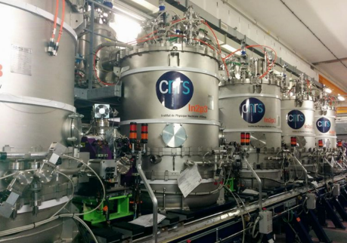
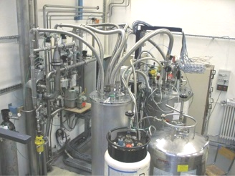
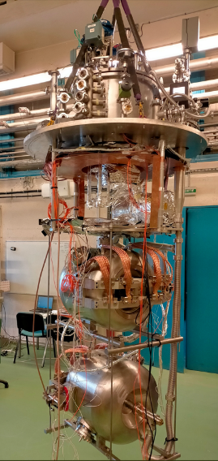



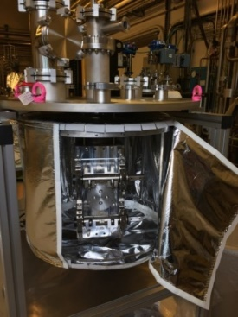
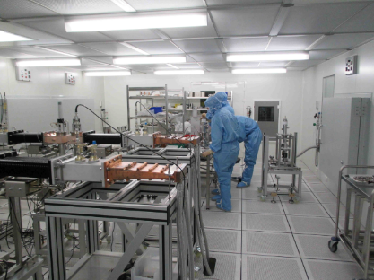
Introduction : History summary and series production
Prototyping Phase
Series production
R&D
Calibration Station (2000)
Clean-room for cryomodule (2007)
Vertical cryostat (CV800)
Chemical facility (2008)
Furnace (2016)
Klystron (2017)
He Liquefier (2008)
Upgrade CV800 (2018)
New Assembly Hall (2020)
Spiral2 : Integration and test of 7 cryomodules
ESS : - preparation & testing of cavities, couplers and tuners
- Integration of 14 cryomodules
LHC
SPIRAL2
SPIRAL2
ESS
ESS
EURISOL
MAX
MYRTE
MYRRHA
MYRRHA
LHC : Calibration of all Cernox thermal sensors (> 6000 units)
TTF3
EU-XFEL
PIP2
PIP2
1995
2000
2005
2010
2015
2020
2025
PIP-II : Testing of 33 Spoke cavities
First cryogenic test of a Spoke resonator in Europe (2002)
First cryogenic test of a cryomodule at Supratech (2007)
Supratech Platform is officially recognized by IN2P3 (2017)
Creation of IJCLab, merging of equipment from LAL and IPNO in Supratech (2020)
Supratech Platform is created (2004)
MYRRHA : - preparation & testing of 60 couplers and tuners
EU-XFEL : Preparation and power testing of 800 couplers

Slide 16
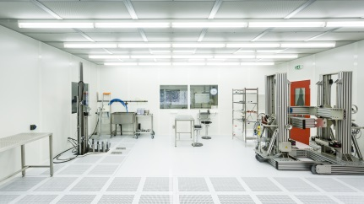
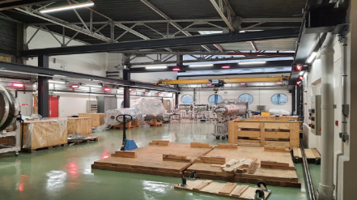

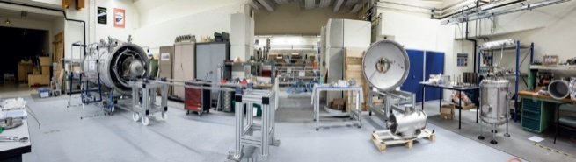
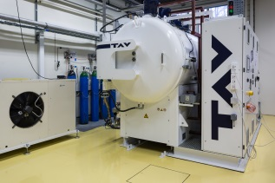
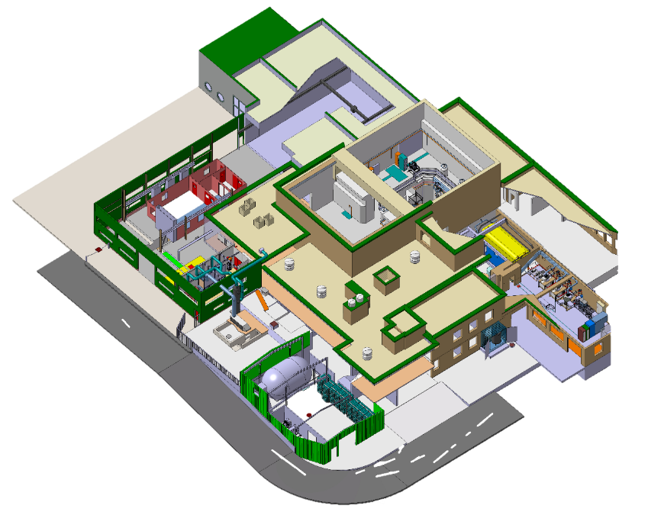
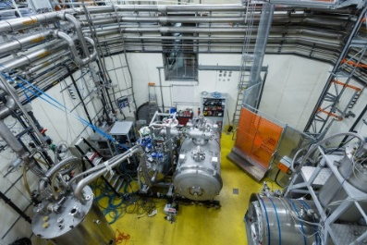
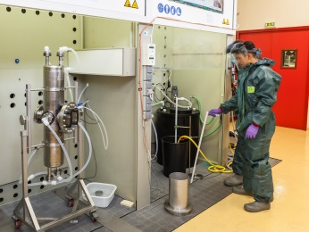
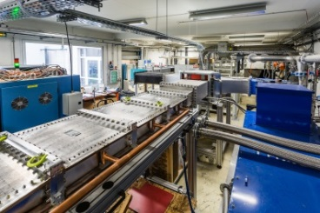
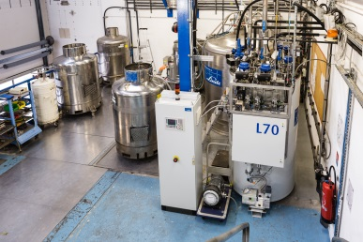
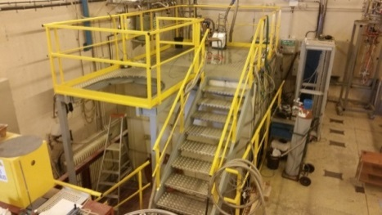
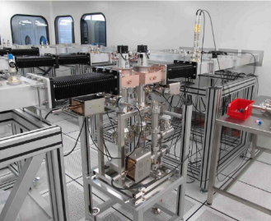
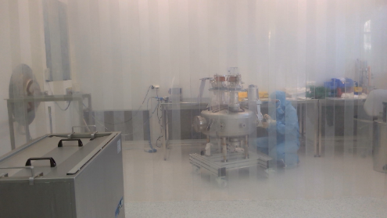
Introduction : Equipment overview
Cryomodule Assembly Hall
Tuner testing cryostat
Cryomodule assembly Hall
Cavity and Cryomodule Assembly Clean Room
Building 106
High T° Vacuum Furnace
Cryomodule Testing Hall
Chemical Treatment Hall
RF Power Source
352 MHz Klystron
Helium Gas Recovery and Compression Hall
High Power RF Conditionning Clean Room
Power Coupler Assembly Clean Room
He Liquefier
Cavity Testing Hall (CV800)
T° Calibration Station
+
+
+
Building 103
Lagarrigue Hall

Slide 17
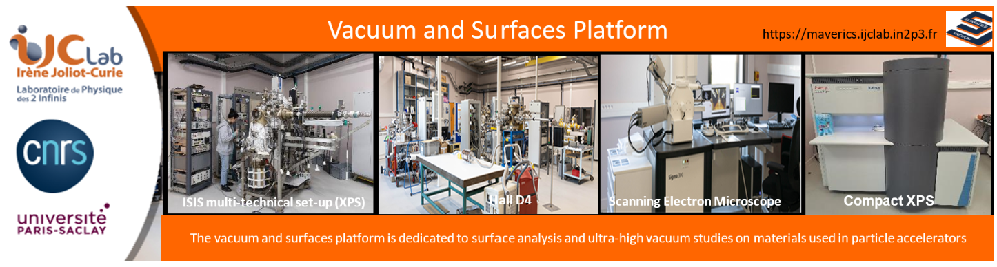

Slide 18
