Slide 1






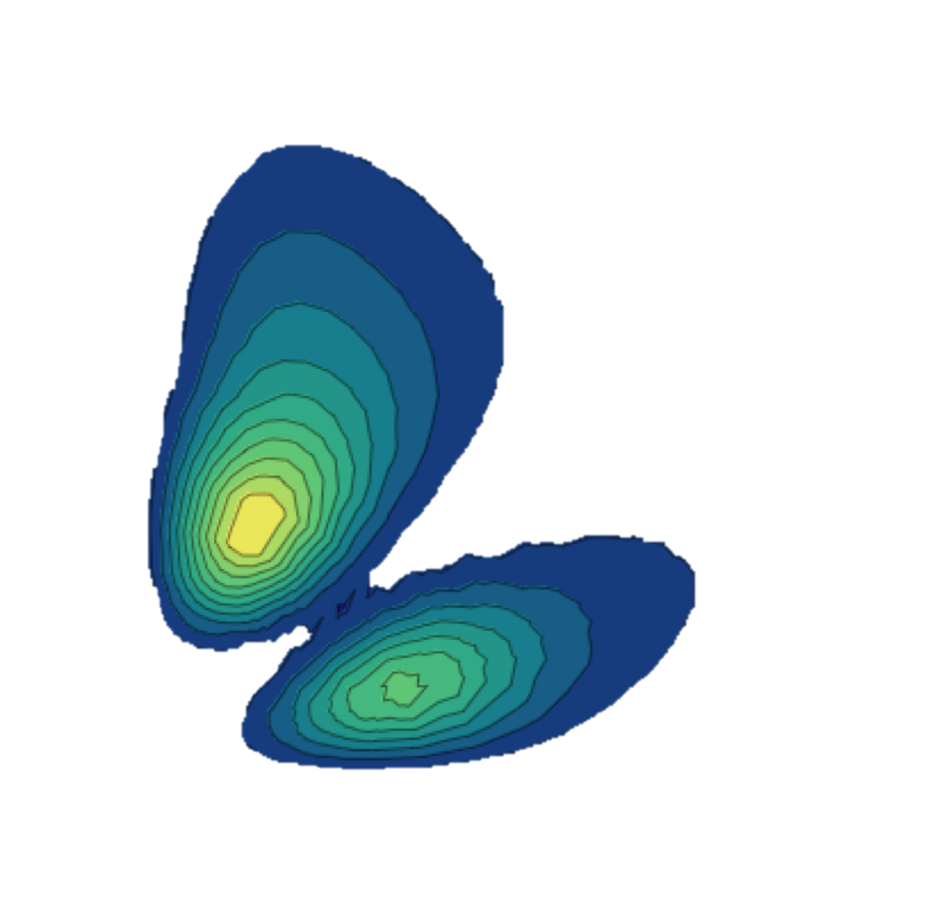




Guillaume Hupin, CNRS IJClab
Collaborators
D. Becht (CEA)
J. Herko (TRIUMF)
P. Navratil (TRIUMF)
K.H.D. Nguyen (CNRS/IJCLab)
N. Pillet&P. Indelicato (CEA&CNRS/LKB)
O. Yaghi (PhD, now industry)
“Nuclear theory projects”
Notes:
Good morning, my name is Guillaume Hupin. I am both a nuclear structure and reaction theoretician. Those two facets are necessary to describe exotic nuclei which lie close in energy to the reaction threshold. I seek to come to an understanding of nuclei starting from first principle that is starting from the underlying theory of QCD.

Slide 2
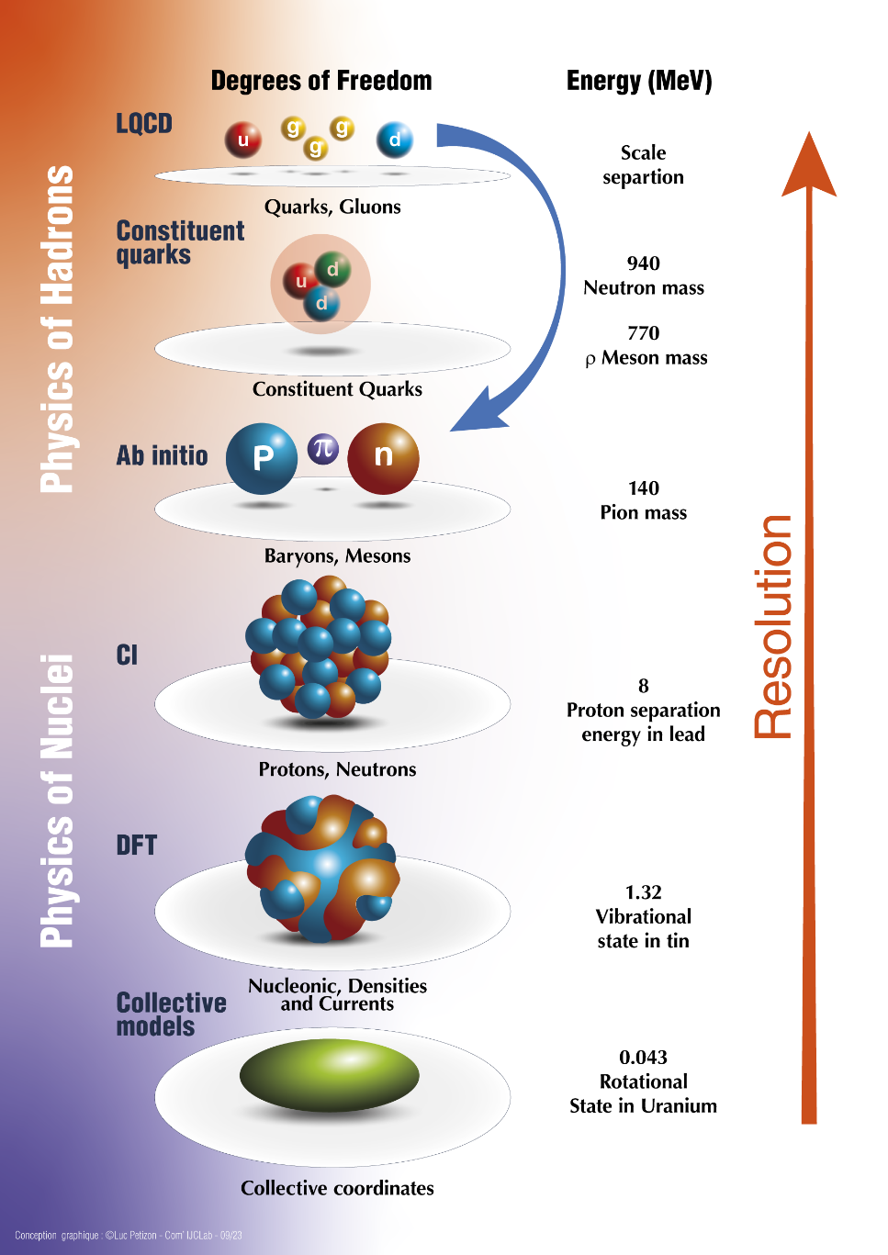
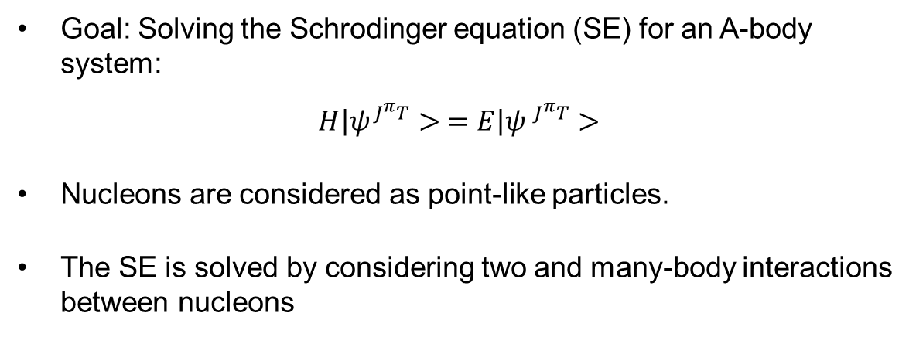




A story of multiple scale
Goal: Solving the Schrodinger equation (SE) for an A-body system:
$$\left.H\right|ψ^{J^{π}T}> =\left.E\right|ψ^{{ J}^{π}T}>$$
Nucleons are considered as point-like particles.
The SE is solved by considering two and many-body interactions between nucleons
$$V_{13}$$
$$V_{123}$$
$$V_{12}$$
$$V_{23}$$

Slide 3
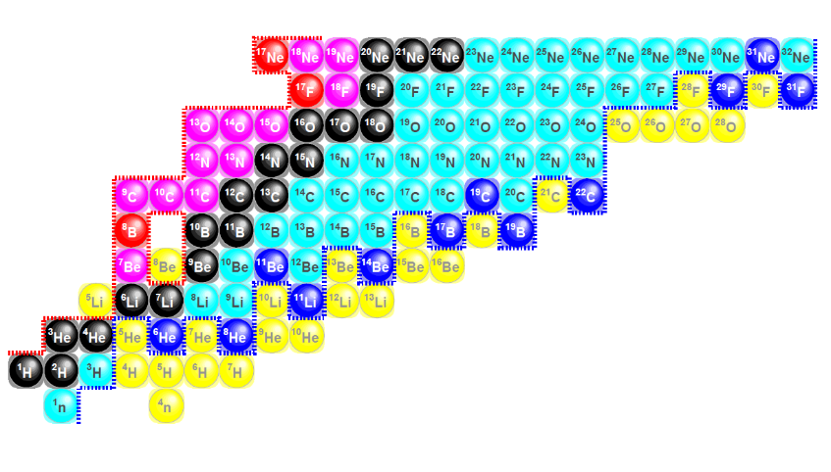

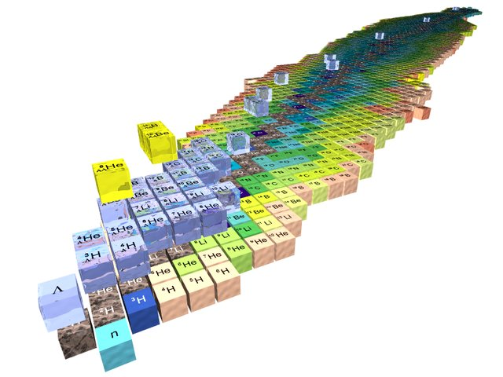
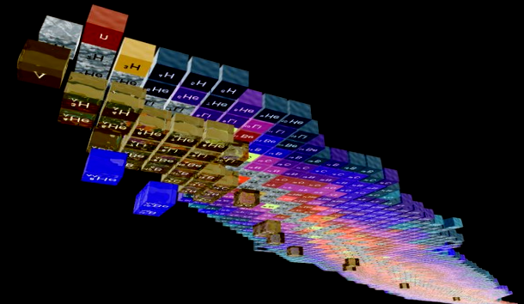

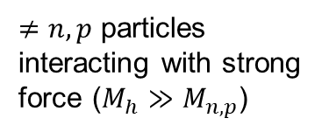
(i) Research directions
Complexity of scattering problem
Complexity of many-body solution
Both
$≠n,p$ particles interacting with strong force ($M_{h}≫M_{n,p}$)
Nuclear theory is data driven.
The lack of accuracy of ab initio structure methods impedes the development of reactions modeling.
$$M_{h}≤M_{n,p}$$
Credits H. Lenske

Slide 4


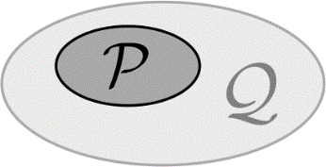

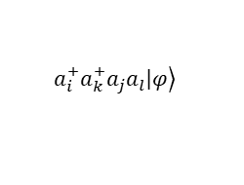

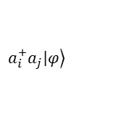
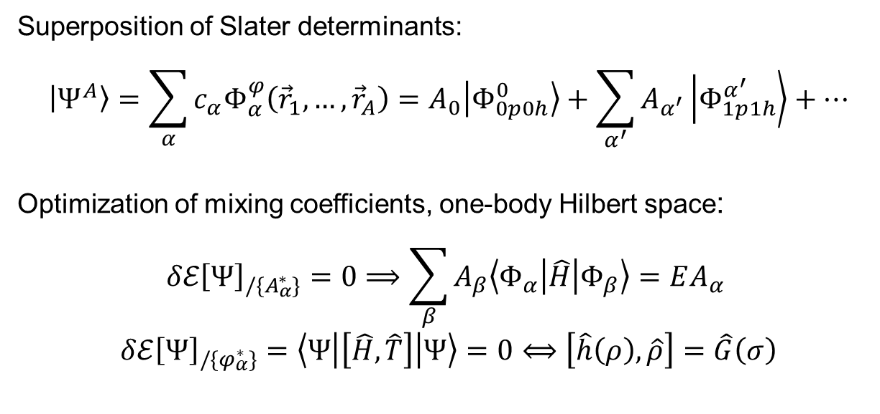
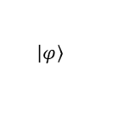
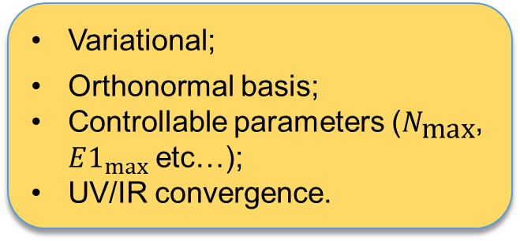

Configuration interaction methods suited for $A≫1$
active domain
Variational;
Orthonormal basis;
Controllable parameters ($N_{\text{max}}$, $E1_{max}⁡$etc…);
UV/IR convergence.
N_{max}
$$ℏΩ$$
$$ℋ$$
Adjustable
No-Core Shell Model
MpMh
Superposition of Slater determinants:
$$\left|\left.Ψ_{ }^{A}\right\rangle \right.=\sum_{α}{c_{α}Φ_{α}^{φ}\left({\vec{r}}_{1},…,{\vec{r}}_{A}\right)}=A_{0}\left|\left.Φ_{0p0h}^{0}\right\rangle \right.+\sum_{α^{′}}{A_{α^{′}}\left|\left.Φ_{1p1h}^{α^{′ }}\right\rangle \right.}+…$$
Optimization of mixing coefficients, one-body Hilbert space:
$$δℰ{\left[Ψ\right]}_{/\{A_{α}^{∗}\}}=0⟹\sum_{β}{A_{β}\left\langle Φ_{α} | \hat{H} | Φ_{β}\right\rangle }=EA_{α}$$
$$δℰ{\left[Ψ\right]}_{/\{φ_{α}^{∗}\}}=\left\langle Ψ | \left[\hat{H},\hat{T}\right] | Ψ\right\rangle =0⟺\left[\hat{h}\left(ρ\right),\hat{ρ}\right]=\hat{G}\left(σ\right)$$
Complexity
$$\left.\left|φ\right.\right\rangle$$
NCSM
IM-SH
MpMh
$$\left.a_{i}^{+}a_{j}\left|φ\right.\right\rangle$$
$$\left.a_{i}^{+}a_{k}^{+}a_{j}a_{l}\left|φ\right.\right\rangle$$
Generalized Brillouin (GB) equation
“In-Medium” Shell Model

Slide 5
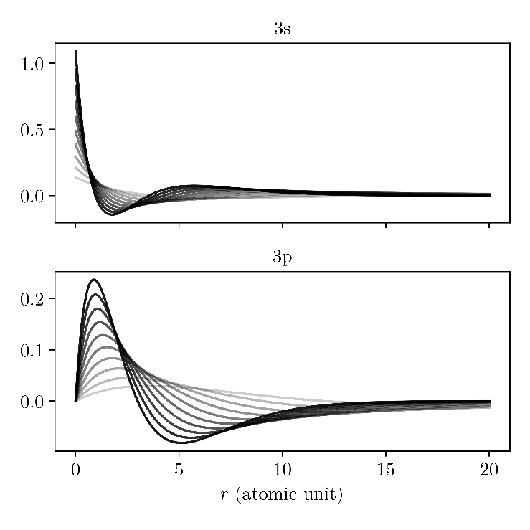
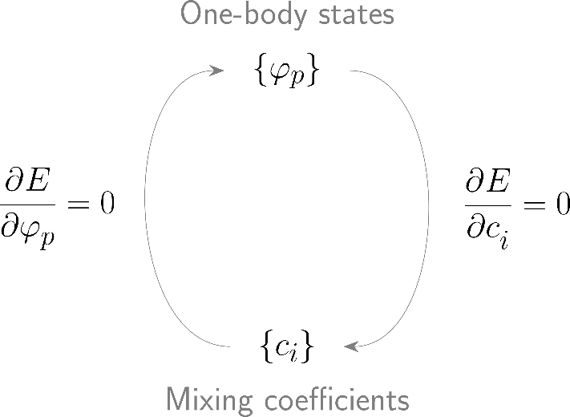
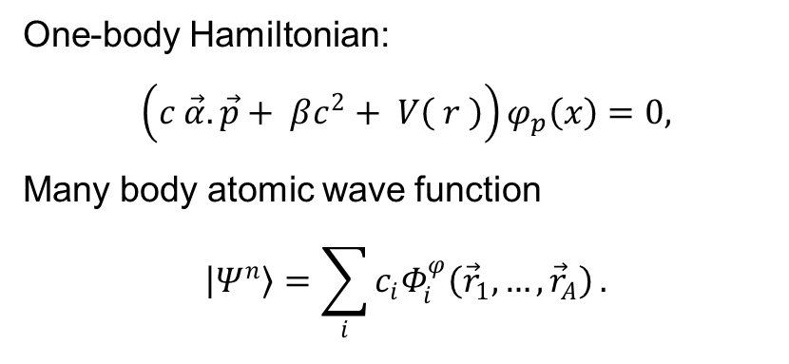
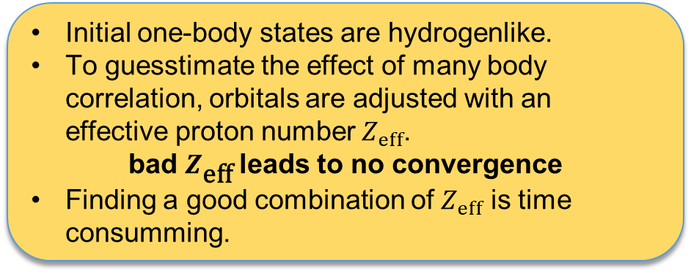
Machine Learning for Atomic Structure Codes: the problem
One-body Hamiltonian:
$$\left(c \vec{α}.\vec{p}+ βc^{2}+ V\left( r \right)\right)φ_{p}\left(x\right)=0,$$
Many body atomic wave function
$$\left|\left.Ψ_{ }^{n}\right\rangle \right.=\sum_{i}{c_{i}Φ_{i}^{φ}\left({\vec{r}}_{1},…,{\vec{r}}_{A}\right)}.$$
Initial one-body states are hydrogenlike.
To guesstimate the effect of many body correlation, orbitals are adjusted with an effective proton number $Z_{eff}$.
bad $Z_{\text{eff}}$leads to no convergence
Finding a good combination of $Z_{eff}$ is time consumming.
MCDF
Variational parameters

Slide 6
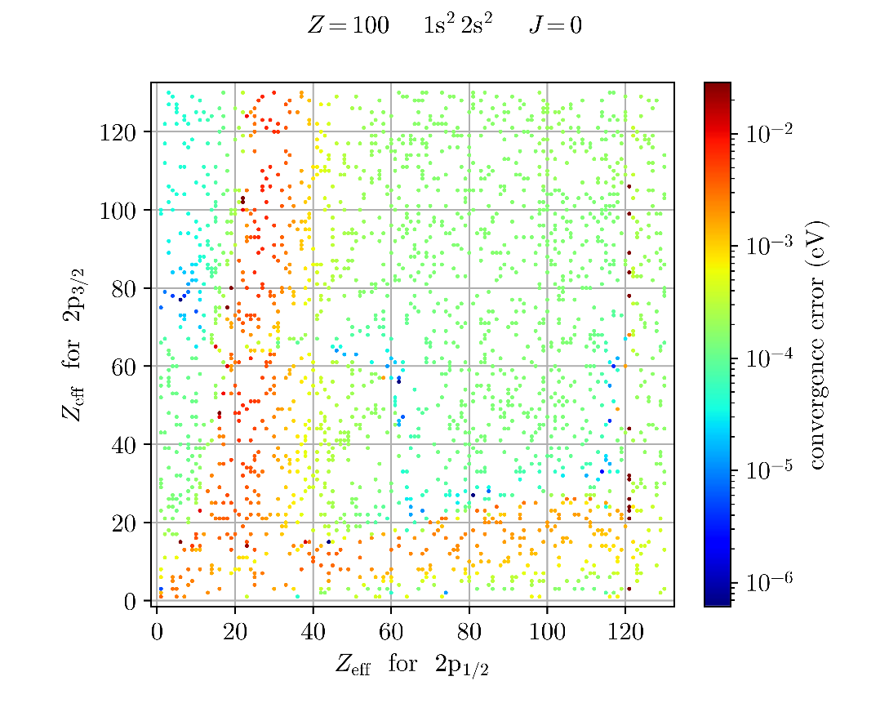
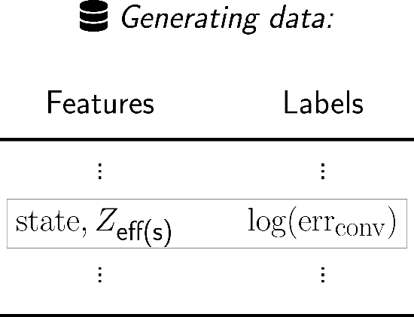
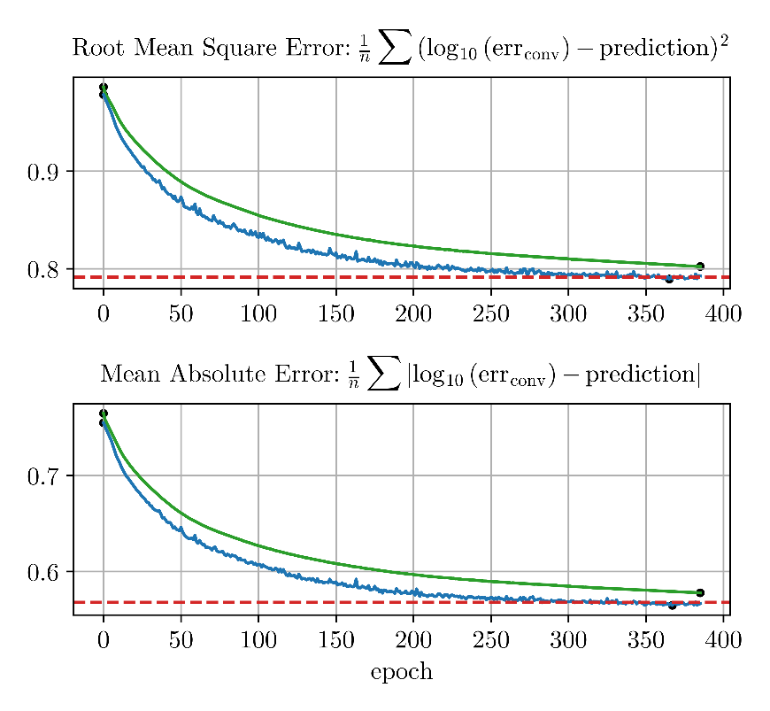
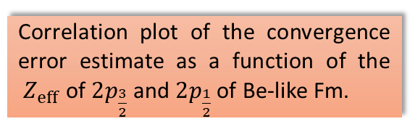
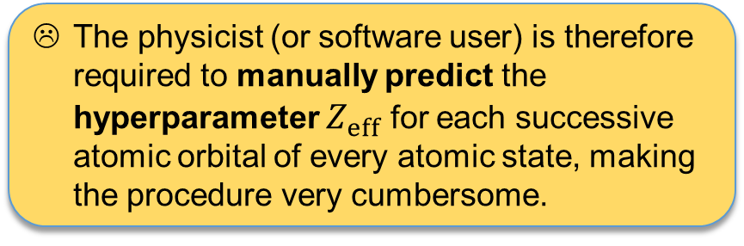
Machine Learning for Atomic Structure Codes: the proposed solution
Correlation plot of the convergence error estimate as a function of the ${ Z}_{eff}$ of $2p_{\frac{3}{2}}$ and $2p_{\frac{1}{2}}$ of Be-like Fm.
This is an excellent candidate problem for machine learning.
The physicist (or software user) is therefore required to manually predict the hyperparameter $Z_{eff}$ for each successive atomic orbital of every atomic state, making the procedure very cumbersome.

Slide 7
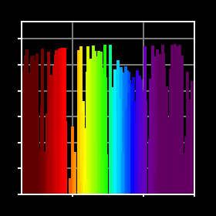
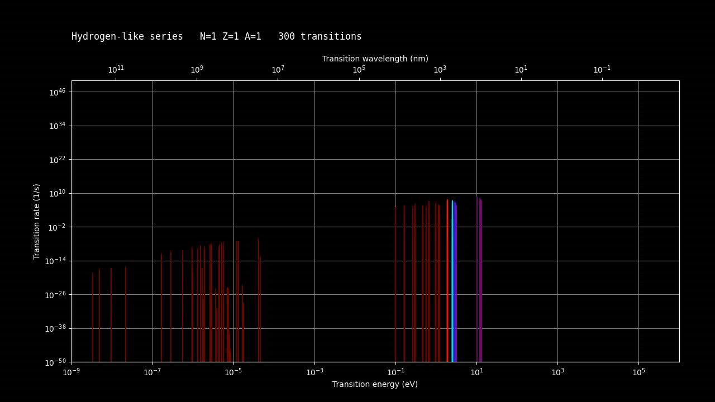
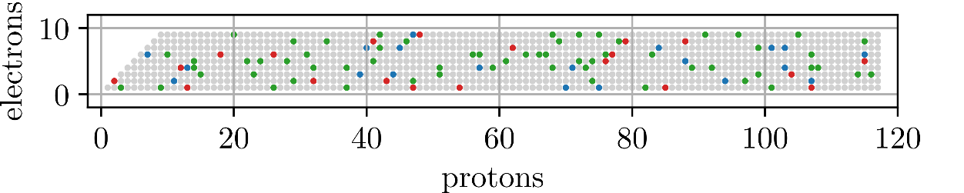
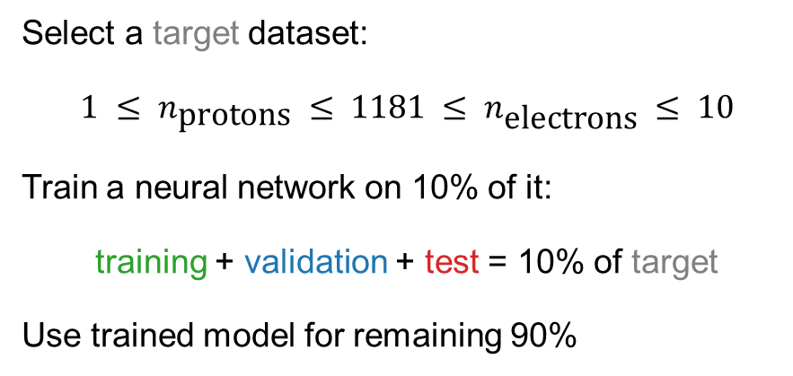
Machine Learning for Atomic Structure Codes: application
Datatom: public repository (soon)
Select a target dataset:
$$1 ≤ n_{\text{protons}} ≤ 1181 ≤ n_{\text{electrons}} ≤ 10$$
Train a neural network on 10% of it:
training + validation + test = 10% of target
Use trained model for remaining 90%
The dataset co-generated by AI is substantially larger than the NIST repository and opens the way to applications such as:
opacity calculations for stellar objects,
spectroscopic identification of stellar events,
the study of metastable states relevant to lasers and atomic clocks…

Slide 8
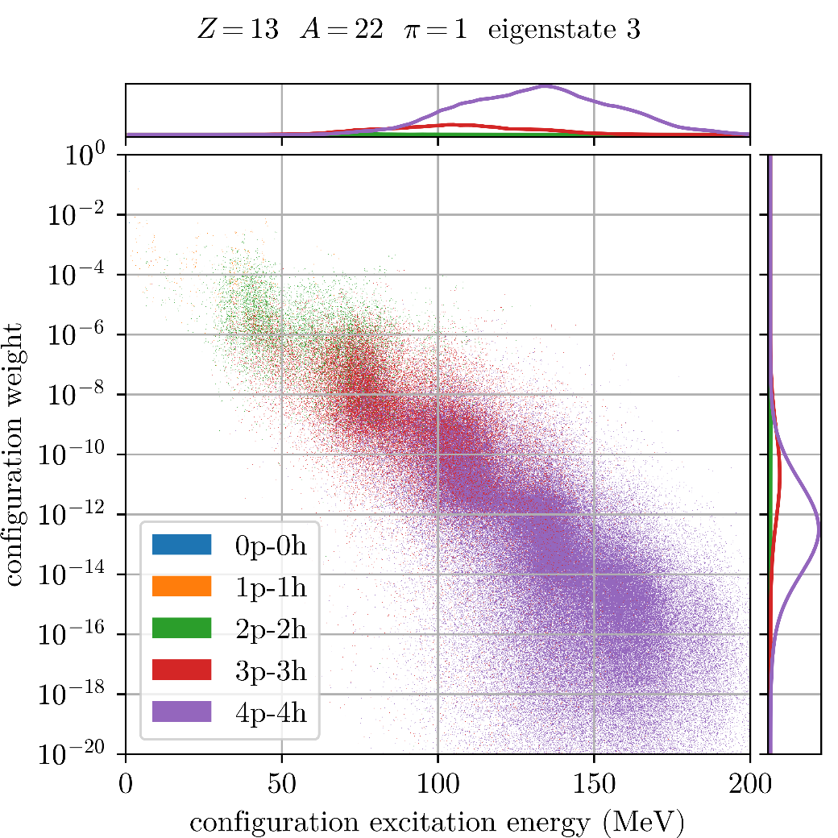
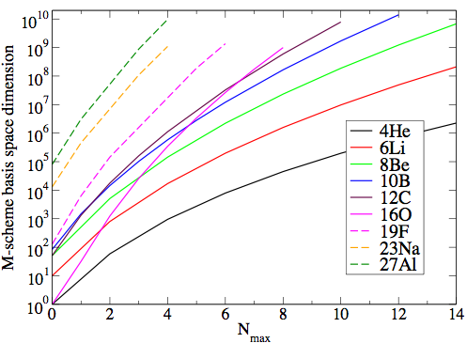
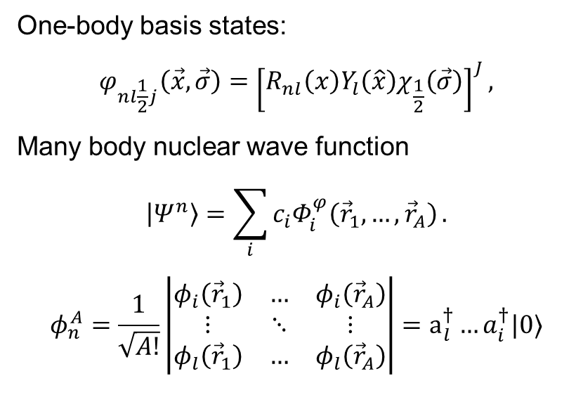
Machine Learning for Nuclear Structure Codes: the problem
One-body basis states:
$$φ_{nl\frac{1}{2}j}\left(\vec{x},\vec{σ}\right)={\left[R_{nl}\left(x\right)Y_{l}\left(\hat{x}\right)χ_{\frac{1}{2}}\left(\vec{σ}\right)\right]}^{J},$$
Many body nuclear wave function
$$\left|\left.Ψ_{ }^{n}\right\rangle \right.=\sum_{i}{c_{i}Φ_{i}^{φ}\left({\vec{r}}_{1},…,{\vec{r}}_{A}\right)}.$$
$$φ_{n}^{A}=\frac{1}{\sqrt{A!}}\left|\begin{matrix}φ_{i}\left({\vec{r}}_{1}\right) & … & φ_{i}\left({\vec{r}}_{A}\right) \\ ⋮ & ⋱ & ⋮ \\ φ_{l}\left({\vec{r}}_{1}\right) & … & φ_{l}\left({\vec{r}}_{A}\right)\end{matrix}\right|=a_{l}^{†}…a_{i}^{†}|0⟩$$
N_{max}
$$ℏΩ$$
No-Core Shell Model
Usual truncation schemes:
Excitation order
Excitation energy
Importance truncation
Usual schemes:
Excitation order
Excitation energy
Importance truncation

Slide 9
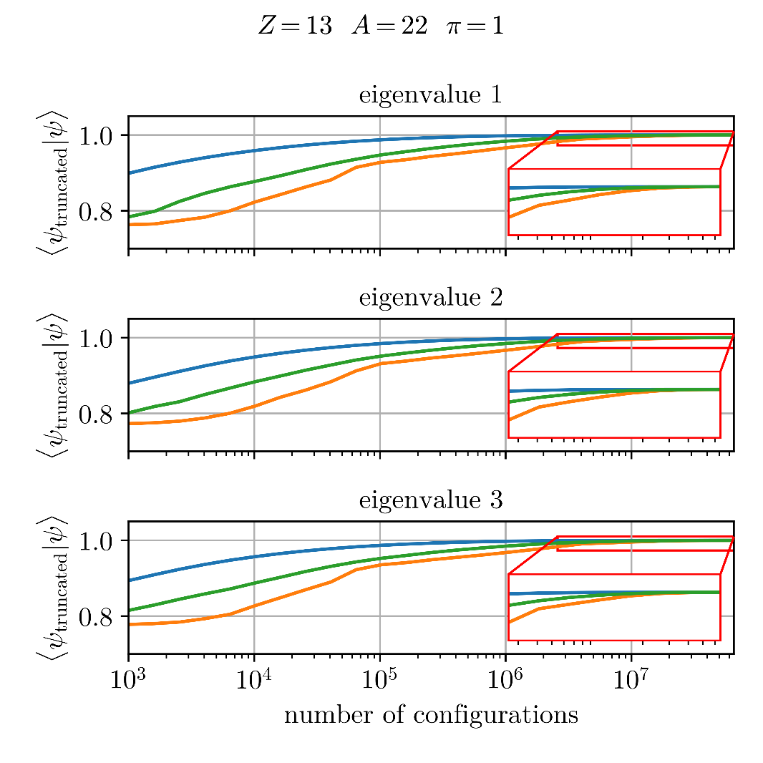
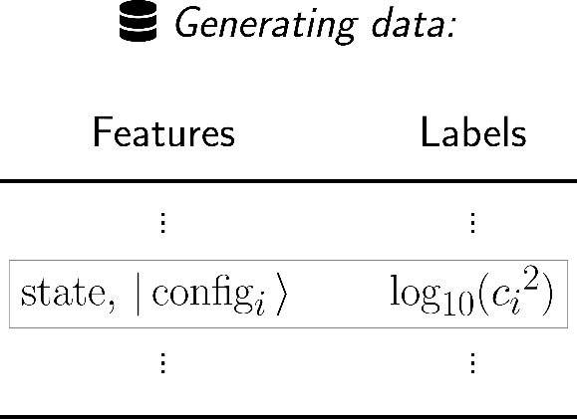
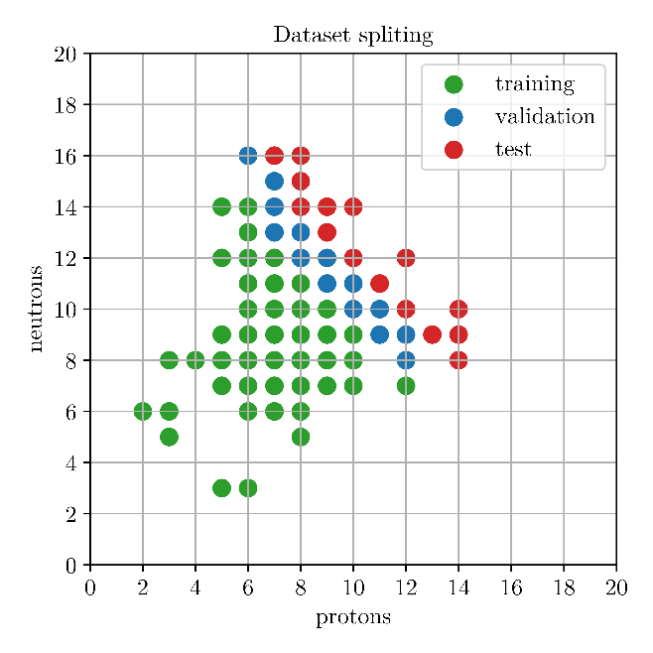
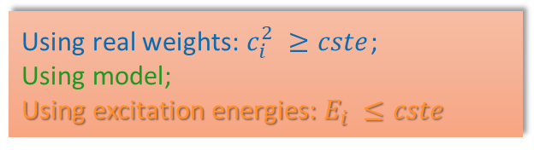
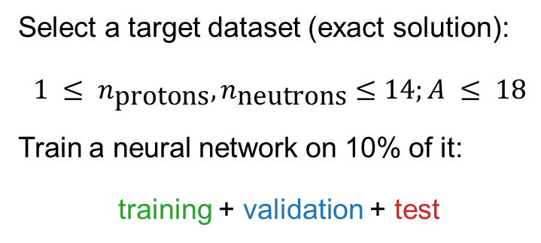
Machine Learning for Nuclear Structure Codes: the problem
Select a target dataset (exact solution):
$$1 ≤ n_{\text{protons}}, n_{\text{neutrons}}≤14;A ≤ 18$$
Train a neural network on 10% of it:
training + validation + test
Each Slater determinants configuration are encoded via a transformer layer
The AI augments, rather than replaces, the MB solver by automatically selecting the relevant subspace for diagonalization, with state-dependent variations.
Using real weights: $c_{i}^{2} ≥cste$;
Using model;
Using excitation energies: $E_{i} ≤cste$

Slide 10
(ii) Research directions
Complexity of scattering problem
Complexity of many-body solution
Both
$≠n,p$ particles interacting with strong force ($M_{h}≫M_{n,p}$)
Nuclear theory is data driven.
Few-body techniques scale very bad with the number of constituents in the continuum.
$$M_{h}≤M_{n,p}$$
Credits H. Lenske
Notes:
The research axis is basically two-fold:
1- More complex reactions
2- Towards heavier mass systems
In higher resolution:
We want to study halo nuclei with full glory NN+3N interaction
Study break up and FSI
Etc…

Slide 11


Motivations
We want to develop a unique tool applicable to both nuclear structure and reactions, to enhance our understanding of the strong force at low energy.
Structure
Extraction of resonance properties for fine tuning interactions and applications to astrophysics.
Reactions
Enabling us to study nuclear breakup reactions including Final State Interaction (FSI)
Calculation of complex charged (and multi-neutron) nuclear decay.

Slide 12
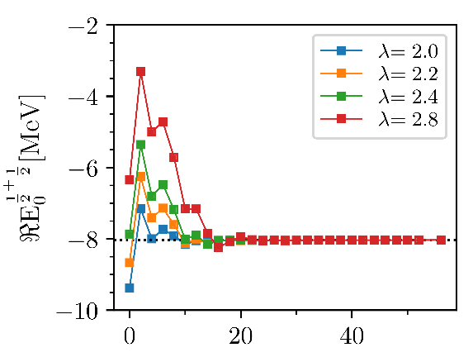
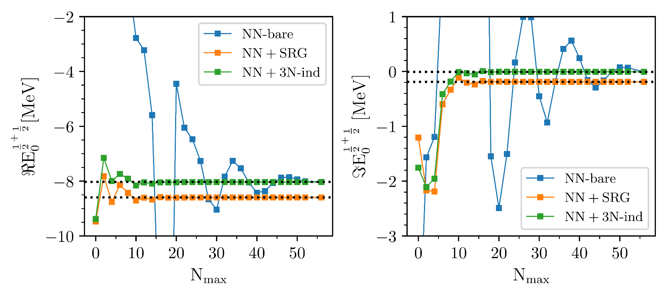
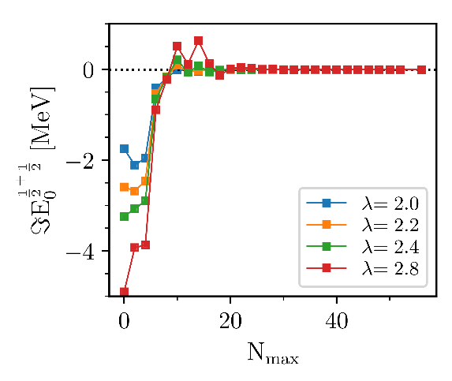
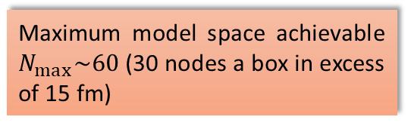
Quality of the rotated Hamiltonian evaluated in A=3
Triton g.s. convergence with CS-Hamiltonian ($θ=0.3$ rad)
SRG leads to faster convergence;
Induced 3N-interaction needs to be accounted for (as expected from literature).
Maximum model space achievable $N_{max}\sim 60$ (30 nodes a box in excess of 15 fm)

Slide 13
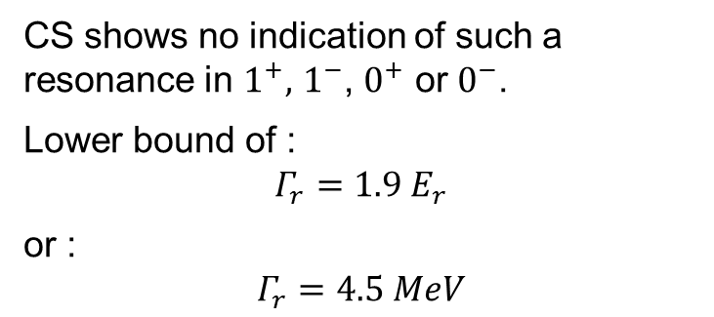
4-neutron: a resonance ?
or
Claimed by experiment
CS shows no indication of such a resonance in $1^{+},$ $1^{−}$, $0^{+}$ or $0^{−}$.
Lower bound of :
$$Γ_{r}=1.9 E_{r}$$
or :
$$Γ_{r}=4.5 MeV$$

Slide 14
(iii) Research directions
Complexity of scattering problem
Complexity of many-body solution
Both
$≠n,p$ particles interacting with strong force ($M_{h}≫M_{n,p}$)
Nuclear theory is data driven.
Global optical models ($NN$ or $N\overline{p}$ or $Nπ$ scattering) are not applicable to exotic systems.
$$M_{h}≤M_{n,p}$$
Credits H. Lenske
Notes:
The research axis is basically two-fold:
1- More complex reactions
2- Towards heavier mass systems
In higher resolution:
We want to study halo nuclei with full glory NN+3N interaction
Study break up and FSI
Etc…

Slide 15

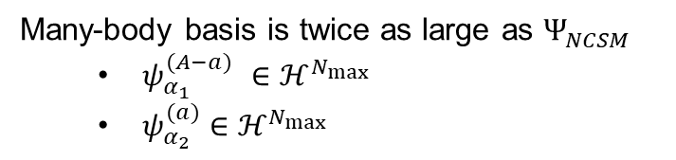


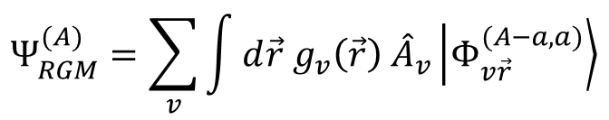

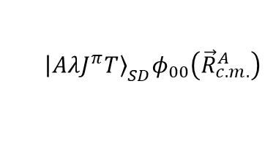


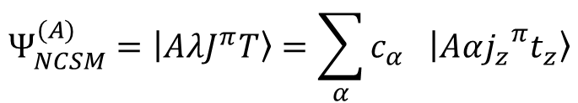
Resonating group method for NCSM: long-range dynamics and scattering S. Quaglioni, P. Navrátil PRL101 (2008).
One way to solve the many-body problem when two scales appear
$$Ψ_{NCSM}^{(A)}=\left|\left.AλJ^{π}T\right\rangle \right.=\sum_{α}{c_{α} \left|\left.Aα{j_{z}}^{π}t_{z}\right\rangle \right.}$$
Can address bound and low-lying resonances (short range correlations)
Mixing coefficients(unknown)
A-body harmonic oscillator states
$${\left|\left.AλJ^{π}T\right\rangle \right.}_{SD}φ_{00}\left({\vec{R}}_{c.m.}^{A}\right)$$
Second quantization
$${\vec{r}}_{A−a,a}$$
$$Ψ_{RGM}^{(A)}=\sum_{v}{\int{d\vec{r} g_{v}\left(\vec{r}\right) {\hat{A}}_{v}\left|\left.Φ_{v\vec{r}}^{(A−a,a)}\right\rangle \right.}}$$
$$a$$
$$(A−a)$$
$$ψ_{α_{1}}^{(A−a)}ψ_{α_{2}}^{(a)} δ(\vec{r}−{\vec{r}}_{A−a,a})$$
Relative wave function (unknown)
Channel basis
Cluster expansion technique
Antisymmetrizer
Many-body basis is twice as large as $Ψ_{NCSM}^{ }$
$ψ_{α_{1}}^{(A−a)}$ $∈ℋ^{N_{max}}$
$ψ_{α_{2}}^{(a)}$ $∈ℋ^{N_{max}}$
NCSM/RGM
Cluster formalism for elastic/inelastic

Slide 16
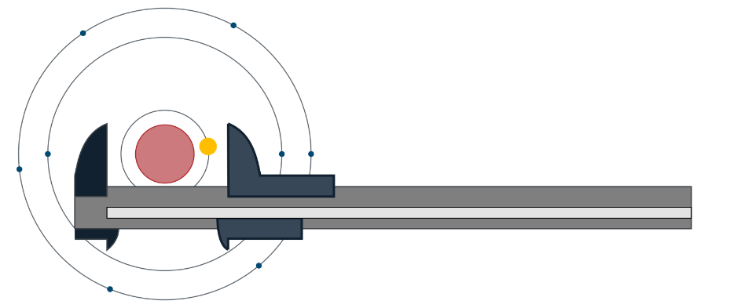
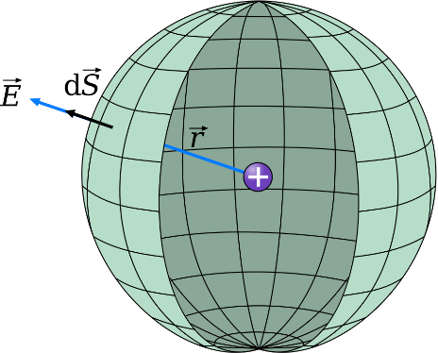
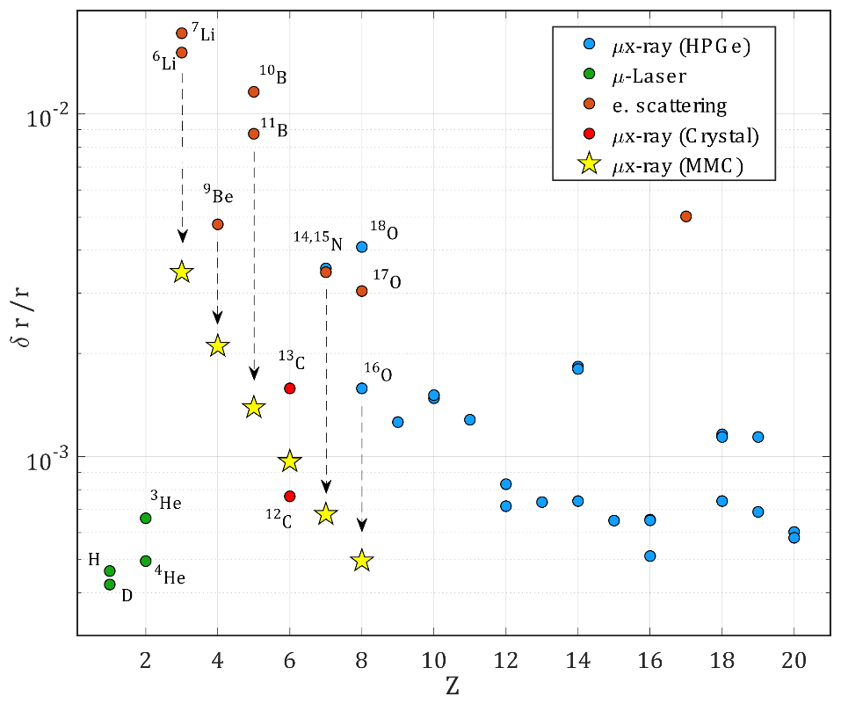
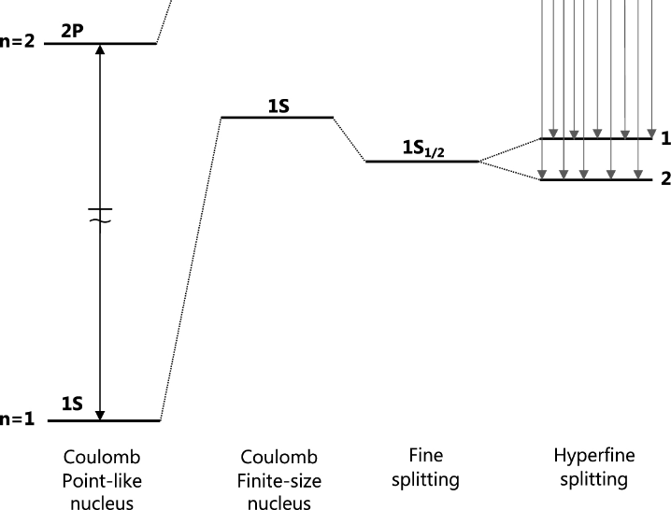



Quartet experiment: connecting ab initio atomic theory to nuclear ab initio structure
The aims is to improve the measurement of absolute charge radii of light nuclei by a factor of 10 (on light systems!).
“Nuclear metrology”: determining fundamental properties such as masses and radii..
$$>8 \text{fm}$$
$$>100 \text{fm}$$
$$r$$
Nuclear structure
Nuclear pandemonium
known asymptotic
Gauss’s law must be used with caution for finite-size nuclei: an accurate charge distribution extending to several tens (to hundred) of fm is required.

Slide 17
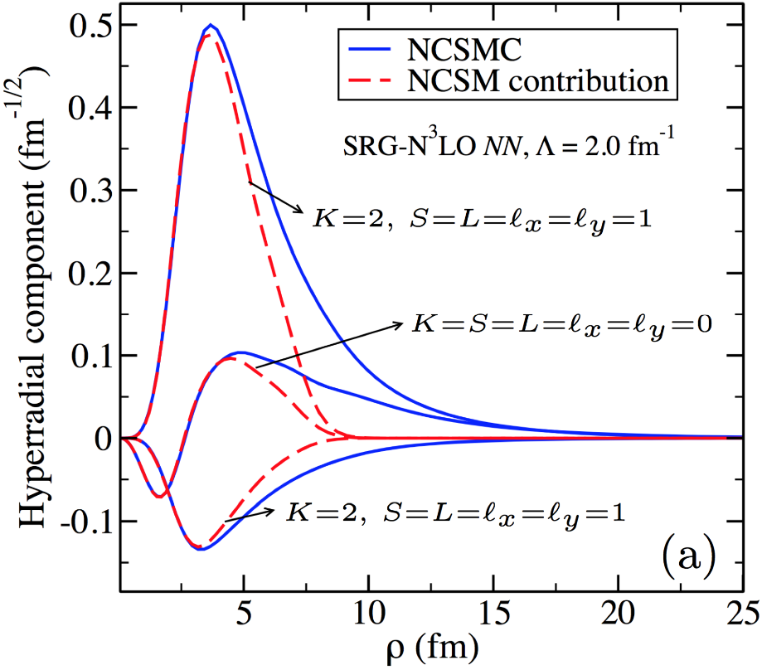

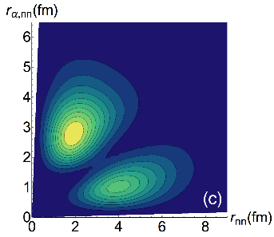

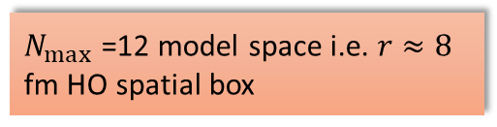
Tail of the nuclear wave function may contains many long-range structure
The nuclear bound state wave function can be decomposed into all the neiboring reaction channels
$$Ψ_{NCSMC}^{(A)}=Ψ_{NCSM}^{(A)}+Ψ_{RGM}^{(A−1,1)}+⋯+Ψ_{RGM}^{(A−3,3)}+⋯Ψ_{RGM}^{(A−2,1,1)}+⋯$$
Observables sensitive to the long-range part of the wave function are also sensitive to reaction channels near the elastic threshold.
$N_{max}$=12 model space i.e. $r≈8$ fm HO spatial box
Long-distance components are mandatory to model ⁶He.

Slide 18












Workplan
Nuclear size ${10}^{−5}$ a.u.
Muonic 1s Bohr radius ${10}^{−3}$ a.u.
Doable with continuum
not scaled
$$μ^{−}$$
$$r_{n} =\frac{ℏc}{Zα} \frac{m_{μ^{−}}}{2μ} n^{2}$$
200 times closer than the electron, 10 times more sensitive to nuclear density
Maybe in 2326
Bound state properties with continuum
$\left\langle Ψ_{NCSMC}^{(A)} | \hat{𝒪} | Ψ_{NCSMC}^{(A)}\right\rangle$
to obtain the charge density $\hat{ρ}\left(r\right)$at large$r$ and the magnetic distribution.
We will also explore the interest of computing localization probabilities: $D_{τσ}(r) =\left(τ_{τσ}−\frac{1}{4}\frac{{\left(∇ρ_{τσ}\right)}^{2}}{ρ_{τσ}}\right)$
Phys. Rev. C 106, 064330 (2022)
Link with DFT (new constraints)

Slide 19

Thank you !
Notes:
In conclusion:
We are extending the ab initio no-core shell model to treat low-energy light-ion reactions.
The nucleon scattering on light nuclei with realistic NN potentials represent our recent achievements in this direction.
We have much more work ahead of us. Indeed, we need to implement and test the approach for heavier projectiles, startng with the deuteron projectile, up to the alpha-particle projectile, which is essential to calculate reactions of astrophysical interest.
Inaddition, it is clear that this approach is not always efficient. In particular when the target has a very small disintegration threshold. But we have already an idea of how make our method more efficient.
Merging the NCSM and RGM approaches represents our best opportunity to build a method able to describe both structure and continuum.
Indeed, the RGM equations can be solved also using bound-state boundary conditions. In this regard the RGM method can provide the long range part of the model space needed to describe system like the 6He.
In the next steps we are planning on introducing the NNN potential terms in the RGM formalism, as well as the treatment of two-cluster basis with two-, three- and four-nucleon projectiles.
Finally: our ultimate goal in the long run is to build a more complete microscopic theory of both structure and reactions, the ab initio NCSM with continuum, by constructing an over-complete model space containing the NCSM basis, the cluster basis, but also the coupling between them. With this kind of basis one has a better hope to tackle problems like the 9Be breakup in n+8Be.

