Slide 1

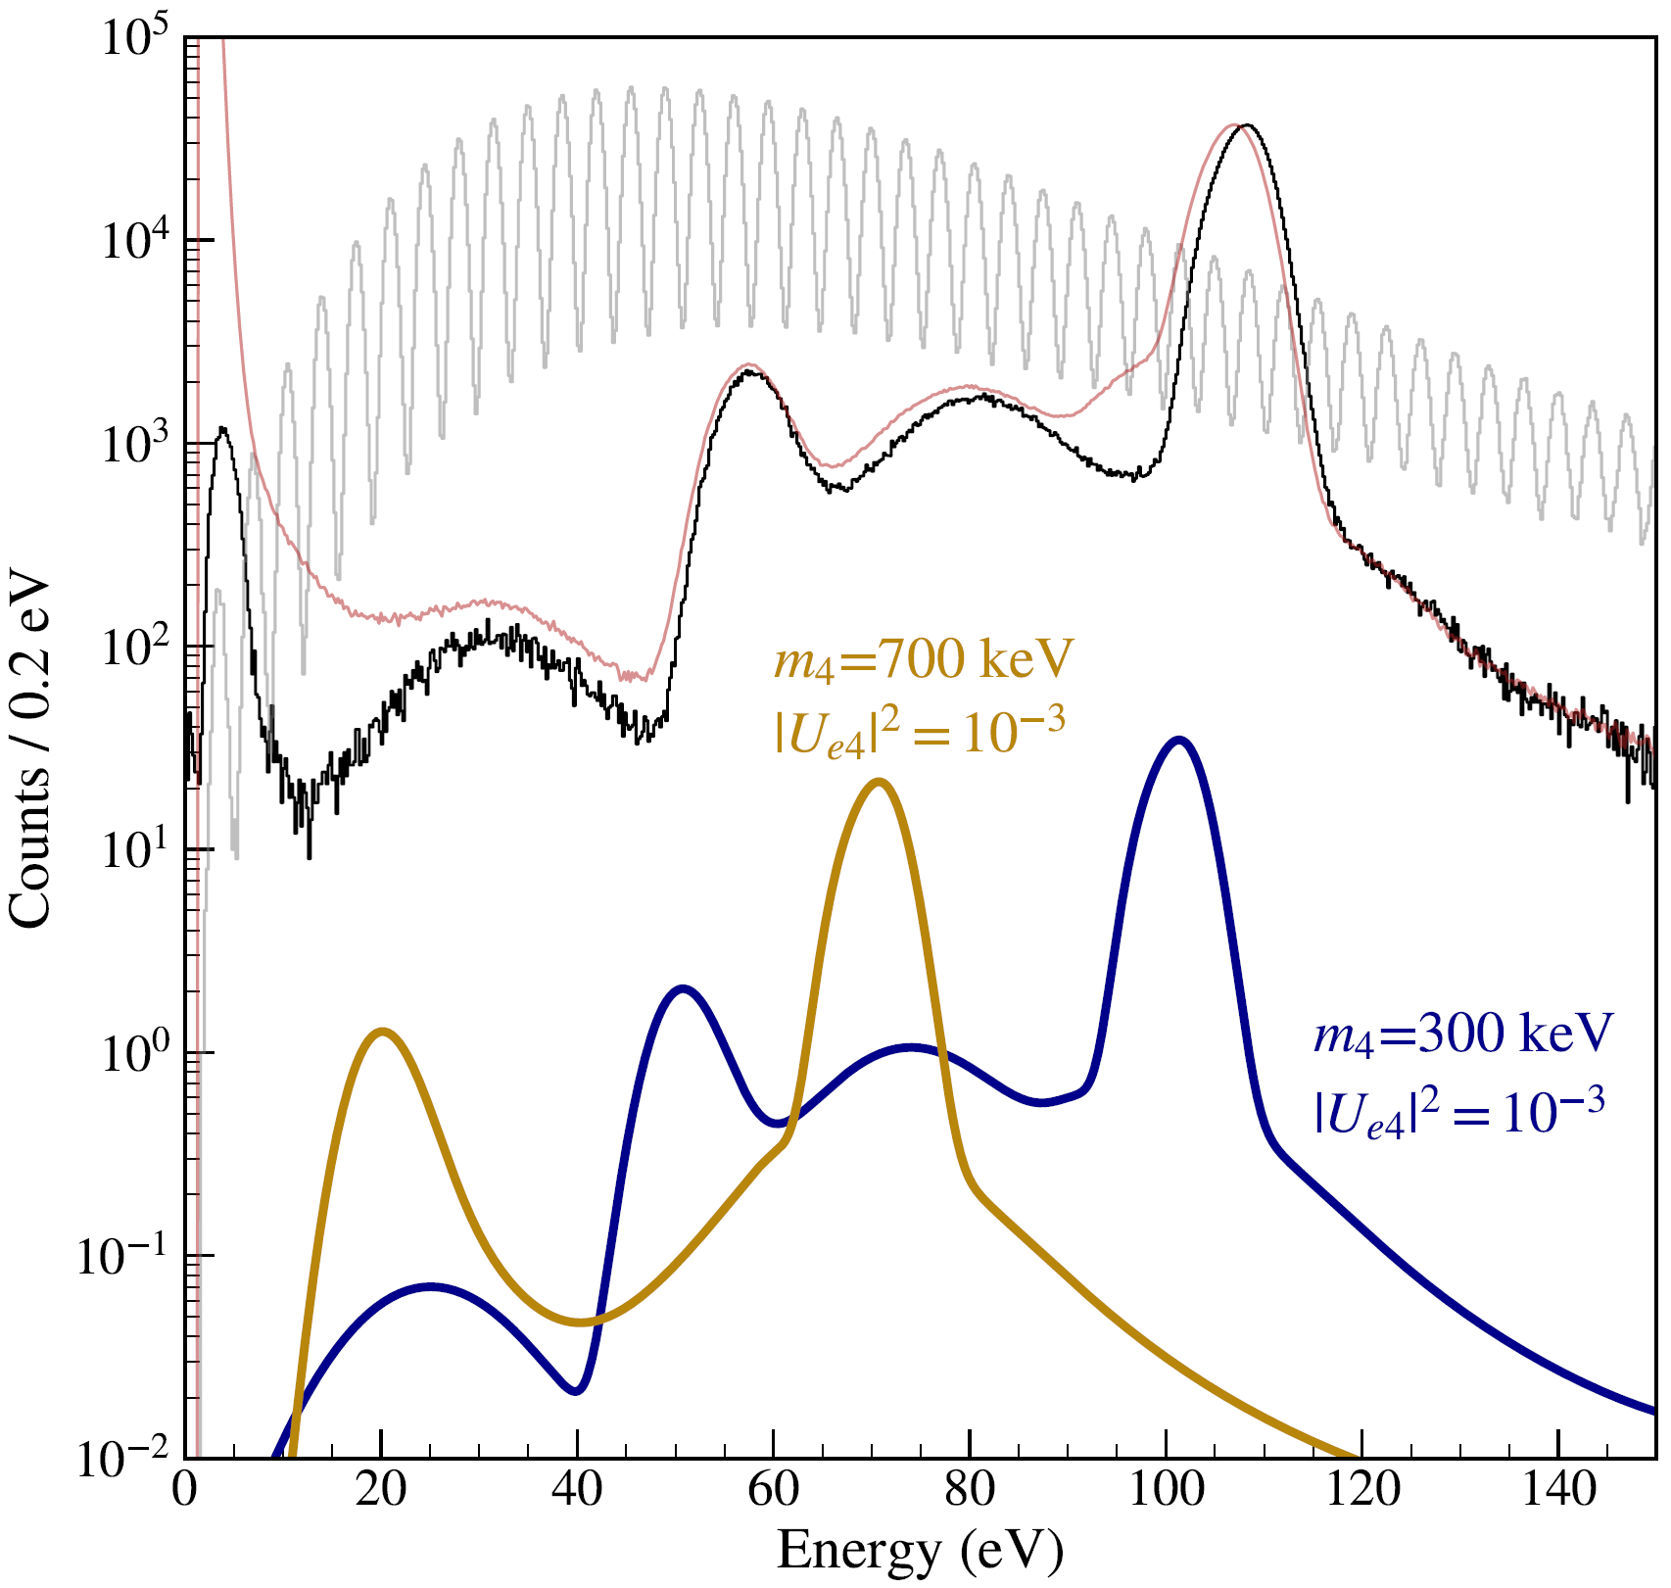
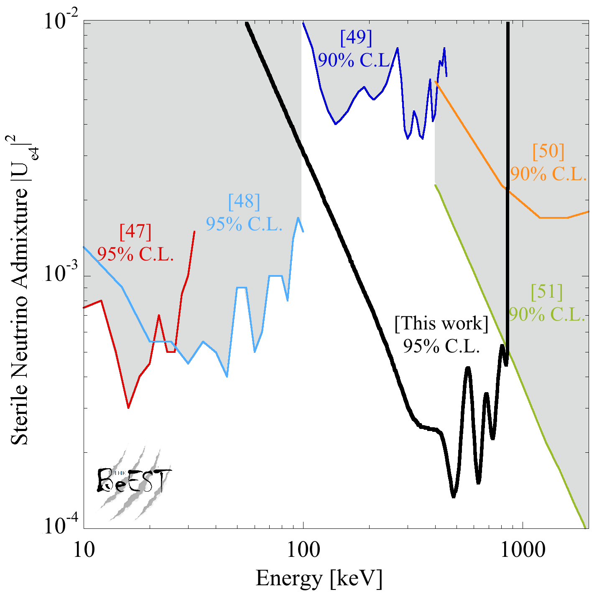
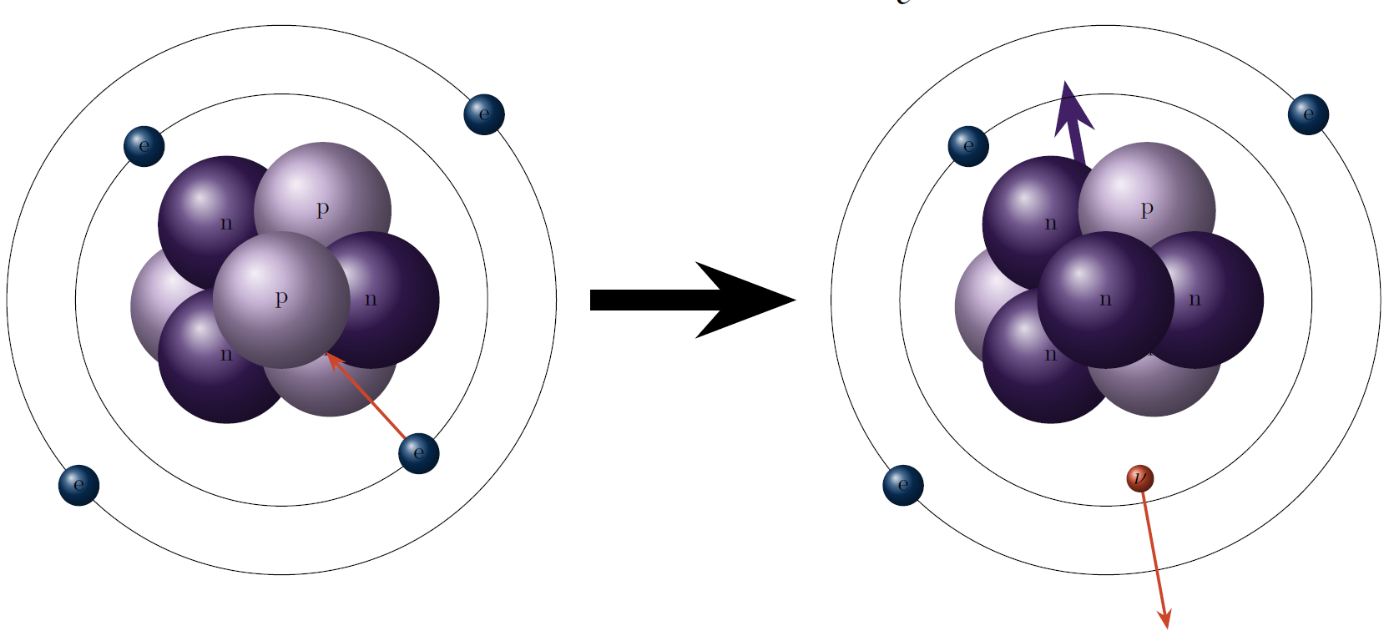
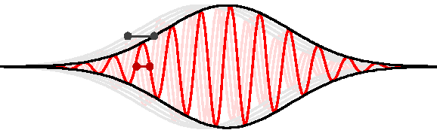
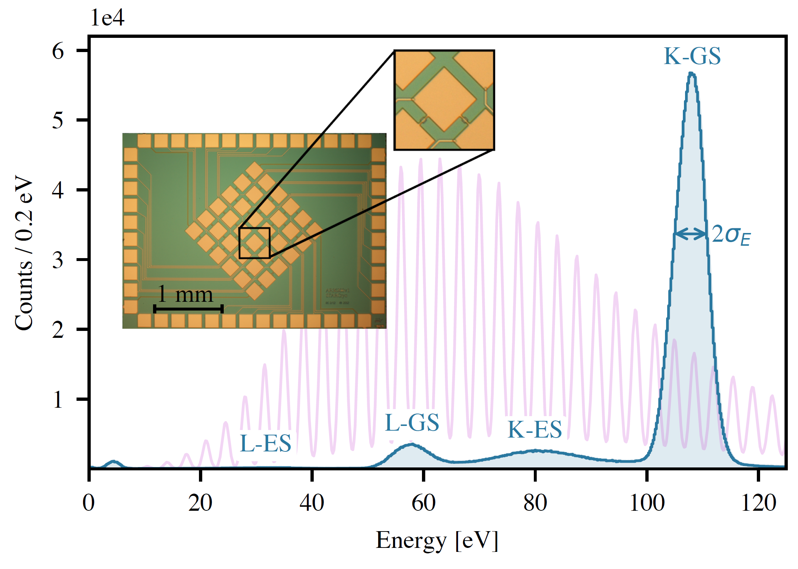
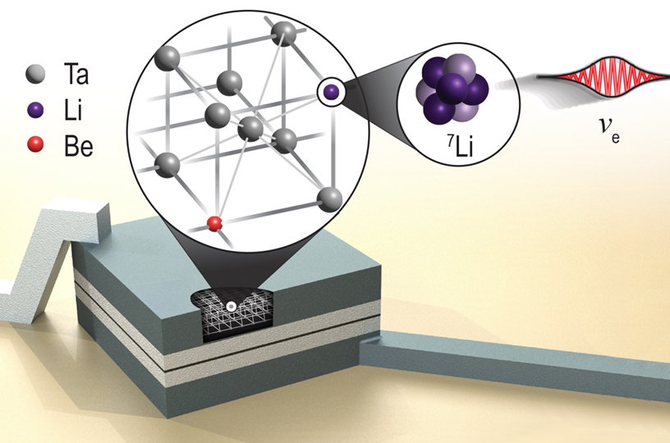
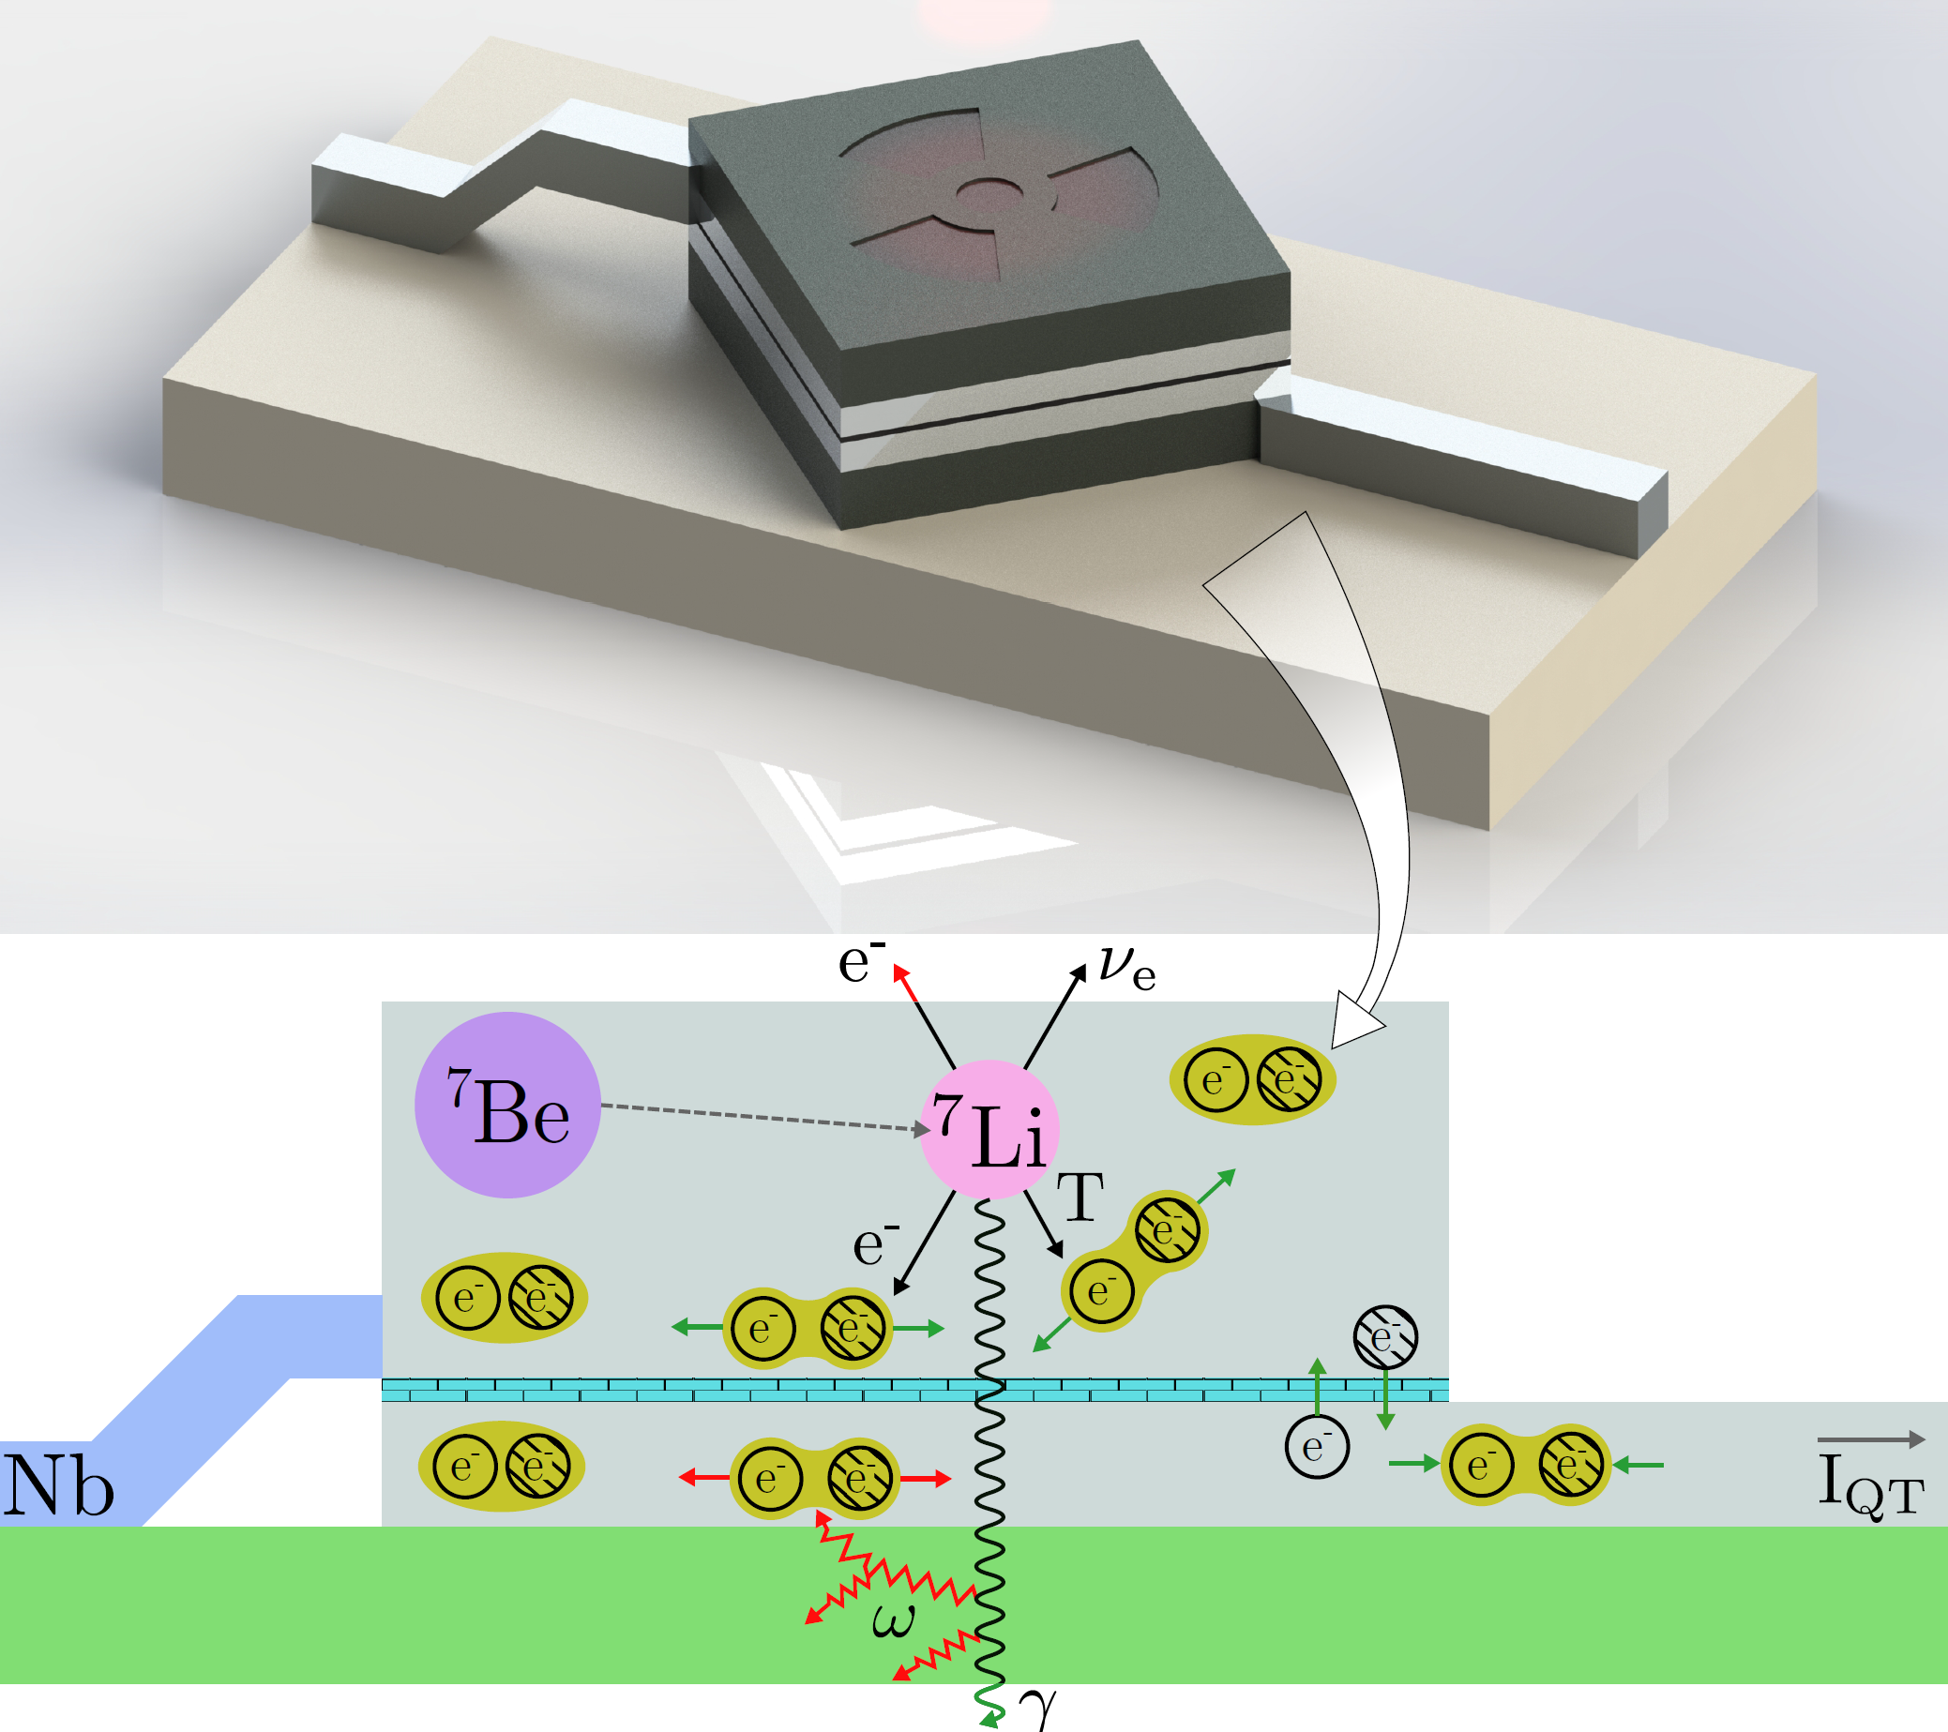
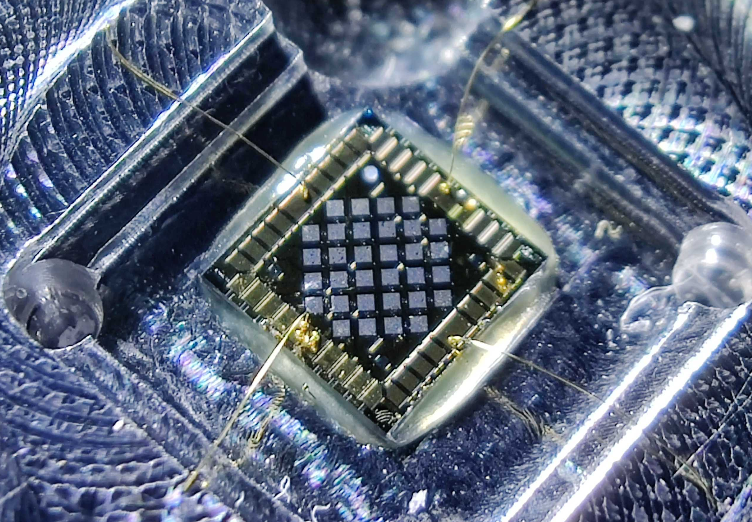

The BeEST experiment
World-Leading Laboratory Search for a Fourth “keV” Neutrino
⁷Be (Z=4)
⁷Li (Z=3)
E_{R} ~ 57 eV
Q = 862 keV
ν_{e}
Phase-II: PRL 126, 021803 (2021)
Phase-III: PRD 111, 052010 (2025)
Eν ~ 862 keV
T_{1/2} = 53 days
RIB Implantation
Direct Probe of Neutrino Wavepacket Heisenberg Width
Phase-III: Nature 638, 640–644 (2025)

Slide 2
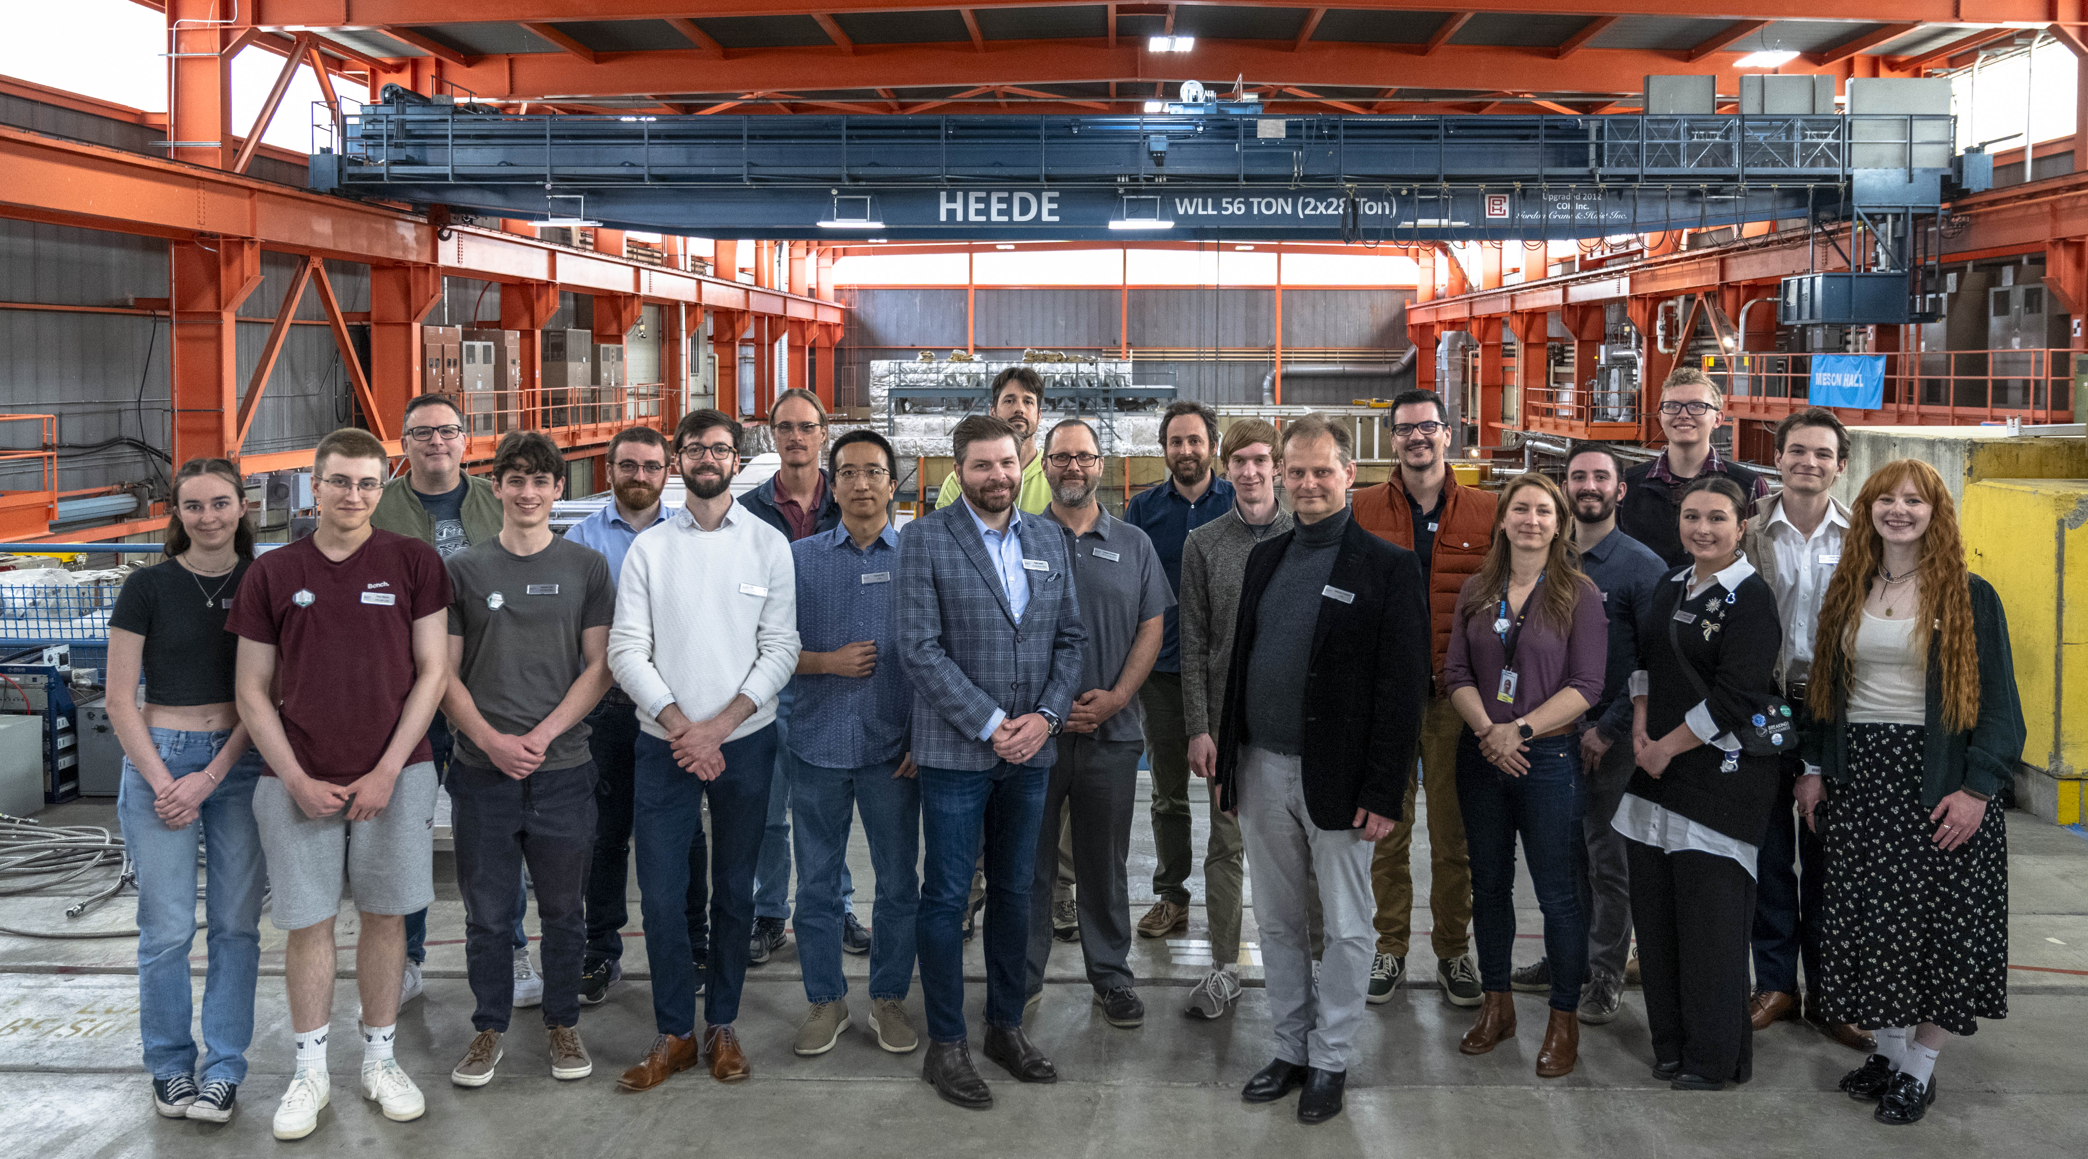








The BeEST Collaboration
2025 Collaboration Meeting
TRIUMF, Canada
CEA Paris-Saclay
Colorado School of Mines
Lawrence Livermore National Laboratory
LPC Caen
McGill University
McMaster University
NOVA School of Science and Technology
Pacific Northwest National Laboratory
SLAC National Accelerator Laboratory
Star Cryoelectronics LLC
TRIUMF
Université Strasbourg
XIA LLC
Yale University
Queen’s University

Slide 3

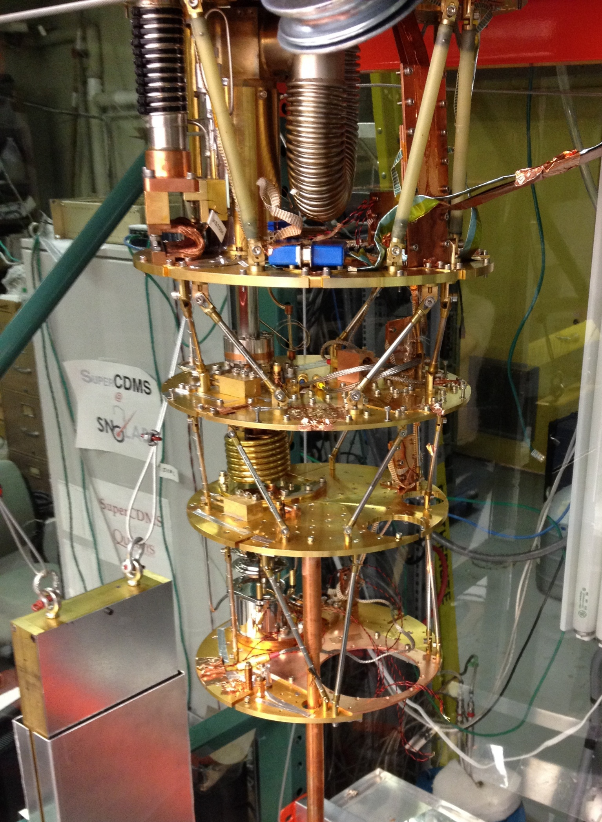
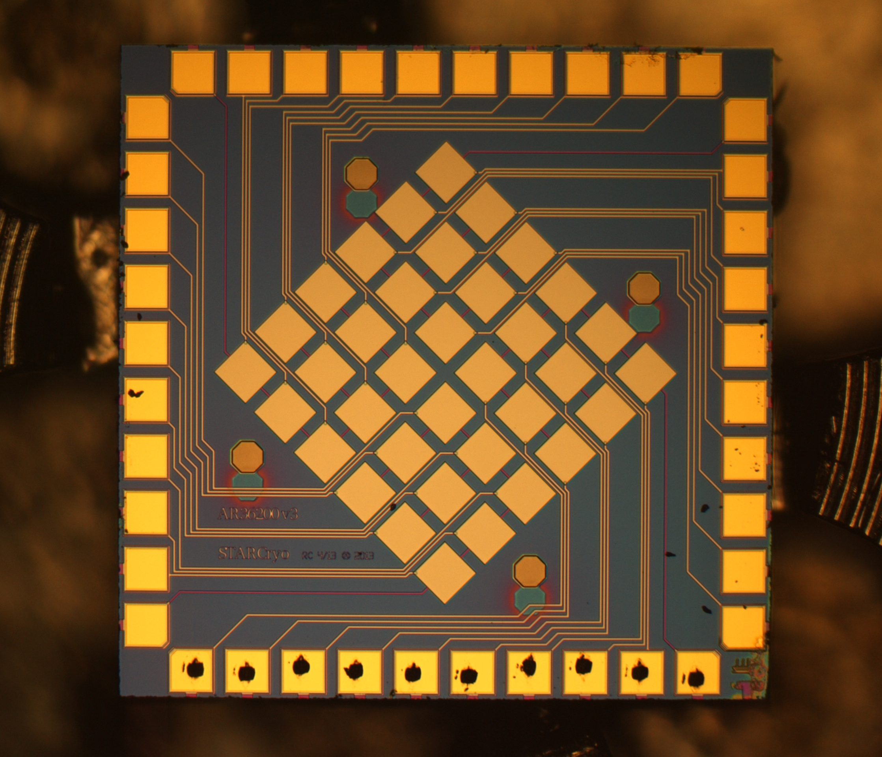

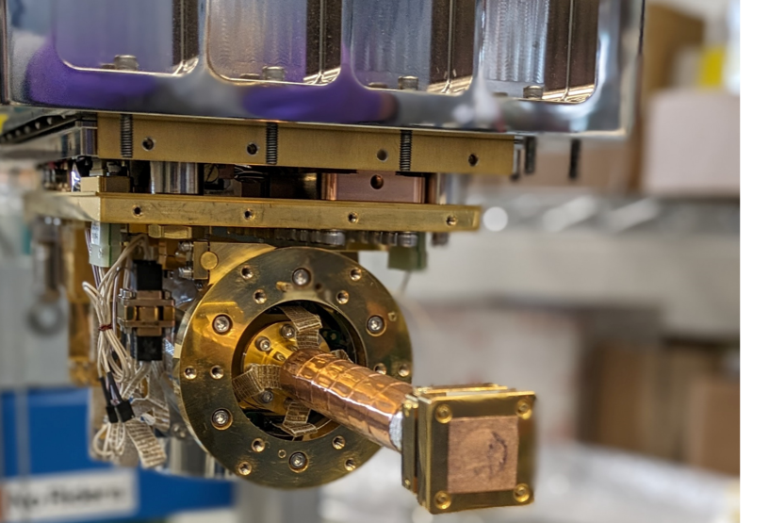
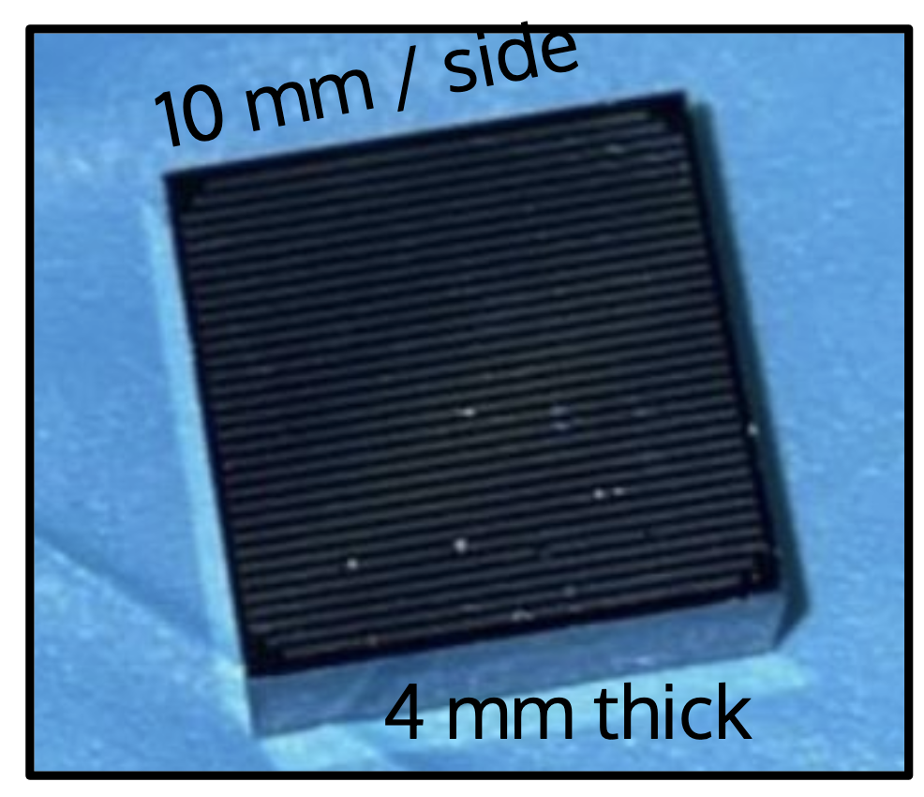
TRIUMF/LPC-Caen activities
FRench And CAnadian STJ Science
Collaboration with Leendert Hayen (Laboratoire de Physique Corpusculaire de Caen)
Co-PI for “SALER: Superconducting Array for Low Energy Radiation” @FRIB ➔ @TRIUMF
Planned: ASCARD: “Assembly of SuperConducting Arrays for Radiation Detection” @GANIL
Plan to host LPC-Caen HQP at TRIUMF this summer
Vice-versa: Involvement of Canadian HQP in ASCARD program
CRONOS
“Cryogenic Research fOr NOvel Sensors”
FRACAS2 - FRench And CAnadian STJ Science
Under the CNRS envelope

