Slide 1

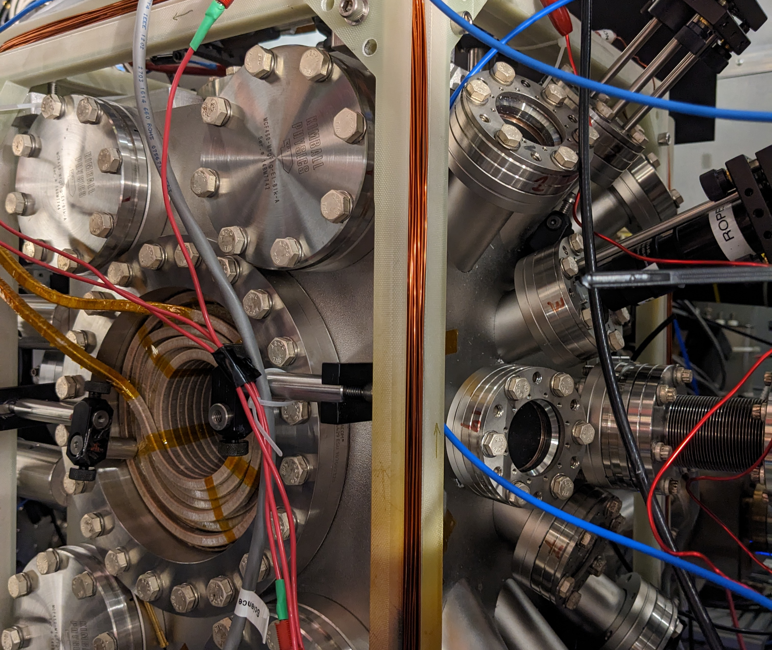
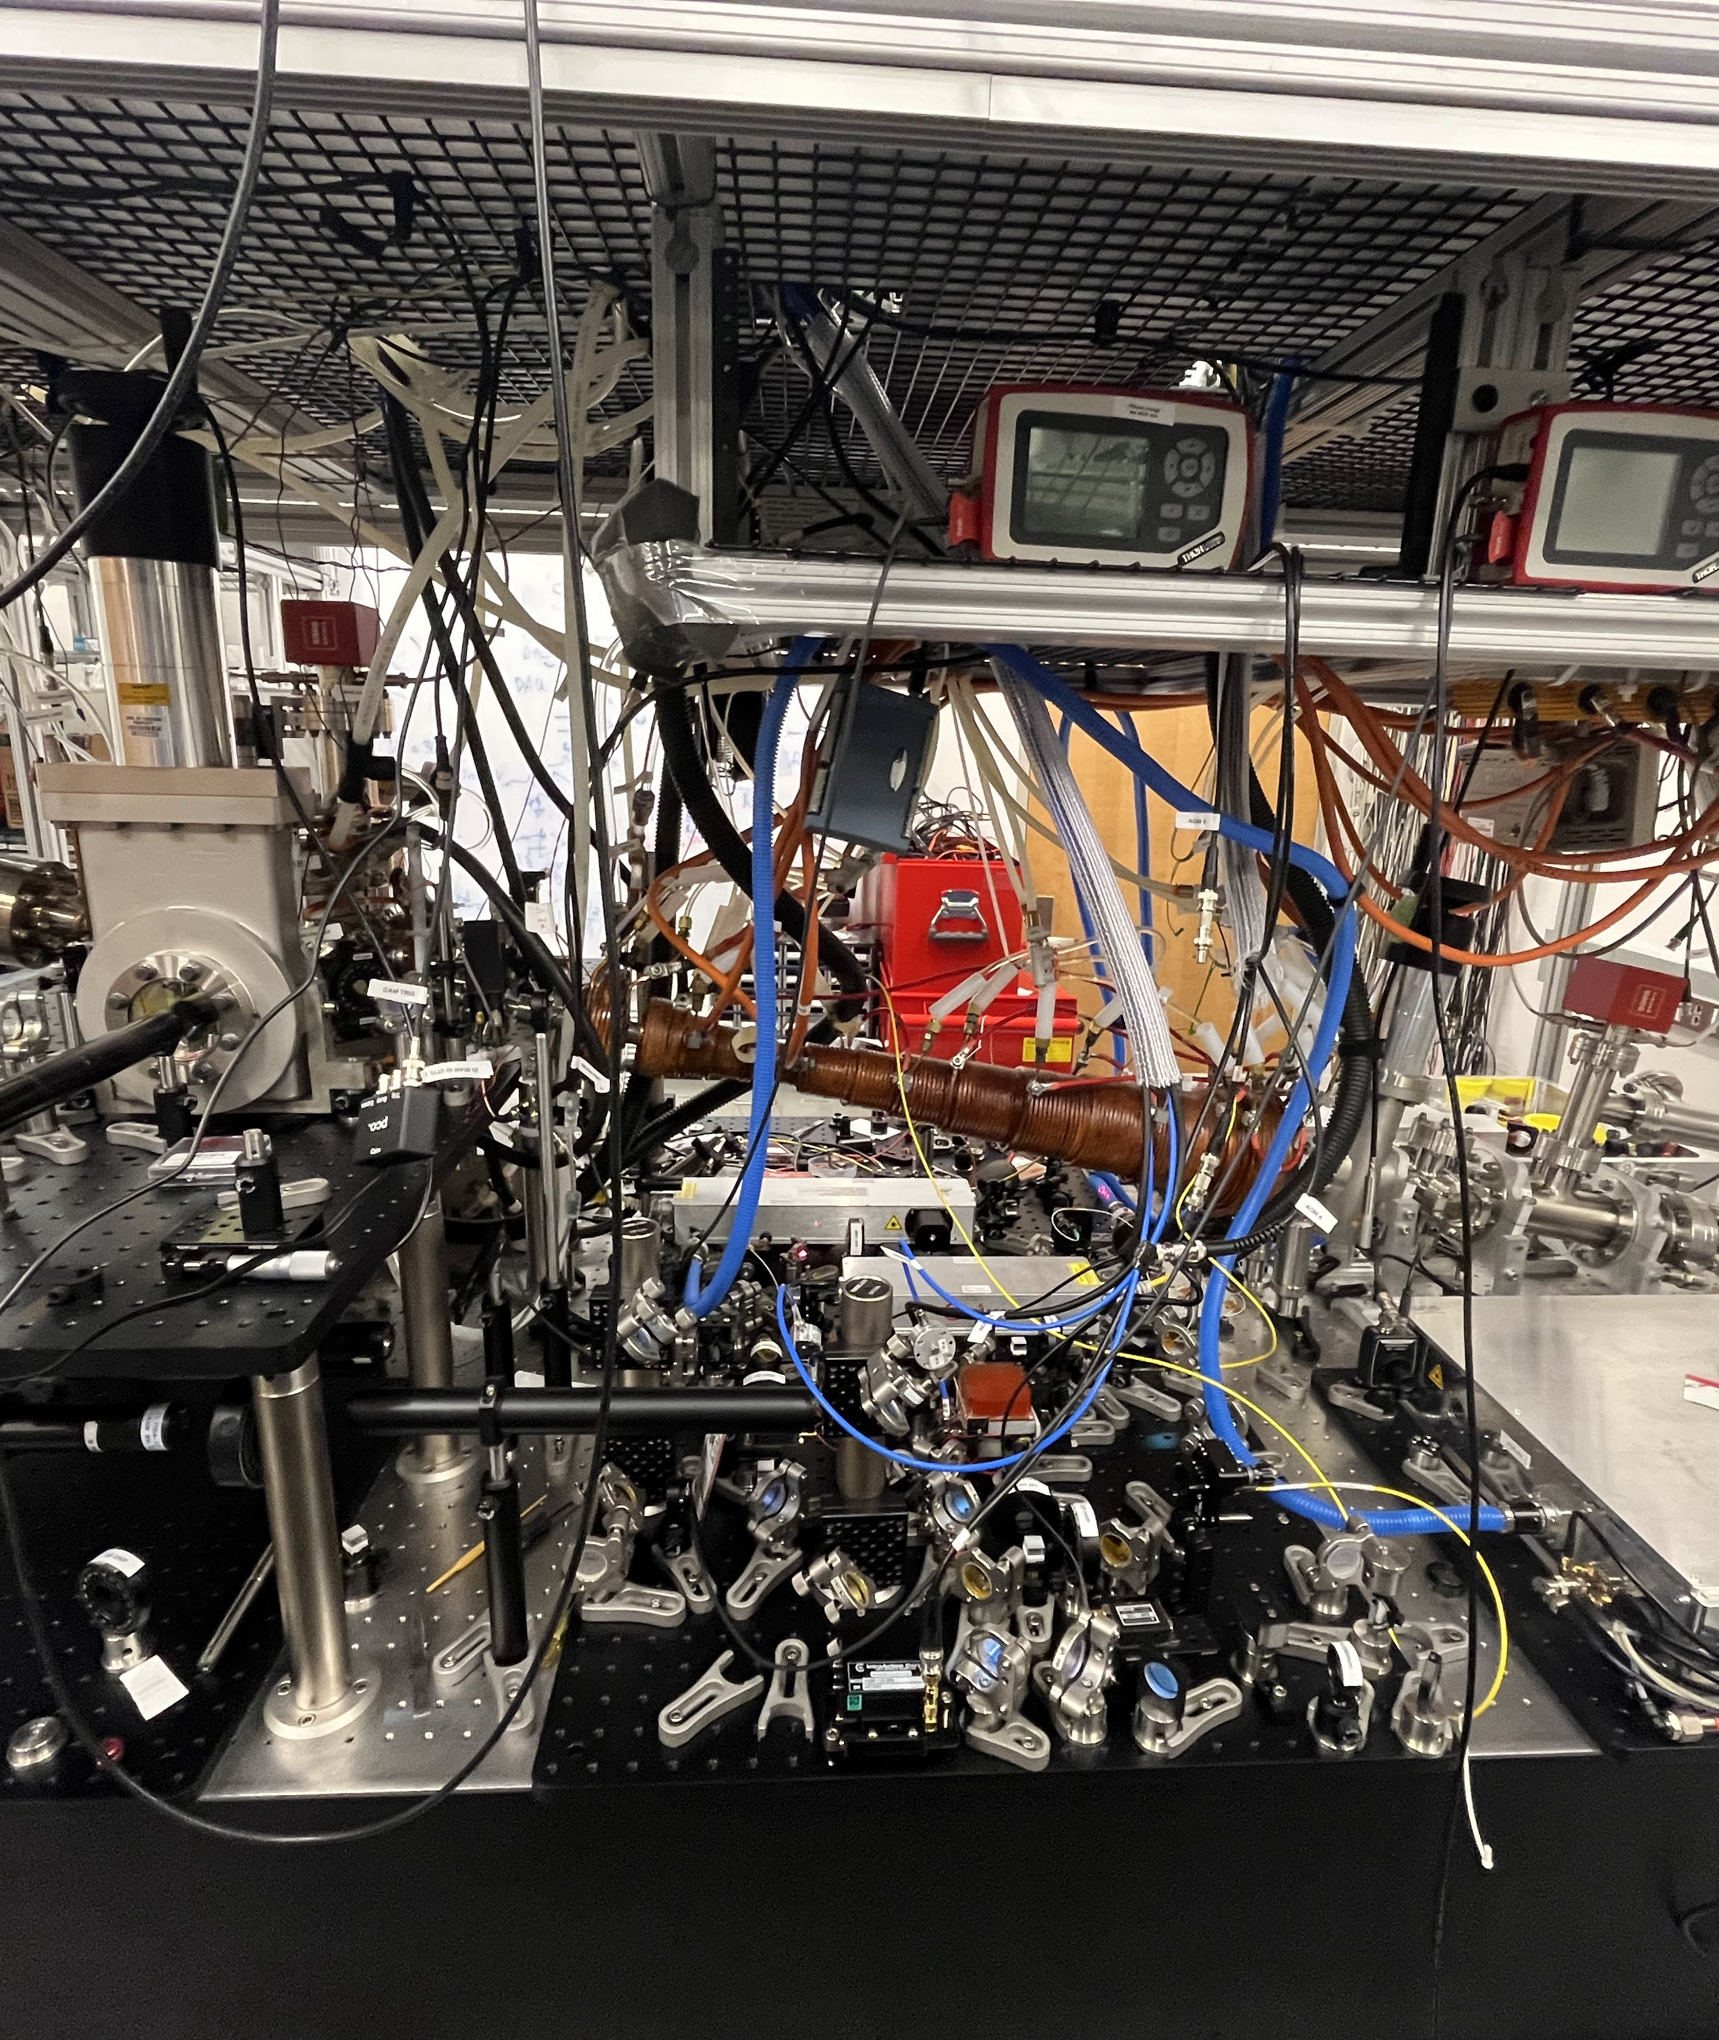
FrX: Searches for Nuclear CP-Violation
FrAg
Alan Jamison
Physics & Astronomy Department and Institute for Quantum Computing
University of Waterloo

Slide 2
Baryon Asymmetry
Sakharov Conditions
  B violation
  Out of equilibrium Physics
  Violation of C and CP symmetries

Slide 3
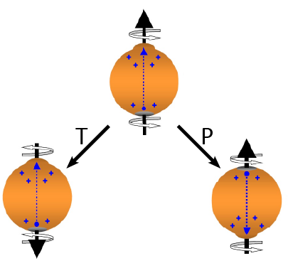
Baryon Asymmetry
Sakharov Conditions
  B violation
  Out of equilibrium Physics
  Violation of C and CP symmetries
    CPT symmetry : CP violation T violation

Slide 4
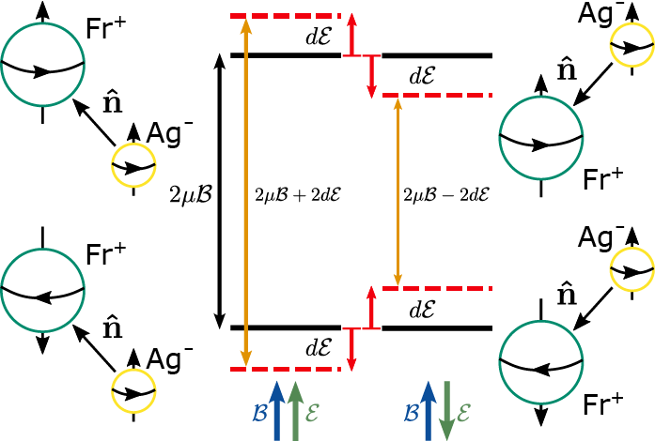
Nuclear Schiff Moment
Nucleon EDM largely screened in an atom
  Residual effect known as a nuclear Schiff moment

Slide 5
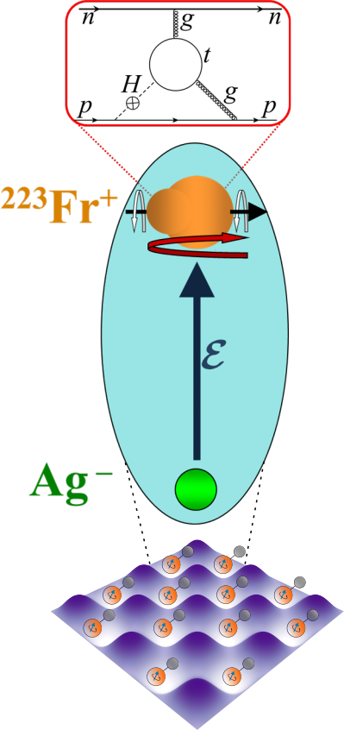
Why FrX?
Internal dipole of the molecule enhances maximum applied E field 10⁴x
Octopole deformation of 221Fr nucleus enhances Schiff induced by nucleon EDM >10²x
Ultracold gives 10 second coherence time
First generation: Expected 100x improvement of sensitivity to fundamental CP violation

Slide 6
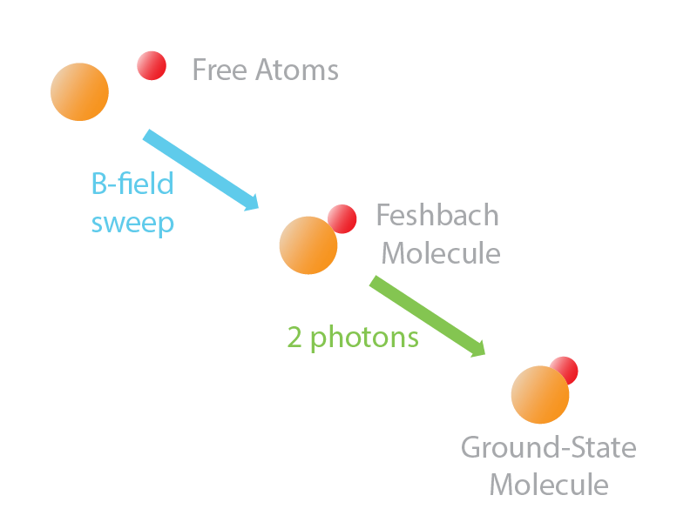
Ultracold Assembly
Much easier to laser cool atoms than molecules
But… Molecules are made of atoms!
Path originated by Debbie Jin and Jun Ye
  Ni, et al.; Science, 322, 231(2008)

Slide 7
Ultracold Assembly

Slide 8
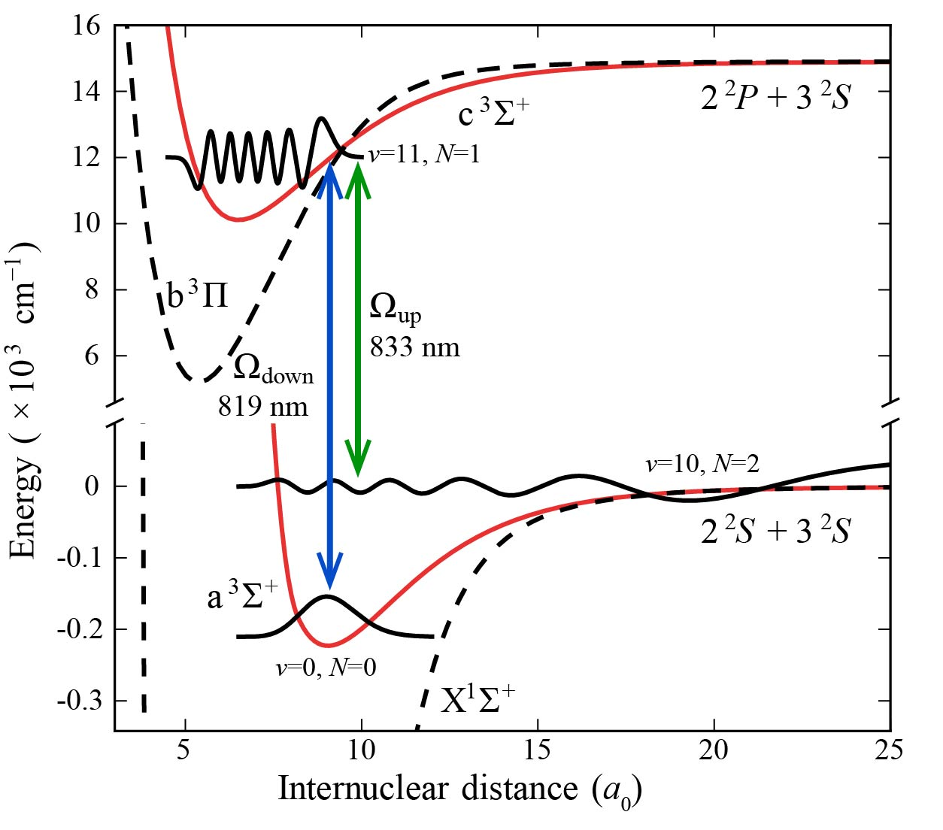
Ultracold Assembly

Slide 9
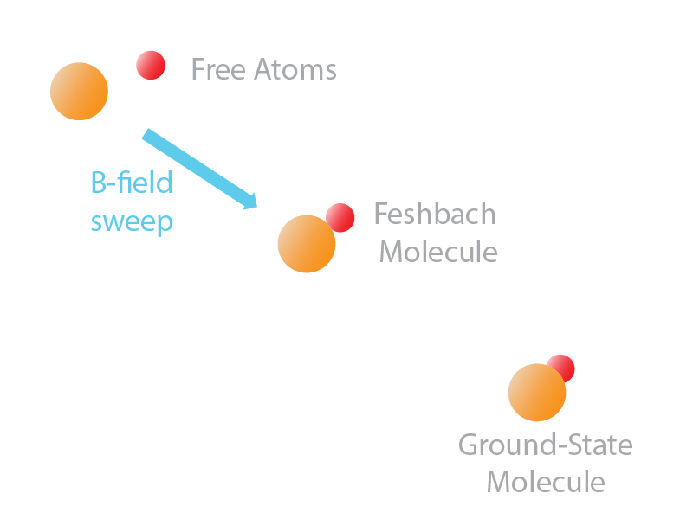
Magnetic Association

Slide 10
Ultracold Assembly

Slide 11
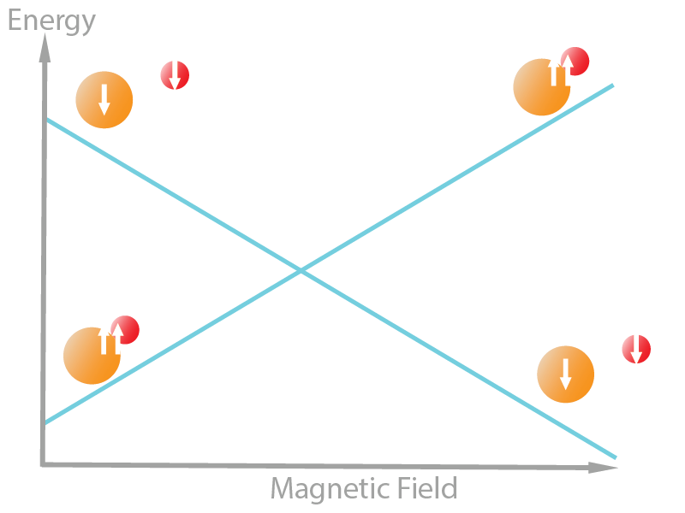
Magnetic Association

Slide 12
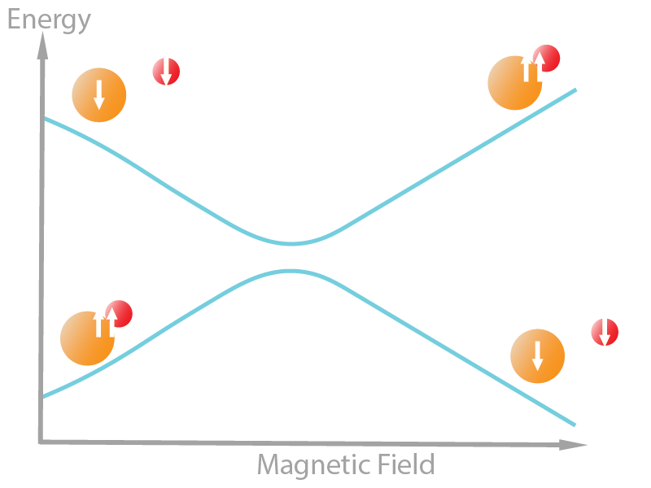
Feshbach REsonance

Slide 13
Ultracold Assembly

Slide 14
Fr PA

Slide 15
Team
  TRIUMF
  University of Waterloo
  University of British Columbia
  University of Manitoba
  University of Maryland (USA)
  Temple University/NIST (USA)
  Johns Hopkins University

Slide 16
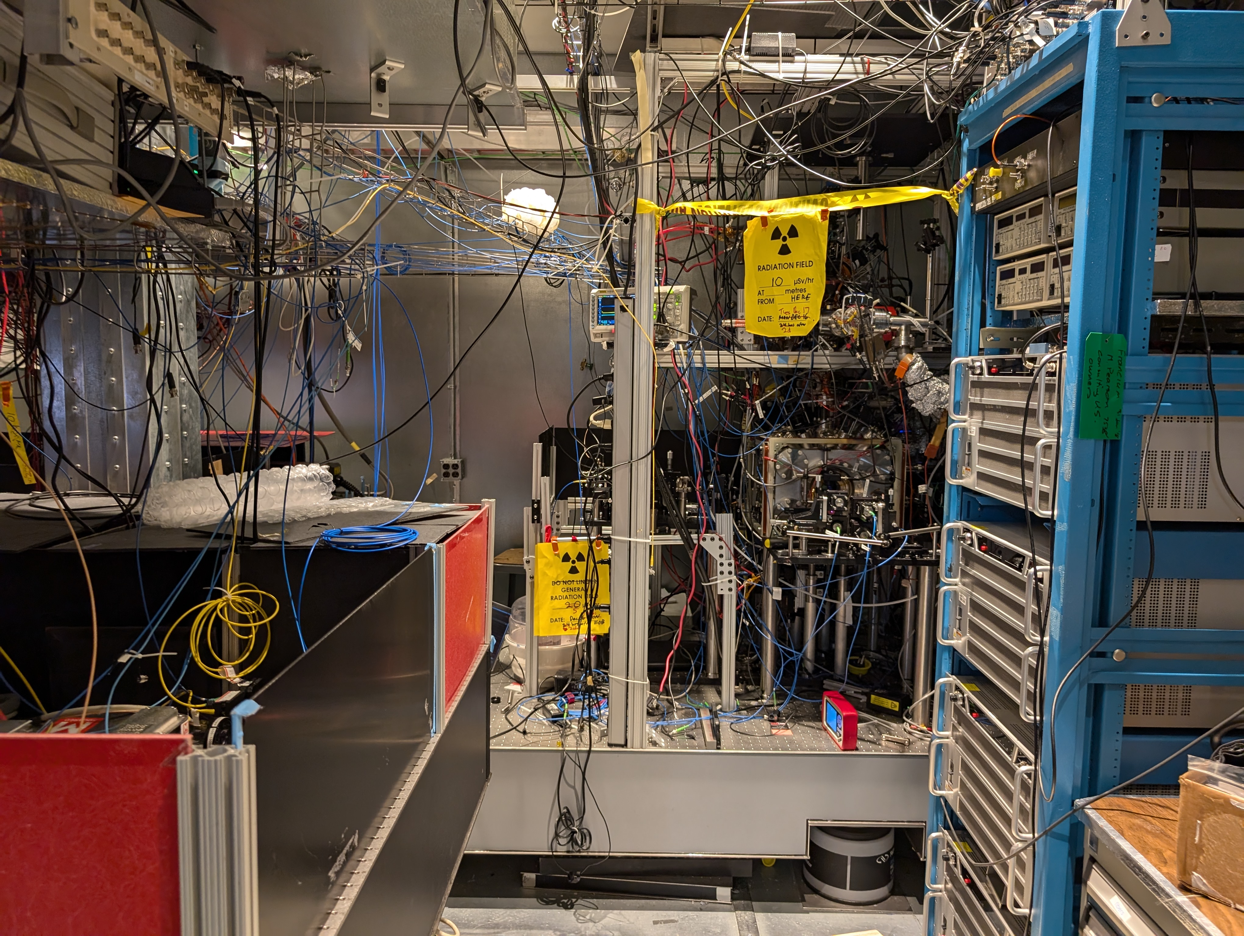
Optical Lattice Potential
  Experiments performed in the Fr PNC lab

Slide 17
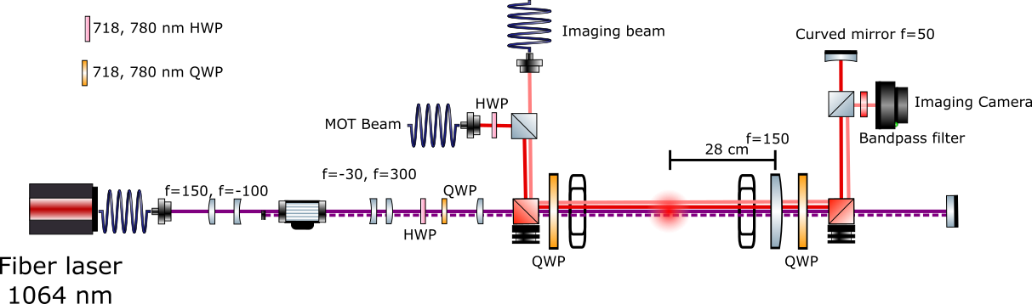
Optical Lattice Potential
  Experiments performed in the Fr PNC lab
  Added capacity for optical trapping and absorption imaging

Slide 18
Optical Lattice Potential
  Experiments performed in the Fr PNC lab
  Added capacity for optical trapping and absorption imaging
  Record low temperatures

Slide 19
Optical Lattice Potential
  Experiments performed in the Fr PNC lab
  Added capacity for optical trapping and absorption imaging
  Record low temperatures
  Improved precision on D2

Slide 20
FrAg

Slide 21

REDRUM
Researching Electric Dipoles with Radioactive Ultracold Molecules
  Johns Hopkins (USA)
  University of Waterloo
  TRIUMF
  University of British Columbia
  University of Manitoba
  Temple University/NIST (USA)
  University of Utah (USA)
  University of Maryland (USA)

Slide 22
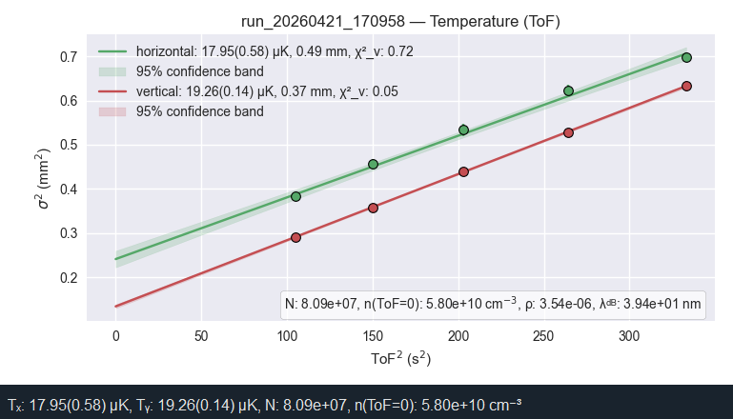
Silver progress
  First sub-doppler cooling of Ag atoms

Slide 23
Silver progress
  First sub-doppler cooling of Ag atoms
  Evaporative cooling

Slide 24
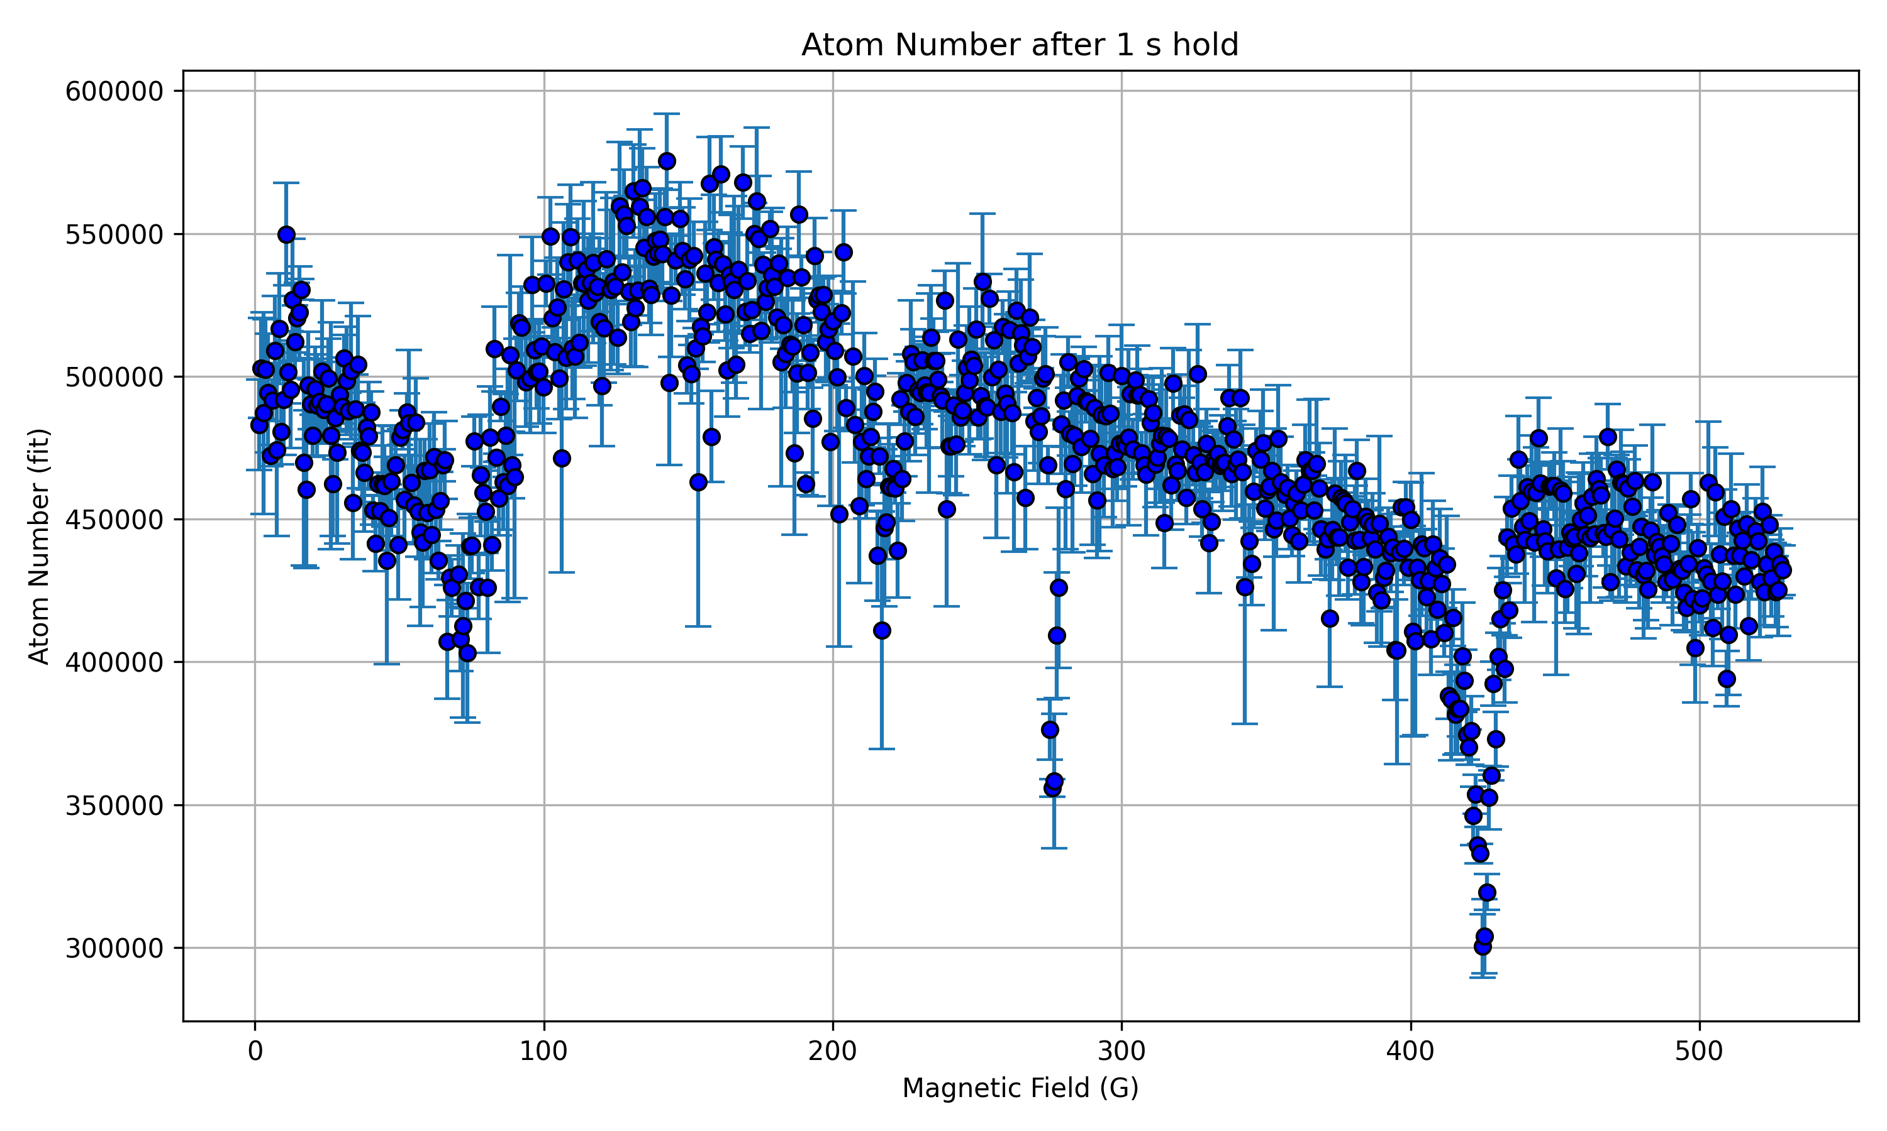
Silver progress
  Feshbach resonance spectrum

Slide 25
RadMol

Slide 26

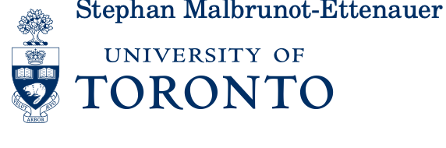
RadMol

Slide 27
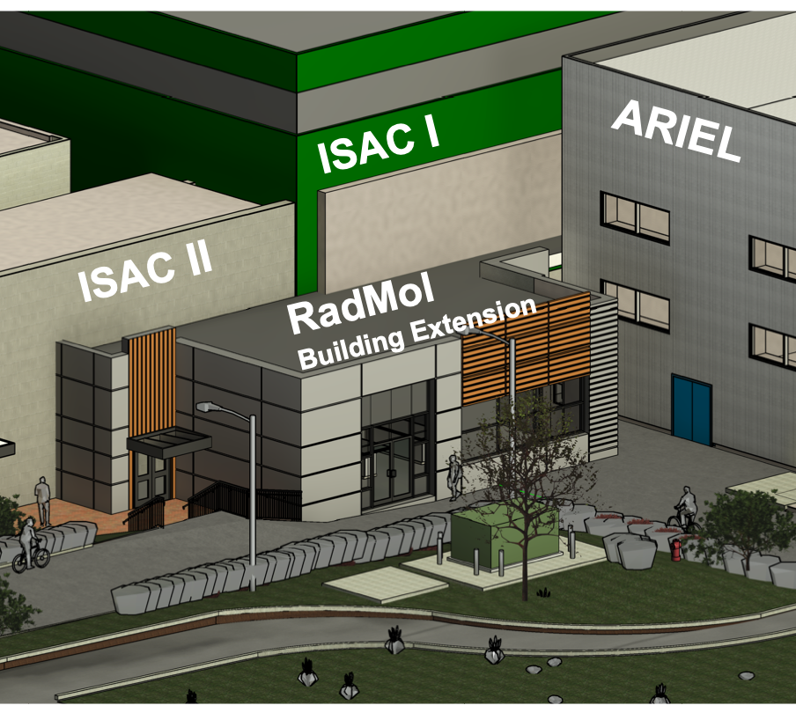
RadMol: Near Future
  CFI-2025
  renovation of laboratory space
  ThF+ and FrX experimental stations
  RadMol building expansion
  RIB beam lines to RadMol labs

Slide 28
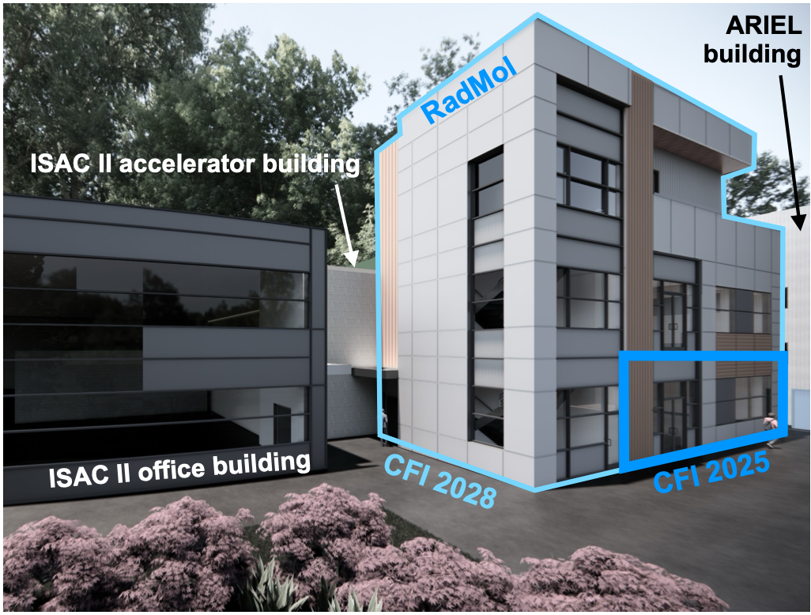
RadMol: Near Future & Beyond
  CFI-2025
  Potential CFI-2029 Proposal

Slide 29
RadMol: Near Future & Beyond
  Potential CFI-2029 Proposal
  new laboratory space
  strengthen synergies between RadMol and medical isotope development
  new physics directions
  nuclear anapole moments
  ultracold (neutral) molecules
  molecules for astrophysics

Slide 31

Baryon Asymmetry Problem
Matter black
Antimatter white

Slide 32
Baryon Asymmetry Problem
Matter black
Antimatter white

Slide 33
Baryon Asymmetry Problem
Matter black
Antimatter white
1/100 of a
pixel is 1 step darker than the others

Slide 34
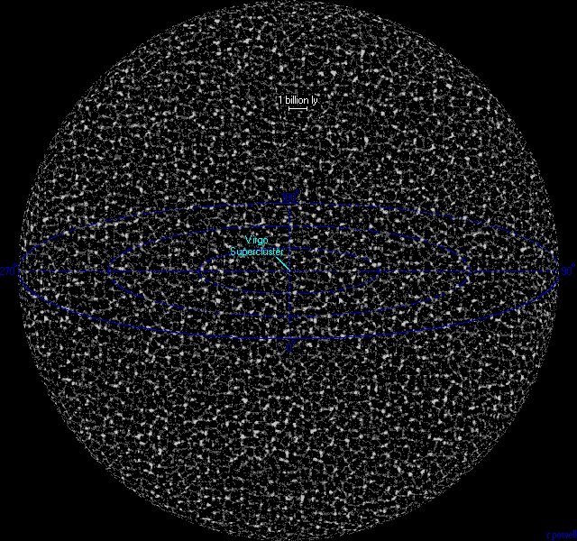

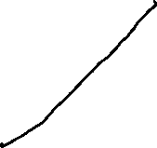
Baryon Asymmetry Problem
Matter black
Antimatter white
1/100 of a
pixel is 1 step darker than the others
http://www.atlasoftheuniverse.com/

