Slide 1
Particle Physics Faculty Meeting
Agenda
  News/Update
  Meet with Ritu at 1pm

Slide 2
TRIUMF is located on the traditional, ancestral, and unceded territory of thexʷməθkʷəy̓əm (Musqueam) people, who for millennia have passed on their culture, history, and traditions from one generation to the next on this site.
TRIUMF’s home has always been a seat of learning.

Slide 3
Meeting guidelines
Speak openly, listen actively – Everyone’s voice matters, and we create space for diverse perspectives.
Assume positive intent – Share questions and disagreements respectfully.
Use inclusive language – Intent is not the same as impact. Please choose your words with care.
Start on time, end on time – Respect everyone’s time by being prompt and focused.
Stay on topic – Consider discussing nuanced and/or complicated topics in a separate, dedicated conversation.
Consult the code – All community members are expected to abide by TRIUMF's Code of Conduct.
Notes:
Here are some meeting guidelines for both your in-person and online conversations.

Slide 4

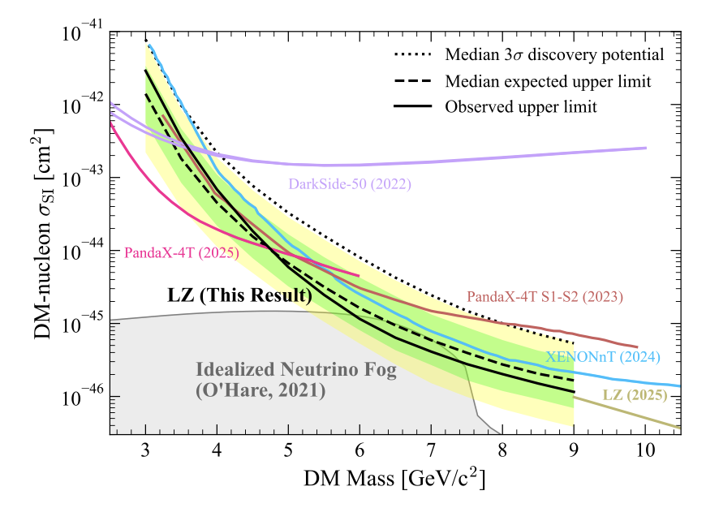
New LZ results

Slide 5
CFI
Successful:
  ATLAS Tier-1
  RadMol
  EIC
  ONC Neptune
  Belle?

Slide 6
Research Talent Initiative
Through this initiative, the Government of Canada will invest up to $1.7 billion over 12 years to attract and support more than 1,000 leading international and expatriate researchers, including Francophone researchers. Recruitment will target individuals who are advancing world-leading research in critical fields that will deliver direct economic, societal and health benefits for Canadians.
The Canada Impact+ Research Chairs program offers $1 billion over 12 years to support institutions in attracting world-leading researchers.
$120 million over 12 years is being provided for institutions to attract international early career researchers (ECRs) through the Canada Impact+ Emerging Leaders program.
Another $400 million will be used to create the Canada Impact+ Research Infrastructure Fund over six years to establish a complementary stream of research infrastructure support to ensure the recruited research chairs and ECRs have the world-class facilities they need to achieve their research goals.
The Canada Impact+ Research Training Awards will invest $133.6 million over three years to enable top international doctoral students and post-doctoral researchers

Slide 7
HQP desk needs
From Xiaoyue:
With the holidays fast approaching, I would like to update the HQP seating information for the next term before everyone goes on vacation. In the spreadsheet below, please delete the lines of your students and postdocs who have left TRIUMF, and add new HQP who are expected to start during the winter 2026 term (please highlight the new additions in red):
PPD_SciTech_SciComp_HQP_Location_2026Winter.xlsx
I will update the seating chart for MOB201, MOB299, and Trailer-Ff accordingly.

Slide 8
Weft and Warp
Report is out
Under:
  Organization Is Defined and Understood
  “Role clarity is a pervasive issue. Many managers and supervisors operate without formal training or defined expectations. Board-Appointed Employees (BAEs), who hold considerable influence, often function outside the formal management system, creating ambiguity and undermining accountability to meeting organizational commitments (vs. individual commitments). Decision-making is centralized and slow, with unclear authority thresholds and a culture that avoids ownership of failure.”

Slide 9
Various
Canadian LRP
  IPP brief released
  CINP brief released
PSD retreat
  Each department to write a summary by Nov 30th
    Draft shared
Holiday Dinner?
  In the past few years had a dinner before the holiday’s
  Options
    Could do the same this year – end of next week?
    Swap to January (given there is no lab wide mid-winter celebration)
    Could do a new format

Slide 10
Meeting with Ritu
CFI outcome
Weft and Warp report
ACOT
PSD retreat follow up
Government of Canada on launching the Research Talent Initiative

Slide 11
Next Meeting
  Jan 8th

