Slide 1
Beamtime Perspective from Physical Sciences Division
(A look at past ISAC performance & program plan for 2020)
Chris Ruiz | Nuclear Physics Department Head
Physical Sciences Division

Slide 2
Outline
Current and past annual radioactive ion beam and stable beam shifts
Current and past annual experiments (by facility)
Experiment failures due to Target & Ion Source (and related) performance
ISAC Target Module bias limitations – outlook for program
“Strawman” Schedules for 2020– examples for discussion

Slide 3
ISAC Schedule
Cyclotron year ~mid-April to third week December, with 2 weeks Mini Shutdown
Prescribed sequence of maintenance days, cyclotron beam development shifts, averaging at 2.1 ISAC non-available / week
Regular ISAC year:
  ~5100 hours (214 days)
“Shortened” ISAC year starts late June:
  ~3800 hours (158 days)
Within these envelopes have to schedule SAP-EEC experiments, MMS-EEC experiments, LSPEC experiments, Beam Development, Yield shifts, Target Startup and Setup shifts

Slide 4
Summary of Radioactive Beam times / Experiments by Category

Slide 6
Tally of Scheduled Radioactive Beam times / Experiments by Facility/Experiment
Facility/Expt. | 2017 | 2018 | 2019 | TOTAL
GRIFFIN | 5 | 5 | 5 | 15 | 20%
TITAN | 3 | 4 | 3 | 10 | 14%
TRINAT | 1 | 1 | 1 | 3 | 4%
POL/LAS | 2 | 3 | 1 | 6 | 8%
FRANCIUM | 1 | 2 | 1 | 4 | 5%
DRAGON/TUDA | 2 | 0 | 1 | 3 | 4%
EMMA | 1 | 0 | 1 | 2 | 3%
TIGRESS | 2 | 2 | 1 | 5 | 7%
IRIS | 3 | 3 | 2 | 8 | 11%
MTV/OSAKA | 1 | 0 | 1 | 2 | 3%
Life Sciences / non-MMS BNMR | 2 | 4 | 4 | 10 | 14%
Other | 1 | 1 | 4 | 6 | 8%
TOTAL | 24 | 25 | 25 | 74 | 100%
Year | Experiments
2017 | 24
2018 | 25
2019 | 25
Have managed to keep experiments constant despite shorter schedules → schedule more short experiments (favours LE at expense of ME, HE)

Slide 7
Not forgetting OLIS….
Year | 2017 | 2018 | 2019
OLIS Pilot | 177 | 125 | 140
OLIS Experiment | 94 | 153 | 129
OLIS TEST | 190 | 144 | 108
OLIS Setup | 143 | 122 | 93
OLIS Maintenance | 17 | 21 | 20
TOTAL | 621 | 565 | 490

Slide 8
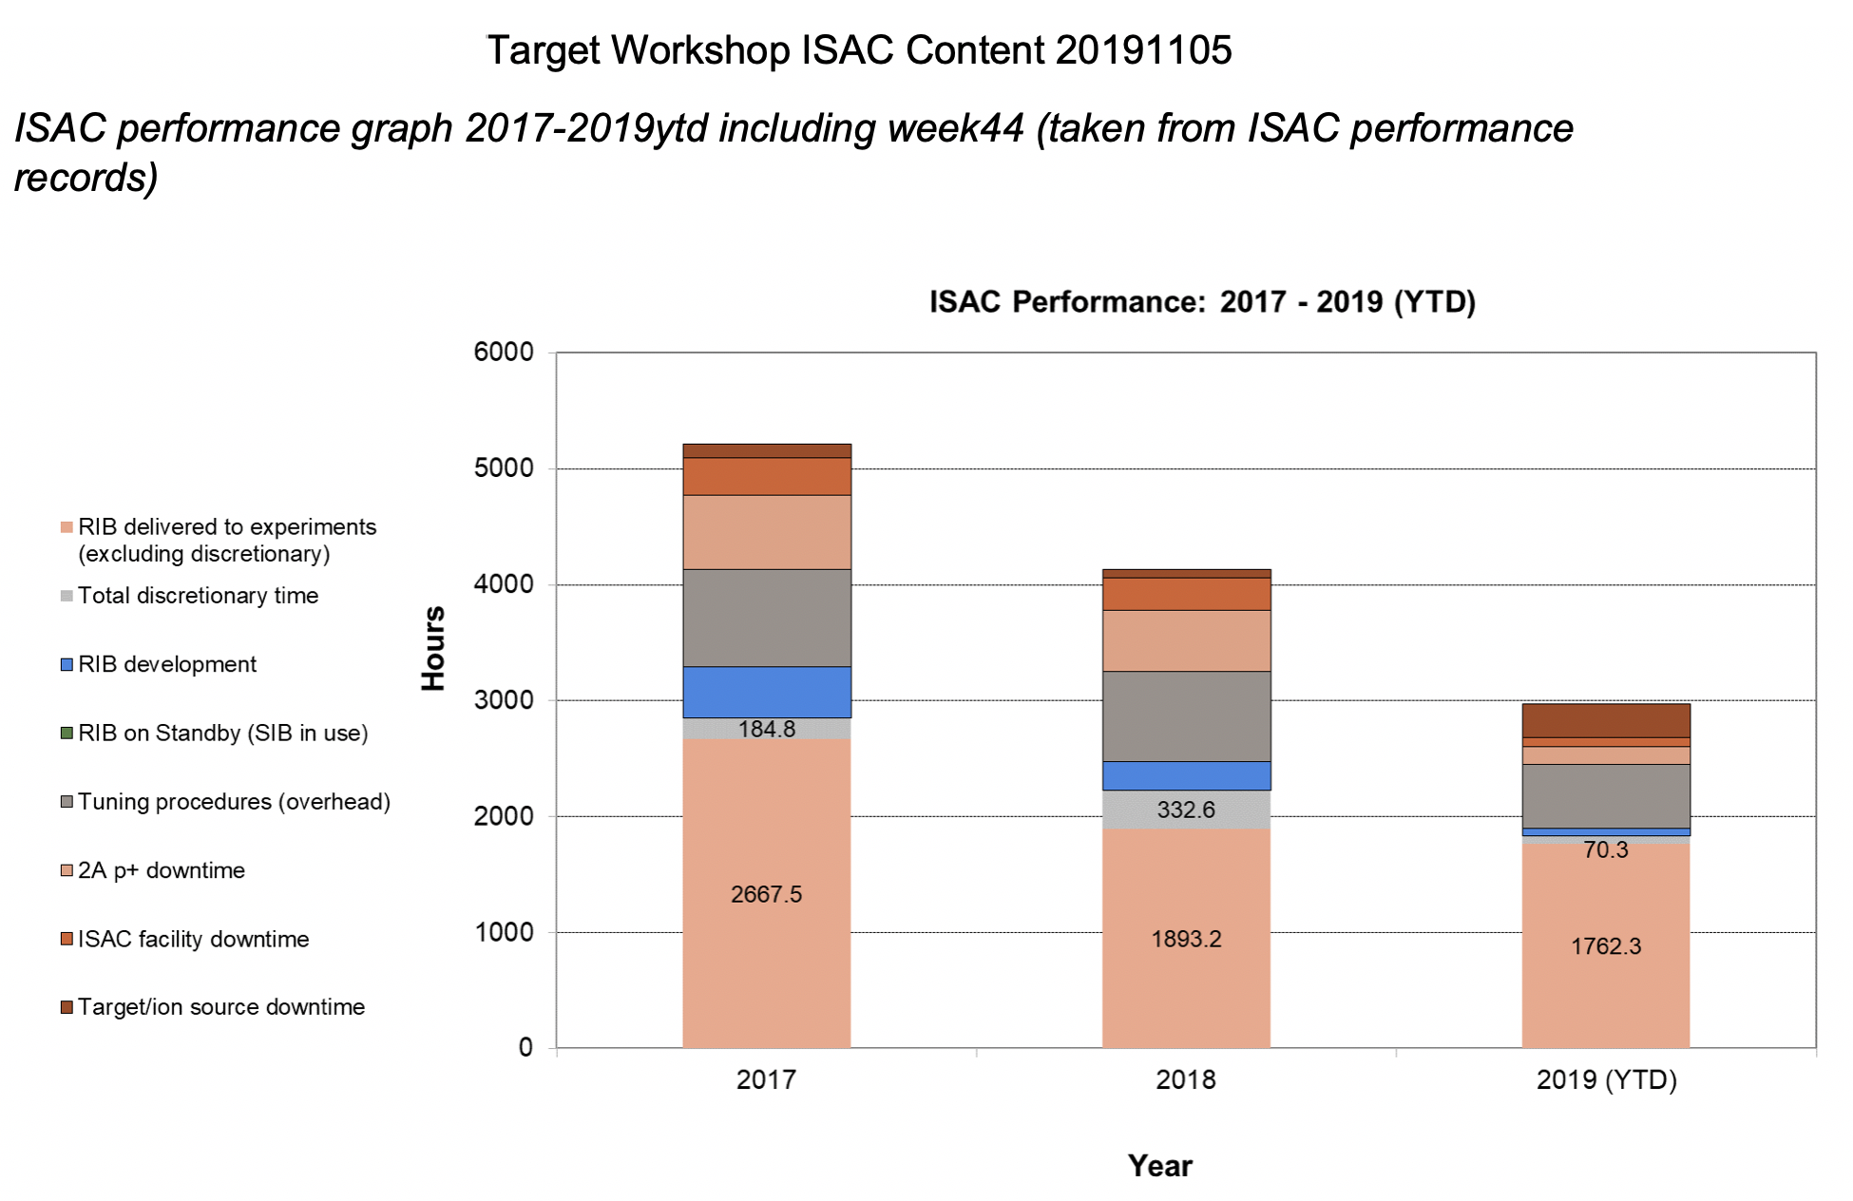
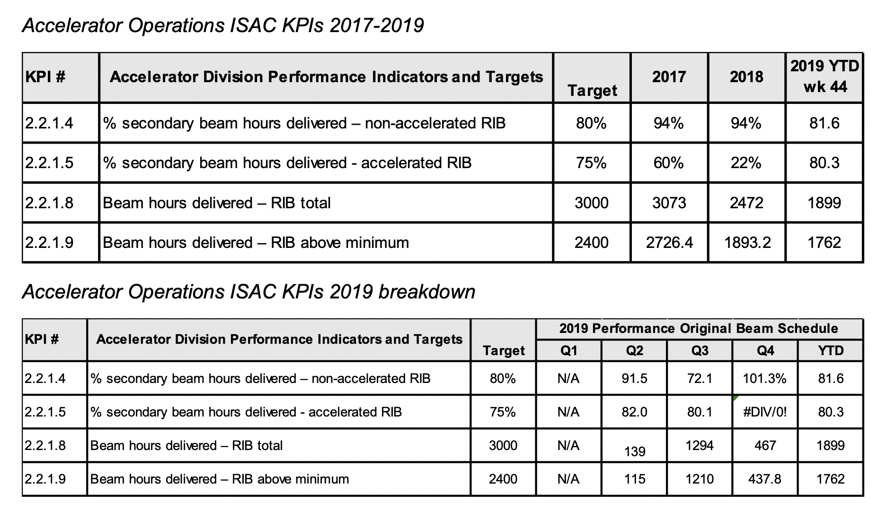
% total RIB available to experiments | ISAC downtime | TIS downtime | 2A (Cyc) downtime
(2017) 74% | 8% | 3% | 16%
(2018) 68% | 10% | 3% | 19%
(2019) 81% | 3% | 11% | 5%
Accelerated beam in 2018 poor due to number of factors: prof mon. leak in BL2A, TM leaks, P/S failures,…
2019 good for Acc Beam so far, numbers influenced by IRIS, TAMU, ⁷Be to DRAGON & ⁹³Rb to EMMA/TIGRESS: either low mass or CSB beams not affected by bias limitations

Slide 9
Experiments that failed (did not achieve required intensity) due to TIS or related performance
Year | Schedule | Exp. No. | Beam | Facility | Reason | Shifts
2015 | 128 | S1554 | ²⁸Mg | TIGRESS | TM Bias | 30
2017 | 132 | S1719 | ²³Ne | TIGRESS | TM Bias | 14
2017 | 133 | S1425 | ¹²C¹⁵O | DRAGON | TM Bias | 30
2017 | 133 | S1763 | ¹¹C¹⁶O | TUDA | TM Bias | 14
2018 | 134 | S1240 | n-rich Ne | TITAN | TM Water Leak | 5
2018 | 134 | S1553LOI | n-rich Ne | TITAN | TM Water Leak | -
2018 | 134 | S1621LOI | n-rich Ne | TITAN | TM Water Leak | -
2018 | 134 | S1290 | n-rich Ne | TITAN | TM Water Leak | 6
2018 | 134 | S1766 | ⁵⁹Cu | IRIS | 2A2M19 Vacuum Leak | 27
2018 | 135 | S1701 | ¹¹Li | IRIS | Raster P/S Failure | 22
2019 | 136 | S1894LOI | n-rich Ag | TITAN | TM Water Leak | -
Overall, 11% of ISAC shifts ended up not as originally scheduled

Slide 10
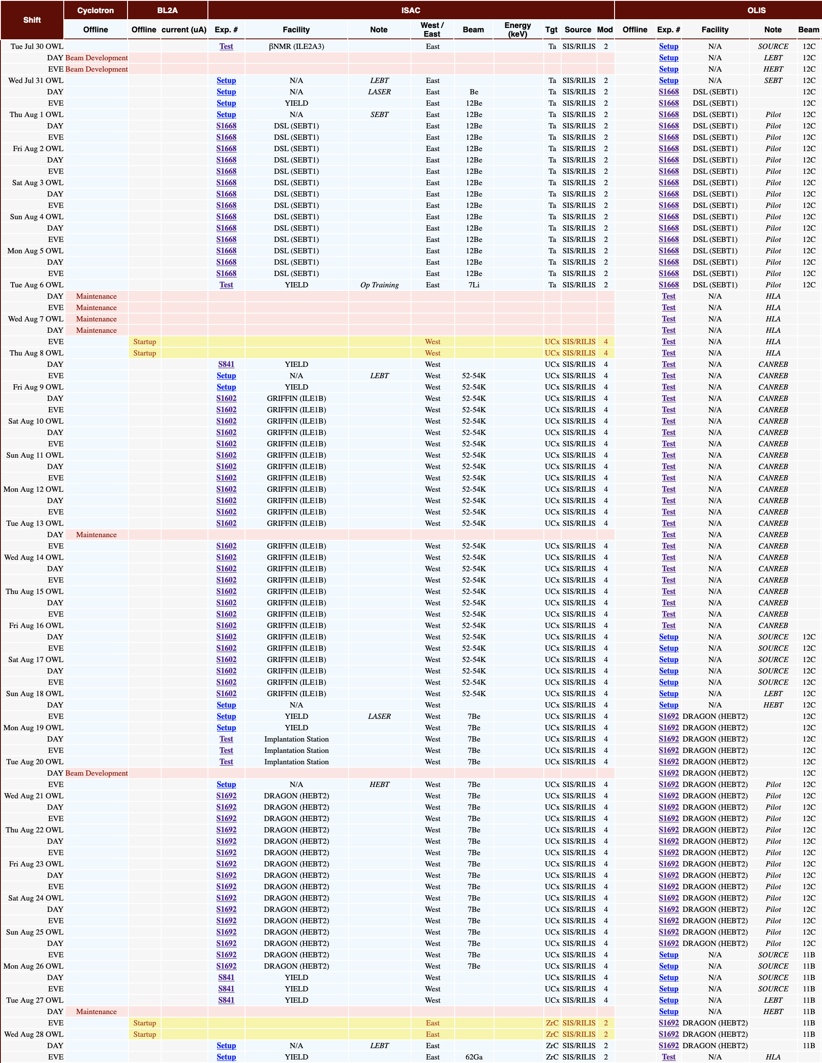
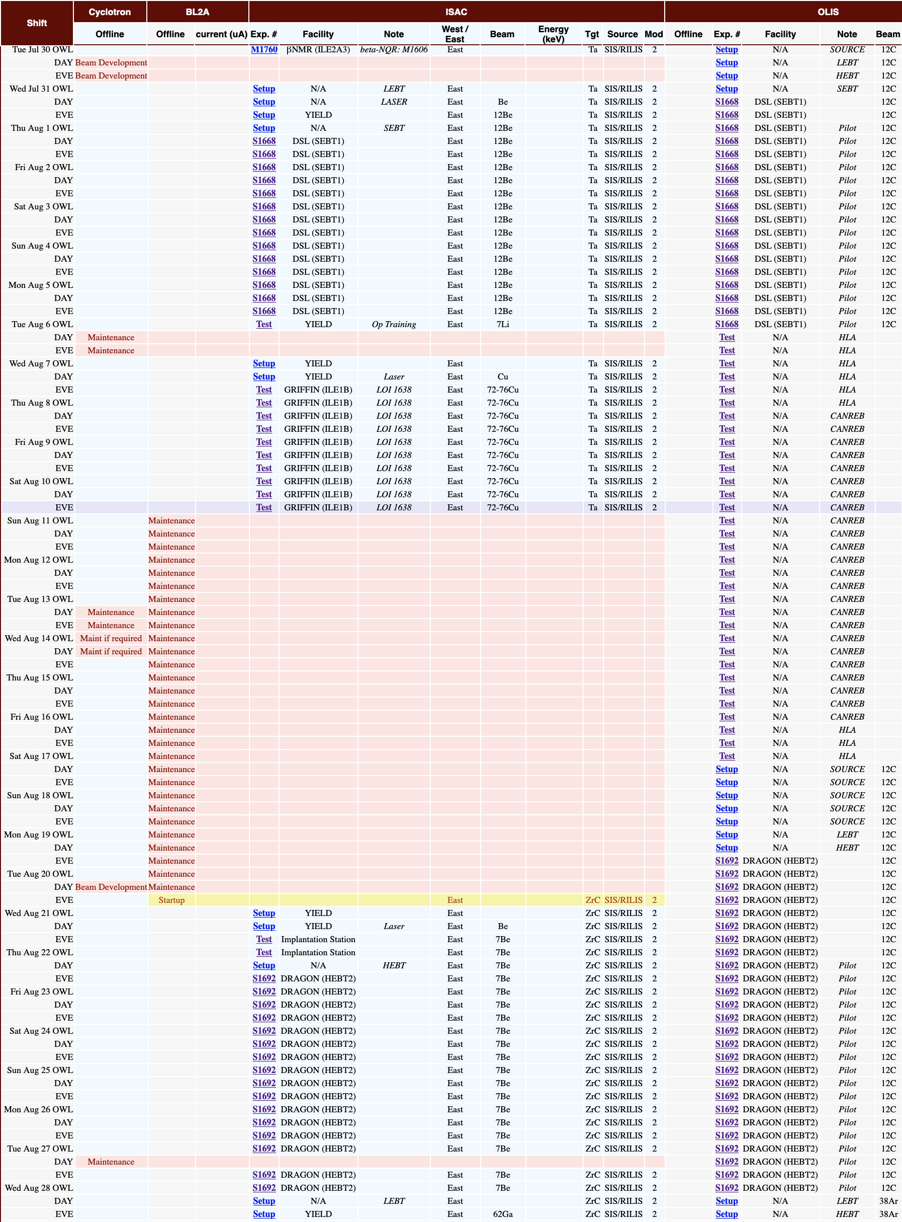
July 24th TM4 issue identified ITW:
Large water leak
Decision made to try emergency indium gasket (not ready in time for as-scheduled experiments)
TM4 failure at critical moment this year serves as an example of vulnerability of two-module inventory with two-module rotation
2 H Priority Experiments,
externally driven by groups with large numbers of personnel ~10-15
Easily $20k-25k
Loss of these shifts plus rescheduling in Fall
Could have been many shorter experiments

Slide 11
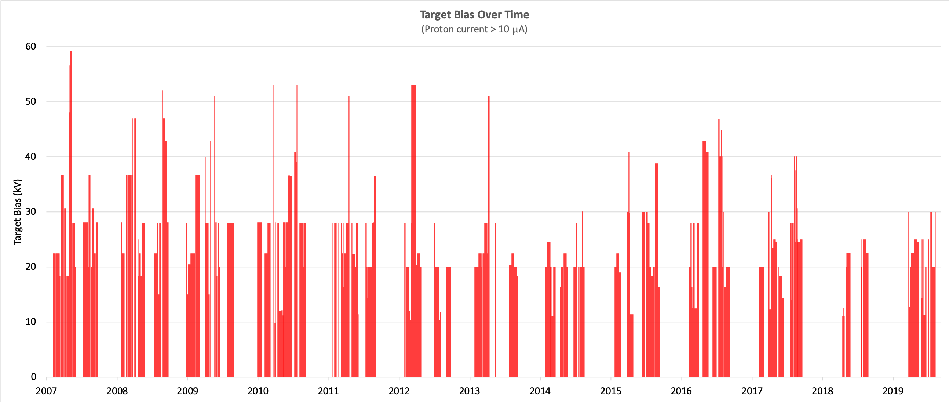

Slide 12
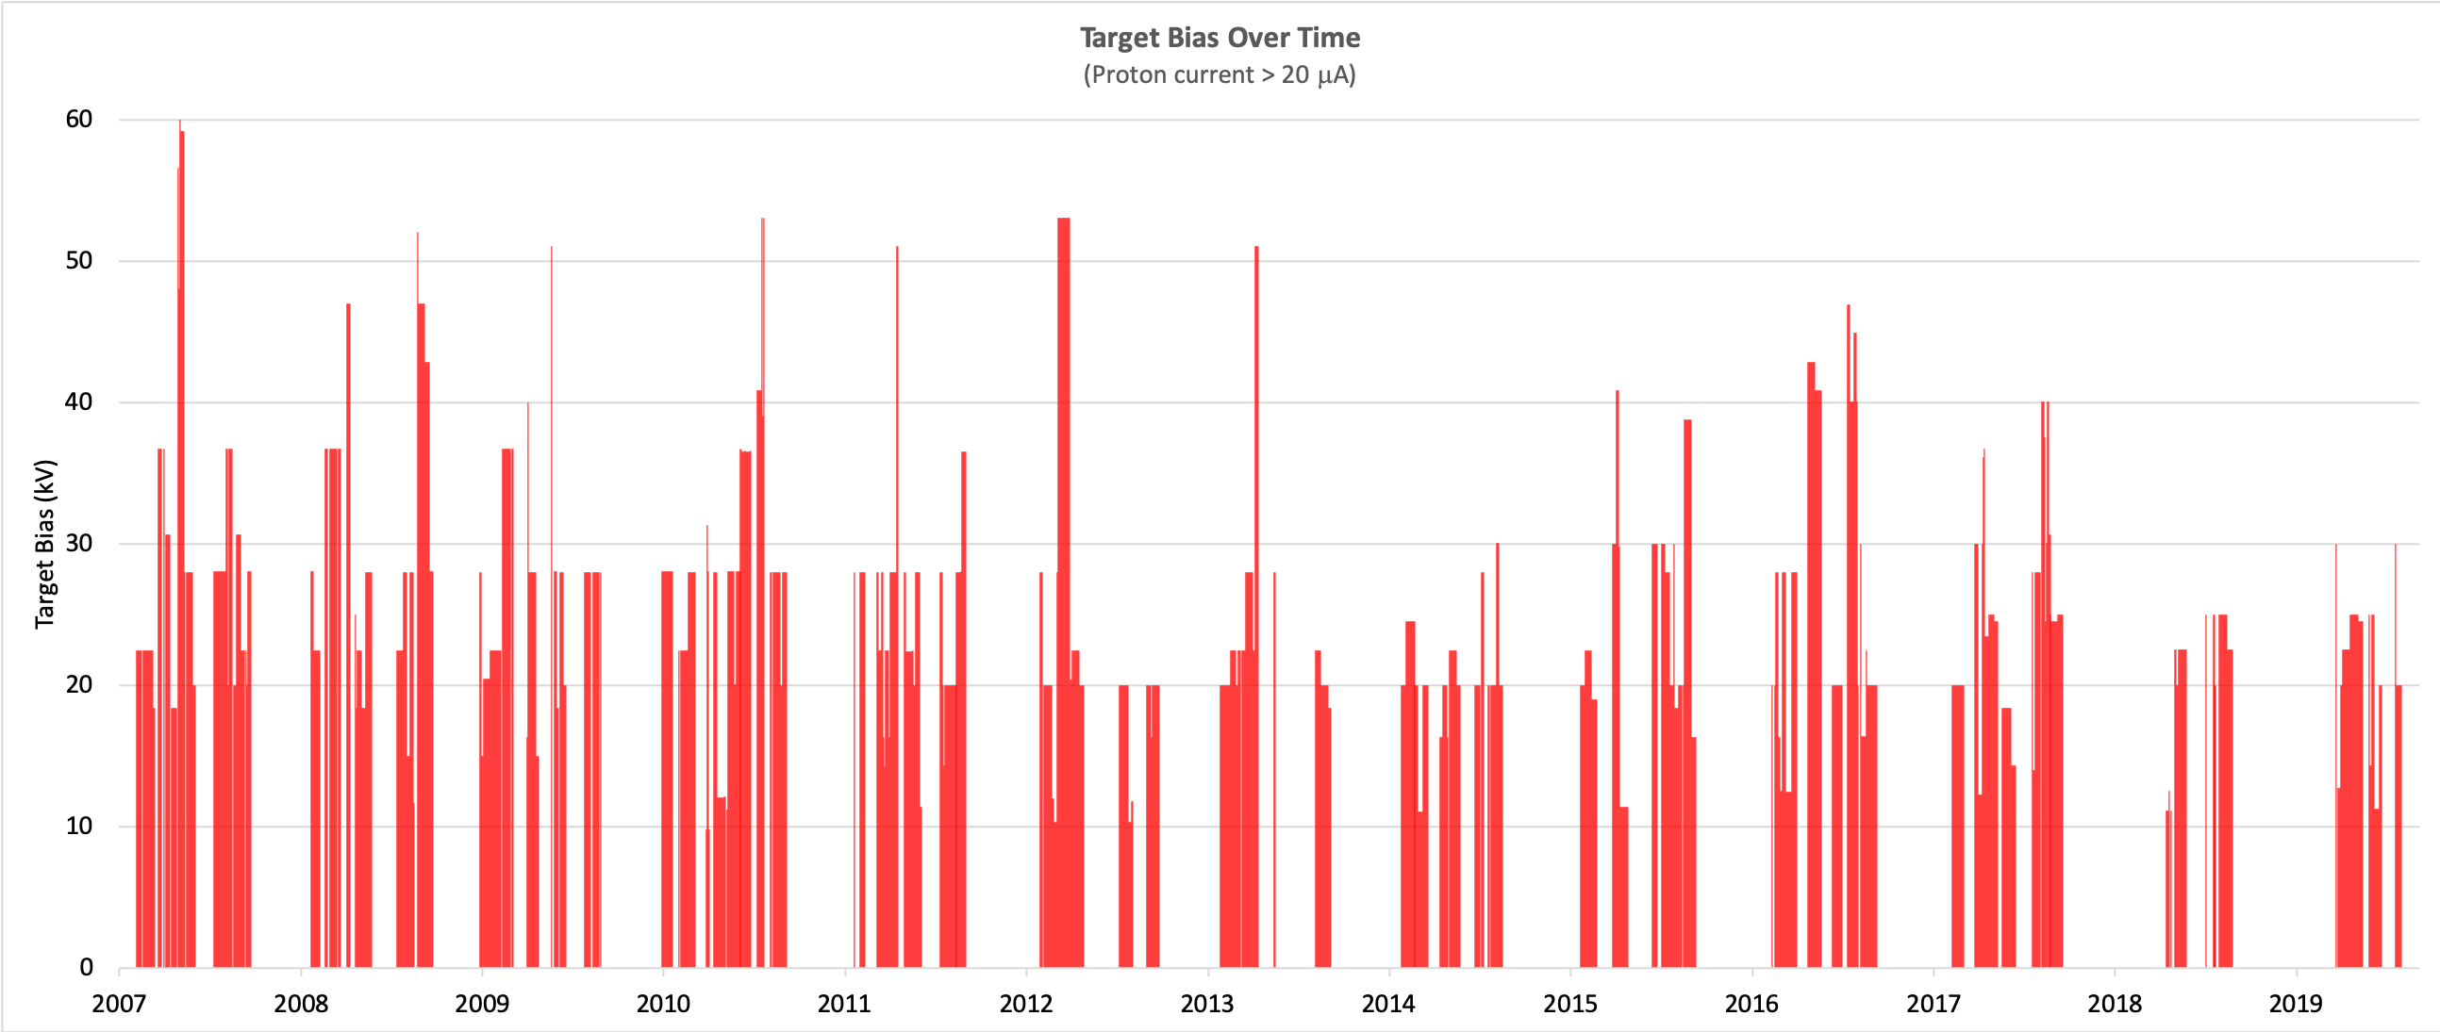

Slide 13
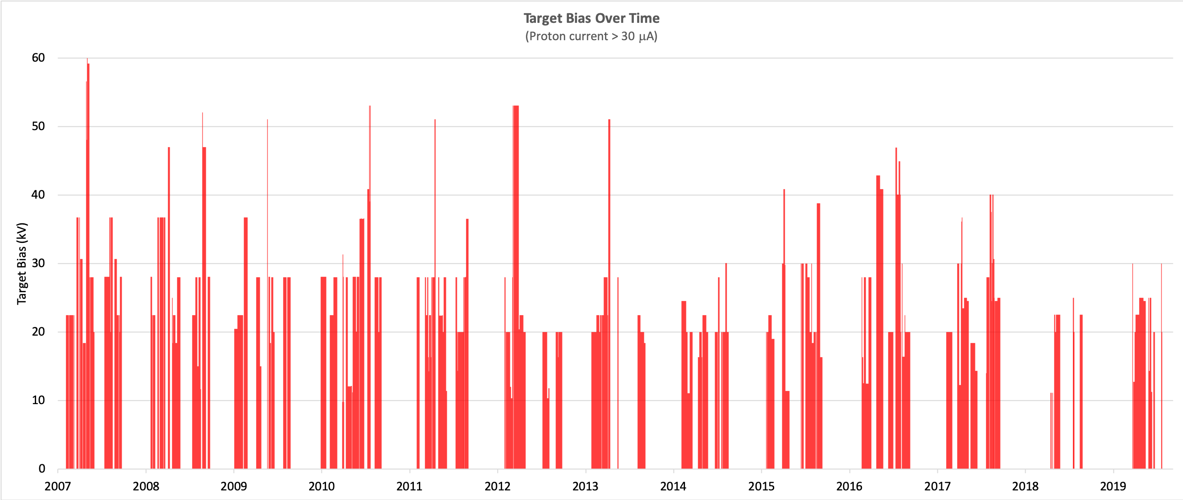

Slide 14
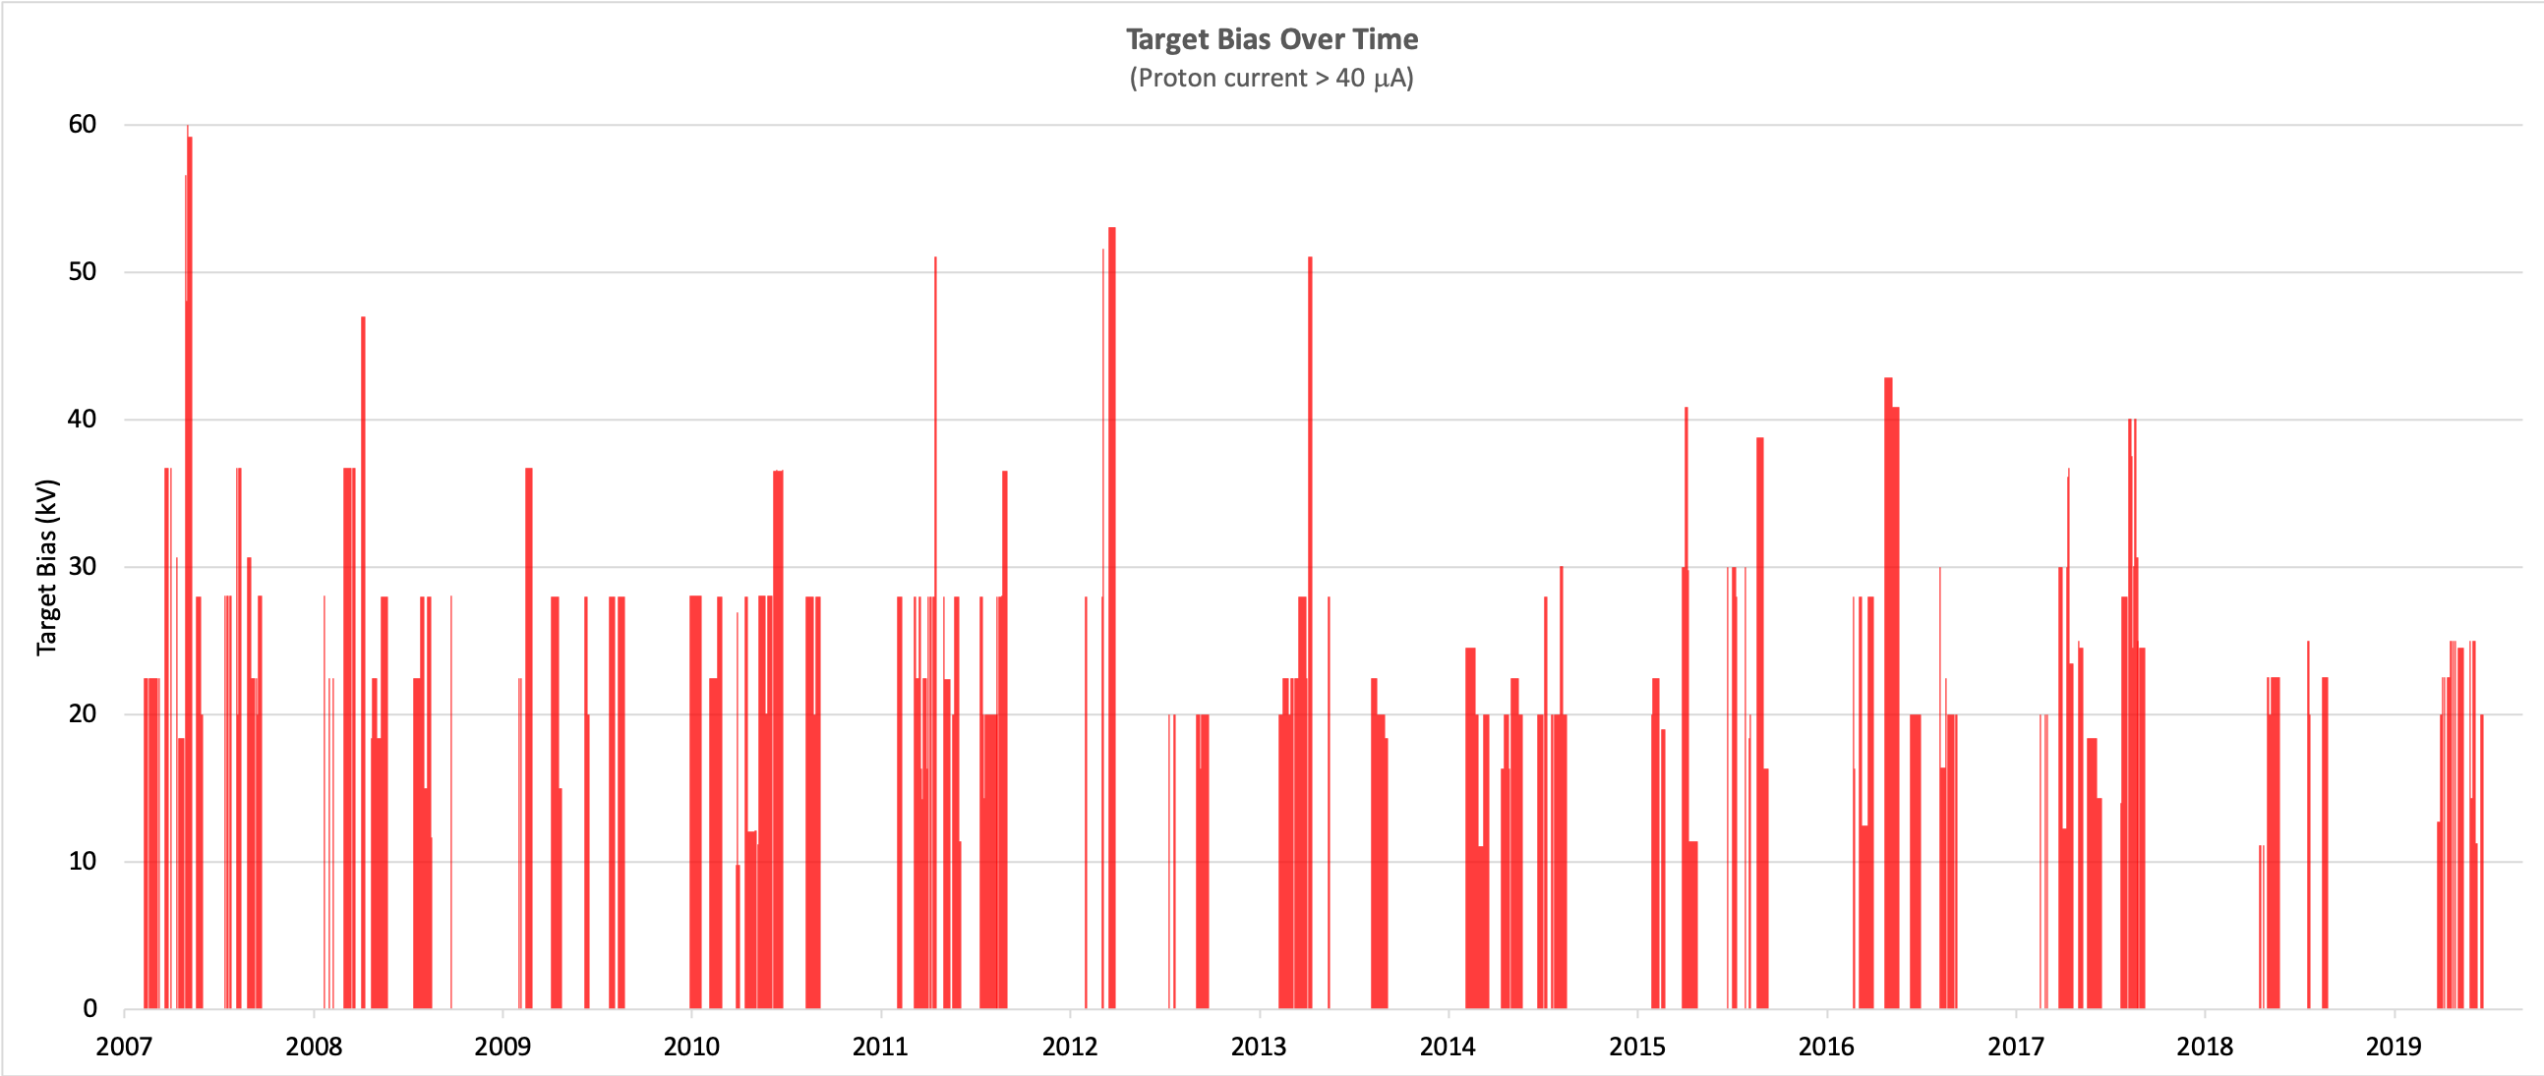

Slide 15
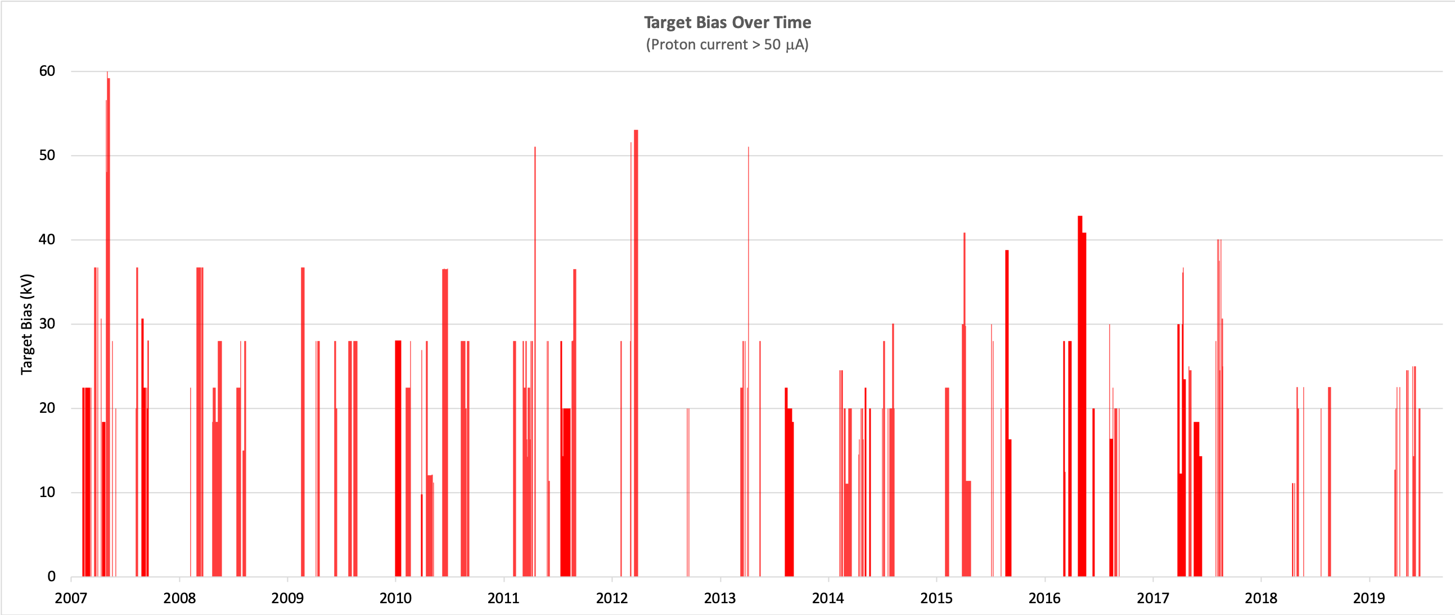

Slide 16
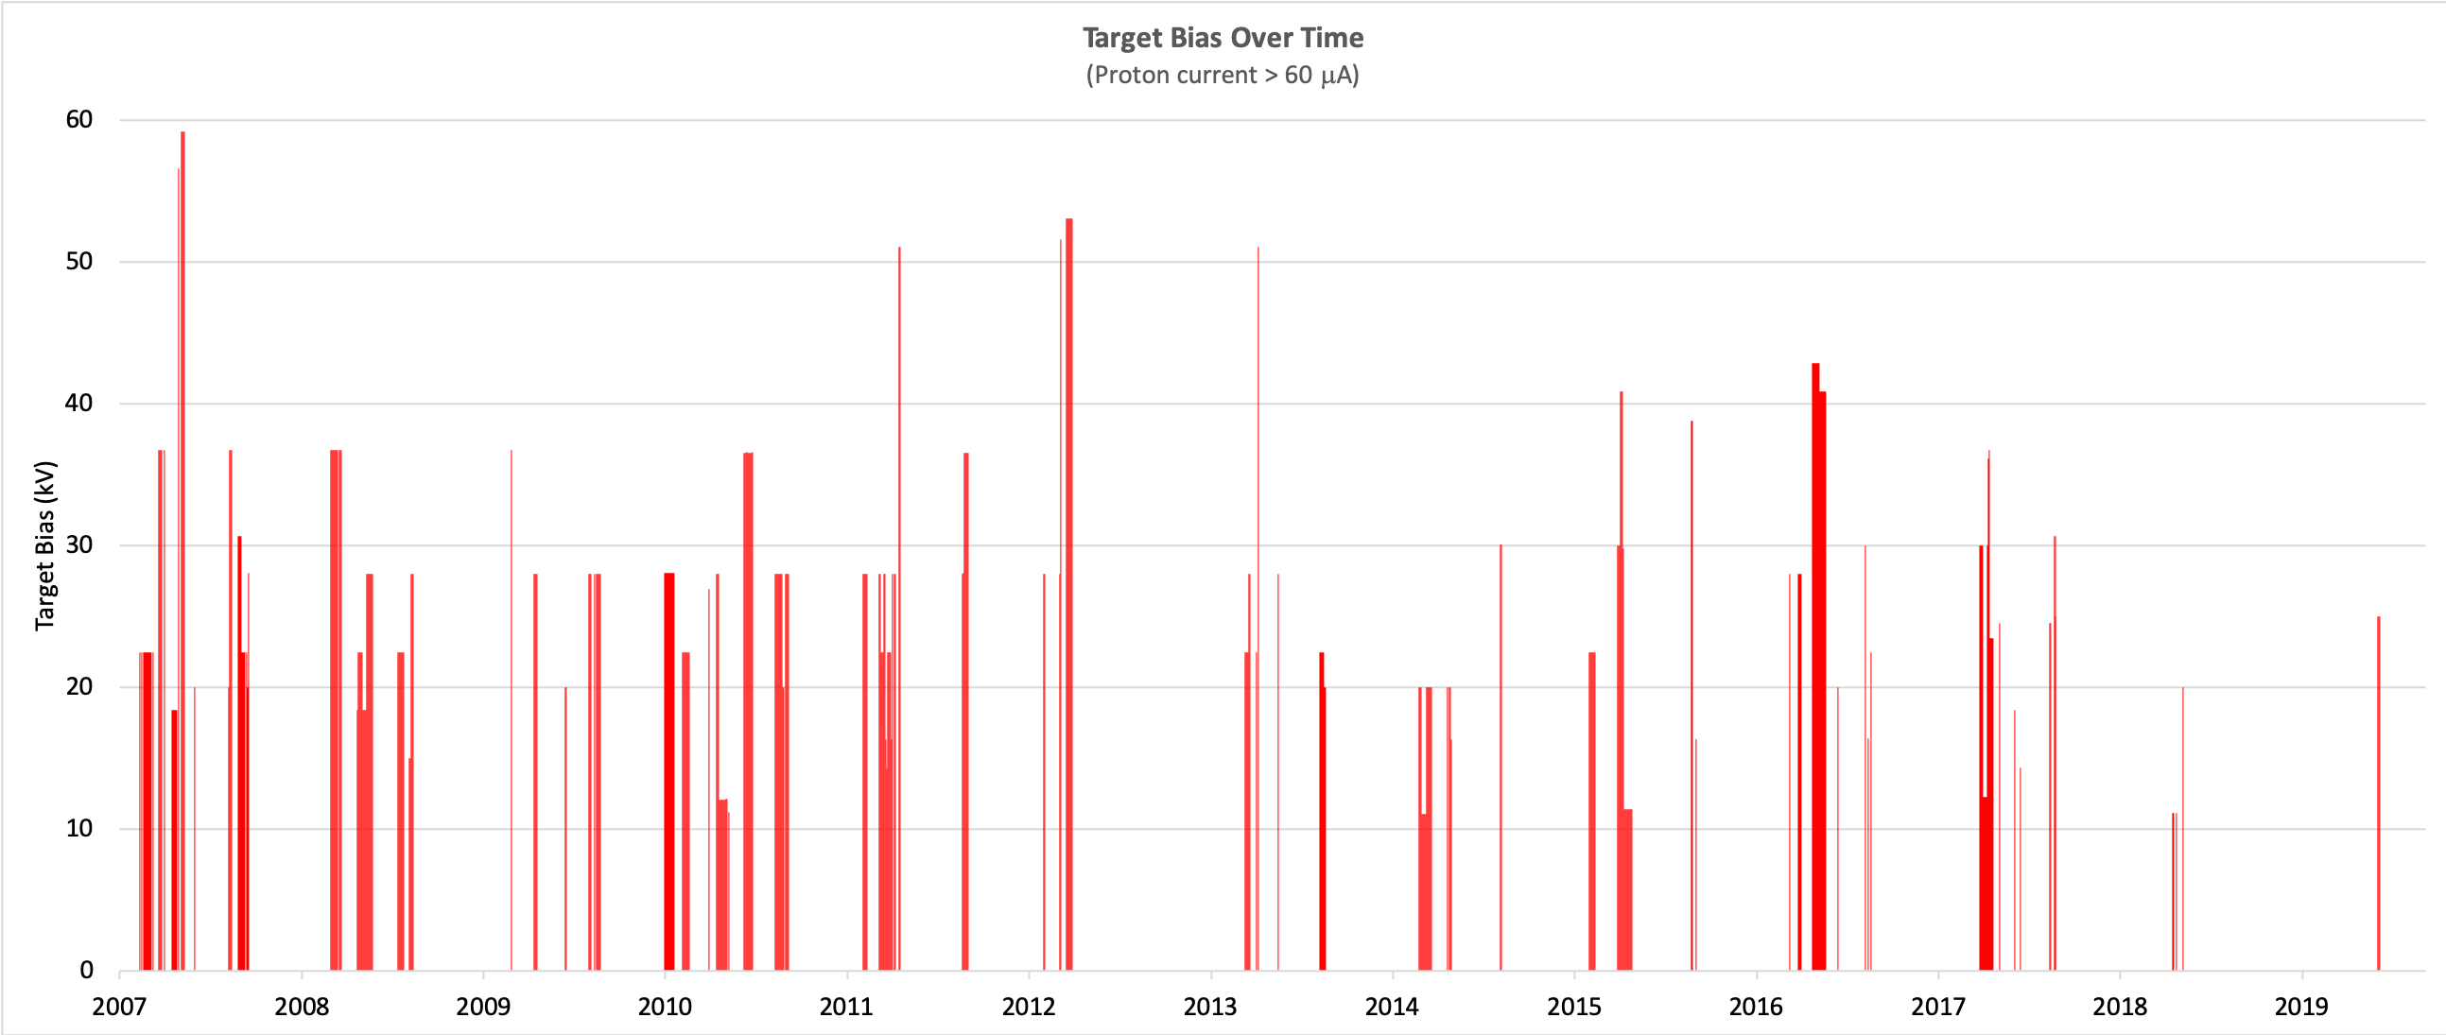

Slide 17
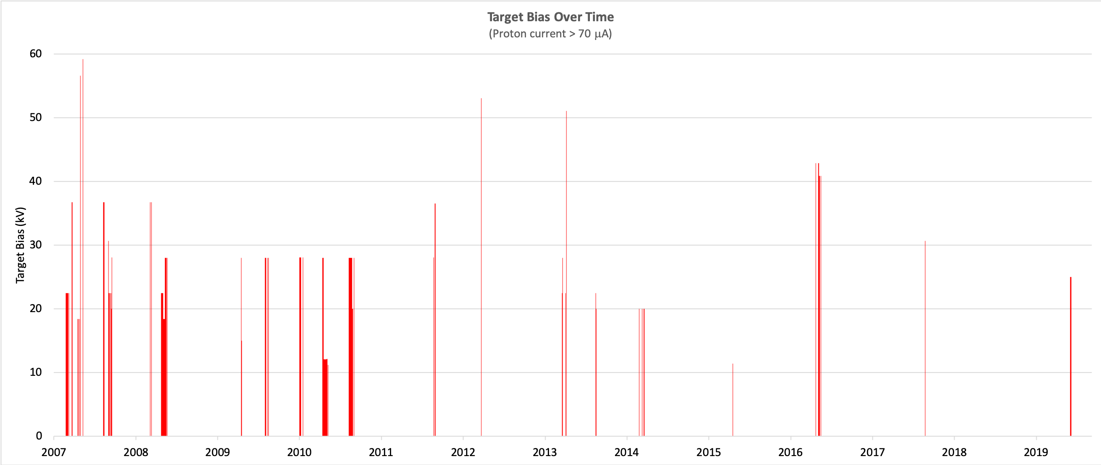
TM2: ²¹Na, ²¹Mg, ²⁰Mg TUDA, TIGRESS, IRIS (HP)
Already experiencing TM bias limitations for A=26-30

Slide 18
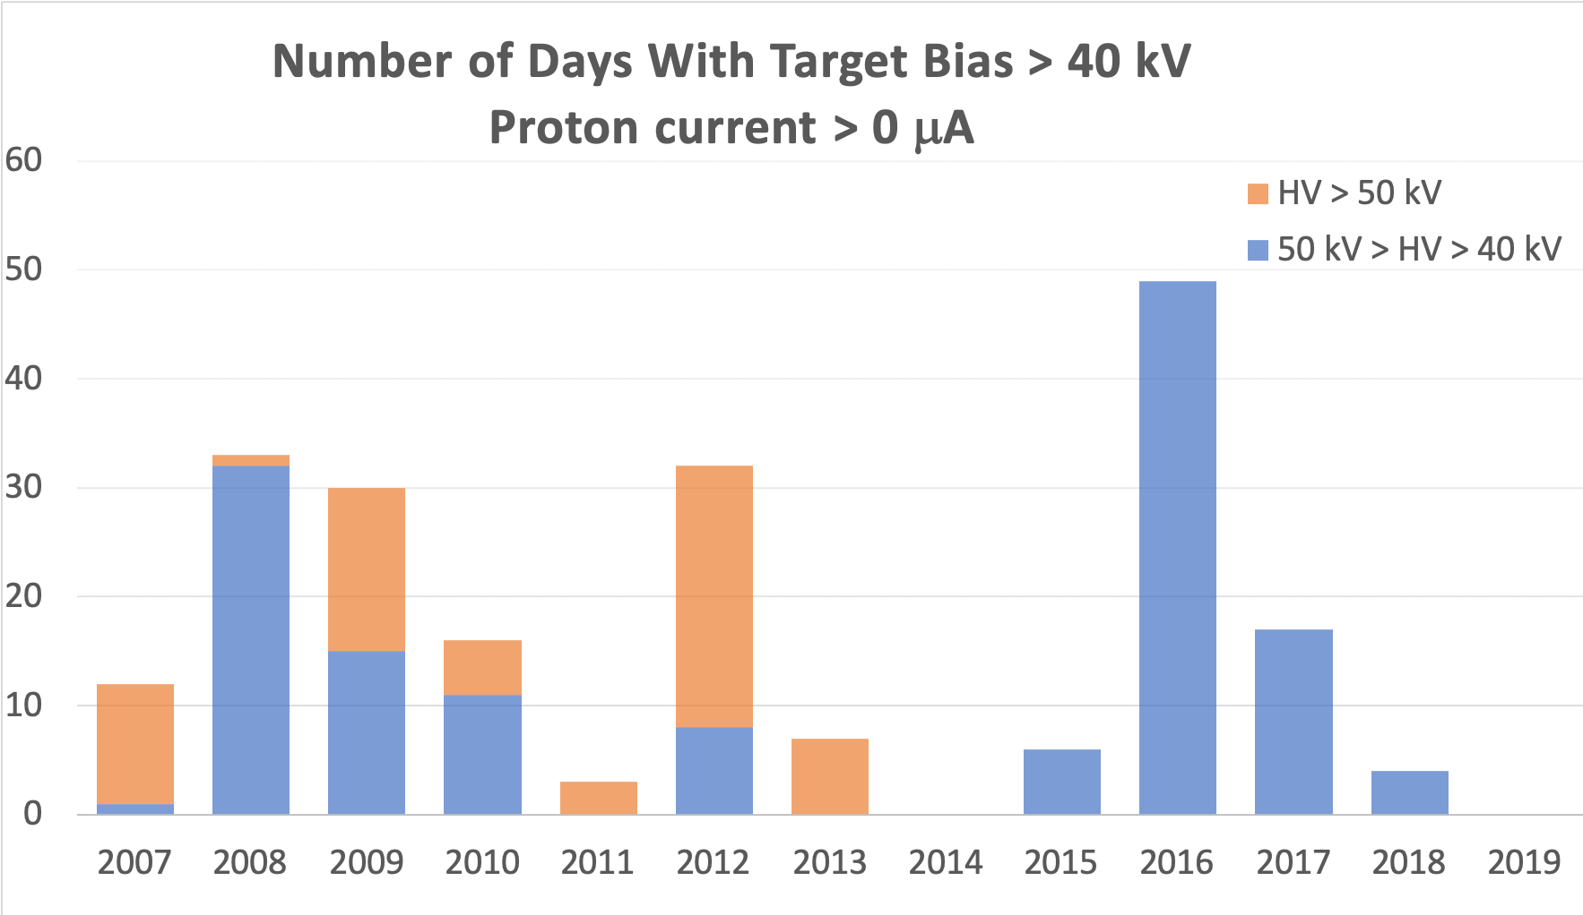
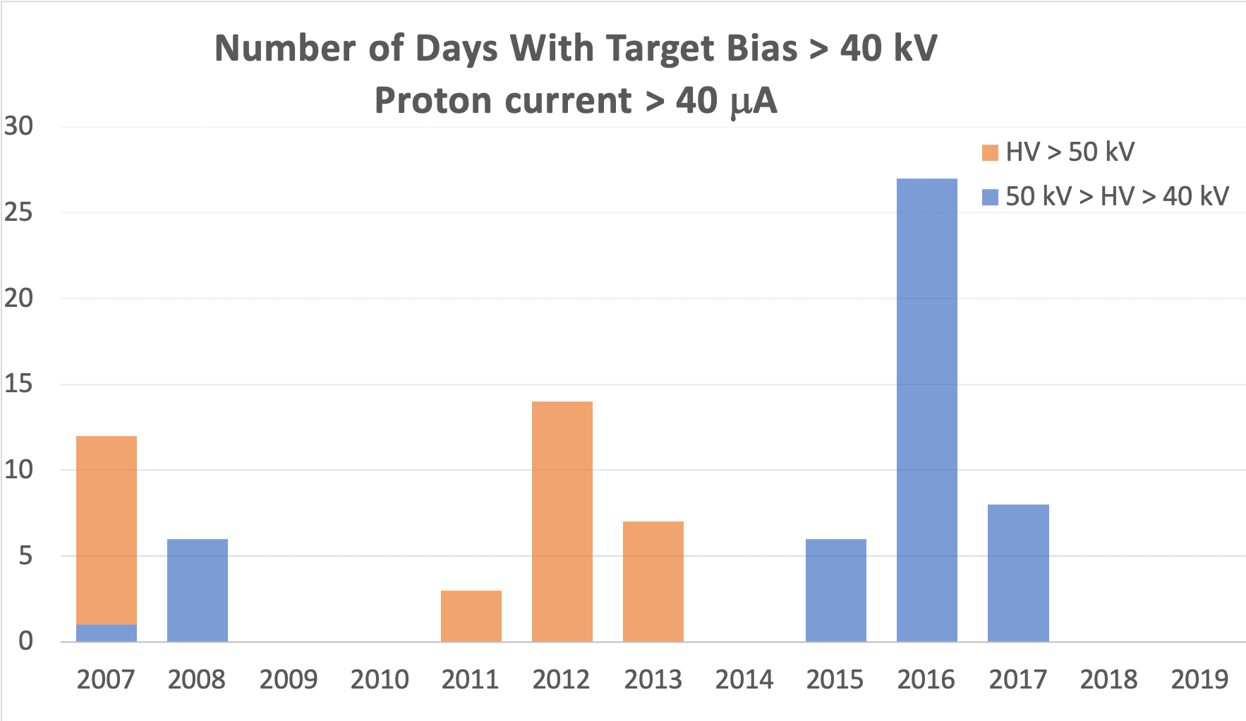
This was LE beam < 10uA
Here is where some accel. beam experiments requiring >50 kV were “frozen” by ALD
Here is where we started limiting EEC proposals to <=40 kV
Captures non-UCx, non-CSB beams delivered to mainly ME, HE areas

Slide 19
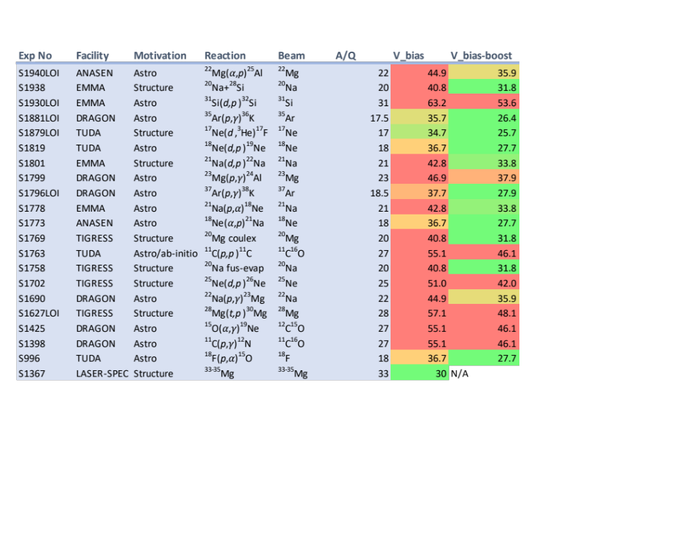
TM Bias Limitations on Experimental Program
V = 33 kV
Feasible
V = 40 kV
→ Infeasible
RF Booster 30-50% transmission efficiency
Note: lots of non-UCx beams

Slide 20
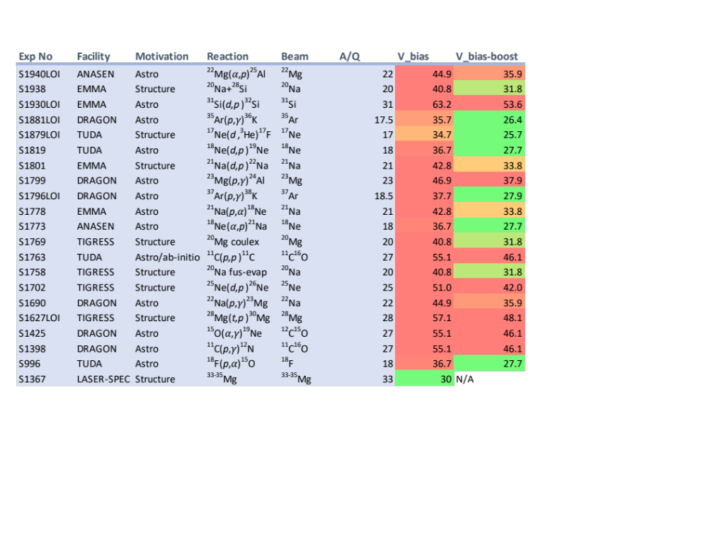
TM Bias Limitations on Experimental Program
V = 30 kV
Feasible
V = 37 kV
→ Infeasible
RF Booster 30-50% transmission efficiency

Slide 21
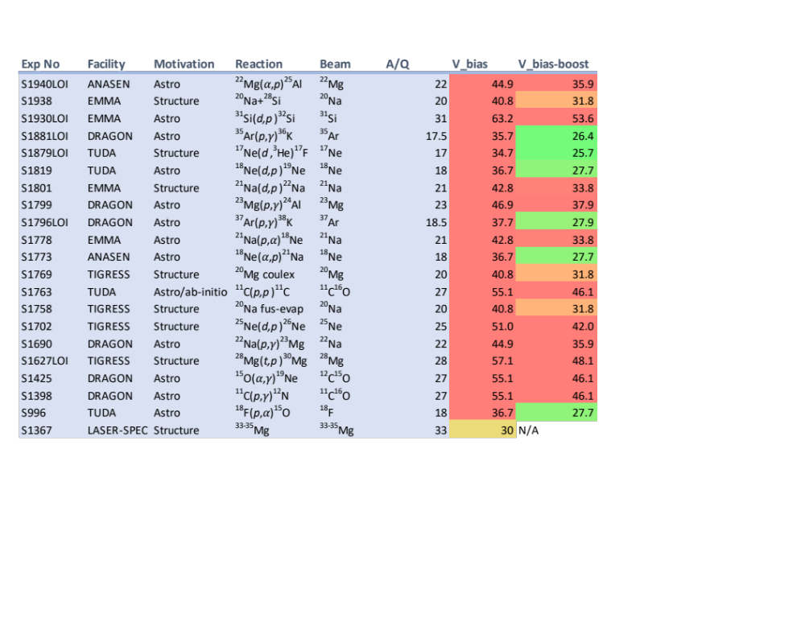
TM Bias Limitations on Experimental Program
V = 27 kV
Feasible
V = 34 kV
→ Infeasible
RF Booster 30-50% transmission efficiency
+ add ⁷Be, ²⁶Al implantation experiments (need 40-50kV)

Slide 22
Impact to Program
Facility | # Experiments affected (inc. LoI) | % of program
DRAGON | 10 | 83%
TUDA | 4 | 67%
ANASEN (FSU, LSU external experiment campaign) | 2 | 100%
EMMA (standalone or with TIGRESS) | 4 | 50%
TIGRESS (standalone) | 4 | 24%
The list overleaf corresponds to ~20-25% of SAP-EEC shifts backlog
Including approved proposals and endorsed Letters of Intent, they correspond to a very large fraction of the Nuclear Astrophysics and Structure at ISAC II programs
Important to include LoIs as these are the science endorsed by EEC that are current, exciting, unique to TRIUMF, and what we’re telling our funding agencies we’re going to do!*
Many of these affected beams are ISAC staples:
²¹Na, ²³Mg, ²⁶Al, ¹⁸F etc
Really diminishes ISAC’s boast as a high intensity radioactive beam laboratory
Scientific Area | # Experiments affected (inc. LoI) | % of program
Nuclear Astrophysics | 18 | 69%
Nuclear Structure at ISAC II (exc. IRIS) | 6 | 32%
*Not least many are what ISAC was built for

Slide 23
Biased conclusion re: bias
The TM bias issue has to be fixed
It jeopardizes Canadian investment in scientific areas and facilities
It won’t be fixed by ARIEL* or CANREB
It will lose TRIUMF users, diminish science scope, threaten uniqueness
* Ok, maybe BL4N… but now delayed until 2025?26?

Slide 24
“Strawman” Schedules
Current year had a “shortened” ISAC schedule in order to facilitate TM source tray refurbishment on both TMs
This was deemed acceptable by users as a path towards greater reliability
At first look, these refurbishments do not appear to have restored full functionality of TMs
When faced with possible failure of 1 of 2 modules in rotation during a schedule, is there a way we can schedule that provides greater certainty, with minimum loss of science? (just like this year was supposed to do)
A look at possible mitigation of TM failure through scheduling

Slide 25
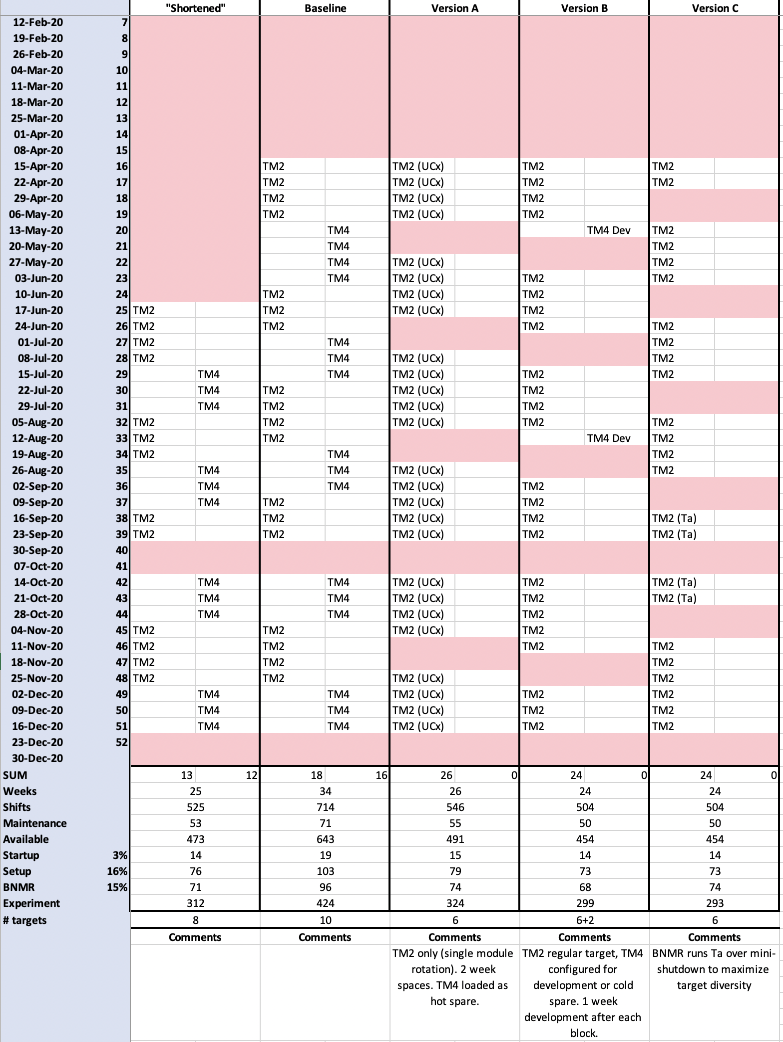
“Single module rotation”
Extreme version: UCx only → other module is a true “hot spare”
→ Minimum disruption if module fails online (immediately switch to other station)
→ High certainty for scheduled experiments
→ Loss of diversity
→ Massively affects accelerated beam program, and same facilities that bias issue hurts
Less extreme versions: run UCx for half year, other targets rest of year
Regular year with both modules → try to maximize science, all targets/sources available
  Bias issue isn’t solved, could continue to worsen → full diversity isn’t restored
  TM4 leak possible
  Worst case: Unfixable (without pulling resources) TM failure close to start of schedule
  → Lose between 50% & 30% (?) of scheduled beamtime
  Fixable in one block: Lose 11%
  + $$ losses to experimental groups
Could mix in development to single rotation?
Have BNMR over mini-shutdown to ensure only 1 Ta target required
Of course, most extreme version is shut down for < a year to bring TM3 forward, TM5?
What are users priorities?

Slide 26
Discussion….

Slide 27




Thank you
Merci
www.triumf.ca
Follow us @TRIUMFLab

Slide 28
Supplementary Slides

Slide 29
 | Schedule 132 | Schedule 133 | Schedule 134 | Schedule 135 | Schedule 136 | Schedule 137
Calendared Shifts | 513 | 235 | 535 | 218 | 315 | 223
Shutdown Cyc | 0 | 27 | 2 | 0 | 0 | 0
Maintenance | 36 | 6 | 18 | 24 | 17 | 6
Cyc Beam Development | 21 | 6 | 14 | 4 | 6 | 6
Shutdown ISAC | 0 | 0 | 191 | 0 | 0 | 0
ISAC Maintenance | 10 | 0 | 3 | 3 | 29 | 2
ISAC Maint coinc w Cyc | 0 | 0 | 0 | 0 | 2 | 0
ISAC Maint coinc w BD | 4 | 0 | 0 | 2 | 1 | 0
ISAC non-available | 63 | 39 | 228 | 29 | 49 | 14
ISAC available | 450 | 196 | 307 | 189 | 266 | 209
ISAC available (hours) | 3600 | 1568 | 2456 | 1512 | 2128 | 1672
ISAC available (days) | 150.0 | 65.3 | 102.3 | 63.0 | 88.7 | 69.7
Year | 2017 | 2017 | 2018 | 2018 | 2019 | 2019
Startup | 24 | 9 | 25 | 13 | 10 | 6
Setup | 41 | 25 | 46 | 33 | 45 | 32
Avaiable for Experiments | 385 | 162 | 236 | 143 | 211 | 171
BNMR | 60 | 43 | 41 | 26 | 39 | 30
non-CMMS BNMR | 17 | 0 | 8 | 0 | 0 | 20
Life Sciences | 6 | 0 | 7 | 7 | 0 | 4
Test | 33 | 42 | 29 | 22 | 17 | 4
Subatomic | 211 | 77 | 148 | 87 | 151 | 90
TIS Development | 0 | 0 | 0 | 0 | 0 | 12
CANREB | 0 | 0 | 0 | 0 | 0 | 6
Test and Development | 15 | 17 | 27 | 0 | 0 | 2
S841 | 58 | 0 | 3 | 1 | 4 | 5
Test no development | 18 | 25 | 2 | 22 | 17 | 2
Total Development | 73 | 17 | 30 | 1 | 4 | 25
sum | 450 | 196 | 307 | 189 | 266 | 209
OLIS Pilot | 129 | 48 | 81 | 44 | 108 | 32
OLIS Experiment | 52 | 42 | 92 | 61 | 48 | 81
OLIS TEST | 145 | 45 | 115 | 29 | 95 | 13
OLIS Setup | 95 | 48 | 72 | 50 | 48 | 45
OLIS Maintenance | 17 | 0 | 9 | 12 | 11 | 9
TOTAL | 438 | 183 | 369 | 196 | 310 | 180

