Slide 1
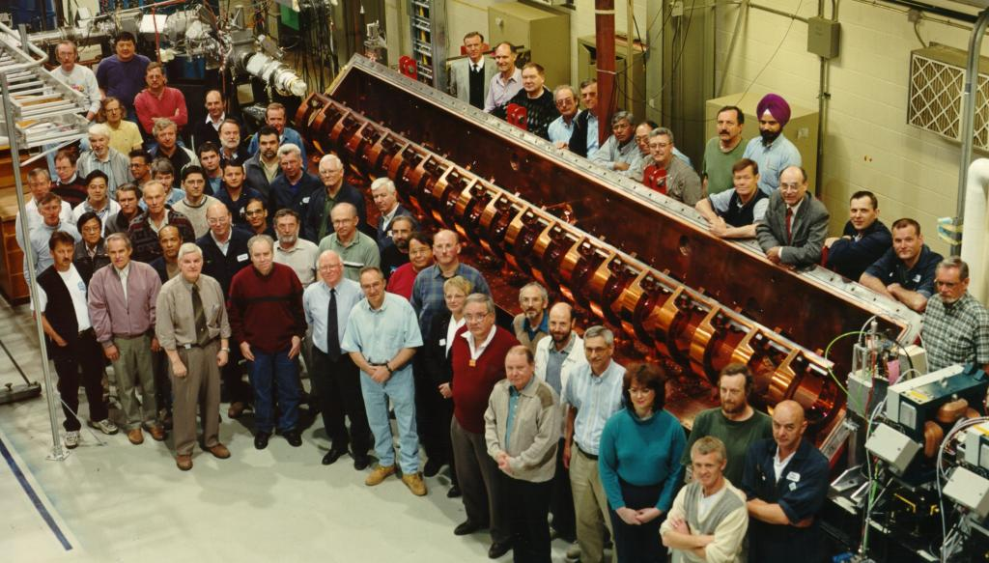
RFQ Updates
Olivier Shelbaya
Beam Physics Group
ISAC Strategy Workshop 2019-11-08
The TRIUMF-ISAC RFQ

Slide 2
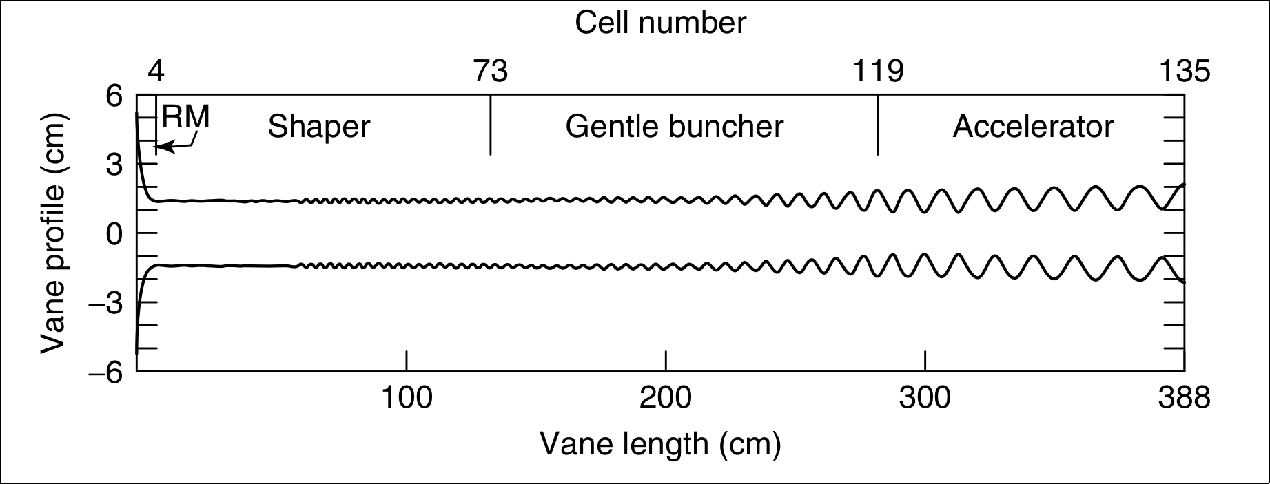
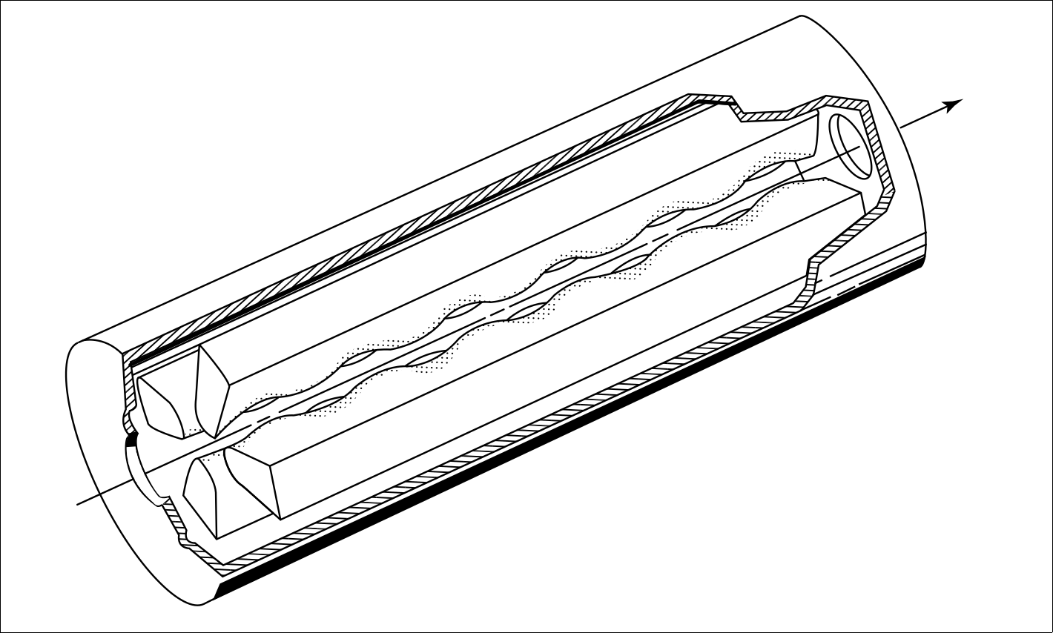
The Radiofrequency Quadrupole Accelerator (RFQ)
4 modulated vanes/rods, increasing cell length
Produces quadrupole-like transverse focusing and longitudinal energy gain
Ideal first-step accelerator
Wangler, RF Linear Accelerators,2nd edition, ch. 8
0

Slide 3
Presentation Overview
1. RFQ Beam Dynamics Update
2. RFQ Facility Status
3. Second Injector Path
1

Slide 4
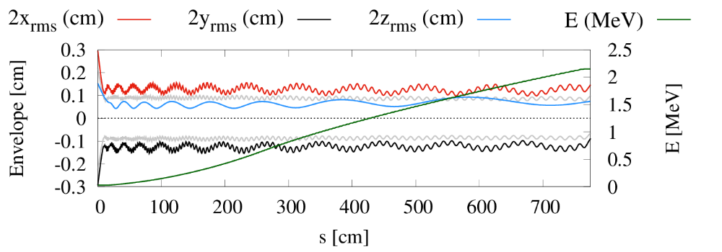
1. RFQ Beam Dynamics Update
Rick Baartman’s envelope code TRANSOPTR can now simulate RFQ acceleration
Part of end-to-end model of ISAC accelerators under development for High-Level Applications project
Model has been used to simulate real RIB Operations tunes at ISAC-I
Led to beamline inspections (more later)
TRANSOPTR simulations of ISAC-RFQ envelopes, O.Shelbaya, R.Baartman, O.Kester. Phys. Rev. - paper accepted
2

Slide 5
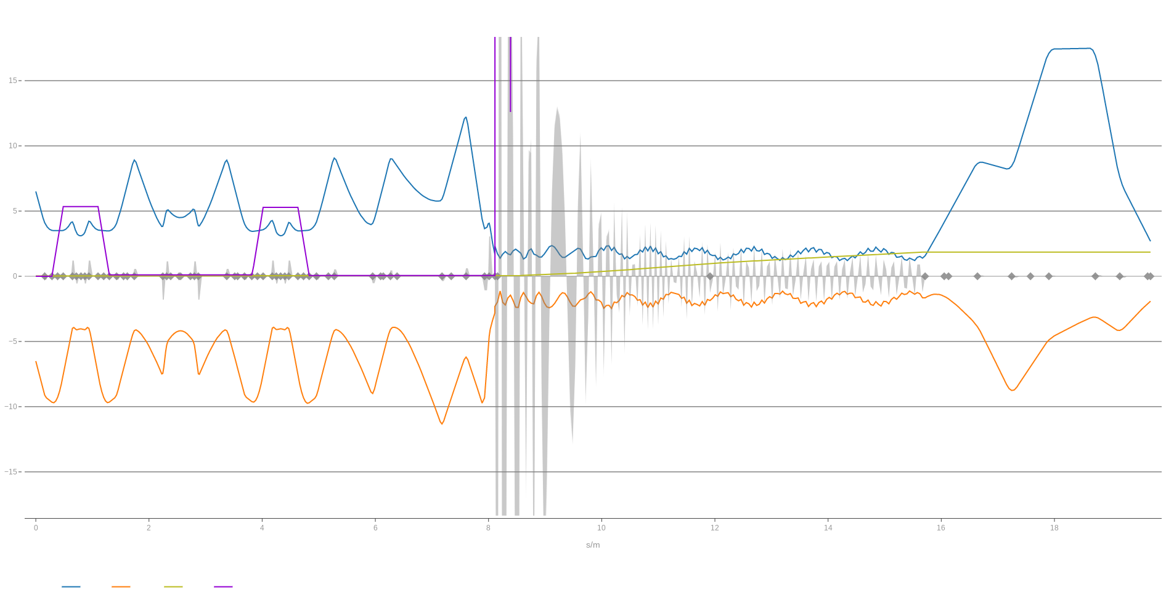
1. RFQ Beam Dynamics Update: TRANSOPTR-RFQ (design theoretical tune including the RFQ)
ILT IRA RFQ MEBT
2rms (x,y) beam envelopes in blue,orange
3

Slide 6
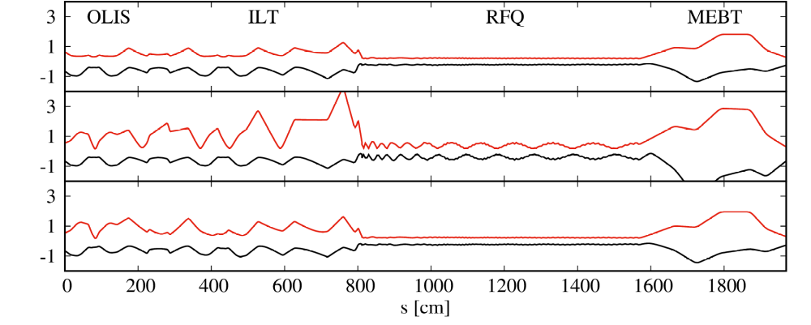
1. RFQ Beam Dynamics Update
Example TRANSOPTR-RFQ model use:
Theory
Mismatch (beam losses)
Model-correction
TRANSOPTR can optimize envelopes through an RFQ.
No other envelope code presently rivals this.
We can now simulate the whole ISAC-I/II linac in a single code for study.
4

Slide 7
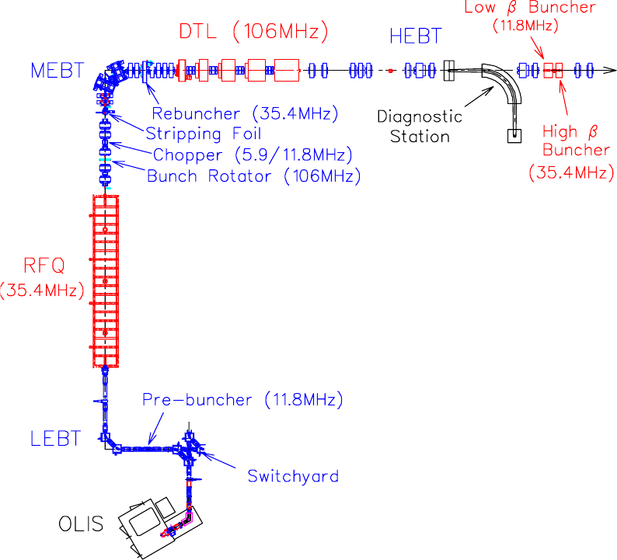
2. RFQ Facility Status
ISAC-RFQ: external bunching
RF Booster (11.8 MHz)
5

Slide 8
2. RFQ Facility Status
ISAC-RFQ: external bunching
RF Booster (11.8 MHz)
5

Slide 9
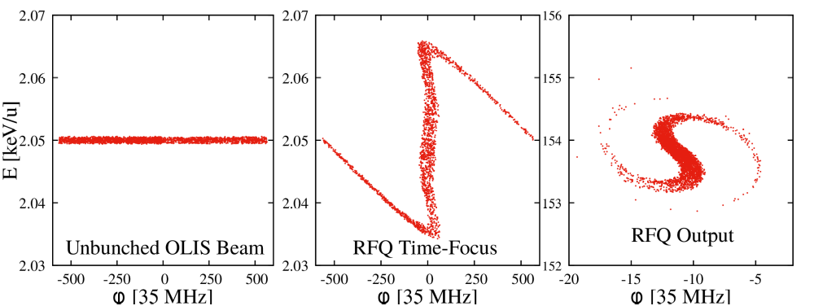
2.1 The RFQ Pre-Buncher
E [keV/u]
All beams must enter the RFQ at the same velocity (energy) and the same time (phase) - blue window
6

Slide 10
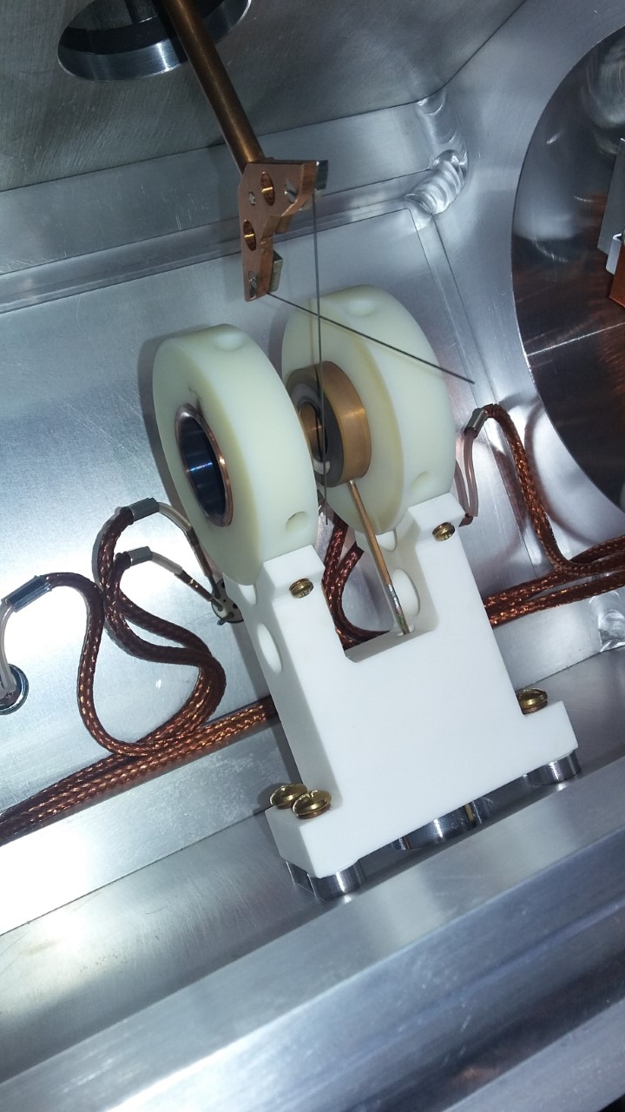
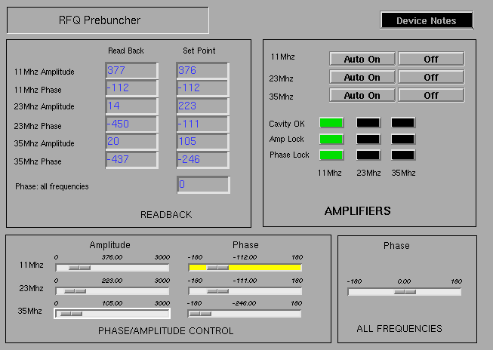
2.1 The RFQ Pre-Buncher
The ISAC Pre-buncher, courtesy M. Marchetto
7

Slide 11
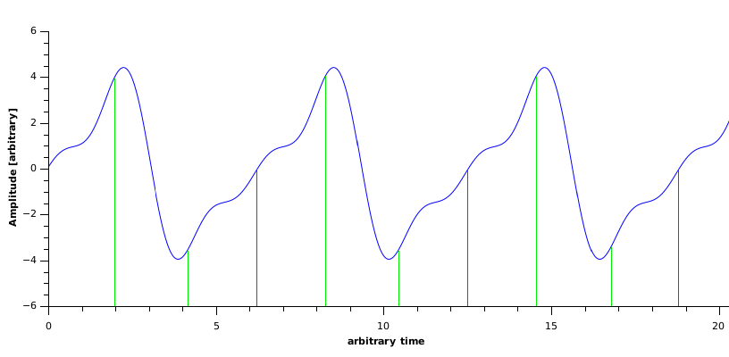
2.1 The RFQ Pre-Buncher
5m upstream of RFQ
Single-gap device
3-harmonic sawtooth modulation
Establishes time-focus at RFQ
Essential for RFQ capture
8

Slide 12
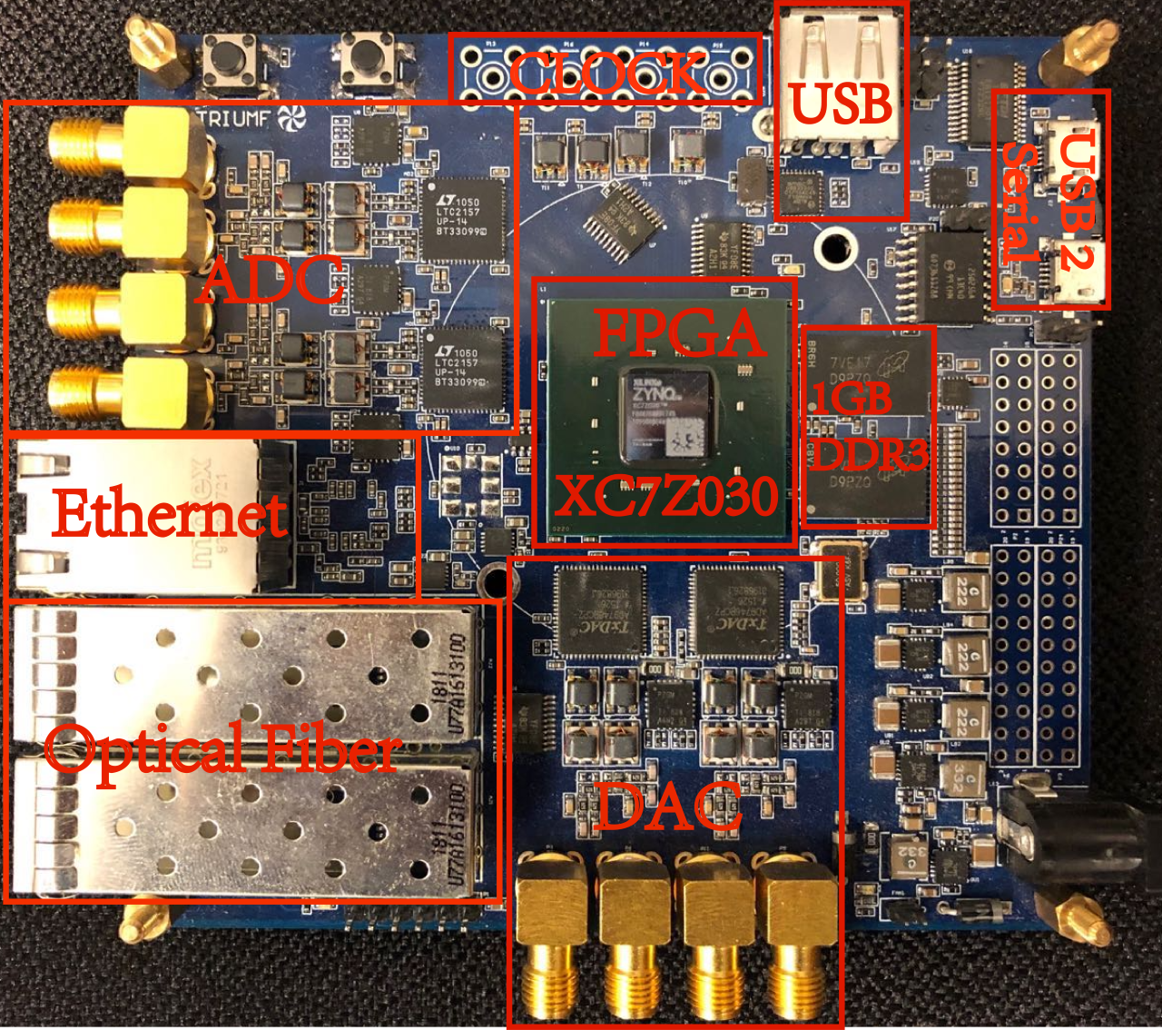
2.1 The RFQ Pre-Buncher: Upgraded Electronics
Analog→Digital upgrade
Old hardware issues: offsets, nonlinearities on phase, amplitude.
Required manual re-tuning of pre-buncher each time by operations for RFQ injection.
New FPGA based hardware installed Sept 2019. (field programmable gate array)
Should allow for optimization of RFQ injection procedure. (time savings)
Pre-buncher sawtooth generator, courtesy X. Fu, LLRF Group
9

Slide 13
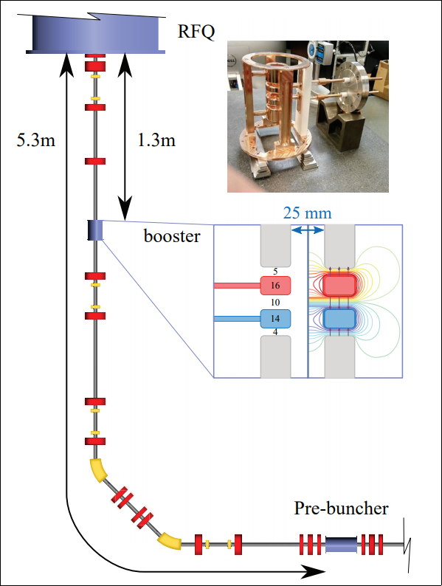
2.2 The ISAC RF-Booster: Overview
3-gap device, 1.3m upstream of RFQ
Enhances RFQ injection capabilities
Buncher mode: supplement pre-buncher
Booster mode: increase beam energy
Device tuning complex due to many possible configurations
Close-up of booster & electrode geometry
Courtesy: S. Rädel
10

Slide 14
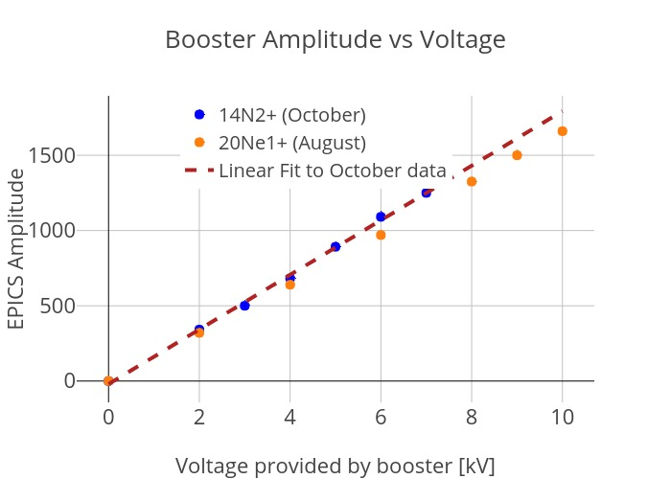
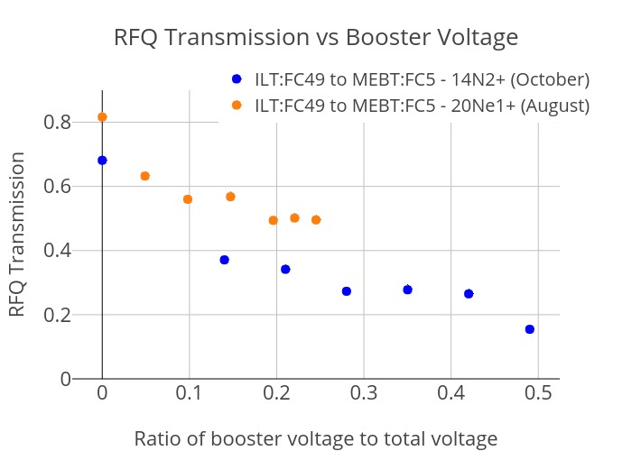
2.2 The ISAC RF-Booster: Performance so far
RF-Booster allows to run the target modules at lower voltage. It also allows for additional bunching of the beam into the RFQ.
Buncher-mode of the device was also tested 2018 and 2019
Device provided 50% energy gain, ¹⁴N²⁺ @ 14.28 keV (source)
ΔE max = 10 keV
Up to 20 keV ΔE possible w/ tube mod.
RFB Booster-mode test results, Courtesy S. Kiy
11

Slide 15
2.3 The ISAC RF-Booster: TRANSOPTR Simulations
TRANSOPTR is fast (~0.3sec/run)
Can scan booster voltage and phase, plot RFQ output beam properties
Surface minima indicate optimum operation points
Model will help define RF booster operation and tuning
TRANSOPTR RFQ output bunch-width for RF-Booster (V,Φ) 100x100 grid scan, O. Shelbaya
12

Slide 16
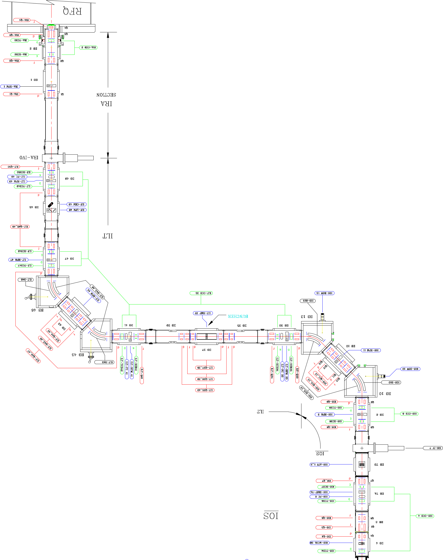
2.3 ISAC RFQ Accelerator & Beamlines
Modeling work led to RFQ beamline scrutiny
Sinking in ISAC-I hall floor identified
Beam-based evidence collected
Corrected MEBT tune development underway
Will help optimize DTL injection and reduce tuning time
The ILT/IRA injection line
13

Slide 17
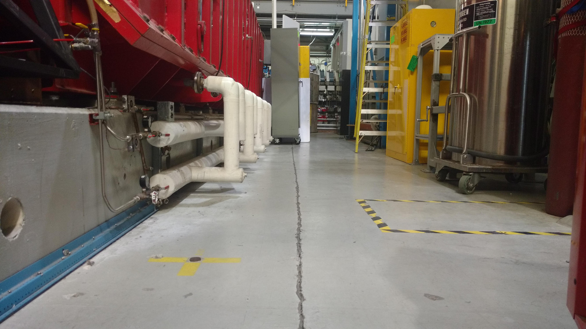
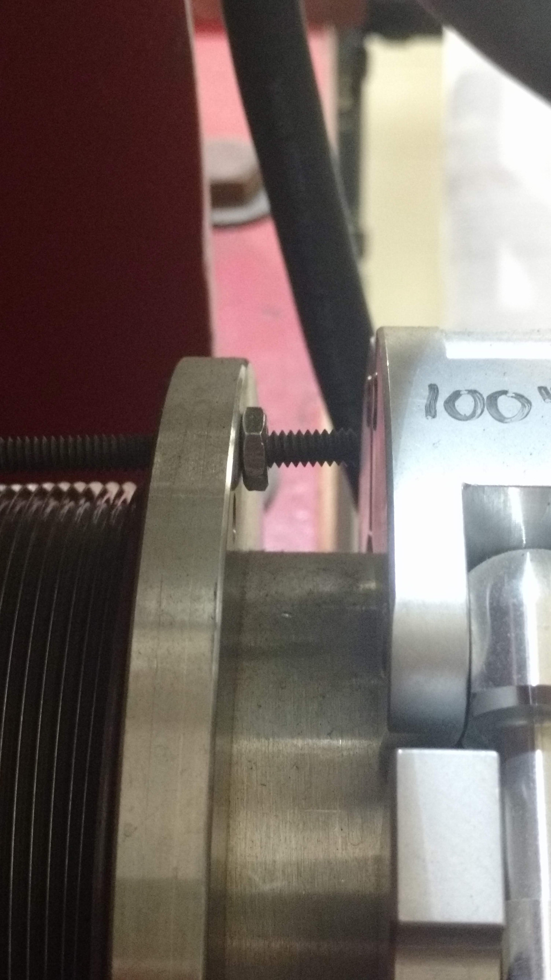
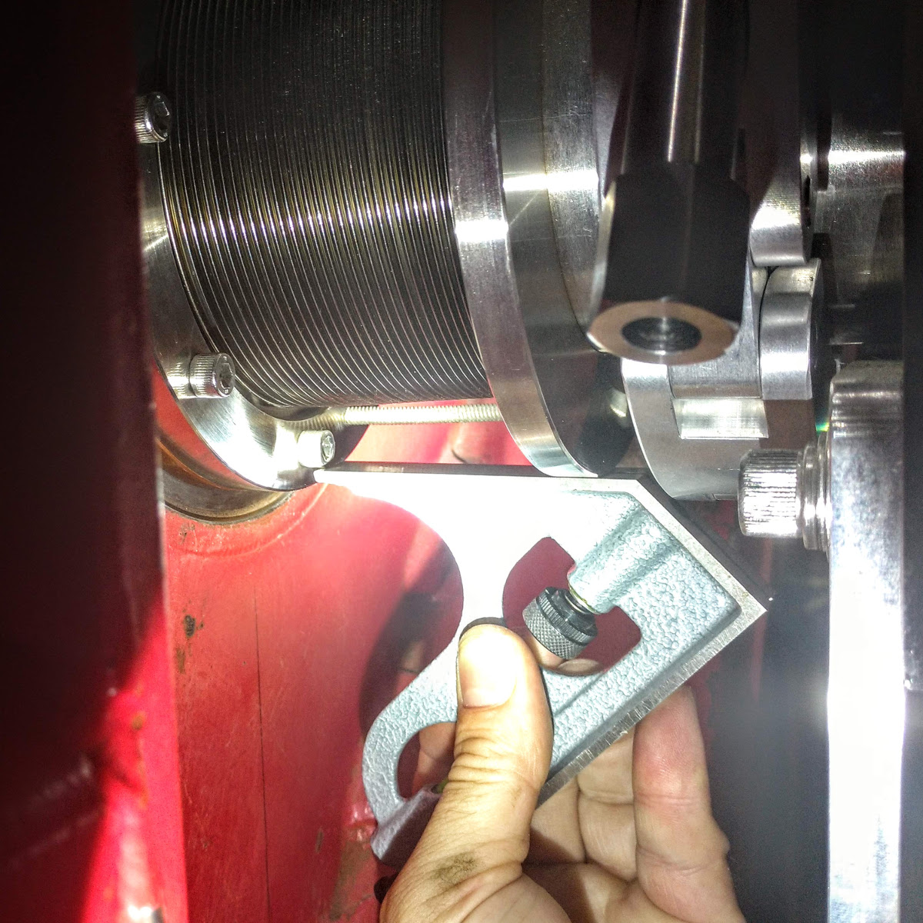
2.3 ISAC RFQ Accelerator & Beamlines
Shifted ISAC floor tiles – confirmed RFQ vacuum tank moved by ~1cm.
Misaligned bellows – RFQ exit (supports but does not confirm!)
14

Slide 18
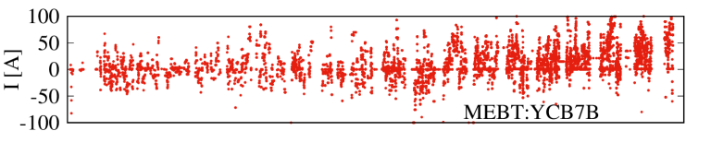
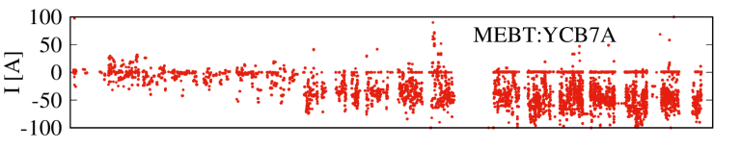
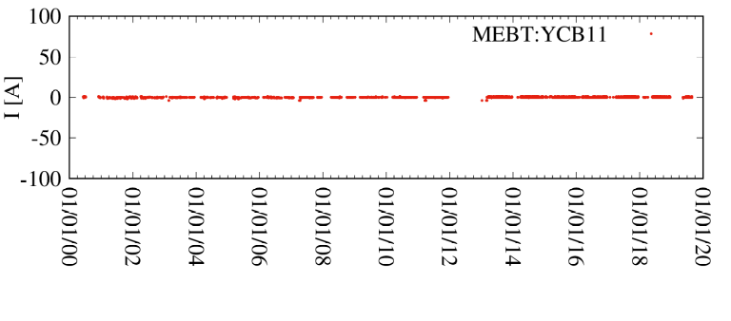
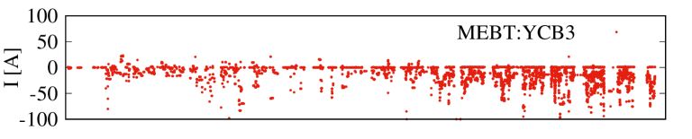
2.3 ISAC RFQ Accelerator & Beamlines
Evidence of increasing y-steering over the years
Suggests operators are using more and more vertical corrective steering
Possible misalignment with respect to MEBT-DTL beamline; investigation ongoing
19 years of Operational tunes
15

Slide 19
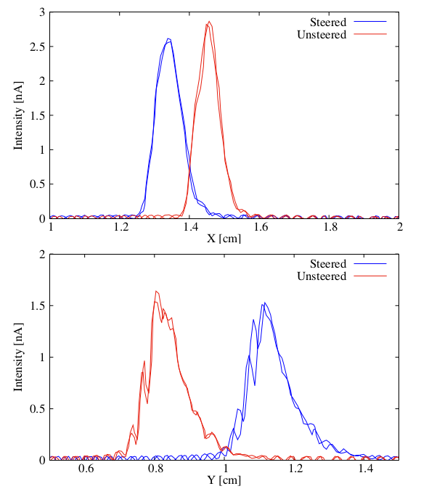
2.3 ISAC RFQ Accelerator & Beamlines
Beam-based evidence of shift
Centroid offset possibly affects DTL tune
Off-nominal DTL injection leads to more tuning time.
Careful understanding required for ongoing development.
Steered & unsteered output RFQ beam – 45^{O} tilt!
MEBT:RPM5
16

Slide 20
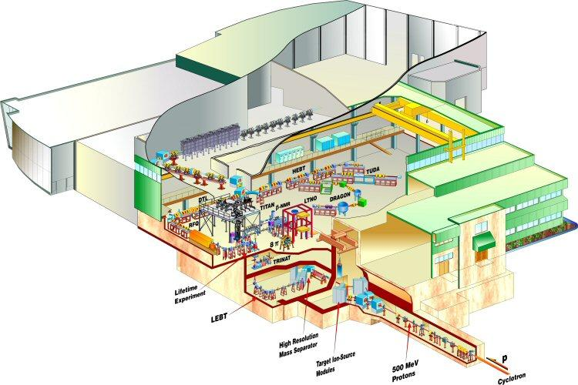
3. Second RFQ path
A new, second RFQ would accept EBIS charge-bred beams from CANREB
Design would have an internal shaper and buncher section, 100% capture efficiency
Maximize CANREB transmission into ISAC-HE
ISAC Facility overview
17

Slide 21
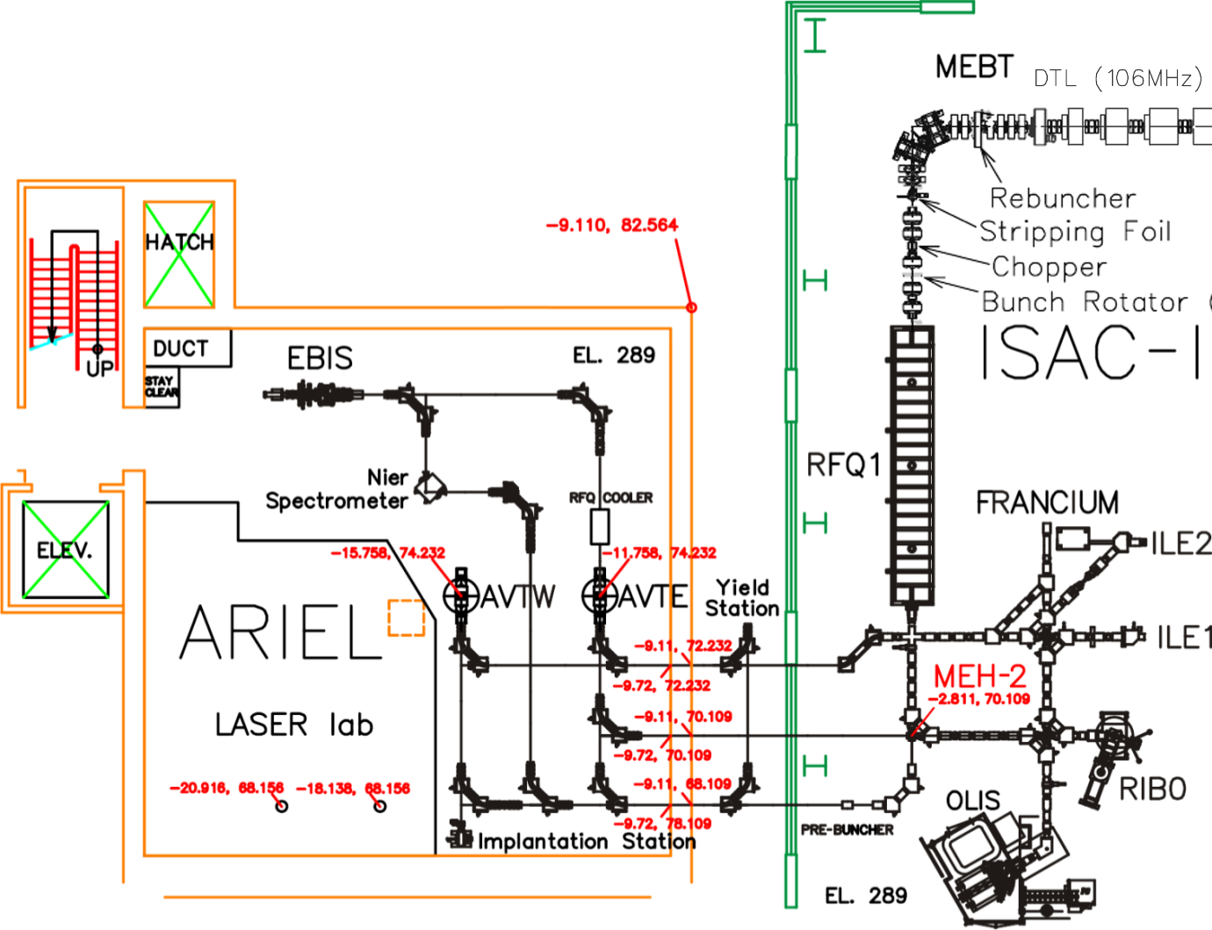
3. Second RFQ path: Current Situation
Near-term CANREB/ISAC Beamlines
18

Slide 22
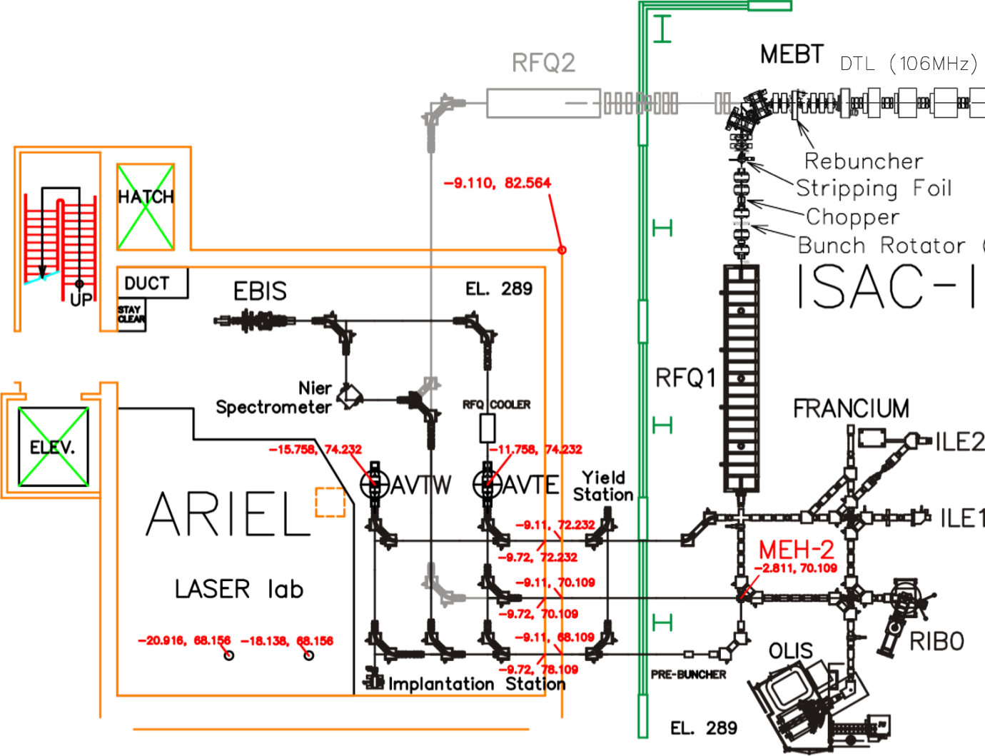
3. Second RFQ path: CANREB to ISAC Connection
Prospective second RFQ path into DTL
19

Slide 23
3. Second RFQ path: Outside enclosure
A new enclosure would be needed to house the RFQ, power supplies and beamlines.
20

Slide 24
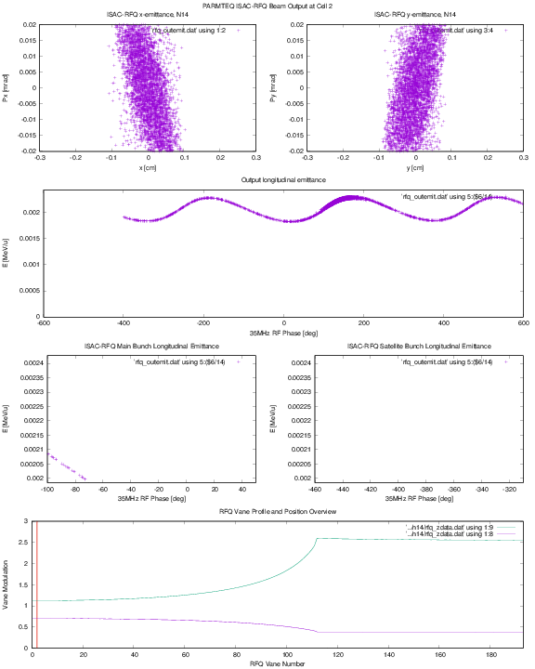
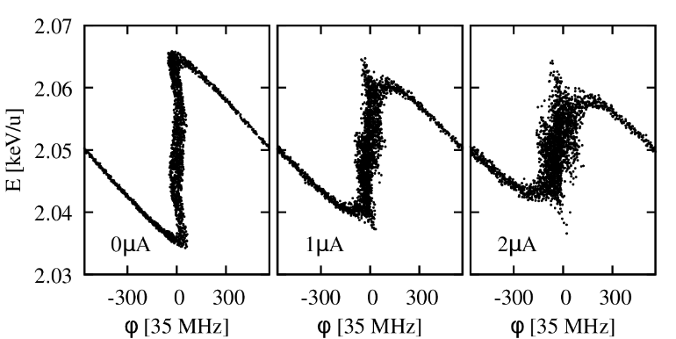
3. Second RFQ path: Efficiency considerations
ISAC RFQ defines capture by chopping
Consequence of external buncher and maximum A/q = 30
Sensitivity to space charge, longitudinal capture suffers at ~1uA
E [MeV/u]
Φ [deg]
PARMELA simulation of time-focus breakdown with increasing current
21

Slide 25
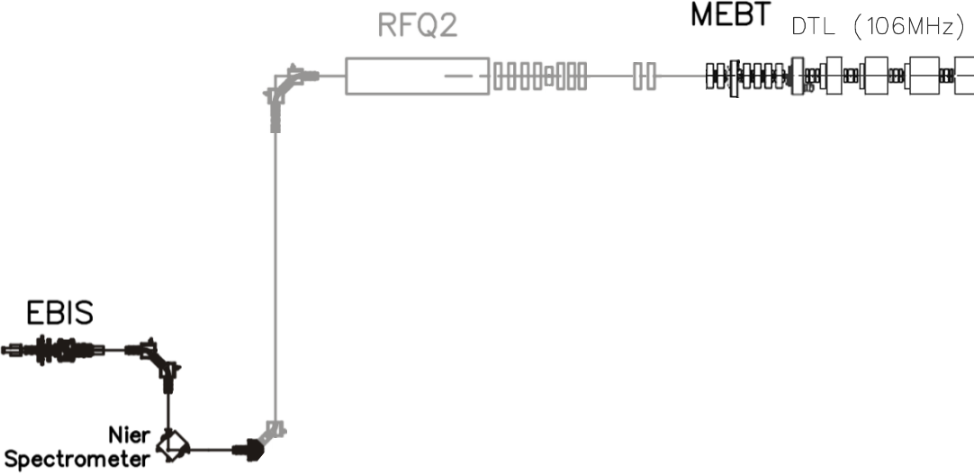
3. Second RFQ path: Design considerations
Internal buncher, 100% capture efficiency
A/q limited to 7 for DTL injection, 106MHz
Pulsed operation with solid-state amplifiers
Higher beam current, up to ~1mA
Compact design, ~3m long
Possible transition to CW amplifiers for direct ISAC-CSB injection
22

Slide 26
3. Second RFQ path: Considerations
By designing RFQ2 for EBIS beams, we decouple linac transmission from target module bias
For very low masses, EBIS can collect ions in a high charge state, producing higher overall efficiency.
For higher masses, EBIS provides higher charge breeding efficiency. Injecting in a 100% capture RFQ allows us to maximize overall transmission.
23

Slide 27
Conclusion
Ongoing beam dynamics work for renewed ISAC-I tuning approach
Pre-Buncher updated, RF Booster operational, can be modified for greater ΔE
RFQ-DTL alignment issue identified, under study
RFQ2 possibility due to flexibility of CANREB layout, enabling future vision for ISAC beam delivery.
24

Slide 28
Thank you/Merci

