Slide 1
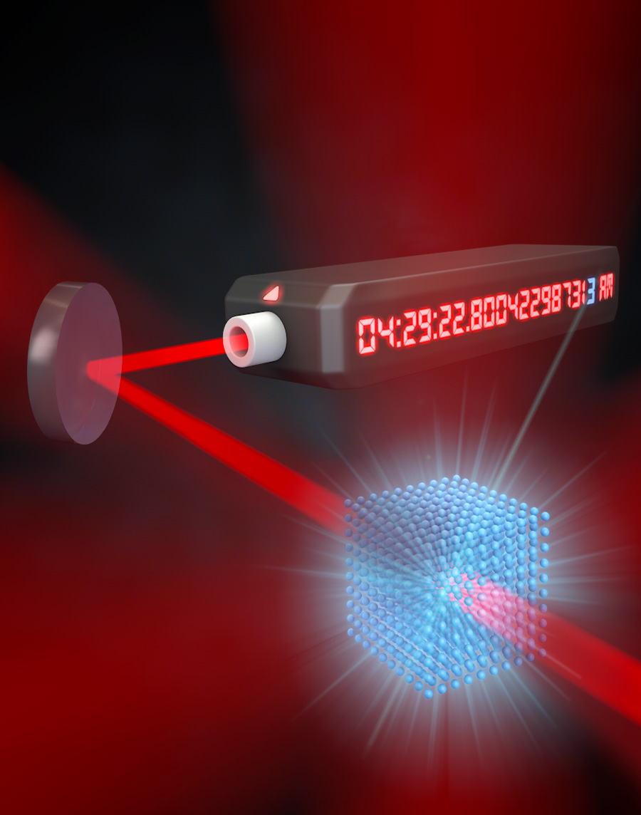
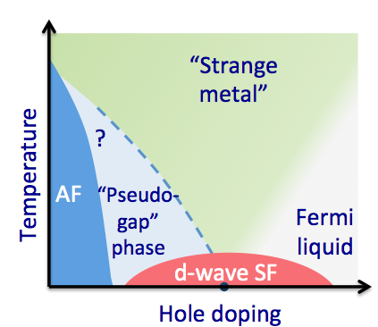
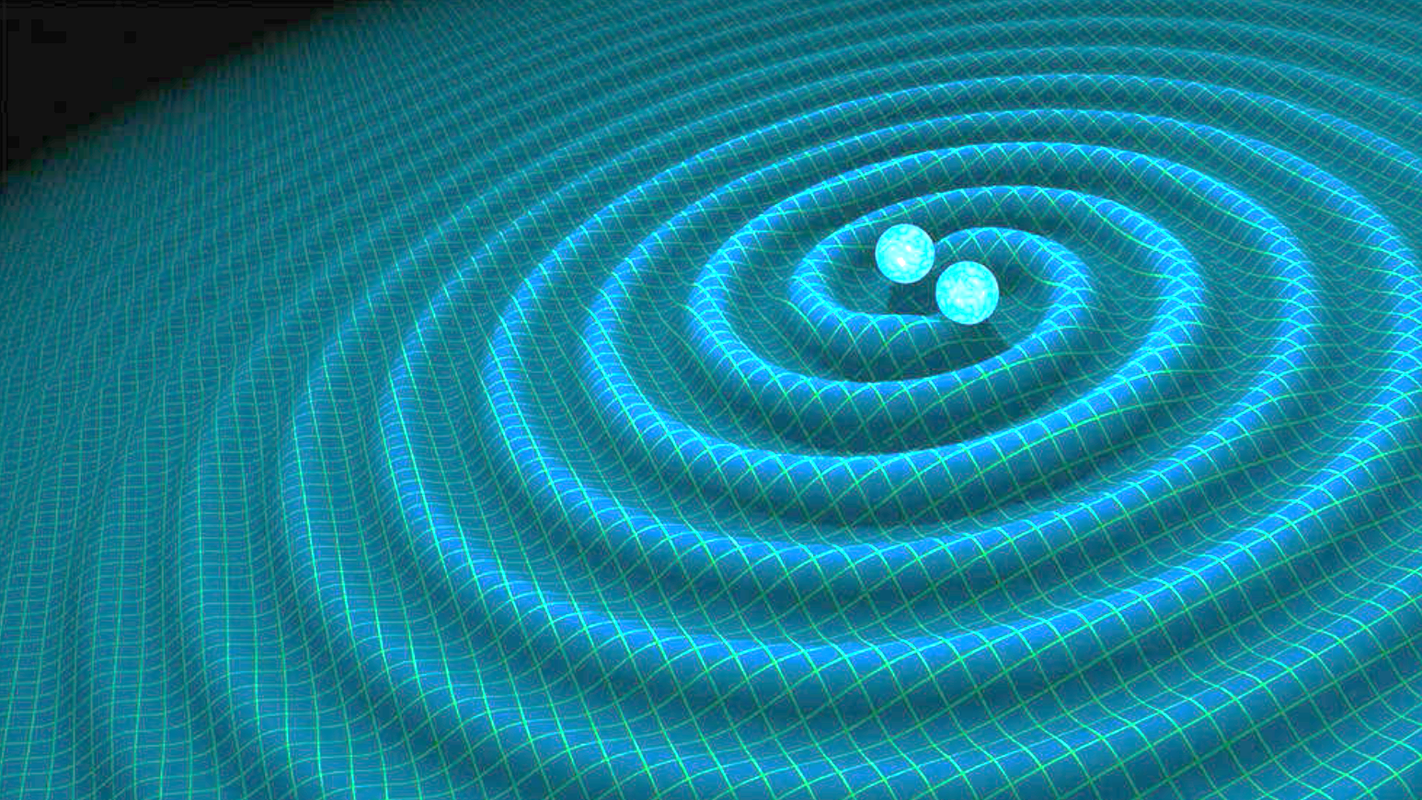
Atomic Clock & Fundamental Physics
Jun Ye
JILA, NIST and University of Colorado Boulder
Developing New Directions in Fundamental Physics (DND)
November 5, 2020
control
understand
apply
Quantum sensing
Quantum simulation
Fundamental physics

Slide 2
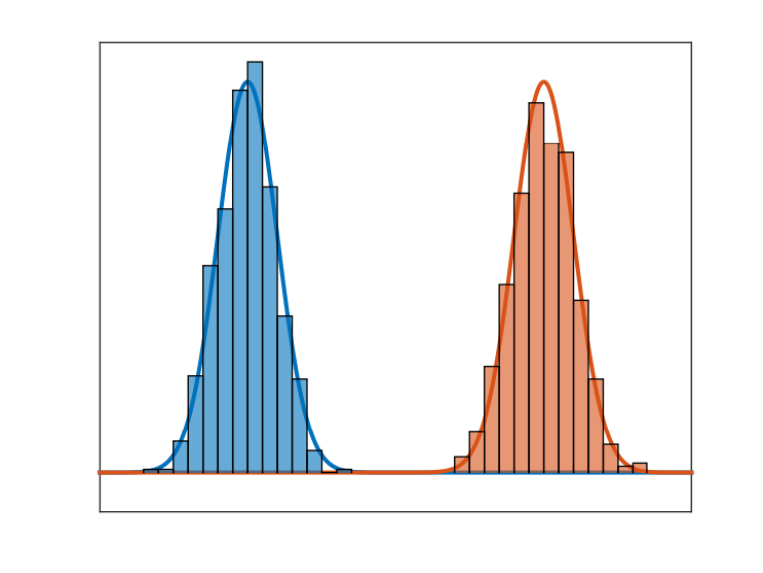
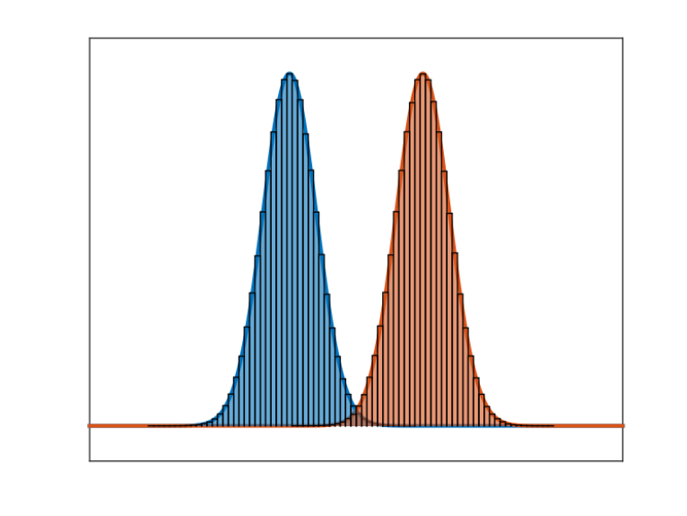
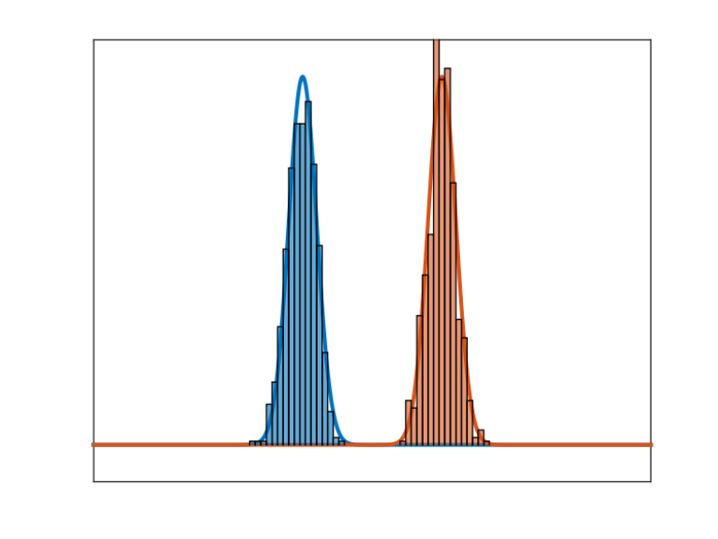
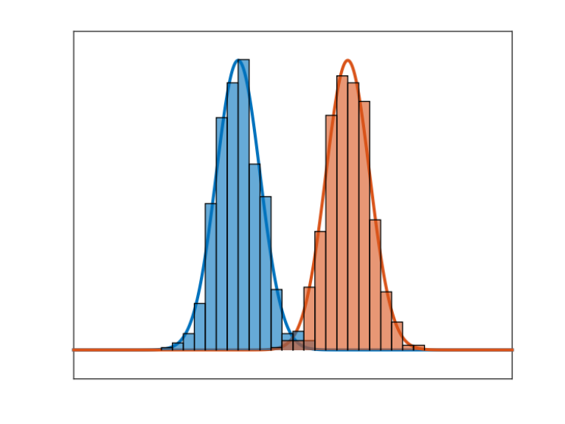
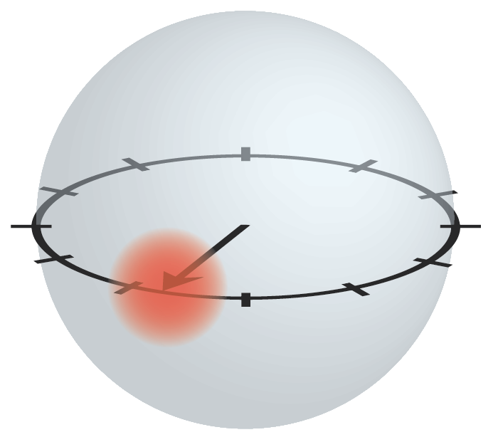
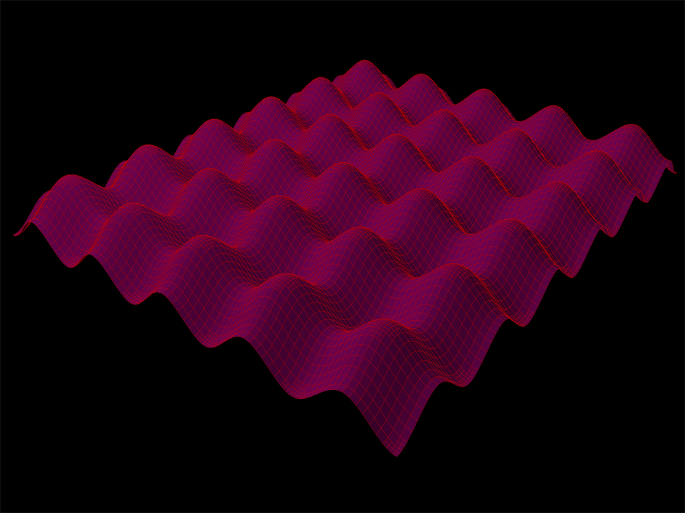
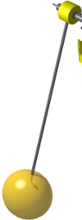



Quantum technology & precision measurement
Measurement of energy/frequency/time/phase
$$A$$
$$1/τ$$
$$\sqrt{N}$$
Intrinsic sensitivity
Large count rate
Long coherence time
11
12
1
Q ~ 10¹⁷
10
2
9
3
8
4
7
6
5
Std quantum limit: N^{1/2}
Heisenberg limit: N
Coherence time:
Quantum state protection
Quantum system design

Slide 3
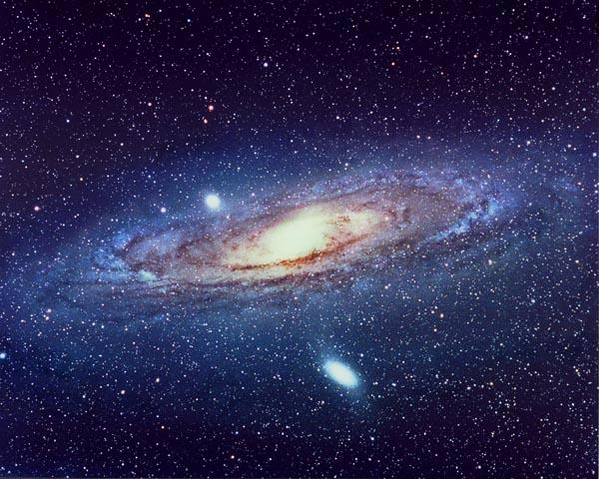
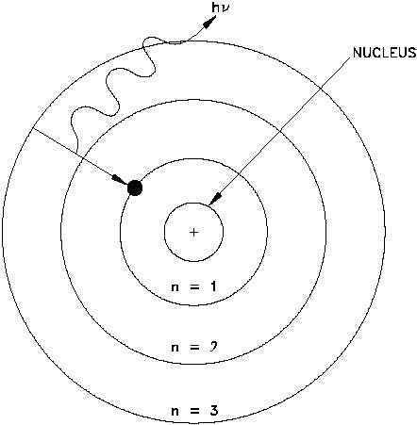
Time Scales
Quantum pendulum period: 10⁻¹⁵ s
0.000,000,000,000,001 seconds
The geometric mean
~30 s
Sr atoms:
¹S₀ ↔ ³P₀ (160 s)
Q ~ 10¹⁷
Life of the Universe: 15 billion years (10¹⁸ s）
1000,000,000,000,000,000 seconds

Slide 4
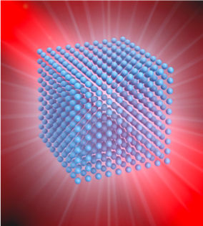
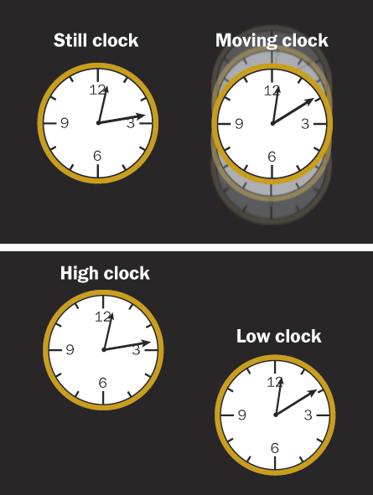
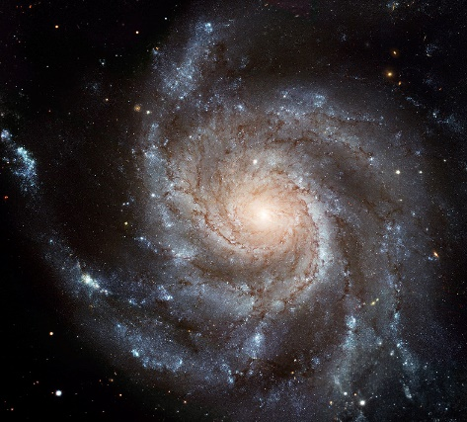
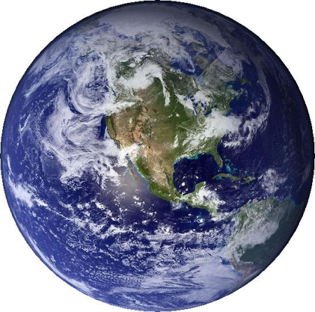
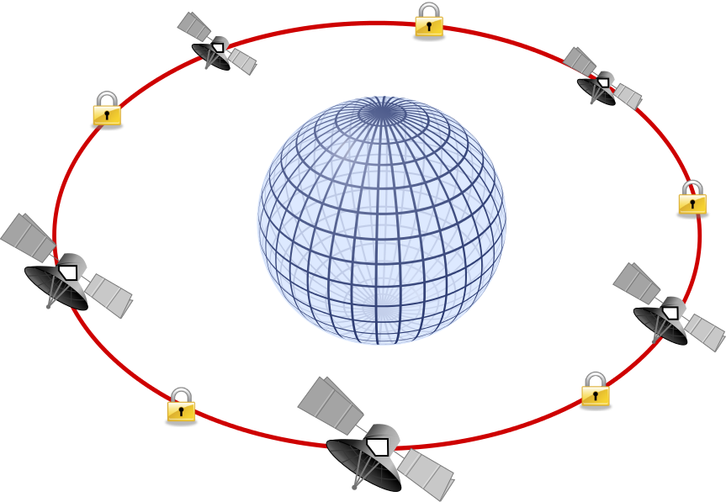
Probes for fundamental physics
Kómár et al., Nat. Phys. 10, 582 (2014);
Kolkowitz et al., Phys. Rev. D 94, 124043 (2016).
Unruly spiral galaxies
Space-time ripples
Network of clocks (10⁻²¹):
long baseline interferometry

Slide 5
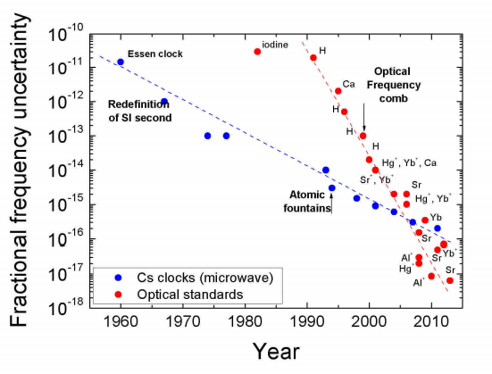
Atomic clock: sensors of space-time
Quantum Technologies:
• Higher Q optical transitions:
trapped ions & neutral atoms
• New laser stabilization methods:
optical coherence ~ 30 s
• Many atoms in optical lattice:
many-body, engineered states
• Optical frequency comb
Sr, Yb, Al⁺
10⁻²⁰
Poli et al., La rivista del Nuovo Cimento, 36 555 (2013); Ludlow et al, RMP 87, 637 (2015).
Current accuracy ~10⁻¹⁸ = grav. redshift @ 1 cm
Precision ~3 x 10⁻¹⁹
(goal) Many-body protected quantum coherence
τ ~ 160 s
Q ~ 10¹⁷

Slide 6
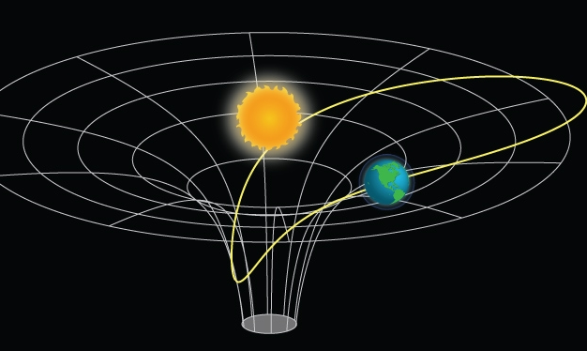
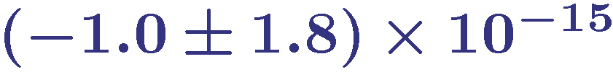
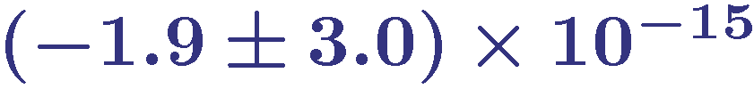
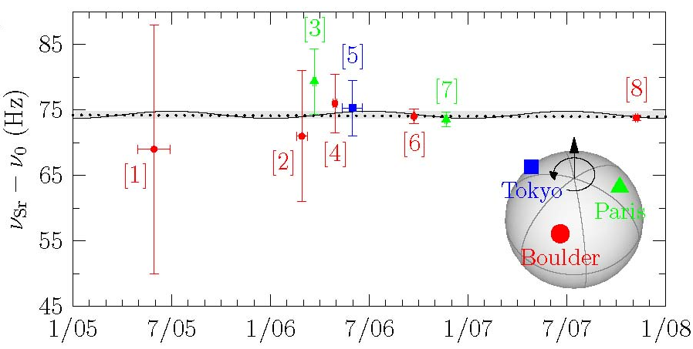
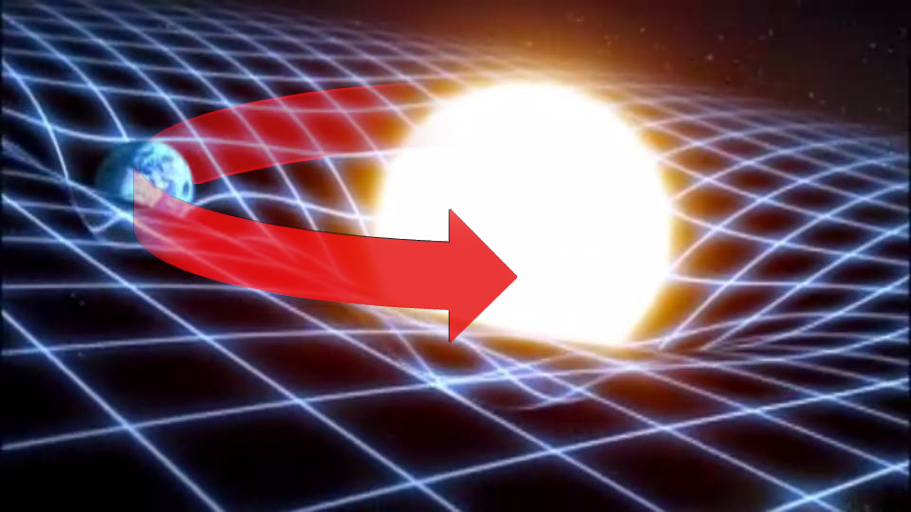
Local Lorentz Invariance
Linear Drift
Sinusoidal amplitude
Fundamental constants
& gravitational potential
← constrains linear drift of fundamental constants
← constrains coupling coefficients to gravitational potential
S. Blatt et al.,
Phys. Rev. Lett. 100, 140801 (2008).
Paris
Date

Slide 7
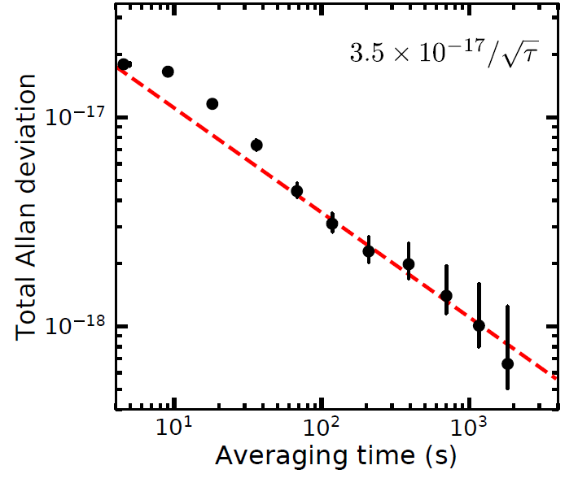
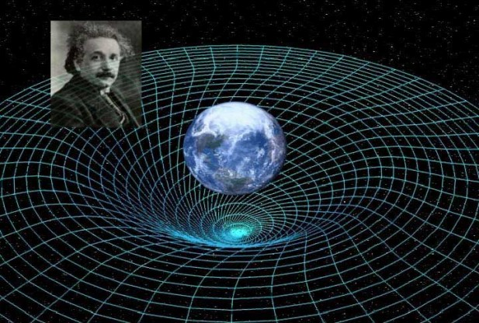
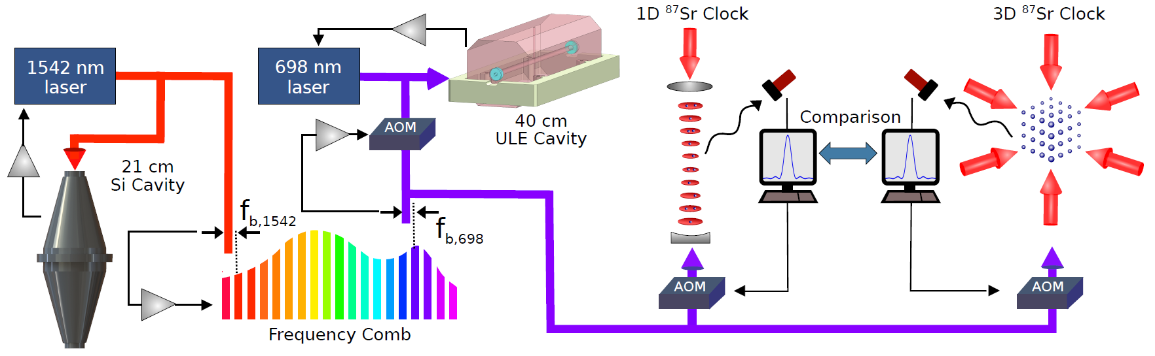
New stability for optical clocks
Oelker et al., Nature Photon. 13, 714 (2019).
5.8 x 10⁻¹⁹ in one hour (x 10 faster than any previous clocks)
Gravitational potential difference of 1 cm in 20 minutes
Local Position Invariance
Relativistic Geodesy

Slide 8
Fermions in a 3D lattice
Fermi-Hubbard Hamiltonian
Quantum simulation & sensing
1 million atoms
(100 x 100 x 100 cells)
Coherence 160 s
Precision 3 x 10⁻²⁰ Hz^{-1/2}
Current: 3 x 10⁻¹⁷ at 1 s
S. Campbell et al.,
Science 358, 90 (2017).

Slide 9
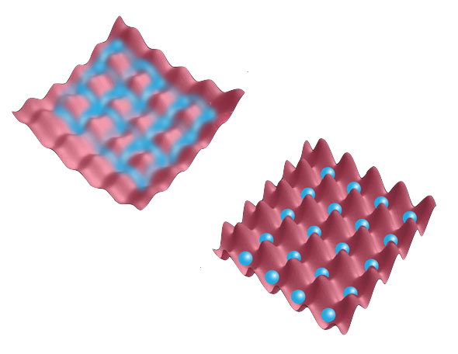
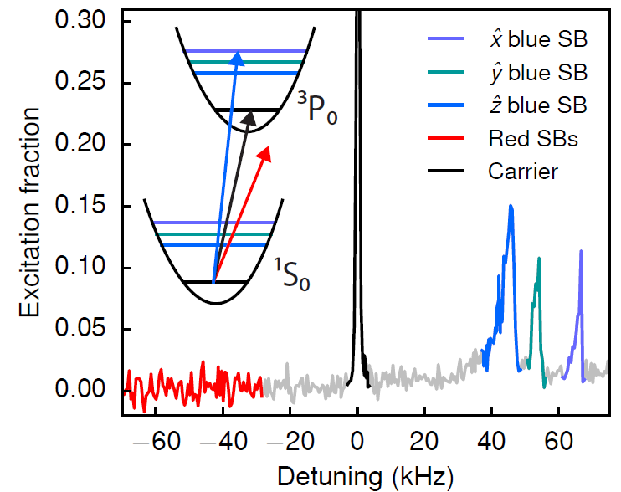
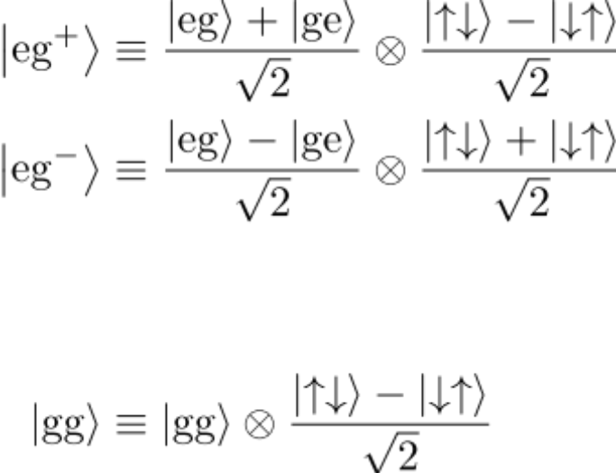
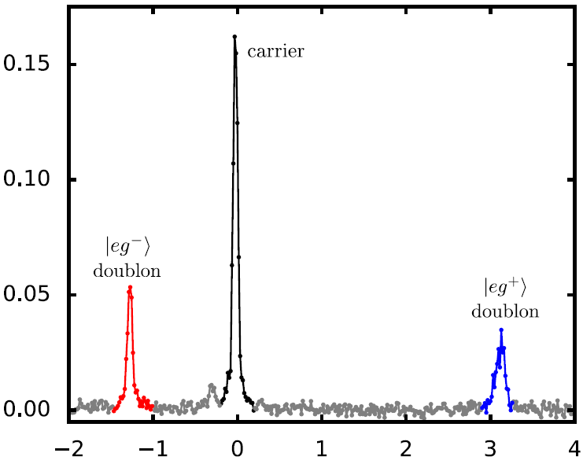
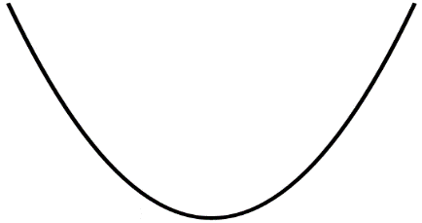
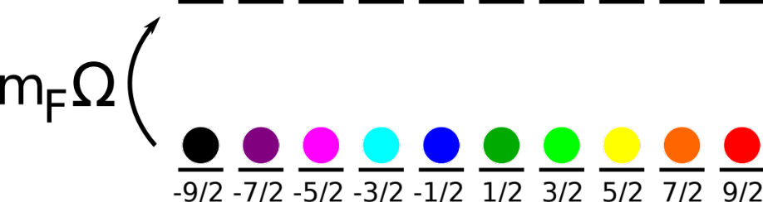
Quantized Motions & Interactions
Goban et al., Nature 563, 369 (2018).
Orbital
Nuclear spin
$$\hat{x}$$
$$\hat{y}$$
$$\hat{z}$$
0
0
0
Excitation fraction
⁸⁷Sr: J = 0, I = 9/2
Clock laser frequency (kHz)

Slide 10
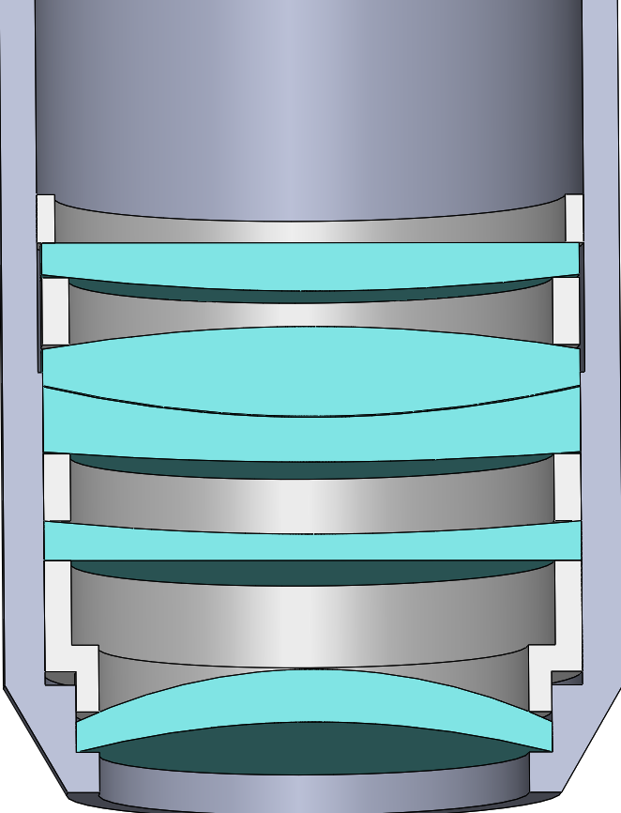
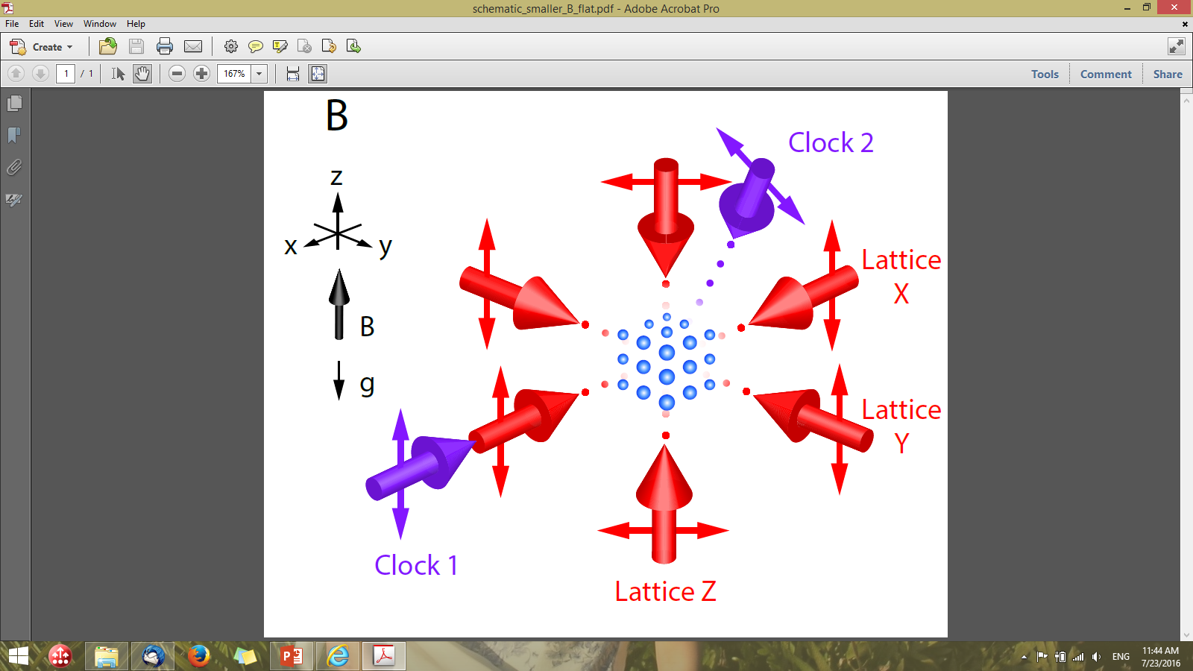
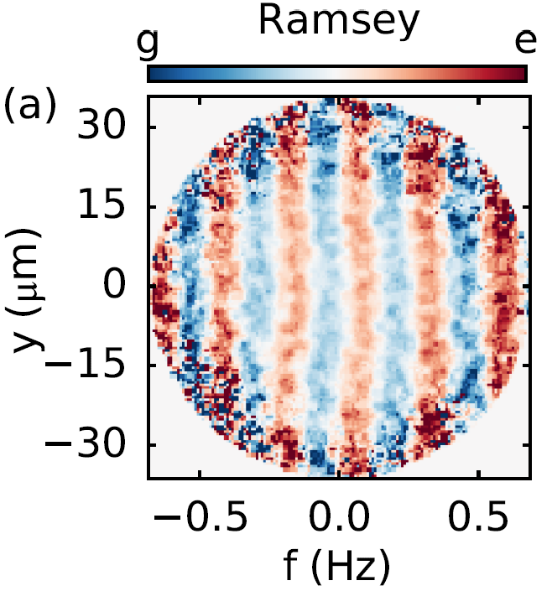
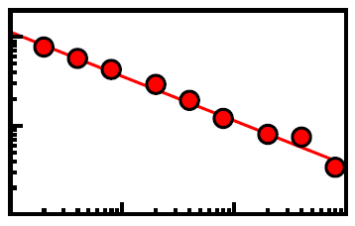

Imaging field gradients via optical phase
Marti et al., Phys Rev Lett 120, 103201 (2018).
$$∇B_{x}$$
10⁻¹⁷
2.5⨉10⁻¹⁹
@ 3 hours
10⁻¹⁸
Allan Deviation
10⁻¹⁹
10⁴
10
10²
10³
Average time (s)

Slide 11
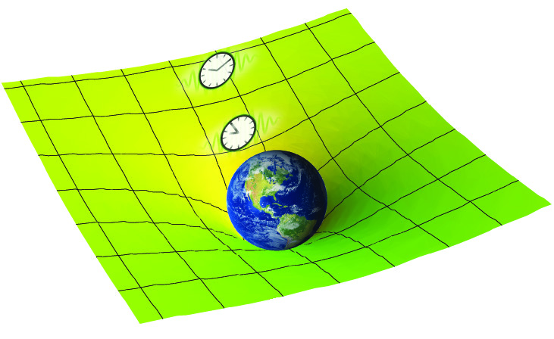
Unexplored regime: entanglement under GR
Extreme spatial resolution & precision
Need clocks at 10⁻²¹

Slide 12
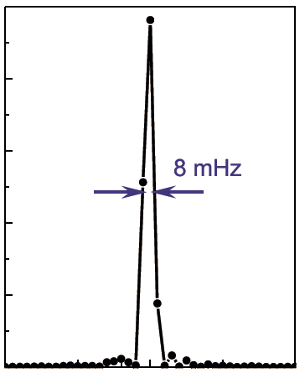
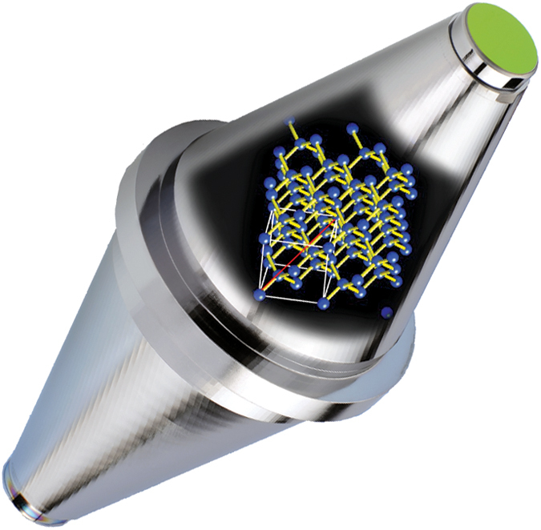
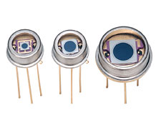
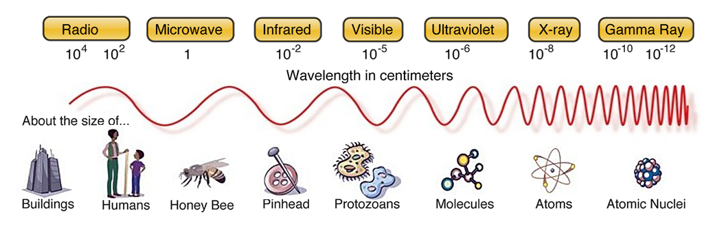
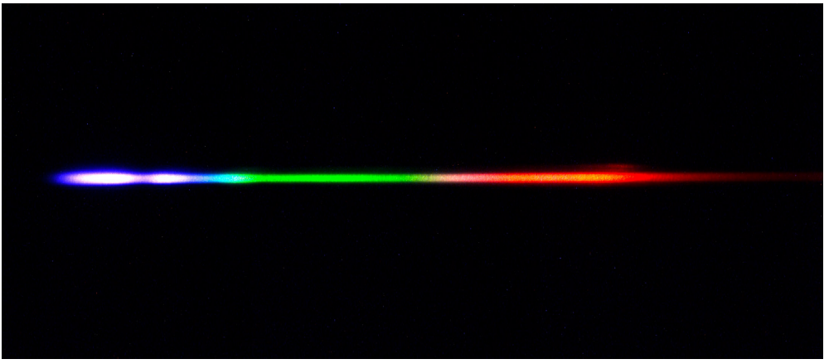
A new generation of stable lasers
Optical coherence at tens of seconds
Matei et al., PRL 118, 263202 (2017); Zhang et al., PRL 119, 243601 (2017).
JILA
0.5
Stability:
4 x 10⁻¹⁷
PTB
Signal amplitude
0.4
0.3
0.2
0.1
0
-0.10
-0.05
0
0.05
0.10
Beat frequency (Hz)
Optical frequency comb

Slide 13
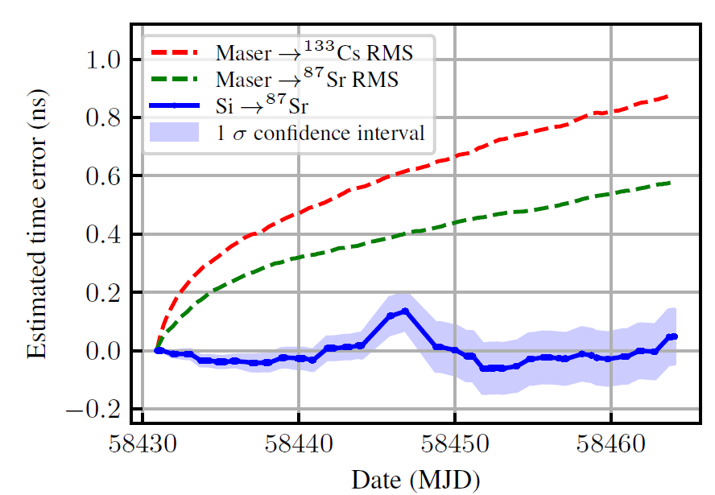
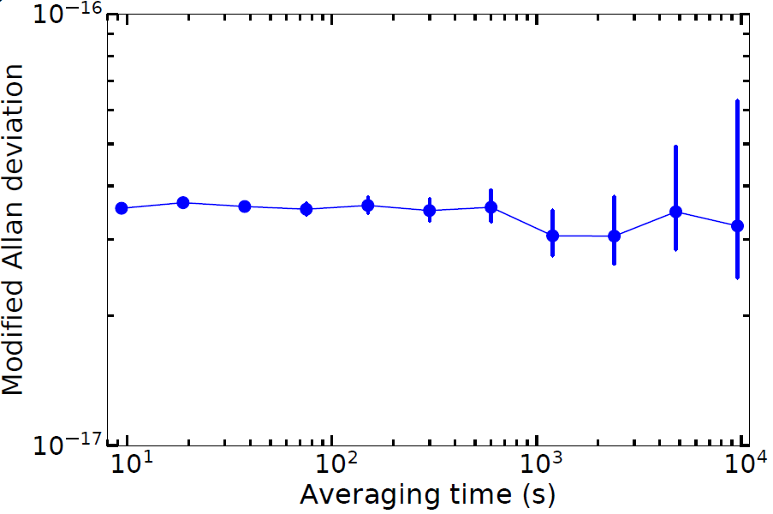
The first ALL-Optical time scale
Milner et al., Phys. Rev. Lett. 123, 173201 (2019).
48 ps error over 1 month
Silicon cavity – Sr
Outperforms existing time scales by x 10
Future redefinition of SI Second
Synchronization for networks

Slide 14
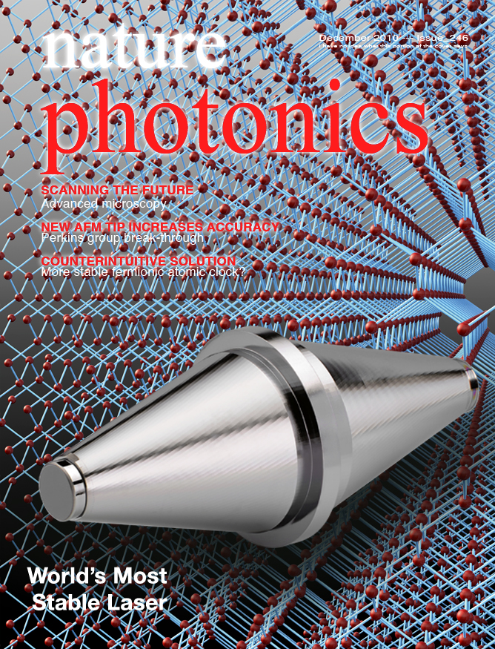
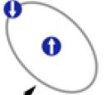



Cavity - atom dark matter search
C. Kennedy et al., Phys. Rev. Lett. in press (2020).
Silicon
$$ω \sim α m_{e}c^{2}$$
$$ω \sim α^{2.06} m_{e}c^{2}$$
$$ω \sim α^{4} m_{e}^{2}c^{2}$$
Sr
H
Godun, et al., PRL 113, 210801 (2014)
Huntemann, et al., PRL 113, 210802 (2014)

Slide 15


Dark matter: particles vs. fields
Compton wavelength:
$$λ_{C}= \frac{ℏ}{m_{DM} c}$$
Galactic size (~10 kpc) > λC > Schwarzschild radius
⇒ 10⁻²² eV << mDM << 10⁺²⁸ eV
$$\frac{{Number}_{DM}}{mode} \sim \left(\frac{ρ_{DM}}{m_{DM}c^{2}}\right)× {\left(λ_{de Broglie}\right)}^{3}$$
“Classical fields”
“Particles”
10⁻²⁰
10⁻¹⁰
10⁰
10⁺¹⁰
10⁺²⁰
mDM, eV
WIMPs
Coherent on detector scale
Particle-like energy deposition
DM field oscillates at Compton frequency: ω_{DM} = $\frac{m_{DM}c^{2}}{ℏ}$ ~ 30 kHz * [m_{DM}/10⁻¹⁰ eV]
DM field virialized ⇒ coherence Q = ω_{DM} / Δω_{DM} $≈ \frac{c^{2}}{{Δv}^{2}} ≈$ 10⁶

Slide 16

Ultralight scalar DM - Dilaton
Dilaton (spin 0, even parity) – A scalar field to modify fundamental constants: fine structure constant α, particle masses, etc.
Transition type | Scaling dependence on constants
Atomic s-p | Ry * (1 + Z²α²)
Atomic p-d | Ry * (1 - Z²α²)
Atomic hyperfine | Ry * α² * (m_{e}/m_{p}) * g_{N}
Molecular rotation | Ry * (m_{e}/m_{p})
Molecular vibration | Ry * (m_{e}/m_{p})^{1/2}
Nuclear | Λ_{QCD} * (m_{q}/m_{p})
Cavity
$$α m_{e}c^{2}$$
Ratio of frequencies from different clocks
➔ sensitive to variations of fundamental constants
Arvanitaki et al., PR D 91, 015015 (2015)
Van Tilburg et al., PRL 115, 011802 (2015)
Notes:
Ry = alpha² m_{e} c / (4pi hbar)

Slide 17
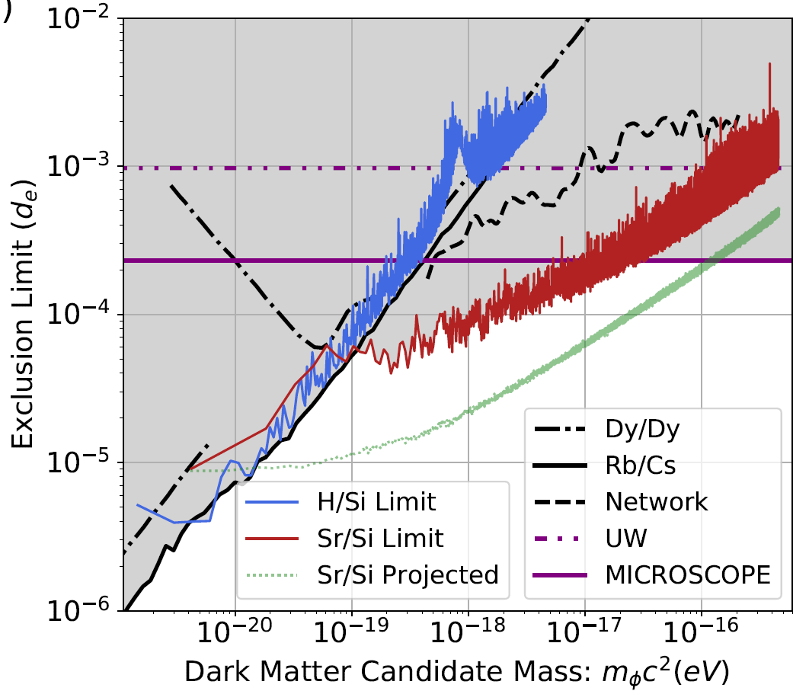
Cavity - atom dark matter search
C. Kennedy et al., Phys. Rev. Lett. in press (2020).
Silicon
$$ω \sim α m_{e}c^{2}$$
$$ω \sim α^{2.06} m_{e}c^{2}$$
$$ω \sim α^{4} m_{e}^{2}c^{2}$$
Sr
H
Godun, et al., PRL 113, 210801 (2014)
Huntemann, et al., PRL 113, 210802 (2014)

Slide 18
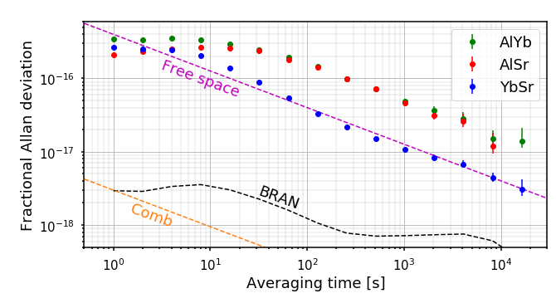
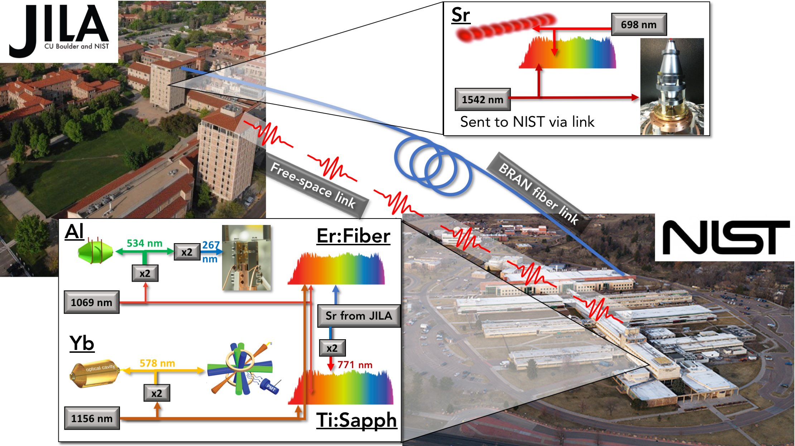
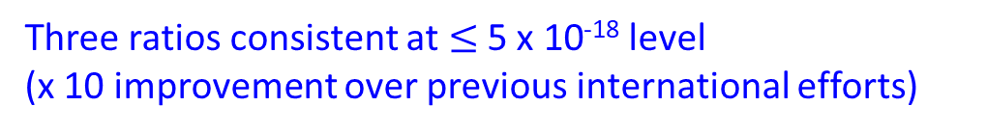
Clock network
Beloy et al., arXiv:2005.14694 (2020).
Three ratios consistent at $≤$ 5 x 10⁻¹⁸ level
(x 10 improvement over previous international efforts)
Si
cavity

Slide 19

Dark matter field & variation of α
Fine-structure constant α: 1/137.035 999 084(51)
Clock comparisons: no change in 17th digit / year
A relativistic effect
$$\frac{∆ω}{ω}=K \frac{∆α}{α}$$
²²⁹Th nuclear transition:
x10⁴

Slide 20

Energy vs half-life: nuclear transitions

Slide 21



Direct laser excitation of nuclear transition
Working on
10⁻¹⁶ (reference to Sr clock)
Beck et al., PRL 98, 142501 (2007).
Seiferle et al., Nature 573, 243 (2019).
VUV Comb:
Linewidth < 1 kHz
100 nW per comb
L. von der Wense
C. Zhang
Average power | 10 mW
Repetition rate | 77 MHz
Bandwidth | 38 meV, 9.2 THz
Number of comb mode | $${10}^{5}$$
Power per mode | 100 nW

Slide 22




Sr optical clock: many-body meets precision
R. Hutson
W. Milner
C. Sanner
L. Sonderhouse
L. Yan
Theory:
A. M. Rey
T. Bothwell
D. Kedar
C. Kennedy
W. Milner
E. Oelker
J. Robinson
Collaboration: PTB, NIST, A. Kaufman
M. Safronova, P. Julienne, M. Lukin, P. Zoller, …

