Slide 1
Discussion
Relating to Albert Young’s and Chen-Yu Liu’s talks
(neutrons)
Jeff Martin, discussion leader
What ideas could (or could not) be turned into actual experiments at TRIUMF/CENPA?
What homework do we need to do to figure this out?
Should we form a working group to answer such questions?
Who are key people to target for this working group?

Slide 2
Ultracold neutron sources that would welcome your experiments
Place | Neutrons | UCN converter | Status
ILL | Reactor, CN | Turbine | Running
J-PARC | Spallation | Doppler shifter | Running
ILL SUN-2 | Reactor, CN | Superfluid He | Running
ILL SuperSUN | Reactor, CN | Superfluid He | Future
RCNP/KEK/TRIUMF | Spallation | Superfluid He | Running/Upgrading
Gatchina WWR-M | Reactor | Superfluid He | Future
LANL | Spallation | Solid D2 | Running
Mainz | Reactor | Solid D2 | Running
PSI | Spallation | Solid D2 | Running/Upgrading
NSCU Pulstar | Reactor | Solid D2 | Running
FRM-II | Reactor | Solid D2 | Future
KEK-TRIUMF combination of spallation target and superfluid helium is unique.
Upgrade schedule is competitive with other leading sources of UCN.

Slide 3
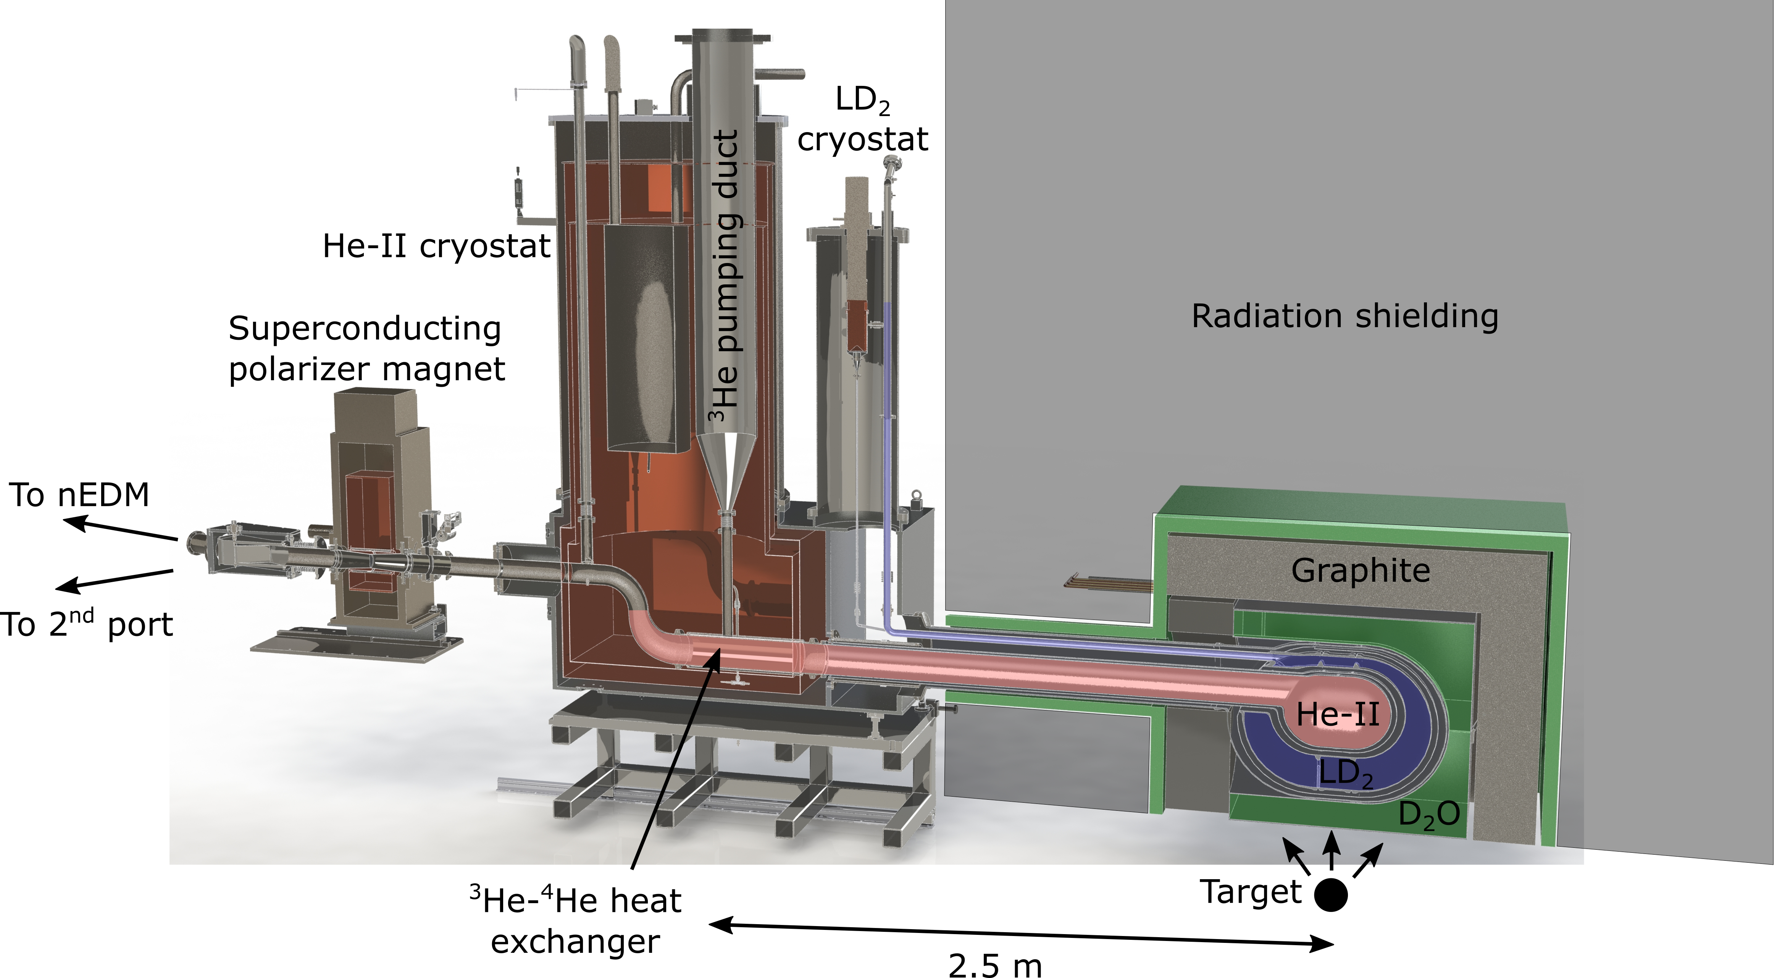
TUCAN Source upgrade
TUCAN = TRIUMF Ultra-Cold Advanced Neutron
Cryostat testing (Japan) successful/ongoing, installation at TRIUMF in 2021-22.

Slide 4
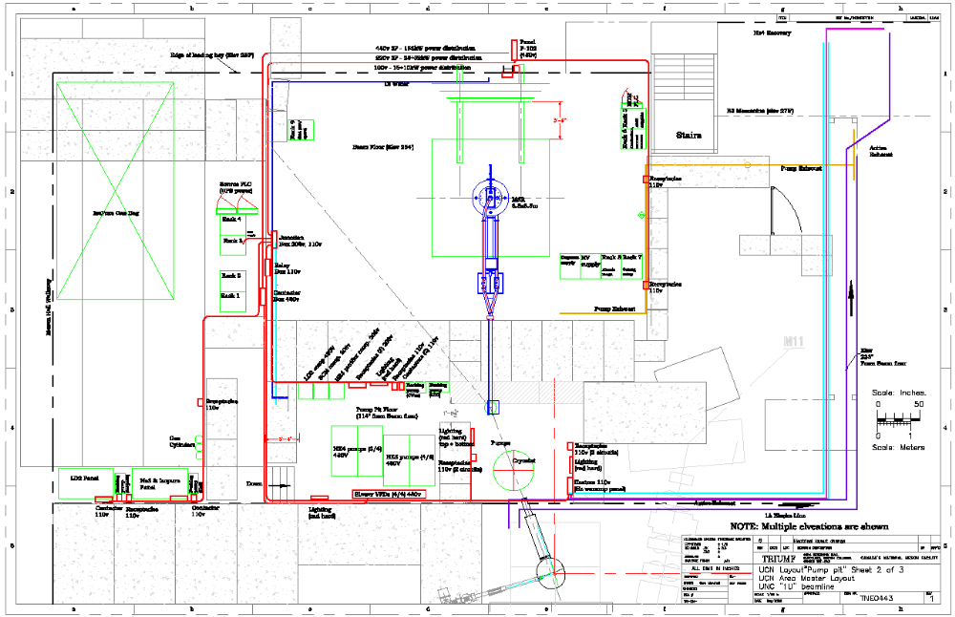
Layout in Meson Hall at TRIUMF
EDM Experiment
Space for
2nd experiment
UCN guides
Proton beam

Slide 5
TUCAN EDM: Opportunities for collaboration, and physical distancing
Based on examples from R&D, there are many opportunities for external (to TRIUMF) involvement:
  UCN detector development and testing
  UCN source cryogenics
  UCN guide coating
  CN experiment analysis
  Hg comagnetometer development
  Cs magnetometer development
  Internal coil design
  External coil design
  Beam physics and magnetic mapping
Each has students and/or university-based PDF/RA involved.
Running at TRIUMF:
  Ran the prototype UCN source one month per year 2017-2019.
  Cryogenic testing of the UCN source upgrade at TRIUMF over the next two years. Expect two PhD’s (UBC, Manitoba) focused on cryogenic aspects.
  UCN production from upgraded source 2022.
  Magnetically shielded room installed 2022 will serve as focal point for magnetic and sensor testing.
  EDM commissioning/running 2023 and beyond.
  Future projects.
Good opportunity to get involved now in local particle physics project at TRIUMF.

Slide 6
Key parameters of the TUCAN Source and EDM experiment (also a reference design for other possible experiments)
Source produces 1.6 x 10⁷ UCN/s when driven by 40 μA beam.
Operate 1 minute beam on (loading the EDM experiment), 3 minutes beam off (EDM measurement and counting) duty cycle.
EDM experiment cells (2 x 30 L) store 20 x 10⁶ UCN at t=0 (after loading).
Ultimately, at the end of each Ramsey measurement we would detect
2 x 10⁶ UCN (includes storage and transport losses, detection efficiency).
We repeat this cycle over and over again. Aim for
δd_{n,stat.} = 1 x 10⁻²⁷ ecm in 400 days of running (+years for systematic studies).
Competitive with/complementary to CENPA ¹⁹⁹Hg EDM program.

Slide 7
Experiments with ultracold neutrons
The “best” experiments:
  Beta decay correlations
  Neutron lifetime (CKM unitarity, new particles in loops, neutron lifetime problem)
  EDM (strong CP problem, SUSY CP problem, EW baryogenesis, …)
  Gravitational levels (modification to gravity at ~um scale, chameleon fields)
Others?
  Invisible and not-so-invisible decays of neutrons (neutron lifetime problem).
  Mirror neutrons (anomalous losses, neutron lifetime problem)
  Axionlike particles (time-varying EDM’s, precision clock comparisons)
  n-nbar oscillation search (B-violation)

Slide 8
Discussion points
What ideas could (or could not) be turned into actual experiments at TRIUMF/CENPA?
What homework do we need to do to figure this out?
Should we form a working group to answer such questions?
Who are key people to target for this working group?
New geometry for experiment measuring A(beta)
Mirror neutrons
  Neutron disappearance vs. magnetic field
  What about effect on precession frequency? Pseudo-magnetic field, non-linearity with B, time-varying fields.
ALP’s
Short-range forces – microfluidic device for short-range force search.
CRES
n-nbar?
new ideas in neutron lifetime?
dark decay, doing better?
mirror neutrons using cold neutron beam (Broussard)
EDM, n-nbar, beta-decay, bouncing neutrons in quantum states

Slide 10
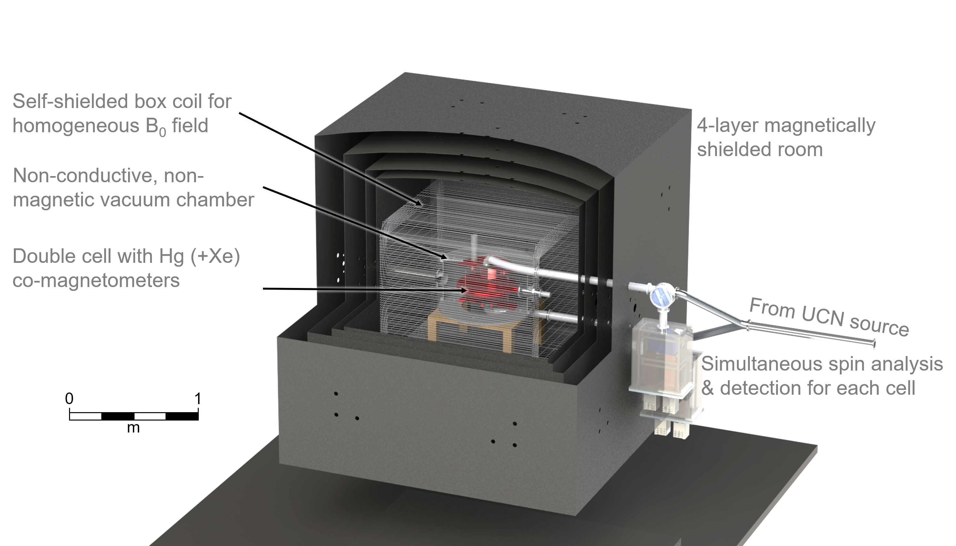
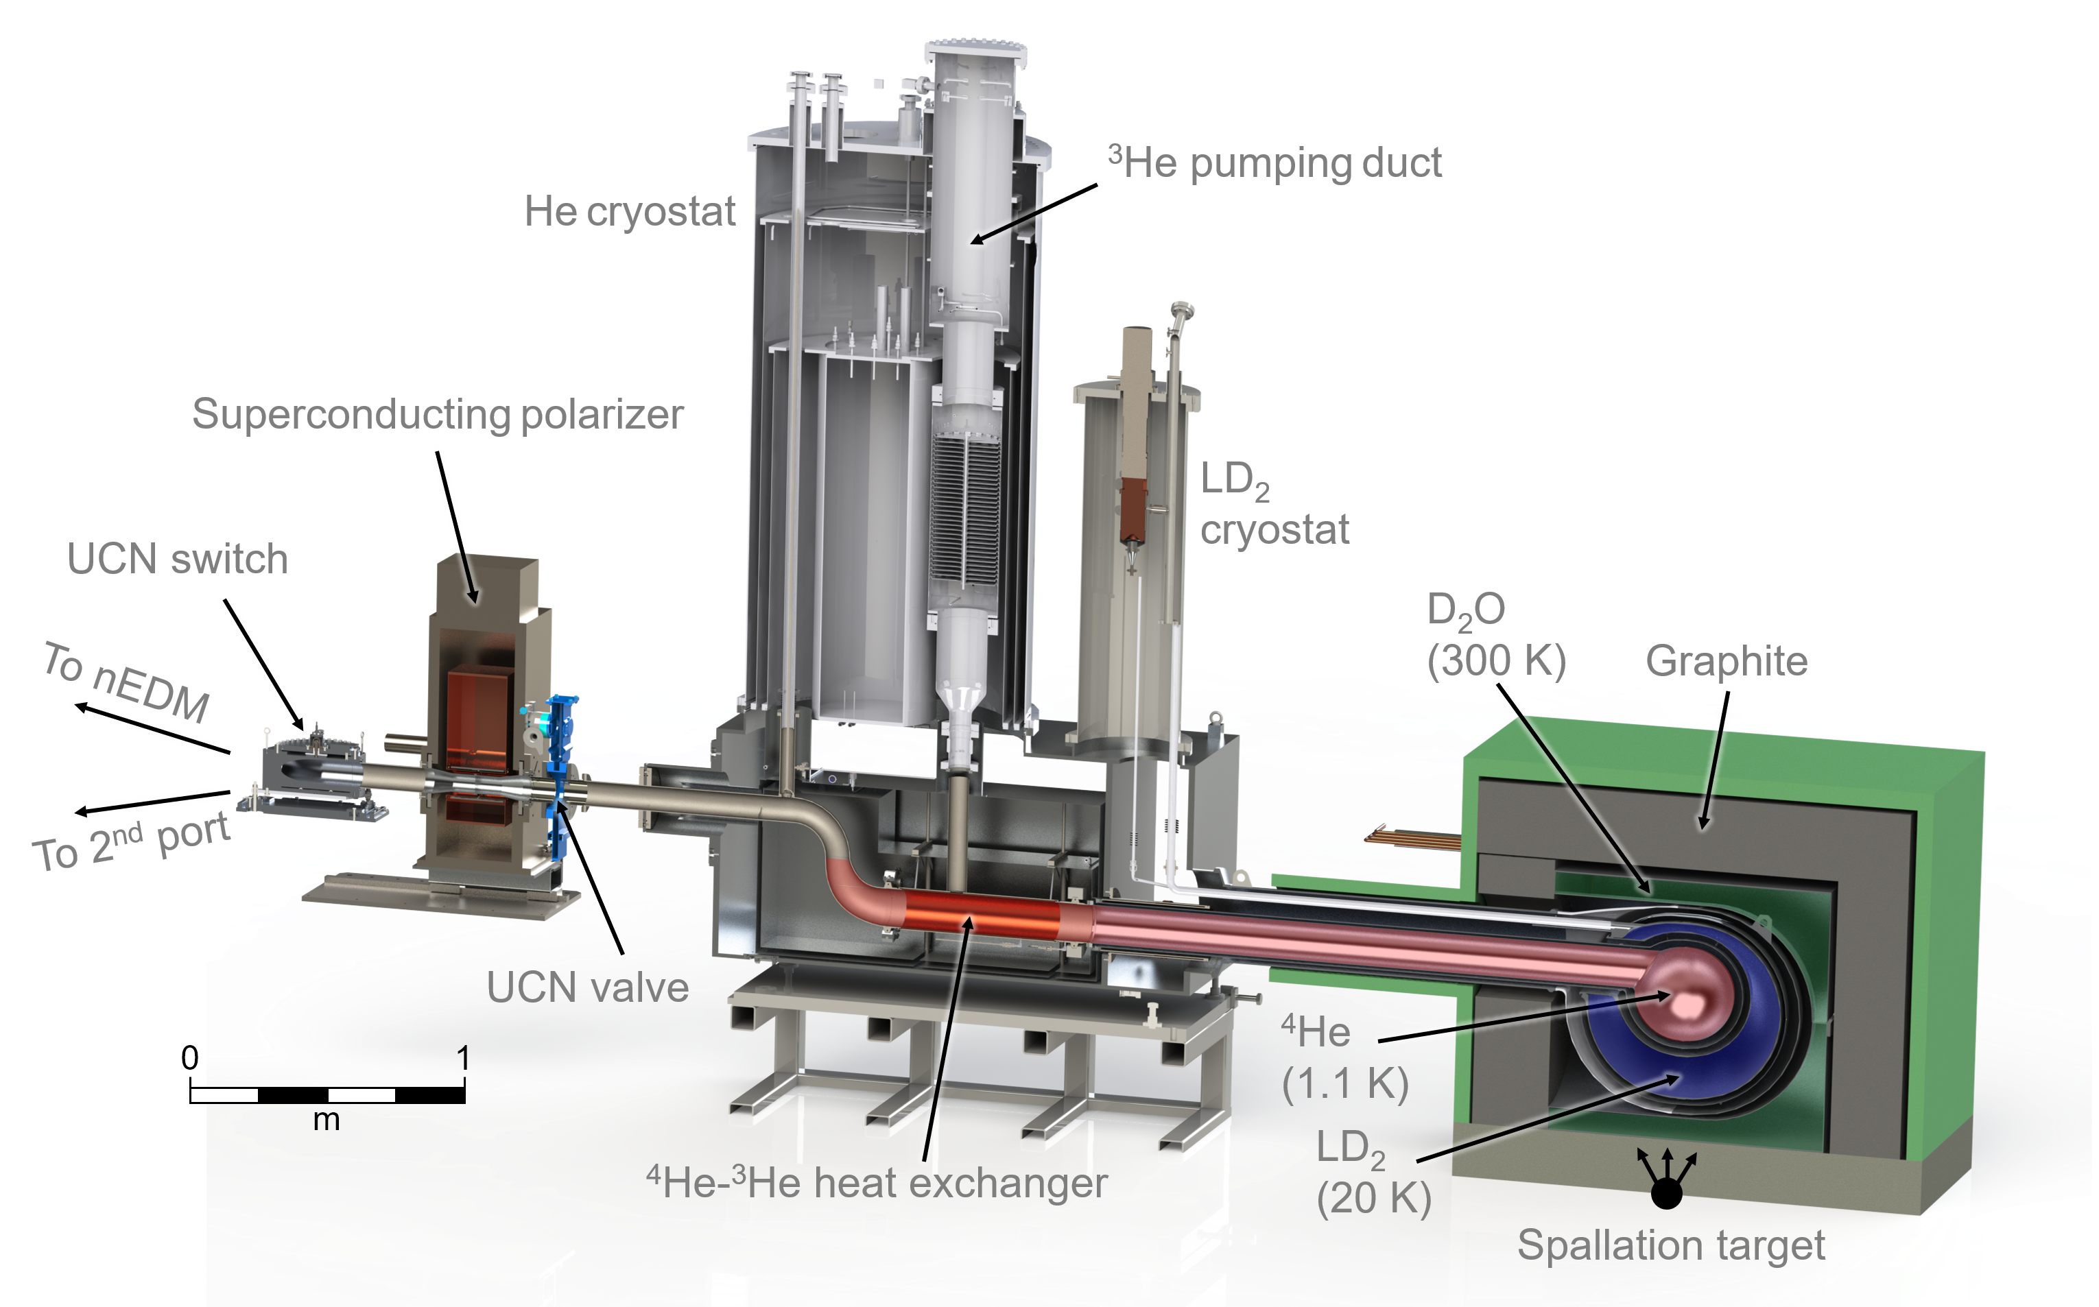
Plans for next five years
2021-22: UCN source installation and commissioning
2022: MSR installation, begin precision magnetometry in situ
2023: nEDM commissioning, thereafter data-taking
Helium liquefaction upgrade in Meson Hall needed to reach full sensitivity

Slide 11
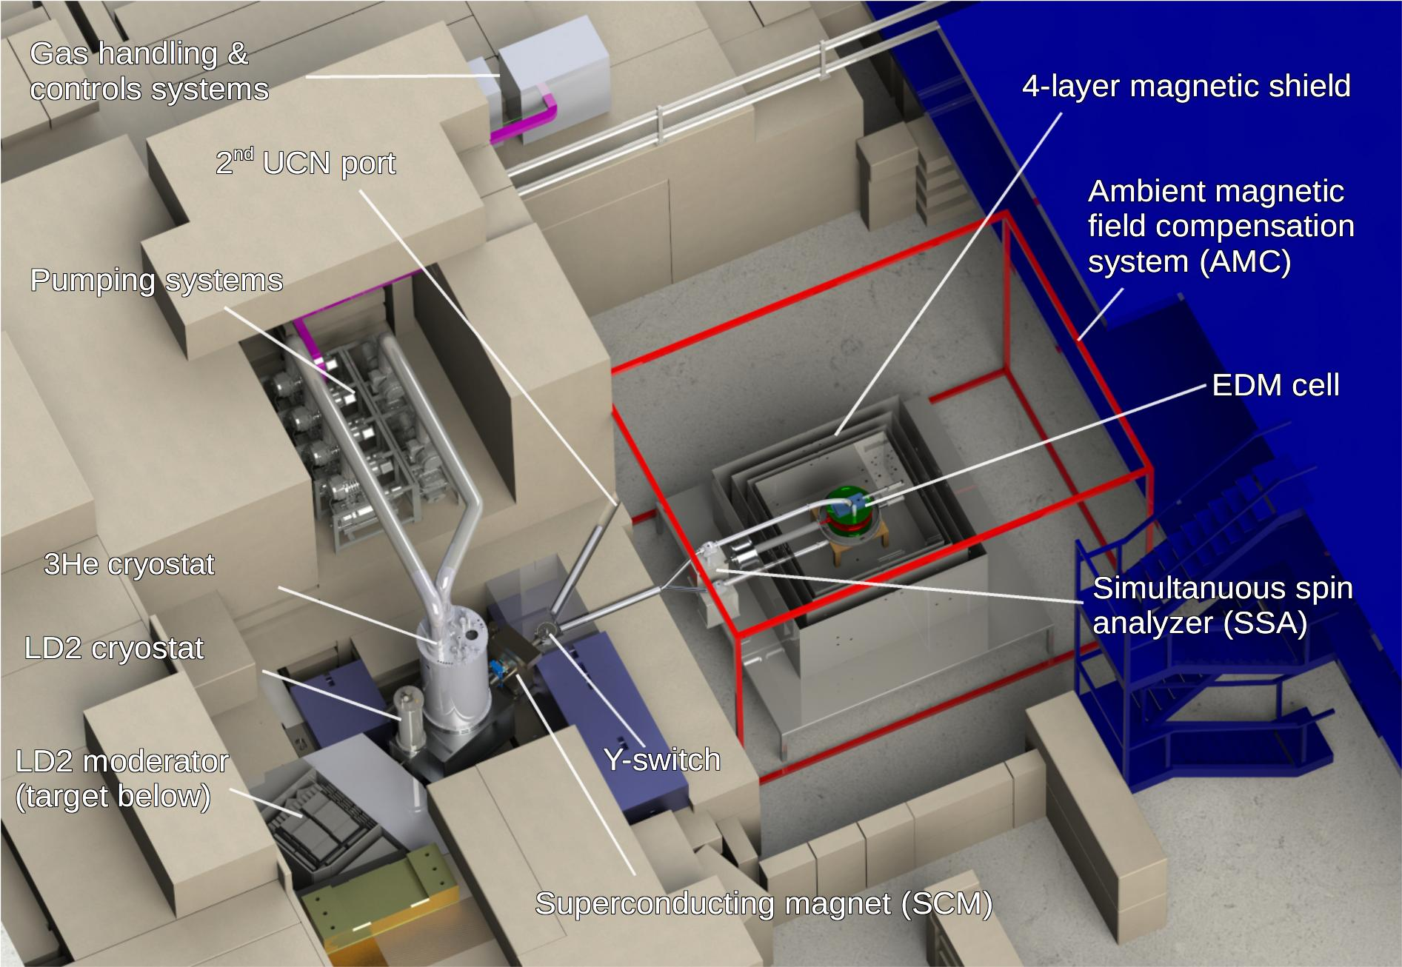
Plans for 2027-36
EDM data analysis and possible additional data taking
Upgrades to UCN source or EDM experiment
  E.g. Xe comagnetometer
User space
UCN source designed as user facility with second port available for other experiments:
  Neutron lifetime puzzle
  Neutron gravity levels experiment
  Exotic interactions
  Bring your ideas!

