Slide 1
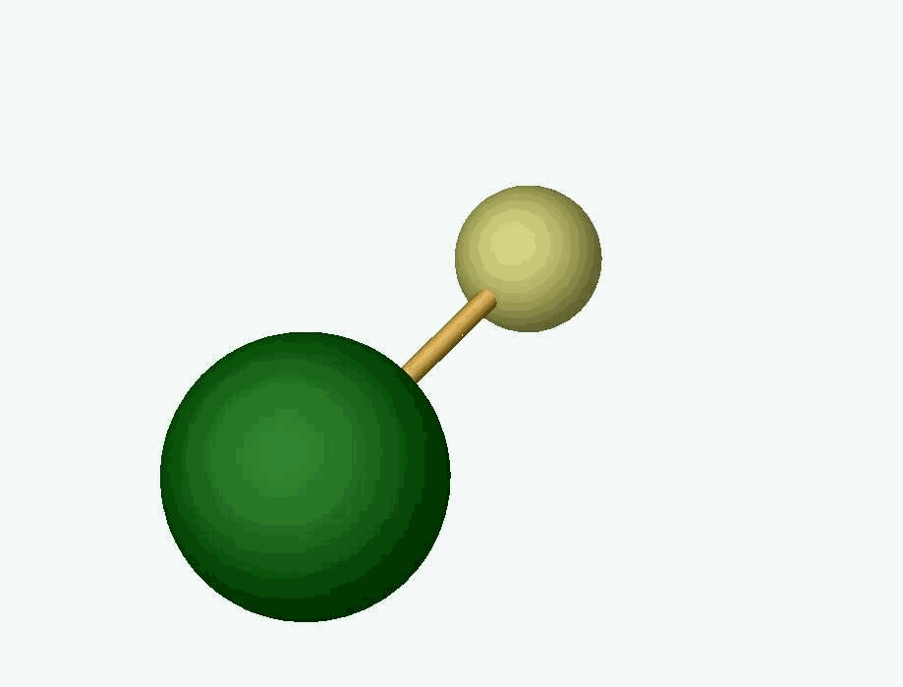

Towards new searches for CP-violating physics
(a.k.a. EDMs) using ultracold molecules
Why EDMs?
EDMs & related effects in simple atoms & simple molecules
Electron EDM: current limit and near future with ACME
New directions:
  CeNTREX: “proton EDM” with TlF molecules
  “Ultimate” EDM experiments with trapped molecules?
Dave DeMille
University of Chicago
and Argonne National Lab
DeMille
Group
Funding:
NSF, Sloan Foundation, Moore Foundation
Heising-Simons Foundation
Notes:
Needed:
a. U of C logo, funding logos?
b. CeNTREX paper reference
Outline:
EDMs & other moments linked to spin→T,P violation→CPV
CPV well motivated: baryon asymmetry, arises easily with new degrees of freedom
For max CPV new physics, already probing 3—30—1000 TeV
Essentially background-free for 5-6/9-10 orders of magnitude
Molecular structure uncertainties small!!!
in electron EDM with ultracold “assembled” molecules

Slide 2
Charge asymmetry along spin axis violates time-reversal symmetry
Purcell
Ramsey
Landau
If every one of
some particle
(electrons, protons, etc.) looks like this…
+
=
d
P
T
This does not exist
⇓
T not good symmetry of nature
Nor this
⇓
P violation
as well
CPT theorem ⇒ T-violation = CP-violation
Additional CPV needed to explain cosmological baryon asymmetry

Slide 3
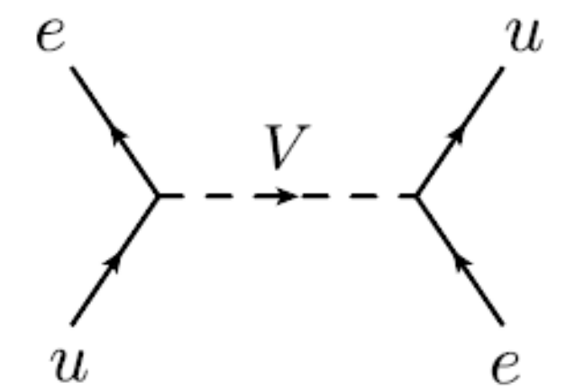

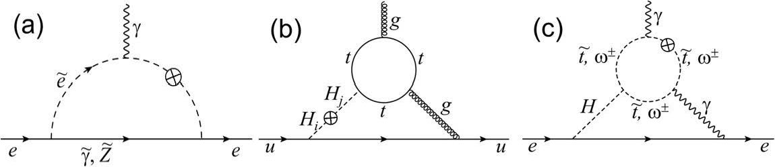


Atoms & nuclei as transducers of CP-violating physics
CPV electron-quark interaction
e.g. via scalar leptoquark exchange
⇒ atomic Hamiltonian
(analogous to Z⁰ exchange)
Supersymmetric partners
with CPV in SUSY-breaking
electron electric dipole moment
atomic Hamiltonian
Extra Higgs doublet with CPV
⇒ quark chromo-EDM
⇒ nuclear Schiff moment
⇒ atomic Hamiltonian
Notes:
e-N, loops, NN

Slide 4
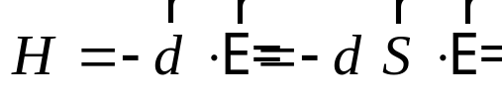
How do EDMs show up in atoms/molecules?
Hamiltonian from EDM:
Fundamental issue:
elementary quantum mechanics [“Schiff theorem”] says <E> = 0
on any* charged particle in neutral atom or molecule
(makes sense intuitively!)
“Loopholes” in Schiff theorem
allow observable atomic/molecular EDMs
*[pointlike, non-relativistic]
electron relativistic motion ⇒ electron EDM observable
nucleus finite size ⇒ nuclear “Schiff moment” observable
roughly, S ∝ unpaired nucleon EDM [neutron or proton]
(but usually larger contributions from CPV n-n interactions…)

Slide 5
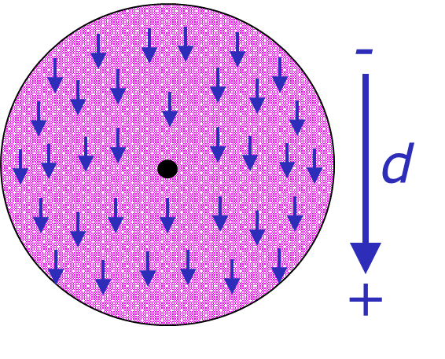
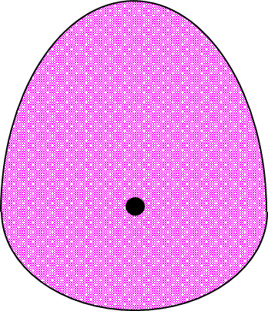
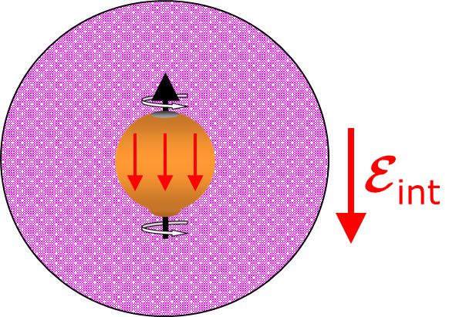
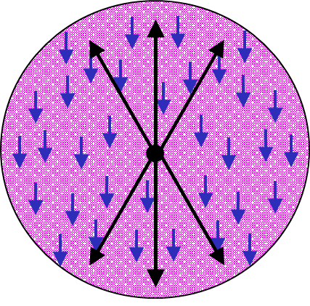
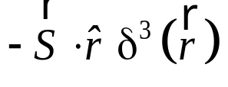
CPV interactions polarize atomic wavefunctions
electron in s-orbital
electron EDM
nuclear Schiff moment
CPV
e-N
interaction

Slide 6
CPV-induced polarization
sv
+η_{CP}p
=
Mixing coefficient η_{CP} grows rapidly w/atomic number Z (roughly ∝ Z ³)
due to relativistic effects, stronger Coulomb field, larger nuclear size,...
needed to evade Schiff theorem
No energy shifts to first order (no diagonal matrix elements)

Slide 7
E-field induced polarization
E_{ext}
s+η_{E} p
p
s
No first-order energy shift due to E-field
Electric polarization P_{E} ≡ induced dipole/D_{sp}

Slide 8
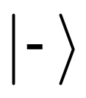


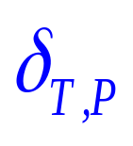
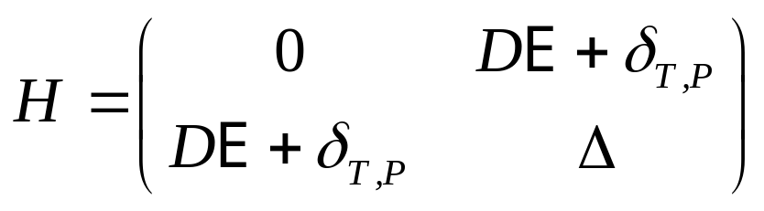
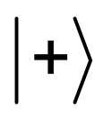
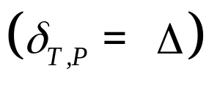
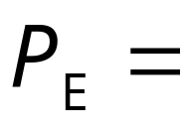
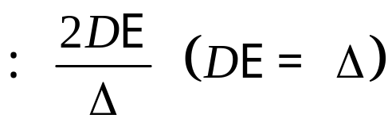
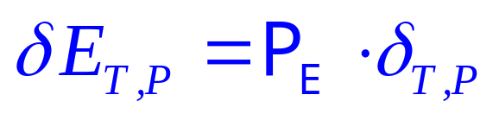
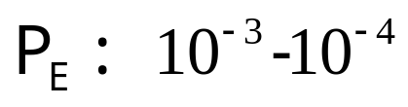
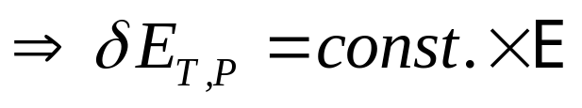
Energy shifts due to EDM/SM & E-field
EDM/SM coupling
Electric polarization
Energy shift due to EDM/SM:
Atoms
max

Slide 9
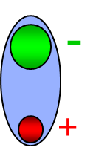
Strong internal E-field in polar molecules fully polarizes atomic valence electron
…BUT free molecules rotate, averaging E-field direction to 0
Notes:
Add Titov & co ref. Add Fleig & co reference? Add something about reliability of calculations

Slide 10
Molecules: small rotational energies ⇒ easy to polarize
No E-field: no dipole!
With E-field:
induced dipole
Strong enough E-field
⇓
full polarization P ~1
z,E
+
++
-
J=1, m_{J}=0
“=“ |p>
|↓> ∝
|s>+|p>
+
+
+
-
+
+
J=0
“=“ |s>
+
+
|↑> ∝
|s>-|p>
+
+
-
+
++
Rotational splitting Δ_{sp} ~ 10⁻⁴ eV (or smaller)
E < 10 kV/cm sufficient for P_{E} ~ 1
Compare: electronic splitting Δ_{sp} ~ 1 eV in atoms
E ~ 10 kV/cm ⇒ P_{E} ~ 10⁻⁴

Slide 11

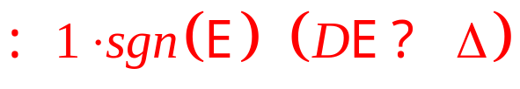
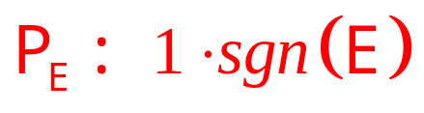
Energy shifts due to EDM/SM & E-field
EDM/SM coupling
Electric polarization
Energy shift due to EDM/SM:
Atoms
Molecules
⇒max
shift
max

Slide 12
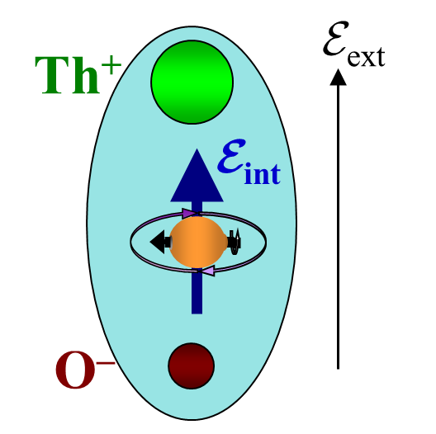
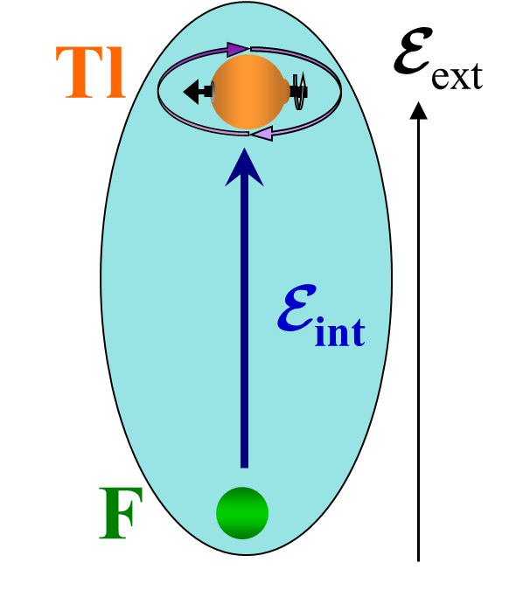
“Effective E-field” on EDMs in a polar molecule
In ~fully polarized molecules,
eEDM or nuclear Schiff moment ⇒ energy shift
⇒ equivalent to effective intramolecular E-field
E_{eff} ≅ 80 GV/cm for e⁻ EDM in ThO* [relativistic enhancement]
E_{eff} ~ 30 kV/cm for p⁺ EDM in TlF [reduced suppression
due to screening]
Notes:
Add Titov & co ref. Add Fleig & co reference? Add something about reliability of calculations

Slide 13
“Fancier” molecules: extra degrees of freedom provide useful tools
Parity-doublet structure
--easily polarized in very small applied E-field
--provides “comagnetometer” state to suppress systematics
--requires “extra” substructure (electron orbital motion, polyatomics)
Second electron to cancel EDM-sensitive electron’s magnetic moment
Nuclear spin w/electron spin:
total J ≥ 1→tensor structure→ suppress motional B-field effects
Second nuclear spin: co-magnetometer and/or magnetic moment cancellation
Notes:
Redo level diagram

Slide 14

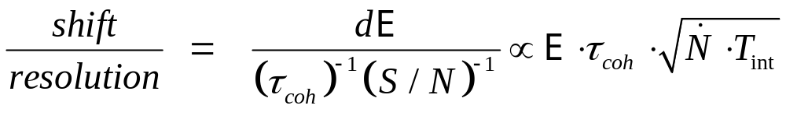
General method to detect an EDM
-2dE

+2dE
B
E
E
Energy level picture:
S
-2dE

+2dE
ω
Figure of
merit:
Notes:
Make it more of a phase measurement

Slide 15
Molecules: Colder = better
collapse of internal state distribution: bigger signals, quantum control
Collapse of velocity distribution:
no Doppler,
long observation
⇒ narrower spectroscopic lines,
better energy resolution
Signal
Signal
Frequency
Frequency
trapping:
longest observation
Best energy resolution
(in principle…)

Slide 16

ACME: cryogenic ThO* for eEDM
[A.C. Vutha et al. J. Phys B 2010]
I ¹Π₁
~Largest effective field E_{eff}: ~80 GV/cm
Sufficient coherence time (>1.9 ms)
lifetime of metastable state H ³Δ₁
Suppressed magnetic moment
<0.01 μ_{B} in H ³Δ₁ reduces B-field systematics
[Idea: Meyer, Bohn, Cornell et al. (JILA);
Measured: A.C. Vutha et al., PRA 2011]
Omega-doublet structure
--easily polarized in small applied E-field
--comagnetometer to suppress systematics
Etc., etc.
ThO
511 nm
fluorescence
703 nm
Probe
C ¹Π₁
1090 nm
Stokes
H ³Δ₁
690 nm
Pump
X ¹Σ⁺
ground state
Notes:
Redo level diagram

Slide 17
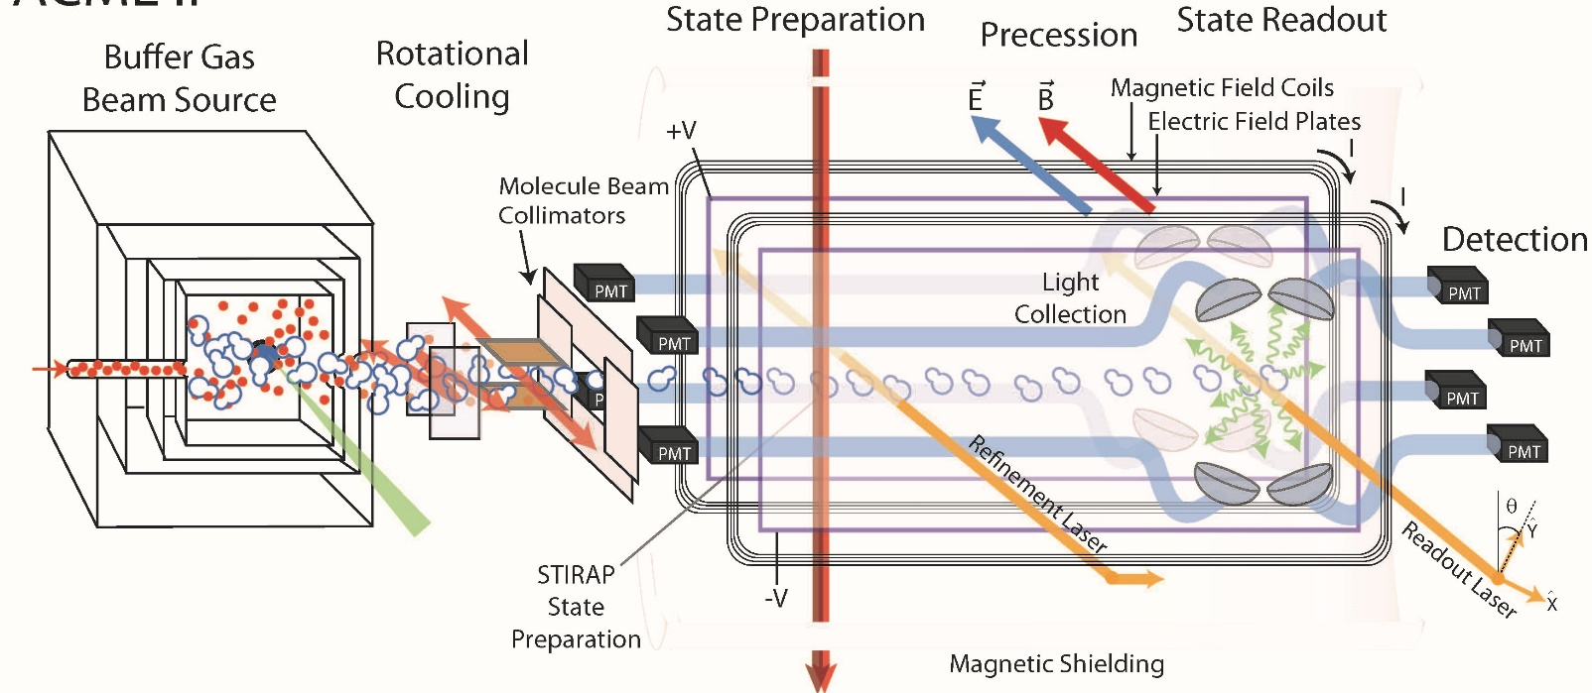
ACME II schematic
Free Spin
Spin
T_{rot} ~ 4 K
L = 20 cm
τ ≈ 1 ms
J = 1,2,3 → 0
2.5x population
STIRAP
~80% efficient
5% overall
detection
efficiency

Slide 18
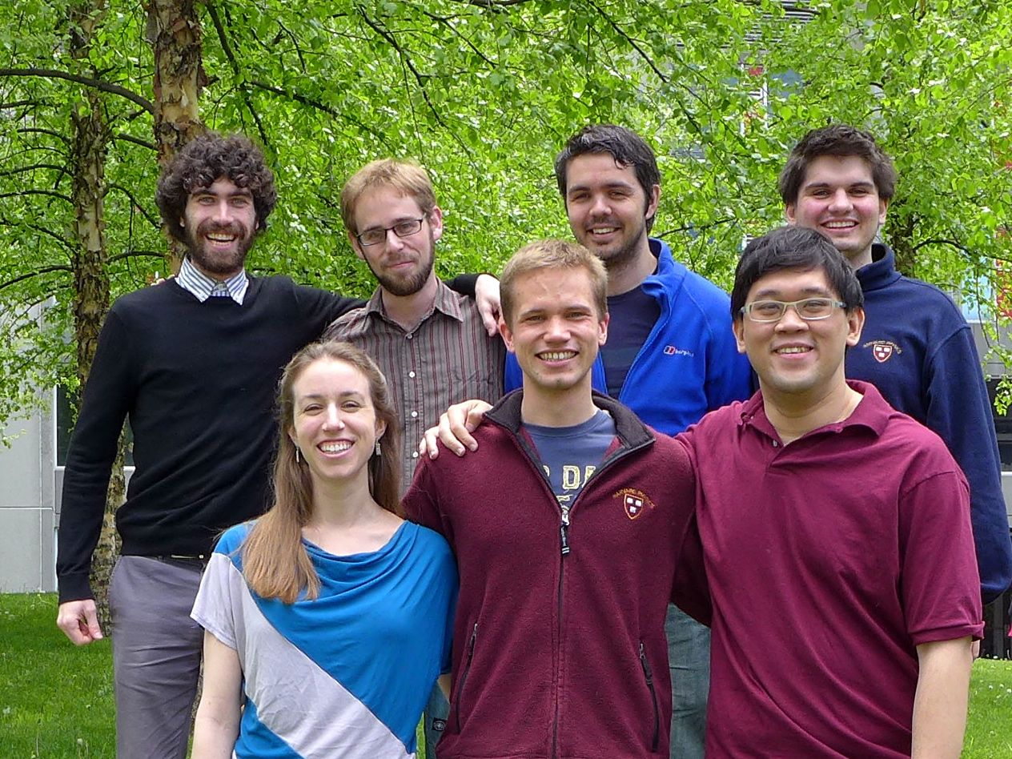
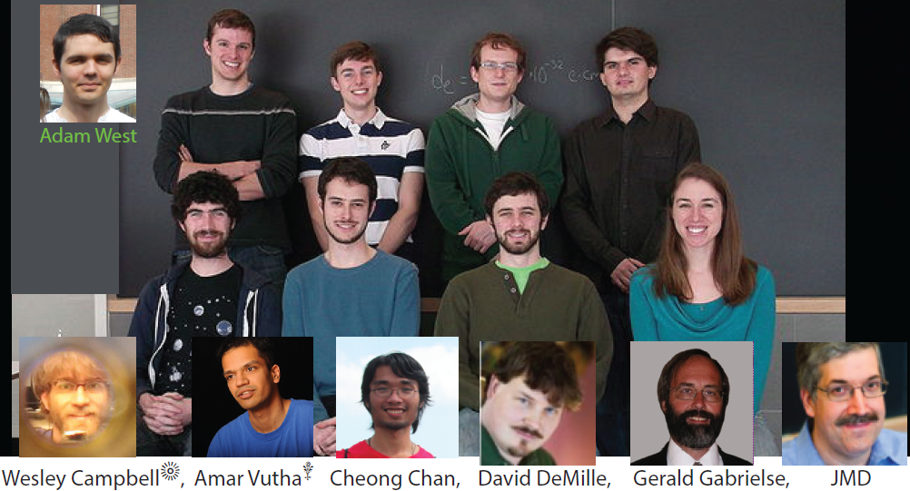

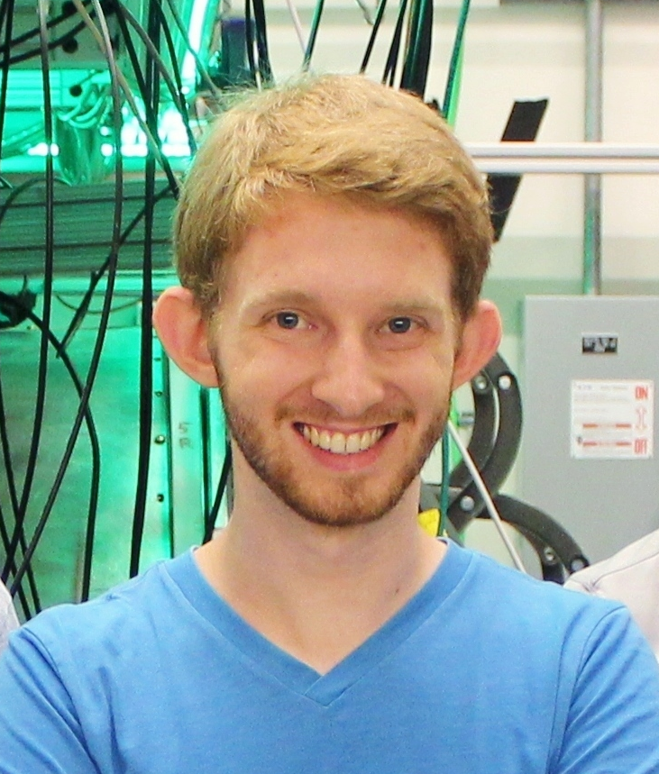

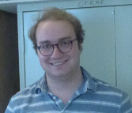
ACME II team 2014-2018
Brendon
O’Leary
Zack
Lasner
Dr. Adam West
Cris Panda
Prof. Nick
Hutzler
(Caltech)
Gerald Gabrielse
Vitaly Andreev
Daniel Ang
John Doyle
Elizabeth Petrik
Jonathan
Haffner
Dr. Xing
Wu
Cole
Meisenhelder
DD

Slide 19
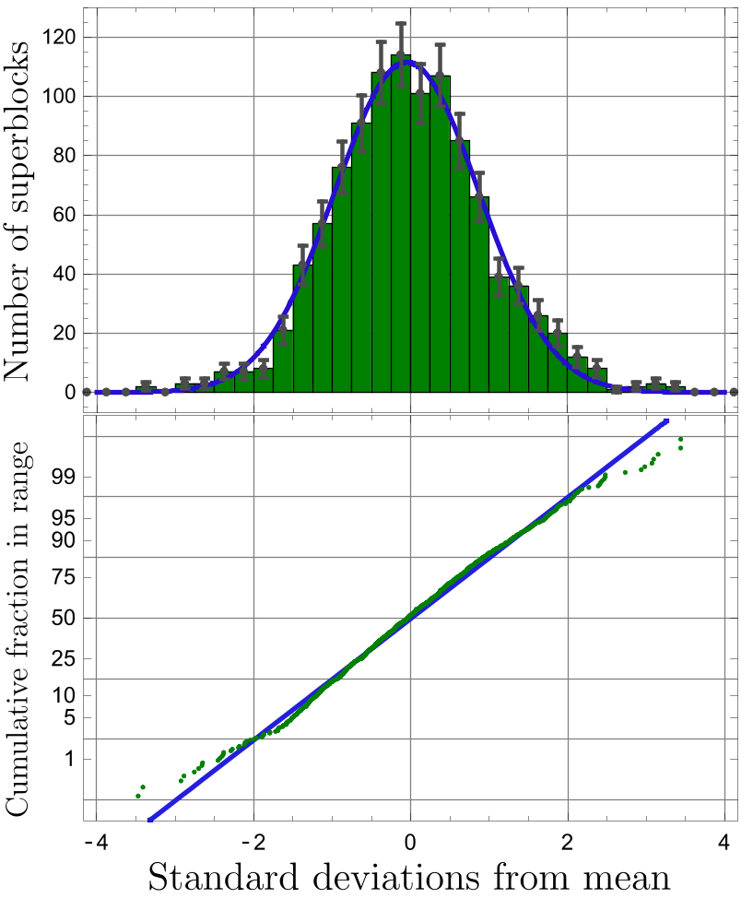
ACME II results
Systematics:
extensive studies with many “knobs” to understand & minimize
Statistics: χ²/d.o.f. ≈ 3
from technical noise source
since understood & eliminated
⇒ reduced sensitivity by √3
relative to shot noise limit
ACME II FINAL RESULT:
d_{e} = (4.3 ± 3.0_{stat} ± 2.6_{syst})×10⁻³⁰ e⋅cm
|d_{e}| < 1.1 × 10⁻²⁹ e⋅cm
reduced 9× vs. ACME I
[V. Andreev et al., Nature 562, 355 (2018)]

Slide 20
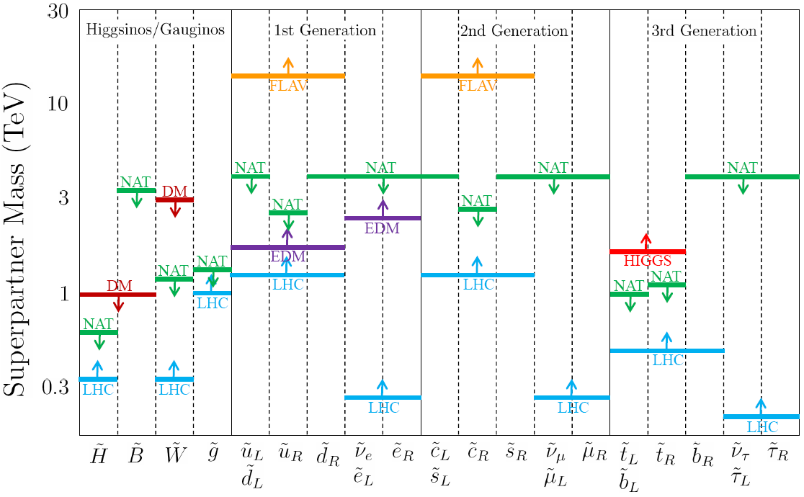
EDMs in particle physics: supersymmetry
J. Feng: “Naturalness and the status of SUSY”, Annu. Rev. Nucl. Part. Sci. (2013)
“All of the constraints shown are merely indicative and subject to significant loopholes and caveats”
Disfavored by
ACME & ¹⁹⁹Hg
t
h
Complimentary info from electron & nuclear “EDMs”
New physics coupling to leptons vs. hadrons

Slide 21
Now starting: ACME Gen III
~5x longer interaction time T
~20x more useful molecules: electrostatic lens
~2.2x detection efficiency with silicon PMTs (SiPMs)
1.7x S/N after timing jitter in ACME II eliminated
Bottom line: ~20× improved sensitivity anticipated, ca. 2023

Slide 22
CeNTREX:
Cold molecule Nuclear Time-Reversal Experiment
(with T. Zelevinsky [Columbia], D. Kawall [UMass], S. Lamoreaux [Yale])
New molecule-based search for nuclear Schiff moment (analogue to EDM)
Electrical polarization P_{E} ~ 0.5 @ E ~ 30 kV/cm
⇒ nuclear spin precession rate ~10⁴× larger vs ¹⁹⁹Hg
²⁰⁵TlF as used in old SM experiments
(before ¹⁹⁹Hg: Ramsey, Sandars, Hinds)
⇒ sensitivity well-known,
spectroscopy & experimental protocols developed
¹⁹F nuclear spin (low Z, small EDM effect)
⇒ internal comagnetometer to suppress systematics
PLAN: use molecular “enhancement” + cycling detection & cooling to obtain
improved sensitivity to hadronic CP-violating interactions at >>TeV scale
Notes:
199Hg slide? Shielding vs. amplification of E-field→ harder
Explain Schiff moment vs. EDM

Slide 23
CeNTREX schematic
Incorporates many methods from ACME + laser cooling experiments
(slow molecular beam, rotational cooling, cycling fluorescence for detection, etc.)
1st generation design/construction underway
Conceptual details in O. Grasdijk et al., arXiv:2010.01451.
Future generations of CeNTREX may incorporate
--transverse laser cooling for increased flux
--laser slowing and/or trapping for increased interaction time
Notes:
Similarity to ACME Gen III
CeNTREX Gen II: add transverse cooling for brighter beam
CeNTREX Gen III: optical lattice trap, maybe spin squeezing?

Slide 24







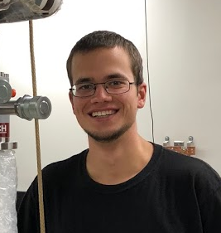


CeNTREX primary team
Principal Investigators
Postdoc
David DeMille
(Chicago)
David Kawall
(UMass, Amherst)
Tanya Zelevinsky
(Columbia)
Steve
Lamoreaux
(Yale)
J. Olivier Grasdijk
(Yale)
Ph.D. students
Konrad Wenz
(Columbia)
Oskari
Timgren
(Yale)
Jakob
Kastelic
(Yale)
Tristan
Winnick
(UMass)
Mick
Aitken
(Columbia)

Slide 25
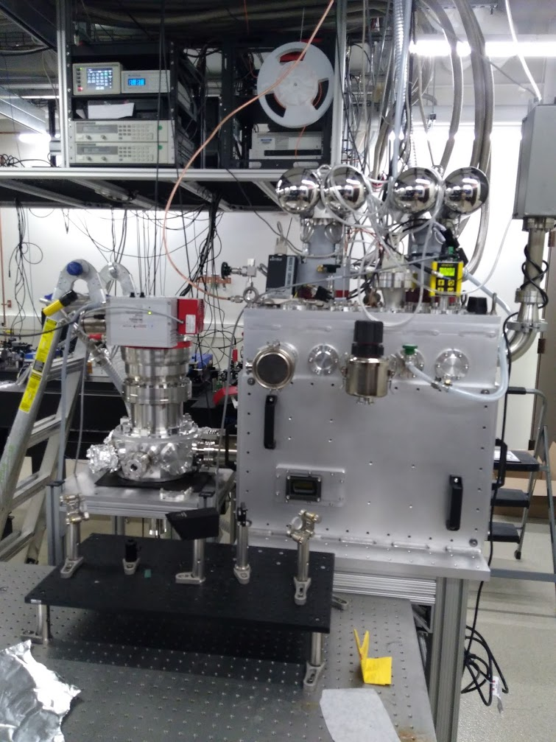
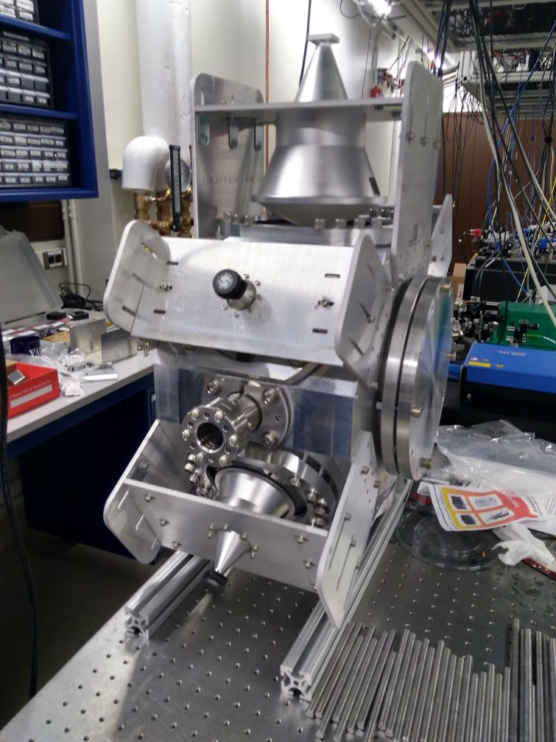
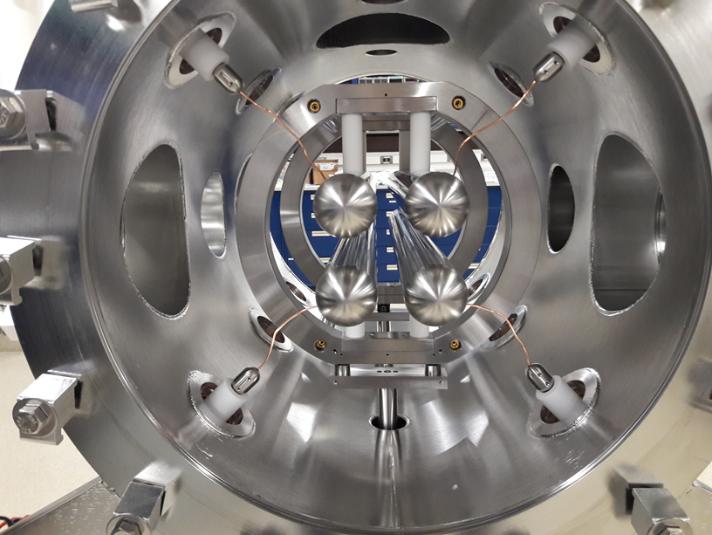
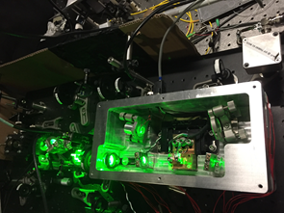
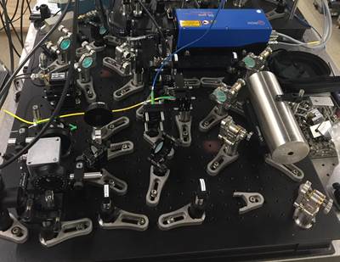
CeNTREX under construction
Cryogenic beam source
Rotational cooling
Electrostatic quadrupole lens
3x tunable UV laser systems
Stable frequency reference
Notes:
Similarity to ACME Gen III
CeNTREX Gen II: add transverse cooling for brighter beam
CeNTREX Gen III: optical lattice trap, maybe spin squeezing?

Slide 26
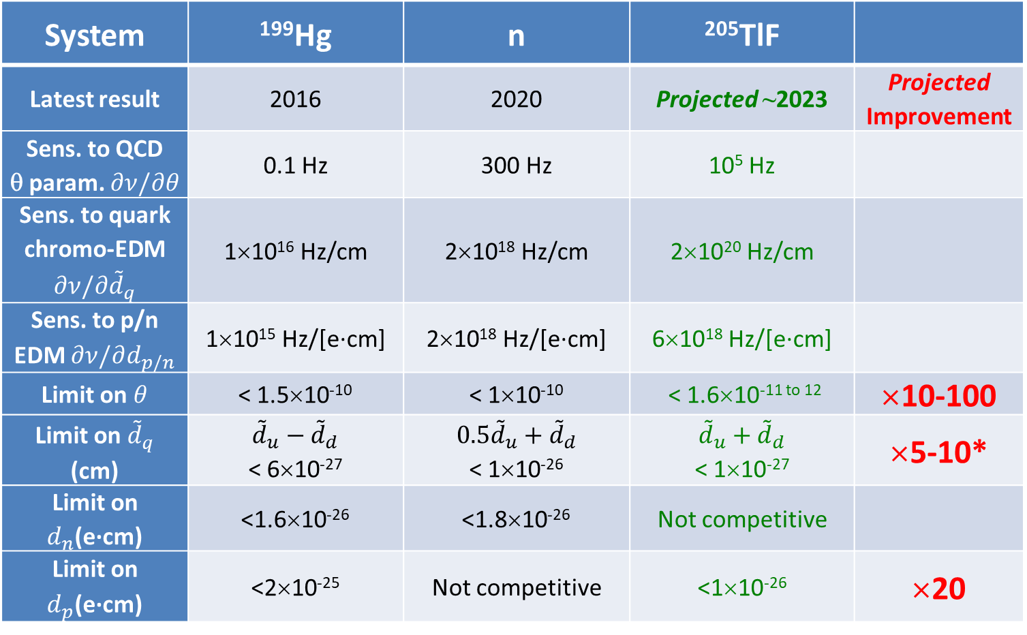
CeNTREX 1st generation projected sensitivity vs. state of art hadronic EDMs
System | ¹⁹⁹Hg | n | ²⁰⁵TlF
Latest result | 2016 | 2020 | Projected ~2023 | Projected Improvement
Sens. to QCD θ param. $∂ν/∂θ$ | 0.1 Hz | 300 Hz | 10⁵ Hz
Sens. to quark chromo-EDM $∂ν/∂{\tilde{d}}_{q}$ | 1×10¹⁶ Hz/cm | 2×10¹⁸ Hz/cm | 2×10²⁰ Hz/cm
Sens. to p/n EDM $∂ν/∂d_{p/n}$ | 1×10¹⁵ Hz/[e·cm] | 2×10¹⁸ Hz/[e·cm] | 6×10¹⁸ Hz/[e·cm]
Limit on $θ$ | < 1.5×10⁻¹⁰ | < 1×10⁻¹⁰ | < 1.6×10^{-11 to 12} | ×10-100
Limit on ${\tilde{d}}_{q}$ (cm) | ${\tilde{d}}_{u}−{\tilde{d}}_{d}$ < 6×10⁻²⁷ | $0.5{\tilde{d}}_{u}+{\tilde{d}}_{d}$ < 1×10⁻²⁶ | ${\tilde{d}}_{u}+{\tilde{d}}_{d}$ < 1×10⁻²⁷ | ×5-10*
Limit on $d_{n}$(e·cm) | <1.6×10⁻²⁶ | <1.8×10⁻²⁶ | Not competitive
Limit on $d_{p}$(e·cm) | <2×10⁻²⁵ | Not competitive | <1×10⁻²⁶ | ×20
*sensitive to different linear combination of parameters vs comparisons
Notes:
Note: intrinsic sensitivity has large uncertainties

Slide 27
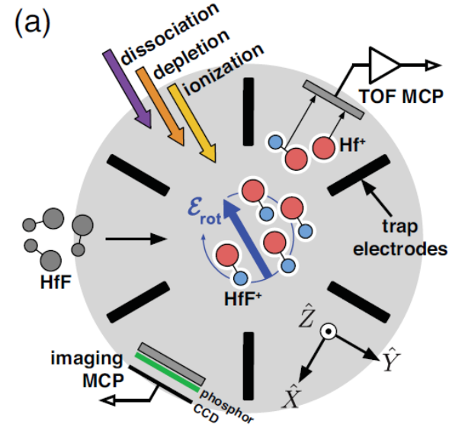
Electron & nuclear spin systems: state of the art
ACME (2014): ThO cryogenic beam
Seattle ¹⁹⁹Hg (2016):
vapor cells
+
d
JILA (2017):
trapped HfF⁺ ions
--all have upgrades ongoing
--all underway for >decade
Striking:
--no use of laser cooling!
--JILA 2017: first use of trapping
--last 4 eEDM limits: molecules

Slide 28
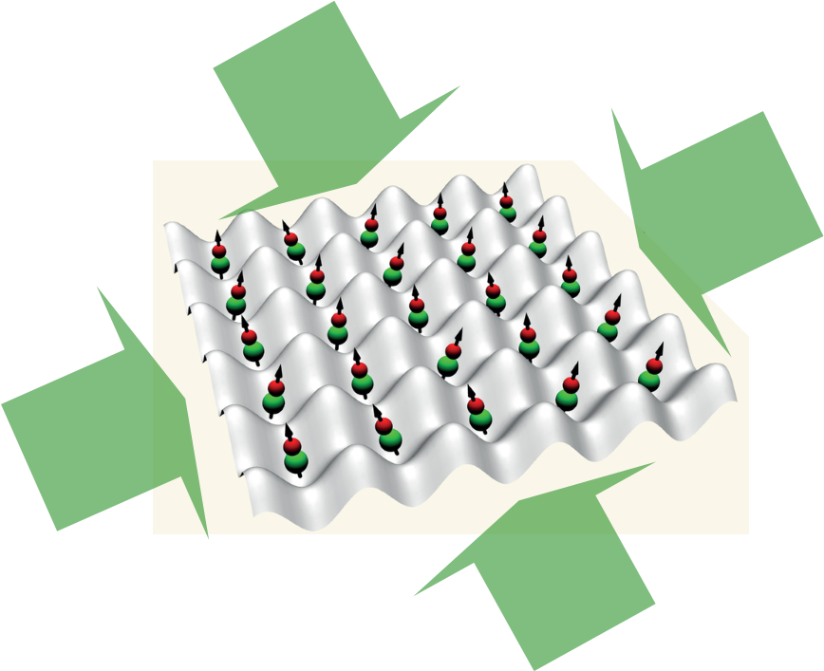
Ultimate version of electron EDM experiments…?
Rapid advances in ultracold molecule production & trapping
⇒ analogue of lattice-trapped optical atomic clocks now in view
Example for eEDM:
with E_{eff} ~ 75 GV/cm
+optimistic expt’l conditions:
--coherence time τ = 10 s
--100% detection
--10⁶ molecules
~1000x ACME II sensitivity
+ Long-term potential for even further improvement:
High density may enable spin-squeezed states for N vs. √N scaling

Slide 29
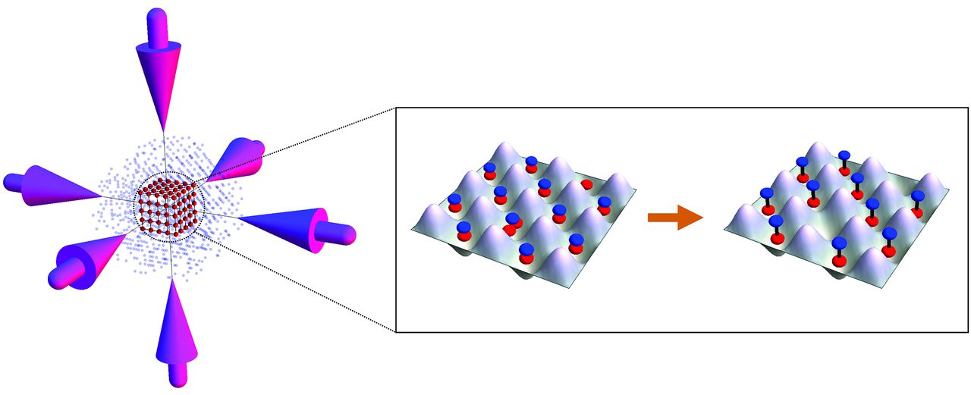
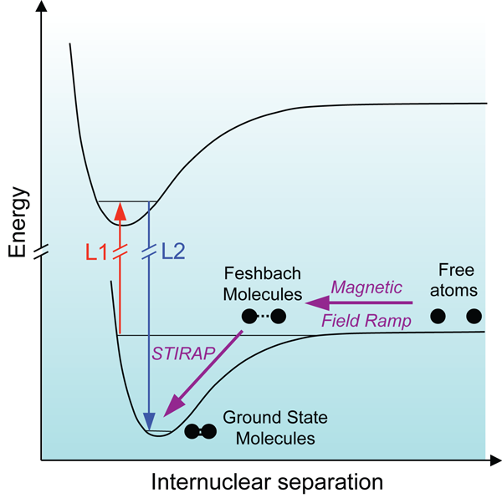
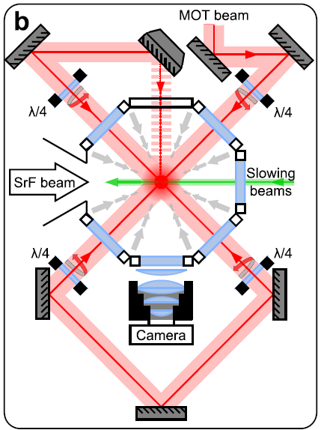
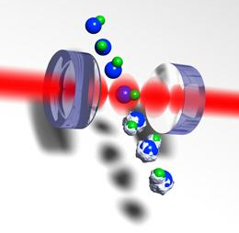
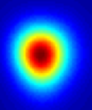
Ultracold, trapped polar molecules
“Assembly” from ultracold atoms:
T ~ 50 nK, high density
[JILA, MIT, Innsbruck, Durham, Hong Kong, Harvard, …]
Direct laser cooling
& trapping:
T ~ 5000 nK,
low bulk
phase-space density
(<10⁻⁷)
[Yale, Imperial College, Harvard, JILA, …]

Slide 30
Molecular species for “ultimate” EDM experiments
Requirements:
Large effective field ⇒ large Z
Easily polarized ⇒ large dipole and/or small parity splittings
Correct electron configuration:
⇒ unpaired spins, at least 1 in σ orbital e.g. ²Σ [eEDM]
⇒ σ orbitals, closed shells preferred e.g. ¹Σ [SM]
Can be made ultracold
Proposed species via direct laser cooling & trapping
--Laser cooled beam/fountain of YbF ²Σ for eEDM [Imperial College] E_{eff} ~24 GV/cm
--Stark-decelerated/laser cooled BaF ²Σ beam for eEDM [Groningen] E_{eff} ~8 GV/cm
--Laser-cooled bent polyatomics: YbOH, YbCCCa for eEDM, YbCCAl for SM
[Caltech + Harvard + Toronto] E_{eff} ~24 GV/cm
--Laser cooled RaF ²Σ? [proposed by TU Darmstadt, PNPI St. Petersburg] E_{eff} ~60 GV/cm

Slide 31
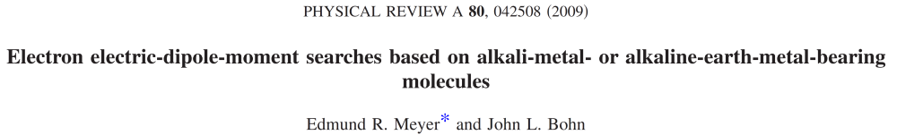
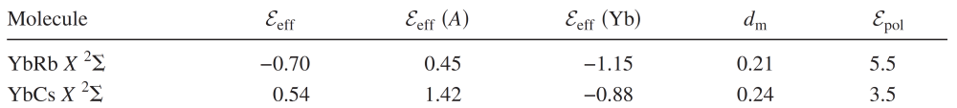
Molecular species for “ultimate” EDM experiments
Requirements:
Large Z, easily polarized, correct electron config., ultracold
Why not use “assembled molecules” e.g. alkali + alkaline earth ²Σ?
An old tale of woe…
(kV/cm)
(GV/cm)
Yb-alkali species ⇒ tiny E_{eff} , ~100x smaller than in ThO* ☹

Slide 32
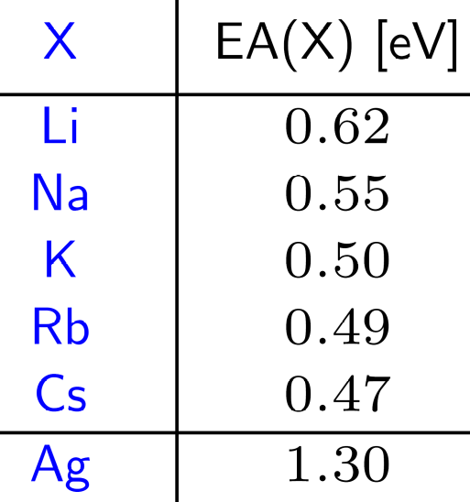
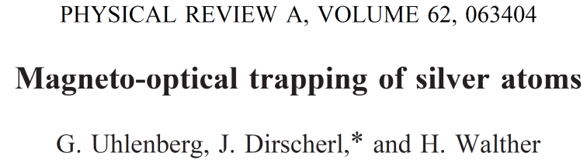

Molecular species for “ultimate” EDM experiments
Why not “assembled molecules”?
Observation 1: YbF, ThO, etc. strongly ionic;
heavy, easily ionized atom bonded to electronegative atom
Observation 2:
no laser-cooled atoms have large electron affinity…
except one!
Atomic silver:
alkali-like structure, UV lasers

Slide 33

Assembled molecules for “ultimate” eEDM?
with
Timo Fleig,
Toulouse
Test case: AgRa
Ra (alkaline earth) = heaviest laser-cooled atom (Z=90) [Argonne]
--Long-lived isotope ²²⁶Ra available in macroscopic quantities
--Shorter-lived isotope ²²⁵Ra has ~100x enhanced nuclear SM
Expect AgRa ²Σ ground state w/valence electron on Ra⁺ (Z=90)
Large E_{eff}, ~60 GV/cm in RaF
Expect strong ionic bond & small rot. const. [^{109/107}Ag heavy]
Small E-field for polarization
All expectations for AgRa verified: E_{eff} = 65 GV/cm
μ = 5.4D; B = 630 MHz ⇒ E_{pol} = 260 V/cm

Slide 34

Feasible pathway to ultracold AgRa?
Preformed pairs in lattice
KRb [JILA];
Cs₂ & RbCs [Innsbruck]
Sr₂ [Amsterdam]
STIRAP to weakly-bound state
Expt: Sr₂ [Amsterdam] ~80%
Theory proposal: RbSr
[Saclay, PRA 98, 053411 2018]
STIRAP to ground state
JILA, Innsbruck, ….
w

Slide 35
Toward EDMs w/“assembled” ultracold molecules
Plausibility argument for “assembled” eEDM molecule AgRa
Many details e.g. collisional properties, molecular spectroscopy, systematics in optical trap, etc. must be worked out experimentally
Analogous species e.g. AgHg, AgYb
give more chances for success
w/(likely) modest reduction in sensitivity
E_{eff} = 65 GV/cm, E_{pol} = 260 V/cm
Similar ideas:
A. Sunaga et al., PRA 99, 040501(R) (2019)
Ag = “magic” electronegative partner for “assembled” molecules?
“assembled” molecules ⇒ efficient use of atoms ⇒
radioactive molecular species very plausible
Plausible application to nuclear Schiff Moment also!
e.g., ²²³FrAg w/enhanced Schiff Mom. from octupole deformation

Slide 36

“Ultimate” Schiff moment experiments?
Conservative Example:
w/ P_{E} ~ 1, Z ~ 88
+ typical molecular structure
+ 100x SM enhancement
+ τ_{coh} = 1 s
+ 100% detection
+ N ~ 10⁴ molecules
Already demonstrated
with analogous species!
⇒ ~100x improvement
vs. ¹⁹⁹Hg current bound
+Long-term potential for dramatic further improvements:
Longer τ_{coh}, larger N, spin squeezing for N vs. √N scaling
BUT: needs good species for cooling AND SM sensitivity

Slide 37
EDMs poised for continued rapid improvements
Next-generation EDMs already started
FAR exceed energy reach of LHC*
…AND plausible ways to keep advancing
if needed
*caviat:
T violation
required !!

