Slide 1


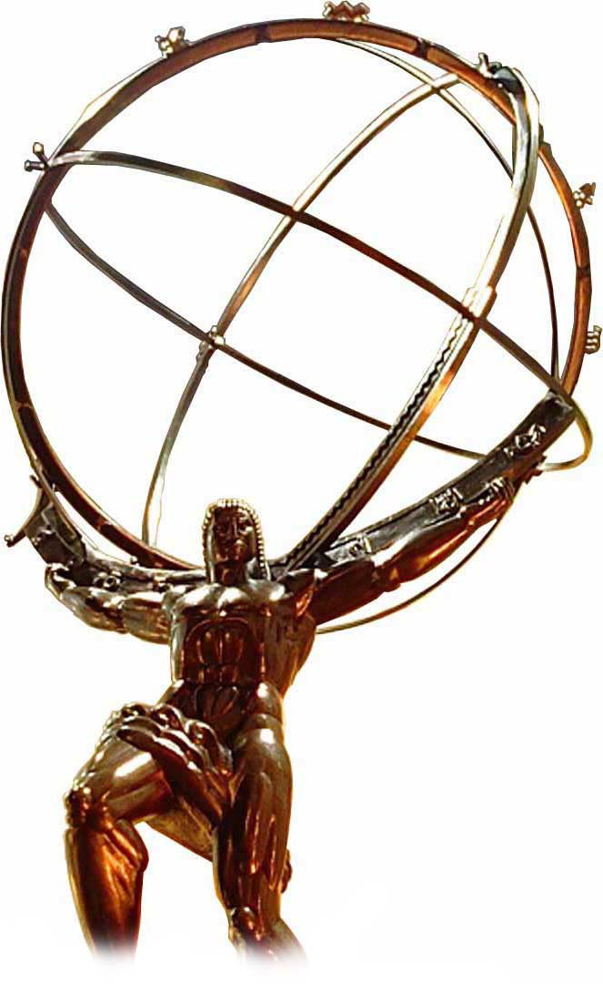


Fast silicon detector technologies for 4D tracking
in future HEP experiments
Dr. Simone M. Mazza (SCIPP, UC Santa Cruz)
DND 2020 - TRIUMF

Slide 2
4D tracking - concept
Efficient tracking in dense environment
Pile-up suppression
Long Lived Particle detection
Appearing/Disappearing tracklets identification
ToF-based particle identification is possible
Jet flavor tagging enhancement
?
Hits
?
Timing
t₁
Collection of hits for multiple tracks in dense environment
Hard to reconstruct tracks
But if particles have different initial position or delayed in time
  We can exploit the time of the hits
Easier to reconstruct single tracks
~ps → ~mm at c, 1→100ps is the needed time resolution for usual collider beam spot size
t₂
t₃
t₄
t₅

Slide 3
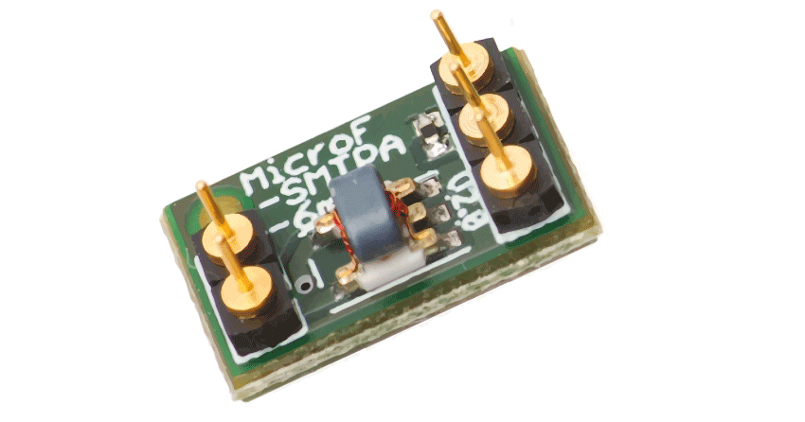
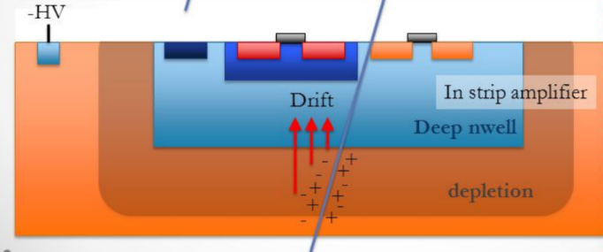
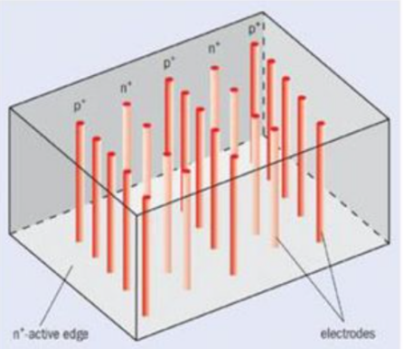
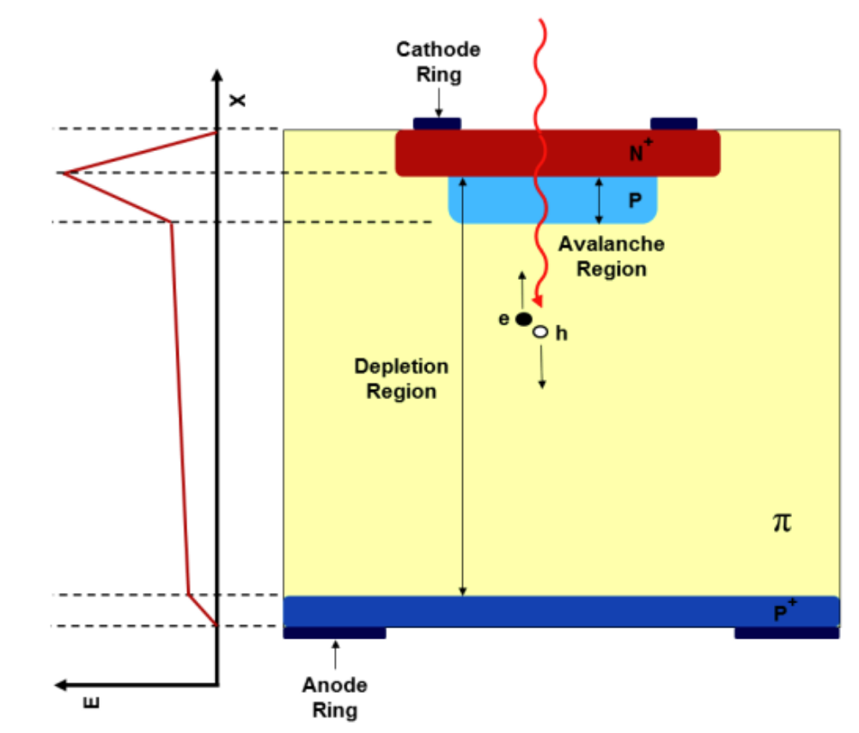
Time precision sensors
Which technology has sufficient time resolution?
SiPM (Silicon photomultiplier)
  But very little radiation hardness and low granularity
HV CMOS detector
  Embedded amplification in the design, down to ~50 ps of time resolution
3D sensors
  Perpendicular charge collection, no gain, ~20-30ps of time resolution
Low Gain Avalanche Detectors (LGADs)
  Intrinsic gain, thin bulk, ~ 20-30ps of time resolution

Slide 4
HV-CMOS

Slide 5
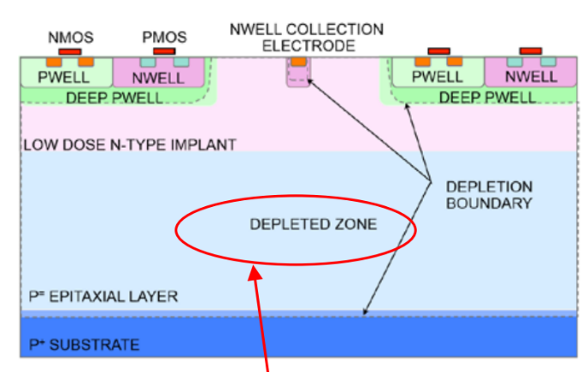
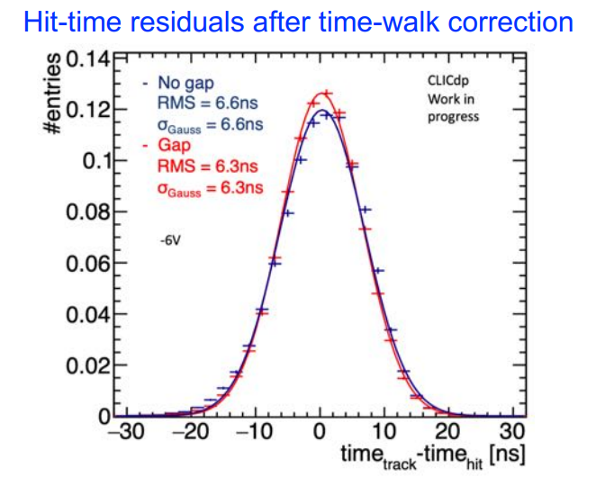
HV-CMOS timing performance
Internal amplification allows for fast signal shaping
  Monolithic chip: no need for bump bonding process
  Lot of RnD in the past year to get to a fully depleted sensor with 100% efficiency
  Promising in terms of timing! But keep an eye on power consumption
HV-MAPS (Monolithic Active Pixel Sensor) MuPix7
  https://arxiv.org/pdf/1803.01581.pdf
  https://arxiv.org/pdf/1603.08751.pdf
  Time resolution of MuPix7 ~10-14ns, ~40um spatial resolution
HR-CMOS CLICTD (for CLIC experiment)
  https://indico.cern.ch/event/813597/contributions/3730879/attachments/1989317/3315977/CLICTD-TREDI2020-Vienna-18Feb2020.pdf
  ~6ns time resolution, ~6um spatial resolution

Slide 6
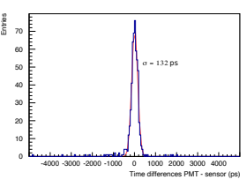
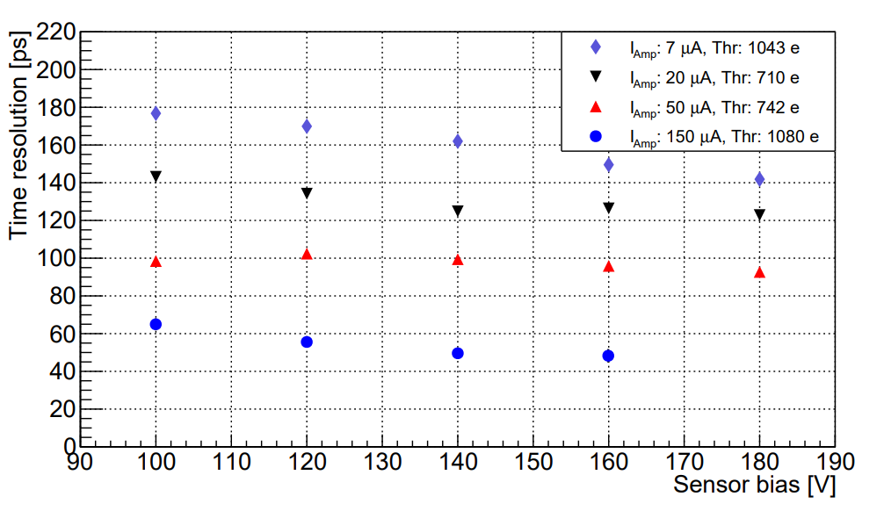
HV-CMOS timing performance
DMAPS CACTUS (future colliders)
  https://authors.library.caltech.edu/103788/1/2003.04102.pdf
  150nm process, 1mm pixel pitch
  Power 145mW/cm^2
  ~180-60ps of time resolution depending on thickness (100-200um)
SiGe BiCMOS SG13G2 (for ToF PET)
  https://iopscience.iop.org/article/10.1088/1748-0221/14/11/P11008/pdf
  https://arxiv.org/pdf/2005.14161.pdf
  ~25um thickness, 65um pixel size (very low pixel capacitance)
  Time resolution depends on power consumption 12→375uW per channel
  Down to ~50ps time resolution
Few examples of good HV-CMOS for timing
  In general time resolution of the order of 50ps-10ns
  Good in terms of spatial resolution and cost
Issue of power density at low pitch, eg: 400uW/ch would give ~300mW/cm^2 at ~400um pitch
  HGTD (1.3mm pitch, timing) power limit is 300mW/cm^2, ITk (50um pitch, standard tracking) is 800mW/cm^2

Slide 7
3D detectors

Slide 8
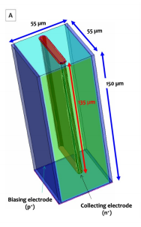
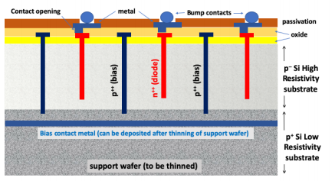
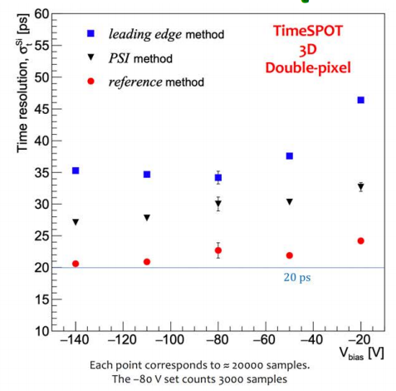
3D sensors timing performance
Charge collection is perpendicular to particle incidence
No internal gain or amplification (low collected charge)
Pixel pitch is proportional to charge collection time (crucial for time resolution)
Charge sharing if MiP is not ~perpendicular
Might be a good candidate technology for vertexing with timing
Small cell 3D sensor
  https://arxiv.org/pdf/1901.02538.pdf
  50um pitch size, ~50ps time resolution
  Issue: Electric field goes down as 1/r
TimeSPOT: Trench 3D sensors
  Large rectangular trenches as electrodes
  Optimized electrodes to have constant field and minimize charge collection time
  150um bulk but charge is collected in 50um
  Time resolution down to 20ps!
  https://indico.cern.ch/event/895924/contributions/3993250/attachments/2111174/3565760/Vertex2020ALai_20ps_re.pdf
  https://iopscience.iop.org/article/10.1088/1748-0221/15/09/P09029/pdf

Slide 9
LGADs

Slide 10
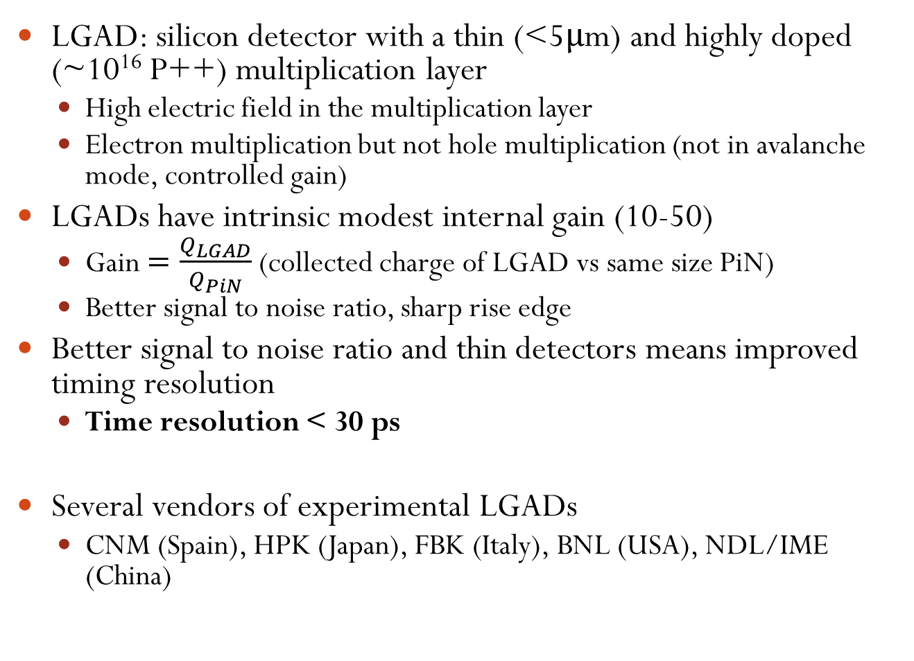
Low Gain Avalanche Detectors
LGAD: silicon detector with a thin (<5μm) and highly doped (~10¹⁶ P++) multiplication layer
  High electric field in the multiplication layer
  Electron multiplication but not hole multiplication (not in avalanche mode, controlled gain)
LGADs have intrinsic modest internal gain (10-50)
  Gain $=\frac{Q_{LGAD}}{Q_{PiN}}$ (collected charge of LGAD vs same size PiN)
  Better signal to noise ratio, sharp rise edge
Better signal to noise ratio and thin detectors means improved timing resolution
  Time resolution < 30 ps
Several vendors of experimental LGADs
  CNM (Spain), HPK (Japan), FBK (Italy), BNL (USA), NDL/IME (China)

Slide 11
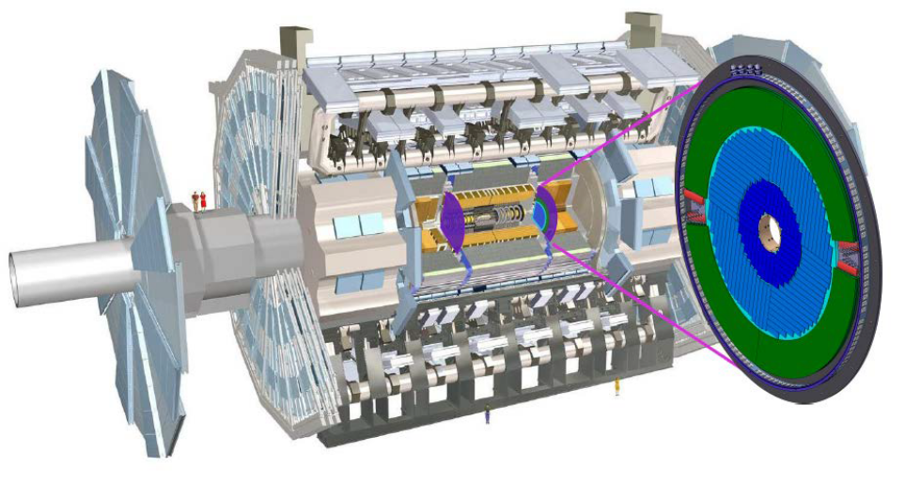
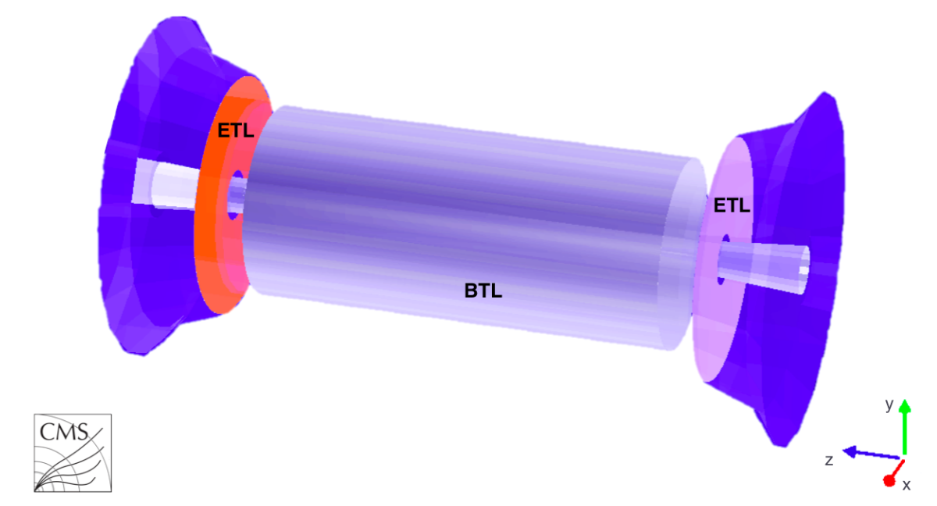
ATLAS and CMS timing layers
First application of LGADs in HEP experiments at HL-LHC (starting ~2026)
  Timing layers in the end-cap (forward) region to mitigate pile-up
ATLAS High Granularity Timing Detector (HGTD)
  https://cds.cern.ch/record/2719855
LGAD requirements:
  Radiation hardness to 2.5E15Neq, 4MGy.
  Time resolution <50ps per hit, collected charge ~10fC.
  Power (sensor-only) <100mW/cm^2
CMS Endcap Timing Layer (ETL)
  https://cds.cern.ch/record/2667167
  CMS will also feature a timing layer in the barrel but with different technology (LYSO bars + SiPM readout)

Slide 12
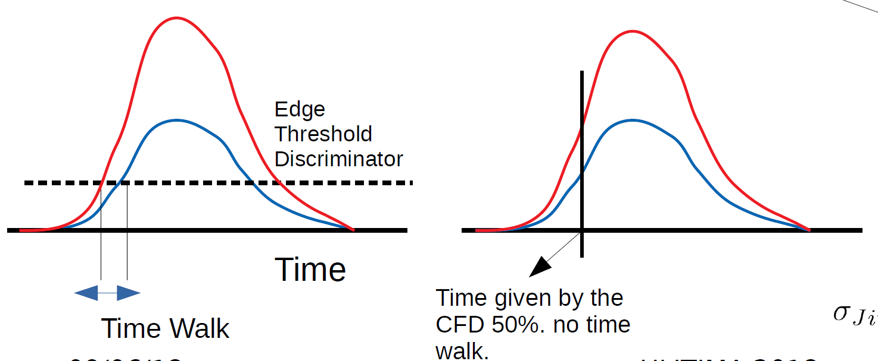
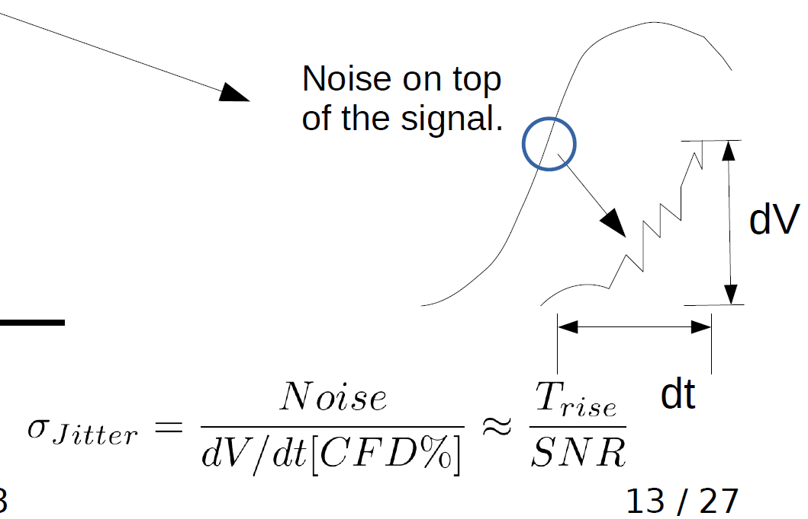
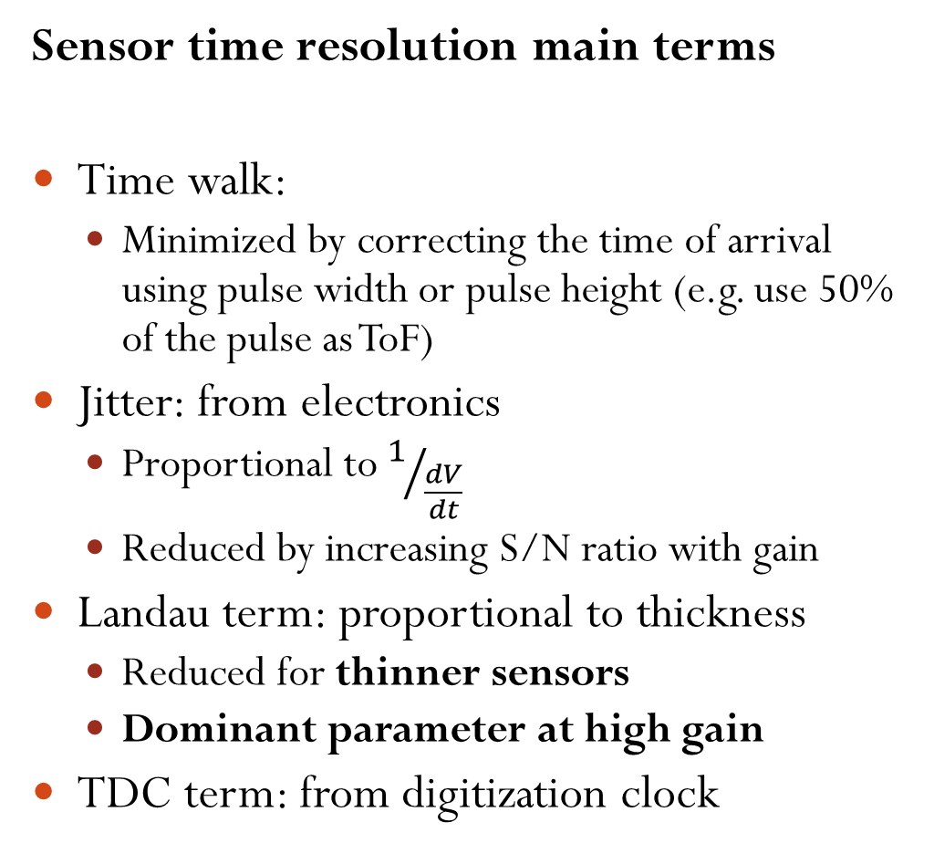
Time resolution
Sensor time resolution main terms
Time walk:
  Minimized by correcting the time of arrival using pulse width or pulse height (e.g. use 50% of the pulse as ToF)
Jitter: from electronics
  Proportional to $1/{\frac{dV}{dt}}$
  Reduced by increasing S/N ratio with gain
Landau term: proportional to thickness
  Reduced for thinner sensors
  Dominant parameter at high gain
TDC term: from digitization clock

Slide 13
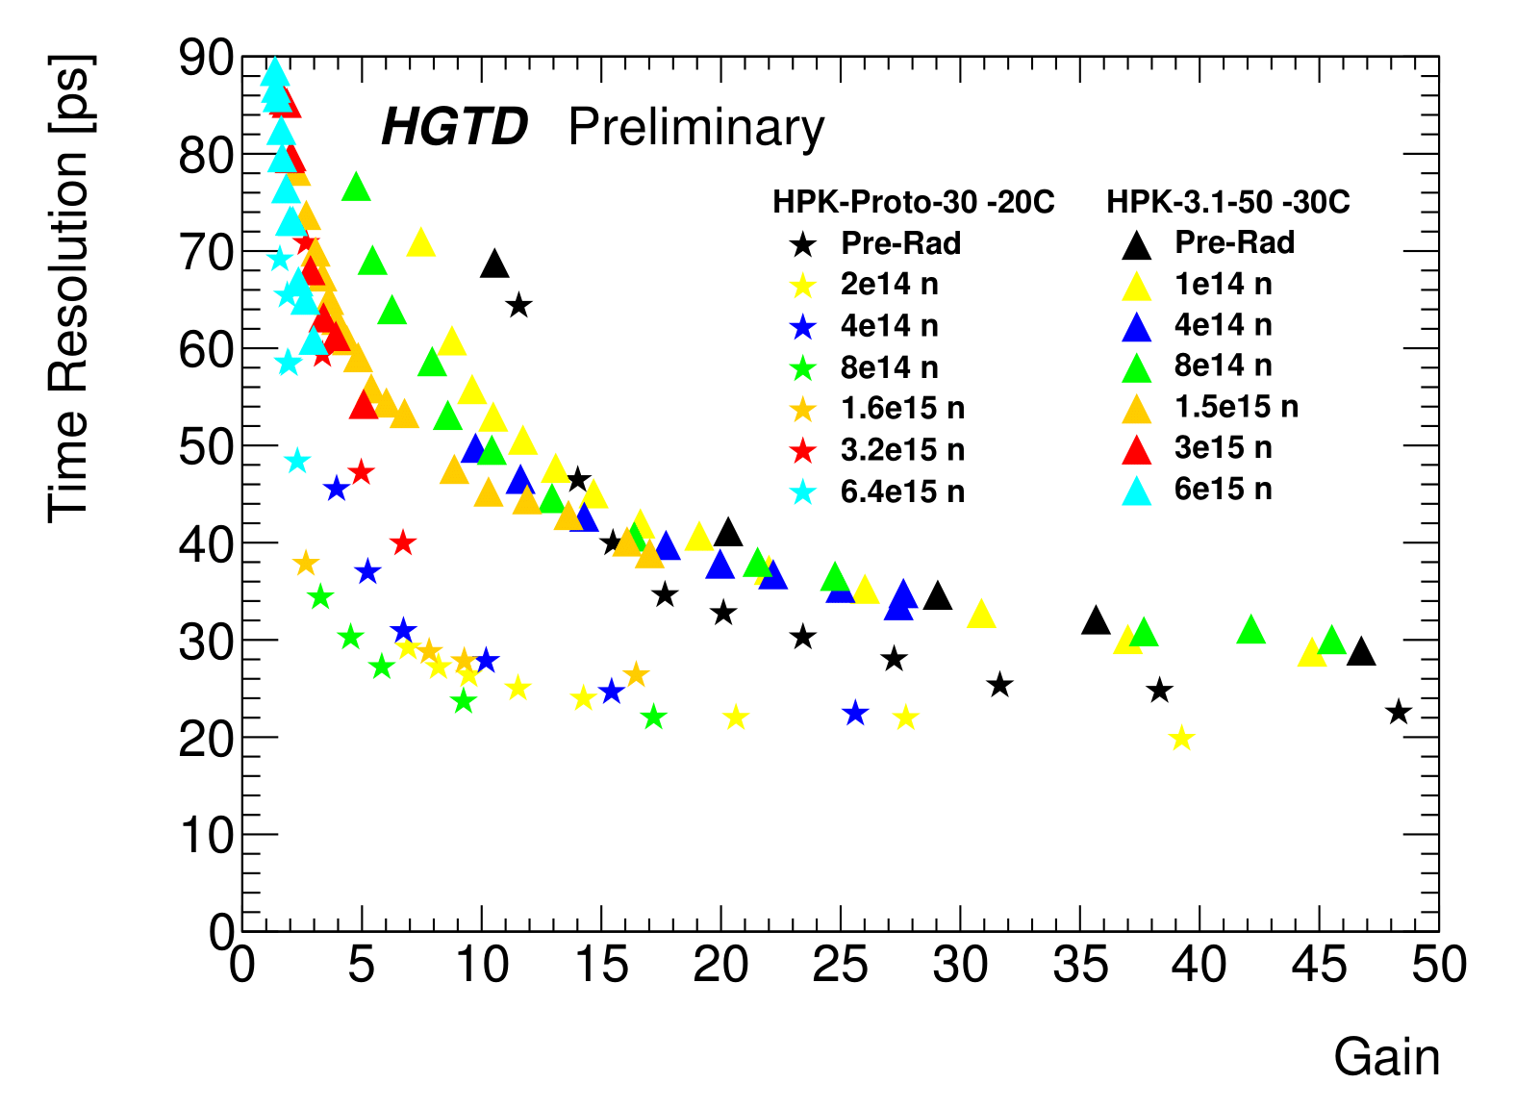
LGAD sensors 50 um vs 30 um
High gain → very low jitter contribution to the time resolution
Time resolution is ultimately driven by Landau component
  Depends on sensor thickness
30ps for 50um sensors
20ps for 30um sensors
15ps possible with 20um sensors
50um
30um

Slide 14
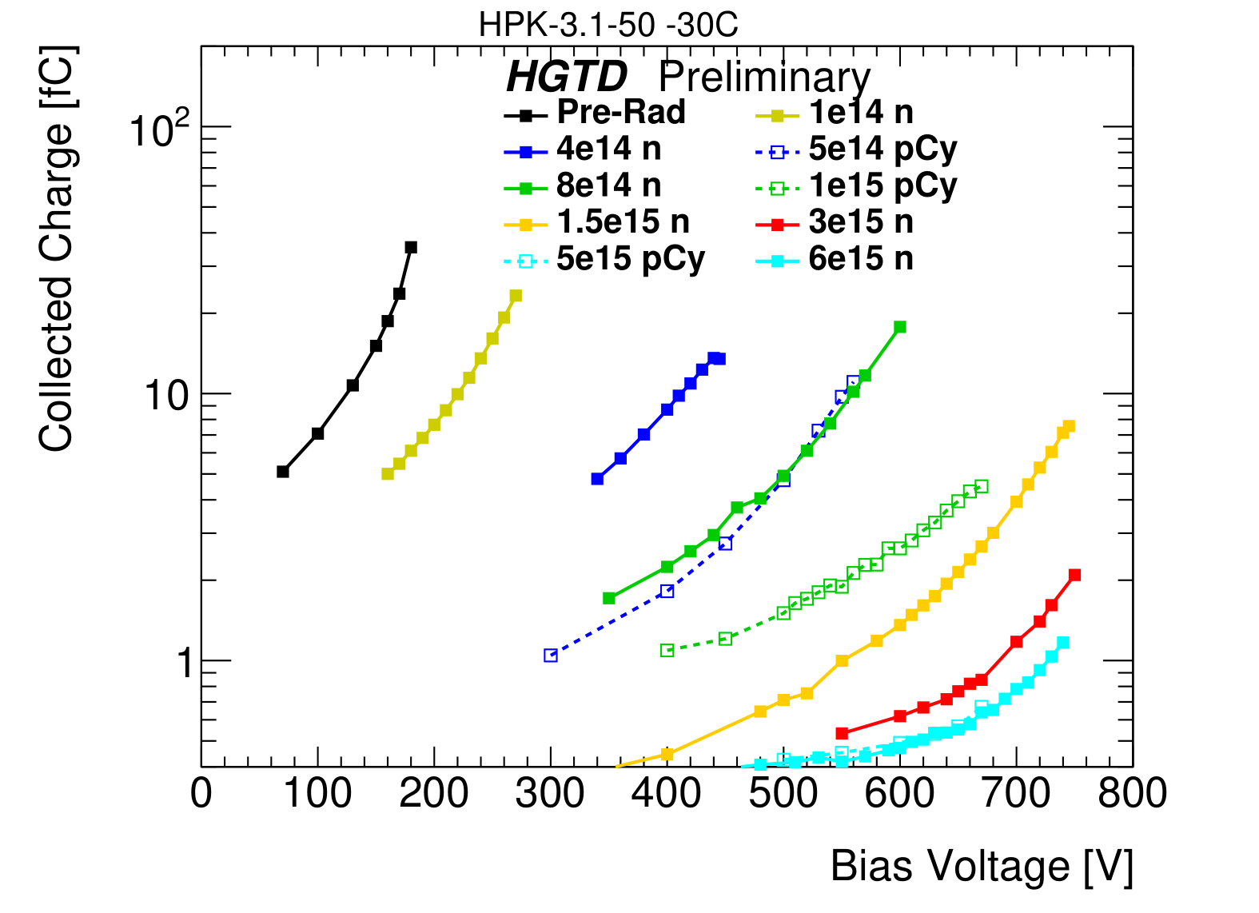
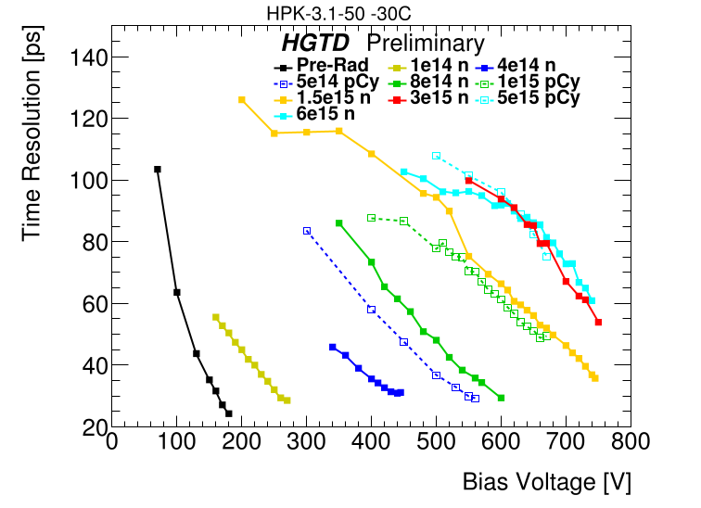
LGAD and radiation damage
https://twiki.cern.ch/twiki/bin/view/AtlasPublic/LArHGTDPublicPlots#2018_2019_Sensor_Performance_TDR
LGADs while operating in high energy physics experiments will sustain radiation damage
  Both in terms of fluence and ionization dose
Change in performance caused by reduced doping concentration in the gain layer by acceptor removal mechanism
  Some details: https://doi.org/10.1016/j.nima.2018.11.121
Performance effects of radiation damage (E.g. on 50um sensor)
Reduction of gain and collected charge
  Charge collected up to 30fC (Gain ~50) before irradiation to 1fC (gain 2-3) after a fluence of 6E15 Neq/cm²
  (equivalent 1 MeV neutrons on cm²)
Increased time resolution
  Time res. of 25ps to 60ps after a fluence of 6E15 Neq/cm²
Partly the performance can be recovered by increasing the bias Voltage applied to the diode (~200V → ~700V)

Slide 15
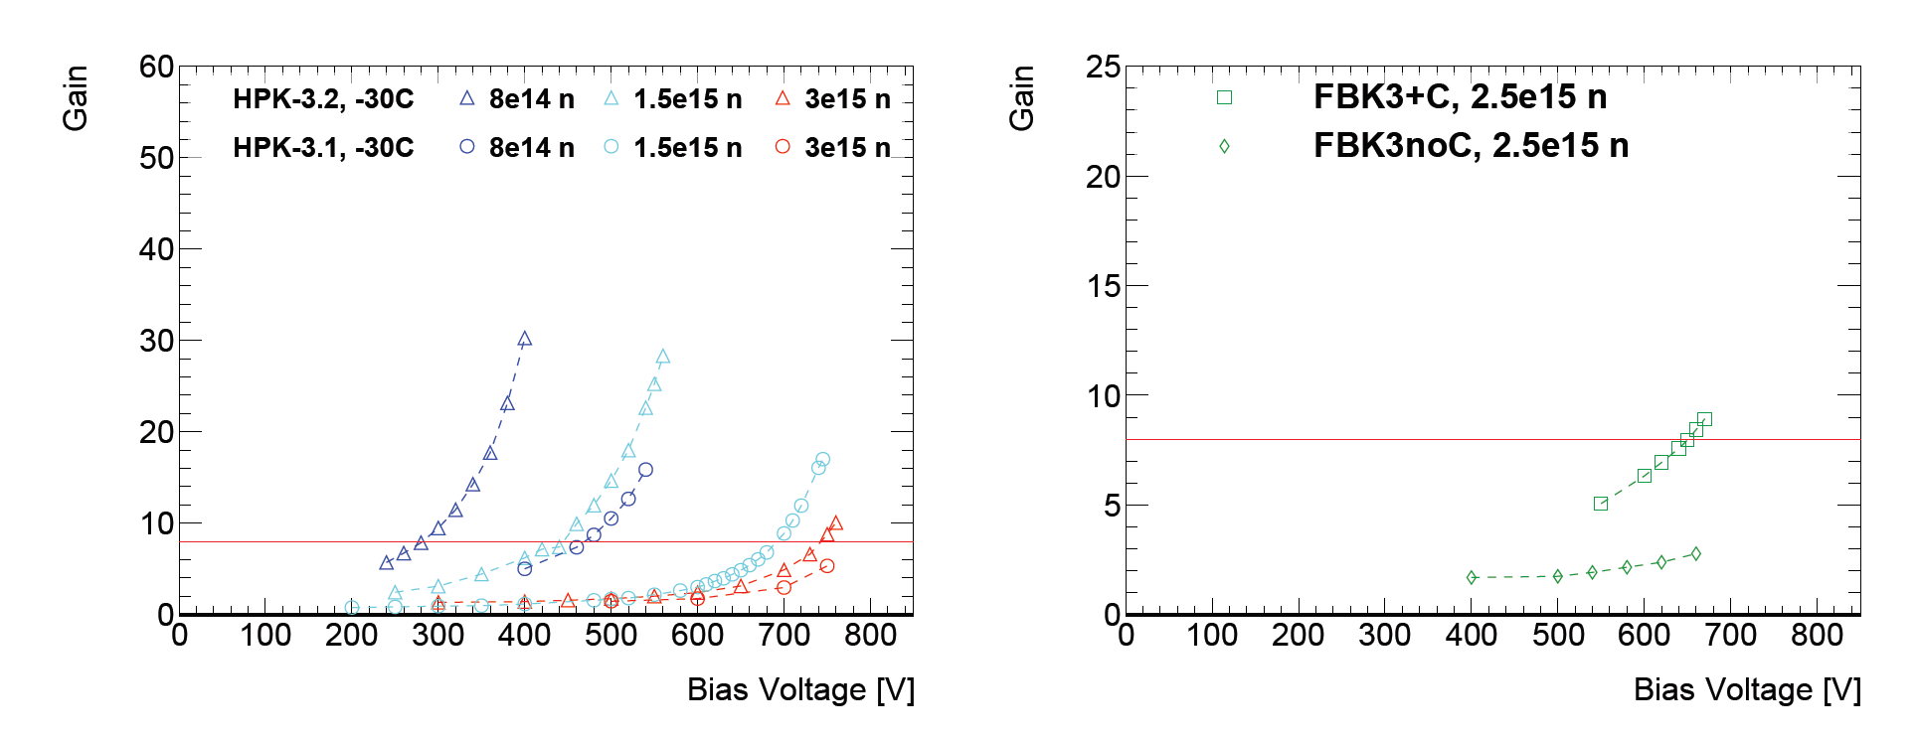
Radiation hard LGAD design
Two ways to increase the radiation hardness of LGADs
Addition of Carbon
  FBK (Fondazione Bruno Kessler) sensors
  Carbon is electrically inactive (no effect pre-irradiation), catches interstitials instead of Boron, reduces acceptor removal after irradiation
Deeper gain layer
  HPK (Hamamatsu Photonics) sensors
  High field for larger volume
  Allows for better recovery of the gain from increased bias voltage after radiation damage
Resources
https://iopscience.iop.org/article/10.1088/1748-0221/15/10/P10003
https://www.sciencedirect.com/science/article/pii/S0168900218317741
https://doi.org/10.1088/1748-0221/15/04/T04008
https://doi.org/10.1016/j.nima.2018.08.040
With Carbon
Without Carbon
Deeper gain layer (triangles)
Less deep gain layer (circles)
(same color, same fluence)

Slide 16
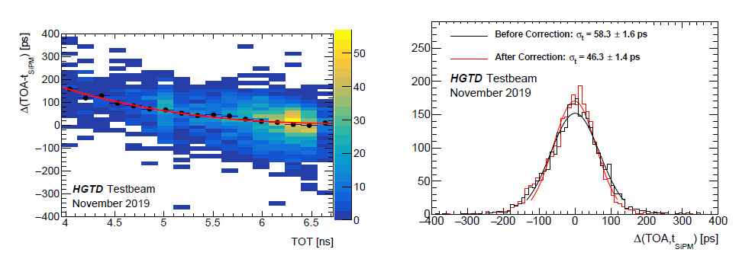
ROC (Read Out Chip) challenge
ATLAS readout chip (ALTIROC) ToT timing
correction to ToA for time resolution evaluation
Readout electronics to maintain the time resolution of the sensor
  Needs fast amplifier to follow the fast LGAD rise-time
Simple ToA (Time of Arrival) method for timing not sufficient
  Prone to time walk uncertainty
Time needs to be corrected in some way:
  Using ToT correction (Time over Threshold) which measures the length of the pulse, current method used by ATLAS and CMS electronics
  Using a variable threshold (eg: at 50% of the Pmax) → (CFD) Constant Fraction Discriminator
  Use zero-crossing of the derivative
  Etc…?
Current electronics in development require high power and a high collected charge to work properly
  Also LGAD sensors after irradiation tend to need high current and voltage
  Especially when the granularity is lower than ~1mm
  Power consumption is and will be an issue for timing layers

Slide 17
LGAD granularity

Slide 18
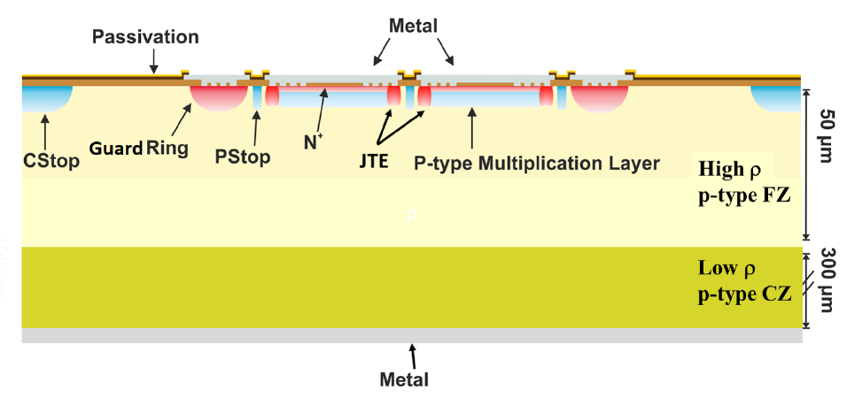
LGAD arrays structure
Very high field area, induces early breakdown
Structure to avoid high field line concentration at the edges
Junction Termination Extension (JTE)
Separation between the pads of an array ~50-100 um
P
N++
P++
P+
Protection structures limit the current granularity of LGADs
~100um pixel size would mean ~50% active area
But intensive R&D is ongoing to overcome this limitation

Slide 19
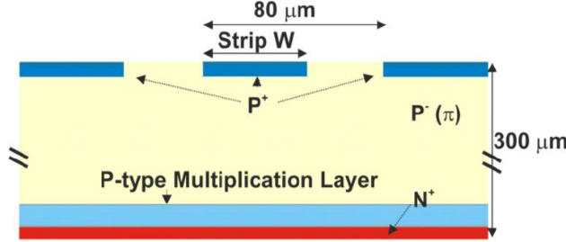
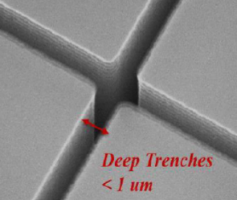
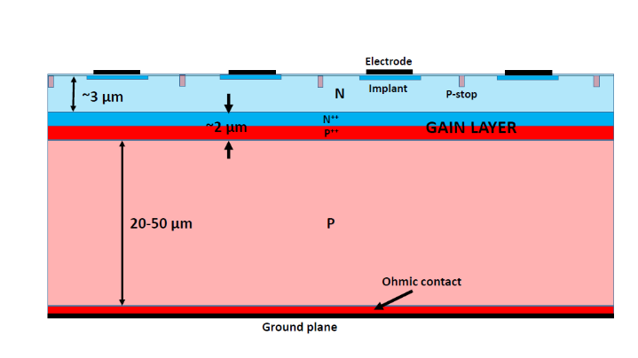
Higher granularity LGADs
Reverse position of gain layer → iLGAD
Trench insulation of pads → TI-LGAD
Deep junction → DJ-LGAD (Patent Application SC 2019-978 (UCSC))

Slide 20




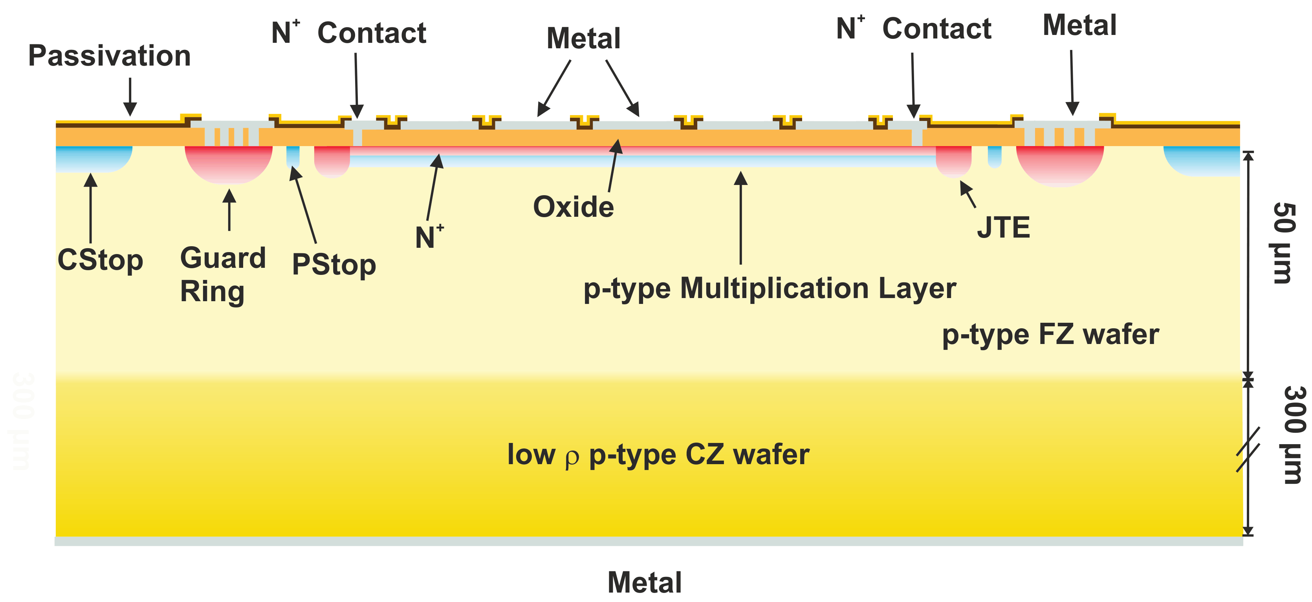
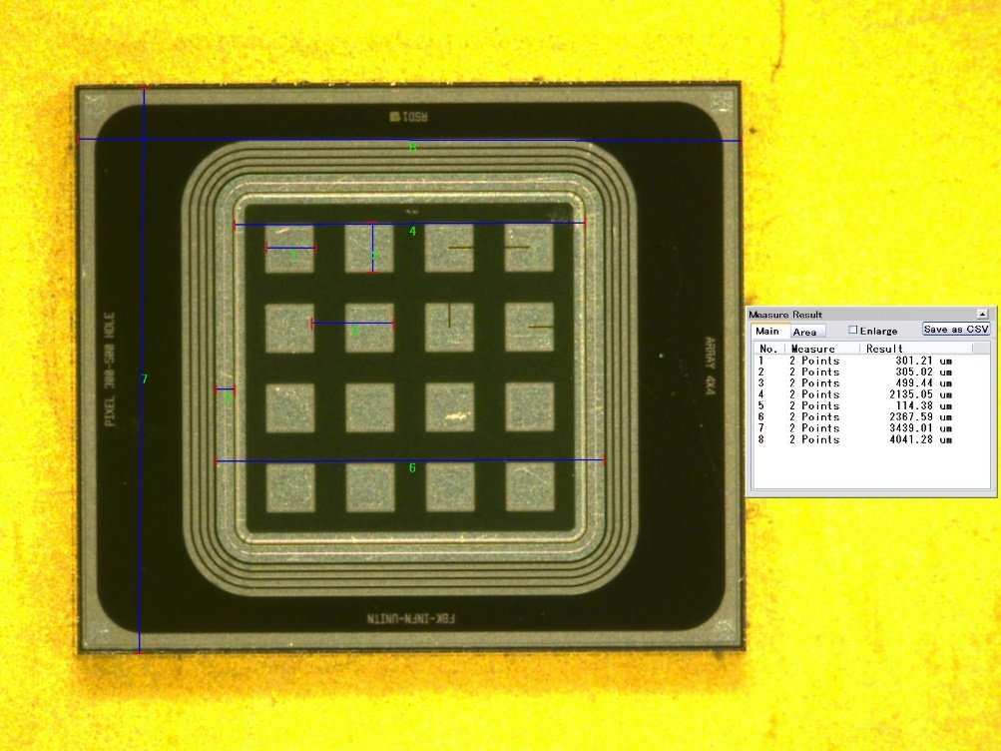
AC-LGAD detectors
AC coupled LGAD (UCSC - US patent N. 9,613,993 B2, granted Apr. 4, 2017)
  Goal: finer segmentation and easier implantation process
Continuous sheets of multiplication layer and N+ layer
N+ layer is grounded through side connections
Readout pads are AC-coupled (Insulator layer between N+ and pads)

Slide 21
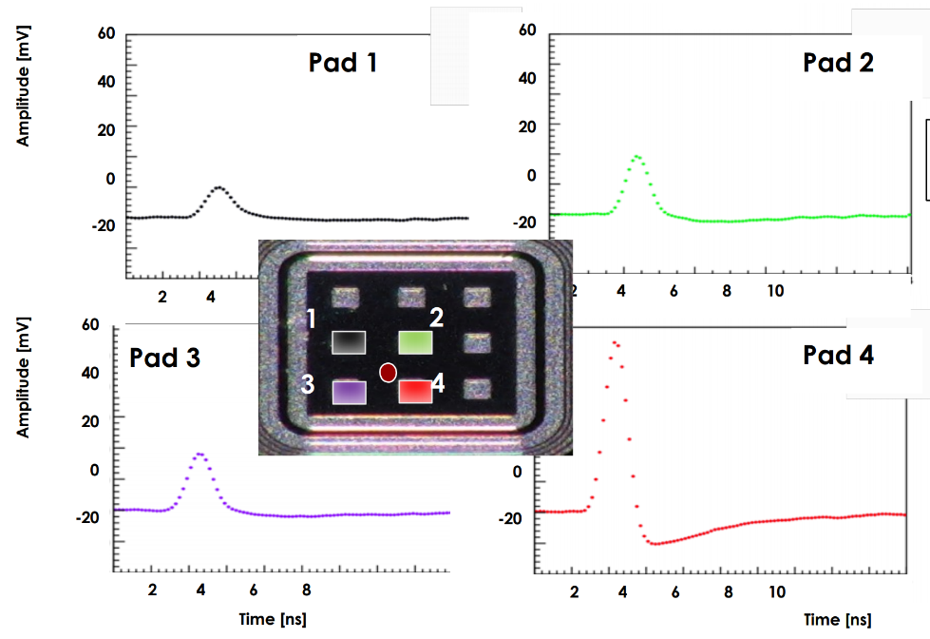
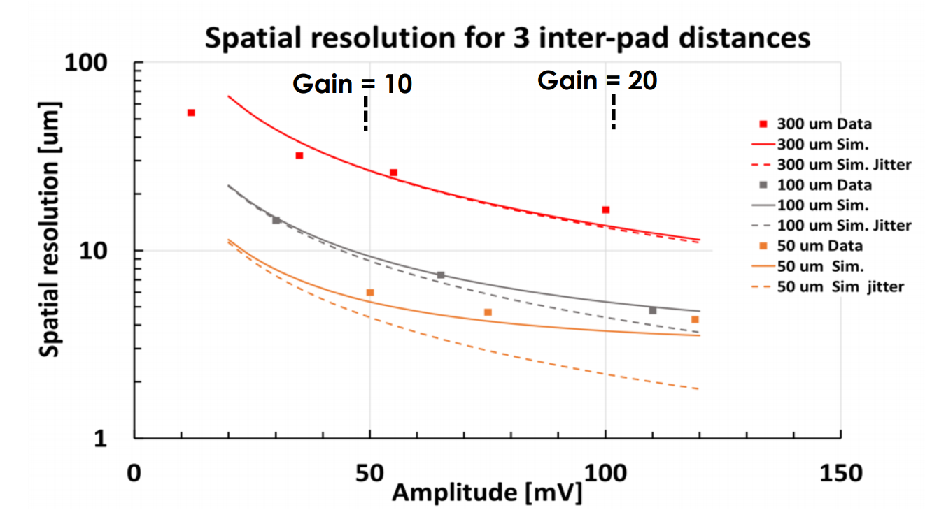
AC event reconstruction and performance
AC-LGAD has intrinsic charge sharing between pixels
Charge sharing might be a great feature for low density tracking environment
Using information from multiple pixels for hit reconstruction
With a sparse pixelation of 300um a <10um hit precision can be achieved!
  Time resolution can benefit too, using the time of several channels the Jitter component of the time resolution can be reduced
Extremely useful for both power dissipation and cabling
Still in a early R&D phase, proposed technology for future EIC experiment at BNL
Resources
  https://indico.physics.lbl.gov/event/1262/
  https://indico.cern.ch/event/918298/contributions/3880516/
  https://arxiv.org/abs/2006.01999
  https://indico.cern.ch/event/895924/contributions/3968867/attachments/2119055/3565898/Vertex2020_KEKLGAD_20201008_upload.pdf

Slide 22
Thin sensors future improvements

Slide 23
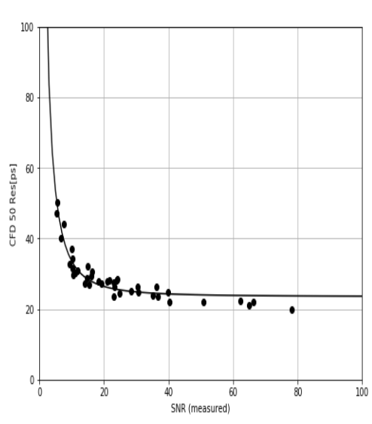
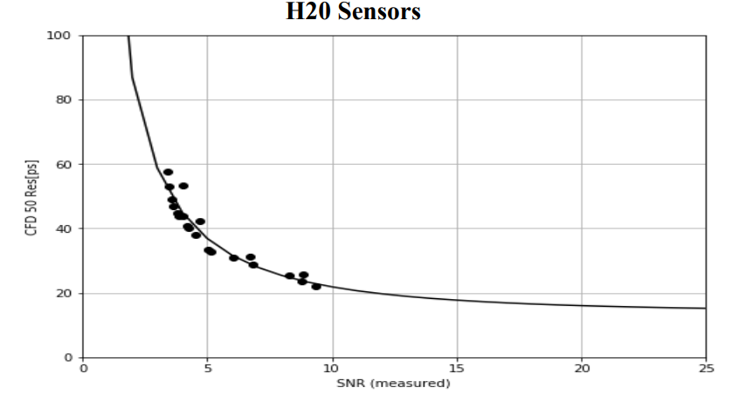
Thin LGAD sensors future uses
G30 sensor
First results with a 20um prototype LGAD
  With issues, gain layer has to be optimized
  However shows possible improvements down to 15ps of time resolution
Compared with 50um sensors (30ps reach) and 30um sensors (20ps reach)
  https://arxiv.org/abs/2006.04241
Very thin sensors can also be candidates for extreme radiation environment
Issue: after substantial radiation damage thick detectors requires 1000s of V for depletion (Even though there is evidence of Charge trapping saturation)
But a 50um sensor at 1E17Neq is fully depleted at 500V
Can be operated in extreme radiation environment
https://doi.org/10.1016/j.nima.2020.164383
https://agenda.hep.wisc.edu/event/1391/session/12/contribution/60
https://indico.desy.de/indico/event/24272/session/0/contribution/13/material/slides/0.pdf
30um sensor, 20ps reach
20um sensor, 15ps reach

Slide 24


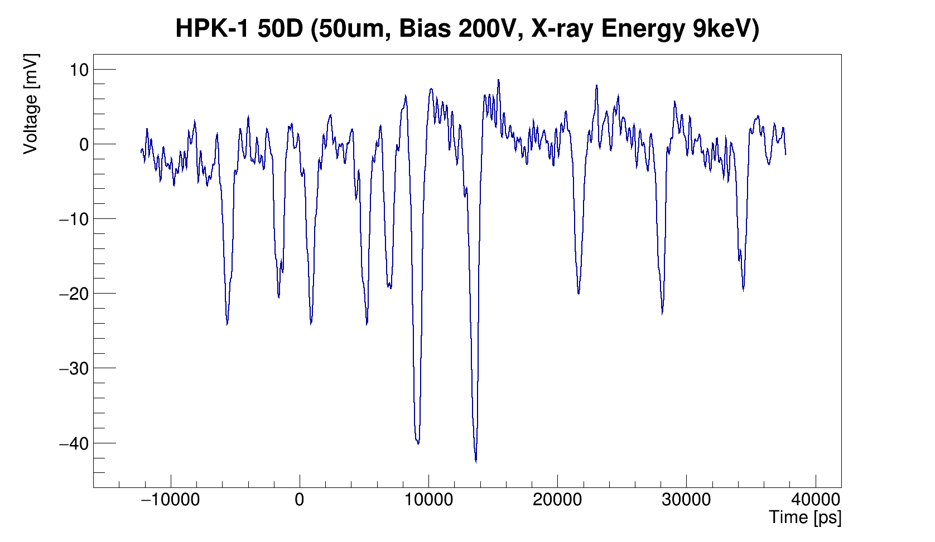
LGADs with X-ray - SSRL
LGAD tested at SLAC SSRL
  Stanford Synchrotron Radiation Light source
X-rays of energy range [6, 16] KeV
  80, 60, 50, 35 um detectors
Very good time resolution ~100ps
Fair energy resolution ~10%
Full collection time ~1ns correspond to GHz repetition rate
Definite pulses even with a 2ns beam separation
  No influence on shape from close-by pulses
  https://doi.org/10.1016/j.nima.2019.01.050
  Application other than HEP are being pursued for LGADs, such as fast beam monitoring
    Challenge: reach 10 GHz of repetition rate
2ns

Slide 25
Conclusions

Slide 26
Fast sensors current performance
HV-CMOS, Monolithic chip with internal amplification
  Good time resolution (~50ps) and avoids bump bonding procedure
  Low production cost
  Power consumption might be too high
3D sensors, No amplification, perpendicular charge collection
  Trench 3D sensors can reach ~20ps or time resolution
  Pitch size proportional to charge collection time
  Good radiation hardness, but low collected charge and charge sharing
  Candidates for vertexing with timing
LGADs, Internal gain, thin sensors of 50-30um
  Can reach 20-30ps of time resolution and a gain of ~50
  Reasonable performance up to a few 1E15Neq
  Granularity limited to ~mm scale (for now)

Slide 27
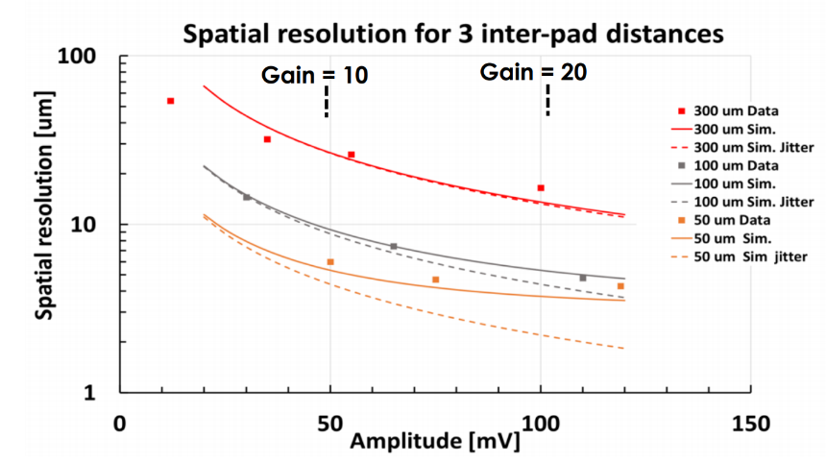
LGAD future development and applications
In the future 15ps per hit is foreseeable with very thin LGADs
Low granularity (10um) can be achieved with AC-LGADs
  In a sparse environment low granularity (10um) with larger pitch (300um) is achievable
Few mentions in the last years of Monolithic LGADs (lower cost and power)
  https://indico.fnal.gov/event/44925/contributions/194082/attachments/132985/163760/Future_silicon_detectors_Aug13_2020.pdf
  ttps://indico.cern.ch/event/669866/contributions/3234993/
HL-LHC confirmed both ATLAS and CMS LGAD timing layers, ~2026
Several Electron Ion Collider (BNL) LoI mention LGADs and AC-LGADs as possible technology for 4D tracking
Application other than HEP are being pursued for LGADs, such as fast beam monitoring
LGADs are also mentioned in several snowmass LoI
A new “LGAD consortium” was formed across US universities and national laboratories to tackle LGAD R&D in the next years
2ns

Slide 28
Many thanks to the SCIPP group students and technicians!
This work was supported by the United States Department of Energy,
grant DE-FG02-04ER41286
This project was supported in part by a Launchpad Grant awarded by the Industry Alliances & Technology Commercialization office from the University of California, Santa Cruz.
This work was partially performed within the CERN RD50 collaboration.
Part of this work has been financed by the European Union’s Horizon 2020 Research and Innovation funding program, under Grant Agreement no. 654168 (AIDA-2020) and Grant Agreement no. 669529 (ERC UFSD669529), and by the Italian Ministero degli Affari Esteri and INFN Gruppo V.

Slide 29
Backup

Slide 30




Irradiation campaigns on LGADs
Irradiation campaign on LGADs
Sensors were irradiated at
  JSI (Lubiana) with ~1 MeV neutrons
  PS-IRRAD (CERN) with 23 GeV protons
  Los Alamos (US) with 800 MeV protons
  CYRIC (KEK, Japan) with 70 MeV protons
  X-rays at IHEP (China)
Neutron irradiation for fluence
  From 1E13 Neq/cm² → 1E16 Neq/cm²
Proton irradiation for fluence and ionizing dose
  Up to 4MGy
X-ray irradiation for ionizing dose

Slide 31
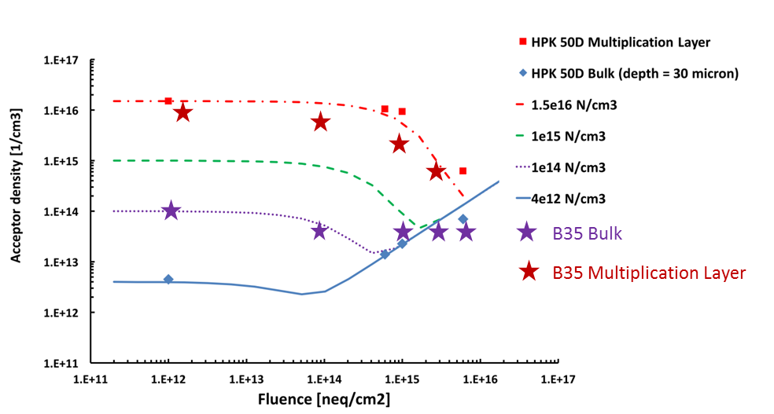
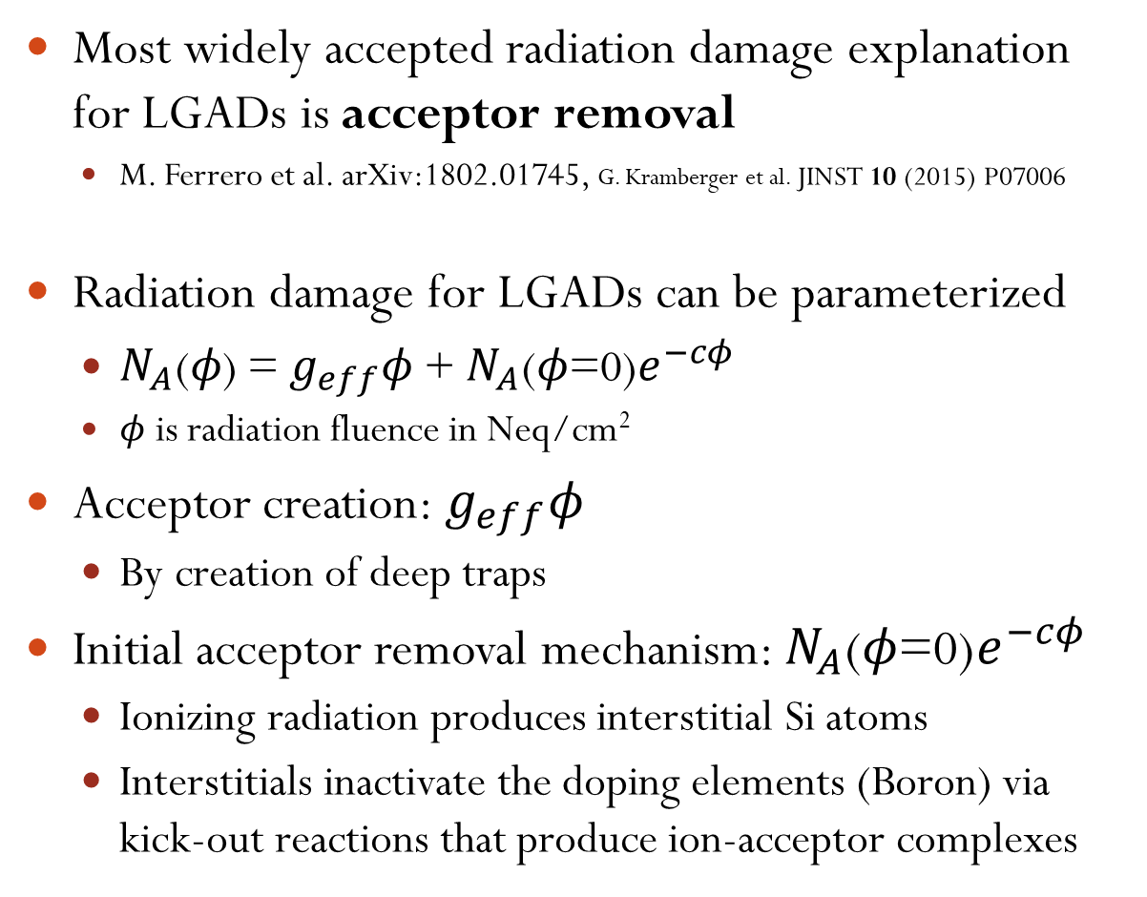
Acceptor removal mechanism
Most widely accepted radiation damage explanation for LGADs is acceptor removal
  M. Ferrero et al. arXiv:1802.01745, G. Kramberger et al. JINST 10 (2015) P07006
Radiation damage for LGADs can be parameterized
  $N_{A}\text{(}φ\text{) = }g_{eff}φ\text{ + }N_{A}\text{(}φ\text{=0)}e^{−cφ}$
  $φ$ is radiation fluence in Neq/cm²
Acceptor creation: $g_{eff}φ$
  By creation of deep traps
Initial acceptor removal mechanism: $N_{A}\text{(}φ\text{=0)}e^{−cφ}$
  Ionizing radiation produces interstitial Si atoms
  Interstitials inactivate the doping elements (Boron) via kick-out reactions that produce ion-acceptor complexes
Multiplication layer
Acceptor removal
Bulk
Acceptor creation
Y. Zhao et al. 10.1016/j.nima.2018.08.040

Slide 32
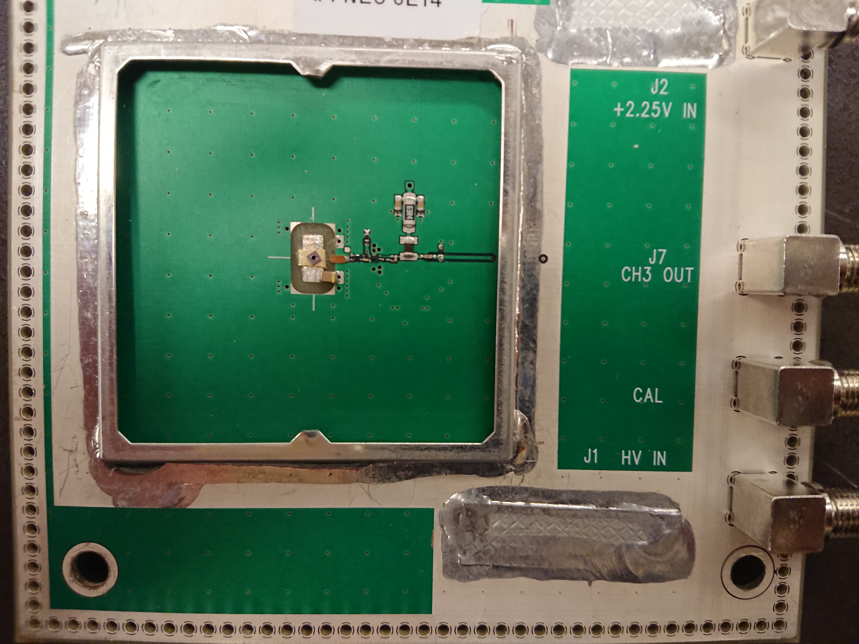
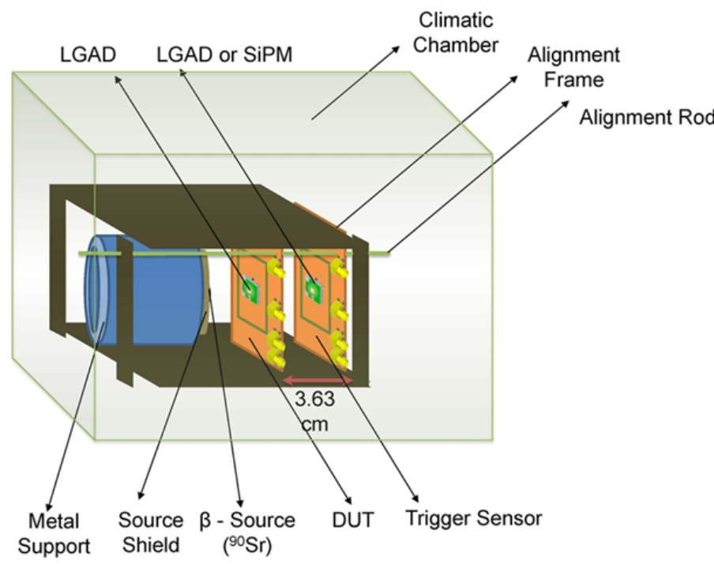
Sensor testing – Sr90 telescope
  Dynamic laboratory testing
    Using MiP electrons Sr90 β-source
    Signal shape, noise, collected charge, gain, time resolution
β-telescope
  Sensors mounted on analog readout board designed at UCSC (Ned Spencer, Max Wilder, Zach Galloway) with fast amplifier (22 ohm input impedance, bandwidth > 1GHz)
  Trigger sensor (fast timing trigger) on the back
    DUT (Device Under Test) is read in coincidence
  Setup in climate chamber to run cold and dry
    20C/-20C/-30C
  (however no position information)
LGAD
S.M. Mazza et al. arXiv:1804.05449

Slide 33

Sensor testing – Sr90 telescope
  Signal to Noise
    Pulse maximum over noise
  10-90% rise time
  Time resolution
    Spread of time difference with trigger sensors and DUT
    Trigger sensor time resolution measured by mounting two identical sensors
  Collected charge
    Pulse area (minus undershoot) divided by trans impedance
  Gain
    Collected charge divided by collected charge in same thickness PiN
    Collected charge in PiN measured with the same β-telescope
$$Δt$$
Measured noise
S.M. Mazza et al. arXiv:1804.05449

Slide 34
Sensor testing – IV/CV
Capacitance over voltage (CV)
  Study doping concentration profile and full depletion of the sensor
Study of the “foot” for LGADs on 1/C²
  1/C² is flat until depletion of multiplication layer because of the high doping concentration
  Proportional to gain layer active concentration
Bulk doping concentration proportional to the derivative of 1/C² before depletion
Full depletion
Multiplication
layer
P
N++
P++
Bulk
45um sensor
P+

Slide 35
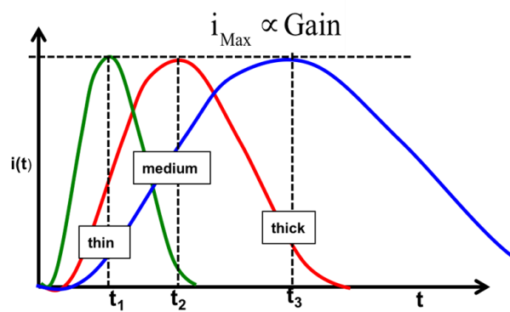
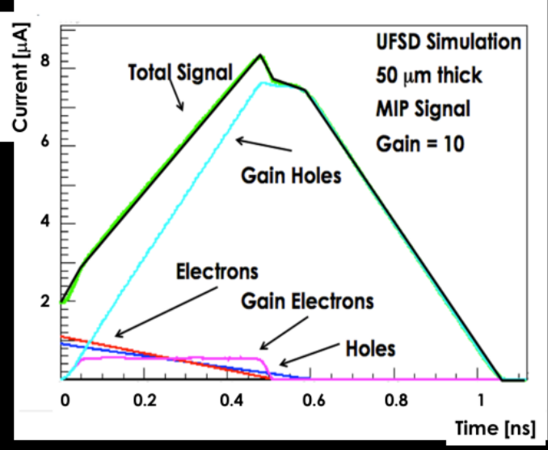
Low Gain Avalanche Detectors
Thin sensors
have shorter
rise-time
Collected charge from MiP is proportional to thickness of a silicon detector
Thanks to gain LGADs can go thinner than normal silicon detectors
  Down to 50um and 20um!
Thinner detectors have shorter rise time and less Landau fluctuations
Gain from multiplication layer
  Better signal to noise ratio
Better signal to noise ratio and thin detectors means improved timing resolution
  Time resolution < 30 ps
Entire pulse is ~1ns
Signal components
in normal silicon

