Slide 1
P4-b: New Physics with Radioactives
L. Hayen: Beta Decay overview and future
B. Graner: Fierz term from Cyclotron Radiation Electron Spectroscopy
K. Leach: Beyond Standard Model Neutrino Studies with Rare Isotopes in Quantum Sensors

Slide 2
P4-b: New Physics with Radioactives
L. Hayen: Beta Decay overview and future
Search for BSM in beta decays via:
non-unitarity of CKM
evidence for non-VA currents
CKM great progress recently: improved modelling, better assessment of uncertainties. More secure basis.
Lighter nuclei → better theory:
Better ¹⁰C and ¹⁴O experiments at TRIUMF?
Nuclear structure improvements give good hope for achieving <10⁻⁴ accuracy for non-VA current searches.
Challenge: need calculation of SM model effects at <10⁻⁴. Non-trivial. Radiative, recoil-order corrections…

Slide 3
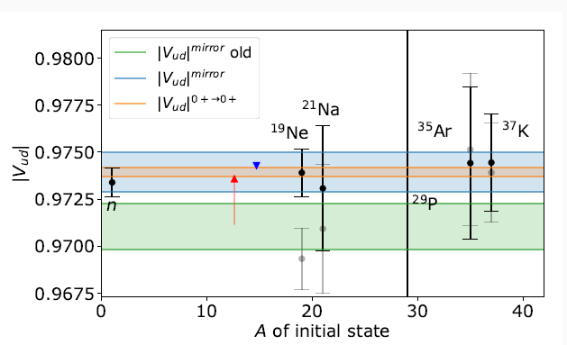
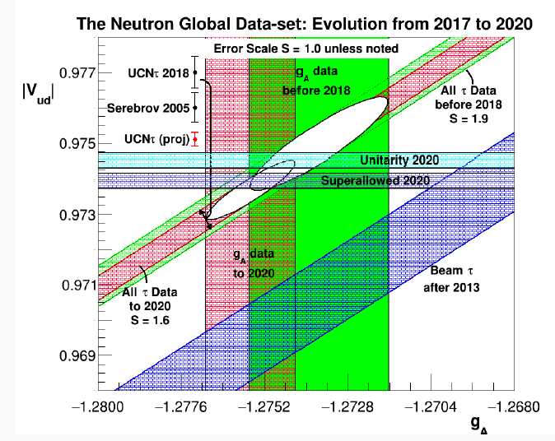
P4-b: New Physics with Radioactives
Resolved issues on mirror log(ft)’s.
From A. Young

Slide 4
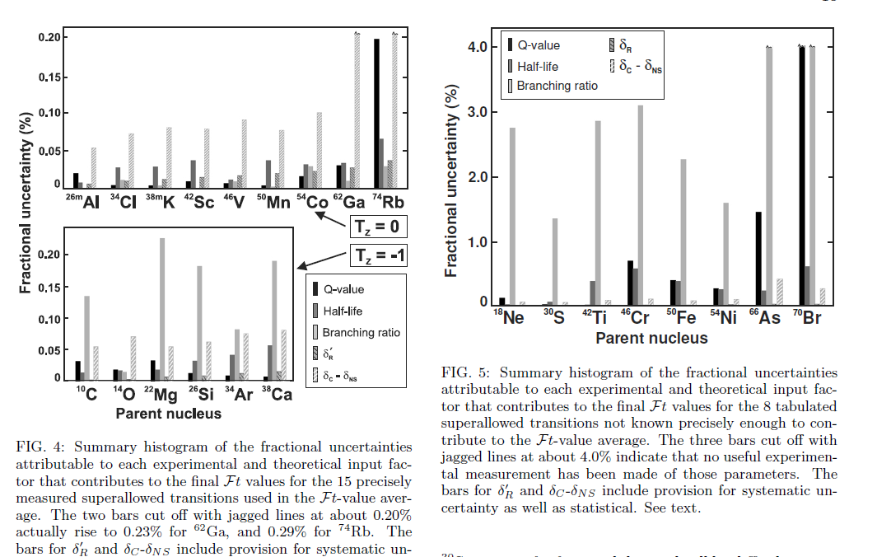
P4-b: New Physics with Radioactives
Hardy and Towner, PRC (2020)

Slide 5
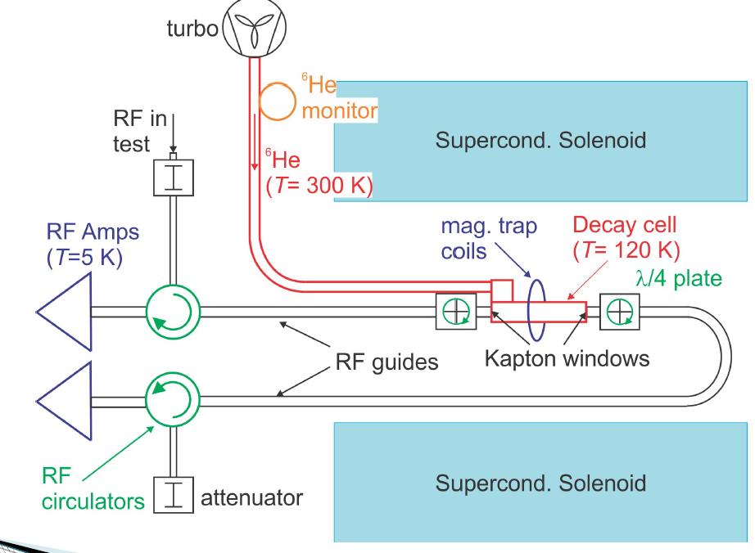
P4-b: New Physics with Radioactives
B. Graner: Fierz term from Cyclotron Radiation Electron Spectroscopy
New method for beta spectroscopy (measures cyclotron frequency).
Could be coupled to ion trap and used with ISAC for a broad range of problems.

Slide 6
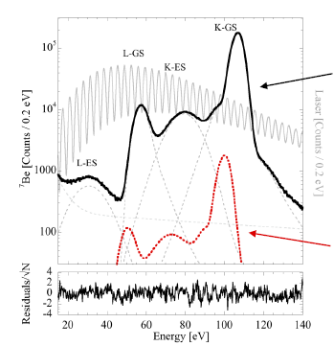
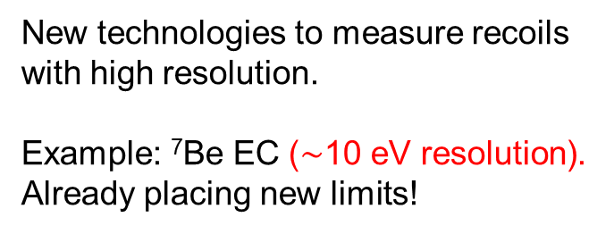
P4-b: New Physics with Radioactives
K. Leach: Beyond Standard Model Neutrino Studies with Rare Isotopes in Quantum Sensors
measured
New technologies to measure recoils with high resolution.
Example: ⁷Be EC ($\sim$10 eV resolution). Already placing new limits!
1% of 300 keV neutrino

