Slide 1
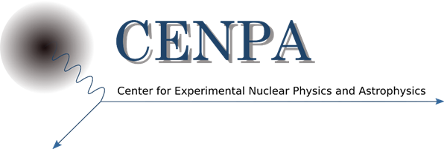
PIONs, MUONs and the occasional KAON
David Hertzog / Peter Kammel
Plenary:
  Martin Hoferichter: Tests of lepton flavor universality and CKM unitarity
  Doug Bryman: Exploring Flavor Physics with Pions and Kaons
Breakout Session:
  Vincenzo Cirigliano: The physics of lepton flavor universality and CKM unitarity
  Toshiyuki Iwamoto: The MEG II experiment and a new idea for the precision test on LUV with the LXe detector
  Simone Mazza: Fast silicon detector technologies for 4D tracking in future HEP experiments
  Dinko Pocanic: Lessons learned from the PiBeta and PEN experiments
  Tristan Sullivan: Lessons learned from PIENU
  Andreas Knecht: Pion and muon beams at PSI, performance and plans

Slide 2
Prompts from organizers – (we return to this at the end)
What ideas could (or could not) be turned into actual experiments at TRIUMF/CENPA?
  A next-generation Rare Pion Decay seems to be our clear focus: Nicknamed (for now) PIENUXe
What homework do we need to do to figure this out?
  Beamlines investigations;
    We know demands from prior efforts. We made good progress in a review of the capabilities and specific options at PSI, and on the limitations and conflicting demands. PSI would “welcome” this.
    The situation at TRIUMF is less clear. There is no “ready to go/borrow/steal” beamline, but there are options with existing areas/lines, or new ones to be considered dedicated to this effort.
  Calorimeter concept.
    Expertise in this group from MEG’s development of LXe and SiPMs. There success is based on a significant R&D efforts and real use of the detector. A huge advantage to draw from.
    We did not discuss crystal calorimeter ideas, but in the bigger picture we will need to address options, even if to simply provide needed comparisons related to funding.
    There are many challenges with windows, readout, cost, geometry, calibrations, installation, …
  Stopper/Tracker “combination”
    Strong case made to track the stop and track the decay positrons from that vertex. Can this be done with modern developments?
    Learned of a candidate new technology that would be great, but made of XY strip geometry. Might be okay ? But have to begin thinking
  Monte Carlo Simulations
    A modified PEN GEANT code has been extracted and readied for use with “toy” detector ideas. Some runs done with LXe calo to demonstrate the importance of a deep calorimeter to address the “tail” systematic in pi e nu, the leading problem.
Should we form a working group to answer such questions? Who are key people to target for this working group?
  The group said “Yes”. The work naturally falls in various divisions related to technological expertise, theory, simulation, beams, …
  We will assemble (softly) with the aim of real homework prior to DND 2021 / Snowmass. Lively email exchanges started.
  We want to, and need to, enlarge the interested parties prior to developing any “formal organizational structure”

Slide 3
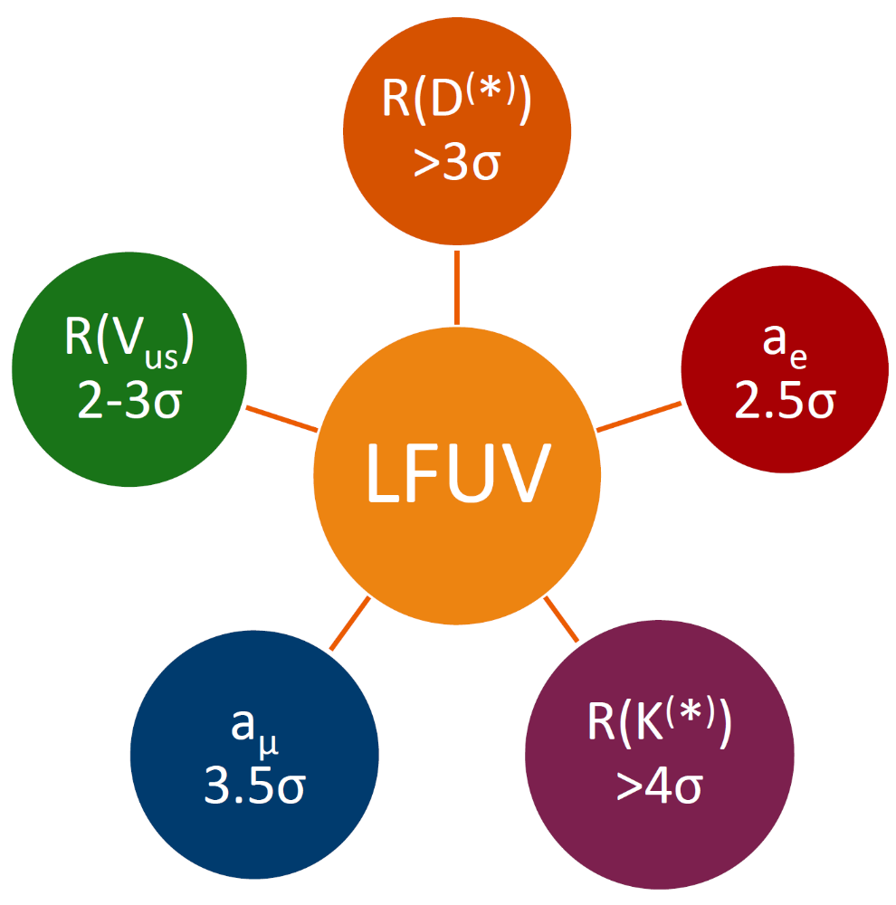
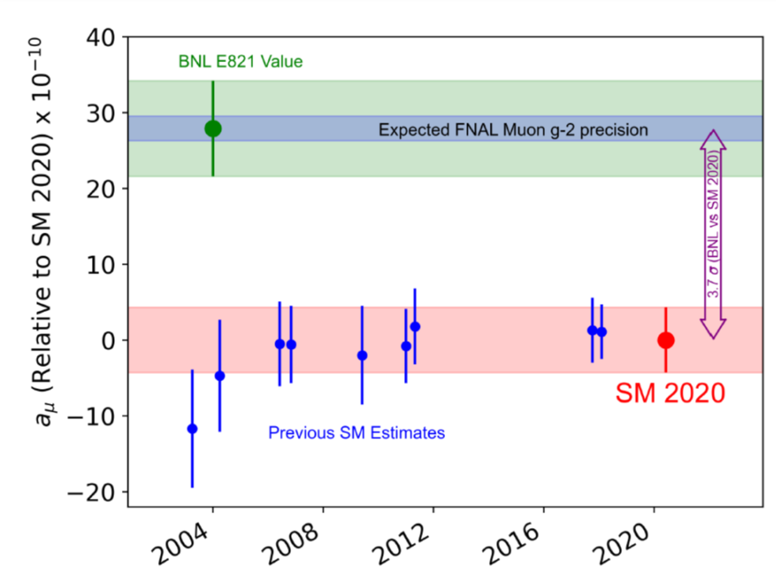
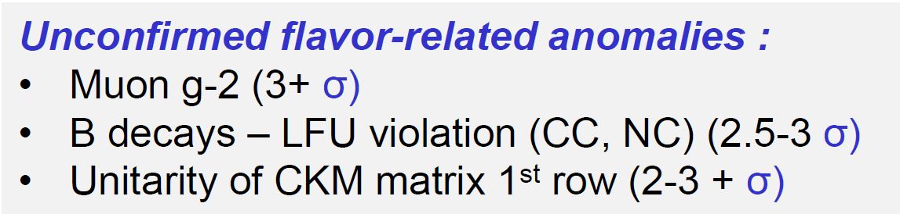
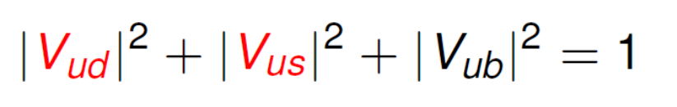
The Physics Motivation(s)
Some things anomalous in the Flavor Sector?
Something wrong with Unitarity?
Andreas Crivellin

Slide 4
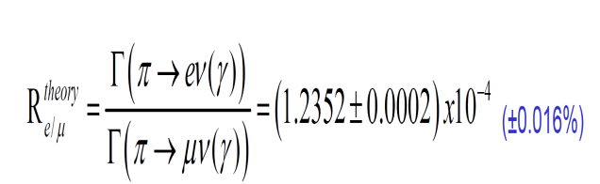
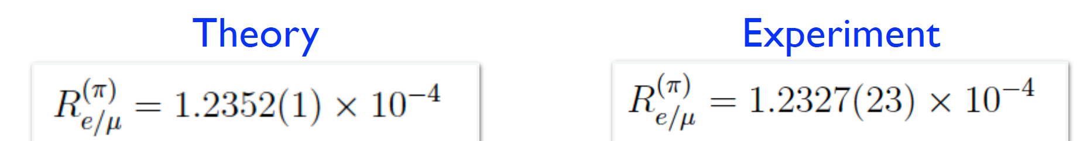
The Physics Case: what we might do about it
Lepton Flavor Universality test in
This just demands to be tested better! A clean generic way to look for new physics. Theory vs Experiment in high precision test

Slide 5
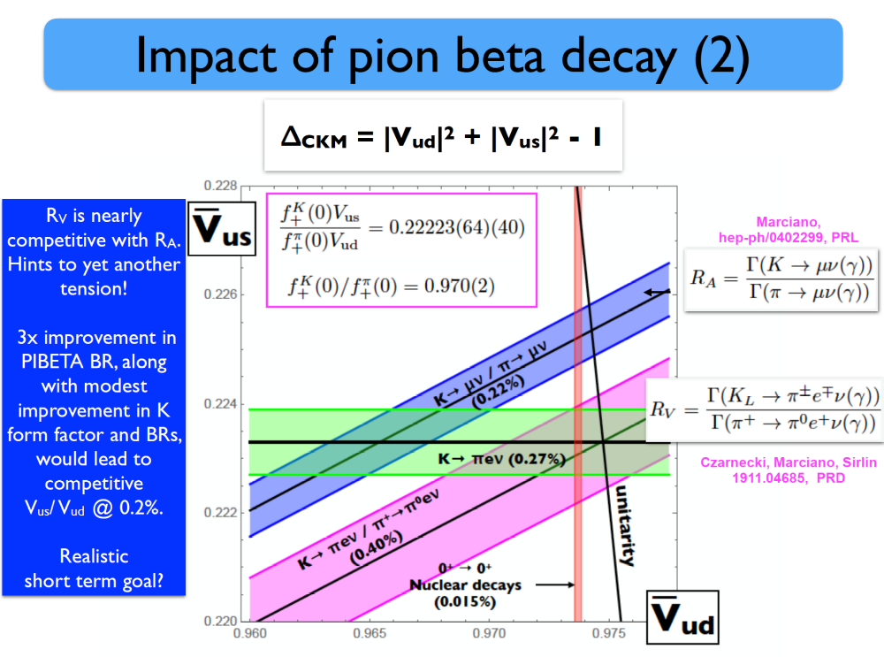

The Physics Case: what else we might do
3 x improved Pion Beta Decay → new ratio R_{V}

Slide 6
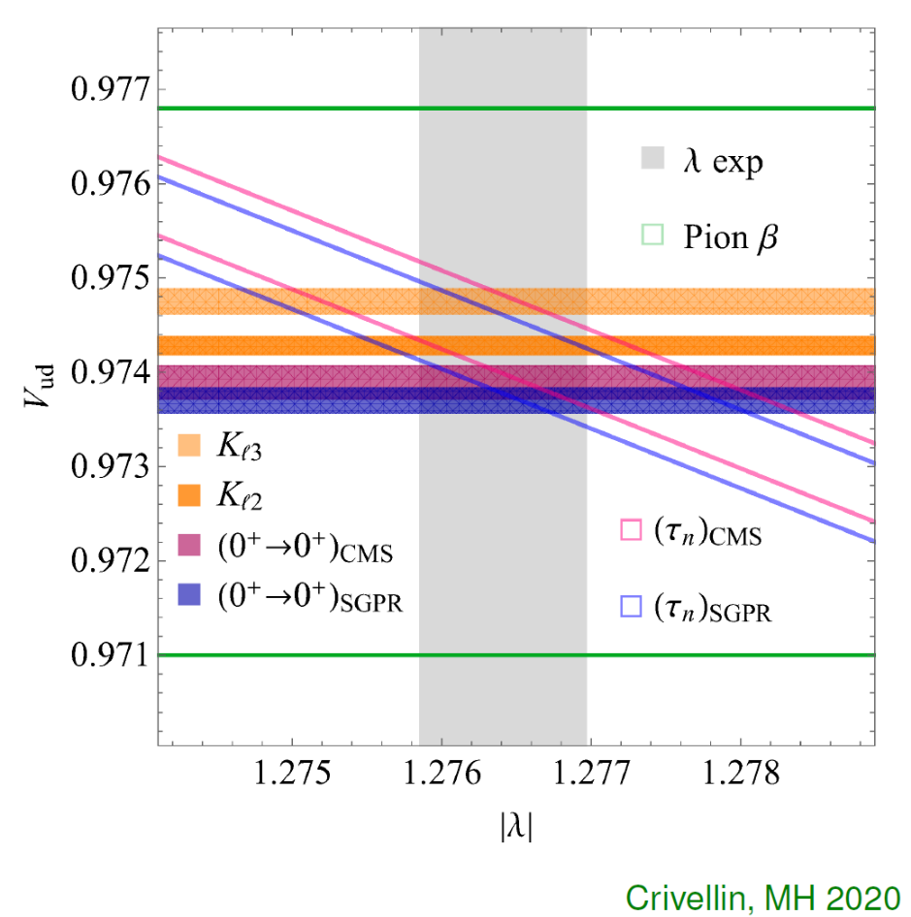
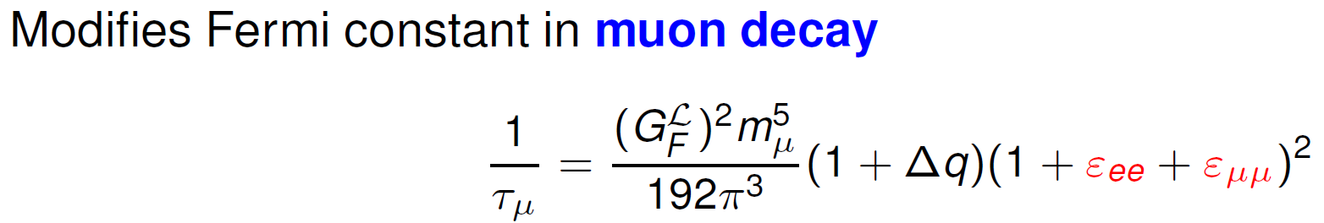

The Physics Case II. They might be related
CKM 1st Row Unitarity. Start by assuming it’s true. But then …The V_{ud} you get by taking: |V_{ud}|² = 1 – |V_{us}|²
Is different than the one you get from beta decay

Slide 7
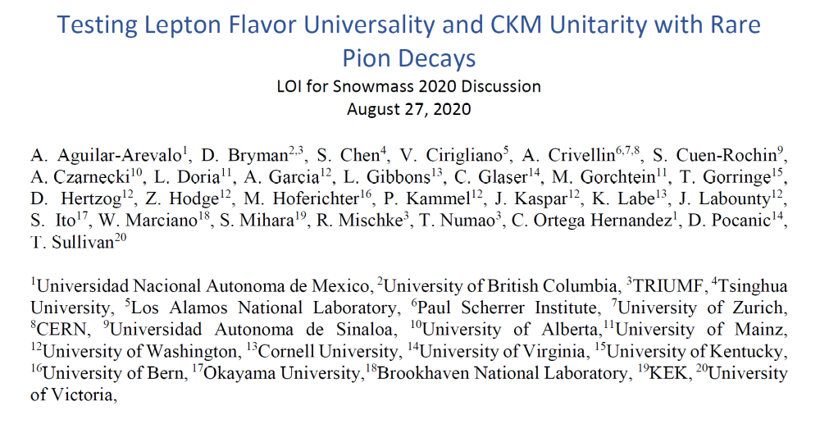
We already wrote a LOI for SNOWMASS … but as an aim for DND 2020

Slide 8
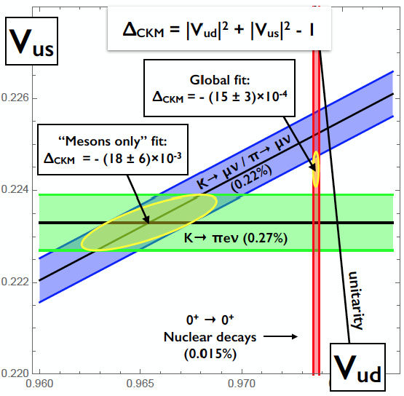
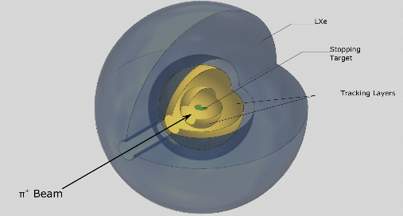
PiENuXE: Testing Lepton Flavor Universality and CKM Unitarity with Rare (stopped) Pion Decays
Goals
  Improve e/μ universality and CKM unitarity tests by an order of magnitude
  Measure π→eν/π◊μν to ±0.015%, matching SM theory precision
  Measure pion beta decay rate to ±0.06%
    Leads to V_{us}/V_{ud} constraint to < 0.1%
Motivation drawn from
  Possibly related tensions from (g-2)_{μ,e}, CKM unitarity, and B decays
  Possibility that the apparent violation of CKM unitarity is a manifestation of Lepton Flavor Universality Violation (LFUV). (PhysRevLett.125.111801, Sept 2020)
  Precise theory, experiments far behind in comparable precision
How
  Next-gen design based on real-world lessons from PEN and PiENu
  28X₀ LXe/SiPM – fast, high resolution, x10 smaller low-energy tail
  Mu3e style silicon trackers – event reconstruction at high rates
  Pixelated target, customized for LFUV or PiBeta (separate) runs
LXe
Please contact us (hertzog@uw.edu) or others on LOI signatory list. 22 Institutes, (27 experimentalist; 5 theorists).

Slide 9
Toward a new experiment involves …
Starting the group … LOI and actively recruiting
Studying the history … talks: “lessons learned”
Learning about new technologies you might use … talks LXe, LGADs,
Exploring where you might do it … talks PSI, TRIUMF
Figuring out how to pay for it … JENS !!!!!!!!!!
Some new simulations
Some prototypes
And then the fun begins.

Slide 10
Dinko Pocanic (PEN/PiBeta)

Slide 11

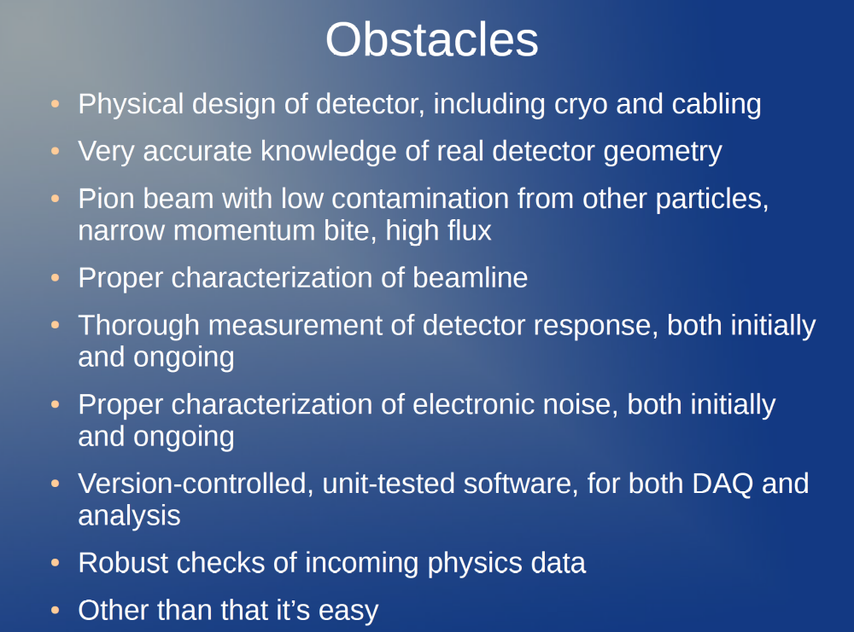
Tristsan Sullivan
(PiENu)

Slide 12
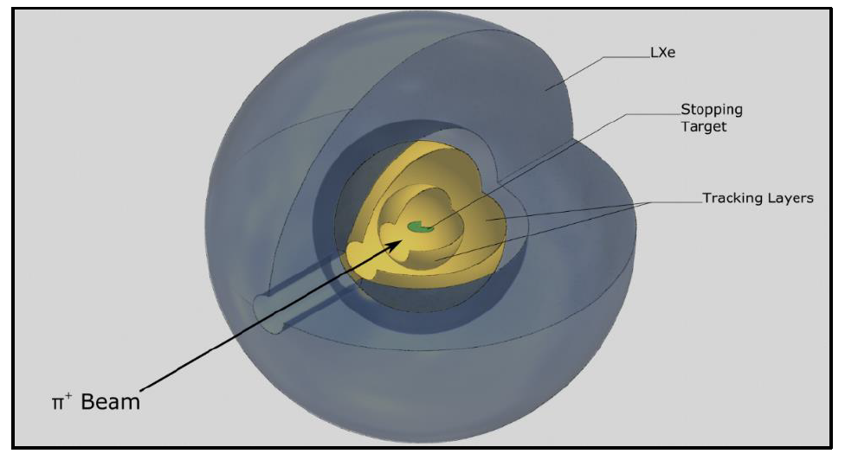
PIENUXE: New Rare π Decay Experiment with LXe
Fast, deep, homogenous
LXe calorimeter
π⁺ beam
10x higher intensity
State-of-the-art
active Si target
Overall
  >20x higher statistics
  >10x reduction systematics
Lessons learned @ TRIUMF and PSI
Dinko (UVa), Tristan (TRIUMF)

Slide 13
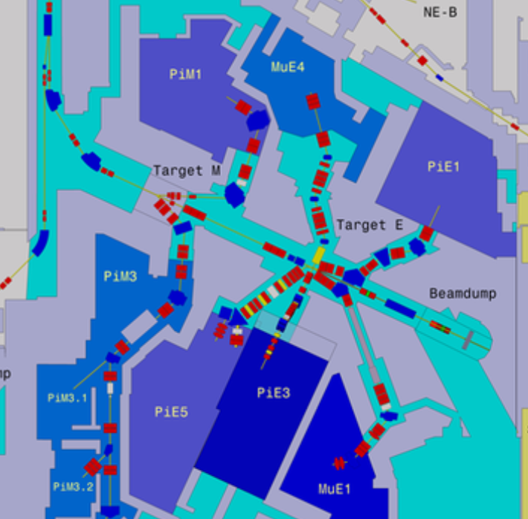
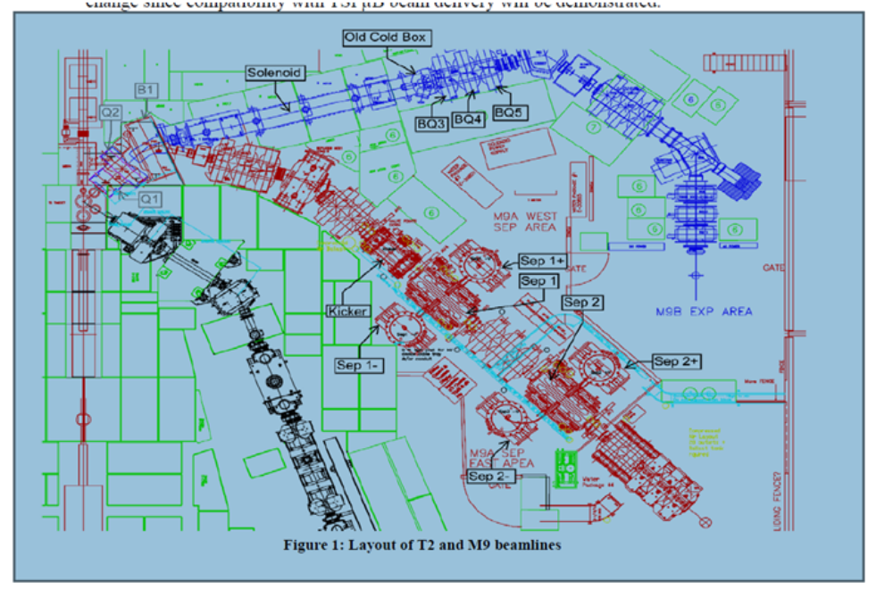
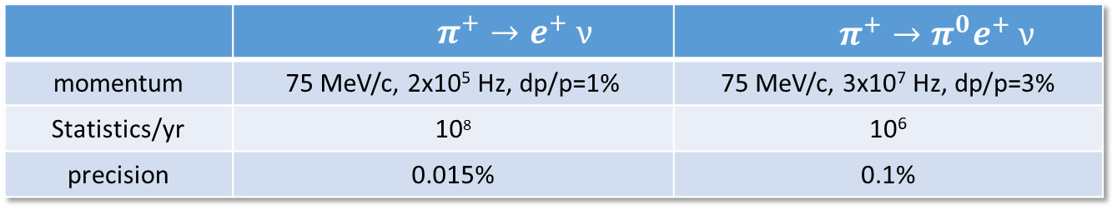
Beam
 | $$π^{+}→e^{+} ν$$ | $$π^{+}→π^{0}e^{+} ν$$
momentum | 75 MeV/c, 2x10⁵ Hz, dp/p=1% | 75 MeV/c, 3x10⁷ Hz, dp/p=3%
Statistics/yr | 10⁸ | 10⁶
precision | 0.015% | 0.1%
PSI
TRIUMF
  some possibilities, at least for pienu
  development studies required !
πE1:
fulfills pienu requirements
shared with μSR community
Doug (TRIUMF)
Andreas (PSI)
Can TRIUMF assemble a Study Group to look into this?
πE5:
fulfills piBeta requirements
world’s highest intensity beamline likely available in a few year’s when MEG finished
experiment welcome at PSI

Slide 14
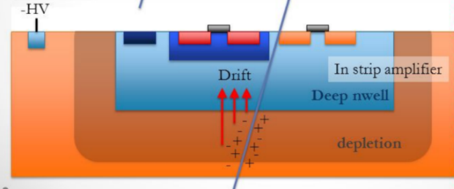
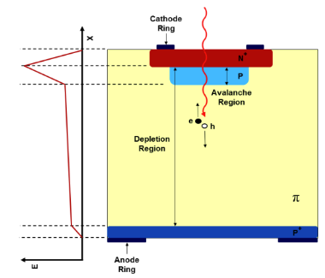
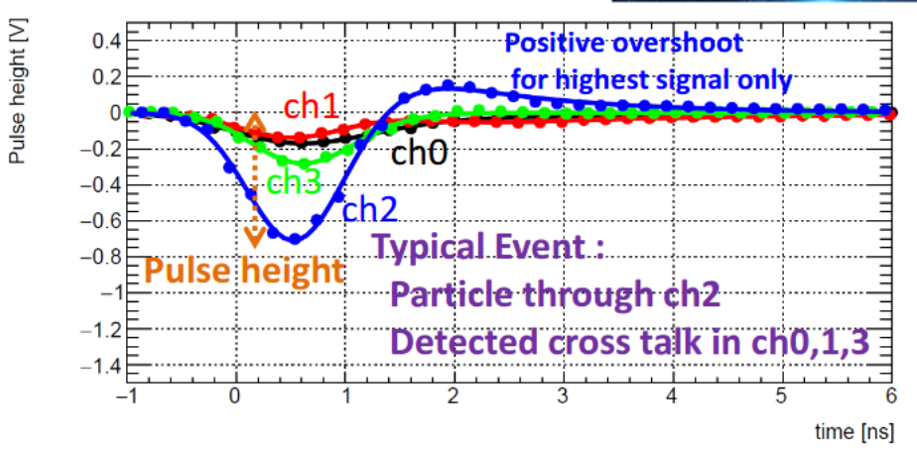
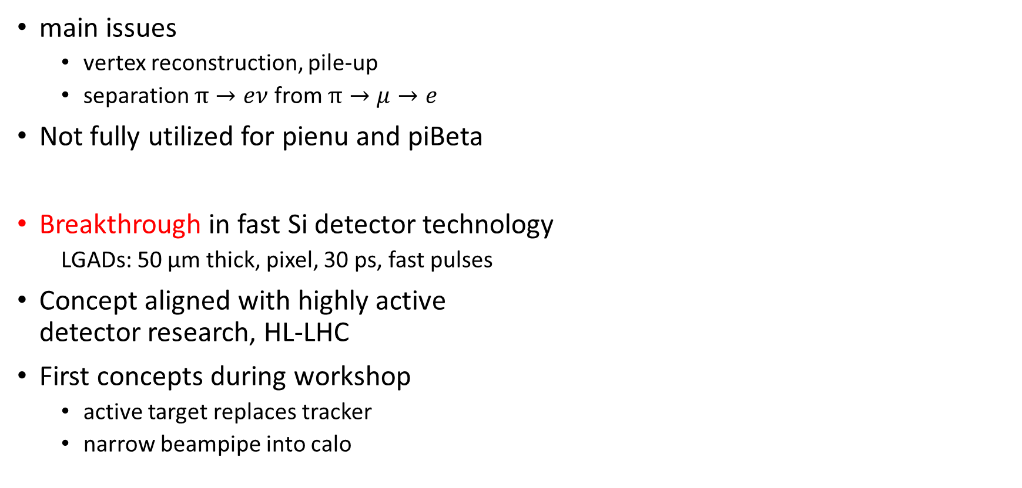
Active target and tracker
HV-CMOS, high granularity, 0.1-10 ns
main issues
  vertex reconstruction, pile-up
  separation $π→eν$ from $π→μ→e$
Not fully utilized for pienu and piBeta
Breakthrough in fast Si detector technology
  LGADs: 50 μm thick, pixel, 30 ps, fast pulses
Concept aligned with highly active
detector research, HL-LHC
First concepts during workshop
  active target replaces tracker
  narrow beampipe into calo
LGADs, mm granularity, 30 ps
Simone (UC Santa Cruz)
Tristan (TRIUMF)

Slide 15
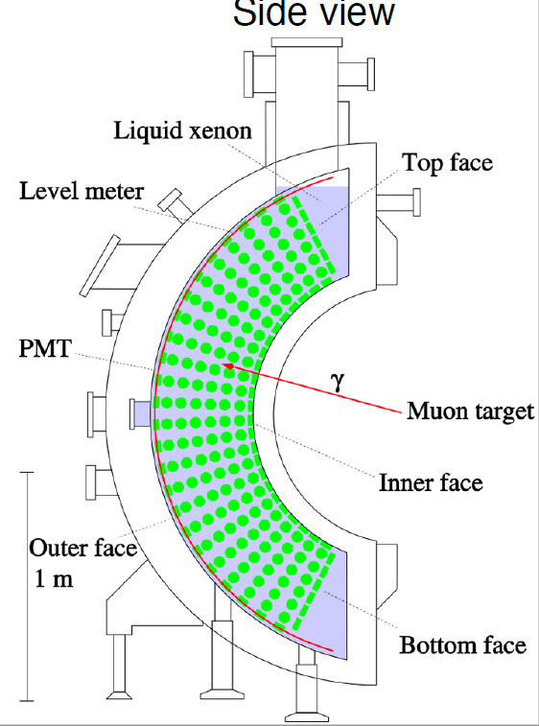
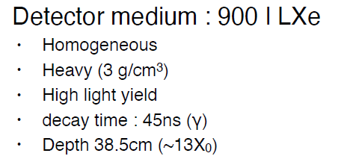
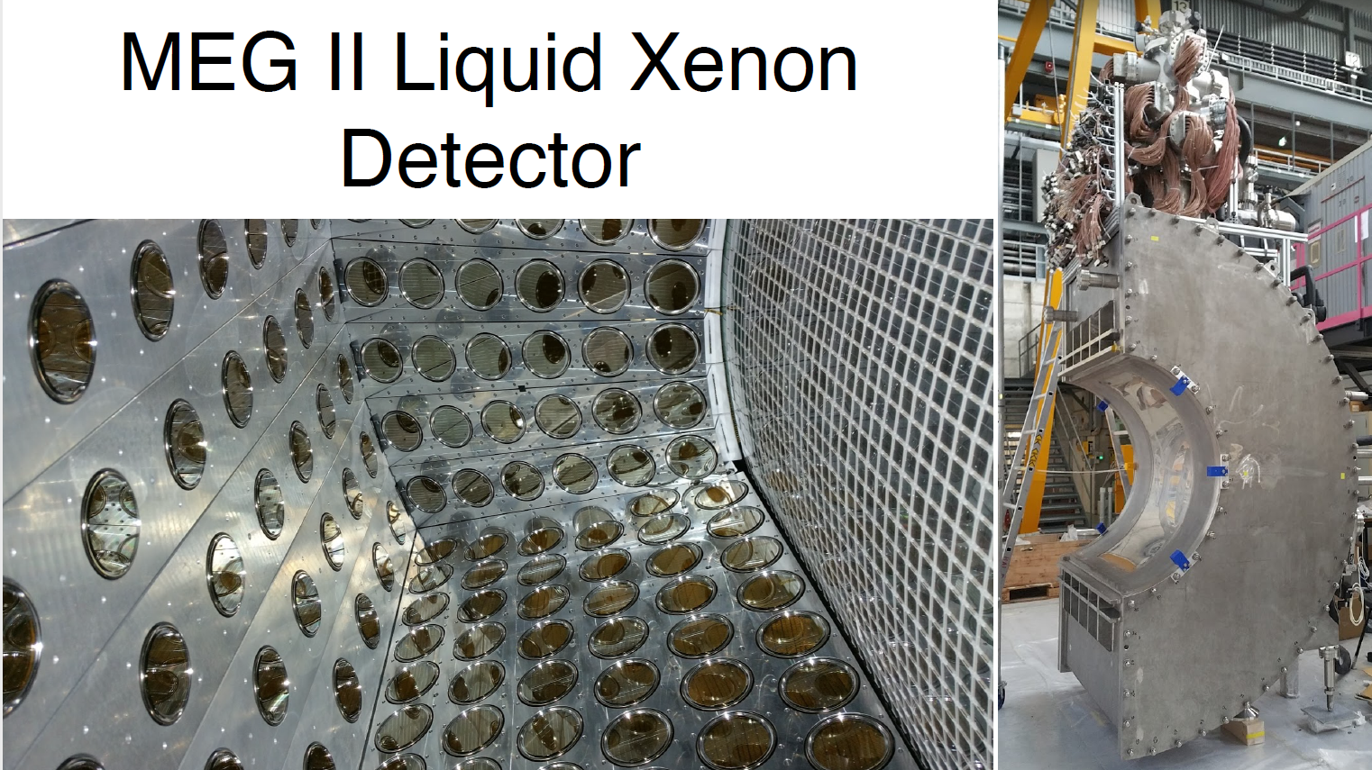
LXe calorimeter
Toshiyuko (Univ Tokyo)
State of the art
Resolution
  ~2.5 mm position
  ~55 ps timing
  ~1.7% energy
Tokyo group
  interested in testing pienu experiment
  with MEGII, related detector characterization
  100 l prototype detector exists
  received R&D funding for new pienu

Slide 16
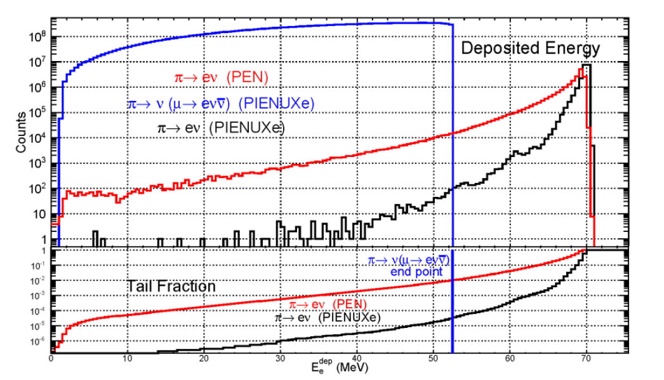
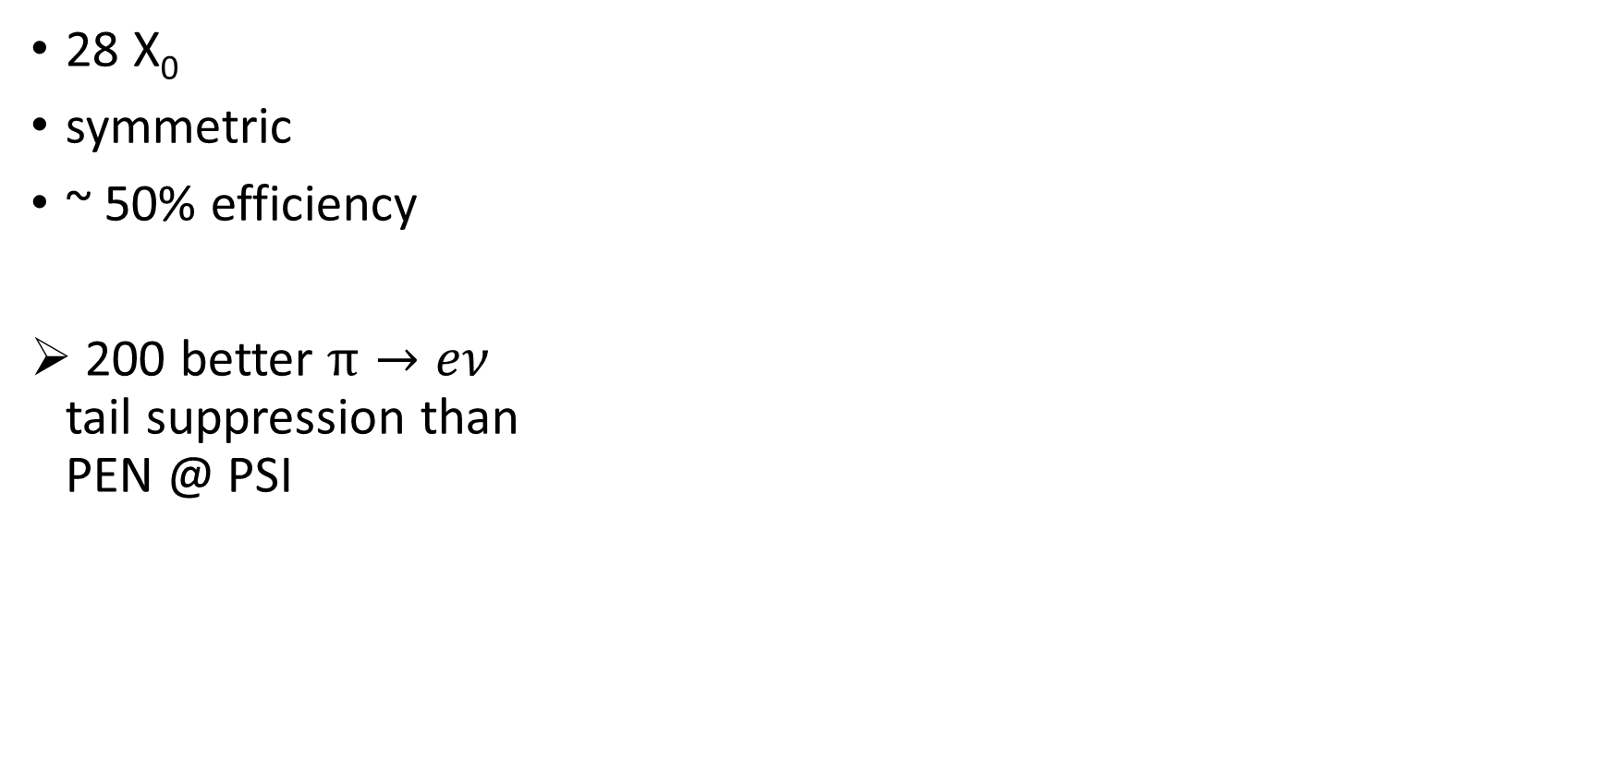
LXe calorimeter for PIENUXe
Dinko (UVa)
28 X₀
symmetric
~ 50% efficiency
200 better $π→eν$
tail suppression than
PEN @ PSI

Slide 17
Prompts from organizers – (we return to this at the end)
What ideas could (or could not) be turned into actual experiments at TRIUMF/CENPA?
  A next-generation Rare Pion Decay seems to be our clear focus: Nicknamed (for now) PIENUXe
What homework do we need to do to figure this out?
  Beamlines investigations;
    We know demands from prior efforts. We made good progress in a review of the capabilities and specific options at PSI, and on the limitations and conflicting demands. PSI would “welcome” this.
    The situation at TRIUMF is less clear. There is no “ready to go/borrow/steal” beamline, but there are options with existing areas/lines, or new ones to be considered dedicated to this effort.
  Calorimeter concept.
    Expertise in this group from MEG’s development of LXe and SiPMs. There success is based on a significant R&D efforts and real use of the detector. A huge advantage to draw from.
    We did not discuss crystal calorimeter ideas, but in the bigger picture we will need to address options, even if to simply provide needed comparisons related to funding.
    There are many challenges with windows, readout, cost, geometry, calibrations, installation, …
  Stopper/Tracker “combination”
    Strong case made to track the stop and track the decay positrons from that vertex. Can this be done with modern developments?
    Learned of a candidate new technology that would be great, but made of XY strip geometry. Might be okay ? But have to begin thinking
  Monte Carlo Simulations
    A modified PEN GEANT code has been extracted and readied for use with “toy” detector ideas. Some runs done with LXe calo to demonstrate the importance of a deep calorimeter to address the “tail” systematic in pi e nu, the leading problem.
Should we form a working group to answer such questions? Who are key people to target for this working group?
  The group said “Yes”. The work naturally falls in various divisions related to technological expertise, theory, simulation, beams, …
  We will assemble (softly) with the aim of real homework prior to DND 2021 / Snowmass. Lively email exchanges started.
  We want to, and need to, enlarge the interested parties prior to developing any “formal organizational structure”

