Slide 1


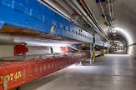
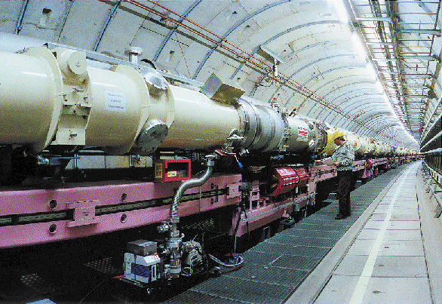
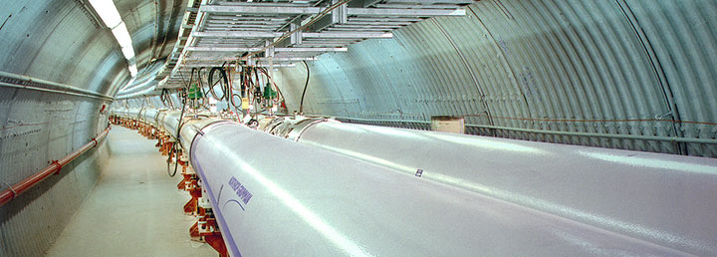
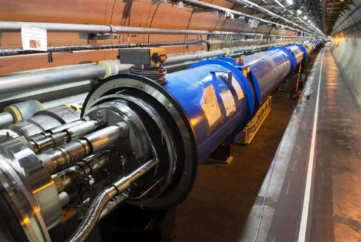
High Field Magnets
for accelerators
Frédérick Bordry
Tevatron
HERA
RHIC
LHC

Slide 2
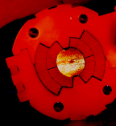
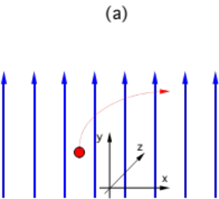

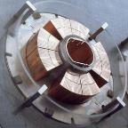
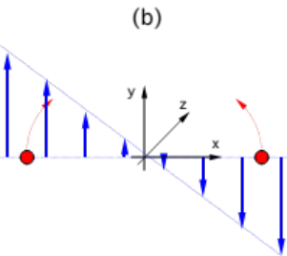
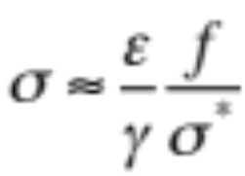
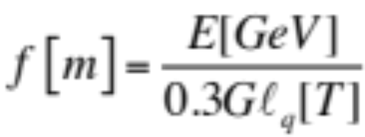

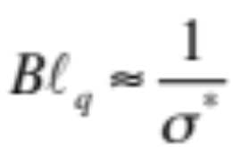
High field accelerator magnets : B ⇑
Beam energy
Bending radius
Dipoles
relativistic synchrotron
Dipole field
  Design for the largest feasible and economic B to reduce the accelerator radius.
  To push and invest in Technology instead of civil engineering !
Final focus quadrupoles
Peak coil field
Emittance
Focal length
Beam size at the quadrupole
Lorentz factor
Integrated quadrupole gradient
Beam size at the collision point
Design for the largest feasible and economic integrated field to achieve the smallest beam size at the IP

Slide 3
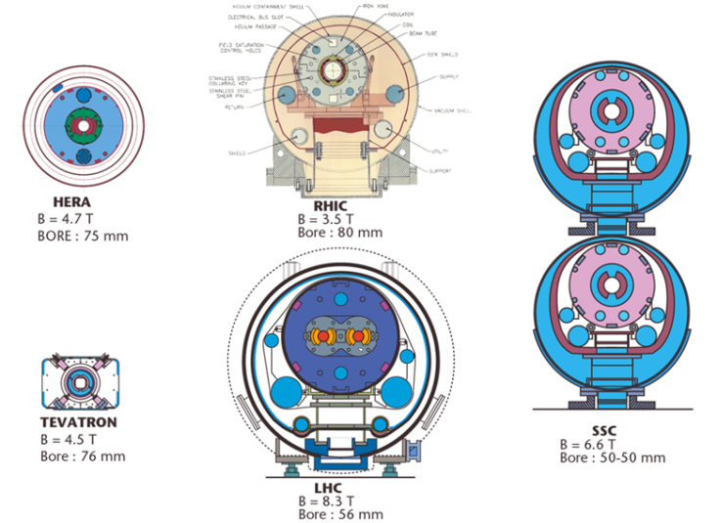
Superconducting accelerators : dipoles
Design and tested at 9T
In operation
High Field magnets ≥ 9T

Slide 4
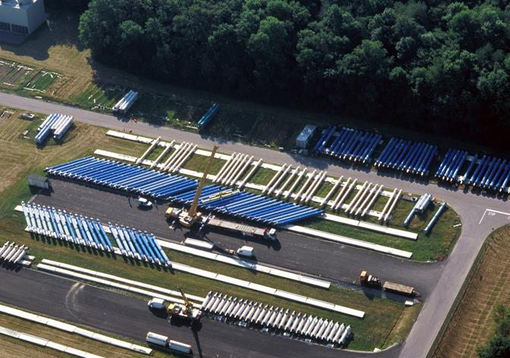
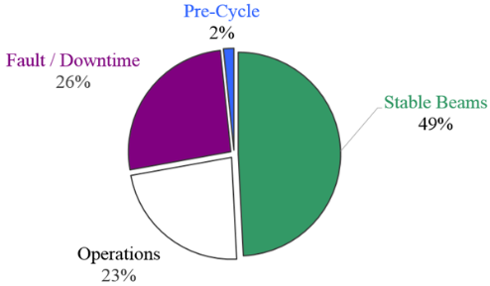
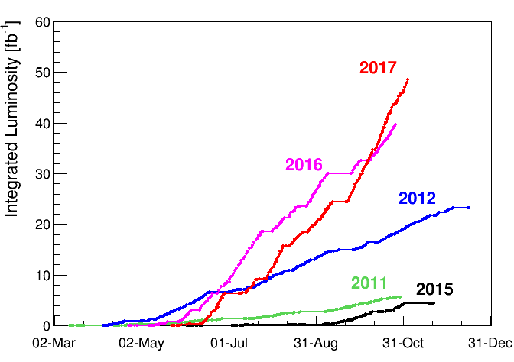
HFM LHC: it works !
1232 dipoles and 400 quadrupoles
produced and in operation

Slide 5
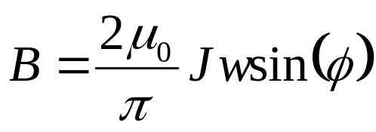
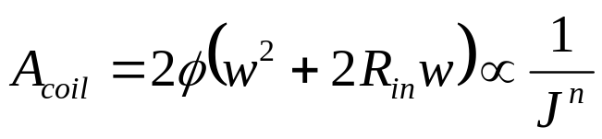
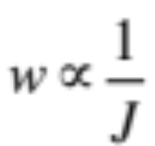

Superconducting magnets : current density ⇑
Dipole field generated by a current distribution with constant current density J over a sector of inner radius R_{in}, outer radius R_{out}, coil width w = R_{out}-R_{in} and opening angle ϕ
n ≈ 1…2
In the range of typical magnet designs considered n≈1.5
B = Cte
R_{in}
ϕ
w ↓
w
J ⬆
B | (T) | 16 |  |  | 16
J | (A/mm²) | 300 |  |  | 600
w | (mm) | 76 |  |  | 38
A_{coil} | (mm²) | 20,000 |  |  | 7000
Factor 2
and space
Factor 3

Slide 6
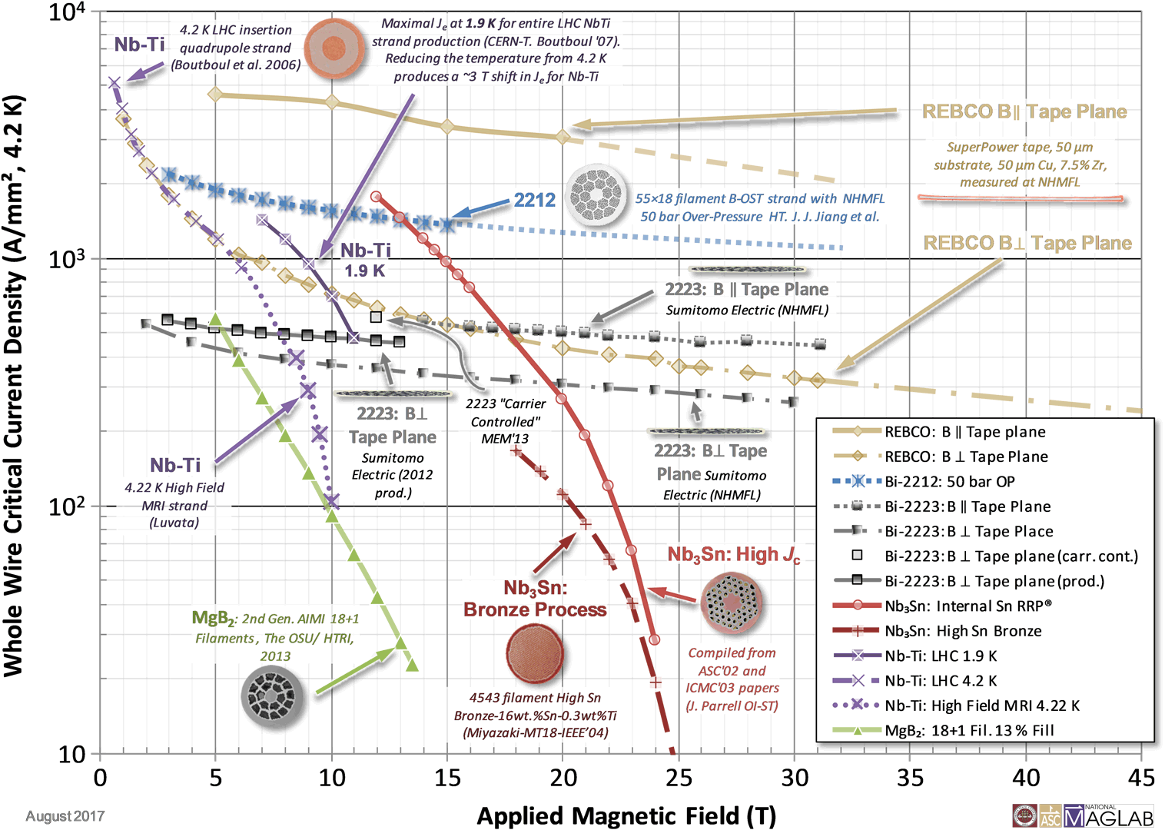
Superconductor landscape
The grand challenge of today is to develop the technology of high-field conductors getting the maximum by minimising the cost:
Jc increase
Bi-2212 (B-OST)
REBCO (EuCARD2, B-HTS)
LHC
(8.33 T)
FCC
(16 T)
REBCO
600 A/mm²
Nb₃Sn
Nb-Ti
Courtesy of P. Lee, D. Larbalestier and D. Abraimov

Slide 7

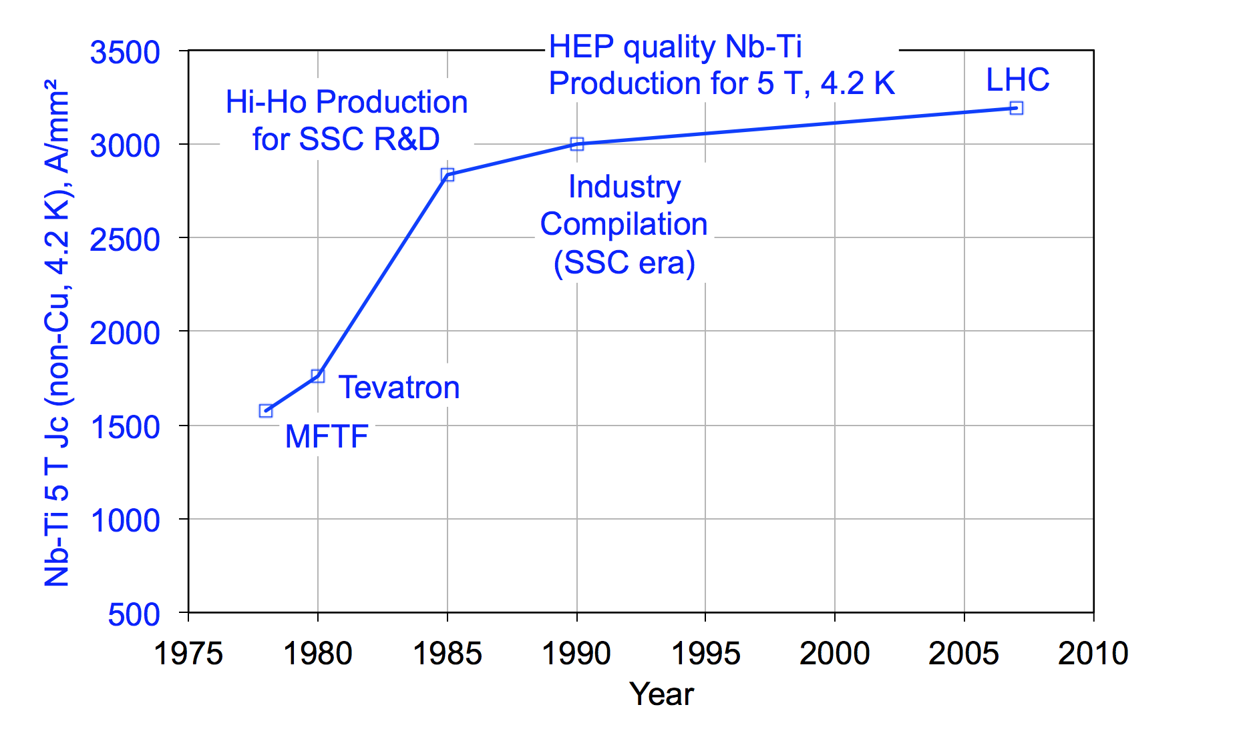
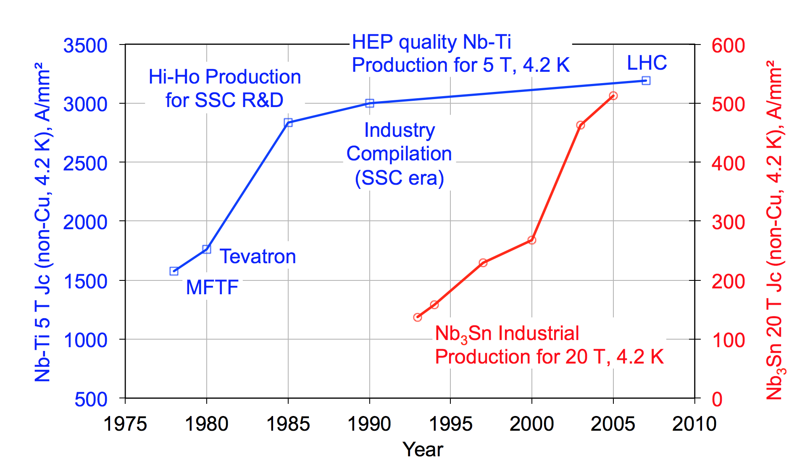
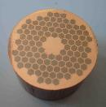
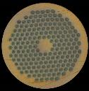
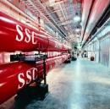
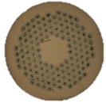
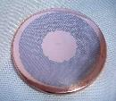

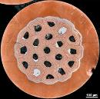
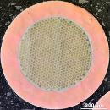
LTS performance: Jc increase
1300 tons of Nb-Ti
SSC R&D
HL-LHC
wires
US-CDP
EU-FP6/FP7
ITER wires
CDP: Conductor Development Program
Data by courtesy of J. Parrell (OST)

Slide 8
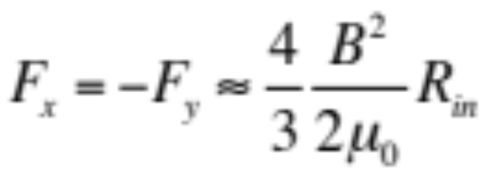
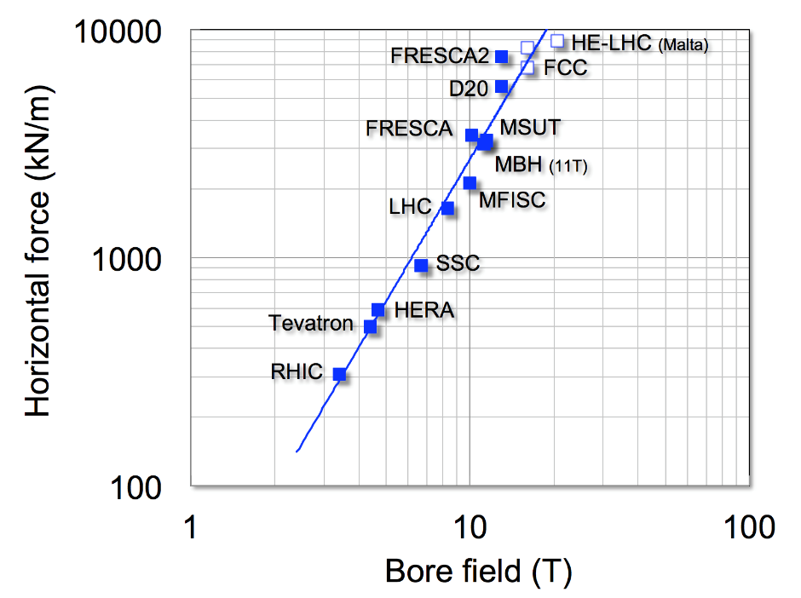
Mechanics at high fields: Lorentz force ⇑
Lorentz forces in the plane of a thin coil of radius R_{in} generating a dipole field B (thin shell approximation), referred to a coil quarter
F_{x}
F_{y}
Progression of F_{x}:
LHC MB(8.33T) ≈ 1700 kN/m
LHC MBH(11T) ≈ 3200 kN/m
FRESCA2(13T) ≈ 7600 kN/m
FCC MB(16T) ≈ 8000 kN/m
HE-LHC MB(20T) ≈ 10000 kN/m

Slide 9
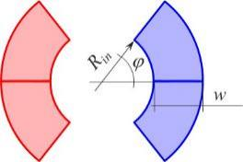
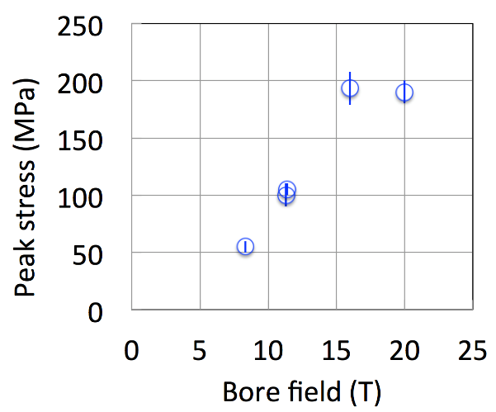

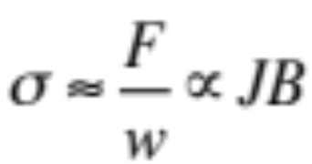
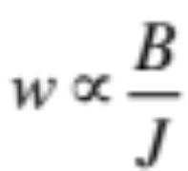
Stress in high field magnets: peak stress ⇑
Stress limited
reducing J
FCC
HE-LHC
QXF
Unconstrained scaling
11T
LHC
The challenge of mechanics:
  - Appropriate support concepts for the coil (bladder-and-key, stress management, canted-cosinus-theta, …)
  - Manage the Increasing stress on the conductor (limit of materials !)
  - Limit mechanical energy release (=> training)

Slide 10
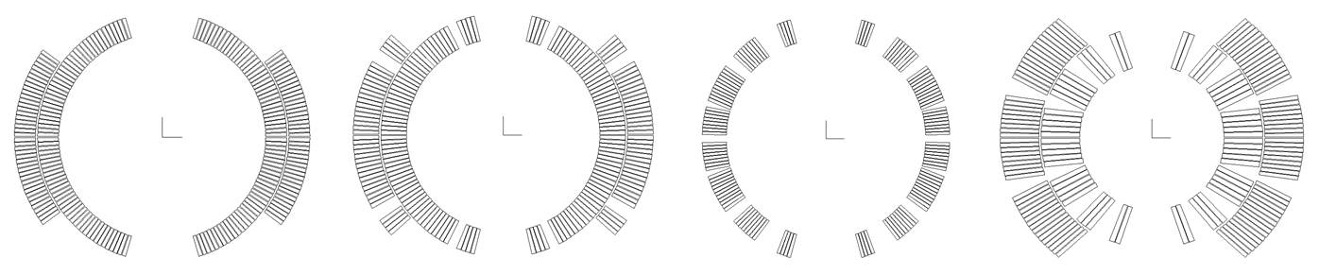

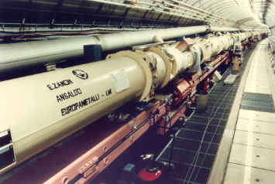
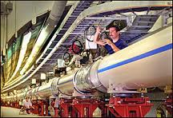

Stress in high field magnets: past and present accelerators
all cosθ, all Rutherford cables
Tevatron
HERA
RHIC
LHC

Slide 11
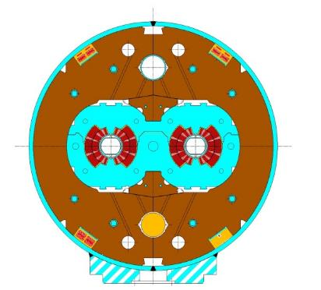
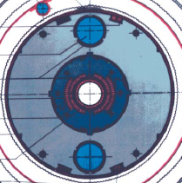
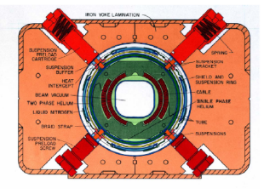
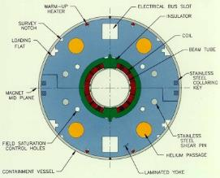
Stress in high field magnets: but different structures
Rutherford cable Collars Aust. Steel
Warm iron
Collars Al alloy
Cold iron
Collars Aust. Steel + yoke
Twin apertures
Cold yoke as collar
Tevatron
HERA
RHIC
LHC

Slide 12
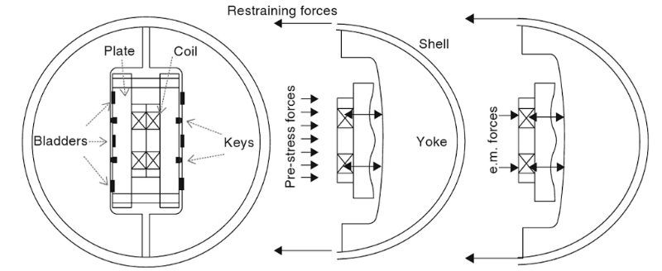
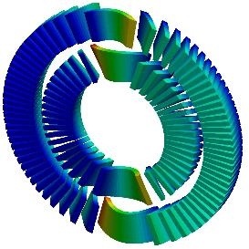
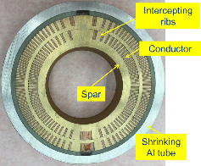
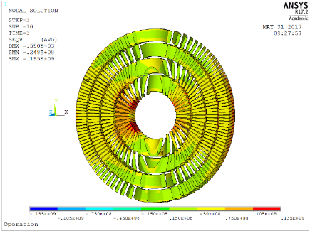
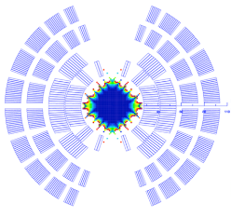

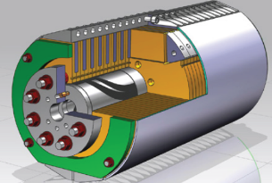
Stress in high field magnets: new structures
2014, LBNL: CCT
S. Caspi, et al., IEEE TAS (2014), p. 4001804.
2002, LBNL: Bladder and keys
R.R. Hafalia, et al., IEEE TAS, 12(1) (2002), pp. 47-50.
Canted-Cosinus-Theta (CCT) option
2017, FNAL: SM cos(θ)
V. Kashikin, et al., Proc. IPAC, Copenhagen (2017), pp. 3597-3599.
LBNL
135 MPa
on the conductor
FNAL

Slide 13
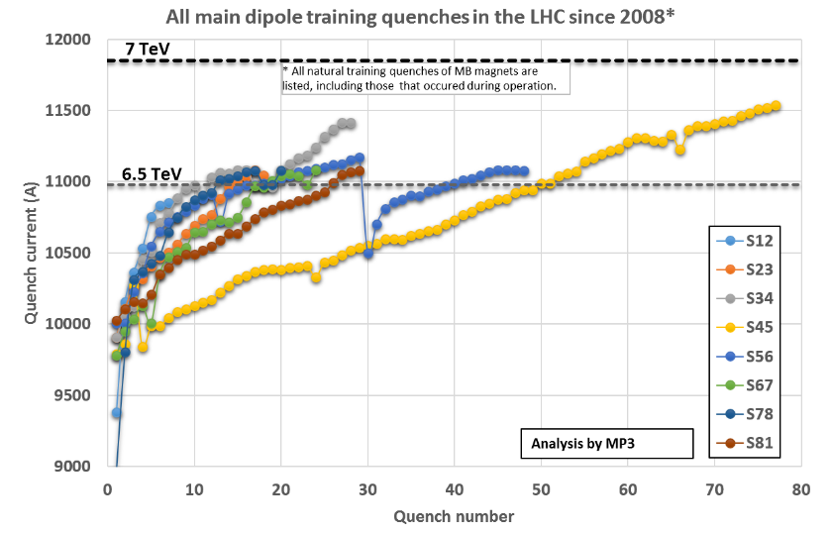
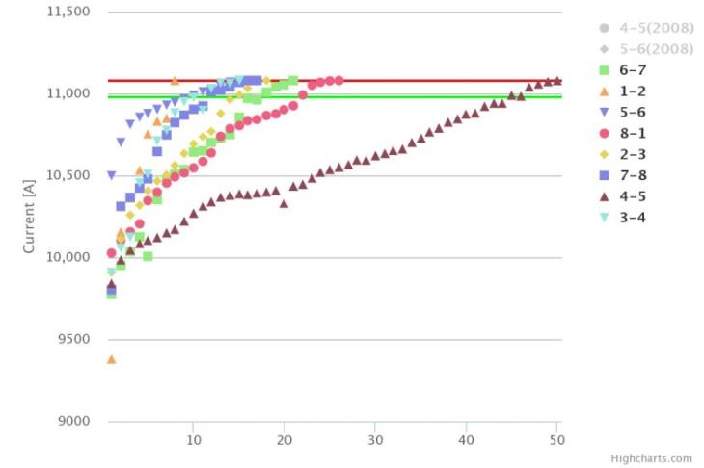
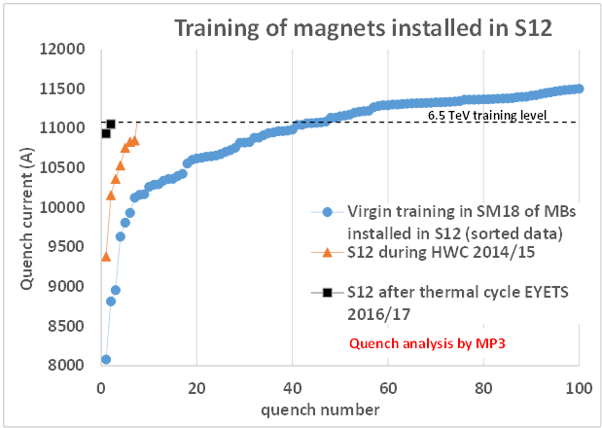

LHC Training Dipoles
2015
Each Sector Trained to 6.55TeV (11080A)
(100 A above the operational field)
≈ 7.82 T
172 training quenches
∼600 secondary quenches
Only 1 quadrupole quench
End of 2016
2017
    ramp with a short to ground appearing ∼1.5s after the1st magnet quench
Earth Fault Burner !
capacitive current discharge

Slide 14




Stored Energy and Protection at high fields: E⇑
Energy per unit length in a sector coil of inner radius R_{in}, outer radius R_{out}, coil width w = R_{out}-R_{in} producing a dipole field B
Voltage per unit length for an external dump with time constant τ
J_{C} ≈ 1000…1250 (A/mm²)
dT/dt ≈ 1000…2000 (K/s)
τ_{(300 K)}≈ 0.15…0.3 (s)
I_{op} ≈ 15 (kA)
E/l ≈ 1000 (kJ/m)
V/l ≈ 500…1000 (V/m)
It is not possible to protect accelerator magnet strings using an external dump
HFM must support its own quench !

Slide 15




Stored Energy and Protection at high fields: E⇑
In the range of typical magnet designs considered n≈1.5
Ultimate
hot-spot limit
Typical energy densities e:
LHC MB(8.33T) ≈ 50 MJ/m³ (one 15m magnet 7 MJ)
LHC MBH(11T) ≈ 85 MJ/m³
FRESCA2(13T) ≈ 100 MJ/m³
The challenge of protection:
  - Fast detection and internal dump (spread the energy)
  - Material and coil limits (hot-spot, thermal stress, voltage)
  - Energy extraction for magnet string (interconnections, energy extraction,
  massive quenches,...)

Slide 16



Protection of LHC sector (154 magnets in series)
I_{o} = 13 kA
Circuit time constant = 23’000 s
Discharge time constant = 120 s
Notes:
Possible suppression ?

Slide 17
LTS (NbTi ; Nb₃Sn)
NbTi mature but limited to 9T
Is Nb₃Sn mature ? Yes, and no
  Performance of Nb₃Sn wires has seen a great boost in the past decade (factor 3 in J_{C} w/r to ITER)
  However, Nb₃Sn accelerator magnets were never built nor operated in accelerators.
  Manufacturing, strain tolerance, protection, quench, training, field quality are the focus today to make this new technology a reality
  Solid and aggressive R&D in Nb₃Sn High Field Magnet for accelerators must be intensified to increase further critical current Jc (up to 16 T)

Slide 18


The HL-LHC Project: 300 fb⁻¹ → 3000 fb⁻¹
New IR-quads Nb₃Sn
(inner triplets)
  New 11 T Nb₃Sn
  (5.5 m dipoles)
  Crab Cavities
  Collimation upgrade
  Cryogenics upgrade
  Cold powering
  Machine protection
  …
Major intervention on more than 1.2 km of the LHC

Slide 19






HL-LHC 11T dipole (MBH) R&D
MBHSP101
MBHDP101
Aperture | 60 | (mm)
Field | 10.8 | (T)
Current | 11850 | (kA)
Peak field | 11.35 | (T)
12.37 T
RRP strand (0.7 mm,108/127)
J_{C}: 2450 A/mm² (12 T, 4.2 K)
Cu:non-Cu: 1.15
40 strands cable
(14.7 mm x 1.27 mm)
Courtesy of F. Savary, J. C. Perez, G. Willering, CERN

Slide 20








HL-LHC quadrupole R&D
RRP strand (0.85 mm,108/127)
J_{C}: 2450 A/mm² (12 T, 4.2 K)
Cu:non-Cu: 1.2
The challenge for high field magnets:
  - Limit the training and keep memory !
  - Increase J_{op}/J_{C} (presently at ≈ 40 % for Nb₃Sn at 1.9 K)
Aperture | 150 | (mm)
Gradient | 132.6 | (T/m)
Current | 16.47 | (kA)
Peak field | 11.4 | (T)
40 strands cable
(18.15 mm x 1.52 mm)
Courtesy of G. Ambrosio, G. Chlachidze, US-LAUP and CERN

Slide 21






Nb₃Sn quadrupole: 1st long prototype under construction
Second short (1.5 m) under preparation for test at CERN
Insertion of coil package inside mechanical structure of the first IT quad prototypes (4.2 m long) in LBNL-USA
Courtesy of Frédéric Savary

Slide 22








HL-LHC Nb3Sn magnets planc
LHC Run II
≈ 100 fb⁻¹
LS2
LHC Run III
≈ 300 fb⁻¹
LS3
Opportunity for first industry experience on Nb₃Sn accelerator magnets

Slide 23



Future Circular Collider
 | LHC | FCC
Circumference (km) | 26.7 | 97.5
Dipole field (T) | 8.33 | 16
C.o.M. energy (TeV) | 14 | 100

Slide 24




Nb₃Sn conductor program
Nb₃Sn is one of the major cost & performance factors for FCC-hh and is given highest attention
Main development goals until 2020:
J_{c} increase (16T, 4.2K) > 1500 A/mm² i.e. 50% increase wrt HL-LHC wire
Reference wire diameter 1 mm
Potentials for large scale production and cost reduction
5400 mm²
3150 mm²
~1.7 times less SC
~10% margin
HL-LHC
~10% margin
FCC ultimate
Notes:
New slide from Davide.
Showing that conductor development is launched at international level, Russia, Japan, (Korea and Europe in preparation)
Underline importance of that development as main cost driver for the hadron collider machine.

Slide 25





collaborations FCC Nb₃Sn program
Established worldwide activities for development:
Procurement of state-of-the-art conductor for prototyping: Bruker (OST)– European/US =>1500 A/mm2 @ 16T, 4.2K
Stimulation of conductor development with regional industry:
  CERN/KEK – Japanese contribution. Japanese industry (JASTEC/KobeSteel, Furukawa) and laboratories (Tohoku Univ. and Tokai University)
  CERN/Bochvar High-technology Research Inst. – Russian contribution. Russian industry (TVEL) and laboratories
  CERN/KAT – Korean industrial contribution
Characterization of conductor & research with universities:
  Europe: Technical Univ. Vienna, Geneva University, University of Twente
  Applied Superconductivity Centre at Florida State University
Notes:
New slide from Davide.
Showing that conductor development is launched at international level, Russia, Japan, (Korea and Europe in preparation)
Underline importance of that development as main cost driver for the hadron collider machine.

Slide 26








16 T dipole design activities and options
Swiss contribution
H2020
Cos-theta
Common coils
Canted
Cos-theta
Blocks
INFN
CIEMAT
LBNL
CEA
PSI
FNAL
Short model magnets (1.5 m length) will be built from 2017 - 2021

Slide 27







Cos-theta, 4 layers, 15 T dipole
Simplify assembly, reduce cost
L1-L2: 28 strands, 1 mm RRP 150/169
L3-L4: 40 strands, 0.7 mm RRP 108/127
Assembly and test expected in 2018
Courtesy of A. Zlobin, FNAL

Slide 28









The US Magnet Development Program is progressing with the development of high-field superconducting accelerator magnets on multiple fronts
Dev. of Canted Cos-theta (CCT) concept
Achieved 86% short sample with 2 layers;
- 9.14T bore-field, 90mm bore
Significant training
- focus of ongoing research
Novitski MT25
Arbelaez, MT25
Steady progress on 4-layer Cosine-theta at FNAL
Wang, MT25
Marchevsky, EUCAS17
First use of CORC® cable in CCT geometry
- Focusing on technology issues, enhancing J_{E}

Slide 29


16 T cryo-dipole integration approach
Design strategy: develop a single 16 T magnet, compatible with both HE LHC and FCC-hh requirements:
  Goal is reduction of external diameter to ~1200 mm (16 T cryostat design based on “classical” approaches gives ~1500 mm diameter!)
  Options und consideration:
    Allow stray-field and/or cryostat as (partial) return-yoke
    Active compensation with (simple) shielding coils
    Optimization of inter-beam distance (compactness of coils)
    (QRL integrated in magnets, → negative impact on integral field because of longitudinal space required for service module (5%))
  → Smaller diam. also relevant for FCC-hh cost optimization
  → Design optimization for specific project after decision
Example magnetic cryostat
coldmass 40t, total mass 62t
Description | ID in mm | OD in mm
Iron yoke | - | 600
Aluminium shrinking cylinder | 600 | 740
Stainless steel He tight shell | 740 | 760
Al radiation shield | 934 | 940
Vacuum vessel (magnetic steel) | 1120 | 1220

Slide 30



Super proton-proton Collider (SppC)
 | LHC | FCC | SppC
Circumference (km) | 26.7 | 97.5 | 100
Dipole field (T) | 8.33 | 16 | 12…24
C.o.M. energy (TeV) | 14 | 100 | 70…125
Courtesy of Q. Xu, IHEP

Slide 31



China high-field magnet R&D
Baseline design
  Tunnel circumference: 100 km
  Dipole magnet field: 12 T, iron-based HTS technology (IBS: Iron-Based Superconductor)
  Center of Mass energy: >70 TeV
Upgrade phase
  Dipole magnet field: 20…24T, IBS technology
  Center of Mass energy: >125 TeV
Development of high-field superconducting magnet technology
  Starting to develop required HTS magnet technology before applicable iron-based wire is available
  ReBCO & Bi-2212 and LTS wires be used for model magnet studies and as an option for SppC: stress management, quench protection, field quality control and fabrication methods
Top priority: reduce cost!
Instead of increasing field
Conceptual design of common coil 12T dipole
Courtesy of Q. Xu, IHEP

Slide 32
HTS
Can HTS displace LTS (NbTi, Nb₃Sn) ?
Not today (performance and cost)
  Much needs to be done to bring this technology to a point where it can be sold as “mature”
    Materials have potential that can be exploited
      OPHT for BSCCO-2212
      Thicker layer for YBCO tapes
      The Holy Grail of a round YBCO wire
      ….
  Production quantities, homogeneity and cost need to evolve
  Step-up application demands, from self-field (SC-link is an ideal test-bed) to high-field accelerator magnets (feasibility)

Slide 33





Ideas for 20 T
A 20 T HE-LHC dipole
L. Rossi & E. Todesco, (CERN)
Stress managed winding
A 24 T LHC Tripler
P. McIntyre (TAMU)
Nb₃Sn
HTS
Nb-Ti
All options are based on an LTS winding (outsert), and an HTS field booster (insert)
Cost optimized, graded winding

Slide 34







HTS for 20 T
BSCCO-2212, CERN provides precursor powders, US program produces wire and cable
Sample of US BSCCO-2212 cable
REBCO option (Roebel)
EuCARD2 program, targeting a 5 T, 40 mm aperture demonstrator, in collaboration with EU laboratories and industry
US-BSCCo program, testing alternative materials and coil configurations (CCT)

Slide 35




US high-field magnet R&D
Nb3Sn
16 T
HTS
20 T
Improvements in Bi2212 powder, overpressure processing, and magnet fabrication now yielding
Shen, EUCAS17
Jiang, EUCAS17
J_{E,cable}=730 A/mm²
Competitive with Nb₃Sn at ~14T

Slide 36
High Field Magnet challenges
- To increase the critical current Jc
- To sustain larger forces
- To protect those magnets (large numbers in series)
To train those magnets faster
To keep the memory after installation and thermal cycles
Global optimization: magnet and powering
current leads, superconducting links, energy extraction, power converters

Slide 37










Superconducting magnet market
At present, the vast majority of the use of superconductors is for magnet applications:
  MRI (NbTi): 5.5 BUSD/year^{[1]};
  7.0 BUSD/year in 2017
  NMR, science and research: (Nb3Sn)
  ∼ 1 BUSD/year^{[1]}
Large scale projects (HEP, Fusion) represent only a fraction of the total market and discontinuities:
  Evaluated cost of LHC magnet system (material): 2 BUSD^{[2]}
  Quoted cost of ITER magnet system (material): 1.4 BUSD^{[3]}
MRI
NMR
LHC
JT60SA
ITER
Sources: [1] from market report at Conectus.org, converted from repored 5.3 BEUR in 2013
[2] Report to the CERN Finance Committee, 2008, reported 1.7 BCHF(2008) escalated to 2013
[3] DOE Assessment of the ITER Project Cost Estimate, reported 1.09 BUSD(2002) escalated to 2013

Slide 38
Superconducting conductor production
NbTi in the world : ∼ 600 tons/year, driven by MRI production
Nb3Sn : ∼ 10 tons/year, driven by NMR magnets and laboratory solenoids
All of HTS (BSCCO, YBCO,…) and MgB2: around 100...200 km of 4-10 mm wide tape per year, presently driven by R&D applications and delivered by around 10 worldwide producers,
In total below 1 ton/year
LHC required 1300 tons of Nb-Ti (300 t/year peak production) (∼30% cost of the magnet)
ITER required 300 tons of Nb-Ti and 600 tons of Nb3Sn (250 t/year peak production)
HL-LHC requires: 30 tons Nb3Sn and about the same for NbTi
HE-LHC will require : ∼ 3’000 tons Nb3Sn
FCC-hh will require : ∼ 9’000 tons Nb3Sn (between 50% to 60% cost of the magnet)

Slide 39



Conductor cost
≈ 30-100
Nb₃Sn: HE-LHC, FCC:
Goal 3.5 €/kA.m
at 16 T and 1.9 K
500...600 EUR/kg, i.e. a factor 2.5...3 better than what the present cost 1300...1500 EUR/kg for HL-LHC (RRP)
€/kA.m
15 m
16 Tesla

Slide 40

Large-scale science, and HEP, have driven major advances in conductors, by consistently pushing performances beyond the state of the art of industrial production, striving to achieve high and stable J_{C}, small filament diameter, high homogeneity, and demanding quality standards
But due to long period (longer !) between project it’s problematic to maintain high performance productions and competition.
Now only ONE conductor qualified (Jc) for HL-LHC (Bruker acquired Oxford Instruments -Nov. 2016- and stopped PIT [Powder In Tube] cable production, now only RRP [Restack Rod Process]): high risk !
How to develop R&D and to prepare production for future high energy accelerator and fusion tokamak (DEMOs,…in spite of lower Jc performance) :
Proposal of a Global R&D superconductor center: To develop and maintain the know how and to transfer it to industry when a project is approved (industries are assemblers and not responsible for the performance but for the Q&A production)
HE-LHC, FCC, SppC
LHC
ITER
DEMOs
Tevatron
HERA and RHIC
HL-LHC

Slide 41


A tentative summary: HFM roadmap for accelerators
The LHC High-Luminosity Upgrade is the foundation for new HFM magnet technology for accelerators, and provides an interesting opportunity for industry
Nb₃Sn accelerator magnet development and production
  Production in 2018-2023
  First use ever of Nb₃Sn in a running accelerator ! (8T to 12T)
The next step is the development of magnets for high energy accelerator : 12T to 16T
(SppC, FCC, HE-LHC,...)
  Model activities are planned in European, US and China laboratories in 2018-2022
  Prototyping in industry (full length, ≈ 5-10 magnets), in 2023-2026
  Performance (Jc), stress, stored energy management, field quality, and cost
  This is the logical sequence of the HL-LHC production, profiting from Nb₃Sn technology established in laboratories and industry (Global Approach)
HTS is only in its infancy, but is the disruptive HFM technology of the further future
  HTS for special applications (energy distribution and current leads for SC magnets) and as option for the 20T (24T ?) programme (insert)
  Niche magnets for next accelerators (as final focussing magnets,…)
  Requires high-tech R&D, spanning from material science to electromechanical engineering, 5-10 years program defined
  More producers than Nb₃Sn: medical, energy (production and transport),… markets
  HTS is the high-risk/high-return investment of the future
Notes:
Please convey my apologies and best wishes for a successful workshop

Slide 42




Acknowledgements and sincere thanks to all the people from whom I have begged, borrowed or stolen slides, especially Luca Bottura, Lucio Rossi, Qingjin Xu, Steve Gourlay and US colleagues, … and many unidentified persons from laboratories and industries.
Thanks for your attention
Cos-theta
"La fonction la plus élémentaire de l'être humain, c'est de créer de l'avenir"
"The task of the mind is to produce future"
Paul Valéry

Slide 43
Objectives of the HFM network
Have an open forum that meets regularly to be able to discuss common scientific and technical issues in a targeted way
Make and maintain a comprehensive map of the HFM landscape, independently of participation to specific projects (EU or non-EU)
Disseminate the plans, progress and issues of the HFM projects to all the partners
Offer intellectual support to the projects
Provide access to the above forum to students and staff of all educational institutions independent of participation to a specific project (EU or non-EU)
Find and co-opt new partners, with relevant interest and contribution in HFMs, whether active in accelerator or other fields

Slide 44
HFM Network Founding meeting on 22 September
17 institutes and universities voted to to join the provisional network
  CEA, CERN, Bochvar, PSI, Ubologna, INFN-Mi, INFN-Ge, EMFL, ASC-FSU, INP-Grenoble, ASIPP, KIT-ITEP, Utwente, EPFL-SPC, LBNL, FNAL, UNIGE
A provisional Steering Committee was elected with 5 members from:
  CEA, CERN, LBNL, PSI, Utwente for a period of 6 months
  A provisional Spokesperson was elected (Gijs de Rijk) for a period of 6 months
A set of provisional bylaws was commented, edited and approved
  The provisional SC will update and adjust the provisional bylaws
  The provisional General Assembly (17 members) will approve and propose further bylaw modifications during the 6 months
The next GA will take place in March
When the provisional bylaws are finalised they can be send to the legal departments of the members for verification, proposed modification and approval. We will probably need an iteration on the bylaws to get them in line with the legal requirements of the members
After that the network members can confirm their membership with a confirmation letter and the network becomes permanent
For the time being CERN will serve as repository for the confirmation letters
This process will probably take up to next summer

Slide 45






MgB₂
20+20 m

Slide 46

Major stakes for the energy needs of the future
Courtesy of RTE (Réseau de Transport d'Électricité )
Electricity transmission system operator in France

Slide 47

Nb₃Sn production for ITER
J_{c} lower than
for FCC,
but large
scale
production
Large
scale
production

Slide 48






e.g. HFM markets
DEMO
NMR: 28.2T (?)
4 mm YBCO tape

