Slide 1
Advances in Nuclear Theory
Jason D. Holt
ICFA Seminar, 6 November 2017
Notes:
----- Meeting Notes (12/5/16 22:53) -----
`

Slide 2
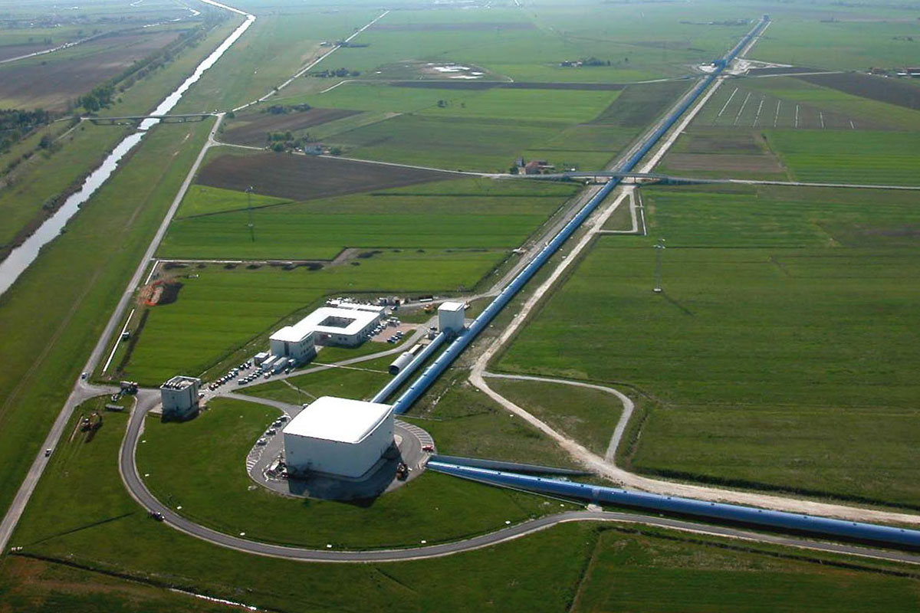
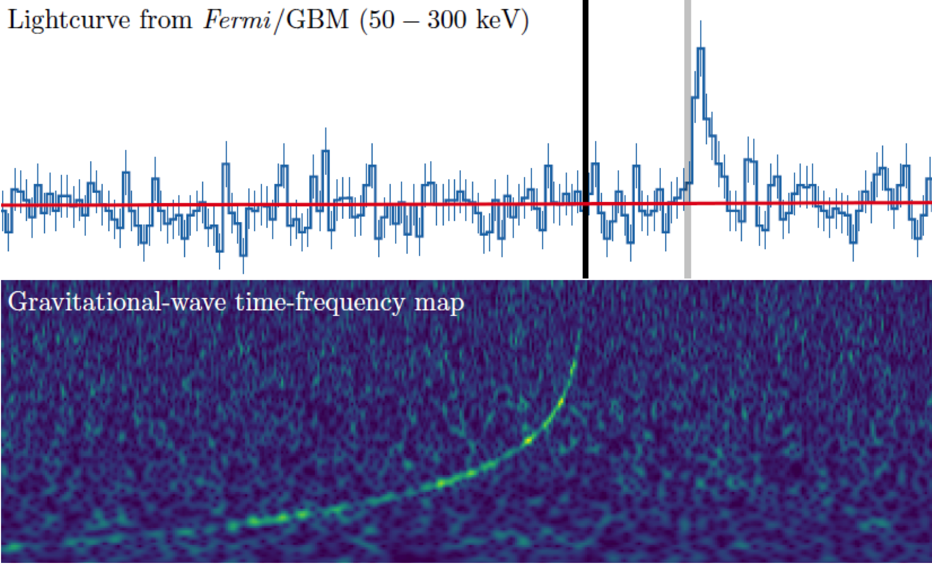
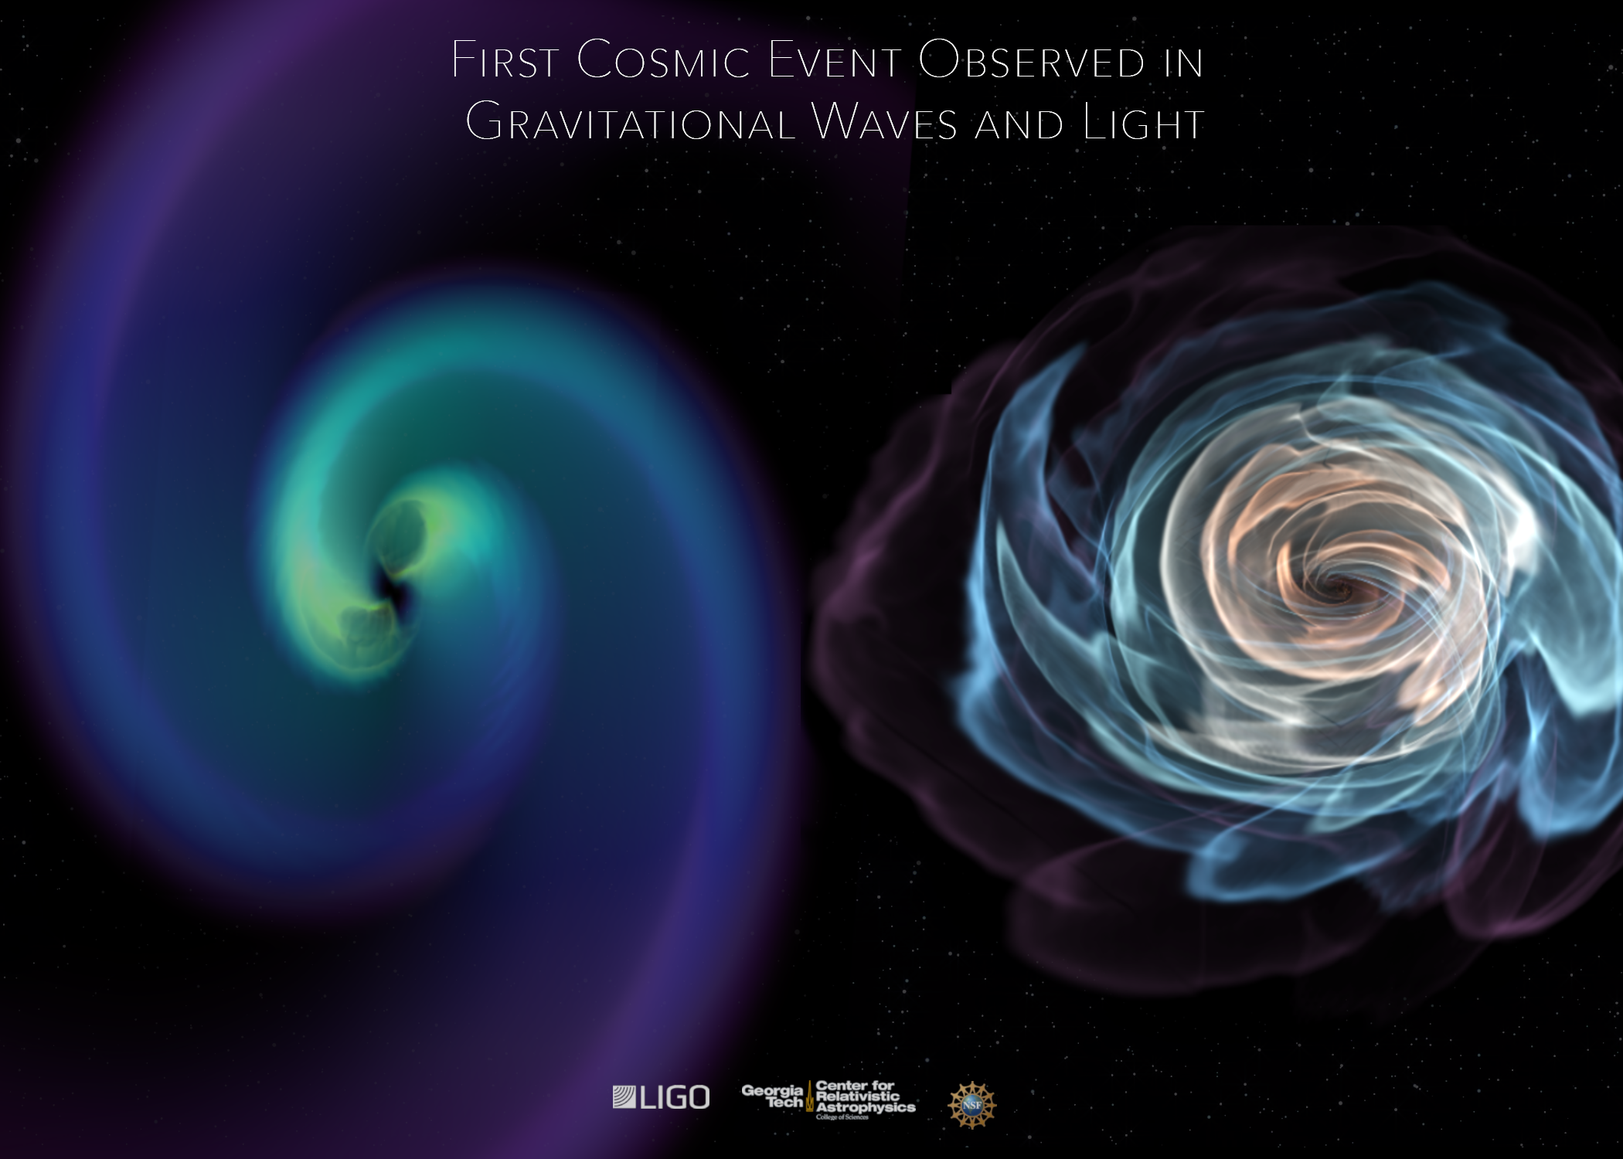
A Recent Breakthrough
August 17, 2017 LIGO detects first gravitational waves
from merging neutron stars!
Coincident with visual signal from Fermi telescope
Explains origin of gamma-ray bursts

Slide 3

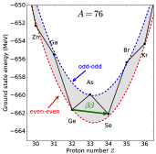
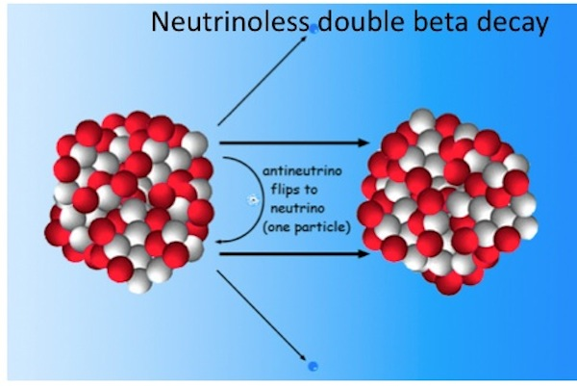
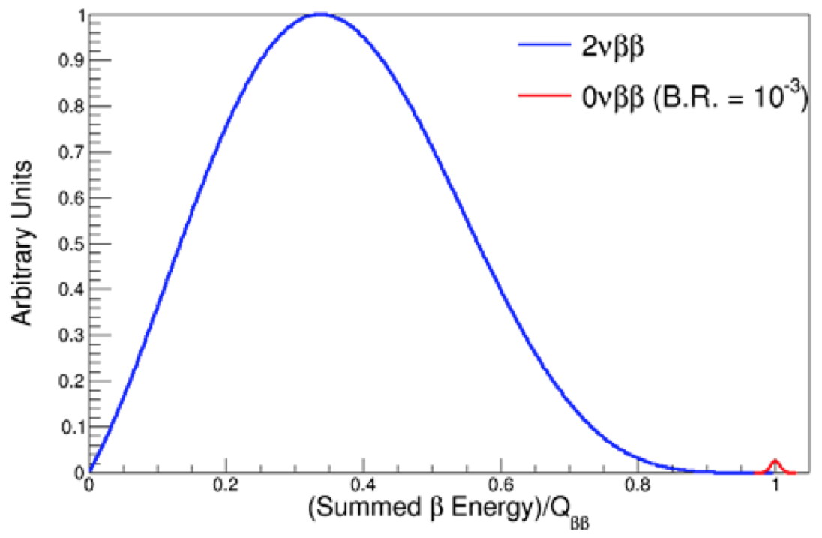
The Next Big Discovery: 0νββ-decay?
Neutrino own antiparticle 0νββ decay
Tremendous impact on BSM physics:
Lepton-number violating process
Majorana character of neutrino
Absolute neutrino mass scale

Slide 4
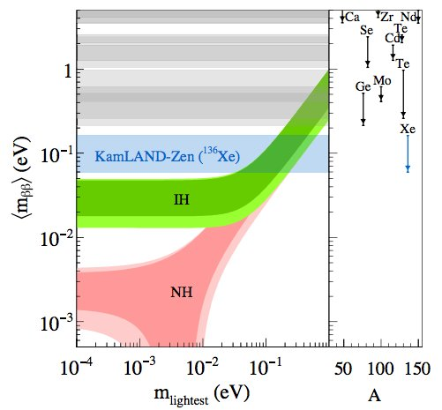
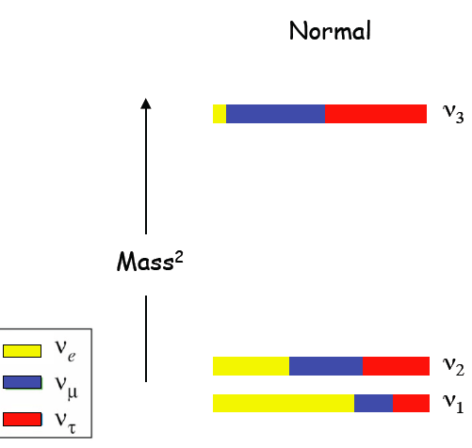
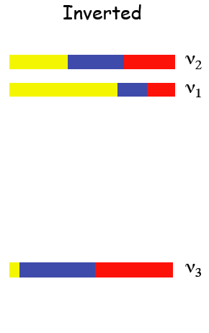
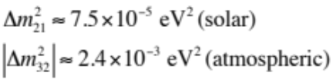


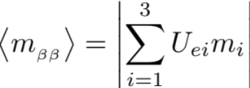
The Next Big Discovery: 0νββ-decay?
Progress in large-scale searches pushing towards IH
Essential ingredient:
Nuclear matrix element

Slide 5
The Next Big Discovery: 0νββ-decay?
Progress in large-scale searches pushing towards IH
Major uncertainty from Nuclear Matrix Element
Essential ingredient:
Nuclear matrix element

Slide 6
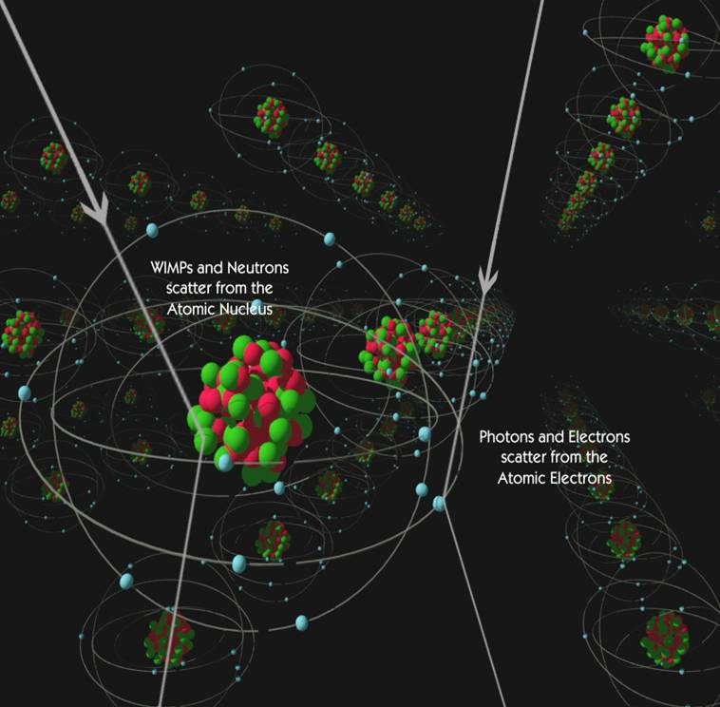
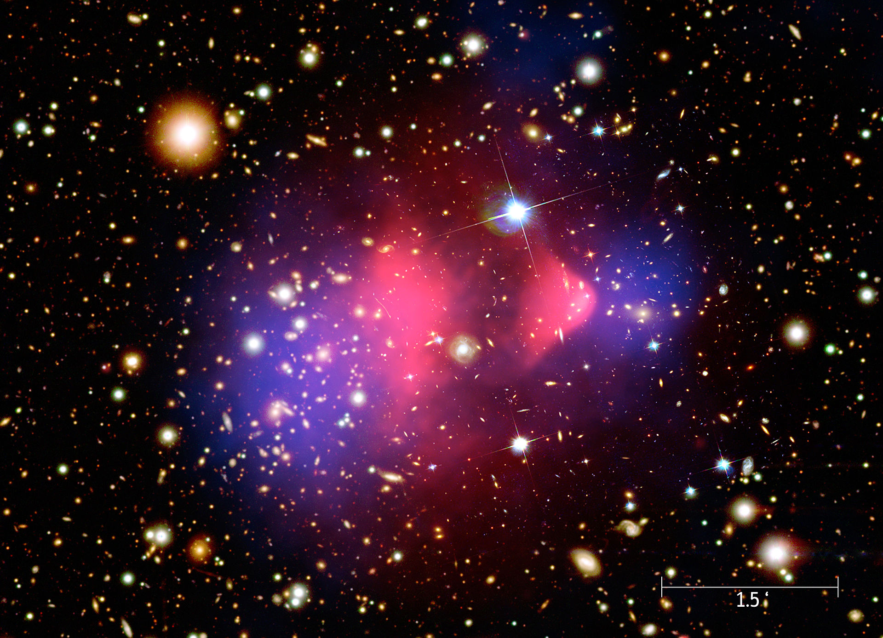
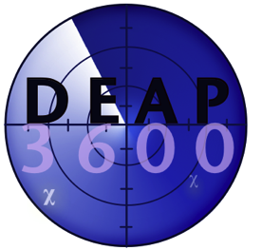


Next Big Discovery: Nature of Dark Matter?
Many direct-detection searches underway worldwide
Direct detection:
Leading candidates: neutralinos
Couples primarily to scalar and axial-vector currents in atomic nuclei
From CDMS collaboration
Wikipedia Commons
Observation of nuclear recoil

Slide 7
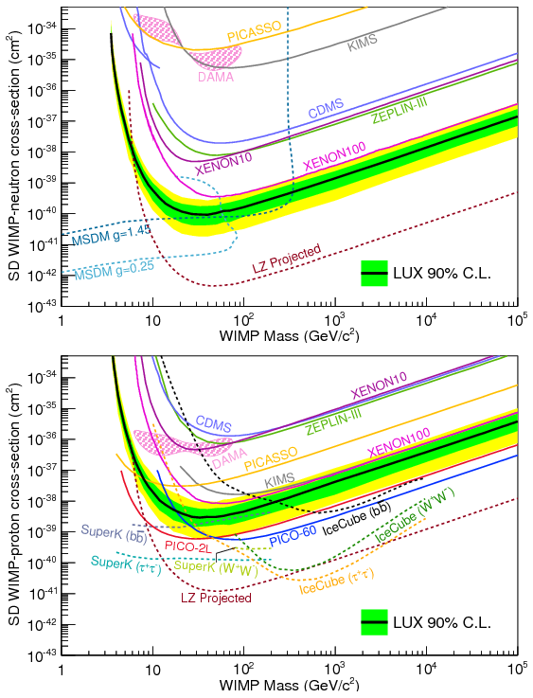
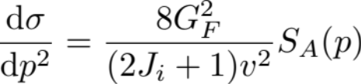
Next Big Discovery: Nature of Dark Matter?
Exclusion plots for WIMP-nucleon total cross section (spin-dependent)
Differential cross section: compare results from different targets

Slide 8
Next Big Discovery: Nature of Dark Matter?
Exclusion plots for WIMP-nucleon total cross section (spin-dependent)
Differential cross section: compare results from different targets
Structure functions required from nuclear theory

Slide 9
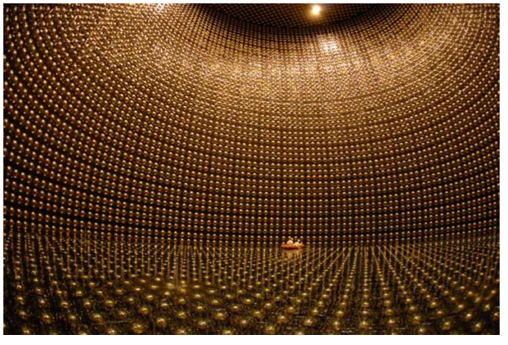
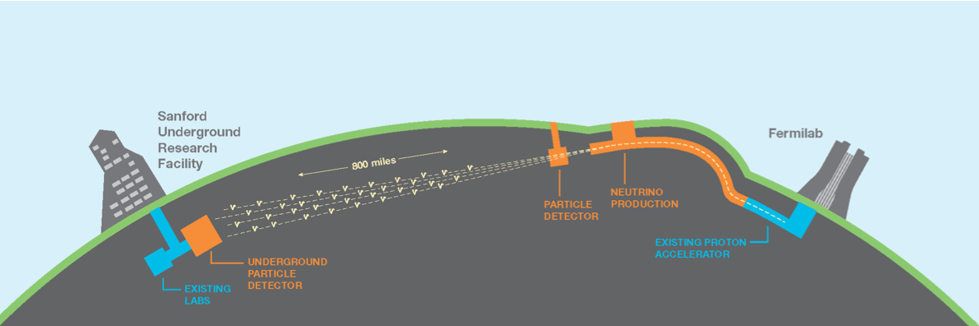
Neutrino Scattering
Long-baseline experiments aim to measure basic neutrino properties
¹⁶O
T2K
LBNF
Detectors made of complex nuclei (¹²C, ¹⁶O, ⁴⁰Ar)
How well do we understand neutrino-nucleus scattering?

Slide 10




Neutrino Scattering
Long-baseline experiments aim to measure basic neutrino properties
¹⁶O
Neutrino scattering ⬄ electron scattering
X
A
Window of opportunity for low-energy nuclear theory

Slide 11
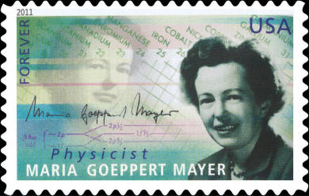
Approaches to Nuclear Structure Theory
“The first, the basic approach, is to study the elementary particles, their properties and mutual interaction. Thus one hopes to obtain knowledge of the nuclear forces. If the forces are known, one should, in principle, be able to calculate deductively the properties of individual nuclei. Only after this has been accomplished can one say that one completely understands nuclear structure…
–M. Goeppert-Mayer, Nobel Lecture

Slide 12
Approaches to Nuclear Structure Theory
“The first, the basic approach, is to study the elementary particles, their properties and mutual interaction. Thus one hopes to obtain knowledge of the nuclear forces. If the forces are known, one should, in principle, be able to calculate deductively the properties of individual nuclei. Only after this has been accomplished can one say that one completely understands nuclear structure…
The other approach is that of the experimentalist and consists in obtaining by direct experimentation as many data as possible for individual nuclei. One hopes in this way to find regularities and correlations which give a clue to the structure of the nucleus… The shell model, although proposed by theoreticians, really corresponds to the experimentalist’s approach.”
–M. Goeppert-Mayer, Nobel Lecture
Ab initio approach vs. phenomenological models
To date, nuclear physics largely phenomenological

Slide 13
What You Probably Think of Nuclear Physics
Models, models, models…

Slide 14
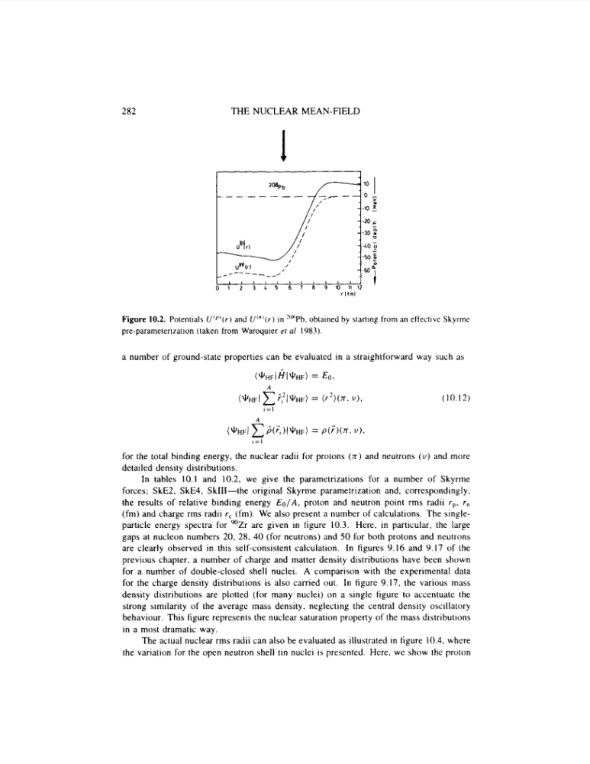
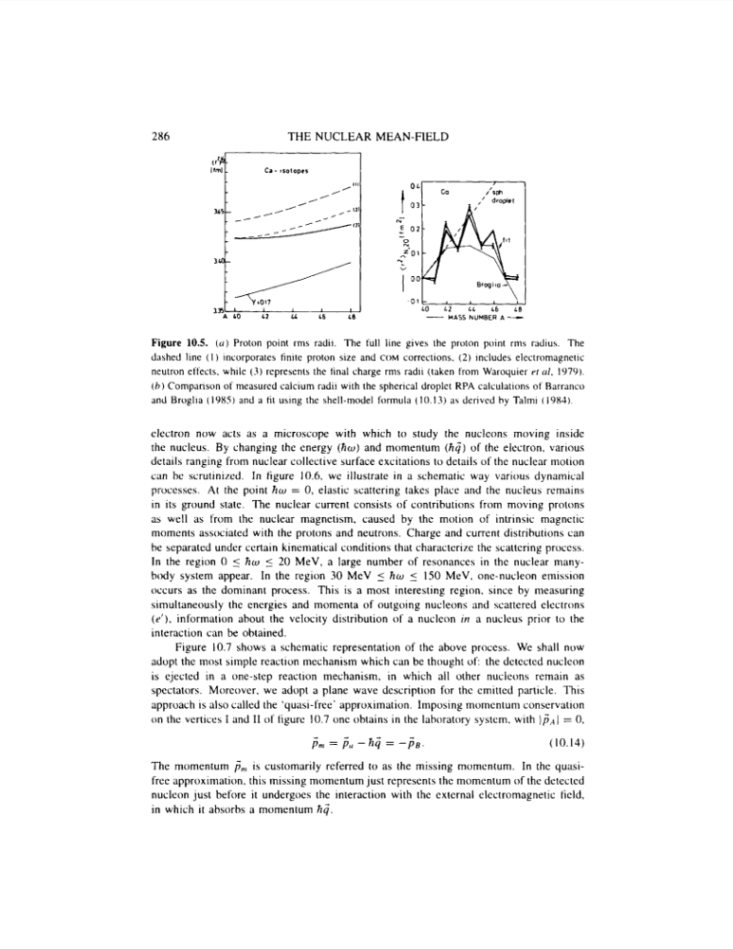
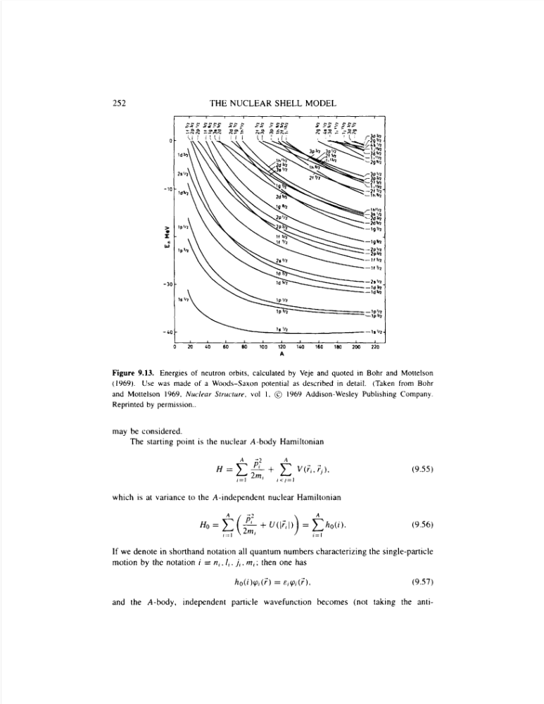
What You Probably Think of Nuclear Physics
Models, models, models…
Mean Field Models (EDF): ~100’s of fits, still no odd-mass

Slide 15
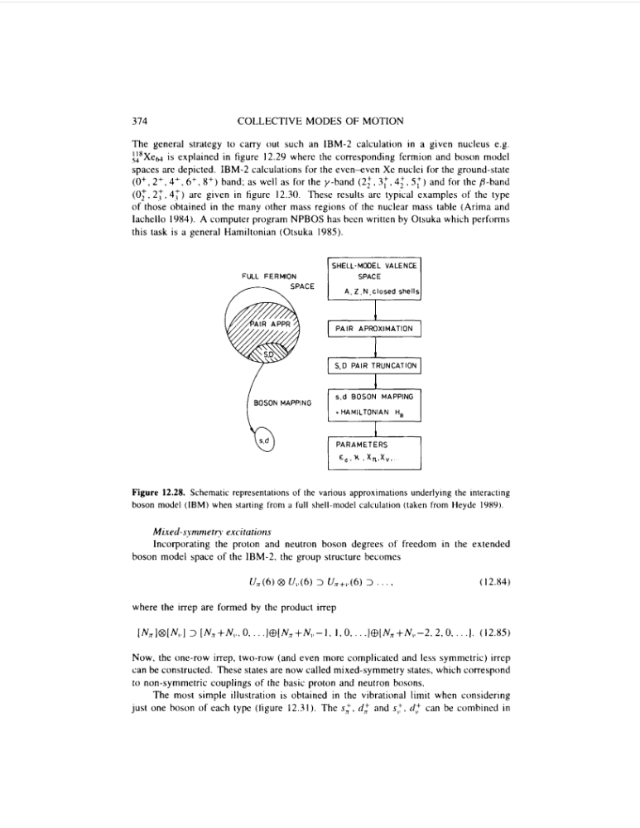
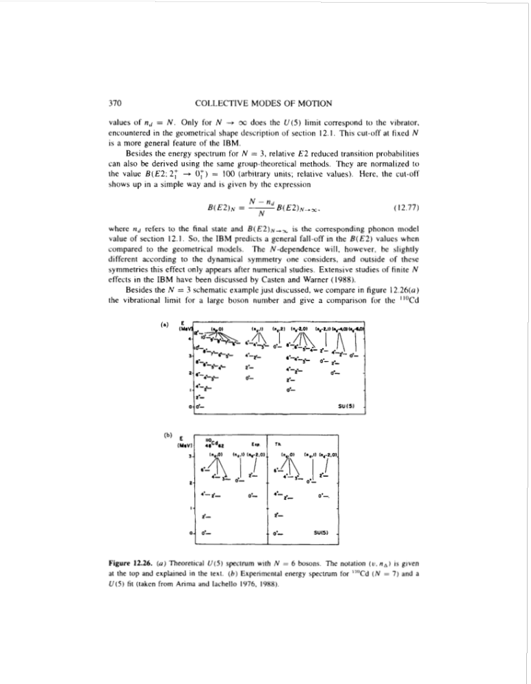
What You Probably Think of Nuclear Physics
Models, models, models…
Mean Field Models (EDF): ~100’s of fits, still no odd-mass
Interacting Boson Model (IBM): Not even two bosons make a fermion

Slide 16
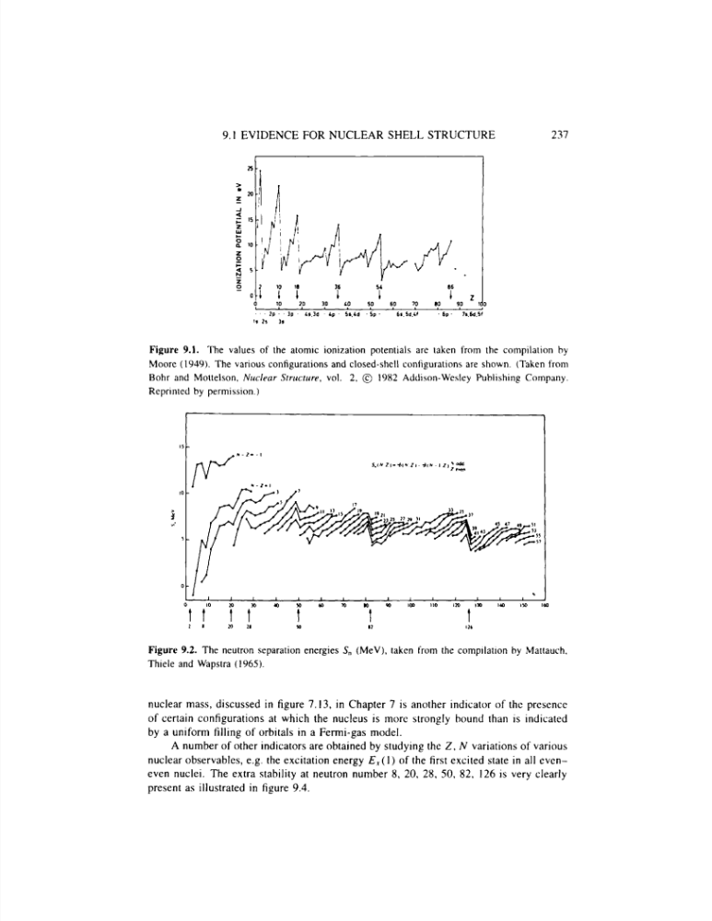
What You Probably Think of Nuclear Physics
Models, models, models…
Mean Field Models (EDF): ~100’s of fits, still no odd-mass
Interacting Boson Model (IBM): Not even two bosons make a fermion
Nuclear Shell Model

Slide 17
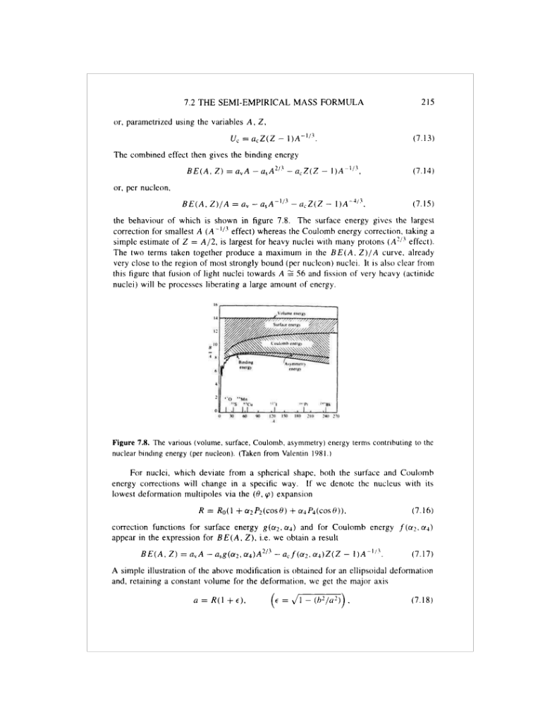
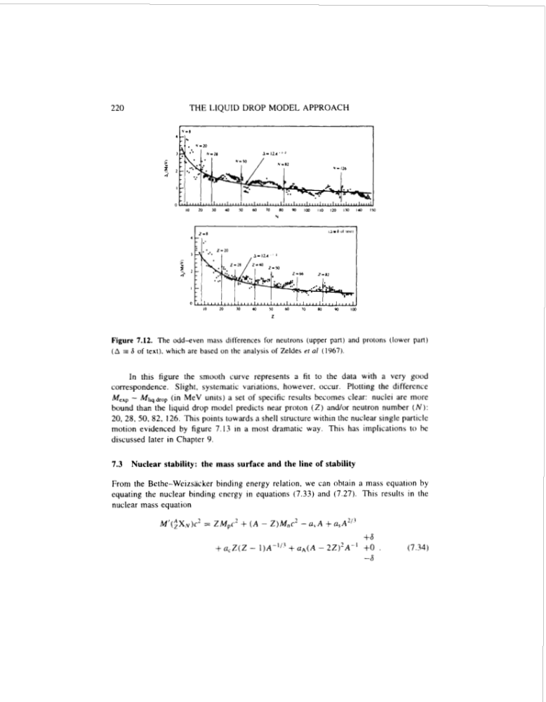
What You Probably Think of Nuclear Physics
Models, models, models…
Mean Field Models (EDF): ~100’s of fits, still no odd-mass
Interacting Boson Model (IBM): Not even two bosons make a fermion
Nuclear Shell Model
Liquid Drop Model

Slide 18
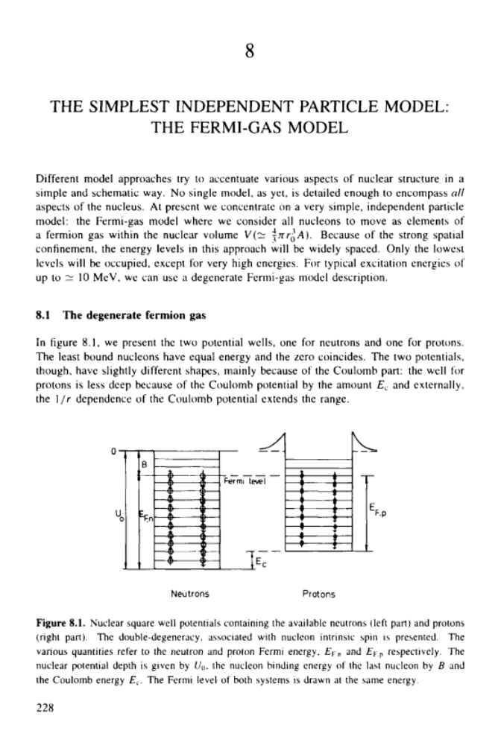
What You Probably Think of Nuclear Physics
Models, models, models…
Mean Field Models (EDF): ~100’s of fits, still no odd-mass
Interacting Boson Model (IBM): Not even two bosons make a fermion
Nuclear Shell Model
Liquid Drop Model
Fermi Gas Model

Slide 19
What You Probably Think of Nuclear Physics
Models, models, models…
Mean Field Models (EDF): ~100’s of fits, still no odd-mass
Interacting Boson Model (IBM): Not even two bosons make a fermion
Nuclear Shell Model
Liquid Drop Model
Fermi Gas Model

Slide 20
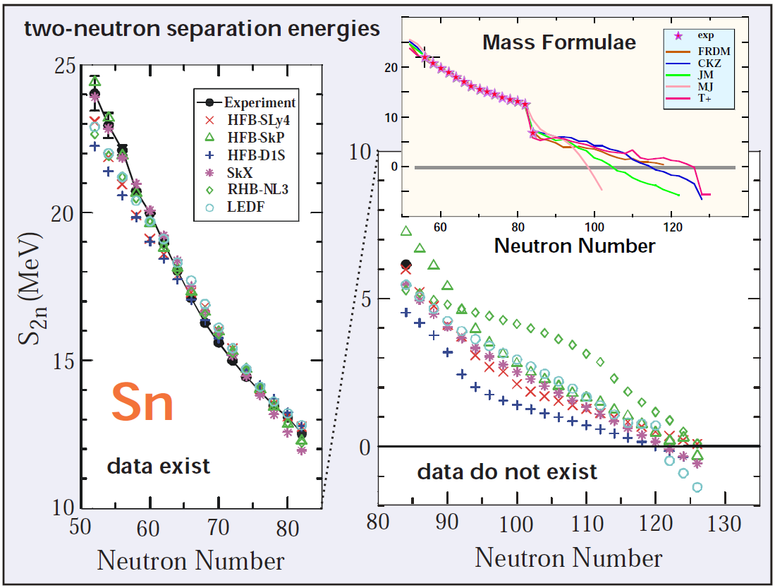
Predictions with Models
How well can phenomenology motivate experiments? How well can it predict beyond data?
Work well in regions where
informed by data

Slide 21
Predictions with Models
How well can phenomenology motivate experiments? How well can it predict beyond data?
Double-beta decay matrix elements
Often extrapolate unreliably
Spread in results = meaningful uncertainty?

Slide 22
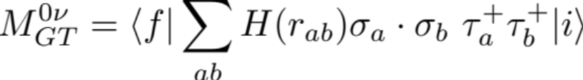
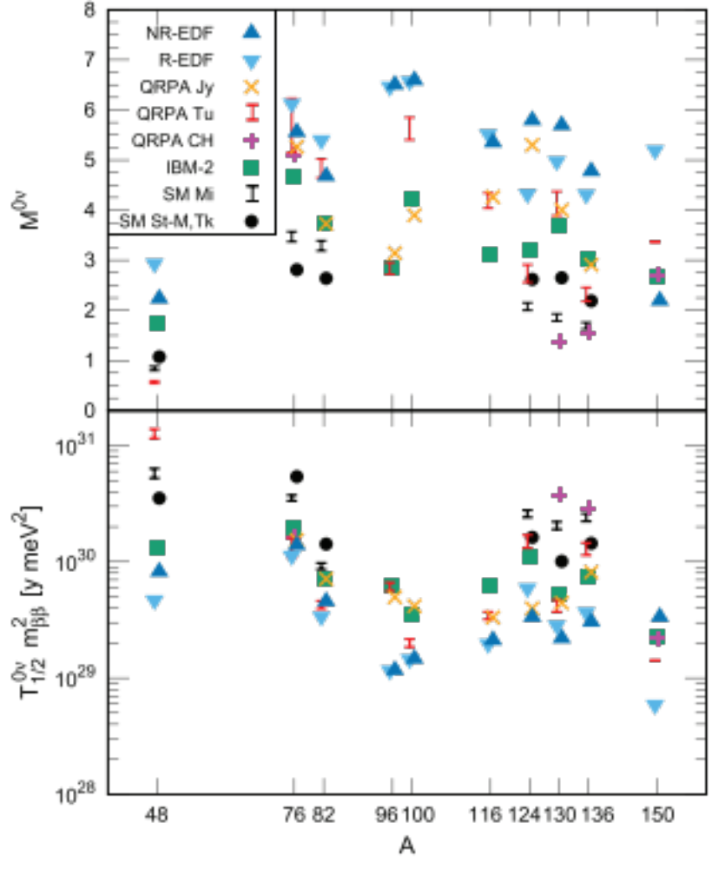
Predictions with Models
How well can phenomenology motivate experiments? How well can it predict beyond data?
Analogous picture in 0νββ decay
Double-beta decay matrix elements
Often extrapolate unreliably
Spread in results = meaningful uncertainty?
Engel, Menendez

Slide 23
0νββ-Decay Nuclear Matrix Element Status
All calculations to date from extrapolated phenomenological models; large spread in results
All models missing essential physics
Engel, Menendez (2016)

Slide 24
0νββ-Decay Nuclear Matrix Element Status
All calculations to date from extrapolated phenomenological models; large spread in results
All models missing essential physics
Engel, Menendez (2016)

Slide 25
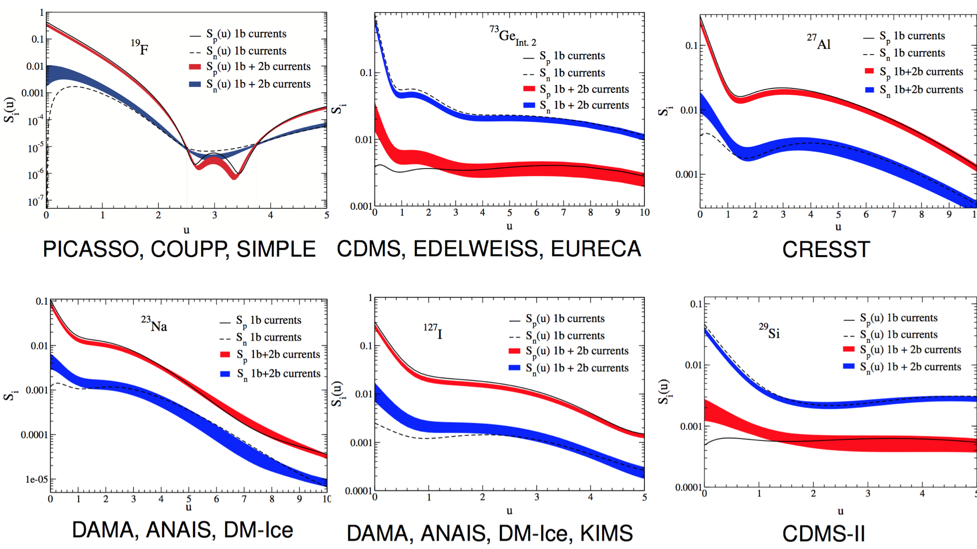

Spin-Dependent Structure Factors
Phenomenological wfs + inconsistent bare operator (with two-body currents)
✓
Klos et al, PRD (2013)

Slide 26
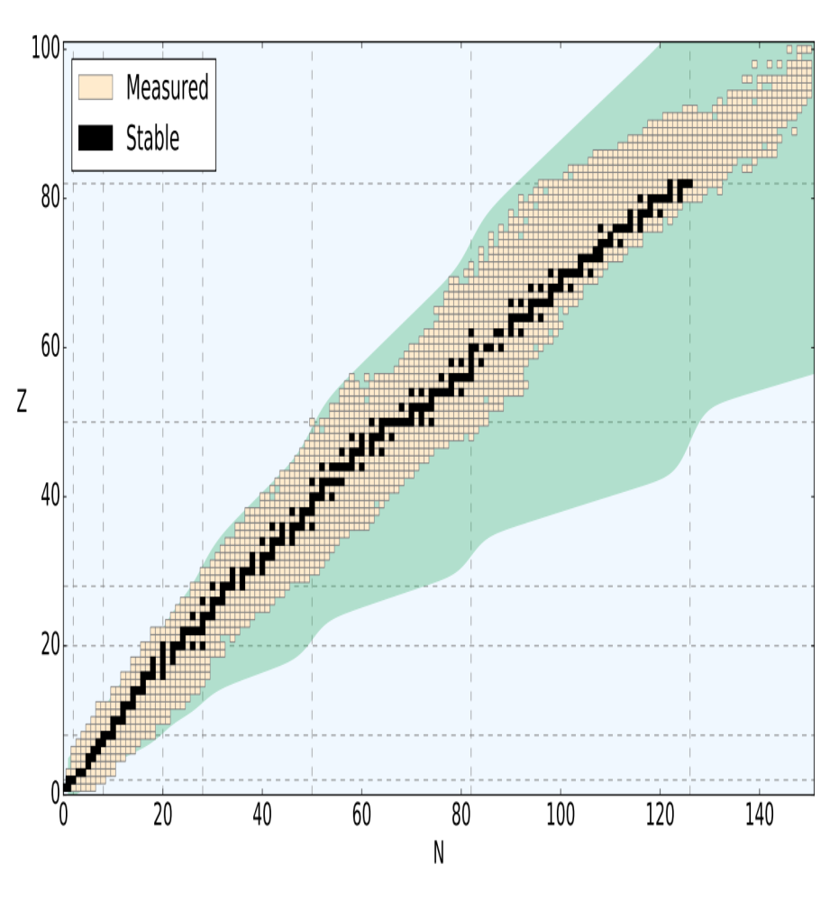

Ab Initio Approach
Aim of modern nuclear theory: Develop unified first-principles picture of structure and reactions

Slide 27
Ab Initio Approach: Interactions
Aim of modern nuclear theory: Develop unified first-principles picture of structure and reactions
- Nuclear forces (low-energy QCD)
- Electroweak physics
“The first, the basic approach, is to study the elementary particles, their properties and mutual interaction. Thus one hopes to obtain knowledge of the nuclear forces.”

Slide 28
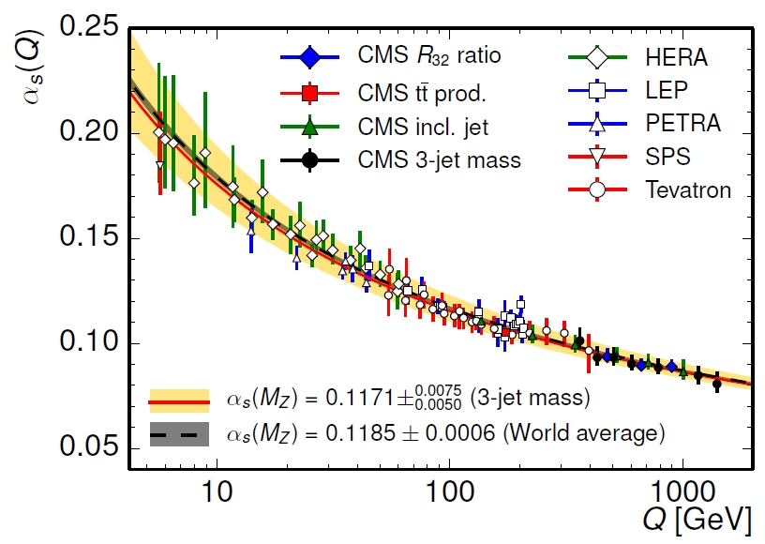
Nuclear Forces
We know QCD, so we’re good… right?
Strong coupling at low energies
Inherently nonperturbative
Lattice QCD for A<5 (see talk of W. Detmold)

Slide 29
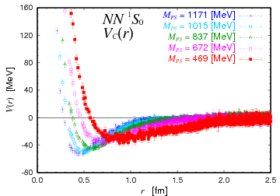
Nuclear Forces
We know QCD, so we’re good… right?
Strong coupling at low energies
Inherently nonperturbative
Lattice QCD for A<5 (see talk of W. Detmold)
Nuclear force from Lattice QCD?
Significant model dependence in extraction
No clear operator structure for 3N forces

Slide 30
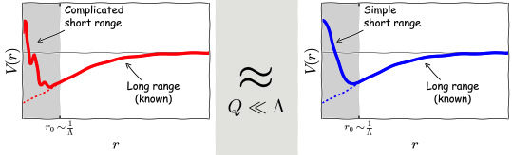
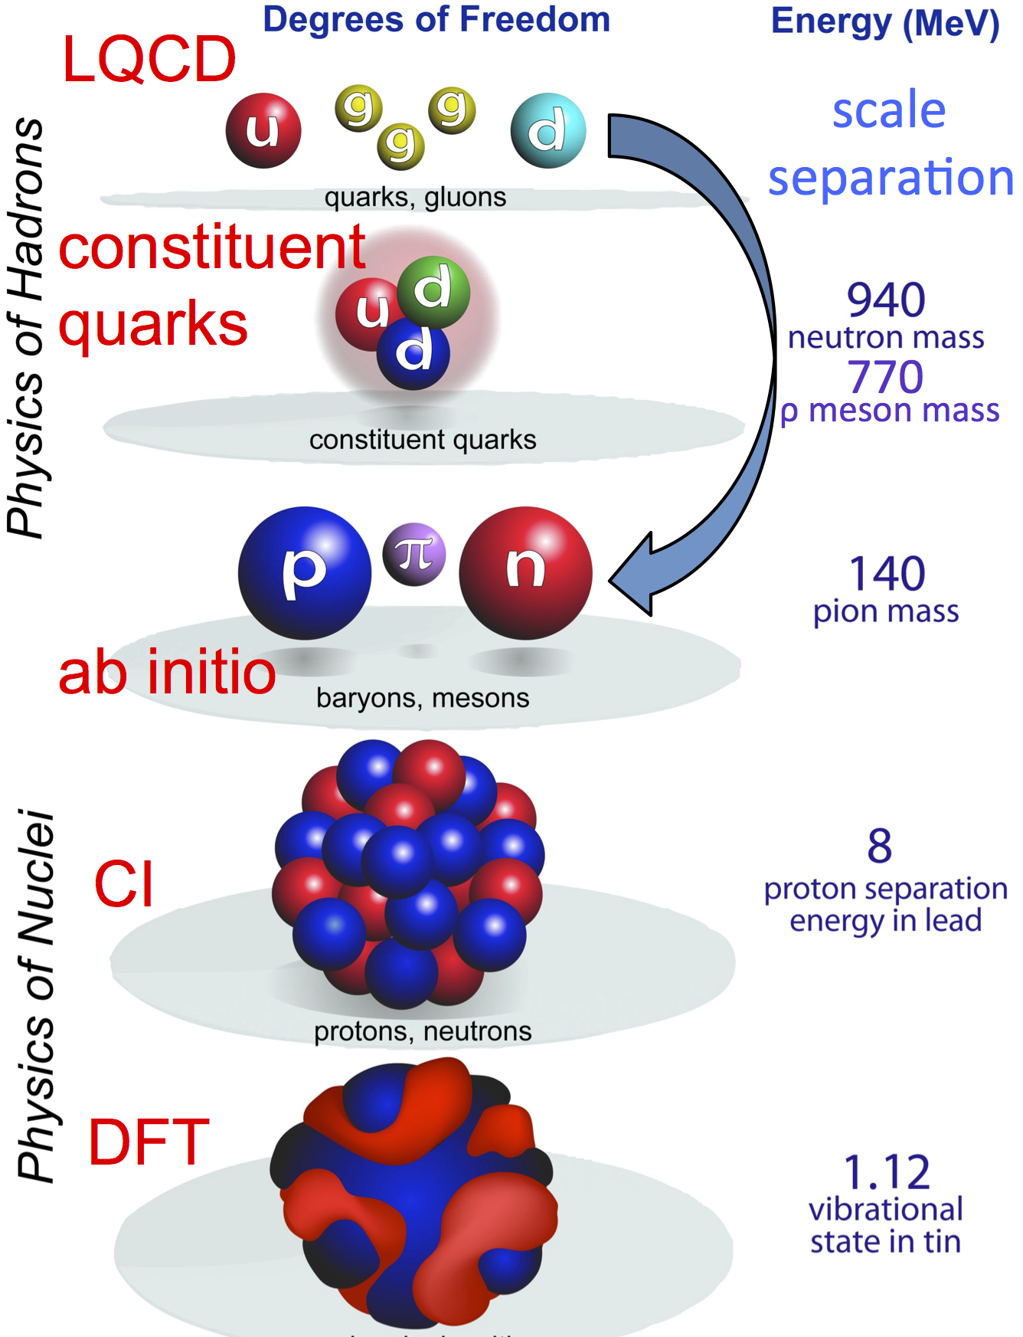
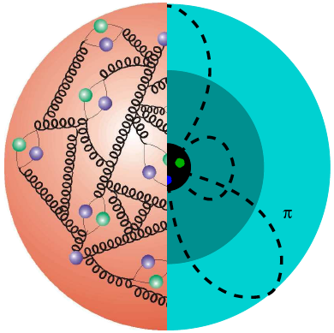

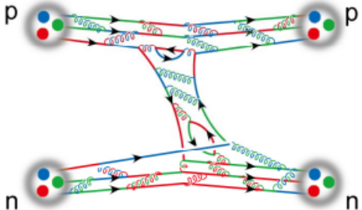

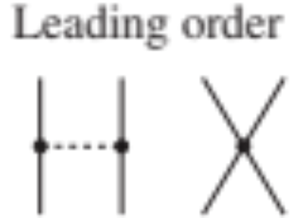
Effective Field Theory in One Slide
Exploit separation of energy scales
\
Keep known (easy) long-range physics
Encode complicated short-range physics in contact interaction

Slide 31

Effective Theory of Nuclear Forces
Chiral effective field theory: systematic expansion of nuclear interactions
Nucleons interact via contact and pion exchanges

Slide 32
Effective Theory of Nuclear Forces
Chiral effective field theory: systematic expansion of nuclear interactions
Nucleons interact via contact and pion exchanges
Undetermined low-energy constants fit to 2,3,4-body data

Slide 33
Effective Theory of Nuclear Forces
Chiral effective field theory: systematic expansion of nuclear interactions
Nucleons interact via contact and pion exchanges
Undetermined low-energy constants fit to 2,3,4-body data
Consistent treatment of NN, 3N, 4N… forces

Slide 34

Effective Theory of Nuclear Forces
Chiral effective field theory: systematic expansion of nuclear interactions
Nucleons interact via contact and pion exchanges
Undetermined low-energy constants fit to 2,3,4-body data
Consistent treatment of NN, 3N, 4N… forces
Quantitative estimation of neglected orders possible

Slide 35
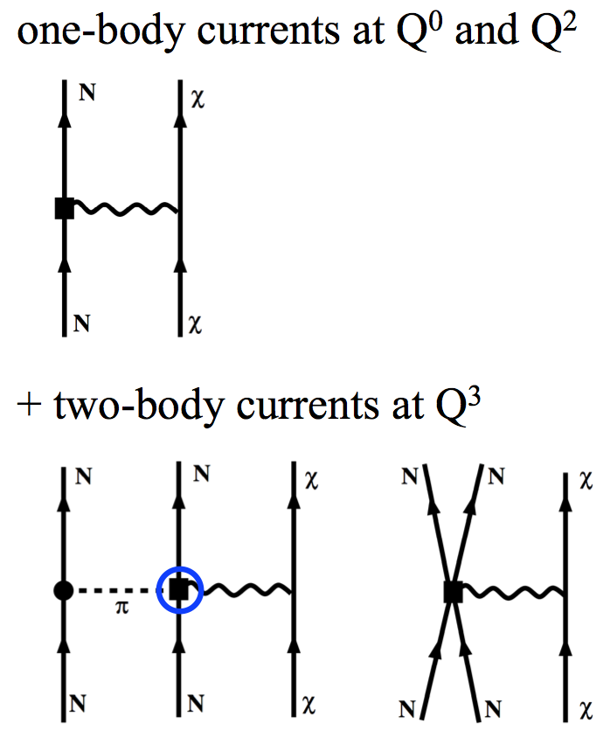
Effective Theory of Nuclear Forces
Chiral effective field theory: systematic expansion of nuclear interactions
Nucleons interact via contact and pion exchanges
Undetermined low-energy constants fit to 2,3,4-body data
Consistent treatment of NN, 3N, 4N… forces
Quantitative estimation of neglected orders possible
Consistent EW interactions
Quantifiable uncertainties possible
Best fitting strategy for ~30
undetermined couplings debated

Slide 36
Ab Initio Approach: Interactions
Aim of modern nuclear theory: Develop unified first-principles picture of structure and reactions
- Nuclear forces (low-energy QCD)
- Electroweak physics

Slide 37
Ab Initio Approach: Many-Body Methods
Aim of modern nuclear theory: Develop unified first-principles picture of structure and reactions
- Nuclear forces (low-energy QCD)
- Electroweak physics
- Nuclear many-body problem
“If the forces are known, one should, in principle, be able to calculate deductively the properties of individual nuclei.”

Slide 38
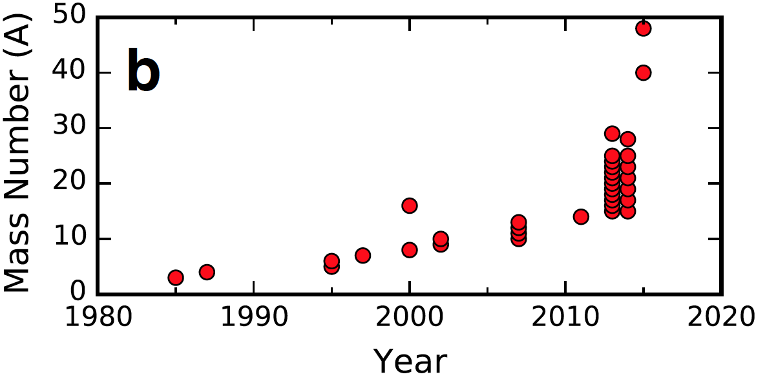
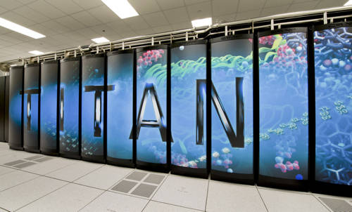
Chronological Reach of Ab Initio Many-Body Methods
Moore’s law: exponential growth in computing power
Methods for light nuclei (QMC, NCSM) scale exponentially with mass

Slide 39
Chronological Reach of Ab Initio Many-Body Methods
Moore’s law: exponential growth in computing power
Methods for light nuclei (QMC, NCSM) scale exponentially with mass
Mid 2000’s polynomial scaling methods developed (coupled cluster, in-medium SRG,…)
Explosion in limits of ab initio theory

Slide 40
Chronological Reach of Ab Initio Many-Body Methods
Moore’s law: exponential growth in computing power 2017: A>100
Methods for light nuclei (QMC, NCSM) scale exponentially with mass
Mid 2000’s polynomial scaling methods developed (coupled cluster, in-medium SRG,…)
Explosion in limits of ab initio theory

Slide 41
Breadth of Ab Initio Many-Body Methods
Aim of modern nuclear theory: Develop unified first-principles picture of structure and reactions
- Nuclear forces (low-energy QCD)
- Electroweak physics
- Nuclear many-body problem
pf
0νββ-decay candidates
open-shell, medium/heavy-mass, deformed
⁴⁸Ca, ⁷⁶Ge, ⁸²Se within reach

Slide 42
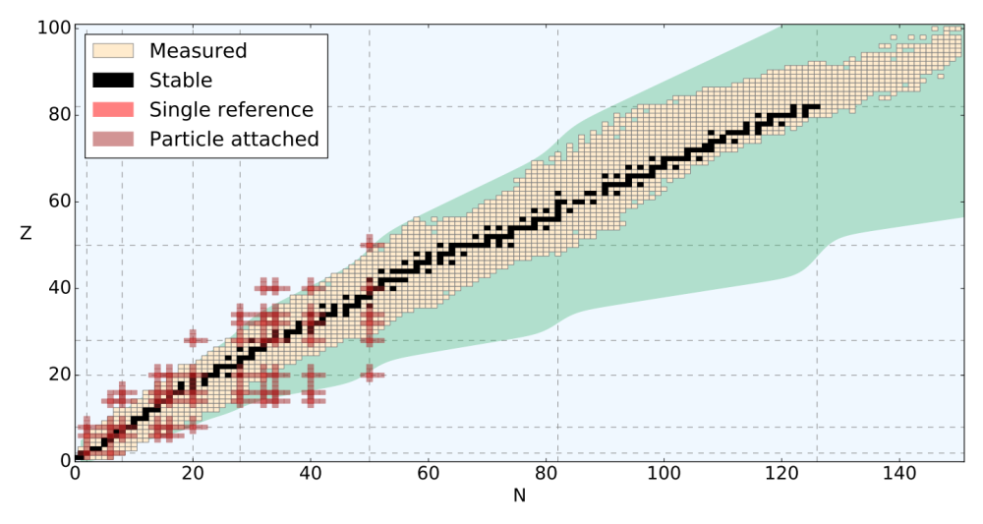
Breadth of Ab Initio Many-Body Methods
Aim of modern nuclear theory: Develop unified first-principles picture of structure and reactions
- Nuclear forces (low-energy QCD)
- Electroweak physics
- Nuclear many-body problem
pf
0νββ-decay candidates
open-shell, medium/heavy-mass, deformed
⁴⁸Ca, ⁷⁶Ge, ⁸²Se within reach

Slide 43
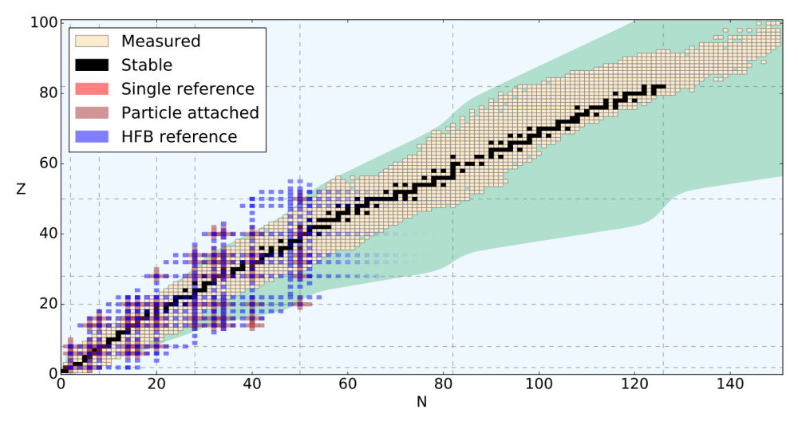
Breadth of Ab Initio Many-Body Methods
Aim of modern nuclear theory: Develop unified first-principles picture of structure and reactions
- Nuclear forces (low-energy QCD)
- Electroweak physics
- Nuclear many-body problem

Slide 44
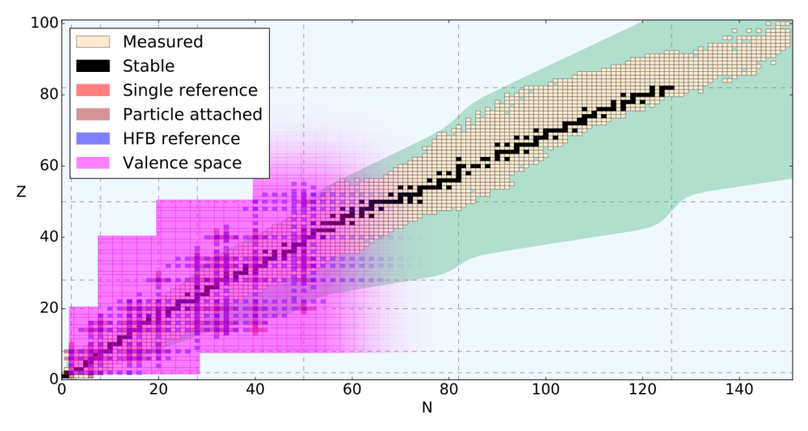
Breadth of Ab Initio Many-Body Methods
Aim of modern nuclear theory: Develop unified first-principles picture of structure and reactions
- Nuclear forces (low-energy QCD)
- Electroweak physics
- Nuclear many-body problem
sdg
pf
0νββ-decay candidates
open-shell, medium/heavy-mass, deformed
⁴⁸Ca, ⁷⁶Ge, ⁸²Se, ¹³⁰Te, ¹³⁶Xe within reach
sd
Extends range to all nuclei up to N,Z≈50

Slide 45
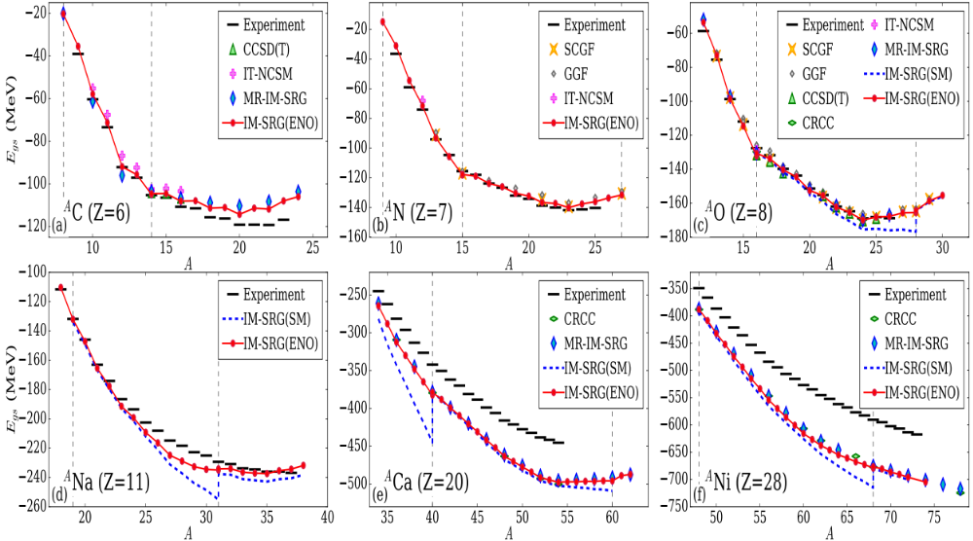
Extrapolating Beyond Data
Stark contrast in extrapolations between model extrapolations and ab initio
All ab initio methods in good agreement when starting from same input NN+3N forces
Only informed by 2,3-body data

Slide 46
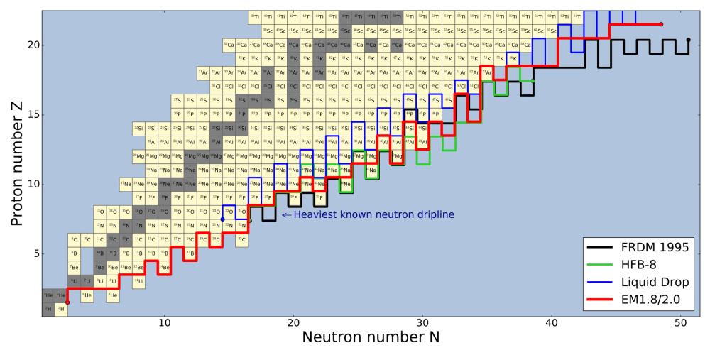
Ab Initio Dripline Prediction
Ab initio prediction of
limits of nuclei
General agreement with model predictions
Significant differences arise for heavy nuclei
Holt, Stroberg, et al.,
p-shell dripline well predicted:
incorrect for well-known halo structures

Slide 47
Towards big questions: 0νββ-decay
Aim of modern nuclear theory: Develop unified first-principles picture of structure and reactions
- Nuclear forces (low-energy QCD)
- Electroweak physics
- Nuclear many-body problem
0νββ-decay candidates
open-shell, medium/heavy-mass, deformed
⁴⁸Ca, ⁷⁶Ge, ⁸²Se; ¹³⁰Te, ¹³⁶Xe within reach

Slide 48

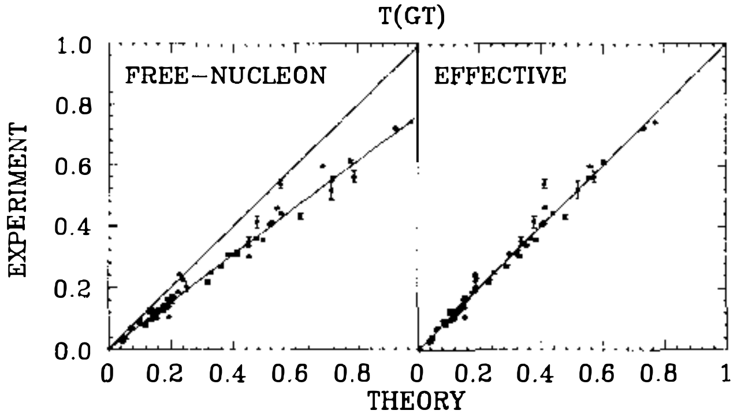
“Quenching” of g_{A} in Gamow-Teller Decays
Long-standing problem in weak decays of nuclei: should g_{A} be “quenched”?
Using agrees with data

Slide 49
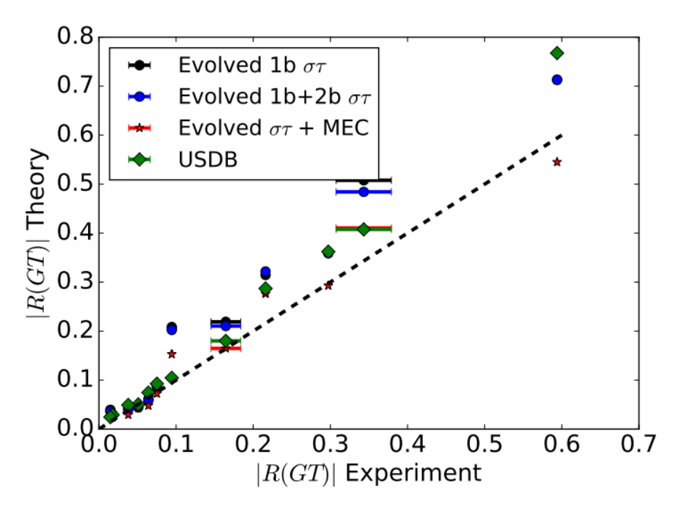

“Quenching” of g_{A} in Gamow-Teller Decays
Long-standing problem in weak decays of nuclei: should g_{A} be “quenched”?
Using agrees with data
Ab initio calculations explain data with unquenched g_{A}

Slide 50

Ab Initio 0νββ-decay
Ab initio: Consistent many-body wfs/operators from chiral NN+3N forces
⁴⁸Ca

Slide 51
Ab Initio 0νββ-decay
Ab initio: Consistent many-body wfs/operators from chiral NN+3N forces
Consistent prediction from independent method
Two-body currents in progress – typically decrease NME
⁴⁸Ca

Slide 52
Towards big questions: WIMP-Nucleus Scattering
Aim of modern nuclear theory: Develop unified first-principles picture of structure and reactions
- Nuclear forces (low-energy QCD)
- Electroweak physics
- Nuclear many-body problem
WIMP-nucleus direct detection candidates
open-shell, medium/heavy-mass, deformed
¹⁹F,²³Na,²⁷Al,²⁹Si,⁷³Ge; ¹²⁷I,^{129,131}Xe within reach

Slide 53


Ab Initio WIMP-Nucleus Response Functions (Isoscalar)
Ab initio: Consistent many-body wfs/operators from chiral NN+3N forces + 2b currents
Leutheusser, Stroberg, Holt

Slide 54


A Recent Breakthrough
August 17, 2017 LIGO
Neutron star mergers verified as site of
astrophysical rapid-neutron capture process

Slide 55

Reach of Ab Initio Methods
Aim of modern nuclear theory: Develop unified first-principles picture of structure and reactions
Approaching region of r-process (major region for future RIB facilities)
Masses and decay rates needed for nucleosynthesis simulations
Many will never be measured – requires input from ab initio theory
sdg
pf
0νββ-decay candidates
open-shell, medium/heavy-mass, deformed
⁴⁸Ca, ⁷⁶Ge, ⁸²Se, ¹³⁰Te, ¹³⁶Xe within reach
sd

Slide 56
Reach of Ab Initio Methods
Aim of modern nuclear theory: Develop unified first-principles picture of structure and reactions
Approaching region of r-process (major region for future RIB facilities)
Masses and decay rates needed for nucleosynthesis simulations
Many will never be measured – requires input from ab initio theory
Era of ab initio nuclear theory: reliable calculations for big questions
Interfacing with Lattice QCD possible/essential
sdg
pf
0νββ-decay candidates
open-shell, medium/heavy-mass, deformed
⁴⁸Ca, ⁷⁶Ge, ⁸²Se, ¹³⁰Te, ¹³⁶Xe within reach
sd

Slide 57





Effective Valence-Space In-Medium SRG Operators
Explicitly construct unitary transformation from sequence of rotations
Step 1: Decouple core
Step 2: Decouple valence space
Step 3: Decouple additional operators

Slide 58
Two-body Currents in Nuclei
Chiral Effective Field Theory – electroweak currents consistent with nuclear forces
Clear Importance in for M1 transitions in light nuclei

Slide 59
Connection to Infinite Matter: Saturation as a Guide
2015: Best NN+3N forces dramatically overbind in medium/heavy-mass systems
Best interactions not useful for predictions beyond oxygen
Binder et al, PLB (2015)

Slide 60

Connection to Infinite Matter: Saturation as a Guide
2017: NN+3N forces with good saturation properties
Only fit to 2-, 3-, 4-body data: reproduces experiment through ⁷⁸Ni
Experiment/Theory: what data is most useful for constraining chiral forces?
From G. Hagen
Simonis et al, PRC (2017)

Slide 61


Major Issue: Where Are the Limits of Existence?
Where (and what) is the nuclear dripline?
Limits defined as last isotope with positive neutron separation energy
- Nucleons “drip” out of nucleus
Neutron dripline experimentally established to Z=8
Ab initio prediction
(2016)
Same result from same input NN+3N forces
Already well beyond where fit to data!

Slide 62
Ground-State Properties in sd-Shell: F (Z=9)
Explore ground-state properties throughout medium-mass region
Remarkable agreement with experiment
Probe dripline and beyond
Artifacts at neutron N=20 gap
Z=28
Z=20
Z=8
Z=2
JDH, Stroberg, et al., in preparation

Slide 63
Ground-State Properties in sd-Shell: Ne (Z=10)
Explore ground-state properties throughout medium-mass region
Remarkable agreement with experiment
Probe dripline and beyond
Artifacts at neutron N=20 gap
Z=28
Z=20
Z=8
Z=2
JDH, Stroberg, et al., in preparation

Slide 64

Ground-State Properties in sd-Shell: Na (Z=11)
Explore ground-state properties throughout medium-mass region
Remarkable agreement with experiment
Probe dripline and beyond
Artifacts at neutron N=20 gap
Z=28
Z=20
Z=8
Z=2
JDH, Stroberg, et al., in preparation

Slide 65

Ground-State Properties in sd-Shell: Mg (Z=12)
Explore ground-state properties throughout medium-mass region
Remarkable agreement with experiment
Probe dripline and beyond
Artifacts at neutron N=20 gap
Z=28
Z=20
Z=8
Z=2
JDH, Stroberg, et al., in preparation

Slide 66

Ground-State Properties in sd-Shell: Al (Z=13)
Explore ground-state properties throughout medium-mass region
Remarkable agreement with experiment
Probe dripline and beyond
Artifacts at neutron N=20 gap
Z=28
Z=20
Z=8
Z=2
JDH, Stroberg, et al., in preparation

Slide 67

Ground-State Properties in sd-Shell: Si (Z=14)
Explore ground-state properties throughout medium-mass region
Remarkable agreement with experiment
Probe dripline and beyond
Artifacts at neutron N=20 gap
Z=28
Z=20
Z=8
Z=2
JDH, Stroberg, et al., in preparation

Slide 68
Ground-State Properties in sd-Shell: P (Z=15)
Explore ground-state properties throughout medium-mass region
Remarkable agreement with experiment
Probe dripline and beyond
Artifacts at neutron N=20 gap
Z=28
Z=20
Z=8
Z=2
JDH, Stroberg, et al., in preparation

Slide 69
Ground-State Properties in sd-Shell: S (Z=16)
Explore ground-state properties throughout medium-mass region
Remarkable agreement with experiment
Probe dripline and beyond
Artifacts at neutron N=20 gap
Z=28
Z=20
Z=8
Z=2
JDH, Stroberg, et al., in preparation

Slide 70
Ground-State Properties in sd-Shell: Cl (Z=17)
Explore ground-state properties throughout medium-mass region
Remarkable agreement with experiment
Probe dripline and beyond
Artifacts at neutron N=20 gap
Z=28
Z=20
Z=8
Z=2
JDH, Stroberg, et al., in preparation

Slide 71
Ground-State Properties in sd-Shell: Ar (Z=18)
Explore ground-state properties throughout medium-mass region
Remarkable agreement with experiment
Probe dripline and beyond
Artifacts at neutron N=20 gap
Z=28
Z=20
Z=8
Z=2
JDH, Stroberg, et al., in preparation

Slide 72
Ground-State Properties in sd-Shell: K (Z=19)
Explore ground-state properties throughout medium-mass region
Remarkable agreement with experiment
Probe dripline and beyond
Artifacts at neutron N=20 gap
Z=28
Z=20
Z=8
Z=2
JDH, Stroberg, et al., in preparation

Slide 73
Ground-State Properties in pf-Shell: Ca (Z=20)
Explore ground-state properties throughout medium-mass region
Remarkable agreement with experiment
Probe dripline and beyond
Artifacts at neutron N=40 gap
Z=28
Z=20
Z=8
Z=2
JDH, Stroberg, et al., in preparation

Slide 74
Ground-State Properties in pf-Shell: Sc (Z=21)
Explore ground-state properties throughout medium-mass region
Remarkable agreement with experiment
Probe dripline and beyond
Artifacts at neutron N=40 gap
Z=28
Z=20
Z=8
Z=2
JDH, Stroberg, et al., in preparation

Slide 75
Ground-State Properties in pf-Shell: Ti (Z=22)
Explore ground-state properties throughout medium-mass region
Remarkable agreement with experiment
Probe dripline and beyond
Artifacts at neutron N=40 gap
Z=28
Z=20
Z=8
Z=2
JDH, Stroberg, et al., in preparation

Slide 76

Dripline Prediction from Density Functional Theory
Recent prediction of entire dripline from DFT methods
Uncertainties obtained from varying input functionals
Erler et al, Nature (2011)
Gwak (UBC)

Slide 77

Dripline in Calcium Isotopes: Phenomenology vs. Ab Initio
Stark contrast between ab initio and phenomenological predictions
Is there a “Calcium Anomaly” similar to oxygen?

Slide 78
Dripline in Calcium Isotopes: Phenomenology vs. Ab Initio
Stark contrast between ab initio and phenomenological predictions
Is there a “Calcium Anomaly” similar to oxygen?
Future: dripline to A≈90 to be reached by future RIB facilities! Ni?

Slide 79

Ground-State Properties in pf-Shell: Ni (Z=28)
Explore ground-state properties throughout medium-mass region
Remarkable agreement with experiment
Probe dripline and beyond
Currently extended to ⁸⁰Ni
Z=28
Z=20
Z=8
Z=2
JDH, Stroberg, et al., in preparation

Slide 80

Ground-State Properties Sn (Z=50)
Tin region from 80Zr core: using Importance-Truncated Shell Model
IMSRG fails to decouple valence space for heavier tin isotopes: reached limit?
Z=50
Z=28
Z=20

Slide 81
Magic Numbers in the Calcium Isotopes: Masses
Series of mass measurements ideal example of theory/experiment overlap
Current ab initio picture 2017
TITAN Measurement @ TRIUMF
Flat trend from ⁵⁰⁻⁵²Ca
Mass ⁵²Ca 1.74 MeV from AME
ISOLTRAP Measurement @ CERN
Sharp decrease past ⁵²Ca
Unambiguous closed-shell ⁵²Ca
Test predictions of various models
Ab Initio from NN+3N
Excellent agreement with new data
Reproduces closed-shell ^{48,52}Ca
Weak closed sell signature past ⁵⁴Ca
Future: New RIKEN data
coming soon!
3+ laboratories contributed within few years
Compelling story of exp/theory interplay

Slide 82

Evolution of N=28,32,34 Magic Numbers: Masses
Series of mass measurements ideal example of theory/experiment overlap
Current ab initio picture 2017
New TITAN Measurements of Ti
Probe “dawning” of N=32 magic number
Ab Initio from NN+3N
Generally good agreement, but predicts appearance too early
Future: Evolution to be measured in Ar, Cl at NSCL

Slide 83


Magic Numbers in the Calcium Isotopes: Spectroscopy
Picture of shell structure in calcium ~2012
?
?
Phenomenological Models
Large gap at N=28,32; discrepancy at N=34 (beyond data)
Ab initio theories
Predict all magic numbers; consistent prediction at N=34
Notes:
Just as in atomic physics atoms exhibit closed shell properties when atomic orbitals are filled, so do nuclei
Atomic – more regular - nuclei more intricate structure due to complicated interaction

Slide 84
Magic Numbers in the Calcium Isotopes: Spectroscopy
Picture of shell structure in calcium 2014: New measurement from RIKEN
Phenomenological Models
Readjusted with appearance of new data
Ab initio theories
Correctly predicted excitation energy of N=34
Notes:
Just as in atomic physics atoms exhibit closed shell properties when atomic orbitals are filled, so do nuclei
Atomic – more regular - nuclei more intricate structure due to complicated interaction

Slide 85


Classic Picture of Nuclear Shell Structure
Picture of shell structure in calcium 2014: New measurement from RIKEN
Phenomenological Models
Readjusted with appearance of new data
Ab initio theories
Correctly predicted excitation energy of N=34
Notes:
Just as in atomic physics atoms exhibit closed shell properties when atomic orbitals are filled, so do nuclei
Atomic – more regular - nuclei more intricate structure due to complicated interaction

Slide 86

Magic Numbers in the Calcium Isotopes: Spectroscopy
Current ab initio picture in Ca/Ni: 2017
Future: New RIKEN data
coming soon!
Ab initio theories
Similar stories in Ni isotopes?
Notes:
Just as in atomic physics atoms exhibit closed shell properties when atomic orbitals are filled, so do nuclei
Atomic – more regular - nuclei more intricate structure due to complicated interaction

Slide 87



Evolution of N=28,32,34 Magic Numbers: Spectroscopy
Current ab initio picture 2017: Predictions of evolution throughout sd shell

Slide 88
Magic Numbers in the Calcium Isotopes: Charge Radii
Charge radii of ^{49,51,52}Ca, obtained from laser spectroscopy experiments at ISOLDE, CERN
Unexpected large charge radius questions the magicity of ⁵²Ca
Theoretical models all underestimate the charge radius
Ab-initio calculations reproduce the trend of charge radii
R. F. Garcia Ruiz et al, Nature Physics (2016)

Slide 89


Evolution of Magic Numbers: Radii
Charge radii measured by COLLAPS in K isotopes shows similar trend
Future: further measurements of neutron-rich charge radii near magic numbers needed!

Slide 90
Major Nuclear Structure Issues
Aim of modern nuclear theory: Develop unified first-principles picture of structure and reactions
- Nuclear forces (low-energy QCD)
- Electroweak physics
- Nuclear many-body problem
Major Nuclear Structure Issues
1) How do nuclei, processes emerge from fundamental interactions of nature?
2) What are the limits of existence of matter? Is there an underlying mechanism?
3) How do magic numbers evolve?
Astrophysics, fundamental symmetries connections (mostly) not discussed
“The nuclear magic numbers are kind of giving way — the dogma begins to break down and the rules of the game have to be expanded.”

Slide 91
Major Nuclear Structure Issues
Aim of modern nuclear theory: Develop unified first-principles picture of structure and reactions
- Nuclear forces (low-energy QCD)
- Electroweak physics
- Nuclear many-body problem
Major Nuclear Structure Issues
1) How do nuclei, processes emerge from fundamental interactions of nature?
2) What are the limits of existence of matter? Is there an underlying mechanism?
3) How do magic numbers evolve? Is there a new paradigm for magic numbers?
Astrophysics, fundamental symmetries connections (mostly) not discussed
“The nuclear magic numbers are kind of giving way — the dogma begins to break down and the rules of the game have to be expanded.”

Slide 92
Major Nuclear Structure Issues
Aim of modern nuclear theory: Develop unified first-principles picture of structure and reactions
- Nuclear forces (low-energy QCD)
- Electroweak physics
- Nuclear many-body problem
Major Nuclear Structure Issues
1) How do nuclei, processes emerge from fundamental interactions of nature?
2) What are the limits of existence of matter? Is there an underlying mechanism?
3) How do magic numbers evolve? Is there a new paradigm for magic numbers?
4) How do novel quantum phenomena (skins, halos, etc) arise in nuclei?
Astrophysics, fundamental symmetries connections (mostly) not discussed

Slide 93

Super Allowed Gamow-Teller Decay of ¹⁰⁰Sn
Coupled-Cluster calculations factor of 3 too large without MEC

Slide 94
Super Allowed Gamow-Teller Decay of ¹⁰⁰Sn
Coupled-Cluster calculations factor of 3 too large without MEC
Future needs: precision measurements o of large GT matrix elements ³⁴S, ⁴⁸Ni, ¹⁰⁰Sn
Significant suppression from MEC

Slide 95


Ab Initio 0νββ-Decay Predictions
Standard SM: phenomenological wavefunctions + bare operator
Ab initio SM: wavefunctions from chiral NN+3N forces + consistent effective operator
Ab initio energies in medium/heavy-mass region
Effective decay operator: decouple valence-space operator
✓
C. Payne (UBC)
⁴⁸Ca | Bare GT | 0.79 | Bare F | 0.14
 | IMSRG/CC | 0.48/0.45 | IMSRG/CC | 0.16/0.11

Slide 96
Theory for Next-Generation RIB Facilities
Fundamental physics
Effective electroweak operators: M1, GT,...
Effective 0νββ decay operator
WIMP-Nucleus scattering
Superallowed transitions
Ab initio valence-shell Hamiltonians
ab initio prediction of nuclear driplines/r-process
Islands of inversion, new magic numbers
Outstanding issues
Controlled many-body approximation
E2 operators problematic
Continuum essential beyond stability
Quantify uncertainties
Experimental overlap
Best data for constraining nuclear forces
New measurements of driplines
Data on magic numbers in exotic nuclei
Precision data on GT transitions

Slide 97
Reach of Ab Initio Methods
Aim of modern nuclear theory:
Develop unified first-principles picture
of structure and reactions
- Nuclear forces (low-energy QCD)
- Electroweak physics
- Nuclear many-body problem
Outstanding issues/limitations
Large valence-space dimensions
Large size of 3N force files
sdg
pf
0νββ-decay candidates
open-shell, medium/heavy-mass, deformed
⁴⁸Ca, ⁷⁶Ge, ⁸²Se, ¹³⁰Te, ¹³⁶Xe within reach
sd

Slide 98
Reach of Ab Initio Methods
Aim of modern nuclear theory:
Develop unified first-principles picture
of structure and reactions
- Nuclear forces (low-energy QCD)
- Electroweak physics
- Nuclear many-body problem
Outstanding issues/limitations
Large valence-space dimensions
Large size of 3N force files
Extend drip line predictions
Approaching region of r-process
sdg
pf
0νββ-decay candidates
open-shell, medium/heavy-mass, deformed
⁴⁸Ca, ⁷⁶Ge, ⁸²Se, ¹³⁰Te, ¹³⁶Xe within reach
sd

Slide 99

Ab Initio GT Transitions from Valence-Space IMSRG
General one-body tensor operators for valence-space IMSRG: Gamow-Teller
First ab initio valence-space calculations of GT transition rates
Small renormalization effect
Stroberg, et al.

Slide 100



Tremendous Progress in Light Nuclei
What are the properties of proton/neutron-rich matter (Halo structures)?
Ab initio reactions for astrophysics and energy generation
Collective phenomena from first principles?
12 fm
7 fm
Notes:
Orient us to regions of interest and big problems I’ll hope to answer
Know as we move away from valley of stab, textbook picture of nuclear structure doesn’t hold
Understanding the unexplored region and the evolution of structure as we move into it constitutes one of the central challenges of modern science

Slide 101

Gamow-Teller Quenching Across the Chart
Coupled-Cluster calculations of GT decay including two-body currents
Describes quenching well from light systems to Sn – IMSRG calculations in progress

Slide 102
Ab Initio 0νββ-Decay Predictions from Valence-Space IMSRG
Conventional SM: phenomenological wavefunctions
Ab initio SM: wavefunctions from chiral NN+3N forces
Ab initio energies in medium/heavy-mass region
  Valence-space IM-SRG for all medium-mass nuclei

Slide 103
Ab Initio 0νββ-Decay Predictions in the Shell Model
Conventional Shell Model: phenomenological wavefunctions
Ab initio valence-space: wavefunctions based on NN+3N forces from chiral EFT
Ab initio energies in medium/heavy-mass region

Slide 104

Ab Initio 0νββ-Decay Predictions from Valence-Space IMSRG
Conventional SM: phenomenological wavefunctions
Ab initio SM: wavefunctions from chiral NN+3N forces
Ab initio energies in medium/heavy-mass region
  Valence-space IM-SRG for all medium-mass nuclei
  Deformation challenging for large-space methods

Slide 105

Ab Initio 0νββ-Decay Predictions from Valence-Space IMSRG
Conventional SM: phenomenological wavefunctions
Ab initio SM: wavefunctions from chiral NN+3N forces
Ab initio energies in medium/heavy-mass region
  Valence-space IM-SRG for all medium-mass nuclei
  Deformation challenging for large-space methods
  First ab initio calculation of ⁷⁶Ge/⁷⁶Se
✓

Slide 106



Ab Initio 0νββ-Decay Predictions in the Shell Model
Conventional SM: phenomenological wavefunctions + bare operator
Ab initio SM: wavefunctions from chiral NN+3N forces + consistent effective operator
Ab initio energies in medium/heavy-mass region
Effective decay operator: decouple valence-space operator (analogous to Hamiltonian)
M_{eff}
✓
V_{eff}
M_{eff}

Slide 107
Ab Initio 0νββ-Decay Predictions in the Shell Model
Standard SM: phenomenological wavefunctions + bare operator
Ab initio SM: wavefunctions from chiral NN+3N forces + consistent effective operator
Ab initio energies in medium/heavy-mass region
Effective decay operator: decouple valence-space operator
✓
C. Payne (UBC)
⁴⁸Ca | Bare GT | 0.79 | Bare F | 0.14
 | IMSRG/CC | 0.48/0.45 | IMSRG/CC | 0.16/0.11

Slide 108
Ab Inito WIMP-Nucleus Scattering
Standard SM: phenomenological wavefunctions + bare operator
Ab initio SM: wavefunctions from chiral NN+3N forces
Ab initio energies in medium/heavy-mass region
✓

Slide 109
Ab Inito WIMP-Nucleus Scattering
Standard SM: phenomenological wavefunctions + bare operator
Ab initio SM: wavefunctions from chiral NN+3N forces + consistent effective operator
Ab initio energies in medium/heavy-mass region
Effective scattering operator: decouple valence-space operator
✓
✓

Slide 110


Ab Initio 0νββ-Decay Predictions in the Shell Model
Standard SM: phenomenological wavefunctions + bare operator
Ab initio SM: wavefunctions from chiral NN+3N forces + consistent effective operator
Ab initio energies in medium/heavy-mass region
Effective decay operator: decouple valence-space operator
Operator corrections
Two-body currents
✓
S. Leutheusser (UBC/MIT)

Slide 111
Ab Initio 0νββ-Decay Predictions in the Shell Model
Standard SM: phenomenological wavefunctions + bare operator
Ab initio SM: wavefunctions from chiral NN+3N forces + consistent effective operator
Ab initio energies in medium/heavy-mass region
Effective decay operator: decouple valence-space operator
Operator corrections
Two-body currents
Exotic exchange mechanisms
Free-space SRG evolution of operators
✓
C. Payne (UBC)
S. Leutheusser (UBC/MIT)
M. Horoi
P. Navrátil, S. Quaglioni

Slide 112
Ab Initio 0νββ-Decay Predictions in the Shell Model
Standard SM: phenomenological wavefunctions + bare operator
Ab initio SM: wavefunctions from chiral NN+3N forces + consistent effective operator
Ab initio energies in medium/heavy-mass region
Effective decay operator: decouple valence-space operator
Operator corrections
Two-body currents
Exotic exchange mechanisms
Free-space SRG evolution of operators
Insights from particle physics
✓
S. Leutheusser (UBC/MIT)
M. Horoi
P. Navrátil, S. Quaglioni

Slide 113
Ab Inito WIMP-Nucleus Scattering
Standard SM: phenomenological wavefunctions + bare operator (with two-body currents)
✓
Klos, Menendez, Gazit, Schwenk, PRD (2013)

Slide 114

Neutrinoless Double-Beta (0νββ) Decay
Neutrino own antiparticle nuclei undergo 0νββ decay
Tremendous impact on BSM physics:
Confirm Majorana character of neutrino
Lepton-number violation (by two units)

Slide 115
The Nuclear Matrix Element
Recent calculations of NME: pronounced differences between phenomenological models
Shell model (SM): exact correlations
in truncated single-particle space
QRPA, IBM: schematic correlations
in larger single-particle space
No model includes all relevant physics
Engel, Menendez

Slide 116
The Nuclear Matrix Element
Recent calculations of NME: pronounced differences between phenomenological models
Shell model (SM): exact correlations
in truncated single-particle space
QRPA, IBM: schematic correlations
in larger single-particle space
No model includes all relevant physics
Phenomenology can extrapolate unreliably
Engel, Menendez

Slide 117
Ab Initio 0νββ-Decay Predictions in the Shell Model
Conventional Shell Model: phenomenological wavefunctions

Slide 118

Magic Numbers in the Calcium Isotopes: Masses
Series of mass measurements ideal example of theory/exp overlap
Addition of 3N forces predicted shell closure in ⁴⁸Ca
TITAN Measurement
Flat trend from ⁵⁰⁻⁵²Ca
Mass ⁵²Ca 1.74 MeV from AME
ISOLTRAP Measurement
Sharp decrease past ⁵²Ca
Unambiguous closed-shell ⁵²Ca
Test predictions of various models
Ab Initio from NN+3N
Excellent agreement with new data
Reproduces closed-shell ^{48,52}Ca
Weak closed sell signature past ⁵⁴Ca
DFT
No reproduction of S_{2n} structure
Wienholtz et al., Nature (2013)

Slide 119
Ab Initio 0νββ-Decay Predictions in the Shell Model
Conventional Shell Model: phenomenological wavefunctions
Ab initio valence-space: wavefunctions based on NN+3N forces from chiral EFT
Ab initio energies in medium/heavy-mass region

Slide 120

The Nuclear Many-Body Problem
Nucleus strongly interacting many-body system – full A-body problem impossible
Large space: controlled approximations to full Schrödinger Equation
Valence space: diagonalize effective valence-space Hamiltonian
In-Medium SRG
Coupled Cluster
Green’s Function
Perturbation Theory
Large-space approach
Valence-space approach
Limited range:
Closed shell ±1
Even-even (spherical)
Limited properties:
Ground states
Some excited states
All nuclei near
closed shells
All properties
Ground states
Excited states
Transitions
Deformation

Slide 121

Normal Ordering
Normal order NN+3N Hamiltonian wrt some reference state (eg, uncorrelated HF)
Naïve first attempt: Take NO reference to be inert core (3N only between core/valence)
One valence-space Hamiltonian for, eg, entire sd-shell

Slide 122


Ground States: Oxygen Isotopes
Large/valence-space methods with same SRG-evolved NN+3N-full forces
Agreement between all methods with same input forces
Discrepancy between valence/large-space results
NN+3N-full
Bogner et al., PRL 2014
Hebeler, JDH, Menéndez, Schwenk, ARNPS 2015

Slide 123

Targeted Normal Ordering
Targeted Normal Ordering: take nearest closed shell as reference slater determinant
Still decouple sd valence space in IMSRG: several VS Hamiltonians

Slide 124
Ground States: Oxygen Isotopes
Large/valence-space methods with same SRG-evolved NN+3N-full forces
Agreement between all methods with same input forces
Discrepancy between valence/large-space results
NN+3N-full
Bogner et al., PRL 2014
Hebeler, JDH, Menéndez, Schwenk, ARNPS 2015

Slide 125

Ground States: Oxygen Isotopes
Large/valence-space methods with same SRG-evolved NN+3N-full forces
Agreement between all methods with same input forces
Capture 3N forces between valence nucleons
“Targeted normal ordering” results agree well with large-space methods
NN+3N-full
NN+3N-full
Hebeler, JDH, Menéndez, Schwenk, ARNPS 2015

Slide 126
Ab Initio 0νββ-Decay Predictions in the Shell Model
Conventional SM: phenomenological wavefunctions + bare operator
Ab initio SM: wavefunctions from chiral NN+3N forces + consistent effective operator
Ab initio energies in medium/heavy-mass region
Effective decay operator: decouple valence-space operator (analogous to Hamiltonian)
M_{eff}
✓
V_{eff}
M_{eff}
Payne, Stroberg, Engel, JDH, in preparation

Slide 127
Effective Operator from Perturbation Theory
First attempts to quantify physics of effective operator from MBPT
Nonperturbative method necessary
⁴⁸Ca | Bare | 0.77
 | Effective | 1.30
M_{eff}
⁷⁶Ge | Bare | 3.12
 | Effective | 3.77
⁸²Se | Bare | 2.73
 | Effective | 3.62
Lincoln et al., PRL 2013
JDH and Engel, PRC 2013
Kwiatkowski et al., PRC 2014
Overall ~25-30% increase for ⁷⁶Ge, ⁸²Se; 75% for ⁴⁸Ca

Slide 128
Valence-Space In-Medium SRG 0νββ-Decay Operator
Explicitly construct unitary transformation from sequence of rotations
Step 1: Decouple core
Step 2: Decouple valence space
Step 3: Decouple additional operators

Slide 129


Ab Initio GT Transitions from Valence-Space IMSRG
General one-body tensor operators developed for valence-space IMSRG: Gamow-Teller
First ab initio valence-space calculations of GT transition rates
Small renormalization effect, but (mostly) reasonable agreement with experiment
Stroberg et al., in prep

Slide 130
Results

Slide 131
eMax convergence in Ca (Z=20)
Explore ground-state properties throughout medium-mass region
Remarkable agreement with experiment
Probe dripline and beyond
Artifacts at neutron N=20 gap
Z=28
Z=20
Z=8
Z=2
JDH, Stroberg, et al., in preparation

Slide 132

eMax convergence in Ca (Z=20)
Explore ground-state properties throughout medium-mass region
Remarkable agreement with experiment
Probe dripline and beyond
Artifacts at neutron N=20 gap
Z=28
Z=20
Z=8
Z=2
JDH, Stroberg, et al., in preparation

Slide 133



Puzzle: High 2+ Energies in Doubly Magic Nuclei
High first excited states in ⁴⁸Ca, ⁵⁶Ni, ¹⁰⁰Sn
Clue: CC 2p2h gives very similar results – significant improvement from 3p3h
Ca

Slide 134

¹⁰⁰Sn: “A Nucleus of Superlatives” _{– G. Hagen}
Diagonalization impossible for sdg valence space: Importance-Truncated Shell Model
Ground and first excited states nearly degenerate (as in experiment)

Slide 135
¹⁰⁰Sn: “A Nucleus of Superlatives” _{– G. Hagen}
Diagonalization impossible for sdg valence space: Importance-Truncated Shell Model
Ground and first excited states nearly degenerate (as in experiment)
Ground-state flip in ¹⁰³Sn

Slide 136

¹⁰⁰Sn: “A Nucleus of Superlatives” _{– G. Hagen}
Diagonalization impossible for sdg valence space: Importance-Truncated Shell Model
Preliminary calculations expect 105Te ground state to be 5/2+
Subtle normal-ordering change flips ground state

Slide 137
¹⁰⁰Sn: “A Nucleus of Superlatives” _{– G. Hagen}
Puzzle in first excited state in 100Sn
IT-SM calculations break down past 115Sn
Reasonable agreement for 2+ energies

Slide 138
¹⁰⁰Sn: “A Nucleus of Expletives” _{– J. Holt}
Puzzle in first excited state in 100Sn
IT-SM calculations break down past 115Sn
Reasonable agreement for 2+ energies

Slide 139





Magnus Expansion
Magnus expansion: explicitly construct unitary transformation
Solve flow equation for:
Leads to commutator expression for evolved Hamiltonian
Nested commutator series – in practice truncate numerically
All calculations truncated at normal-ordered two-body level IMSRG(2)

Slide 140
Deformation in Ab Initio Framework
Prediction of ground-state and gamma bands
Compare with phenomenology in sd-shell nuclei
Stroberg et al., in prep

