Slide 1


LHC Electroweak Physics
Mayda M. Velasco, Northwestern University November 6-9, 2017

Slide 2
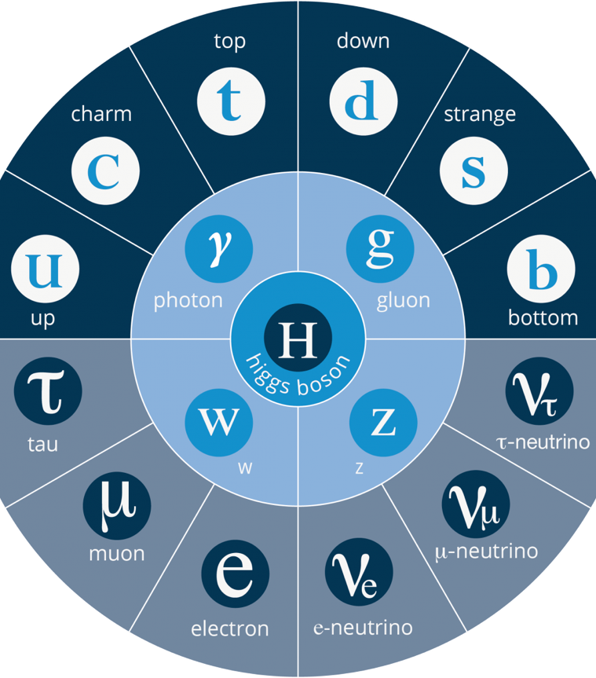
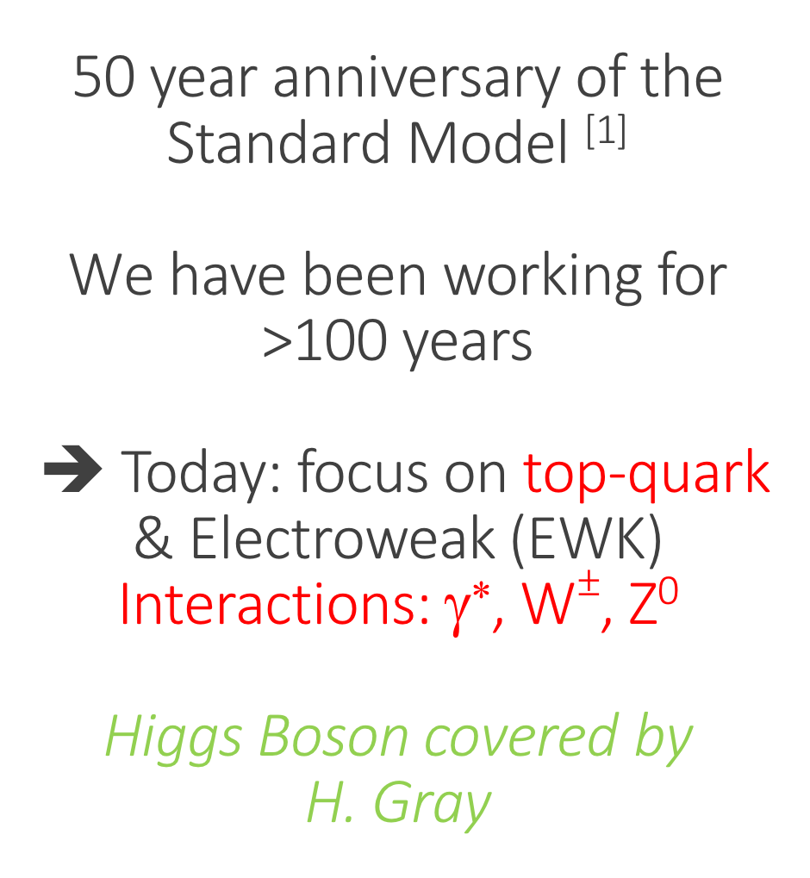
50 year anniversary of the Standard Model ^{[1]}
We have been working for >100 years
➔ Today: focus on top-quark & Electroweak (EWK) Interactions: γ∗, W$±$, Z⁰
Higgs Boson covered by
H. Gray
1968 -- 1994
1955 -- 1977
2012
1900
1979
1983
1897 -- 1975
1956 -- 2000
[1] S. Weinberg, A Model of Leptons, Phys. Rev. Lett. 19, 1264 (1967)

Slide 3
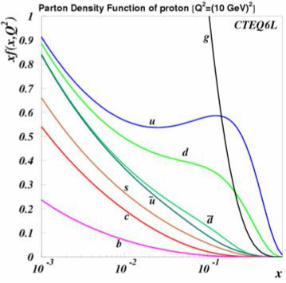
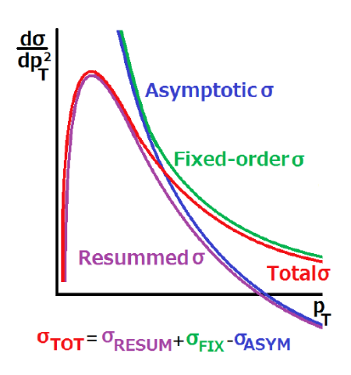
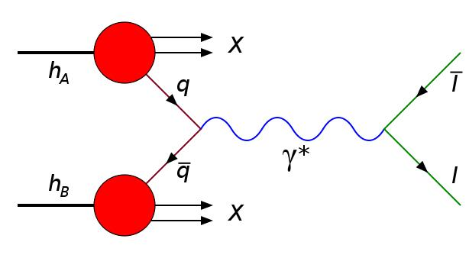
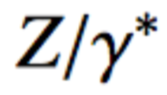
Disclaimer: QCD outside the scope of this talk… But cannot be ignored in precision EWK, not even for the must basic production mechanism of bosons at the LHC
→ Predictions needed as input
→ Serious test of QCD with EWK processes
Example, Drell-Yan Process: pp→ Z or W
High p_{T}: described at fixed-order of α_{s} by perturbative QCD predictions
Small p_{T}: described using resummation of multiple soft-gluon emissions. Non-perturbative part that has to be parametrised and extracted from the data. [2]
Main uncertainty in important EWK
precision measurements
[2] Low pileup runs of the LHC necessary to reduce systematics of W-mass

Slide 4
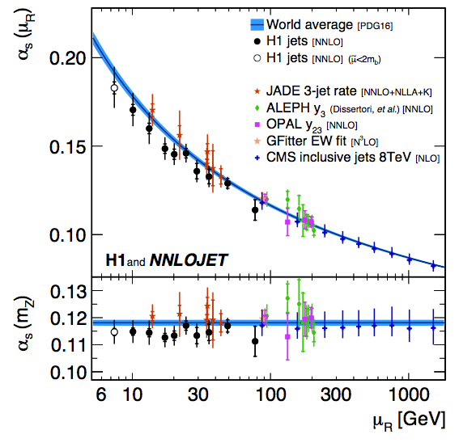
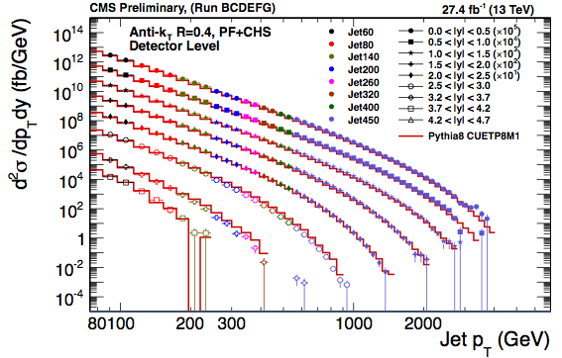

Prelude: α_{s} is one of the fundamental parameters used as input or output of our global fits @ LHC obtained from jets and tt production
@ 13 TeV continue to push triggers to have a wider range in energy and pseudorapidity
αs(μR) in NNLO QCD from H1, arXiv:1709.07251 ;
CMS 8 TeV covers highest μR

Slide 5
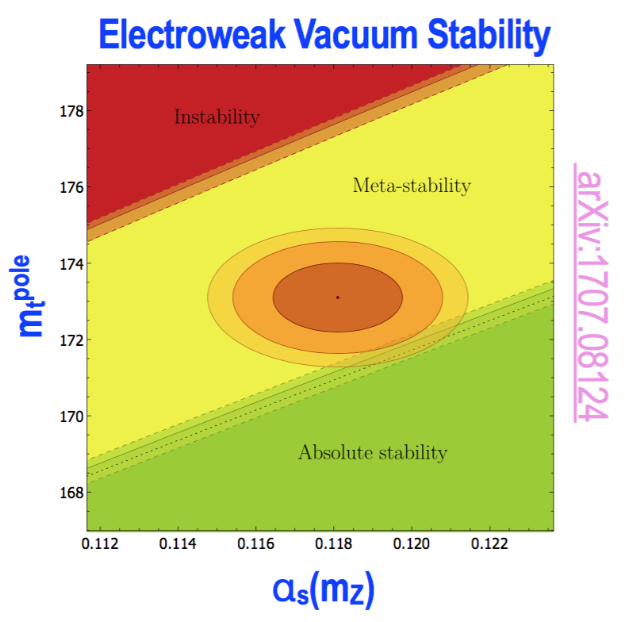
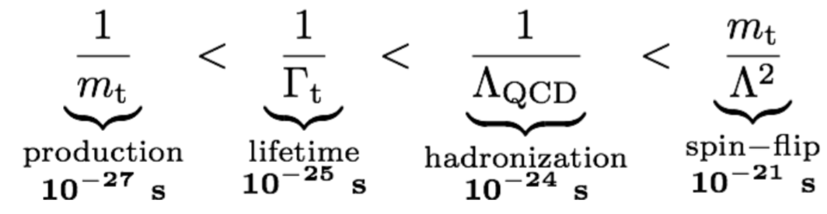
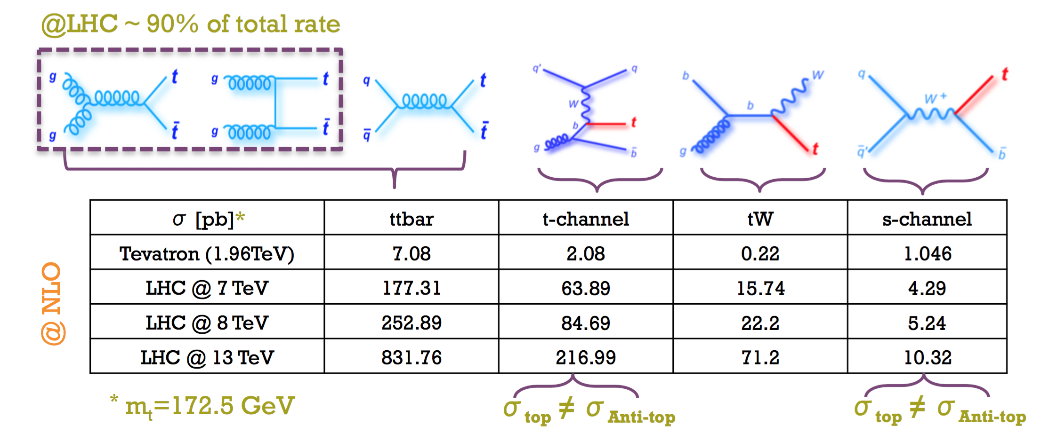

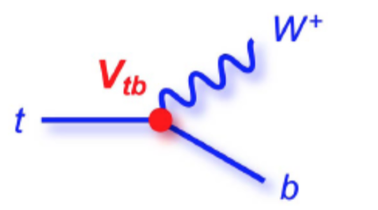
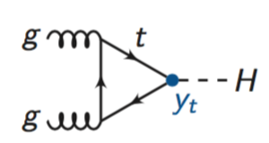
  Why include top-quark as a probe of EWK physics?
Heaviest known elementary particle → strong coupling to Higgs
Timescales → study bare quarks
Measure SM parameters:
…

Slide 6
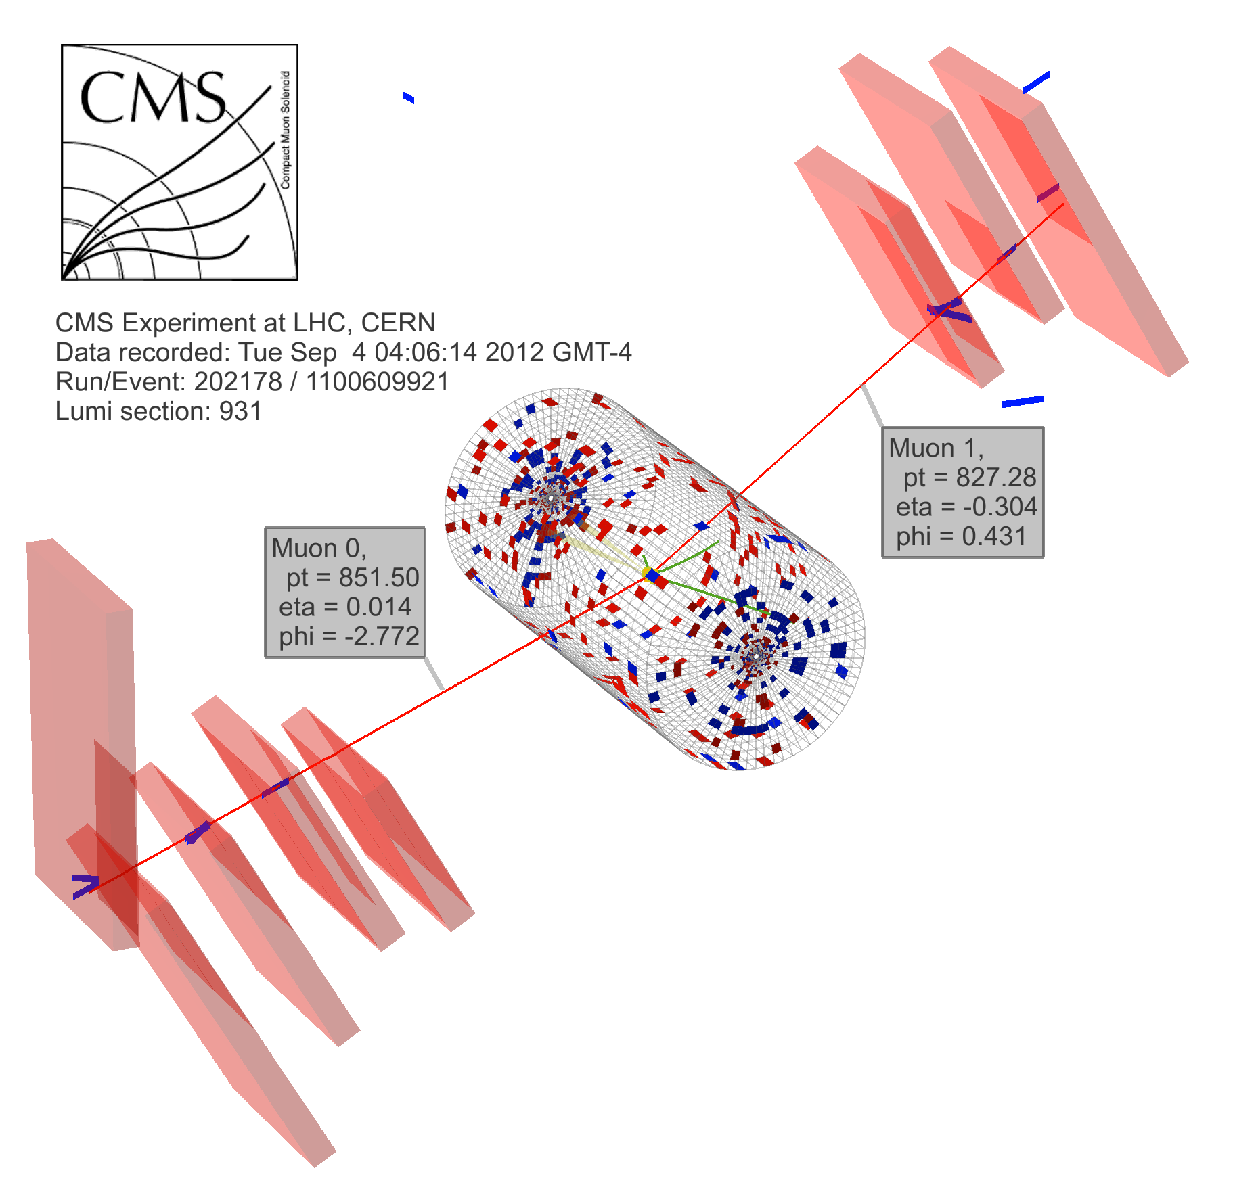
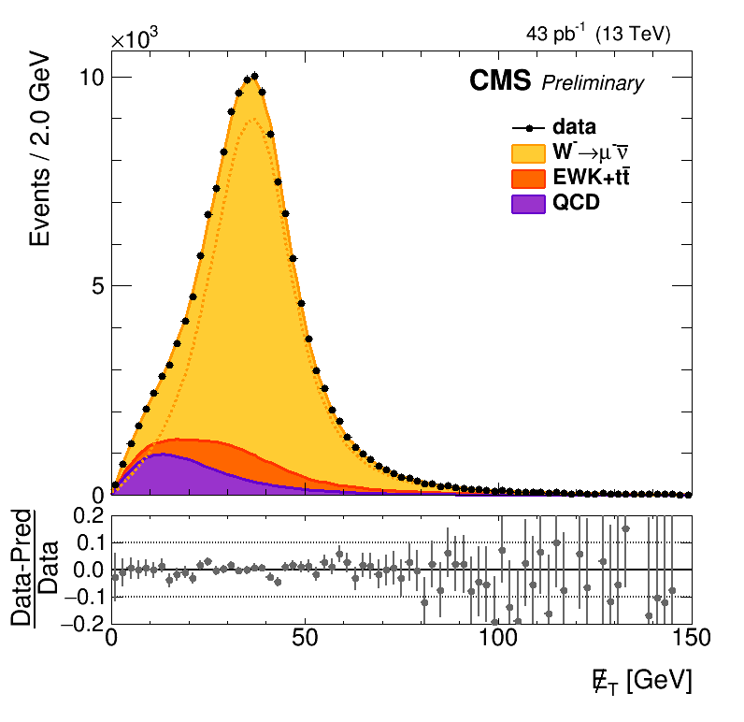
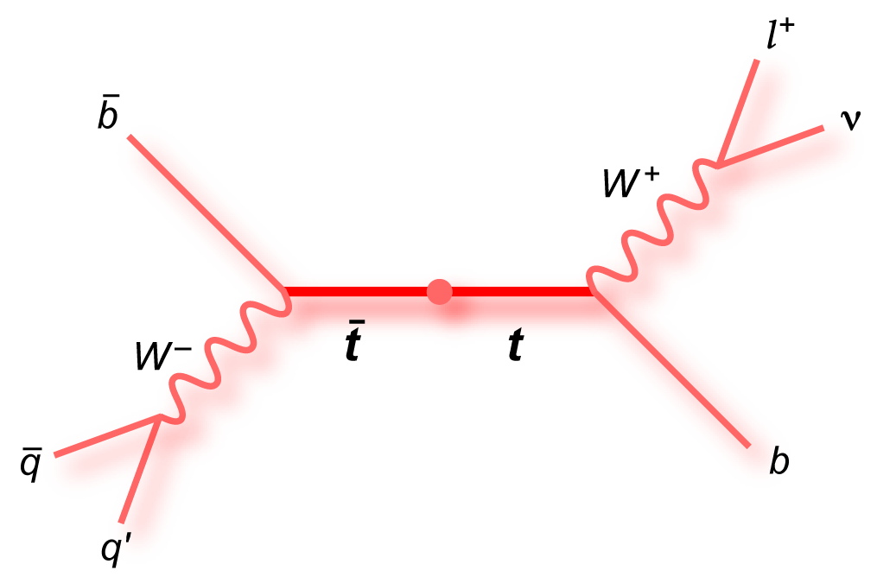
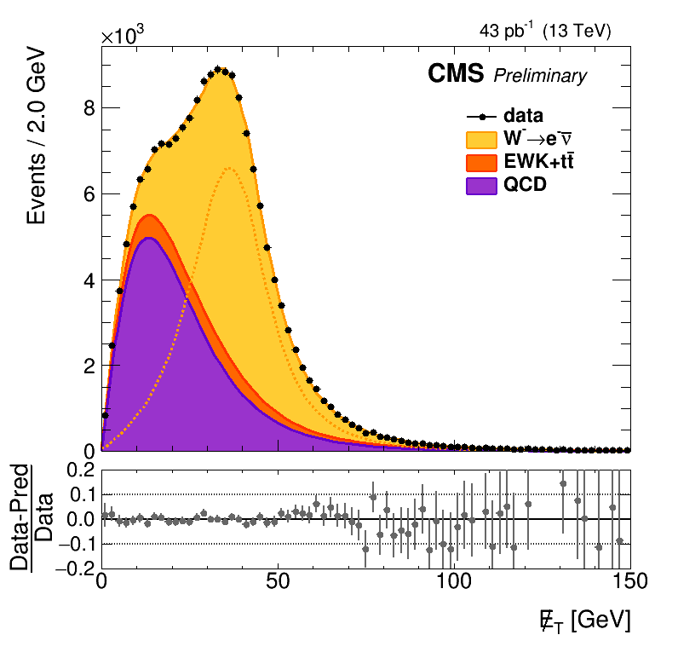
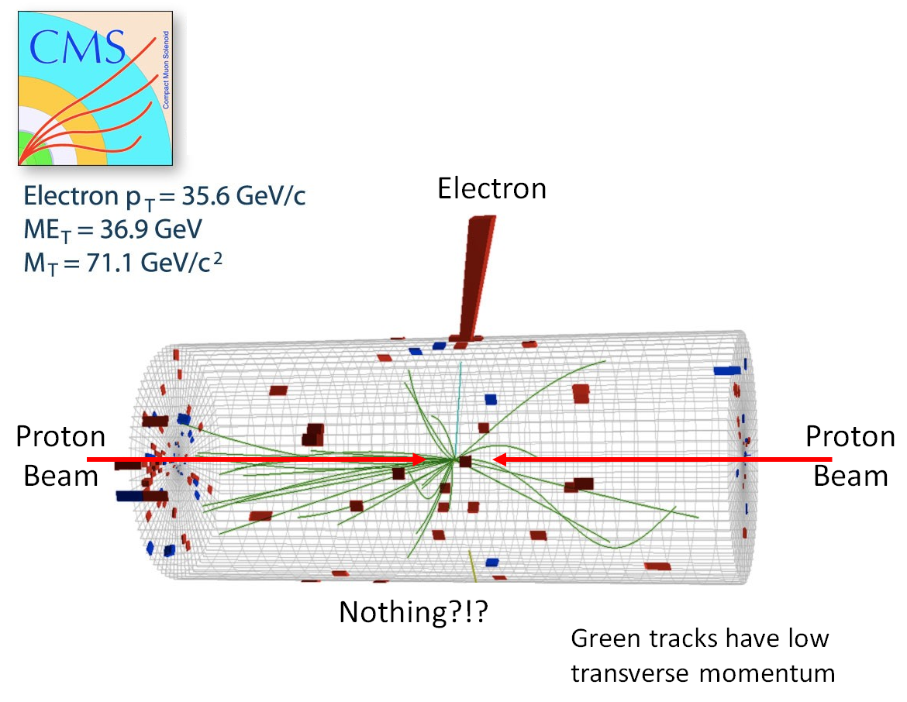
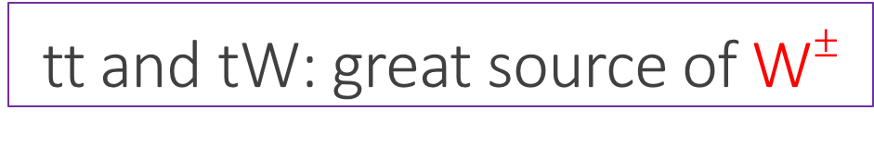
tt and tW: great source of W$±$
Becoming harder to mantain low energy
thresholds for single lepton triggers level
@ the LHC
➔ Future requires new trigger schemes

Slide 7
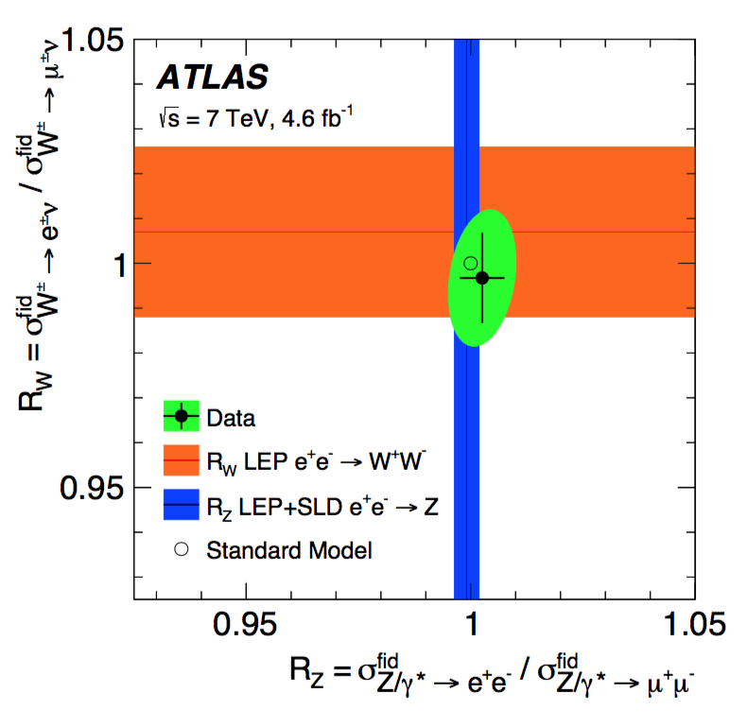
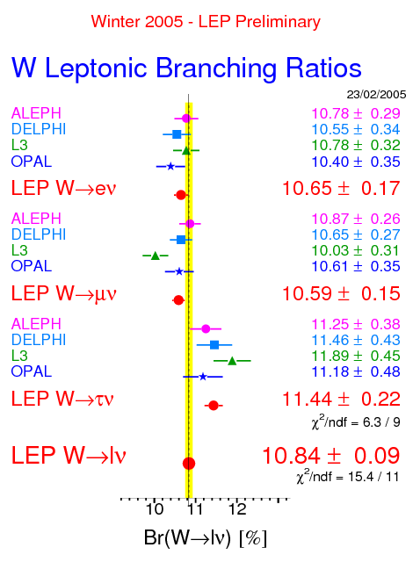
Large W samples : Test of Lepton Universality
If anomalies in
b-meson decays into τ’s (D*τν) persists, it
becomes more important to
revise our assumptions
on Lepton
Universality
arXiV:1612.03016
τ BR ~2.7 σ larger than e/μ

Slide 8
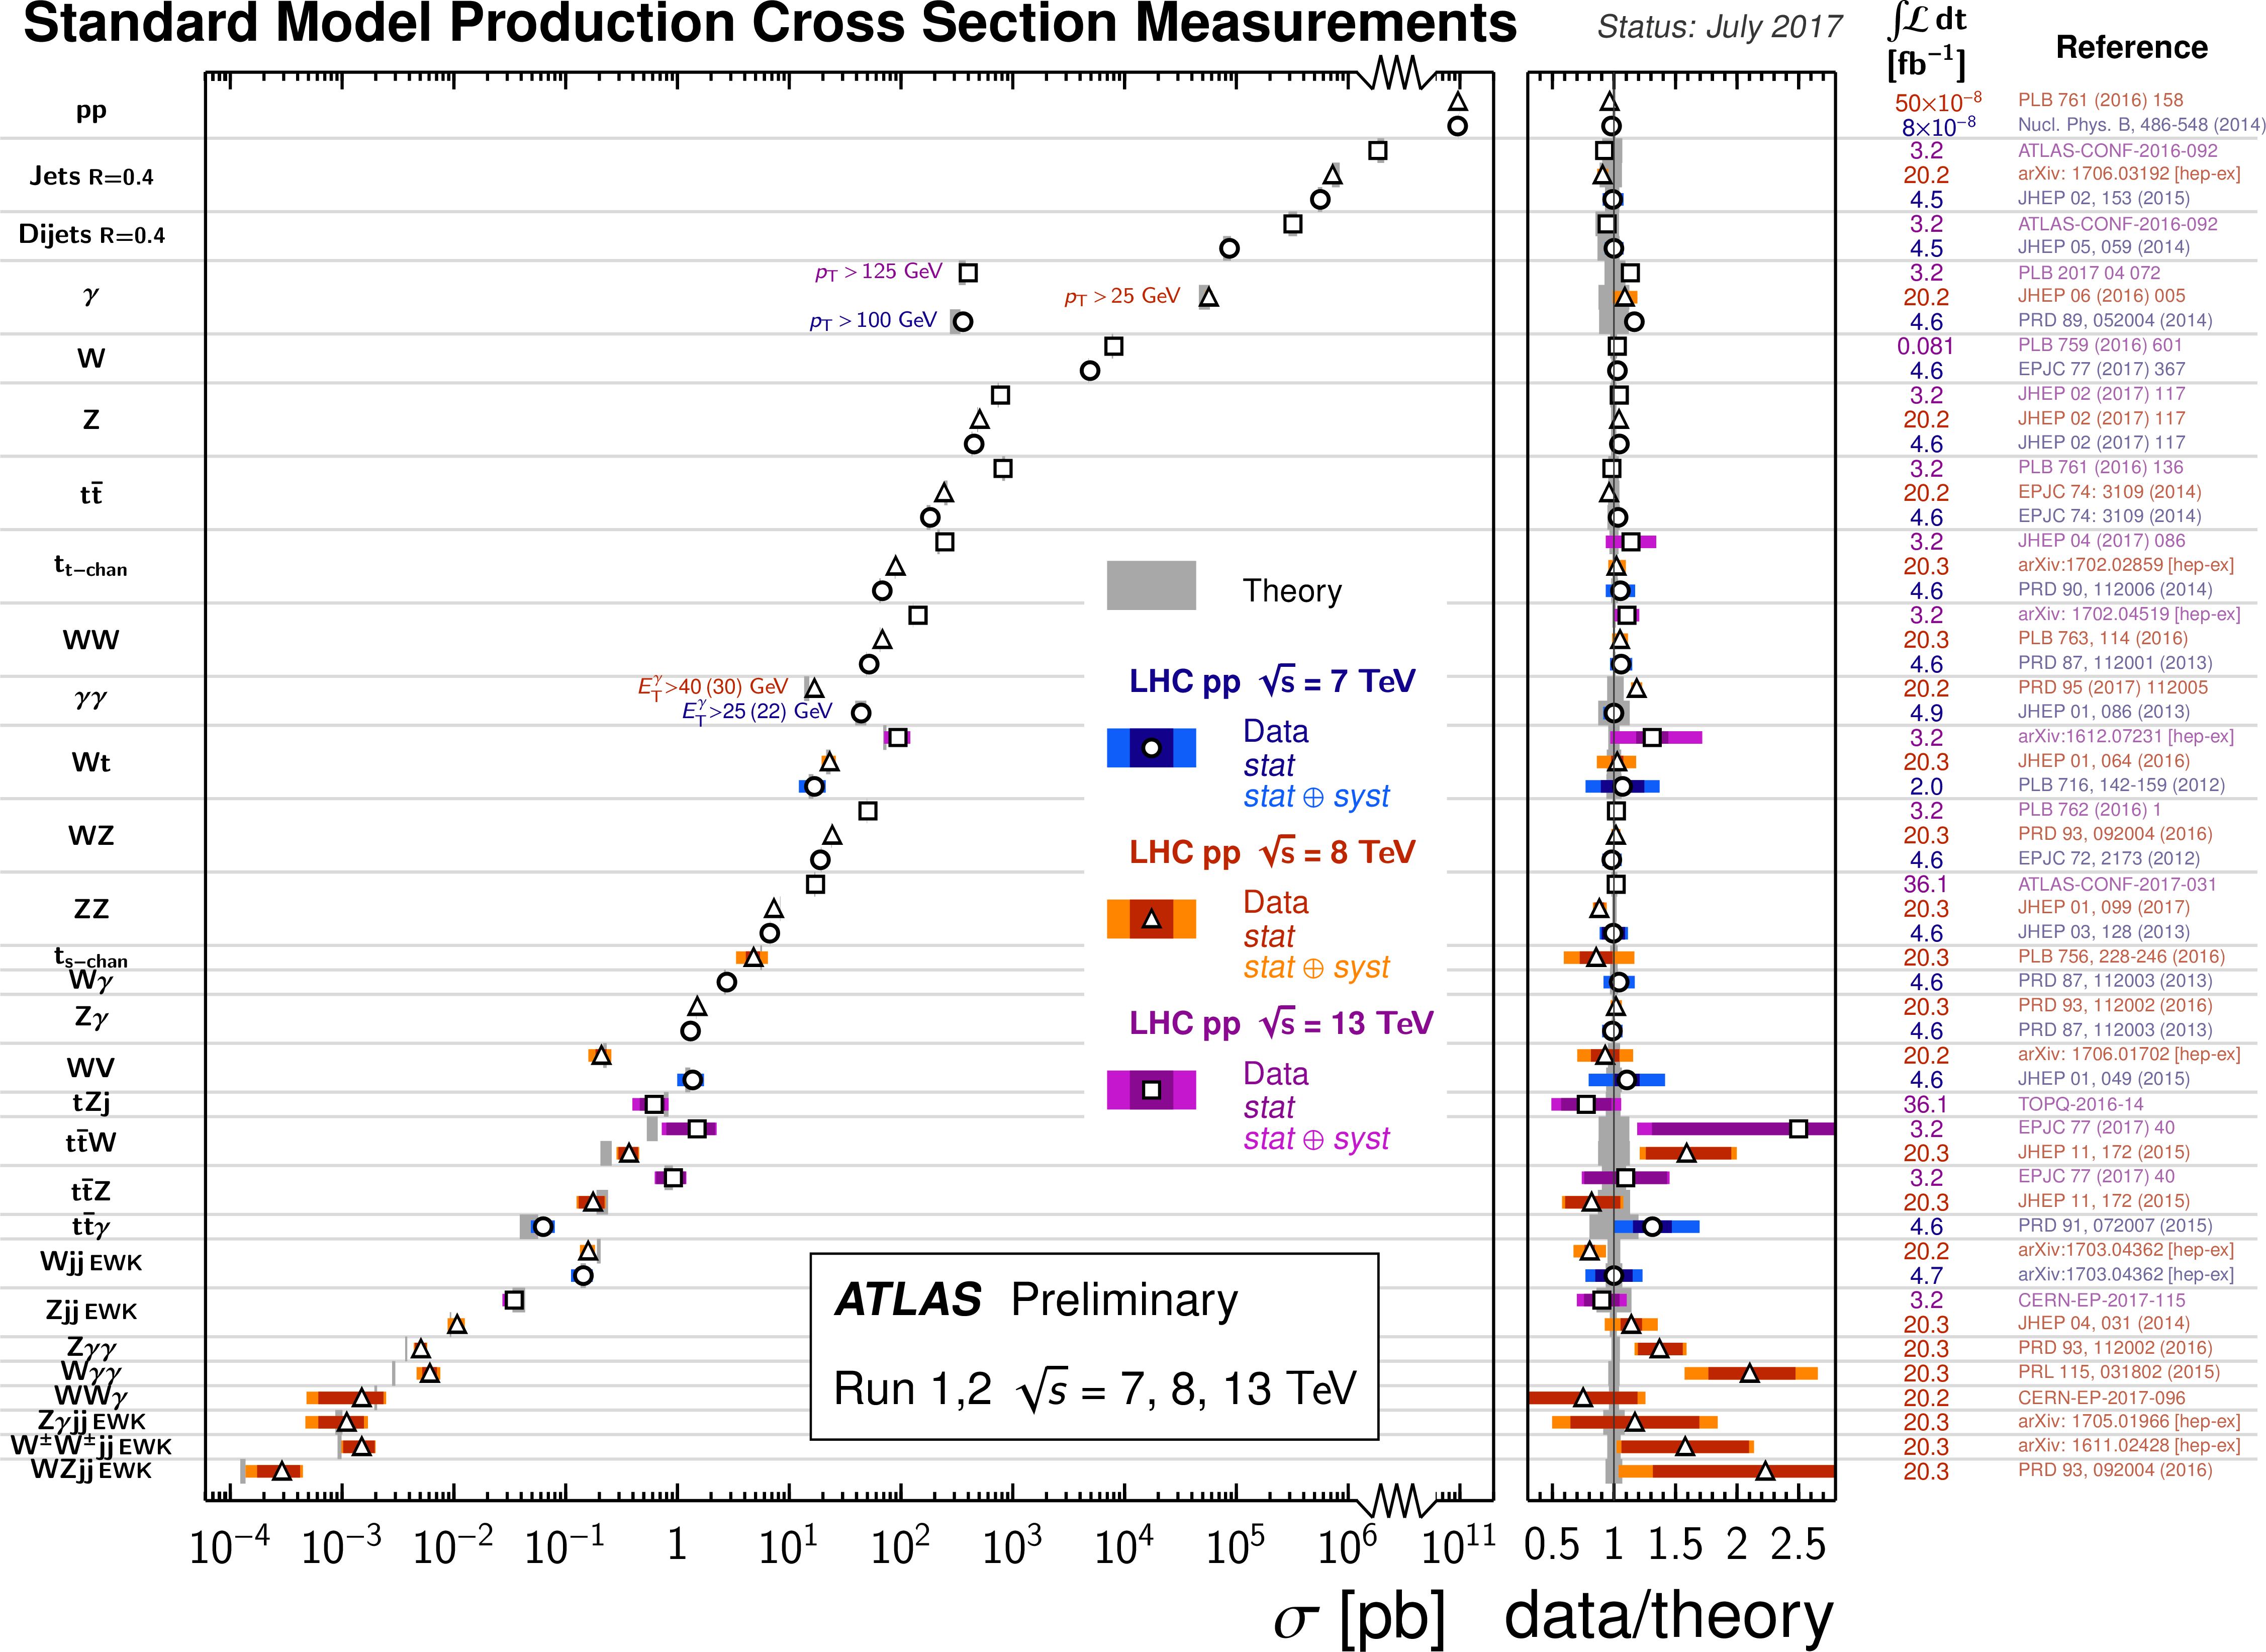
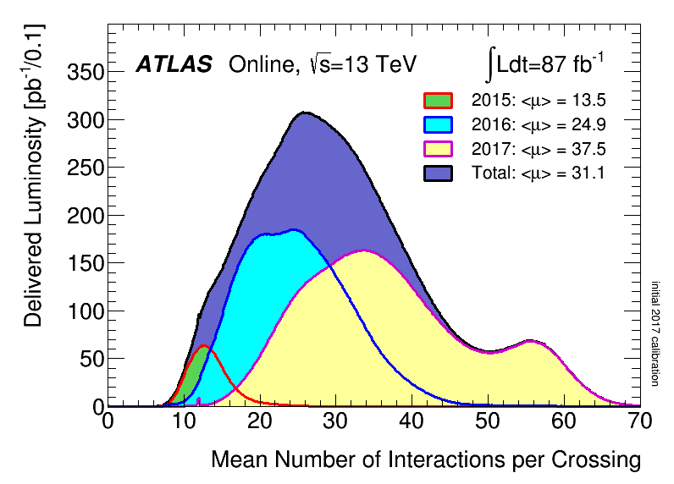
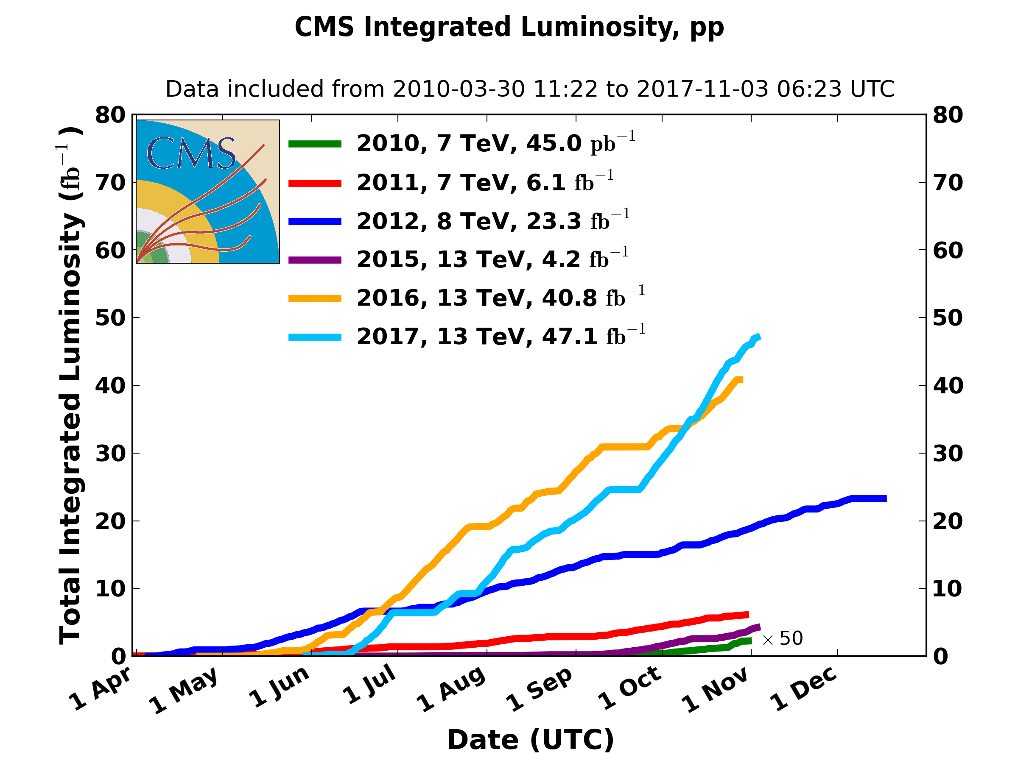
Already
ATLAS + CMS has
> 150 fb⁻¹ @ 13 TeV

Slide 9
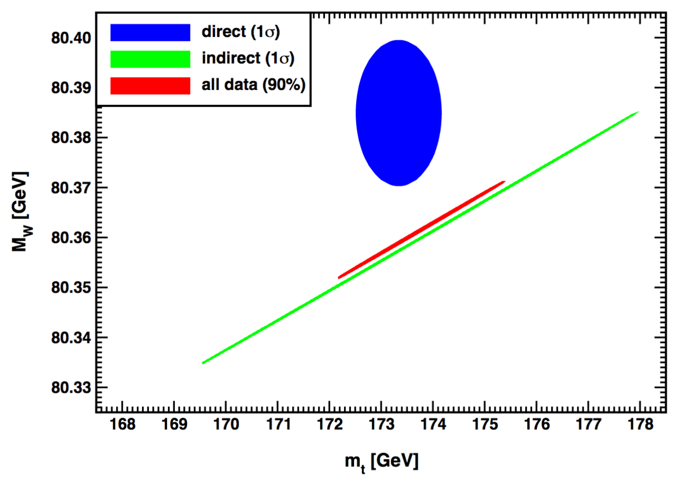
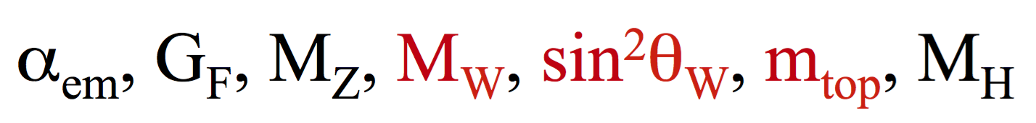
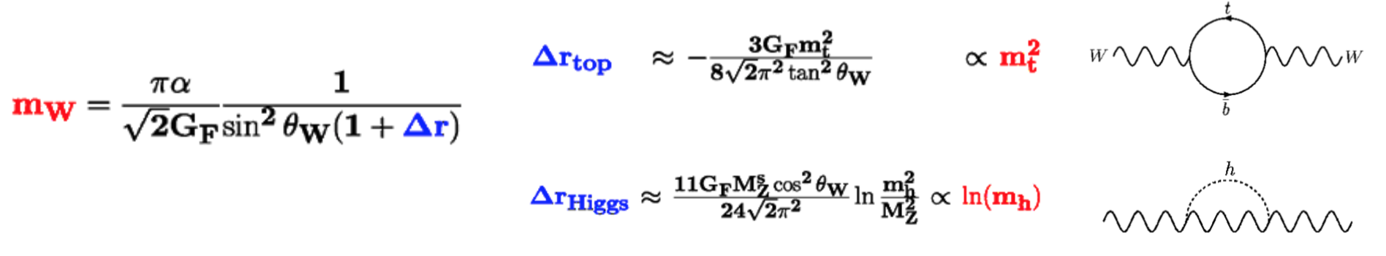
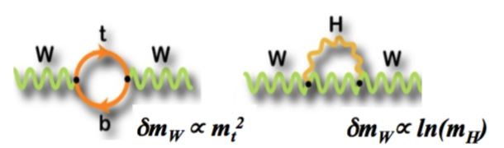

  Role of precision EWK measurements @ Hadron Colliders
  To provide precise measurements of fundamental parameters to tests the theory:
  Why? To have access to potential virtual new particles that might not be directly accessible at the current center of mass energy… just as we did for the Higgs
α_{s}
J. Erler
A. Freitas
Some tension already in data … Better precision before we can conclude if significant

Slide 10
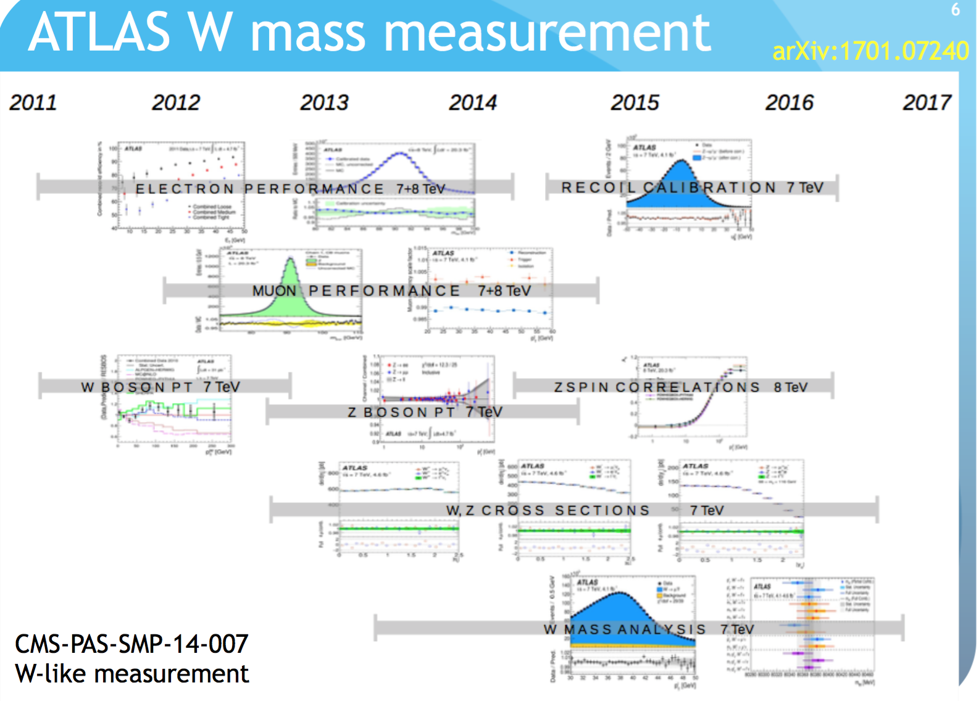
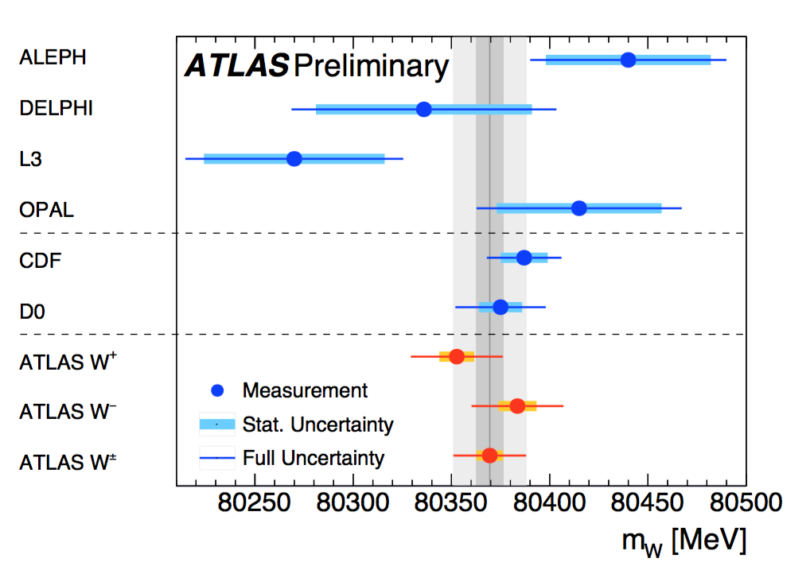
Not trivial
to measure the
W-mass

Slide 11
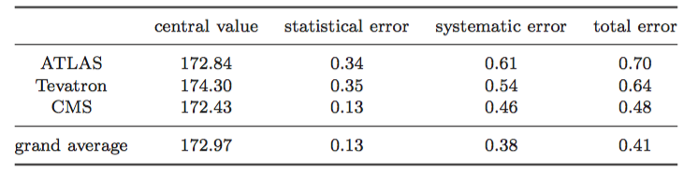

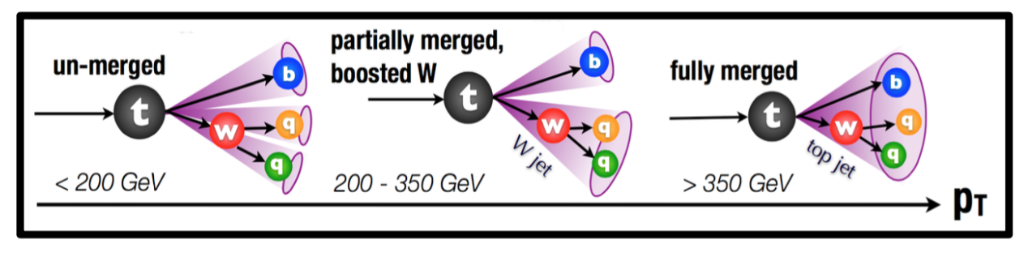
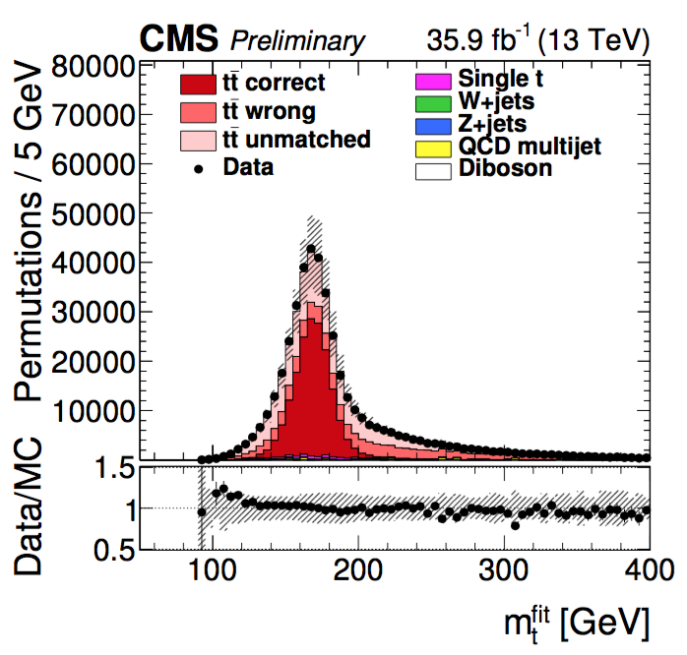
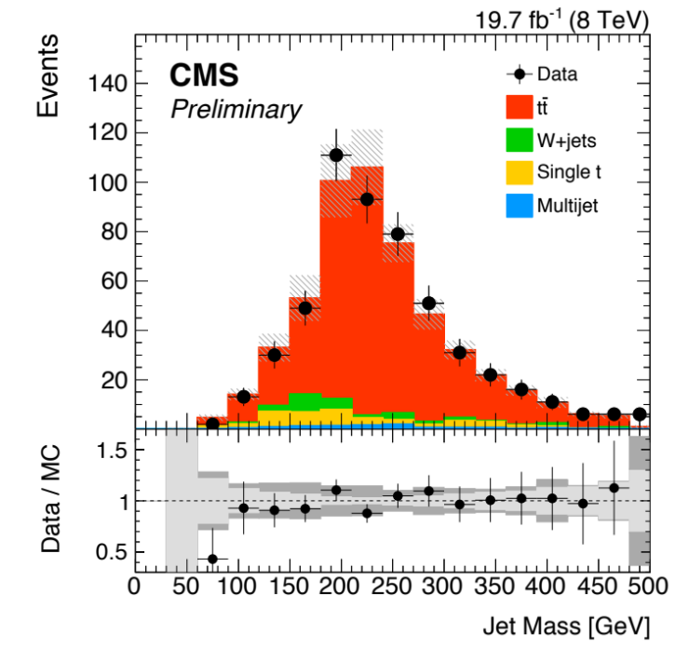
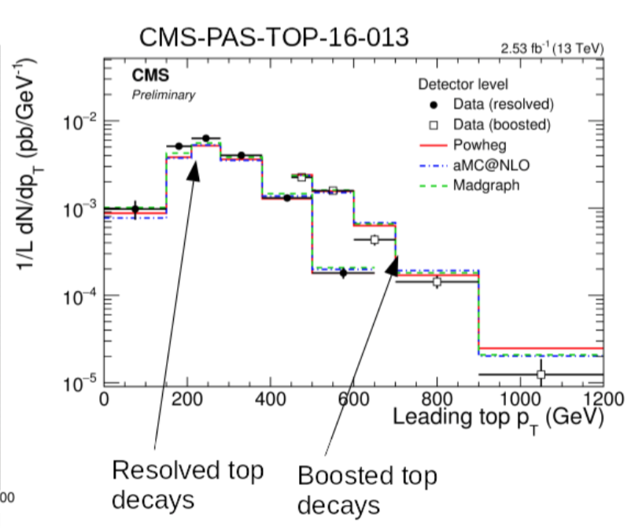

Top mass “easier”: more measurement
7 + 8 TeV
We still need to improve M_{top} – the recent shift on the world average of the top mass resulted in a lowering of 3 GeV on the predicted Higgs mass
Future improvements will include the exploitation of boosted objects topology with W’s decaying hadronically
“old”
p_{T}> 500 GeV
boosted

Slide 12
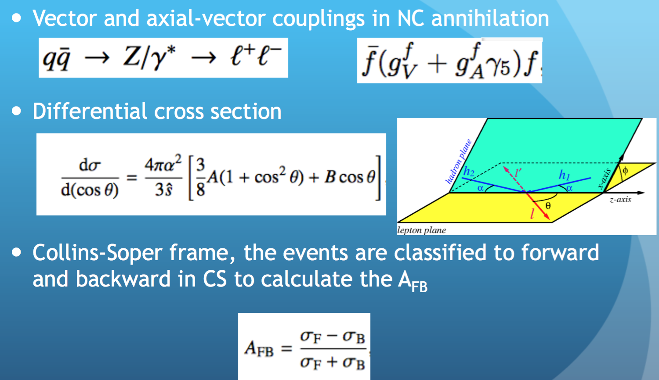
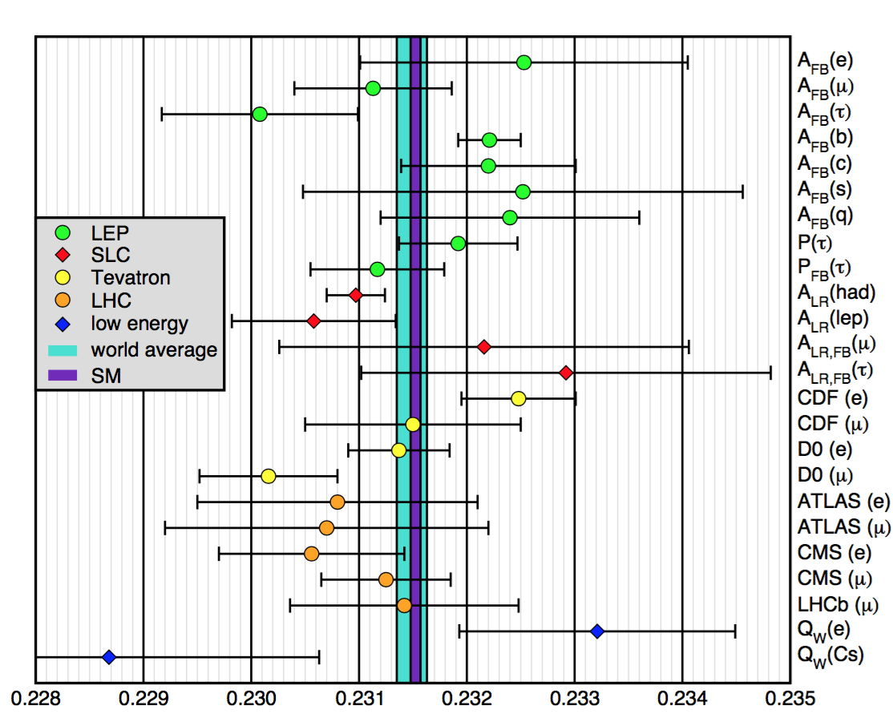
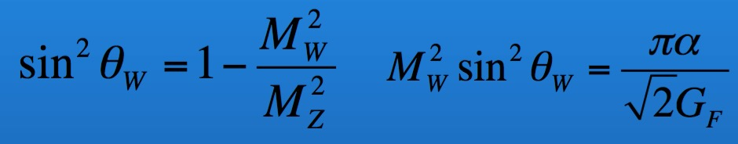
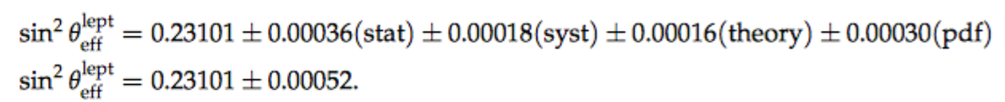
_{Reduction by} _{factor of 2}
_{expected with 13 TeV data}
_{By 4 at the HL-LHC}
effective leptonic weak mixing angle
CMS @ 8 TeV

Slide 13
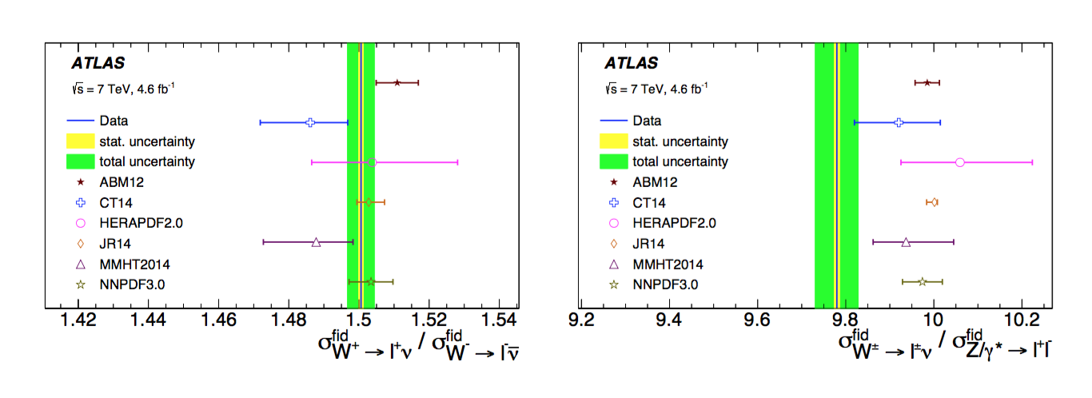
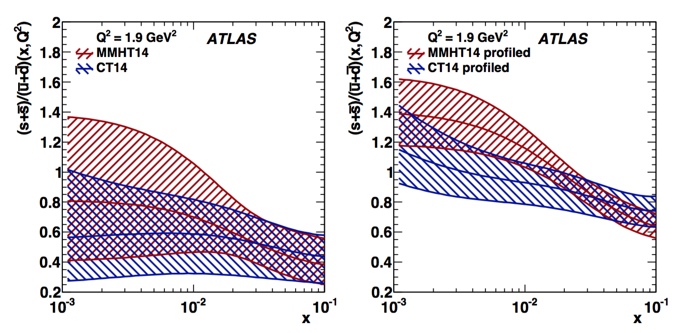
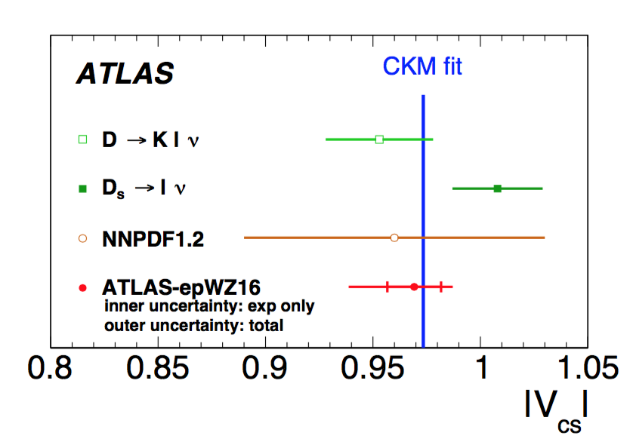
V_{cs} from PDF fit
Indication that assumed PDF’s are not correct… More specifically the
content of strange quarks in the proton ➔ Strange quarks again misbehaving
Without
W/Z data
With
W/Z data
arXiV:1612.03016

Slide 14
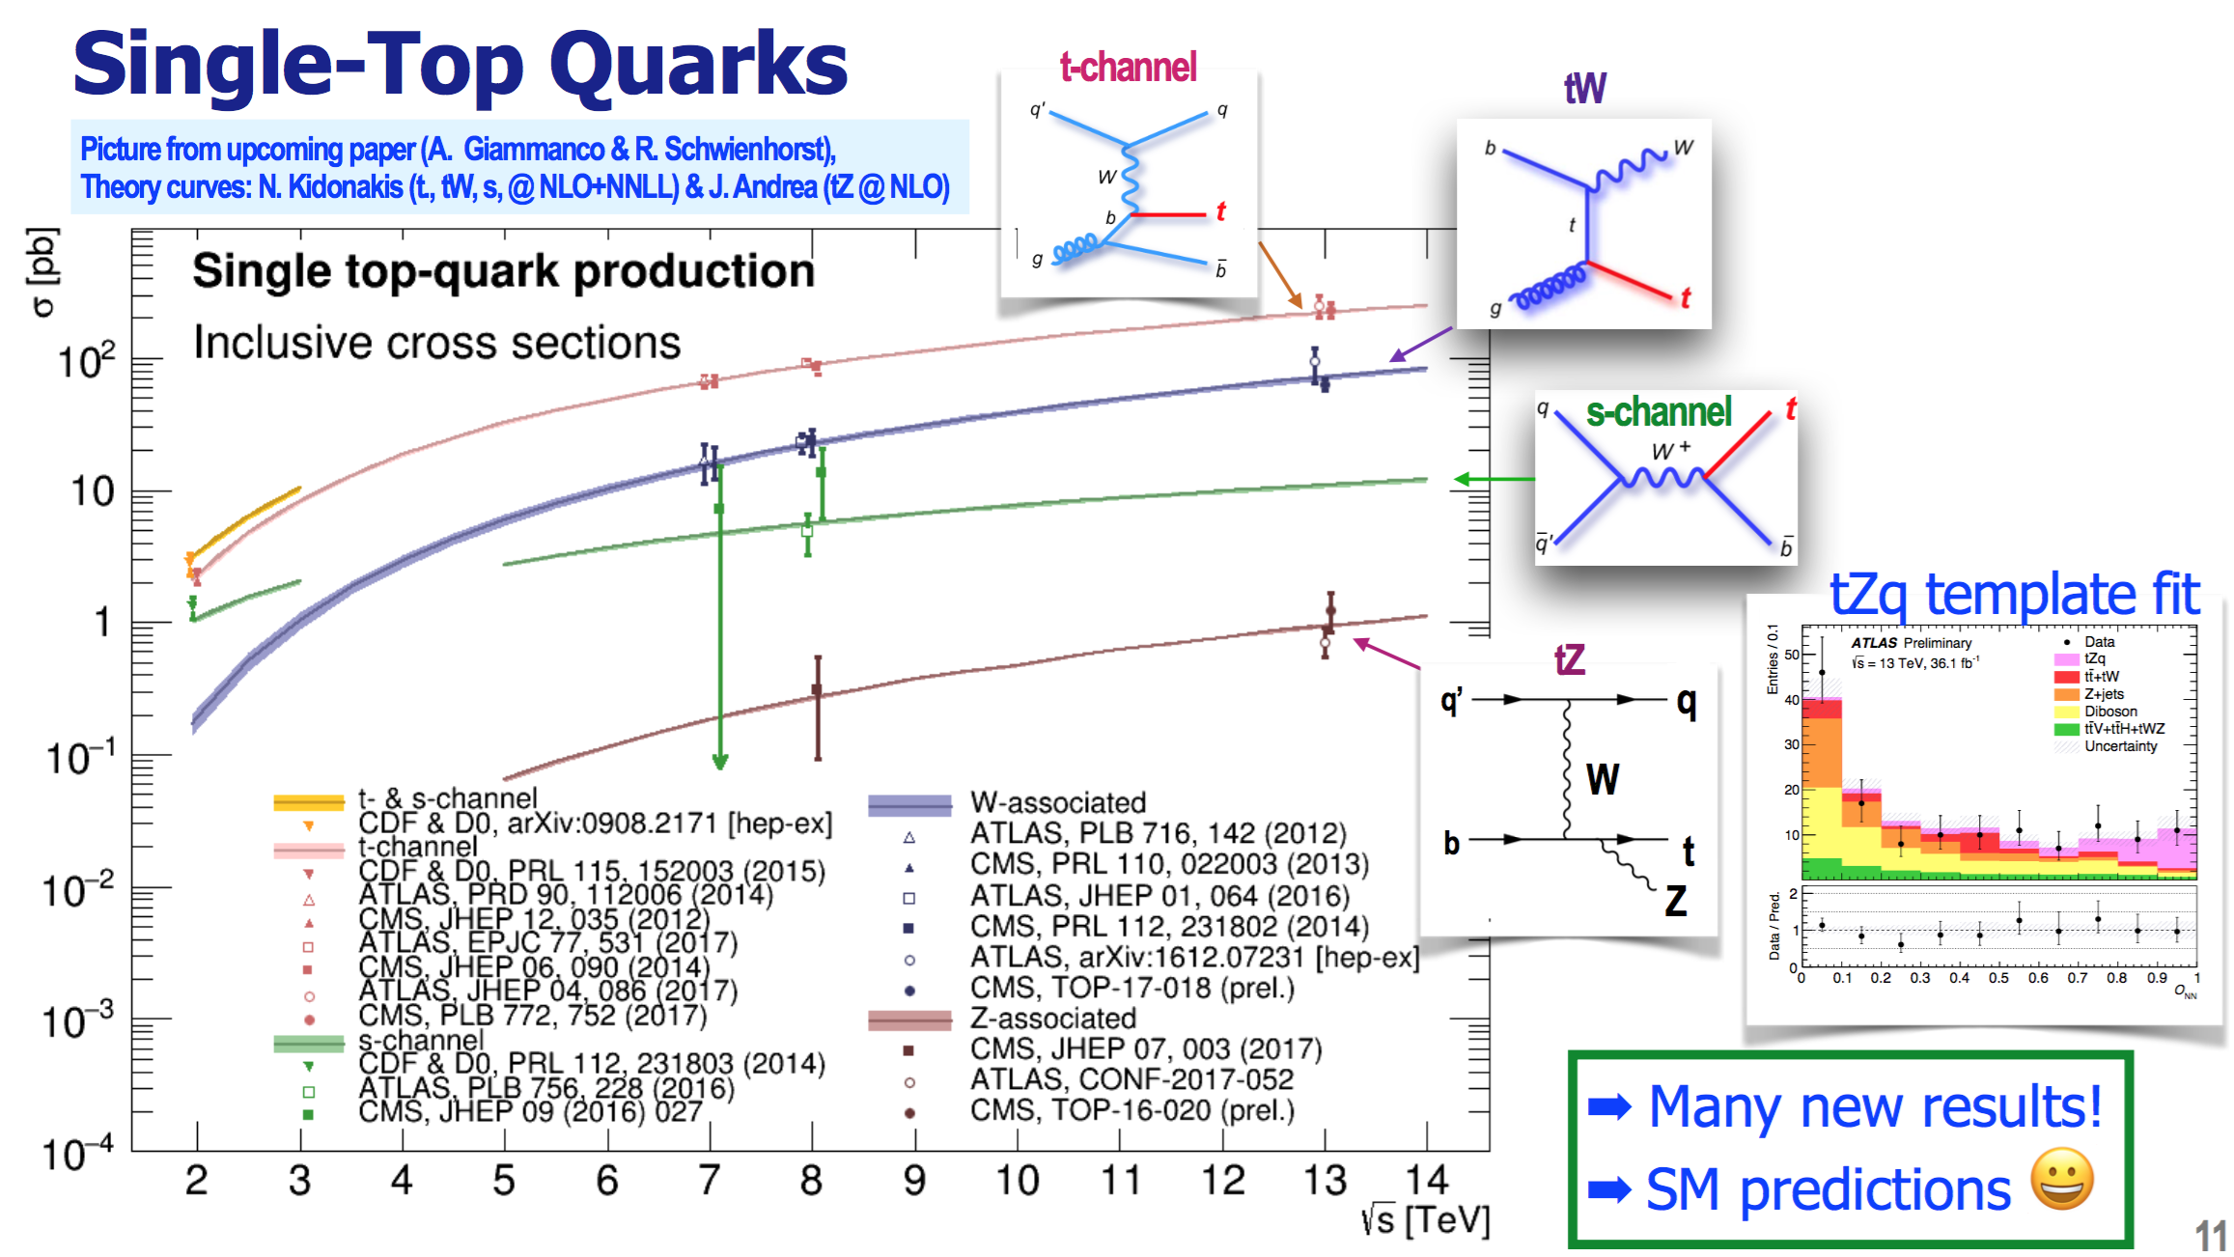
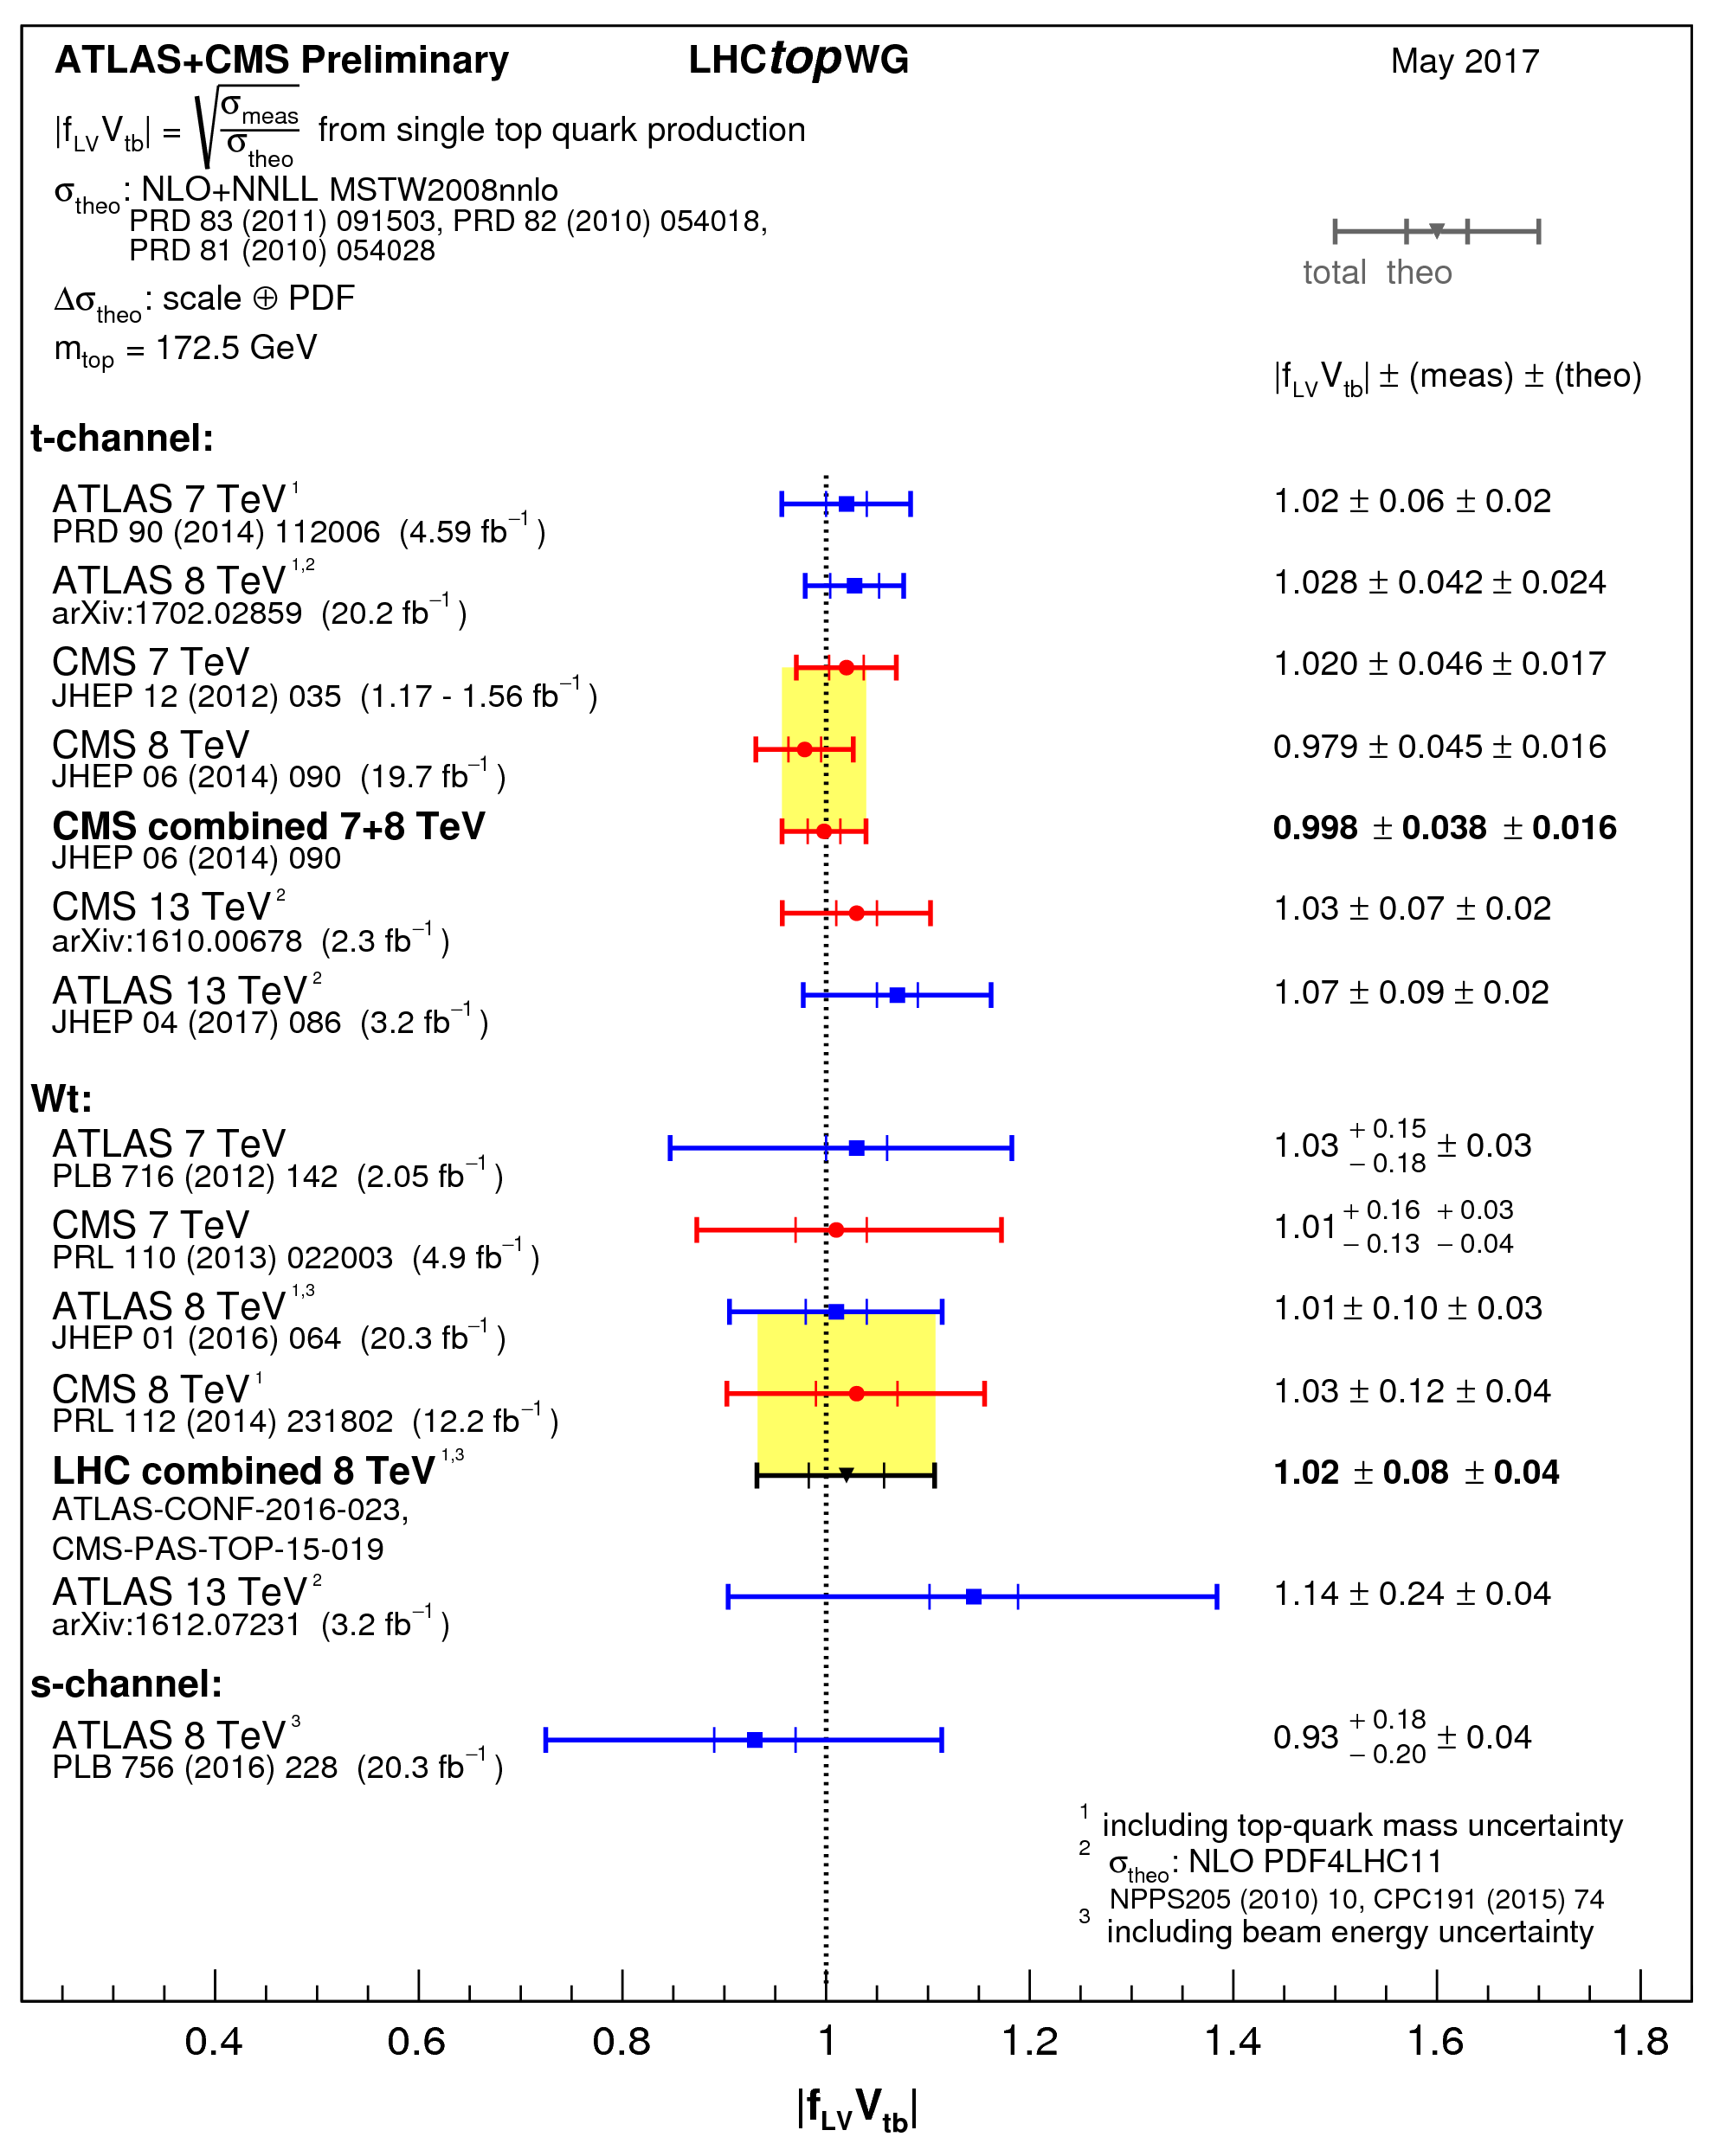
Single top ➔ V_{tb} at 1-2% level* will be possible with the full 13 TeV data compared to 4% at 8 TeV
* Assuming the theoretical error will go down

Slide 15
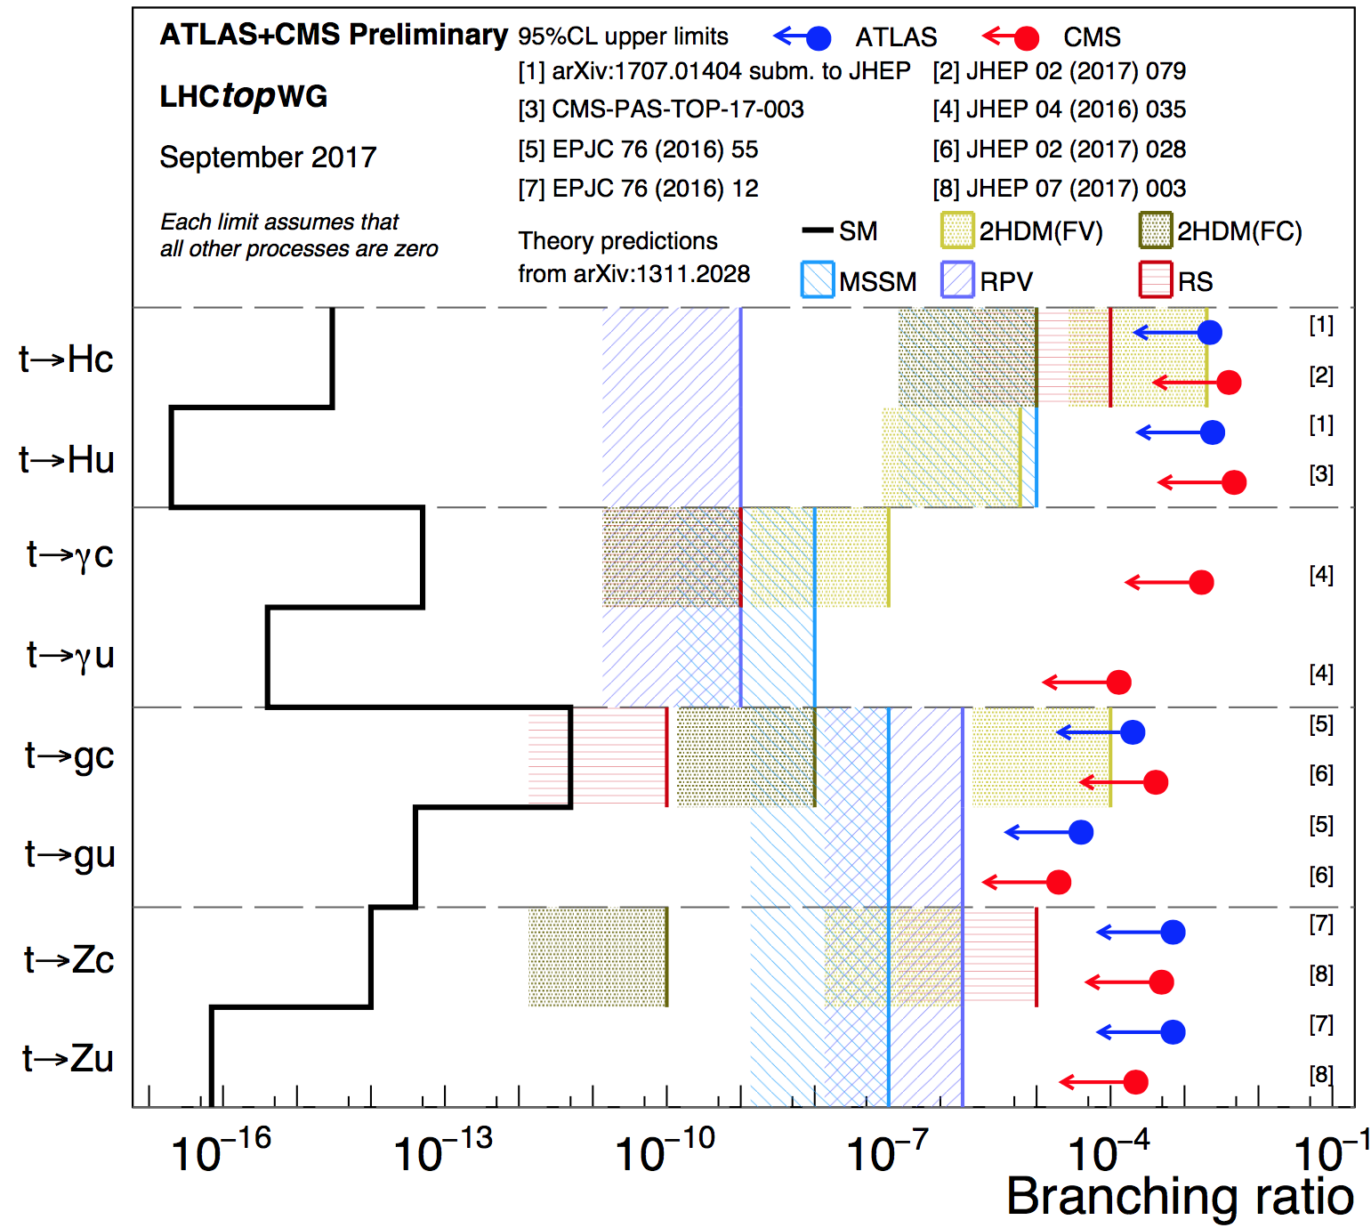
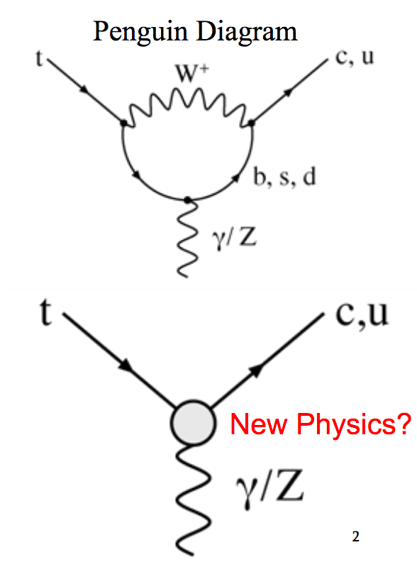
Searches for Flavor-Changing-Neutral Currents in top decays… Decay into real Z’s & Higgs boson kinematically possible
γ/g/Z/H
γ/g/Z/H

Slide 16
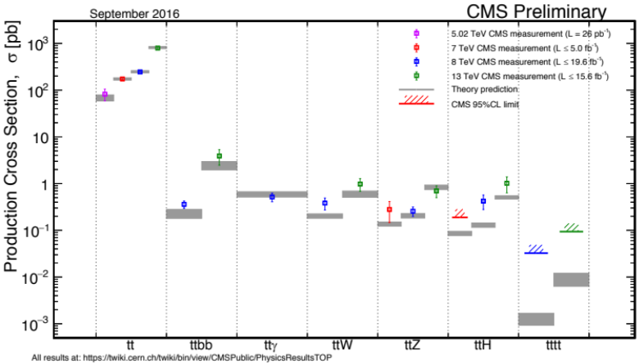
Next big target... multi-boson interactions
Last comment of on top related process

Slide 17
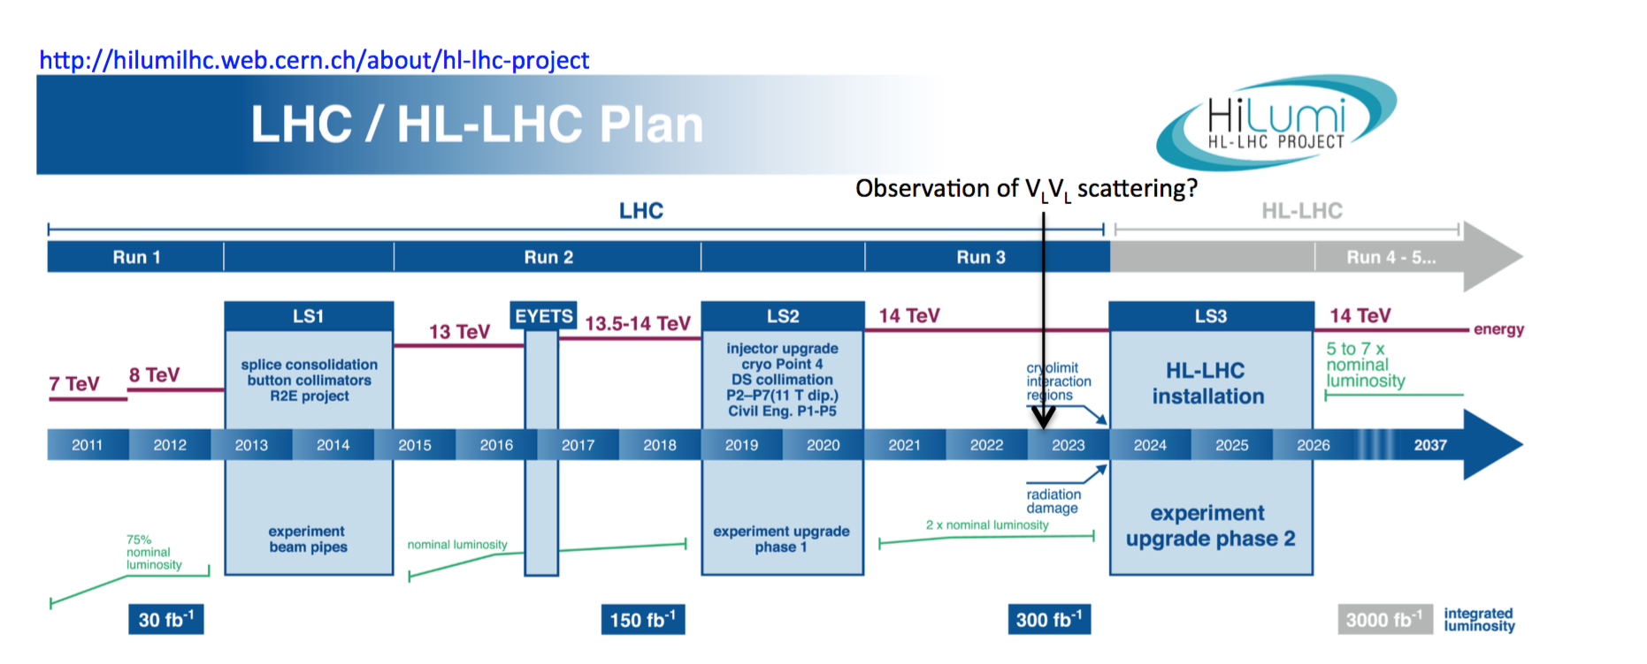
Preparing the ground for the scattering of longitudinal W’s
Already have 80 fb⁻¹/experiment

Slide 18
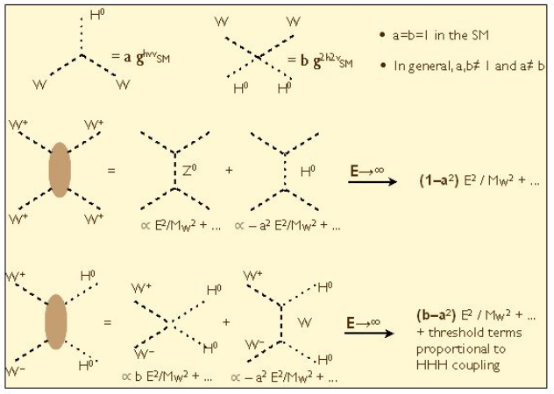
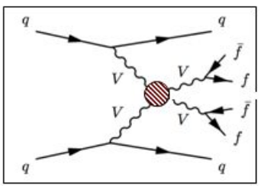

In SM, (i) W_{L}W_{L} → W_{L}W_{L} vanishes, only (ii) W_{T}W_{T} → W_{T}W_{T} is present
(i) $≠0:$additional
particles are
Responsible for EWSB
M_{H}
M_{VV}

Slide 19

V+ 2 jets
Multiboson
production
Huge range of
production
Cross Sections
Boson
EW
Dibosons
EW

Slide 20


pp→ j j W± W±
pp→ j j Z Z

Slide 21





Identification of pp→ qqV or qqVV
pp→ jj V
pp→ jj VV
V_{L} V_{L} scattering linked to the mechanism responsible for the EWSB which give us the particle content in the SM:
VBF Efficient way of producing resonances

Slide 22




Multibosons are also used to search for new physics via anomalous couplings

Slide 23



Vector Boson
Scattering
M_{jj} > 500 GeV
Zγ and W±W± production in association with a high-mass dijet system @ 8 TeV (ATLAS)
ZZ and W±W± @ 13 TeV (CMS) with full 2016 data
→ 1st observation of EW--VV production at 13 TeV

Slide 24


Tribosons
arXiv:1704.00366

Slide 25


Tribosons
First study by ATLAS of W±W±W∓ to
l±𝜈 +l± 𝜈+l± 𝜈 and l±𝜈+l± 𝜈+𝑗𝑗
More statistics will come @13 TeV

Slide 26


Anomalous couplings
Limiting factor: Observed statistics in the tail, systematics and statistical uncertainty on the S/B model ➔ Will improve as luminosity increases
Anomalous couplings result in an increase of cross sections at high energies
  Invariant mass of the diboson system and the boson p_{T} are particularly sensitive

Slide 27
Conclusion
LHC giving us plenty of interesting EWk results and more to come based on run-2 data…

Slide 28


