Slide 1
TUCAN
UCN source and nEDM update November 2019
R. Picker

Slide 2
Topics
Prototype source experimental campaigns
New UCN source construction
Neutron EDM development
Beamline readiness

Slide 3
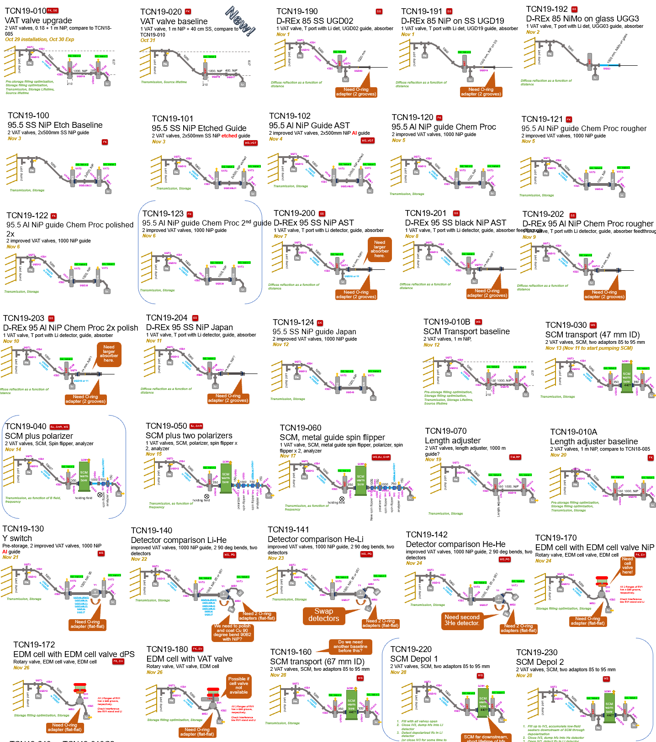
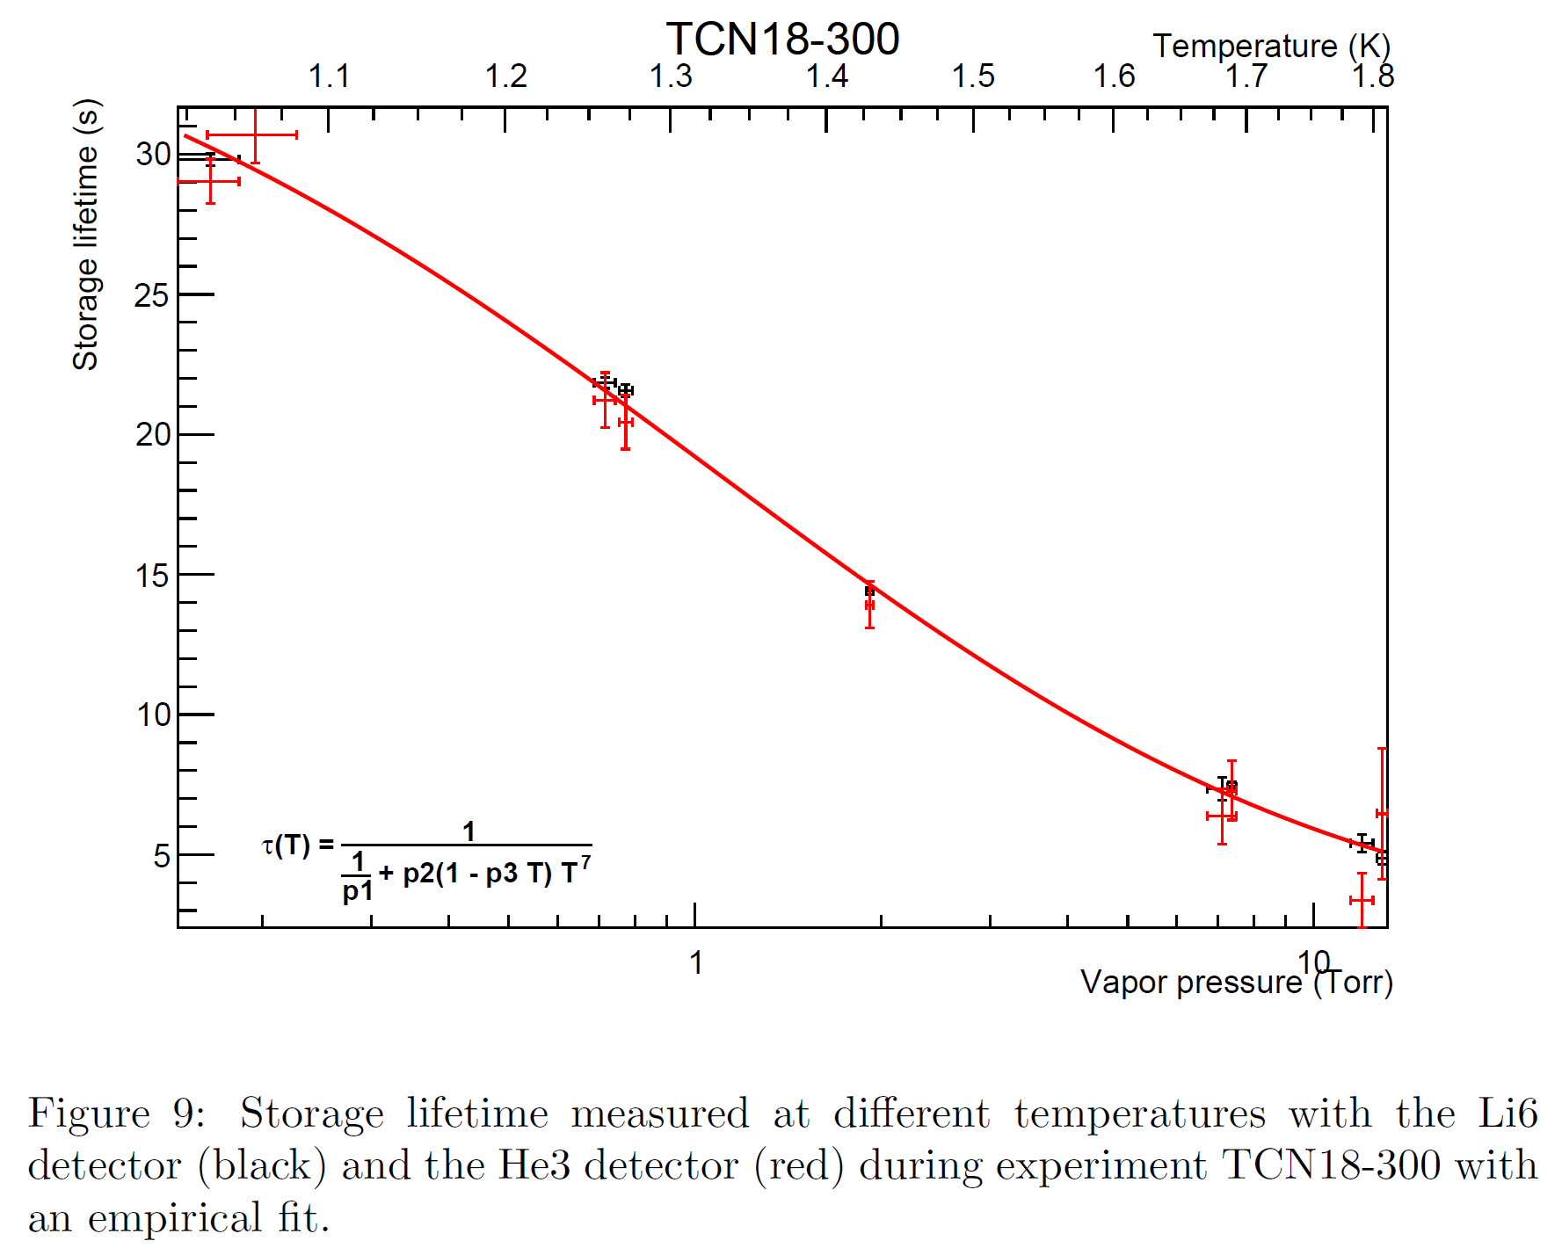
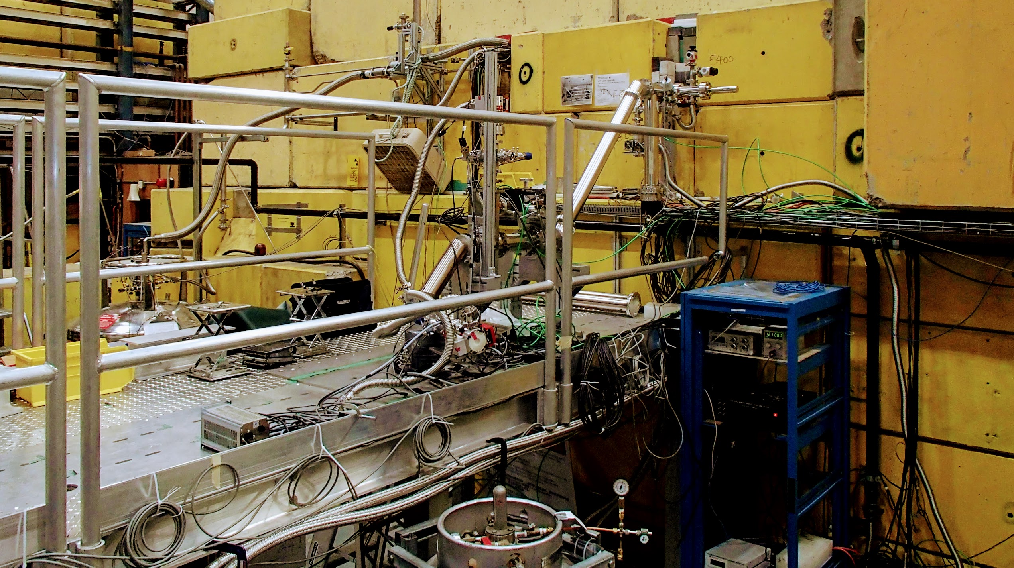
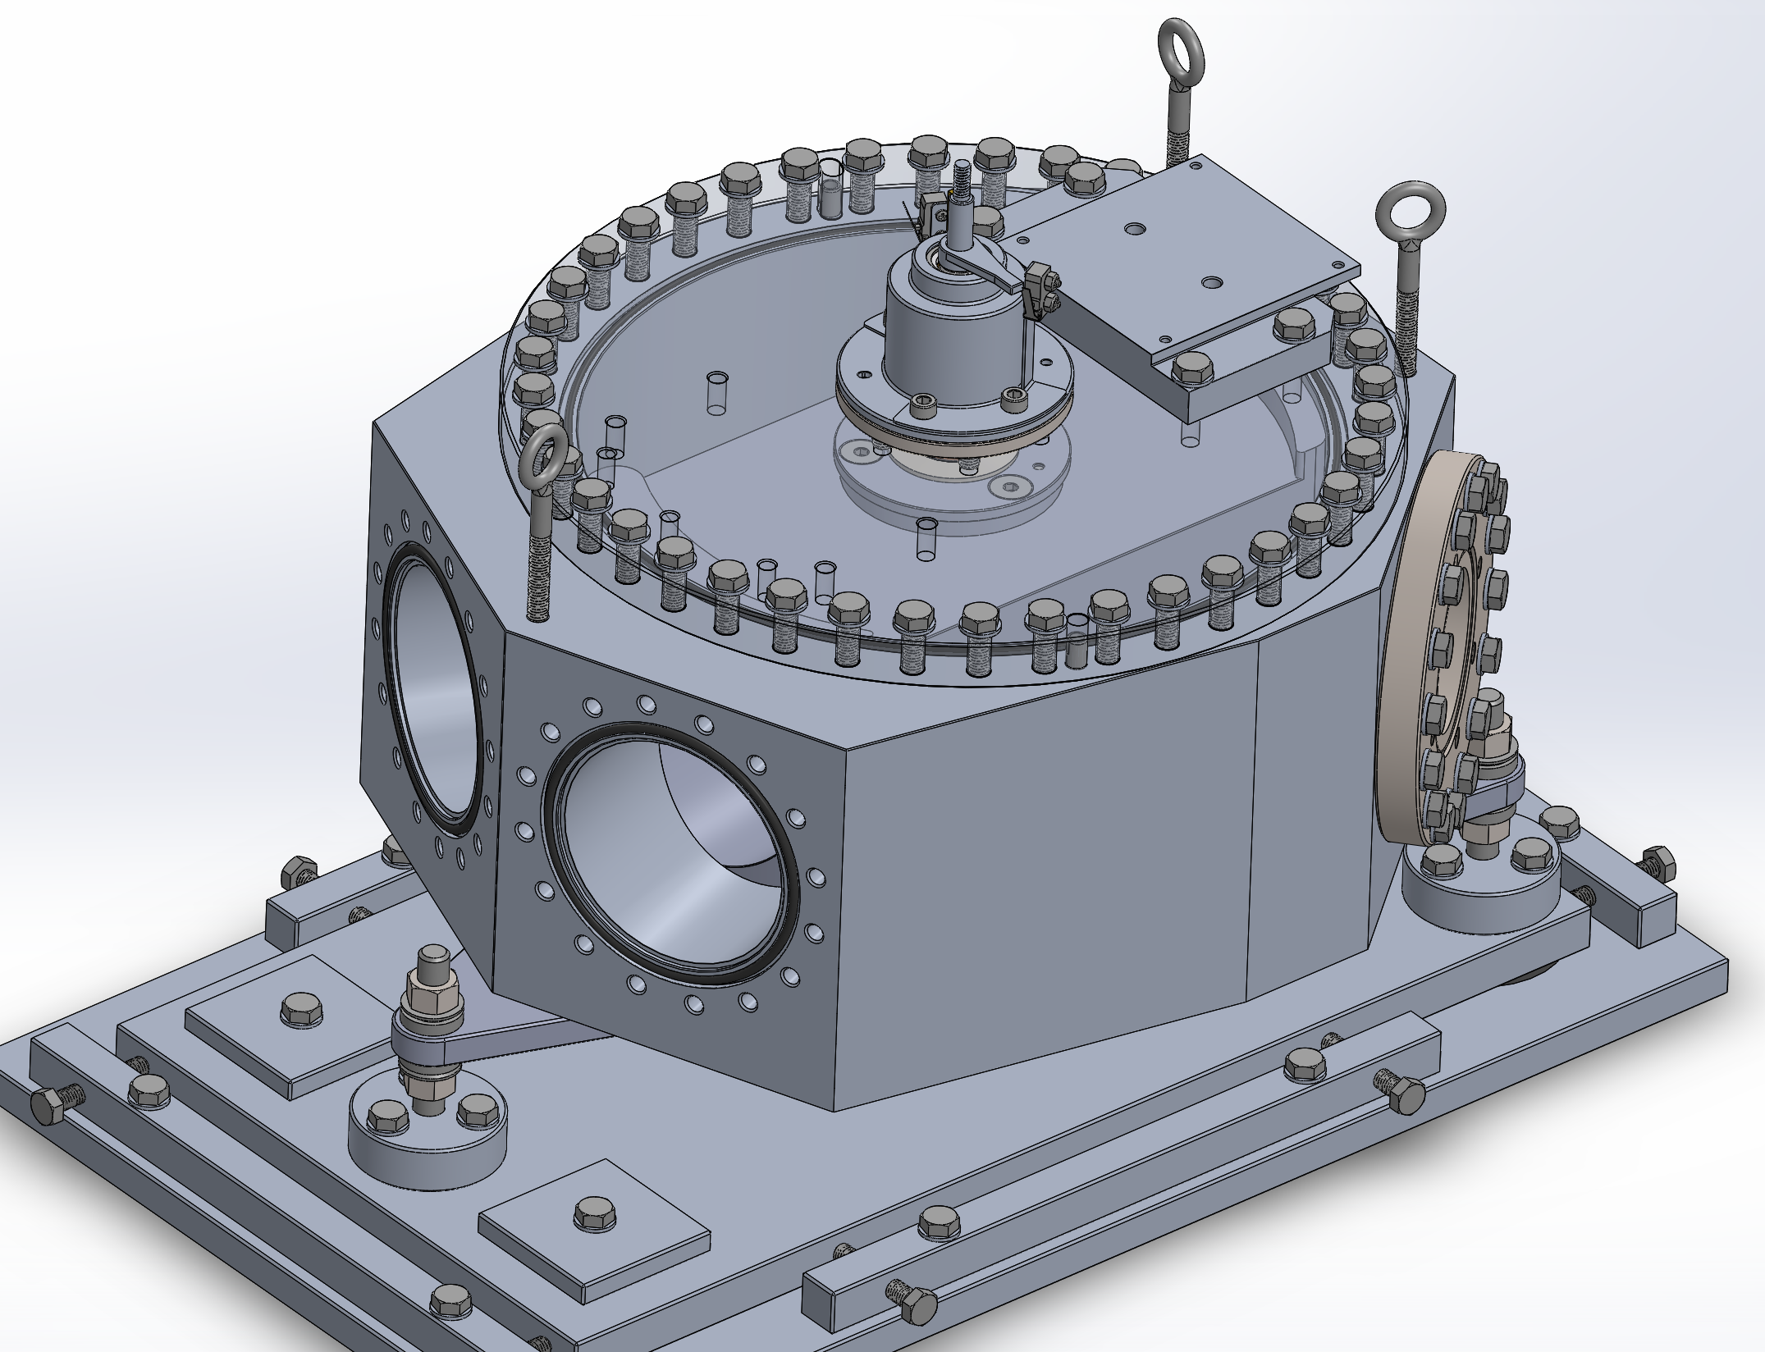
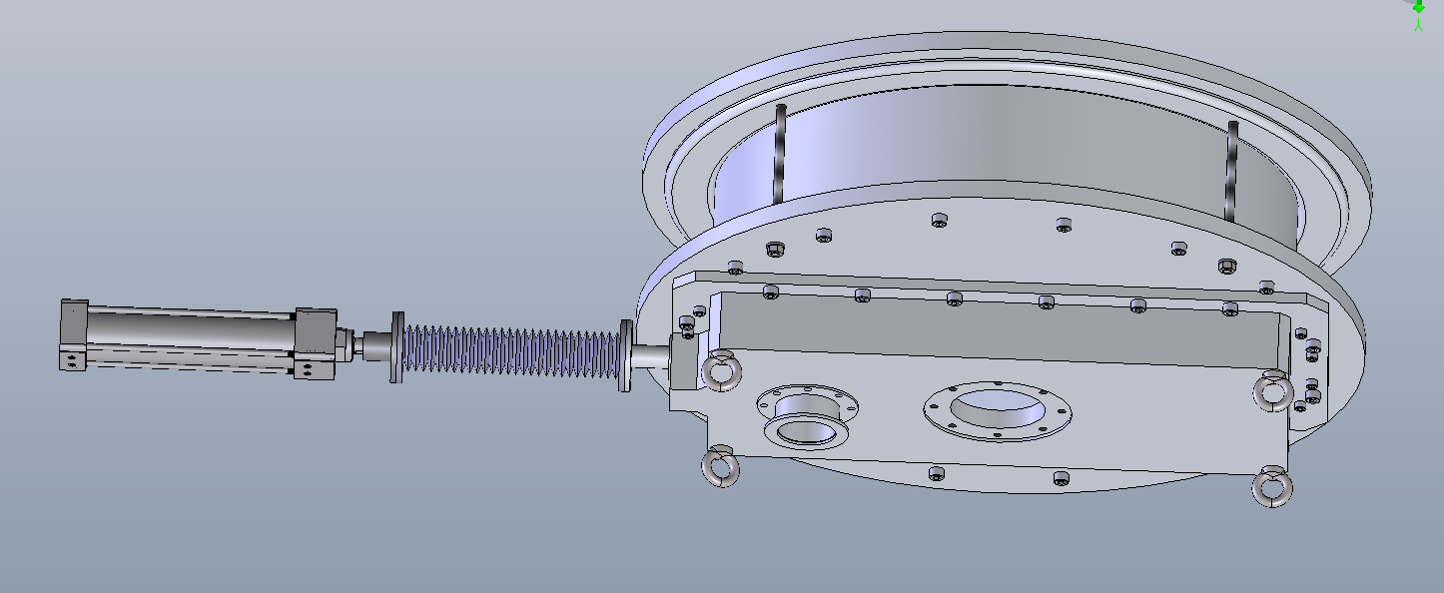
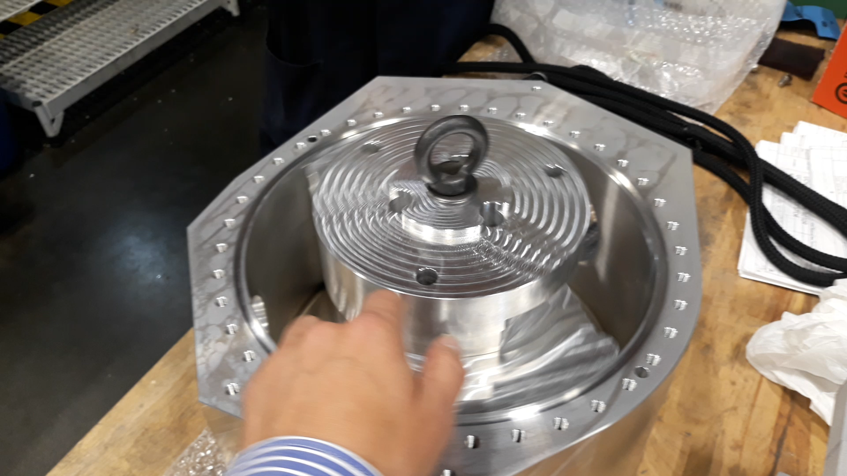
Prototype source experiments
2018 data analysis
Clear dependence of source storage lifetime on 3He
New UCN source components were qualified or marked for improvement
2019 experiments (Oct 30 to Dec 4)
First improved components for new source worked very well (UCN source valve).
Component iterations: superconducting polarizer, foil polarizers.
New components: UCN beam switcher, neutron EDM storage cell prototype.
UCN platform,
Meson hall
UCN beam switcher
EDM cell prototype

Slide 4
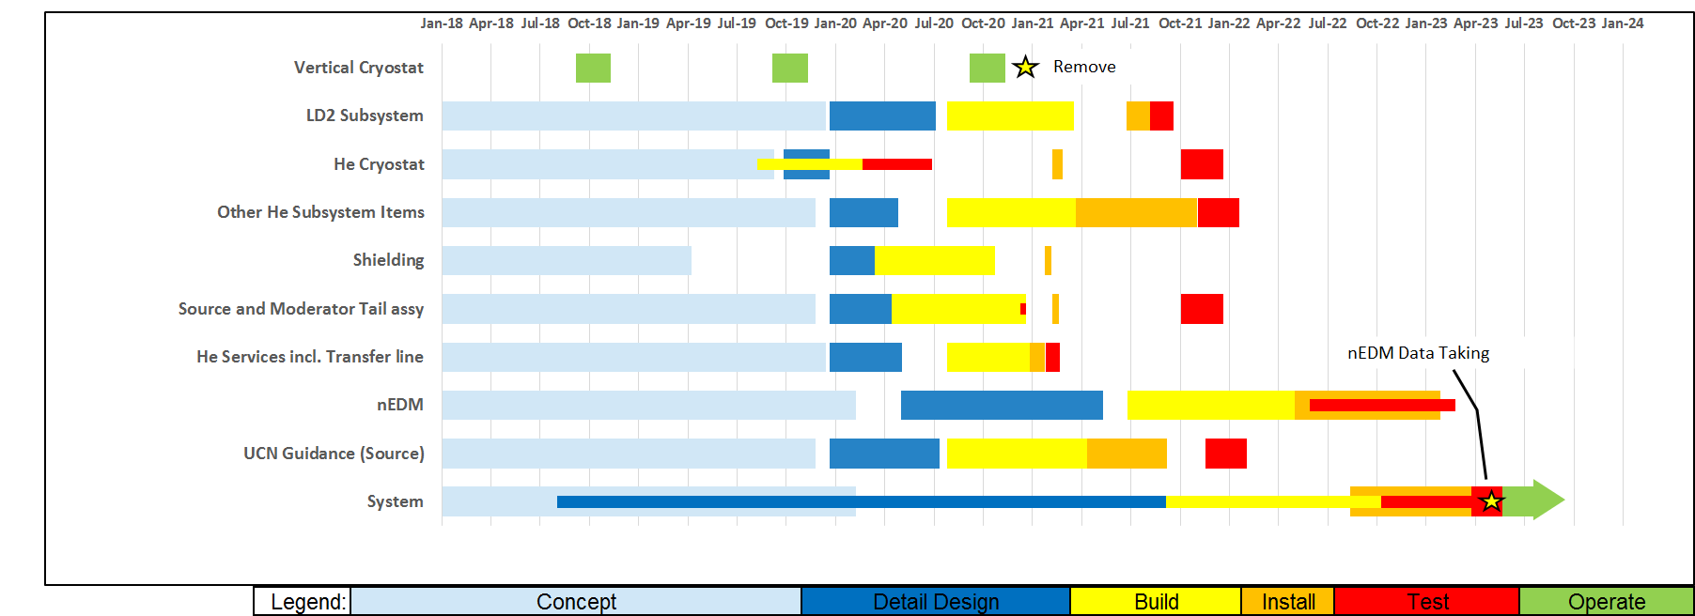
Project Timeline
2019
2020
2021
2022
2023
Running 1 month per year
Construction has started
Pump design review completed
Design review completed
Design note completed
Prototyping
First parts completed
Aiming for 2021
source installation

Slide 5
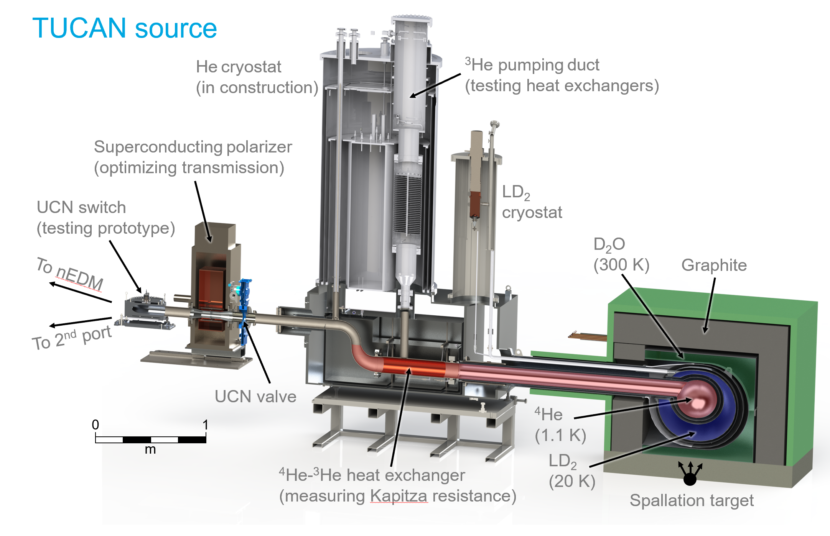

New UCN source design and construction
Latest UCN source model
UCN platform,
Meson hall
UCN beam switcher

Slide 6
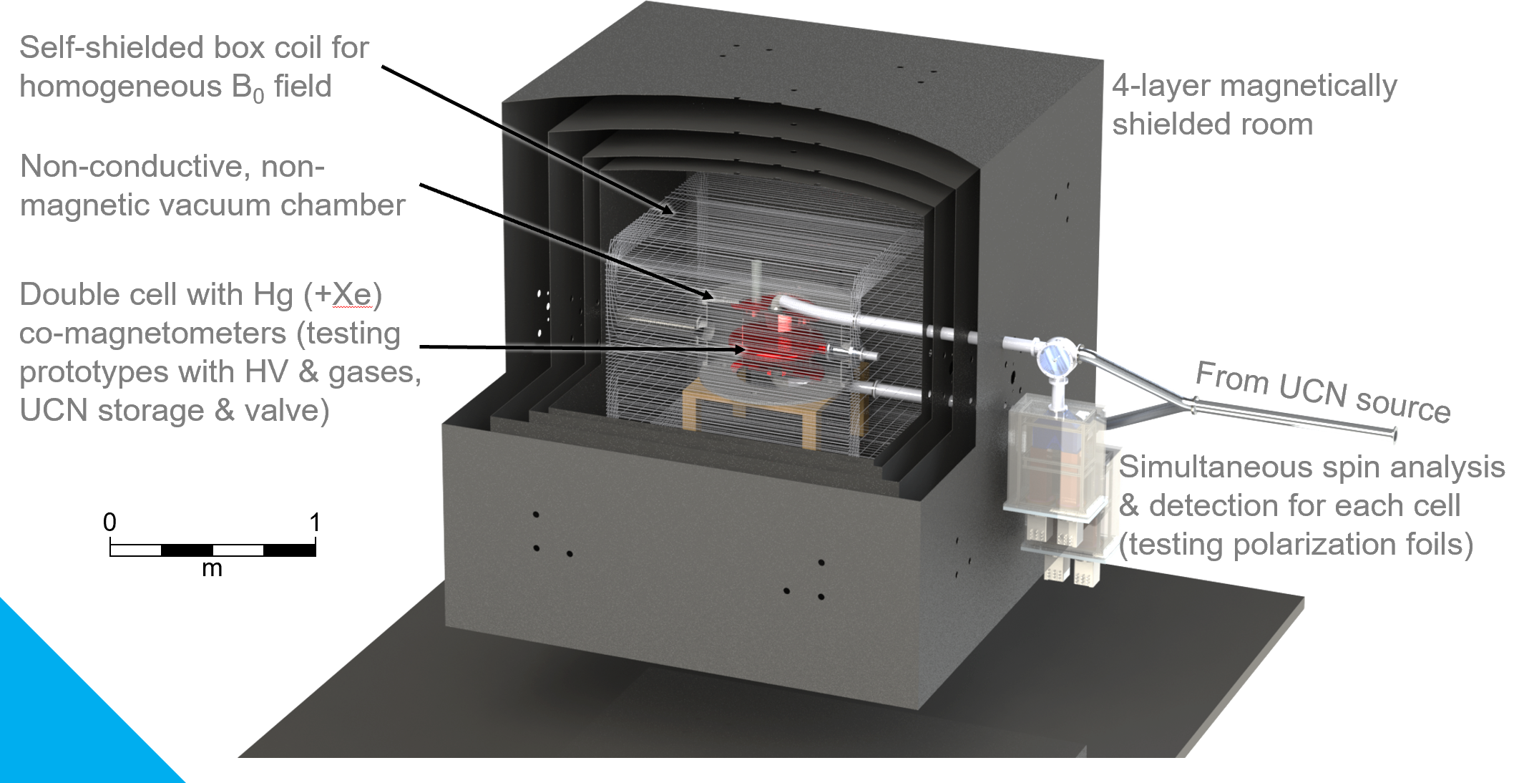
EDM developments
Biggest ticket item for nEDM.
Tendering process to be started early 2020.
UCN platform,
Meson hall
UCN beam switcher

Slide 7
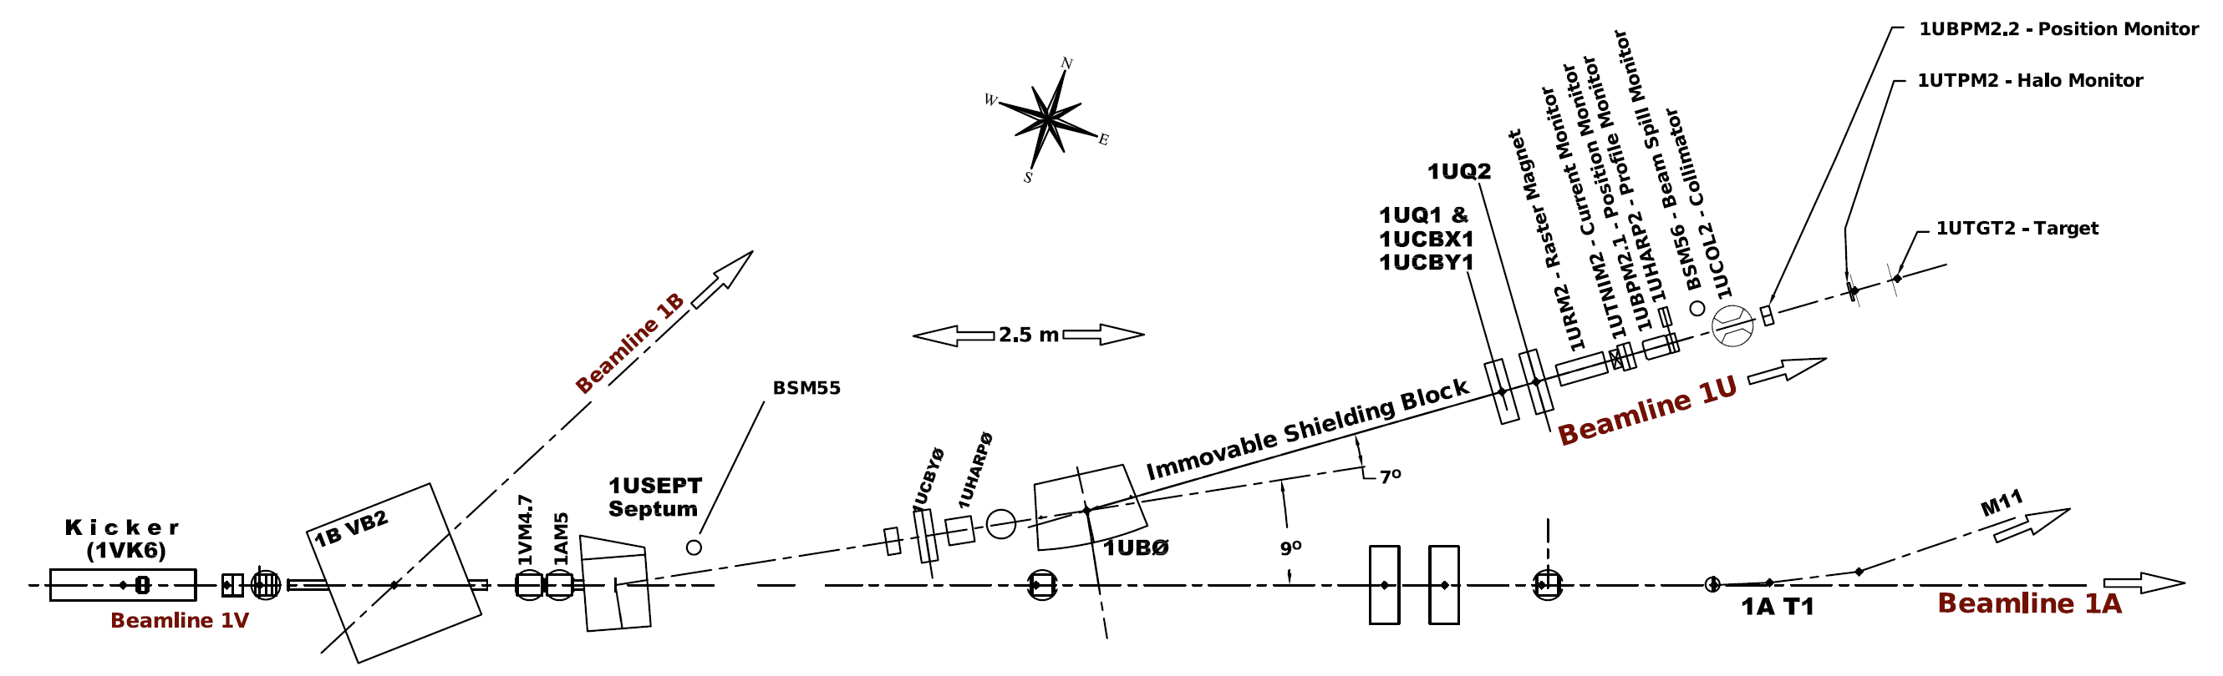
Proton beamline still haunting us…
Designed and built by UCN group, not Acc Div due to ARIEL
Completed 2016 except raster magnet
Some diagnostics still not implemented (Control Group)
Currently at 1 µA, need 40 µA and (probably) raster magnet
Beamline hand-over to Acc Div slow
  Acc Div wants to be handed a finished beamline.
  We need Acc Div support to finish.

Slide 8
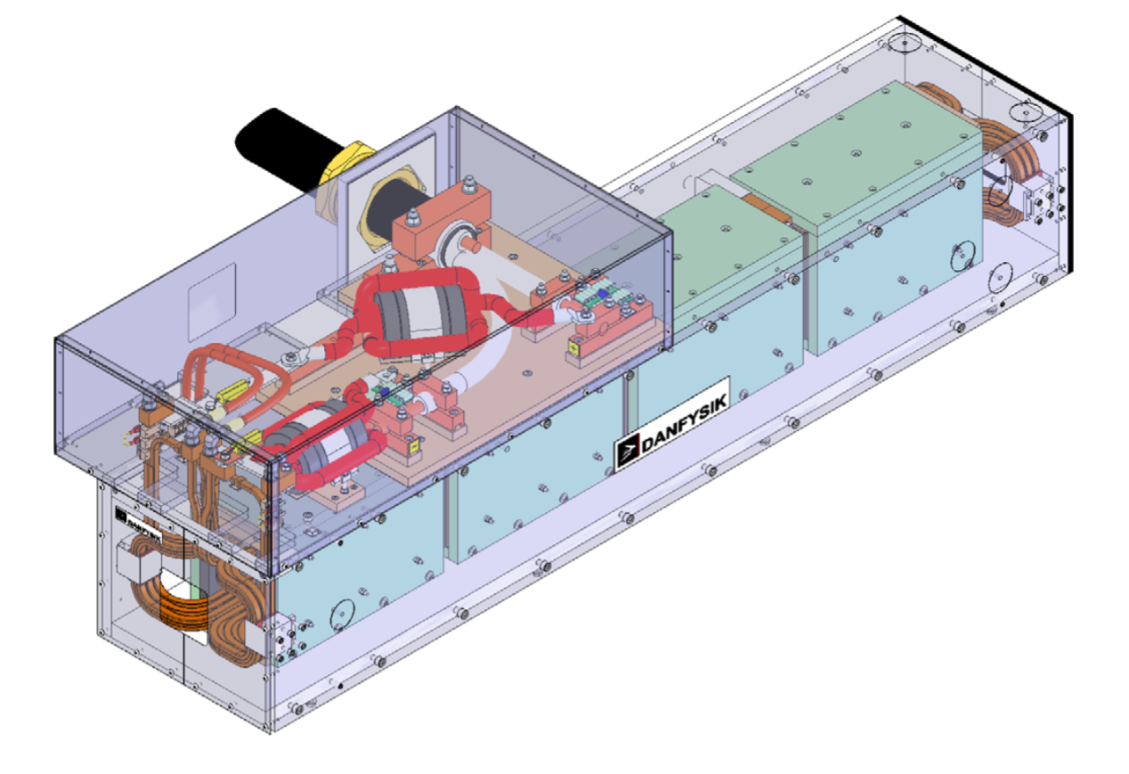
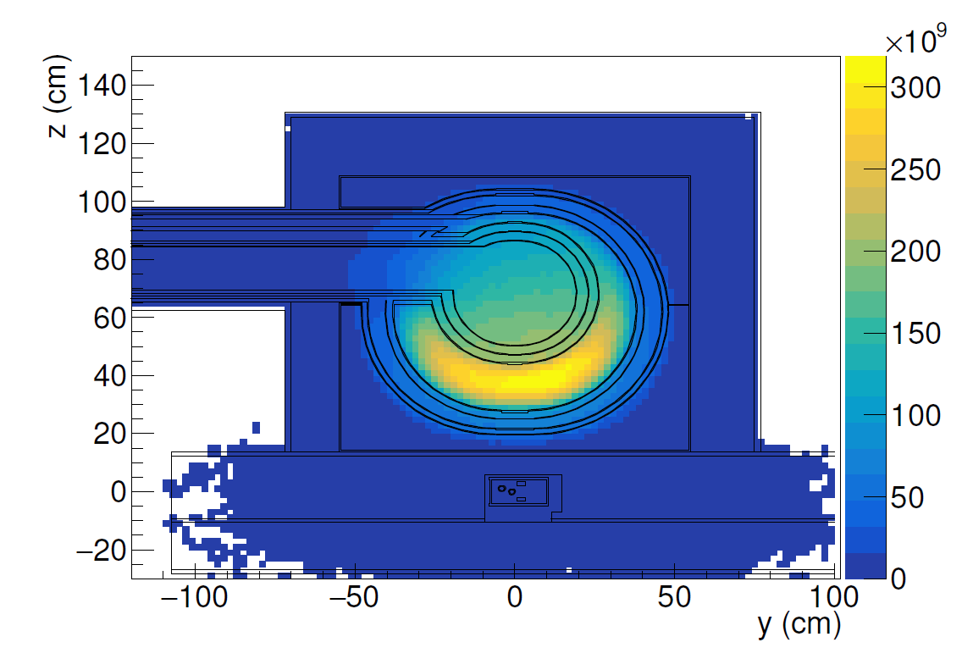
TUCAN publications
Fast-switching magnet serving a spallation-driven ultracold neutron source
S. Ahmed et al.
Phys. Rev. Accel. Beams 22, 102401 – Published 11 October 2019
https://link.aps.org/doi/10.1103/PhysRevAccelBeams.22.102401
Optimizing neutron moderators for a spallation-driven ultracold-neutron source
W. Schreyer et al. submitted to Nucl. Instr. Meth. A

Slide 9




Thank you
Merci
www.triumf.ca
Follow us @TRIUMFLab

Slide 10





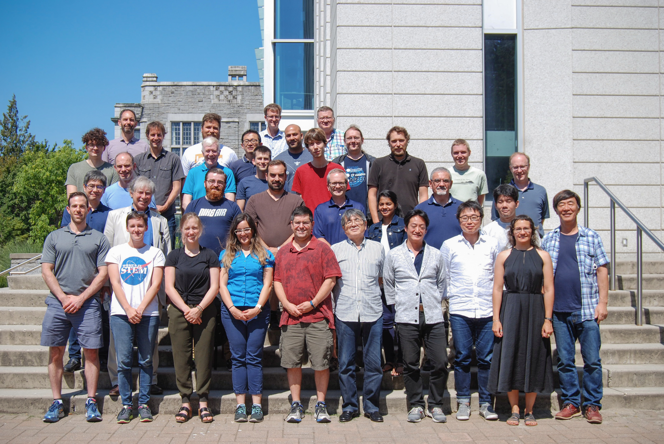





TUCAN – TRIUMF Ultracold Advanced Neutron collaboration
Collaboration objectives:
Search for the nEDM at a sensitivity level of 10-27 ecm
Build the world’s strongest ultracold neutron (UCN) source
Create an international UCN user facility at a second UCN port

