Slide 1
Science Technology dept.
Project and R&D
F. Retière for the Sci Tech dept.

Slide 2
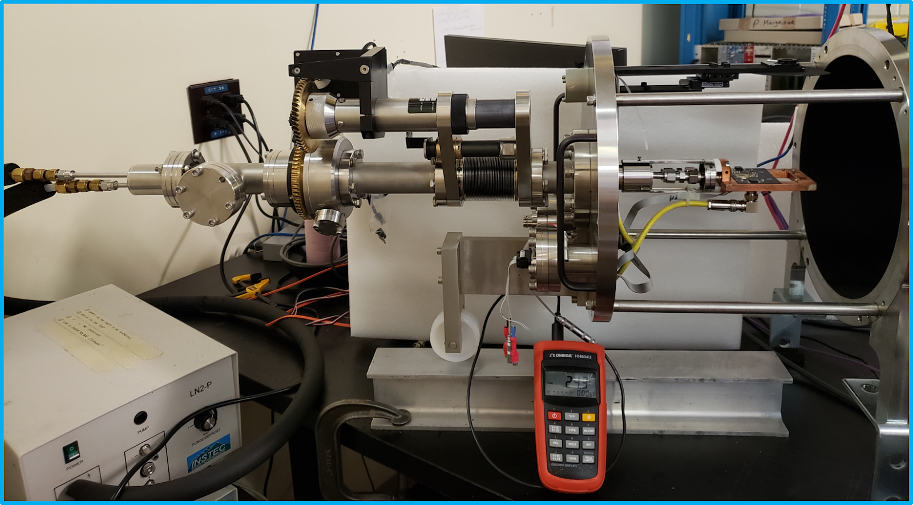
Photon lab
Completing CFI-IF9 program
  Vacuum UV characterization setup operational
  Microscope for SiPM characterization being procured
New photon lab in MHESA
  50% supported by McDonald Institute
  50% for PMT testing facility (neutrino)
Single photon detector(SiPM and PMT) characterization facility

Slide 3
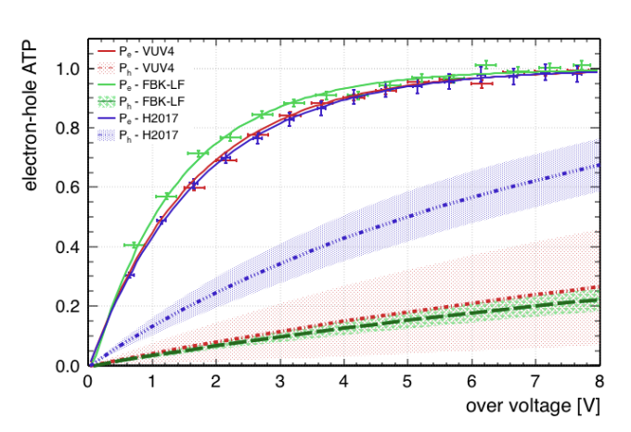
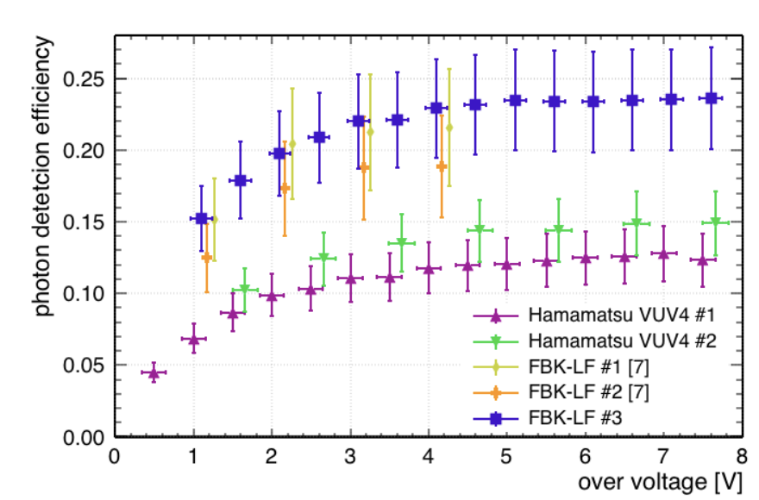
Single photon detector R&D
Infer avalanche triggering probability for electrons and holes
G. Gallina, IEEE TED, https://doi.org/10.1109/TED.2019.2935690
Gallina, G. et al. Nucl.Instrum.Meth. A940 (2019) 371-379
Hamamatsu VUV4 efficiency at 175nm

Slide 4
Photon to Digital Converter
Collaboration with U.Sherbrooke + Carleton and McGill
TRIUMF contribution
  Leading development for astro-particle. Secured funding:
    CFI IF9 (Boulay PI)
    McDonald Institute: manpower + VUV development
    NSERC: manpower (EXO project), silicon interposer (RTI)
  Measure VUV efficiency
  Back-Side illuminated development
    Starting collaboration with UK (e2v + RHUL) and Italy (FBK)

Slide 5
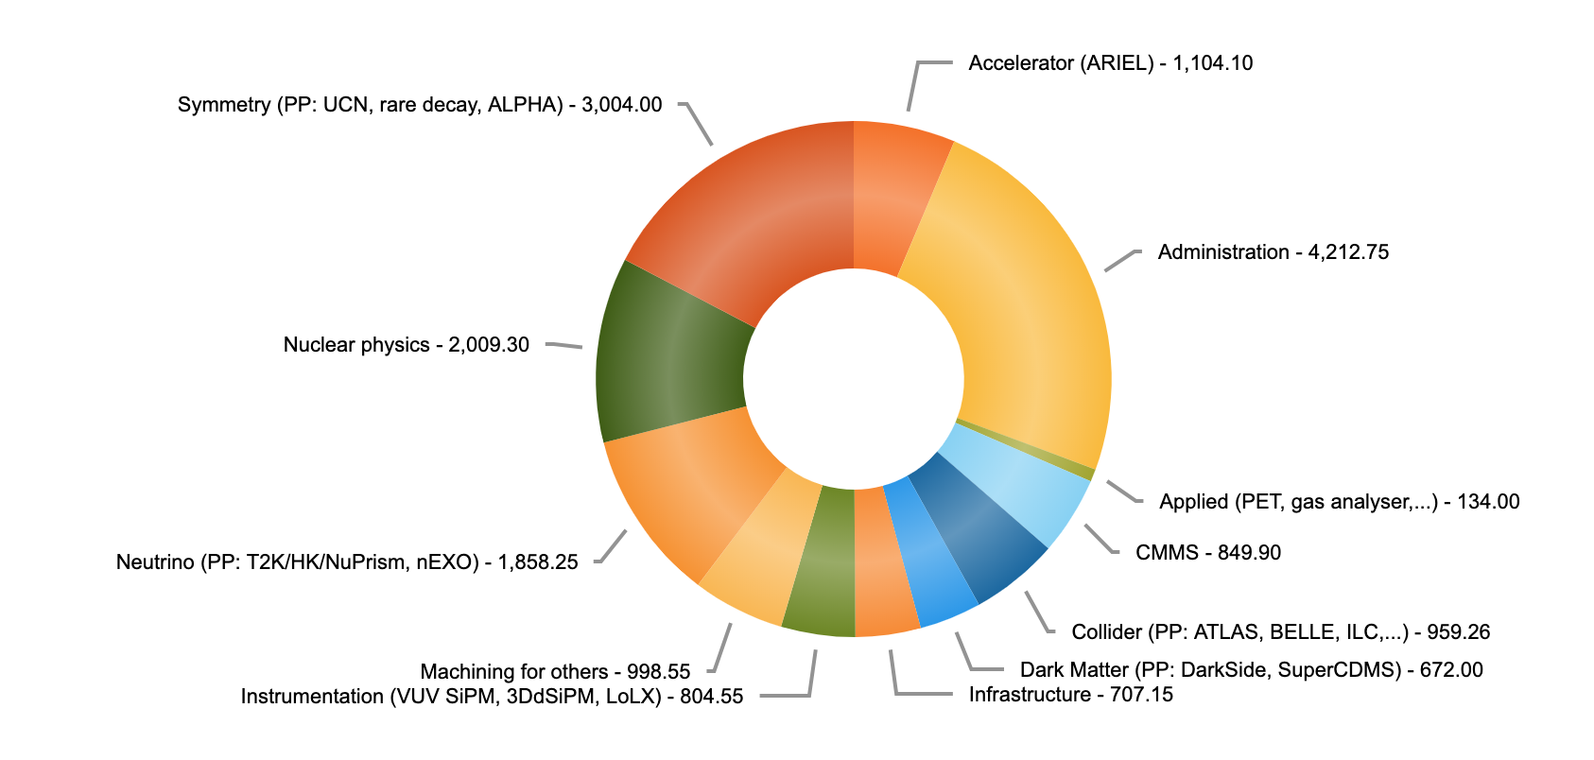
Current projects
Project type. Mid May to mid November 2019
ALPHA-G TPC came back for repair
mPMT for IWCD (neutrino)
Preparing CFI applications
ARIEL:
  Secondary gas volume
  Beam line installation
  Beam monitoring electronics

Slide 6
Future projects
CFI Project | Leadership | Funding for Sci. Tech.
DarkSide-20k | Queens – (TRIUMF) | 1,000k$
Intermediate Water Cerenkov Detector | UVic - TRIUMF | 800k$
MOLLER | U. Manitoba | 350k$
nEXO | UBC - TRIUMF | 1,000k$*
Other projects
  ARIEL Target Module
  Pacific Ocean Neutrino Observatory (P-ONE)
    May support some electronics work
  Non SAP applications
    Liquid Xenon PET. Exploring Transformation grant
    Single Photon Air Analyser
    Exploring development with Life Science
* Excluding TRIUMF project management (non Sci Tech)

Slide 7
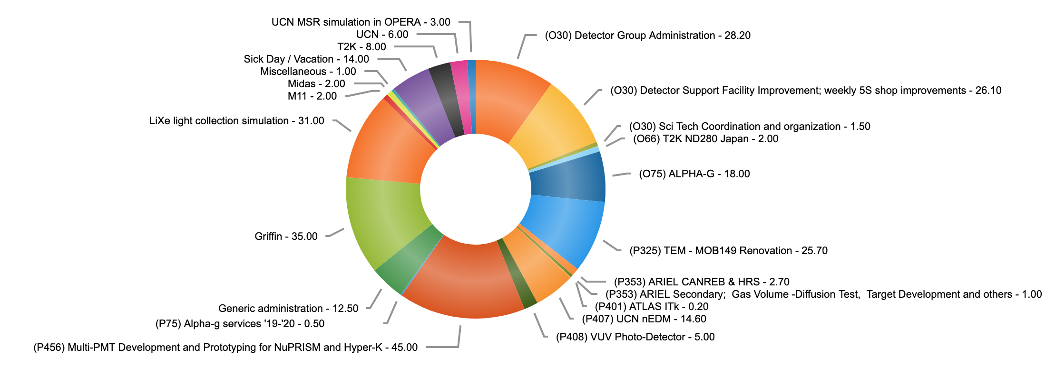
Managing projects
Project Insight used for day to day operation
Forecasting resource usage
  Currently ad-hoc
  Proposing quarterly ”retreat”
    Fill-up Project Insight
Last week by project

Slide 8
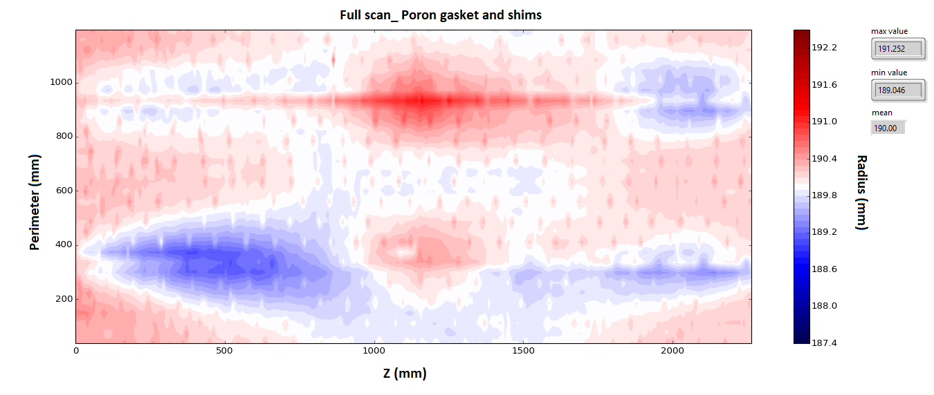
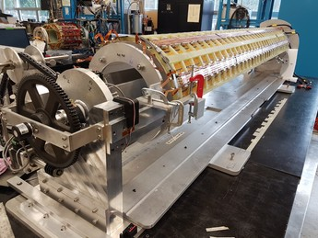
Managing risk
ALPHA-G TPC outer shell not cylindrical enough
  Fulfilled specifications for 2018 run but gain variations too large requiring repair
  Cylinder radius variation was not specified. Not in risk registry. Why?
Our approach to risk
  Team work – From tech. to physicist, everyone gets involved
    => we are good at implementation
  But we missed a conceptual risk
    Management level issue
    Proposal => retreat

Slide 9
Sci. Tech. expertise evolution
Instrum. physics
Mech. Eng.
Electronics
DAQ
Gas detector
Expand expertise
  Cryogenic system. From UCN to other applications
  Photonic. Continue to be a booming field. Key characterization tools
  Solid state calorimeter. Support new SuperCDMS effort and beyond
Light based detectors
Detector readout
Solid state trackers
Solid state calorimeters
Photonic
Cryogenic system

Slide 10
Summary
Compelling R&D program on single photon detector
  Well integrated within detector development for astro-particle physics
  Seeking applied projects
Sci. Tech. supporting a wide range of projects
  Significant contribution to CFI projects being applied for
Sci. Tech organization
  Formalizing resource management forecast
  Addressing risk management issue
  Adapting expertise to future

Slide 11
Thank you

