Slide 1
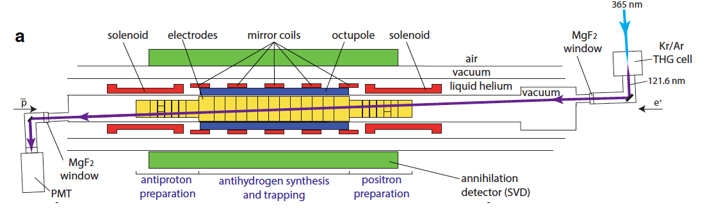
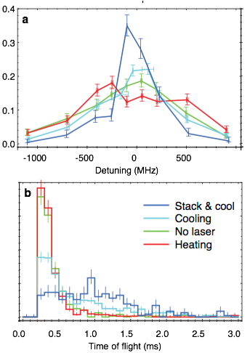

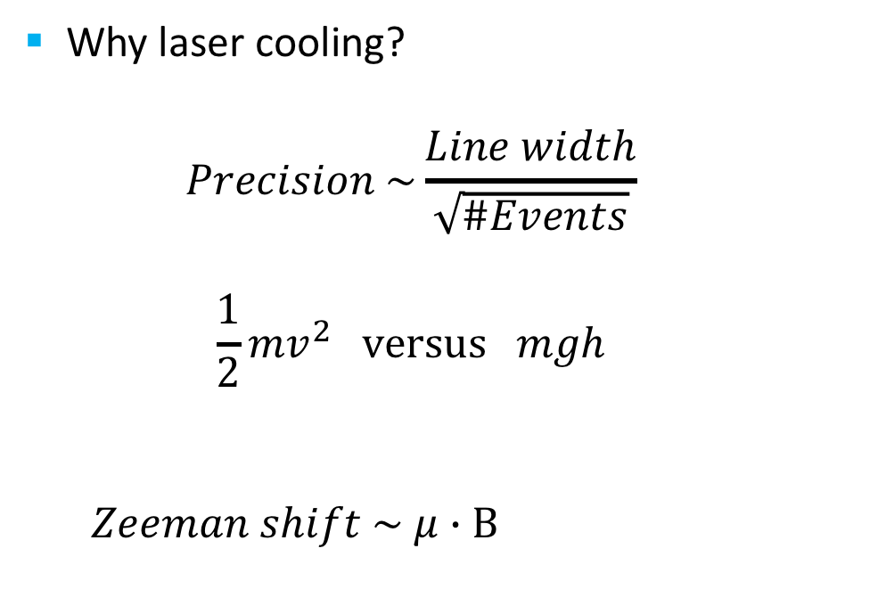


ALPHA-2: First demonstration of laser-cooled antihydrogen
ALPHA-Canada, led by TRIUMF, is 1/3 of ALPHA
$$∝\sqrt{\text{T}\text{emperature}}$$
Why laser cooling?
  $$Precision \sim \frac{Line width}{\sqrt{\#Events}}$$
  $$\frac{1}{2}{mv}^{2} versus mgh$$
  $Zeeman shift \sim μ∙Β$
Preliminary
Lineshape contains a contribution from the Doppler width
Time of flight reflects transverse energy; cold particles come out later
3d cooling is observed despite single axis laser access
Preliminary
$∝$ Temperature
$∝$ Temperature
Analysis by Fujiwara, So

Slide 2
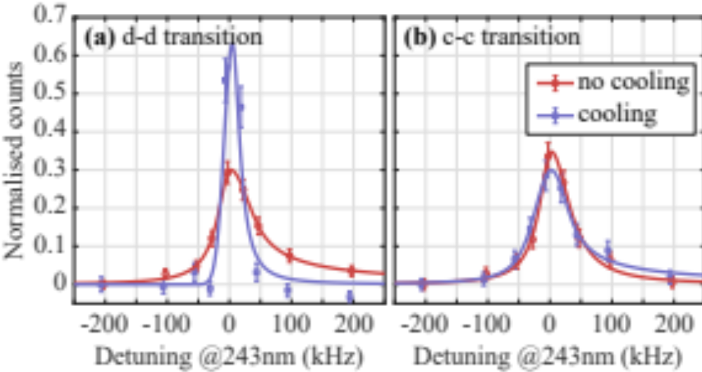
ALPHA-2: New Analysis (Art Olin, Emeritus, et al)
1S-2S spectroscopy on laser cooled anti-H
  So far 10⁻¹² precision was achieved
  Limitations:
    Transit-time broadening (uncertainty principle)
    Zeeman shift due to B inhomogeneity
  Both will be improved by using colder, and localized anti-H samples
    First demonstration of spectroscopy on laser cooled atoms
    Quantitative analysis is underway
      Art Olin co-leading the analysis
Preliminary
Significant narrowing of
1S-2S transition observed!
→ Will lead to a higher precision

Slide 3
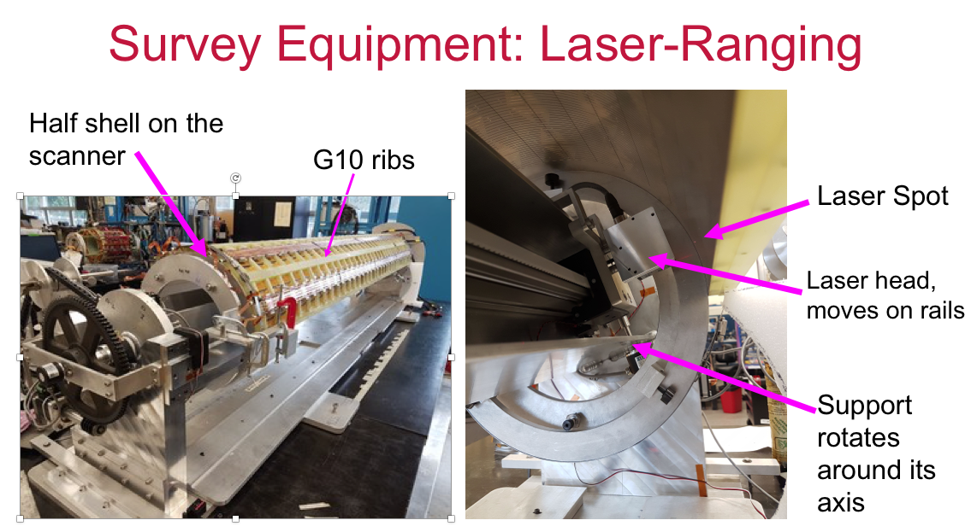
ALPHA-g (80% Canadian funded)
Non-uniformity in Radial TPC gain observed
  Deformation in outer cylinder identified as the cause
  Manageable for the first measurement, but would affect precision measurements
  Decided to fix this once for all during LS2
  Detector sent back to TRIUMF
  Excellent progress in repairs
  Will be shipped back to CERN in spring
  Project Leader: Andrea Capra
Other activities
HQP:
  Student won the best poster prize at TRIUM User Group poster bash
  Exchange student from Swansea Univ
  TRUIMF-KEK exchange: C. So (poster)
Future initiatives:
  R&D for future experiment; quantum sensing with anti-atomic fountain (UBC-led CFI; Fujiwara co-PI)

Slide 4
Summary
ALPHA-2 analysis is progressing with strong Canadian contributions
Major publications are expected in the next several months
ALPHA-g TPC repair/upgrade progressing well
TRIUMF scientist has important responsibilities as ALPHA-Canada spokesperson, NSERC grant PI, CFI grant co-PI
Office and Lab space a challenge
Eagerly looking forward to a new hire to maintain critical mass!

Slide 5
Summary text
The ALPHA-Canada team is leading several high profile analyses for recent results from the ALPHA-2 apparatus.
Major publications are expected in the next several months.
The ALPHA-g radial TPC detector is being upgraded/repaired to address the gain uniformity issues.
Also, future initiatives are explored with an upcoming CFI. Overall, the TRIUMF team, and the technical team are playing important roles in ALPHA.

Slide 6
ALPHA back up slides (A. Capra)

Slide 7
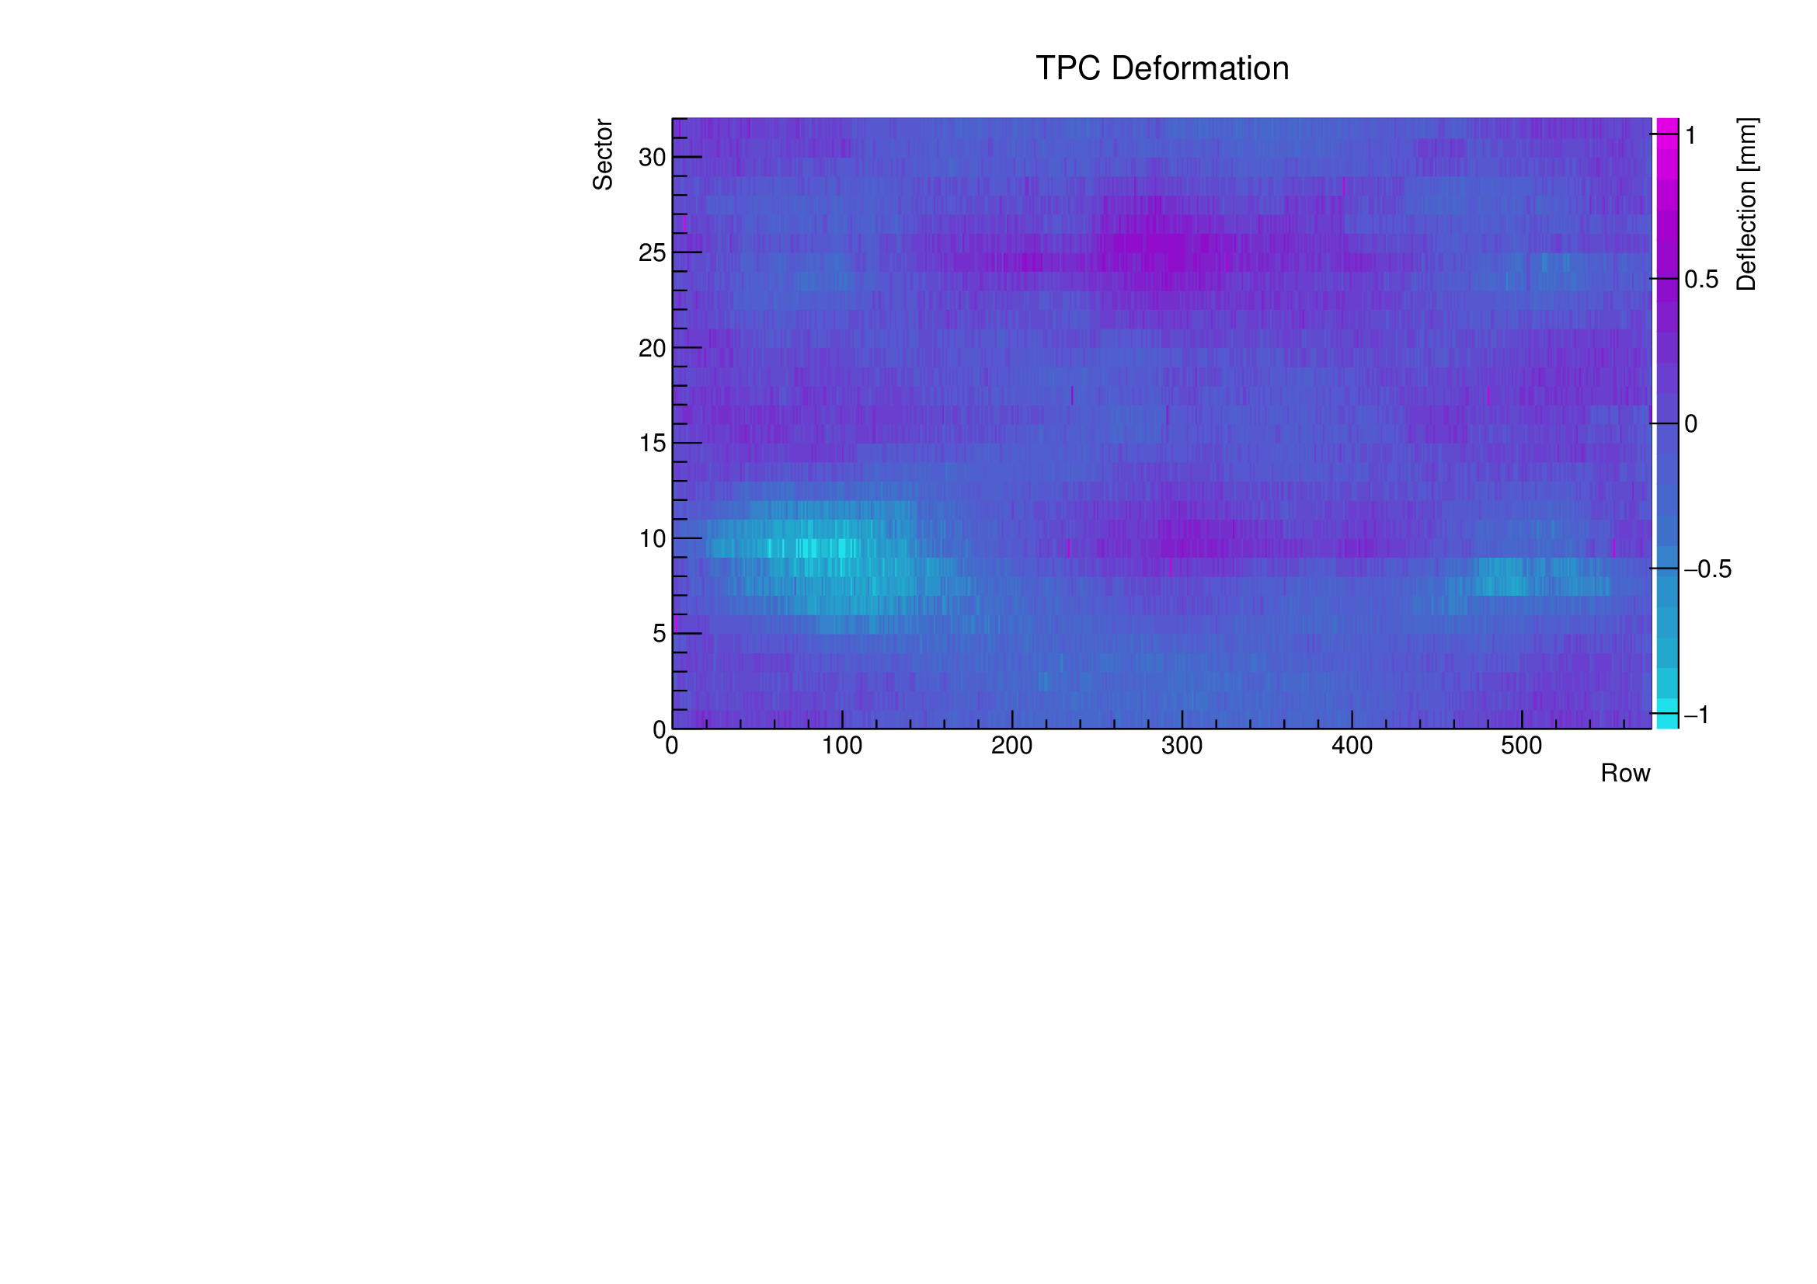
Deformation of the rTPC Outer Cylinder
Qualitatively identified before shipment to CERN (July 2018)
Deformation: ~ 2 mm
It will affect the “1% measurement”
LS2 is the best time to fix this issue
ALONG rTPC axis

Slide 8
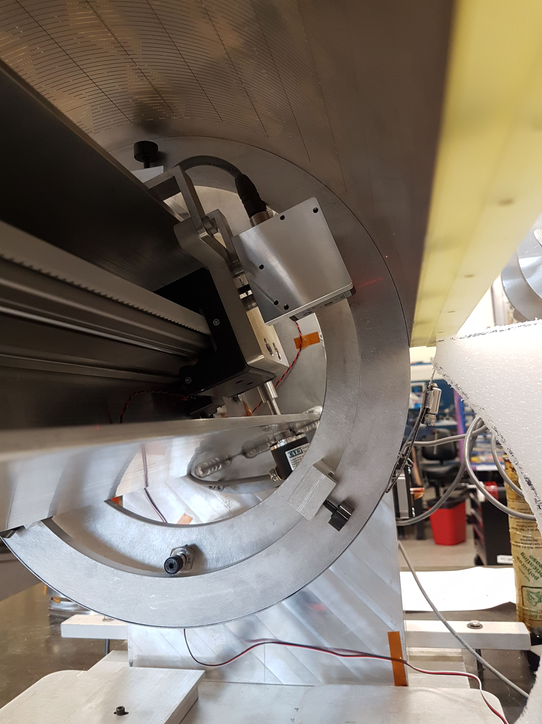
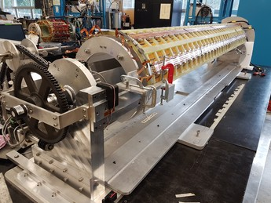
Survey Equipment: Laser-Ranging
Half shell on the scanner
G10 ribs
Laser Spot
Laser head, moves on rails
Support rotates around its axis

Slide 9
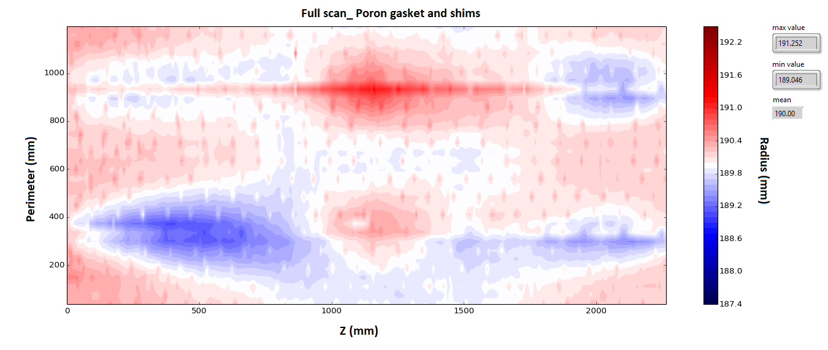
Survey of the rTPC Outer Cylinder
Full scan (two halves) finds quantitatively same defect

Slide 10
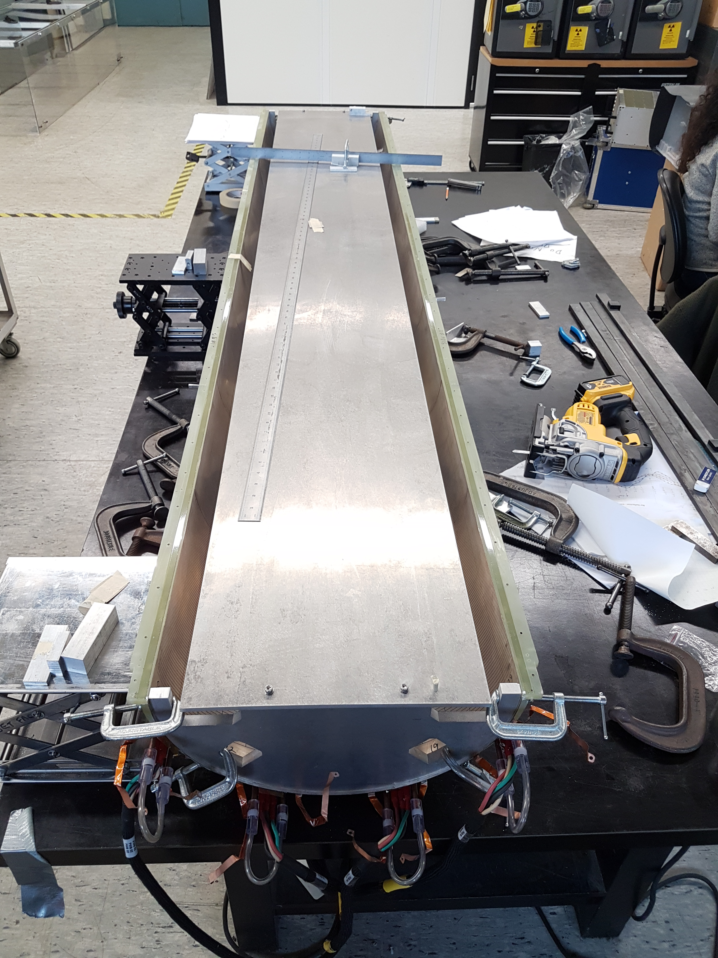
Current Status
rTPC arrived from CERN on 19 Aug.
Survey system commissioned
First iteration to apply correction in progress
Goal is to reduce deformation by a factor of ~5: +/-1mm → +/-200um or better
Strategy is to reduce “stiffness” of “G10 ribs”

