Slide 1

SuperCDMS and CUTE
Dark Matter Search with Cryogenic Detectors
W. Rau

Slide 2

Overview
SuperCDMS group at TRIUMF
SuperCDMS status
CUTE

Slide 3
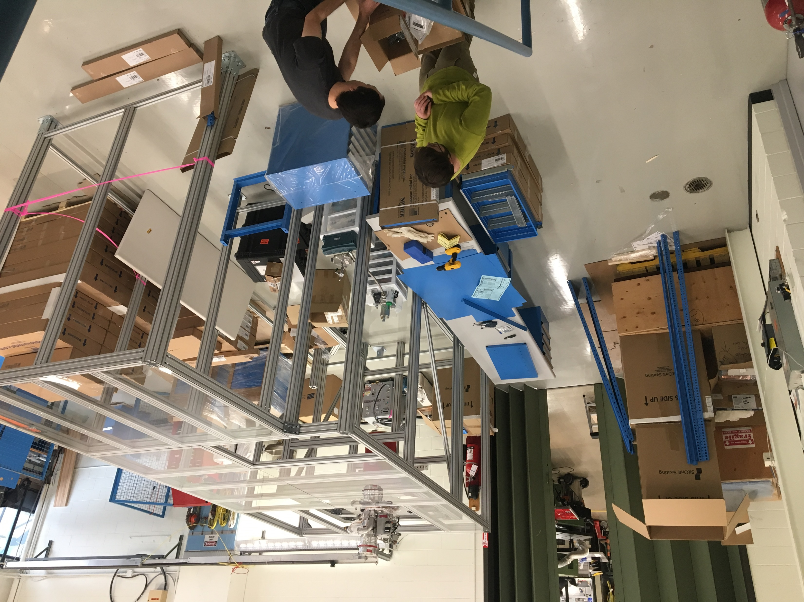
SuperCDMS at TRIUMF
Local SuperCDMS group:
W. Rau: 3 PhD students, 1 postdoc
(2 more students at Queen’s)
S. Oser: 3 MSc students, 1 postdoc
(one more joining in April)
Lab in MOB
Space ready – some services still need work
Cryostat stand and clean room frame installed
New furniture arrived last week
Starting to set up cryostat
Analysis
Dark Photon and Axion-like Particle search: paper in final round of internal review
(analysis lead by Richard Germond and Eleanor Fascione, TRIUMF)
Photo-neutron analysis close to completion (lead by Emanuele Michielin, UBC)
New effort using Machine Learning tools (support from Wojciech Fedorko)
Analysis of data from CUTE (lead by Ryan Underwood and Eleanor Fascione, TRIUMF)

Slide 4
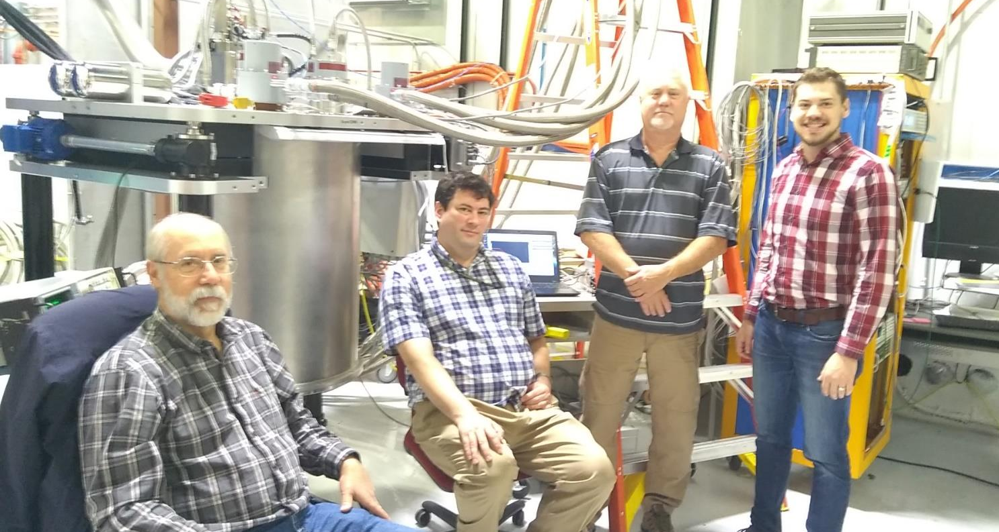
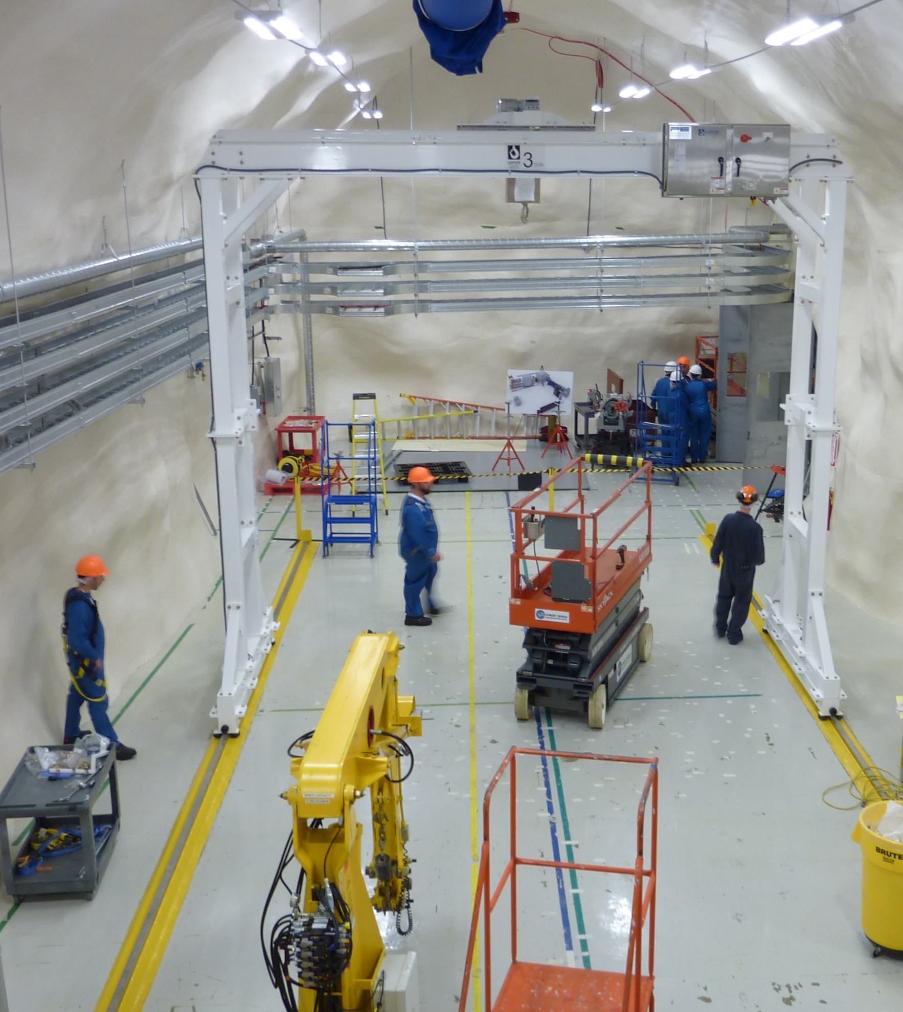
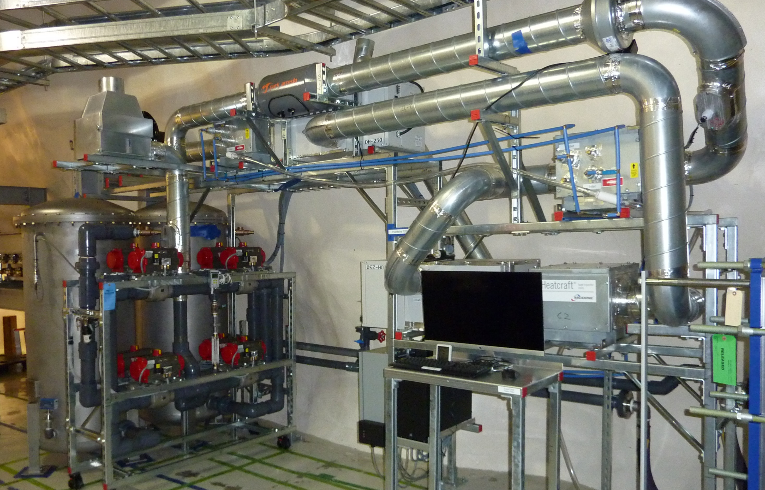
SuperCDMS
Progress in the last half year:
Radon filter installed at SNOLAB
Gantry crane installed
Dilution refrigerator delivered (to FNAL)
Detectors:
  super conducting cables ordered
  settled on detector production recipe and sequence
Shielding (except water tanks) at SNOLAB (in boxes)
DAQ development on track
Concerns:
Project: Recent ‘Estimate To Complete’ revealed that contingency funding is mostly used up. SuperCDMS Project Management is looking for savings, additional funding and options to move parts of installation to operations funding.
Operations: Operation funding from US less than desirable
(in particular issues with acquiring adequate funds from NSF)

Slide 5
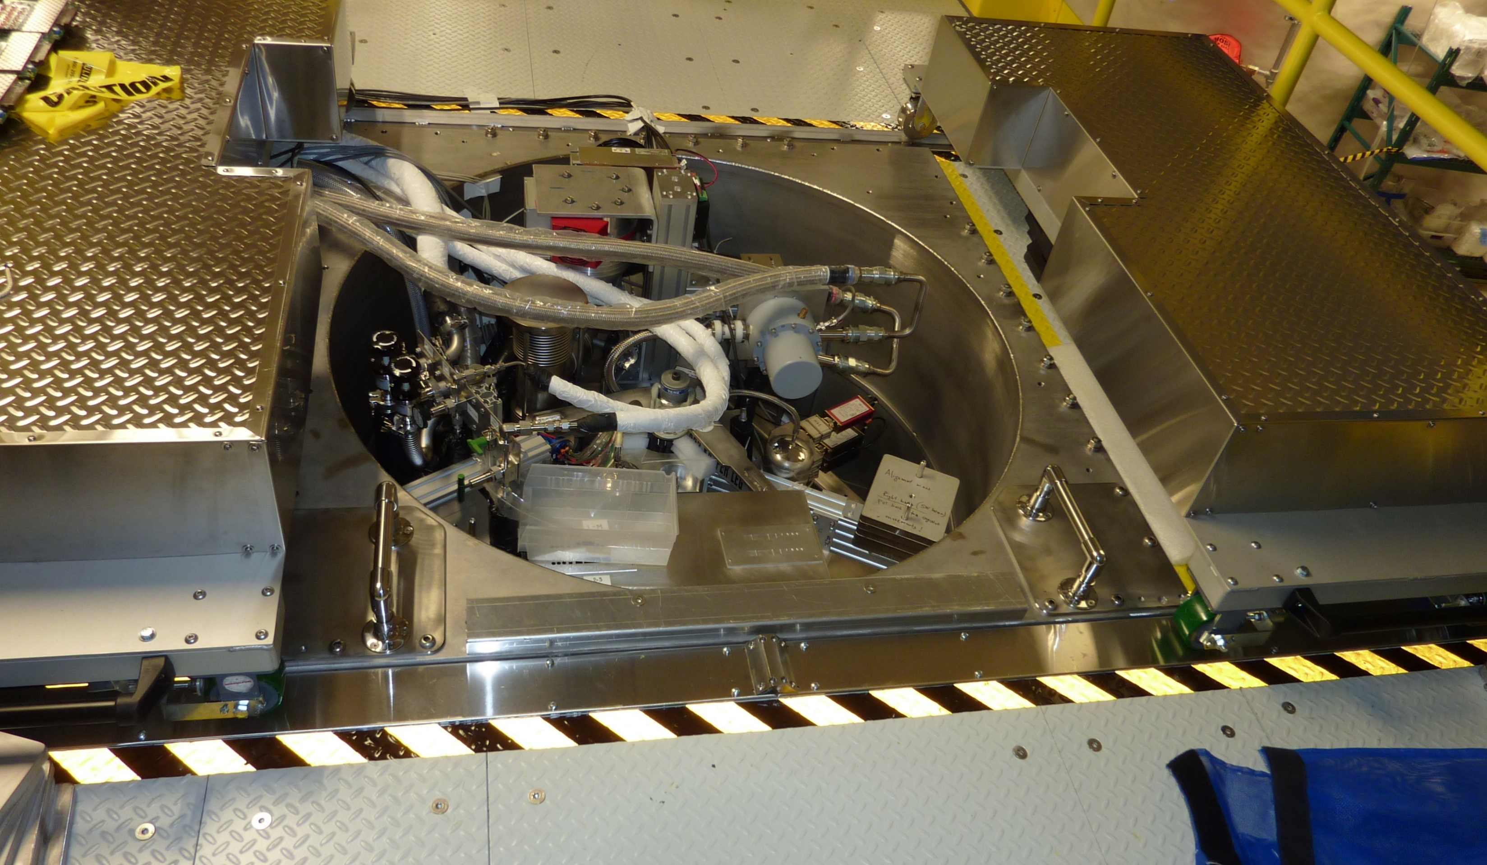
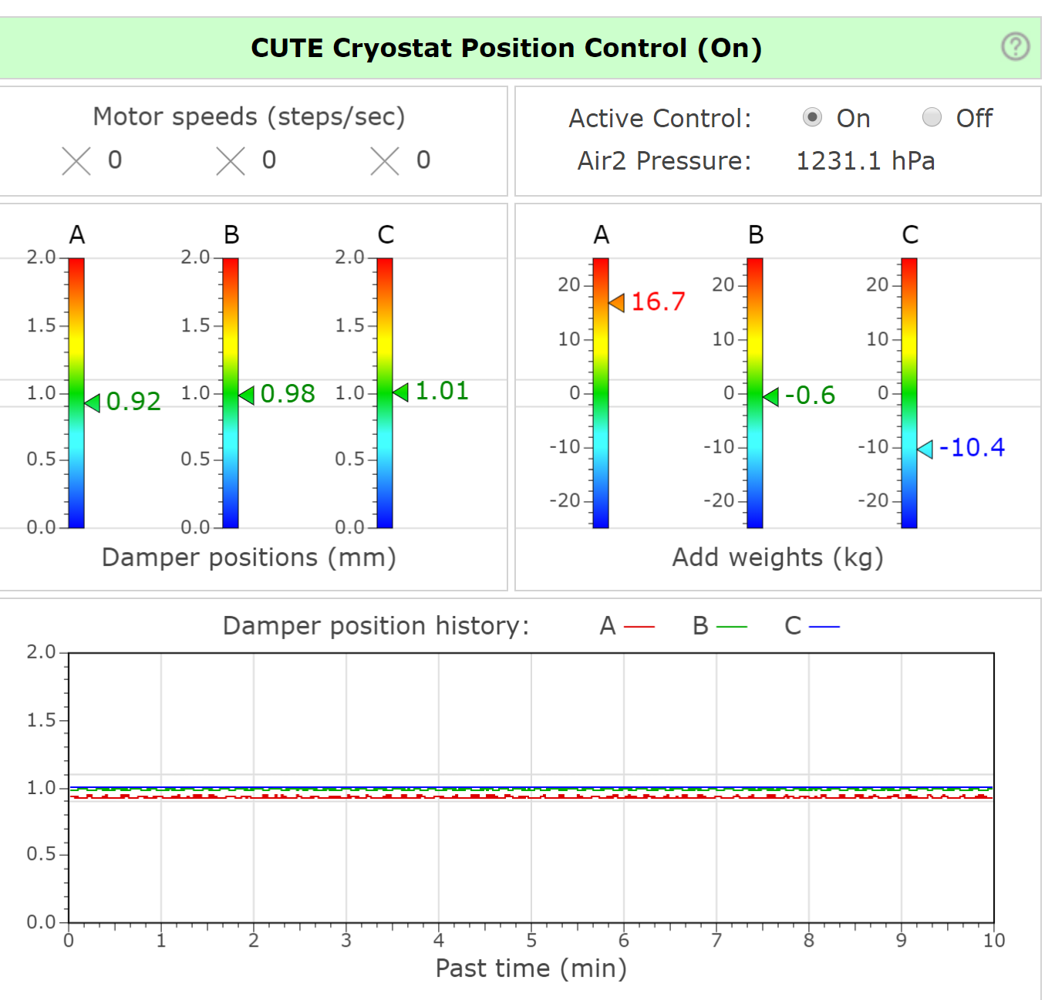
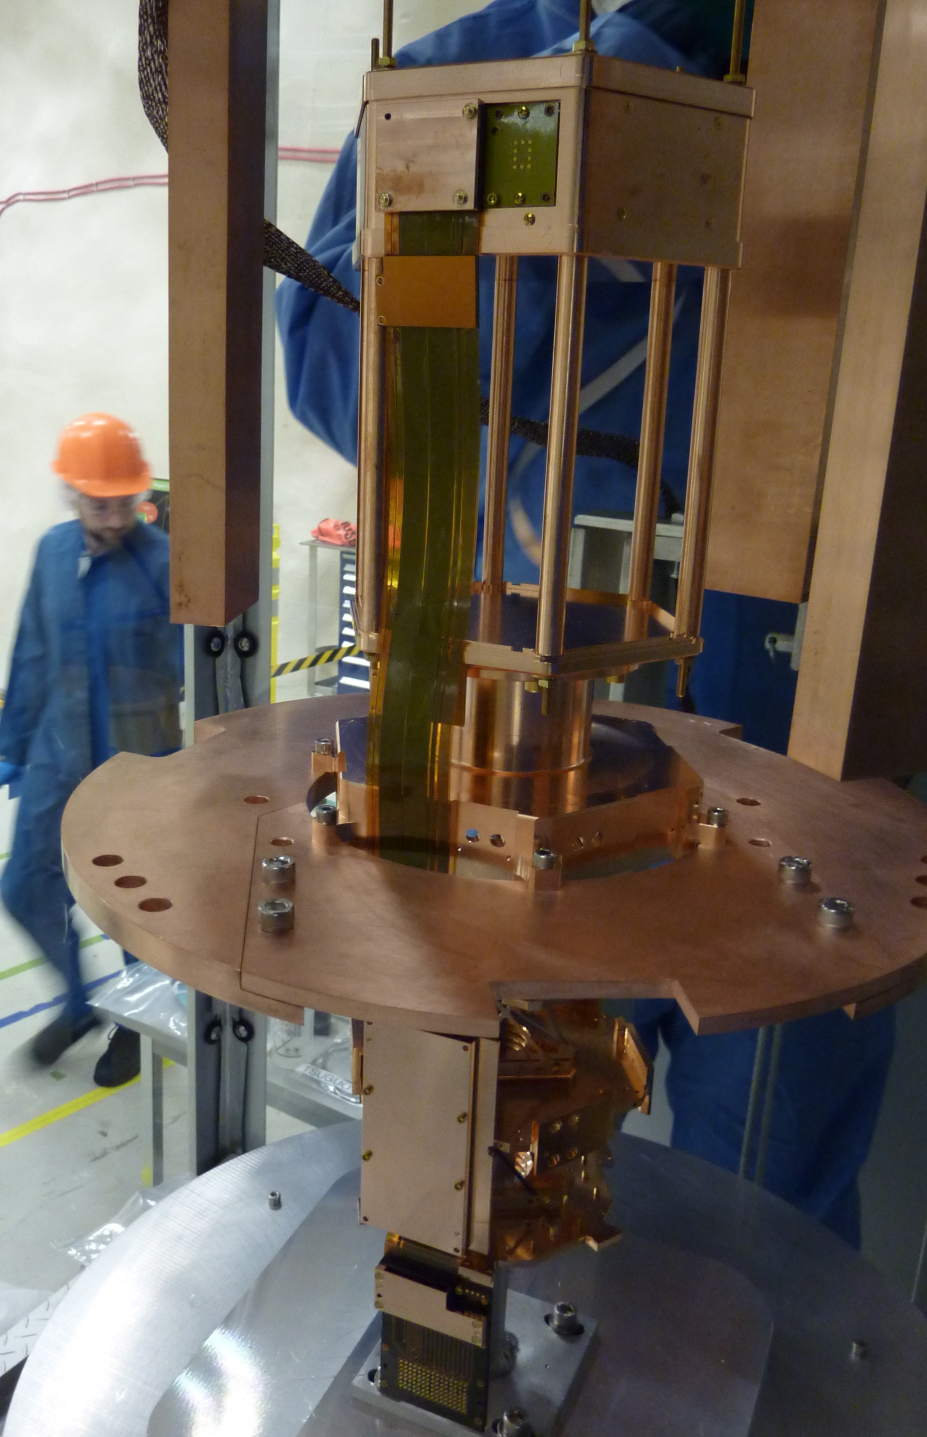
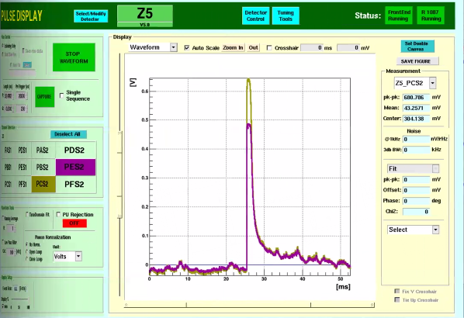
CUTE
Commissioning complete (as of last week)
First runs performed with new SuperCDMS detector
Several concerns in first run (thermal link, electrical short) resolved
Vibration isolating suspension system operational since last week; vibration performance still under study
Interference between vibration isolation system and calibration system (software) needs to be resolved

Slide 6
Summary
SuperCDMS construction is making good progress, but using up contingency at too high rate. A plan for addressing the gap between available funding and anticipated needs is being developed. Anticipated start of commissioning is now beginning of 2021.
CUTE is operational with a few technical issues still to be addressed. First new SuperCDMS detector has been tested and operated for the first time with voltage bias. Data are under analysis. CUTE schedule is busy at least until detectors will be mounted in SuperCDMS.
The TRIUMF SuperCDMS lab is making slow progress; hope to do first test of cryostat in the next few months.
Graduate students at TRIUMF have been leading a recent analysis searching for dark photons and ALPs and TRIUMF/UBC group is leading the analysis of data from CUTE.

