Slide 1

Big Data Analytics Working Group Update
Wojtek Fedorko, Frank Schluenzen

Slide 2
On-going research / ML projects
Particle physics:
  Particle/object/event identification (HyperK, LHC, NA62, Belle, Super CDMS…)
  Synthetic data generation/simulation (GAN/VAE)
  Tracking
  PET using LXe TPC+SiPM
Nuclear:
  Gaussian Processes based extrapolation of No-Core Shell Model calculations
Accelerators:
  XFEL accelerator optimization
  Predictive maintenance
  ISAC I tuning
Photon Science
  Tomography segmentation
  Electron Microscopy particle detection/classification
  Serial (femto-second) X-ray Crystallography image classification
  Image denoising and calibration

Slide 3
Projects with potential for collaboration
Gaussian Processes being applied to machine control (DESY) and nuclear physics (TRIUMF)
Gaussian Process with derivative constraints (TRIUMF)
  Currently studied for No-Core Shell Model calculation extrapolation (talk later)
  Given data considered ‘exact’
  Further method enhancements could include incorporation of uncertainty
  Potential other applications:
    LHC data analysis e.g. background prediction extrapolation, searches
    Model building for control applications
  Obstacles:
    Method ‘working’, but uncertainty too large to yield scientifically interesting outcomes
    Need more time and development before meaningful collaboration can be established
    Manpower and time investment a concern
    Data sharing

Slide 4
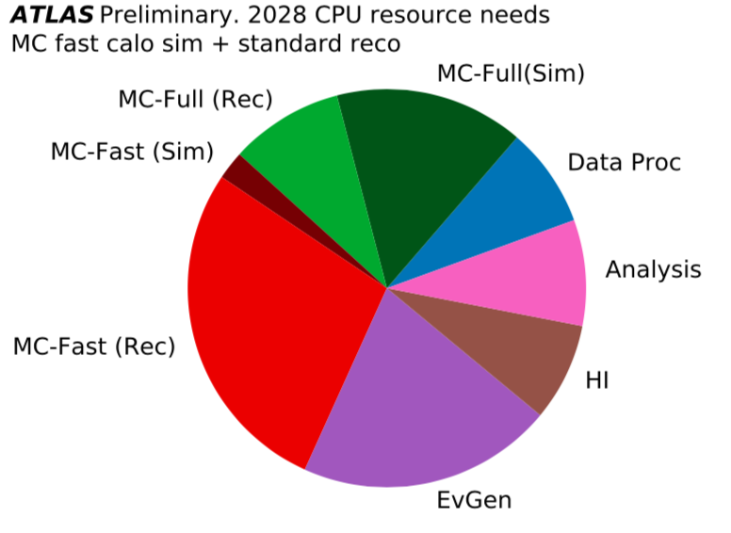
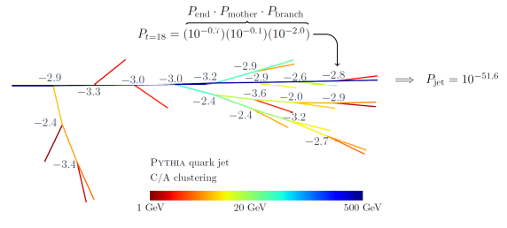
Projects with potential for collaboration
Generative models:
  TRIUMF:
    VAEs based models being developed for Hyper-K / NuPRISM and SuperCDMS
    Target: semi-supervised learning with ‘restricted’ ‘labelled’ data sets for classification/regression
    Mitigation of experimental uncertainties
    Want to explore GANs as well starting Jan for NuPRISM
  Helmholtz:
    Belle II: (beam backgrounds, shower calibration, e→γ ‘simulation’)
  Potential areas for collaboration:
    Learning with real data with restricted ‘labelled’ set
    Simulation replacement (e.g. LHC)
1804.09720

Slide 5
Collaboration goals
  Plenty of activity in ML space
  BUT so far activities separated institutionally
  Must improve communication
  Grass roots initiative needed
    If science goals common,
    Methods seem applicable across specific domains
-Reach out and make connections.
      Slack, mailing lists, contact group leaders wfedorko@triumf.ca frank.schluenzen@desy.de
  Want to have a publication with authors from both institutes
    Gaussian Processes; Generative Modelling; seem like good opportunities
    Open to suggestions!
  Opportunity to make whole greater than than sum of parts
  Funding opportunities for student exchanges and scholarships.

