Slide 1

Announcements

Slide 2
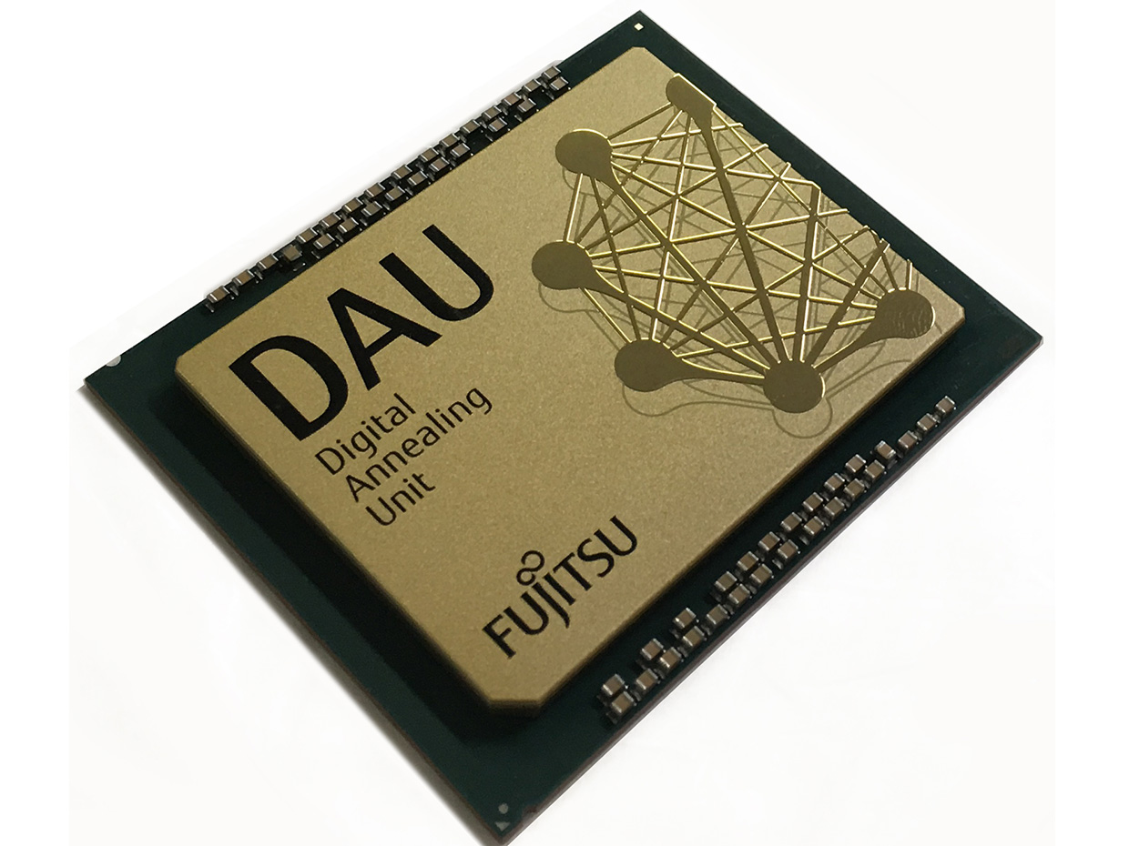
Seminar November 20th Fujitsu Digital Annealer and QUBOs
Nov 20th 17:00 CET = 8:00 a.m. PST
Agenda:
  5 Minutes: Welcome and intro
  15 minutes: Digital Annealer: High-level overview (Andreas Rohnfelder)
  30 minutes: Digital Annealer Deep Dive incl. QUBO building (Dr. Sebastian Engel)
  10 minutes: Q&A
Skype for business connection:
  https://lync.global.fujitsu.com/ts/Meet/andreas.rohnfelder/HY9YVFGF
Photo: Fujitsu

Slide 3


Slack workspace
Workspace created for rapid discussion on
  Research ideas
  Education
  Meeting planning
  Specific WG business
Join using this invite link:
  https://join.slack.com/t/triumf-helmholtz/shared_invite/enQtODIwMTY1MDkyMTk1LTY5MGZlYjBkNTIyNjdmOTg0OTFiZGJmMWYxODFiYzNjNTBlMTIyY2IyNGVjMjczZTgzOTMwNjkzZTMxMGNlNGU

