Slide 1
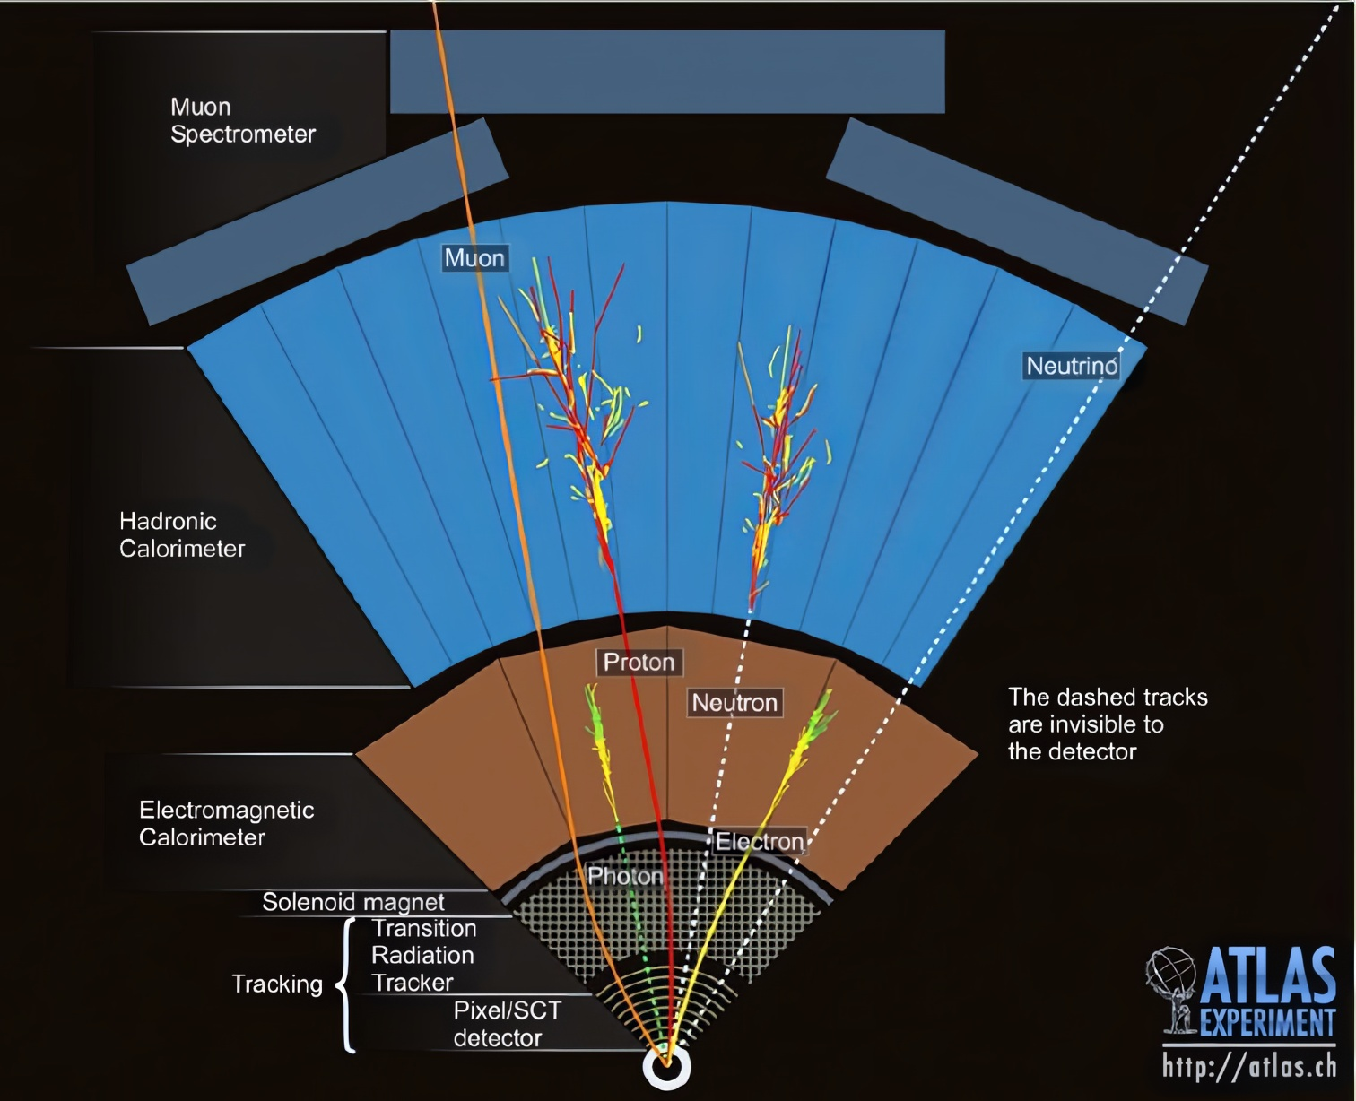
Interactions of Particles through Bulk Matter:
THE Fundamental of Radiation Detectors
Dr. Marcello Pavan
TRIUMF
GRIDS 2026

Slide 2
Overview
What is a Detector?
Energy Loss of Heavy Charged Particles
Electron/Positron Energy Loss
Photon Energy Loss
Particle “showers”
Cherenkov radiation
Summary and Further Reading

Slide 3
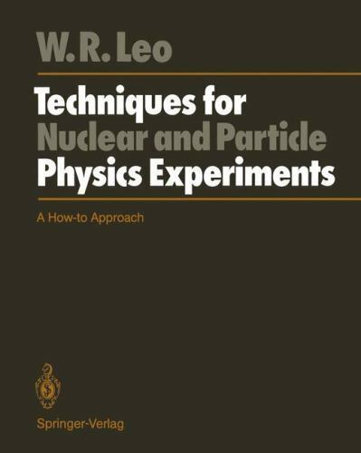
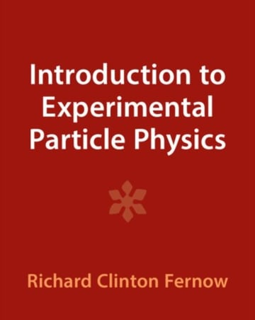
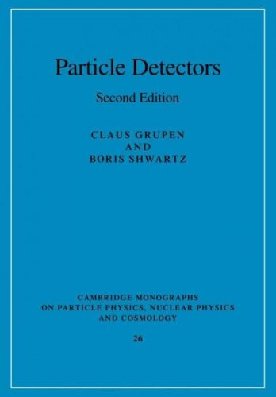
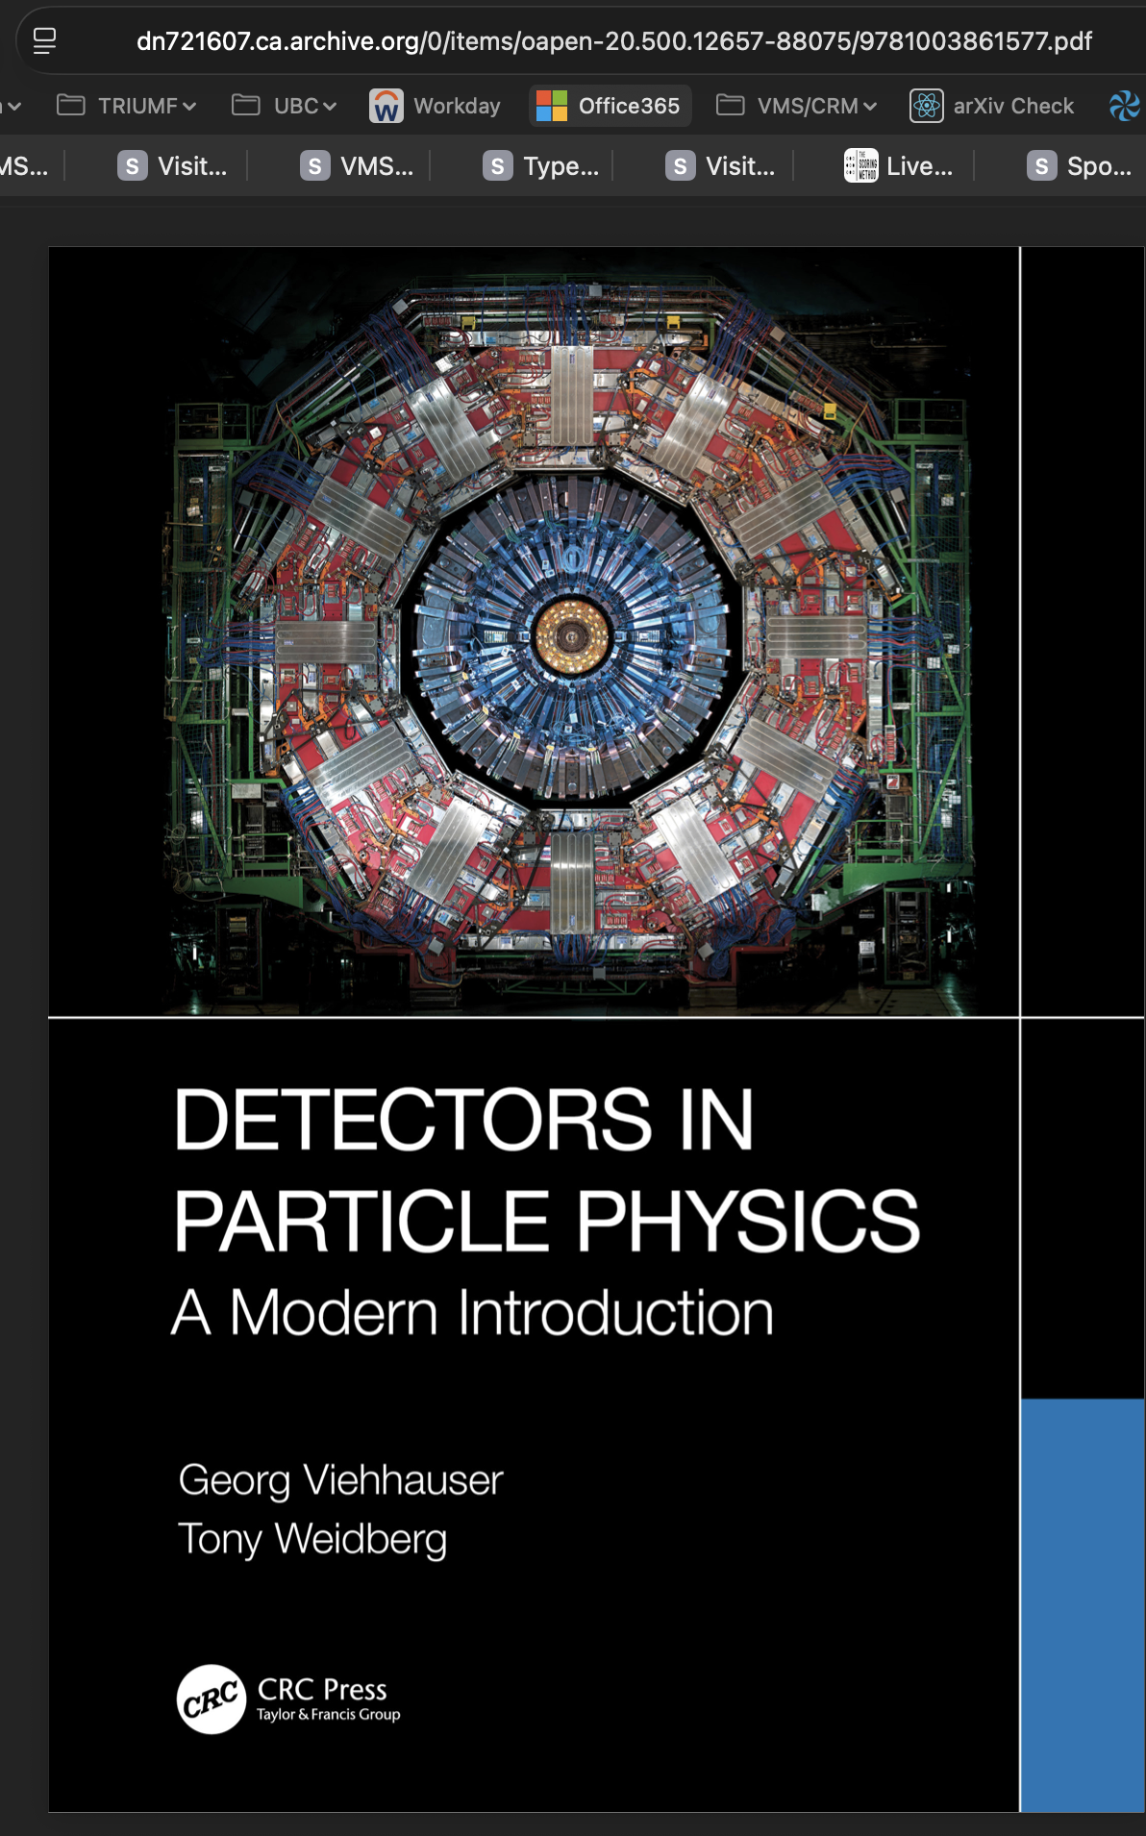
References
Basics
Energy Loss
e-/e+
Photons
Showers
Cherenkov
Summary
W.R. Leo, Techniques for Nuclear and Particle Physics Experiments (Springer-Verlag)
Fernow, Richard, Introduction to experimental particle
physics (Cambridge University Press; ISBN 0-521-37940-7)
Grupen, Claus & Shwartz, Bori, Particle Detectors
(Cambridge Monographs; ISBN 978-0-521-18795-4)
Viehhauser, George & Weidberg, Tony, Detectors in Particle Physics – A Modern Introduction (https://archive.org/details/oapen-20.500.12657-88075/mode/2up)

Slide 4
What does a (modern)
Particle Detector
DO exactly?
Basics
Energy Loss
e-/e+
Photons
Showers
Cherenkov
Summary
Basically one thing:
  Generate and then register a pulse of ionization
  Generate a flash of light
    But then that light must be converted to a pulse of ionization before its registered

Slide 5
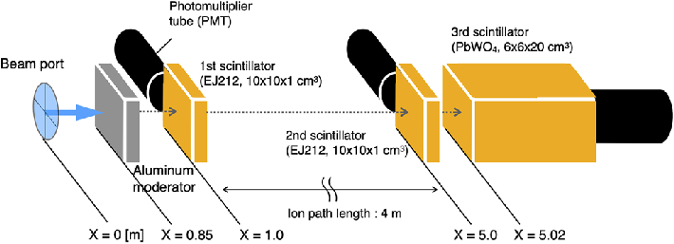
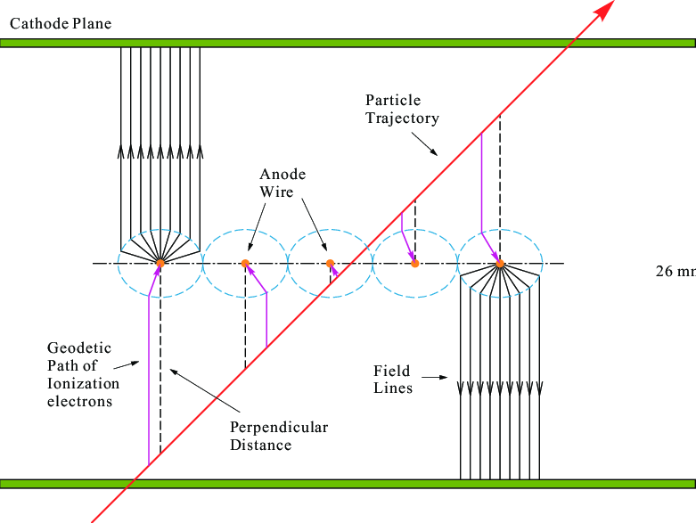
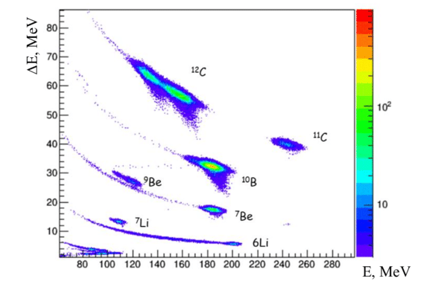
Particle Detector functions
Basics
Energy Loss
e-/e+
Photons
Showers
Cherenkov
Summary
simply detect (or not!) passage of a particle into a larger detector volume or array
  i.e. neutral particles won’t “trigger” system
Measure time-of-flight between two parts of detector → measure speed
  Can be used to identify particles
Localize charge to infer passage of particle at a certain point
  Track trajectory through many layers
Measure energy loss and total energy deposit
  Can be used for Particle Identification
Notes:
Chernenkov radiation has a threshold

Slide 6
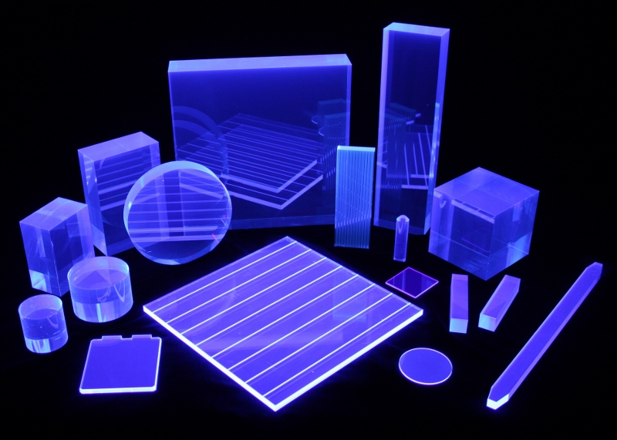
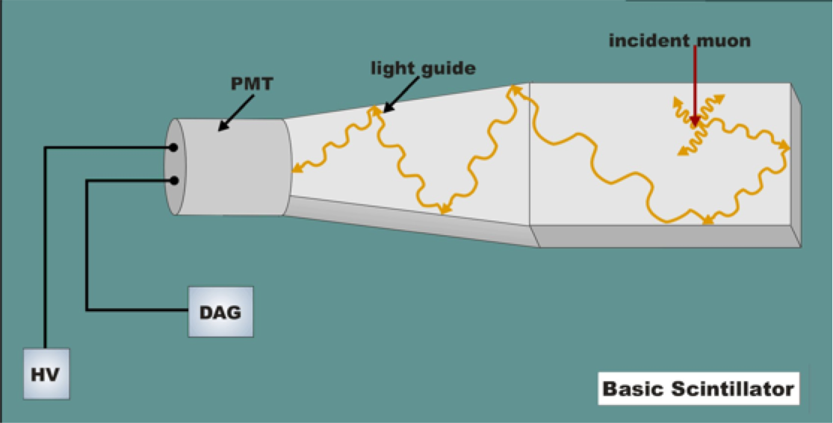
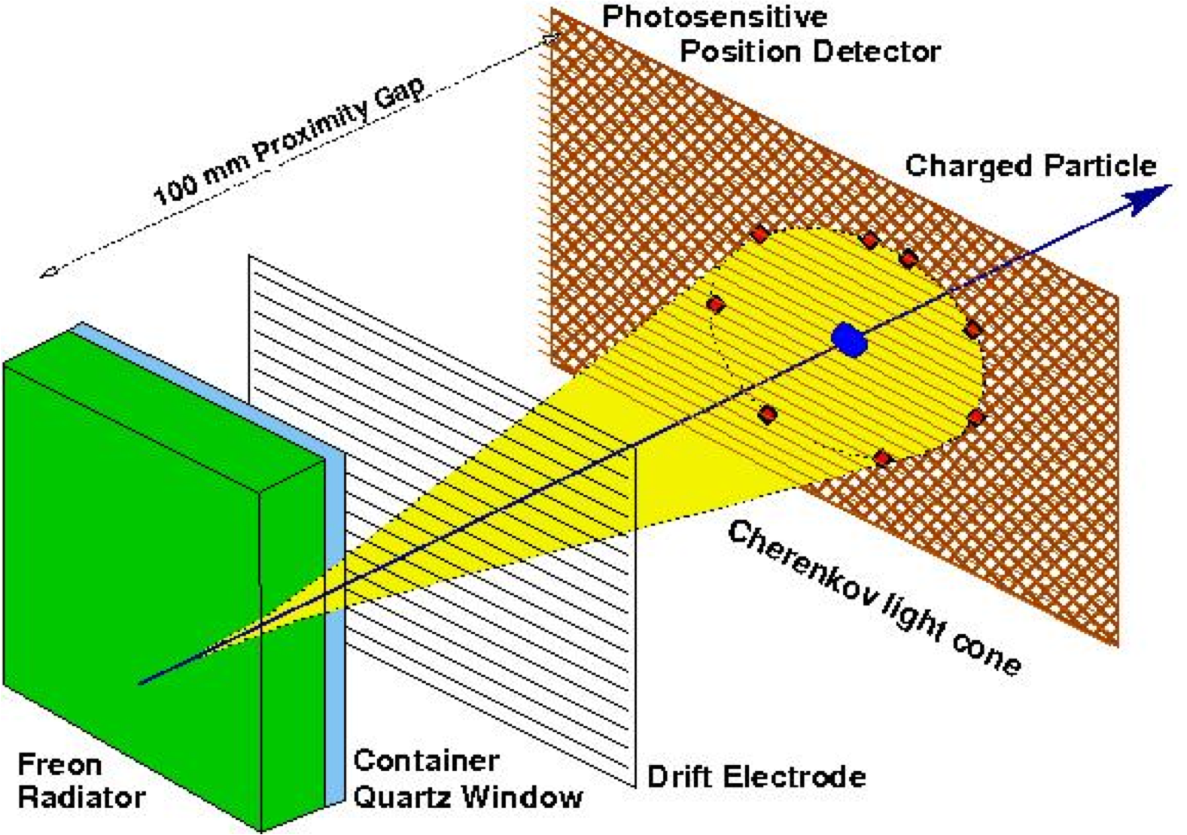
Examples of Particle Detectors – “light-based”
Basics
Energy Loss
e-/e+
Photons
Showers
Cherenkov
Summary
Passage of ionizing radiation excites atoms to release light
Scintillators (Darren Grant June 4)
  Light output depends on energy deposition
  No inherent directionality to light
  Solid or liquid material
Cherenkov Detectors
  Light output depends on energy and speed of charged particle
  Light “cone” highly directional
Ultimately, light must be converted to electrical pulse to be “registered”.
DAQ & Electronics (Ben Smith June 8)

Slide 7
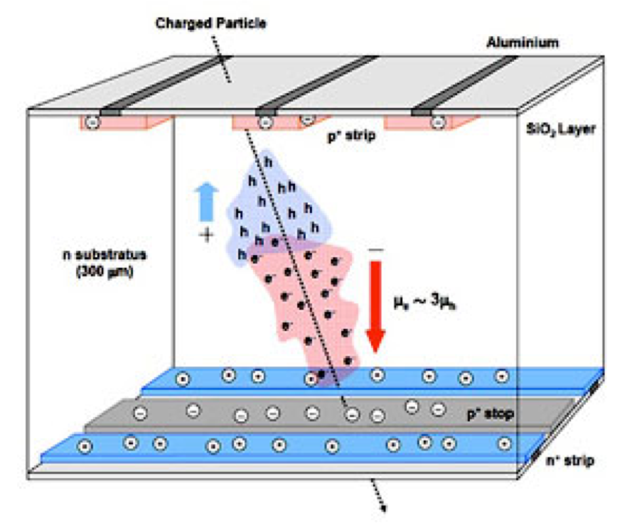
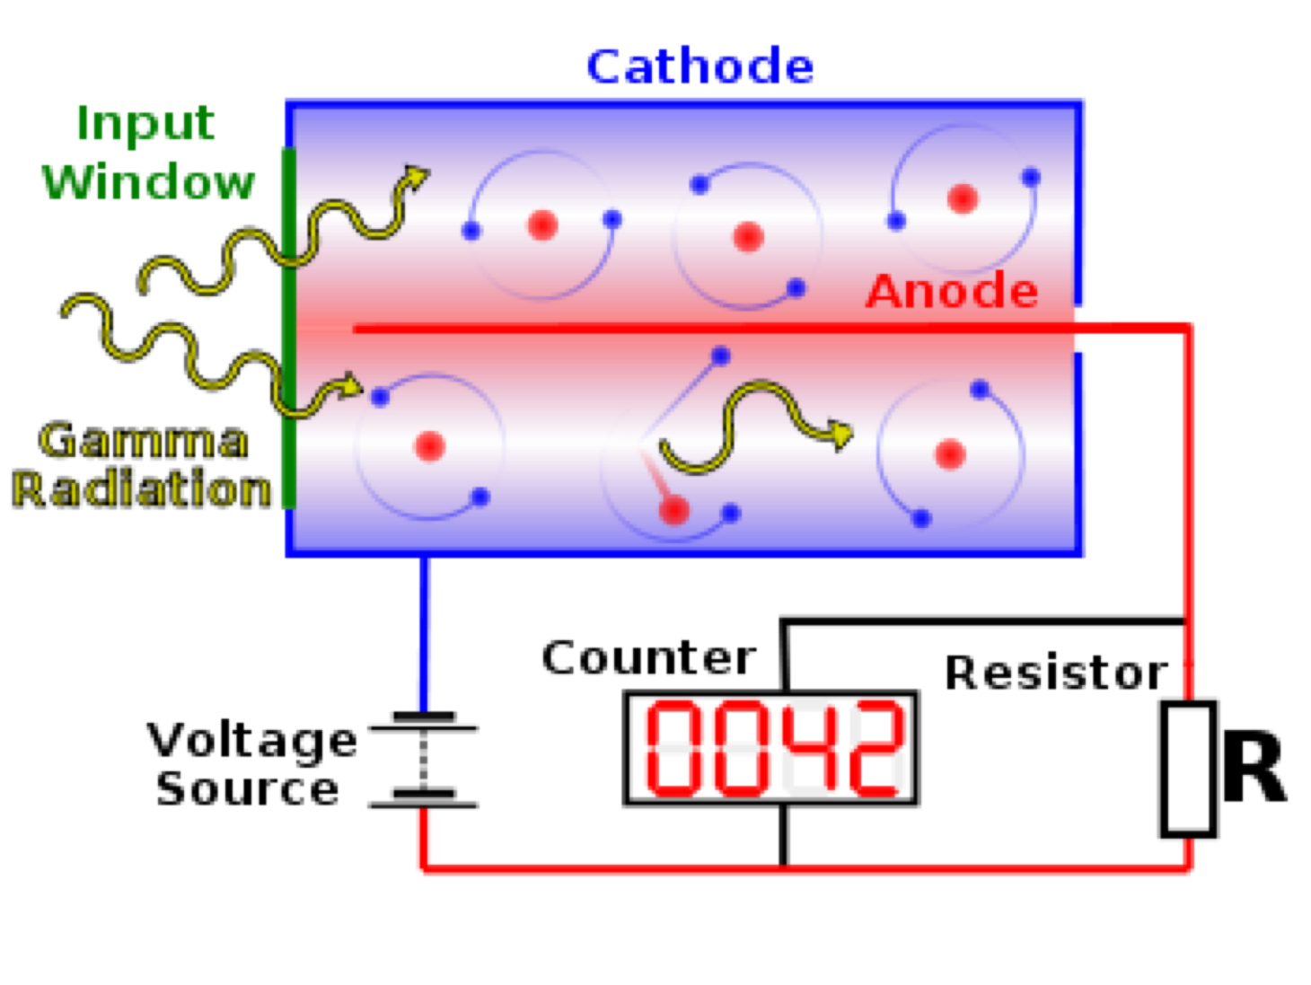
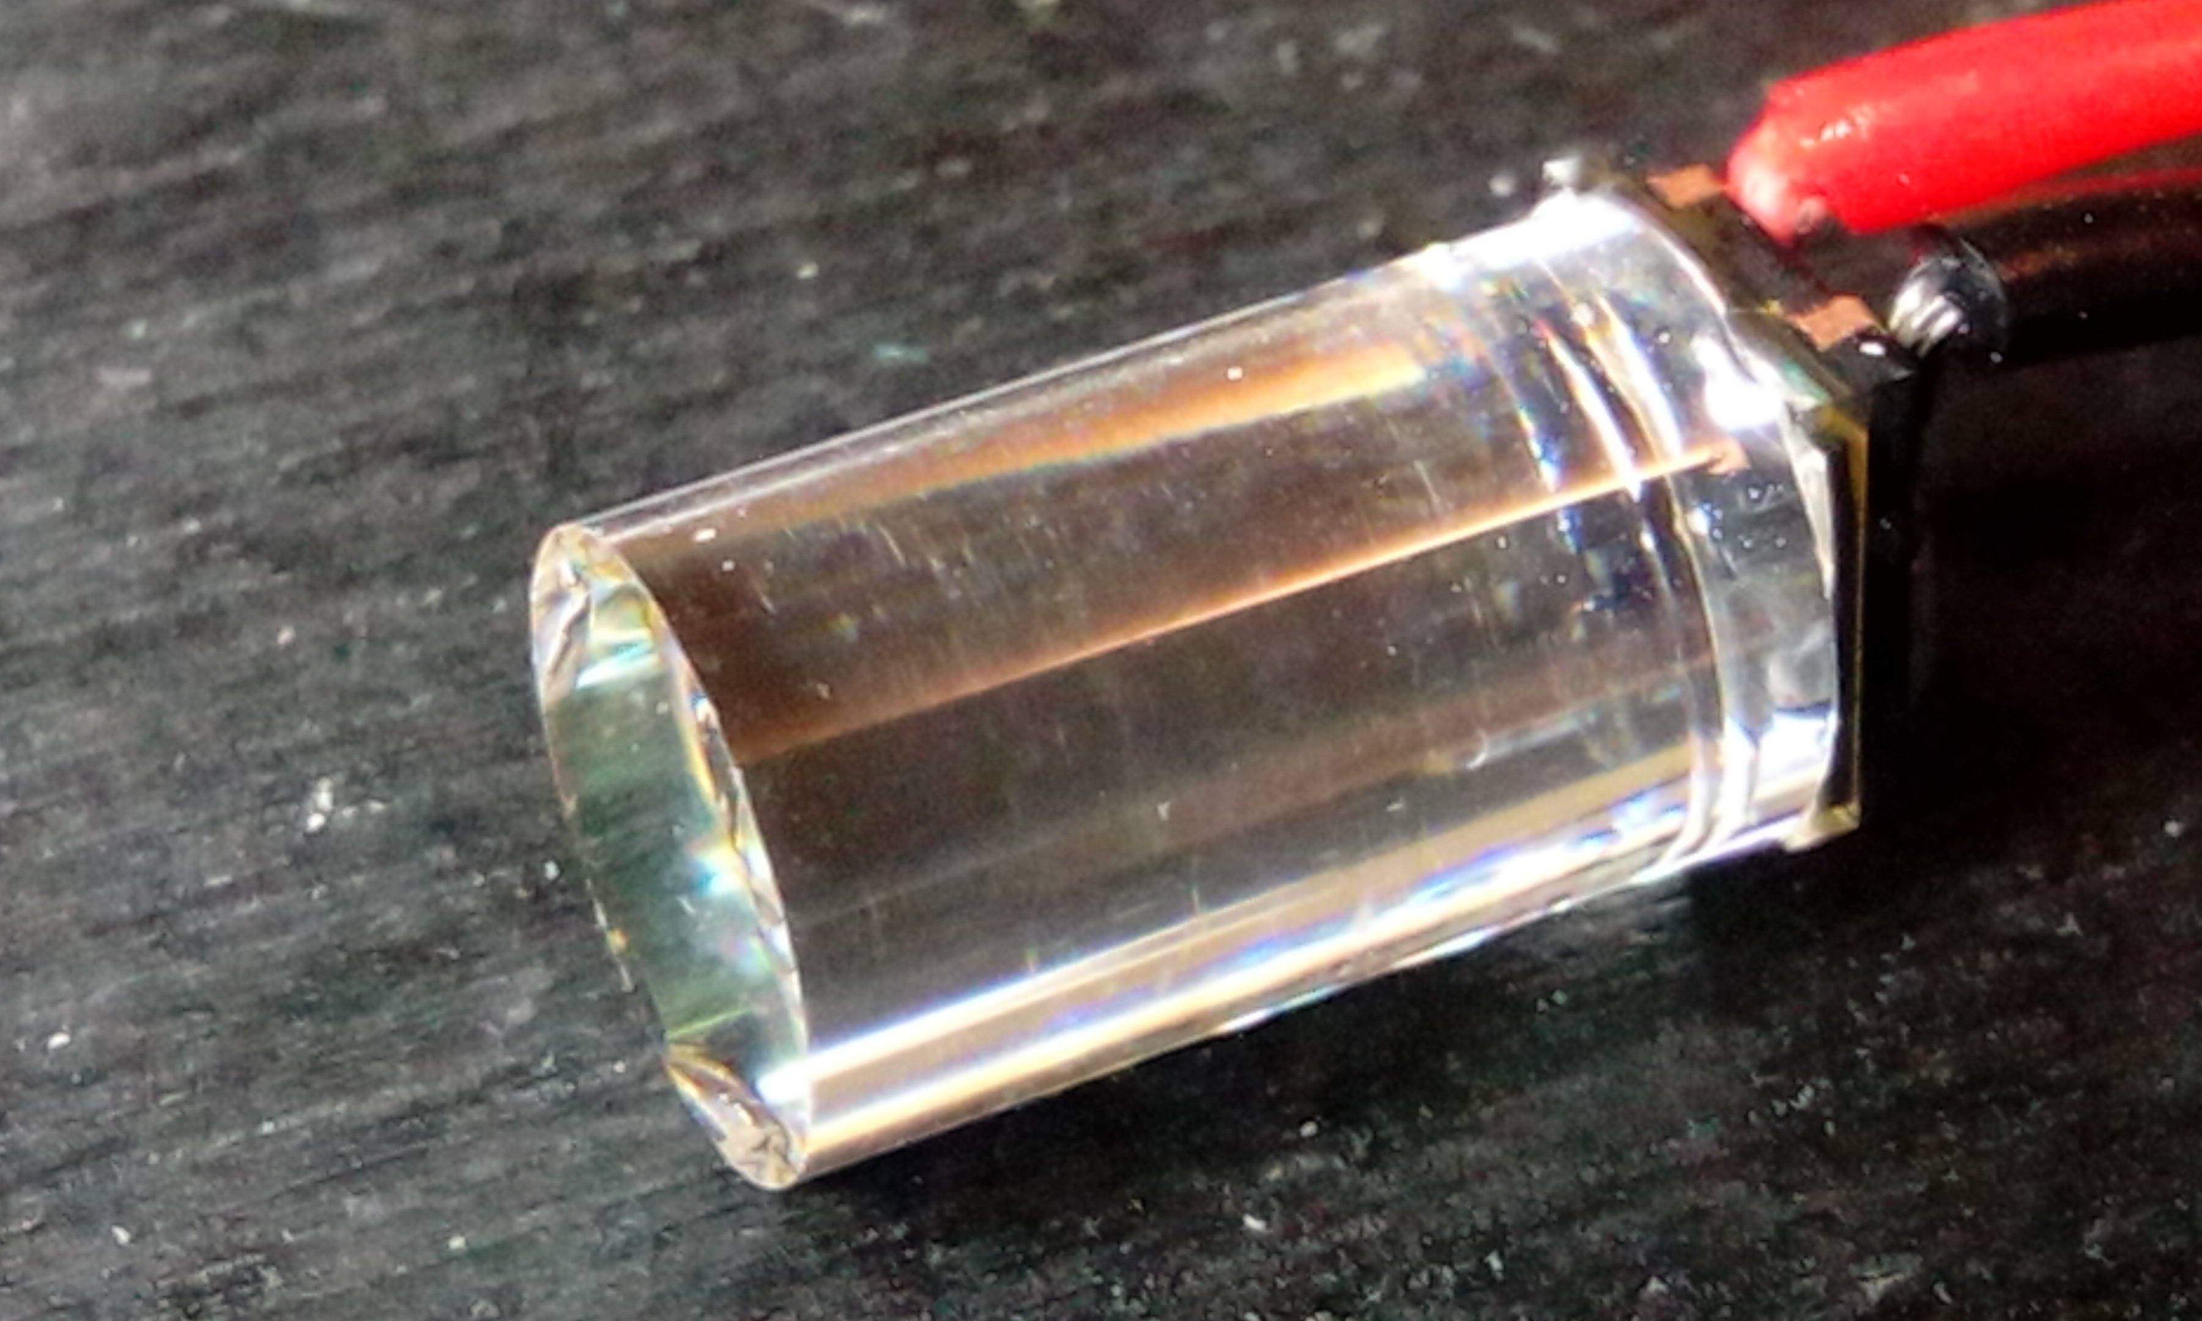
Examples of Particle Detectors – Ionization based
Basics
Energy Loss
e-/e+
Photons
Showers
Cherenkov
Summary
Semiconductor-based detectors (Serge Charlebois June 3):
  For precise position localization
  Good timing accuracy
  Expensive
Gas-based detectors (Scott Menary June 2):
  Position localization
  Energy measurements
  Can be deployed over large areas
Crystal-based detectors (Garnsworthy, Vachon, Diamond)
  Very dense, can stop particles in short distances
  Generally excellent energy resolution
  Weak position resolution, decent timing

Slide 8
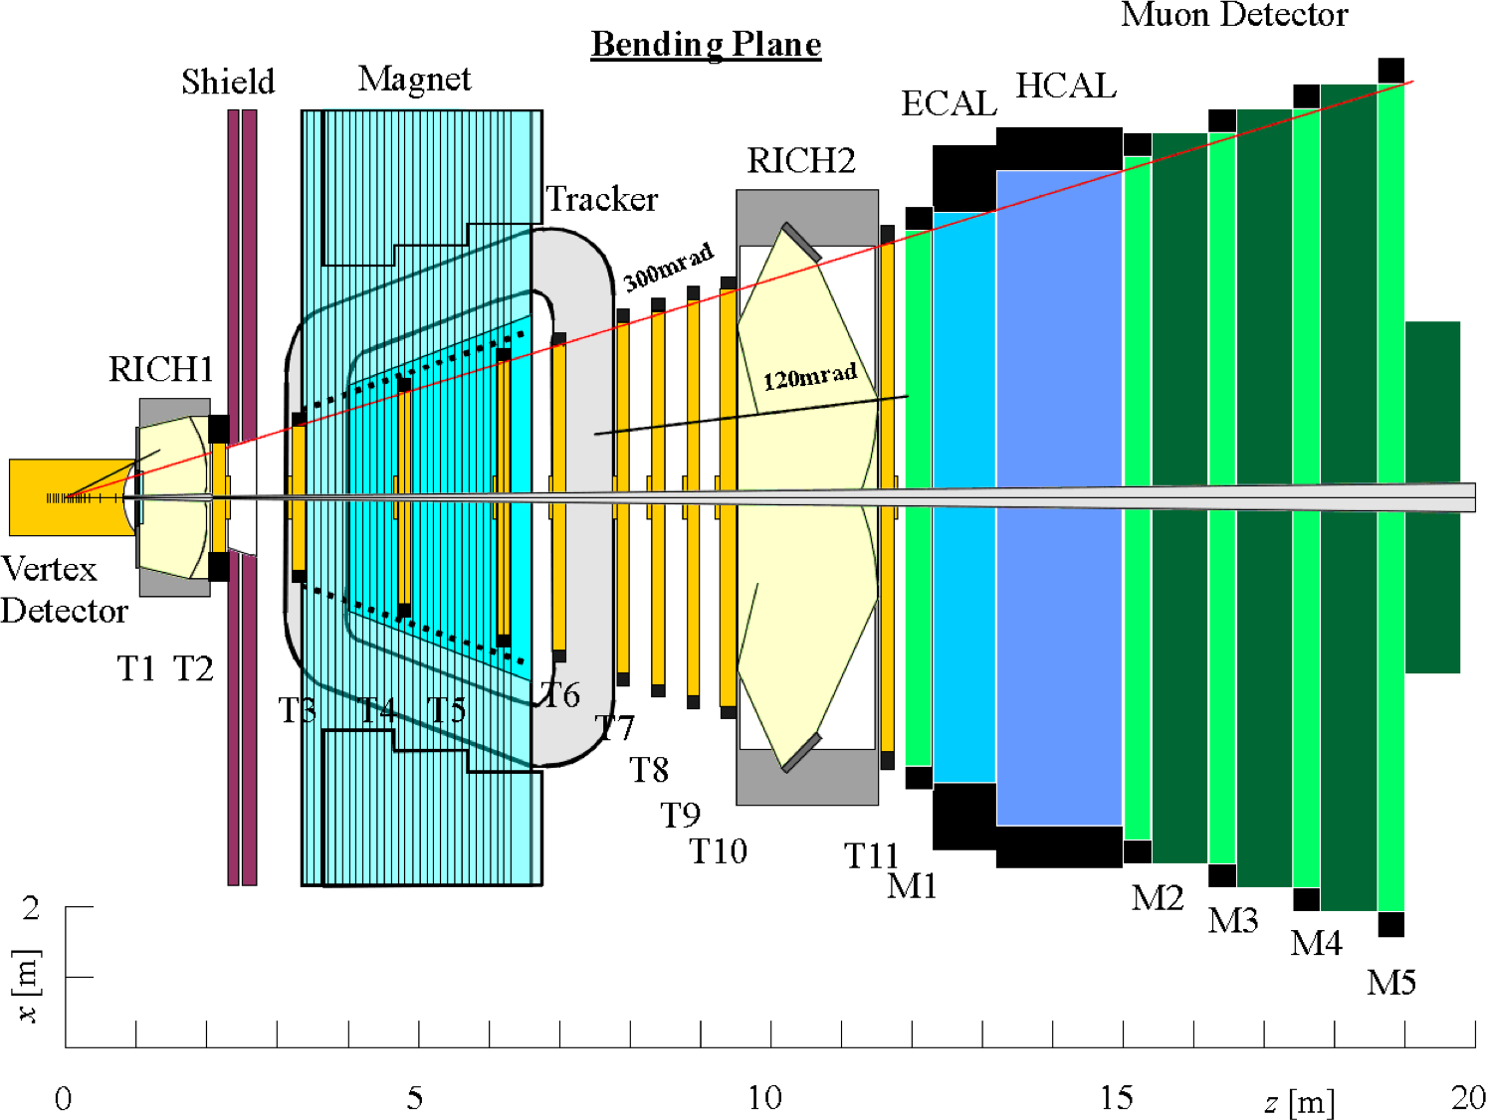
Energy Loss interactions crucial to detector design choices
Basics
Energy Loss
e-/e+
Photons
Showers
Cherenkov
Summary
Modern detectors, especially in particle physics, are a complex mix of subdetectors with multiple functions
  Designing these systems half science, half art, half engineering
  The performance of these complex systems dictate what can and cannot be detected, and what can and cannot be discovered (or inferred)
  They really are foundational to modern subatomic physics

Slide 9
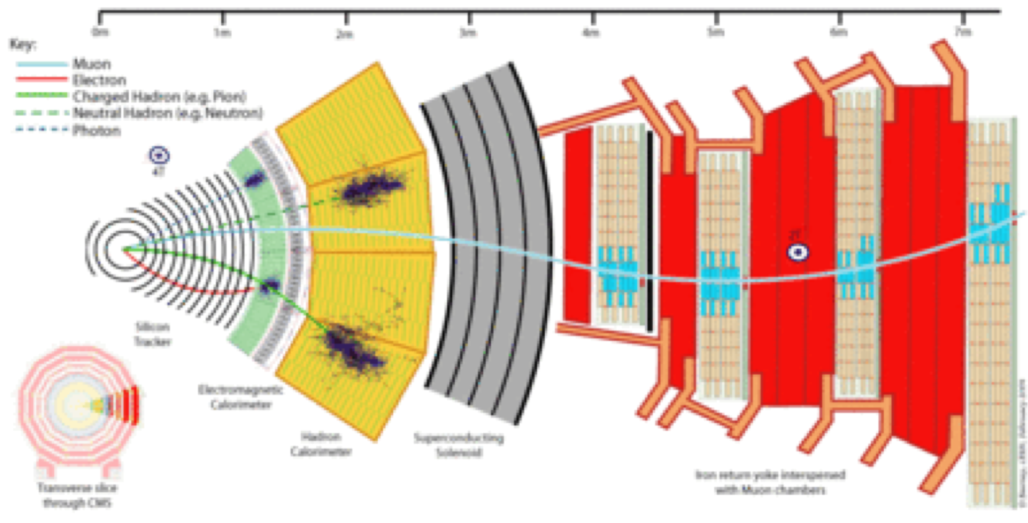
Therefore, important to understand basics of particle interactions with bulk materials, especially EM energy loss
Basics
Energy Loss
e-/e+
Photons
Showers
Cherenkov
Summary

Slide 10
Which particles CAN we detect directly?
Basics
Energy Loss
e-/e+
Photons
Showers
Cherenkov
Summary

Slide 11
Which other particles CAN we detect directly?
Basics
Energy Loss
e-/e+
Photons
Showers
Cherenkov
Summary
+ charged stable or long-lived nuclei (⁴He⁺⁺, ¹⁶O⁺, etc)

Slide 12
Which particles CAN we detect semi-directly? i.e we can detect the scattered particle and infer the incident one
Basics
Energy Loss
e-/e+
Photons
Showers
Cherenkov
Summary

Slide 13
ALL other particles can be “detected” only indirectly through the decay products that we can detect.
Basics
Energy Loss
e-/e+
Photons
Showers
Cherenkov
Summary
i.e we detect the daughter products and infer the parent
Aside: this is one of THE key challenges for identification of short-lived particles…

Slide 14
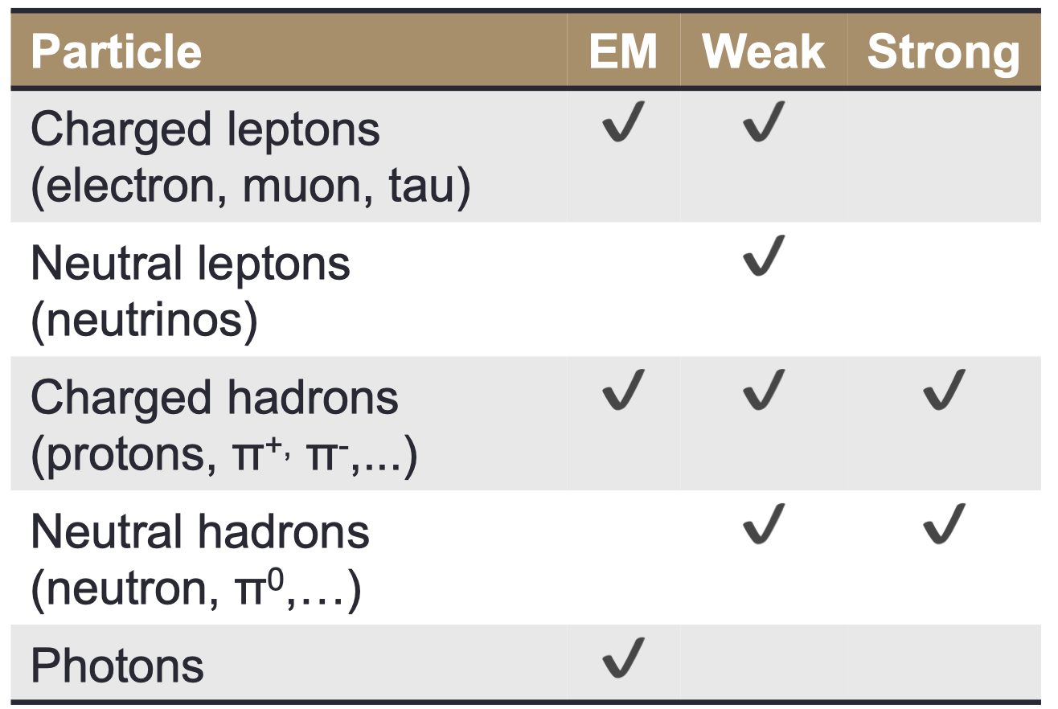
Particle interactions and Fundamental forces
Basics
Energy Loss
e-/e+
Photons
Showers
Cherenkov
Summary
Particle must interact somehow with the detector in order to be “seen”
  Gravity will be ignored as irrelevant
Ultimately, either the particle or interaction products must interact electromagnetically in order to be detected electronically

Slide 15
Relativistic Kinematics notation we will need…
Basics
Energy Loss
e-/e+
Photons
Showers
Cherenkov
Summary
These show up all over the derivation of charged-particle energy loss we are about to explore.
Velocity:
Energy:
Momentum:
Taking c=1, m=m₀:

Slide 16
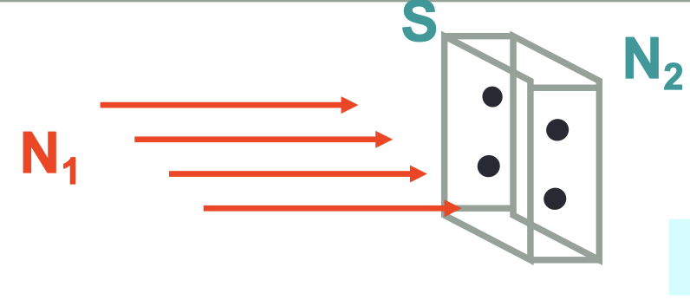
QM reigns: Interactions are probabilistic
Basics
Energy Loss
e-/e+
Photons
Showers
Cherenkov
Summary
The interaction probability p depends on:
  Density of medium ρ
  Thickness of medium d
    Define “areal density” S= d*ρ
    Units [mass/area], Usually [g/cm²]
  Interaction “cross-section” σ
    units [area], usually “barn”
    1 barn = 10⁻²⁸ m² = 100 fm²
    Depends on specific interaction (strong,
    weak, EM), energy, etc
So, the interaction rate R …
  R = I *σ *S, where I=N_{incident}/(unit time)
Define:
  ρ = medium density
  d = medium thickness
  S = medium surface area
  N₂ = # particles in medium volume
  σ = “cross section” probability of incident particle on medium particle
  N₁ = # incident particles
Notes:
Cross section is interaction probability per unit area

Slide 17
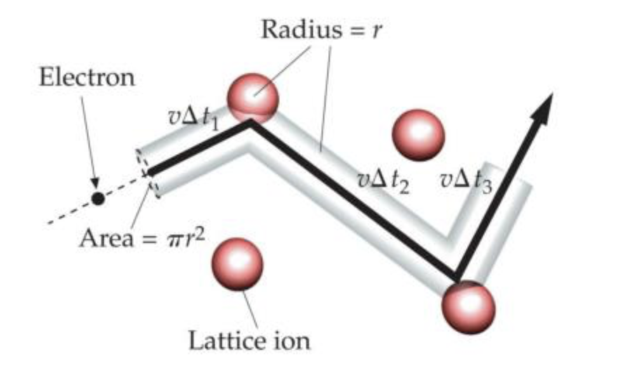
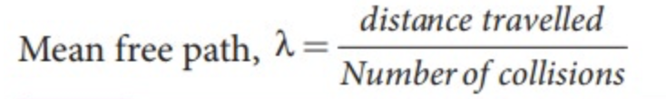
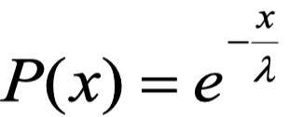
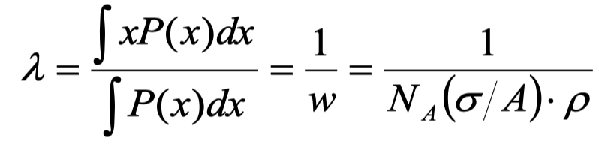
The Mean Free Path: λ
Basics
Energy Loss
e-/e+
Photons
Showers
Cherenkov
Summary
The mean distance between successive interactions:
Derivation: Calculate the probability that a particle doesn’t interact
after having traversed a length x in the medium of area density S
  Interaction probability per unit distance
    w = p/d = σ (S/d)
  Interaction probability between x et x+dx
    w dx = σ (S/d) dx
  Probability to not have an interaction between x and x+dx
    P(x+dx) = P(x) (1- w dx)
      Expanding: P(x) + P’(x)dx = P(x) – P(x) w dx
    Therefore P’(x) = -wP(x)
    P(x) = e^{-wx}
Define thus,
Notes:
Substitute P(x) = exp(-w x) into the integral

Slide 18
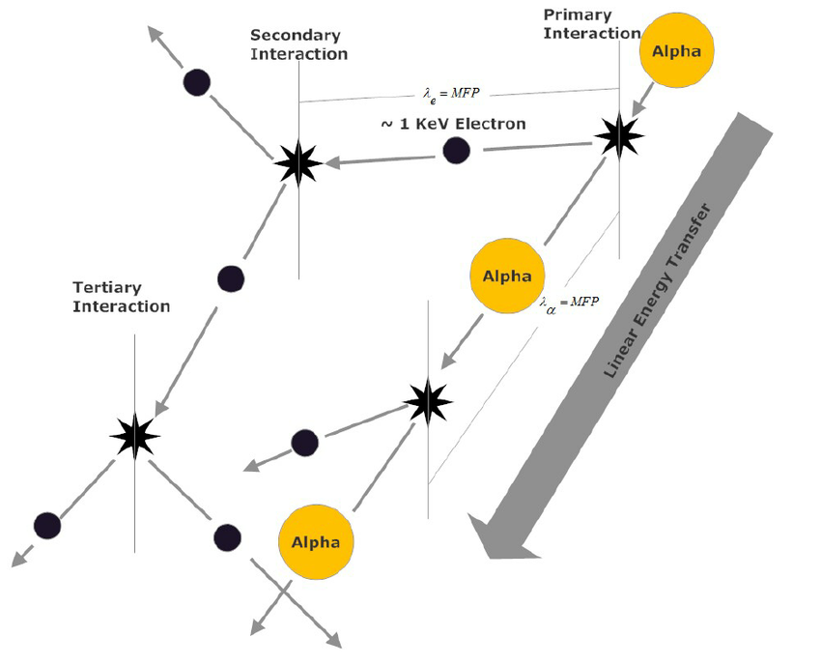
Energy Loss by Heavy Charged Particles
Basics
Energy Loss
e-/e+
Photons
Showers
Cherenkov
Summary
“Heavy” means all charged particles heavier than electrons (positrons)
At low energy (keV to MeV)
  Energy loss dominated by EM interactions with atomic electrons
    Size of an atom ~10⁻¹⁰ m
    Size of a nucleus ~10⁻¹⁴ m ~ 10fm
  Interaction transfers part of the energy of the incident particles into kinetic energy of the atom that will either get excited (electrons move to higher orbitals) or ionized (electrons break free)
    The physics behind this is the same in both cases, just differences in the amount of energy transferred
The interaction cross section can be very small (~10⁻²¹ m²) but the high atomic density (N_{A}= 6 *10²³ g⁻¹) of most materials can result in significant energy loss
  10 MeV protons lose all their energy in 0.25mm of copper (on average)

Slide 19
“Classical” derivation of Energy Loss
Basics
Energy Loss
e-/e+
Photons
Showers
Cherenkov
Summary
Let’s dispense with all the quantum mechanically mumbo jumbo to gain some intuition…
  An incident charged particle with charge z₁e creates an electric field at the position of a particle 2 in the medium.
  The incident particle is at a transverse distance b (impact parameter) from the medium particle
  By symmetry the net force on 2 is transverse to the trajectory of 1.
  If v₁ is small, we can ignore the magnetic field.

Slide 20
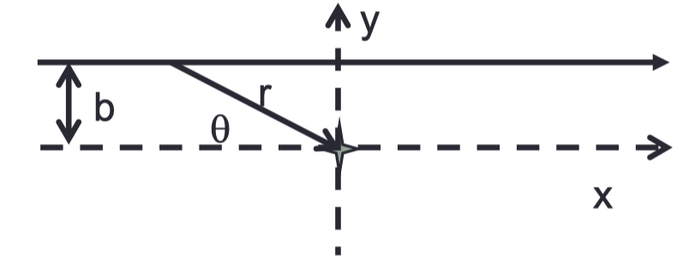
“Classical” calculation of momentum/energy transfer
Basics
Energy Loss
e-/e+
Photons
Showers
Cherenkov
Summary
The force F by the electric field is F = q
  So the momentum transfer Δp is:
→
  Thus the energy transfer per interaction ΔΕ is:
1/b²v₁² => energy loss is dominated by close collisions and slow particles.
n.b. the energy loss is dominated by the interactions with atomic electrons, not the nuclei (m_{nucleus} >> m_{e}).

Slide 21
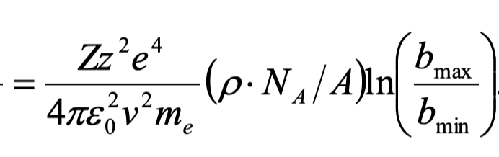
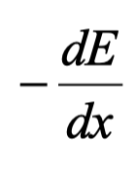

Now integrate over all atomic electron interactions…
Basics
Energy Loss
e-/e+
Photons
Showers
Cherenkov
Summary
In a vertical slice of the cylinder at right, there are
atomic electrons.
Integrating over all the interactions n_{e}*ΔE we get the energy loss per unit length,
Doing the integral, and using n_{e} = ρ(N_{A}/A) Z and the vacuum permittivity ε₀, we get:

Slide 22
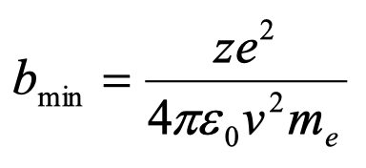
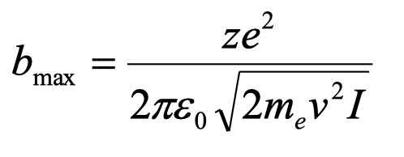
“Classical” derivation of Energy Loss, final result
Basics
Energy Loss
e-/e+
Photons
Showers
Cherenkov
Summary
b_{min} b_{max}
The ln(b_{max}/b_{min}) term diverges for either
b_{max} → ∞ or b_{min} → 0
∴ introduce physically realistic limits
If projectile mass >> m_{e}, then
ΔE_{max,e} = 2m_{e}v² , consequently:
Minimum energy transfer must be enough to ionize an atomic electron
So ΔE_{min,e} = I (ionization constant),
consequently:

Slide 23
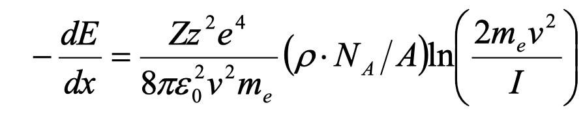
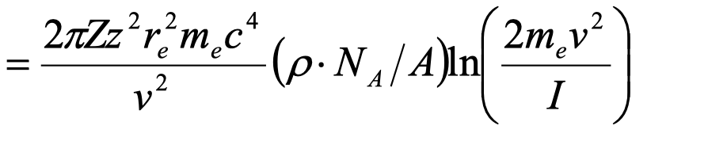
“Classical” derivation of Energy Loss, final result
Basics
Energy Loss
e-/e+
Photons
Showers
Cherenkov
Summary
b_{min} b_{max}
Redoing the integration with the new
”realistic” limits b_{max} , b_{min} , we get our
final result
1/v² decrease at low energies
Slower ln(v²) at high energies
Depends on (incident charge)²
Where r_{e} is the “classical electron radius”

Slide 24
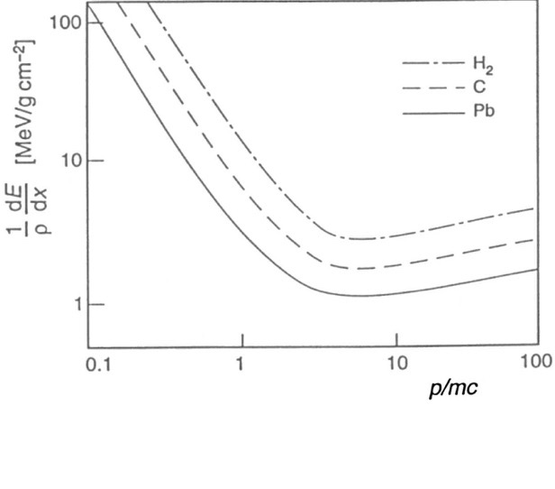
“Classical” derivation of Energy Loss, final result
Basics
Energy Loss
e-/e+
Photons
Showers
Cherenkov
Summary
1/v² decrease at low energies
Slower ln(v²) at high energies
Depends on (incident charge)²

Slide 25
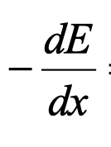
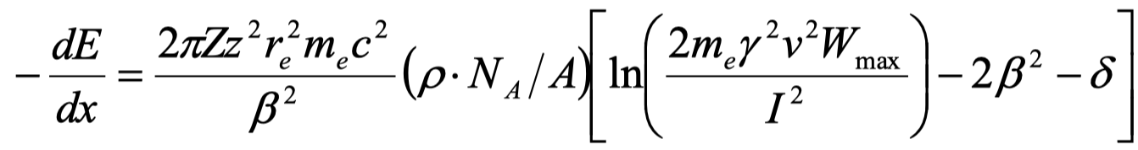
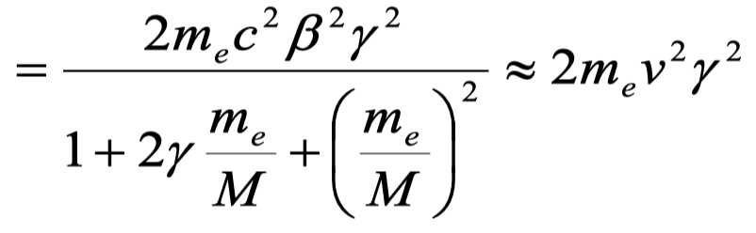
Result of better Quantum Mechanical calculation
Basics
Energy Loss
e-/e+
Photons
Showers
Cherenkov
Summary
Our semi-classical derivation was:
Hans Bethe and Felix Bloch did the QM calculation
(famous Bethe-Bloch formula) and got:
where δ is a charge density correction, and
W_{max} = max (ΔE) for a collision for large M

Slide 26
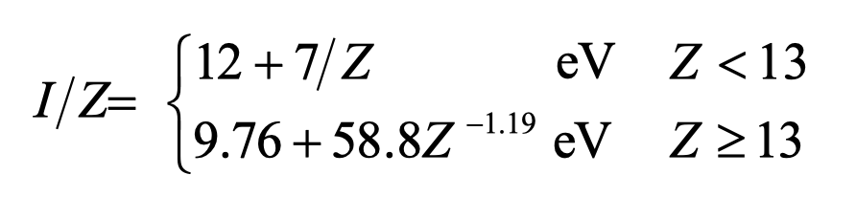
Bethe-Bloch formula: new features
Basics
Energy Loss
e-/e+
Photons
Showers
Cherenkov
Summary
The ionization constant (I) groups together the global properties of atoms
  Measured experimentally for different materials
  Parameterized as a function of the number of electrons (Z)
The charge density (δ) correction is due to:
  the electric field of the incident particle polarizing the atoms close to its trajectory thus reduces the impact of the electric field of the further away electrons (like a screening effect) which consequently reduces the energy loss i.e. δ >0
  The effect becomes larger if the energy of the incident particle increases (longer range electric field) or the density of material increases

Slide 27
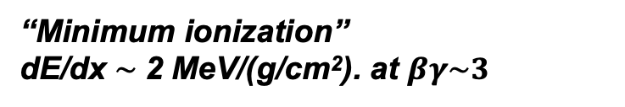
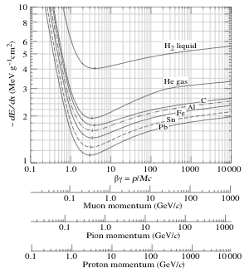
Bethe-Bloch formula in action
Basics
Energy Loss
e-/e+
Photons
Showers
Cherenkov
Summary
Particles with larger charge
lose energy faster
Fermi Plateau:
Screening of the Coulomb field by atomic electrons for large b.
Energy loss is inversely proportional
to the velocity squared (v²)
Relativistic rise
due to the relativistic deformation of the Coulomb field, which makes b_{max} larger)
“Minimum ionization”
dE/dx $\sim$2 MeV/(g/cm²). at $βγ\sim 3$
Heavier materials do not
stop particles as well, BUT density makes it up

Slide 28
Material Properties vis a vis Energy Loss
Basics
Energy Loss
e-/e+
Photons
Showers
Cherenkov
Summary
.

Slide 29
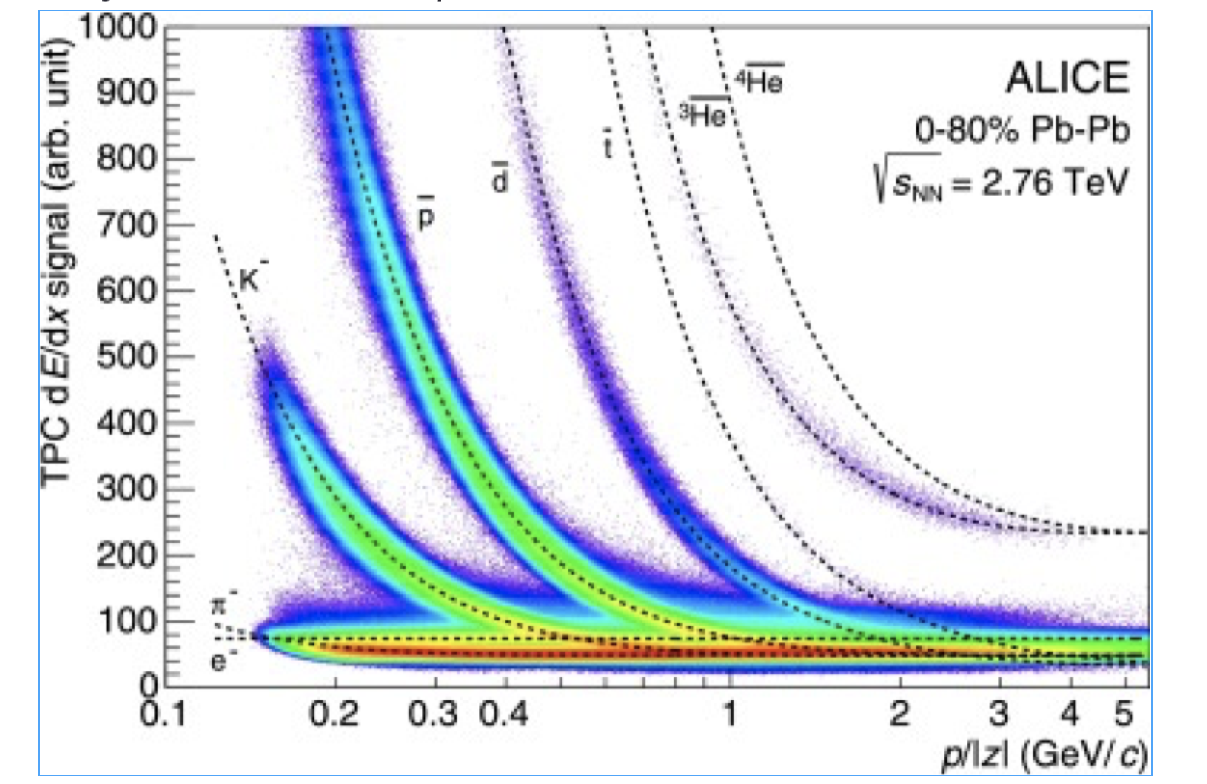
Energy loss in the real world
Basics
Energy Loss
e-/e+
Photons
Showers
Cherenkov
Summary
Different particles traversing gaseous chamber in the ALICE detector at the CERN LHC

Slide 30
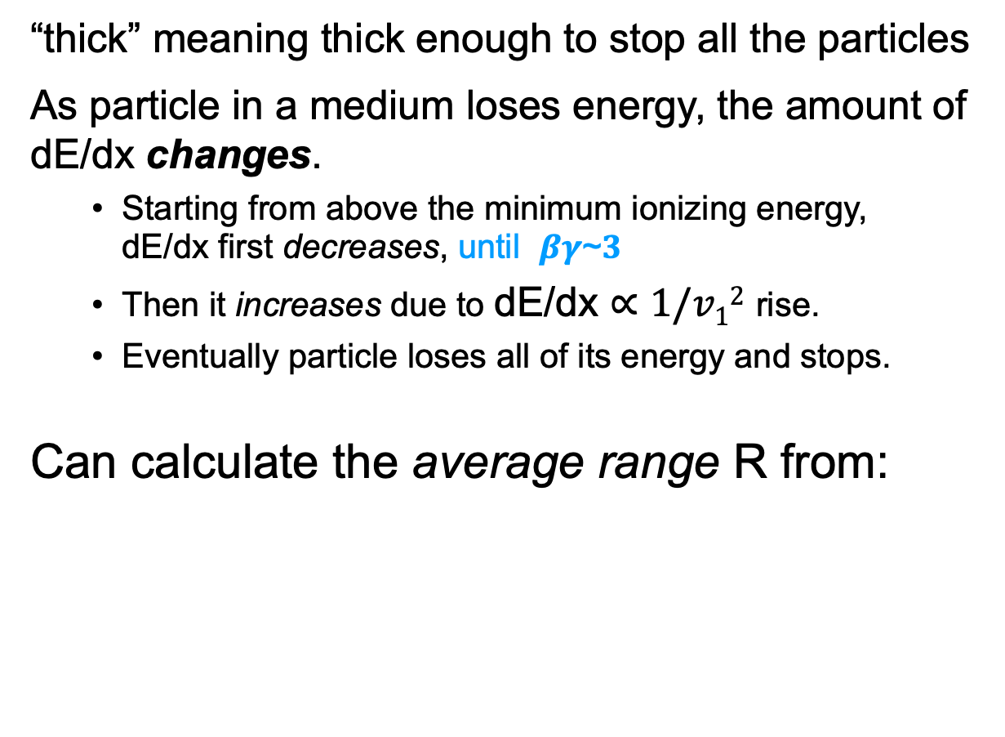
Range of stopped heavy charged particles in thick media
Basics
Energy Loss
e-/e+
Photons
Showers
Cherenkov
Summary
“thick” meaning thick enough to stop all the particles
As particle in a medium loses energy, the amount of dE/dx changes.
  Starting from above the minimum ionizing energy,
  dE/dx first decreases, until 𝜷𝜸~𝟑
  Then it increases due to dE/dx $∝1/v12$ rise.
  Eventually particle loses all of its energy and stops.
Can calculate the average range R from:

Slide 31
Range scaling relations
Basics
Energy Loss
e-/e+
Photons
Showers
Cherenkov
Summary
Doing the range integral yields average range R:
where h is a universal function
This demonstrates the scaling law, e.g. comparing
protons to alpha particles:
  At a given energy, lighter particles go deeper, linearly
  Particles with larger charge go shallower, quadratically

Slide 32
Fluctuations in Energy Loss
Basics
Energy Loss
e-/e+
Photons
Showers
Cherenkov
Summary
The aforementioned discussion was about the average energy loss (and range)
But, energy loss is a statistical process. The number of ionizations varies depending on particle trajectory.
  One expects a roughly Gaussian distribution for large #s of collisions
  However, sometimes a “head on” collision with an atomic electron can occur, where the electron ejects with substantial energy (maybe even exiting material).
  These electrons are called δ-rays, resulting in a long Landau tail at large energy transfer

Slide 33
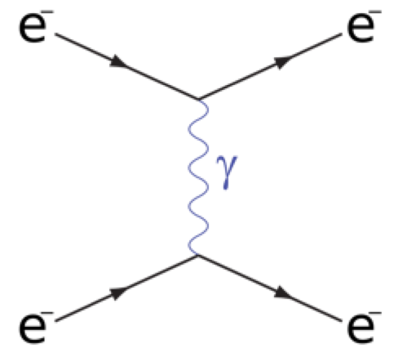
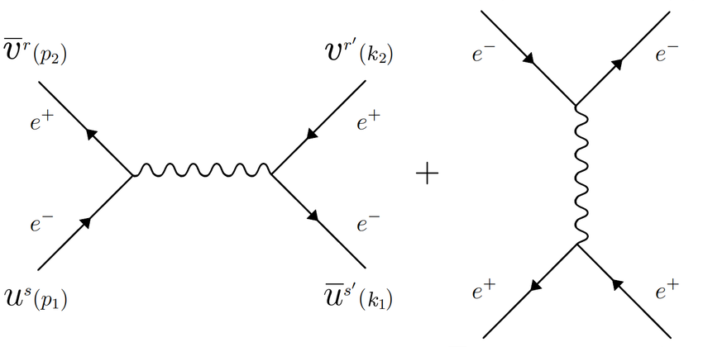
Energy Loss by Electrons and Positrons
Basics
Energy Loss
e-/e+
Photons
Showers
Cherenkov
Summary
Bethe-Bloch assumes M >> m_{e}
  When M= m_{e} , even a single interaction with an atomic electron can change the incoming particle energy substantially
  Moreover, the positron also can annihilate with an atomic electron
So we get a different dE/dx for e⁻ and e⁺
  Electron Moller scattering
  Positron Bhabba scattering

Slide 34
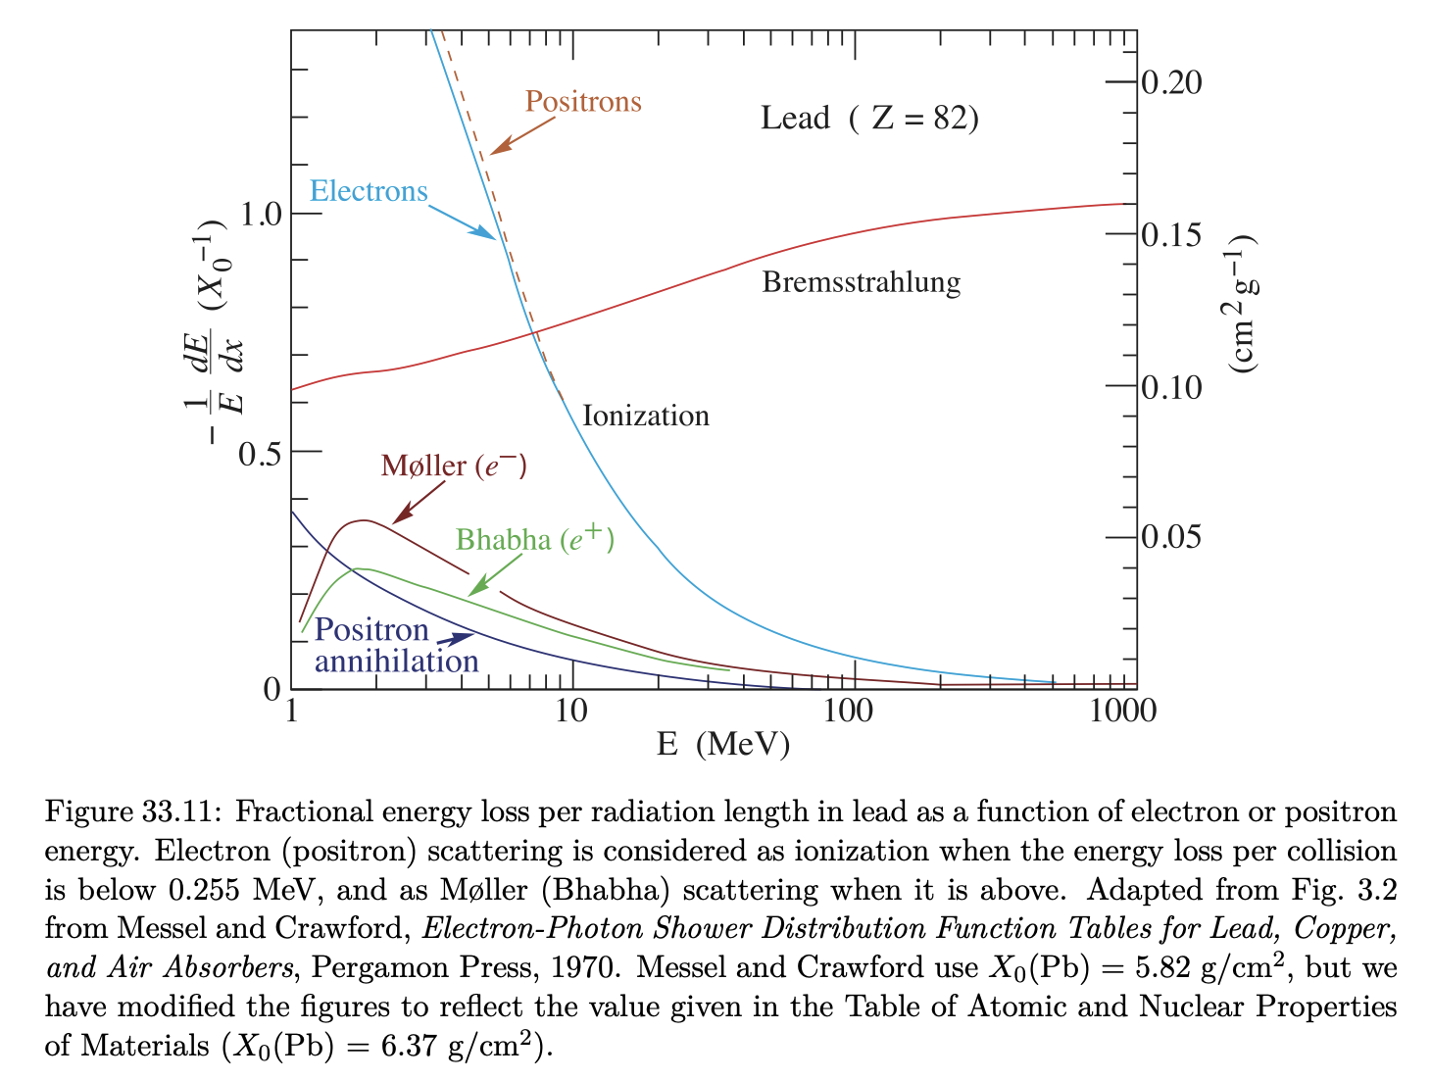
Energy Loss by Electrons and Positrons
Basics
Energy Loss
e-/e+
Photons
Showers
Cherenkov
Summary

Slide 35
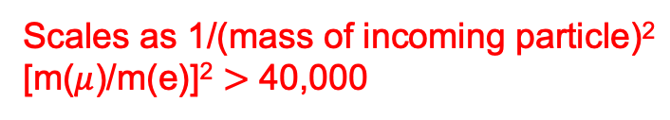
Bremsstrahlung energy loss for Electrons and Positrons
Basics
Energy Loss
e-/e+
Photons
Showers
Cherenkov
Summary
Charged particles emit EM radiation when accelerated in an electric field.
e.g. a particle slowing down due to dE/dx in the electric field of a nucleus
  For photons of wave-number k, bremsstrahlung cross section is:
Scales as 1/(mass of incoming particle)²
[m($μ$)/m(e)]² $>$ 40,000
The cross-section drops off with increasing photon energy as 1/k
Heavy elements are more efficient at producing brems.
Because of 1/M² dependence, really only matters for electrons/positrons
in most scenarios

Slide 36
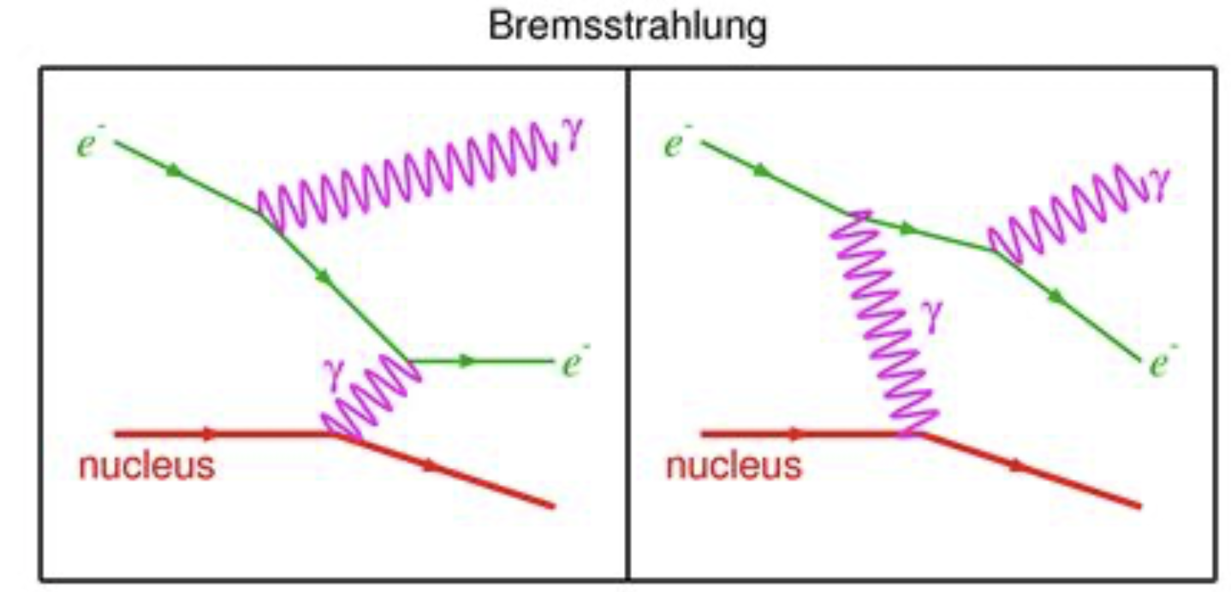
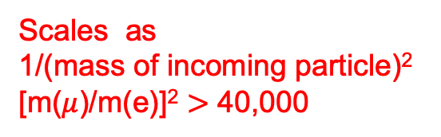
Electron and Positron Bremsstrahlung
Basics
Energy Loss
e-/e+
Photons
Showers
Cherenkov
Summary
Charged particles emit EM radiation when accelerated in an electric field.
e.g. a particle slowing down due to dE/dx
in the electric field of a nucleus
For photons of wave-number k, bremsstrahlung cross section is:
Cross-section falls as
1/k with increasing γ energy
Scales as
1/(mass of incoming particle)²
[m($μ$)/m(e)]² $>$ 40,000
Heavy elements are more efficient at producing brems.
Because of 1/M² dependence, really only matters for electrons/positrons
in most scenarios

Slide 37
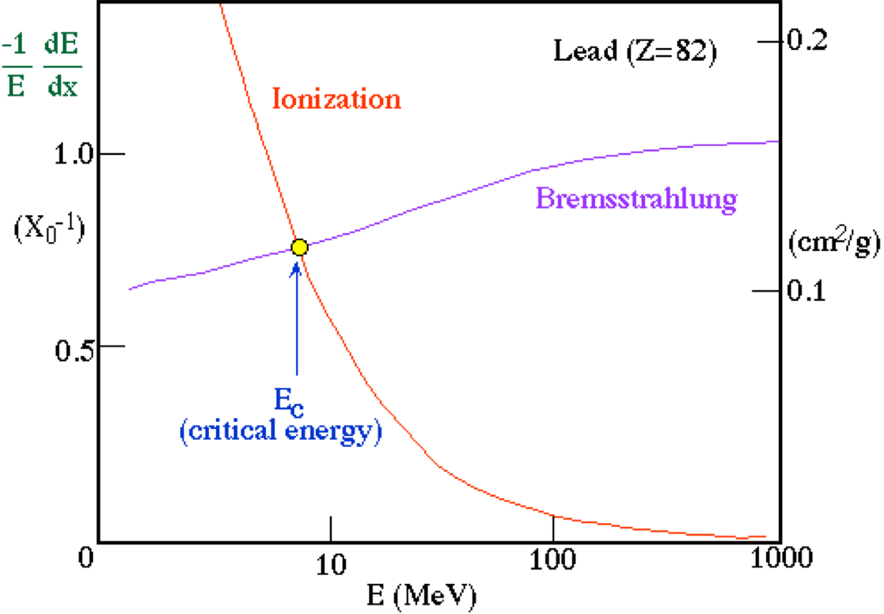
Bremsstrahlung energy loss, part deux…
Basics
Energy Loss
e-/e+
Photons
Showers
Cherenkov
Summary
Energy loss due to bremsstrahlung is:
where
and
Energy loss increases with increasing E_{incoming}
  Radiation energy losses dominate above E_{crit}
  Lower E_{crit} for higher Z media. (e.g. lead, tungsten,..)

Slide 38
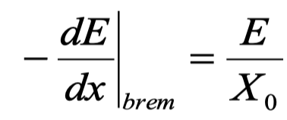

Radiation length: L_{R} (or X₀)
Basics
Energy Loss
e-/e+
Photons
Showers
Cherenkov
Summary
We can rewrite bremsstrahlung energy loss as:
where,
Solving the simple ODE, one gets:
X₀ is the radiation length, where on average the incoming particle energy is reduced by a factor 1/e due to bremsstrahlung

Slide 39
Material Properties vis a vis Energy Loss
Basics
Energy Loss
e-/e+
Photons
Showers
Cherenkov
Summary
.

Slide 40
Photon Interactions
Basics
Energy Loss
e-/e+
Photons
Showers
Cherenkov
Summary
Photons interact with matter in 4 basic ways (here ordered by increasing photon energy):
  Photoelectric effect: photon absorbed by atomic electron, which is then ejected
  Rayleigh scattering: photon scatters coherently off all the electrons in an atom
  Compton Scattering: photon scatters incoherently off a single atomic electron
  Pair production: For E_{γ}>2m_{e}, photon converts into an electron-positron pair
n.b. Photon interactions are important as eventually even high-energy particles end up producing photons.
(foreshadowing…)
Also, photons are either absorbed (disappear) or scattered by a large angle, largely keeping its energy
  So one usually refers to photon attenuation rather than energy loss

Slide 41
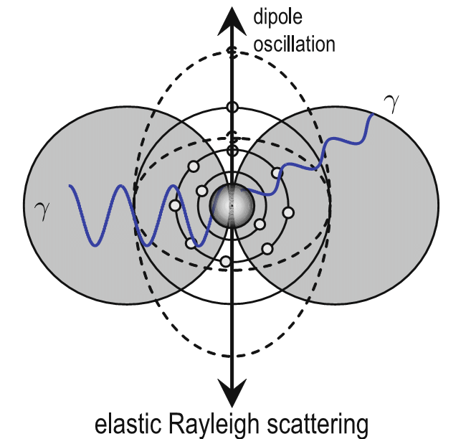
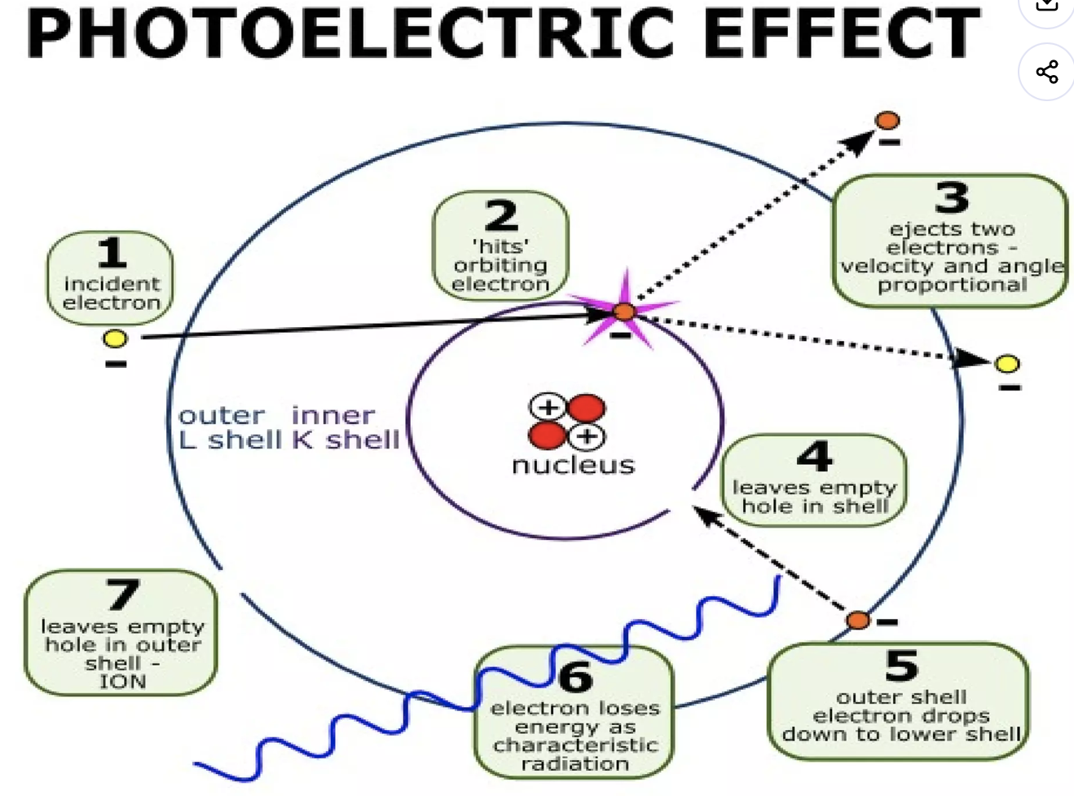
Rayleigh and Photo-electric effects
Basics
Energy Loss
e-/e+
Photons
Showers
Cherenkov
Summary
Rayleigh dominated by very low wavelengths:
σ_{R} ~ 1/λ⁴ (why the sky is blue)
In the Photoelectric effect, an atomic electron is freed after absorbing a photon T_{e} = k - E_{bind}
  where E_{bind} is the binding energy of the electron (which depends on the orbital layer: k,l,m)
  This process (γ+e → e) is not possible for a free electron since it violates momentum conservation
If E_{γ} > B_{K-shell}, the cross section is dominated (80%) absorption in the innermost layer k as the proximity to the nucleus allows easier absorption of the recoil energy

Slide 42
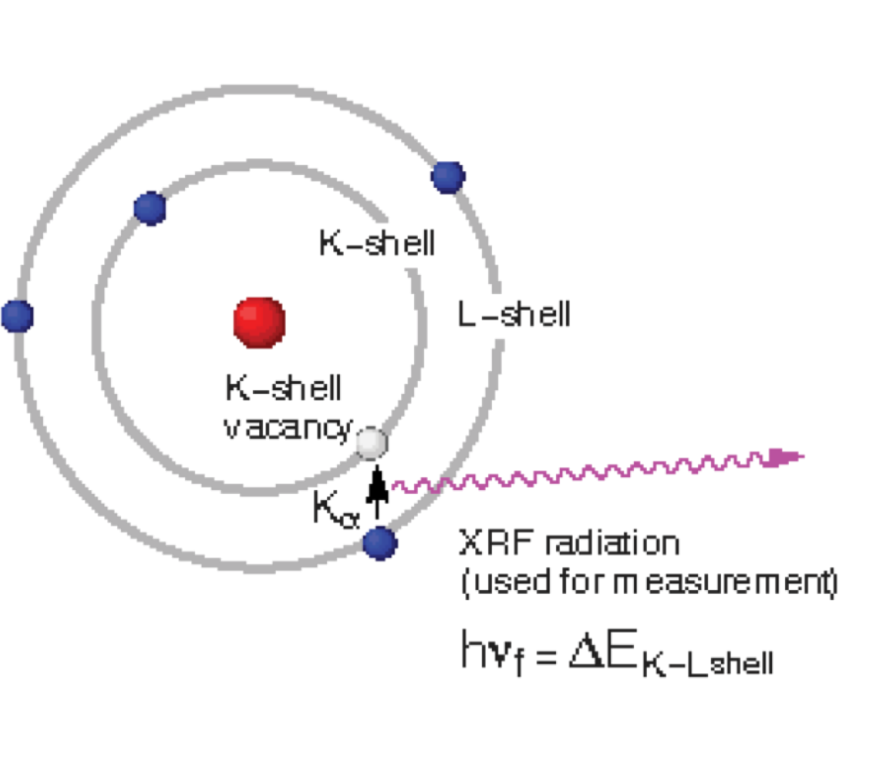
Atomic relaxation after P.E. effect
Basics
Energy Loss
e-/e+
Photons
Showers
Cherenkov
Summary
General trend of p.e. cross section is
σ_{p.e}. ~ Z⁵/E_{γ}^{-7/2}
i.e. dominates at low energies in heavy materials, like lead
Low energy cross sections complicated by electron shell structure
  Cross section jumps way up at each shell
Shell edges
After the electron is ejected, another atomic electron from a higher orbital (say L) can “drop down” into the hole (say K), resulting in either:
  a new emitted X-ray photon with energy B_{K} – B_{L}
  or a second “kicked out” (Auger) electron when B_{K} – B_{L} > B_{L}

Slide 43





Compton Scattering
Basics
Energy Loss
e-/e+
Photons
Showers
Cherenkov
Summary
Photon scatters off a (quasi-)free electron
E_{γ} >> B_{i} i=K,L,M, etc
Angular distribution (Klein-Nishima)
  At low energy, angular distribution is symmetric
  At high energies, it peaks near 0⁰
The total cross section is:

Slide 44





Pair Production
Basics
Energy Loss
e-/e+
Photons
Showers
Cherenkov
Summary
For E_{γ} > 2m_{e} ~ 1.2 MeV, photon can convert into a e⁺/e⁻ pair in the field of a nucleus (or an electron)
  The nucleus supplies the other photon to conserve momentum
    Recoil energy of nucleus is very low <1 MeV
Dominates photon interactions at high energies
At low energies, cross section rises with E_{γ}
But above ~ 1GeV, it becomes ~constant due to a screening effect and only depends on the medium

Slide 45

Electromagnetic Showers
Basics
Energy Loss
e-/e+
Photons
Showers
Cherenkov
Summary
So we’ve seen that:
  electrons can interact to produce photons (bremsstrahulung), and
  photons can interact to produce electrons (pair production, Compton, etc)
these interactions happening in combination result in an electromagnetic shower
  Particularly important at high energies
  Rigorous calculation only by Monte Carlo simulation
Starting with a photon E₀, after a distance:
  X₀: create e⁺/e⁻ pair each with E₀/2
  2 X₀: Bremsstrahlung yields 4 particles (e⁺,e⁻, γ, γ)
  N X₀: after each step X₀ get twice as many particles, each with ½ the energy E(N)=E₀/2^{N}
  Shower development stops when E(N)=E_{crit}, or N_{max} = ln(E₀/E_{cr})/ln(2)

Slide 46

Hadronic Showers
Basics
Energy Loss
e-/e+
Photons
Showers
Cherenkov
Summary
Strong interactions between hadrons (pions, protons, neutrons) and nuclei in medium also can lead to showers.
  Strong interaction cross sections MUCH less than EM, but at high energies in dense media, it becomes important
Shower initiated by the secondary hadrons produced by the primary incident hadron
  Longitudinal development characterized by nuclear absorption length λ_{nucl}
    λ_{nucl} >> X₀ so detectors have to be much thicker than for EM showers
  Secondary hadrons have high transverse momentum, so shower width is wider
Fluctuations are large (due to lower interaction probability), so energy measurements
using hadronic showers are less precise than for electrons and γs

Slide 47
Shower Calorimeters at CMS and ATLAS (CERN)
Basics
Energy Loss
e-/e+
Photons
Showers
Cherenkov
Summary
1m
5m
Silicon
tracker
EM
calorimeter
hadronic
calorimeter

Slide 48




Cherenkov Radiation
Basics
Energy Loss
e-/e+
Photons
Showers
Cherenkov
Summary
Emitted when a charged particle passes through a dielectric (polarizable) medium with v_{particle} > c_{light}/n, where n=refractive index
  Particle polarizes the molecules in the medium
  Molecules de-exciting emit EM radiation isotropically in the rest frame
  Locus of each outgoing wavefront outruns the previous wavefront
    This results in a “shock front” at an angle θ_{ch} to the trajectory
Exact form of emission angle:
  At threshold θ_{ch} =0, which implies
  i.e. particles heavier than m_{th} will not emit light
  → particle discriminator

Slide 49

Differential Cherenkov detector
Basics
Energy Loss
e-/e+
Photons
Showers
Cherenkov
Summary
β_{min} determined by threshold 1/n
β_{max} determined by:
  Physical aperture
  Total internal reflection angle in light guide
e.g using diamond (n=2.42) as radiator, we have β_{min} =0.413 and β_{min} ~ 0.454
Δβ/β ~ 0.10 resolution
Best differential counters can achieve
Δβ/β ~ 10⁻⁷ resolution for particle discrimination

Slide 50

RICH imaging Cherenkov detector
Basics
Energy Loss
e-/e+
Photons
Showers
Cherenkov
Summary
Ring Imaging Cherenkov uses position sensitive light detectors to image the Cherenkov light cone patterns
  use to determine type of particle, its speed, and its direction
  e.g. basis of the huge underground neutrino detectors at Kamiokande, Japan

Slide 51
Still Awake?
Basics
Energy Loss
e-/e+
Photons
Showers
Cherenkov
Summary

Slide 52
Summary
Basics
Energy Loss
e-/e+
Photons
Showers
Cherenkov
Summary
Reviewed the fundamental electromagnetic interactions at the basis of all particle detectors
  Ionization by charged particles (heavy, and electrons)
  Radiation by accelerating charged particles
The physical dependencies of these interactions are essential for detector design and performance
The “art” and “engineering” comes in the clever use of these mechanisms and in their optimization to achieve a specific goal.
i.e. it is worth your while to internalize these principles and mechanisms as you pursue experimental subatomic physics

Slide 53




Thank you for your attention
Merci
www.triumf.ca
Follow us @TRIUMFLab

