Slide 1
HAICU
TRIUMF Infrastructure status and schedule
Nicolas Massacret
February 09th , 2026

Slide 2
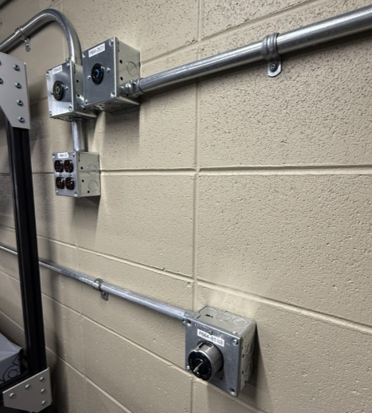
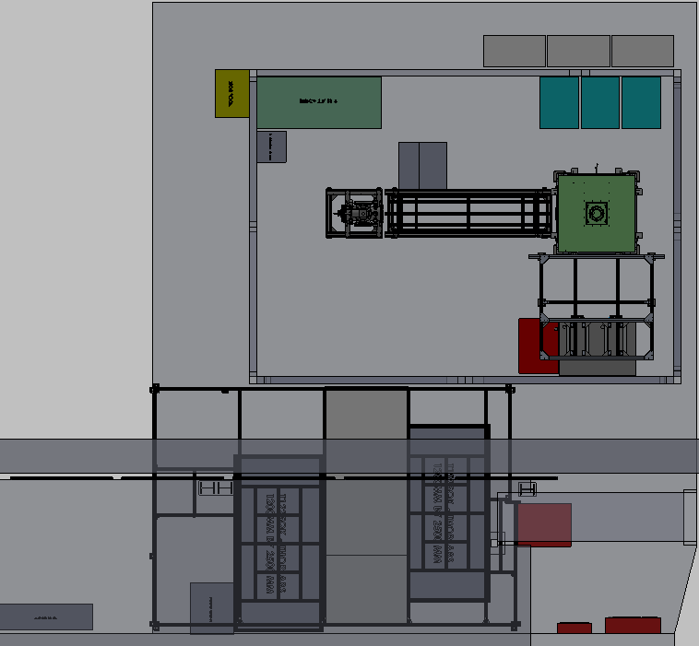
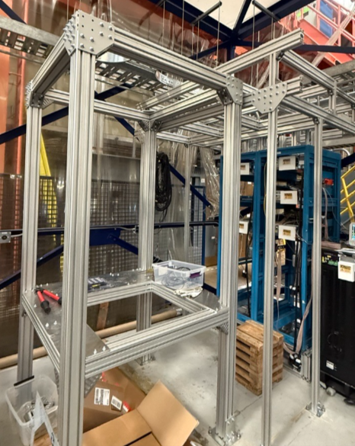
TRIUMF Infrastructure
Electrical upgrade:
- Engineering drawings (2025)
- Installation (2025)
- NB: Electrical services to stamp
the drawings (in progress)
Electrical upgrade
Traps Support structure:
- Design (2024)
- Engineering approval
and construction (2025)
Support structure
Traps Electrical services:
- Procurement (2025)
- Installation starting this month (not started)
HAICU Experimental area: Top View

Slide 3
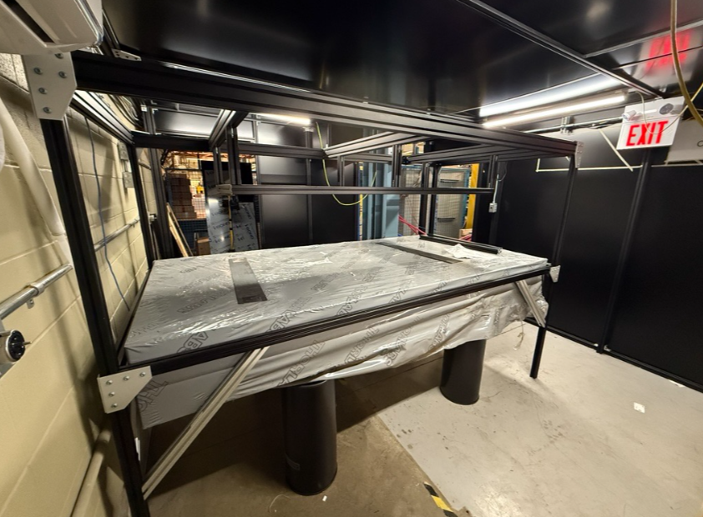
TRIUMF Infrastructure
Traps Water cooling:
- Water manifold starting this month (not started)
- No schedule for 10-15 l/s water supply (will start run with 5 l/s)
Laser hut:
- Optical table installation (2024)
- Optical tables shelves (2025)
- Air conditioner system (2025)
- Room structure (In progress)
- Interlock system (Not started)
HAICU Experimental area: Top View
Laser hut: inside

Slide 4
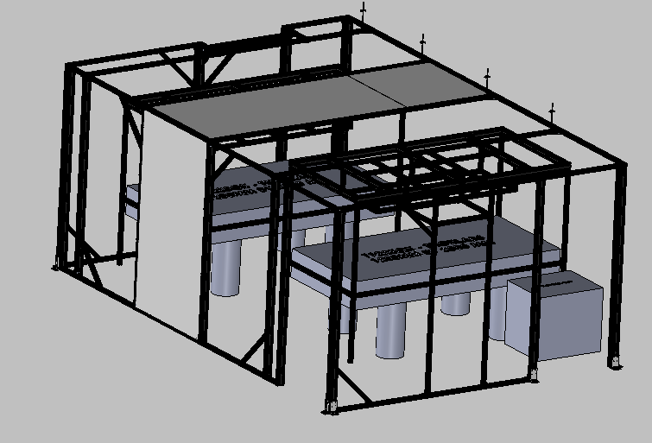
LASER Room
Laser room update:
2025:
- Room features triggered need of engineering review for seismic compliance (November)
- Refine requirements (no need of UBC permit) find contractor, and sign contract (December)
2026:
- Final drawings expected to be done in February.
- Modification of the room and review: end of March/early April (affected by parts procurement)
Laser hut

Slide 5
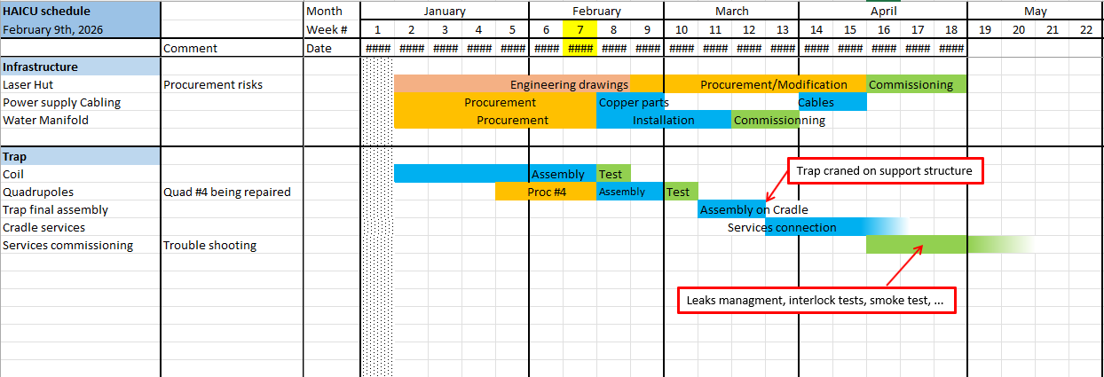
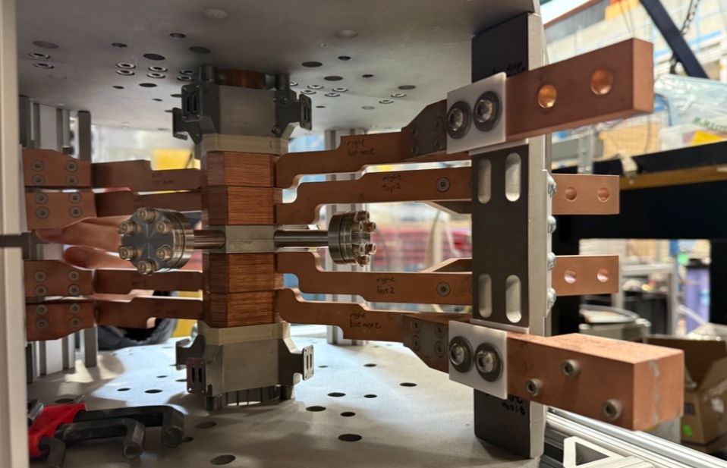
Schedule
Magnetic trap: Assembly in progress

Slide 6




www.triumf.ca
Follow us @TRIUMFLab

