Slide 1

Source & Decelerator re-commissioning at TRIUMF
HAICU General Meeting at UBC
9 February 2026
Andrea
haicu.triumf.ca

Slide 2
Commissioning DAQ – A proposal
Option 1
Option 2
Option 3
Use UBC system as is
Initially minimal development
Harder integration later on
Use UBC system for monitoring (oscilloscope)
Use TRIUMF sequencer
See Lars’s slides
On the optimal path for integration with TRIUMF systems
Use TRIUMF CS and DAQ
Diagram in next slide
It can be also be implemented in small increments

Slide 3
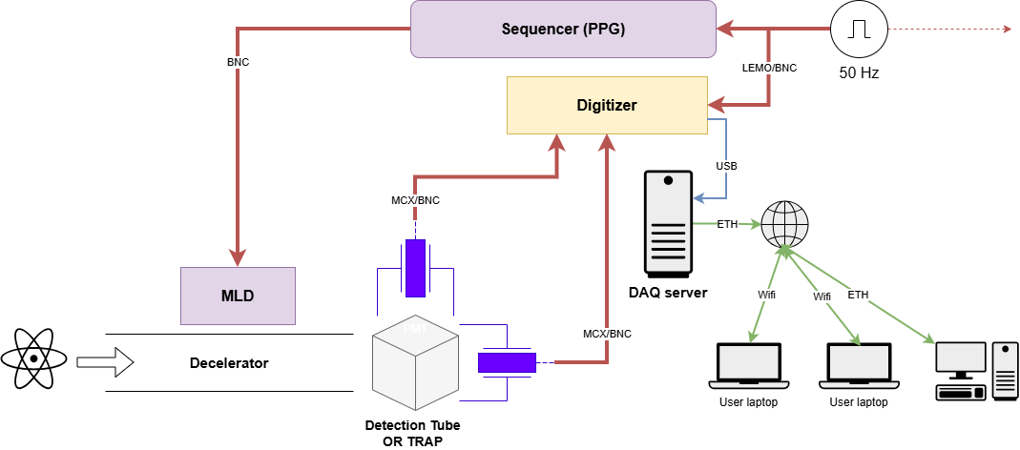
Detectors are either 2 PMTs, or 1 PMT and SiPM/MCP

Slide 4
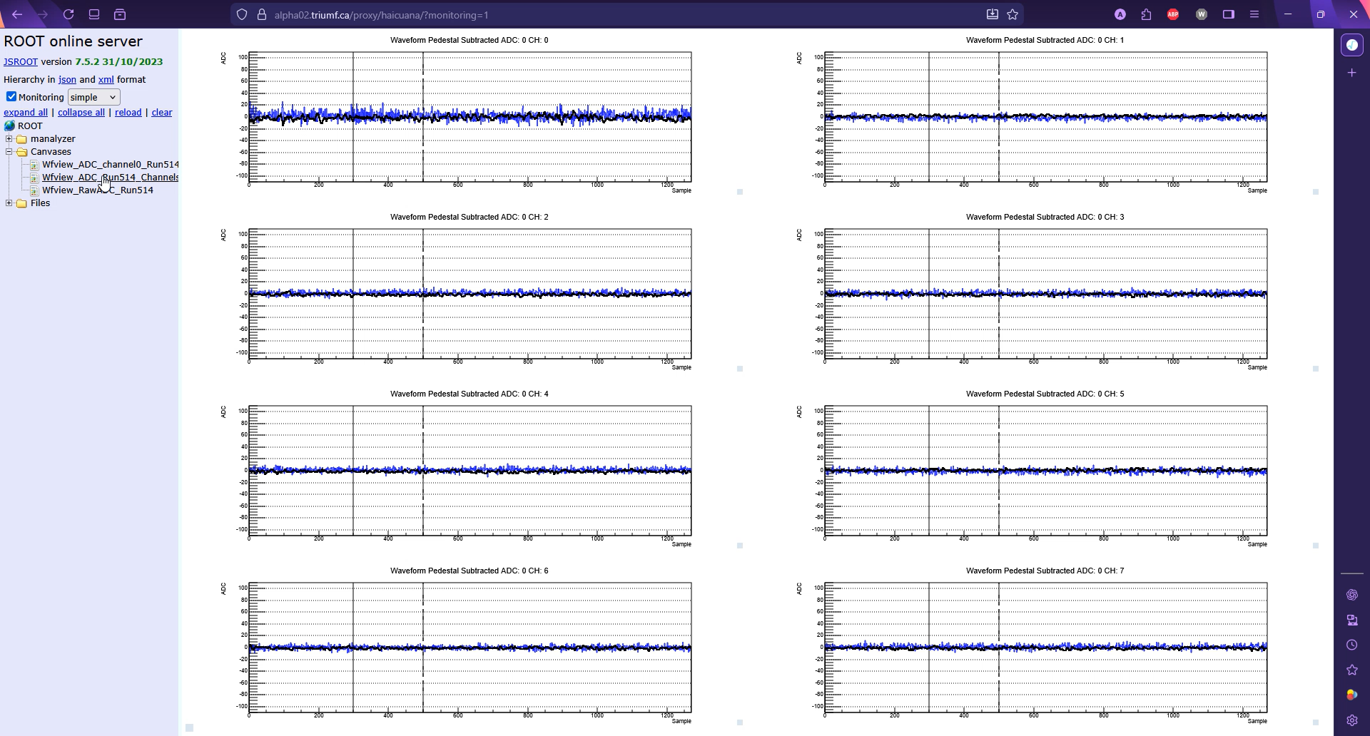
Live data at 50Hz, 2.54us per channel, ~1MB/s

Slide 5
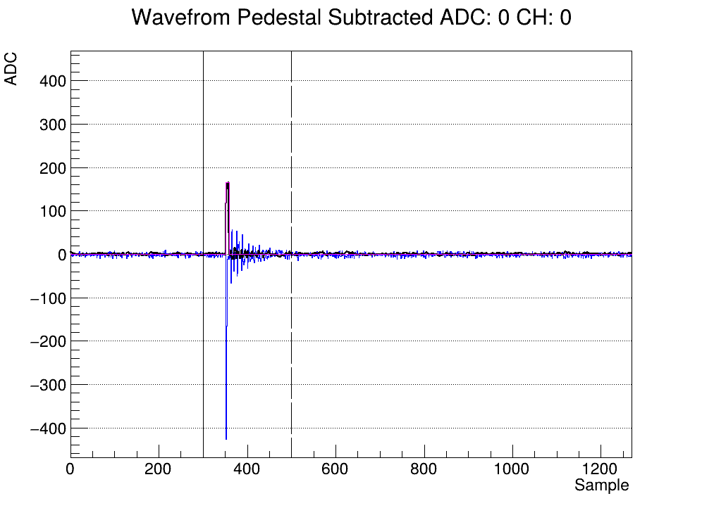
Advantages of custom DAQ
Live analysis
Pulse finding
Application specific histograms (e.g., charge distribution)
+ve ions on MCP
Baseline subtracted waveform
Filtered (moving average) waveform (no noise)
Pulse

Slide 6
Digitizer CAEN DT5730S
8 channels
500x10⁶ samples/s
14 bit @ 2V_{pp} →122 uV resolution
250 MHz Bandwidth

Slide 7




Thank you Merci
www.triumf.ca
Follow us @TRIUMFLab

