Slide 1
HAICU Laser paths & Monitors
Nicolas Massacret
Andrea Capra
February 09th , 2026

Slide 2
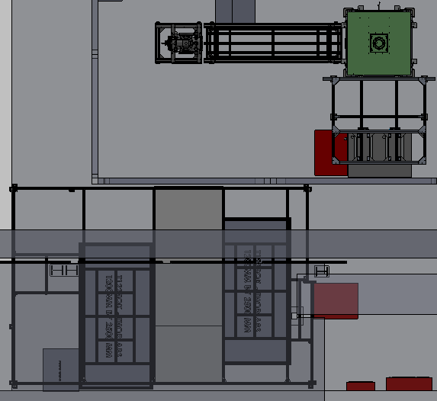
Laser path and generation
365 nm
(Class 4)
SiPM
Proposal
THG cell
121 nm
PMT
Ar-Kr gas system
Entrance
121nm switchable path (source/trap)
Is UBC in charge of laser path and monitors here ?
Ar-Kr gas
Enclosed Beam Path
Seed Laser
(730nm Class 3b)
Amplifier cavity
365 nm
(Class 4)
YAG Pump Laser (532nm Class 4)
HAICU Experimental area: Top View

Slide 3
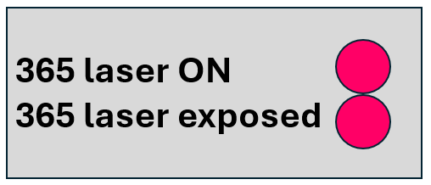
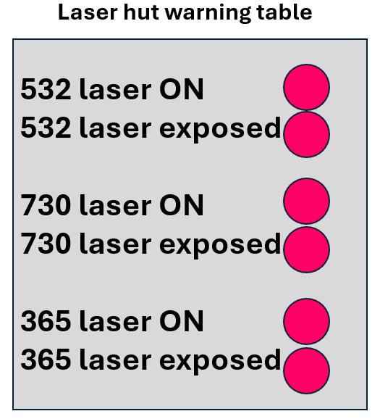
Interlock and Safety
Emergency stop
Source: Reza
Safe area protected by interlocked curtain
Laser traveling within enclosures
Opening enclosure trigger warning table
HAICU Experimental area: Top View

Slide 4
Interlock & Commissioning
Interlock development steps:
Interlock definition (Nicolas, Giulia, Colin?)
General review (all team)
Review from TRIUMF expert (Jens Lassen)
Procurement/Installation of Laser Hut Safety system (Nicolas) and decelerator safety system (Giulia ,Colin)
Commissioning & development unknown:
Laser 50Hz development -> Who, where, when, how long?
Commissioning of laser at TRIUMF-> Who, how long?

Slide 5




www.triumf.ca
Follow us @TRIUMFLab

