Slide 1
Sequencer for
HAICU
Lars Martin
9 Feb 2026

Slide 2
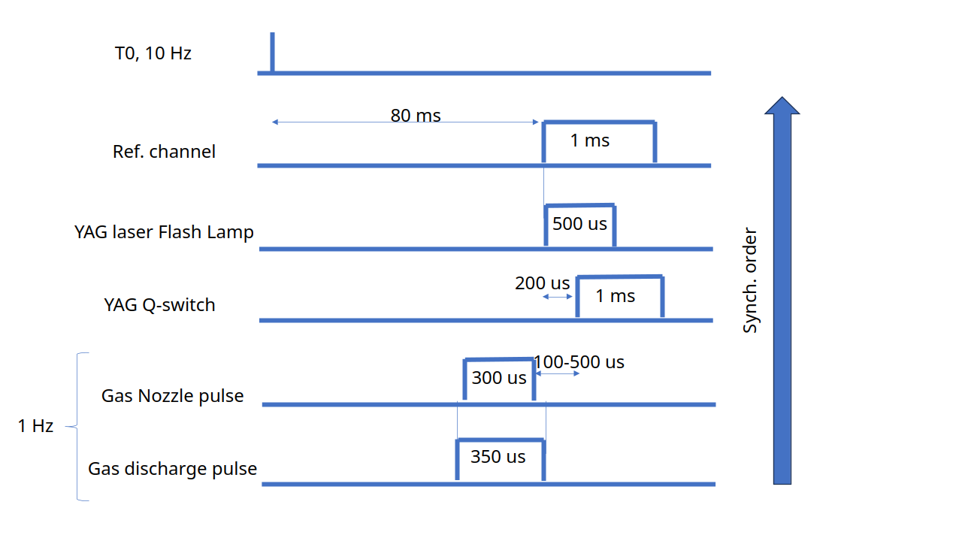
Requirements
Source sequence
Other sequence signals
MLD 1-4 (separate?)
EM bender
"slow" trap magnets (quad, top gate, booster)
Bottom gate
DAQ trigger(s?)

Slide 3
Requirements
Synchronize to laser trigger pulse (10Hz-50Hz)
Produce sequence of pulses over hundreds of ms or more
~10 channels
Accuracy/synchronization of order microseconds
Gate inputs to prevent triggering partial system

Slide 4
PPG capabilities
FPGA based Programmable Pulse Generator
100MHz clock, i.e. 10ns resolution
Up to 32 independent outputs
Up to 16 gate inputs and 16 veto inputs
External trigger input
Inputs and outputs can be freely mapped to ribbon connectors on back panel or coax connectors on front panel
Coax in-/outputs can be switched between 3.3V and 5V
Design modified from https://daq00.triumf.ca/DaqWiki/index.php/VME-PPG32

Slide 5
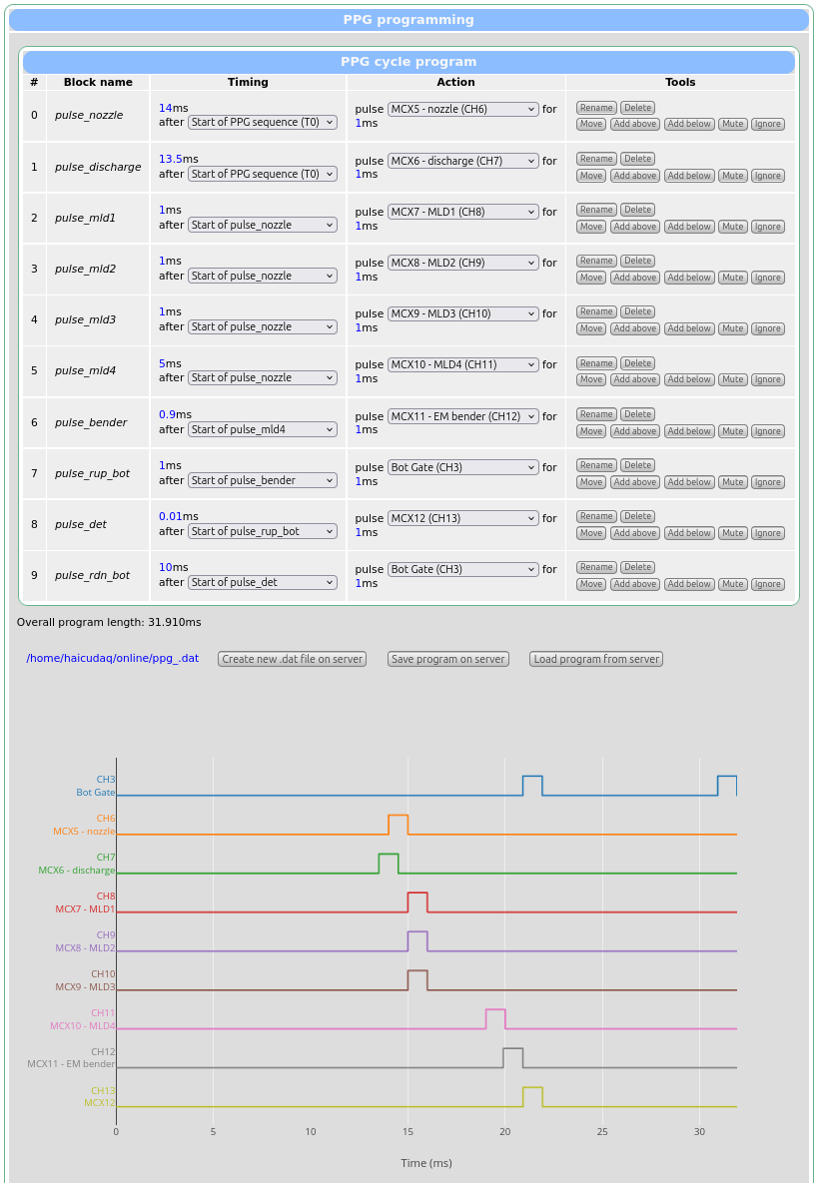
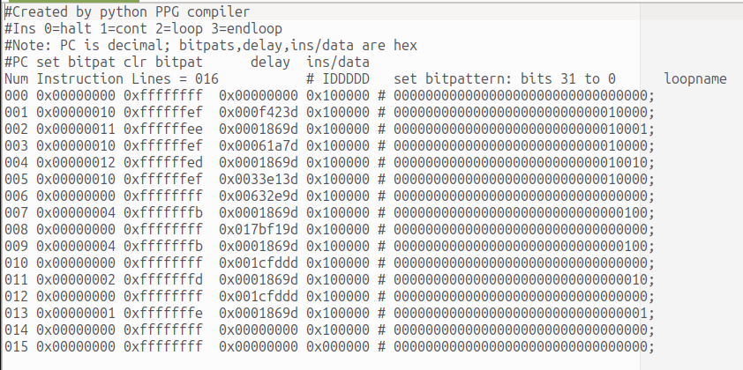
User interface
Sequences saved and loaded as hard-to read text file
But convenient compiler with web-interface exists

Slide 6
Demonstration
https://haicudaq01.triumf.ca/?cmd=custom&page=PPG

Slide 7
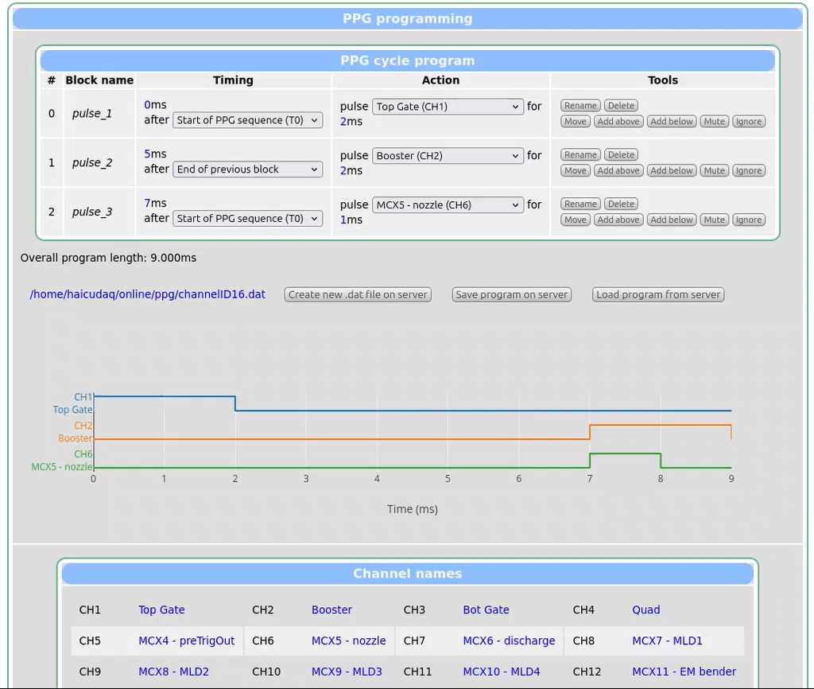

Slide 8
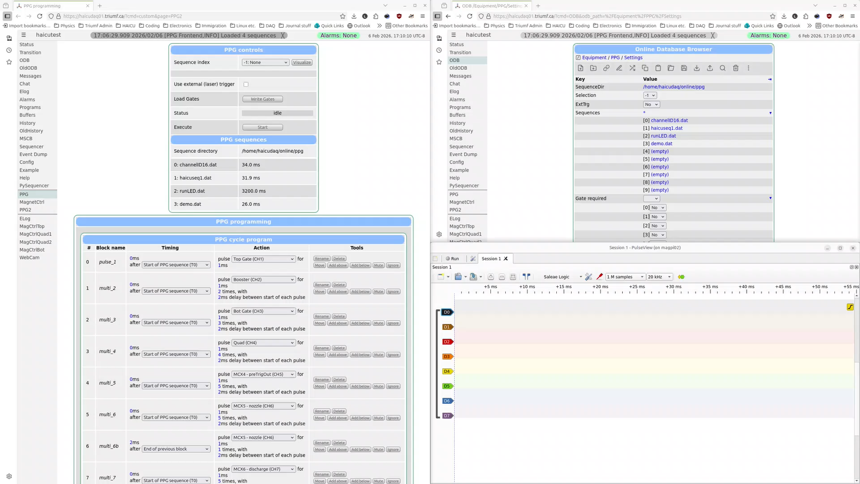

Slide 9
Future/Feedback
Questions?
Additional requirements?
Problems or concerns?

