Slide 1

HAICU in-person meeting
Feb 9, 2026, at UBC

Slide 2
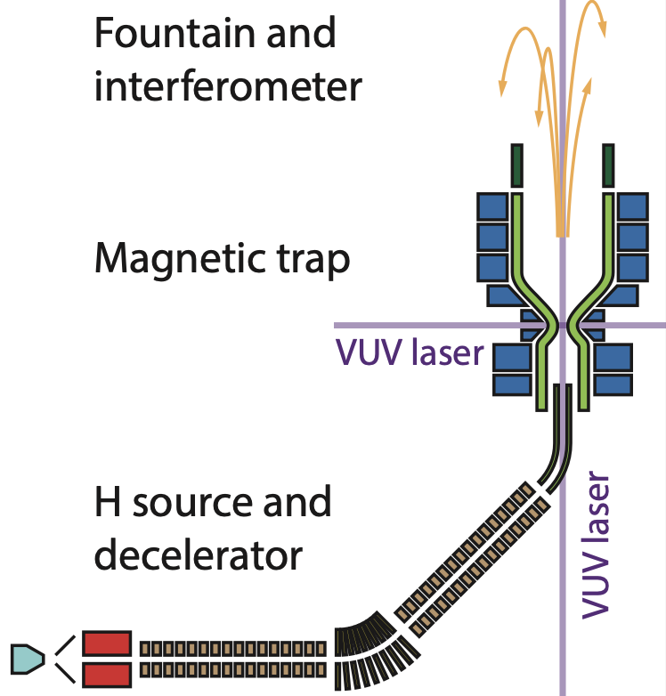
Long-term & short-term objectives
Long-term objective: Develop (anti)hydrogen fountain & interferometer!
Towards ultra-precise measurements of matter-antimatter symmetries
Many intermediate “world firsts” milestones
3D laser cooling, Raman transitions, coherent quantum control (e.g. STIRAP), fountain launch etc
Immediate short-term milestone: trapping of H
It will be first time H be trapped in a trap which is (i) stable (i.e. without holes), (ii) with dry loading (i.e. without superfluid He walls), (iii) with quadrupolar radial field, and (iv) with radial optical access.
All 4 conditions are necessary for 3D laser cooling and efficient fountain production.
Figure: Chukman

Slide 3
External factors
Funding related timelines
CFI IF 2027: UBC deadline May 2026; CFI deadline Jan 2027?
NSERC Subatomic Project: Sep 2026
Canadian Subatomic Physics Long Range Planning – on-going
MEXT grant: June 2026
We want to achieve our first H trapping as soon as possible!

Slide 4
Objectives & Agenda
It’s good to meet in-person! We have only 2.5 hours
Focus on: Status & Plans for UBC systems and Interface Issues
Defer TRIUMF specific issues to a separate meeting
Agenda: https://indico.triumf.ca/event/920/
Introduction & objectives: Makoto [10 min]
UBC systems status, plans & milestones: 14:10 – 15:20
Laser status & plan: Taka [20 min]
H source status & plan: Taka/Colin [20 min]
Decel. commissioning status & plan (incl. benders): Giulia/Colin [30 min]
Coffee [10 min]: 15:20 – 15:30
Interface issues: 15:30 – 16:20
TRIUMF infrastructure & high-level schedule: Nicolas [15 min]
Safety & Gate reviews related to UBC systems : Nicolas, Andrea [5 min]
Laser paths & Monitors (PMT): Nicolas/Andrea [10 min]
Sequencer: Lars [10 min]
Any other interface issues [10 min]
HAICU upgrade wish list discussion [10 min]: 16:20 – 16:30

Slide 5
Next in-person meeting
At TRIUMF in two months? Week April 1 or April 8?

