Slide 1
Particle Physics Faculty Meeting
Agenda
  News/Update/Discussion
  Committee updates

Slide 2
TRIUMF is located on the traditional, ancestral, and unceded territory of thexʷməθkʷəy̓əm (Musqueam) people, who for millennia have passed on their culture, history, and traditions from one generation to the next on this site.
TRIUMF’s home has always been a seat of learning.

Slide 3
Values Moment
Excellence & Integrity
We have a passion for excellence in all that we do.
We are decisive, bold, courageous, and compassionate.
We take responsibility for our actions, our commitments, and our contributions to the larger community.
Safety & Accountability
We respect the health and safety of our employees, our visitors, and our neighbours.
We build quality into our processes and seek continual improvement in all of our systems.
We embrace transparency and authenticity, and hold ourselves and each other accountable.
Equity & Inclusion
We empower our people and foster an inclusive work environment, enriching our science and our community.
We value teamwork and open communication to ensure that everyone belongs and all voices are heard.
We respect each other, take care of each other, and support the success of all.

Slide 4
Safety Moment
Assessment of positions in Particle Physics to determine if they will be under Systematic Approach to Training (SAT)
  Assessment based on SAT scoring method (see word file SAT Validation Method)
  Decided that all Particle Physics Scientist as “SAT recommended” (score medium)
  This will require a training plan etc, more to come
Day of Mourning on Tuesday, April 29, from 10:00 to 15:00
All staff and users are expected to join and you must have a reason not to come and the reason has to be approved by LT. The day will include
  Group talks and facilitated discussions
  A series of safety focused activities
  An all-hands meeting, including a Moment of Silence
  A Hazard Hunt, followed by a lucky draw for participants
All safety notes: https://documents.triumf.ca/docushare/dsweb/View/Collection-21974
Other safety concerns/reports?

Slide 5
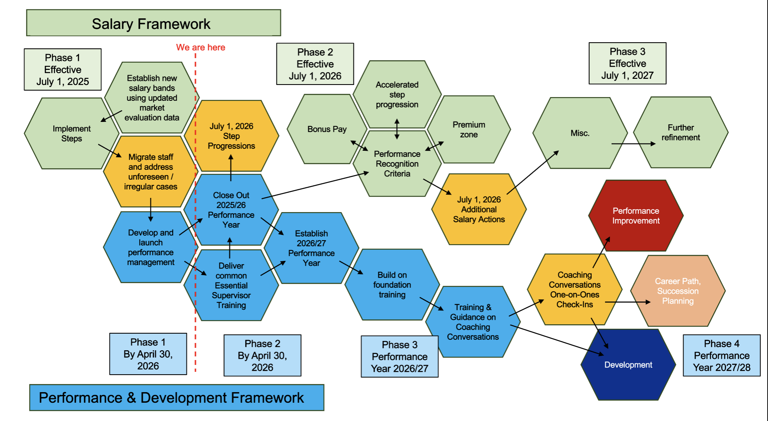
New Performance Framework
Revised Due Date for Performance Review Completion: April 30th
Revised Due Date for Performance Planning: May 15th

Slide 6
ACOT
ACOT will be taking place during the week of May 11, with the poster session tentatively scheduled for Tuesday, May 12 around lunchtime
The session is expected to run approximately 60–90 minutes (TBD), and the committee is particularly interested in showcasing the work of our co-op students, graduate students, and postdoctoral fellows
As in previous years, we aim to highlight a broad range of projects, with a preference this year for the green projects and LS26-related work where possible
At this stage, we are seeking nominations for poster presenters. Following past practice, we are aiming for a total of 20 presenters, with an approximate distribution of 5 from AD, 4 from LSD, and 11 from PSD (with some flexibility)
Diverse and representative group of presenters, considering factors such as gender, domestic and international representation, background, experience level, and a broad cross-section of research areas
A poster template will be provided once presenters are confirmed, and lunch will be served during the session
Ritu suggested at minimum 3+ from PP: ATLAS ITK, UCN, DarkLight, +?

Slide 7
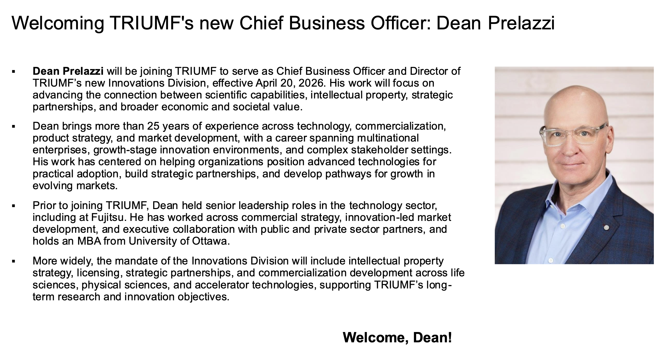
New Innovations Division

Slide 8
Various
Sabbatical visitors need to be declared to Ritu on Jan 15th and June 15th
New procedure for Temporary Alternate Work Request
  Needs unforeseen or extenuating circumstances the required providing accommodation to support the staff member
NSERC results, and CFI internal review outcome
Lauren's away April 21st to July 20th. Remote work between May 4th-June 26th
Colloquium speaker Ann Wang (SLAC), speaking on recent results from LZ
Interested in soccer? join the TRIUMF tournament? Let Chloe know (we need ~10)
  Chloe booked April 21st, 28th each from 4-5pm for practice

Slide 9
Next Meeting
  Regular May 21st
  Likely need one before May 11th (ACOT week)

Slide 10
AOB

Slide 11
Committee Updates
  IPP Council / CINP / CAP
  Science Council
  Space
  Seminar/Colloquia
  SciTech seminars / Quantum Forum / Dark Matter Forum
  Mixer
  Science Week
  TUEC
  Safety
  Summer schools

