Slide 1
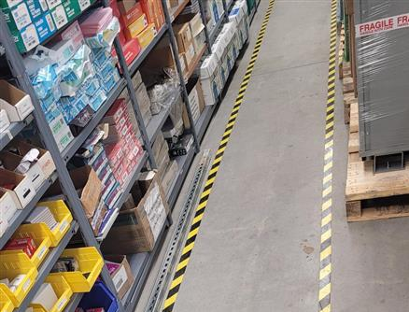
⚠️ Risks at the Stores
Equipment failures
Failure or malfunction of forklifts, pallet jacks, racking, or handling equipment can result in loss time.
Contamination risks
Improper storage, or damaged packaging may lead to contamination of products, or posing health risks and non‑compliance.
Injury risks
Associates may sustain cuts, strains, crush injuries, or serious harm due to manual handling of heavy goods and packaging.
Dangerous goods
Improper handling dangerous goods (e.g., radioactive, chemical, or hazardous materials) can result in serious safety incidents.
Slip hazards Wet floors due to liquid in aisles and work areas increase the likelihood of slips, trips, and falls among associates.
Door blockage
Obstructed emergency exits or access doors caused by stored materials, pallets, or equipment can delay evacuation.
Tiredness & fatigue Fatigue resulting from long shifts, repetitive tasks, or insufficient rest can reduce alertness and reaction time, increasing the likelihood of errors.
Fire hazards
Accumulation of combustible materials, improper storage of flammable goods, overloaded electrical equipment, can elevate the risk of fire.

Slide 2

⚠️ Risks in Finance
Ergonomic
Desk set up, screen / keyboard
Electrical
Power supplies, laptops, printers, chargers, cables
Visual fatigue
Extended screen time
Occupational stress
Intense workloads at key times (year end, audit deadlines, urgent requisitions)
Slip hazards Wet floors due to spillage
Door blockage
Obstructed emergency exits or access doors caused by stored materials, or equipment can delay evacuation.
Tiredness & fatigue Fatigue resulting from long shifts, repetitive tasks, or insufficient rest can reduce alertness and reaction time, increasing the likelihood of errors.
Fire hazards
Accumulation of combustible materials, improper storage of flammable goods, overloaded electrical equipment, can elevate the risk of fire.

