Slide 1

Canada's Particle Accelerator Centre
Psychological Health and Safety

Slide 2
What is Psychological Health and Safety
Psychological health and safety is a shared belief where members feel secure to express ideas, concerns or mistakes without fear of humiliation, retribution or marginalization. (Amy Edmonson)
This is a new concept and as important in managing physical health and safety.
2
Notes:
So now we are going to move onto a different type of health safety that you might be used to and this is called psychological health and safety.

Slide 3

Having a psychological safe workplace can enable the employees to:
Admit and discuss mistakes
Openly address problems and tough issues
Seek help and feedback
Trust that no one on the team is out to get them
Notes:
Psychological safety refers to an environment where individuals feel safe to take interpersonal risks, such as asking questions, admitting mistakes, offering feedback, or sharing new ideas, without fear of judgment, ridicule, or retribution (McKinsey),. It is not merely about protecting mental health but about creating a space where people can contribute fully and authentically (APA),. Harvard Business School professor Amy Edmondson coined the term in 1999, emphasizing its role in learning, innovation, and team performance
Having a psychological safe workplace can enable the employees to:
Admit and discuss mistakes
Openly address problems and tough issues
Seek help and feedback
Trust that no one on the team is out to get them

Slide 4
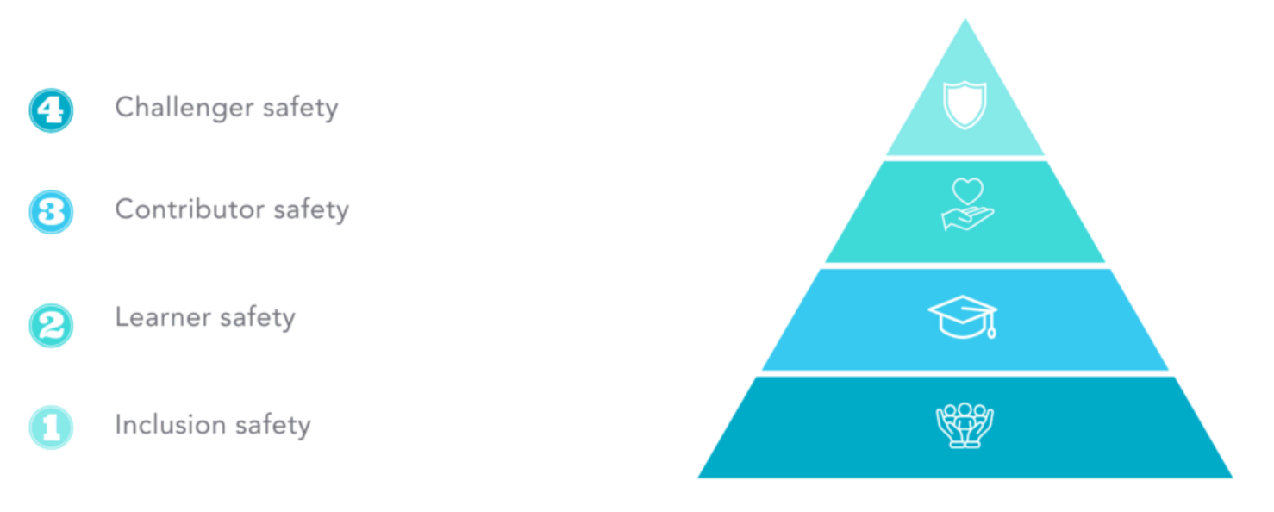
4 Stages of Psychological Safety
Notes:
1 inclusion safety – employees feel safe, valued, treated fairly and believe their experiences and thoughts matter
2 learner safety – employees feel safe to learn and grow. They ask questions and give and receive feedback
3 Contributor safety – employees feel safe contributing their ideas. They feel they can use talents and abilities to make a difference
4 Challenger Safety – employees feel safe to challenge the status quo, suggest changes and see positive change opportunities.

Slide 5
Psychological Safety and Accountability
ACCOUNTABILITY
 | Low | High
High | Comfort Zone Employees really enjoy working together but don't feel particularly challenged. Nor do they work very hard. | Learning Zone Here the focus is on collaboration and learning in service of high-performance outcomes.
Low | Apathy Zone Employees feel neither supported or challenged. They are unlikely to speak up, share ideas or take initiatives. | Anxiety Zone Such organizations are breeding grounds for anxiety. People fear to offer tentative ideas, try new things or ask colleagues for help even though great work requires all three.
PSYCHOLOGICAL SAFETY
Notes:
What does psychologically safe environment look like? Well it hinges on the balance between psychological safety and accountability. As this balance shifts, your team can experience different psychological zones: comfort, apathy, anxiety and learning.
‍Comfort zone: teams have high psychological safety and low accountability. It’s a relaxed place to be and people will likely feel safe, familiar, and at ease. But while stable, there’s no push for creativity and growth.
‍Apathy zone: Employees feel neither supported or challenged. They are unlikely to speak up, share ideas or take initiatives.
‍Anxiety zone: teams have low psychological safety and high accountability. A state of heightened stress, fear, or uncertainty, the anxiety zone signals that teams feel overwhelmed, unable to take risks, and are fearful of being judged or criticised.
‍Learning zone: teams have high psychological safety and high accountability. Or rather, there’s a balance between challenge and support. It’s the optimal environment for innovation and growth as teams feel empowered to take risks, embrace challenges, learn from failures, and continually improve.

Slide 6
Actionable Tips to Promote Psychological Health and Safety
Engage authentically
Encourage open communications
Practice empathy
Normalize mistakes
Creating a psychologically safe workplace takes time, effort and vulnerability.
It is a specific, targeted concept that is critical for innovation and success.
6
Notes:
Engage Authentically: Managers should interact with their teams in a genuine and considerate manner. Understanding team members' experiences is crucial for building trust and safety.
Encourage Open Communication: Create an environment where employees feel comfortable sharing their ideas and concerns. Regularly invite feedback and ensure that all voices are heard.
Practice Empathy: Leaders should lead with empathy rather than ego. This means being self-aware, providing respectful feedback, and supporting team members without resorting to manipulative behaviors.
Normalize Mistakes: Encourage a culture where mistakes are seen as learning opportunities rather than failures. This helps reduce the fear of repercussions and promotes a growth mindset.

