Slide 1

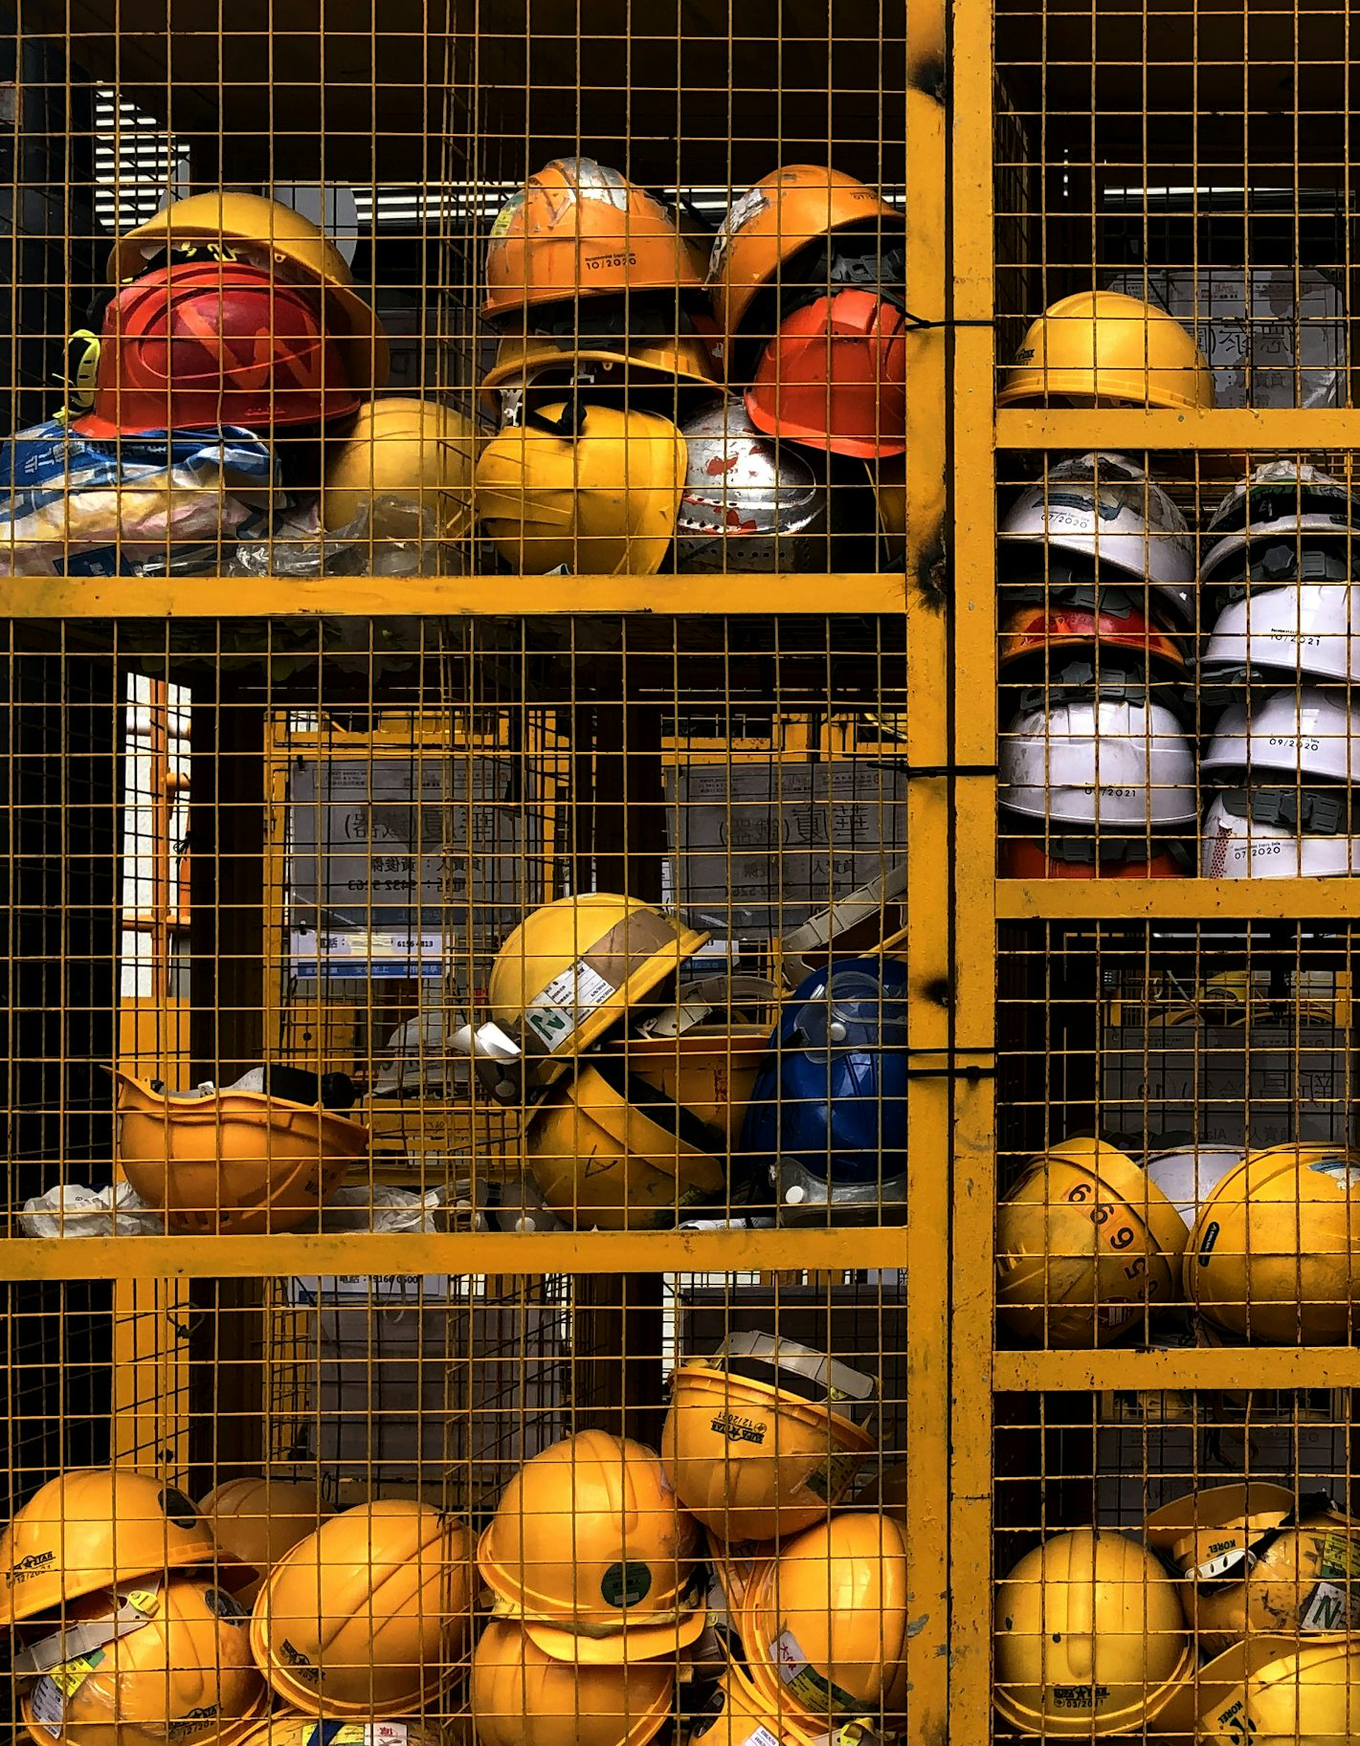
Canada's Particle Accelerator Centre
Safety within the Projects and Infrastructure Division

Slide 2
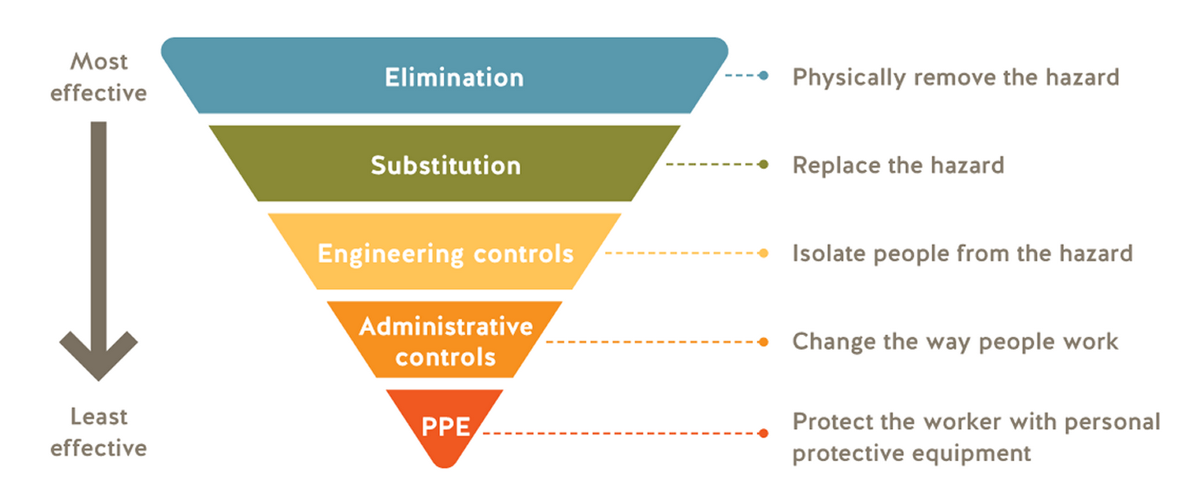
Hierarchy of Controls

Slide 3

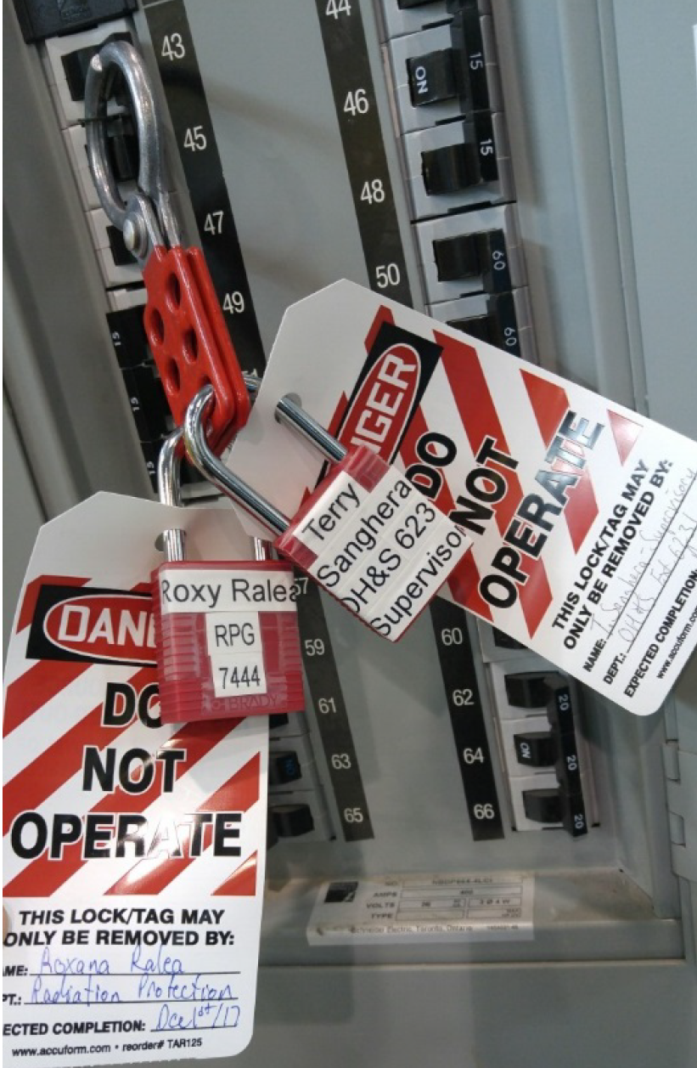
Hierarchy of Controls
Elimination or Substitution:
Elimination removes hazard entirely
Elimination is always the first choice
Replace materials or processes with less hazardous ones
Examples (Electrical Safety):
At TRIUMF: Achieving a verified de-energized state by LOTO and grounding before maintenance or troubleshooting
At TRIUMF: Use battery powered tools when possible
At Home: Unplugging appliances before repair and replacing old appliances with grounded or double-insulated models.

Slide 4
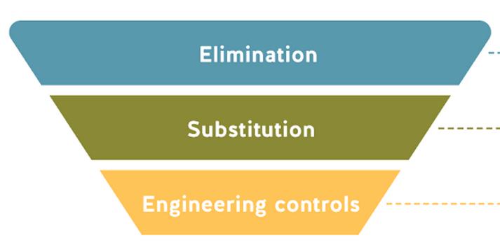
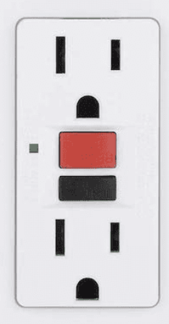
Hierarchy of Controls
Engineering controls:
Use equipment or other means to separate people from hazards using enclosures, barriers, and interlocked doors, etc
reliable, automatic protection that reduces risk continuously without relying on user actions
Examples (Electrical Safety):
At TRIUMF: GFCI receptacles, overload-protected power bars, HV grounding, certified equipment, properly rated test instruments and permanently installed protective devices
At TRIUMF: Disconnect switches, emergency stop buttons, covered terminals
At Home: Use GFCIs in wet locations in kitchens/bathrooms/outside, CSA certified appliances

Slide 5
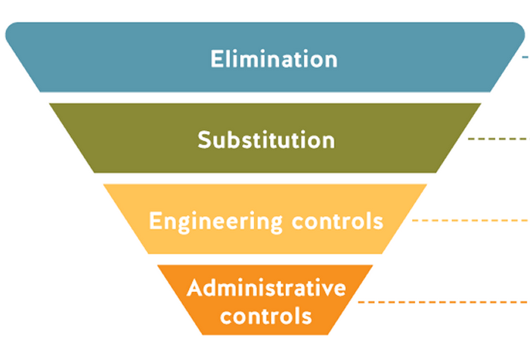
Hierarchy of Controls
Administrative controls:
Procedures, rules and practices that reduce risk by guiding how work is performed.
Relies on individuals to comply with procedures
Examples (Electrical Safety):
At TRIUMF: Training, pre-job briefings, HV signage, arc flash labels
At TRIUMF: Work Permits, LOTO Permits, Energized Electrical Work Permits, independent electrical equipment inspections,
At Home: don’t overload outlets, following manufacturer instructions, hire electricians to perform regulated work, stand to the side to reset breakers

Slide 6
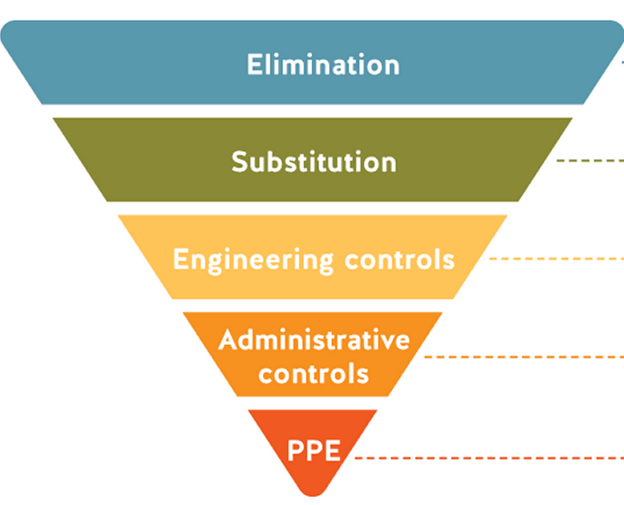
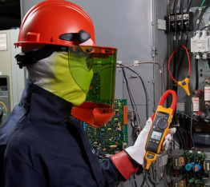
Hierarchy of Controls
PPE:
Last line of defense
provides direct protection to individuals but does not eliminate hazards
Must be properly selected, maintained, and combined with higher-level controls for effective protection
Examples (Electrical Safety):
At TRIUMF: Safety glasses, insulated tools and gloves
At TRIUMF: Arc flash blast gear, arc-rated clothing
At Home: Insulated tools and gloves, glasses, rubber soled shoes

Slide 7
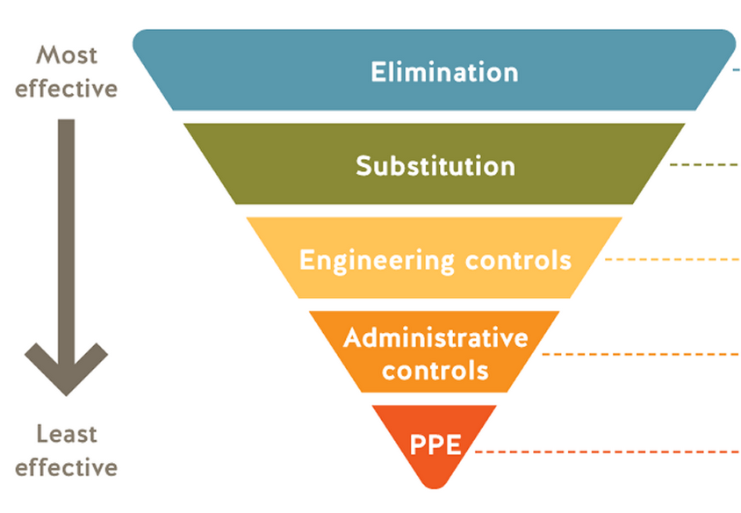
Hierarchy of Controls
Key takeaways:
Start by eliminating or substituting hazards before engineering controls, administrative rules, or PPE
If you are only relying on PPE ask what higher level control is missing
Apply safety controls daily at work and home to reduce electrical risks and protect everyone
Have a safety mindset: Pause and assess hazards before tasks to foster a proactive safety culture beyond simple compliance

