Slide 1
Accelerator Division Safety Aspect
TRIUMF All Hands Meeting
Day of Mourning
April 29, 2026
Oliver Kester

Slide 2
Work environment of a particle accelerator complex
TRIUMF operates a large particle accelerator complex featuring a diverse suite of accelerators and a broad range of particle species -- electrons, protons, heavy ions – supported by wide spectrum of technologies.
There are common hazards associated with these particle accelerators are
Ionizing radiation
Electromagnetic: Electrical power systems, HV, magnetic fields
Mechanical: Pressurized systems, support and lifting structures, vacuum systems
Cryogenics: Oxygen deficiency, frost burn
Hazard identification and mitigation steps are important and are embedded into TRIUMF's processes
Workplace Hazards -- A Closer Look….

Slide 3
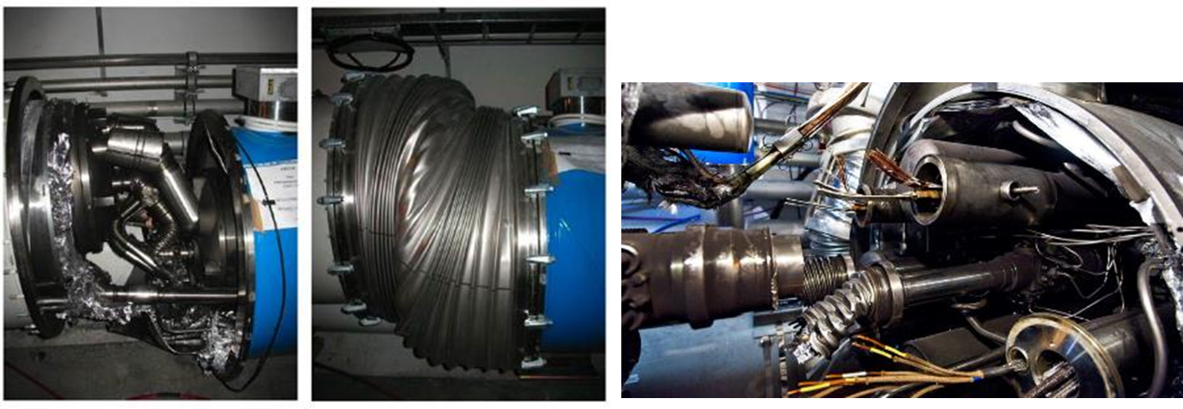
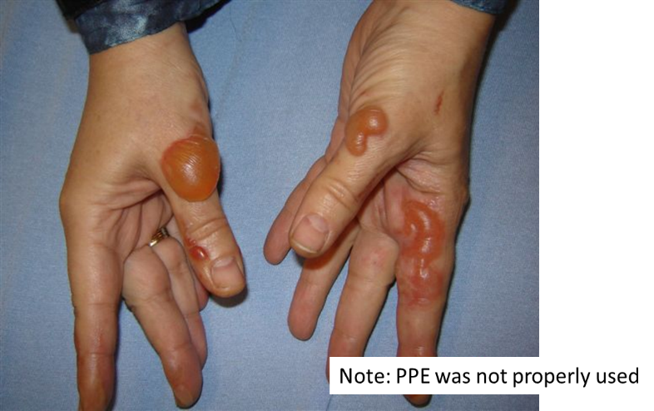
Cryogenic Hazards [Thanks to Alexey – Koveshnikov]
Why should be concerned with cryogenic hazards at TRIUMF?
The famous incident at CERN in 2008 where a faulty electrical connection between two superconducting magnets at the LHC caused a rapid quench (loss of superconductivity).
Liquid helium to cool the magnets vaporized almost instantly, expanding to 700 times its liquid volume.
The pressure wave displaced magnets weighing several tons, tore open the vacuum pipe, and caused roughly $40 million in damage. The LHC was shut down for over a year for repairs.
Cryogenics hazards can lead to severe injuries or in case of oxygen deficiency to death
Everybody working at TRIUMF has to be aware of Cryogenic Hazards and everybody who is dealing with handling of Cryogens or working in the vicinity of Cryoplants has to be trained in Cryogenic Safety!
https://www.youtube.com/watch?v=0h0MMrPNM60

Slide 4
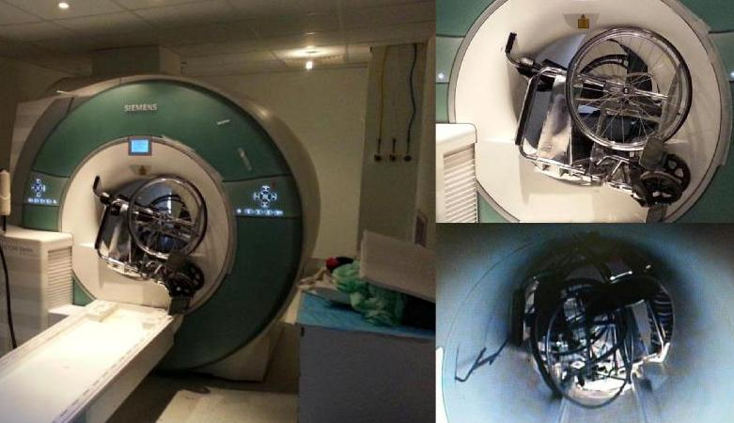
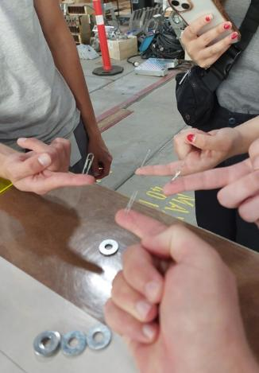
Magnetic Field Hazards [Thanks to Marco Marchetto]
National Institute of Standard and Technology - NIST S 7101.53: “The primary safety concern with exposure to static and time-varying magnetic is the attraction of magnetic objects in or on the body in an external magnetic gradient that could lead to a “missile effect” or striking hazard, injuring body tissue.” Before working on or in proximity of a magnet, always make sure the magnet is turned off and the relative power supply is locked!
At CERN ISOLDE we captured the heaviest particle ever in the so-called REX-TRAP and wrote an abstract: “The capture of 5.5 kg of Drillium in a large Penning trap”!
Static magnetic field above 5G can be harmful to people who have a pacemaker. At TRIUMF we exceed this value of 5 Gauss on the cyclotron vault roof.

Slide 5
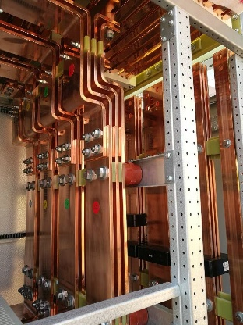
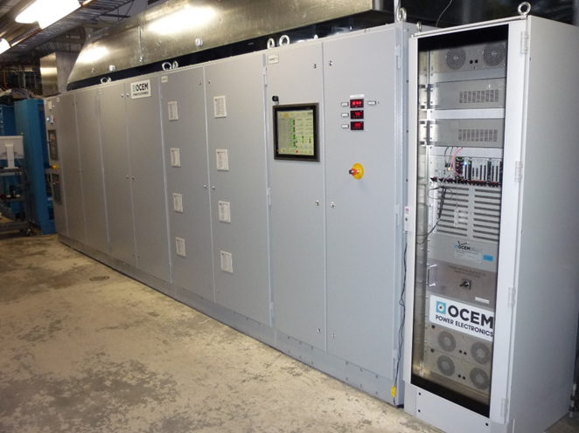
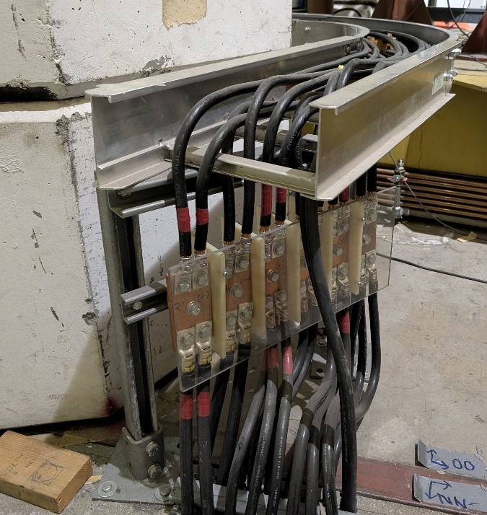
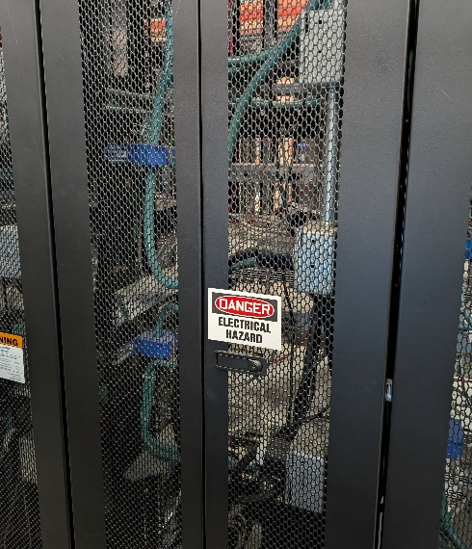
High Current Hazards [Thanks to Arthur Leung]
TRIUMF accelerator complex requires some high-power systems like the 520 MeV Cyclotron Main Magnet Power Supply. It provides 18,000 Amperes to the coils of the cyclotron magnet.
Busbars guide the current to the magnet and together with the power supplies they are sources for hazards:
Electrical shock
Burns due to the high current heating metal objects → melted tools (dropped tools on active high current bus bars)
Fire
The main sources for these hazards are
(Skin) Contact with exposed power supply, magnet, or DC cables
Contact with conductive surfaces touching exposed connections
Improper or loose electrical connections
For mitigation you need interlocked enclosures, barriers around terminals, Lockout/Tagout (LOTO) and Power converter cabinets only accessed by or with approval from Power Converter experts !

Slide 6
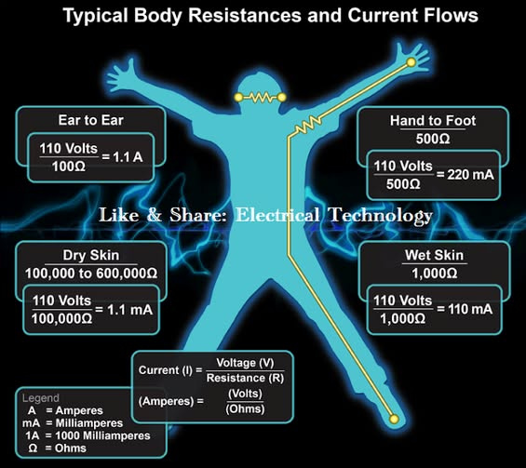
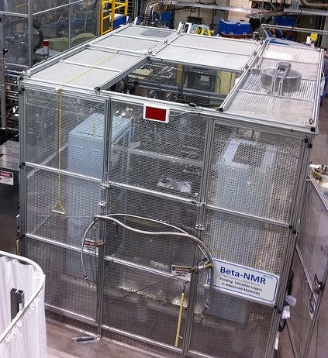
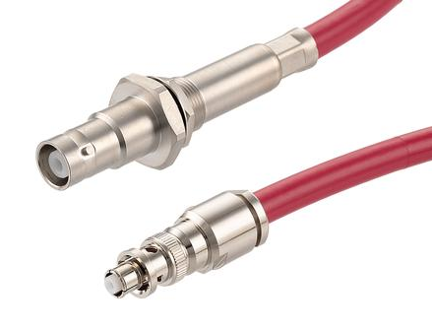
Electrical hazards: High Voltage [Thanks to Tomislav Hruskovec]
High Voltage is common for any particle accelerator and several hazards are associated with it at TRIUMF:
Physical contact with a HV exposed surface or wire, exposure to high electric DC fields
Discharge through the body due to proximity to a HV surface
X-rays, from systems where HV is applied inside a vacuum
HV cables can store significant energy, which can be released accidently
To protect workers against these hazards TRIUMF uses enclosed power supplies and high voltage platform where the enclosure (a Faraday cage) is grounded.
The conductors carrying the HV to a load are shielded, with the shield grounded.
High voltage SHV connector

Slide 7
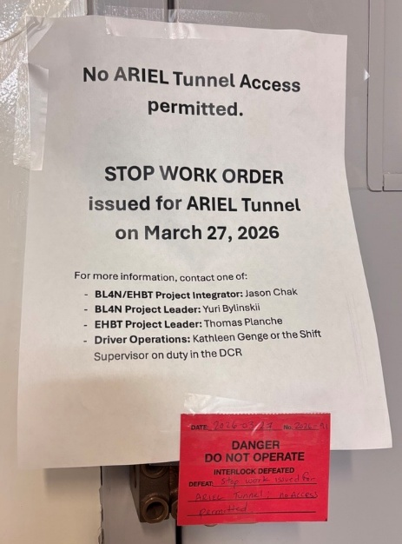
ARIEL Team Reminder - Stop Work Authority [Thanks to Cherishma Sadasivuni]
Everyone at TRIUMF has the right and responsibility to pause or temporarily suspend work if an unsafe or unacceptable condition is identified. This applies your own work and that of others.
See TSN 1.10 for more information.
Recent success story: In response to concerns about conditions in the ARIEL Tunnel, an employee exercised their Stop Work Authority (SWA), pausing work in the tunnel until concerns were addressed.
Be cognizant of the work conditions for yourself and others. Take time to assess the situation and suggest improvements.

Slide 8
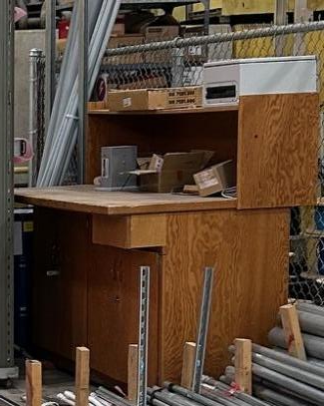
Housekeeping aspects
In addition to an increase in productivity, improved housekeeping practices can enhance health and safety in the workplace (fewer slips, trips, and falls; reduction in combustible loading; etc).
Good housekeeping practices are contagious. When people see their peers taking pride in their space, it sets a new 'normal' which is hard to ignore.
In the ACC division we encourage and celebrate good housekeeping practices.
We advertise to integrate housekeeping into your work routines. It should be part of the workday, not in addition to it.
Divisional funds are made available for housekeeping initiatives, especially those that involve the replacement of wooden cabinets and workbenches.

Slide 9
Thanks to the Divisional Safety Officer,
Jonathan Aoki
for preparing and running the divisional safety talk meeting and material for this overview!

Slide 10




Thank you Merci
www.triumf.ca
Follow us @TRIUMFLab

