Slide 1
Day of Mourning
Life Sciences Division Hazards
April 29, 2026

Slide 2
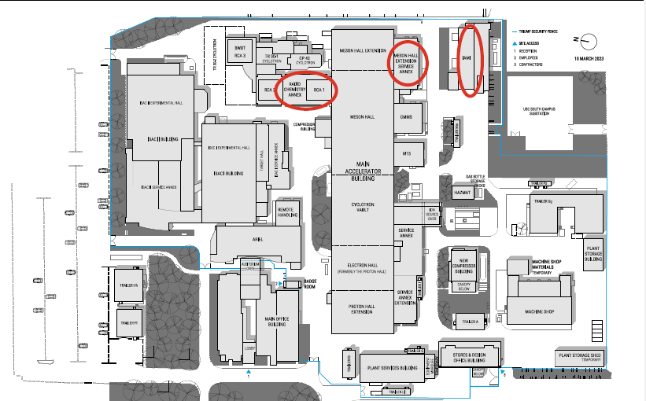
Life Sciences Division Facilities

Slide 3
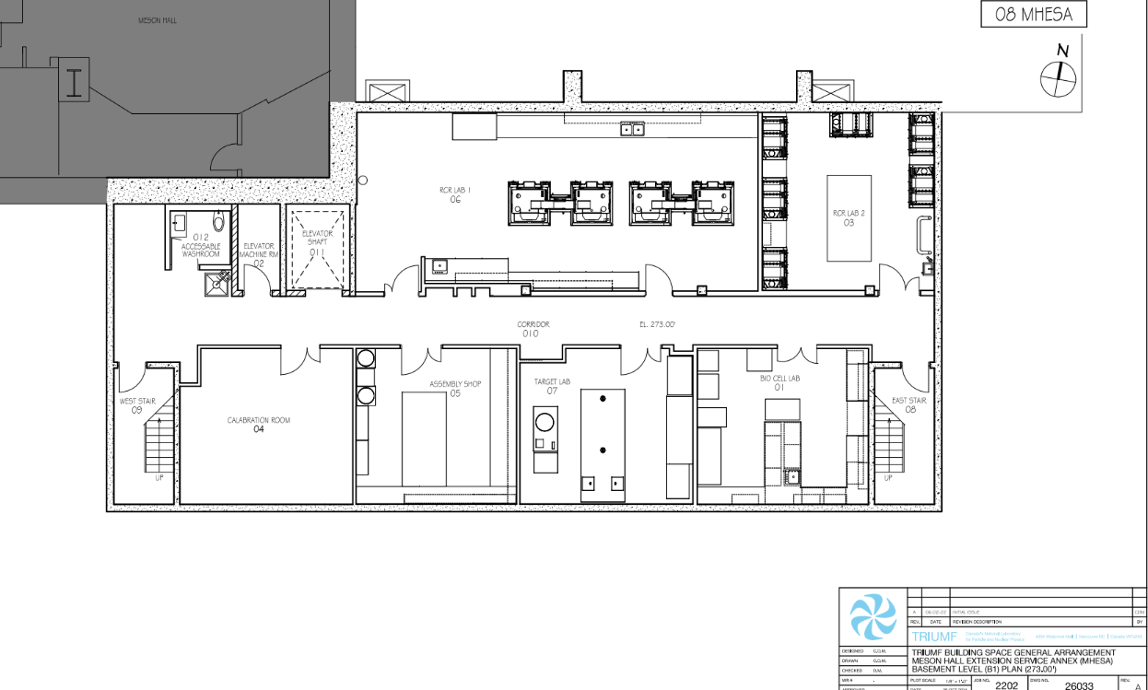
Life Sciences Labs MHESA Basement

Slide 4




Thank you
Merci
www.triumf.ca
Follow us @TRIUMFLab

