Slide 1
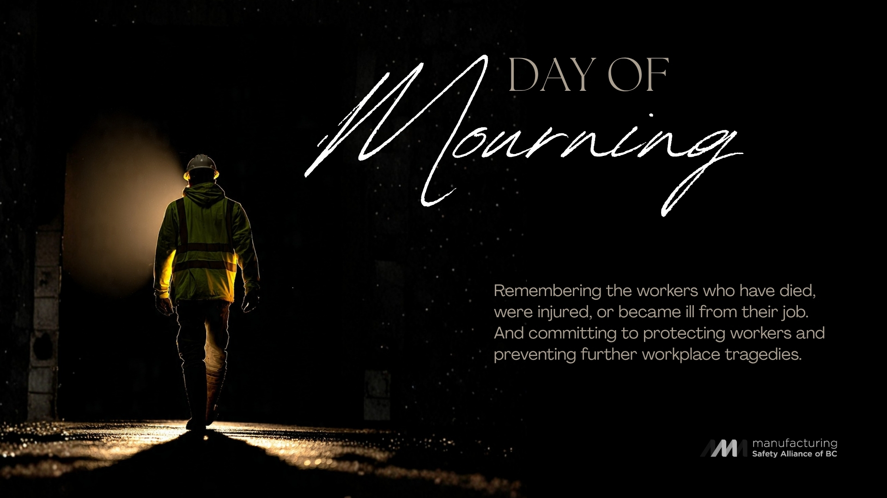
Notes:
Next week, on April 28, we mark the Day of Mourning: a somber reminder of all those we’ve lost to work-related injury and illness. A thousand every year in Canada—some right here in the beautiful Okanagan. But today is about prevention. Taking proactive steps—together—to prevent another injury or death on our watch.

Slide 2
DAY OF Mourning
April 28
The Canadian Labour Congress first recognized the Day of Mourning in 1984.
Canada was the first nation to recognize the Day of Mourning, with the proclamation of the National Day of Mourning on April 28, 1991.
This day of recognition is now observed throughout the world.

Slide 3
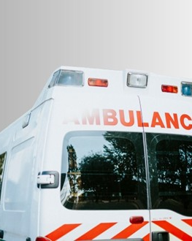
This year we remember the 138 BC workers who lost their lives to occupational injury or disease in 2025

Slide 4

Safety is everyone's responsibility

Slide 5
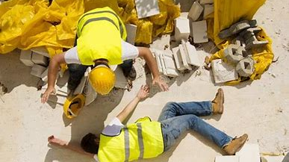
Too many reminders of when it goes wrong

Slide 6
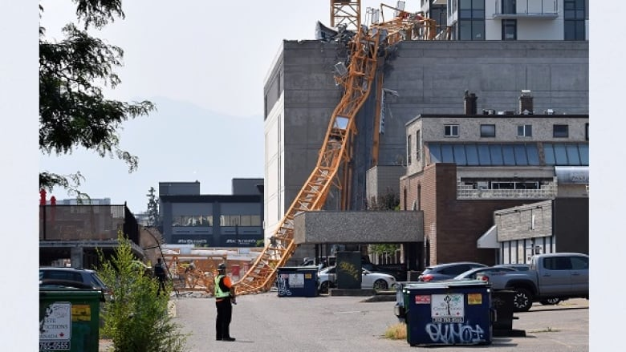
Crane collapse – Kelowna 5 lives lost when a crane collapsed at worksite in Kelowna – July 2021

Slide 7
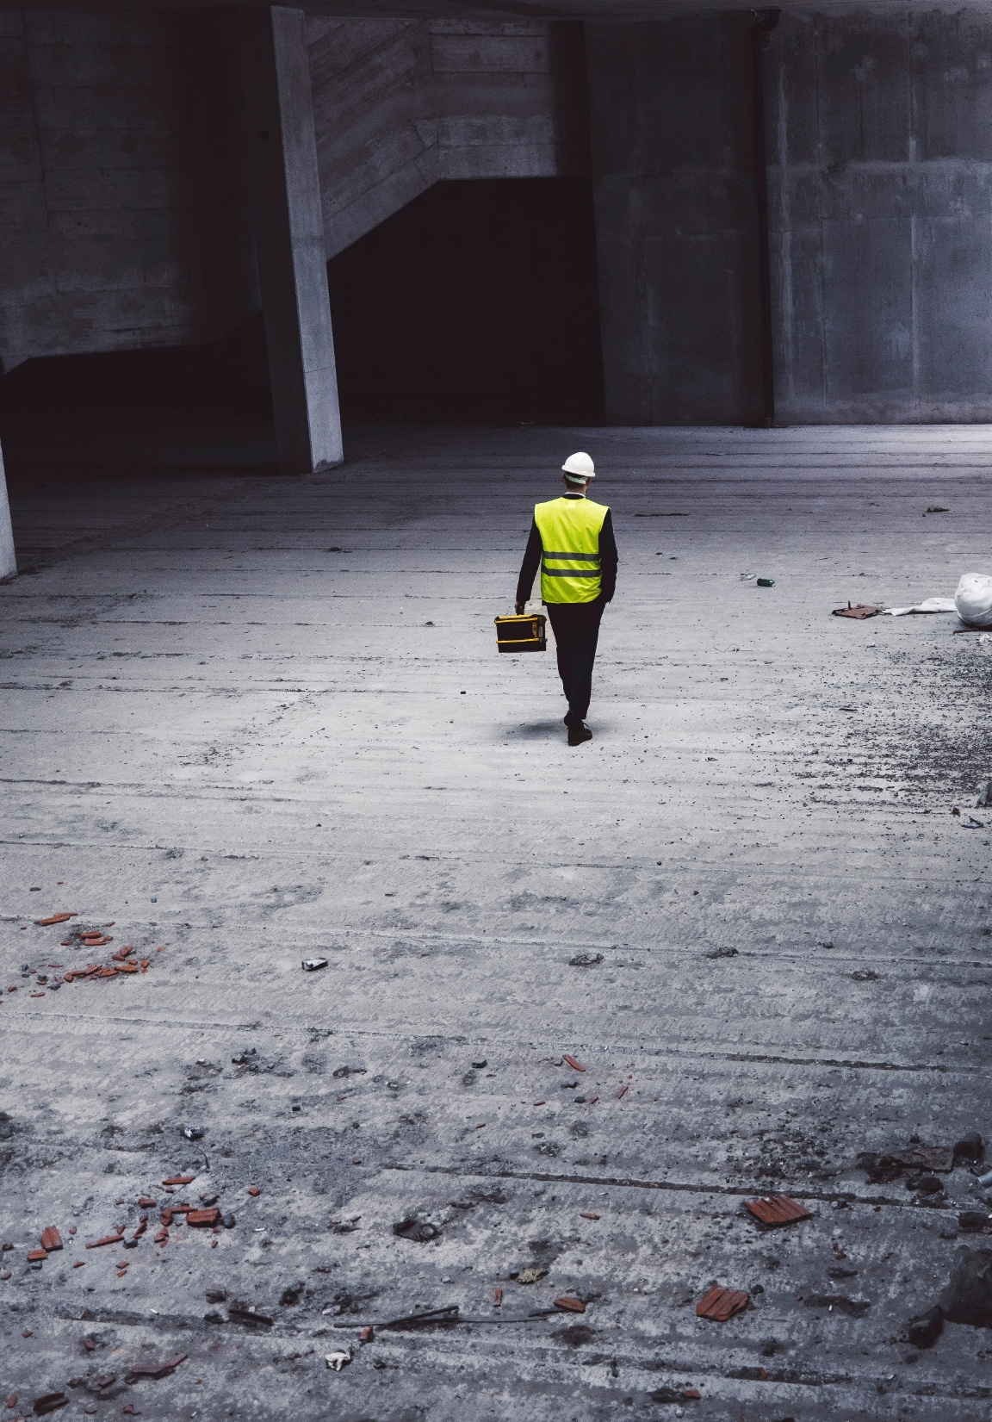
More than a statistic… every number has a name, a family, a community.
Of 138 work-related deaths in 2025:
2 were young workers,
44 died from traumatic injury
79 from occupational disease, and
36 the result of asbestos exposure

Slide 8
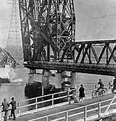
Ironworkers Memorial Second Narrows Crossing.
Construction on the bridge in B.C. started in 1957. In June 1958, part of the bridge collapsed, leading 79 workers to fall 30 meters into the water below. 18 workers were killed (either instantly or later succumbing to their injuries), and one diver searching for the bodies drowned.
A report found that the collapse was a result of poor engineering.

Slide 9
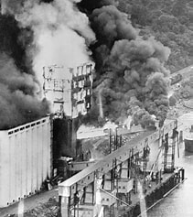
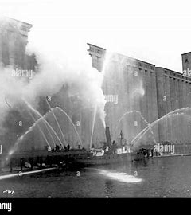
North Vancouver Grain elevator explosion
5 Men died and 17 men were severely burned with some sustaining burns to over 80% of there bodies.

Slide 10
Today we renew our commitment…
To identifying the hazards around us
To honouring those who have lost their lives by safeguarding our own
To speaking up when someone is at risk
Notes:
WSBC Compliance
Confined Space, First Aid, Fall Protection. Ergonomics, Emergency Response

Slide 11
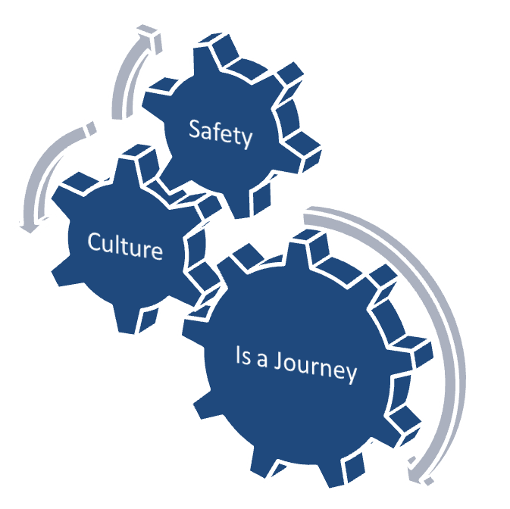
Building a Safety Culture is a journey
Its about creating a vision that is endorsed and held at the most senior level of a company or organization
Changing attitudes, behaviors and setting expectations and commitments at all levels in the company
Its about empowerment and accountability. Making a commitment at all levels of the company, promoting and reinforcing safety as a core value

