Slide 1
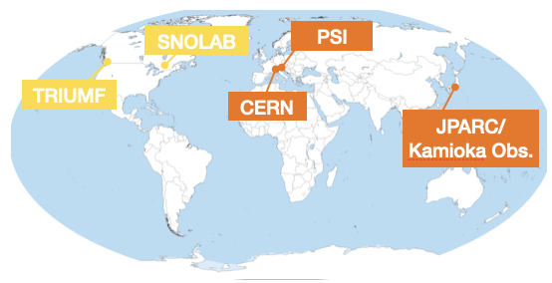
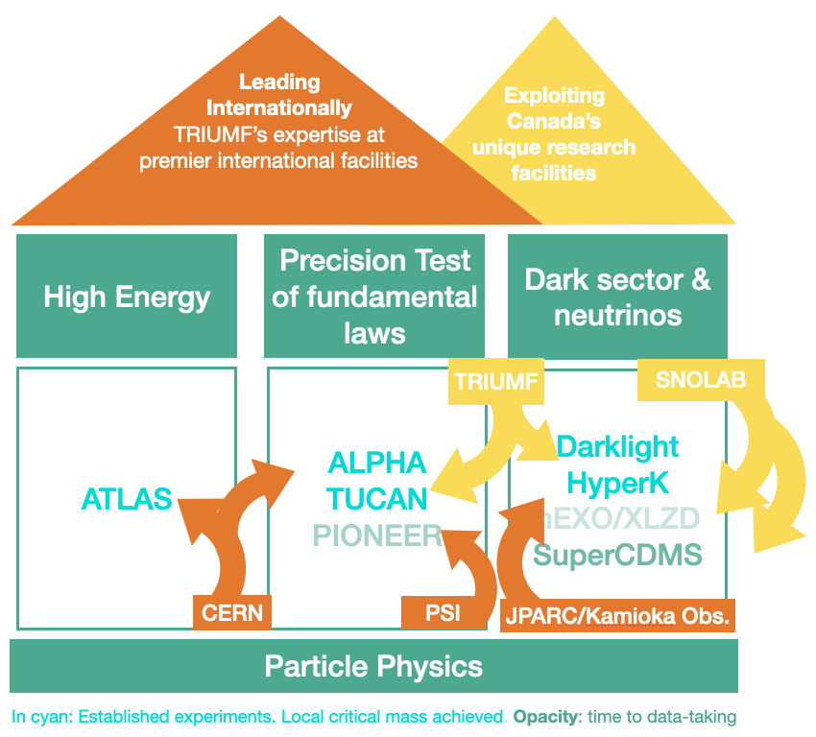
Particle Physics

Slide 2



















TRIUMF Particle Physics Collaborators across Canada
SNOLAB
TRIUMF

Slide 3
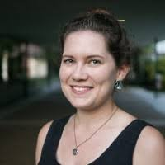
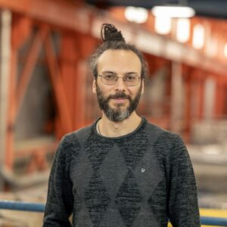
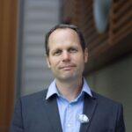

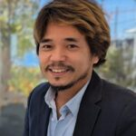
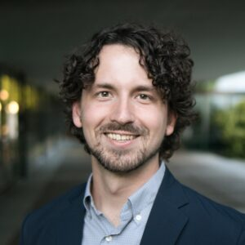
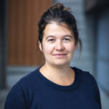

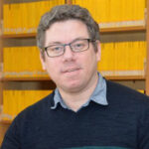
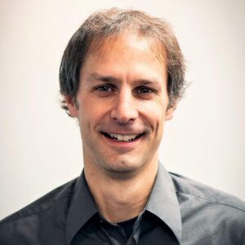
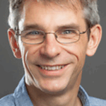
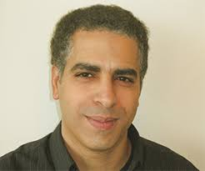

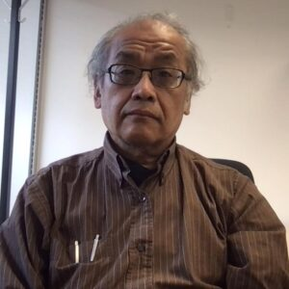
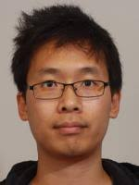
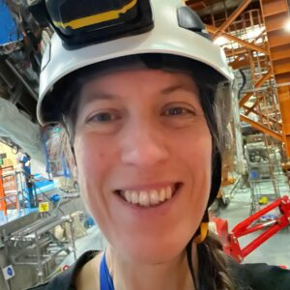
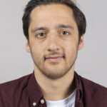
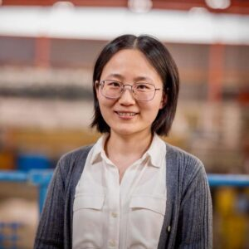
Particle Physics
BAEs
High Energy
Precision Test of fundamental laws
Dark sector & neutrinos
BAEs
BAEs
ATLAS
ALPHA TUCAN PIONEER
Darklight HyperK
nEXO/XLZD SuperCDMS
Kate Pachal
SciTech
Andrea Capra
P&S
Oliver Stelzer
Nigel Hessey
SciTech
Makoto Fujiwara
Thomas Lindner
Max Swiatlowski
P&S
Chloe Malbrunot
Mark Hartz
P&S
Reda Tafirout
SciComp
Ruediger Picker
Wolfgang Rau
Luise Poley
Joint
Akira Konaka
Joint
Chukman So
Dean Karlen (UVic)
Doug Gingrich (UofA)
Pierre Savard (UofT)
Bernd Stelzer (SFU)
Affiliates
Affiliates
Doug Bryman (UBC)
Andrei Khramov (BCIT)
Taka Momose (UBC)
Willem van Oers (UofM)
Rob Thomson (Calgary)
Sampa Badhra (York)
Mike Hasinoff (UBC)
Scott Oser (UBC)
Patrick de Perio (IPMU/Tokyo)
Barry Pointon (BCIT)
Affiliates
Noah Yazdandoost
Isabel Trigger
Matthias Danninger (SFU)
Rob McPherson (UVic)
Xiaoyue Li

Slide 4
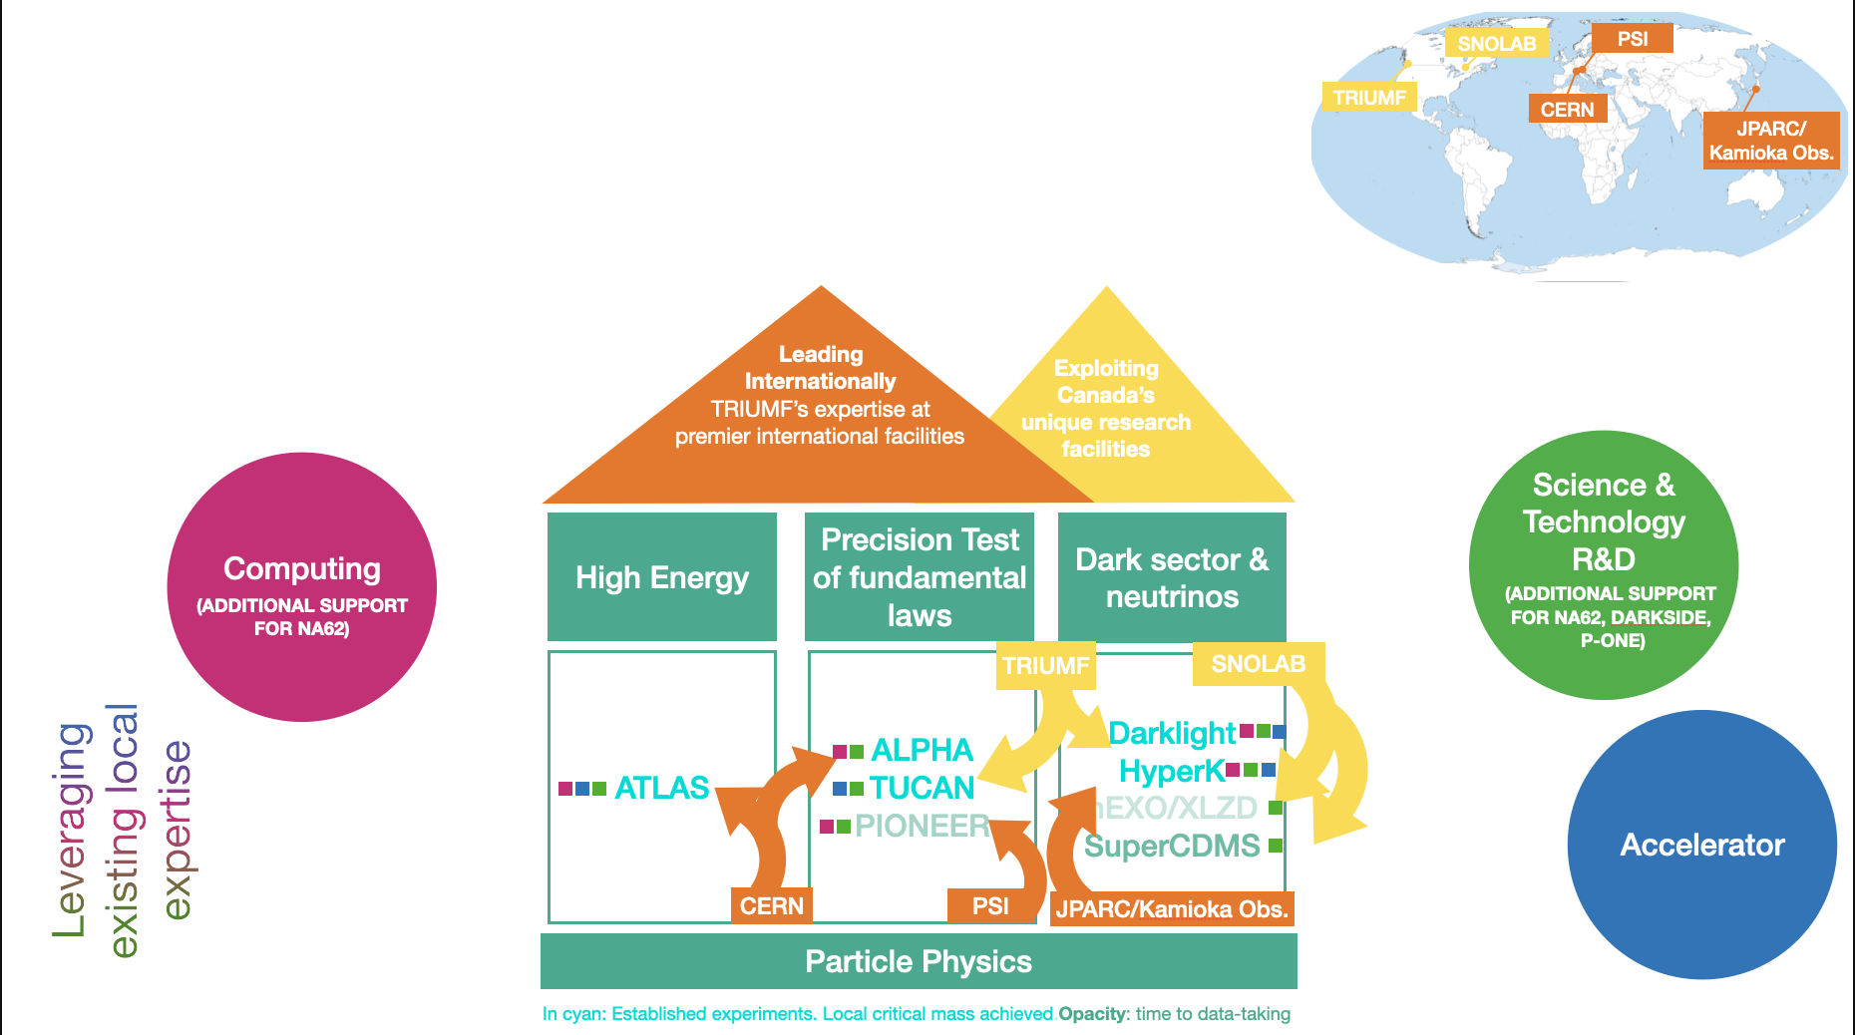
Connections across TRIUMF

Slide 5
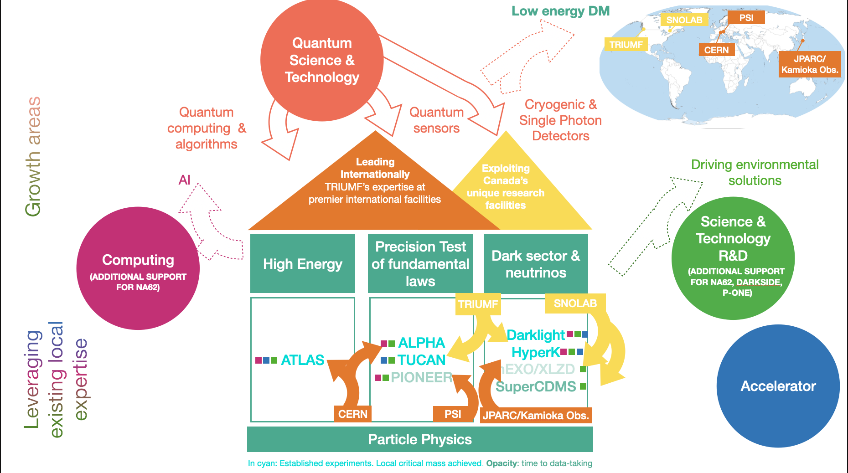
Growth Areas

Slide 6


Funding and Training
High Energy
Precision Test of fundamental laws
Dark sector & neutrinos
Summary of all local HQP and average funding (TRIUMF portion)
Excellent track record in HQP training
Successful history in obtaining funding from NSERC and Canadian Foundation of Innovation (CFI)
ATLAS
ALPHA TUCAN PIONEER
Darklight HyperK
nEXO/XLZD SuperCDMS
5 BAEs
2 P&S 2 Affiliates 3 Joints
5 BAEs
1 P&S 5 Affiliates
5 BAEs
0.5 P&S 5 Affiliates 1 Joint
in 2025
Grad students
Postdocs
Undergrads
12
6
5
9
7.5
11
6
8
8
Average NSERC
~$1M
~$1.3M
~0.8M
CFI 2013-2023
Other
CFI 2025
$11M+$12M
DRAC+BCKDF $4M
$13.5M
$13M+$27M
JSPS $2M
$2.5M

Slide 7
Funding and Future
High Energy
Precision Test of fundamental laws
Dark sector & neutrinos
NSERC funding success for several projects this year
PIONEER
Hyper-K
TUCAN
ALPHA
CFI Innovation Fund
CFI 2027 (proposals in preparation)
Total ask for 2027 ~$57M
ATLAS
ALPHA TUCAN PIONEER
Darklight HyperK
nEXO/XLZD SuperCDMS
Proposals in preparation:
CANFINDD ~$8M
ALPHA ~$17M
TUCAN ~$25M
PIONEER ~$5M
XLZD ~$2.5M
Strong university support through large envelope share allocation

Slide 8

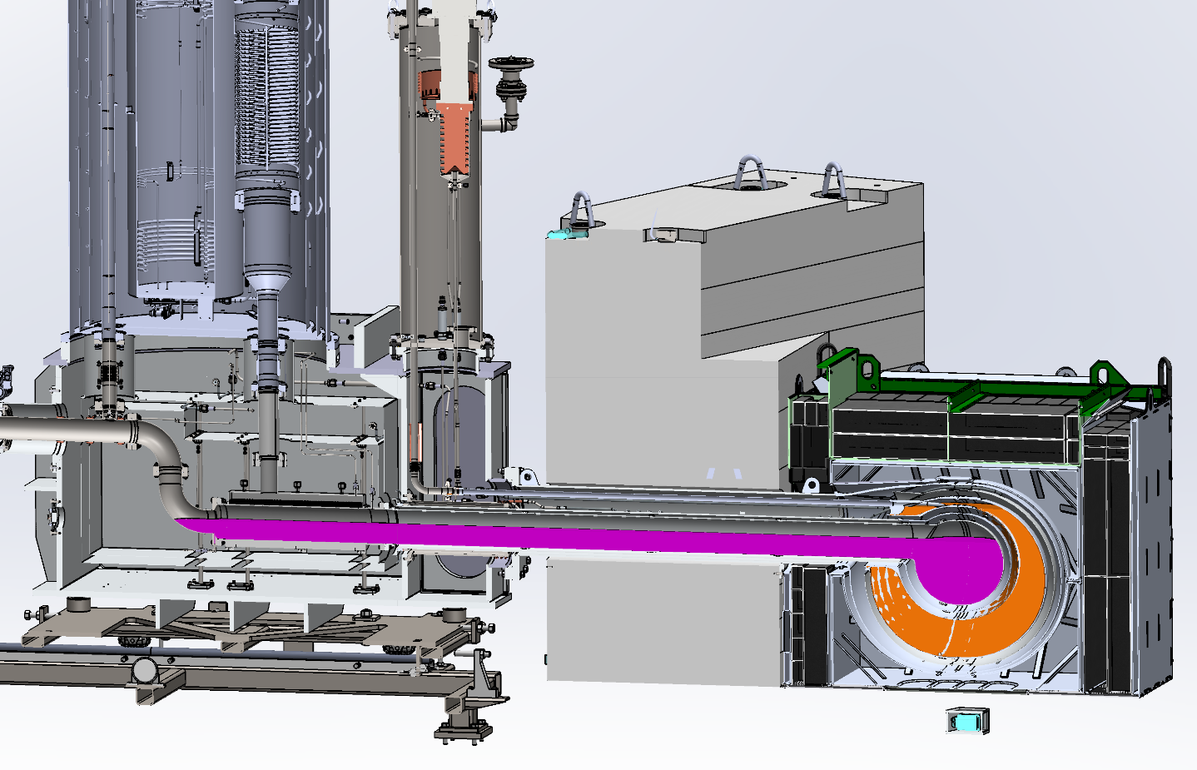
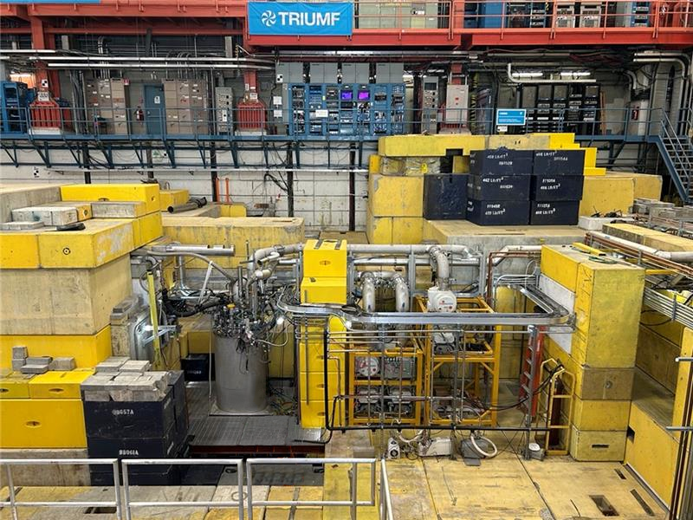
Major breakthrough in UCN production
December 2025: First condensation of liquid deuterium moderator, UCN production, UCNs delivered outside shielding
January 2026: Delivered UCNs to nEDM-like measurement cell, stored, and counted
We have set a new world record for UCN production and delivery to an external cell

Slide 9
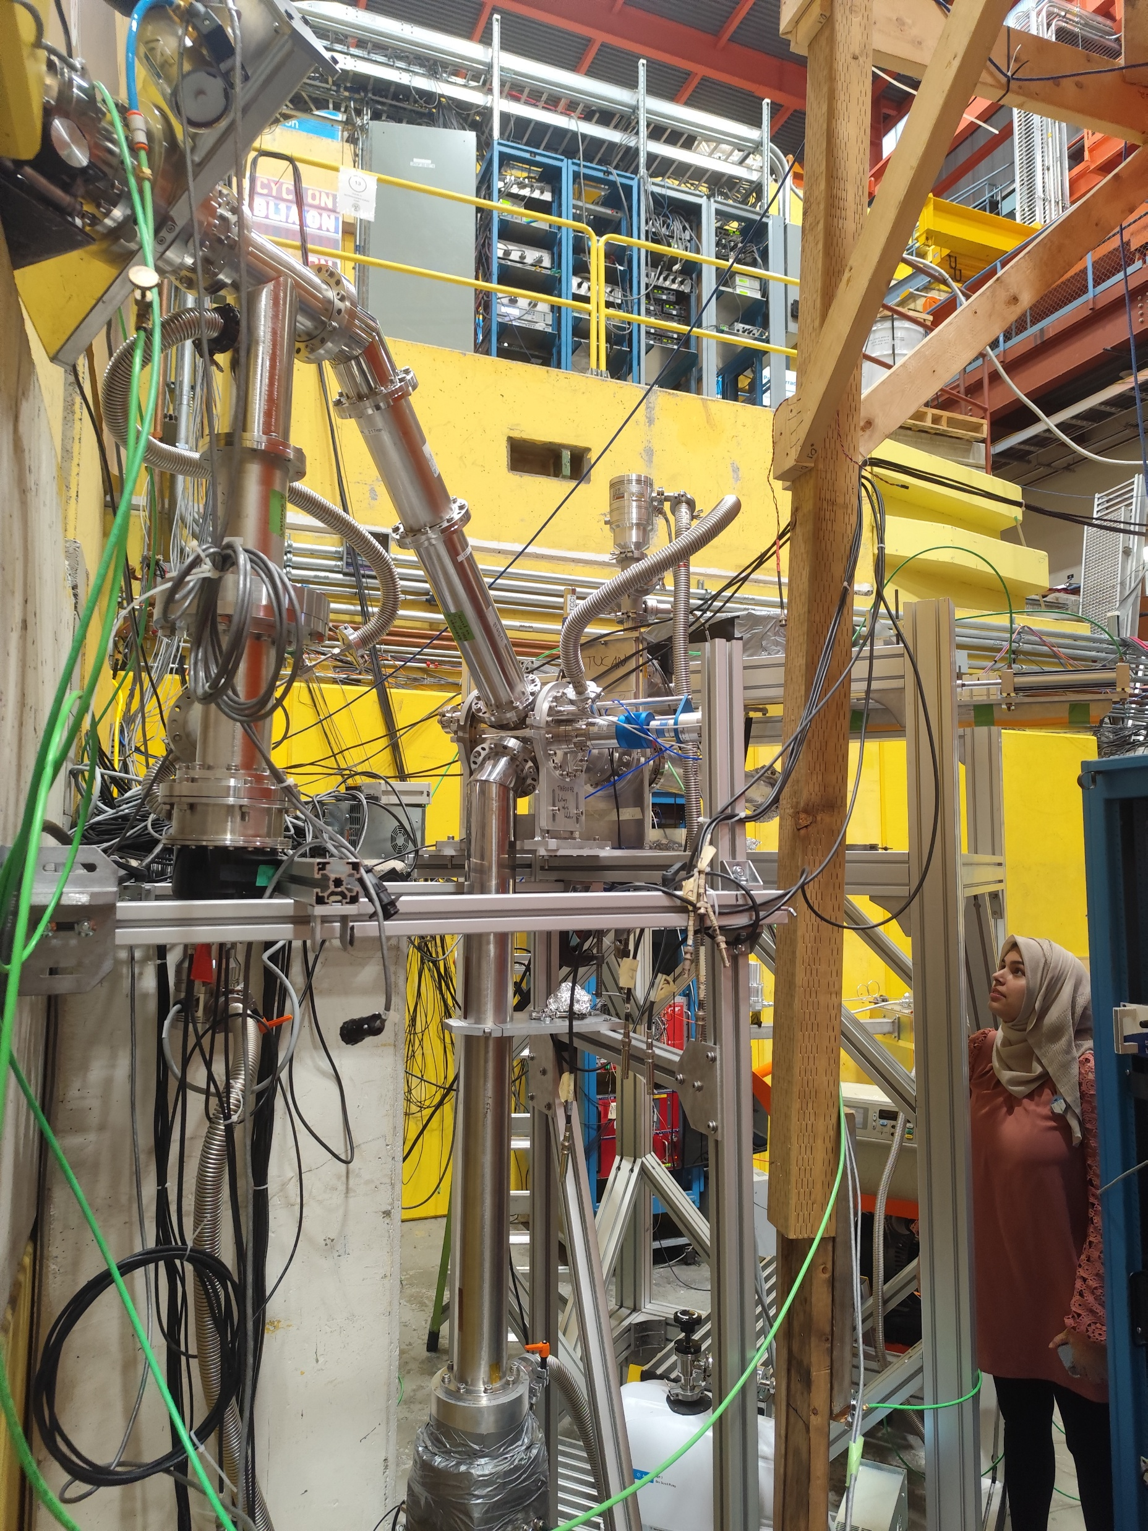
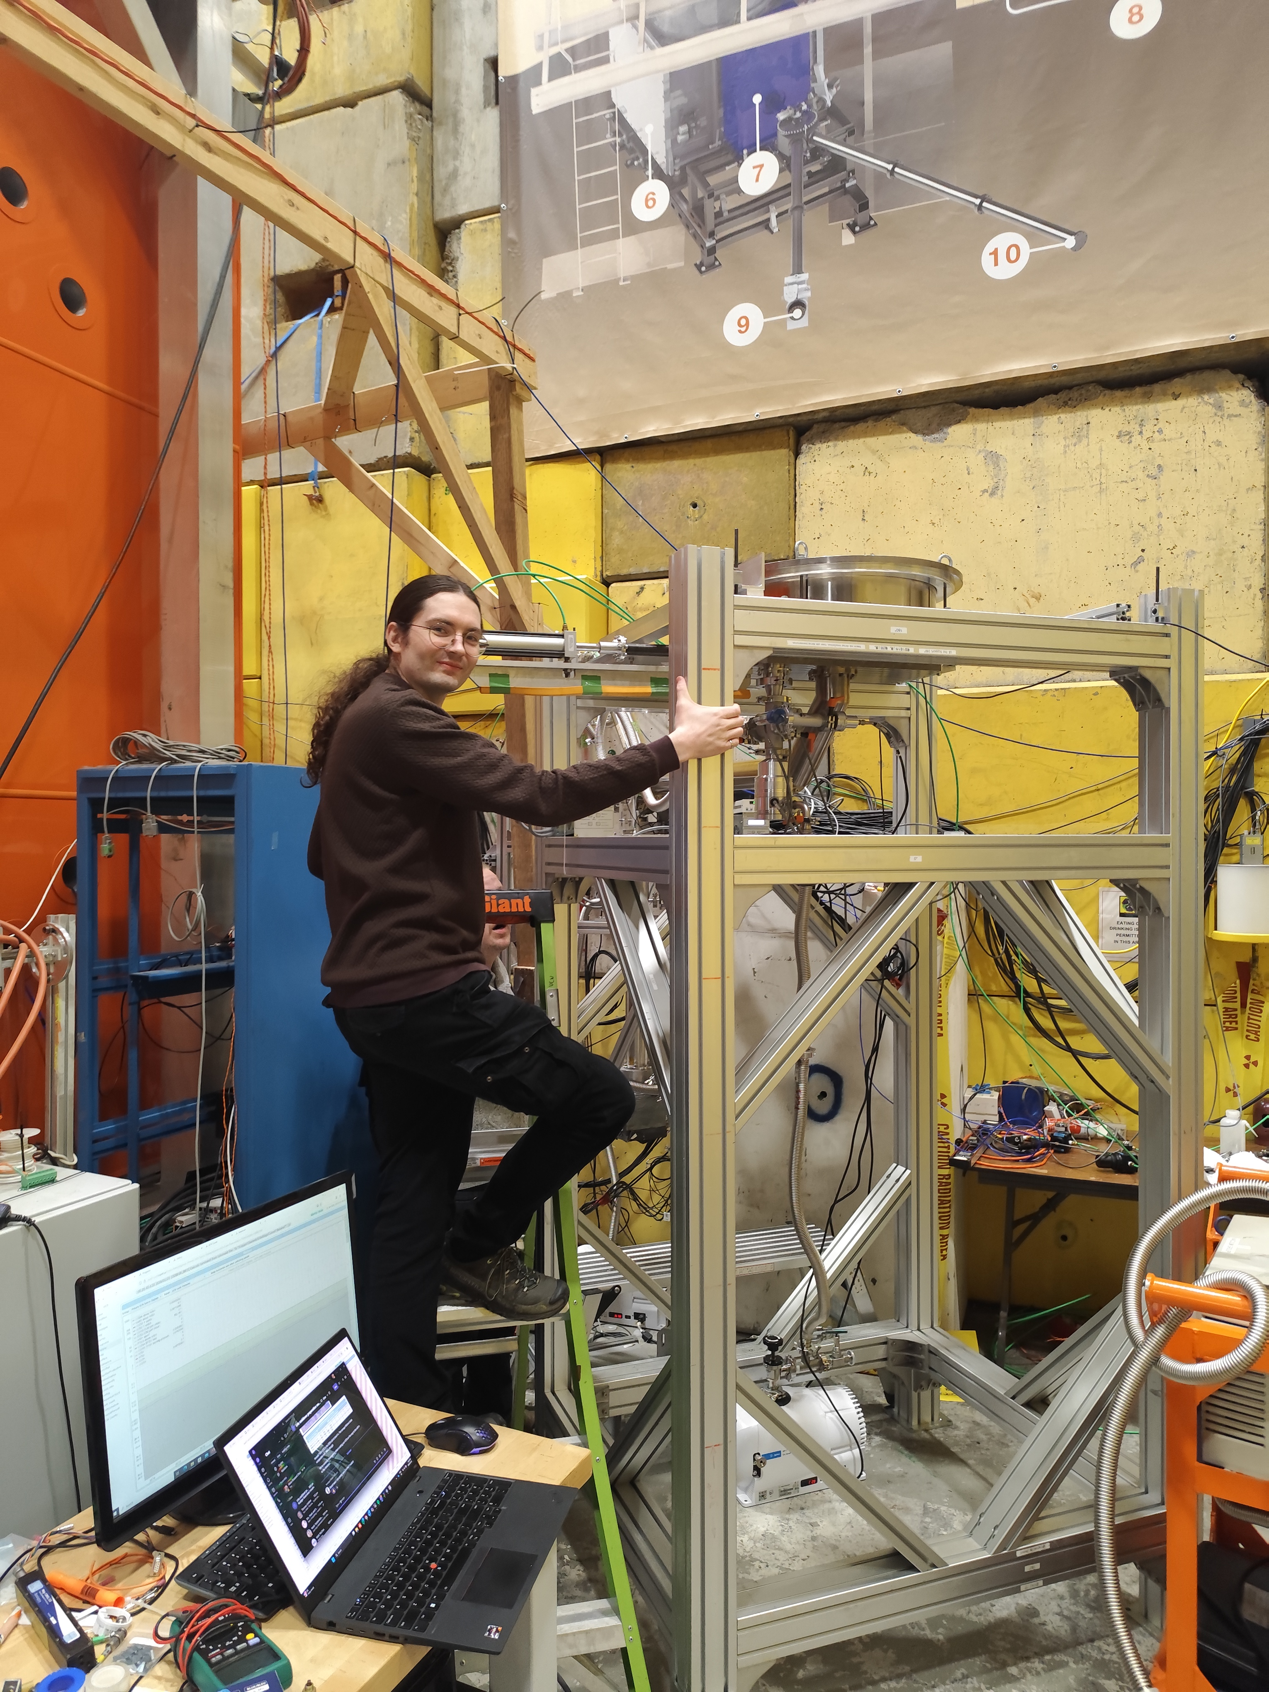
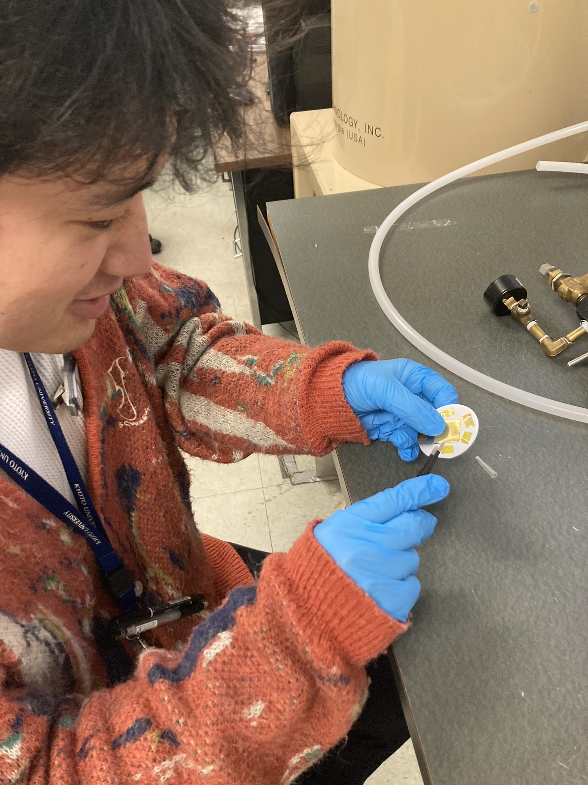
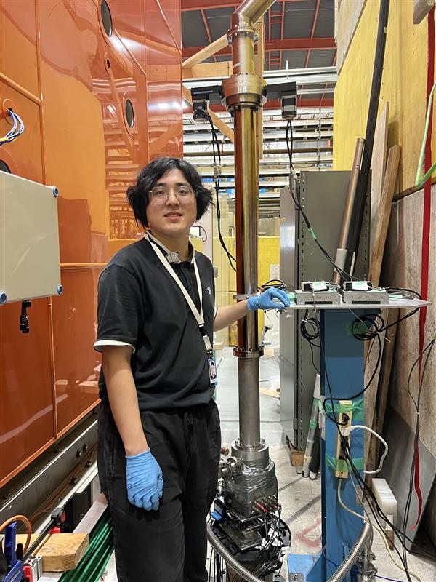
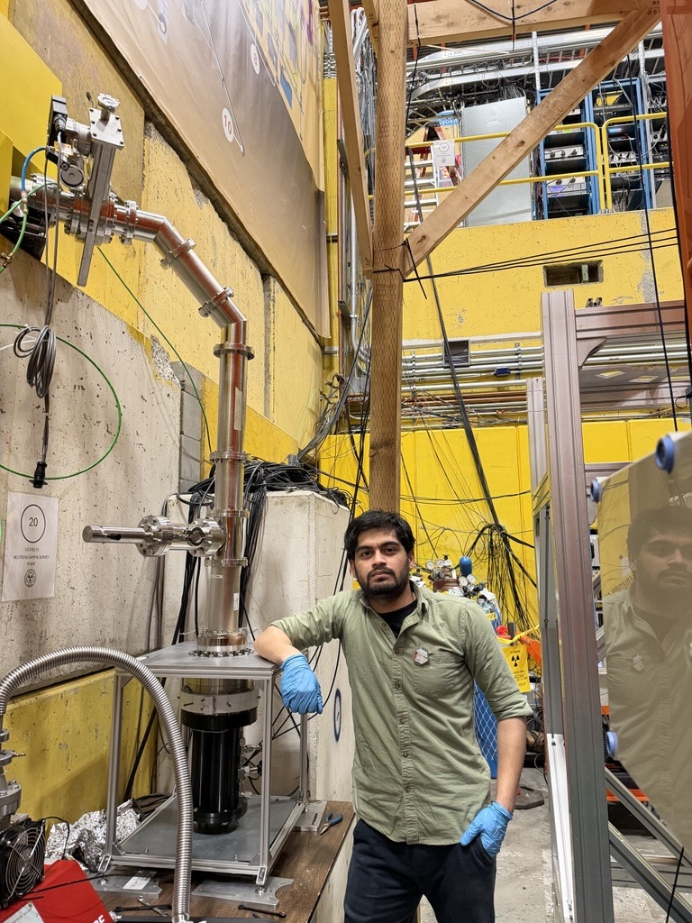







Measurements done in 2025/2026
Source characterization
Prototype EDM cell and sensitivity benchmarks
Tested new coatings
for UCNs Abeer Zahra
Determined cold neutron flux via gold-foil activation Ryuto Fujitani
UCN energy spectrum using time of flight Kelin Qiao
Characterized detector for nEDM experiment Tushar
Prototype EDM cell
Sean Vanbergen

Slide 10
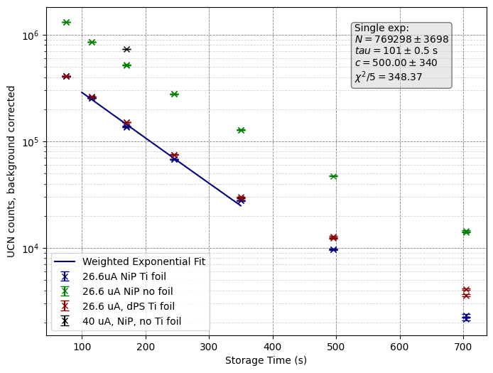
A new world record in UCN delivery
Delivered UCNs from source into a storage cell similar to nEDM measurement cell (25.2 L)
Store for 170 seconds (typical nEDM experiment precession time)
Drain from cell and count UCNs
Result: up to 730,000 UCNs after 170 s!
Previous PSI experiment: typically 15,000 UCNs after 180 s
n2EDM projected: 60,000 UCNs/cell (larger cells) after 180s
Caveats: unpolarized, not in full EDM expt.

Slide 11
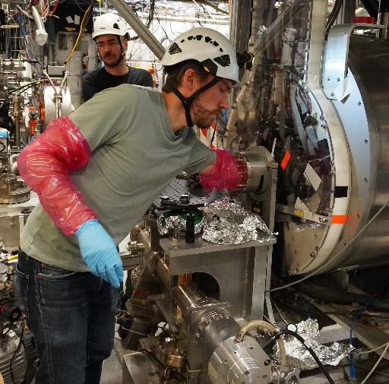
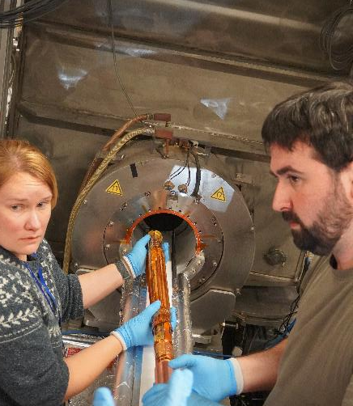
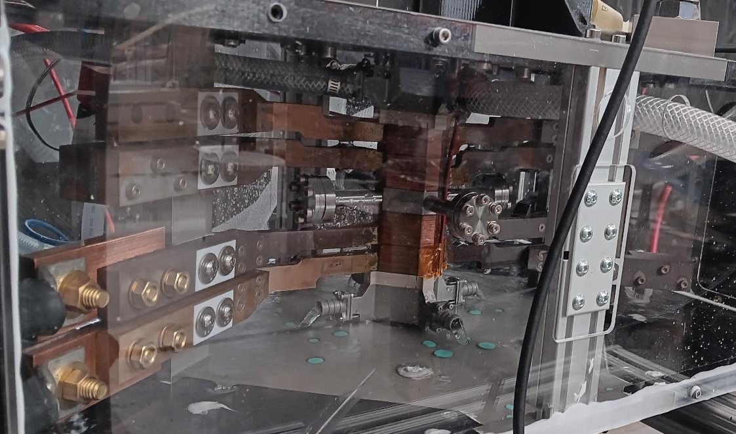
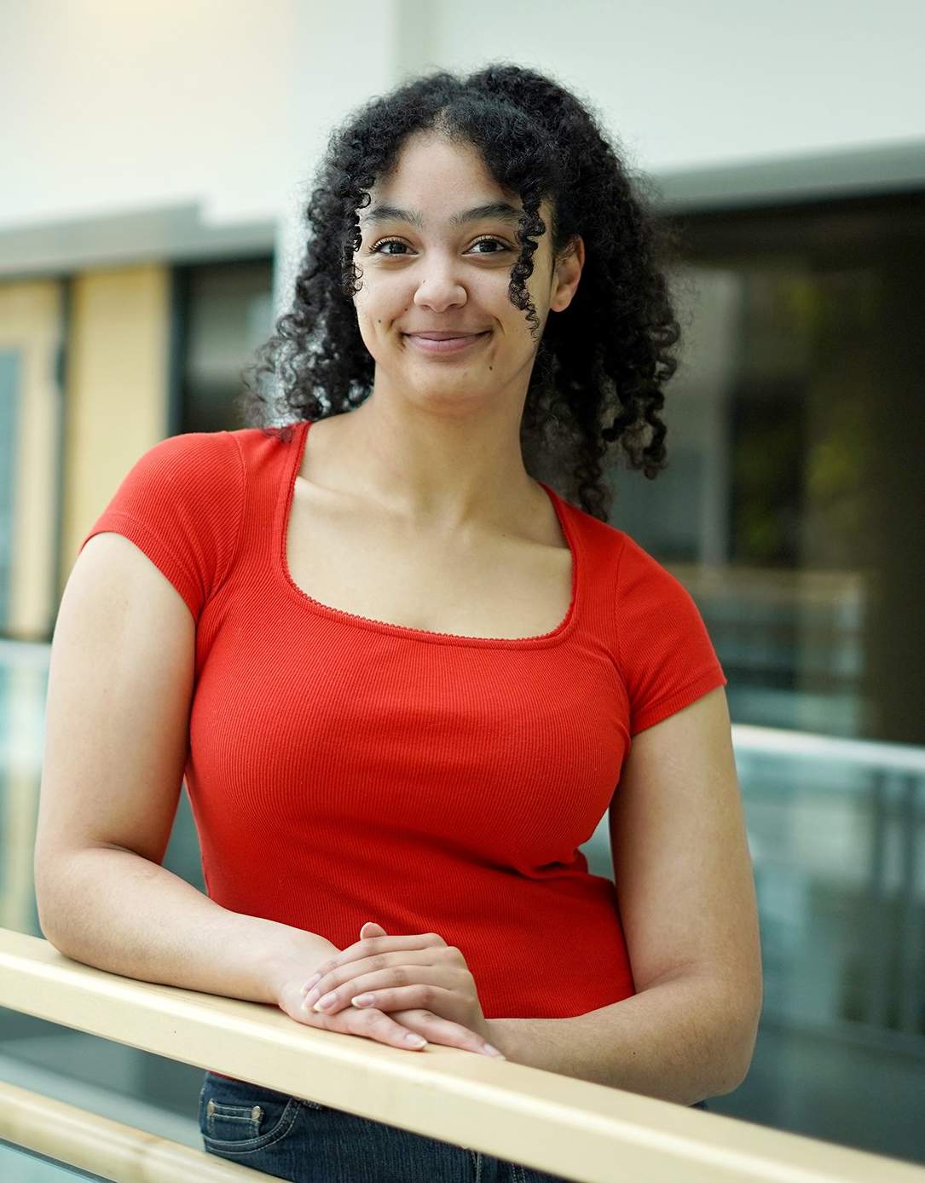
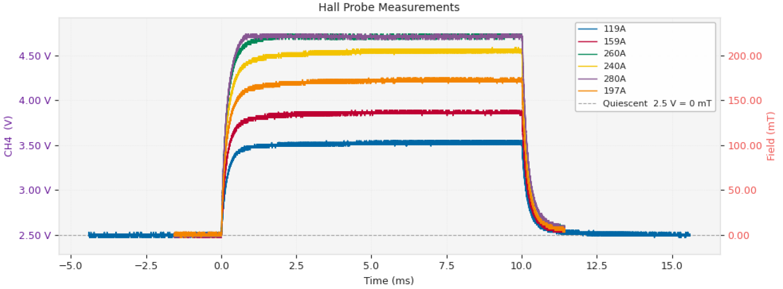
Precision Tests
ALPHA: antihydrogen-hydrogen symmetry tests
TRIUMF plays a leadership role in ALPHA
ALPHA-Canada (20-25 physicists):
Led by TRIUMF; > 1/3 of entire ALPHA
Canadian-led major spectroscopy result, to be published soon
New Penning trap and laser (243 nm) enhancement cavity → ALPHA-3
HAICU is Canadian infrastructure to develop quantum techniques on H atoms; currently:
Commissioning H decelerator @ UBC
Completing H magnetic trap @ TRIUMF
Personnel News
Prof. Frisen (Calgary) at TRIUMF on sabbatical, Mar/Apr
Tehya Mohammed, R. Azuma Fellow student (4th in a raw for ALPHA)
Jan. 2026
A. Powell (former ALPHA-Canada post-doc, now Technical Coordinator)
H. Pahl (post-doc TRIUMF)
T. Friesen (UCalgary)
Apr. 2026
HAICU magnetic trap undergoing field measurements

Slide 12
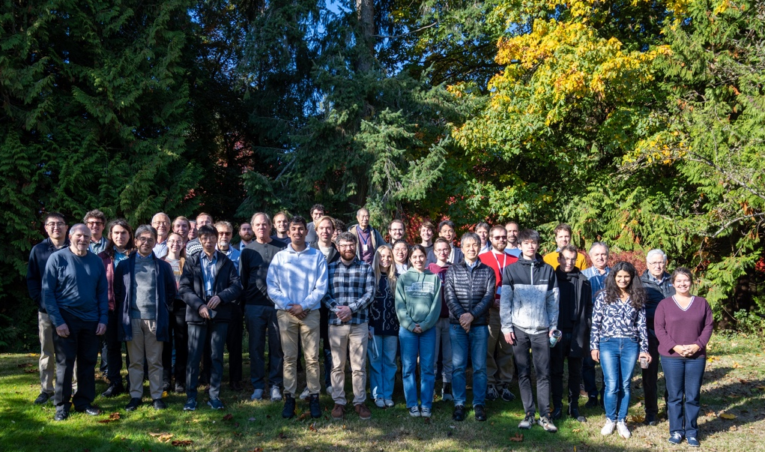
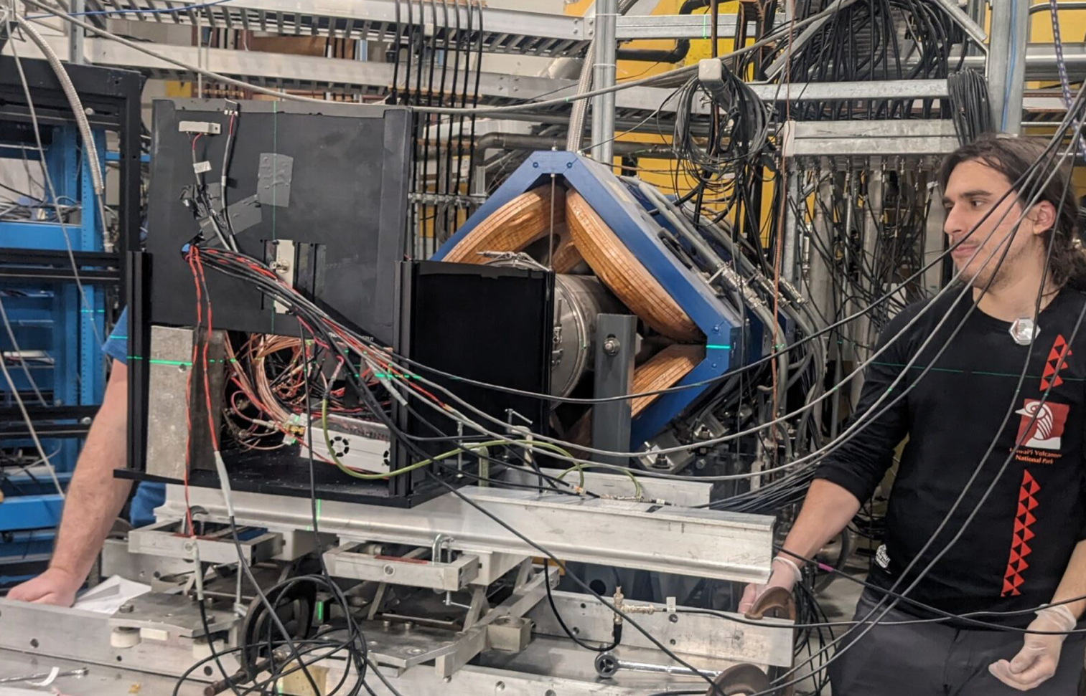
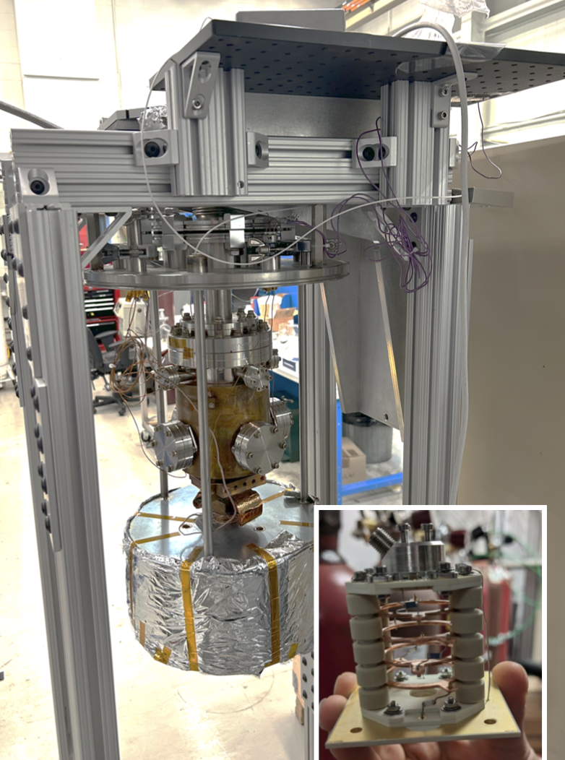
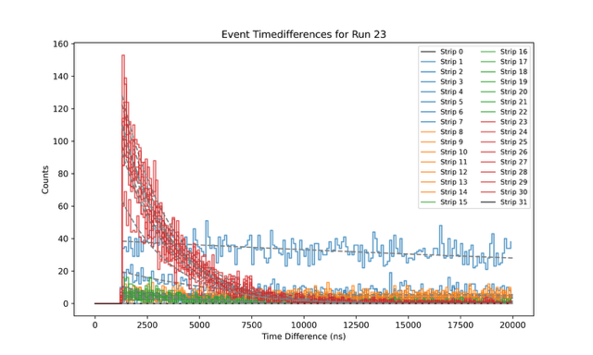

Precision Tests
PIONEER Collaboration meeting at TRIUMF
PIONEER
World's most precise e-µ universality test
2 collaboration meetings at TRIUMF in 2025: 40 in-person participants from Canada, Europe (France and Switzerland), Japan and US (+20 online)
Thinned new Ti-LGAD (Trench-isolated Low-Gain Avalanche Diodes) tested in TRIUMF M20 beamline in Dec 25/Jan 26. Very thin: only 20um active thickness and 5um support Collaboration between TRIUMF, UCSC, UW, LPNHE/CNRS TRIUMF PD D. Gallacher analyzing the data. First observation of a surface muon stop and decay positron in the same strip! Very good separation. Proof of principle of PIONEER technology
​
LGAD beamtest in M20
Multiple beamtimes scheduled at PSI in 2026 involving the PIONEER TRIUMF group (LGAD assembly test, VuV SiPM irradiation, beam characterization)
PIONEER Lab in MOB 149
New setup ​in MOB 149 to test purity monitor assembly in a LXe cryostat
Time difference between stopped muon and decay positron in the same strip: observe muon lifetime
PIONEER TRIUMF group organizing XeSAT conference next week at TRIUMF​

Slide 13

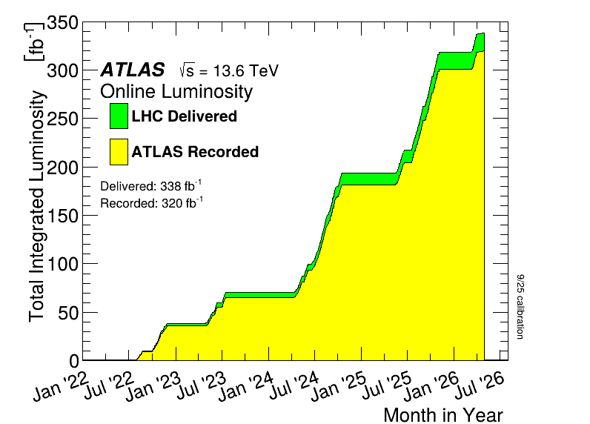


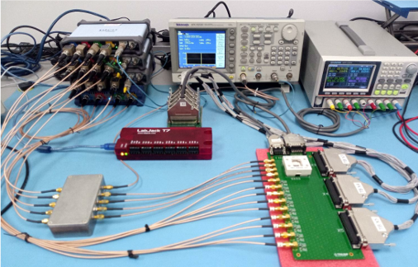
High Energy
Personnel:
Laura Miller joined in January as post-doc, splitting her time with DarkLight
Advertising for additional post-doc at CERN to work on sTGCs
Juan Cristobal Rivera defended PhD at Victoria in October
Josephine Brewster joined as MSc student at UBC in September; awarded NSERC CGRS-M
ATLAS recorded 120/fb in 2025, ~20 so far in 2026, bringing Run 3 total over 320/fb
Good data-taking efficiency thanks in part to good trigger performance of New Small Wheels and LAr electronics upgrades
Triples size of dataset for many ongoing analyses
April 2026 devoted to special low-pileup run for precision measurements
Liquid Argon Calorimeter upgrade:
Hadronic Endcap Pre-Shaper (HPS) ASIC QC tests at TRIUMF complete for 80% of production batch
95% yield (far exceeding required 75%)
First batch of 200 ASICs prepared for shipment to front-end board production site (Nevis).
LAr ASIC QC test setup

Slide 14
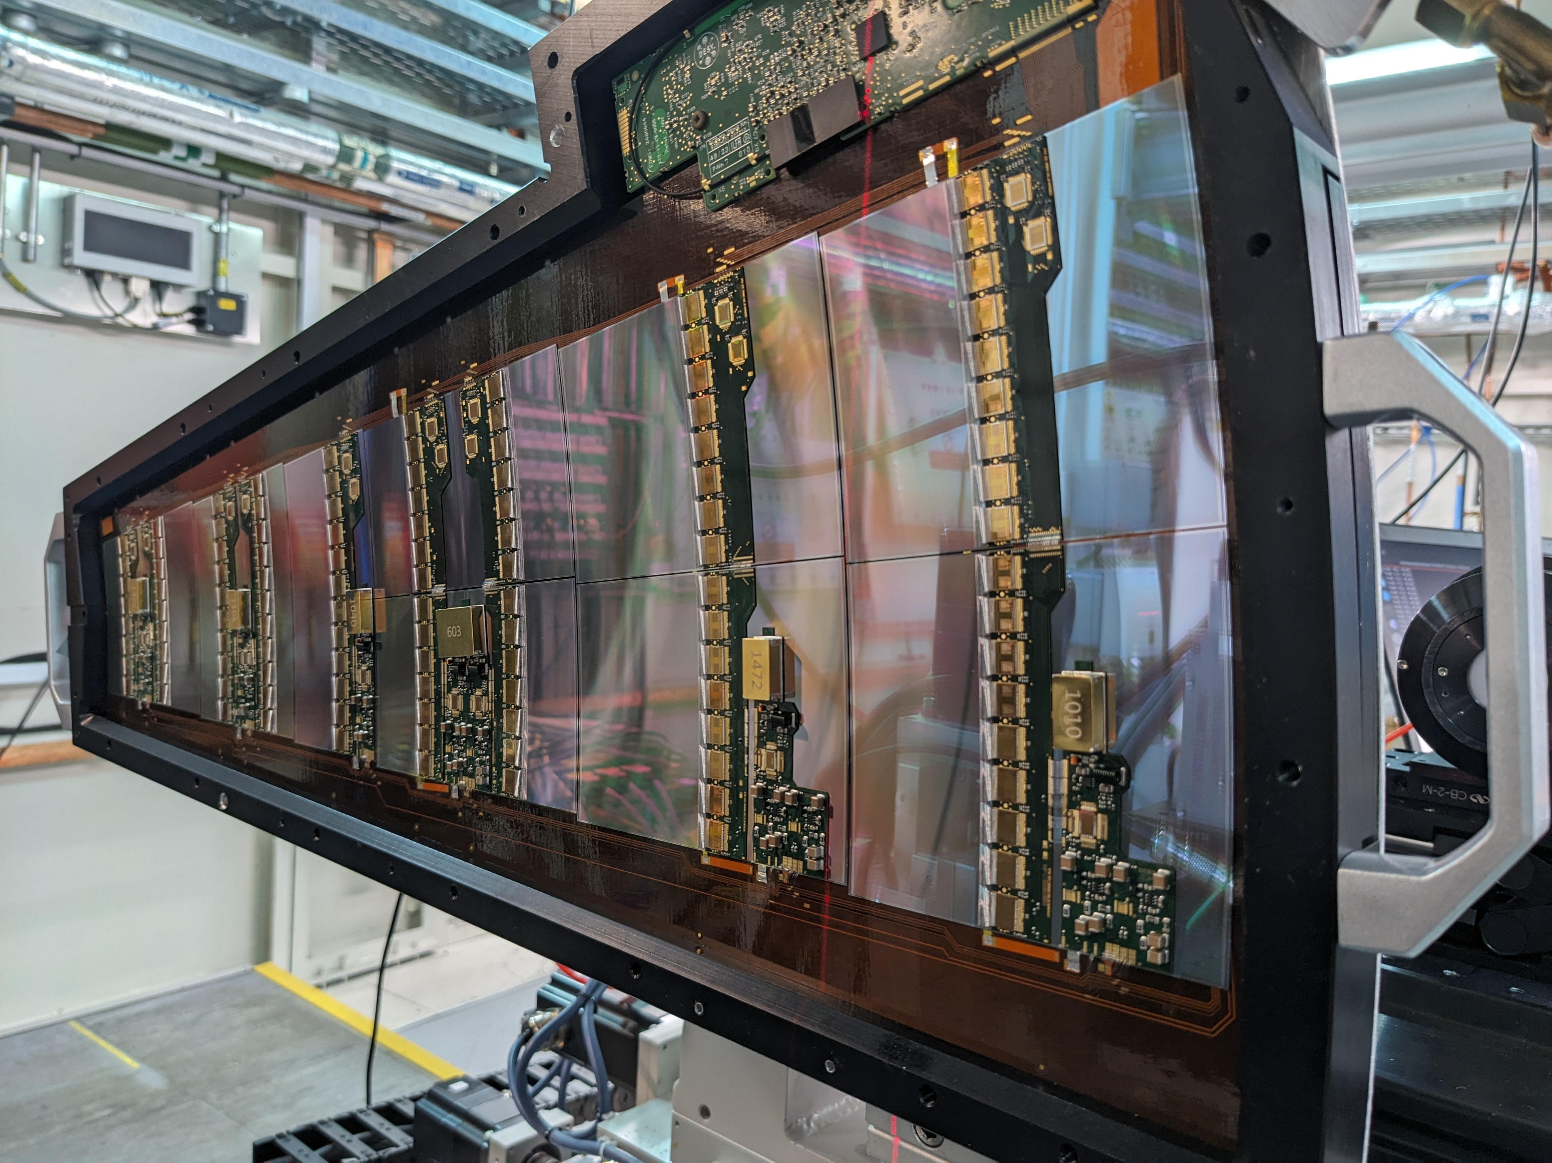
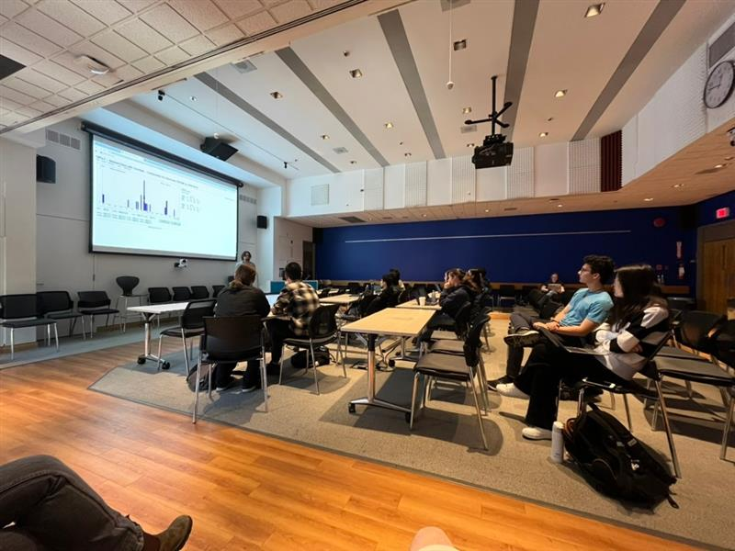
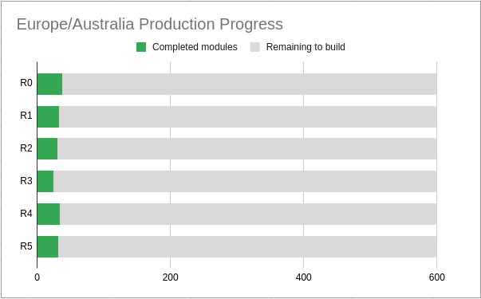
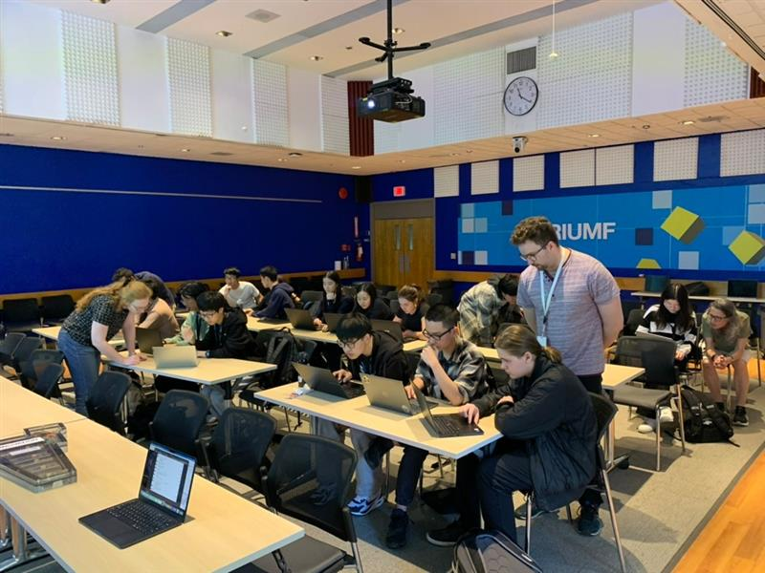
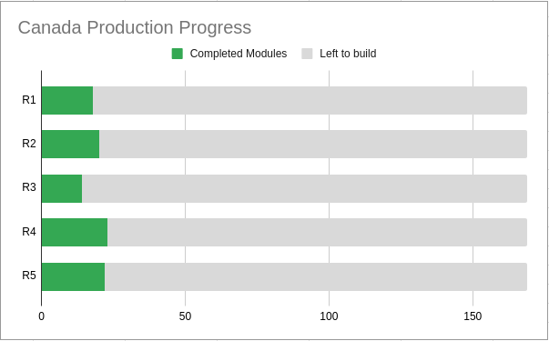
High Energy
Inner Tracker Upgrade (ITk):
Local SFU/TRIUMF ITK team built 8 petals to be installed in the detector (half for all of ATLAS)
Waiting for (Toronto) R3 modules to build more
Meanwhile switched to "interposer" construction (common solution to sensor cracking issue)
Module production is in full swing
Successful first beam test of a petal at Diamond Light Source in UK (press release)
Several new papers:
“Silicon Wafer fracture Stress for tracking sensors” Haider Abidi et al 2025 JINST 20 P10020
"Investigating the impact of the diode edge geometry on the effective active area of silicon sensors using AREA-X" Luise Poley et al 2025 JINST 20 P05010
"Test beam measurements and computer simulations of the ATLAS ITk R2 silicon strip detector" J.-H. Arling et al 2025 JINST 20 P07033
ATLAS Masterclass at TRIUMF May 2
Outreach event for high school students
ITk petal beam test at Diamond LS
ITk Strips Endcap Module Production:

Slide 15
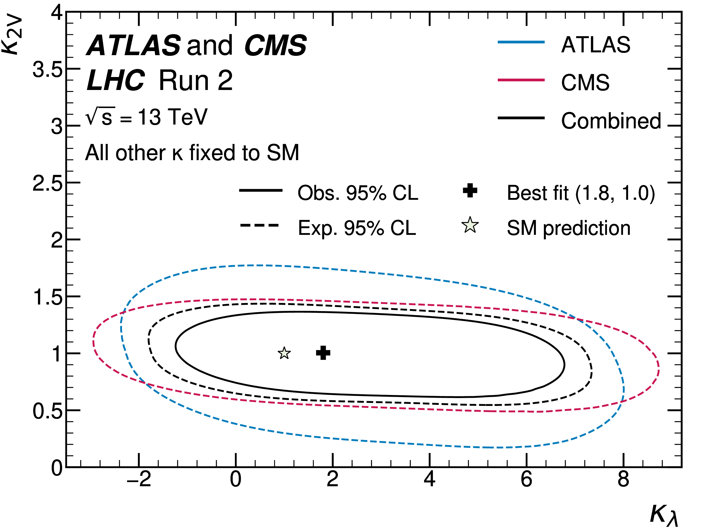
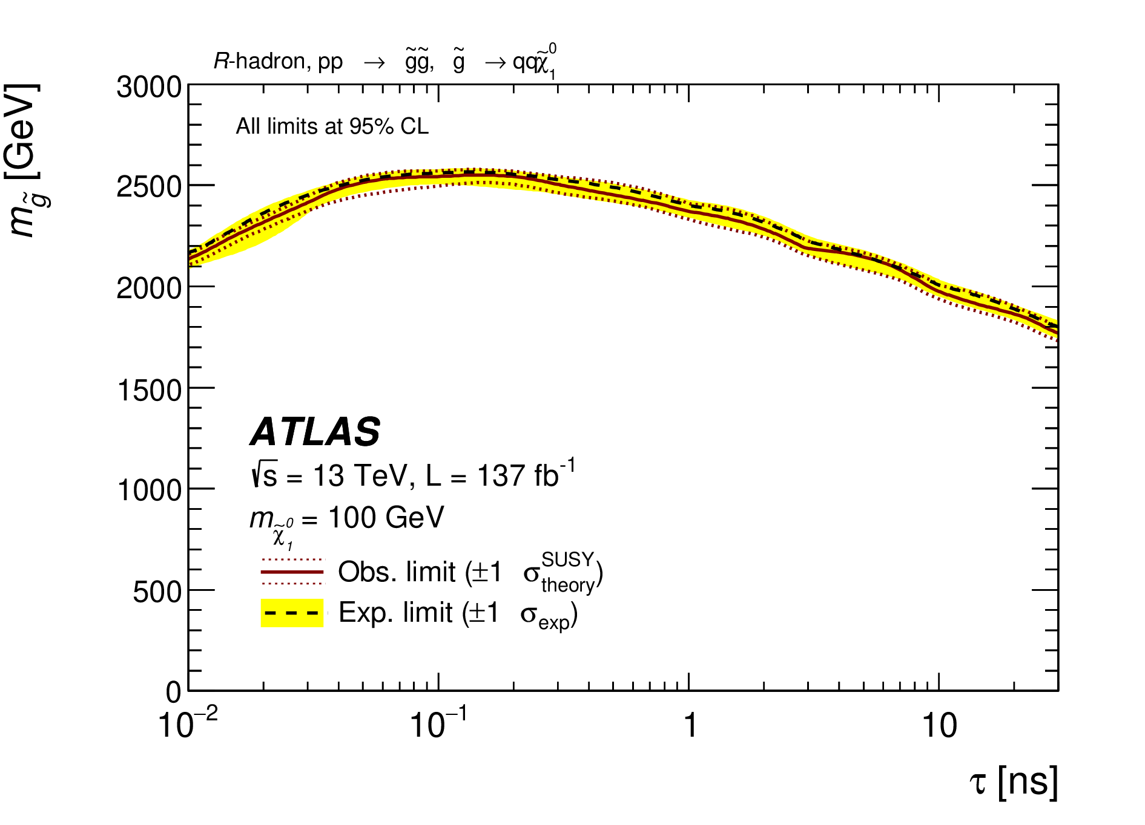
High Energy
2602.23991
Higgs self-coupling
Recent publications with substantial TRIUMF contributions to analysis:
Measurements of the production cross-sections of a Higgs boson in association with a vector boson and decaying into WW* … JHEP 08 (2025) 034
Constraining off-shell Higgs boson production and the Higgs boson total width using WW to lνlν final states... Phys. Lett. B 870 (2025) 139898
Measurements of Higgs boson production via gluon-gluon fusion and vector-boson fusion using H→WW∗→ℓνℓν decays in pp collisions ... and their effective field theory interpretations Eur. Phys. J. C 85 (2025) 1403
Combination of ATLAS and CMS searches for Higgs boson pair production at √s=13 TeV (arXiv:2602.23991, submitted to PRL)
Search for long-lived charged particles using large specific ionisation loss and time of flight in 140 fb−1 of pp collisions... JHEP 07 (2025) 140
Breaking barriers: the impact of ATLAS Virtual Visits in science communication (arXiv:2601.22457, accepted EPJP Apr.30)
Measurements and interpretations of WZ production cross-sections in pp collisions at √s=13 TeV JHEP 11 (2025) 006
Search for displaced decays of long-lived particles in events with missing transverse momentum in √s=13 TeV pp collisions (arXiv:2603.12051, submitted to JHEP)
No moresilicon tracker hits
Like prompt
2603.12051

Slide 16


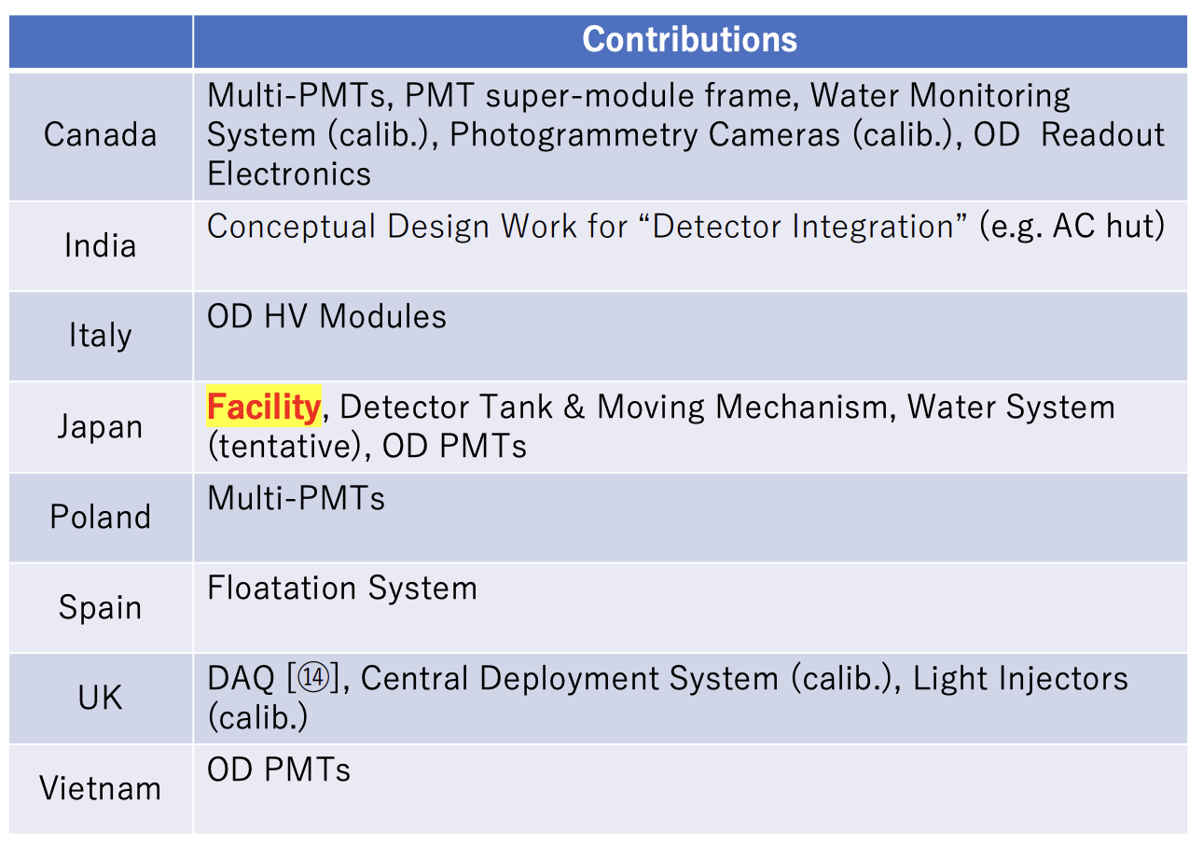
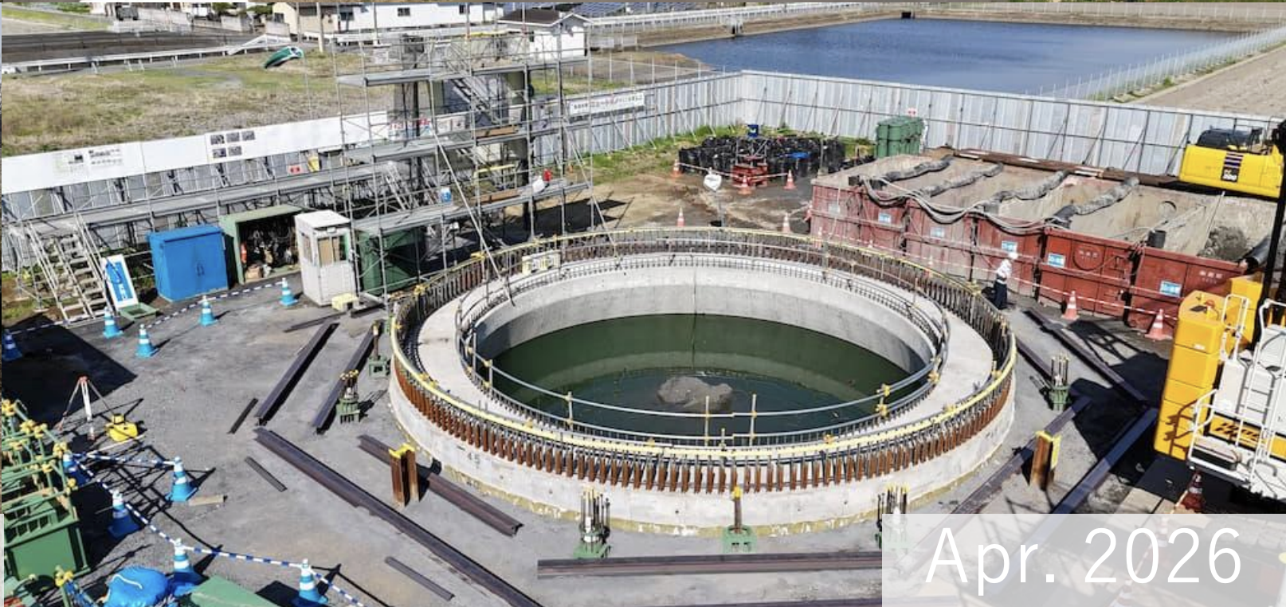
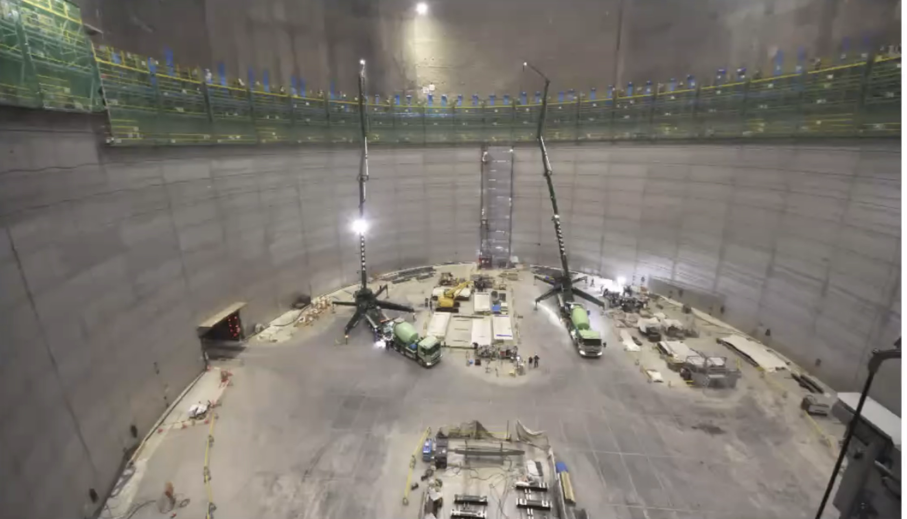
Dark Sector and Neutrinos
IWCD Contributions
Intermediate detector (IWCD) facility construction is underway with first caisson for pit excavation completed (pictured)
IWCD is Canadian (and TRIUMF) led project (right)
Hyper-K Detector cavity excavation complete and tank construction proceeding (pictured)
IWCD Pit Excavation
Hyper-K Tank Construction

Slide 17
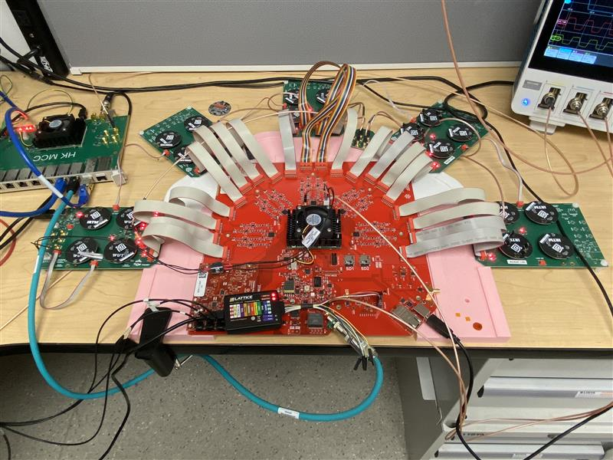
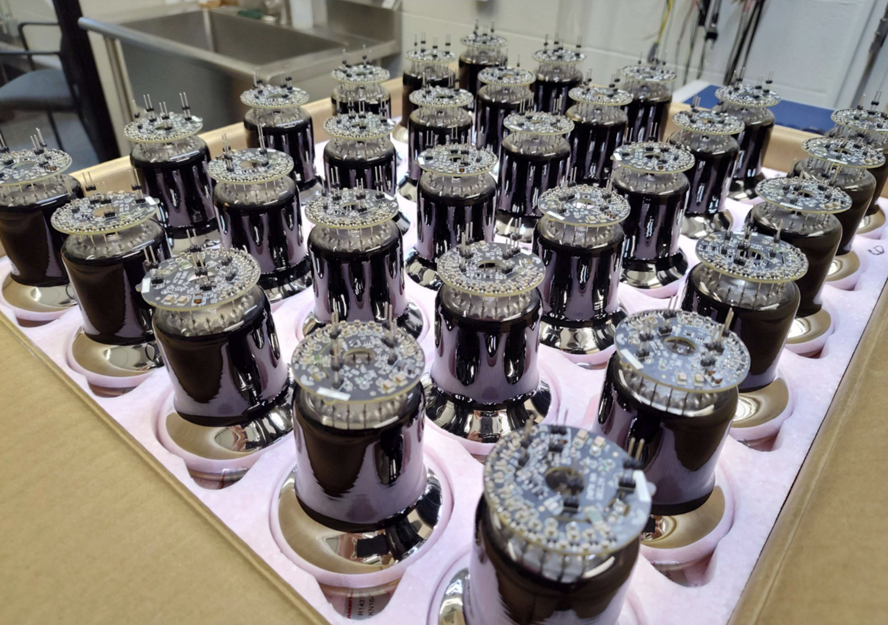

Dark Sector and Neutrinos
TRIUMF SciTech group supported production and testing of IWCD multi-PMT and Outer Detector electronics mainboards in progress with expected completion this summer
Preparation for initial IWCD and Hyper-K multi-PMT production at UVic and Carleton with TRIUMF support is nearing completion and production will start soon
Water Monitor System (WMS) development at TRIUMF is continuing after successful initial operation in WCTE
Detailed characterization and study of tap water and deionized water
Input for IWCD water filling plan
Multi-PMT Mainboard Testing at TRIUMF
PMTs for Hyper-K multi-PMT Assembly
WMS Response to Gd Loading

Slide 18



Dark Sector and Neutrinos
DarkLight completed installation during Summer 2025
First commissioning run on carbon target at energies from 10 to 30 MeV took place December 25-January 26
Now analyzing data and tuning reconstruction algorithms
Observations of elastic line and Moller scattering in commissioning data
Not able to observe Bethe-Heitler or inelastic processes at this time due to high backgrounds in accelerator hall
Found poor performance in GEM tracking detectors and must either refurbish or replace for future runs
Trigger detectors (TRIUMF/UBC) performing well as expected
Personnel news:
MSc student Gabby Gelinas (UBC) graduated; new MSc student Dean Reiter (UBC) joined
Supported 5 undergraduate student research projects since May 1 2025
Postdoc Laura Miller gave several seminars on DarkLight results
Left: DarkLight collaboration with the installed experiment.
Right: observed elastic peak in 10 MeV electrons scattering from a 1 micron carbon foil. The tail in data at high ΔE is due to backgrounds and radiative tails. ​

Slide 19


Dark Sector and Neutrinos
SuperCDMS
Direct dark matter (DM) search with cryogenic Ge and Si detectors
Construction at SNOLAB completed; detectors cold since January 2026
Intense commissioning effort ongoing
First neutron activation of Ge detectors for low energy calibration completed
Transition from commissioning to dark matter data taking expected in early fall
Planned operation for the next ~4 years
World-leading sensitivity for Dark Matter in the 0.5-5 GeV/c² mass range expected
Recent publications on calibration (PRD 112, 092014), event reconstruction (NIMA 1087, 171437), detector R&D (NIMA, arXiv: 2601.16307), DM search with small detectors (PRD113, 032001)
SuperCDMS cryostat: payload fully connected
Early event from a Ge detector: pulses from 12 individual phonon sensors

Slide 20


Joint contribution of the PP, NP, Comp. and TH departments to IYQ2025 showcasing Quantum Science and Technology at TRIUMF

Slide 21




First detector line of P-ONE successfully completed
P-ONE detector line integration was completed in April 2026!
MEHSA clean room facility was used for final component testing and integration
Clean space, SciTech support, and expert crane support were essential for the success
Completed detector line is fully functional, lab tested and all its performance is as expected

Slide 22



First Canadian Meeting on FCC
Establishing FCC-Canada
As part of 2026 CAP Congress, TRIUMF scientists are co-organizing a symposium as a first meeting towards establishing FCC-Canada
CERN decision on FCC expected in ~2028: need to gather interest and organize contributions
Not expected to apply for explicit funding for some time yet
Main constraint: build and commission ATLAS Phase 2
But important to establish community and understand potential detector contributions

Slide 23
Summary
Particle Physics addresses many of the most compelling and fundamental questions
Embedded in international and national collaborations
Onsite effort with new opportunities
Major highlight: TUCAN set a new world record for UCN production and delivery to an external cell
Excellent track record on designing, enabling and extracting science from Particle Physics
Successful funding track record
Leadership in international collaborations
Large number of student and postdoc training
ARIEL
Support ARIEL completion
Most projects do not ask for TRIUMF resources in quarterly QRPP (blue project) with the exception of minimal asks from UCN, DarkLight and ALPHA (orange projects)
Making engineers and techs available from ATLAS ITK and ALPHA to work on ARIEL
Hired three undergraduates with Particle Physics supervisors who help with urgent design, simulations and assembly tasks
Canadian Long-Range Plan
Department members engaged in IPP and CINP white papers and townhall discussions

