Slide 1
Particle Physics Faculty Meeting
Agenda
News/Update/Discussion
ACOT slides

Slide 2
ACOT
Plenary session on Monday morning May 11th
ACOT Parallel Sessions: Monday, May 11, 2026: 15:00 – 16:30 (90 mins)
Particle Physics, Sci Tech, and Scientific Computing
Location: MOB Conference Room
Join Zoom Meeting Meeting ID: 943 0035 9157 Passcode: 4321
Poster session scheduled for Tuesday, May 12 around lunchtime
ATLAS ITK - Richard Salami (PhD student)
UCN - Kate Dong (coop student)
DarkLight - Laura Miller (postdoc)
PIONEER - Emma Klemets (PhD student)
ARIEL - Enzo de Oliveria (co-op student)

Slide 3
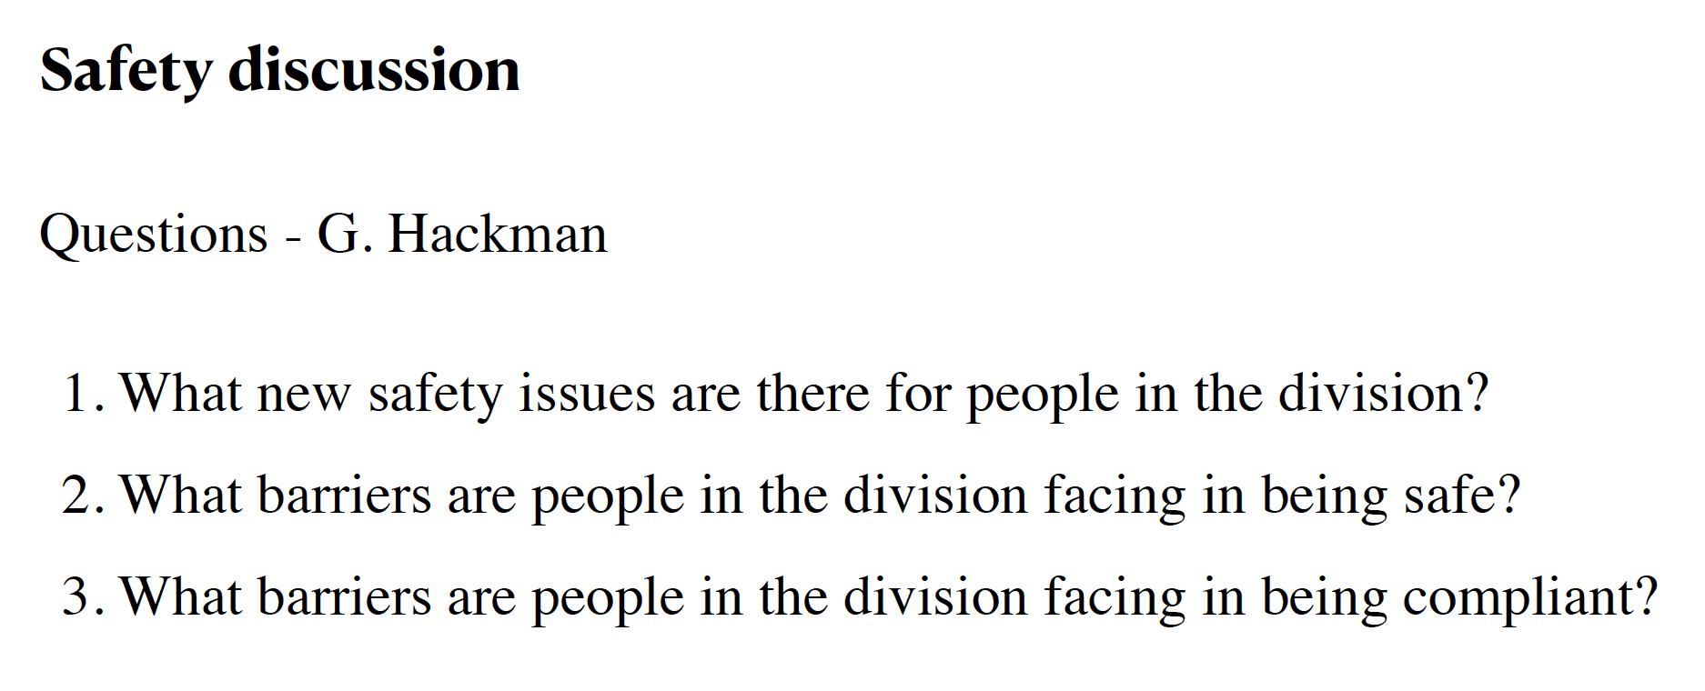
Safety Moment
We are asked to provide input on these questions

Slide 4
Answers to 3 questions
1) What new safety issues are there for people in the division?
No major new safety hazards identified at this time
2) What barriers are people in the division facing in being safe?
Limited availability of dedicated safety support resources for major technical hazards such as HV, cryogenics, lasers, radiation, and complex electrical systems
It would be beneficial to have dedicated technical staff who are also safety experts, potentially cross-appointed between the safety group and engineering, it would strengthen both safety and engineering capabilities
Lack of centralized and easily accessible safety information and best practices. A central website containing approved procedures, example documentation, compliant PPE lists and common solutions would be valuable
“A safety walk through” prior to installation of equipment or experiments would help identify overlooked hazards earlier and improve overall safety outcomes.
Limited personnel ultimately makes it more difficult for groups to implement optimal safety practices
3) What barriers are people in the division facing in being compliant?
Some rules can be difficult to implement in practical experimental environments
Example: restrictions on extension cords connected to rack-mounted power bars, where standard cable lengths are often insufficient to directly reach wall outlets
ECO and compliance requirements for externally built or custom equipment can be challenging to navigate without dedicated support and clearer guidance documentation
Safety responsibilities assigned to facility coordinators should be accompanied by dedicated training and clearer definition of expectations and authority
In general, compliance becomes significantly easier when expectations, approved solutions, and support contacts are centralized and easy to access

Slide 5
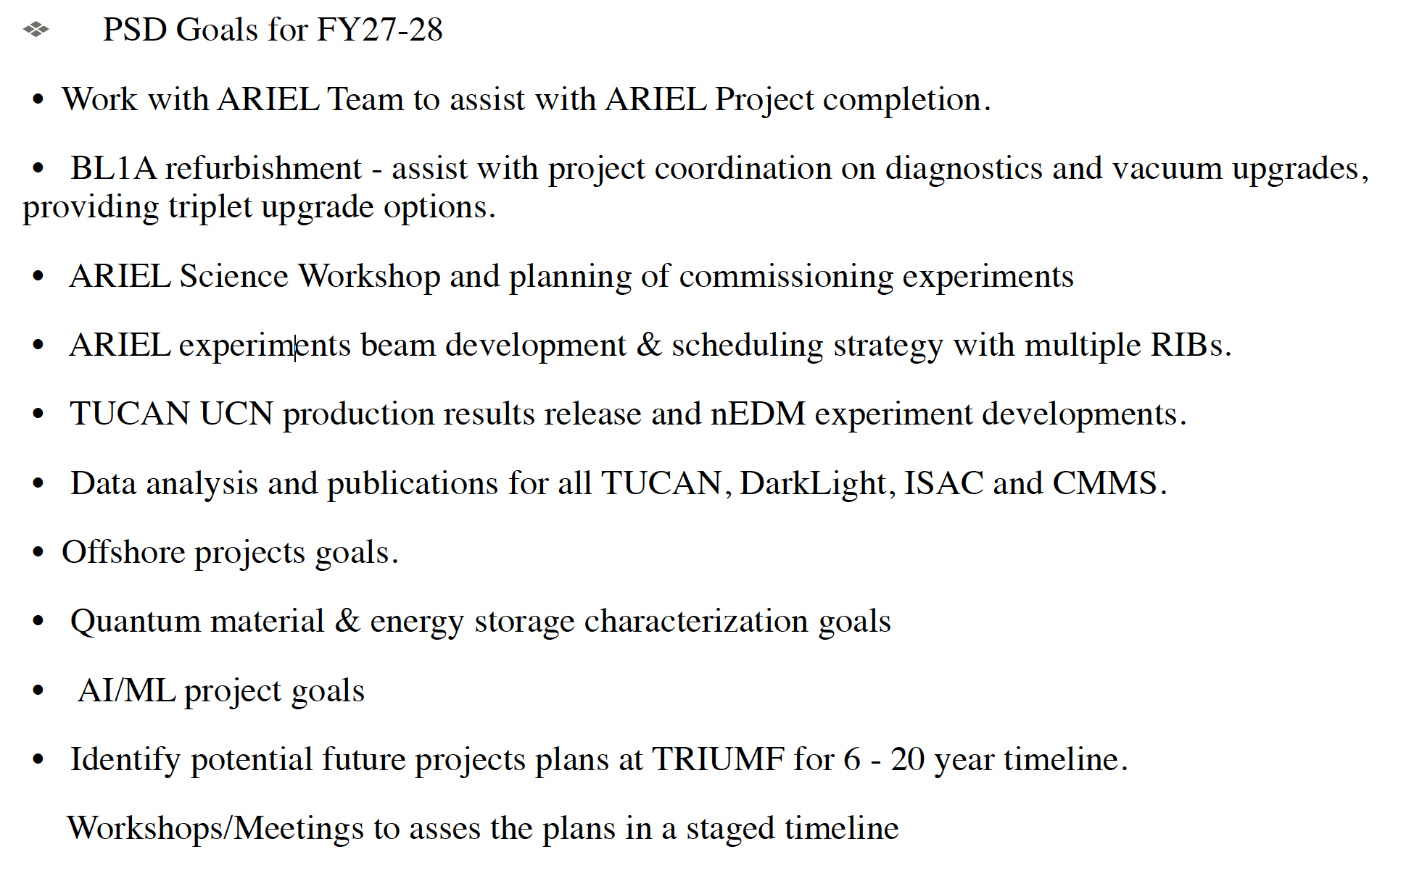
Goals
We are asked to provide 2-year (April 2026 - March 2028) goals for each experiment
Initial list from Ritu

Slide 6
.
Goals
2-year (April 2026 - March 2028) goals for each experiment
ATLAS: Data analysis and publications of Run 2 and 3 data, 2 NSW wheels on surfaces, decide on maintenance, complete nominal ITK module and petal production, complete LAr Phase-2 upgrades
T2K/Hyper-K: Complete construction of Hyper-K detector. All components of IWCD ready. Analysis and publication from WCTE. Building and installing new OTR beam monitor components.
TUCAN: Routine operation of UCN source, commission single cell EDM experiment and publish results
ALPHA: Demonstrate Hydrogen trapping with HAICU, upgrade of ALPHA
SuperCDMS: Complete commissioning of the experiment and take and analyze first science data
PIONEER: Secure funding through CFI IF 27 call for construction of the LGAD target
Perform beam tests at PSI in 2026 and 2027 for target demonstrator
DarkLight: Complete 30 MeV run, publish commissioning run results
XLZD: Contribute to XLZD CDR, secure funding for R&D related to XLZD through CFI IF 27
Secure NSERC funds, support efforts toward a compelling case for XLZD at SNOLAB

Slide 7
Call for nominations - Samit and Reshma Sharma Award
An award of $3,600 have been made available through an endowment established by the Samit and Reshma Sharma Foundation for outstanding graduate students in the Department of Physics & Astronomy. Preference will be given to students who have participated in or will be participating in research projects with TRIUMF physicists and/or students studying particle physics, nuclear physics, materials research or medical physics.
If you would like to nominate a student, write a short paragraph explaining why the student deserves recognition of outstanding work at TRIUMF.
Please send your nomination to gradcoord@phas.ubc.ca by May 14, 2026.
Ritu:
We should plan on nominations from PSD for this. We should probably plan for at least 3 or 4 nominations from different areas of research, to improve our chances of success.
Please discuss with your Departments to collect possible names by this week.
Xiaoyue:
I have updated the Particle Physics/SciTech/SciComp HQP desk assignment for the summer term: hqp_seating_summer_2026 .pptx
Please let her know if you have any comments.
Various

Slide 8
AOB

Slide 9
Next Meeting
May 21st is canceled

