Slide 1
New TRIUMF facility: ARIEL
Oliver Kester
Director, Accelerator Division
for the ARIEL team
KEK / TRIUMF Symposium
September 28, 2025

Slide 2
ARIEL: ISAC×3
The Advanced Rare IsotopE Laboratory (ARIEL) is the world’s most powerful Isotope Separation OnLine (ISOL) complex.
It will triple the present rare isotope capabilities of the Isotope and ACcelerator facility (ISAC).
ARIEL is the only rare isotope facility that will provide three RIB beams simultaneously to experiments.

Slide 3
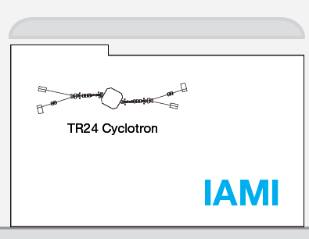
ARIEL - TRIUMF’s flagship project
Simultaneous RIB production from 3 targets
  50 kW existing ISAC proton target
  50kW new ARIEL proton target
  100kW new ARIEL electron target
Multi-user capability with more and new isotopes for
  Nuclear Structure and Dynamics
  Nuclear Astrophysics
  Fundamental Symmetries
  Materials Science
  Life Sciences
Unique beam preparation and transport system (CANadian Rare isotope facility with Electron
Beam ion source - CANREB)
  High resolution separator
  Beam preparation with RFQ cooler buncher and EBIS
TRIUMF campus

Slide 4
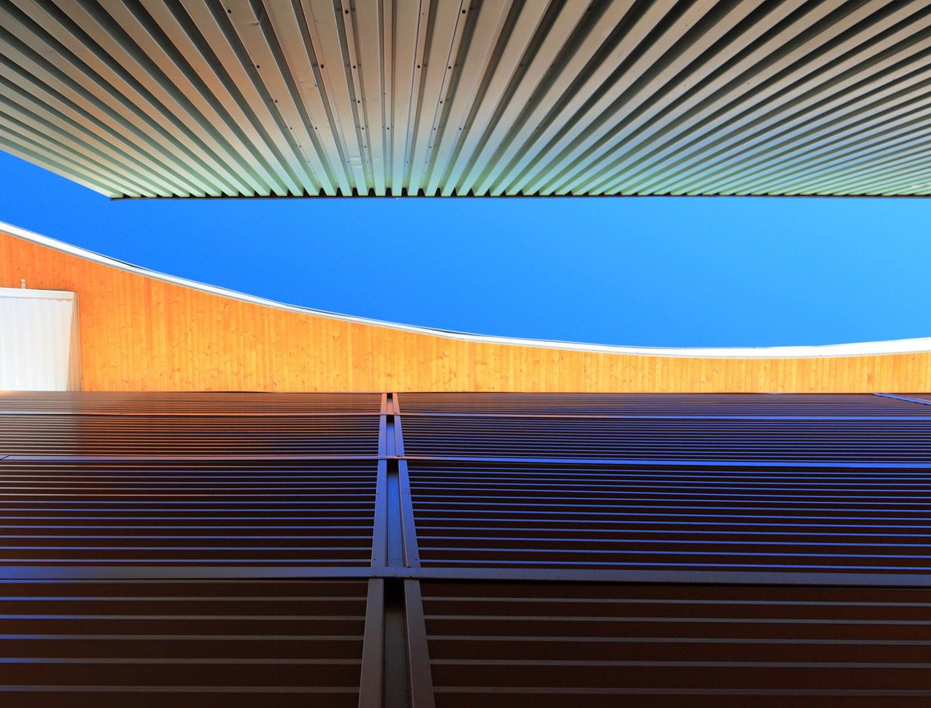
Development of ARIEL – the ARIEL project
ARIEL-I (2012 - 2014)
e-Linac, beam tunnel, target building
ARIEL-II (2017 - 2028)
target stations, shielding, hot cells, RIB distribution
CANREB (2014 - 2019)
charge state breeding and purification for post-acceleration in ISAC II
Therapeutic Isotopes (2020 - 2028)
production and processing of medical isotopes at ARIEL proton target station
$200 million investment by federal and provincial governments; supported by 21 universities across Canada, about 700 FTE years total effort

Slide 5
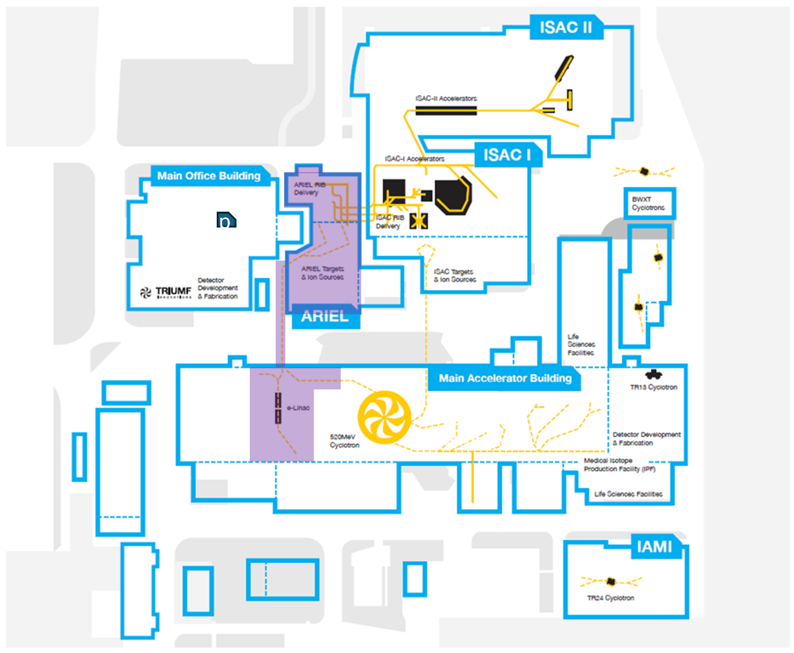

ARIEL
Cyclotron & beamlines (since ~1975)
RIB lines
ARIEL ISOL targets (from 2027)
E-linac and beamline (since ~2013)
ARIEL
(ISOL)
APTW
AETE
30 MeV – 10 mA
e-Linac
500 MeV – 400 μA
P+ Cyclotron

Slide 6
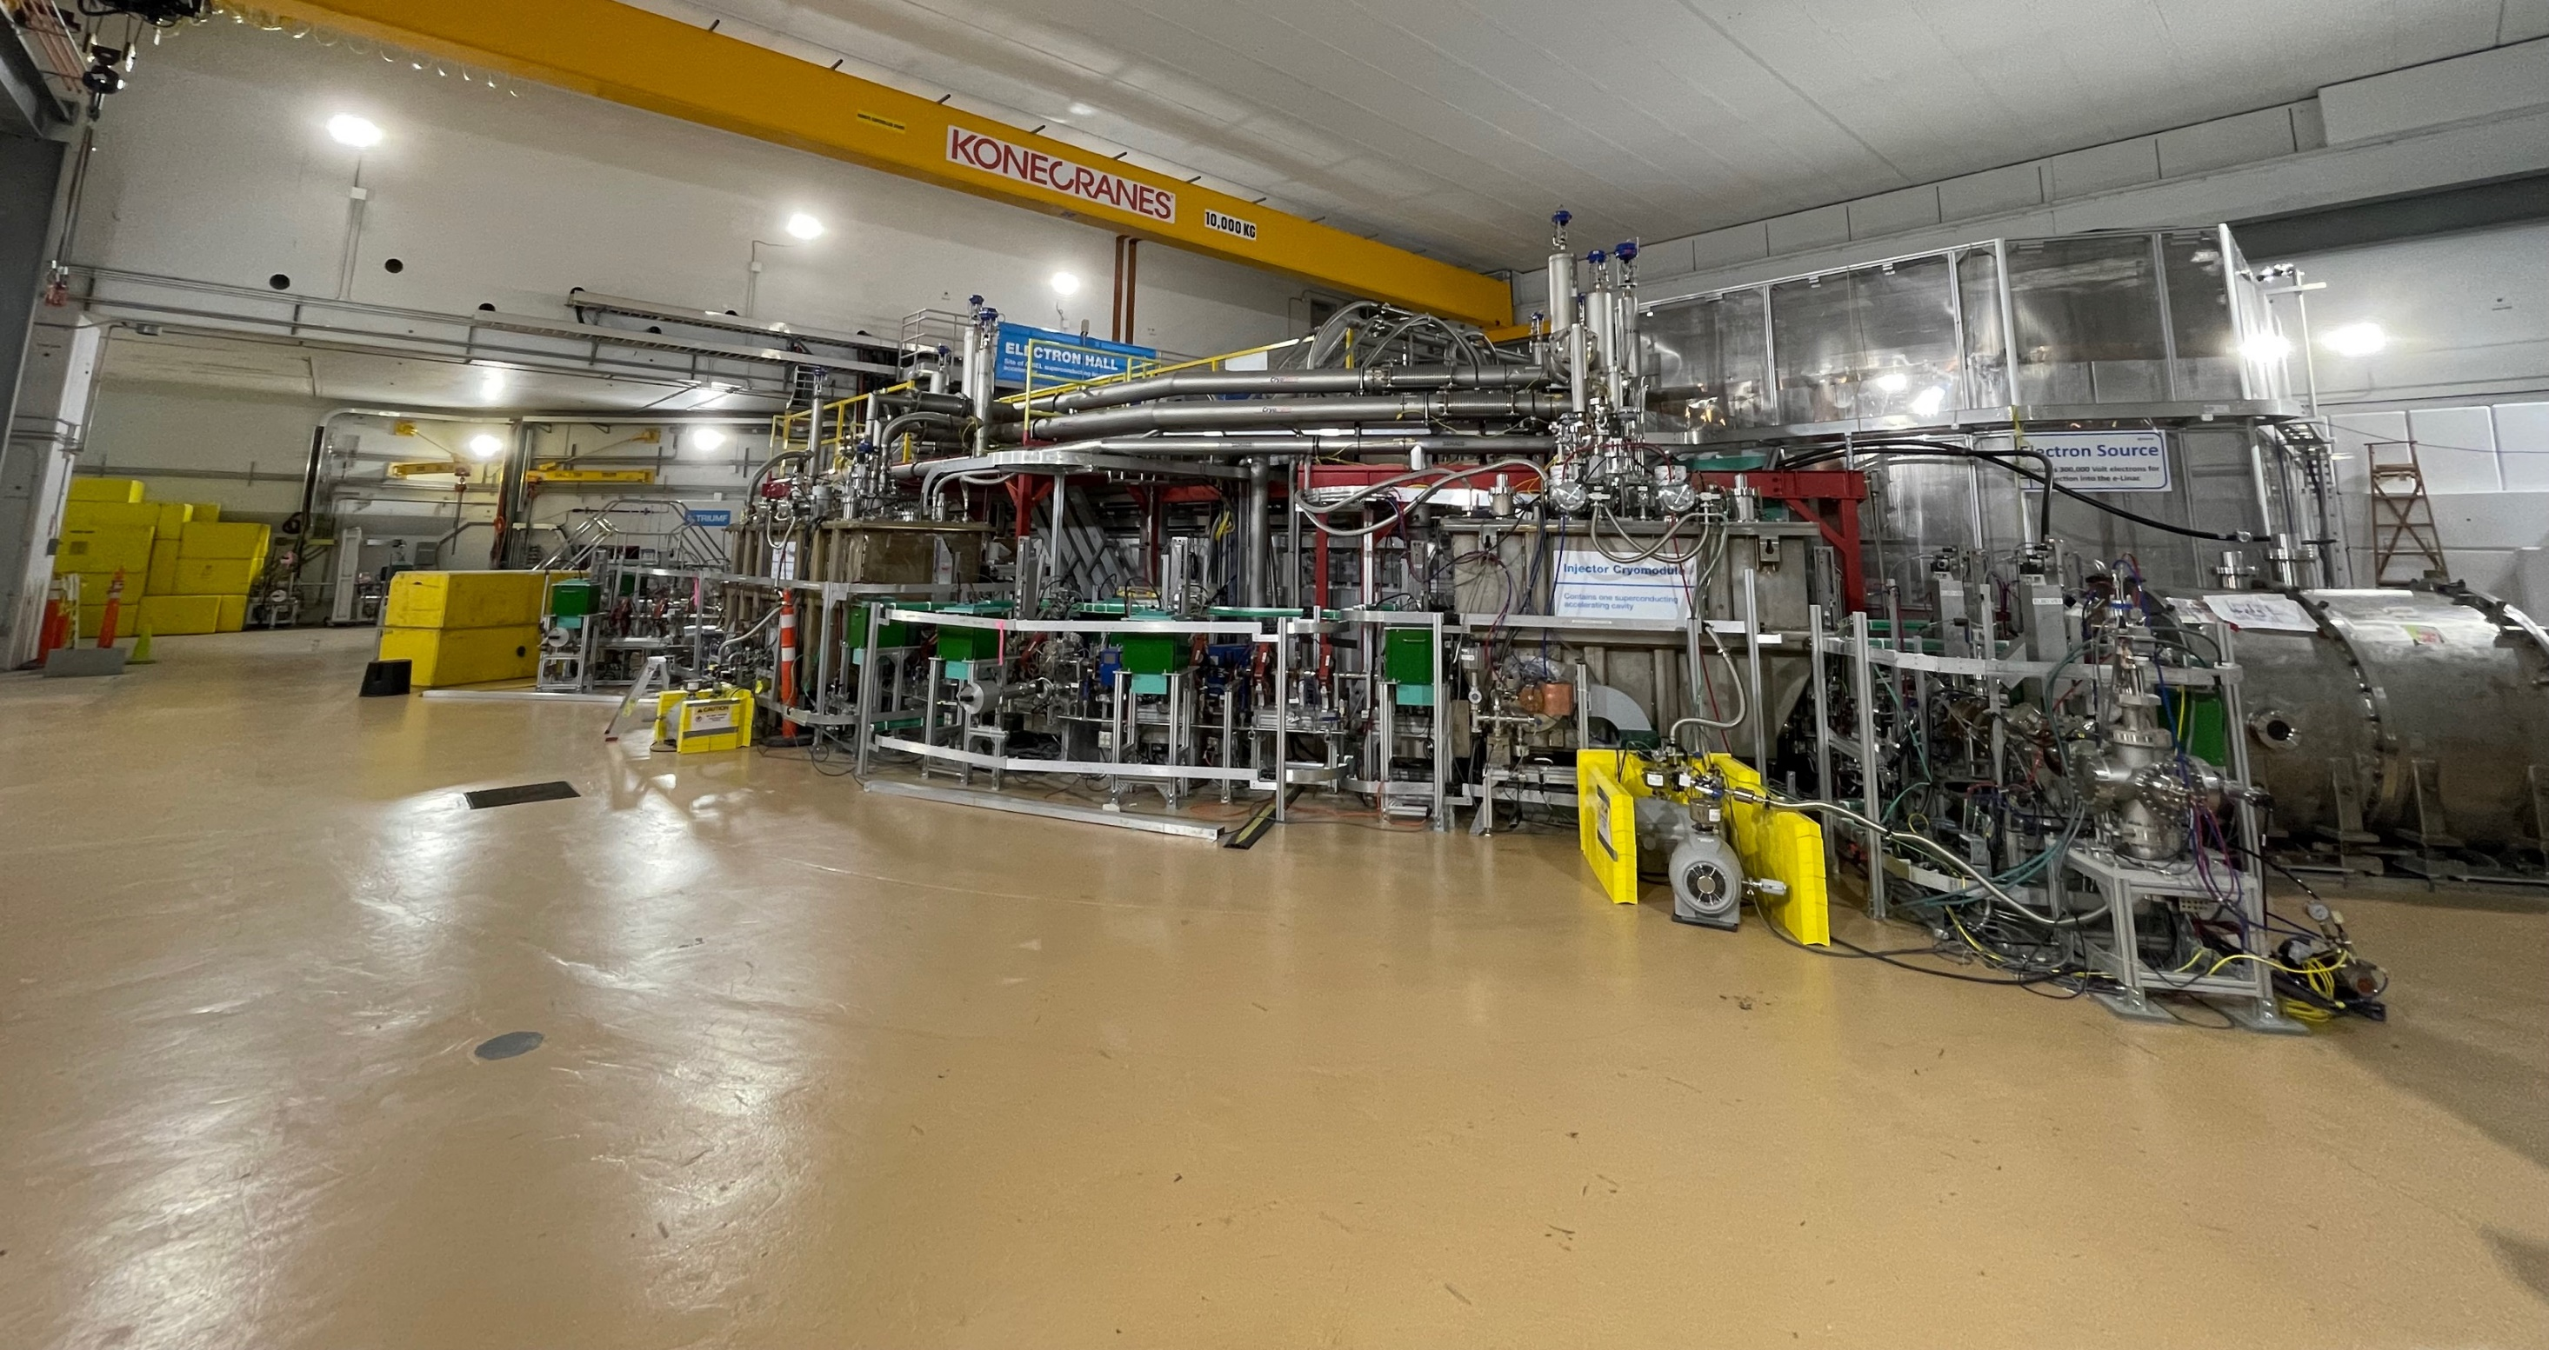
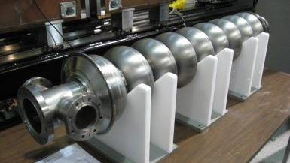
ARIEL – superconducting electron-Linac
10 kW beam dump
cryo-module 2
e⁻gun
cryo-module 1
e-Gun delivers max. 10 mA at 300 keV beam
The injector cryomodule (1) accelerates to 5-10 MeV
The accelerator cryomodule (2) is equipped with two cavities and reaches max. 30 MeV.

Slide 7
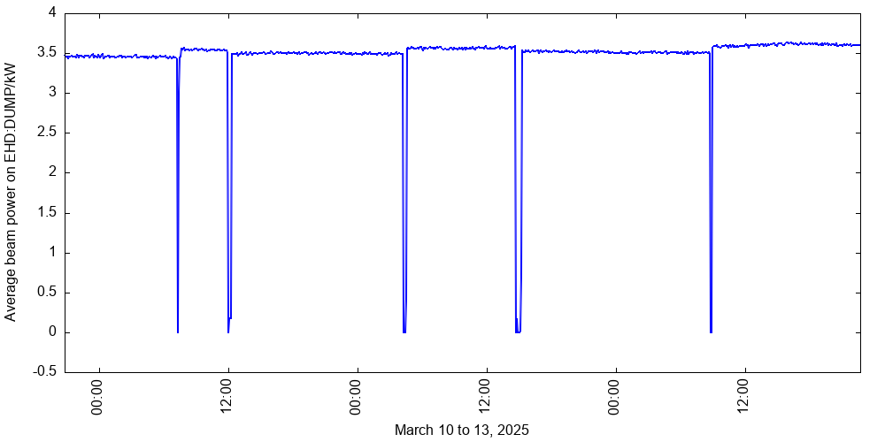
e-Linac updates
10 kW demonstration @ 30 MeV : September 2021
Reliability efforts
  3-days of continuous beam delivery in March 2025
Currently e-Linac shutdown
  Next step, in 2027: commissioning the beamline in the ARIEL tunnel

Slide 8
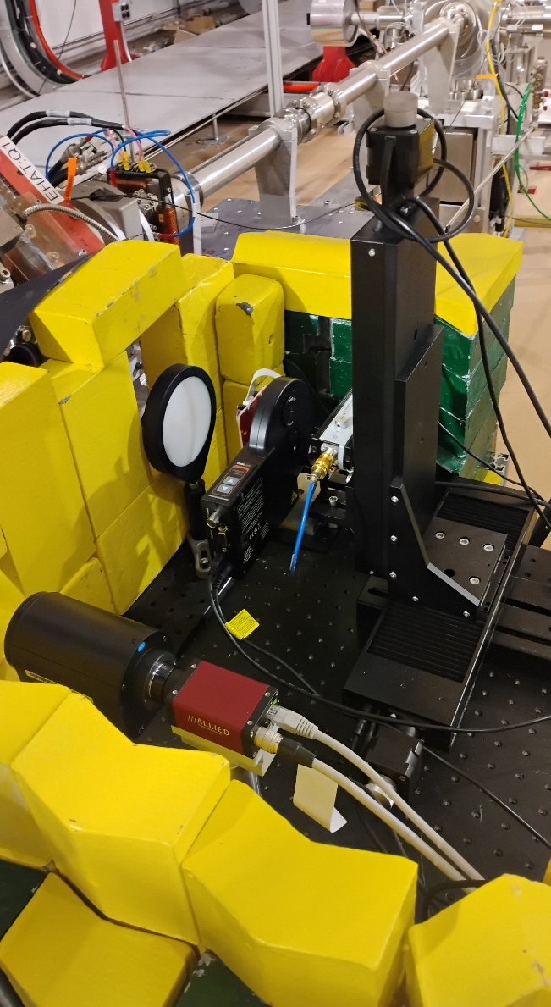
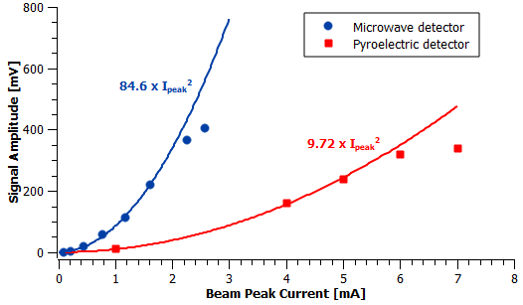

e-Linac : Terahertz (THz) test facility project
Milestones:
Succeeded to secure a CFI grant in 2023.​
A series of demonstration experiments were conducted since 2024 to learn the THz-oriented e-Linac operation and to develop the THz instrumentation.
First e-Linac-THz paper published 2026 in Canadian Journal of Physics [1].​
Upcoming:
Build and install a new photo-gun
capable of producing high-charge
electron bunches.
Construct a laser lab to host the
laser system.
Design, build and install a magnetic compressor to shorten the electron bunches (wavelength >> bunch length)
Will increase the availability of beam from the e-linac for ARIEL operation!
[1] V.A. Verzilov, et. Al. 2026. First observation of coherent THz radiation at TRIUMF electron accelerator. Canadian Journal of Physics. 104: 1-9.

Slide 9
ARIEL
Cyclotron & beamlines (since ~1975)
RIB lines
ARIEL ISOL targets (from 2027)
E-linac and beamline (since ~2013)
ARIEL
(ISOL)
APTW
AETE
30 MeV – 10 mA
e-LINAC
500 MeV – 400 μA
P+ Cyclotron

Slide 10
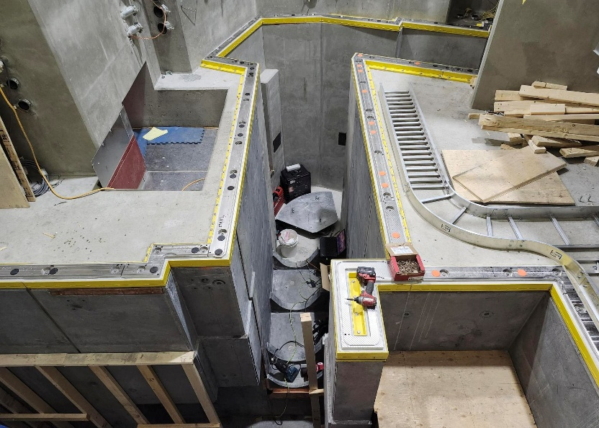
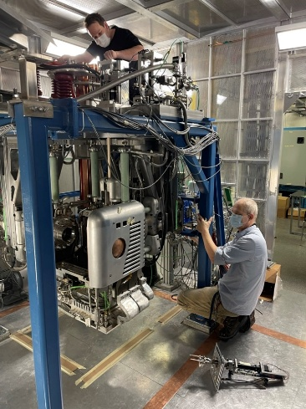
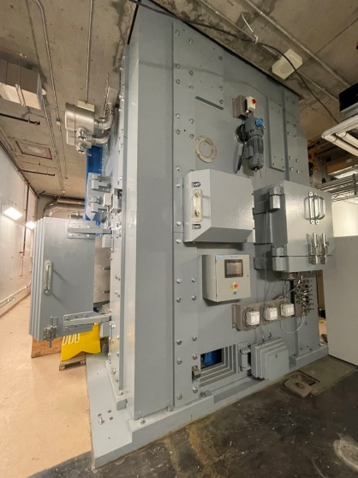
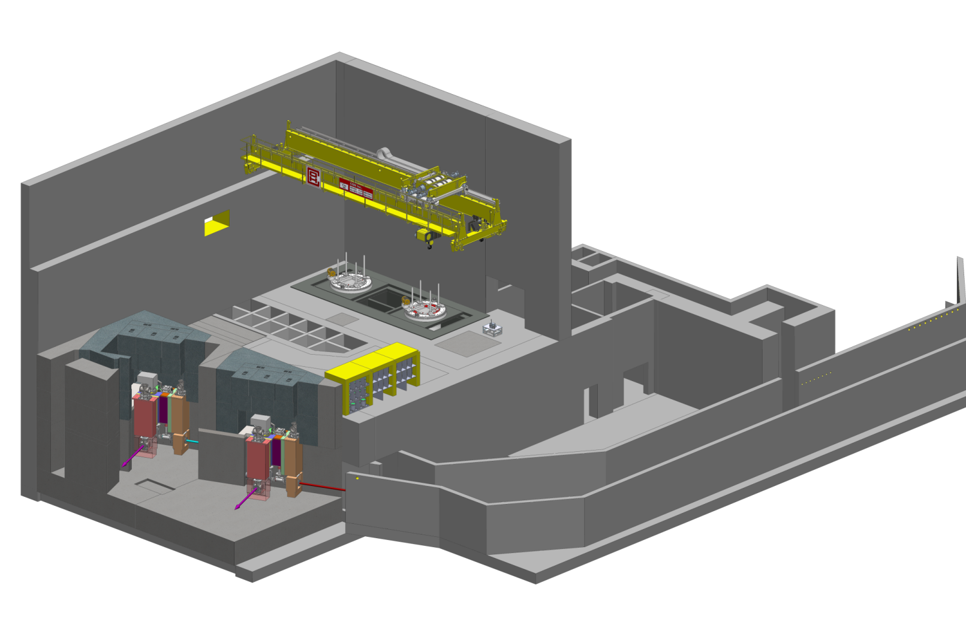
Completion of the ARIEL project
Requires the target hall
infrastructure for both stations
(shielding, target building
infrastructure, gas handling,
HV infrastructure, vacuum
systems)
Target and RIB modules and
beam dumps including the
medical target and transfer system
Beam line 4 North (BL4N) and the electron beam line and the integration, testing and commissioning of all systems
Required for the ramp up in operation :
  Spent target decay storage vault
  Target production infrastructure (laboratories)
  Offline target acceptance stand – TISA
  HV infrastructure for APTW
  e-Linac upgrade to full performance
  CANREB operation (EBIS, RFCB and HRS)
Target Hall
TISA
Remote-controlled crane
Hot cell facilities consisting of maintenance cell and target disposal cell
module storage
AETE
spent target storage
APTW
drivers beam tunnel
electrons
RIB
protons
RIB
2000t of steel and concrete

Slide 11
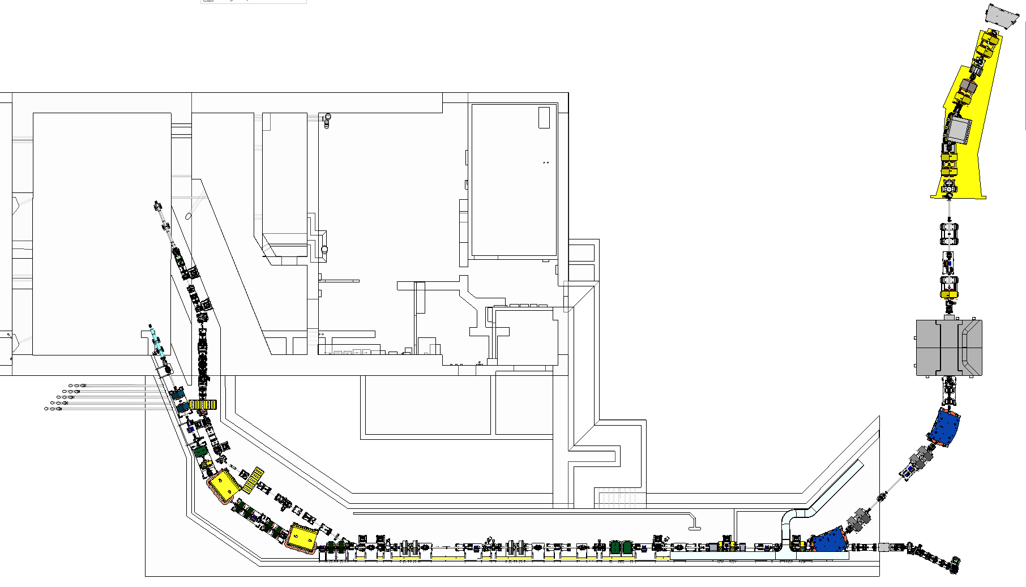
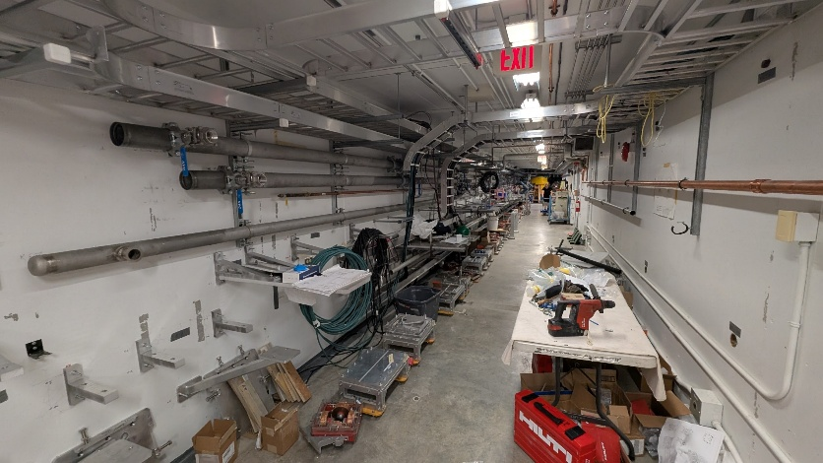
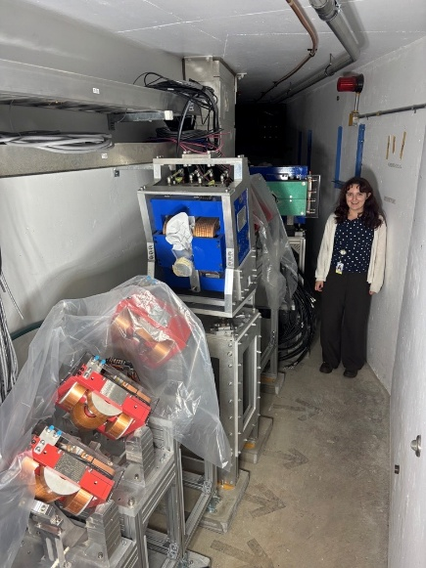
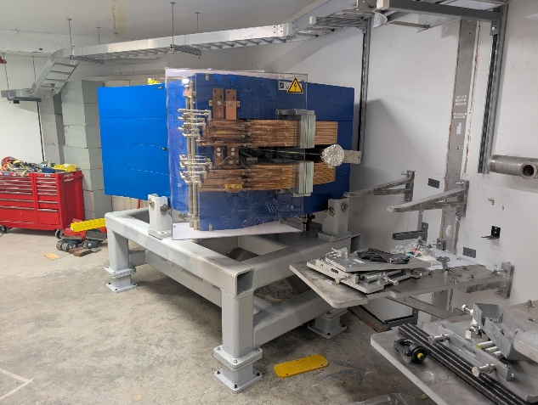
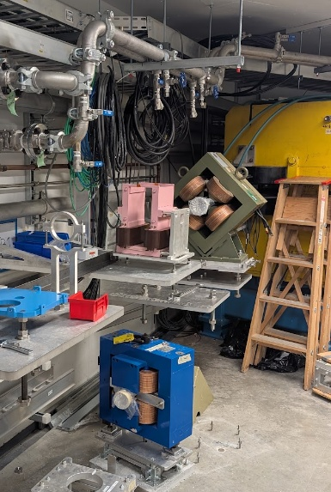
Tunnel
Overview
EHBT (Electron Beam Transport) delivers an electron beam from the e-Linac to the AETE Target Station
BL4N (Beam Line 4 North) delivers a proton beam from the Cyclotron to the APTW Target Station
NORTH
BL4N Vault region
AETE
APTW
BL4N Pharoah’s tomb region
BL4N & EHBT
North Tunnel bend section
BL4N Proton Cave region
BL4N & EHBT
Straight Tunnel section
EHBT dogleg region

Slide 12
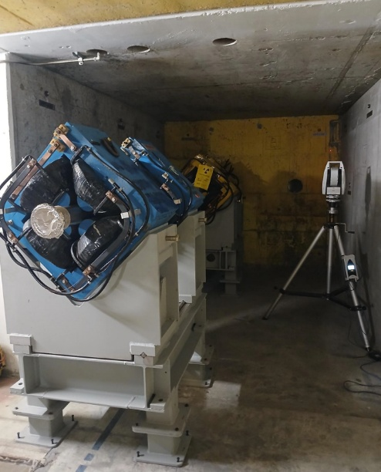
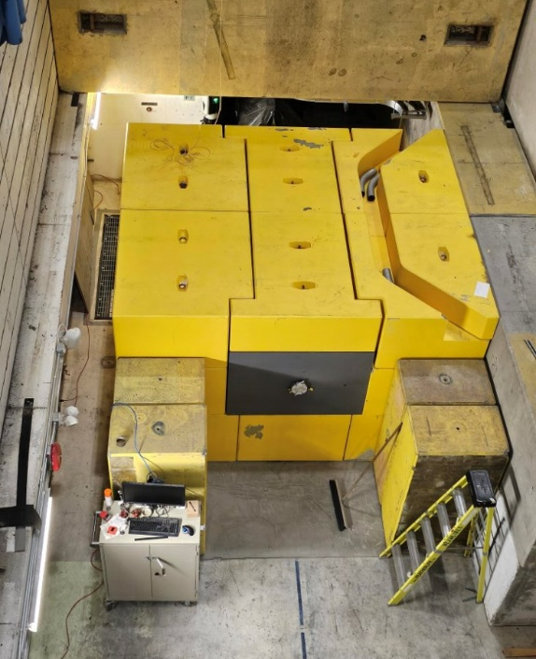
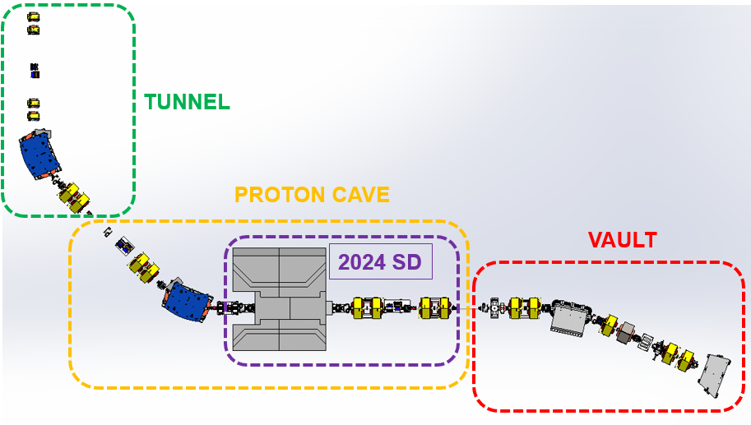
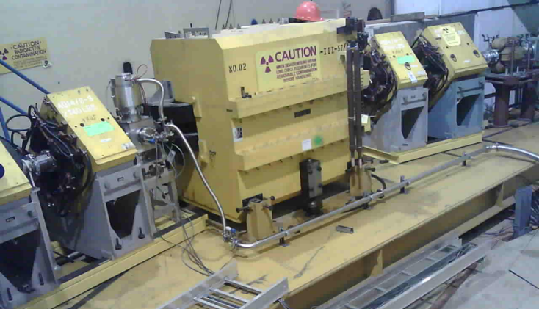
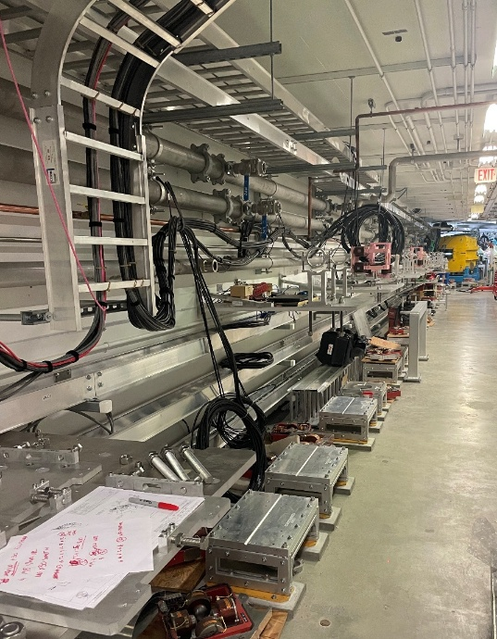
BL4N Overview

Slide 13
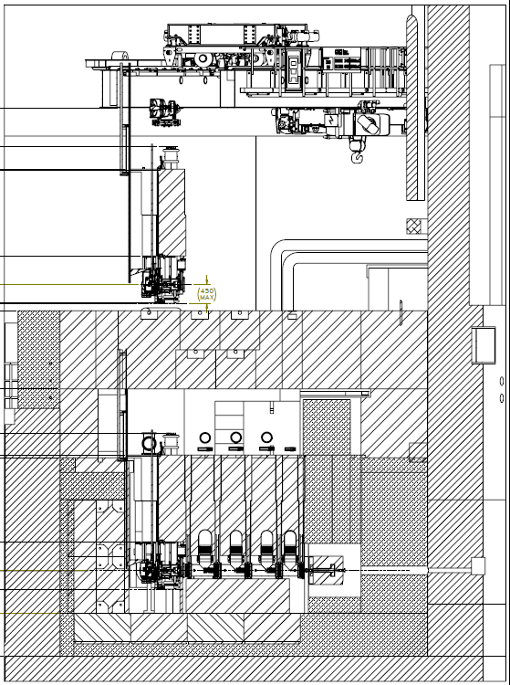
Shielding Design Structure
The Target Pit Shielding → ensure the access to the hall while beam operation, provide all services (cooling water, ventilation, compressed air etc.)
It consists of 9 layers of fixed shielding and removable cap shielding.
Level 4b: Removable Cap Shielding
Level 4a: Fixed Cap Shielding
Level 3: Service Space
Level 2-4, 2-5, 2-6: Upper Canyon
Level 2-1, 2-2, 2-3: Lower Canyon
Level 1: Below Station
8.1m
Notes:
The entire shielding construction had to be split into layers to allow for all the components to be built and placed

Slide 14
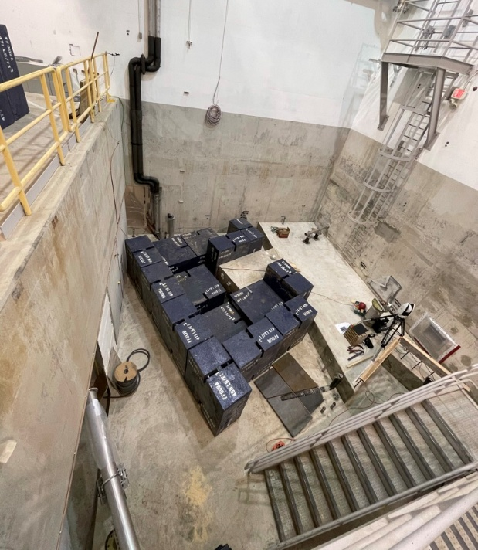
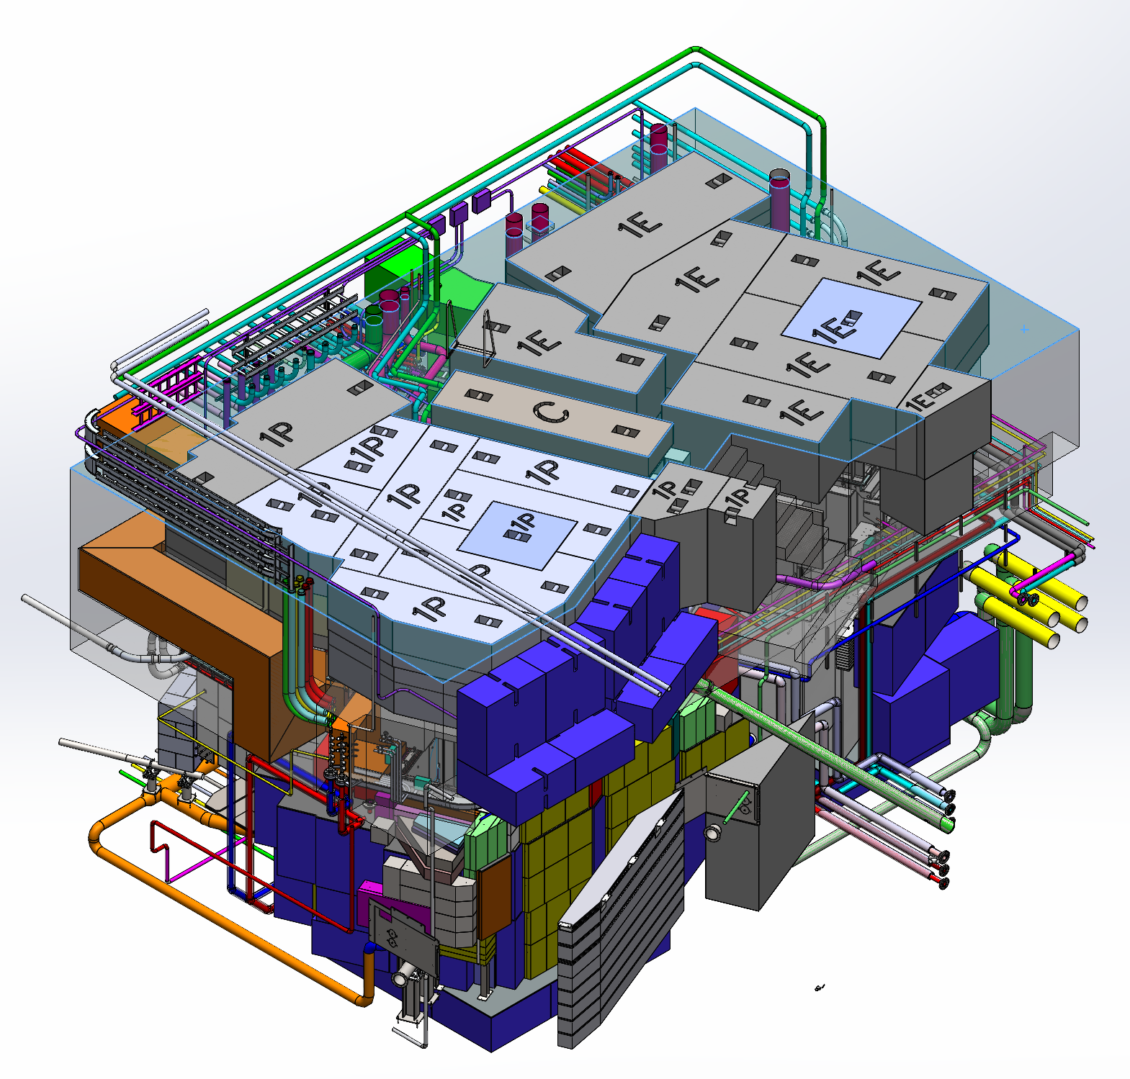
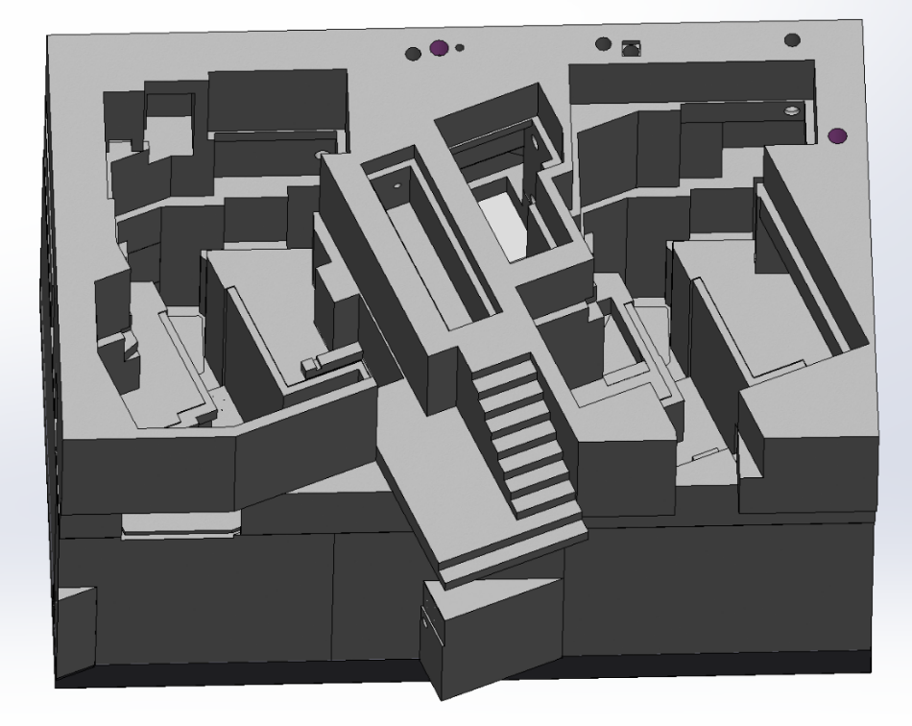
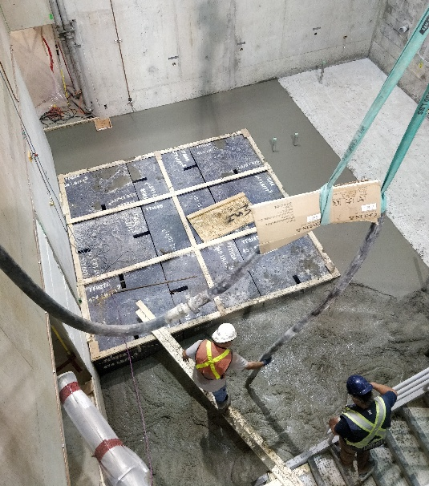
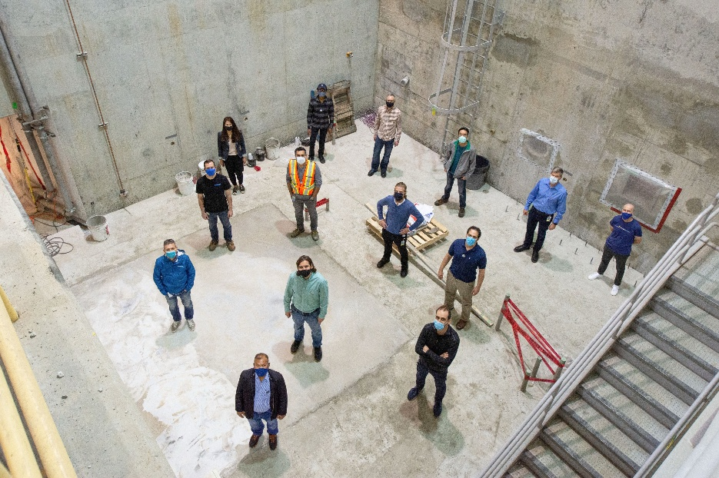
Target Hall Shielding Progress
Concrete poured for all levels combined:
~ 595 m³ or ~ 1430 metric tons
Level 1 Complete 2020
beam

Slide 15
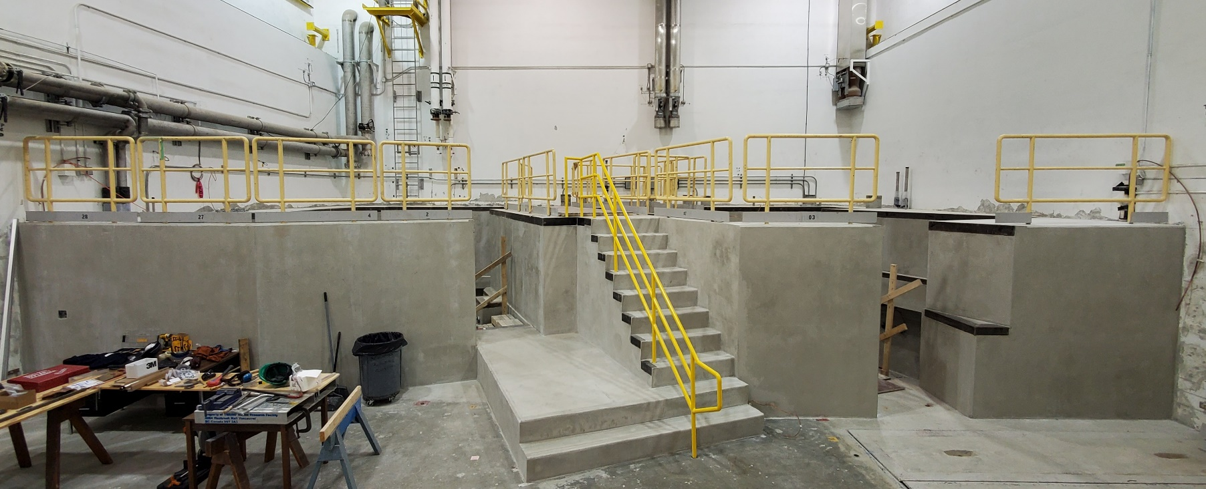
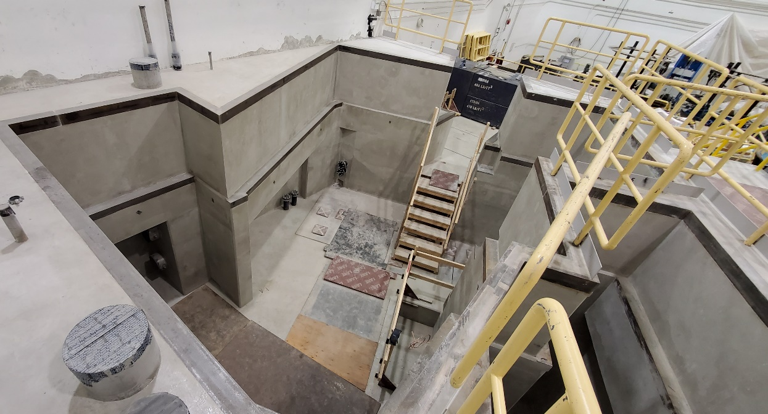
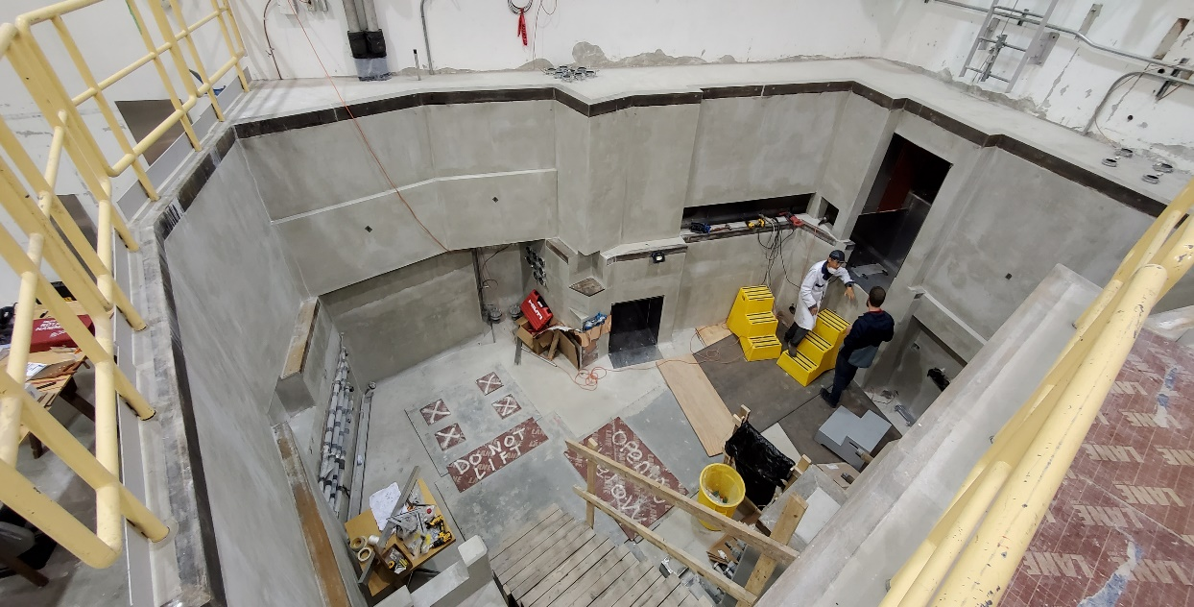
Target Hall Shielding Progress
Finally, Summer 2025 level 9 completed!
Installation work in the target hall started.
Layer 9 Complete

Slide 16
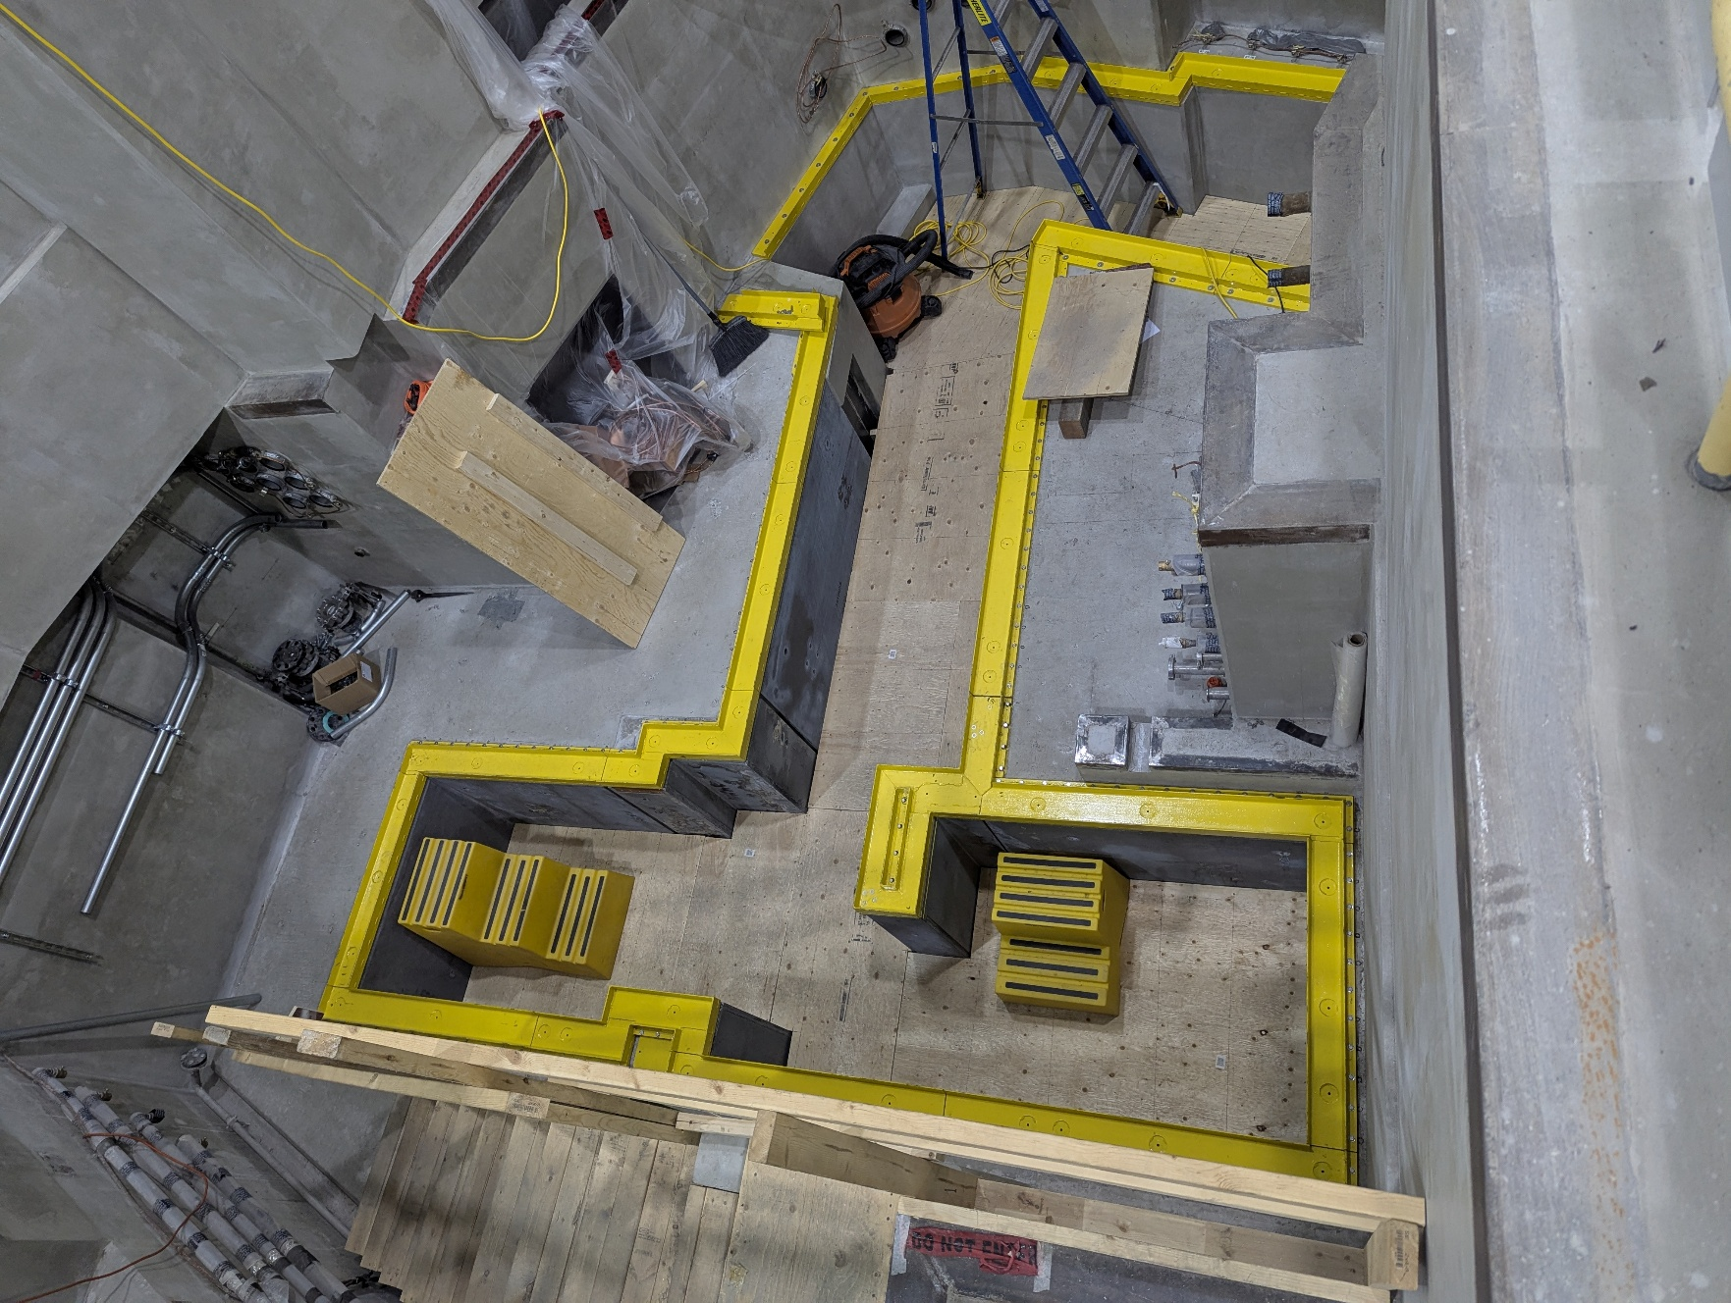
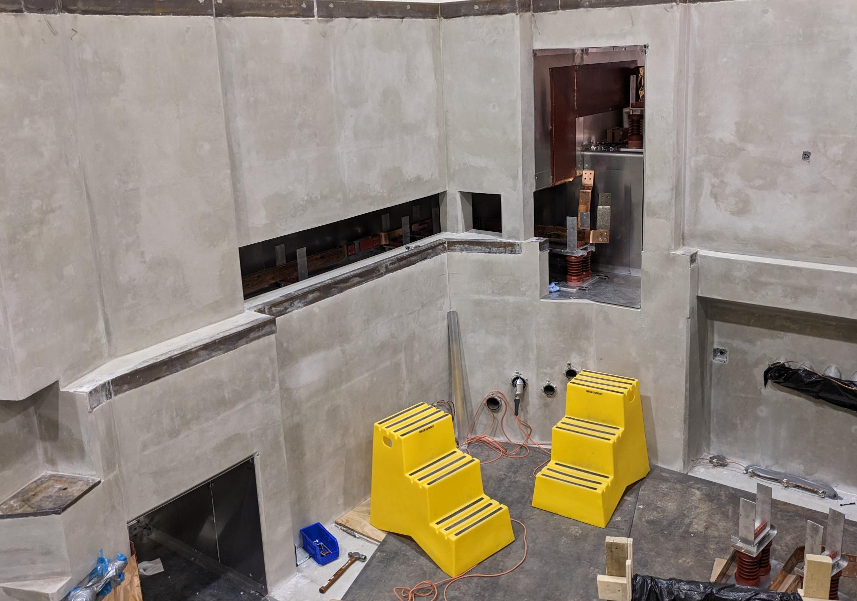
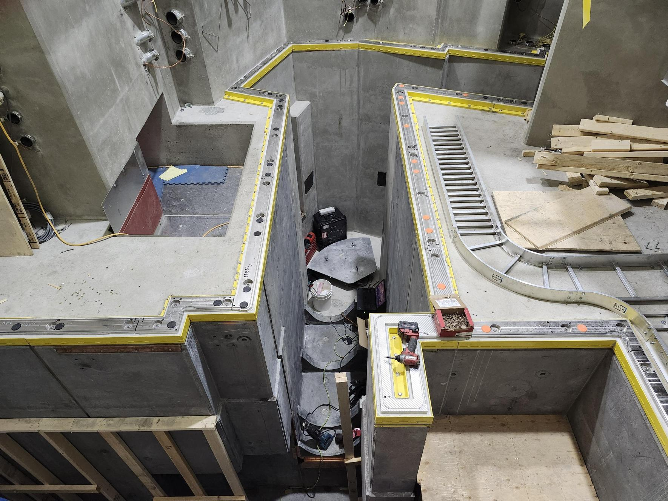
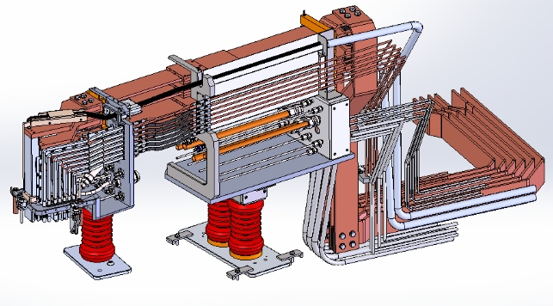
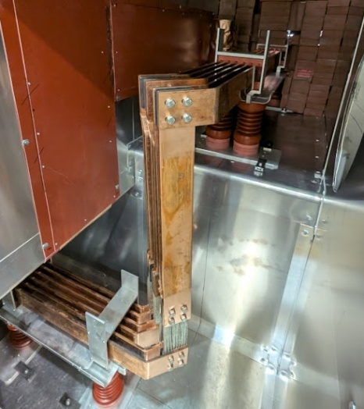
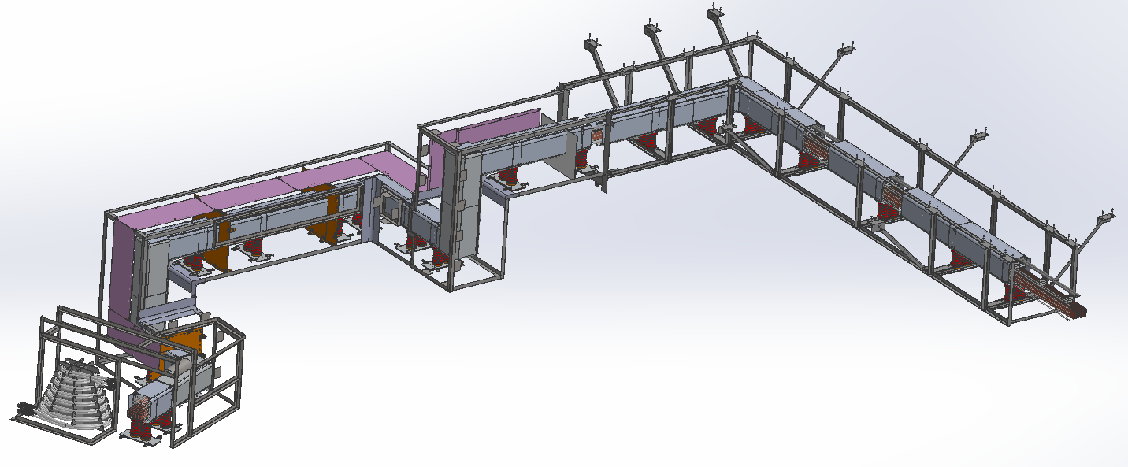
Target Hall installations
With module mounting system installation complete, ARIEL is now ready* to receive modules!
Module mounting system is the module interface with the ARIEL canyon and provide a smooth, level landing surface → Allows for repeatable positioning of modules and seals the secondary gas
volume
HV chase provides
supply lines for high
voltage, high current
(target heating) and
cooling water.
ARIEL Module Mounting System
High voltage chase

Slide 17
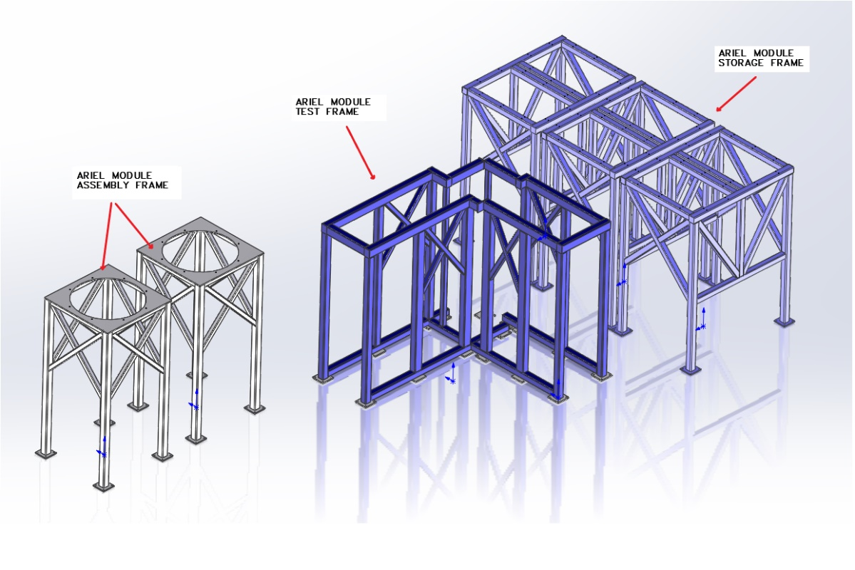
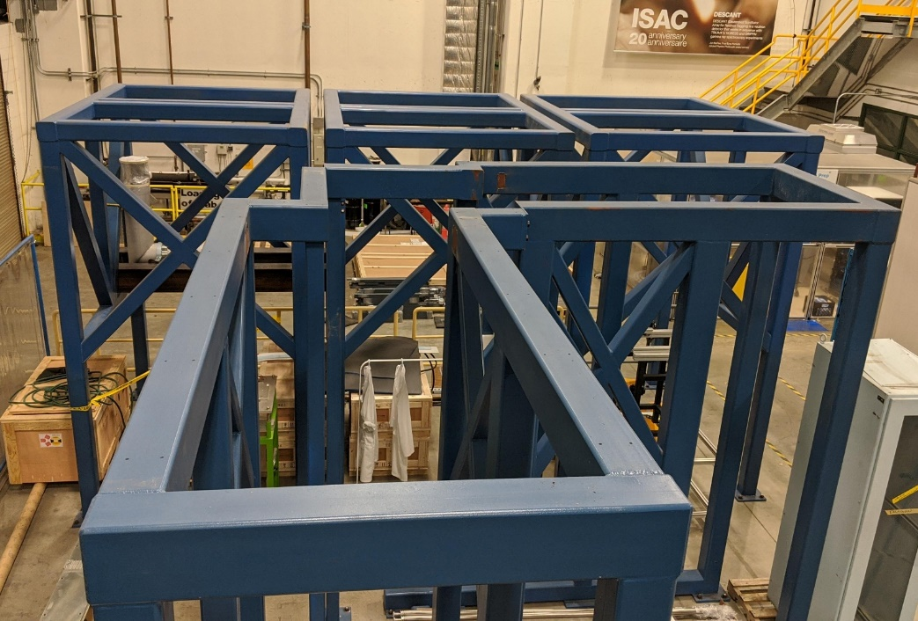
ARIEL module assembly in ISAC-I
ARIEL Module storage frame
ARIEL Module test frame
ARIEL Module assembly frame
Assembly of the modules requires assembly of
the shielding and of the related beam line element
Target module, RIB modules → support structure

Slide 18
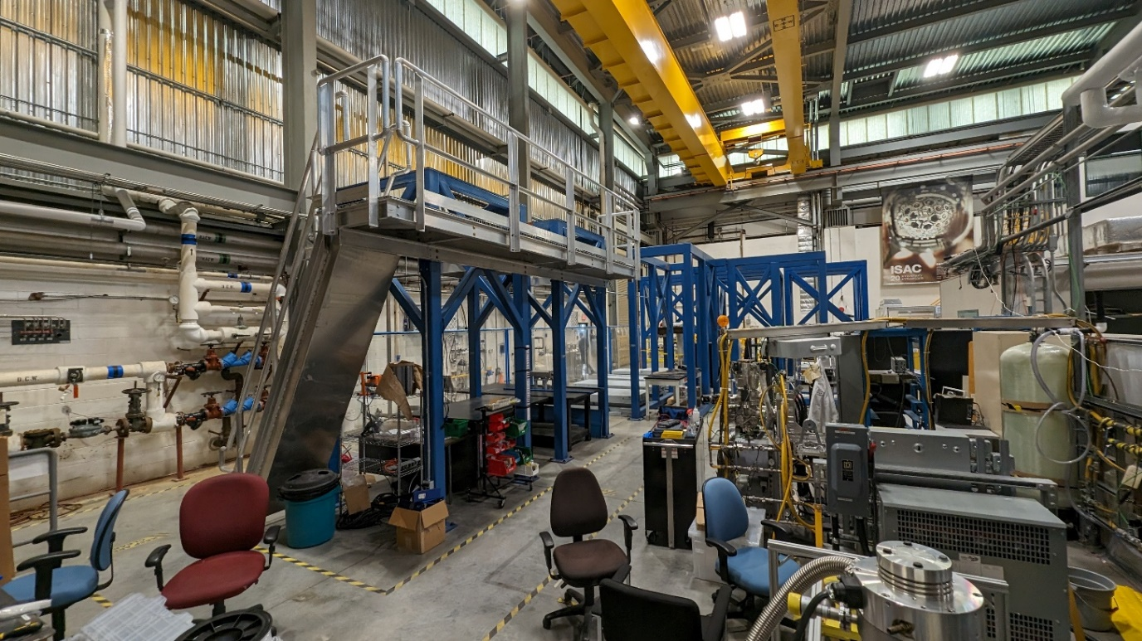
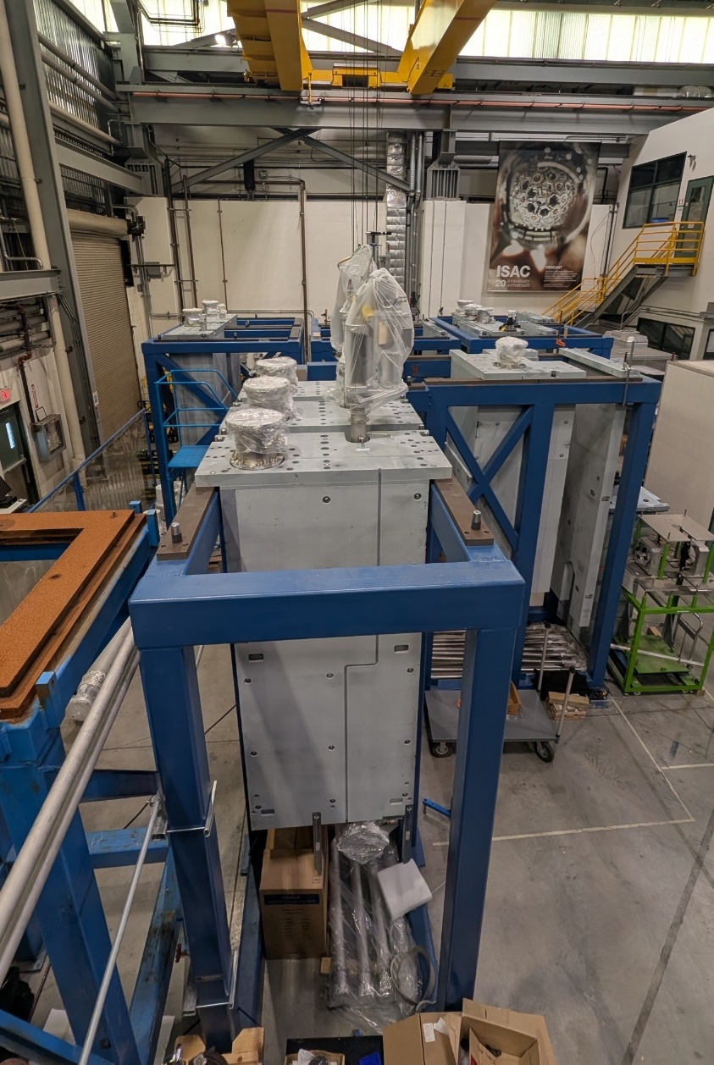
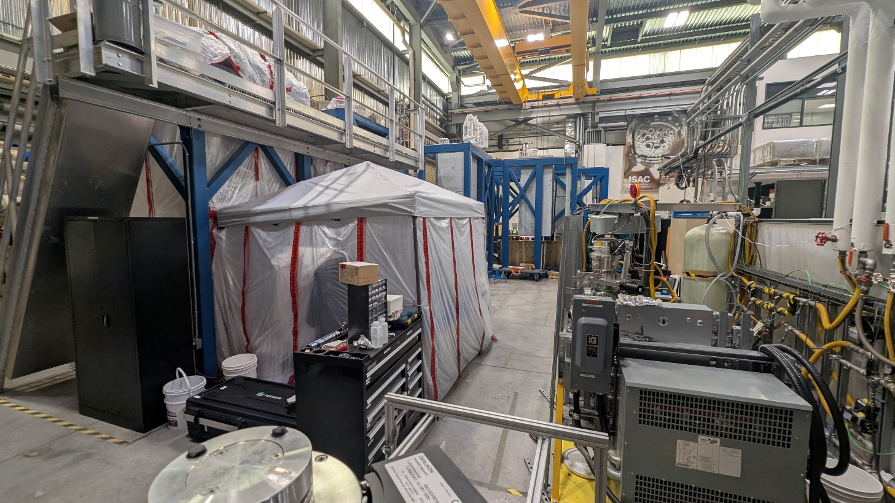
Module assembly jungle

Slide 19
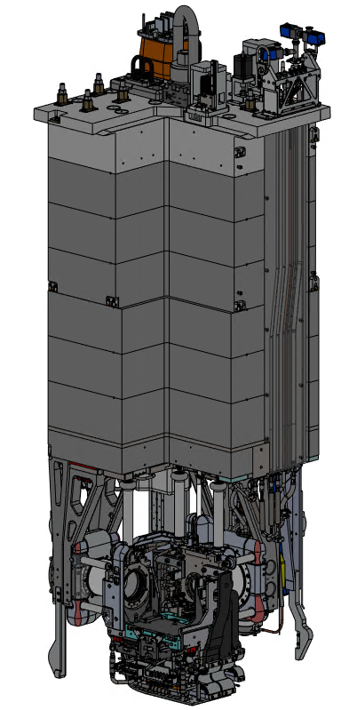
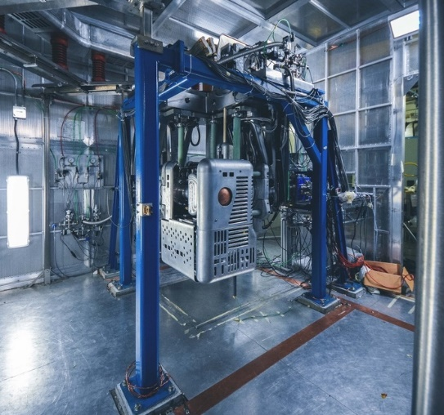
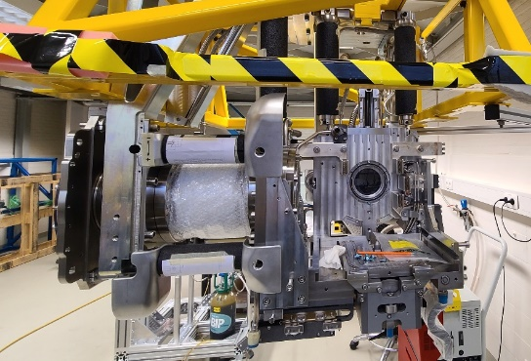
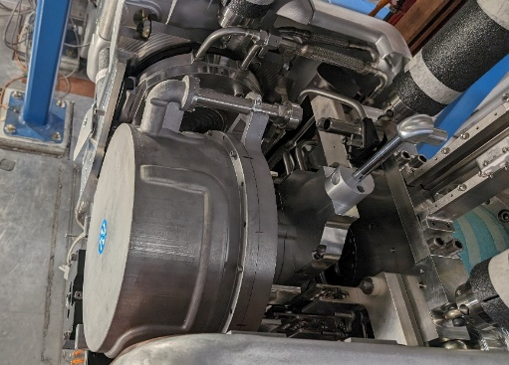
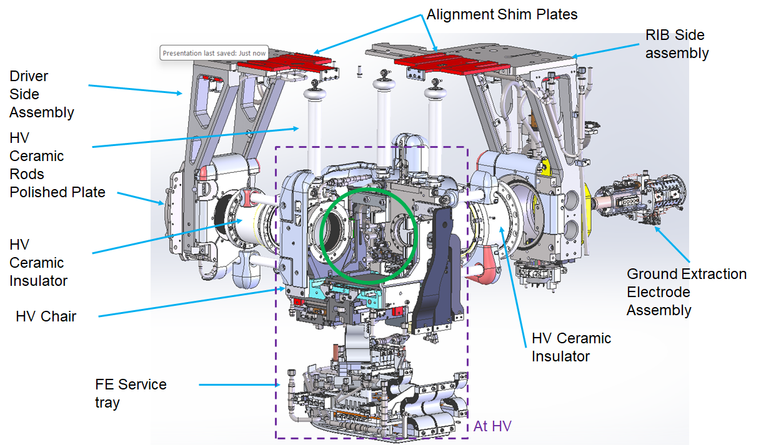
ARIEL target modules
HV Services (HVFT)
Ground Services
(GSI)
2m
RIB Beam OUT
1.2m
Driver Beams IN
Proton on APTW
Electron on AETE
Tested to 75 kV
No Services in Vacuum

Slide 20
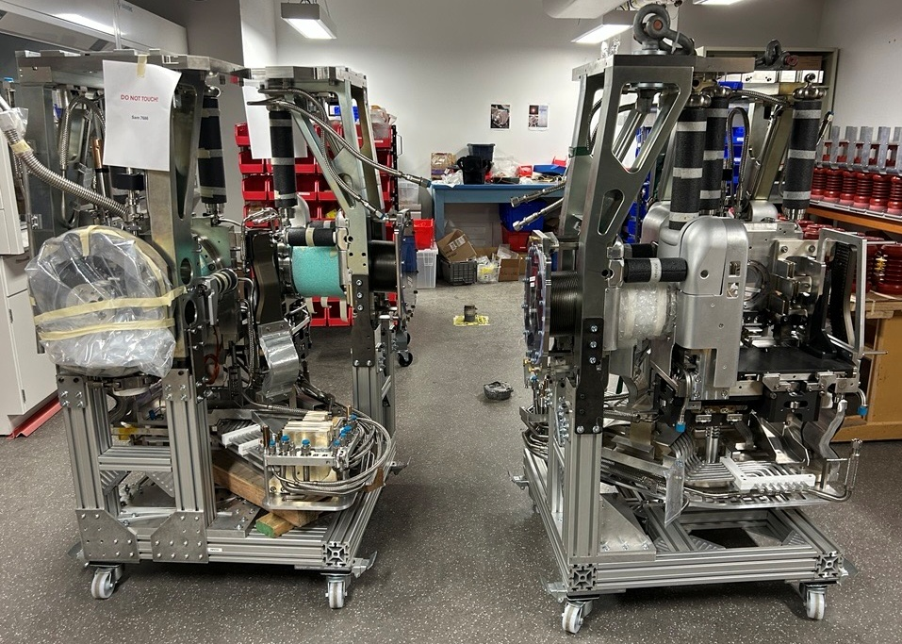
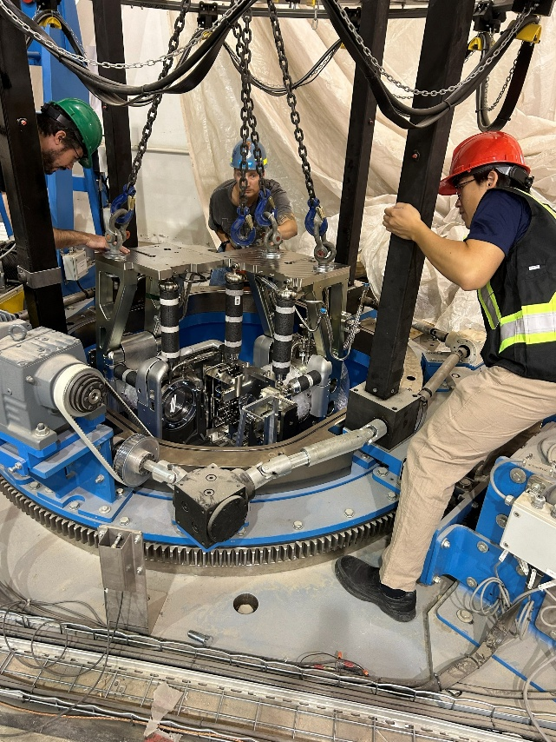
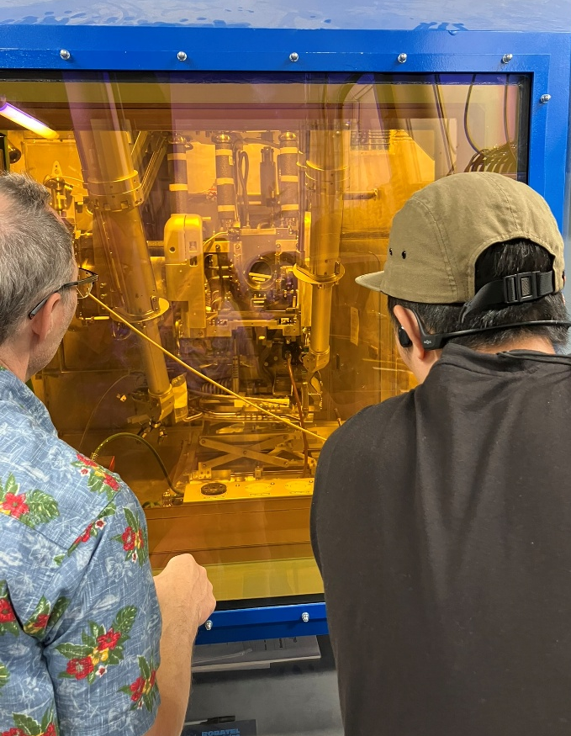

ARIEL target module front end (FE) Remote Handling (RH) tests
The ARIEL FE has around 120 RH maintenance operation possible, 6 times more than the ISAC FE → ARIEL hot cell
Exchange of every services possible (hoses, connectors, pistons, limit switches)
Exchange of the Extraction electrode, swap from an AETE configuration to an APTW configuration

Slide 21




Status of Beam Delivery Systems - CANREB
Completed:
250 m of RIB beam
distribution lines
CANREB HRS with
world-record mass
resolving power
ARIEL yield station
Ongoing:
Address remaining issues with CANREB EBIS (e-gun test stand) and CANREB RFQ
HRS HV enclosure to be assembled
RIB modules → module assembly

Slide 22



ARIEL Science Workshop, 20-23 April 2026
Nuclear Physics - Nuclear Astrophysics - Fundamental Interactions
Around 135 international participants.
Nuclear-physics focused workshop was the first in a series of ARIEL Science Workshops.
Series of invited presentations, panel discussions on ten nuclear physics research topics.
Strong endorsement of the existing research programs at ISAC and the plans to strengthen and expand these with ARIEL beams.
A clear message that post-accelerated RIBs are needed and have been a problem in the past.
There is a large demand for a ramp up to the 9000 RIB hours RIB operation ARIEL will be able to provide in the futre.
A consensus on new ideas emerged for nuclear structure and astrophysics to perform dedicated campaigns of study around the peaks of photo-fission production (Ga, Sn and Ba etc).
Radioactive molecules at ARIEL show significant promise and excitement for impactful science.
Suggestions for TRIUMF to host an active time-projection chamber and a solenoid-based transfer reaction detector were put forward.

Slide 23















ARIEL Progress in Long Shutdown 2026 is significant
towards the completion of ARIEL

Slide 24
Thank you
Merci

Slide 25
Additional slides

Slide 26

TRIUMF accelerator complex
ISAC-II
High energy
ARIEL
Primary beam driver:
Cyclotron, 500 MeV, H⁻
Produces rare isotopes, neutrons and muons!
Providing beam for:
Isotope Separator and Accelerator facility – ISAC (ISOL facility)
ISAC-I: Normal conducting-linac, 0.15-1.5 MeV/u
ISAC-II: Superconducting-linac, 5-15 MeV/u
And the
Advanced Rare Isotope Laboratory - ARIEL
4 Cyclotrons for medical isotope production
(with a TR24 to be commissioned in the Institute for advanced Medical Isotope – IAMI)
ISAC-I
Low and
medium
energy
Cyclotrons
for medical
Isotope
production
500 MeV
Cyclotron

Slide 27

ARIEL ORG CHART

